Slide 1

Sit & Chow – Smart Training Dog Feeder
Critical Design Review
Group 25
Advisor:
Dr. Saleem Sahawneh – ECE
Review Committee:
Dr. Tong Wu – ECE
Dr. Shahana Ibrahim – ECE
Dr. Truong Nghiem – ECE

Slide 2

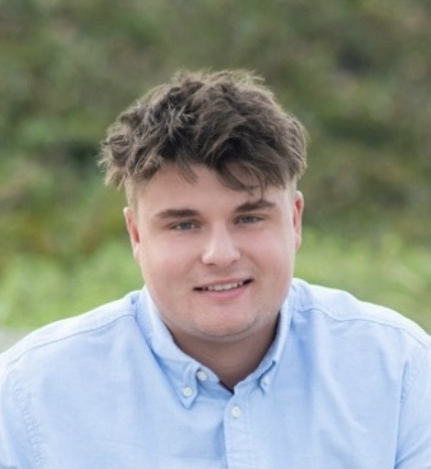

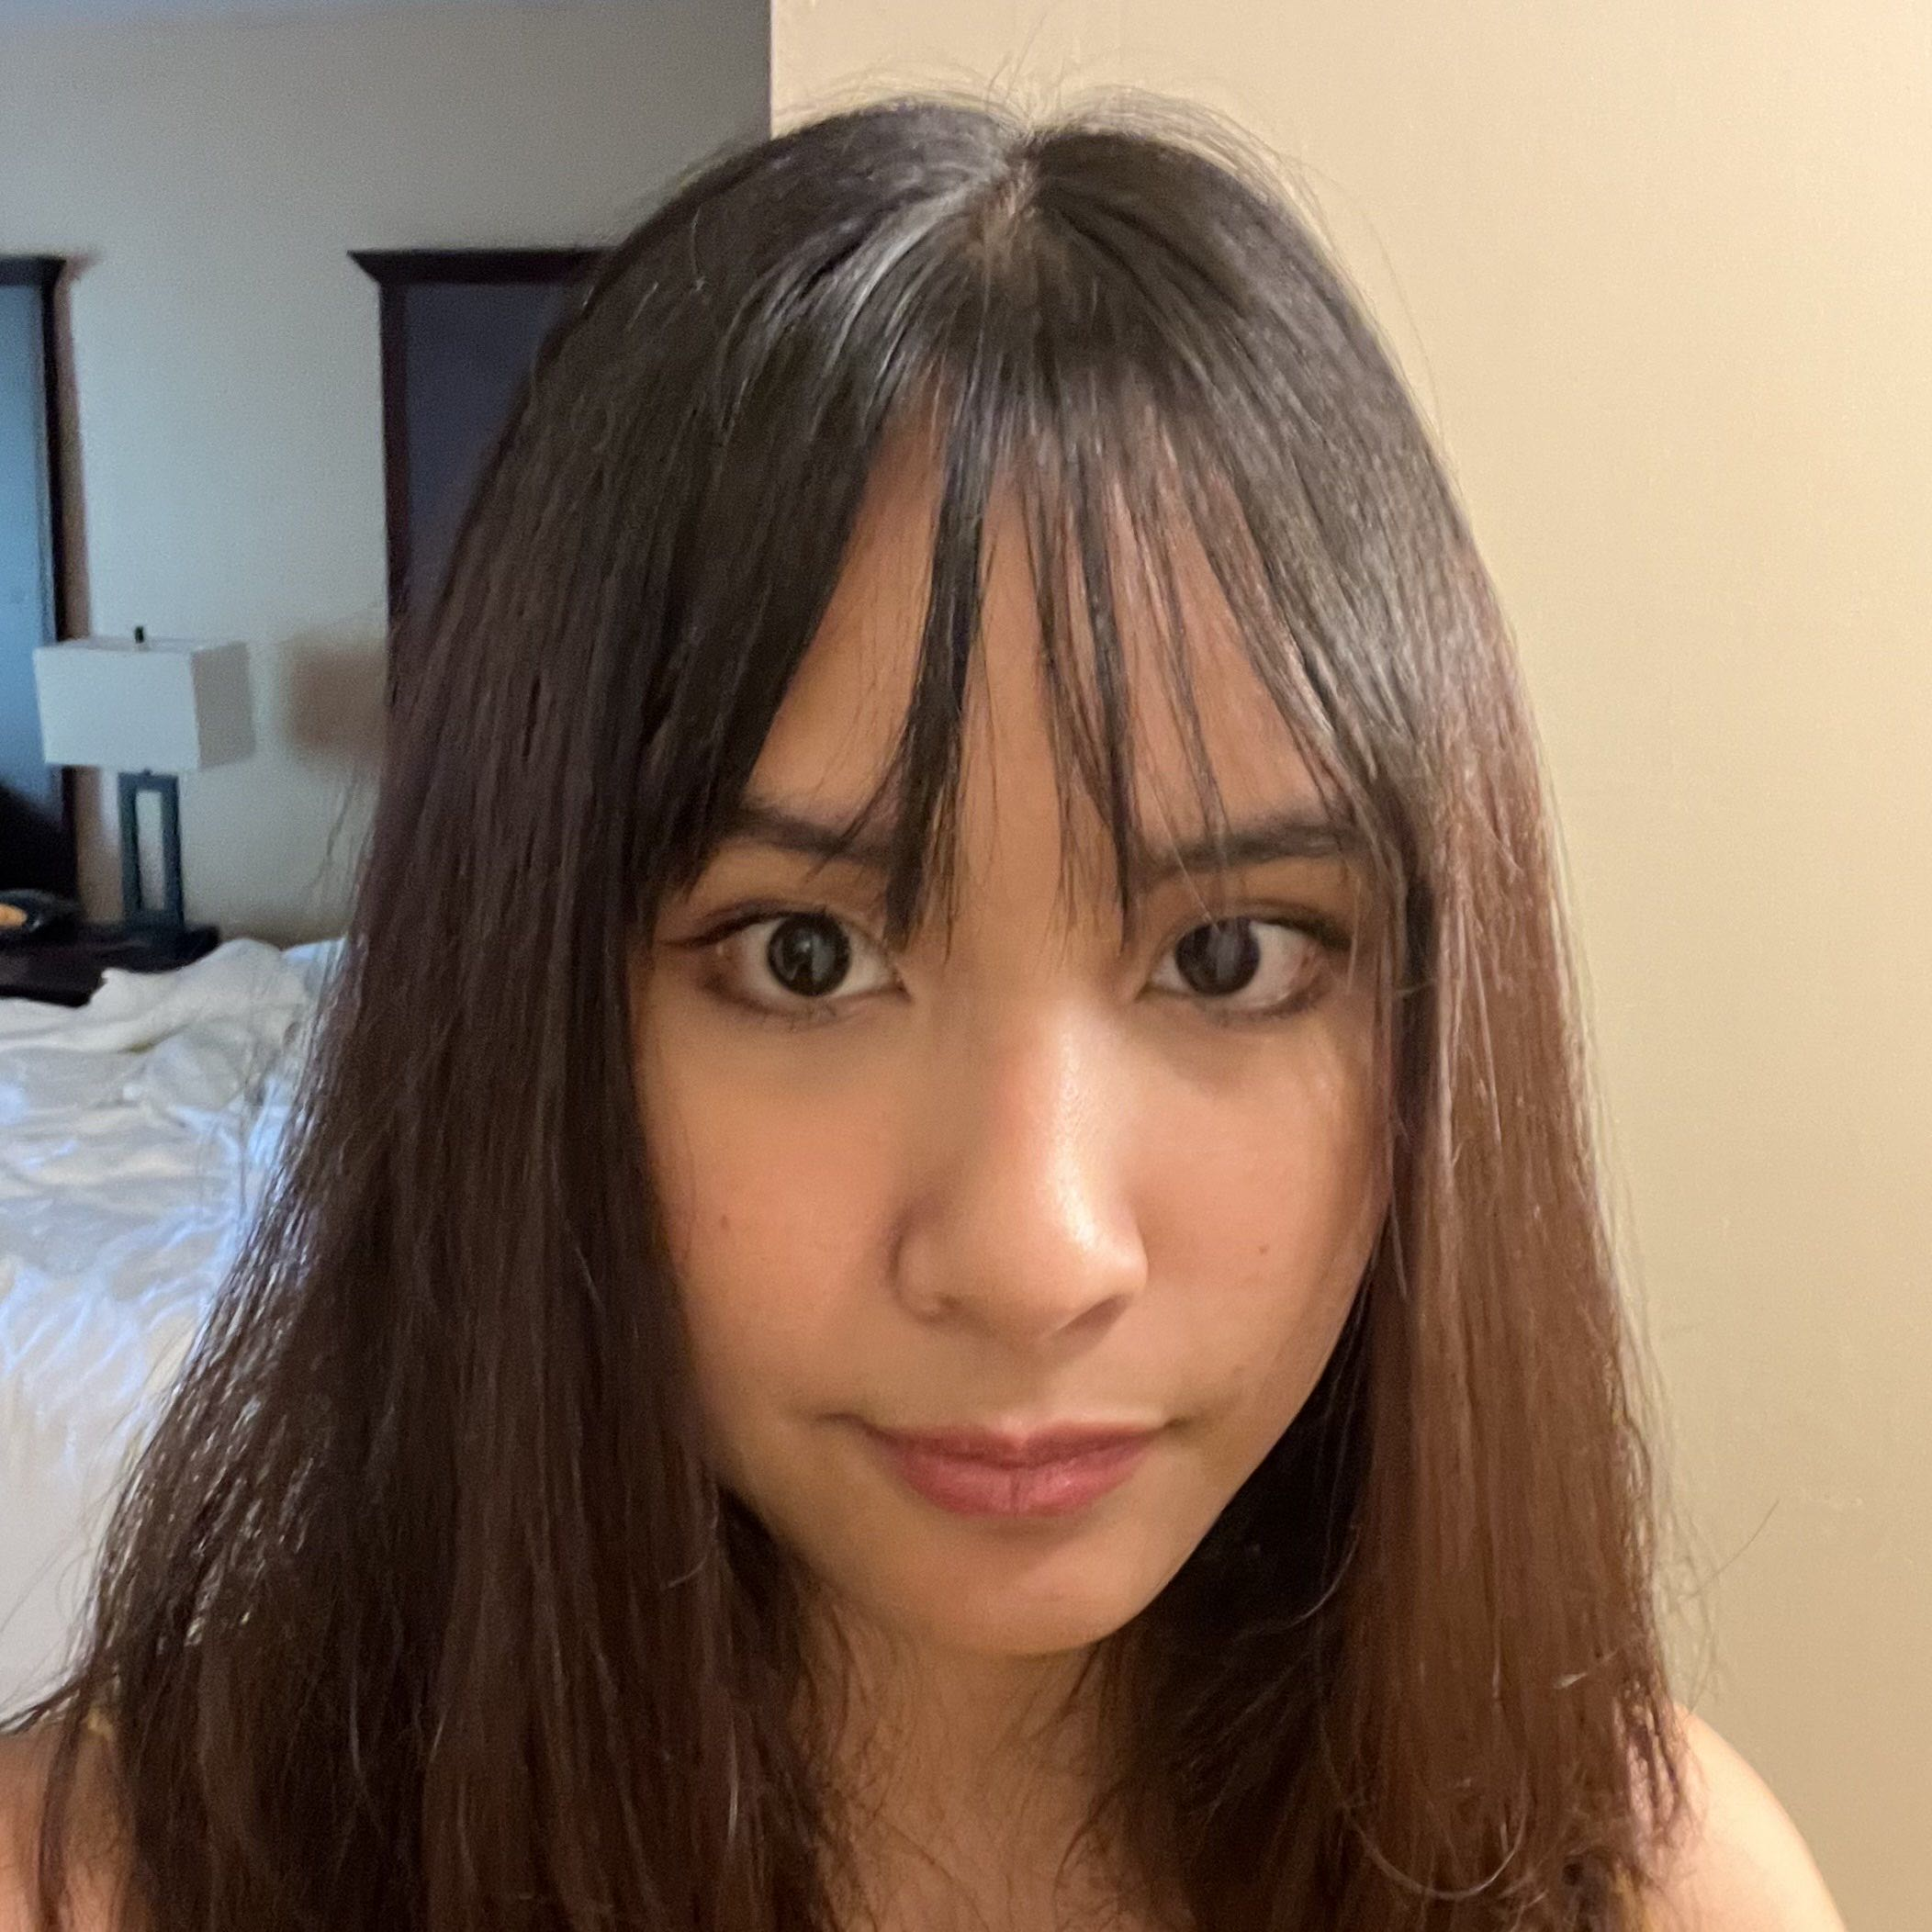
Group 25 Members
Andres Arzola Computer Engineering | Andrew Balmes Electrical Engineering | Natalie Nguyen Electrical Engineering | Maria Tran Computer Engineering

Slide 3
Motivation and Background
Many pet owners do not have the time to feed or train their dog.
Automatic feeders offer a convenient solution to feeding your pet on time.
There are many newer automatic feeders with cameras and other modifications, however, none offer any aid in the dog’s behavior towards food.
We want to create a system that combines automated feeding and helps train their behavior.

Slide 4
Goals
Allow for owners to check in with their dog at any point of the day through the mobile app and camera.
5
Provide a reliable, automated feeding solution for dogs.
1
Reinforce obedience training by requiring a dog to sit before eating.
2
Allow for owners to conveniently manage feeding times and portions through a mobile app.
3
Monitor system status and system reliability.
4
Objectives
Develop a food dispensing system that operates on a timer.
1
Incorporate a camera to detect a dog’s posture.
2
Design a mobile app for scheduling feeding times, adjusts portion sizes, logs feeding history.
3
Include sensors to check food supply level and how far a dog is from the system.
4
Include a speaker on the system and add the feature on the app.
5

Slide 5
Engineering Specifications
Aspect | Specifications
Food Storage Capacity | Maximum 5 kilograms
Dispensing Time | Under 30 seconds
Portion Accuracy | ±5 grams
Depth Sensing range | Up to 2 feet
Sound Output | 65-70 dB
Camera FPS | 10-30 FPS
Posture Detection Accuracy | At least 90%
Feeding Schedule Accuracy | Within 3 minutes
Mobile App Features | Creating and editing feeding schedules, feeding override, logs of past, feeding schedules, notifications, and user authentication
Data Logging Retention | Minimum 30 days

Slide 6

Hardware Comparisons

Slide 7
ESP32-S3
 | ESP32-WROOM-32 | ESP32-CAM | ESP32-S3
CPU Architecture | Dual-core Tensilica LX6 @ 240 MHz | Dual-core Tensilica LX6 @ 240 MHz | Dual-core Tensilica LX7 @ 240 MHz (improved performance and efficiency)
Camera Support | None (no DVP/CSI interface) | Built-in OV2640 2MP camera (via GPIO) | Native DVP camera interface (supports OV2640, OV5640)
USB Inferface | Requires external UART adapter | Requires FTDI programmer | Native USB OTG — direct flashing and debugging
Peripheral Interfacees | SPI, I²C, UART, I²S, PWM, ADC/DAC, GPIO | SPI, I²C, UART (limited GPIO due to camera/SD use) | SPI, I²C, UART, I²S, CAN, PWM, ADC/DAC, GPIO (expanded pin matrix)
GPIO Availability | 30+ usable GPIOs | 6–7 available after camera/SD use | 30+ usable GPIOs (depending on module configuration)
Wireless performance | Wi-Fi 2.4 GHz + BLE 4.2 | Wi-Fi 2.4 GHz + BLE 4.2 | Wi-Fi 2.4 GHz + BLE 5.0 (improved throughput)
Ease of Programming | Easy; widely supported by Arduino and ESP-IDF | Moderate; requires UART flashing and external power stability | Easy; native USB simplifies programming and debugging
Cost | $5–$8 | $7–$10 | ~$9
Why We Chose The ESP32-S3
The ESP32-S3 has built-in camera support for the OV2640 and OV5640, allowing for a simpler integration.
More memory than the ESP32-CAM and ESP32-WROOM, which is necessary for camera frame buffering.
Improved performance over the ESP32-CAM, and more flexible and suitable for handling simultaneous camera and sensor processing.
Built in Wifi/Bluetooth allows for a reliable connection with the mobile app.
Overall, the ESP32-S3 offered the best performance and flexibility for our system.

Slide 8
OV5640 Camera
Desired Camera Features/Qualities
Resolution: The resolution of the camera that we picked out had to have a good enough resolution to be able to see when the dog has entered the camera's view.
Field of View: The Camera's FOV had to be wide enough to pick up the dog if it were to be located on one of the sides of the dog feeder.
Low-Light Sensitivity: Picking out a camera that could effectively pick up if the dog was present during poor lighting situations.
Cost
Integration into our MCU
OV5640
The OV560 contains a resolution of 2592x1944 pixels. Allowing for reliable accuracy in the detection of the dog and its posture.
Proficient when operating under varying lighting situations.
Contains an interface that allows it to work cleanly with the ESP32-S3.
 | OV2640 | OV5640 | Realtek AMB82
Resolution | 2 MP (1600x1200) | 5 MP (2592x1944) | 2 MP (1920x1080)
Frame Rate | 15-30 Fps | 30 fps / 1080p | 30 fps /1080p
Field Of View | Modest | Wide | Wide
Low-Light Sensitivity | Decent but needs good lighting | Good Low-Light Performance | Best
Cost | Cheap | Moderate | High
Size | Around 25 x 24 mm | 30 x 28 mm | 40 x 30 mm
Ecosystem Support | Large Ecosystem | Good Ecosystem | Less support than the other two cameras

Slide 9
Motor & Motor Driver
Motor | Pros | Cons | Notes
Stepper (NEMA-17) | Open-loop precision, easy microstepping, stall detect with modern drivers | Higher current draw and heat when holding, more expensive | Best choice for auger metering
DC + gearbox | Low cost, efficient | Requires encoder or feedback loop for precision | Suitable for timed dispensing systems
RC Servo | Simple control set up | Limited torque and shorter lifespan | Ideal for flap gates only
Feature | A4988 | DRV8825 | TMC2209
VMOT Range | 8–35V. | 8.2–45V. | Up to ~28V.
Max Current (typical use) | ~1–2A/phase with cooling. | ~1.5–2.2A/phase with cooling. | 2A RMS, 2.8A peak/phase.
Max Microstepping | 1/16 step. | 1/32 step. | 1/256 (via interpolation).
Noise Level | High (audible whine). | High–moderate. | Very low (StealthChop2).
Special Features | Basic protections. | Strong current regulation, protections. | StealthChop2, SpreadCycle, StallGuard4, CoolStep.
Suitability for Dog Feeder | OK for budget prototypes. | Overkill voltage, too noisy. | Best match: quiet, smart, enough current.

Slide 10
Speaker
Feature | 1W 8Ω Speaker | 5W 8Ω Speaker | 3W 4Ω Full-range Speaker
Speaker Type | A standard speaker, possibly optimized for a specific, narrower range of frequencies. The sound could be less balanced than the full-range option. | A standard speaker, potentially with a narrower frequency range. | A single driver designed to produce a wide range of frequencies, from low to high. This is ideal for voice playback and alert tones.
Impedance (Resistance) | Higher impedance (8Ω) | Higher impedance (8Ω) | Lower impedance (4Ω)
Wattage (Power Handling) | Lower wattage (1W) | While capable of handling more power (5W) | The 3W
Loudness (Sensitivity) | Less efficient and likely quieter than the 4Ω option for the same input voltage. | Less efficient than the 4Ω option. | A 4 Ω speaker can be louder than 8 Ω speaker
Pros | Low power rating means very modest current or drive required. 8Ω is a common safe impedance for small amplifiers (the microcontroller audio driver likely can handle it). Lower cost, smaller size. | Higher power handling given more headroom for louder notifications, which may help in presence of ambient noise. Still 8Ω, which is compatible with many drivers. | 4 Ω impedance draw more current at a given voltage, meaning more available acoustic output for the same voltage – useful in low-voltage system. A full-range speaker covers the tone/frequency band of interest (the dispense chime) without needing separate tweeter/woofer 3W rating is the modest but sufficient for a small feeder environment.
We decided 3W 4Ω Speaker is a best balance for what we need: moderate power (3W) suitable for embedded drive, lower impedance (4Ω) to use voltage efficiently, and full range for nice tone. The other options either under-power (1W) or over-spec (5W) potentially wasting cost and driving complexity.

Slide 11
Amplifier
Features | Class A | Class AB | Class D
Efficiency | ~25% (very low). | ~50-70% (moderate). | >90% (very high).
Heat Dissipation | High, requires a large heat sink. | Moderate. | Low, minimal or no heat sink needed.
Fidelity | Very high, low distortion. | High, with minimal crossover distortion. | High, modern designs offer excellent audio quality.
Advantage | Excellent linearity and low distortion (very little crossover distortion) because the device is always on and in its linear region. Good for high-fidelity audio (audiophile territory). | Good compromise: lower distortion than Class B, better efficiency than Class A. Widely used in home audio stereo amplifiers. | Very high efficiency because the devices are either fully on or off (hence minimal wasted power as heat) Compact size, lower heat sink requirement, good for embedded systems (battery or low-power).
Feature | MAX98357A | PAM8403 | PAM8302
Input Type | I²S Digital | Analog | Analog / PWM
Channels | Mono | Stereo (2 ch) | Mono
Noise & Quality | Clean digital path. Low hiss. Great clarity. | Acceptable for simple tones. Noise depends on analog path. | Can pick up noise. Dependent on analog cleanliness.
Power Output (5V) | ~3.2W into 4Ω | ~3W ×2 into 4Ω | ~2.5W into 4Ω
MCU Compatibility | Native support on ESP32 & similar MCUs | Works with PWM/DAC | Works with PWM or simple DAC
Ease of Use | Moderate. Needs I²S setup but straightforward. | Easy. Many ready boards. | Very easy. Minimal configuration.
The MAX98357A offers superior audio quality and immunity to noise by accepting a digital audio stream directly, which is a major advantage for a reliable, multi-featured project like a pet feeder.
Notes:
When we made the table, we did not compare class B, class G and class H. Since class B is generally considered unsuitable for audio applications. In addition, classes G and H were not included in the comparative table because they are specialized, more complex and less common. For a dog feeder, a Class D amplifier is the optimal choice

Slide 12
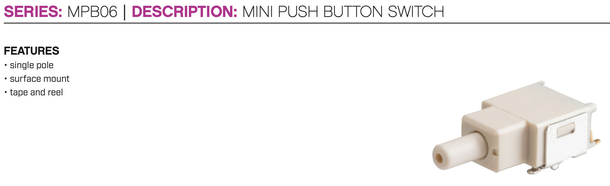
Button
Feature | Tactile Switch | Metal Push Button
Use for | PCB mounted | Panel mounted
Durability | Moderate. Can be damaged by heavy or repeated pressure. | Very high. Designed to withstand heavy use and resist vandalism
Tactile Feedback | Clear, audible "click." | Distinct, high-quality "push" feel.
Aesthetics | Utilitarian. Not typically visible to the end user. | Premium, industrial appearance.
Mounting | Requires soldering to a specific footprint on the PCB. | Requires a circular cutout in the enclosure and a fastening nut.
Cost | Very low. | Moderate to high, depending on material and features.
User Experience | Best for internal testing or user interfaces where the button is covered. | Provides a robust, confident interaction for the end user.
Feature | Elegoo-Style 6×6×6 mm Tact | TS02-66-70-BK-160-LCR-D | Adafruit 6 mm Tact
Mounting | Through-hole, breadboard-friendly | Through-hole, long crimped pins | Through-hole, breadboard-friendly
Contact type | SPST-NO, momentary (typical) | SPST-NO, OFF-(ON) | SPST-NO, momentary
Electrical life | Vendor-dependent, ~50–100k cycles typical | 80,000 cycles | High (B3F family is typically 1M mechanical cycles)
ECAD models | Usually generic 6×6 footprint | Vendor ECAD & 3D models available | EAGLE lib, Omron B3F-10xx footprint
Cost / availability | Extremely cheap, widely available in kits | Slightly higher, but still low for OEM | Low–medium, sold in hobby packs
Breadboard prototyping | Excellent | Less convenient (long crimped pins, but works) | Excellent
Back up plan for feeding if product doesn’t work
Easier for owners
Need to change for surface mounting
Notes:
Although our project had planned for the feeding time to be pre-programmed to schedule feedings and eject food, we still wanted to have a backup. This would be a push button in case the machine had a software error and does not dispense food on time. This would allow the owner to press a button to still deliver food. Instead of the user having to open the machine and retrieve food from the food storage, the push button would be a more convenient function as it could be delivered straight from the storage to the food tray.

Slide 13
Sensing Storage Capacity
Feature | Load cell Sensor | Infrared Sensor (IR) | Capacitive Sensor | Ultrasonic Sensor
Accuracy | Very high, ideal for precision weight measurements. Must be properly calibrated for the specific load | Fair for simple presence detection, but can be unreliable with different food colors, textures, or ambient light. | Good for level sensing in a controlled environment but can be affected by food density and moisture. | Good for distance measurement and non-contact level sensing
Environment Factors | Mostly immune, especially with hermetic sealing. Sensitive to vibrations if measuring minor | Prone to interference from dust, direct sunlight, and changing ambient light. | Sensitive to temperature, humidity and material build-up on the sensor. | Can be affected by extreme temperature changes, but generally reliable in typical home environments.
Pros | Measures actual weight for precise portion control; Can be very accurate and reliable for batching. | Inexpensive and easy to implement. | Low cost, durable, and suitable for non-conductive materials. | Non-contact method is hygienic and not affected by food type or color; Affordable, widely available, and simple to interface with microcontrollers.
Feature | RCWL-1601 | JSN-SR04T | A02YYUW
Supply Voltage & Logic | 3.0–5.0 V, logic = supply | 5 V supply (some variants 3.3 V logic tolerant) | 3.3–5 V supply (UART output)
Range (Typical) | ~2–400 cm | ~25–600 cm | ~6–750 cm
Key Features | HC-SR04 protocol but works at 3.3 V or 5 V | Waterproof transducer on cable | Waterproof ultrasonic with digital UART output
Pros | Direct ESP32 compatibility; no level shifting; low cost; compact | Very rugged; moisture/dust resistant; long range | Waterproof; noise-filtered digital output; good accuracy
Cons | Not waterproof; dust may degrade accuracy over time | More expensive; mounting more complex; cable + puck footprint | More expensive; UART parsing required; slower update rate
Suitability for Dog Feeder | Best choice for indoor dog feeder; ideal electrical compatibility | Excellent for outdoor or washable feeders; overkill for indoor use | Good for industrial feeders; more complex than needed
Notes:
We also need to check how much food we have left, that’s why we need sensing storage capacity
Each sensor technology has unique benefits, but the environment of a pet feeder imposes specific constraints: dust, non-uniform particle shapes, and variable lighting. Load cells are mechanically accurate but prone to drift if the feeder is moved. IR sensors are too dependent on surface reflectivity. Capacitive sensors can be unstable under varying humidity levels. In contrast, ultrasonic sensors perform consistently across these conditions because they rely on sound wave reflections rather than optical or physical contact.
Then, when we decide the model, we select the RCWL-1601 over the other ultrasonic modules because it delivers the best balance of electrical compatibility, simplicity, and performance for an indoor dog-feeder system

Slide 14

Depth Sensor
High Distance Accuracy: cm-level precision, great for verifying that the dog is within feeding range.
Digital I2C interface: clean integration with the ESP32-S3. No need for pulse timing measurements like ultrasonic sensors.
Quiet: ToF sensor does not emit any audible sounds that may disturb the dog like ultrasonic waves.
Fur: most sensors are sensitive to reflections and light. The ToF sensor is sensitive to sunlight, but the system must be operated indoors.
Sensor | Advantages | Disadvantages
Ultrasonic Sensor | Cheap Simple to integrate with GPIO | Sensitive to noise reflections like the bowl or fur Dogs can potentially hear the wave noise
Infrared Sensor (IR) | Compact and low power Good for short range detection | Sensitive to ambient light Dark fur color can reflect poorly
Time-of-Flight Sensor (ToF) | Works in dark or light environments Easy to integrate with I2C connection | Narrow FOV (~15–27°) Sensitive to sunlight
mmWave | Unaffected by light and fur color Can detect subtle motions | High power High cost More complex data parsing
Category | VL6180X | VL53L0X | VL53L5CX | TMF8701
Range | 0 – 200mm | 20 – 2000mm | 0.05 – 4m | 2cm – 1m
Accuracy | ±5mm | ±25mm | ±15mm | ±20mm
Features | Great for short distances Too short for feeder | Slightly reduced accuracy beyond 1m Stable up to 2m; Low power | Higher cost and power Strong ambient light immunity | Extremely small; Low power Less accurate with dark fur
Cost | $7 – 9 | $7 – 10 | $25 – 30 | $10 – 13

Slide 15
Power Management – Power Supply Type
Power Supply | Advantages | Disadvantages
USB Power Banks | Portable, lightweight, rechargeable. Built-in protection: overcurrent, short-circuit, thermal. Very clean 5 V output, often low ripple. Widely available at low cost. | Auto-shutoff under low-load conditions (<50–100 mA). Cannot naturally output 9–12 V without boosters. Capacity degrades with age and temperature. Many units cannot simultaneously charge and discharge.
Bench Power Supplies | Highly accurate voltage regulation. Adjustable current limiting prevents component damage. Ideal for debugging, prototyping, and electrical characterization. | Expensive compared to consumer power sources. Bulky and not portable. Not suitable as a final embedded power solution.
Wall Adapters (AC-DC adapters) | Reliable, continuous 24/7 power. Electrically isolated for safety. Available in many voltage/current ratings. Perfect for stationary appliances. | Requires access to a wall outlet. System loses power during outages unless battery backup is added. Cheap adapters may cause electromagnetic noise.
Battery Packs | No auto-shutoff issues (unlike USB banks). Flexible voltage design (1.2 V–12 V+). Inexpensive and safe. Excellent for backup power. | Heavy and bulky. Voltage decreases as cells discharge. Need periodic replacement or charging.
Switching Power Supplies (SMPS) | Very efficient (>85–95%). Minimal heat generation. Supports high input voltage ranges. Available as ICs or off-the-shelf modules. | Switching noise and EMI. Layout must follow strict rules. Requires additional components (inductor, diode, capacitors).
Solar Panels | Renewable energy source. Ideal for remote or outdoor project. Reduces dependency on AC mains. | Unusable indoors or at night. Requires charge controller. Needs a battery to stabilize voltage. Larger physical footprint.

Slide 16
Power Management – Wall Adapter
Feature | 12V Wall-Mount Adapter | USB-C PD Charger + PD Sink | Desktop Brick
Output Type | Fixed 12 V DC | Negotiable (5–20 V) via PD protocol | Fixed 12 V DC
Complexity on PCB | Very low (just barrel jack & filtering) | High: PD sink IC, CC negotiation, etc. | Low (similar to wall-mount)
Connector | Barrel (e.g., 2.1 mm) | USB-C | Barrel (2.1–2.5 mm)
Availability at 12V/ 3A | Very common | Common, but PD sink design adds work | Common GST series bricks
Cost & BOM Impact | Low total cost | Higher total (charger + PD sink BOM) | Slightly higher than wall wart
User Familiarity | Very familiar | Also familiar, but expects USB devices | Common for laptops/routers
Mechanical Integration | Adapter hangs from outlet | Charger + cable; feeder still needs jack | Brick sits on floor or shelf
Feature | Facmogu 12V 3A Adapter | Mean Well GS36U12-P1J ( 36 W) | CUI SMI36-12-V-Px (36 W)
Output Voltage / Current | 12 V / 3 A | 12 V / 3 A | 12 V / 3 A
Power Rating | 36 W | 36 W | 36 W
Headroom for Motor Peaks | Minimal (just 3 A) | Minimal | Minimal
Barrel Connector Fit | Flexible (two barrel sizes) | Specified barrel size | Specified barrel size, known connector
Cost / Availability | Likely lower cost | Slightly higher cost but trade-off in reliability | Slightly higher cost but trade-off in reliability

Slide 17
Power Management – Barrel jacks
Feature | Standard open-frame PCB barrel jacks | Sealed or locking barrel jacks | Non-barrel alternatives
Pros | Cheap, widely available; easy to mate with 12 V adapters. Good EDA models and footprints; 2–3.5 A ratings common. | Locking mechanism prevents accidental disconnect. High current rating (~5 A); robust build; long life (5000+ cycles). | Simple, robust clamping of bare wires. No special plug format. Can handle high currents.
Cons | Can be unplugged accidentally. Not sealed. Current rating must be checked vs motor load. | More expensive. Special mating plug. Slightly more mechanical complexity and height. | Less user-friendly (requires screwdriver). Easier to mis-wire. No quick-connect feel.
Fit for Dog Feeder | Very good baseline choice | Great for mission-critical devices Arguably overkill for student dog feeder | OK for internal wiring. Not ideal for “user-facing” power input
Feature | CUI / Same Sky PJ-102A | Kycon KLDX-0202-AC | Switchcraft BKZ Series Locking Jack
ID / OD | 2.0 mm / ~5.5 mm barrel family | 2.0 mm ID / 5.5 mm OD | 2.0 mm or 2.1 mm options, DC barrel family
Voltage / Current rating | ~16 V DC @ 2.5 A | ~24 V DC @ 3.5 A (variant dependent) | 24 V @ 5 A
Mounting style | Right-angle, through-hole PCB | Right-angle, through-hole PCB with kinked pins | Right-angle PCB; through-hole, SMT, hybrid options
Special features | Simple open-frame jack | Some variants include switch contact | Locking bayonet mechanism, high-current design
Mechanical robustness | Good for standard duty | High (kinked pins, higher rating) | Very high; designed for critical equipment
Cost | Low | Medium | High

Slide 18
Power Management – Voltage Regulators
Feature | Linear Regulators | Non-Synchronous Buck Regulators | High-Current Simple Switcher Buck Regulators | Off-the-shelf Buck Modules
Typical Efficiency (12→5 V) | ~42%. | ~70–85 %. | ~85–92 %. | Similar to IC used.
Current Capability | Up to a few A (with huge heatsink). | Up to ~3A. | Up to 5A. | Often 2–3A typical.
Thermal Behavior | Enormous heat: (12–5)·I, up to 35W at 5A. | Moderate heat, manageable at 2–3A. | Several watts of loss at 5A, heat sinkable. | Depends on module quality.
PCB Complexity | Very simple. | Moderate. | Moderate. | Very easy.
Feature | LM2596 | LM2679 | LM22678
Topology | Non-synchronous buck. | Non-synchronous buck. | Non-synchronous buck.
Vin range | 4.5–40 V. | 8–40 V. | 4.5–42 V.
Vout option | Fixed 5V available. | Fixed 5V available. | Fixed 5V available.
Iout max | 3A. | 5A. | 5A.
Typical efficiency (12→5 V) | ~75–85% (design-dependent). | ~85–92% (design-dependent). | ~85–92% (design-dependent).
Layout difficulty | Low–moderate. | Moderate (comfortable for 2-layer). | Moderate–high (more EMI care).
Fit for 5V at 5A dog feeder | Undersized. | Excellent, recommended. | Excellent, but more layout-sensitive.

Slide 19

Software Comparisons

Slide 20

Mobile Application Stack - Frontend
Familiarity & Reduced Learning Curve: Our team has prior experience with Flutter from previous coursework, allowing us to develop more efficiently and reduce implementation time.
Seamless Firebase Integration: Flutter integrates directly with Firebase, enabling smooth real-time data handling, authentication, and backend communication.
Near-Native Performance: Ahead-of-time compilation to native ARM code ensures high performance on iOS devices, providing a smooth user experience.
Consistent & Customizable UI: Flutter’s Skia rendering engine delivers consistent visuals across platforms while allowing full UI customization.
Rapid Development Tools: Features like hot reload enable fast iteration, debugging, and UI refinement, accelerating overall development.
Category | React Native | Ionic | Flutter
Language | JavaScript / TypeScript (React) | HTML, CSS, JavaScript / TypeScript (Angular, React, or Vue) | Dart
Performance | High performance, close to native; slight overhead from JS bridge | Moderate performance due to WebView reliance; best for lightweight apps | Near-native performance via AOT-compiled Dart and direct rendering
UI Consistency | Matches native look using system components | Mimics native look using web components and CSS | Pixel-perfect, consistent UI across all platforms via custom widgets
Development Speed | Fast — shared codebase, hot reload, large ecosystem | Very fast — uses standard web technologies and tools | Fast — hot reload, unified widget tree, rich tooling
Learning Curve | Easy if familiar with React/JS | Easiest for web developers (HTML/CSS/JS skills reusable) | Moderate — requires learning Dart and widget-based UI paradigm
Ecosystem & Libraries | Mature, vast NPM ecosystem, backed by Meta | Large plugin base, strong web developer community | Growing rapidly, strong official support from Google
Integration with Backend (Firebase, REST APIs) | Excellent — native Firebase SDKs and REST API support | Good — uses JavaScript SDKs; works well with Firebase | Excellent — first-class Firebase integration and SDKs

Slide 21
Mobile Application Stack - Backend
Fast & Beginner-Friendly Setup: Firebase provides native Flutter SDK support and requires no server management, allowing us to deploy quickly without extensive backend experience.
Real-Time Cloud Synchronization: Firestore and the Realtime Database enable instant data updates between devices, ensuring a responsive and seamless mobile app experience.
Built-In Authentication & Security: Firebase offers secure, ready-to-use authentication methods (email/password, Google, anonymous, etc.), simplifying multi-user and multi-device management.
Automatic Scaling & High Reliability: Powered by Google Cloud infrastructure, Firebase scales automatically with usage and maintains strong uptime without manual configuration.
Integrated Storage & Cost Efficiency: Firebase Storage securely handles images and video snapshots, integrates with Cloud Functions and analytics, and offers a generous free tier with scalable pay-as-you-go pricing.
Category | Firebase | Supabase | AWS Lightsail
Ease of Setup | Easiest setup; no servers to manage; seamless with Flutter and mobile SDKs. | Simple setup with SQL-like structure; integrates quickly with Flutter via REST or SDKs. | Requires manual API and server setup; more configuration needed for databases and hosting.
Real-Time Communication | Built-in real-time sync with Firestore and Realtime DB. | Supports real-time updates using PostgreSQL’s replication features. | Must implement custom WebSockets or MQTT for real-time data.
Authentication & Security | Built-in user auth (Google, email, custom tokens) and rule-based security. | JWT/OAuth auth with role-based access via SQL policies. | Uses AWS Cognito or custom JWT; full control over IAM and firewalls.
Database Model | NoSQL (Firestore) and JSON structure; ideal for live sync. | SQL (PostgreSQL) with relational querying and constraints. | Choose any (MySQL/PostgreSQL/MongoDB) — manual setup required.
Storage & Media Handling | Firebase Storage handles snapshots and logs easily. | Supabase Storage for files and media, similar to Firebase. | S3 integration for media; supports HLS streaming and large file handling.
Scalability | Auto-scales seamlessly with traffic; fully managed. | Scales with PostgreSQL cluster upgrades; moderate management. | Manual scaling by upgrading instances or adding load balancers.
Cost | Free tier + pay-as-you-go; cost increases with high read/write frequency. | Generous free tier; predictable pricing. | Fixed monthly per instance; predictable but may cost more idle time.
Maintenance | Minimal maintenance (serverless). | Low maintenance; open source with optional self-hosting. | Higher maintenance—updates, security patches, backups managed manually.

Slide 22
Embedded Software
Deterministic Real-Time Control: C provides precise timing and predictable execution, ensuring immediate responses when the dog is detected sitting and the motor, LED, or speaker must activate.
Low Memory & High Efficiency: With the ESP32-S3’s limited RAM and processing power, C’s low overhead and direct memory control make it ideal for efficient embedded execution.
Direct Hardware Access: C allows direct interaction with registers, drivers, and peripherals, enabling accurate control of the motor, camera, LEDs, speaker, and Wi-Fi module.
Reduced System Overhead: By using a structured main control loop with interrupt service routines instead of a full RTOS, the system avoids context-switching delays and unnecessary computational costs.
Industry-Standard for Embedded Systems: C is the most widely used language for microcontrollers and real-time systems, providing reliability, performance, and long-term maintainability.
Category | C/C++ with FreeRTOS | MicroPython | TinyML Frameworks
Use Case | Low-level embedded control for MCU. Run components concurrently. | Python-based embedded control for MCU. | Compressed machine learning detection model for MCU
Advantages | Direct access to hardware registers and peripherals. Runs efficiently with minimal memory. High performance and timing precision. Real-time scheduling ensures deterministic behavior. Enables parallel task management. | Extensive built-in libraries for networking and sensors. Readable syntax. | Low latency. Offline operation. Enhances data privacy.
Disadvantages | Manual memory management. Limited abstraction. Longer development cycles. Requires careful task priority tuning. More complex. | Much slower execution. Limited real-time control. Higher memory requirement | Limited to small CNNs. Low accuracy.

Slide 23
Cloud Server
No sever management: Google Cloud Run does not require any server management, so no Linux maintenance, firewall configuration, or patching.
Built for HTTPS interface APIs: allowing for an easy integration with Firebase and request routing is handled automatically.
Auto-scaling: It scales automatically for any future upgrades or multiple feeders.
Simple deployment: build a Docker container, deploy, and get HTTPS URL.
Less operational overhead: It does not need to run 24/7, unlike VMs and Amazon EC2.
Less complex: Google Cloud Run is less complex compared to AWS SageMaker. AWS SageMaker is a full ML platform that is overkill for an inference endpoint, and it is expensive and more configuration.
Feature | Google Cloud Run | Google Compute Engine (VM) | Amazon EC2 | AWS SageMaker
Setup | Easy | Medium | Medium | Hard
Server Management | None | OS | OS | Minimal
Auto-Scaling | Yes | Manual | Manual | Yes
Best For | REST APIs | Full Control | Full Control | Enterprise ML
CPU Control | 1-8 vCPU (selectable) | Full Control | Full Control | Instance-based

Slide 24
Hardware Design
Wall Adapter
Ultrasonic sensor
Depth Module
12V
Camera
Button
3.3V regulator
ESP32
Motor Driver
Motor
CP2102
5V regulator
Amplifier
Speaker

Slide 25
PCB Design

Slide 26
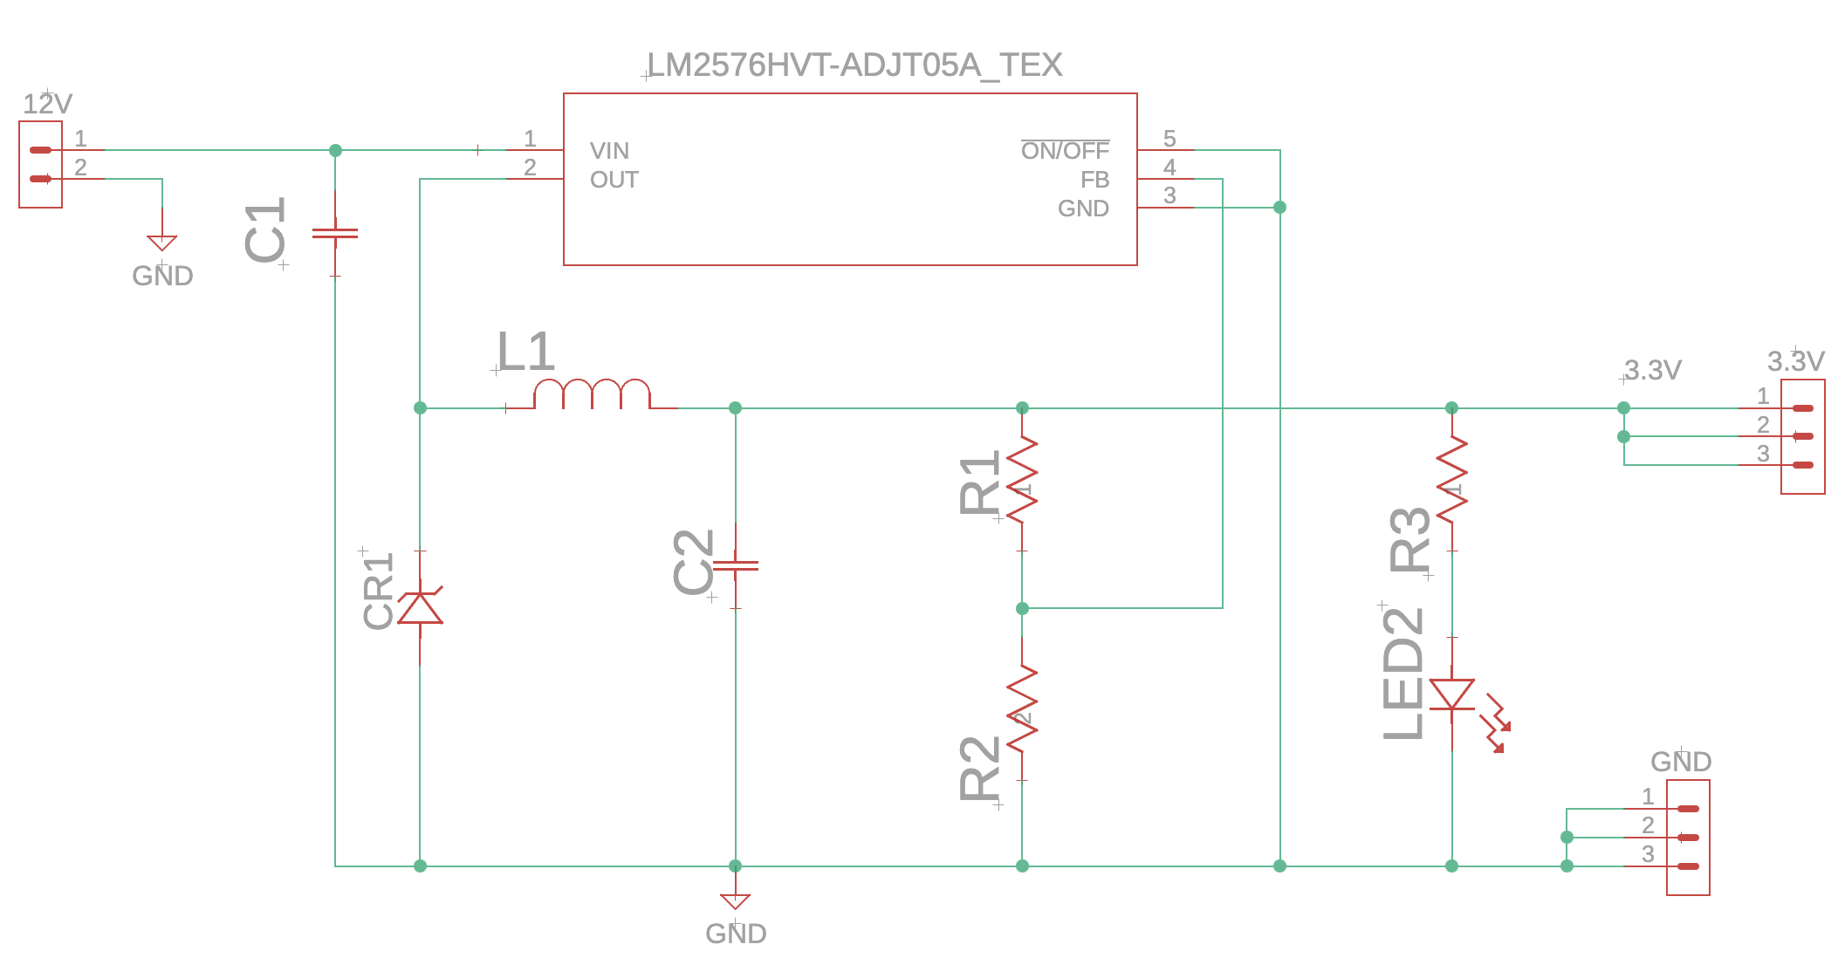
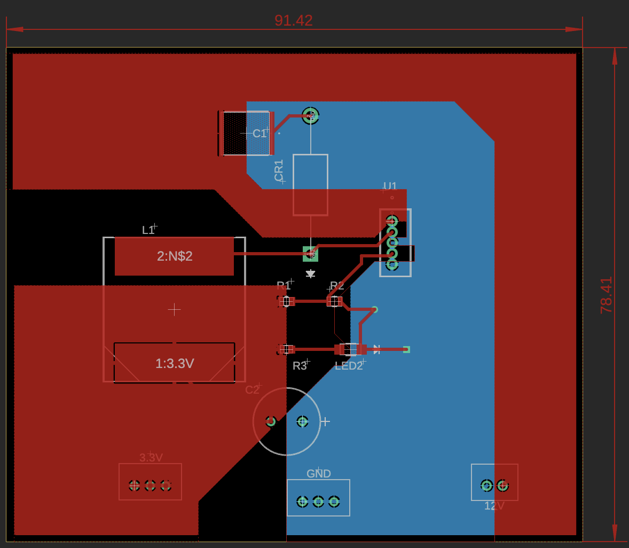
Voltage Regulators
 | R1 | R2
3.3V | 2.7k | 1.6k
5V | 11k | 3.6k

Slide 27
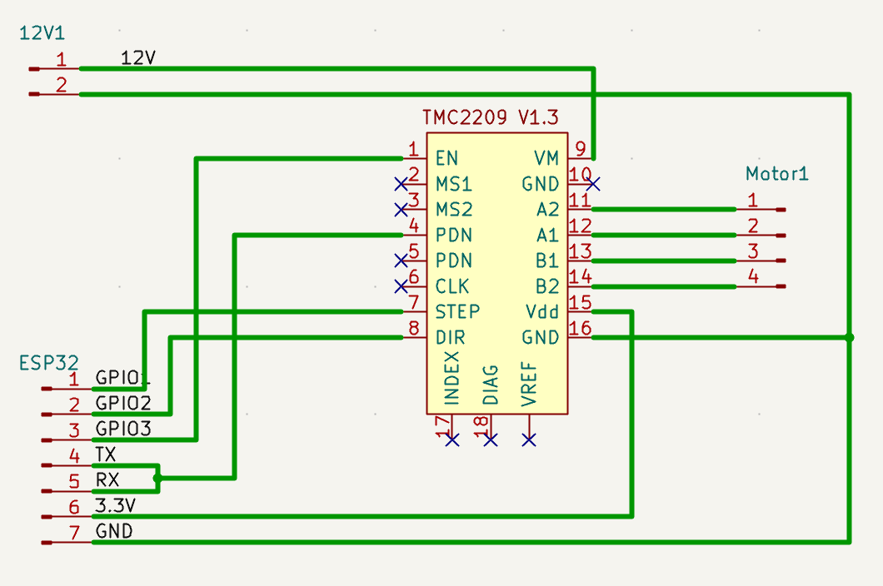
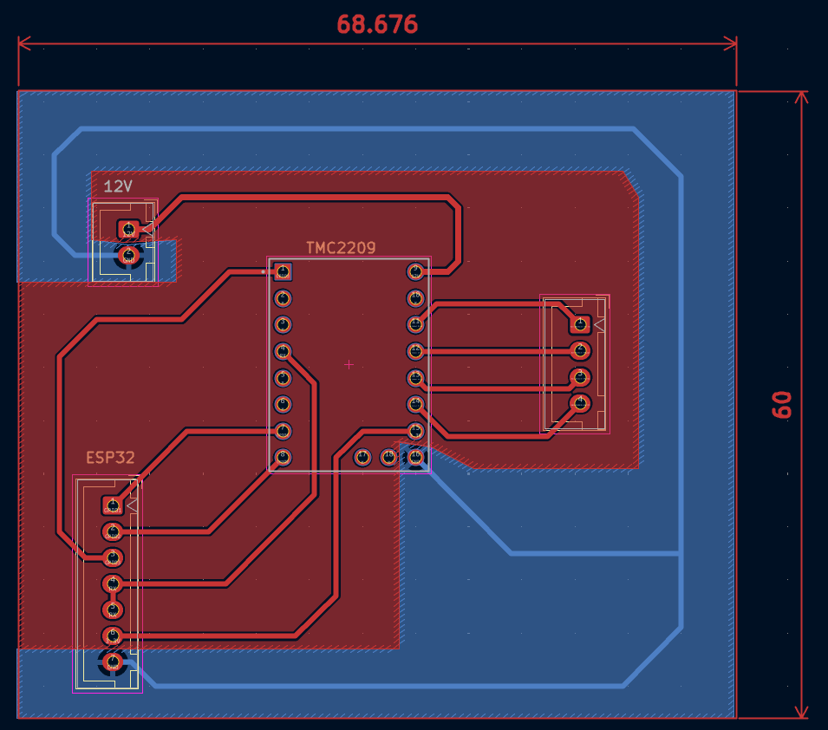
Motor & Motor Driver

Slide 28
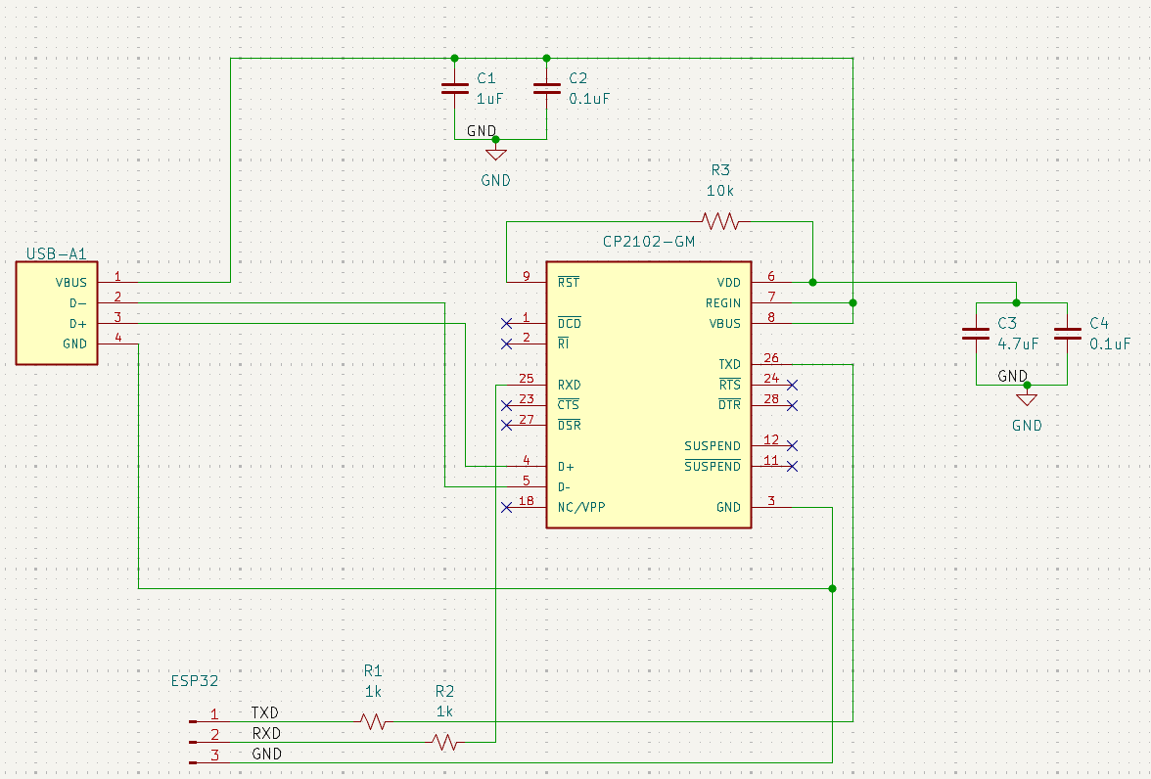
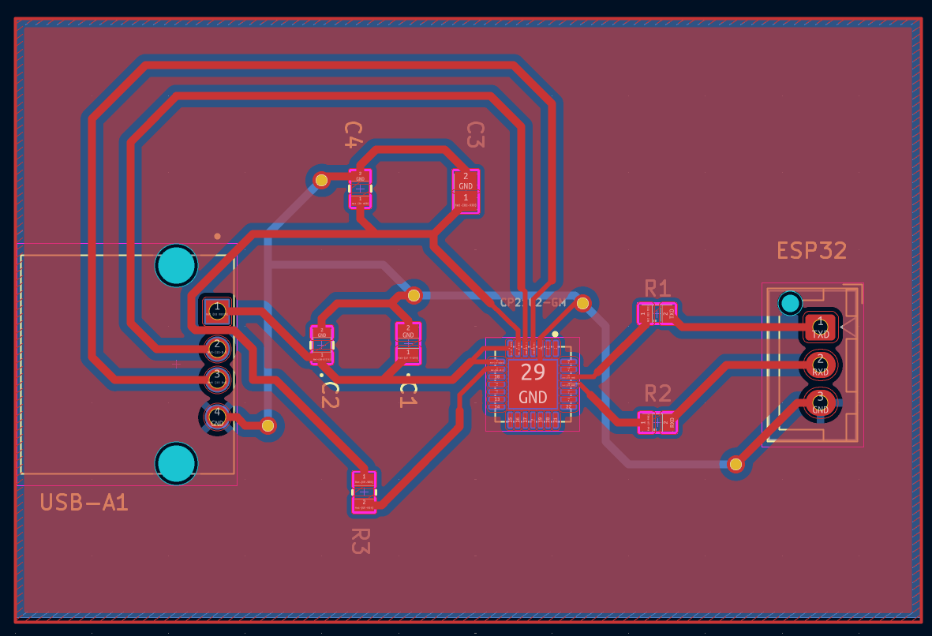
CP2102 programming

Slide 29
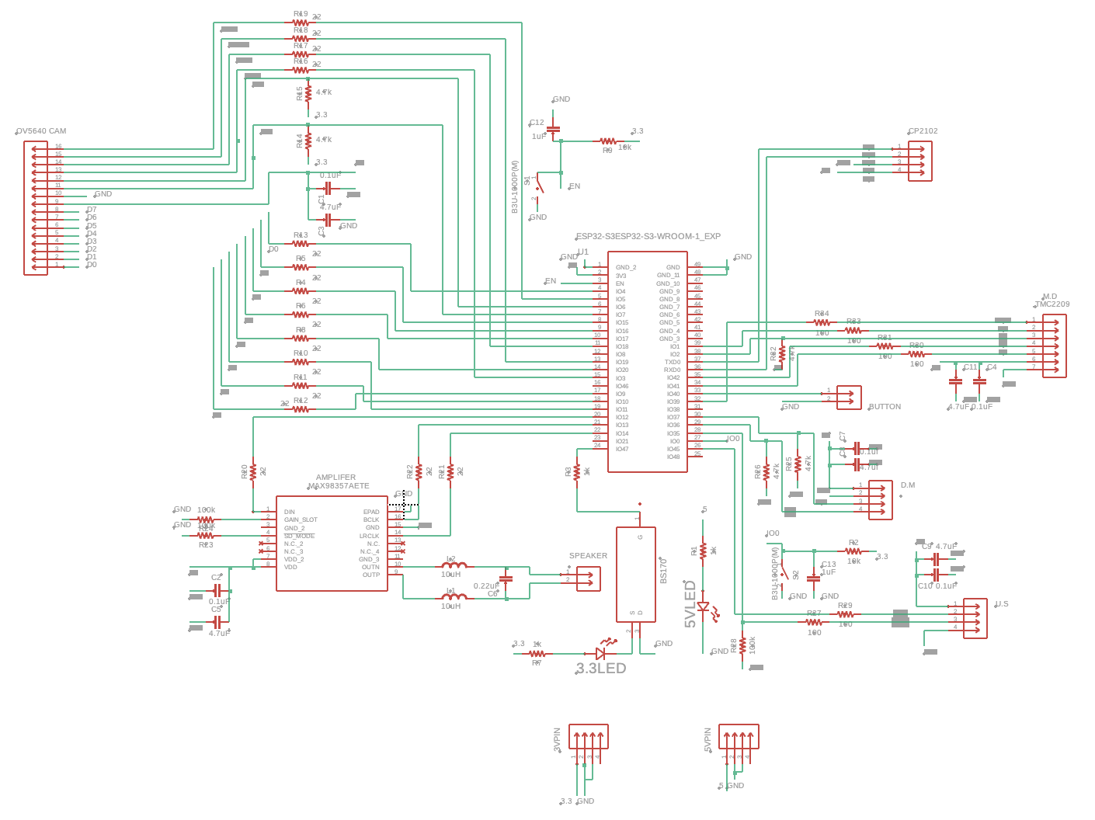
Main MCU
What The MCU PCB Contains
ESP32-S3
MAX98357A Amplifier
Adafruit Speaker Connector
Connecter to the CP2102 Programmer
Connecter to TMF8701 Depth Module
TMC2209 Motor Driver Connecter
OV5640 Camera connecter
Connecter to a pushbutton
RCWL-1601 Ultrasonic sensor connecter

Slide 30
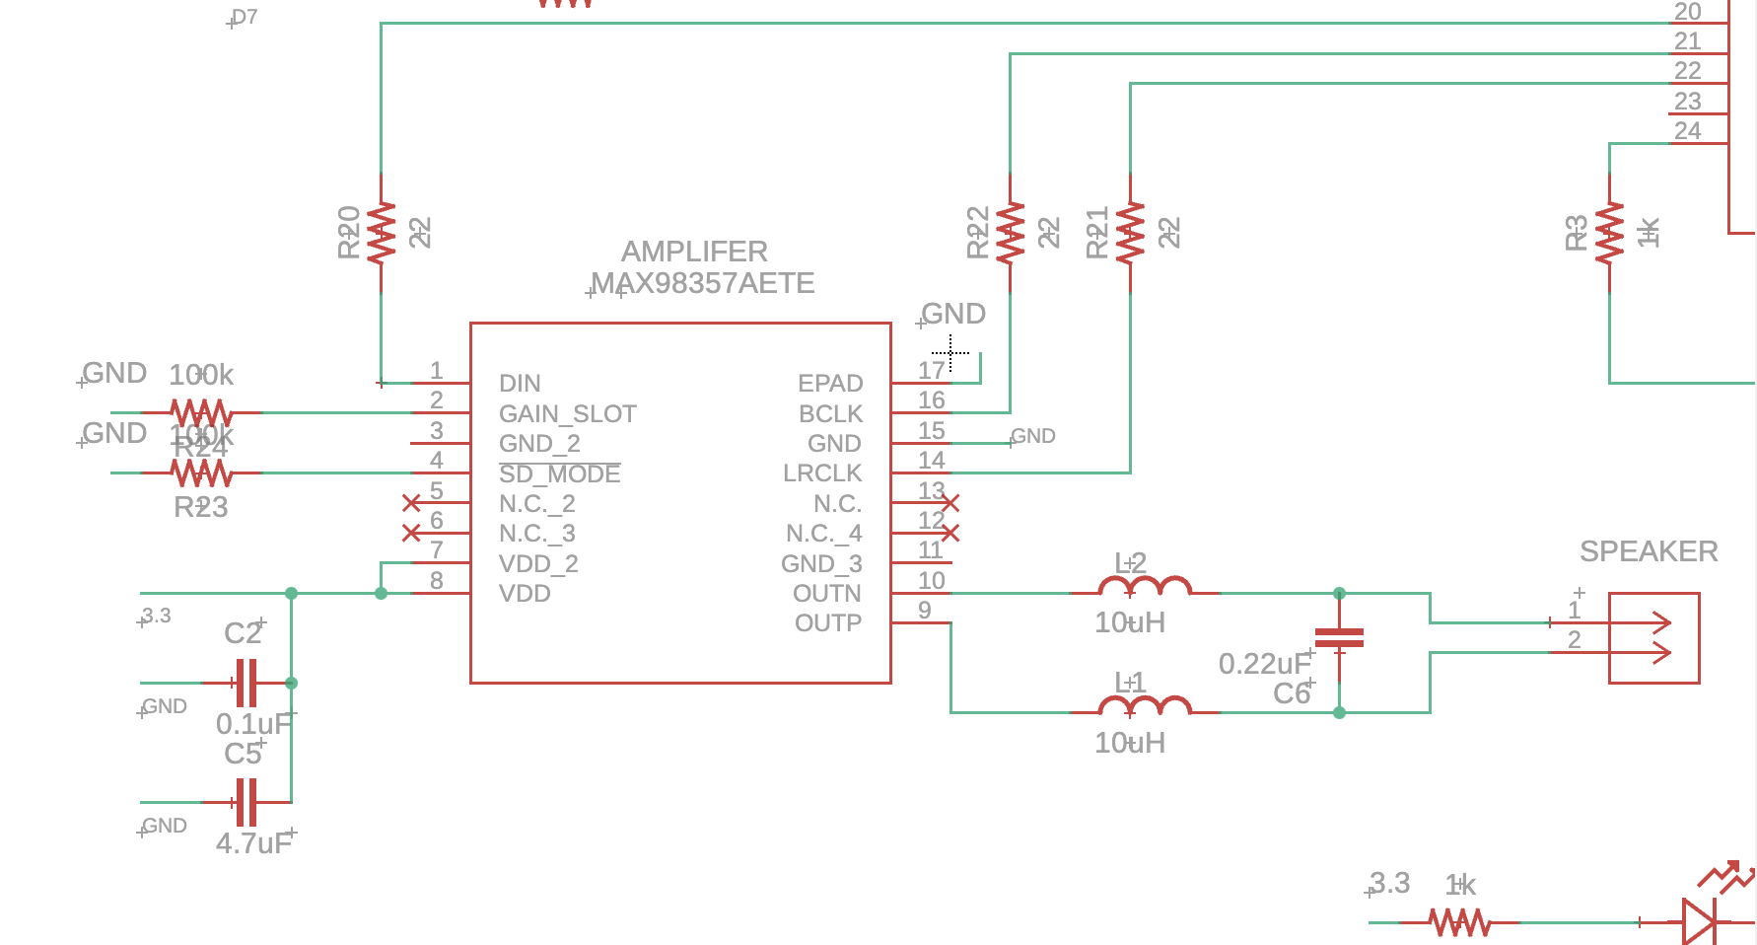
Main MCU: Amplifer

Slide 31
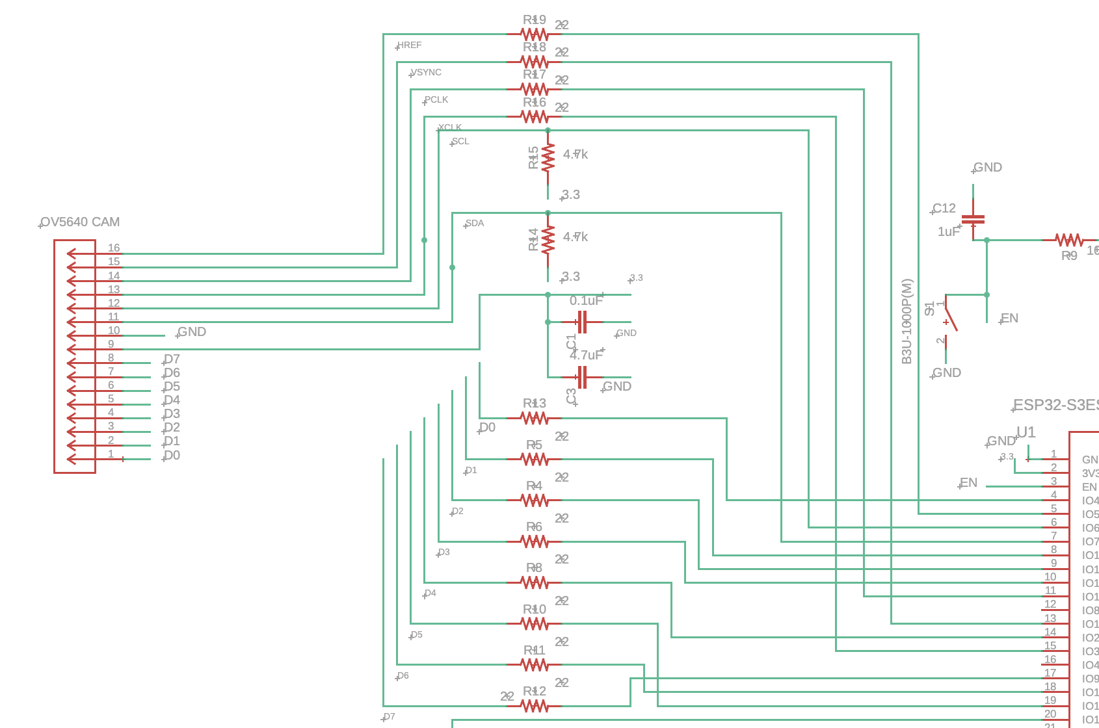
Main MCU: Camera

Slide 32
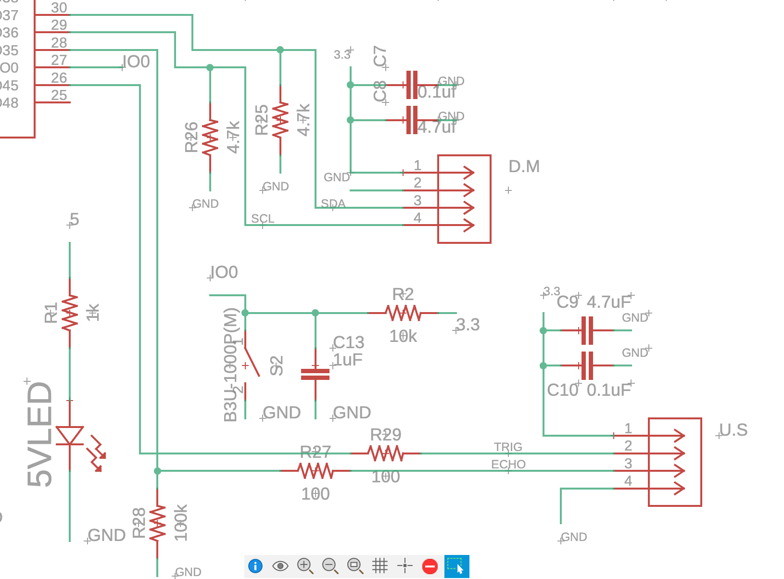
Main MCU: Depth Module + Ultrasonic sensor

Slide 33
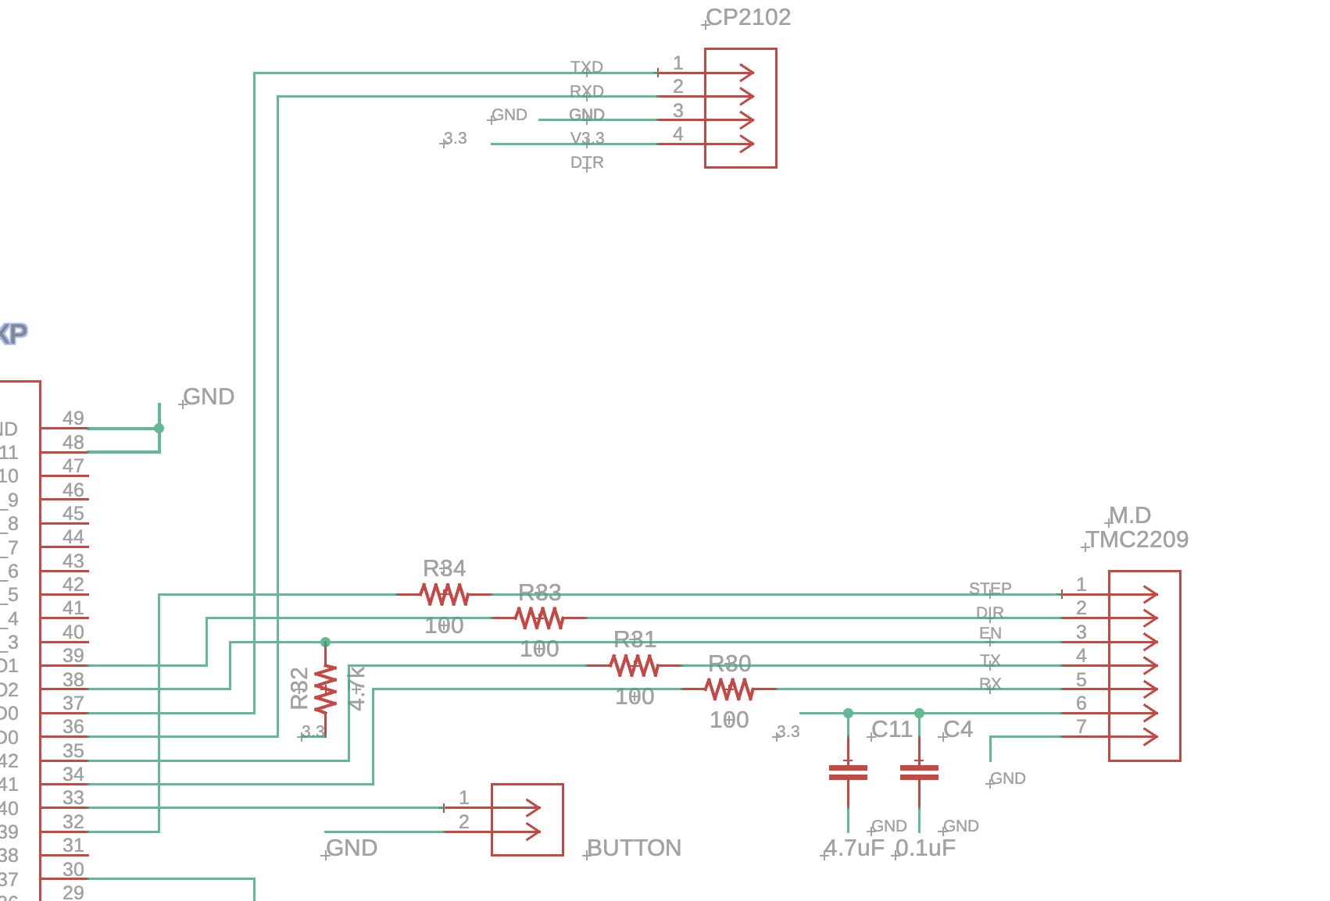
Main MCU: CP2102, Motor Driver, and Pushbutton

Slide 34
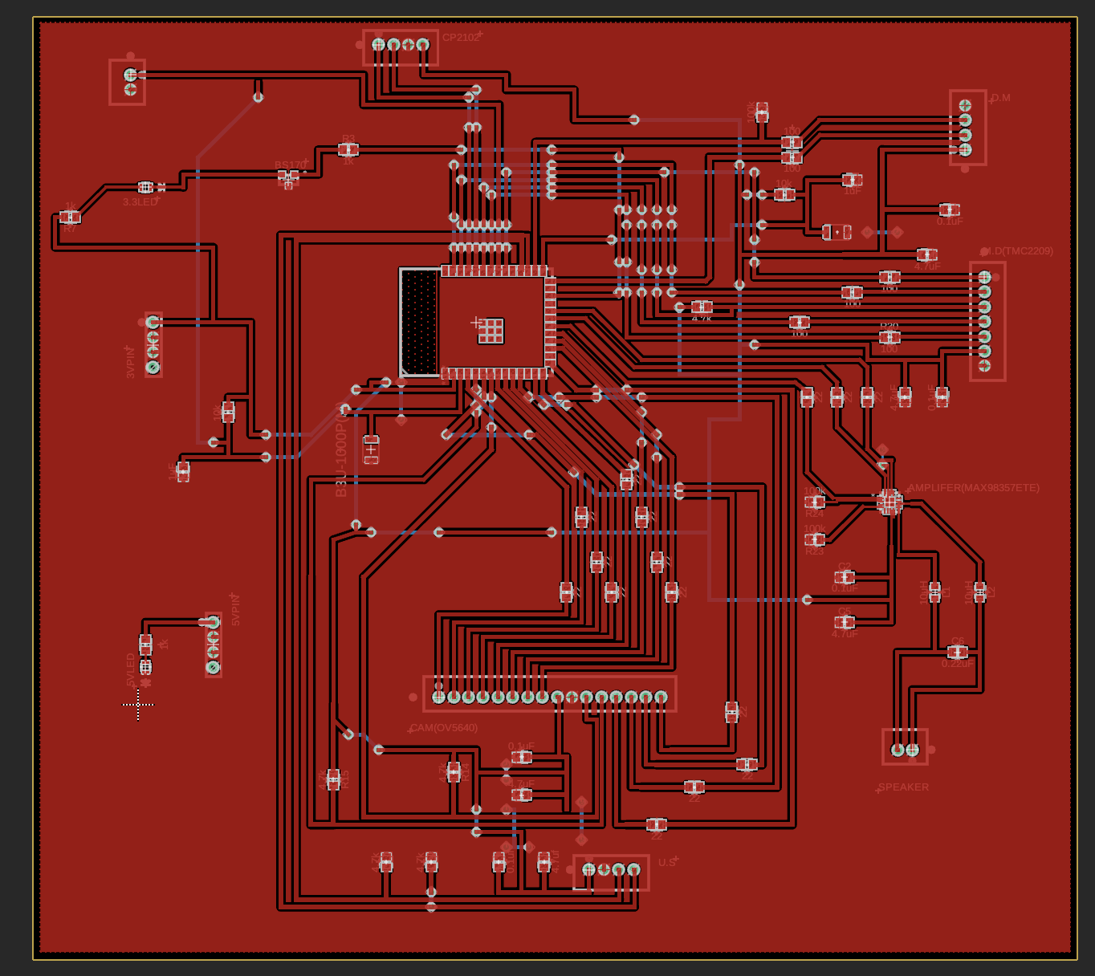
Main MCU Layout
CP2102
Button
Ultrasonic Sensor
ESP32-S3
Motor Driver
Amplifer
Camera
Speaker
Depth Module

Slide 35

Software Design

Slide 36
Software Design
Scheduled Feed Workflow
User Scheduled Feeding Time
Activate Camera
Stream Frames to Backend Server to Send to Cloud Server
Dispense Food
Yes
Sitting
Check If Dog Is In Range
Apply Detection and Classification Algorithm
No
Not Sitting
Feed After 3 Minutes Anyways
Publish Outcome to App Logs

Slide 37
Mobile
Application

Slide 38
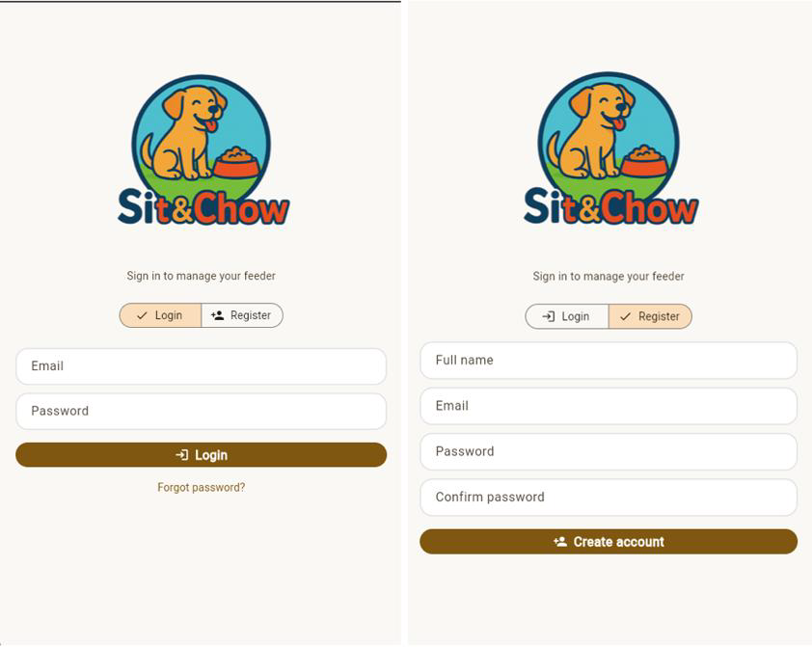
Mobile Application – Login and Register
The first page that the user sees is the login and register page
When they register, the information they enter is sent to the Realtime Database in Firebase to authenticate the user in the login process
Once they register or login, they are sent to the landing page

Slide 39
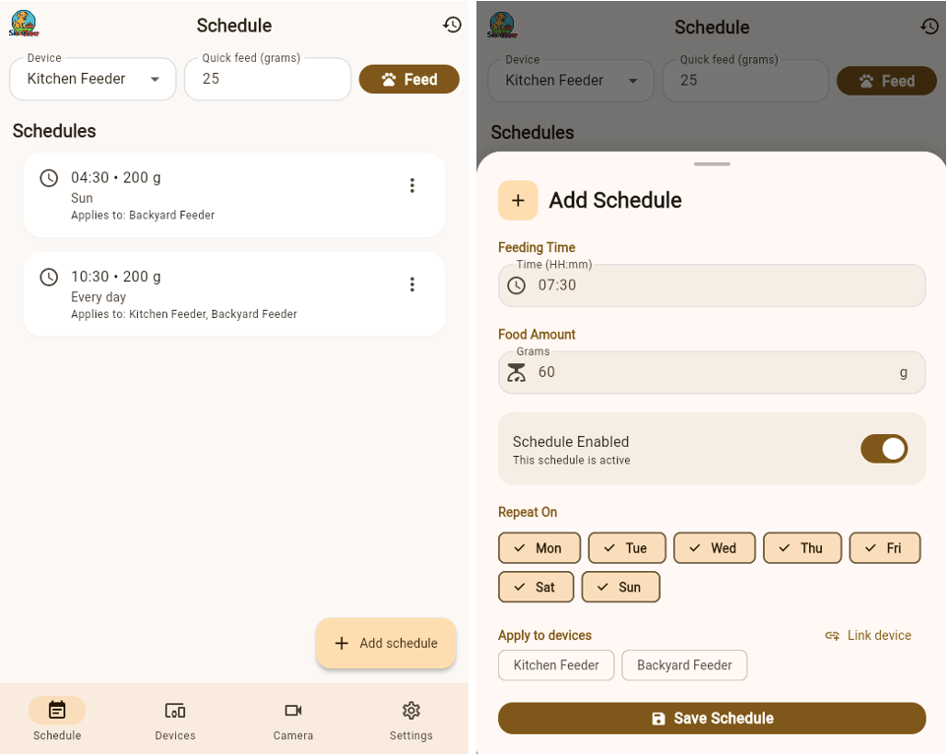
Mobile Application – Schedules
The schedules page displays all of the schedules the user has created
A quick feed option is available to immediately activate the feeder, bypassing the detection model should the user need to do so
The user can create a new schedule, assigning different days, times, food amount, and devices the schedule is assigned to
The user can freely edit or delete the schedules created at any time

Slide 40

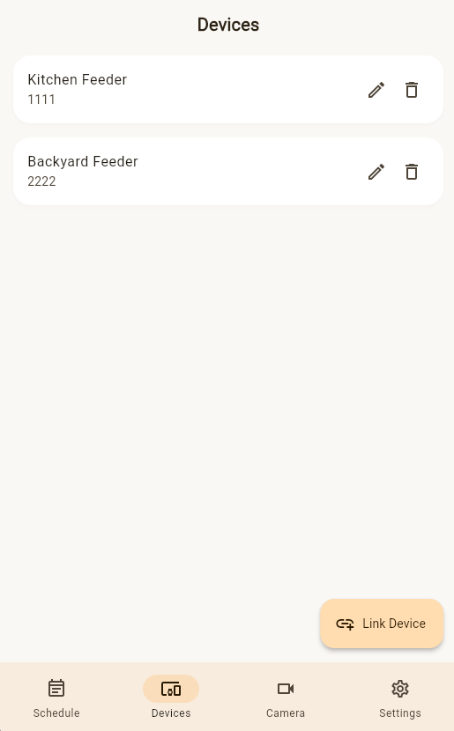
Mobile Application – Feed Logs & Devices
By clicking the history icon on the top right of the schedules page, the feed logs page appears
All this marks is whether or not a sitting position was detected within the feeding time frame
If no sitting position is detected within 5 minutes, a failure will be marked, otherwise it will be marked as a success
The device page displays all of the currently linked devices
The user will have to manually input the Device ID to connect to it
The Device ID is randomly generated and will be given to the user per device
The user can name the device once connected and can then freely edit or delete said device

Slide 41
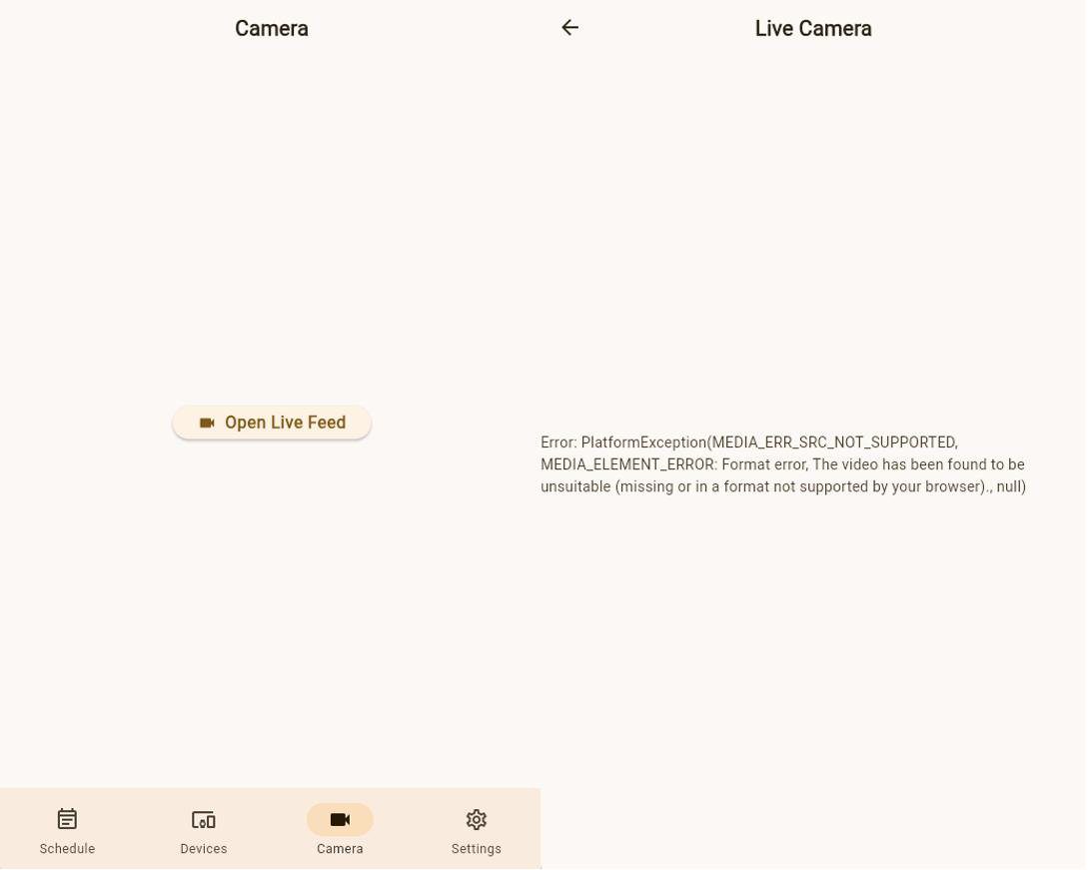
Mobile App – Live Camera Feed
The camera page will not immediately go to the live camera feed and will instead have an interactable button in the center to enter the live camera feed
We do this to reduce performance costs because the user may accidentally open the camera page and doing this without the extra page will start the live feed events, possibly causing significant performance issues
Once the live feed page is open, the live feed events will activate, and the user will be able to see through the camera
There will be an interactable microphone symbol that allows the user to speak through their phone out through the speaker on the dog feeder

Slide 42
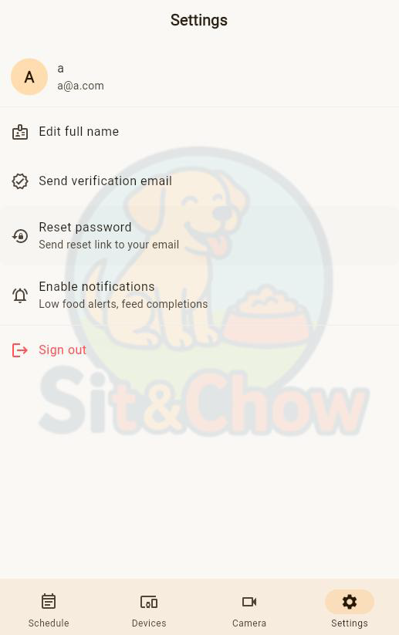
Mobile Application – Settings
On the settings page, the user will be able to change their full name
They will be able to verify their email address
A reset password function is available should the user wish to change their password
They are also able to enable their notifications on this page if they turned it off before
Lastly, they can sign out of their account if they wish to do so, sending them back to the login and register page

Slide 43

Posture Detection and Classification Algorithm
Cloud Server Receives Frames
The detection and classification pipeline operates in 5 main stages:
Getting the image
Detecting the dog
Displaying and cropping the bounding box
Classifying the posture
Executing the event
YOLO Model Detects Dog
Not Sitting
YOLO is a computer vision model that is pretrained on the COCO dataset. Dogs are one of the objects it has learned to detect.
A box will be drawn around the dog, and the image will be cropped around the box.
Image Is Cropped Around Dog
Classification Model
The new image will be passed through a classification model to determine if the dog is “sitting” or “not sitting.”
Sitting
Dispense Food

Slide 44
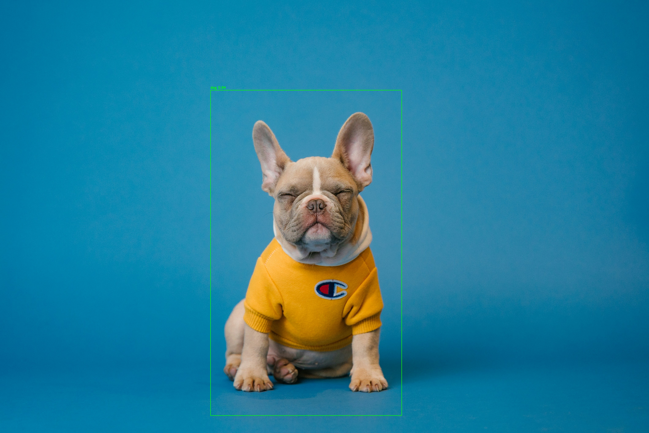

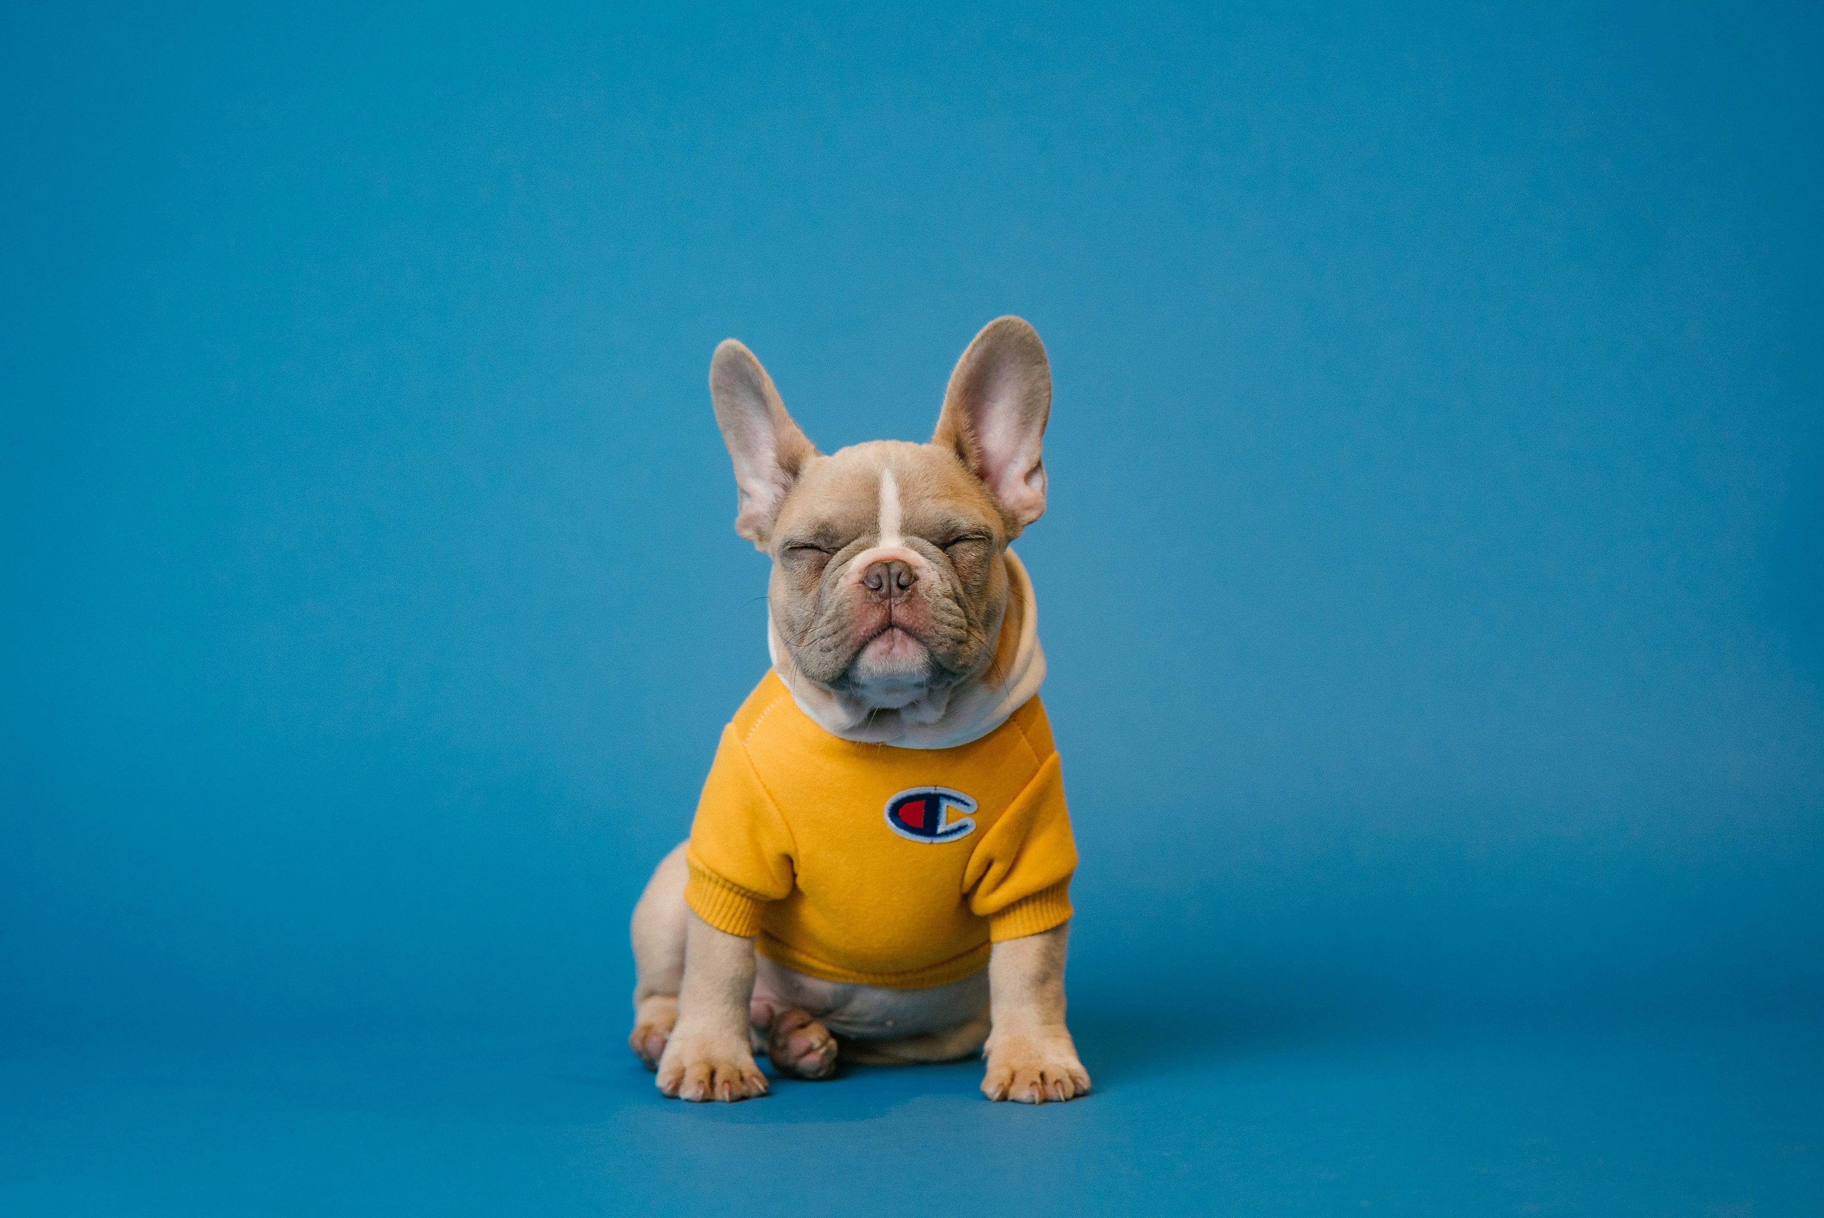
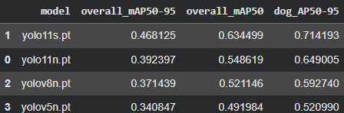
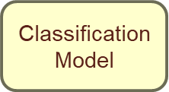
How it works:
The mobile app server will send the images to the Google Cloud Run server. A container is created to load the models and run the inference. The output will be sent back to the system until the food is dispensed.
Which YOLO model?
We need to measure the detection rate, confidence, bounding box, and inference time.
Models: YOLOv11, YOLOv8, and YOLOv5
The nano version will be tested, and the best model will be tested amongst its other versions to give the average precision.
Then the best model will be tested on a set of images that will be like the ones seen from the system’s camera.
Further testing will be done on the cloud server to check inference time.
YOLO Model Detects Dog
Image Is Cropped Around Dog
Cloud Server Receives Image

Slide 45
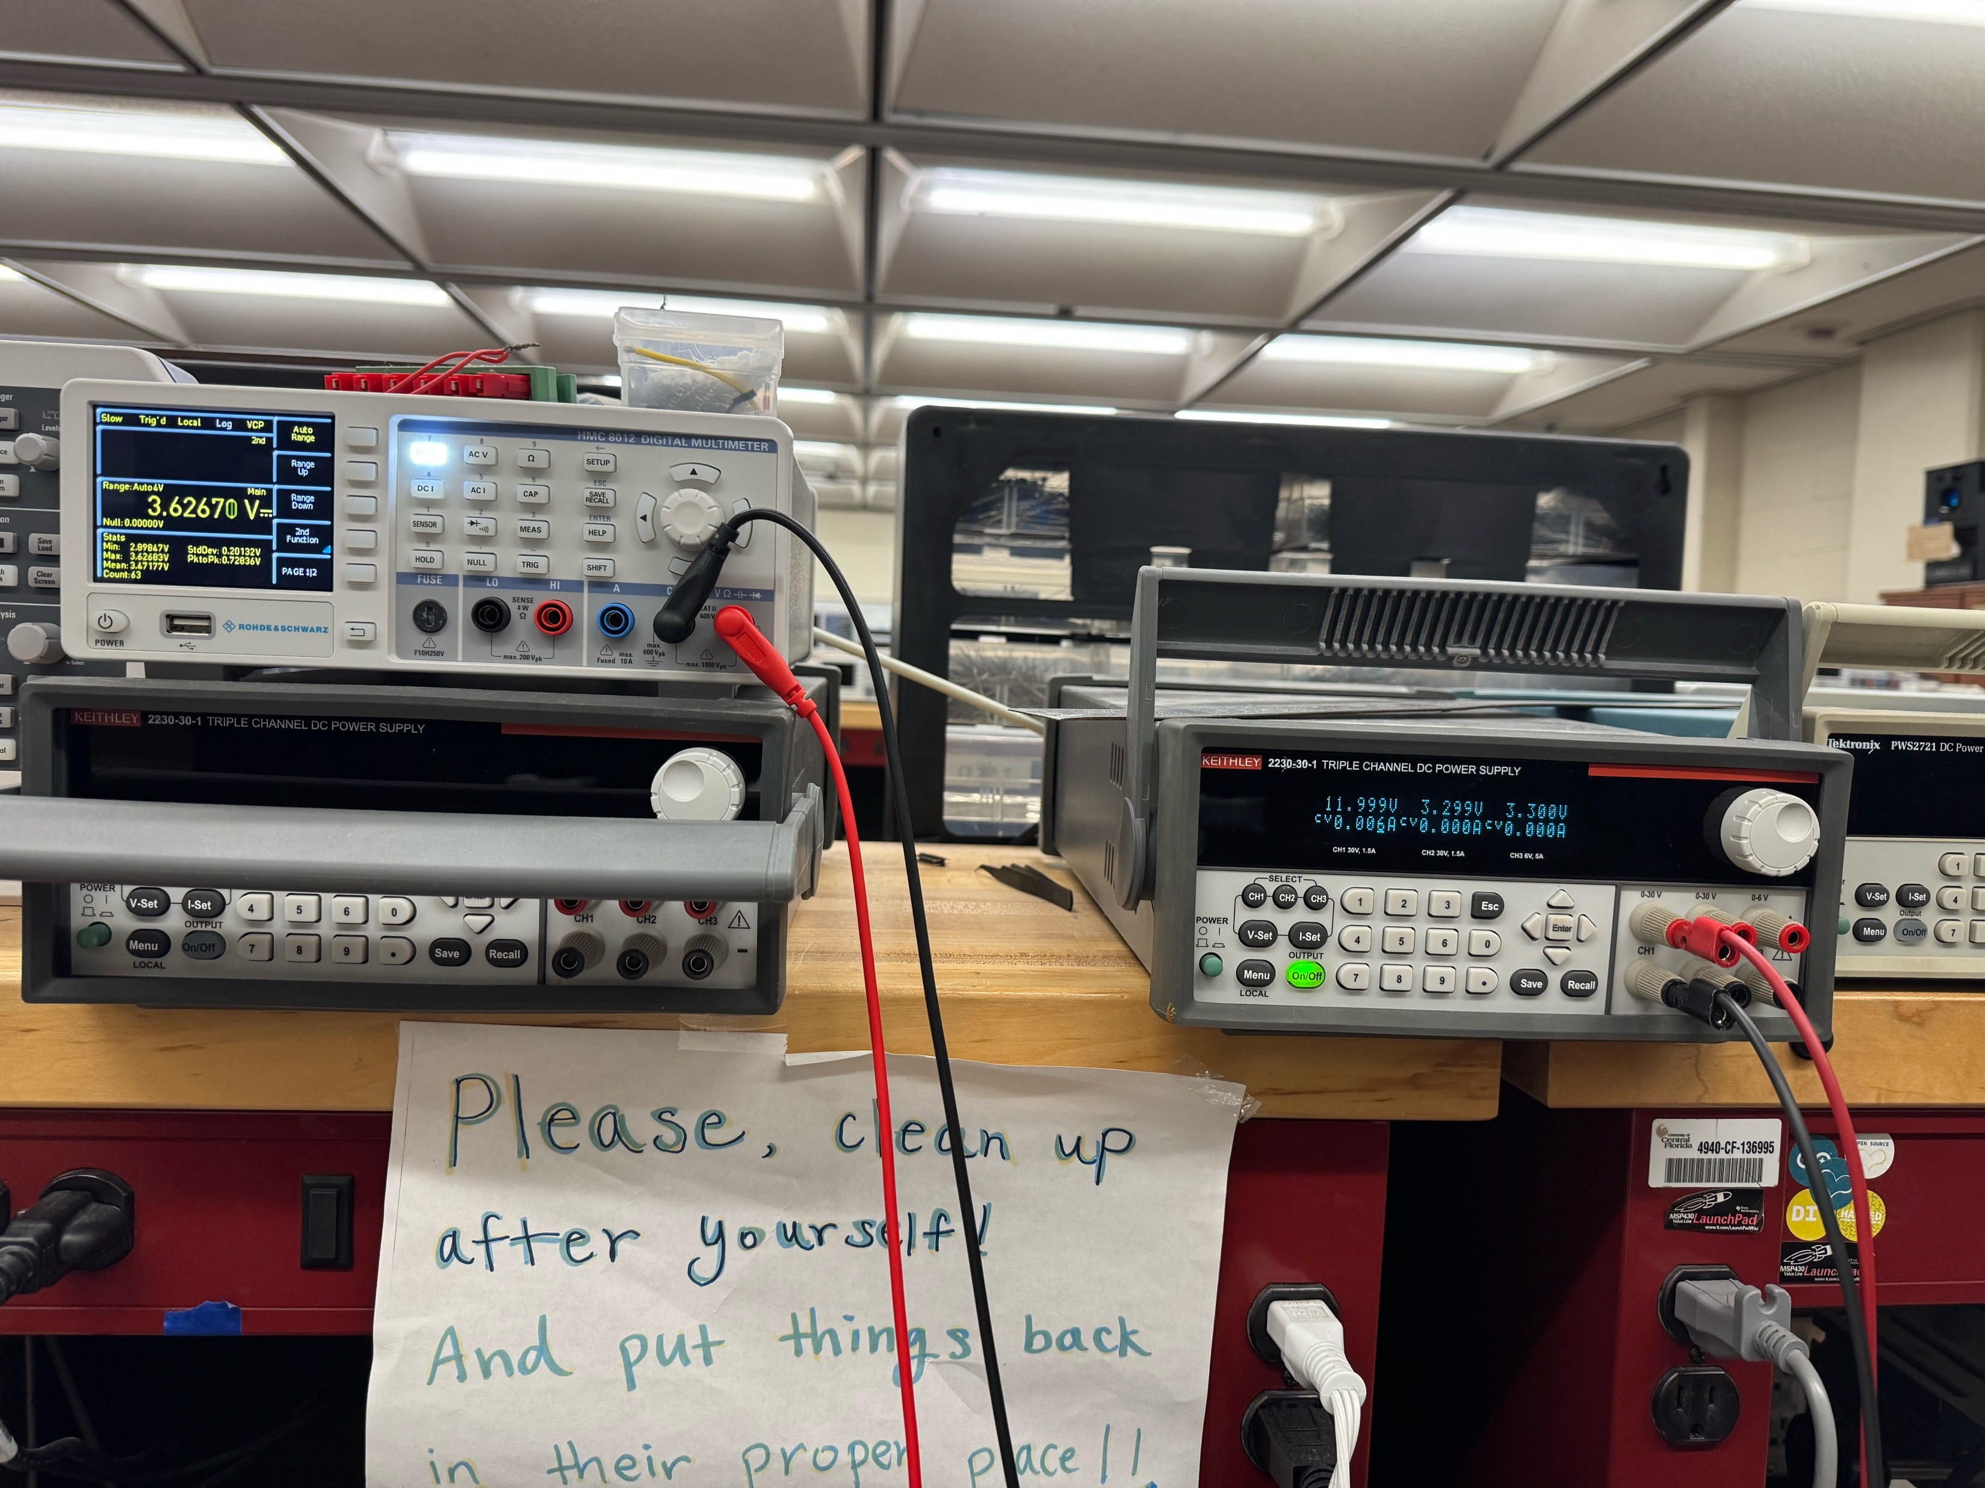
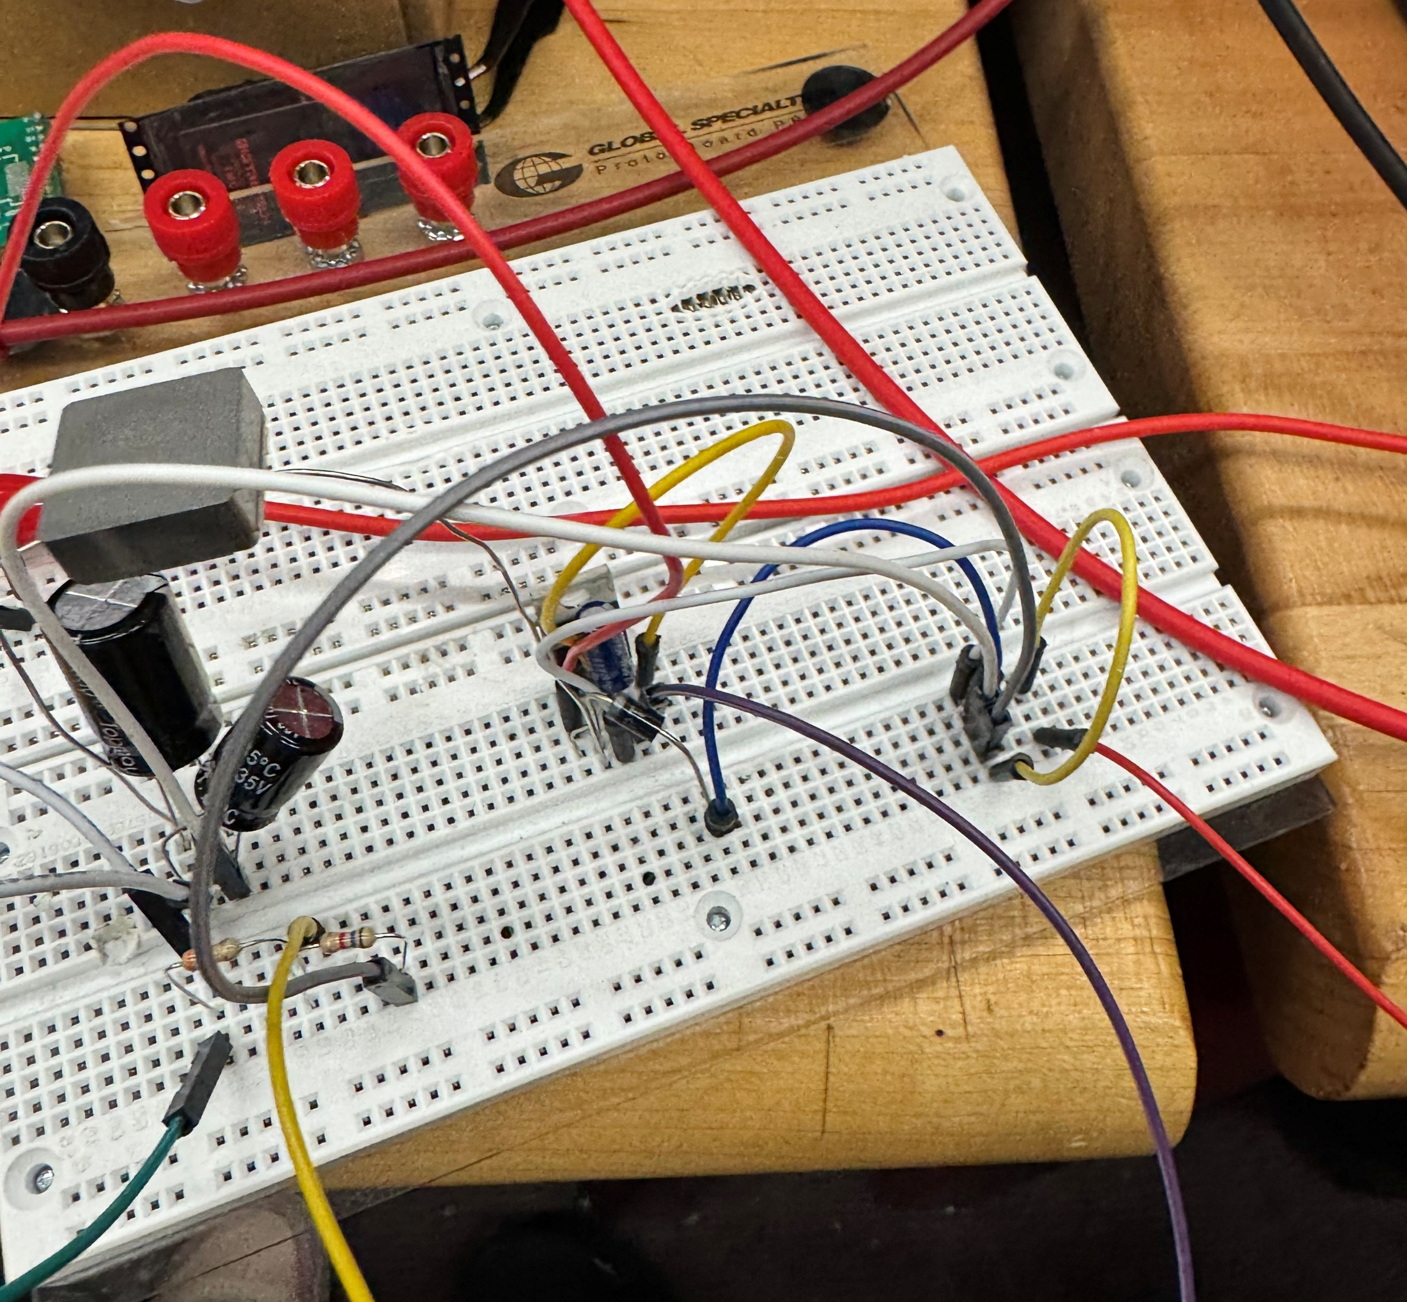
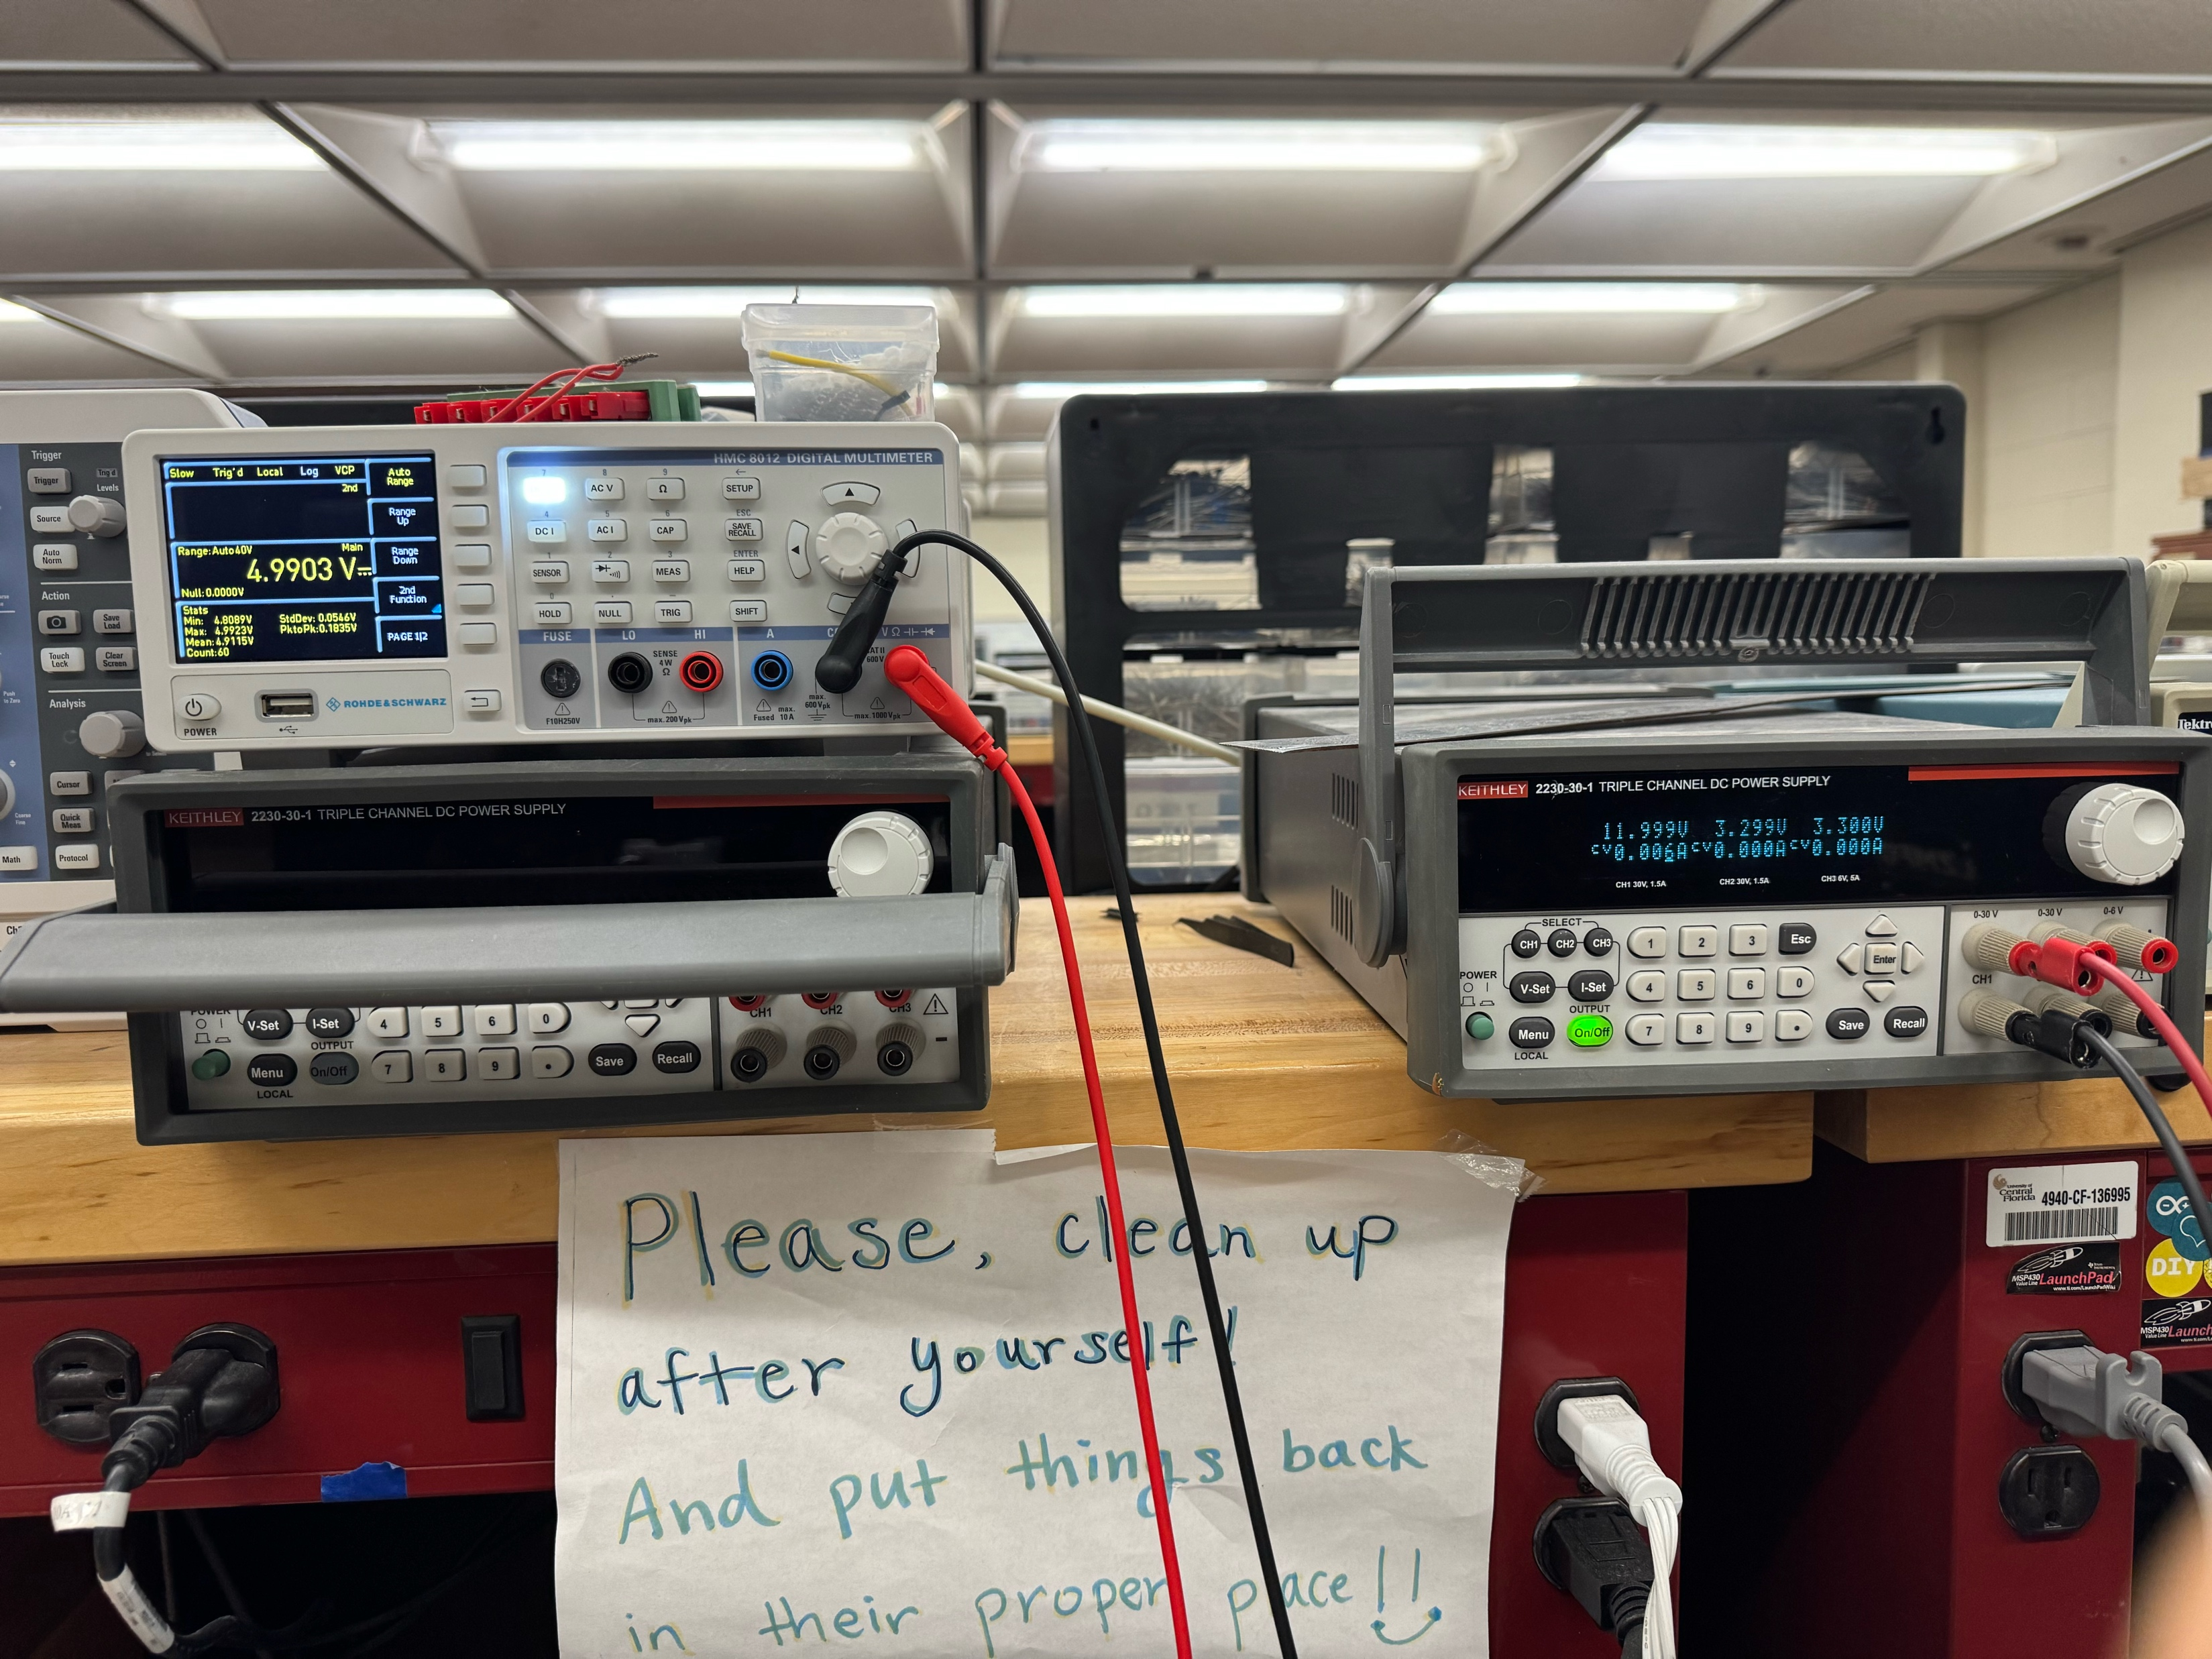
Prototyping and Testing

Slide 46
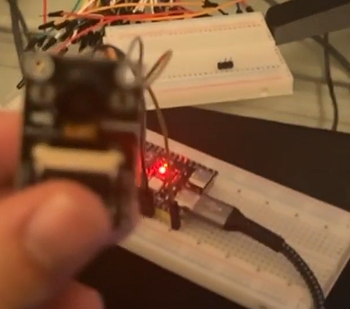
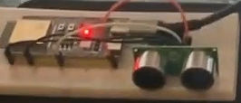
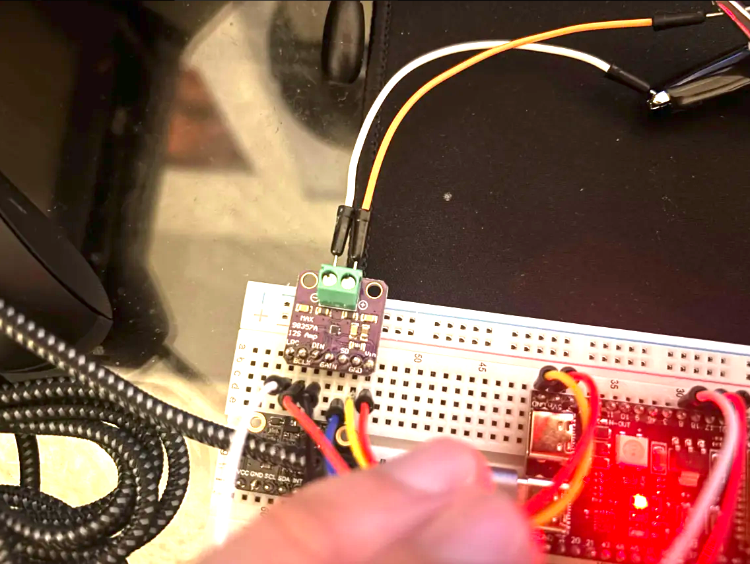
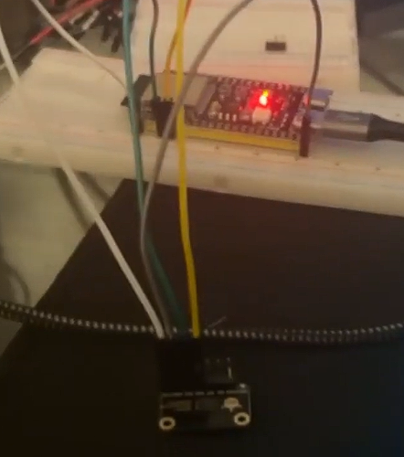
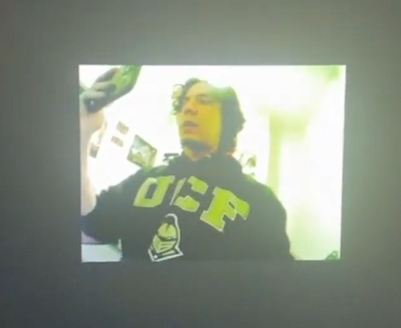
Prototyping and Testing

Slide 47

Administrative Content

Slide 48
Contributions
Senior Design 1
Andres | Project Description, MCU Selection, Mobile Communications, MCU and Mobile Application Software Design, Case Study, Software Testing
Andrew | Hardware Selection (Camera), Standard Constraints, Hardware Design, PCB
Maria | Introduction, Project Description, Hardware (Depth Module), Detection and Classification Model, Software Constraints, Software Testing, BOM
Natalie | Hardware Selection (Motor, Motor Driver, Speaker, Amplifier, LEDs, Button, Sensing Storage Capacity, Power Management), Case Study, Hardware Design, PCBs, Hardware Testing, BOM, Milestone
All | HOQ, Specification Table
Senior Design 2
Hardware
Andrew | ESP32, Camera, 2 Sensors, Amplifier-Speaker, Button
Natalie | Motor driver - Motor, Voltage Regulators (3.3V & 5V), CP2102
Software
Andres | Embedded Software, Mobile Application
Maria | Detection and Classification Pipeline, Cloud Server
All | Testing together to see if the product works

Slide 49
Budgeting
Component | Quantity | Price Total
Stepper Motor | 1 | 3.33
Motor | 1 | 4.59
Power Adapter | 1 | 9.99
Barrel jack | 1 | 0.65
Camera | 1 | 13.76
Voltage Regulators | 2 | 18.64
Amplifier | 1 | 5.95
Speaker | 1 | 1.95
Button | 1 | 4.39
CP2102 | 1 | 8.88
Ultrasonic Sensor | 1 | 3.95
Depth Module | 1 | 13.00
ESP32 | 1 | 10.67
PCBs | 5 | 99.10
Mechanical assets |  | TBD
Total Cost |  | 198.85

Slide 50
Progress and Plan for Completion
Goal | Finish By Date
Individual Hardware Testing (Completed) | 1/16
Individual Embedded Software Testing | 1/16
Finish Detection and Classification Pipeline | 3/6
1st PCB Iteration Complete | 3/6
Design and 3D-Print Encloser | 3/6
Test and Troubleshoot System | 4/10

Slide 51
THANKS

