Slide 1
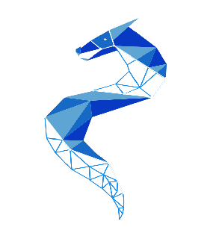
Group 27: 3-D
Data/Topology Visualization Grid
Sean Jacob
Trevor Chesley
Tomas Yepez
Dallas Moody

Slide 2




Meet
the team
Sean Jacob
Computer
Engineering
Trevor Chesley
Computer
Engineering
Tomas Yepez
Electrical
Engineering
Dallas Moody
Computer
Engineering

Slide 3
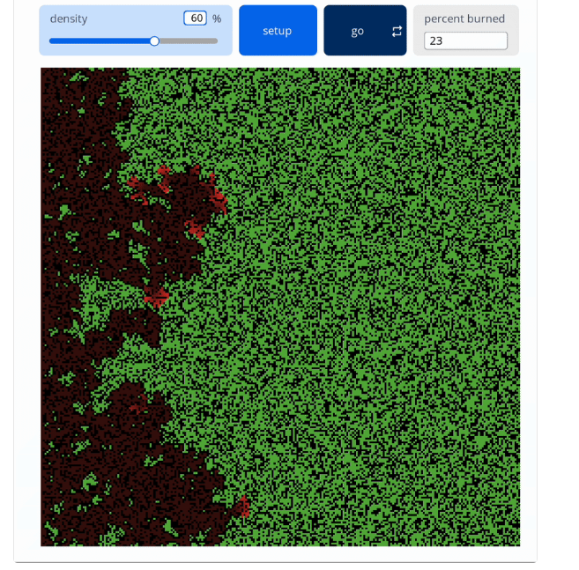

Motivation
Visualizing 3D data on a 2D screen is difficult and limiting
Static physical displays like styrofoam or blocks can’t dynamically change with the data
Educational tools for data-based learning is limited in ability to show data beyond three dimensions

Slide 4

Solution
A motorized grid of addressable towers paired with LEDs that physically extends to create a true 3D display with color
Using CAD designed rack and pinion mechanisms, we can design a system able to extend to fit 3D datasets

Slide 5
Goals and
Objectives
Main Goals
Create a mechanism to display data in 3 dimensions
Implement a minimum of 4 levels to be raised/lowered
Design a housing to encompass the mechanical components & the custom PCB
Provide a beginner-friendly interface to upload data
Advanced Goals
Faster matrix refreshing
Allow for additional modules to be connected

Slide 6
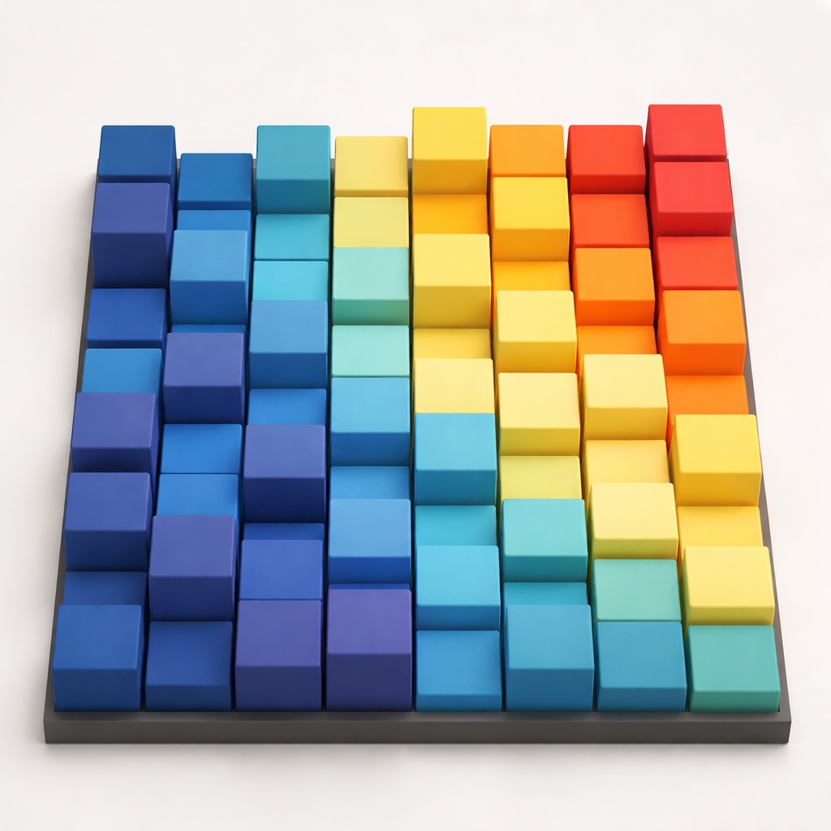
Specifications
Project Specifications
3D printed housing
Low voltage/safe operation
Z-axis actuation
Demonstration Specifications
1 matrix per minute cycling
4 levels of z-axis actuation
Color changing LEDs
Addressable solenoid actuation
Fully functional PCB

Slide 7
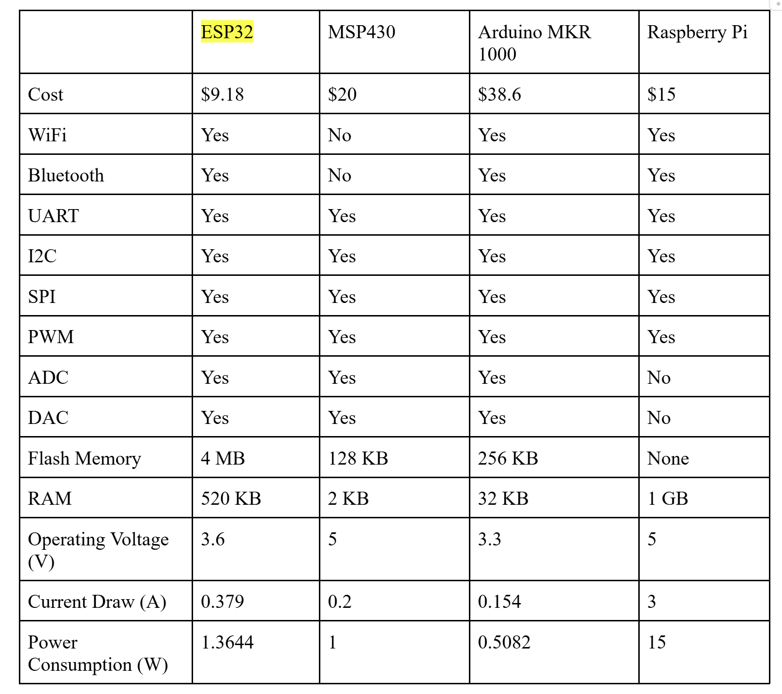
MCU
Comparison
ESP32 S3 was chosen for platform IO familiarity, cost, and flash memory
Many of the group members have already worked with the ESP32
Cost for other components was very expensive so keeping cost low here is imperative

Slide 8
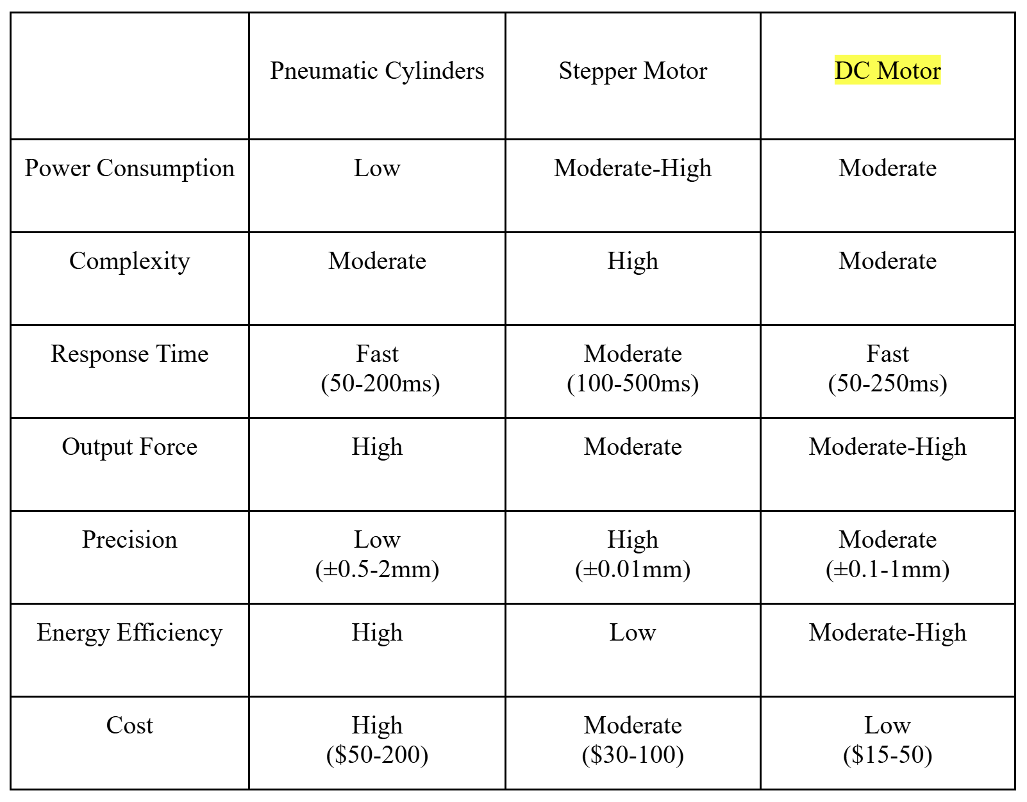
Height-Control
Comparison
Initial plan involved pneumatics but was quickly shifted to a motorized system
The group was much more familiar with motors
12V Greartisan motors were chosen for RPM range, low current draw, torque capabilities, and directional control

Slide 9
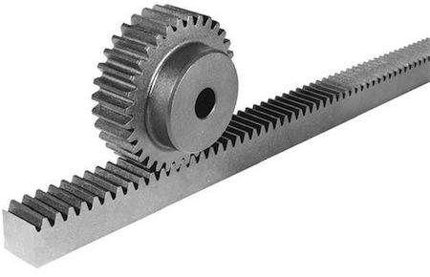
Vertical Movement
Example of rack and pinion method used to raise towers
Changing rotation of motor to vertical motion
Looked into long actuators, but were expensive and didn’t meet height requirements
Decided with choosing a rack and pinion for height control

Slide 10
Motor
Comparison
Greartisan and NFP-GM37 were close but eventually went with the Greartisan
Pololu 37D was far too expensive and overkill for what we needed
Greartisan’s low current draw, low complexity, price, torque, and directional control were the deciding factors for our selection
 | NFP-GM37-3429-EN | Pololu 37D | Greartisan 12V DC
Torque | Moderate | High | Moderate
RPM | 40 RPM | 70 RPM | 15 RPM
Complexity | Moderate | Moderate | Low
Operating Voltage | 12V | 12V | 12V
Cost | $21 | $40 | $14

Slide 11
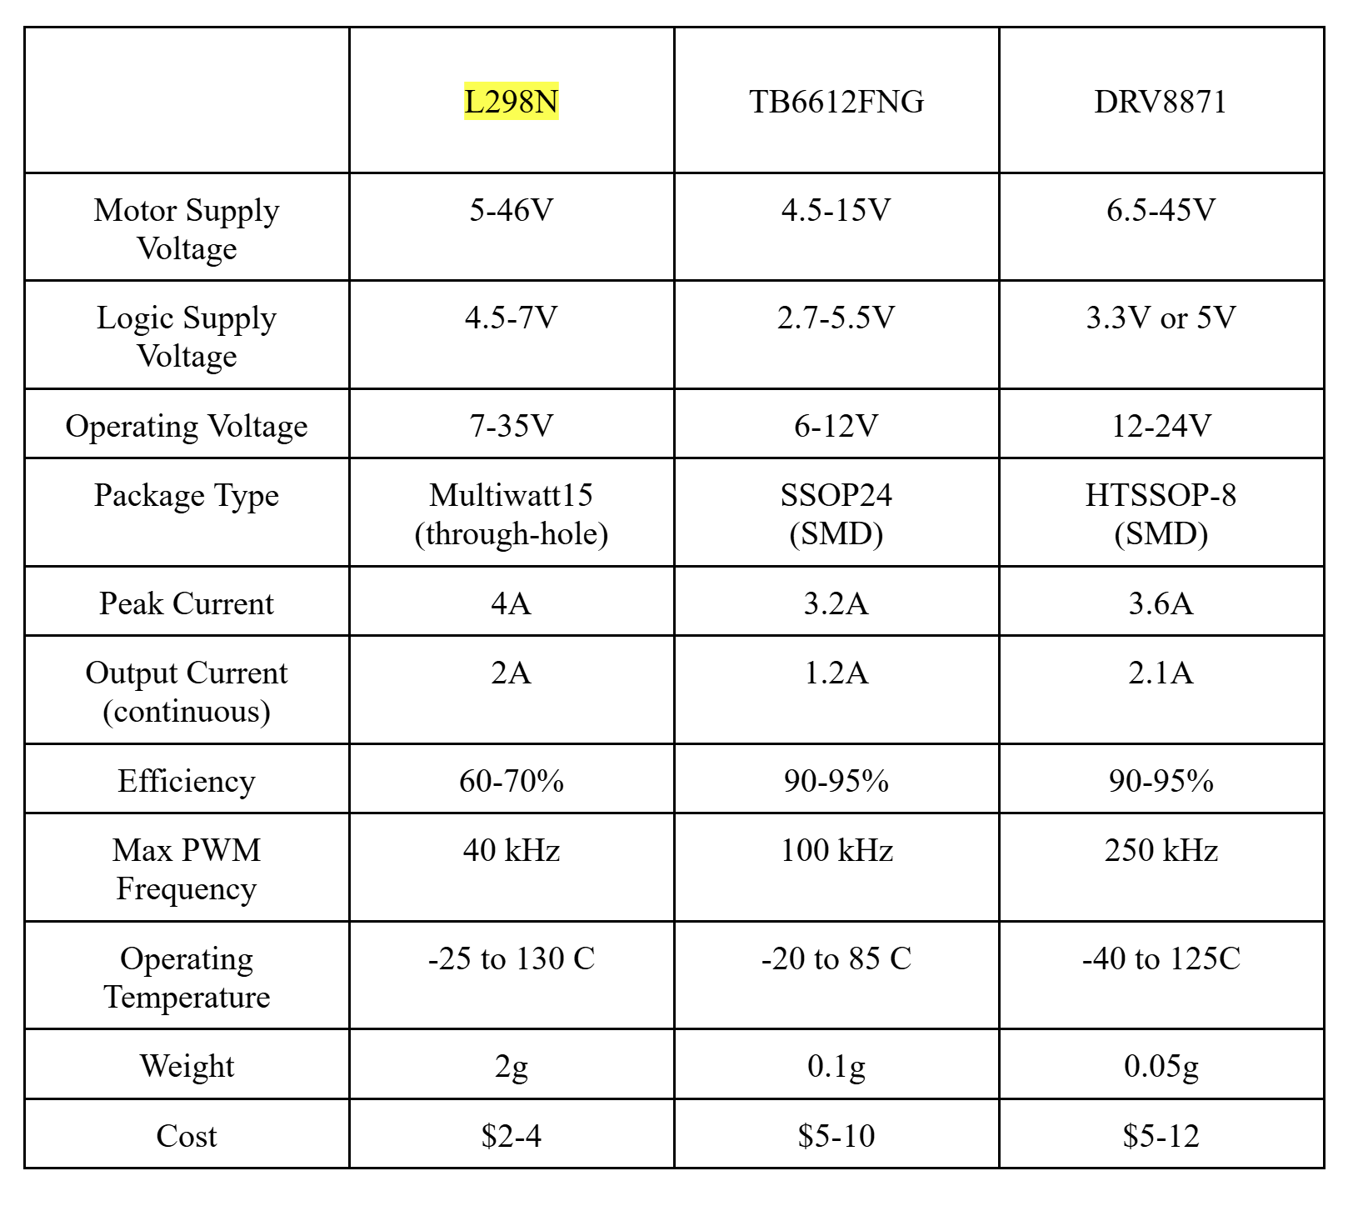
Motor Driver
Comparison
Choice ultimately came down to familiarity and price point of the L298
Familiarity is important for troubleshooting, programming, and circuit wiring
$4 price was the lowest by far & a big deciding factor

Slide 12
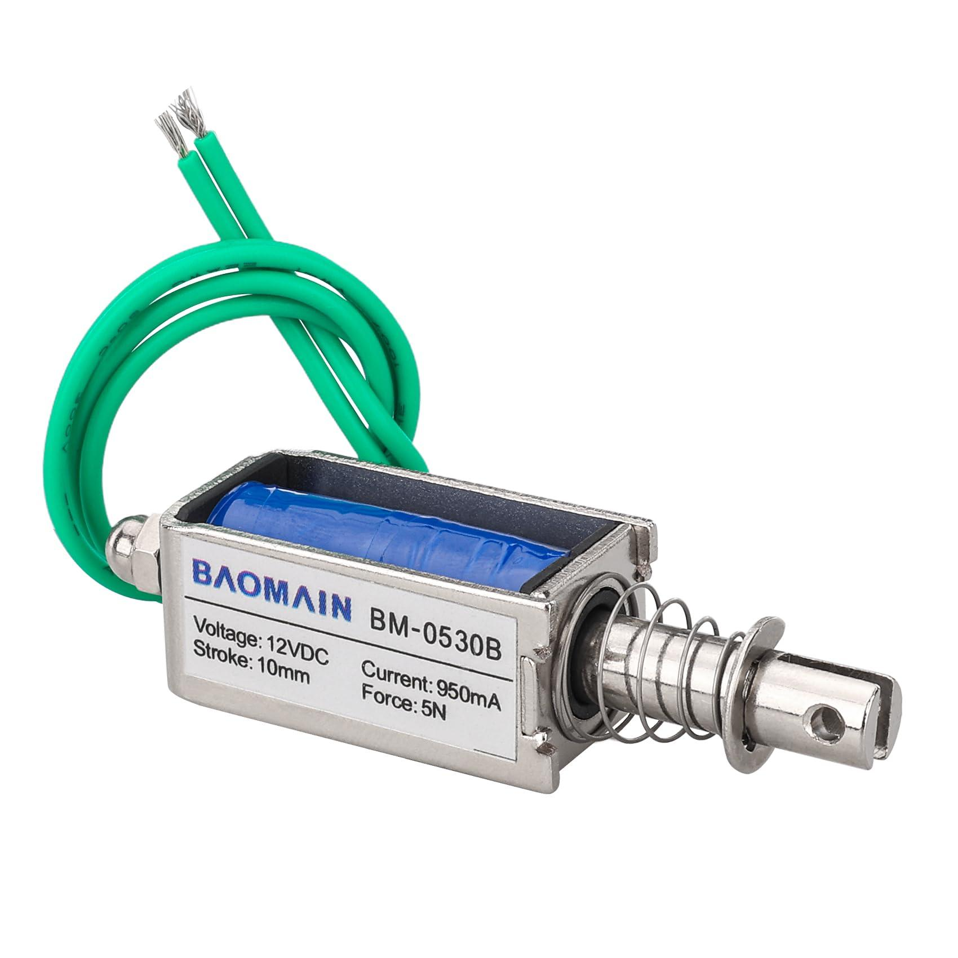
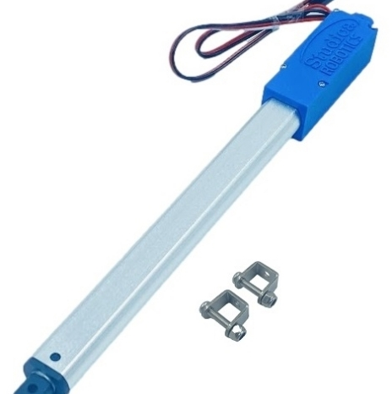
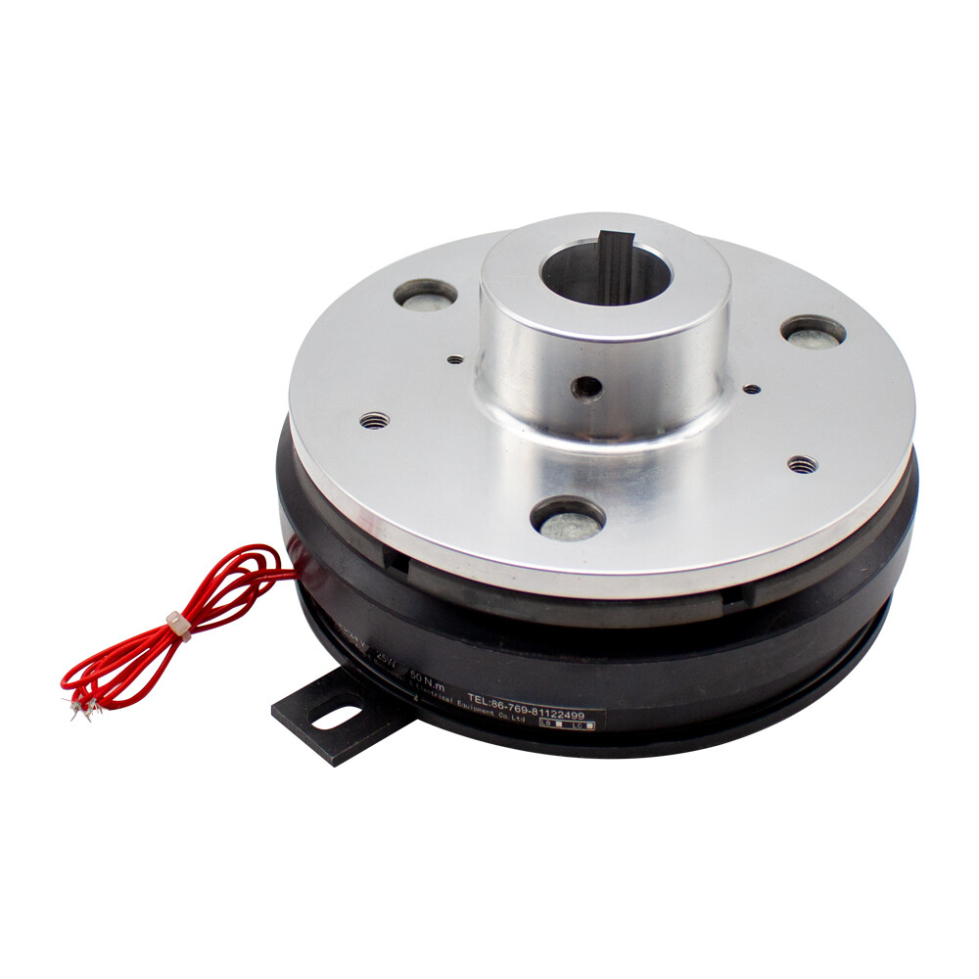
Selecting Devices
Solenoid
Motor Actuator
EM Clutch
 | Solenoid Actuator | Servo Motor Actuator | Electromagnetic Clutch
Cost per Part | $4-7 | $15-70 | $20-100
Complexity | Low | High | Low
Power Requirements | 5W | 1W | 3.8W

Slide 13
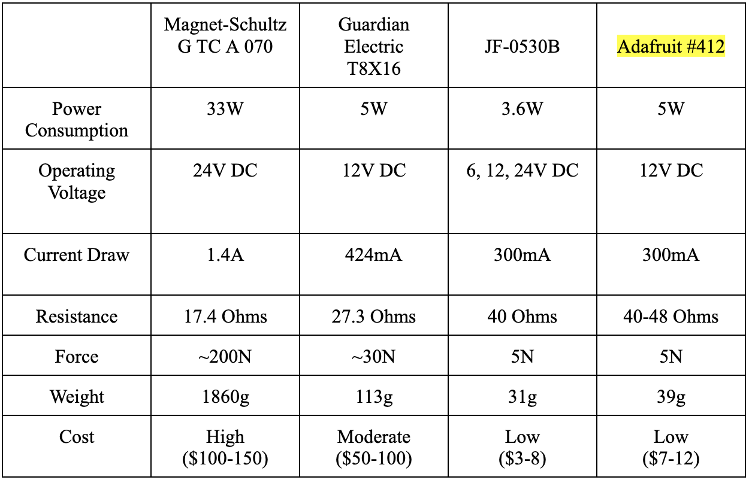
Solenoid
Comparison
Smaller solenoids are better to fit into housing
Quality and durability of Adafruit solenoids are worth to spend a little more money
Need to have reliable operation
5N force is enough to lift racks & towers

Slide 14
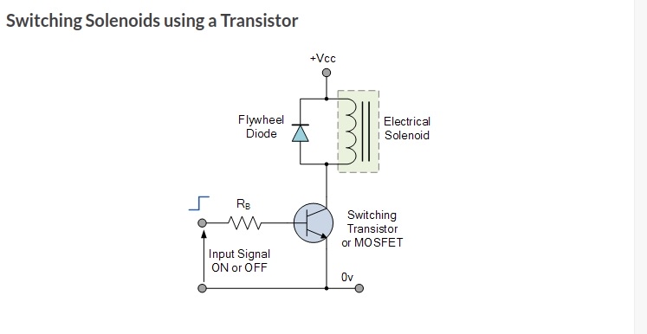
Solenoid Actuation and MOSFET Switching
GPIO pin sends signal to the MOSFET allowing for power to flow through and actuate the solenoid
Flyback diode used to help with high energy dissipation as a result of solenoid being powered off

Slide 15
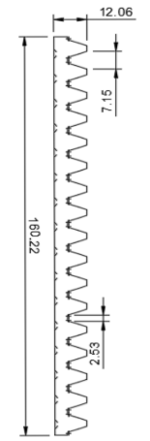
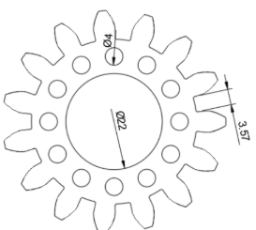
Solenoid System
Vertical Rack with tower attached to top
A bearing is placed inside the gear, and a spinning rod goes through the center
When the rod spins, the inside of the bearing spins but not the gear
The solenoid is attached to the rod and spinning at all times
When the solenoid activates, it goes into a hole on the gear and causes the gear to spin
The gear drives the rack up or down
Gear that rotates clockwise to lift tower

Slide 16
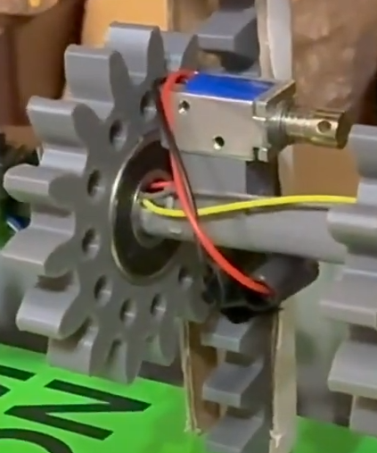
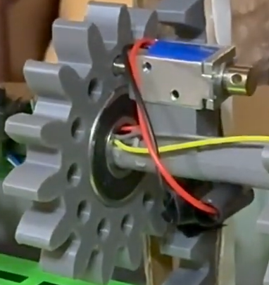
3D Printed Gear with holes on the side for solenoid activation
Solenoid actuated into gear hole so the gear rotates with the rod
Motor Rod
Gear will not rotate with motor rod due to bearing as long as solenoid is not actuated. Solenoid rotates with gear rod at all times
Rack

Slide 17
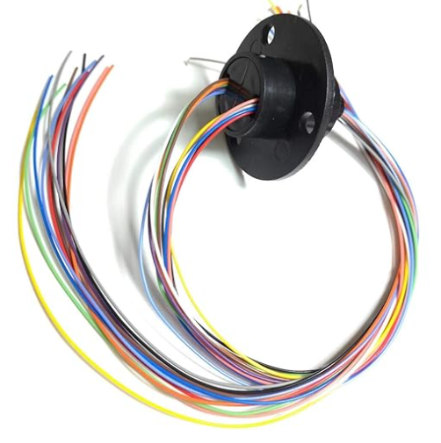
Solenoid Actuation - Slip Ring
Solenoids spin, so we needed a rotating connector for wires from PCB to solenoids
Handles 200 RPM and 2A
Can handle between 6-12 connections
Wires on the slip ring can now rotate with the rod to keep power to solenoids
Slip Ring

Slide 18
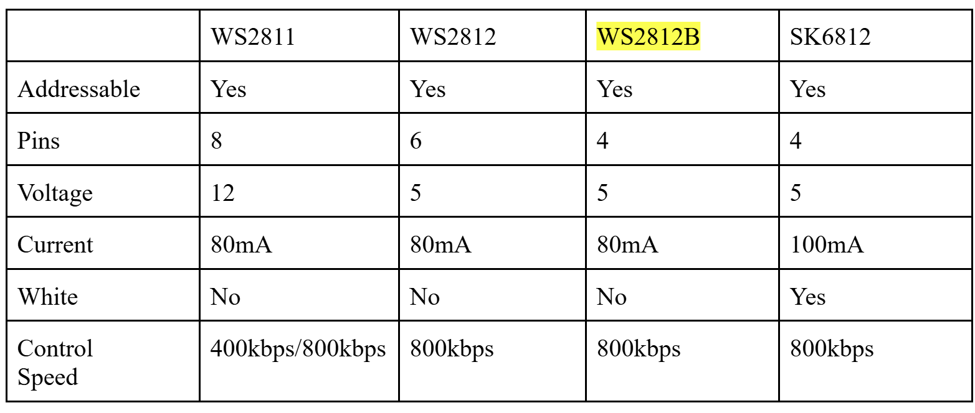
LED
Comparison
-WS2812B LEDs are individually addressable
-Least amount of pins for circuit simplicity
-Low input voltage

Slide 19
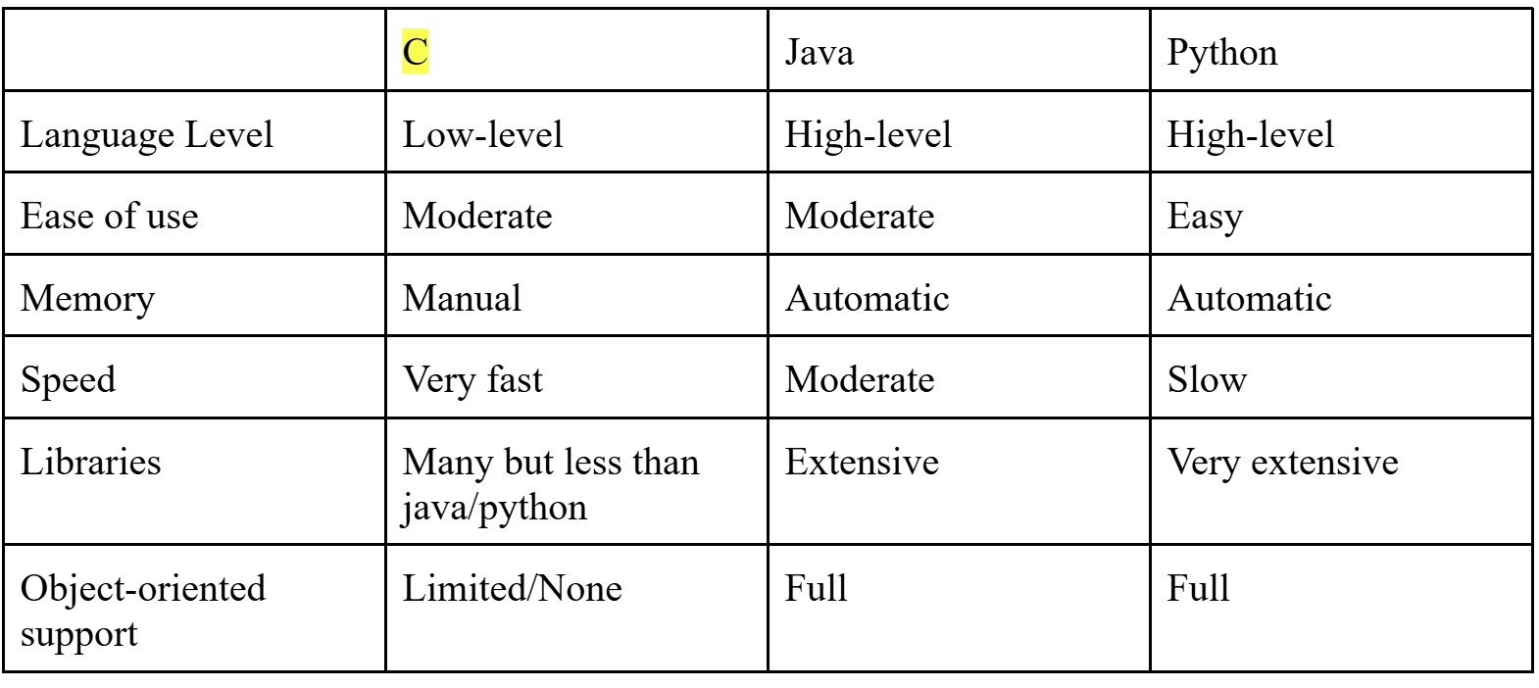
Language
Comparison
-All group members are most familiar with coding in C & C++
-Ease of use and group members being able to understand the code is very important
-Fast data transmission is something to capitalize on

Slide 20
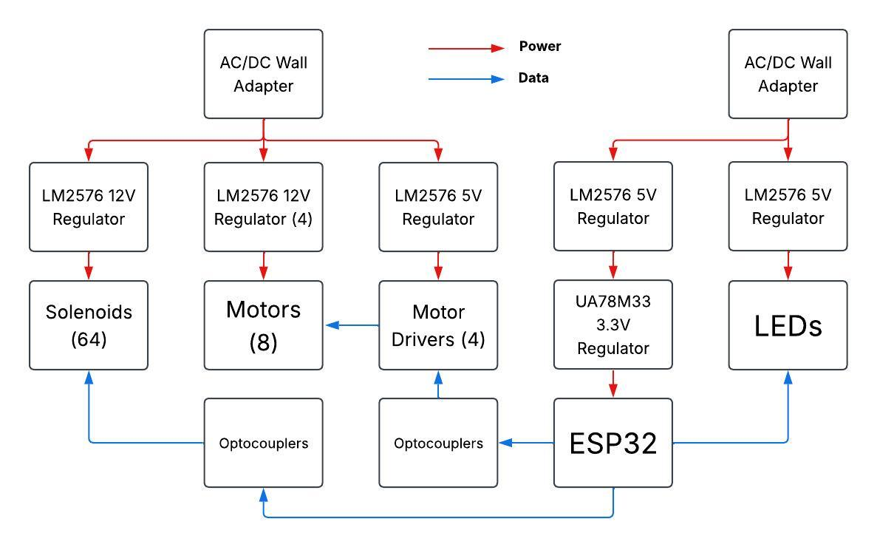
Hardware
Diagram

Slide 21
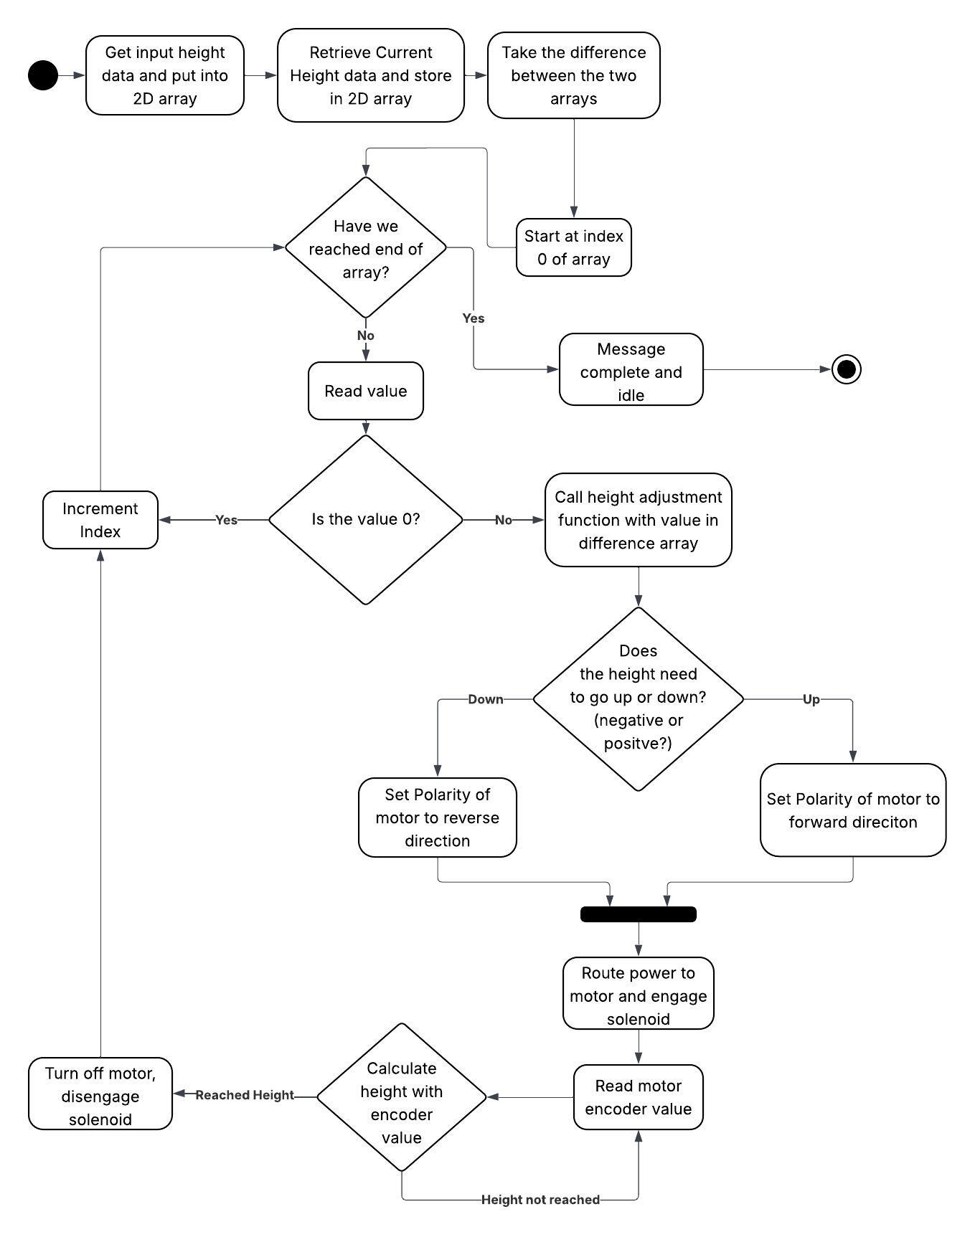
Software
Flowchart

Slide 22
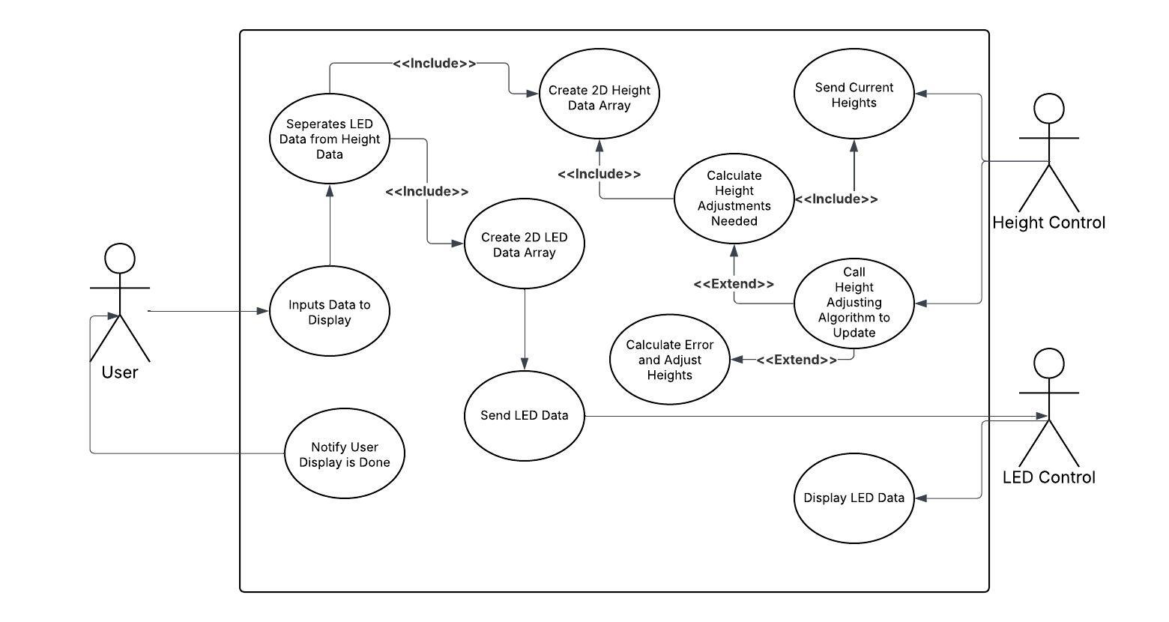
Use Case Diagram

Slide 23
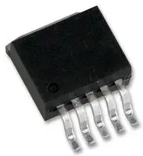
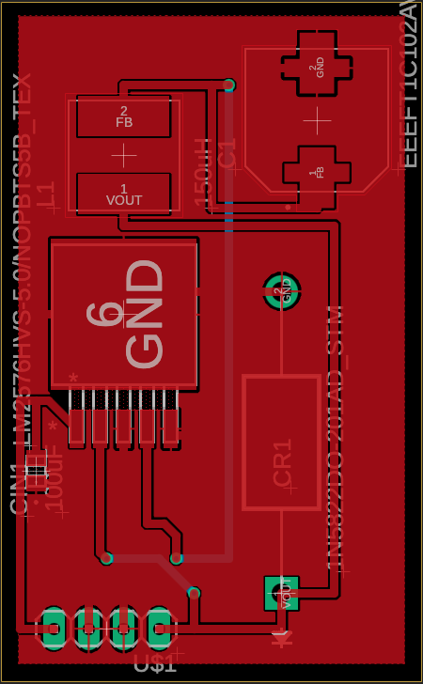
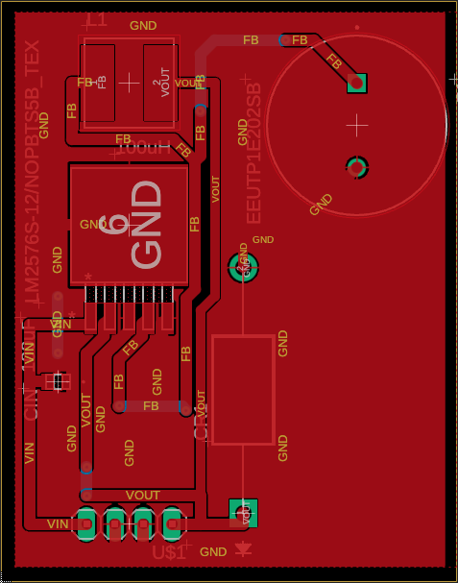
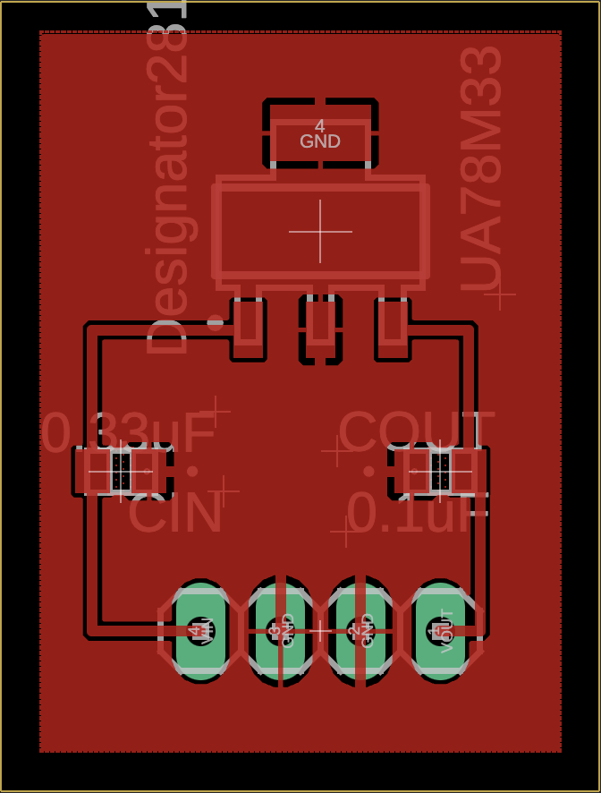
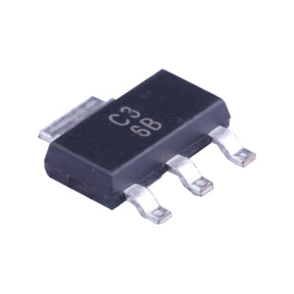
Regulator
PCB
5V Regulator
12V Regulator
LM2576
Specific 5V and 12V fixed versions
Input comes from AC/DC wall adapter
5V version feeds LEDs and motor driver logic circuit
12V version feels solenoids and motors
UA78M33
Fixed 3.3V output directly to ESP32
Input comes from one of the 5V LM2576
24V down to 3.3V would dissipate too much heat as a linear regulator
3.3V Regulator

Slide 24
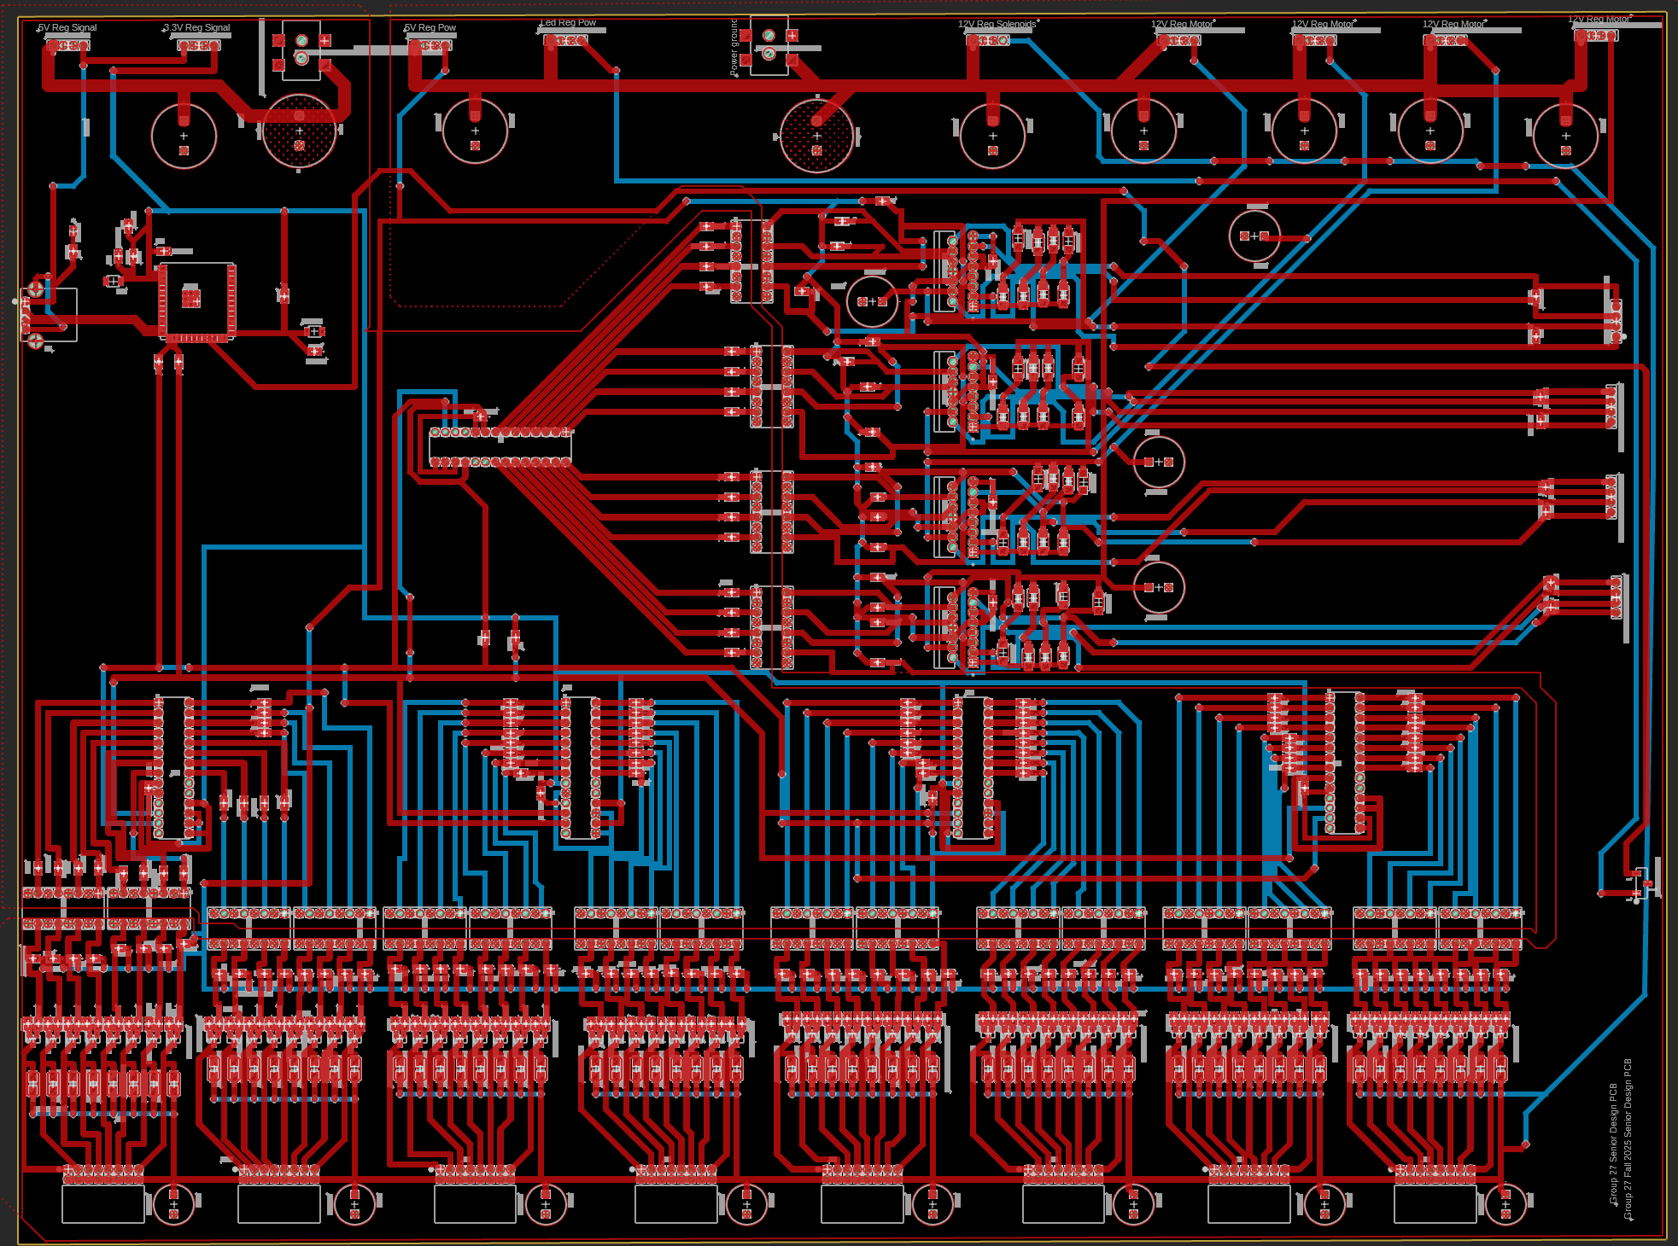
Main PCB
Wall Adapter Signal
Wall Adapter Power
ESP32
Motor Connections
Motor Drivers
Pin Expanders
Optocouplers

Slide 25
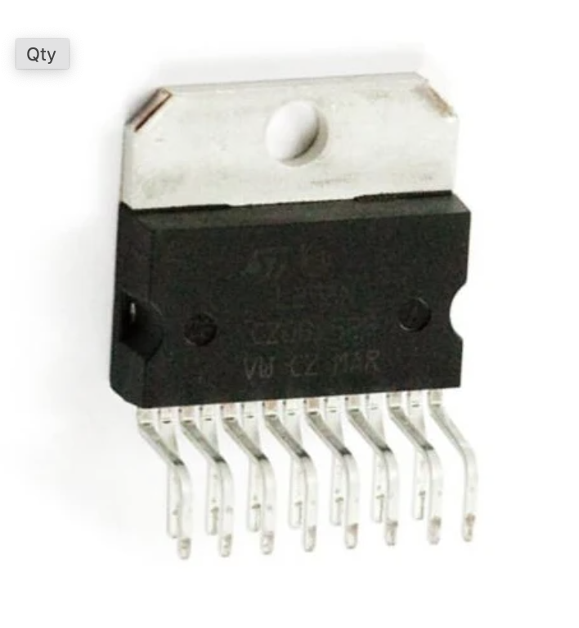
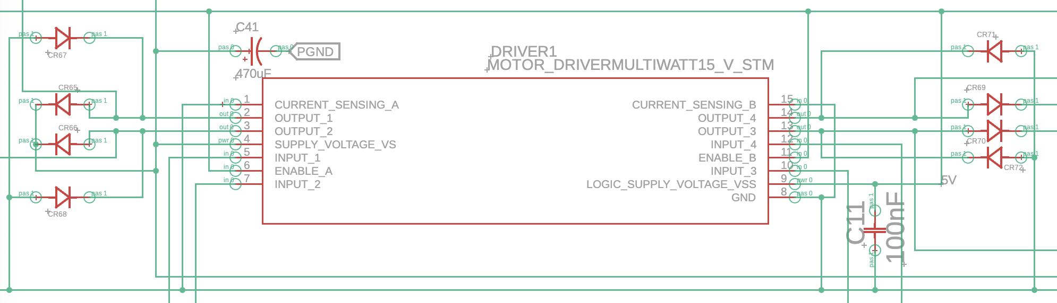
Motor Driver
PCB
Motor Driver IC
We chose the L298N motor drivers
Each driver can control 2 motors
The drivers can signal the motor to move clockwise and counterclockwise via diode H bridges
Motor Driver Schematic with Motor Connections

Slide 26
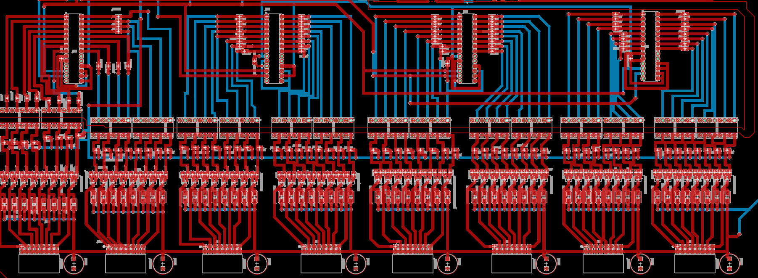
Selection Circuit PCB
Pin Expanders
Optocouplers
Solenoids
MOLEX Connection Headers

Slide 27
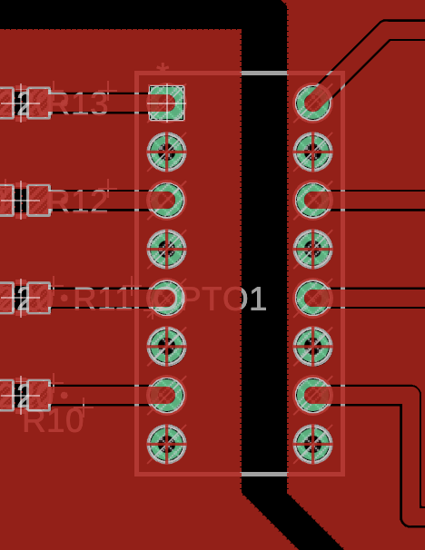
Power/Signal
Power and signal grounds were separated on the PCB to ensure low-noise channels for effective data transmission
Optocouplers were used to separate these channels
Optocouplers turn data signals into light via infrared LEDs
On the other side is a light sensitive transistor that converts the light back into a signal to be sent
Signal From ESP32
Signal Outgoing to Motor Drivers

Slide 28
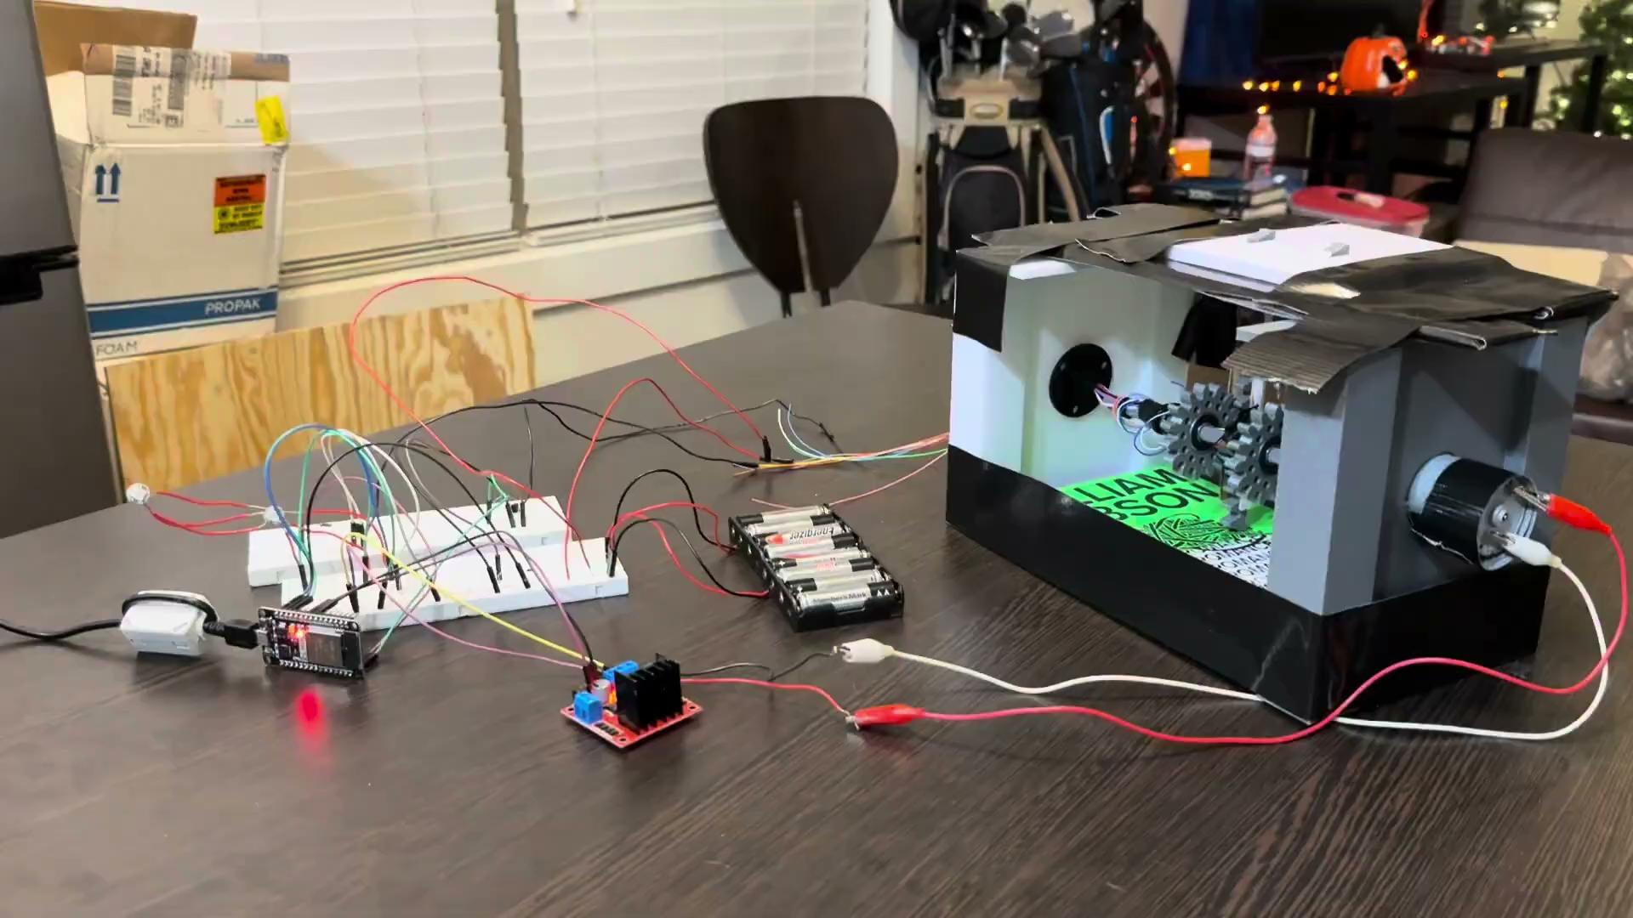
Hardware
Testing
All of our hardware was tested working alongside each other in the demo video shown
We can see the LEDs, solenoids, and motor all working side by side

Slide 29
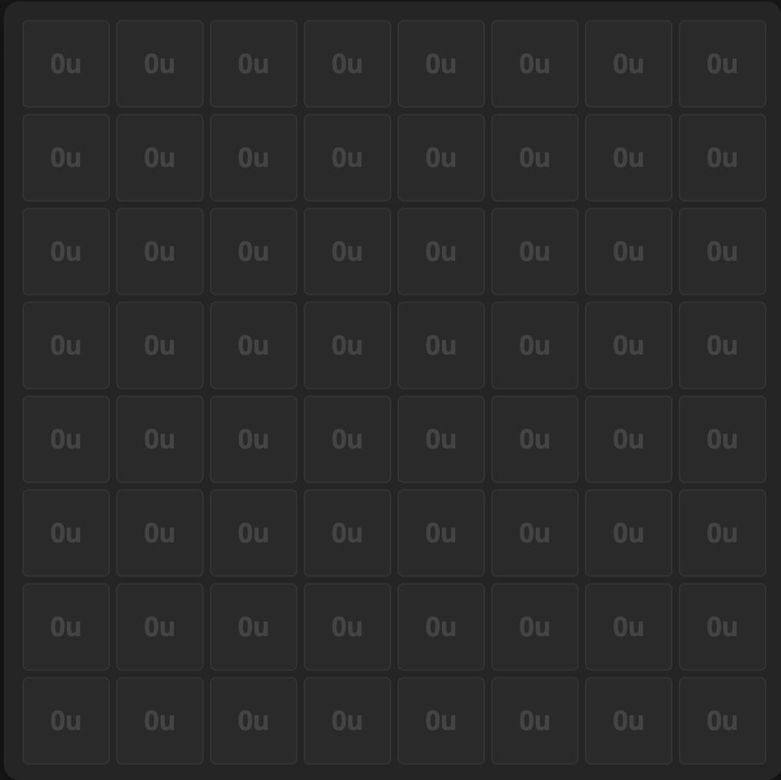
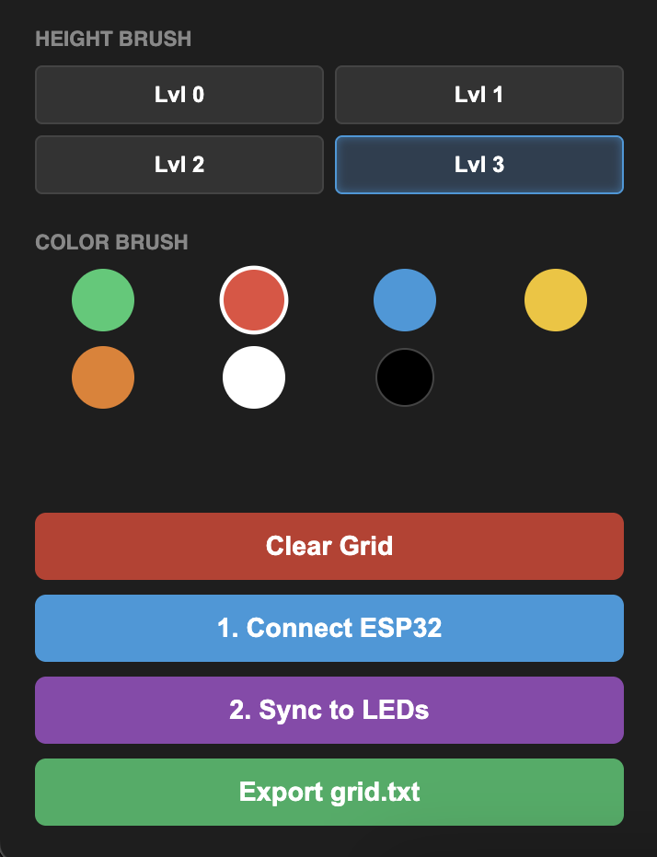
Webapp UI
Individual LED Configuration (Color, Height, etc)
Visual Display of 64 LEDs (Top View)
-On this page, users can select specific LEDs with the mouse to configure
-Users can change the color here with the color wheel and adjust the brightness of the LED
-UI also shows the status of each LED here in real time

Slide 30
Budget
PCB is the most expensive item by far
PCB comes with 5 boards for each
Large amounts of very small components
$250 credit from Draco Labs not included in budget on the left
Item | Cost
PCB & Regulator Circuits | $636.07
PCB Components | $204.78
Motors | $104.93
Solenoids | $210.14
Slip Rings | $160.56
Motor Drivers | $40.24
LEDs | $14.99
Total | $1,371.71

Slide 31
Work
Distribution
Dallas | Motor Driver Circuit LED array Webapp UI
Trevor | Selection Circuit CAD design Selecting mechanism
Tomas | Regulator Circuit PCB Design Power/Signal Distribution
Sean | Optocoupler design USB circuit Switching Circuit Motor Selection

Slide 32
Challenges
Pcb challenges - Ground planes, Diode directions, resistor values
Stabilization challenges - stabilizing our towers and racks. U brackets and L brackets
3D printing challenges - different cad iterations to find prints that would work consistently
Soldering challenges - soldering specific components were very difficult and took time

