Slide 1

Group 27: 3-D
Projection Grid
Sean Jacob
Trevor Chesley
Tomas Yepez
Dallas Moody

Slide 2




Meet
the team
Sean Jacob
Computer
Engineering
Trevor Chesley
Computer
Engineering
Tomas Yepez
Electrical
Engineering
Dallas Moody
Computer
Engineering

Slide 3
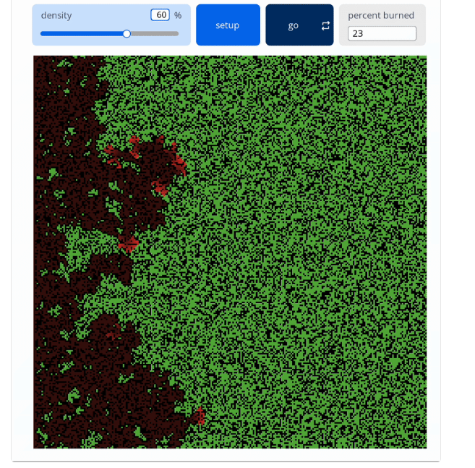

Motivation
Visualizing 3D data on a 2D screen is difficult and limiting
Static physical displays like styrofoam or blocks can’t dynamically change with the data

Slide 4

Idea
A motorized grid of addressable LEDs that physically extends to create a true 3D display
Inspired by NetLogo's pixel arrays and retractable lightsaber mechanisms

Slide 5
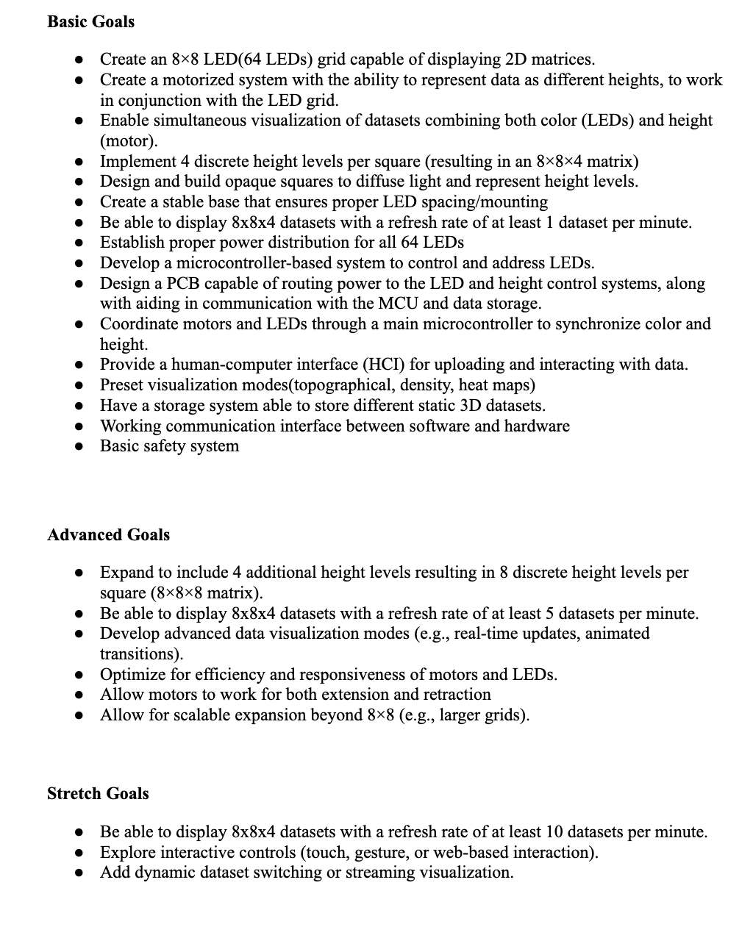
Goals and
Objectives
Main Goals
Create a mechanism to display data in 3 dimensions
Implement a minimum of 4 levels to be raised/lowered
Design a housing to encompass the mechanical components & the custom PCB
Provide a beginner-friendly interface to upload data
Advanced Goals
Faster matrix refreshing
Allow for additional modules to be connected

Slide 6
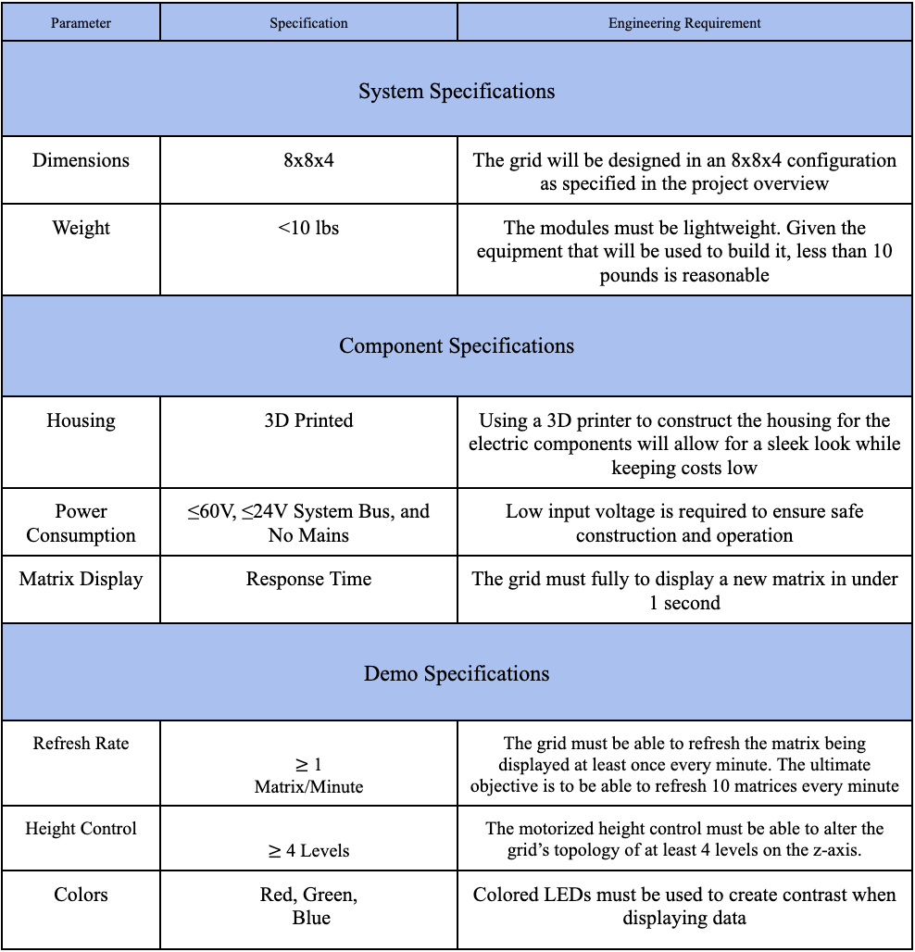
Specifications
Project Specifications
3D printed housing
Low voltage/safe operation
Z-axis actuation
Demonstration Specifications
Minimum 1 matrix per minute cycling
4 levels of z-axis actuation
Color changing LEDs

Slide 7
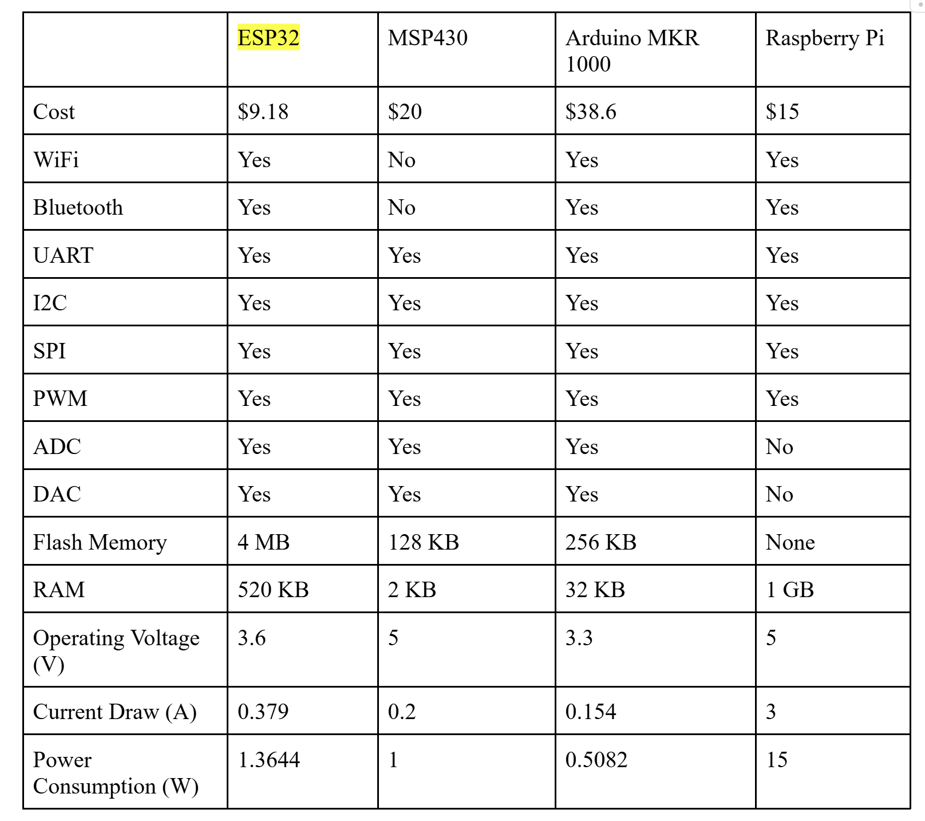
MCU
Comparison

Slide 8
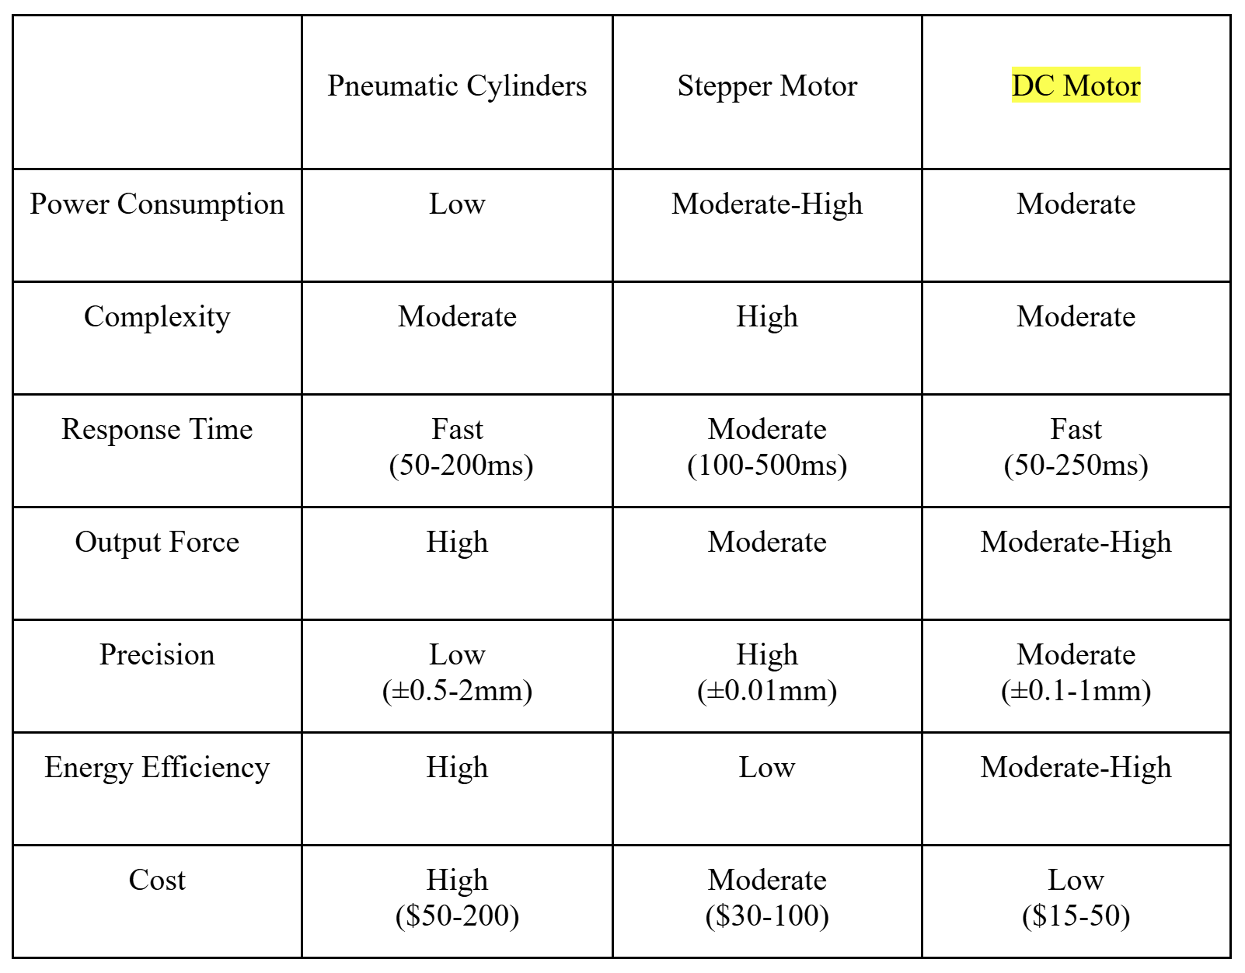
Height-Control
Comparison
Initial plan involved pneumatics but was quickly shifted to a motorized system
The group was much more familiar with motors

Slide 9
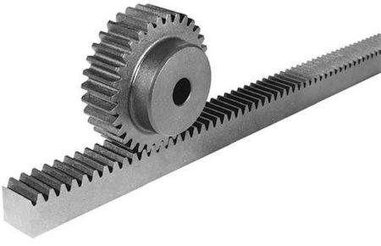
Vertical Movement
Changing rotation of motor to vertical motion
Looked into long actuators, but were expensive and didn’t meet height requirements
Decided with choosing a rack and pinion for height control

Slide 10
Motor
Comparison
Greartisan and NFP-GM37 were close but eventually went with the Greartisan for mainly price and ease of use
Pololu 37D was far too expensive and overkill for what we needed
 | NFP-GM37-3429-EN | Pololu 37D | Greartisan 12V DC
Torque | Moderate | High | Moderate
RPM | 40 RPM | 70 RPM | 15 RPM
Complexity | Moderate | Moderate | Low
Operating Voltage | 12V | 12V | 12V
Cost | $21 | $40 | $14

Slide 11
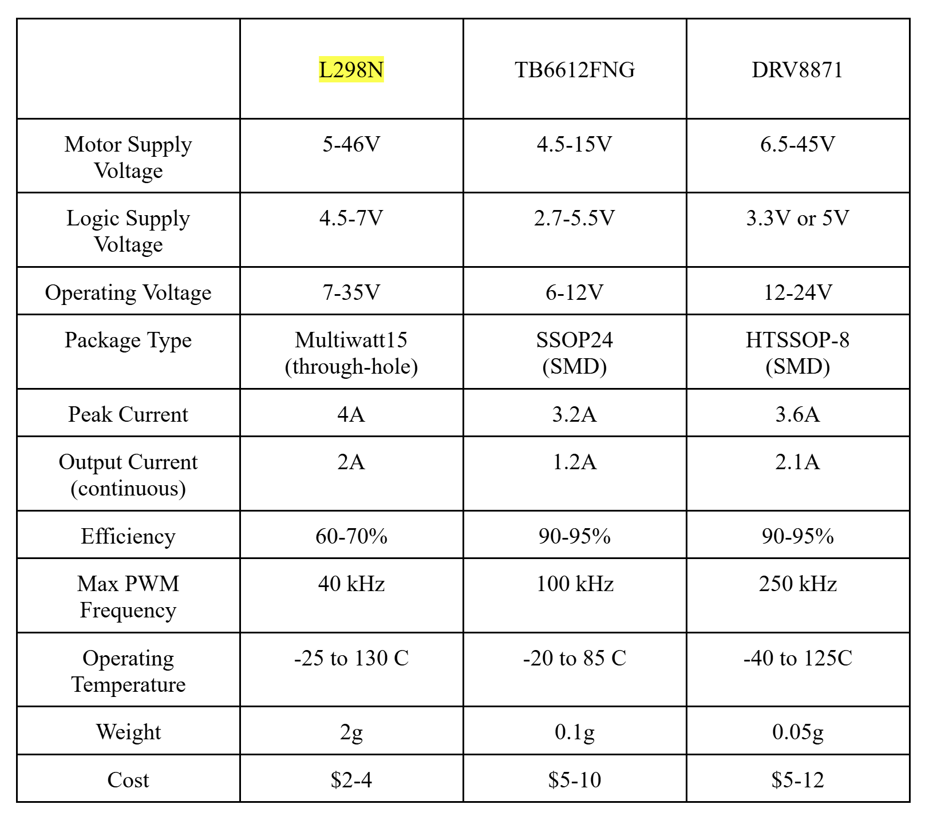
Motor Driver
Comparison
Lots of similarities between drivers
Choice ultimately came down to familiarity and price point of the L298

Slide 12
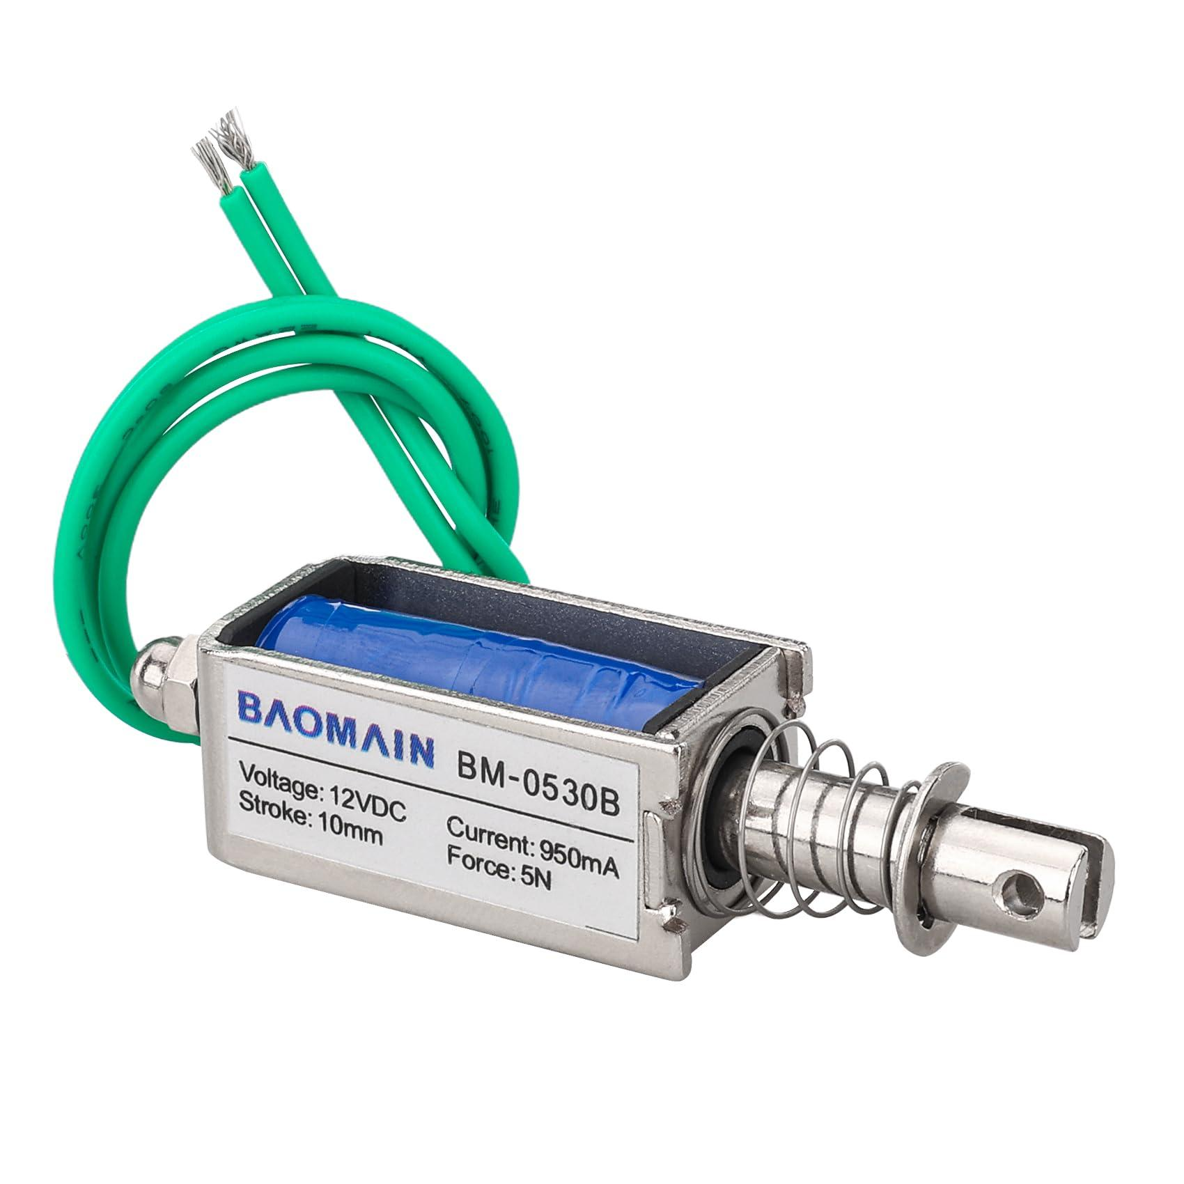
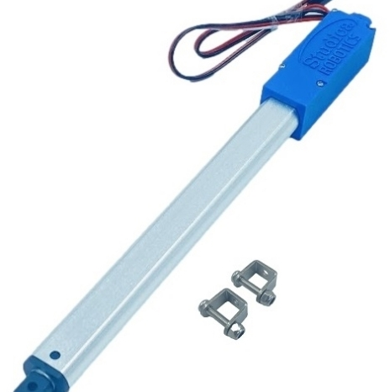
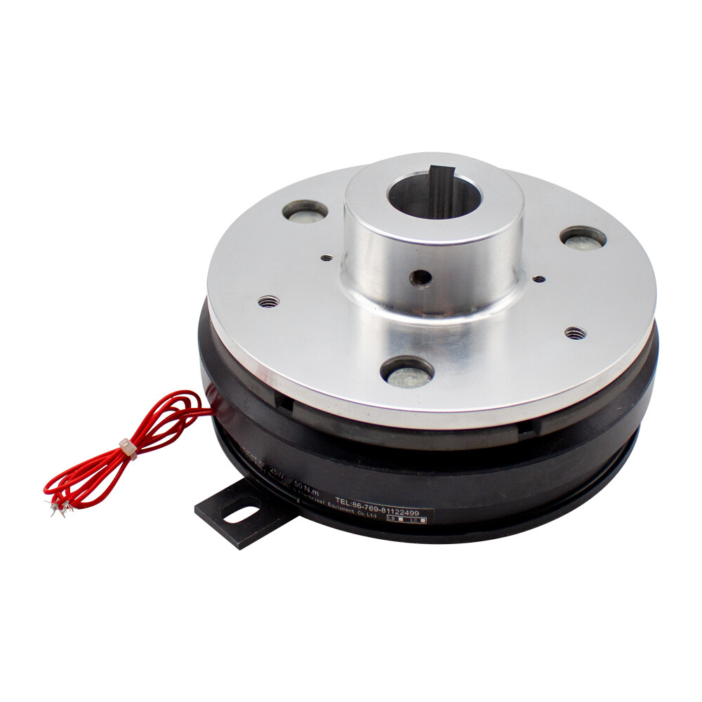
Selecting Devices
 | Solenoid Actuator | Servo Motor Actuator | Electromagnetic Clutch
Cost per Part | $4-7 | $15-70 | $20-100
Complexity | Low | High | Low
Power Requirements | 5W | 1W | 3.8W

Slide 13
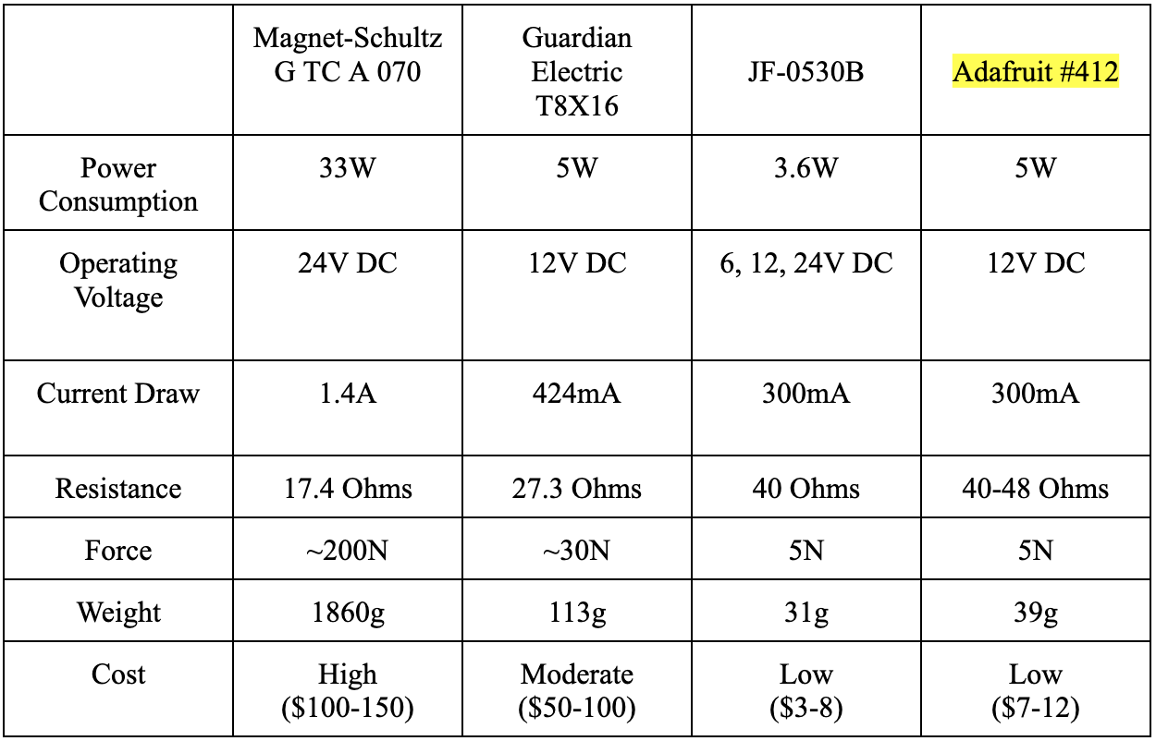
Solenoid
Comparison
Smaller size is better
Smallest cost possible
Need to have reliable operation
Speed and Heat not much of a concern

Slide 14
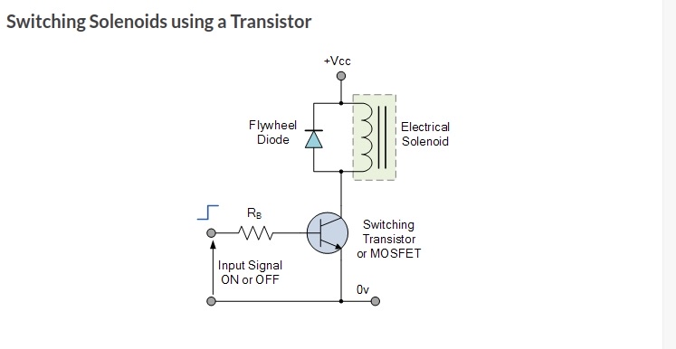
Switching Circuit
GPIO pin sends signal to the MOSFET allowing for power to flow through and actuate the solenoid
Flyback diode used to help with high energy dissipation as a result of solenoid being powered off

Slide 15
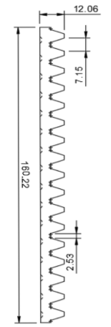
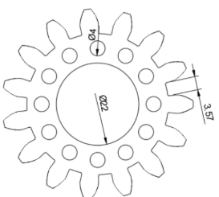
Solenoid System
A bearing is placed inside the gear, and a spinning rod goes through the center
When the rod spins, the inside of the bearing spins but not the gear
The solenoid is attached to the rod and spinning at all times
When the solenoid activates, it goes into a hole on the gear and causes the gear to spin
The gear drives the rack up or down

Slide 16
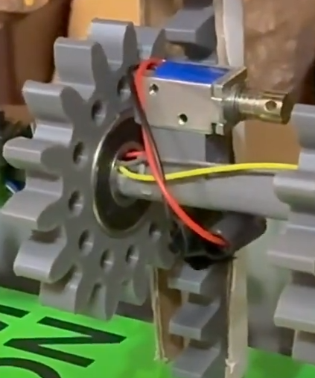
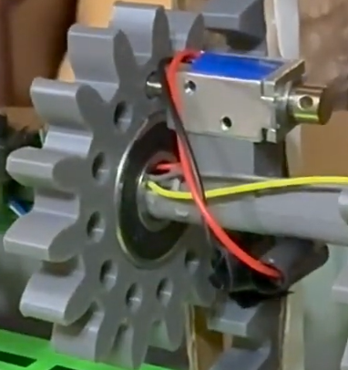

Slide 17
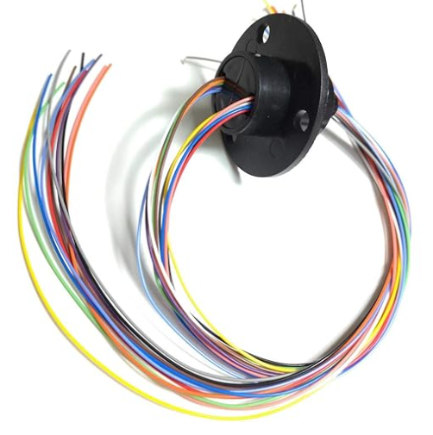
Slip Ring Requirements
Solenoids spin, so we needed a rotating connector
Handles 200 RPM and 2A
Can handle between 6-12 connections
Needed to allow solenoids to rotate with the motor rod

Slide 18
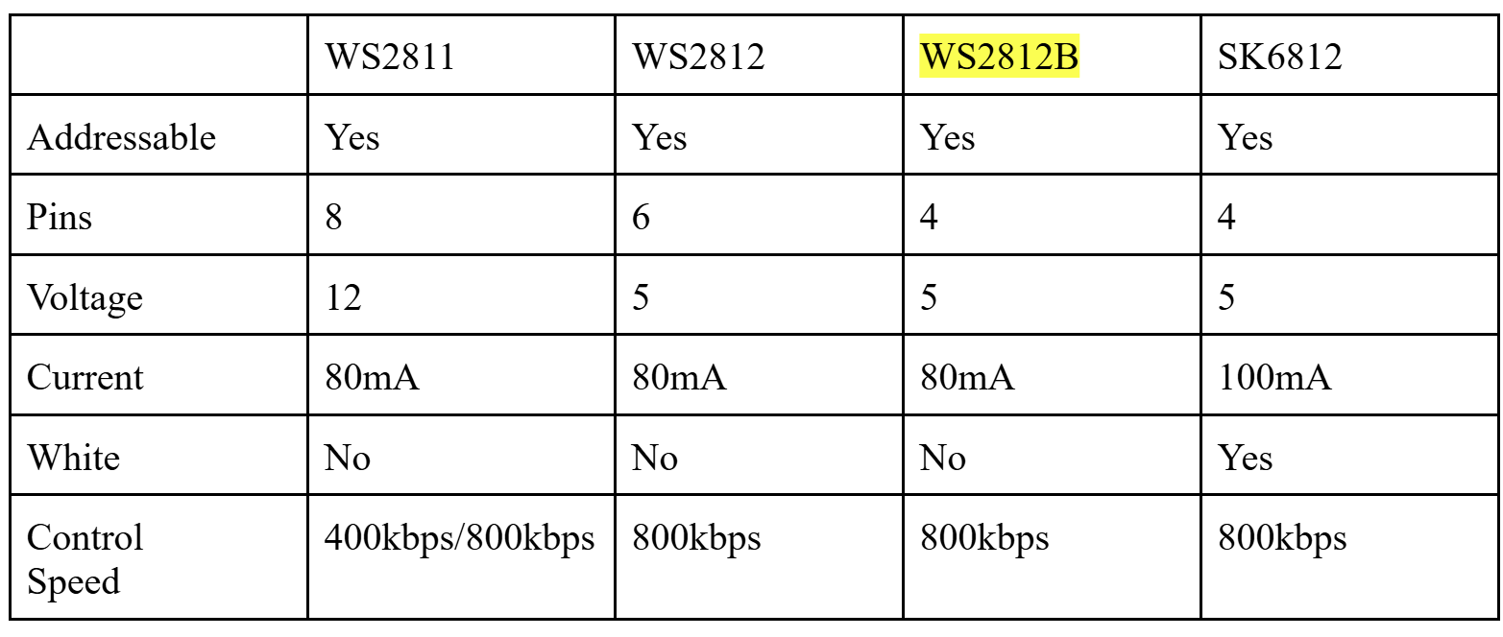
LED
Comparison

Slide 19
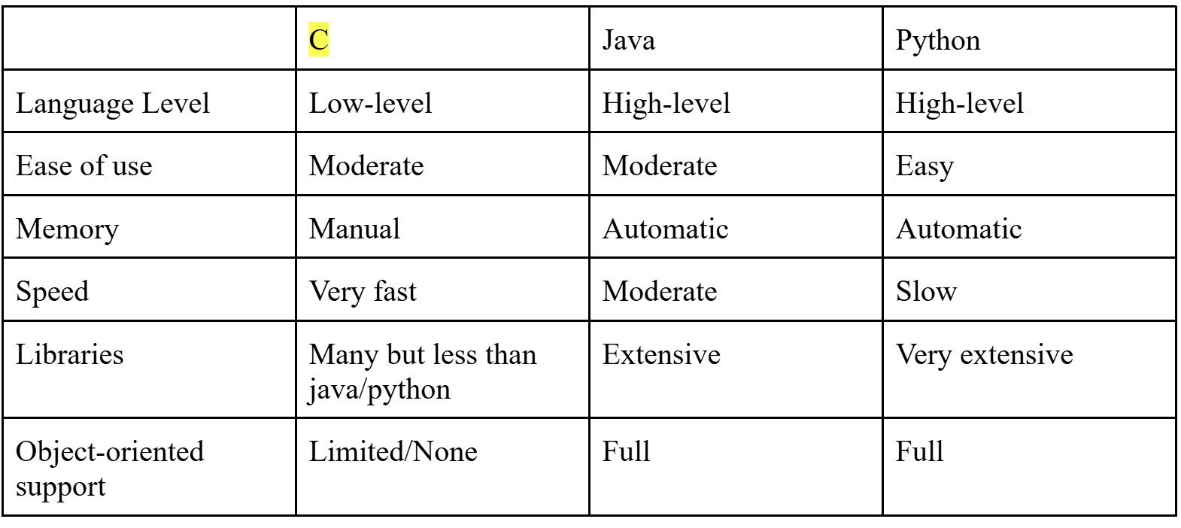
Language
Comparison

Slide 20
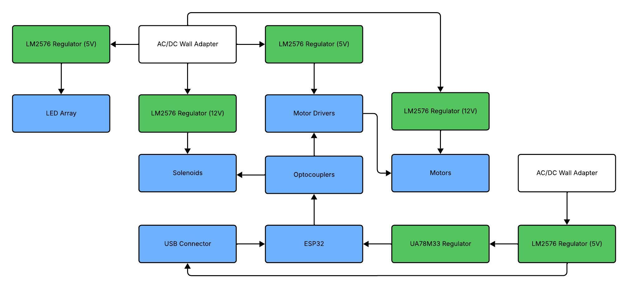
Hardware
Diagram

Slide 21
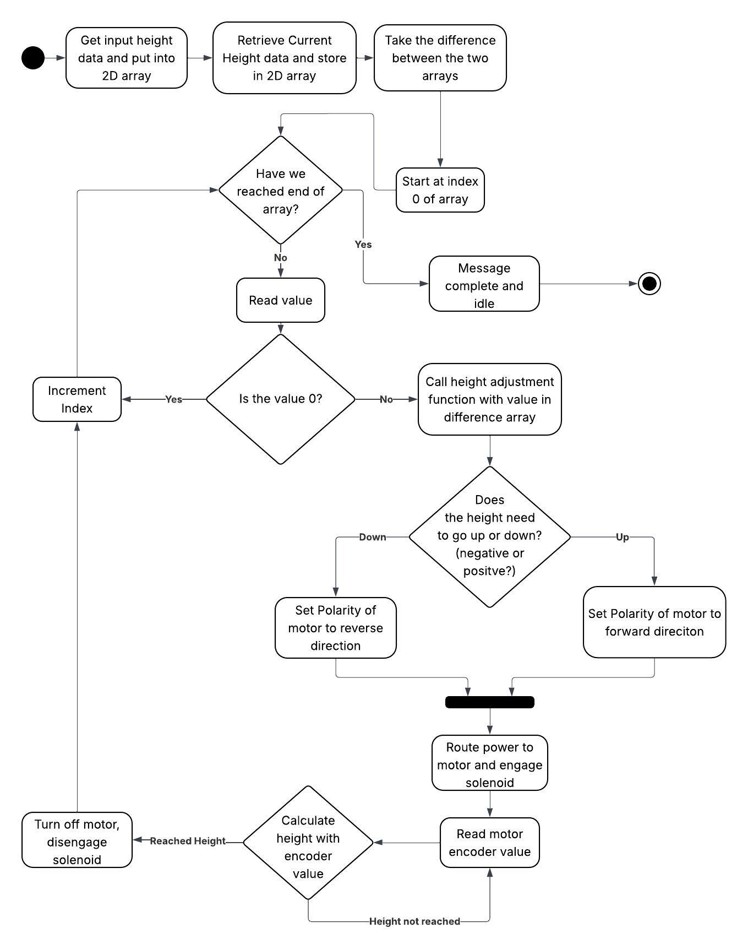
Software
Flowchart

Slide 22
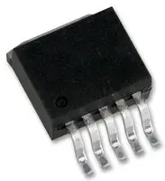
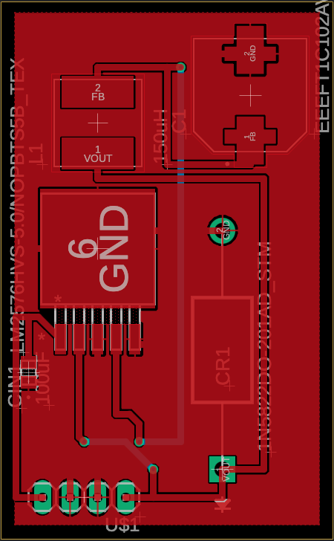
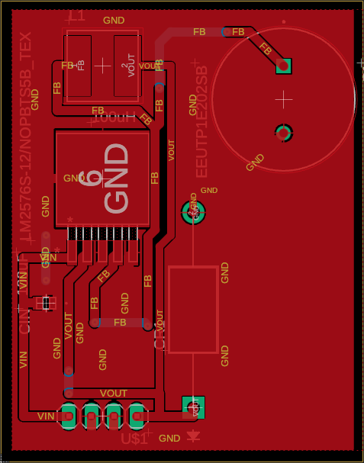
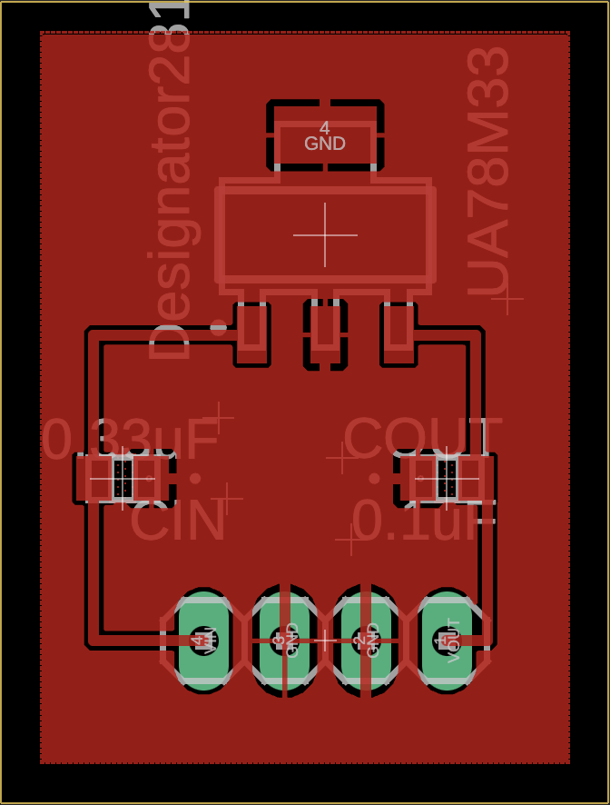
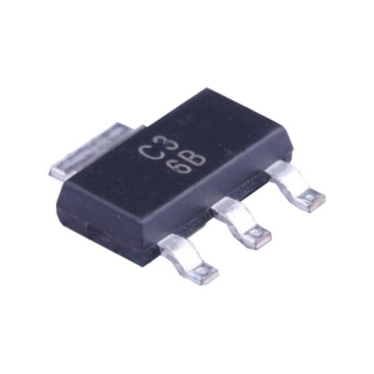
Regulator
PCB
LM2576
Specific 5V and 12V fixed versions
Input comes from AC/DC wall adapter
5V version feeds LEDs and motor driver logic circuit
12V version feels solenoids and motors
UA78M33
Fixed 3.3V output directly to ESP32
Input comes from one of the 5V LM2576
24V down to 3.3V would dissipate too much heat as a linear regulator

Slide 23
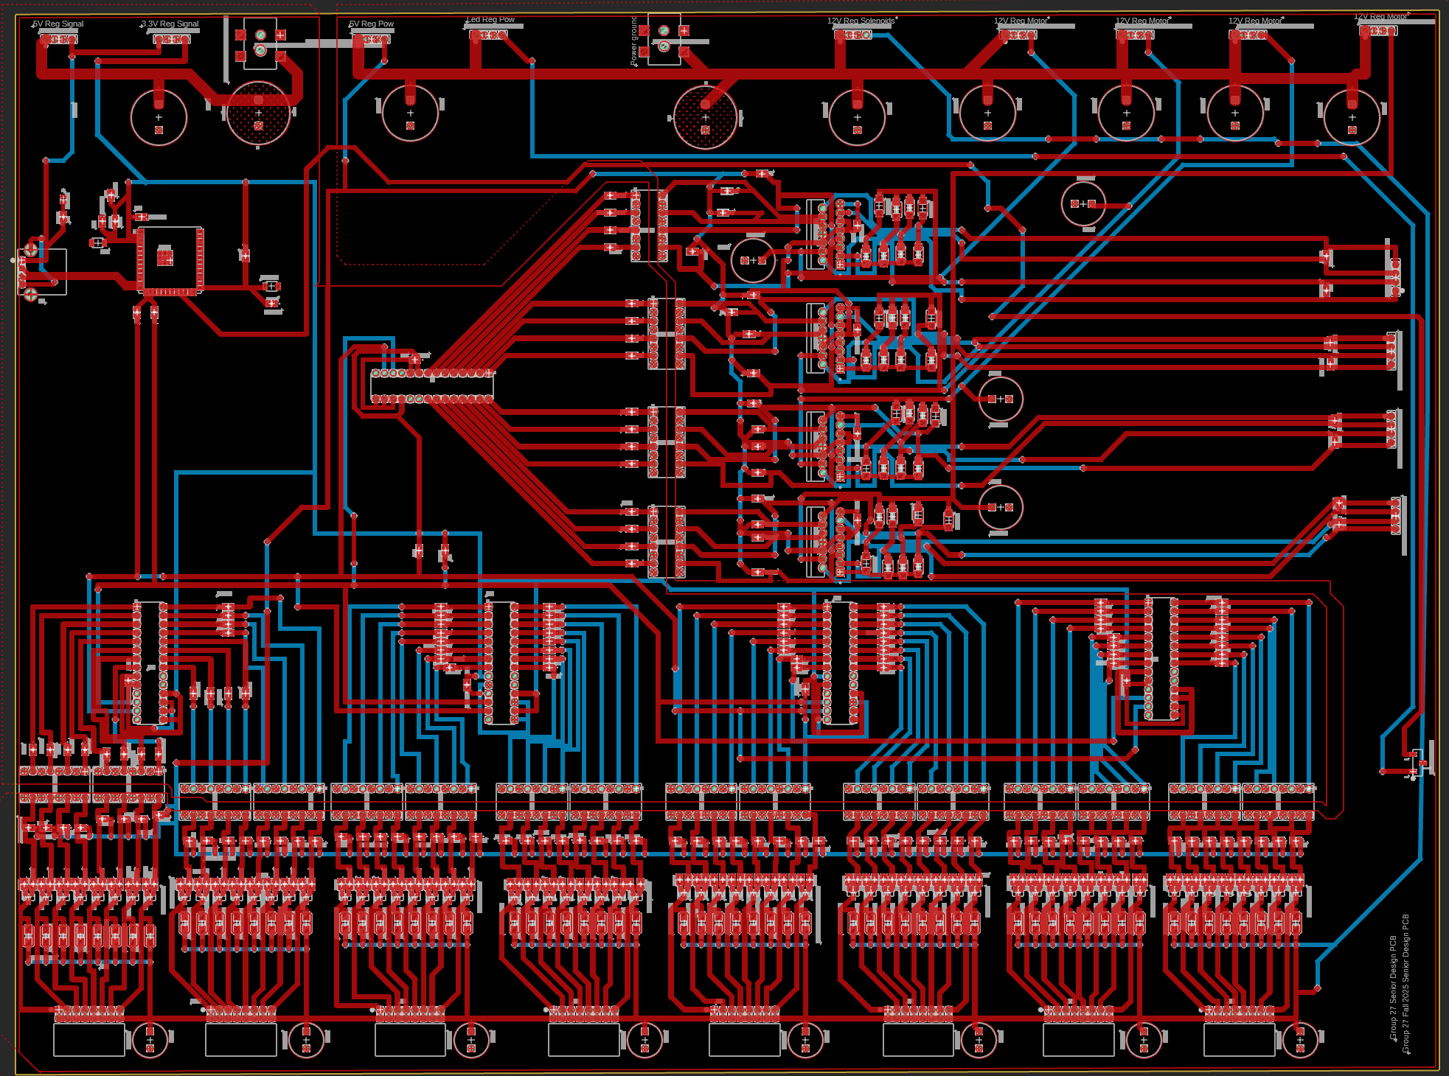
Main PCB

Slide 24
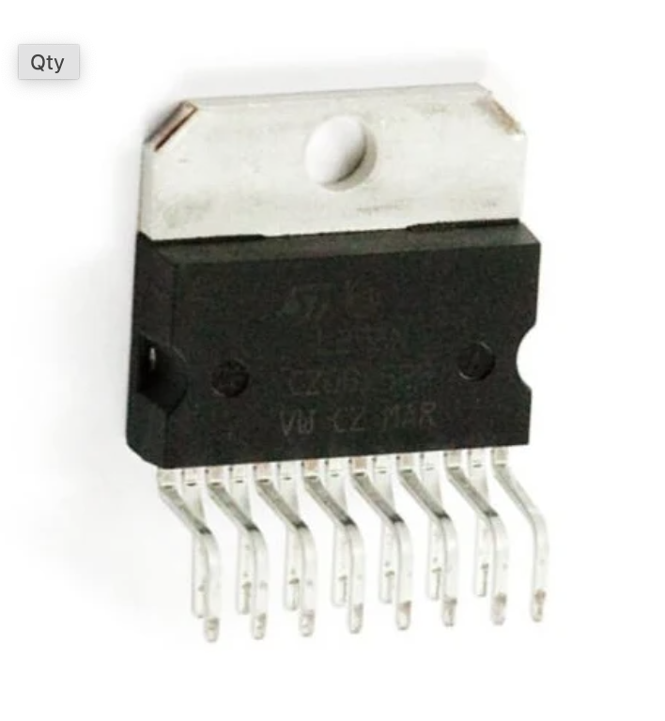
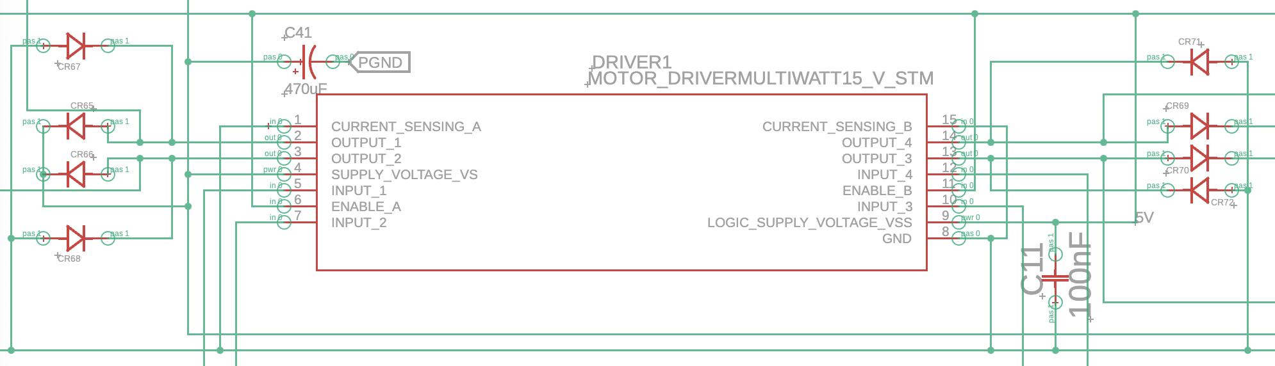
Motor Driver
PCB
We chose the L298N motor drivers
Each driver can control 2 motors
The drivers can signal the motor to move clockwise and counterclockwise via diode H bridges

Slide 25
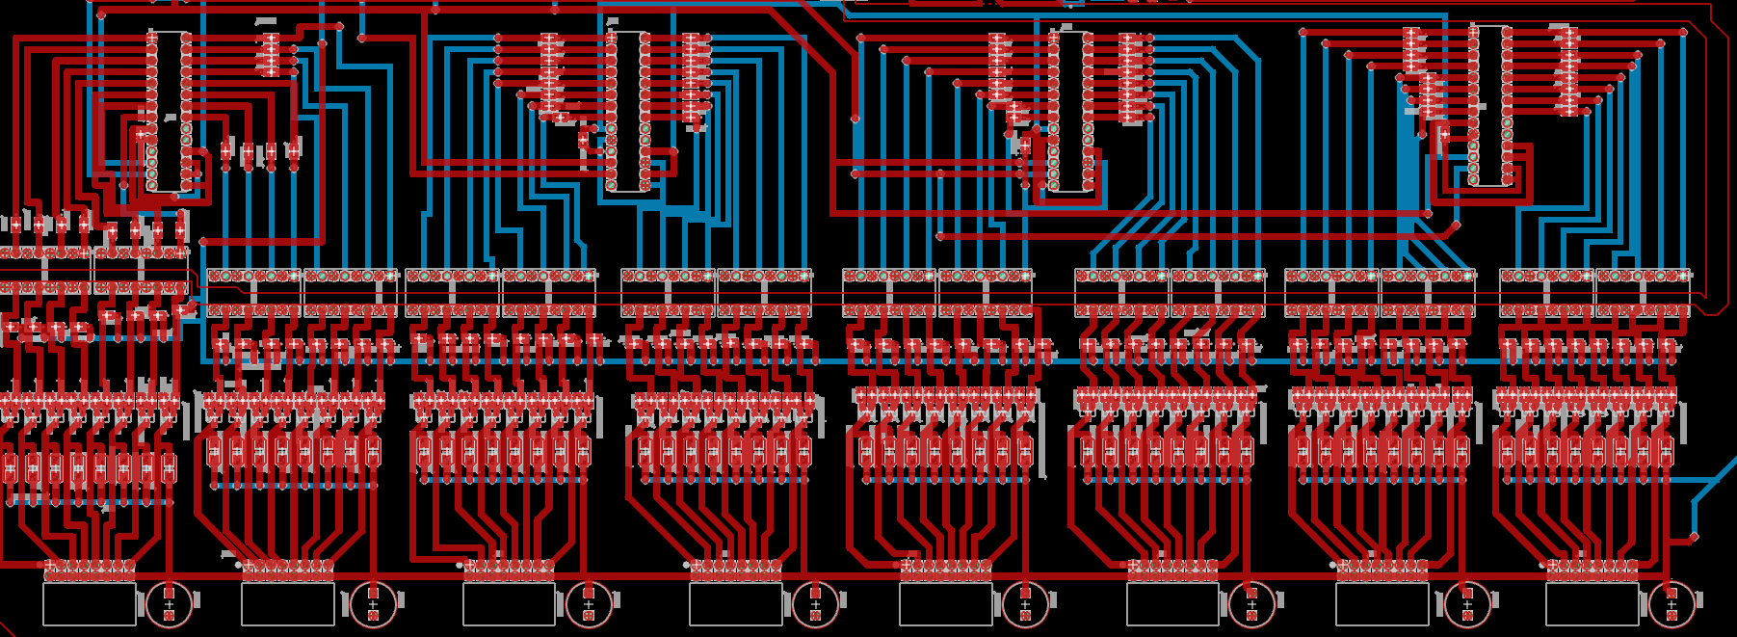
Selection
Circuit
PCB

Slide 26
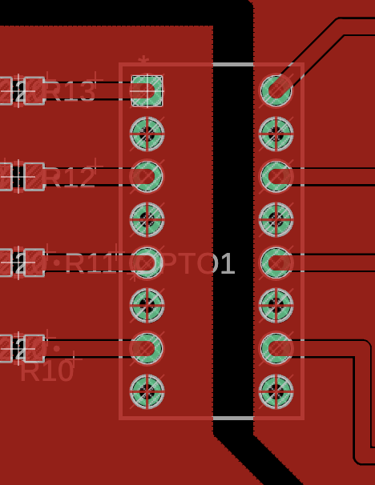
Power/Signal
Power and signal grounds were separated on the PCB to ensure low-noise channels for effective data transmission
Optocouplers were used to separate these channels
Optocouplers turn data signals into light via infrared LEDs
On the other side is a light sensitive transistor that converts the light back into a signal to be sent

Slide 27
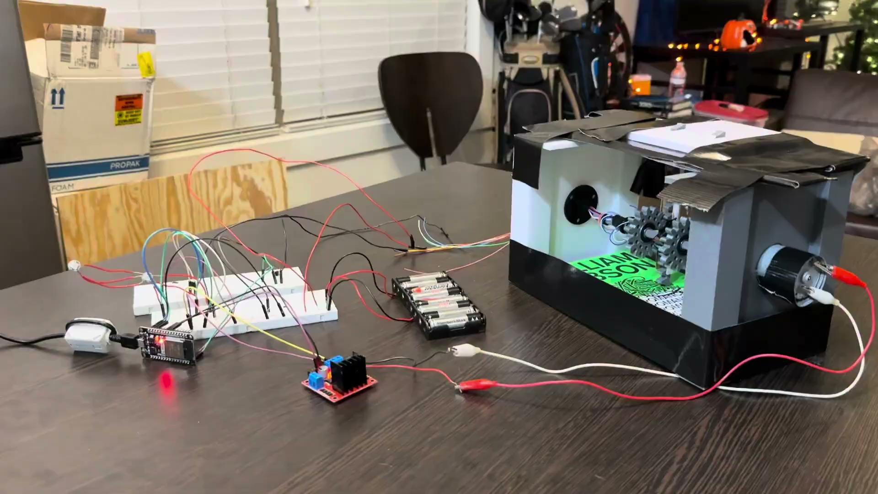
Hardware
Testing
All of our hardware was tested working alongside each other in the demo video shown
We can see the LEDs, solenoids, and motor all working side by side

Slide 28
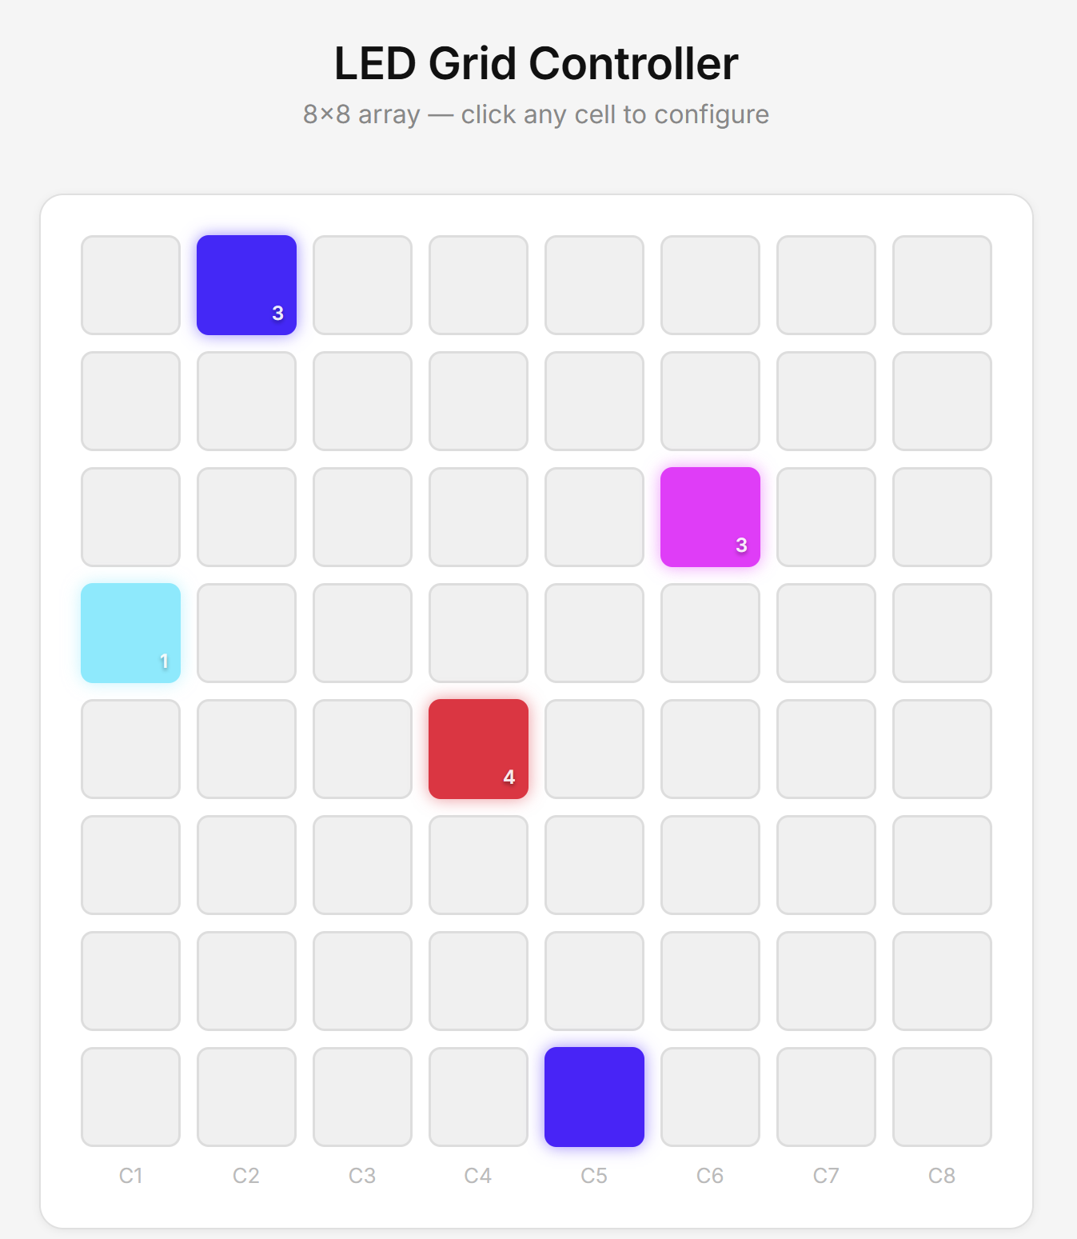
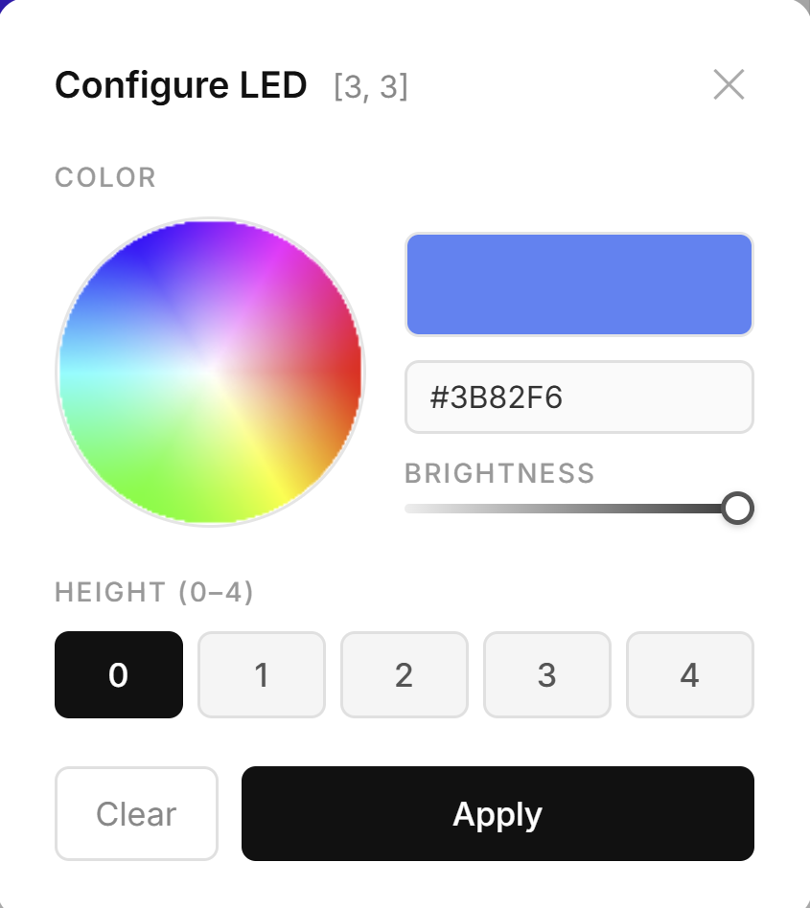
Webapp UI

Slide 29
Budget
PCB is the most expensive item by far
PCB comes with 5 boards for each
Large amounts of very small components
$250 credit from Draco Labs not included in budget on the left
Item | Cost
PCB & Regulator Circuits | $636.07
PCB Components | $204.78
Motors | $104.93
Solenoids | $210.14
Slip Rings | $160.56
Motor Drivers | $40.24
LEDs | $14.99
Total | $1,371.71

Slide 30
Work
Distribution
Dallas | Motor Driver Circuit LED array Webapp UI
Trevor | Selection Circuit CAD design Selecting mechanism
Tomas | Regulator Circuit PCB Design Power/Signal Distribution
Sean | Optocoupler design USB circuit Switching Circuit Motor Selection

Slide 31
Current
Progress
We are waiting for our pcb to be delivered
Working on our CAD design for the housing and mechanical components
Brainstorming different ideas and software design

