Slide 1
Strike Sense
By Group 37
Critical Design Review

Slide 2



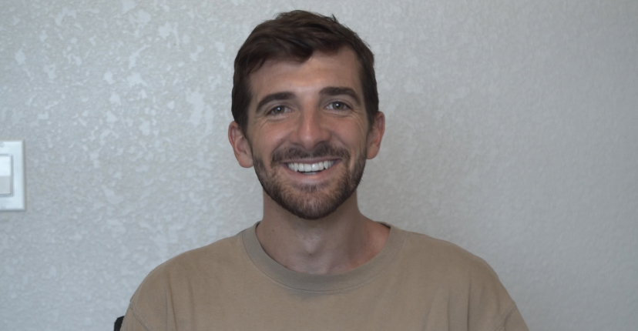
MEET THE TEAM
Timothy Azinord
Landon Wright
Benjamin Bolton
Shem Fils-Aime
Electrical Engineer
Computer Engineer
Computer Engineer
Electrical Engineer

Slide 3
MOTIVATION & BACKGROUND
Sports serve as a intersection between health, technology, and human performance. Many athletes rely on trusted routines and careful feedback from cutting edge technology to improve.
Martial arts is one sport that is behind in this endeavour.
Strike Sense was made from a desire to provide a way for martial artist to track their training and be safer along the way.
The biggest goal was to do this in a non intrusive way yet robust manner. We want users to feel no difference during training and all the difference after.

Slide 4
GOALS & OBJECTIVES
Create a system with a hardware component comprised of 2 IMU designs: one with 9 DoF, heart rate monitor and MCU and the other with 9Dof, and MCU
  Hardware component will be contained in housing and will be equipable with a strap on left and right wrist
  Accelerometer, Gyroscope and Magnetometer output will be translated to quaternions
·Design deep neural network architecture which takes the input of quaternions from the IMU’s and can identify strikes within that stream of data
  This neural network architecture will have a strike identification percentage of >=80%
  This architecture will be, at a high level, composed of a transformer and LSTM
Create a dataset that is deep and broad enough to be used to train the neural network.
  Neural network will run locally on machine where application is running
· Deepen neural network architecture by adding the Alpha pose pose estimation model + Transformer+LSTM+LLM to use spatiotemporal coordinates obtained through video to further support initial predictions provided by IMU data

Slide 5
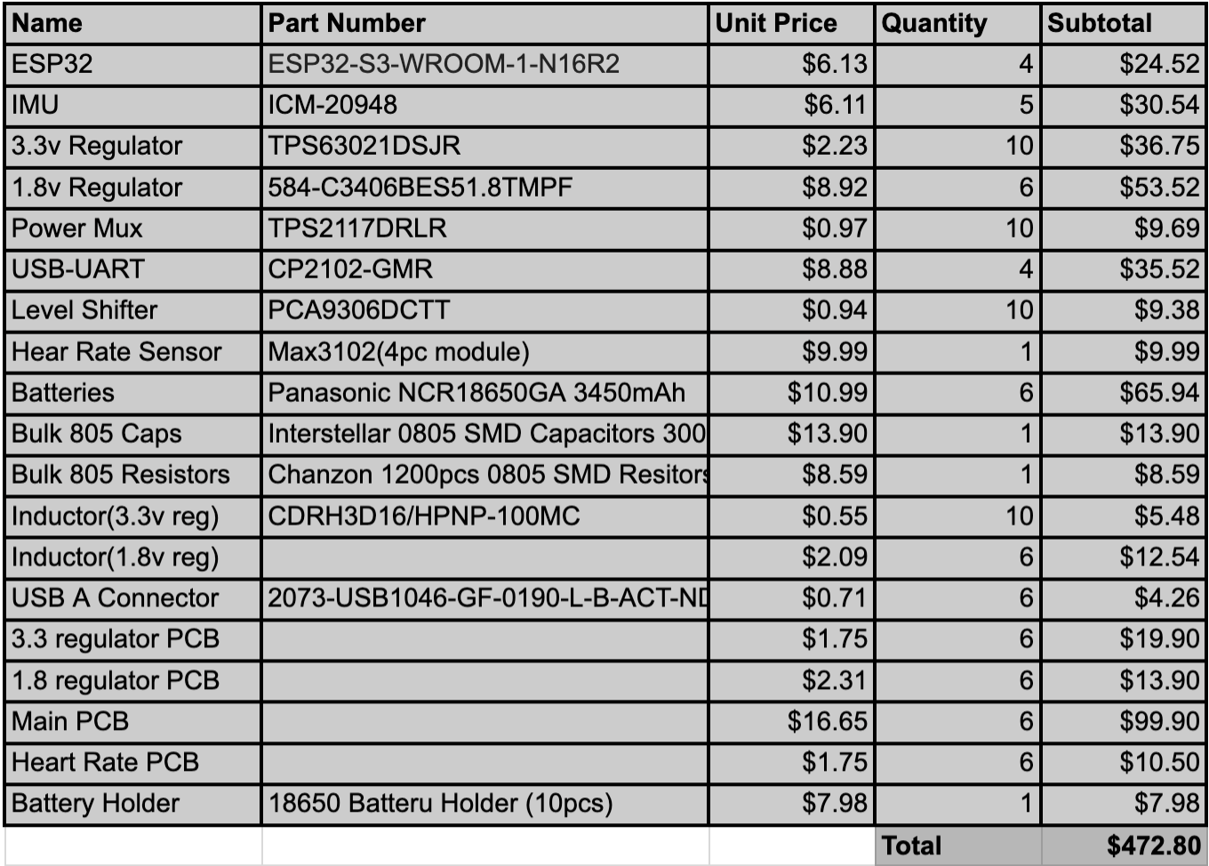
BOM

Slide 6
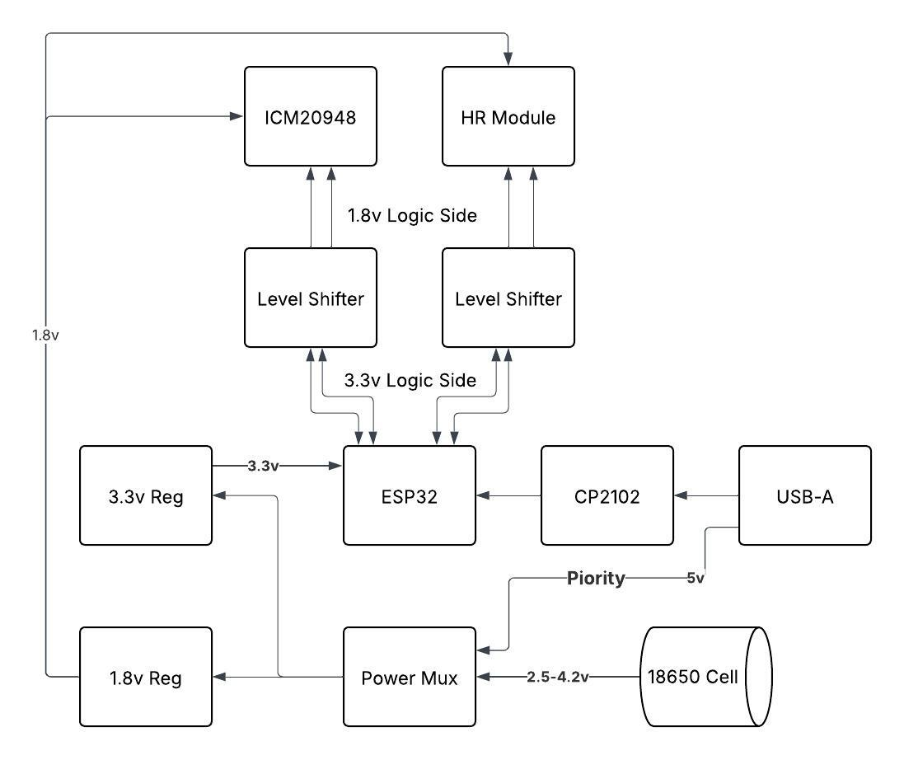
Hardware Block Diagram

Slide 7
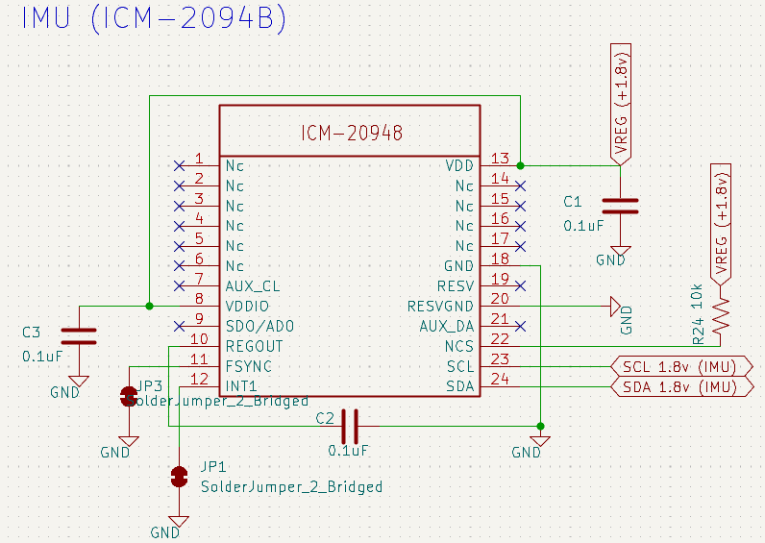
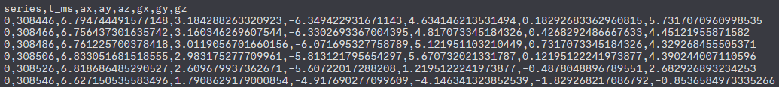
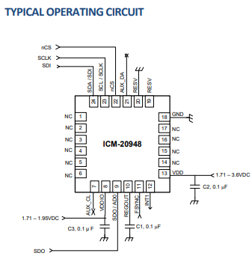
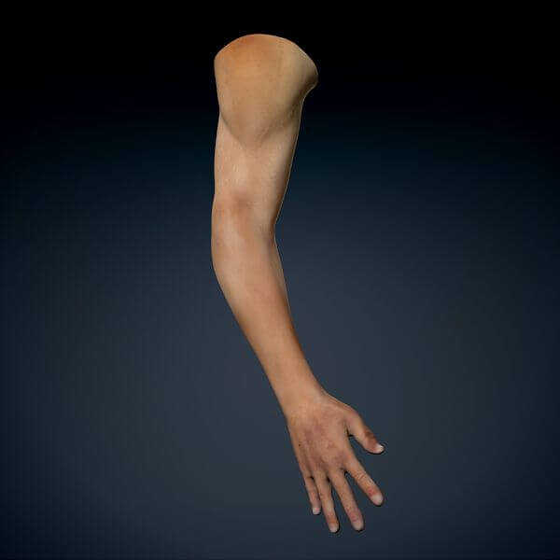
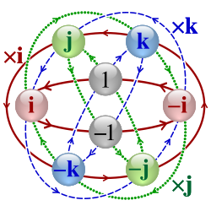
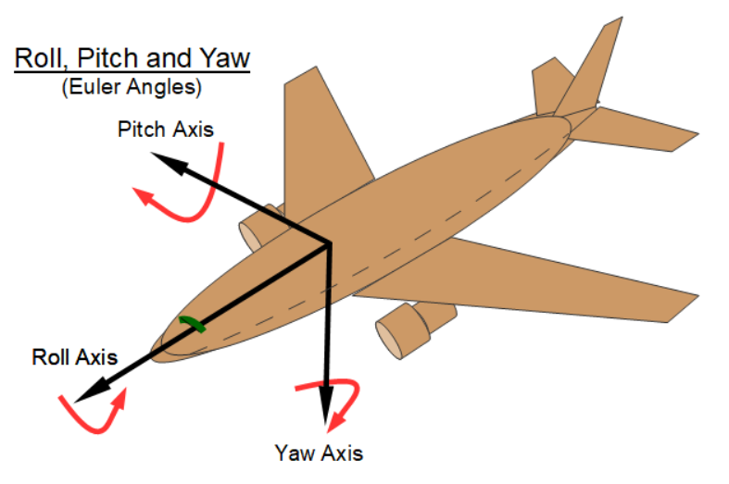
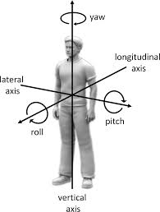
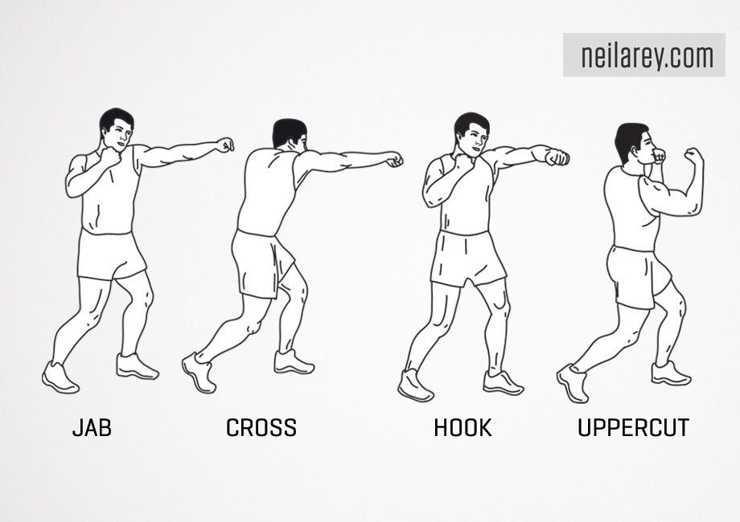
IMU
Raw Data
Translated data
Strike Data

Slide 8
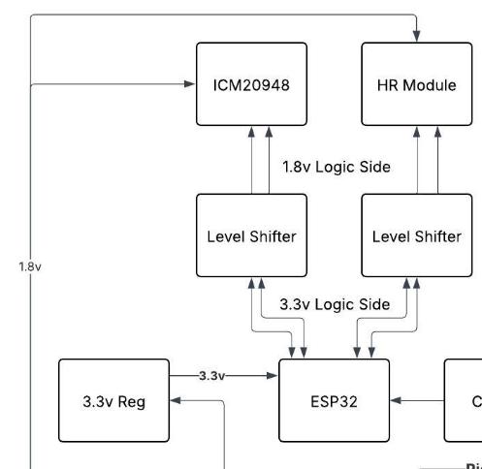
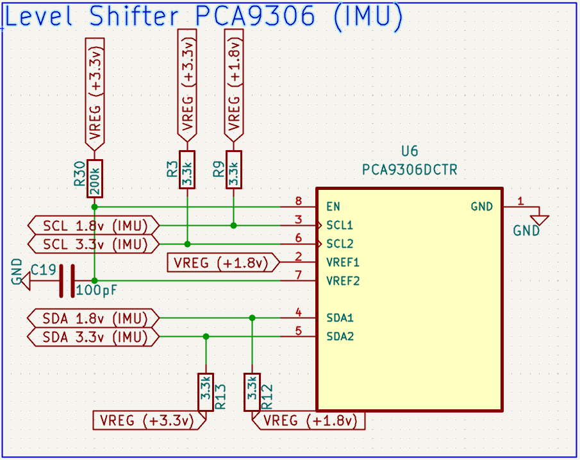
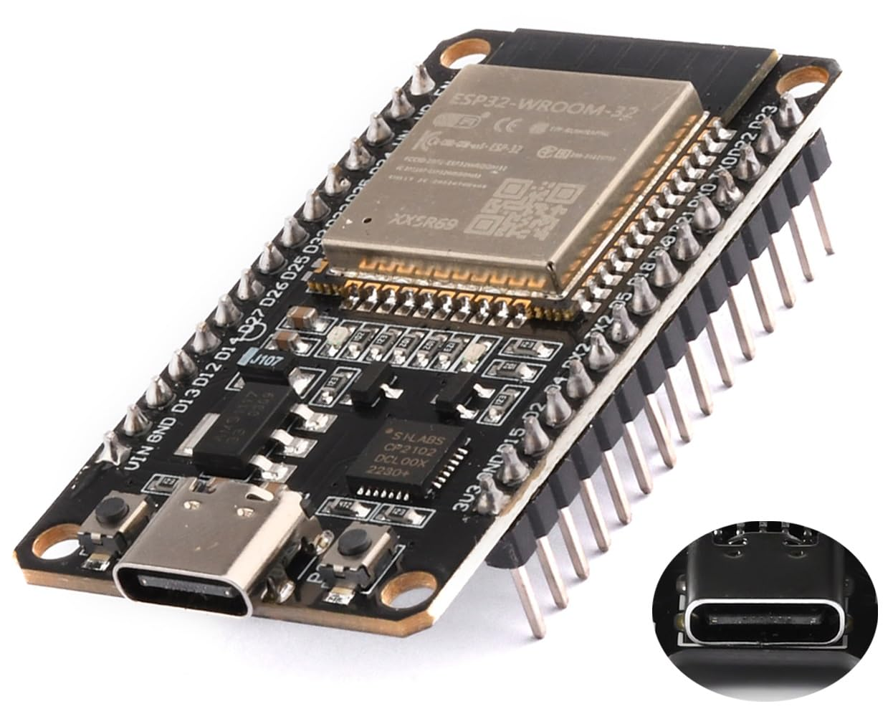
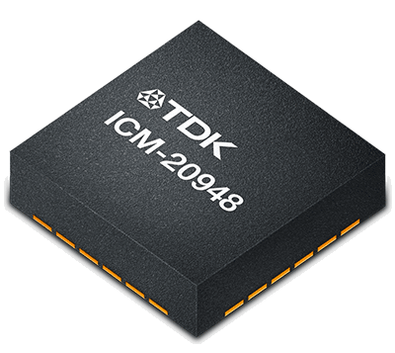
Level Shifting

Slide 9
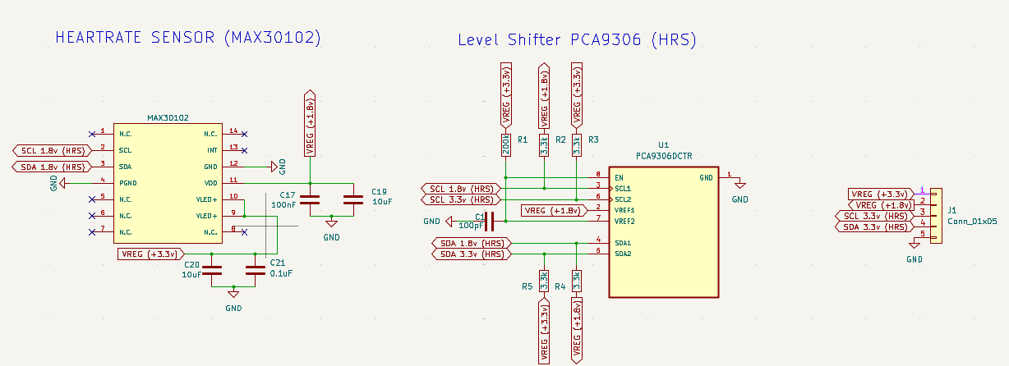
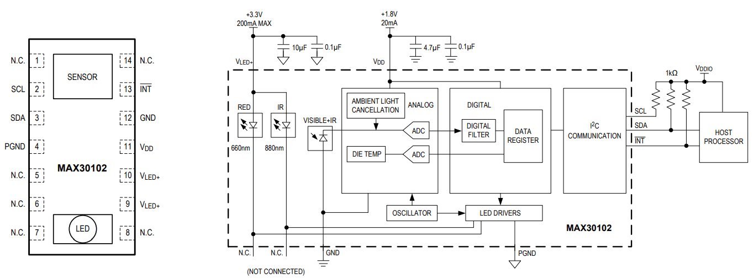
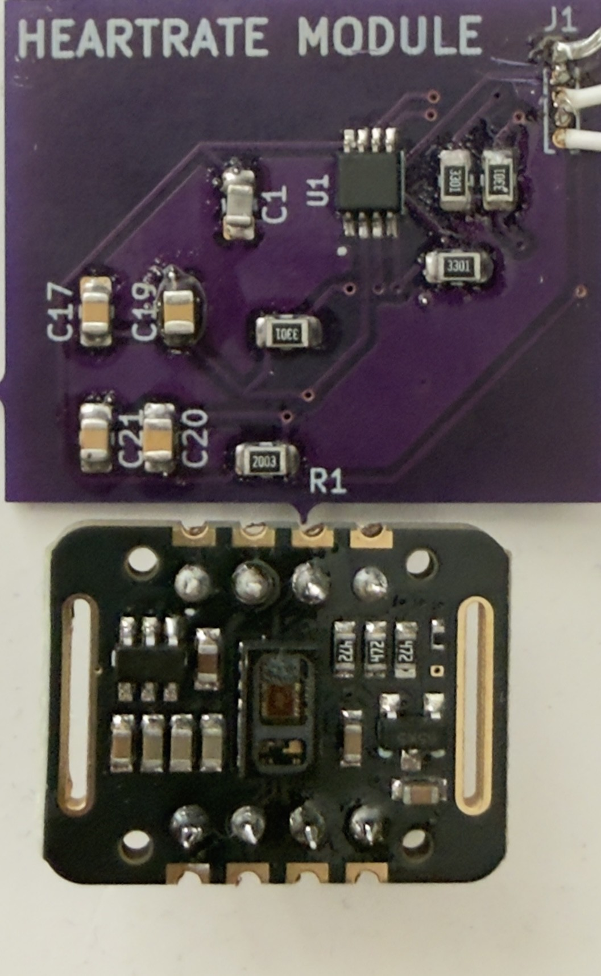
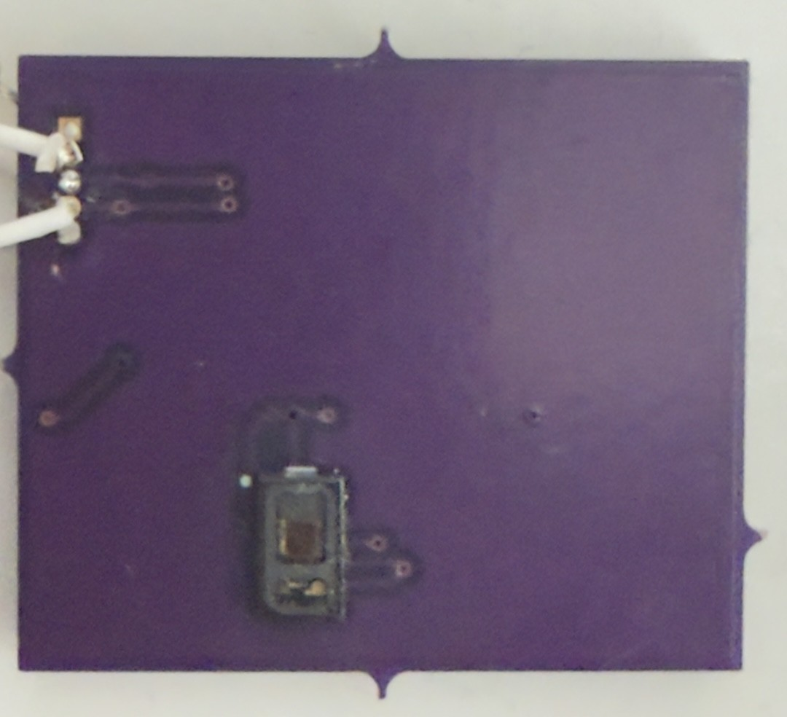
Heart Rate Monitor
Custom PCB Module
(top)
Custom PCB Module
(bottom)
Dev Kit

Slide 10
Heart Rate Monitor
Custom PCB Module
(top)
Custom PCB Module
(bottom)
Dev Kit

Slide 11
Custom PCB Module
(top)
Custom PCB Module
(bottom)
Dev Kit

Slide 12
Heart Rate Monitor (cont.)
Spec Demo
Parameter | Specification
Heart Rate Monitoring | Continuous, ± 2 BPM accuracy

Slide 13
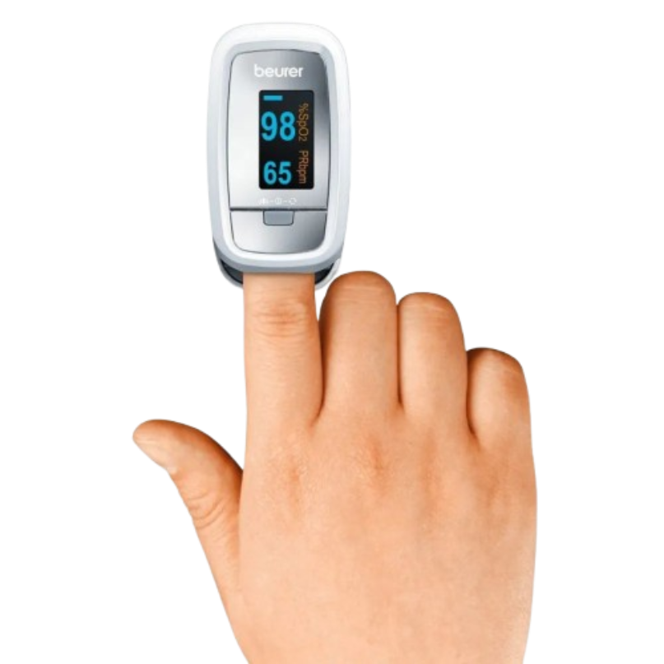

1
Goal | Plan
Continuous Measurement | Apparatus to fix device
Consistent Data | Software to handle fluctuations
Size | Reduce PCB size
1
2
2
3
1.125 in
0.75 in
.875 in
3
0.5 in

Slide 14
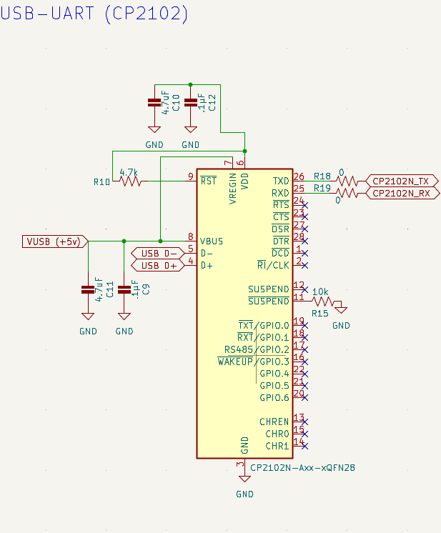
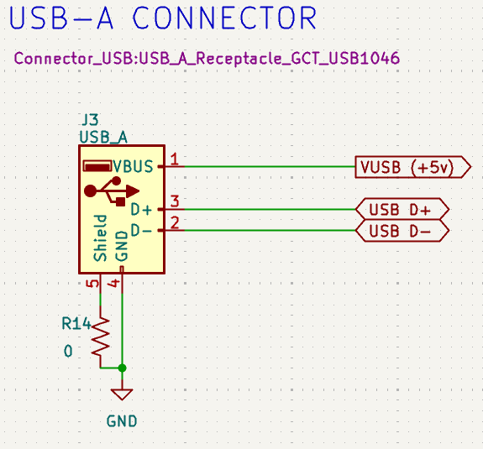

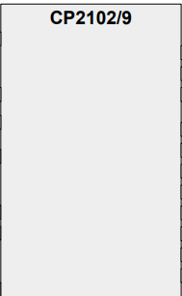
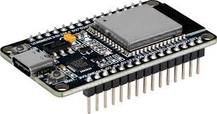
USB-Uart Communications
Usb
To Uart Bridge

Slide 15
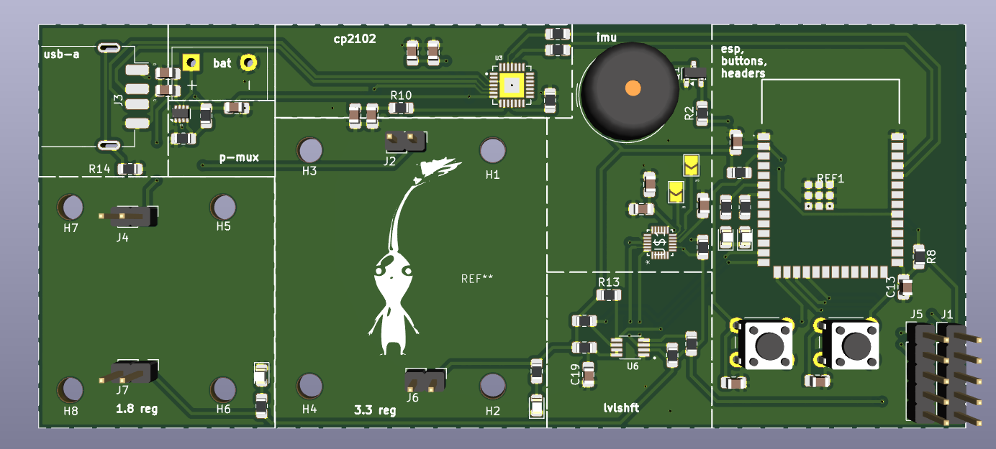
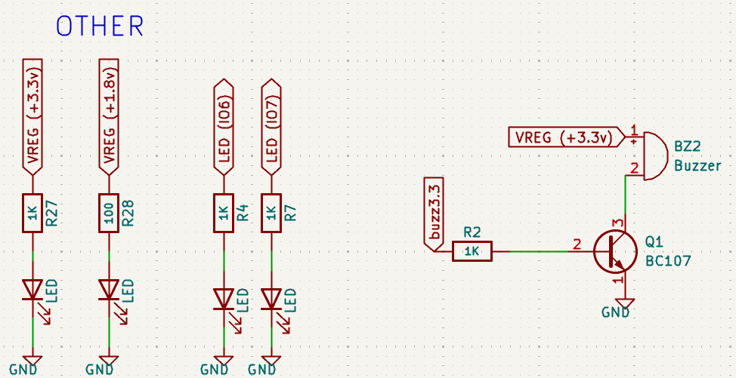
Feedback
Leds on power lines for power monitoring
Extra Floating io connectability to pin header in case we need to add functionality
Buzzer for user feedback

Slide 16
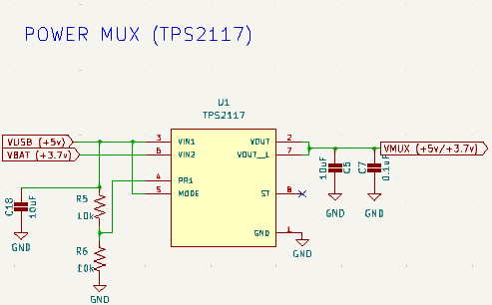
Power Mux
•Device: TPS 2117 Power Multiplexer
•Function:
• Configured to selects between two power sources
• Typically USB and Battery
•Key Features:
• Seamless switchover without brownout
• Adjustable current limiting
• Reverse current blocking
• Controlled inrush behavior
•System Impact:
• Prevents backfeeding into USB
• Eliminates manual power switching
• Improves user experience and reliability

Slide 17

Batteries
•Battery Choice: 18650 Protected Li-ion Cells
•Why 18650?
• High energy density (compact, long runtime)
• Widely available and cost-effective
• Rechargeable and scalable (parallel/series if needed)
•Built-in Protection Circuit:
• Overcharge protection
• Over Discharge protection
• Overcurrent / short-circuit protection
•Application Benefit:
• Increased system safety
• Reduced need for external protection circuitry

Slide 18
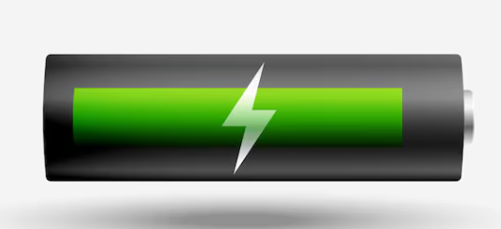
Battery Monitoring Strategy
•Voltage Monitoring via ESP32 ADC
•Implementation:
• Voltage divider scales battery voltage
• Output connected to ESP32 ADC pin
• Firmware calculates real-time battery level
•Why This Matters:
• Prevents deep discharge
• Enables low-battery warning
• Allows runtime estimation and telemetry
•Design Consideration:
• Divider values selected to stay within ADC limits
• Minimize current draw through high-value resistors

Slide 19
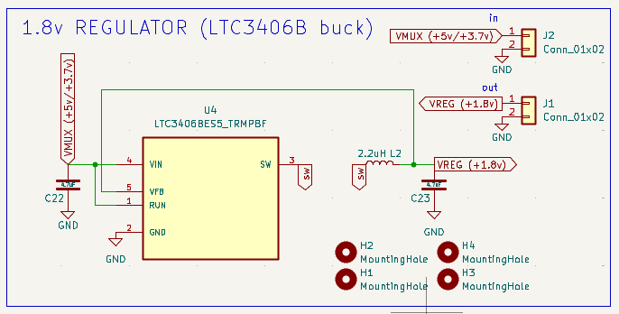
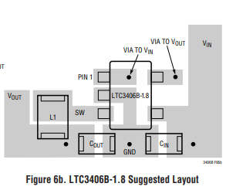
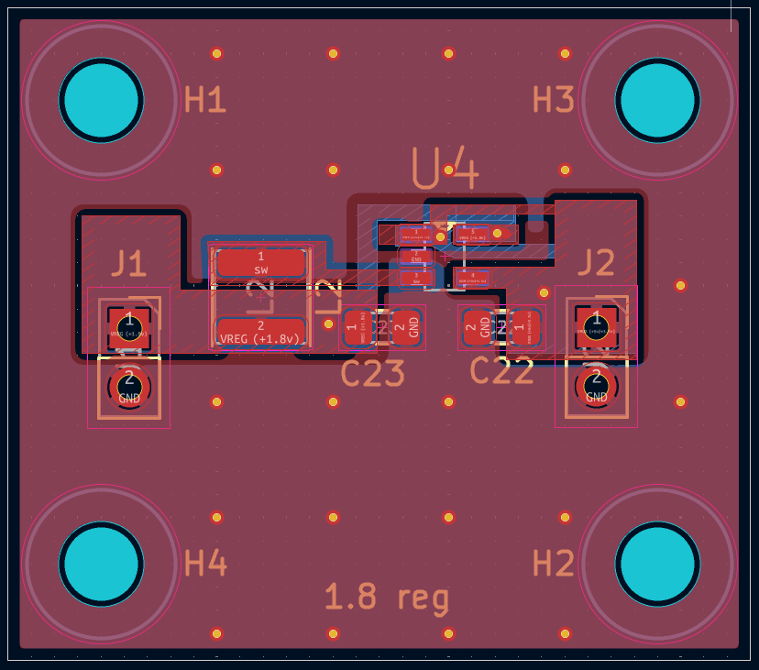
1.8 Regulator
Device: LTC3406B
•Topology: Step-Down (Buck) Switching Regulator
•Purpose:
• Generate stable 1.8V rail
• Power low-voltage digital logic or sensors
•Key Advantages:
• High efficiency at moderate loads
• Compact external component count
• Suitable for space-constrained designs
•System Considerations:
• Switching frequency vs efficiency tradeoff
• Output ripple management
• Grounding and layout critical for noise control

Slide 20
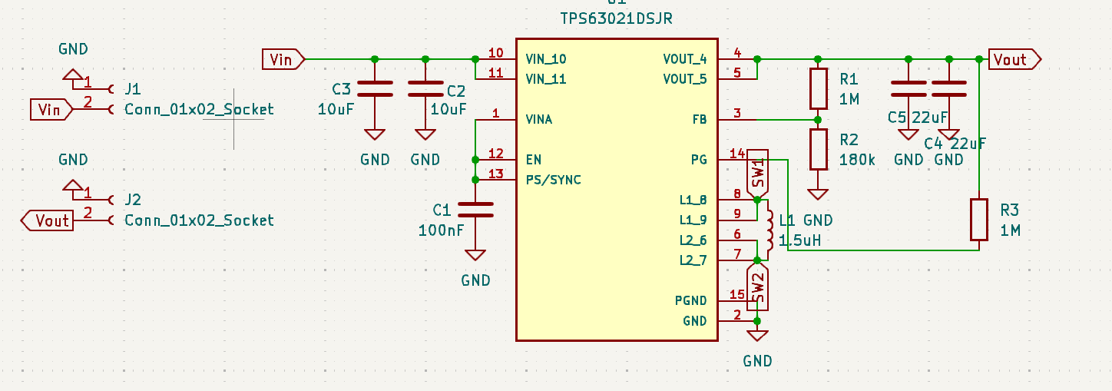
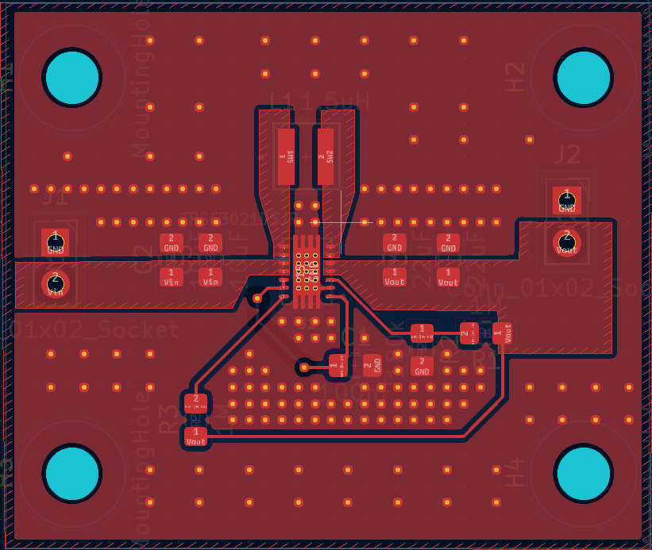
3.3 Regulators ( Boost-Buck Converter)
•Device: TPS63021
•Why Boost-Buck?
• Battery voltage varies (above and below 3.3V)
• Maintains constant 3.3V output
• Operates in both step-up and step-down modes
•Benefits:
• High efficiency across wide input range
• Stable rail for ESP32 and digital logic
• Reduced heat compared to linear regulators
•Design Focus:
• Proper inductor selection
• Careful PCB layout to reduce switching noise

Slide 21
MCU
Considered Solutions
 | Processing | Wireless Support | Power Consumption | Memory | Development Complexity
Raspberry Pi | ↑↑↑ | ↑↑ | ↑↑↑ | ↑↑↑ | ↑↑
Arduino | ↓ | ↓ | ↓ | ↓ | ↓
STM32 | ↑↑ | ↓ | ↓ | ↑↑ | ↑↑
ESP32 | ↑↑ | ↑↑↑ | ↑ | ↑↑ | ↑
Processing - Higher is better
Wireless Support - Higher is better
Power Consumption - Lower is better
Memory - Higher is better
Development Complexity - Lower is better
Red - Worst
Green – Best
Our Chip:
ESP32-s3-1-WROOM -N16R2
Dual-core 240 MHz processor
Integrated BLE and Wi-Fi
16MB Flash and 2MB PSRAM
Power consumption 344mA*
Plethora of reference designs and supported libraries
*Peak BLE TX current: 344 mA at +20 dBm (datasheet worst case)

Slide 22
Wireless Communication
Strike sense requires a wireless link that can stream 9-axis data in real time, maintain low latency and ensure reliable packet delivery while minimizing power consumption.
Wifi | Bluetooth LE
Intended for high-throughput networking Real world throughput 10-300+ Mbps Variable latency often unpredictable Large range 10s-100s of meters Significantly higher power consumption Added complexity (Router/AP + full TCP/IP stack) | Intended for low-power device links Real world throughput up to 100kB/s Low and predictable latency Shorter ranged 10s of meters Low power consumption (optimized for battery powered devices) Simple point-to-point connection
Strike Sense Worst Case BLE Payload
Type of Payload: Raw Data | Gyroscope: 2 bytes x 3 axes x 1000 samples/s | Accelerometer: 2 bytes * 3 axes *1000 samples/s | Magnetometer: 2 bytes * 3 axes *100 samples/s | Metadata: Timestamp(uint32) 4 bytes *1000/s | Total: 16.6kB/s
*Note this estimation is derived based on maximum ODR and resolution and excludes BLE overhead, and still represents a conservative overestimation of actual payload

Slide 23
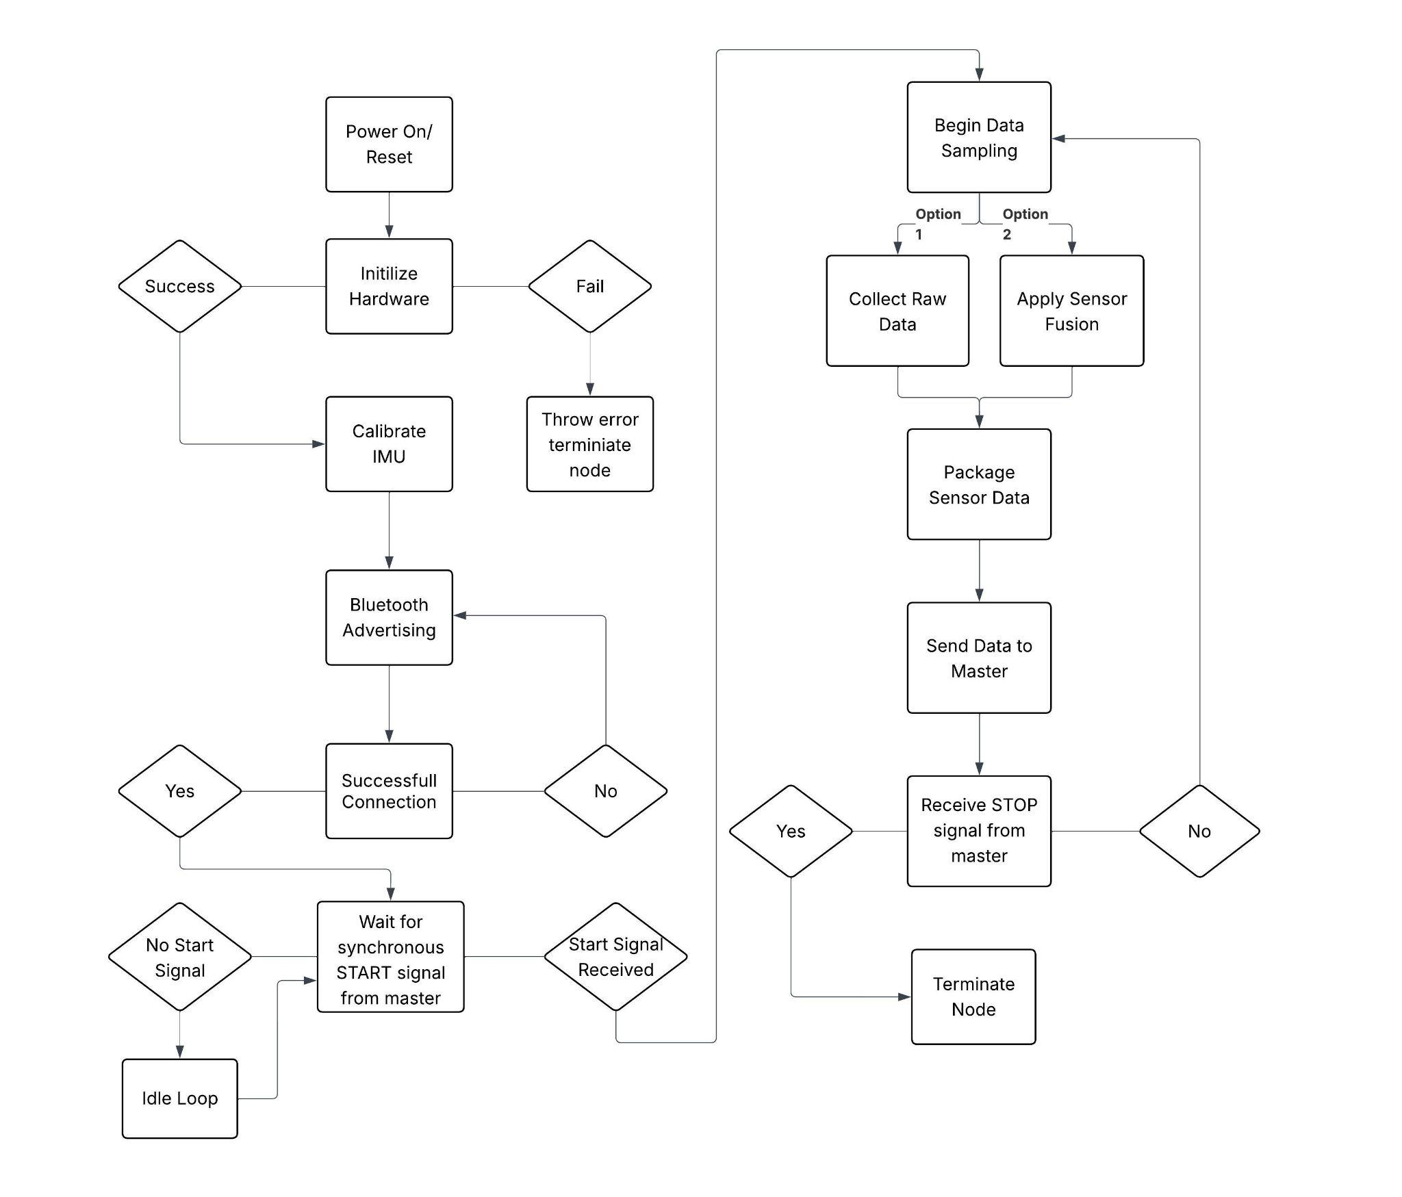
Embedded Software
Libraries:
Arduino Core (Arduino.h)
Microcontroller runtime (GPIO, timing, serial)
I²C Interface (Wire.h)
Communication with ICM-20948 IMU
IMU Drivers (Adafruit_ICM20948)
9-DoF sensor initialization & data acquisition
Sensor Fusion (Fusion.h)
Quaternion-based orientation estimation
BLE Stack (NimBLEDevice.h)
Low-power GATT server for wireless IMU streaming
Memory Utilization:
Ram Usage - 30,493 bytes ~9.3% utilization
Flash Usage- 3,342,336 bytes ~16.3% utilization

Slide 24
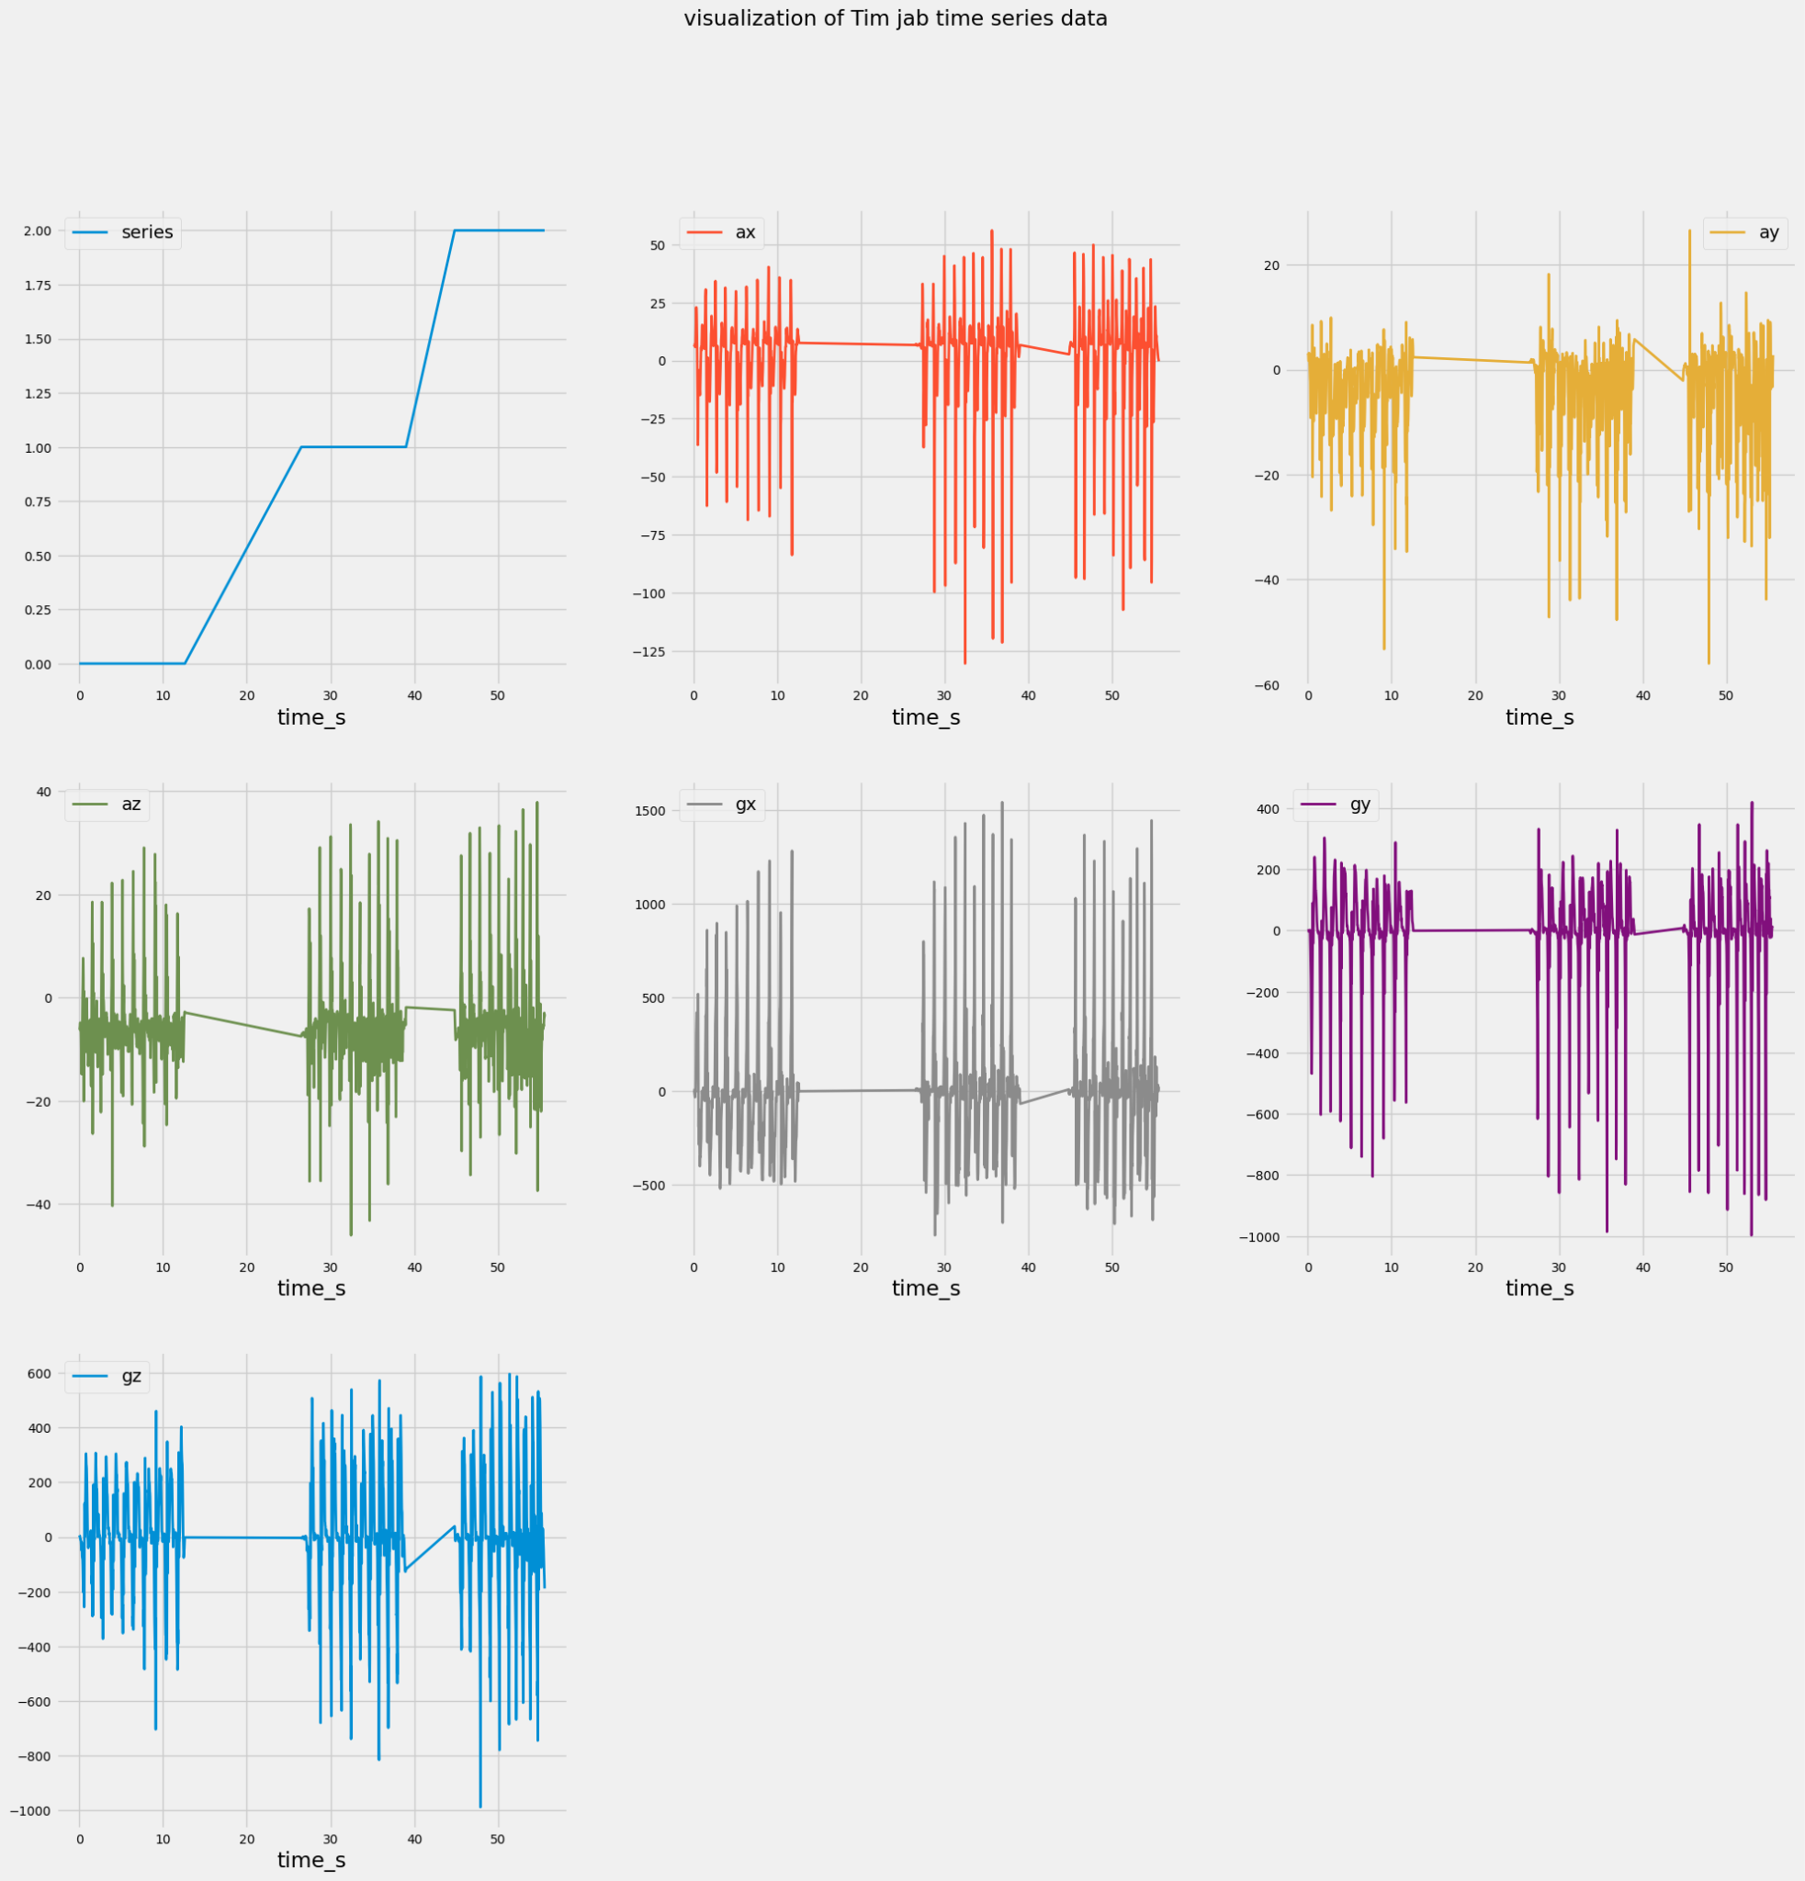
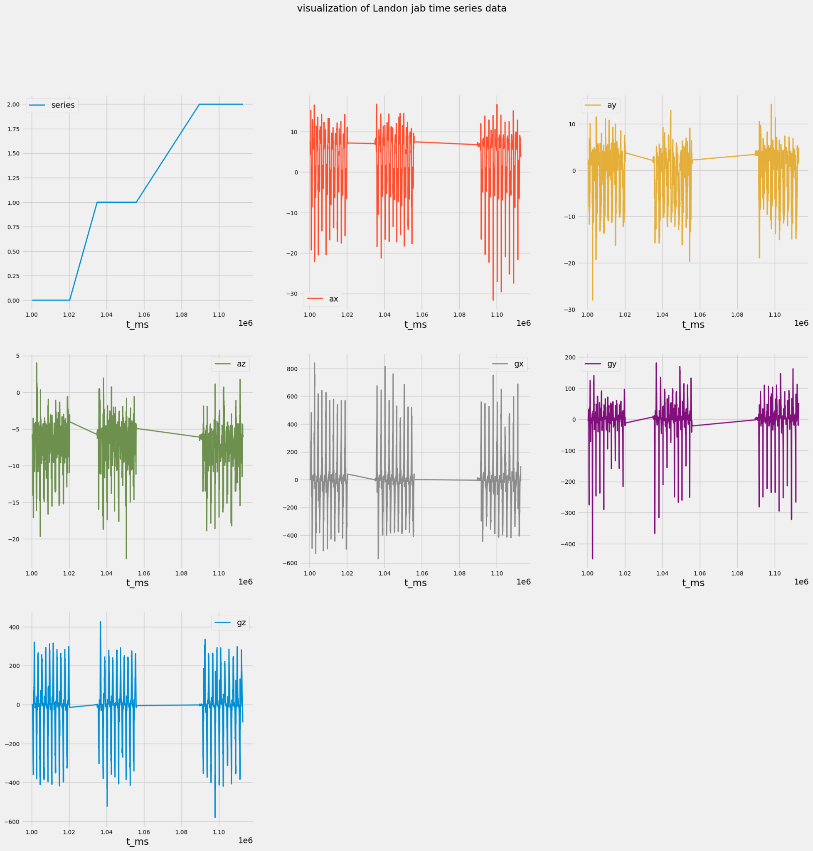
Data Pipeline (IMU)

Slide 25
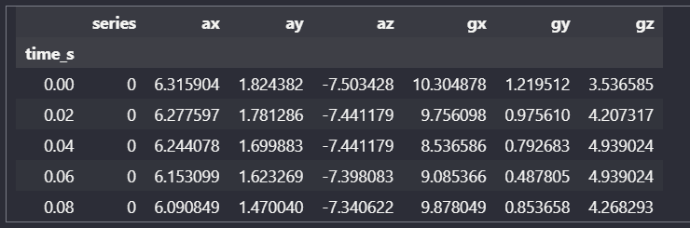
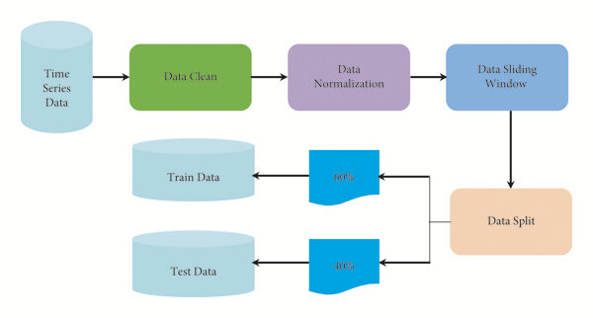
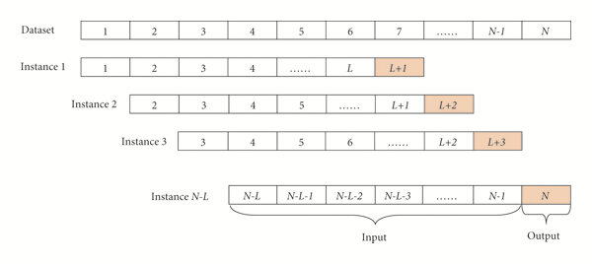
Data Pipeline
Our complete pipeline has two sectors: IMU data and computer vision data
We currently have out IMU data pipeline in defined & in use with the computer vision data pipeline only defined

Slide 26
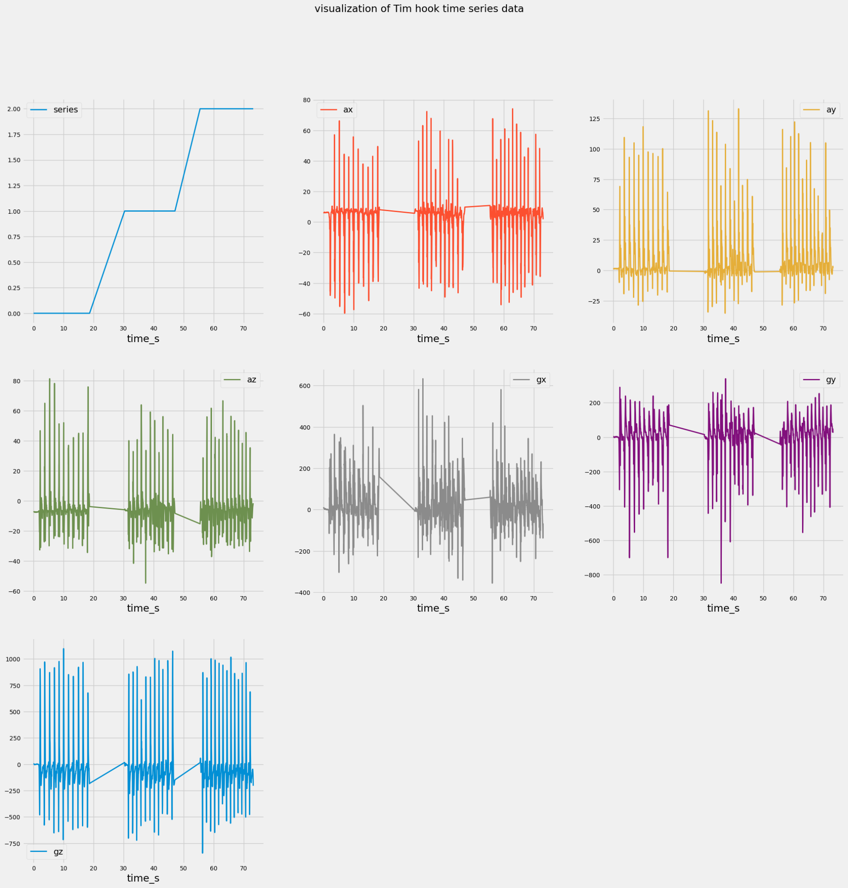
Data Pipeline (IMU)

Slide 27
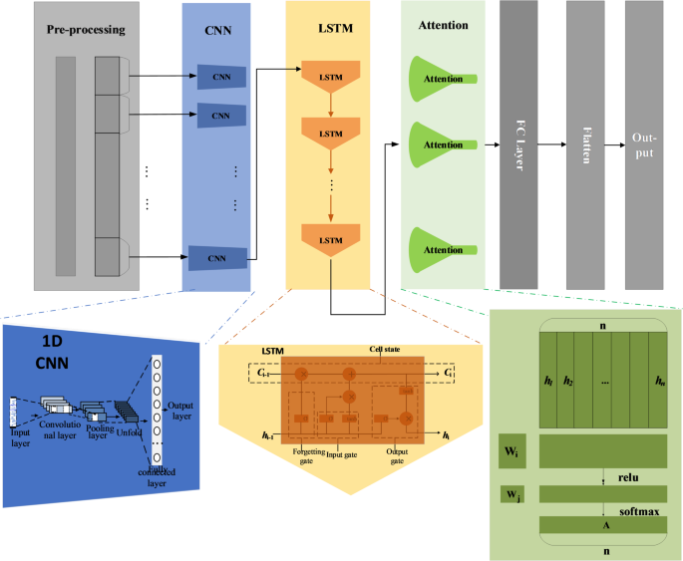
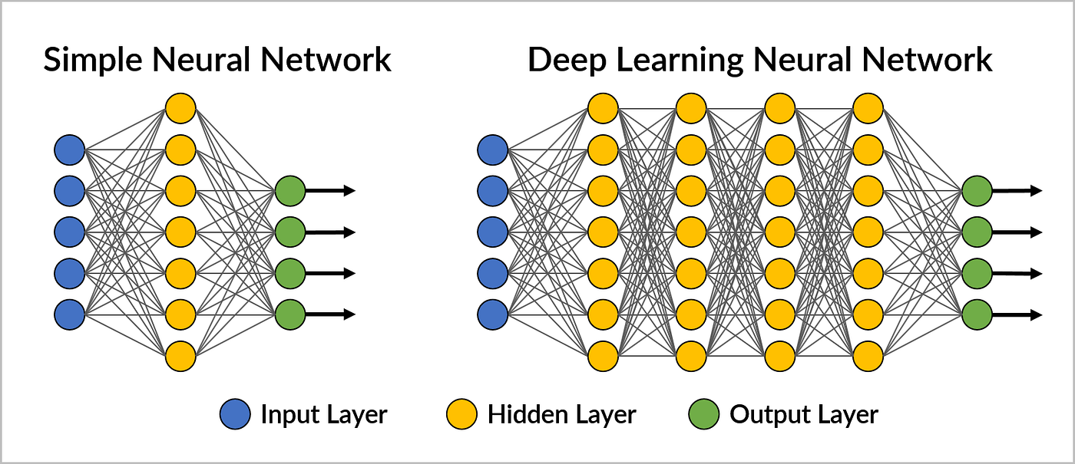
Machine Learning Implementation
We are currently using a neural network architecture composed of the following
1D CNN : Extracts local spatial features from the input using convolutional filters
Long Short Term Memory(LSTM): captures long range temporal dependencies.
Attention: Weighs the most relevant parts of the sequence for the models learning progression
Fully Connected: Maps the representations being learned to final output predictions

Slide 28
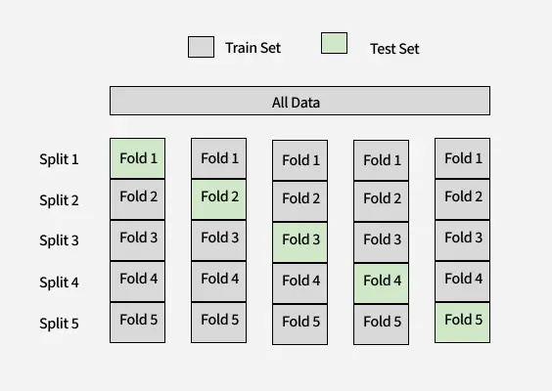
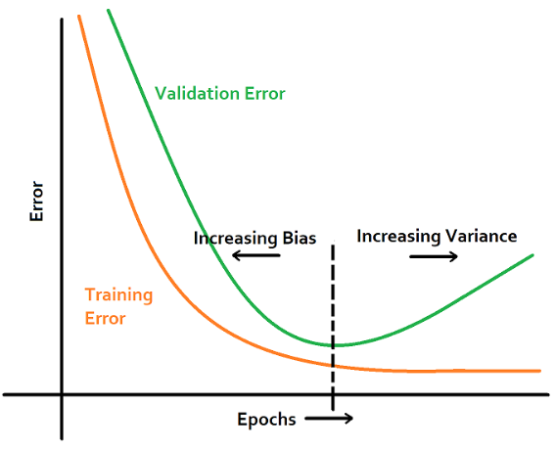
Machine Learning Strategies and Hyperpameter Tuning
We implemented the following strategies along the way to accomplish our current results
Weighted Loss: penalizes mistakes on smaller classes more during training
Window size/stride adjustment: Adjusted window and stride size to alternate between capturing multiple punches and one. Settled on a window size = 80 and stride = 70 for training. Based on a 50Hz sampling rate
Optimizer and Weight Decay: Set weight decay to 1e-4 and used Adam optimizer to penalize imporportianate large weights
K-Fold Cross Validation: Set a rotation of samples to be used for validation each epoch as to avoid overfitting
  With each fold generating a model, we select the model closest to the mean validation accuracy
ReduceLROnPlateau scheduler: halves learning rate whenever there is a plateau in validation accuracy
Early Stoppage: Within each fold we implemented this to avoid extensive plateaus in validation accuracy. Patience was set to 7.

Slide 29
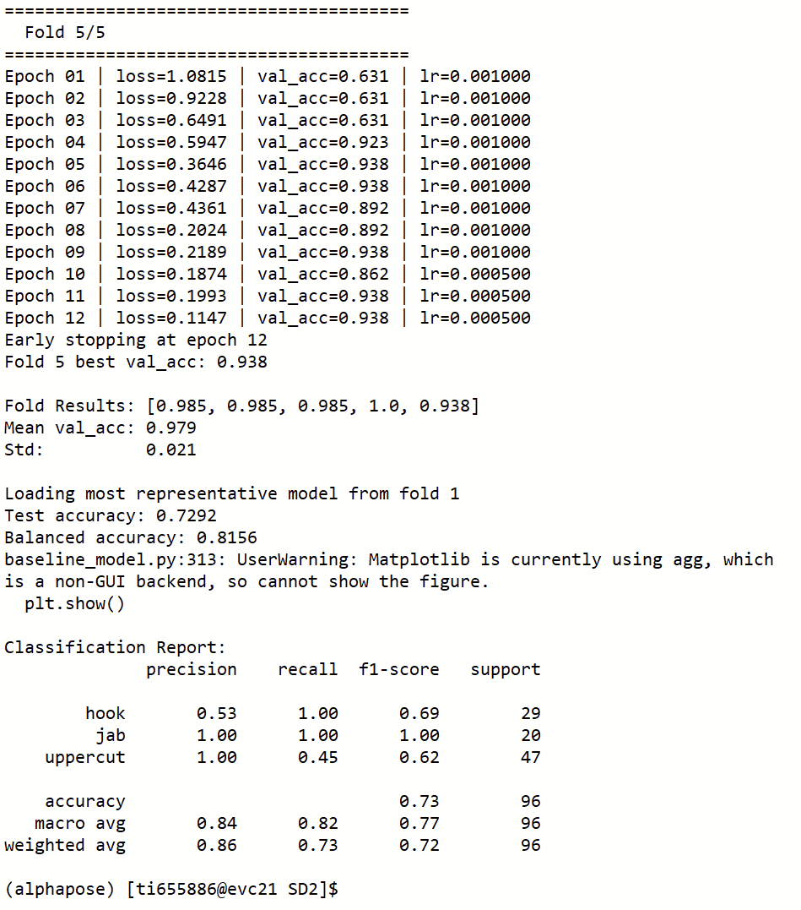
Machine Learning Results

Slide 30
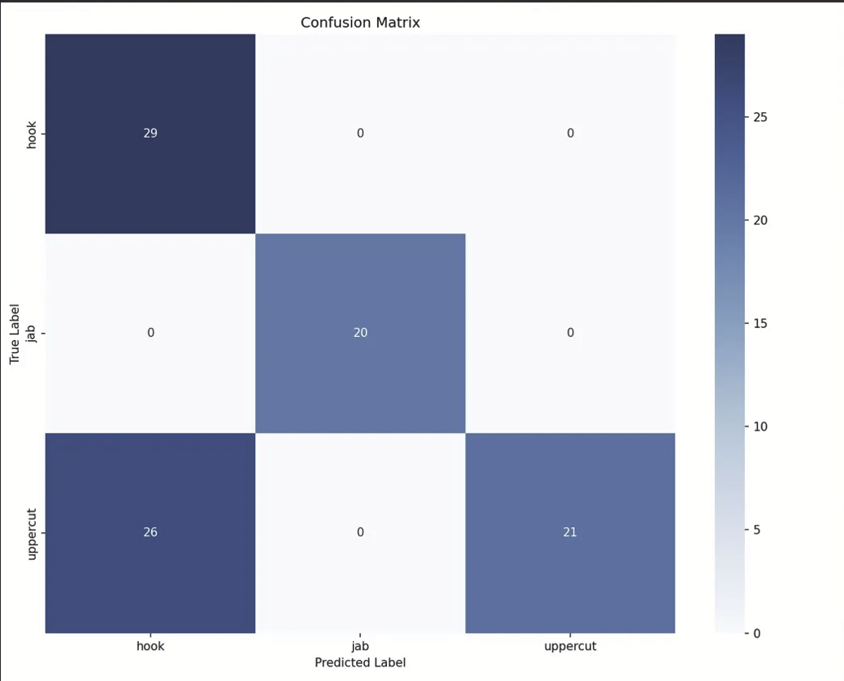
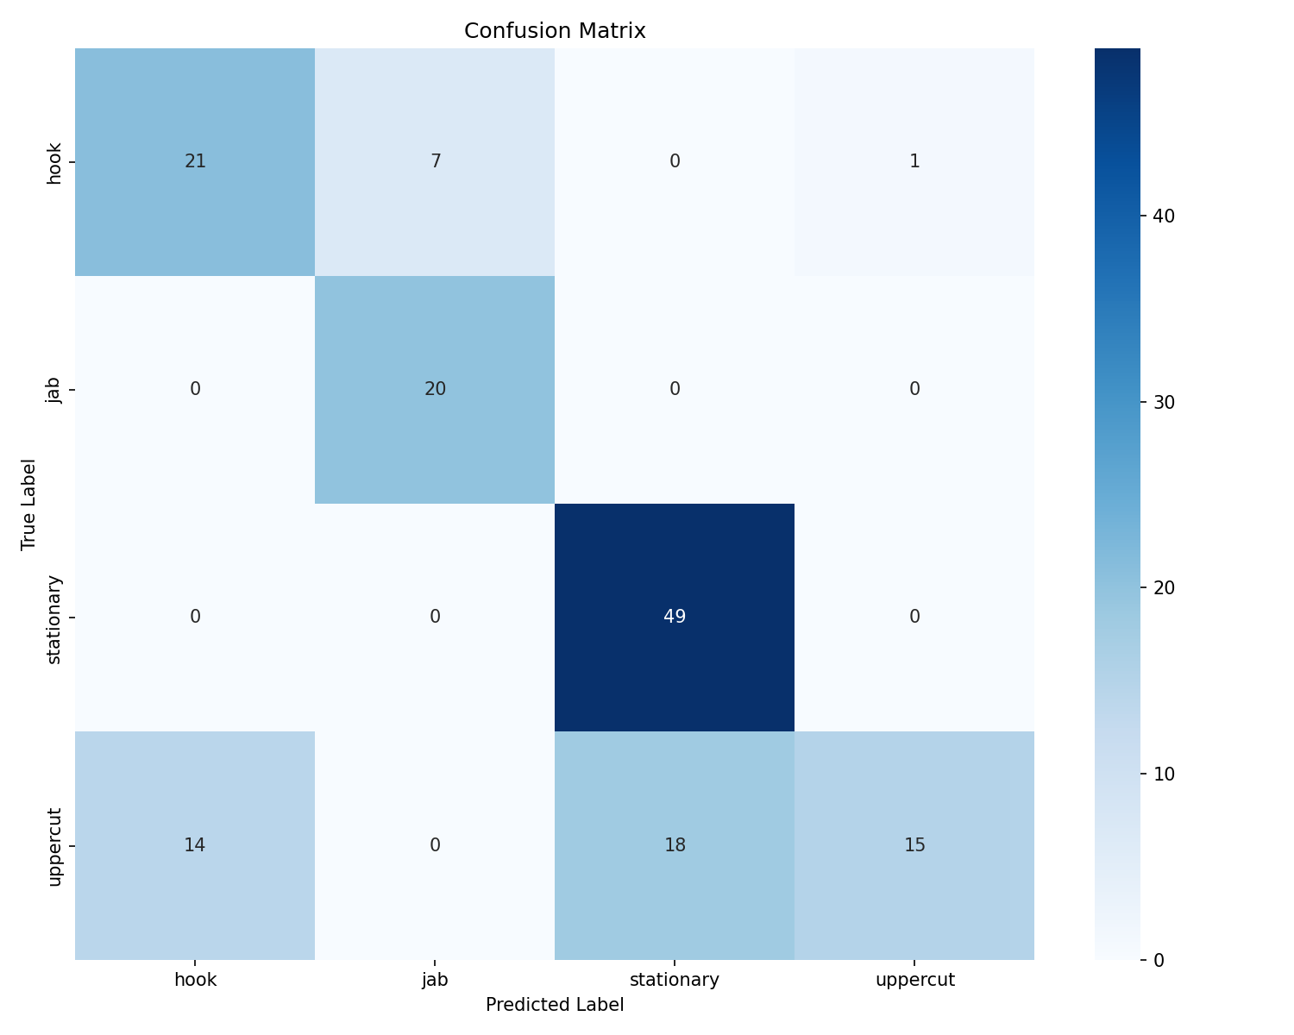
Machine Learning Results

Slide 31

Machine Learning Results

Slide 32
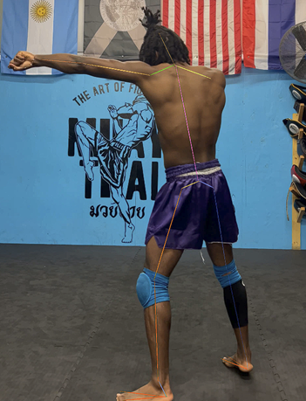
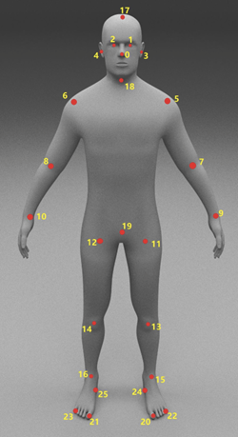
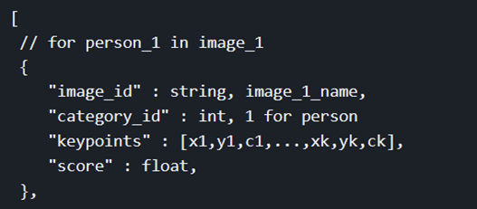
Computer Vision
We will be implementing a similar data pipeline to our IMU proccessing
We will use Alphapose, a Pose estimator due to its use of PoseFlow
Length of one strike = 0.5 – 1 sec = 15-30 frames
  Each frame returns 136 keypoints(coordinates, confidence)
  In one strike, a total of 2040 individual keypoints are extracted
We have a dataset and will continue to expand and then proceed into training

Slide 33


Dashboard
Our dashboard is made of the following stack:
Next . js , React. Js (frontend)
Node. js + Express (backend)
PosgreSQL (database)
FasAPI
Python

Slide 34
THANK YOU

