Slide 1
Midterm Presentation
Group 37 - Senior Design 2 Spring 2026
Benjamin Bolton, ECE
Landon Wright, CPE
Shems Fils-Aime, ECE
Timothy Azinord, CPE

Slide 2
What is Strike Sense?

Slide 3
Why?
Sports serve as a intersection between health, technology, and human performance. Many athletes rely on trusted routines and careful feedback from cutting edge technology to improve.
Martial arts is one sport that is behind in this endeavour.
Strike Sense was made from a desire to provide a way for martial artist to track their training and be safer along the way.
The biggest goal was to do this in a non intrusive way yet robust manner. We want users to feel no difference during training and all the difference after.

Slide 4
What?
StrikeSense is an application which will allows users to get insight into their technique and provide gentle suggestions towards future training sessions
This is done through identifying strikes being thrown during sessions as well as effort and providing feedback in a post session report
Users will be able to refer to this throughout their training journey and monitor growth as well better plan for the future

Slide 5
Who is This For?
We are creating this with your average person in mind. Someone who is interested in starting martial arts but has limited access to training resources
StrikeSense would serve as a way for them to cultivate the inner foundation and understanding before going into the gym to get the real work done
Someone such as a young busy professional who desires to learn muay thai but isn’t sure if its worth such a big chunk of their paycheck just yet. StrikeSense gives them a way to take a peek into the world of martial arts without getting bad habits before they truly broaden their horizons

Slide 6
Goals & Objectives
Real time counting of strikes thrown out of a defined set of strikes [Straight, Hook, Uppercut, Elbow]
  Real Time heart rate monitoring
  Post training session insight on strikes
  Post Training information on heart rate in relation to strikes
· Integration of computer vision in real time counting of strikes
All data displayed in a clean UI on a local application
Create a system with a hardware component comprised of 2 IMU designs: one with 6 DoF, heart rate monitor, charging circuit, and MCU and the other with 6 Dof, charging circuit, and MCU
  Hardware component will be contained in housing and will be equipable with a strap on left and right wrist
  Accelerometer and Gyroscope output will be sent through bluetooth to our application
·Design deep neural network architecture which takes the input from the IMU’s and can identify strikes within that stream of data
  This neural network architecture will have a strike identification percentage of >=80%

Slide 7
Specifications
Parameter | Specification
⭐Strike Classification Accuracy | ≥ 80% correct identification of strikes
⭐Heart Rate Monitoring | Continuous, ± 2 BPM accuracy
Size | ≤ 50 mm × 40 mm × 15 mm (L × W × H)
Session Runtime | ≥ 1 hour continuous operation
⭐Wireless Data Transmission | ≥ 95% packet success rate
Weight | ≤ 60 g per wrist unit (including strap)
Total Cost | ≤ $800 BOM
Battery Life | Infinite

Slide 8
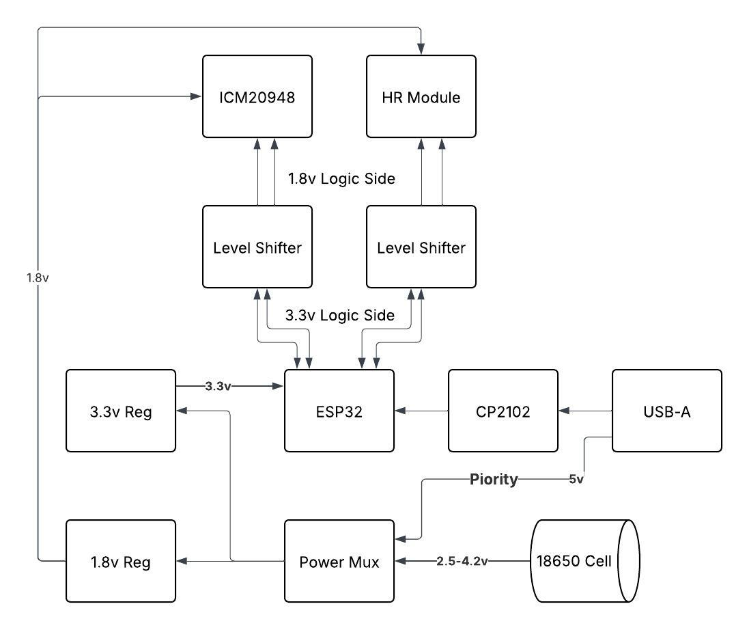
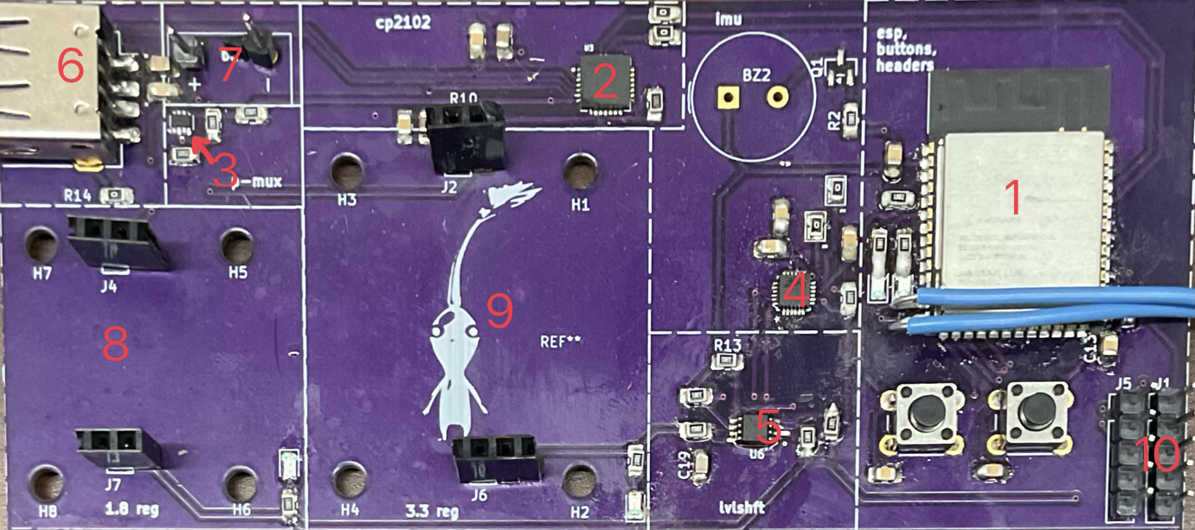
Hardware System Overview
*Green Box = Separate From Main PCB
4
10
5
9
1
2
6
8
3
7

Slide 9
1.5 Minutes
Introduction
-Hook (Set up the Problem)
Ex: what is the problem, why did we choose particular problem, what is the goal/objective of the project
-Product (Introduce strike sense and how can it solve previous problem)
-Transition to how it works
1 Minutes
Hardware walkthrough
-Block Diagram w/ images of final pcb
-Brief Imu Discussion
Discuss Specifications
-Engineering specs (think about what consumers would want to hear)
-ie weight, battery life, size, accuracy, bom

Slide 10
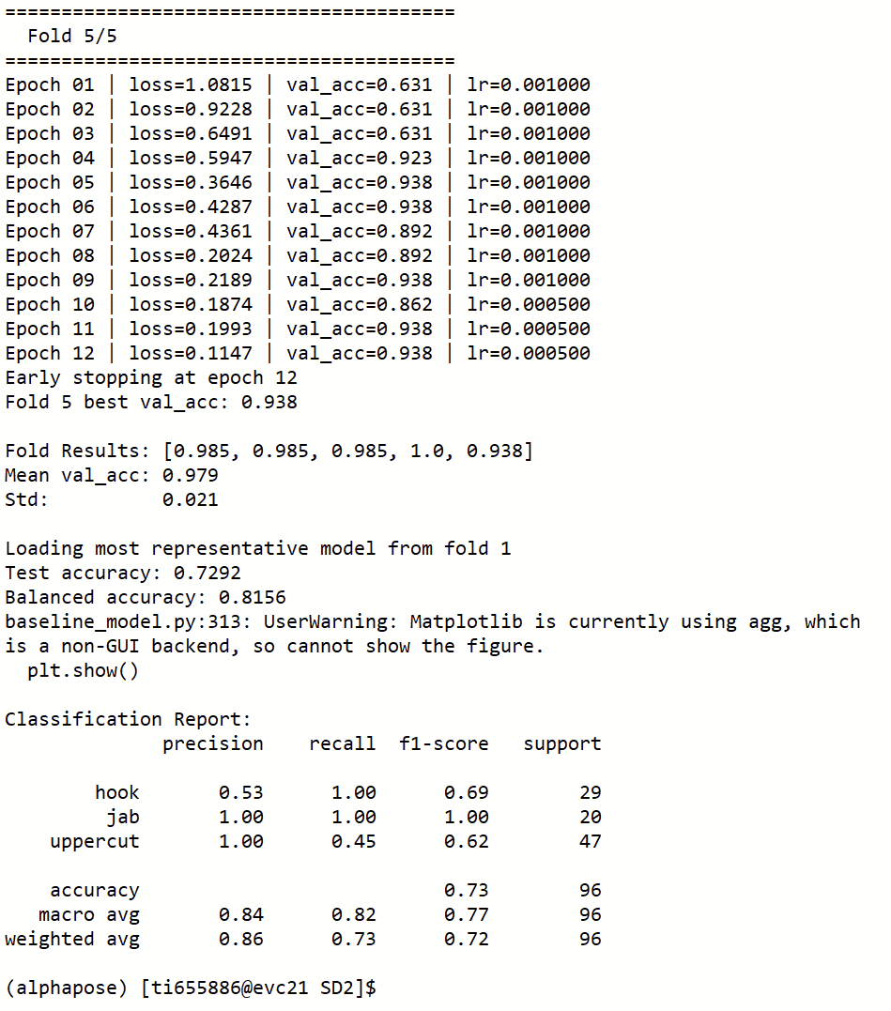
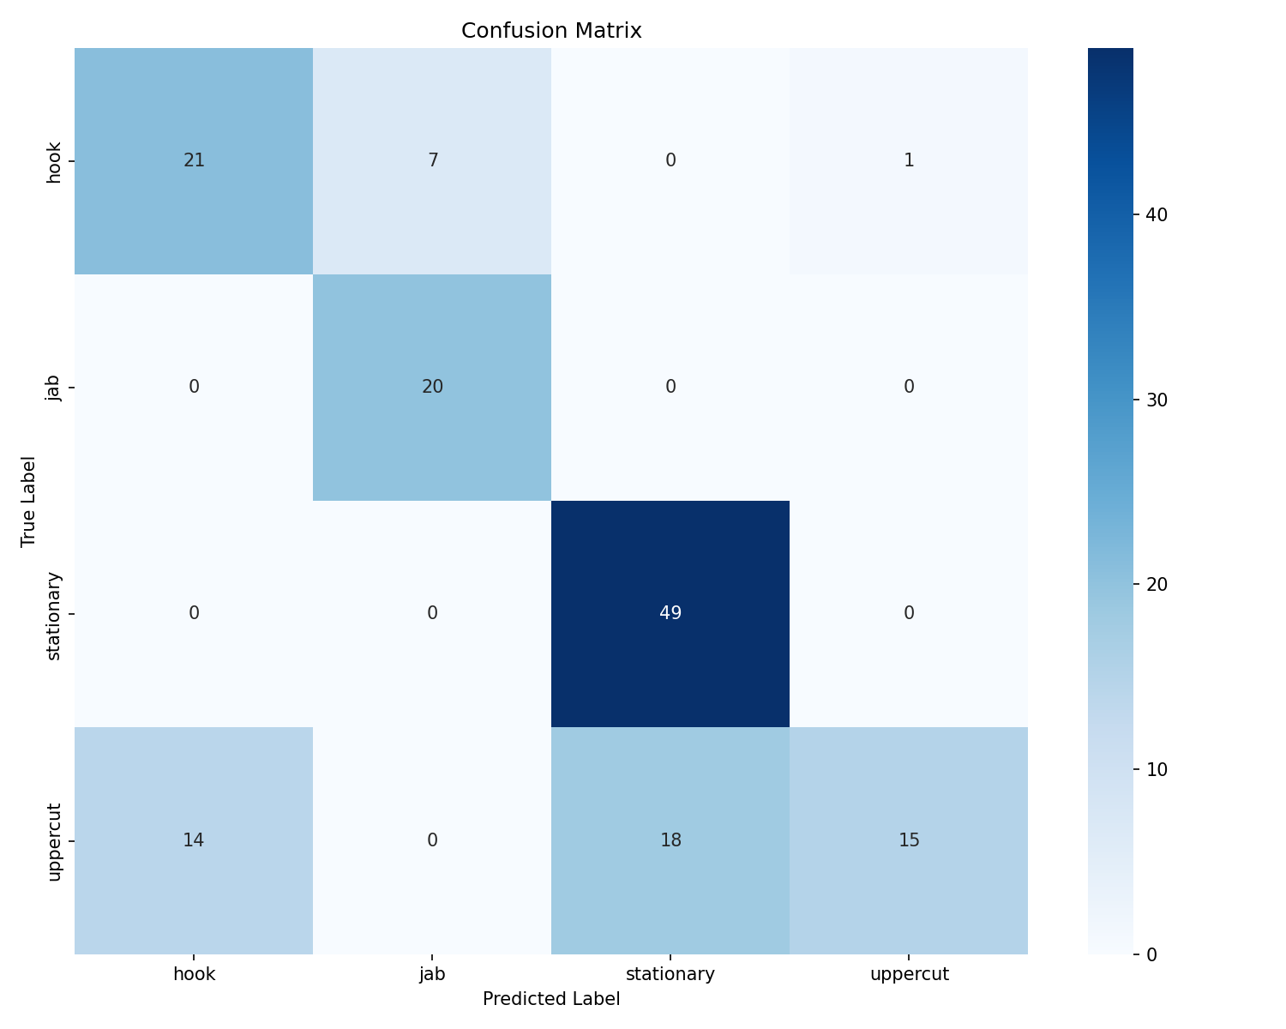
Specification 1 Strike Classification

Slide 11

Specification 1 Strike Classification

Slide 12
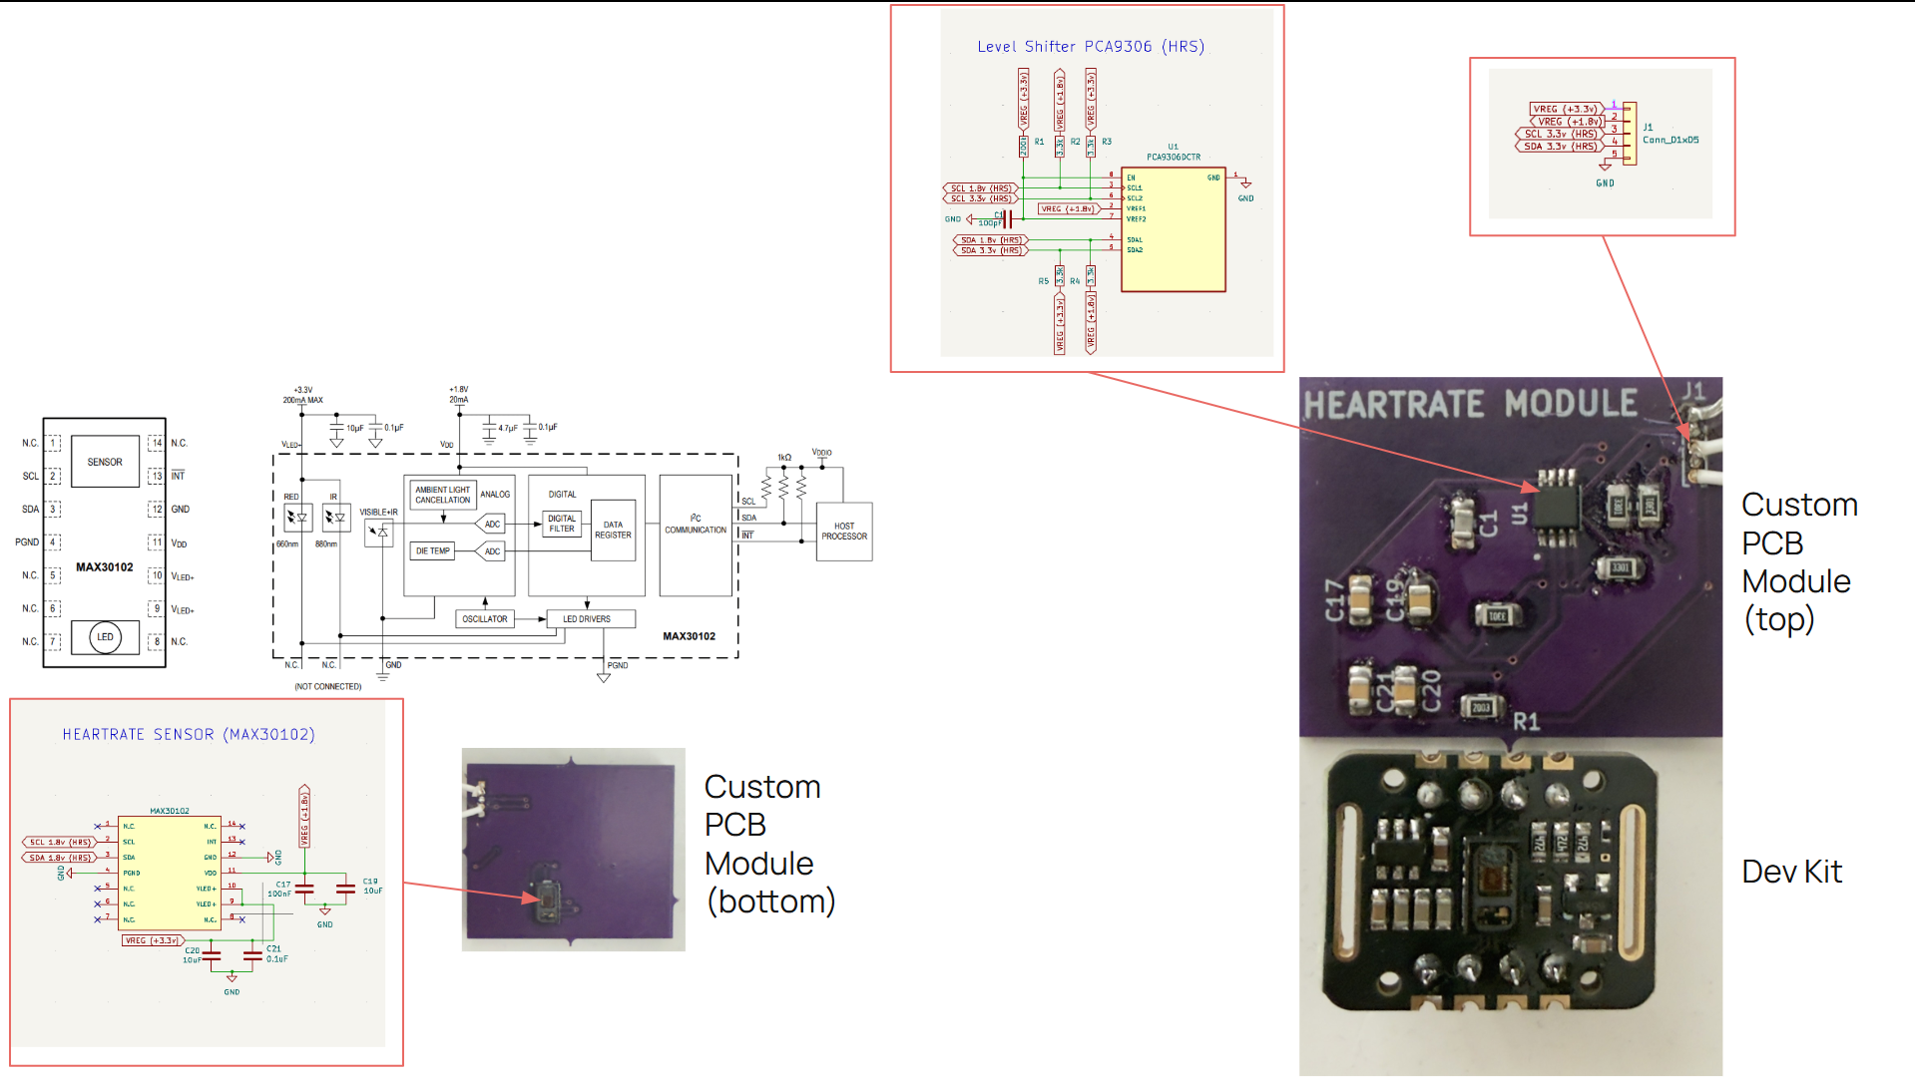
Heart Rate Monitor

Slide 13
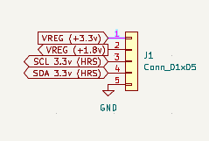
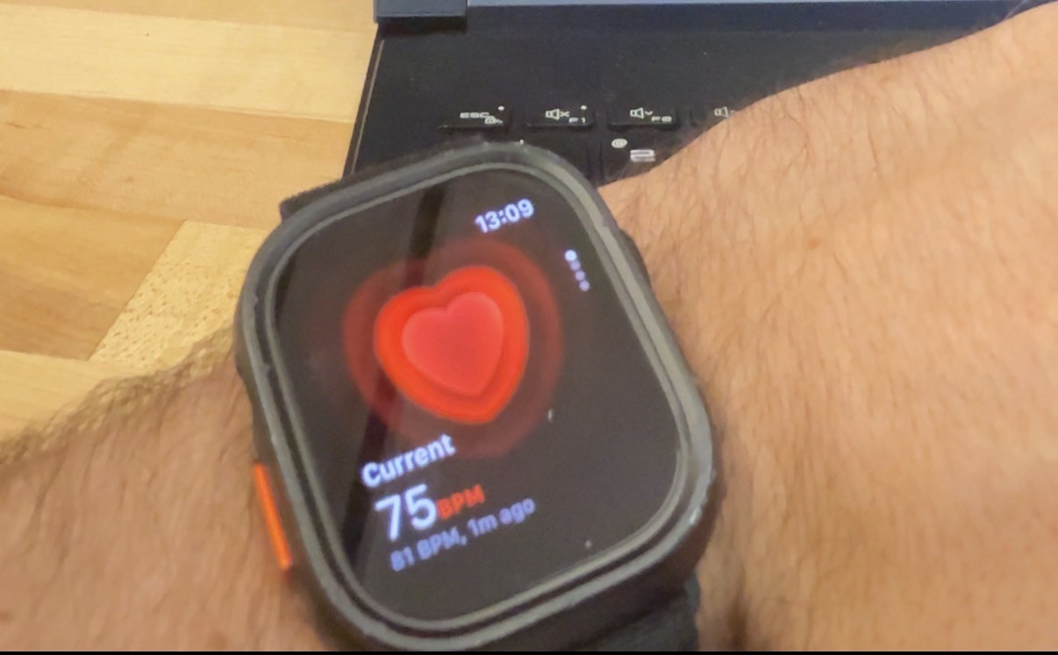
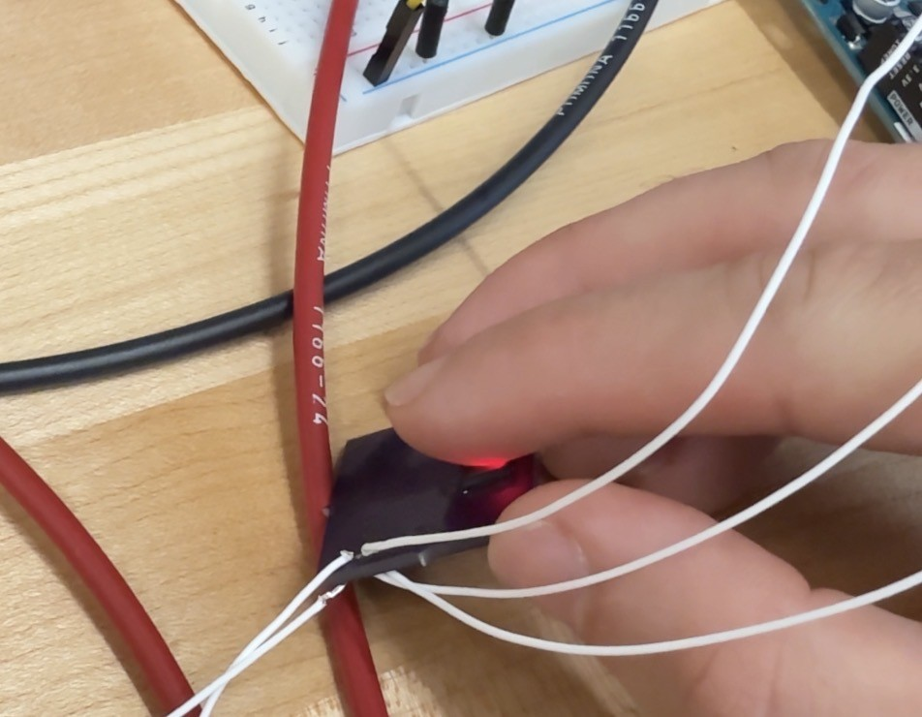
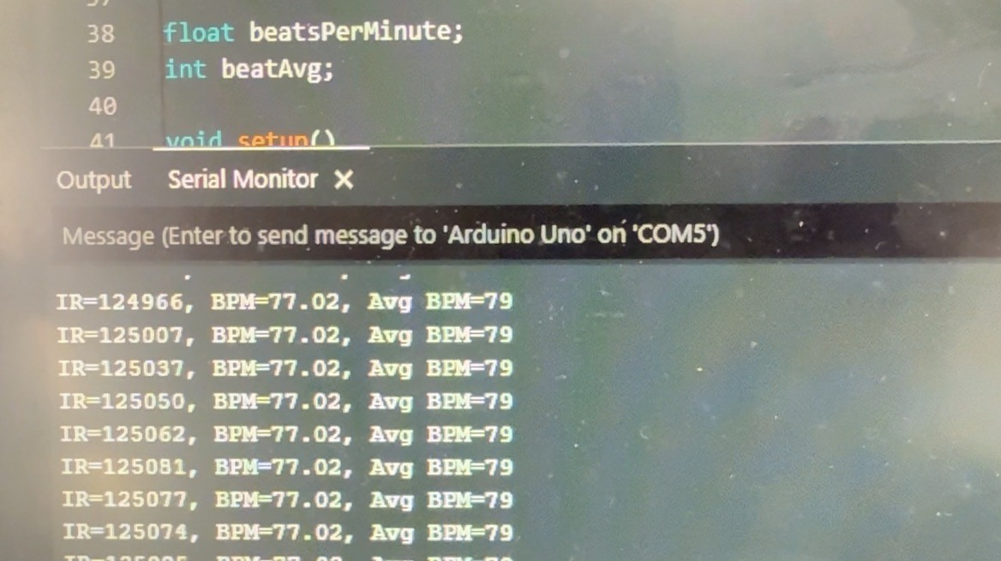
Heart Rate Monitor (Cont.)
*Spec Demo
Parameter | Specification
Heart Rate Monitoring | Continuous, ± 2 BPM accuracy
Specification successfully met: yes and no
See demo video

Slide 14
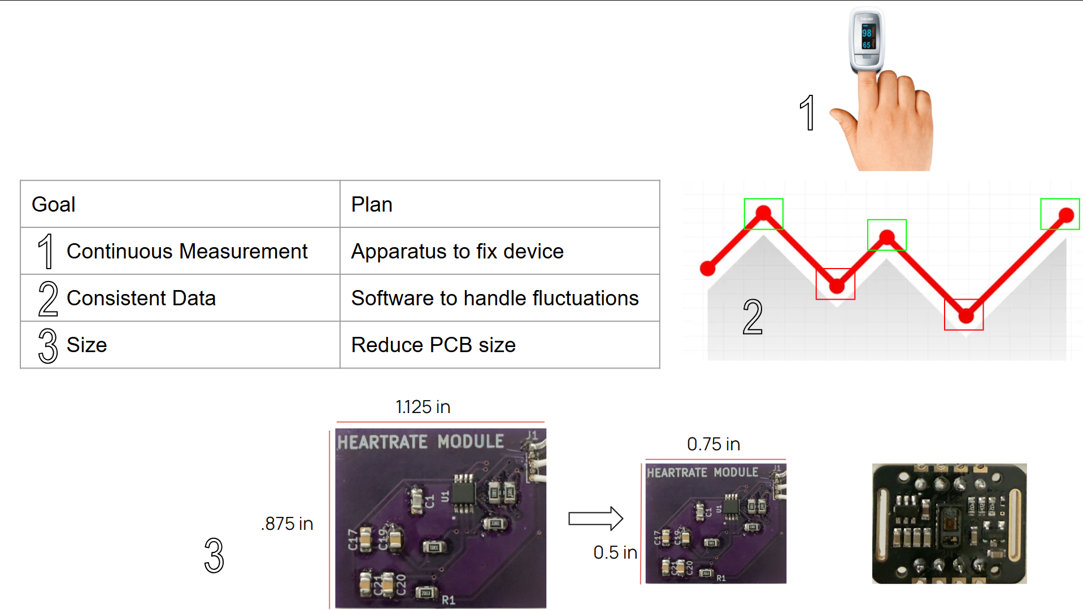
Heart Rate Monitor (Cont.)
*Notes

Slide 15
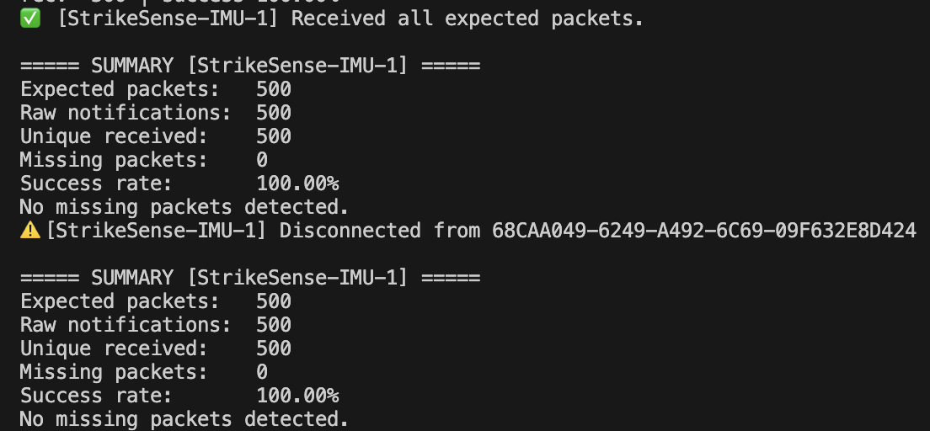
Specification 3 Wireless Data Transmission
To validate the reliability of our wireless communication system, we modified the StrikeSense sensor module firmware to transmit a fixed number of BLE packets during a test run.
A Python client application connected to the modules over Bluetooth Low Energy and logged every packet received. By comparing the expected number of packets to the number of packets actually received, we calculated the packet success rate of the wireless link.

Slide 16
TPS 2117
In it current configuration the power mux should give priority to VBUS when both sources are connected or allow voltage from either source through when a single source is connected
Connected Sources | *Battery Terminal Voltage | *USB Vbus voltage | 1.8v regulator input voltage | 3.3v regulator input voltage
USB(5v) | 3.3mV effectively 0 | 5.22V | 5.22V | 5.22V
Battery(3.7v) | 3.69V | 0.008mV | 3.69V | 3.69V
USB(5v) + Battery(3.7v) | 3.69V | 5.22V | 5.22V | 5.22V
*This is important as we want to verify we don’t backfeed into our lipo battery from Vbus or vice versa

Slide 17
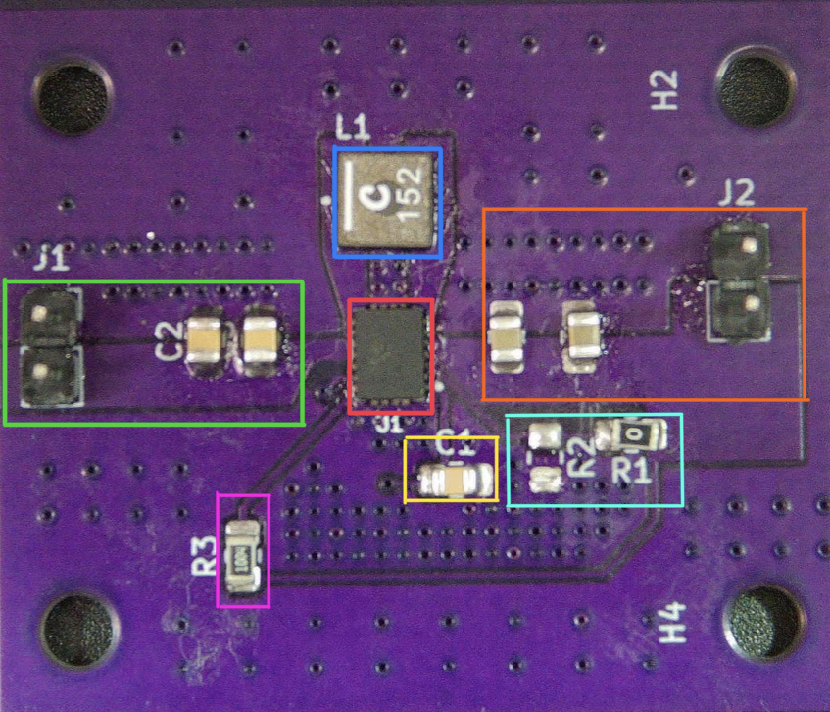
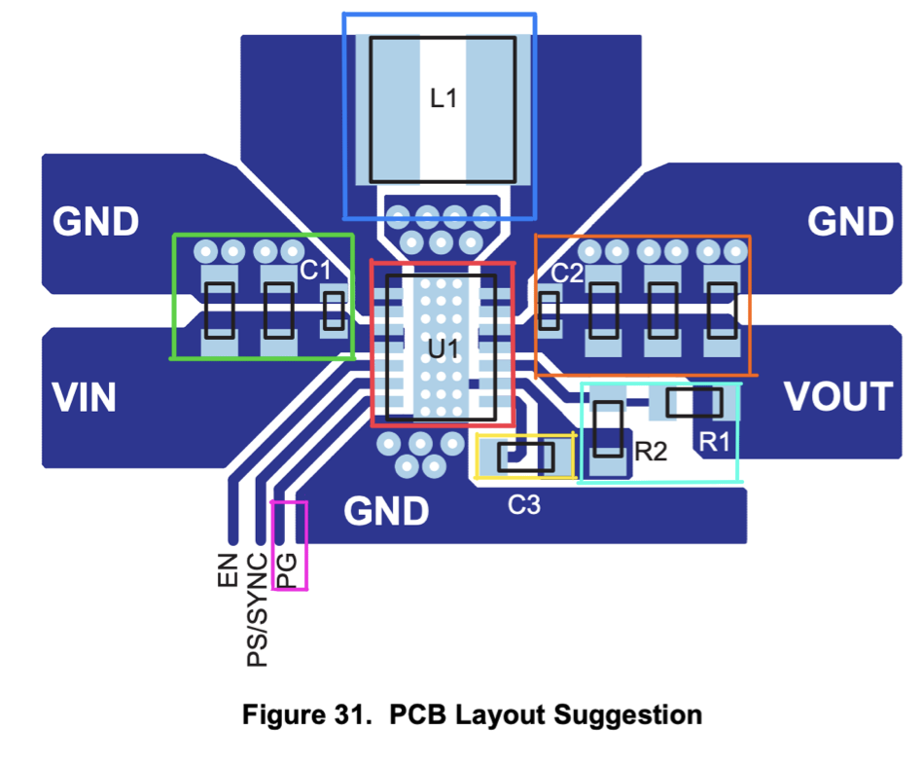
3.3v Regulator
Regulator Specs:
Red | 3.3 Reg Chip | Switching regulator IC that converts VIN to regulated 3.3 V output
Blue | Switching Inductor | Energy storage element used in the switching conversion
Green | Input Caps | Decoupling capacitors
Orange | Output Caps | Output filter capacitors
Cyan | Output Voltage Divider Network | Resistor divider that sets VOUT = 3.3 V through the regulator feedback pin
Yellow | Enable | Logic control pin used to turn the regulator ON or OFF
Pink | Power Good | signals when the regulator output voltage is stable
Notes:
we choose the fixed output and we tied the output to the feedback the divider was unnecessary thats why its its un occupied

Slide 18
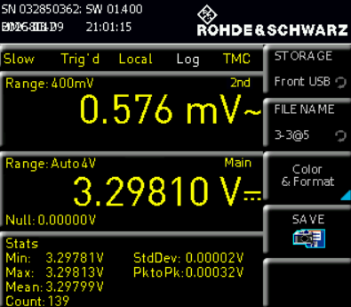
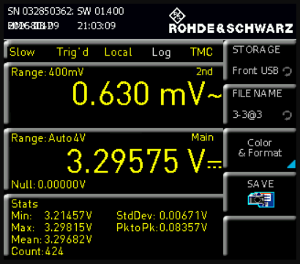
3.3v Regulator Testing
Tested with 3.7 and 5V
Output voltage measured at ~3.297 V – 3.298 V, very close to the expected 3.3 V
Ripple measured between 0.576 mV and 0.630 mV
Stable voltage ensures reliable operation of digital components such as the ESP32 and other logic circuits
Low-noise power rails help prevent signal errors and improve overall system stability
Results confirm the 3.3 V regulator is functioning correctly and providing stable power to the system
Clean power is especially important when the system includes sensitive electronics or mixed-signal components that could be affected by voltage fluctuations.

Slide 19
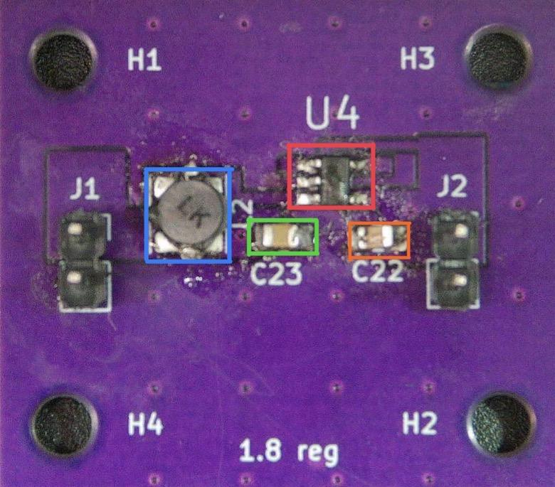
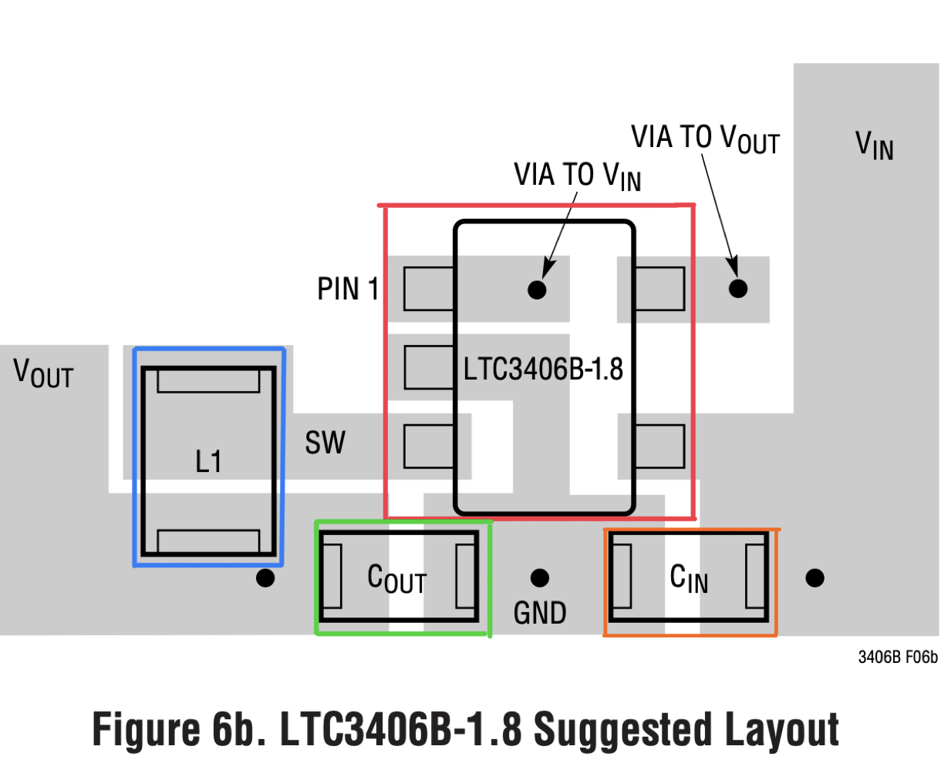
1.8V Regulator
Red | 1.8 Regulator Chip | Switching regulator IC that converts VIN to regulated 1.8 V output
Blue | Inductor | Which stores and transfers energy
Green | Capacitor out | Smooth the output voltage and reduce ripple
Orange | Capacitor In | Which filters the incoming supply and stabilizes the regulator

Slide 20
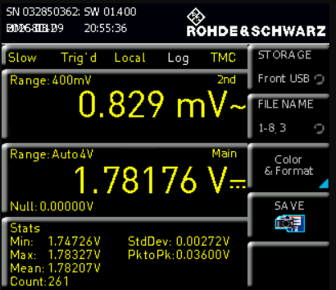
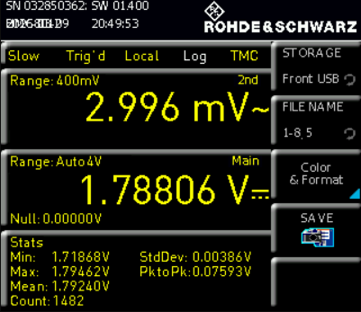
1.8 Regulator Testing
Tested with 3.7 and 5V
Oscilloscope measurements used to verify performance of the 1.8 V regulator
Output voltage measured between 1.781 V and 1.788 V, close to the intended 1.8 V supply
Ripple measured between 0.829 mV and 2.996 mV
Ripple remains very low, indicating stable voltage regulation
Clean 1.8 V rail is important for low-voltage digital logic and sensitive electronics
Stable power helps reduce noise and improve system reliability
Results confirm the 1.8 V regulator is operating correctly and delivering consistent power

Slide 21
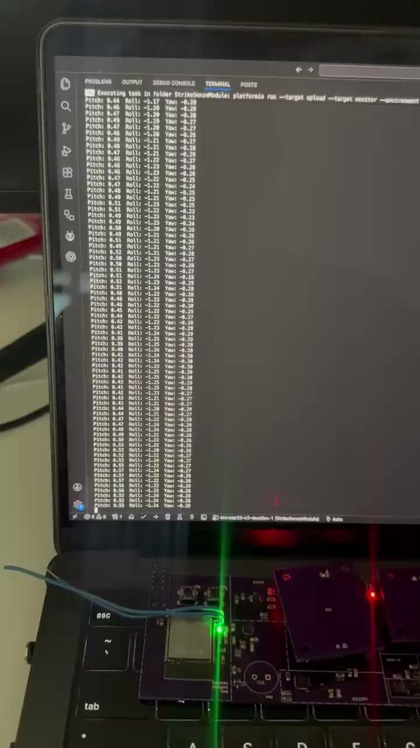
Full Strike Sense Node Testing
This demonstration showcases our fully custom StrikeSense PCB with all systems and subsystems operating together. It verifies the functionality of the power system, MCU, and key peripherals including the IMU, CP2102 USB-UART interface, and level shifters.

