Slide 1
Strike Sense
By Group 37
Final Presentation

Slide 2



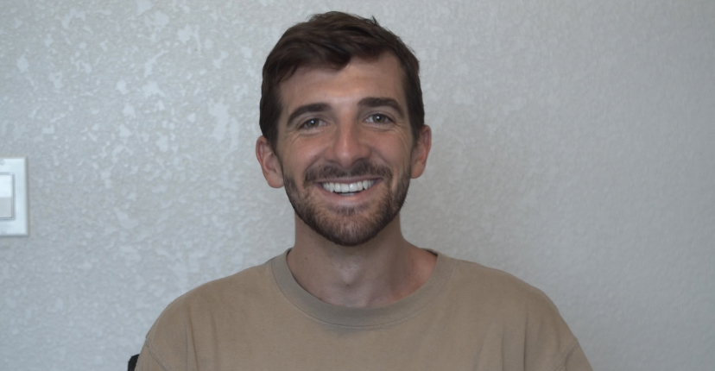
MEET THE TEAM
Timothy Azinord
Landon Wright
Benjamin Bolton
Shem Fils-Aime
Electrical Engineer
Computer Engineer
Computer Engineer
Electrical Engineer

Slide 3
MOTIVATION & BACKGROUND
Sports serve as a intersection between health, technology, and human performance. Many athletes rely on trusted routines and careful feedback from cutting edge technology to improve.
Martial arts is one sport that is behind in this endeavour.
Strike Sense was made from a desire to provide a way for martial artist to track their training and be safer along the way.
The biggest goal was to do this in a non intrusive way yet robust manner. We want users to feel no difference during training and all the difference after.

Slide 4
GOALS & OBJECTIVES
Create a system with a hardware component comprised of 2 IMU designs: one with 9 DoF, heart rate monitor and MCU and the other with 9Dof, and MCU
  Hardware component will be contained in housing and will be equipable with a strap on left and right wrist
  Accelerometer, Gyroscope and Magnetometer output will be translated to quaternions
·Design deep neural network architecture which takes the input of quaternions from the IMU’s and can identify strikes within that stream of data
  This neural network architecture will have a strike identification percentage of >=80%
  This architecture will be, at a high level, composed of a transformer and LSTM
Create a dataset that is deep and broad enough to be used to train the neural network.
  Neural network will run locally on machine where application is running
· Deepen neural network architecture by adding the Alpha pose pose estimation model + Transformer+LSTM+LLM to use spatiotemporal coordinates obtained through video to further support initial predictions provided by IMU data

Slide 5
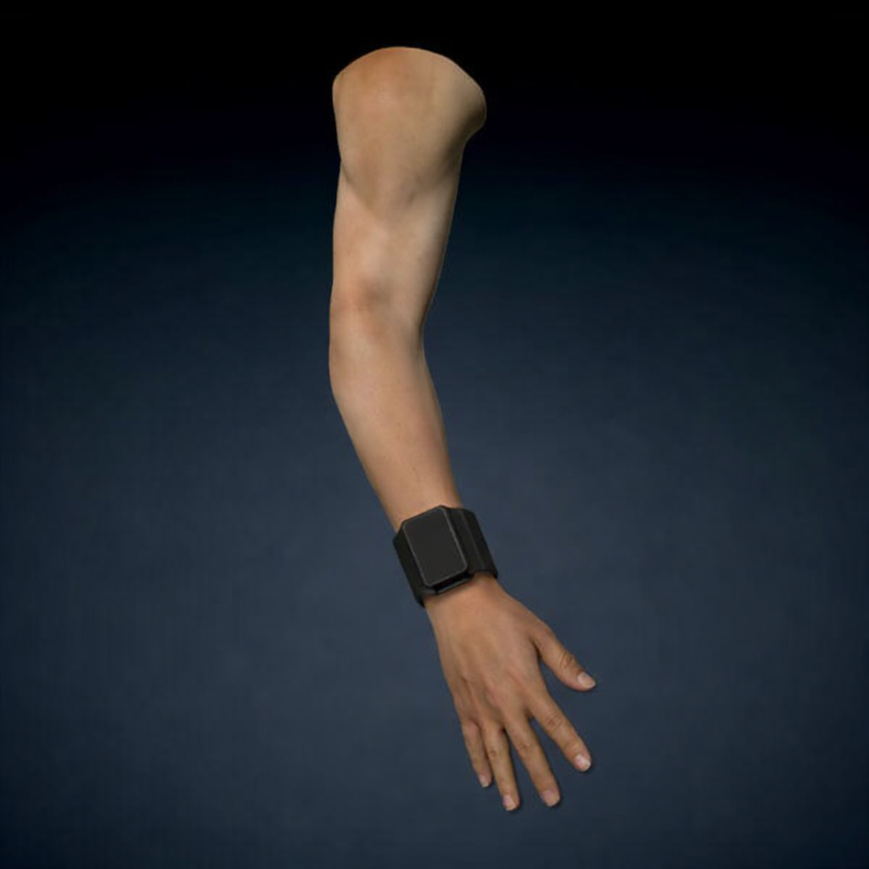
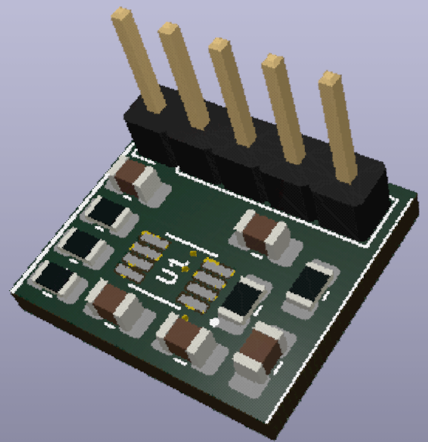
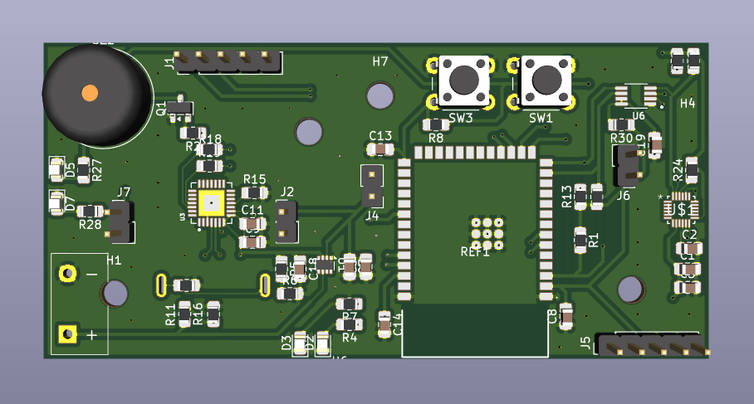
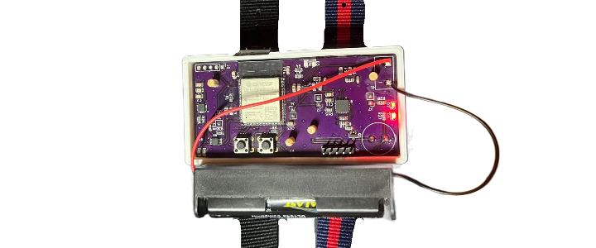
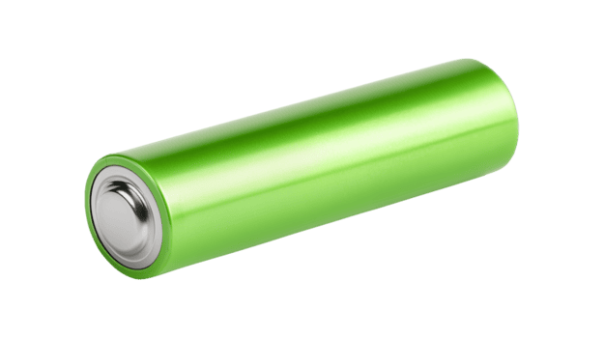
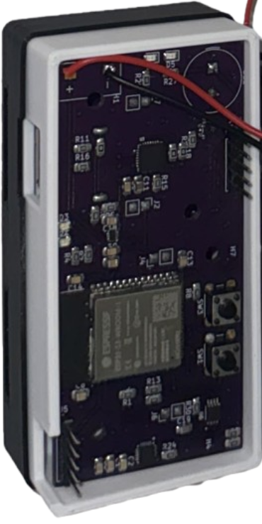
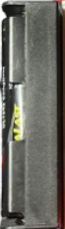
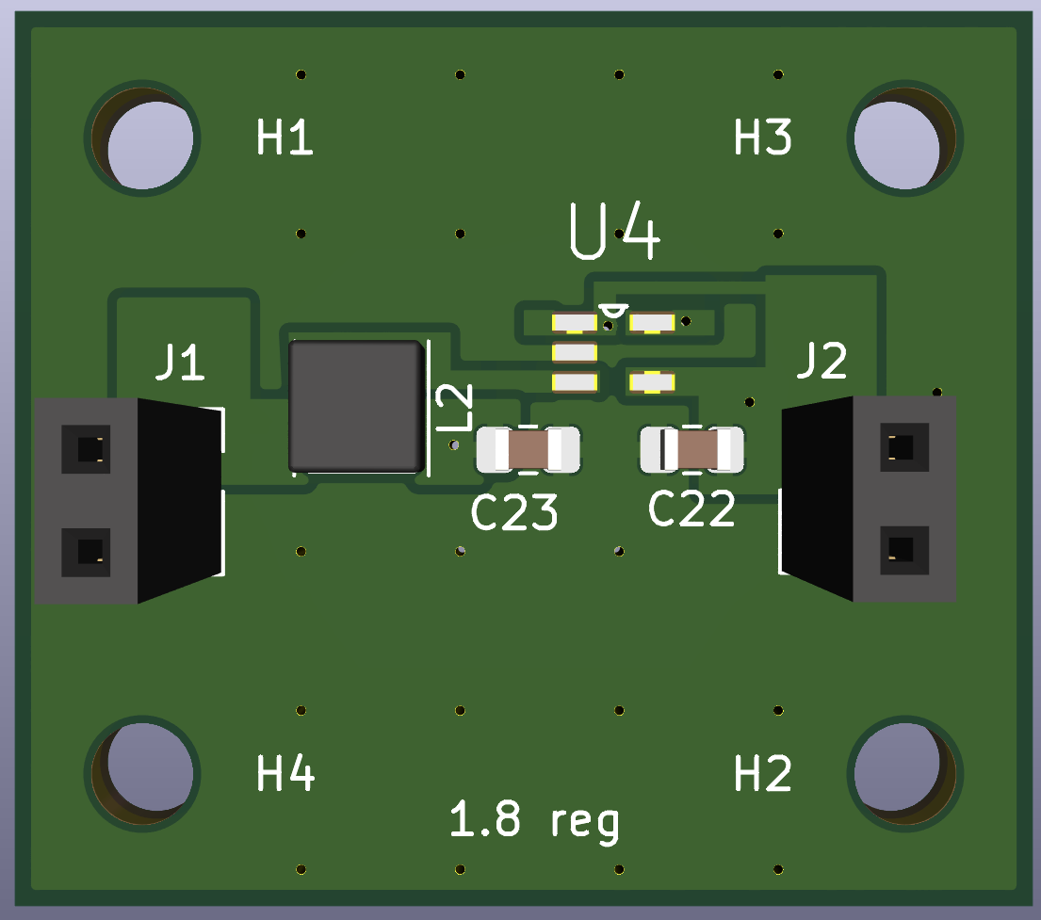
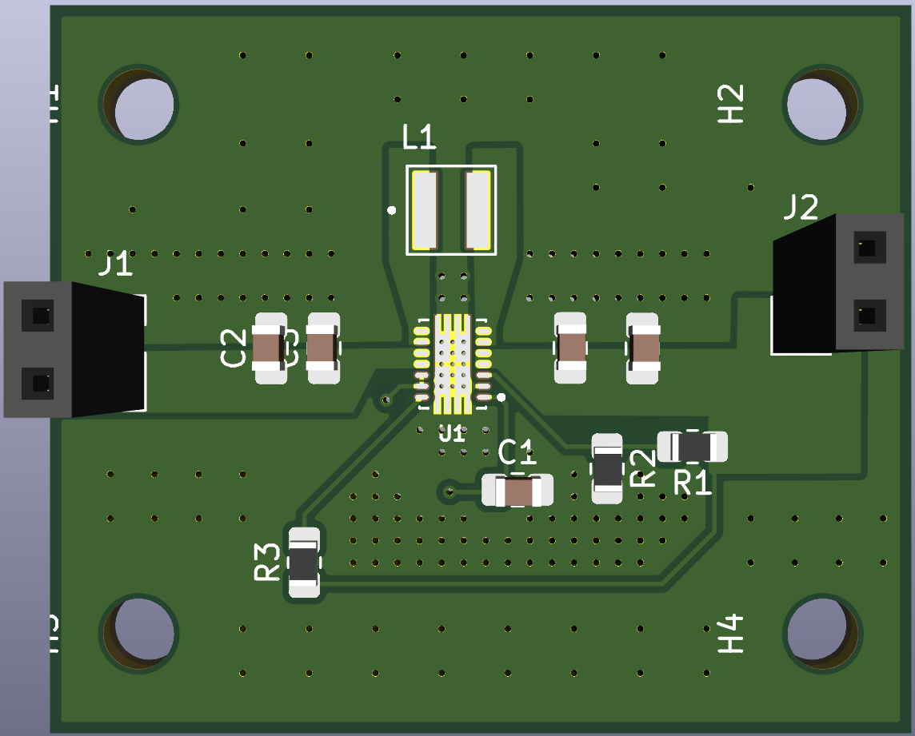
Physical Product Description
Heartrate
Module
Main Board
18650
Protected
Cell
1.8V
Regulator
3.3V
Regulator
STRIKE SENSE

Slide 6
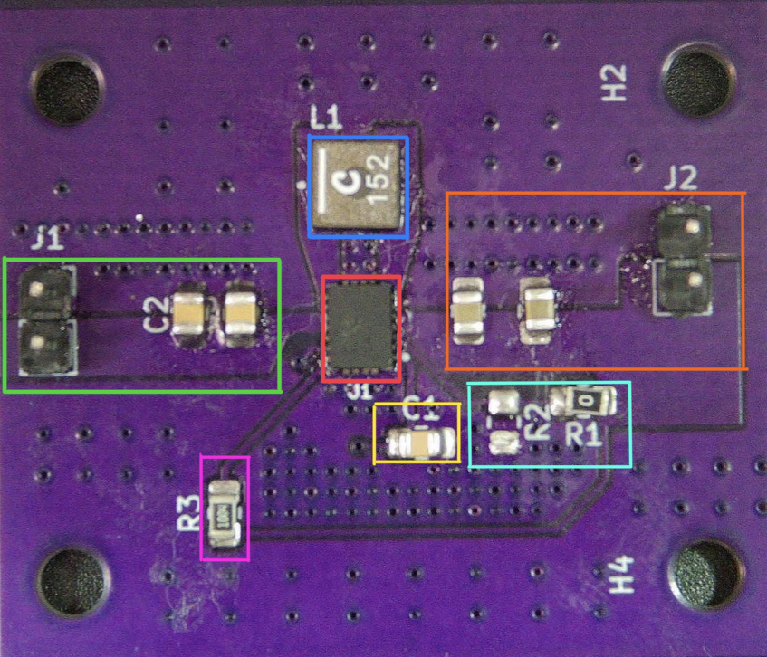
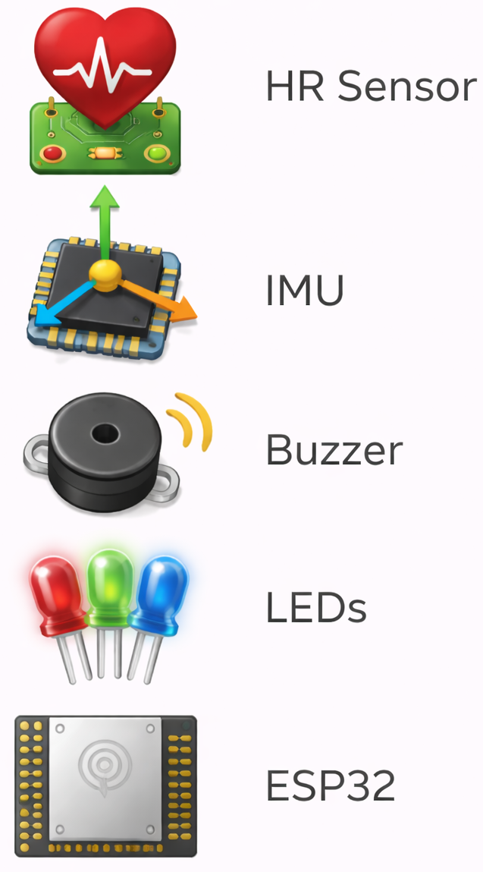
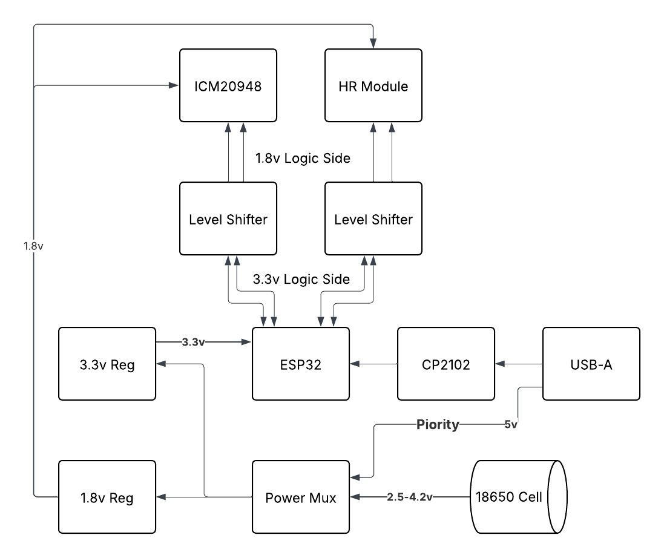
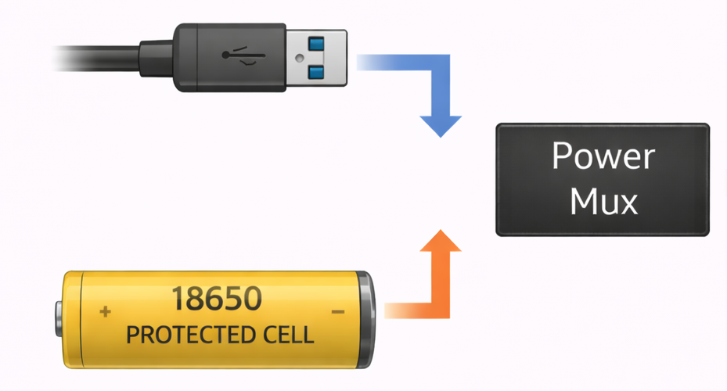
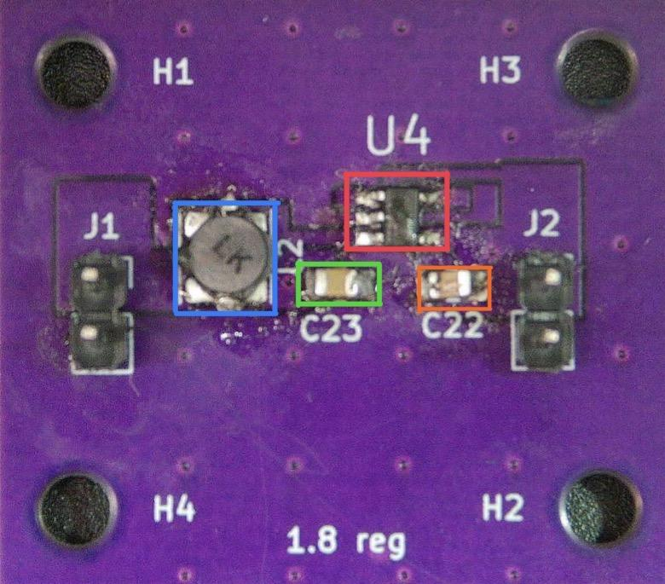
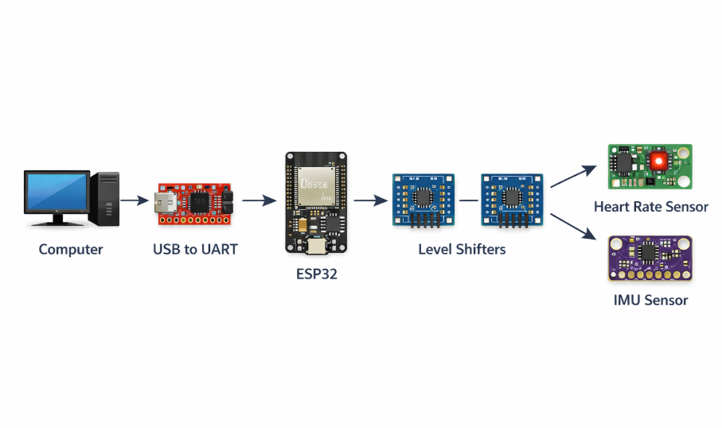
Hardware Block Diagram
Power Path
3.3V Regulator
1.8V Regulator
Data Path

Slide 7
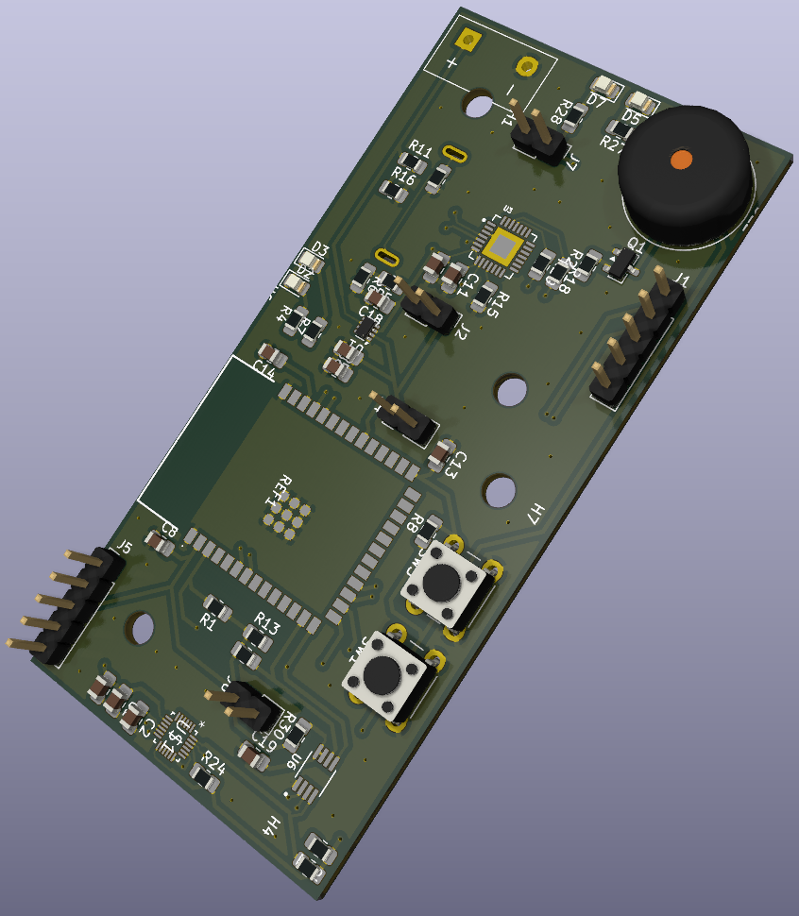
Specifications/Protocols
Parameter | Specification
Strike Classification Accuracy | 85% recorded strike classification accuracy. Also includes combo recommendations based on least thrown strikes
Heart Rate Monitoring | Can detect user heartrate in less than 5 seconds with an experimental accuracy of +- 2BPM
Size (Full board) | ≤ 82 mm x 39 mm
Session Runtime | ≥ 1 hour continuous operation
Wireless Data Transmission | ≥ 95% packet success rate
Weight | ≤ 140 g per wrist unit (including strap)
Total Cost (BOM) | 553.2$
Battery Life (Run Time) | 17 Hours

Slide 8
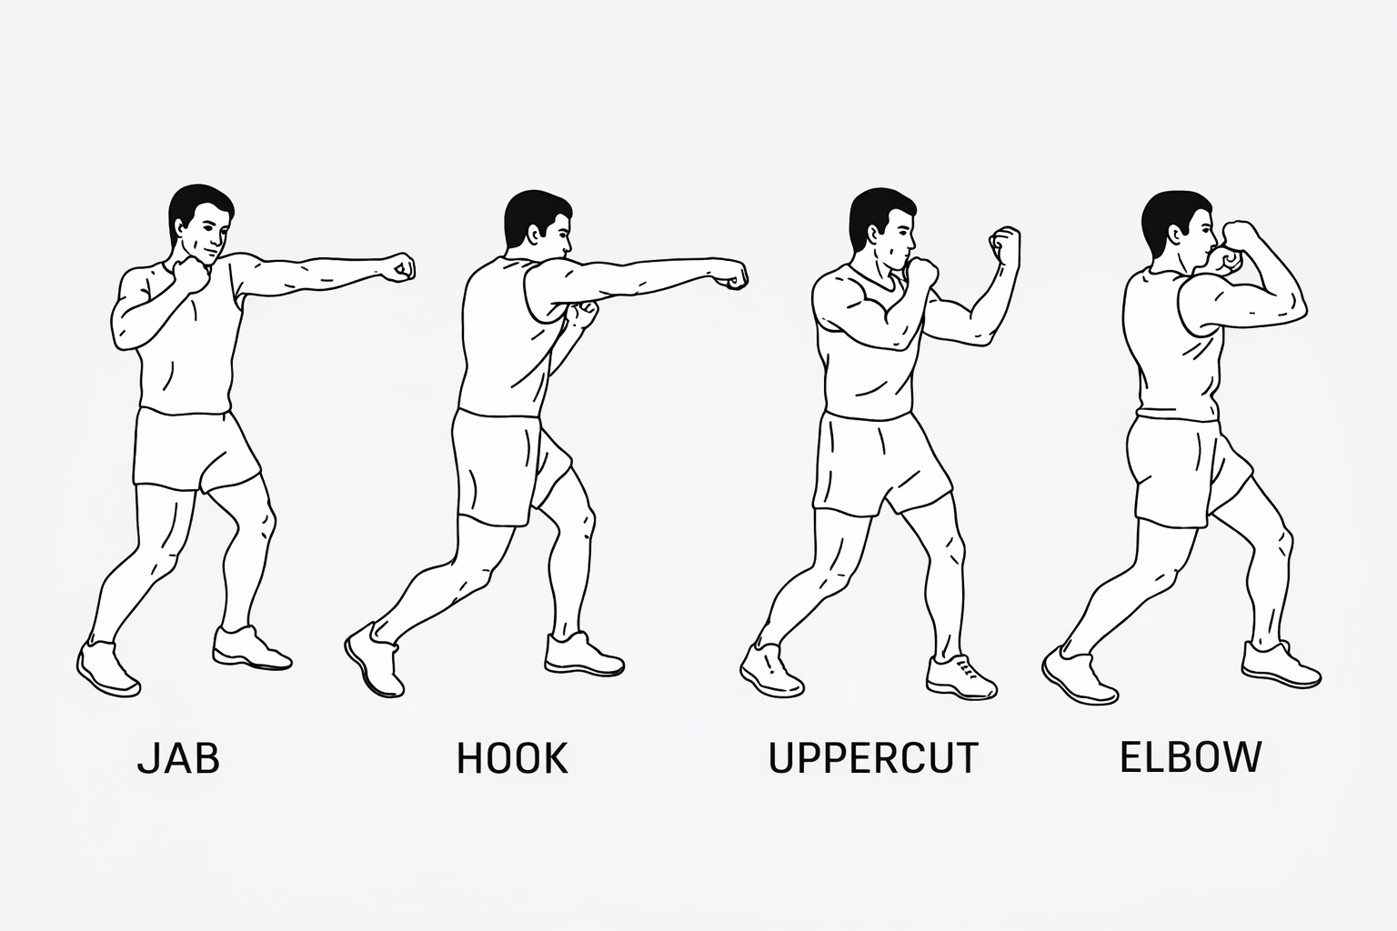
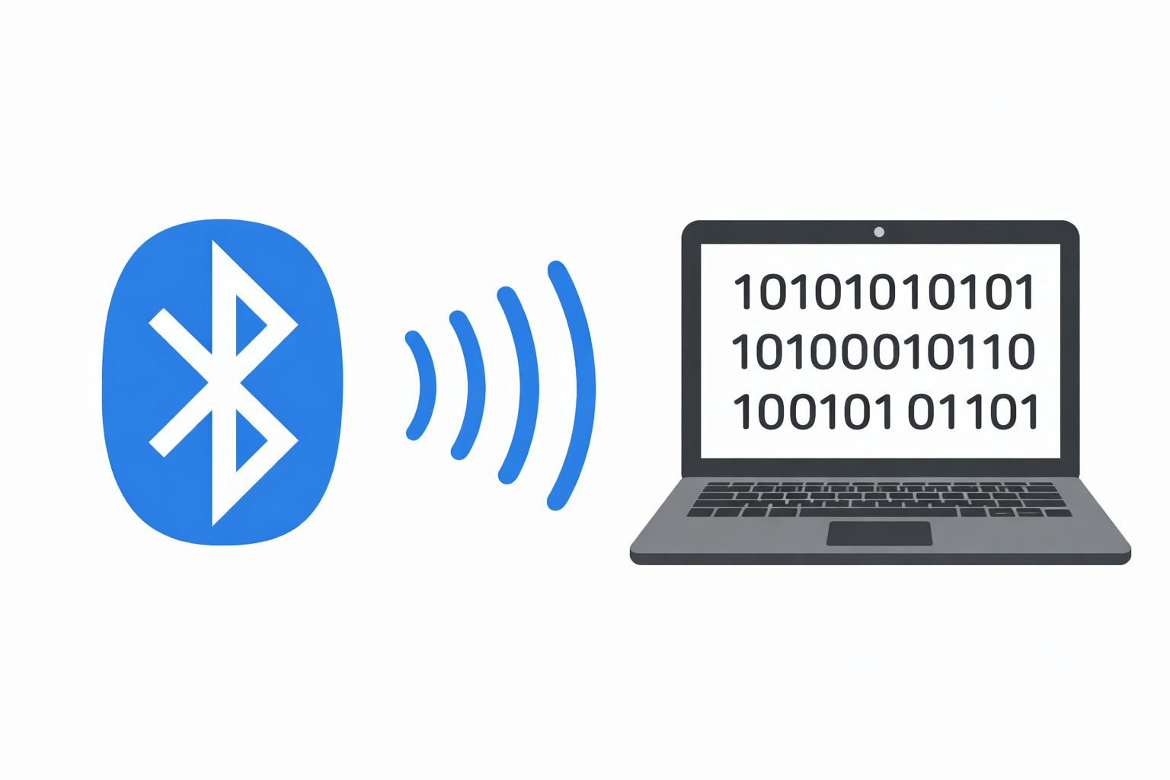
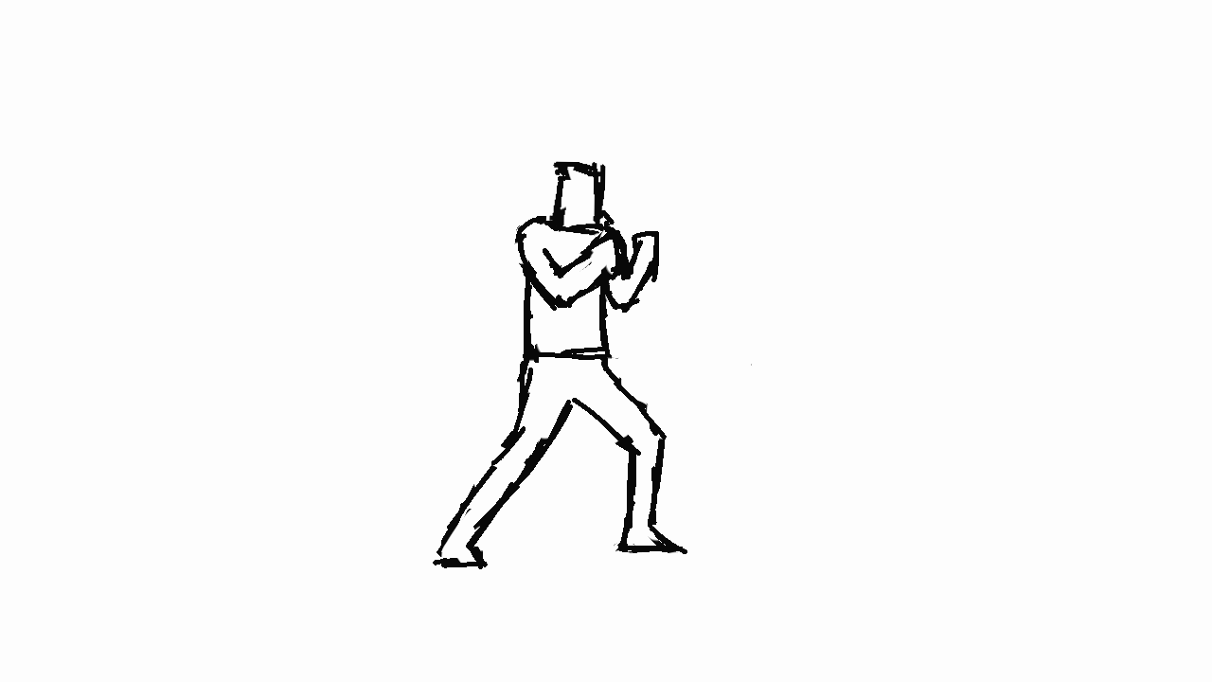
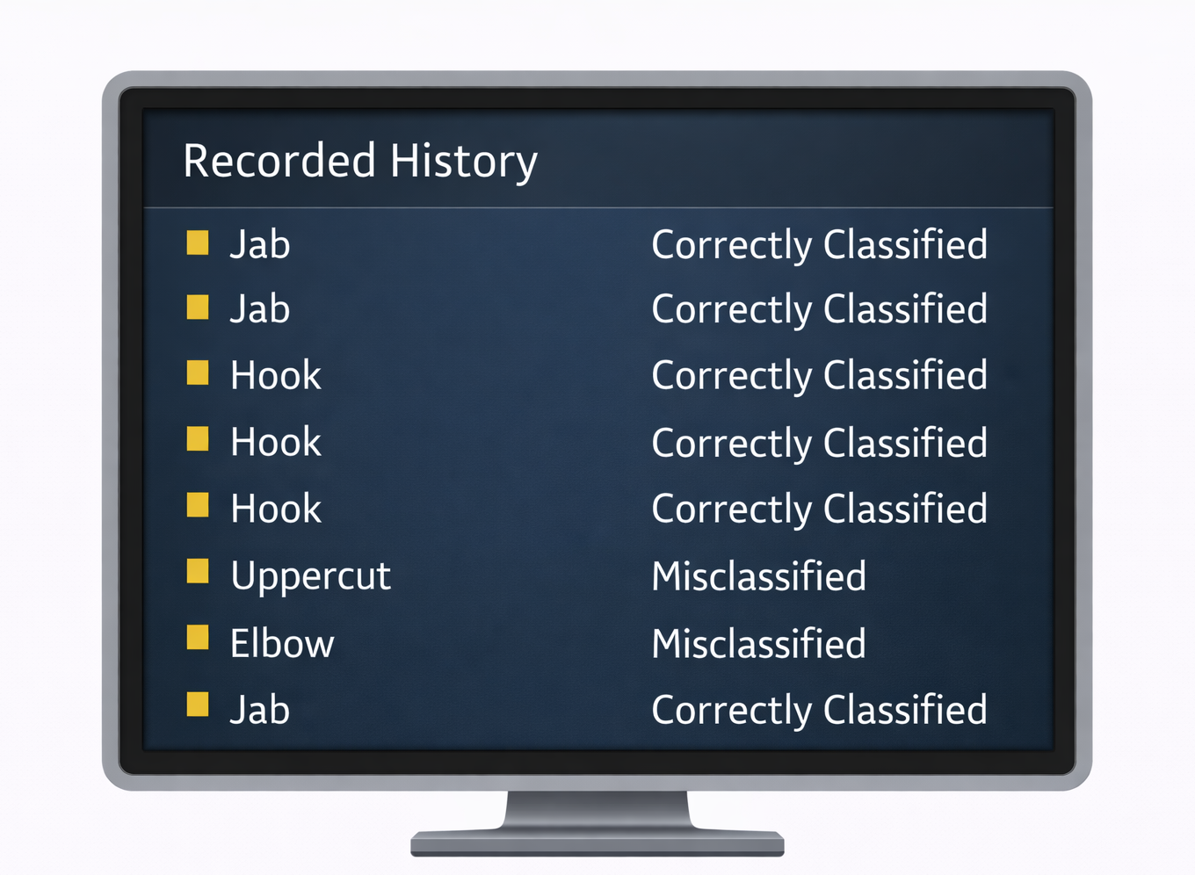
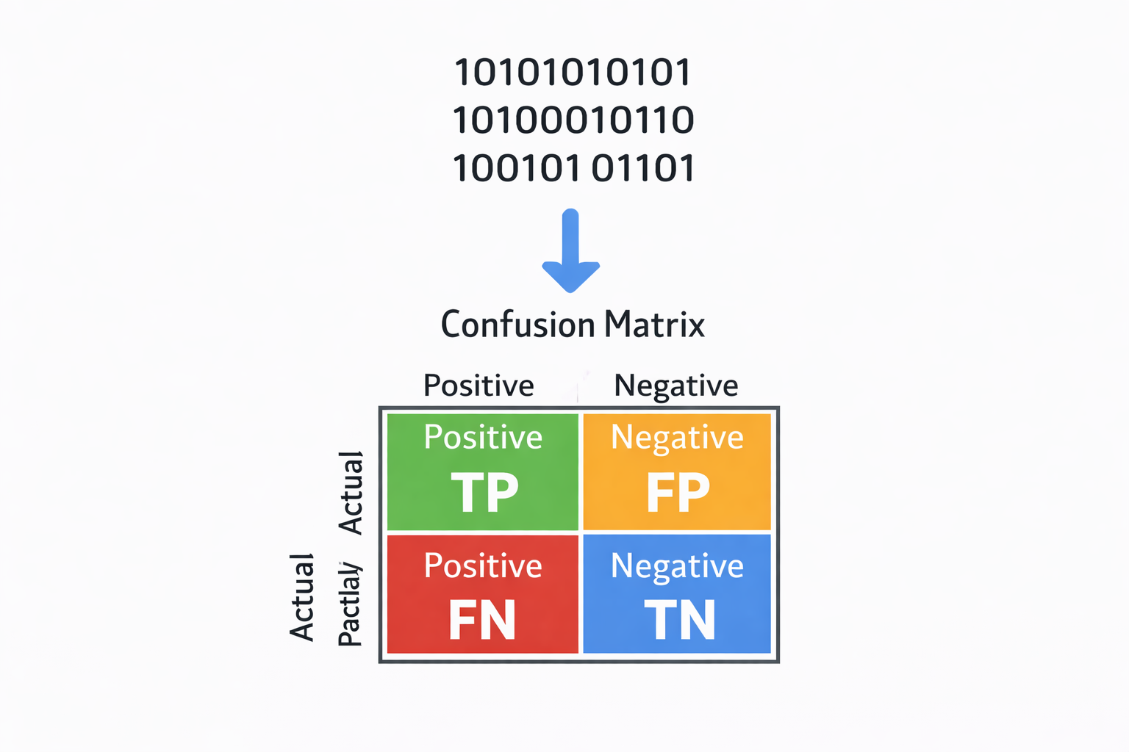
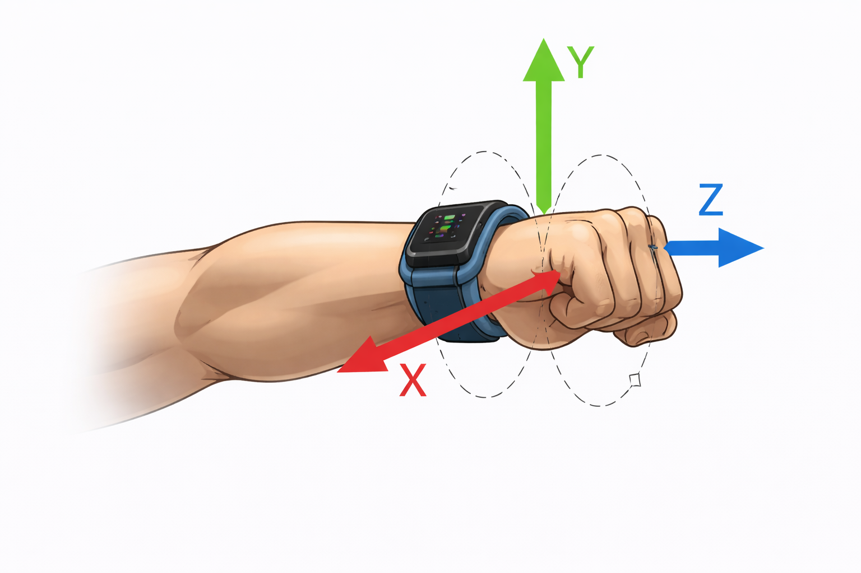
IMU
Input
Data Processing
Output
Output
Notes:
“The core functionality of the Strike Sense device is centered around the inertial measurement unit, or IMU. As the user throws a punch, the IMU captures real-time motion data, including acceleration and rotational movement across multiple axes.
This data is then transmitted via Bluetooth to a nearby computer, where it is fed into the Strike Sense backend. From there, a machine learning algorithm processes the motion data and classifies it into one of four strike types based on learned patterns.
The final output is displayed to the user in real time, allowing them to track and analyze their strikes throughout a training session, and gain insight into patterns in their performance.”

Slide 9
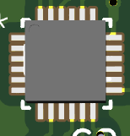
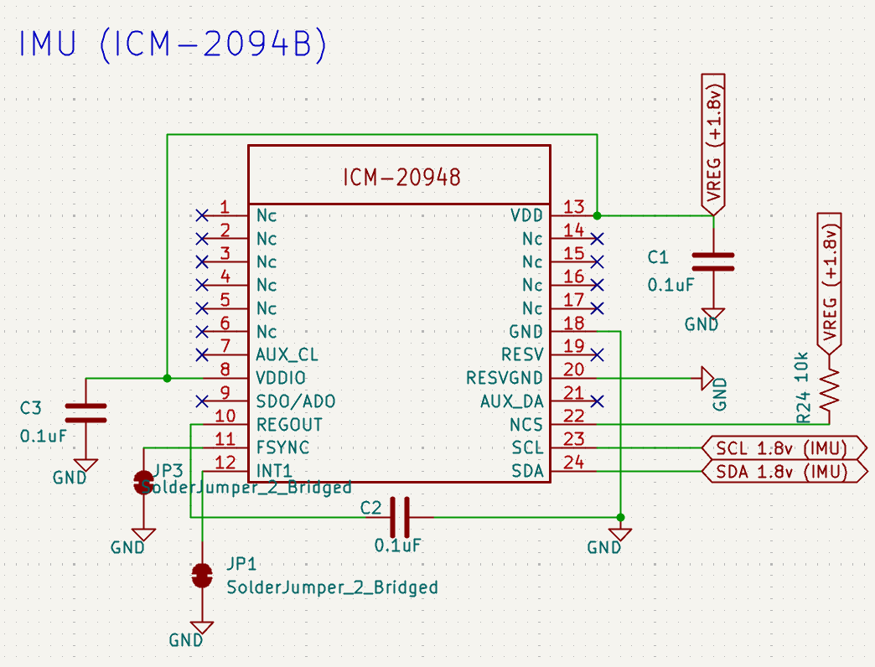
IMU cont.
Specification | Value
Power Consumption | ~2.5 mW (lowest-in-class)
9-Axis Integration | accelerometer + gyroscope + magnetometer
Package Size | 3 × 3 × 1 mm
Price | ~$5 – $7 per chip (low quantity)
Notes:
The ICM-20948 was selected due to its ultra-low power consumption, compact form factor, integrated 9-axis sensing, and onboard motion processing, enabling a highly efficient and space-optimized wearable system.

Slide 10
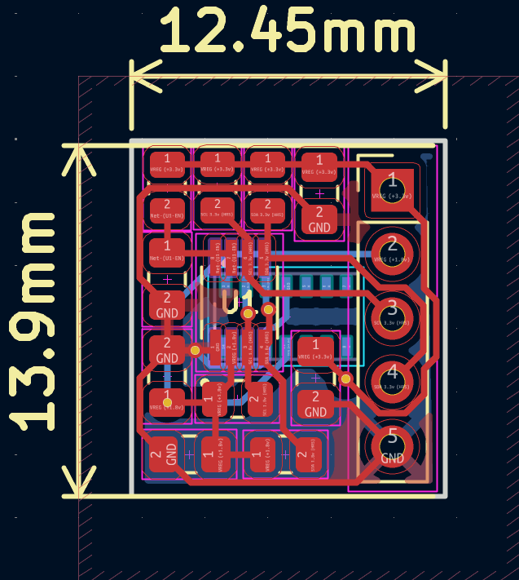
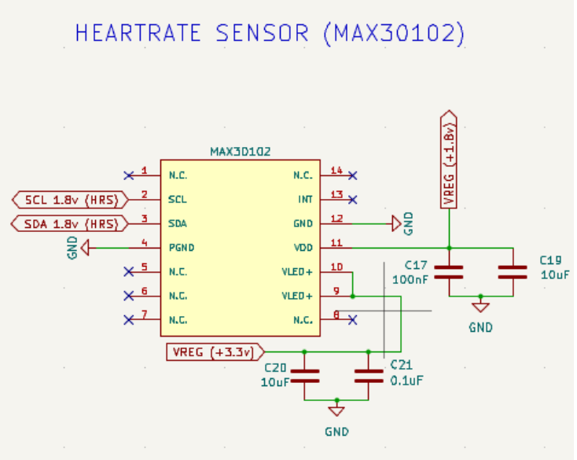
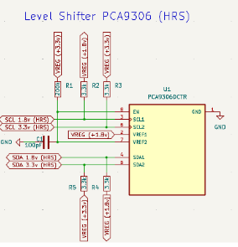
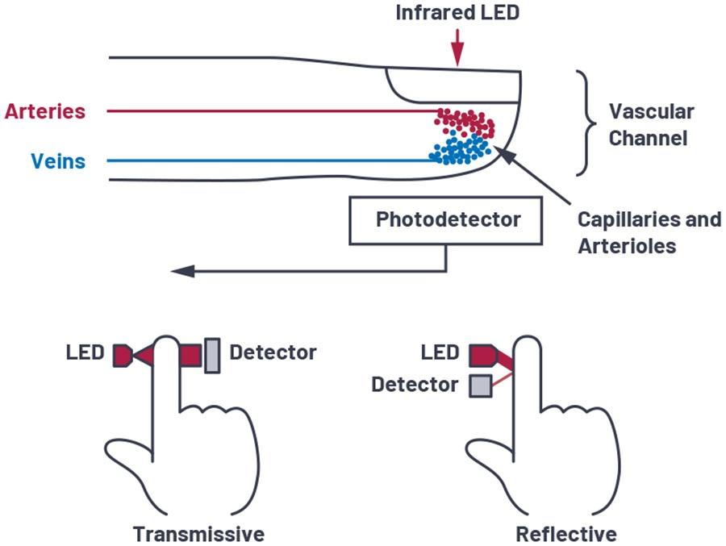
Heart Rate Sensor
*Smaller than dev kits
Specification | Value
Support | Extensive documentation and coding libraries
Power Consumption — Ultra-low (optimized for wearable use) | ~600 µA
Package Size | 5.6 mm × 3.3 mm × 1.55 mm
Price | ~$8 for 3 dev kits

Slide 11
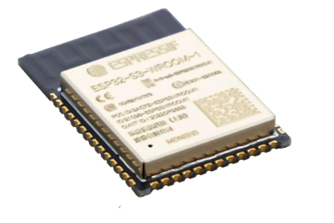
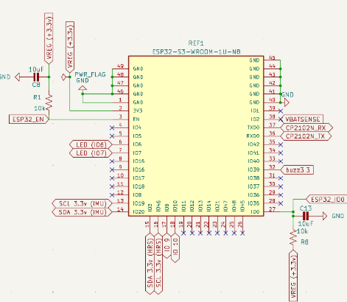
ESP32
Specification | Value
Integrated Wi-Fi + BLE | Reduces PCB complexity
High Performance | Handles sensor fusion, real-time processing
Rich Interfaces | Easily connects to IMU, heart rate sensor
Price | ~ $6.32

Slide 12
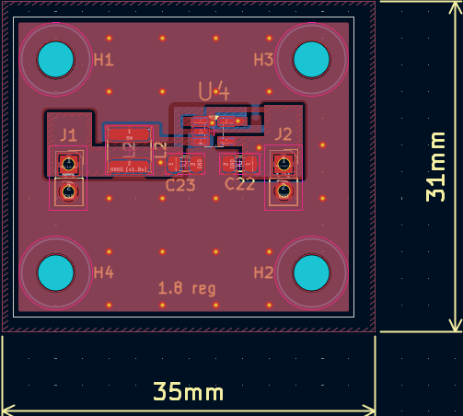
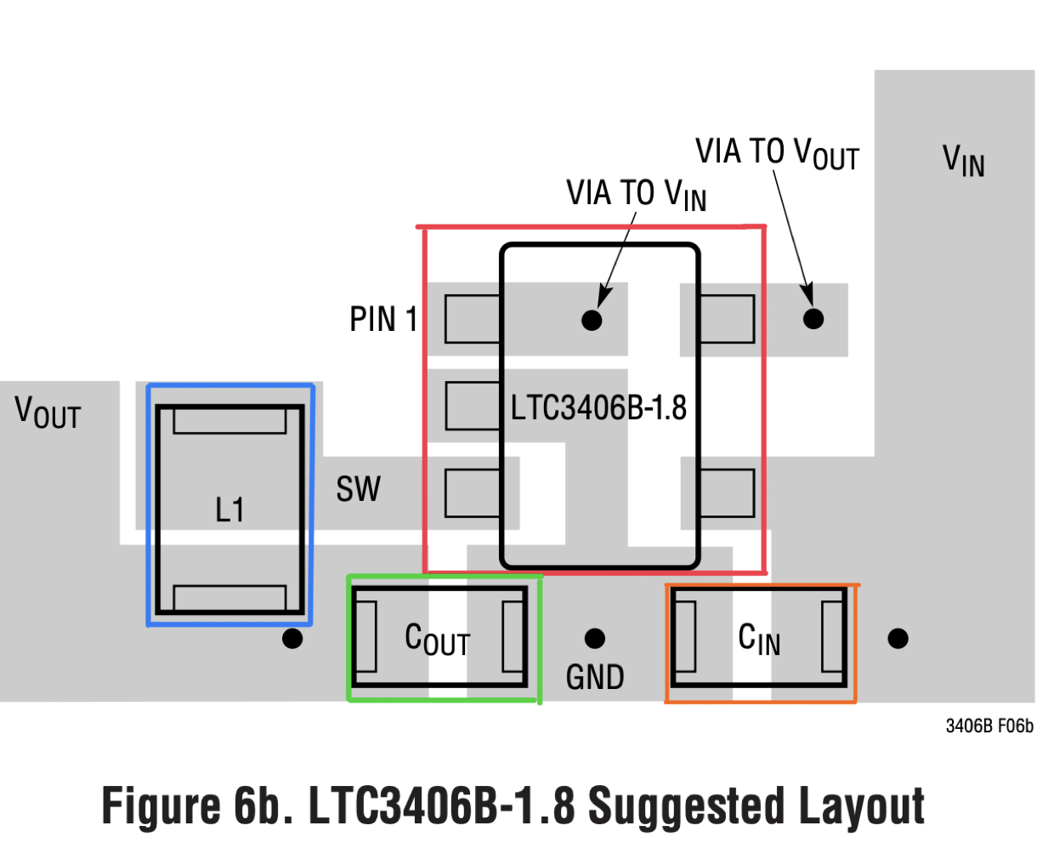
Power Path: 1.8V Regulator
Red | 1.8 Regulator Chip | Switching regulator IC that converts VIN to regulated 1.8 V output
Blue | Inductor | Which stores and transfers energy
Green | Capacitor out | Smooth the output voltage and reduce ripple
Orange | Capacitor In | Which filters the incoming supply and stabilizes the regulator

Slide 13
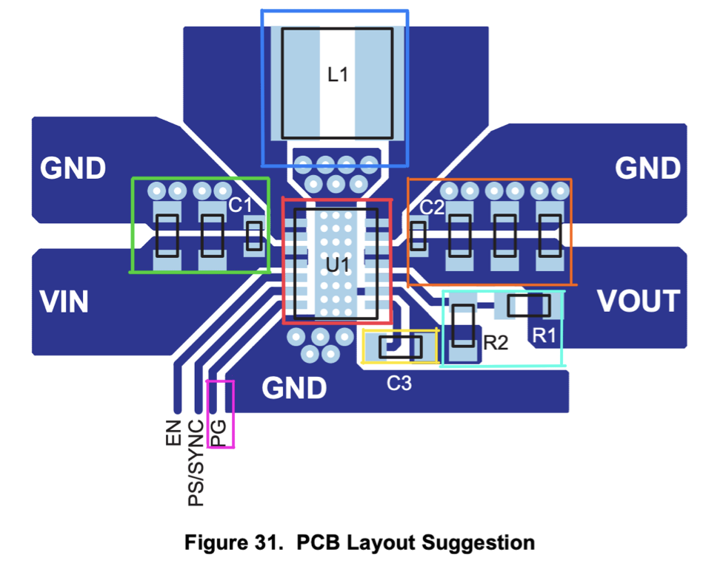
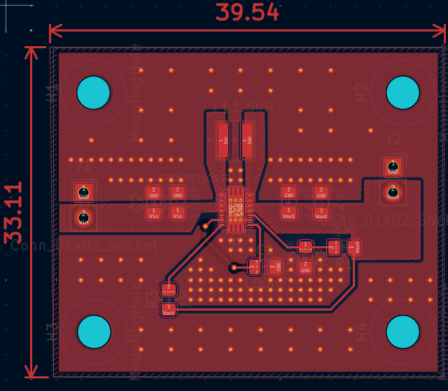
Power Path: 3.3V Regulator
Red | 3.3 Reg Chip | Switching regulator IC that converts VIN to regulated 3.3 V output
Blue | Switching Inductor | Energy storage element used in the switching conversion
Green | Input Caps | Decoupling capacitors
Orange | Output Caps | Output filter capacitors
Cyan | Output Voltage Divider Network | Resistor divider that sets VOUT = 3.3 V through the regulator feedback pin
Yellow | Enable | Logic control pin used to turn the regulator ON or OFF
Pink | Power Good | signals when the regulator output voltage is stable

Slide 14
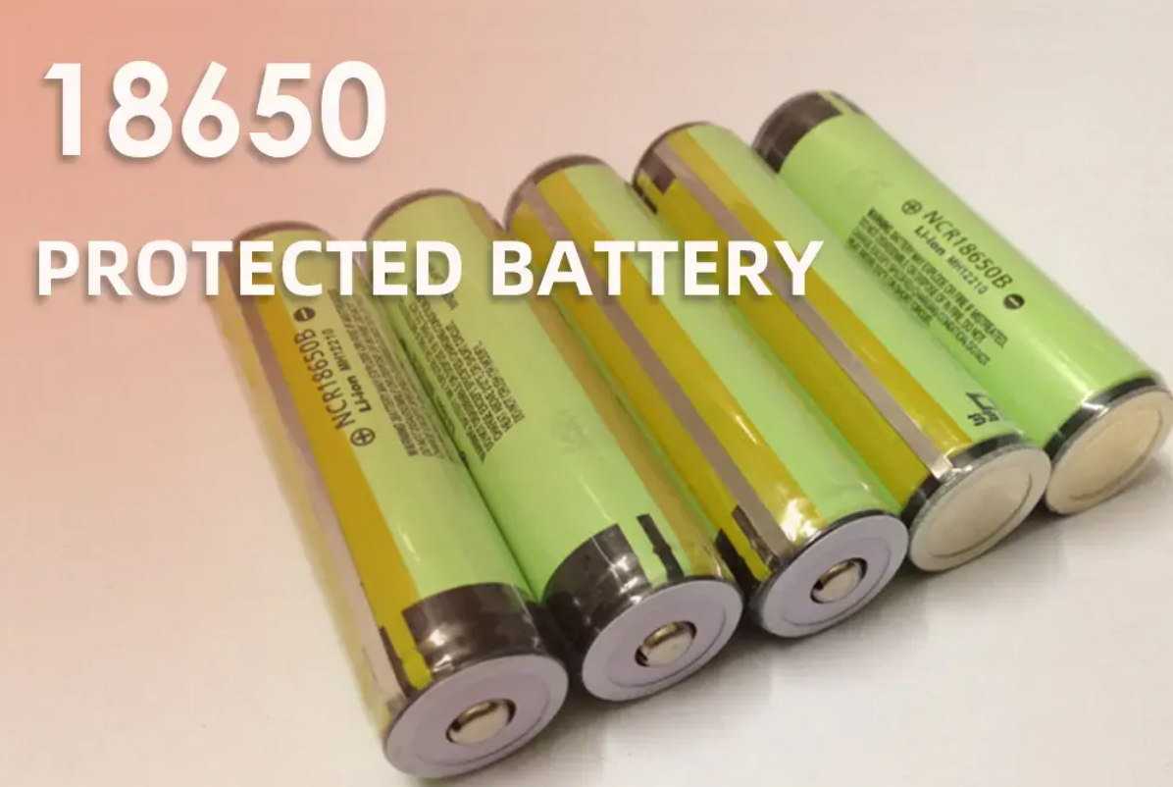
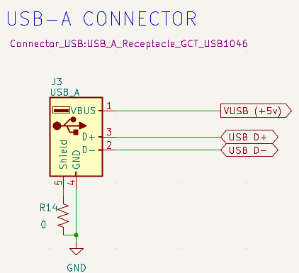
Power Path: Sources
High energy density (compact, long runtime)
Widely available and cost-effective
Rechargeable and scalable
Built-in Protection Circuit:
Overcurrent / short-circuit protection
Reduced need for external protection circuitry
Universal compatibility | Works with almost all computers and chargers
High current capability | Can supply up to 500 mA
Simple implementation | No complex orientation or negotiation
Robust & durable | Physically strong connector

Slide 15
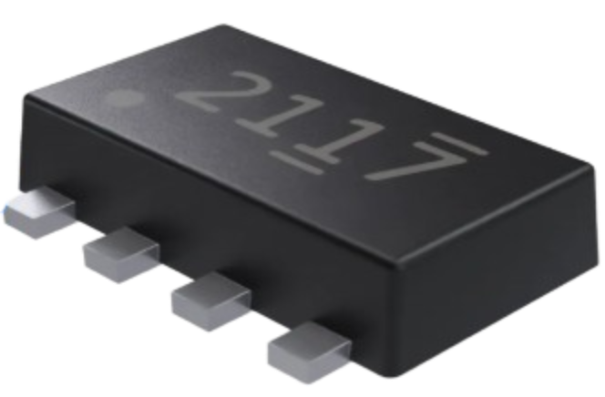
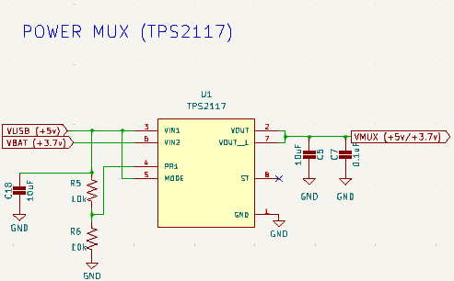
Power Path: Power MUX (TPS2117)
Feature | TPS2117
Automatic Switching | Seamless switching between sources
Low Power Consumption | 1uA current (Perserces battery life)
High Current + Low Loss | Up to 4A (Hanfles load spikes)
Built in Protection | Prevents damage using reverse current blocking

Slide 16
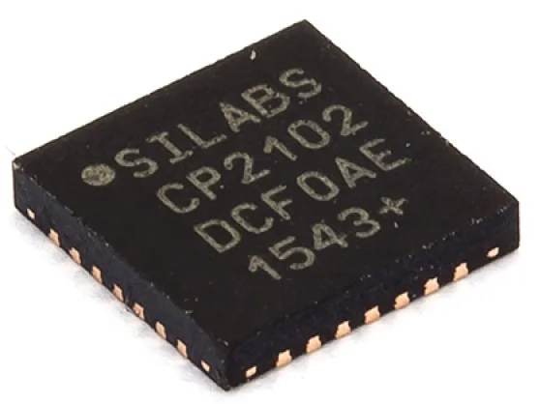
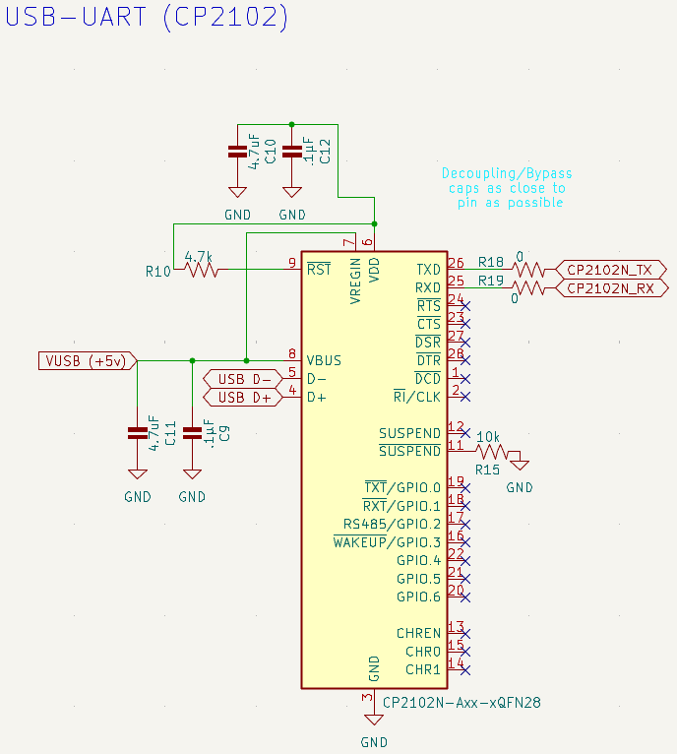
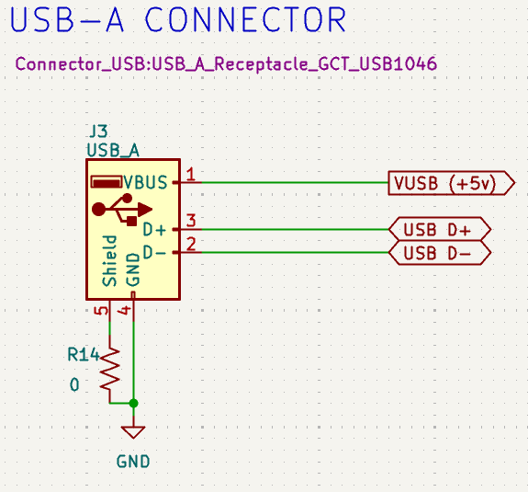
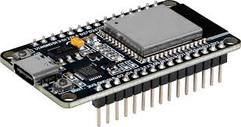
Data Path: USB to UART
Integrated USB-to-UART bridge
Reliable plug-and-play drivers
Compact, low-power design
Price — ~$4 IC / ~$5 module
Size — 3×3 mm (compact QFN)
Voltage — 3.0–3.6 V
Data Rate — ~1 Mbps UART
Usb
To Uart Bridge
ESP32

Slide 17
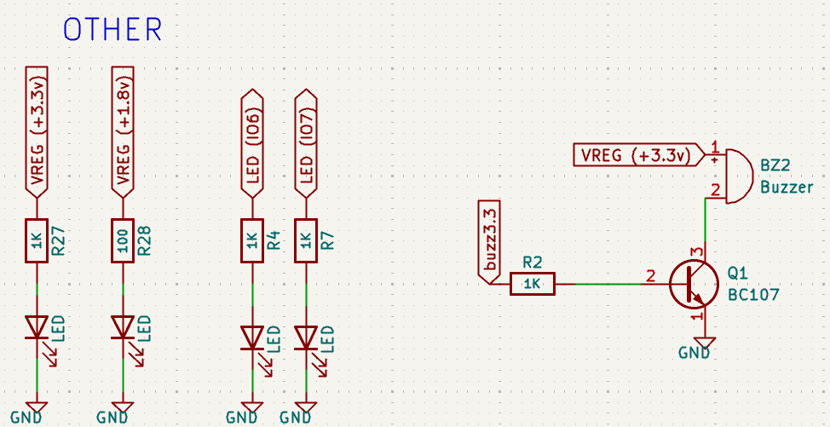
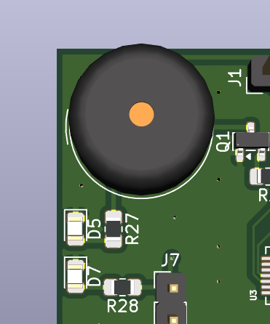
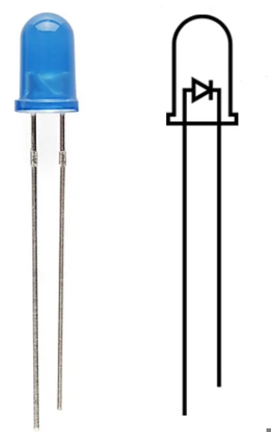
LEDs/Buzzer
LED provides real-time visual feedback for motion tracking and system status
Buzzer delivers immediate audible alerts for critical events
Combined LED and buzzer feedback improves reliability across different environments Both peripherals enhance user interaction by making the system easier to monitor
GPIO-controlled outputs allow simple integration with the ESP32 with minimal hardware overhead
LED is useful for debugging by indicating code execution, errors, or state changes to the end user

Slide 18
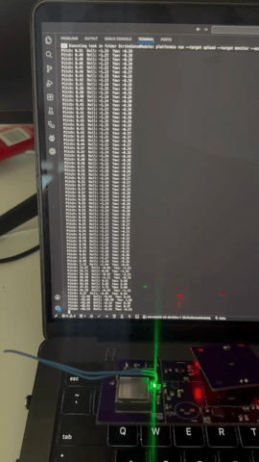
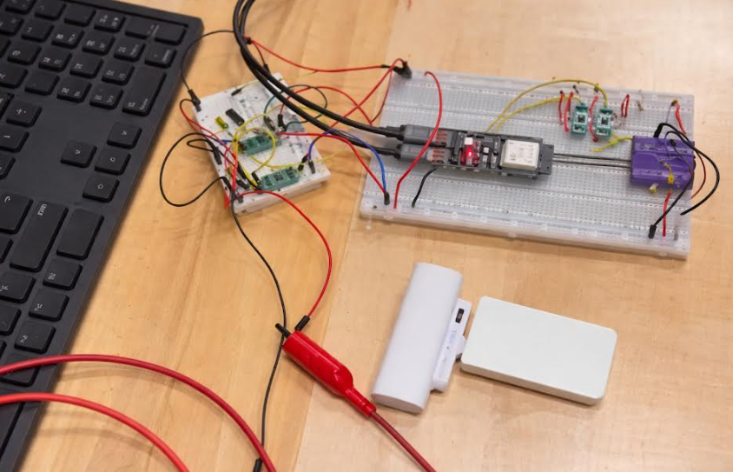
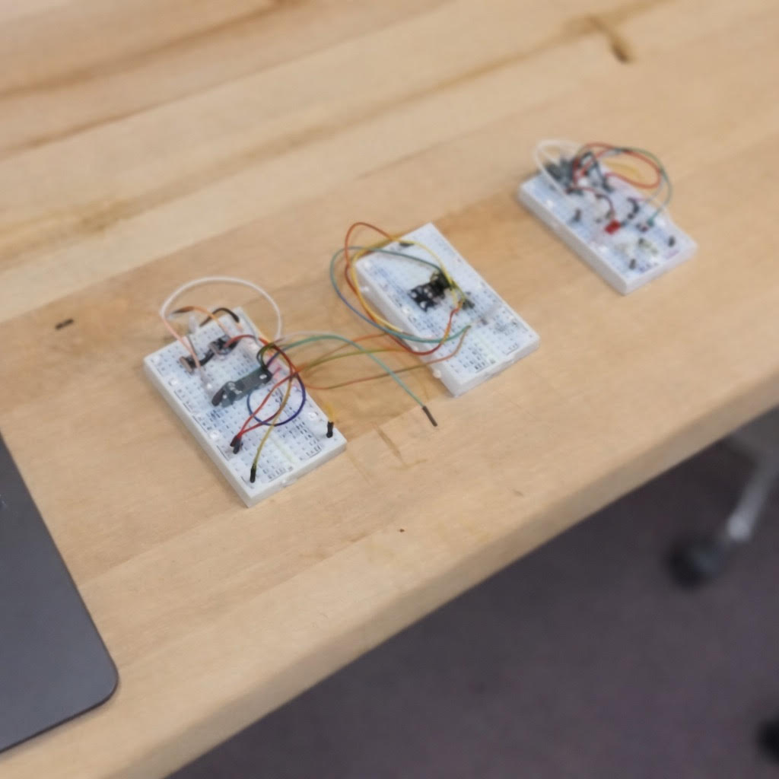
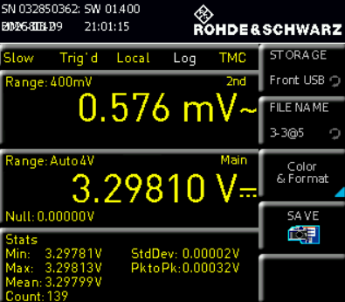



Peripheral Testing
Notes:
Tested with 3.7 and 5V
Oscilloscope measurements used to verify performance of the 1.8 V regulator
Output voltage measured between 1.781 V and 1.788 V, close to the intended 1.8 V supply
Ripple measured between 0.829 mV and 2.996 mV
Ripple remains very low, indicating stable voltage regulation
Clean 1.8 V rail is important for low-voltage digital logic and sensitive electronics
Stable power helps reduce noise and improve system reliability
Results confirm the 1.8 V regulator is operating correctly and delivering consistent power
Tested with 3.7 and 5V
Output voltage measured at ~3.297 V – 3.298 V, very close to the expected 3.3 V
Ripple measured between 0.576 mV and 0.630 mV
Stable voltage ensures reliable operation of digital components such as the ESP32 and other logic circuits
Low-noise power rails help prevent signal errors and improve overall system stability
Results confirm the 3.3 V regulator is functioning correctly and providing stable power to the system
Clean power is especially important when the system includes sensitive electronics or mixed-signal components that could be affected by voltage fluctuations.

Slide 19




Heart Rate Module Testing

Slide 20







Hardware Changes / Improvements
Mid Term Goals
Reduce Size
Reduce Cost
Increase Accuracy
*images not to scale
Consistent Visible Pulses
Improved correlation between actual strikes and predictions
Notes:
Following our midterm prototype, we defined three primary goals for the final iteration: reduce size, reduce cost, and improve overall functionality.
We successfully achieved all three. The full PCB footprint was reduced by approximately 50%, and the heart rate module saw a 45% reduction in size. In addition, the total system cost was reduced from roughly $150 to $40.
These smaller form factors allowed for improved device mounting on the user, which led to more consistent and reliable data collection. For the heart rate sensor specifically, we also refined our signal processing to mitigate motion-induced noise, resulting in significantly more stable readings and faster monitoring response.”

Slide 21


Slide 22
MCU
Considered Solutions
 | Processing | Wireless Support | Power Consumption | Memory | Development Complexity
Raspberry Pi | ↑↑↑ | ↑↑ | ↑↑↑ | ↑↑↑ | ↑↑
Arduino | ↓ | ↓ | ↓ | ↓ | ↓
STM32 | ↑↑ | ↓ | ↓ | ↑↑ | ↑↑
ESP32 | ↑↑ | ↑↑↑ | ↑ | ↑↑ | ↑
Processing - Higher is better
Wireless Support - Higher is better
Power Consumption - Lower is better
Memory - Higher is better
Development Complexity - Lower is better
Red - Worst
Green – Best
Our Chip:
ESP32-s3-1-WROOM -N16R2
Dual-core 240 MHz processor
Integrated BLE and Wi-Fi
16MB Flash and 2MB PSRAM
Power consumption 344mA*
Plethora of reference designs and supported libraries
*Peak BLE TX current: 344 mA at +20 dBm (datasheet worst case)

Slide 23

MCU Implementation
PIN | LABEL | FUNCTIONALITY
1,40-49 | Ground | 0v
2 | VIN | 3.3v
3 | Enable | Reset
6,7 | GPIO6,GPIO7 | Status LEDs
13,14 | I2C | IMU
15,16 | I2C | HR Sensor
17,18 | GPIO9, GPIO10 | Extra GPIOs
27 | IO0 | Boot
32 | IO39 | Buzzer
36,37 | RX,TX | UART communication
38 | ADC1_CH1 | Battery Monitor

Slide 24

Embedded Software
Libraries:
Arduino Core (Arduino.h)
Microcontroller runtime (GPIO, timing, serial)
I²C Interface (Wire.h)
Communication with ICM-20948 IMU
IMU Drivers (Adafruit_ICM20948)
9-DoF sensor initialization & data acquisition
Sensor Fusion (Fusion.h)
Quaternion-based orientation estimation
BLE Stack (NimBLEDevice.h)
Low-power GATT server for wireless IMU streaming
Memory Utilization:
Ram Usage - 30,493 bytes ~9.3% utilization
Flash Usage- 3,342,336 bytes ~16.3% utilization

Slide 25
Wireless Communication
Strike sense requires a wireless link that can stream 9-axis data in real time, maintain low latency and ensure reliable packet delivery while minimizing power consumption.
Wifi | Bluetooth LE
Intended for high-throughput networking Real world throughput 10-300+ Mbps Variable latency often unpredictable Large range 10s-100s of meters Significantly higher power consumption Added complexity (Router/AP + full TCP/IP stack) | Intended for low-power device links Real world throughput up to 100kB/s Low and predictable latency Shorter ranged 10s of meters Low power consumption (optimized for battery powered devices) Simple point-to-point connection
Strike Sense Worst Case BLE Payload
*Note this estimation is derived based on maximum ODR and resolution and excludes BLE overhead, and still represents a conservative overestimation of actual payload

Slide 26
Packet Structure
IMU Packet | T_ms (4B) | Type (1B) | AX (4B) | AY (4B) | AZ (4B) | GX (4B) | GY (4B) | GZ (4B) | Total 29 Bytes
HR Packet | T_ms (4B) | Type (1B) | Avg_bmp (4B) | Total 9 Bytes
Status Packet | T_ms (4B) | Type (1B) | *Code (1B) | Battery % (1B) | Total 7 Bytes
*Status Codes: ST_IDLE, ST_IMU_STARTED, ST_IMU_STOPPED,
ST_HR_STARTED, ST_HR_STOPPED, ST_ERROR

Slide 27

Specification 3 Wireless Data Transmission
To validate the reliability of our wireless communication system, we modified the StrikeSense sensor module firmware to transmit a fixed number of BLE packets during a test run.
A Python client application connected to the modules over Bluetooth Low Energy and logged every packet received. By comparing the expected number of packets to the number of packets actually received, we calculated the packet success rate of the wireless link.

Slide 28

System Architecture Overview
Notes:
“The system is organized as a staged post-processing pipeline. First, synchronized IMU and video are recorded. Next, strike events are detected using IMU motion-energy peaks. Those events are classified using a trained IMU model. The resulting strike timestamps are mapped onto the video timeline. Then computer vision outputs, such as AlphaPose skeletons, are used to provide visual context for replay. Finally, all of this is assembled into a dashboard payload.”

Slide 29
System Architecture & Data Pipeline
IMU strengths
precise motion timing
robust to occlusion
robust to camera angle changes
low-dimensional, high temporal fidelity
CV strengths
visual explanation
replay
pose overlay
qualitative form analysis
Notes:
I initially explored a more equal fusion design, but experimentally the system became much more stable when IMU was used as the primary event source. This is because strike timing is fundamentally easier to recover from wrist motion than from video alone. Computer vision remains valuable, but mainly for replay, pose visualization, and supporting evidence rather than primary event detection.”

Slide 30

Data Pipeline (IMU)
Notes:
The IMU data is captured as a time series of accelerometer and gyroscope measurements. Simultaneously, the webcam records video. On this slide we will focus on The IMU data.

Slide 31



Data Pipeline (Computer Vision)
We will be implementing a similar data pipeline to our IMU proccessing
We will use Alphapose, a Pose estimator due to its use of PoseFlow
Length of one strike = 0.5 – 1 sec = 15-30 frames
  Each frame returns 136 keypoints(coordinates, confidence)
  In one strike, a total of 2040 individual keypoints are extracted
We have a dataset and will continue to expand and then proceed into training

Slide 32

Data Proccessing for IMU Model
Continuous Input to Features: Magnitude features are computed for acceleration and angular velocity.
Peak Detection: Local maxima are detected on the smoothed energy signal.
Merging Peaks: Weak peaks are rejected and nearby peaks are consolidated into one strike event.
Event Window Extraction: A fixed temporal window is created around each accepted peak, producing the strike segment passed into the classifier.
Notes:
The classifier does not operate directly on the full continuous IMU stream. First, the system has to isolate candidate strike events.
This is done by detecting motion peaks through the computation of a motion energy signal as seen in the slide. In this equation E(t) is the overall motion energy score at time t, omega is the gyroscop vector at t , and a(t) is the acceleration vector at t
In our computation, Gyroscope magnitude is weighted more heavily than acceleration magnitude because rotational motion was more informative for punch timing. This can be seen with the 0.7 multiplier added to the gyroscope vector
After smoothing the energy signal, we detect local maxima and apply an adaptive threshold so that only meaningful peaks are retained. If multiple peaks occur too close together, they are merged so that a single punch does not create multiple detections.
Once the final peaks are selected, we extract fixed windows around each accepted peak. These windows become the actual inputs to the neural network

Slide 33

IMU Model Architecture
Xyz coordinates from the accelerometer and gyroscope along with both magnitudes become our features per timestamp
A 1D convolutional stem projects the input into a learned temporal feature space.
Stacked residual convolution blocks learn motion features while preserving stable gradient flow during training
Dilation is increased progressively to expand the temporal receptive field and capture the full strike trajectory
Adaptive average pooling compresses the temporal dimension, and a fully connected head maps the learned representation to class logits.

Slide 34


Machine Learning Strategies / Hyperpameter Tuning
Weighted Loss: penalizes mistakes on smaller classes more during training
Optimizer and Weight Decay: Set weight decay to 1e-4 and used Adam optimizer to penalize imporportianate large weights
K-Fold Cross Validation: Set a rotation of samples to be used for validation each epoch as to avoid overfitting
  With each fold generating a model, we select the model closest to the mean validation accuracy
ReduceLROnPlateau scheduler: halves learning rate whenever there is a plateau in validation accuracy
Early Stoppage: Within each fold we implemented this to avoid extensive plateaus in validation accuracy. Patience was set to 7.

Slide 35

Machine Learning Results for IMU

Slide 36

Machine Learning Approach for Computer Vision
We implemented a temporal pose-based strike classifier using a CNN + Bidirectional LSTM + Attention architecture
Input: Each sample is represented by a sequence of body kepoints extracted by windows
CNN Temporal Front-End: Two stacked 1D convolution layers extract local motion features from the keypoint sequence.
Bidirectional LSTM: The CNN output is passed into a stacked bidirectional LSTM, which models the motion trajectory in both forward and backward time directions
Attention Layer: A learned attention module assigns higher weight to the most informative frames in the sequence and produces a context vector summarizing the strike motion.
Classifier and Output: The context vector is passed into a fully connected classification head with batch normalization, ReLU, dropout, and a final linear layer that outputs class logits. The final logits are converted to class probabilities with softmax.

Slide 37

Machine Learning Results for Computer Vision

Slide 38

Machine Learning Results

Slide 39


Dashboard
Our dashboard is made of the following stack:
Next . js , React. Js (frontend)
Node. js + Express (backend)
PosgreSQL (database)
FasAPI
Python

Slide 40
Thank
you

