Slide 1

Substation Monitoring System
Group 6
John Blackburn
Steve Johnson
Anish Raj Pant
Devin King
Sponsored by BCI Technologies

Slide 2
Motivation
All group members were in the same power systems class.
To become familiar with SCADA (Supervisory Control and Data Acquisition) – Used in the real-world to monitor power.
BCI Technologies sponsorship.

Slide 3
Goals and Objective
Monitor electrical values for a simulated power substation.
Open and close the relay remotely.
Check the status of the relay.
Send status messages wirelessly.
Easy to use graphic interface.
Device to be enclosed in a protective case with manual switch.

Slide 4
Requirements / Specifications
Maximum load current of 10A.
Station alarm with audible level of at least 70dB.
Wireless communication range of at least 30m.
Controller with at least 15 I/O pins.
A NEMA rated panel enclosure.

Slide 5
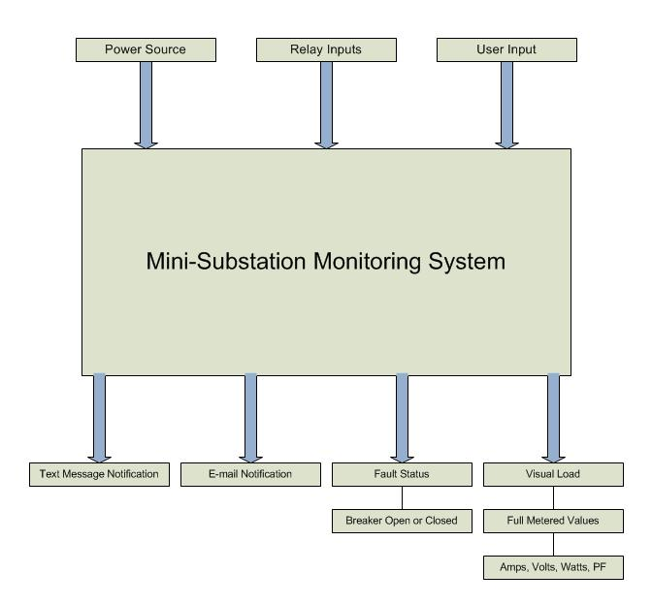
Block Diagram - Inputs and Outputs

Slide 6
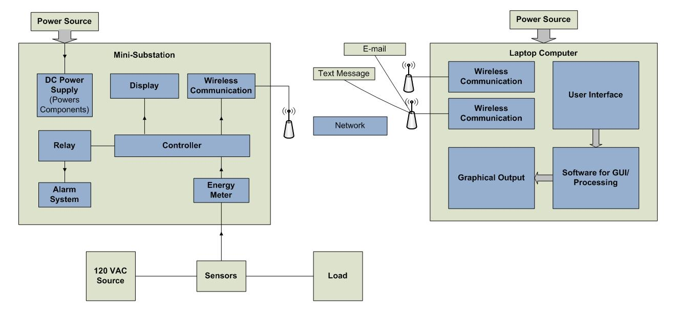
Block Diagram

Slide 7
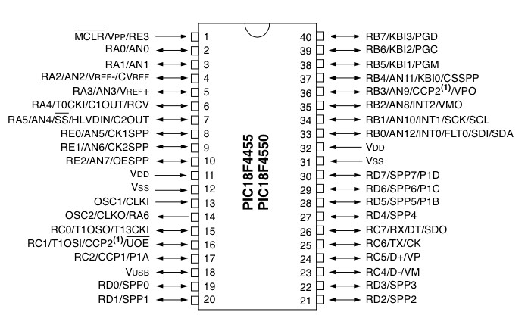
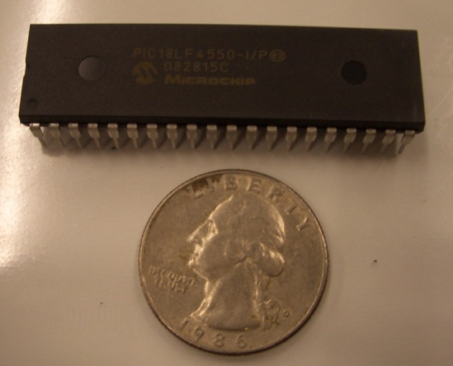
Microcontroller
PIC18F4550
  40 pins
  13 A/D inputs
  18 GPIO’s
  Wide Operating Voltage Range:
  2V – 5.5V
  Internal Oscillator : 31kHz – 8MHz

Slide 8
Modbus Protocol
A simple protocol data unit (PDU) independent of underlying communication layers.
Modbus is used in many devices such as:
  PLC, HMI, Control Panels, Drivers, Motion Controls, and other I/O devices
  To control and initiate remote operations.
  Can be done on serial interfaces as well as TCP/IP.
  We are using Modbus serial to do our communications.

Slide 9
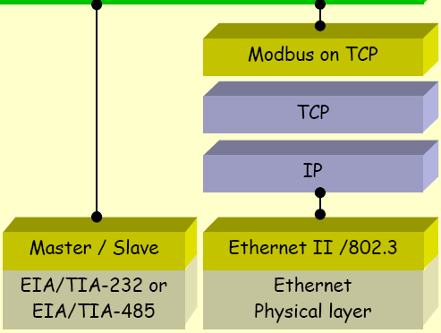
Modbus Communication Stack
Modbus Application Layer

Slide 10
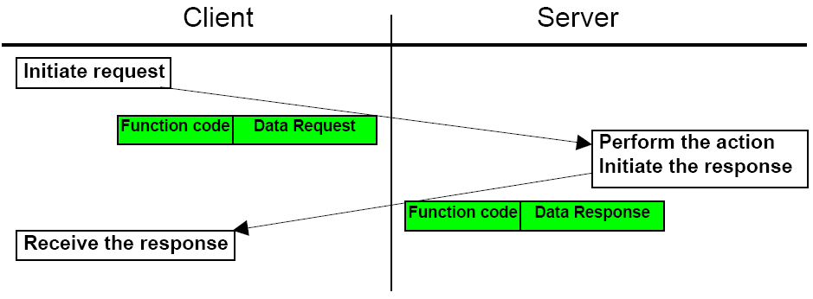
Modbus cont.
Handshake type serial transmission
Modbus Message Transaction

Slide 11
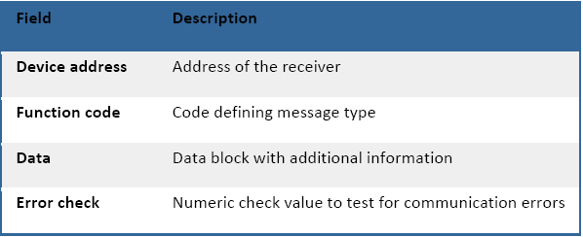
Modbus cont.
Format written in Hex→
  Request
        usually 8 bytes
A positive Response
  The response function code = the requested function code.
An Exception Response
  Error detected during processing.
  Exception code = requested function code + 0x80h for the reason of the error.
The microcontroller must be programmed to accept the modbus library of functions and error exceptions.

Slide 12
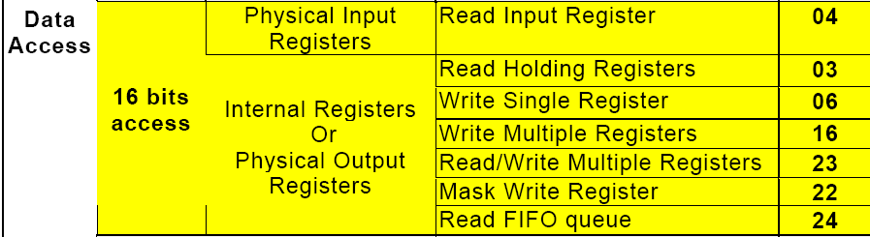
Modbus cont.
Function code 03-Read Holding registers to access the data from our microcontroller.
Function code 06-Write Single Register to wirelessly control and receive the status of the relay.

Slide 13
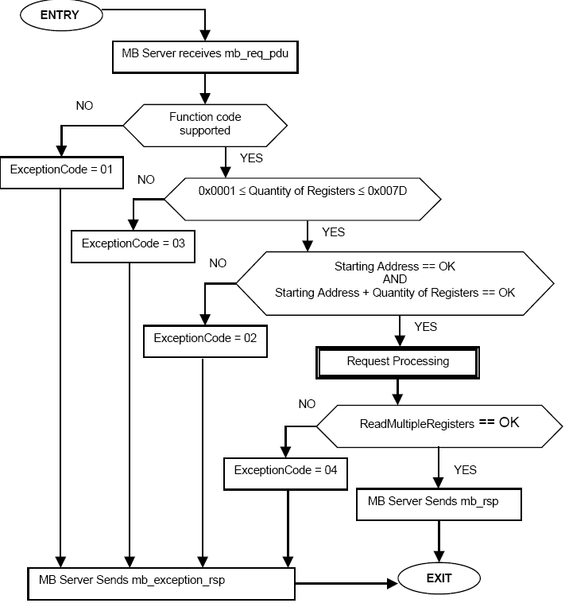
Modbus cont.

Slide 14
Wireless communications
Specifications
Bi-directional communications
3.3 to 5 DC operational voltage
Small form factor < 3”x3”x3” for panel
Small form factor < 2”x2”x2” for computer interface
Serial communications
Data transfer rate minimum of 50Kbps
Effective range of >30 meters

Slide 15
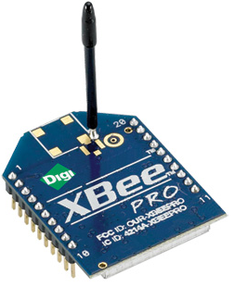
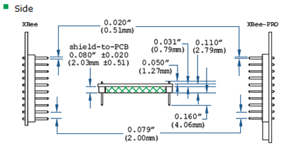
Wireless Communications
X-Bee RF module
  Small form factor
  ZigBee 802.15.4 standard
  Decent range (100 meters)
  Low power consumption (1 mW)
  Data rate of (250 Kbps)
  Mesh or point to point
  topology
  Inexpensive ($19 from digi.com)

Slide 16
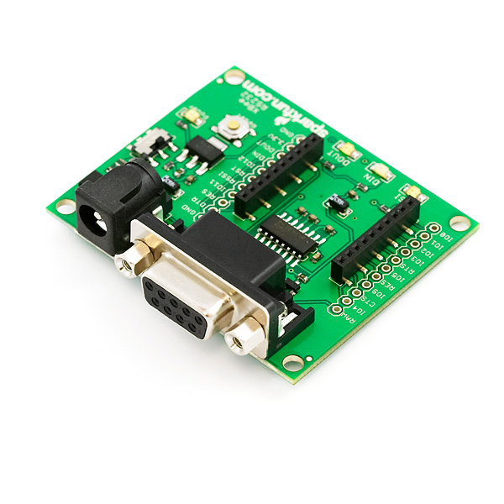
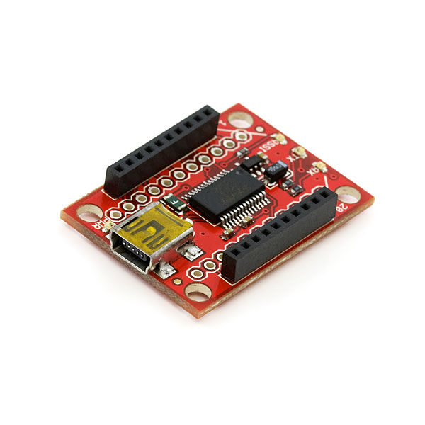
Serial and USB Explorers
  Configuration of modules
  Testing
  Cost of $24 from Sparkfun.com

Slide 17
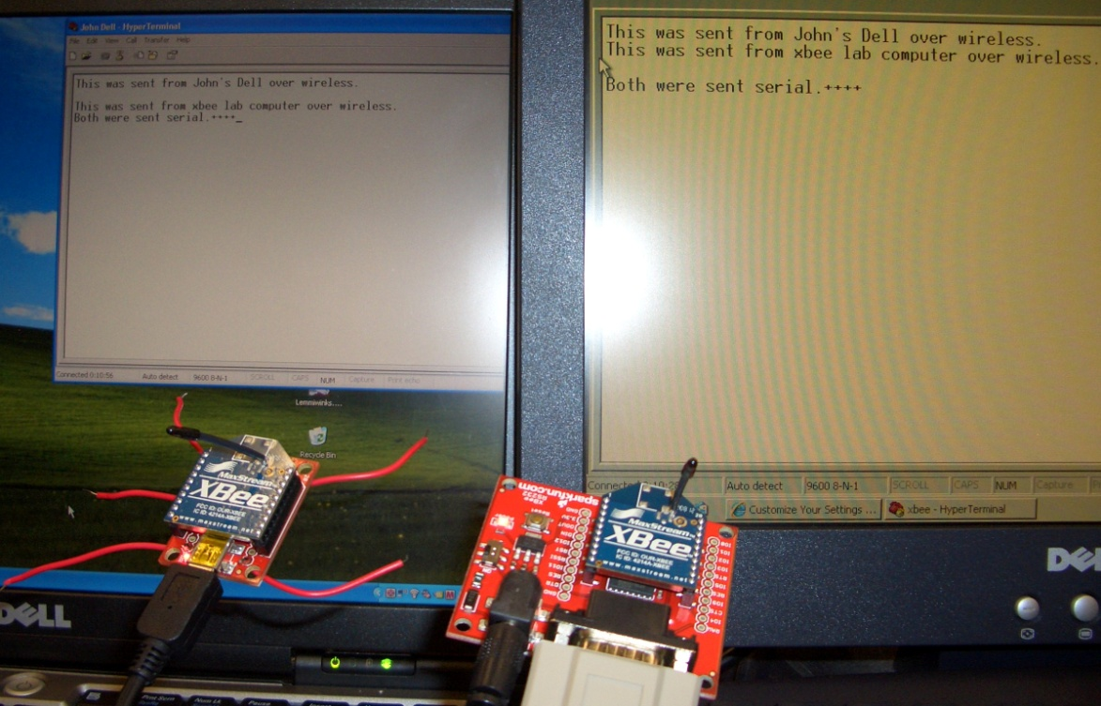
Testing of X-Bee Modules
Computer to computer test
  HyperTerminal
  Two X-Bee modules using RS232 and USB explorers

Slide 18
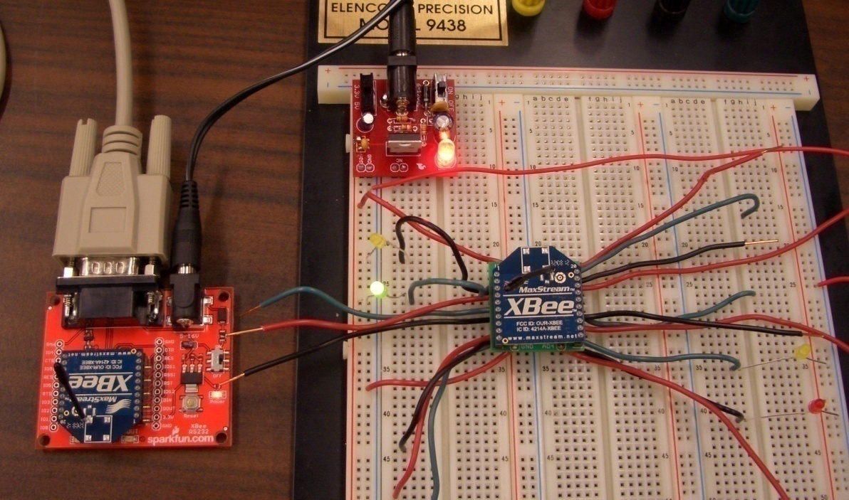
Testing of X-Bee Modules
Stand alone test
  Using USB Explorer and stand-alone module and HyperTerminal
  3.3 volt power supply

Slide 19
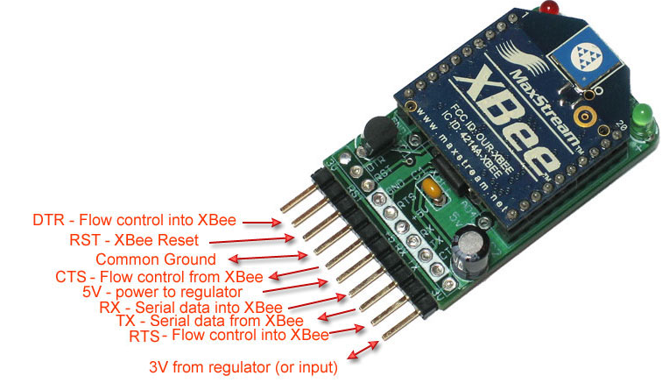
X-Bee Adapter Kit
  Connects via USB with FTDI cable
  Onboard voltage regulator
  Cost of $10 from Adafruit Industries

Slide 20
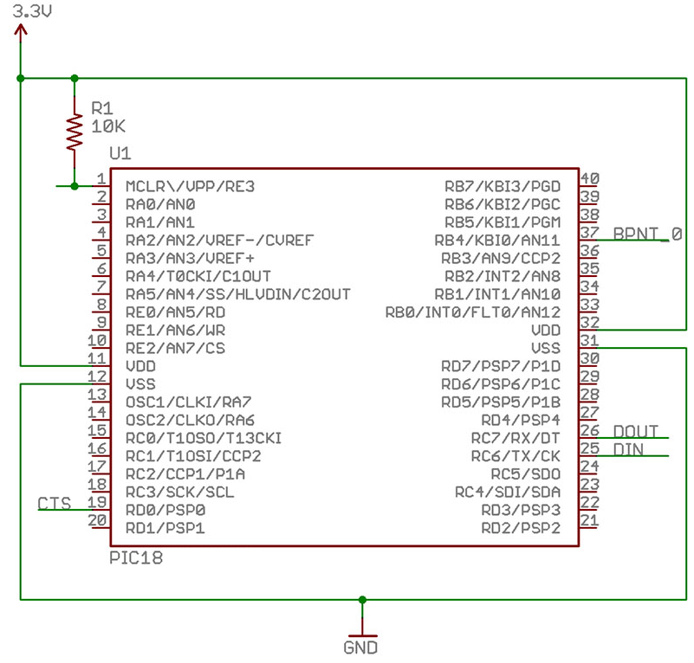
Connecting X-Bee to Microcontroller

Slide 21
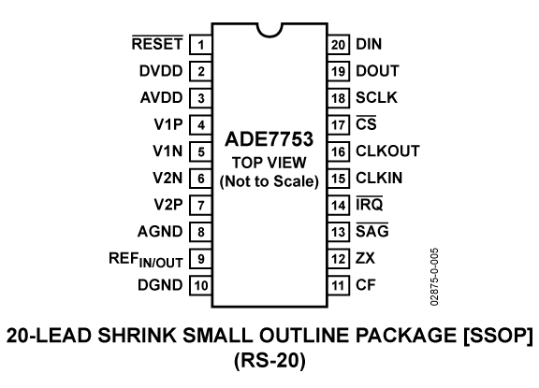
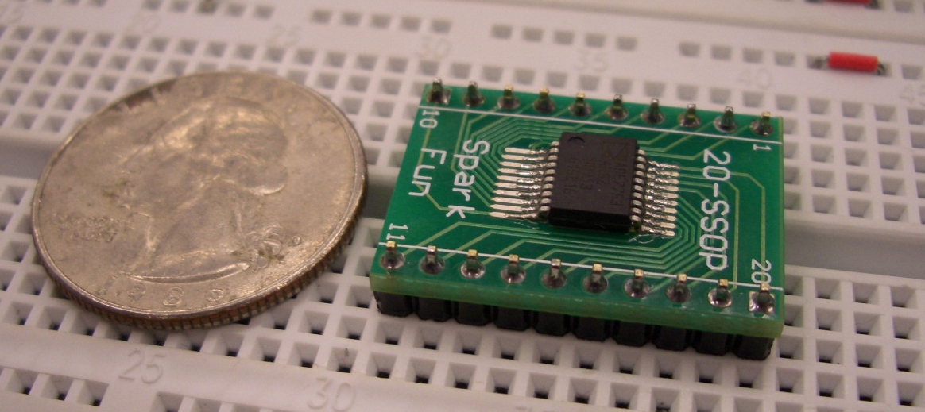
Energy Meter
ADE7753
  Single Phase
  Voltage and current sensor inputs
  Active, reactive, and apparent energy measurements, rms calculation on the voltage and current.
  Serial interface

Slide 22
Energy Meter
Supply current: 7mA
IRMS accuracy: 0.5%
VRMS accuracy: 0.5%
Analog input range: +/-32mV to +/- 500mV peak

Slide 23
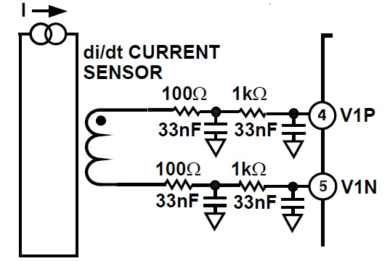

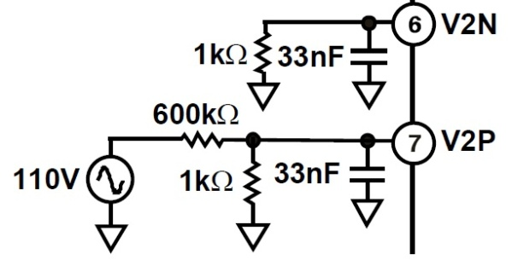
Current and Voltage Sensor
Current Transformer
  CR8351-2000-N
  Low Cost
  50Hz - 400Hz
  Maximum primary current: 350A (RMS)
Current Sensor Input
Voltage Sensor Input

Slide 24
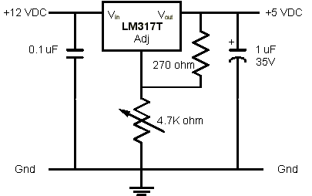
Power Supply
12VDC to 5VDC
  LM317T
    Variable voltage
    regulator
  10K potentiometer for adjusting the output voltage
  Capacitors to reduce voltage ripple

Slide 25
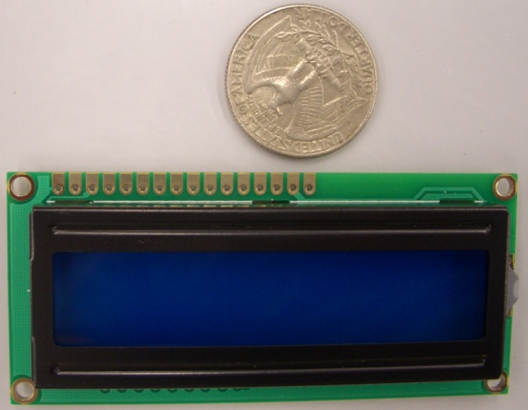
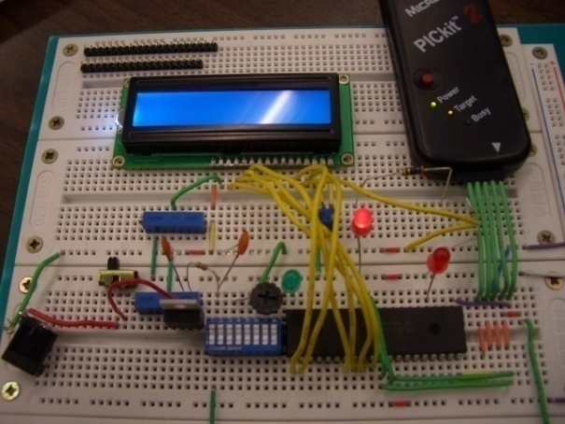
Liquid Crystal Display
Model Number: SSC2F16DLNW-S
Features:
  16 X 2 Display
  Dimensions
  3.13”(W) X 1.42”(H) X 0.53” (D)
  4-bit or 8-bit parallel interface
  Standard Hitachi HD44780
  equivalent controller.
  LED backlight

Slide 26
Double Pole Double Throw Relay
Control the power usage
The relay will act as an
overload device.
The microcontroller will
be programmed to send a
signal.
The relay will trip the alarm.
Easily mounted inside the
panel.

Slide 27
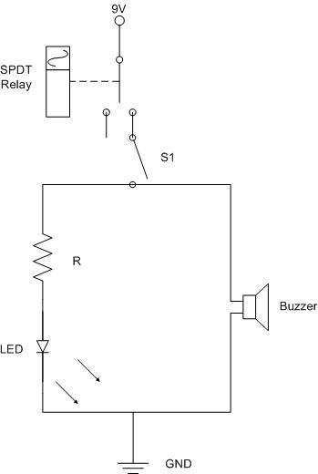
Alarm
Piezo Buzzer – Audible alert if fault detected
  100dB
LED’s for relay status
Will sound when a fault is detected by the relay

Slide 28
SCADA - ClearScada
High level Industrial software
  Integrated Development environment using an Object Oriented database of information
  Allows us to create an easy to use graphical interface.
  Create all analog and digital points to be monitored.
  Configure alarm limits to trip the breaker on an over-current condition or manually with the scripts written for the breaker buttons.
  Difficult problem: connecting high level industry standard software back to small circuit design.
  Software Demo License courtesy of BCI Technologies. (free)

Slide 29
SCADA cont.
The software is a development environment much like LabVIEW or Visio.
It must be customized, configured and programmed to your specific need or application.
It can be configured and programmed in a few different ways.
  Scripting to run behind the buttons, so when they are pressed it will set the object to 1 or 0.
  Structured Text Program – similar to a C program, our use is to write a 1 or 0 to the relay status register.
  Function Block-our use is to break up to get the high byte or the low byte of an address or piece of information passed in.

Slide 30
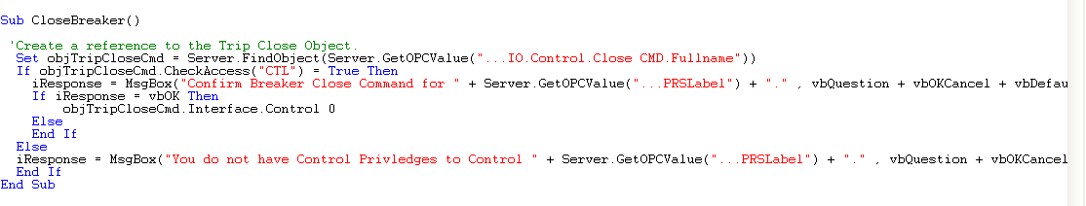
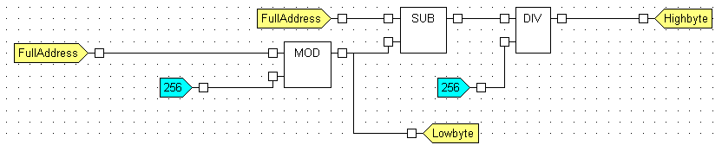
SCADA cont.
Scripting Code written to close relay.
Function block to separate the high byte from the low byte for the 2 byte address in modbus protocol. This could also be used to read or write to a single bit in the byte.

Slide 31
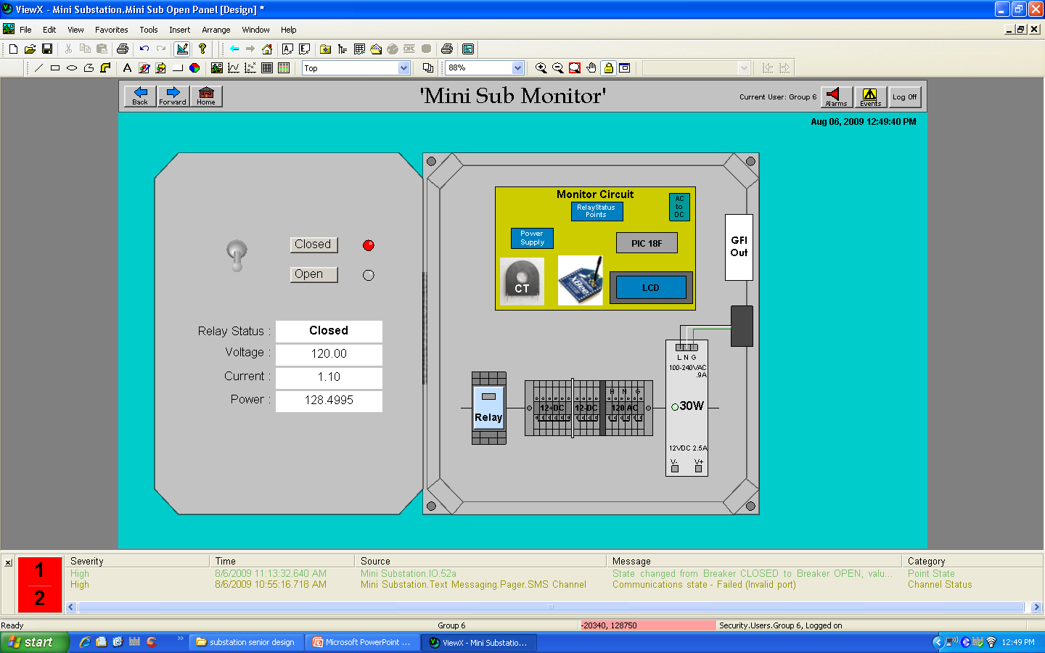
Panel in ClearSCADA Environment

Slide 32
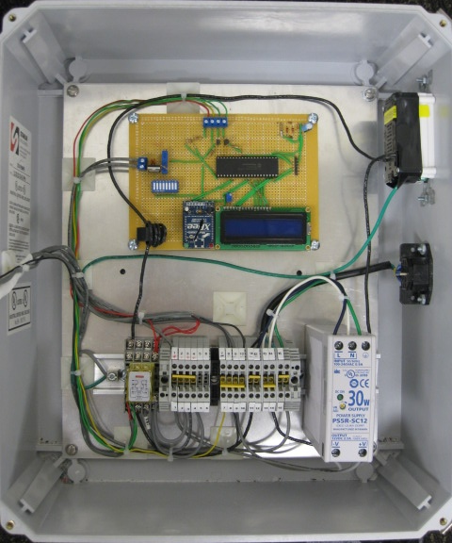
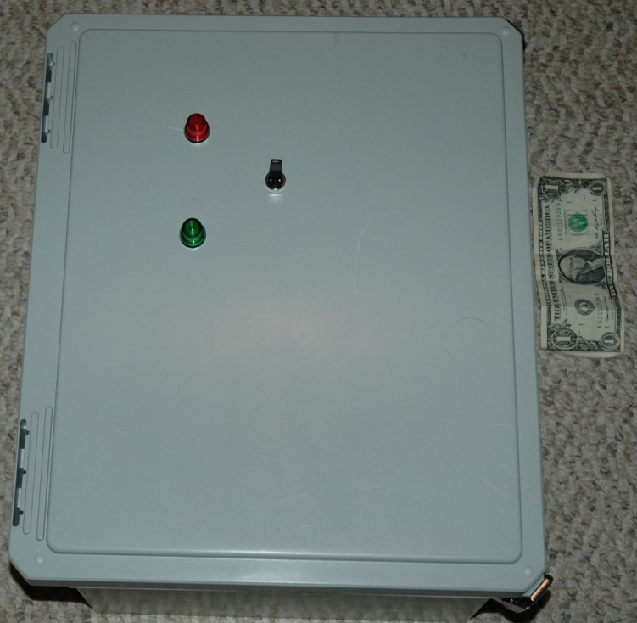
Actual Panel
Stahlin Non-Metallic Enclosure
  16x14x8 in Temp. Rating: -40˚ F to 250 ˚ F
  Nema 4x rating Industrial Grade
  Cost $57 but donated by BCI Technologies

Slide 33
PCB Design

Slide 34
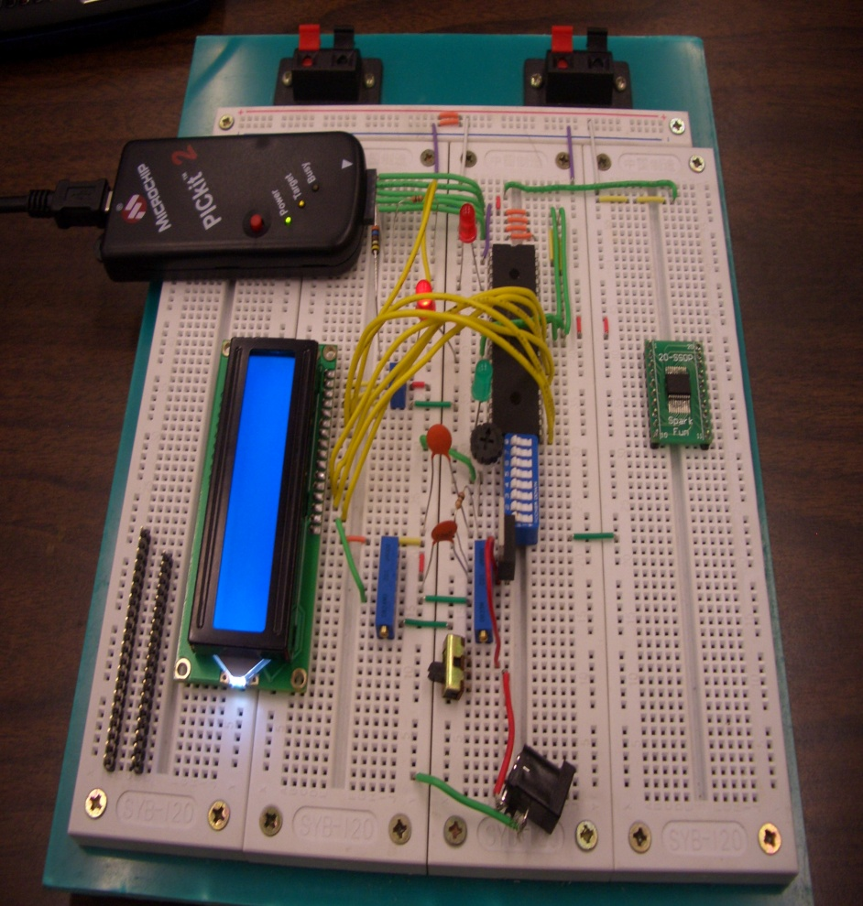
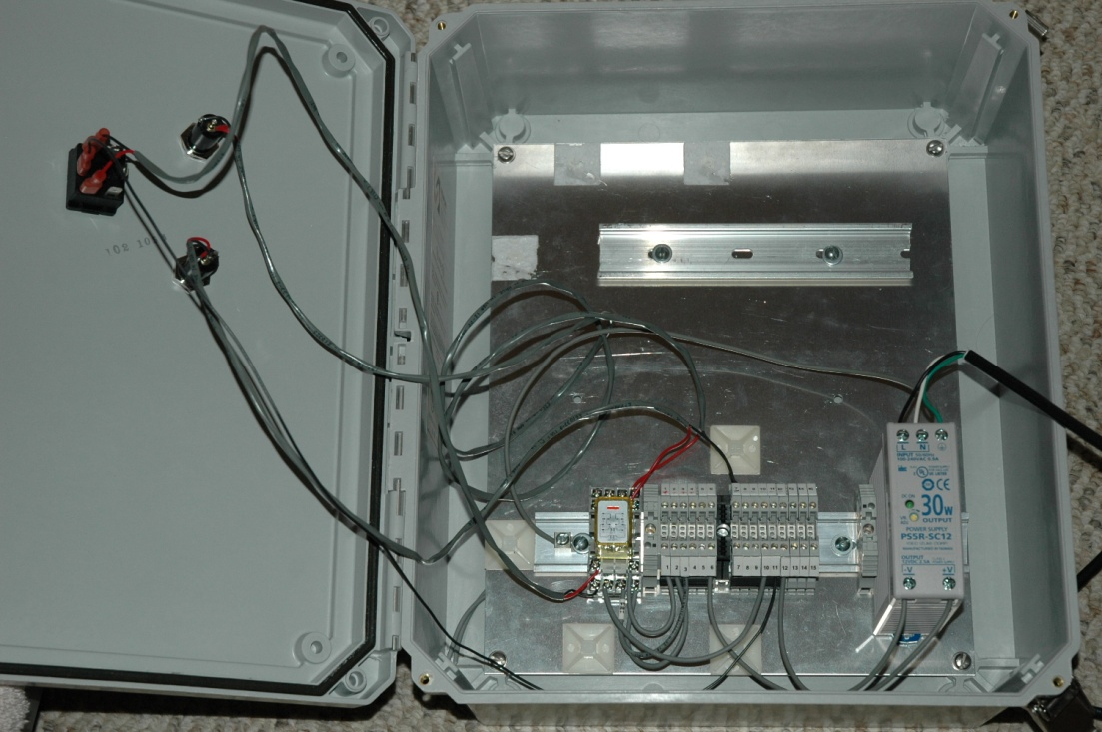
Current Status

Slide 35
Progress Chart

Slide 36
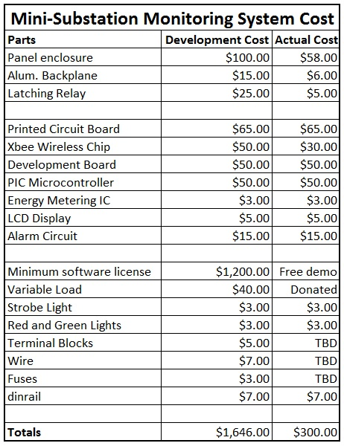
Project Budget
Most of the parts donated
by BCI Technologies.
We have currently spent
$200.
We are currently on track
with the budget.

Slide 37
Questions

