Slide 1
AMDV: Autonomous Metal Detecting Vehicle Critical Design Review
Bob Augustine
Christopher Bond
Mike Grasso

Slide 2
Project Overview
To design, build, and test a robotic vehicle to locate and mark the location of metallic objects.
The project idea targets both recreational and official use although the primary goals and objectives of this preliminary design and prototype will mainly target the recreational audience.
Recreational use of this device would be by treasure hunter enthusiast to find lost metallic objects which may or may not be buried in the ground without having to manually search the area themselves.
Future design revisions may be targeted more towards the official use of the device by law enforcement and military personnel to locate possible hazardous metallic objects.

Slide 3
Goals and Objectives
The AMDV will be low cost, easy to use, and have a light weight, portable design
The AMDV must be able to perform outside in good weather conditions
ie-The AMDV does not have to be weatherproofed
The AMDV will go through the following recursive pattern once initiated until the user turns it off:
The vehicle shall move autonomously or manually in areas outdoors or indoors
This mode shall be determined by user input wirelessly via a computer
When operating autonomously, the vehicle will use a pre-programmed search pattern while performing obstacle avoidance and detecting metallic objects.
While operating manually, the vehicle shall communicate to the aforementioned computer for movement and other commands
The vehicle shall sense when it has gone over metal, stop, log the location, and notify the user it has found a metallic object via a feedback mechanism
Upon User-Input, the AMDV will continue operation under the previous operational mode

Slide 4
Requirements and Specifications
The AMDV must run for a continuous 15 minutes
The AMDV must be able to detect metal within a depth of 5 inches
The AMDV must have a method of recording at least 20 waypoints (locations)
The AMDV GPS must be accurate to within 5 meters
The AMDV must detect obstructions at a minimum of 12 inches

Slide 5
Block Diagram: Project Breakdown
GPS
(Bob)
Bluetooth
(Chris)
Bluetooth
(Chris/Bob)
Microcontrollers
(Chris)
Software
(Bob)
Metal Detector
(Mike)
AMDV
Computer
Software/GUI
(Bob)
R/C Car:
Motors, Steering
(Mike/Chris)
Sensors
(Bob)
Power Center
(Mike)

Slide 6
Hardware

Slide 7
Sensor: Requirements
Sensor Purpose: Used for collision avoidance
The sensor must be able to meet the following specifications:
Works outside
Works at a wide range of distances
Minimal Distance: at least 6 inches
Maximum Distance: at least 1 meter
Operate at 5V
Well documented

Slide 8
Sensor: Options
 | PARALLAX PING))) | Maxbotix LV-EZ1 | Sharp GP2Y0A21YK
Technology | Ultrasonic | Ultrasonic | IR
Can use in sunlight? | Yes | Yes | Limited
Supply Voltage | 5 +- 10% | 2.5 – 5.5 | 4.5 – 5.5
Min Detection Distance | 2 cm | 6 in | 10 cm
Max Detection Distance | 3 m | 254 in | 80 cm
Connections | Vdd, Vss, 1 I/O pin | RS232, Analog, PWM | Vo, Vcc, GND (JST)
Cost | $29.99 | $24.95 | $9.95

Slide 9
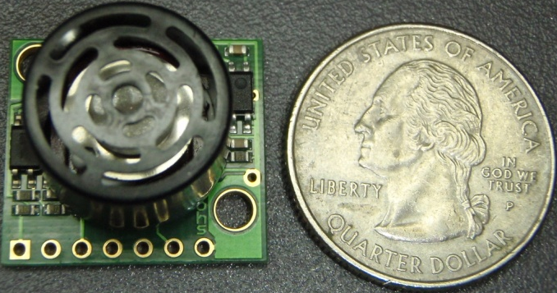

Sensor: LV-EZ1
Choose Maxbotix LV-EZ1
Can be used in sunlight
Can be powered by3.3V or 5V
Good detection range
Analog Communication
Relatively low cost
Connected to analog input pins on MCU
Cost: $0.00
Donated by manufacture

Slide 10
GPS: Requirements
GPS Purpose: Used to mark location of metallic objects found
The GPS must be able to meet the following specifications:
Fast satellite fix time
Small, inclusive chipset – GPS module and engine board
Well documented
Support WAAS
High Accuracy (less than 5 meters)

Slide 11
GPS: Options
 | EM-406a | EM-408 | ET-112
Chipset | SiRF StarIII/LP Single | SiRF StarIII/LP Single | MediaTek MT3318
Number of Channels | 20 | 20 | 12
Accuracy | 5 Meters (WAAS) | 5 Meters (WAAS) | 5 Meters (WAAS)
Cold Start / Hot Start Acquisition Time(sec) | 42 / 8 | 42 / 8 | 48 / 8
Data Communication | TTL | TTL | TTL
External Antenna | No | Yes | Yes
Cost | $46.99 | $47.99 | $43.99

Slide 12
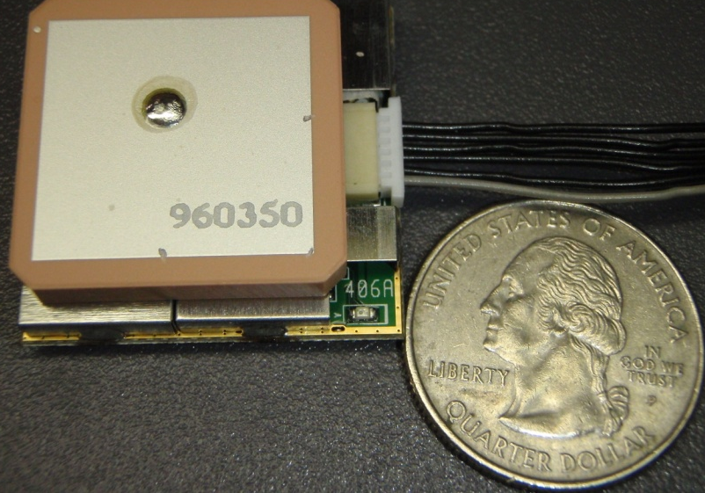
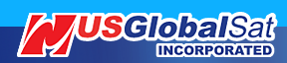
GPS: EM-406a
Choose EM-406a
Good reviews and support
Operating Voltage of 4.5-6.5V
TTL Communication
Relatively low cost
Connected to digital pins on MCU
Cost: $37.59
Discounted by manufacture

Slide 13
Detection Types
Very low frequency (VLF)
Receiver coil
Transmitter coil
Pulse induction (PI)
Short power burst
Usually a one coil system
Beat-frequency oscillation (BFO)
Search coil
Reference Coil
Notes:
VLF uses a two coil system. The problem with using the VFL for our application is that is expensive to buy and try to reverse engineer, and also, if we were to find a schematic of simple components, there are a lot of precision factors with both of the coils and the faraday shielding.
Pulse inductotion detection sends short power brusts down into the ground which can penetrate the deepest of all the three. The Pulse Induction can be related to an echo in the room, yelling would be your short burst and the wall would be the metal that’s reflecting it back. The Pulse induction detector is the most expensive type of metal detection and there is no simple way to build one from a schematic given.
Beat-frequency oscillation is the easiest type of metal detection technology to implement. It’s the same technology used in morse code and many other radio applications. It has a tunable reference coil oscillation at a given frequency and the search coil oscillating at the same frequency.

Slide 14
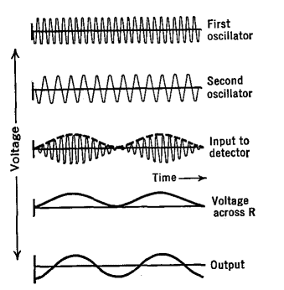
BFO
A change in the oscillation creates a voltage through the output.
When both oscillators are the same, it reaches ‘zero beat’ in which there is 0 voltage outputted
Notes:
These two frequencies are then mixed together and if they have the same oscillation, then zero beat is reached creating 0 volts for the output. Otherwise the mixer creates an oscillation which is the difference of the two frequencies, and it is then amplified and produces a given voltage.

Slide 15
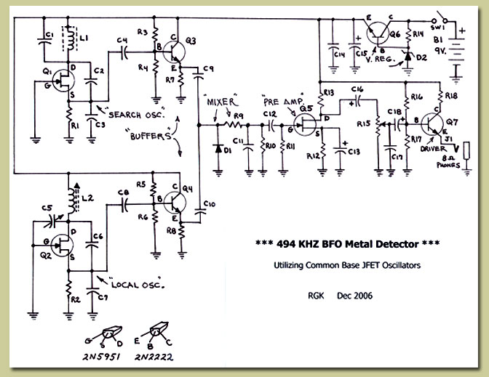
Metal Detector Design
Notes:
Here is a “simple” schematic if you were to search online for a BFO detector. The problem we had with this is that to are too many passive components and trying to build this device would be laborious at best. If something did not work, debugging this and trying to find the problem would be hectic. So we searched online for an IC version of this.

Slide 16
Metal Detection Design
CS209A
Made by cherry semiconductors
Has a better detection range
No longer in production
TDA0161
Made by ST Microelectronics
Readily available
Notes:
The two proximity IC chips we found were the cherry semiconductor CS209A and the ST Microelectronic TDA0161. Both of these ICs had very similar specs to them. If the CS209A was still in production it would be my top choice because of its apparent reliability and detection range. So we took what we can get and went with the TDA0161, which is still better than trying to build the whole schematic itself.

Slide 17
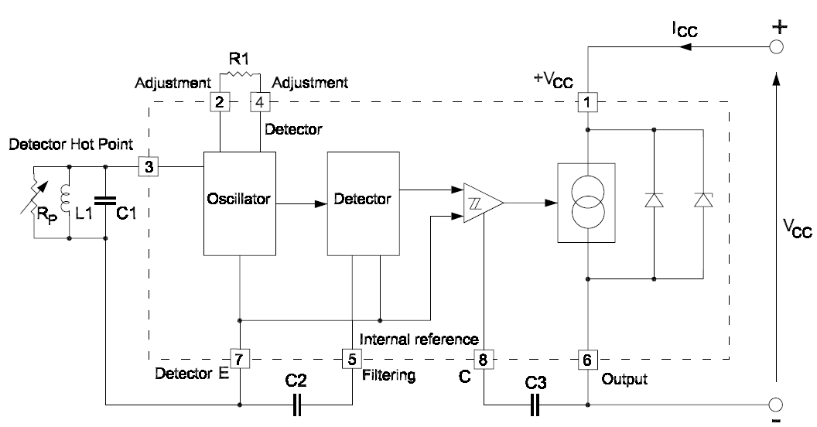
TDA0161
Notes:
The inner workings of the TDA0161 are shown here. You can see all the components that were present in the more complicated schematic a couple slides before. In this schematic, R1 and Rp need to be equal to each other so the BFO will produce a zero beat. Rp is not an actual resistor but rather an equivalent resistance of the external oscillator and R1 will be a potentiometer to adjust to that Rp value.

Slide 18
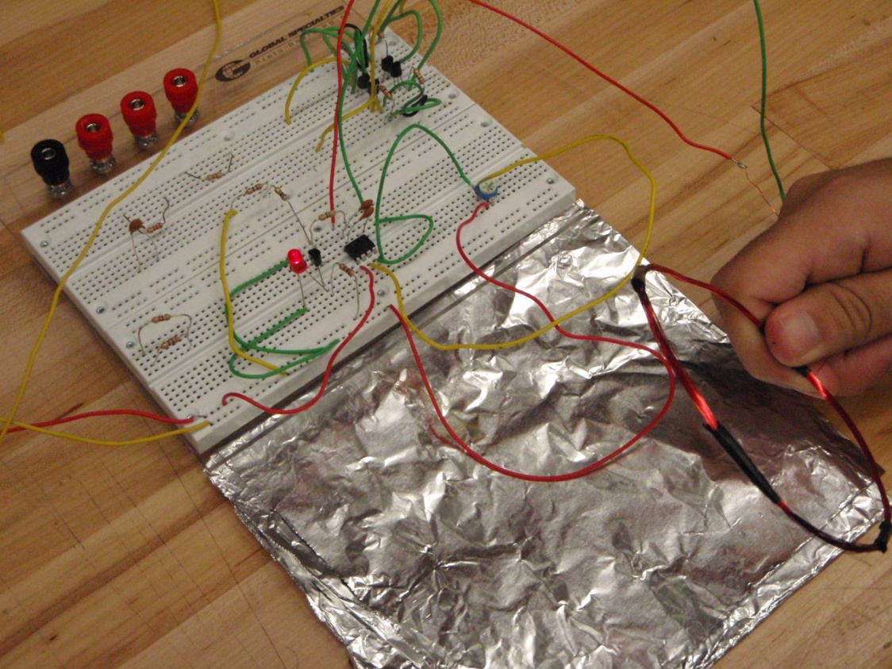
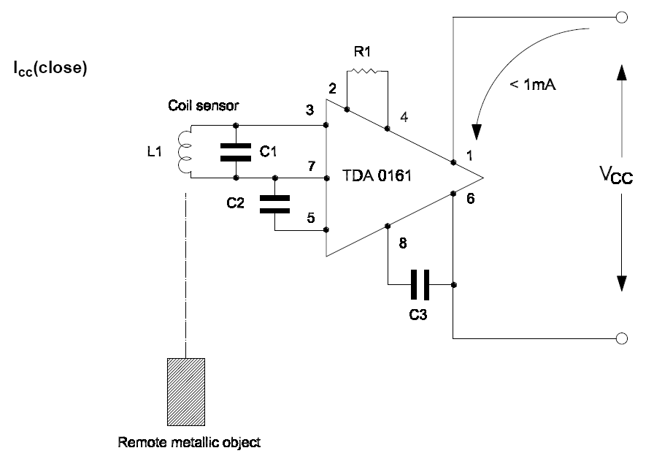
TDA0161 Implementation
Notes:
When the metallic object is placed away from the search coil, the output pin (pin 6) should put out <1mA of current.

Slide 19
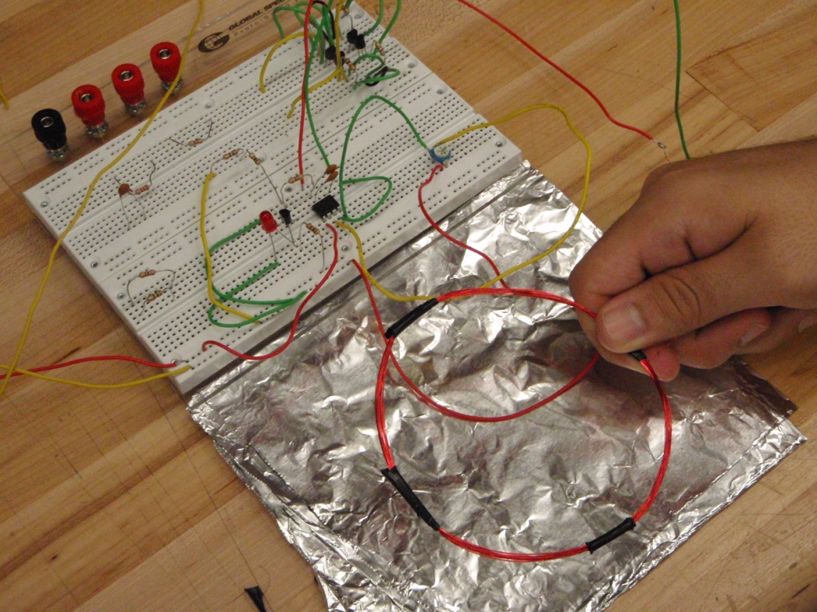
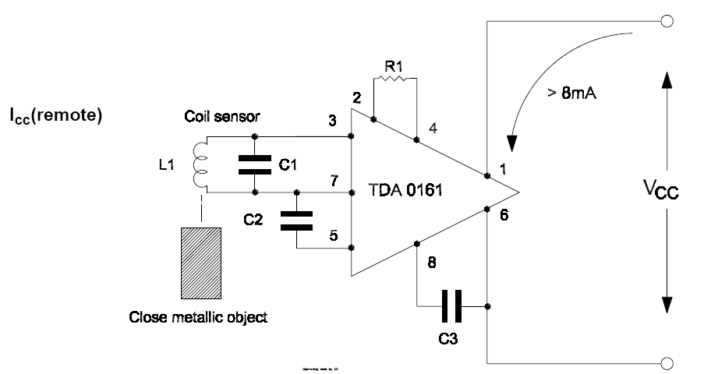
TDA0161 Implementation
Notes:
However, when the metallic object gets close to the search coil, the output should be greater than 8mA.

Slide 20
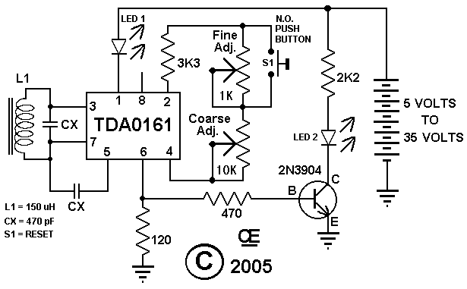
TDA0161 Schematic
Notes:
This is the schematic that is currently built in the lab. We’re implementing the two potentiometers to improve on the sensitivity and I came to the conclusion that the device works best when running at 9 volts.

Slide 21
Metal Detection Status
Metal detection works
Range up to 3’’
Sensitivity could be improved
Higher range detection
Still implemented as a subsystem
Needs to be integrated with the microcontroller
Needs to be tested outside the lab
Notes:
The current status of the metal detector is that it works. It range as of right now is at 3” but I think it could be improved to 5” with a little tweaking. The sensitivity could be improved by selecting lower values for the potentiometer so it get a more accurate resistor value that is equivalent to the Rp resistance of the external oscillator.

Slide 22
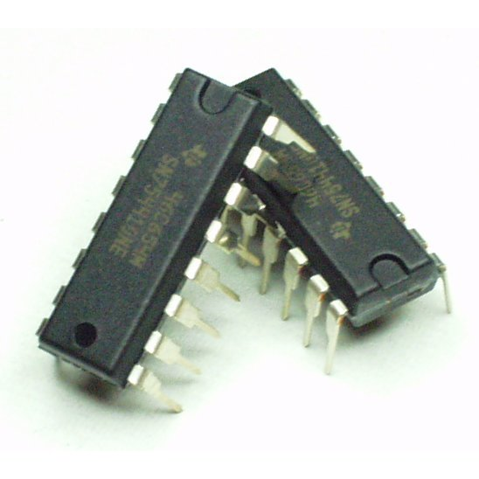
H-Bridge
Two Designs
Built using transistors
4 transistors
Built implementing ICs
SN754410 1A Motor Driver
More compact
Easier to use
Notes:
We’re going to need an H-Bridge to control both the front motor and the rear. The two designs being considered are one using simple transistors to make a switching circuit and the other implementing the IC which acts as an effective H-Bridge

Slide 23
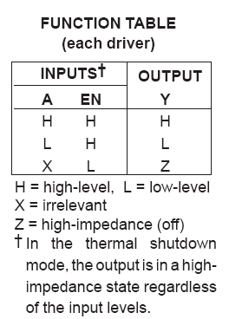
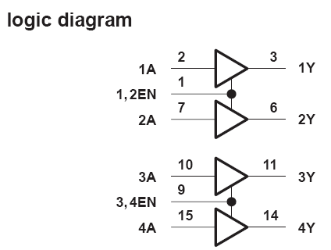
H-Bridge SN754410
Notes:
This slide shows how to use the enable pins to get the high or low outputs desired.

Slide 24
H-Bridge Issues
Overheated the original H-Bridge
Built the H-Bridge using Transistors
Overheated
Mostly likely due to hooking it directly to the 9V battery
Notes:
Our current issues with the H-Bridge are that it keeps overheating. We tried to use the H-Bridge from the RC car but we think one of the transistors went bad when we powered it down too fast. Also, when the H-Bridge was built using transistors and it didn’t turn the motor so we think they got overheated, probably due to the fast the transistors themselves were burning hot.

Slide 25
Power Supply
9V main power supply
Regulated with variable voltage regulators
LM317T
The RC car used a 6V power supply
The microcontroller will use 5V
Metal Detector will use 9V
Notes:
The power supply must use regulated using a series of the LM317T voltage regulators. As you can see almost every component uses a different power supply. The regulators run cheap so it won’t put us over budget.

Slide 26
R/C Car: Requirements
The Vehicle must be able to meet the following specifications:
Cost below $60
Large frame size to maximize PCB working room
Off-road frame type

Slide 27
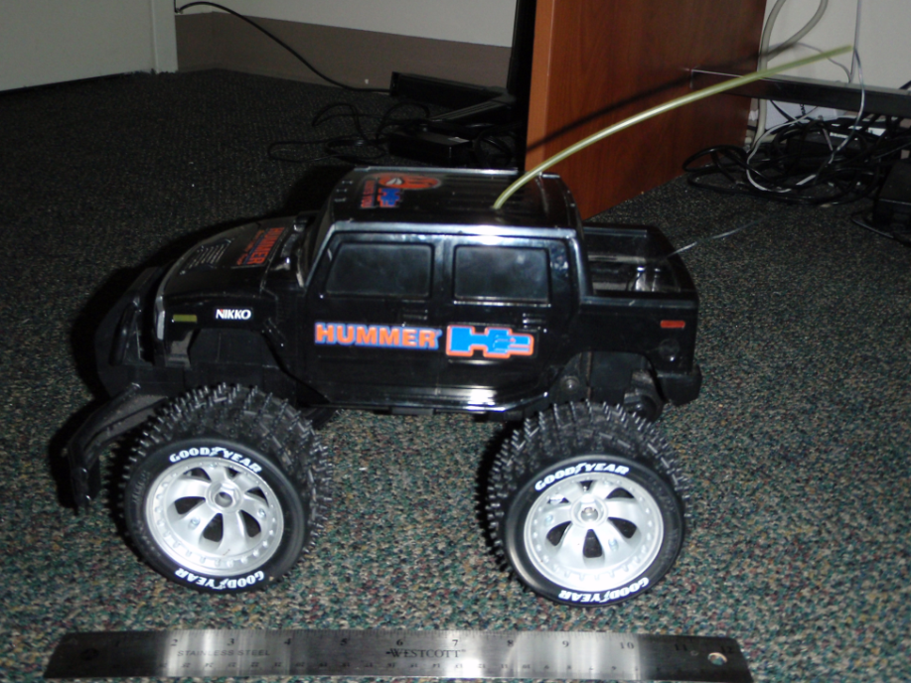
R/C Car: Hummer H2
Already on hand
$0 to implement
Off-Road Frame

Slide 28
Wireless Module: Requirements
The Wireless Module must be able to meet the following specifications:
Cost under $100
Communicate without being in the line of sight
Communicate from at least 20 feet away
House an integrated antenna
Operating voltage of 5V

Slide 29
Wireless Technology: Options
XBee Ranges/Power Consumption
Max. Permitted Power (mW) | Approx. Range (M) | Approx. Range (ft) | Efficiency (M/mW)
900 | 10,000 | 31,360 | 11
50 | 1,500 | 5,280 | 30
2 | 120 | 400 | 60
1 | 100 | 300 | 100
Bluetooth Classes
Class | Max. Permitted Power (mW) | Approx. Range (M) | Approx. Range (ft) | Efficiency (M/mW)
1 | 100 | 100 | 328.1 | 1
2 | 2.5 | 10 | 32.8 | 4
3 | 1 | 1 | 3.3 | 1
Bluetooth and XBee/ZigBee Comparison
Wireless Technology | Focus Application | Battery Life | Bandwidth | Typical Range | Advantages
XBee/ZigBee | Monitoring and Control | Years Estimated | 250 Kbps | 100+ Meters | Low Power, Range
Bluetooth | Device Connectivity | 1 Week Estimated | 720 Kbps or 2-3 Mbps | 10-100 Meters | Convenience

Slide 30
Bluetooth Module: Options
Chip Name | Roving Networks RN-41 | NXP/Philips BGB203 | Bluegiga WT11-A-HCI
Modem Module Name | BlueSMiRF Gold/RP-SMA Modem | BlueSMiRF Silver Modem | Unavailable
SMD Module Cost | $34.95 | $29.95 | $29.33
DIP Module Cost | $59.95 | $54.95 | Unavailable
DIP with RP-SMA Antennae Price | Unavailable | $59.95 | Unavailable
Modem Module Cost | $64.95 | $49.95 | Unavailable
SMD Dimensions | ~25.4 x 22.9 mm | ~22 x 22 x 5.6 mm | 35.3 x 14 x 2.3 mm
DIP Dimensions | 25.4 x 22.9 mm | ~22 x 22 x 5.6 mm | Unavailable
Modem Dimension (mm) | 51.5 x 15.8 x 5.6 mm | 51.5 x 15.8 x 5.6 mm | Unavailable
Antenna | Compact Ceramic (integrated) or RP-SMA (modem only) | Compact Ceramic (integrated) or RP-SMA (module only) | Compact Ceramic (integrated) or U.FL connector
Power Consumption | 25 mA average | 25 mA average | 30 mA max
Operating Voltage | 3.3V | 3.3V | 3.2V-3.4V
Modem Operating Voltage | 3.3V-6V | 3.3V-6V | Unavailable
Interface | UART | UART | UART
Purchase web site | SparkFun | SparkFun | SemiconductorStore.com
Class | Class 1 | Class 2 | Class 1
Range | up to 350ft (106m) | up to 100ft (30m) | up to 328ft (100m)
Frequency | 2.4~2.524 GHz | 2.4~2.524 GHz | 2.4~2.524 GHz
Operating Temperature | -40°C + 70°C | -40°C + 70°C | -40°C +85°C
Bluetooth Version Support | 2.1/2.0+EDR/1.2/1.1 | 1.2 | 2.0+EDR Compliant, 2.1 Ready
Data Throughput | 2-3Mpbs | 721Kbps | 2-3Mpbs

Slide 31
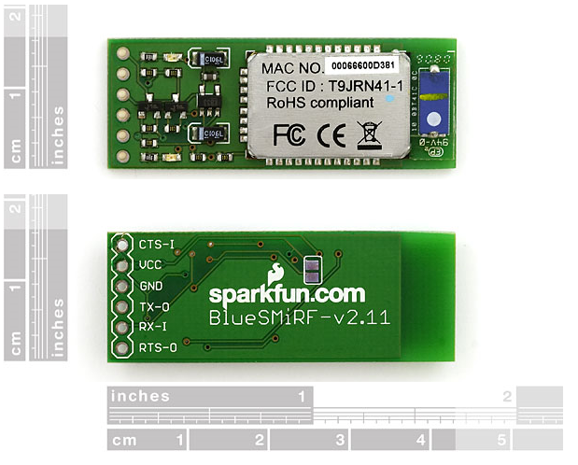
Wireless Module: Bluetooth - BlueSMiRF Gold
$64.95 from Sparkfun Electronics
5V operating voltage
Simple pinout – 6 pins
BT technology doesn’t require line-of-sight
BT Class 1 Device – Range up to 350ft
Integrated compact ceramic antenna

Slide 32
Remote Controller: Requirements
The RC must be able to meet the following specifications:
Cost less than $100 to acquire
Can turn the vehicle left/right
Accelerate the vehicle forward/backward
Put the vehicle in either automatic or manual control mode using a button
Contain feedback device for metal detector component

Slide 33
Remote Controller: Options
 | Wii Remote | PS3 Dualshock 3 Controller | MSI Wind U100 Laptop | Included RC Remote
Connectivity | Bluetooth | Bluetooth | Bluetooth/XBee via dongle | RF
Buttons | 6 digital buttons + 8-way direction pad | 10 analog buttons + 2 digital buttons + 8-way directional pad + 2 analog sticks | 104+ | 2 2-way sticks
Battery Type/Life | 10 hrs | 10 hrs | 4 Hrs | 4 Hrs Est.
Cost | 39.99 | 42.99 | 379.95
Units In Hand | 4 | 0 | 1 | Included with RC Vehicle

Slide 34
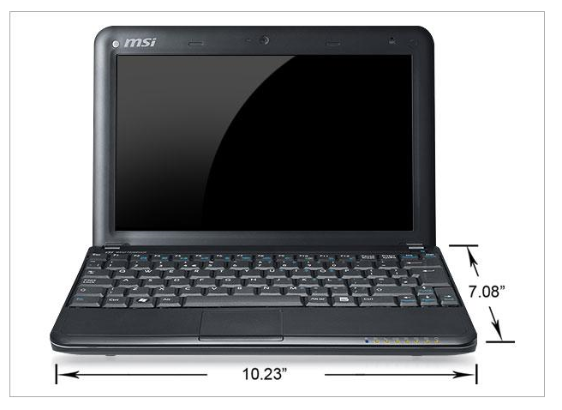
Remote Controller: MSI Wind Netbook
Already on hand
$0 to implement
Can program and control the AMDV via built-in Bluetooth
10-inch LCD screen
4 hour battery life

Slide 35
Microcontroller (MCU): Requirements
The MCU and its development board must meet the following specifications:
Cost under $100, including development board
Use a familiar programming language, like C/C++
Have lots of online free documentation and examples
Sufficient amounts of memory, I/O ports, and processing power
Operating voltage of 5V
MCU must be small, within 10cm x 10cm
Low power consumption

Slide 36
MCU: Options
 | MSP430F2013IN | Atmega328
Company | Texas Instruments | Atmel
Price | $1.90 | $5.50
CPU Architecture | 16-bit RISC | 8-bit RISC
Flash Memory | 2 KB | 32 KB
EEPROM Memory | 256 B | 512 B
RAM | 128 B | 1 KB
I/O Lines | 10 | 23
Temperature Range | -40°C to 85°C | -40°C to 85°C
Operating Voltage | 2.2V - 3.6V | 1.8V -5.5V
Power Consumption - Active | 220µA @ 1Mhz, 2.2V | 300µA @ 1Mhz, 1.8V
Power Consumption - Standby | 0.5µA @ 1Mhz, 2.2V | 0.8µA @ 1Mhz, 1.8V
Power Consumption - Off (RAM Retention) | 0.1µA @ 1Mhz, 2.2V | 0.1 @ 1Mhz, 1.8V
Theoretical Max Power Consumption | 7.7 mW | 10.8 mW
Performance | Up to 16 MIPS @ 16 MHz | Up to 20 MIPS @ 20 MHz
Package | 14 pin PDIP | 28 pin DIP
Dimensions | 19.69(L) x 6.6(W) mm | 37.5(L) x 9.5(W) mm

Slide 37
MCU Development Board: Options
 | eZ430-F2013 | Arduino Duemilanove
MCU | TI MSP430 | Atmel ATmega328
Cost | $20.00 | $29.95
PC Connection | RS232/USB | USB
Power | USB | USB/DC Power Supply
Dimensions | ~65(L) x 20(W) mm | 68.6(L) x 53.3(W) mm
Site | ti-estore.com | SparkFun

Slide 38
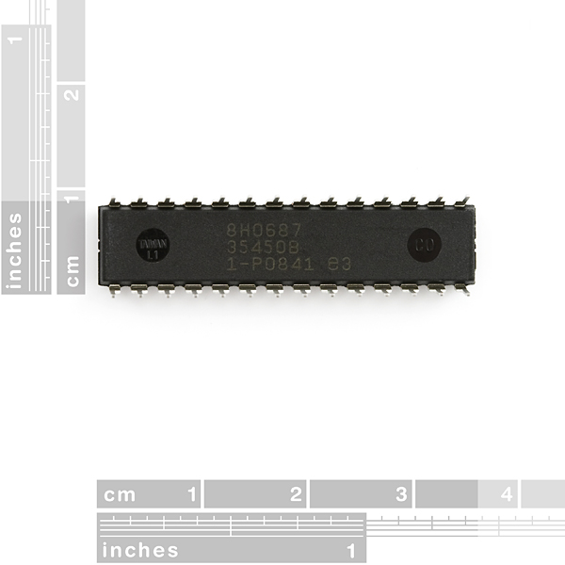
MCU: Atmel ATmega328
Cheap: $5.50 each (for a total of $11.00 for two) from Sparkfun Electronics
Arduino Bootloader
Allows use of same C/C++ code from development board
28 pin DIP package
8-bit RISC @ 16 MHz
32KB of program space
23 I/O Lines
5V Operating Voltage

Slide 39
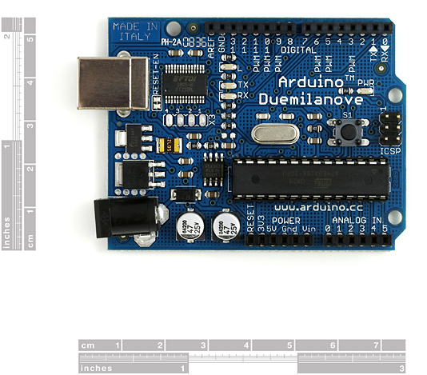
MCU Development Board: Arduino Duemilanove
Cheap: $29.95 from Sparkfun Electronics
USB for power and data
Open Source
C/C++ Compiler
Lots of easily accessible tutorials & examples
http://www.arduino.cc/
http://www.sparkfun.com/commerce/tutorials.php

Slide 40
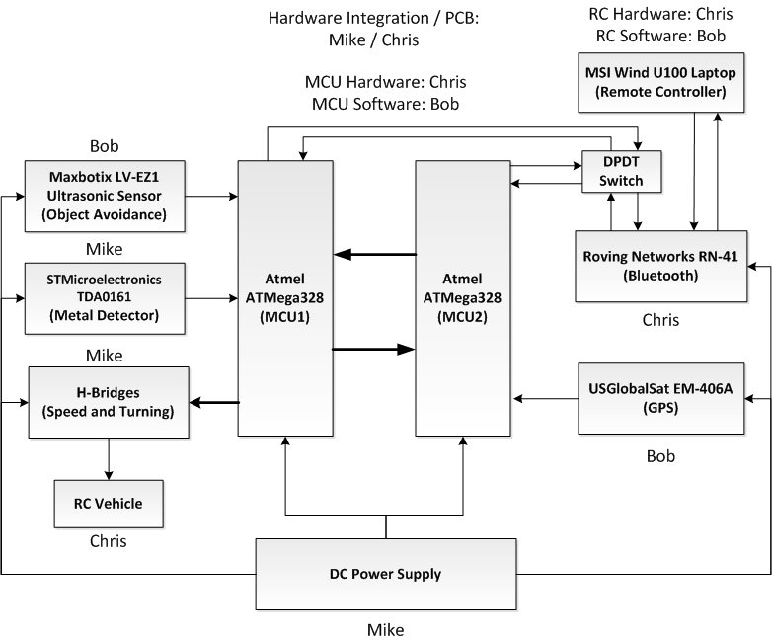
Block Diagram: Top Level Hardware View

Slide 41
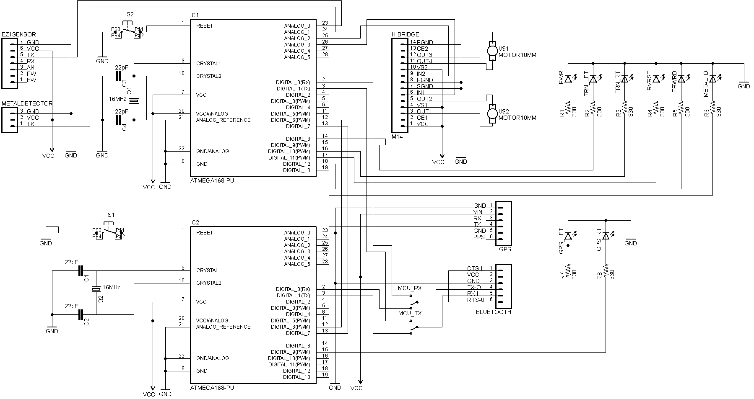
Electrical Schematic

Slide 42
Software

Slide 43
GUI
Used to send and receive information to and from the AMDV via a COMM port on the computer
Event Driven
User mouse and button clicks
Incoming communications from the AMDV
Programmed in Java
Version: JDK 1.6.0_13
IDE: Eclipse 3.4.1

Slide 44
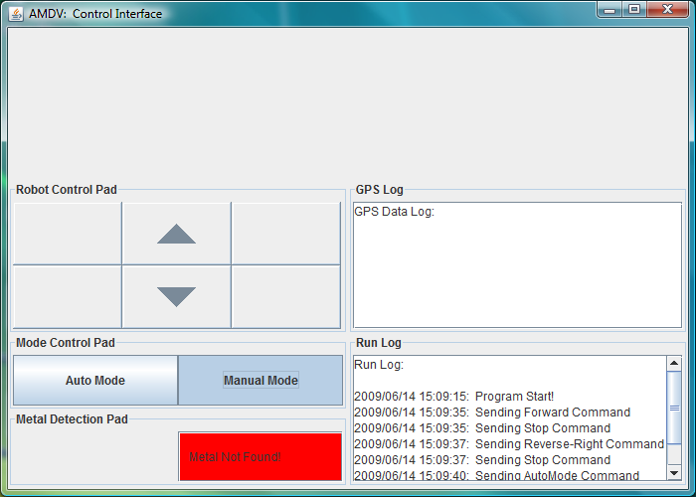
Current GUI (V1.3)

Slide 45
Libraries
Standard Libraries:
Used to create and use the GUI
java.awt.*;
javax.swing.*;
java.awt.event.*;
javax.swing.border.TitledBorder;
javax.swing.plaf.basic.BasicArrowButton;
Used for system date and time
java.text.DateFormat;
java.text.SimpleDateFormat;
java.util.Date;
Used for data storage
java.util.Vector;
Used for serial I/O
javax.comm.*;
java.io.IOException;
java.io.InputStream;
java.io.OutputStream;
Non Standard Libraries:
Javax.comm.*;
Used for communication with computer ports in java
Originally created by Sun Microsystems but no longer supported. Sun recommends a 3rd party library called Rx/Tx.
Rx/Tx didn’t work correctly all the time
Original release still works, so using it

Slide 46
Functions
public static void main(String[] args)
Starts new instance of GUI
public static void run(JApplet applet, int width, int height)
Creates the applet
public void init()
Creates the GUI interface
public void start()
GUI’s actual running function
Currently empty because GUI is event based
public void actionPerformed(ActionEvent buttonPressed)
Called when the auto/manual mode button is pressed
Processes which button was pressed
public void mousePressed(MouseEvent buttonPressed)
Called when mouse is pressed on directional pad
Processes which button was pressed
public void mouseReleased(MouseEvent buttonPressed)
Called when mouse is released
Processes which button was released on directional pad
Required functions but not used:
public void mouseClicked(MouseEvent e)
public void mouseEntered(MouseEvent e)
public void mouseExited(MouseEvent e)
public String currentTime()
Gets the current system time
public void updateRunLog(String message)
Updates the run log
public void updateGPSLog(String message)
Updates the GPS log

Slide 47
Functions (continued)
public void prepCommand(AbstractButton button)
Processes and prepares the command to send to AMDV
public void deactivateManualButtons()
Deactivates the manual control buttons
public void activateManualButtons()
Activates the manual control buttons
public void portSelection()
Prompts user for communication port
public void portNotSelected()
Bad port selection
public void connect ( String portName )
Connects to the AMDV over the chosen port
public boolean sendCommand(int commandID)
Sends the command across the chosen port (data to AMDV)
public void serialEvent(SerialPortEvent arg0)
Reads the communication ports (data from AMDV)

Slide 48
Microcontroller Software
Used to communicate between and control two onboard microcontrollers.
Used to send and receive information to and from the AMDV via a serial Bluetooth connection to a computer.
Programmed in a subset of C
IDE: Arduino alpha V0015

Slide 49
Microcontroller Software
Currently software is being developed as needed to test hardware components
These test beds will serve as a basis for the final software design

Slide 50
Administrative Aspects

Slide 51
Cost Breakdown As of 6/14/09
Part | Estimated Cost | Real Cost
R/C Car (Motors, Frame, Motor Control) | $45.00 | $7.85 (Already Had Frame and Motors)
Metal Detector (Full metal dection circuit) | $15.00 | $10.24
Bluetooth Communication (Computer + AMDV hardware) | $464.95 | $64.95 (Already had computer Bluetooth)
Microcontroller (Development + final hardware) | $40.95 | $40.95
Power Center (Batteries + connections) | $9.00 | $13.72
GPS | $46.99 | $37.59
Sensor | $24.95 | $0.00
Shipping and Tax | $30.00 | $37.23
Total Costs: | $676.84 | $212.53

Slide 52
Progress Overview
Percent Complete

Slide 53
Questions?

