Slide 1
CartRegister
Group 11
Heath Hensley
Oscar Salas
Mike Sieben

Slide 2
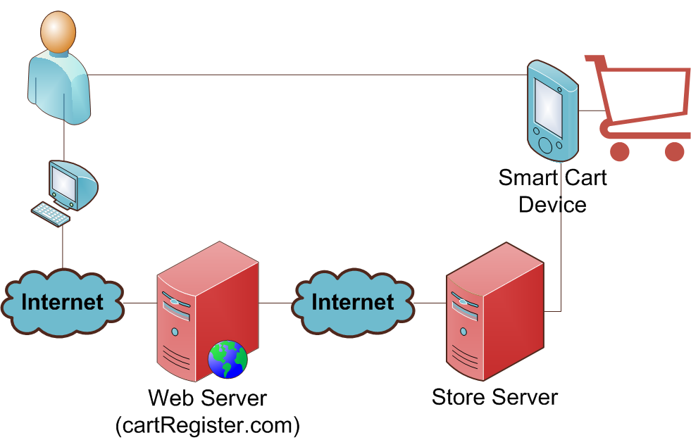
Our Project in Plain English

Slide 3
Motivation and Goals
Facilitate Grocery Shopping
Provide Online Interface to Create Grocery Lists
Reduce Labor Costs
Provide Customer Convenience
Increase Customer Loyalty

Slide 4
Block Diagram & Work Distribution
Web Application
(cartRegister.com)
Store Server Software
Smart Cart Device
Heath
All Members
Oscar - MCU, Firmware
Mike - Hardware

Slide 5
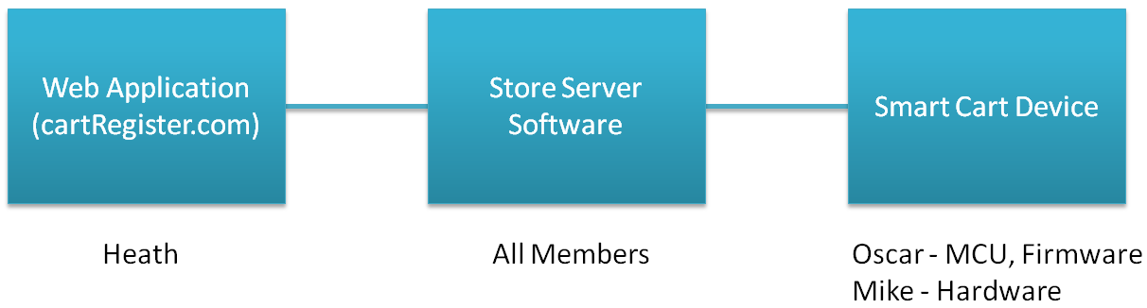
Web Application
Web Application
(cartRegister.com)
Heath

Slide 6
Web Application Goals
Online web interface that is accessible from any computer that has access to the Internet.
Standard Membership based system that will link with store membership card ID’s
Ability to browse through a large inventory of products and easily add and remove them to and from an online shopping list.
Ability to search a database of recipes and easily add all needed ingredients to the shopping list.

Slide 7
Web Application Specifications
Compatibility with all major web browsers (Firefox, IE7, IE8, Chrome, and Safari)
Database storage (minimum requirements for demo purposes):
Items table will contain at least 500 rows (.641 MB)
for production: 650,000 grocery records @ 833.3 MB
10 users with at least 3 lists containing approximately 30 items each
At least 10 recipes, each containing at least 5 items
At least 3 simultaneous users logged into the system

Slide 8
Web Application Development Environment and Technology Used
Visual Studio 2008 (IDE)
Microsoft Visual SourceSafe 2005 (version control)
SQL Server 2008 (database)
C# and ASP.NET 3.5
JavaScript and the JQuery Library
AJAX (asynchronous JavaScript + XML)
HTML and CSS

Slide 9
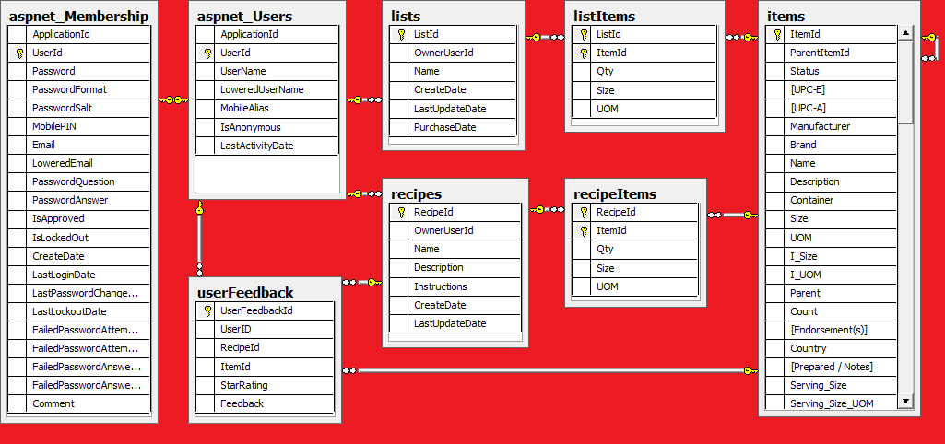
Database Structure

Slide 10
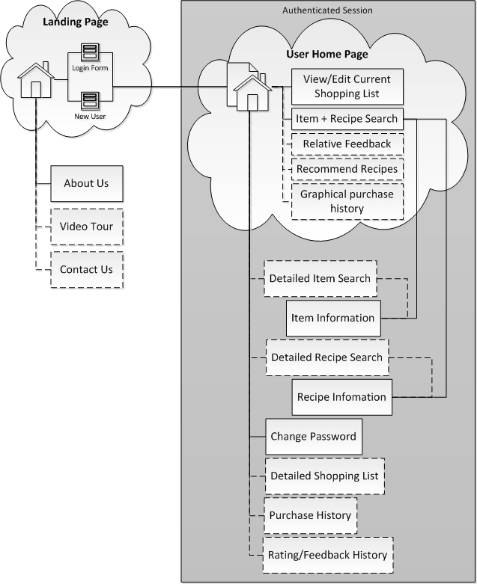
Site Map
Main Landing Page
Information about the website
Login Form
Sign up form
Authenticated Section
User home page
Edit grocery lists
Item & recipe browsing
Account management

Slide 11
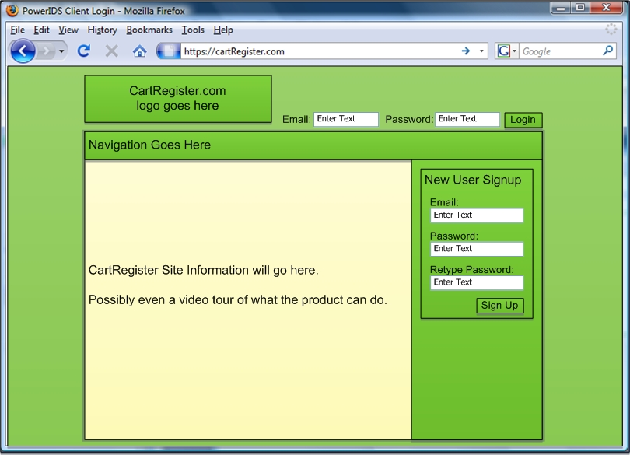
Main Landing Page

Slide 12
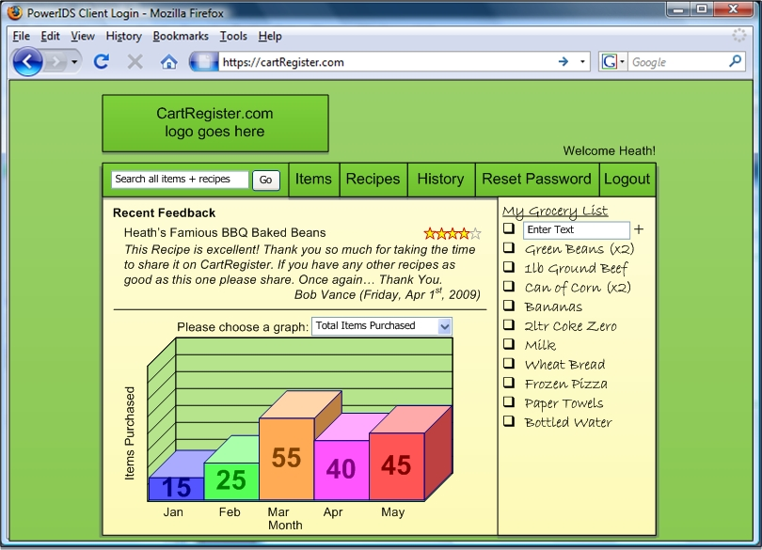
User Home Page

Slide 13
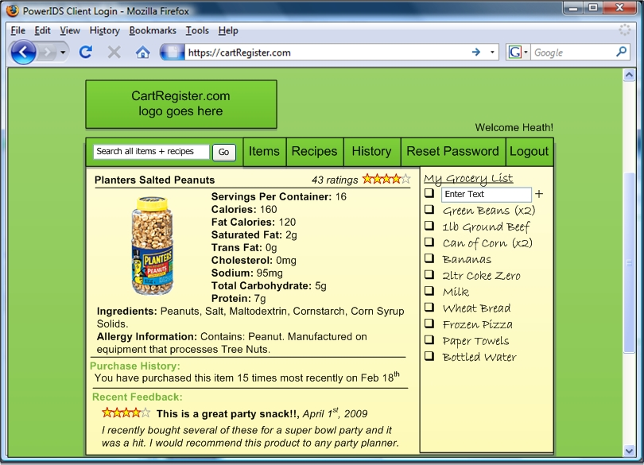
Item Information Page

Slide 14
Store Server
Store Server Software
All Members

Slide 15
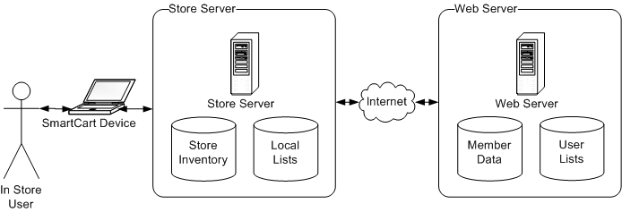
Server Interaction
Objectives of the Store Server
Retrieve and maintain users grocery list
accomplished with the use of a web service
Maintain a list of items in the users cart
Continual communication with the Cart Register Device providing requested information

Slide 16
Success and Challenges with the Web Application and Store Server
Fully functional database
Completed framework for the website
On track with the web application with no major roadblocks
Anxious about the Store Server Software
Area where the team has little to no experience

Slide 17
Smart Cart Device
Smart Cart Device
Oscar - MCU, Firmware
Mike - Hardware

Slide 18
MCU Design Approach
Ability to interface with several peripherals
Relative Easy Programming
Low or no Cost IDE
In Circuit Serial Programming (ICSP)
Reliability
USB interface (2.0)
Abundant Tech information

Slide 19
MCU Selection
 | PIC 18F2455 | Atmel - AT89C1051U | RCM2100 RabbitCore
Pin Count | 28 | 20 | 34
Comp Speed | 48MHz | 24MHz | 24Mhz
Communication | 2.0 USB, UART | UART | RJ-45
Cost | $.3.30 | $3.45 | $89 (full module)
EE Prom | 256 Bytes | 0 | 0
RAM | 2048 K | 512K | 512K
Power | 2V - 5.5V | 2.7 to 6V | 4.75-5.25 V
Development Kit | $46 | $99 | $279

Slide 20
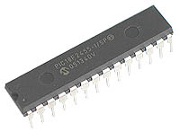
Microcontroller
Microchip PIC18f2455
Low power Consumption: Clocking the Controller from Timer1 or RC oscillator reduced Op. Power by as much as 90%
High computational performance
48 MHz (12MIPS)
Low cost : $3.96 /chip
Total of 28 pins
Affordable Development Key $46 (pick kit 2)
Full Speed USB 2.0 (12Mbit/s) interface
1K byte Dual Port RAM + 1K byte GP RAM
Full Speed USB transceiver
16 Endpoints (IN/OUT)
Internal Pull Up resistors (D+/D-)

Slide 21
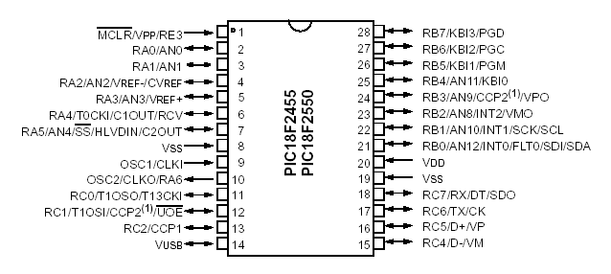
PIC 18F2455 Pin Assignment

Slide 22
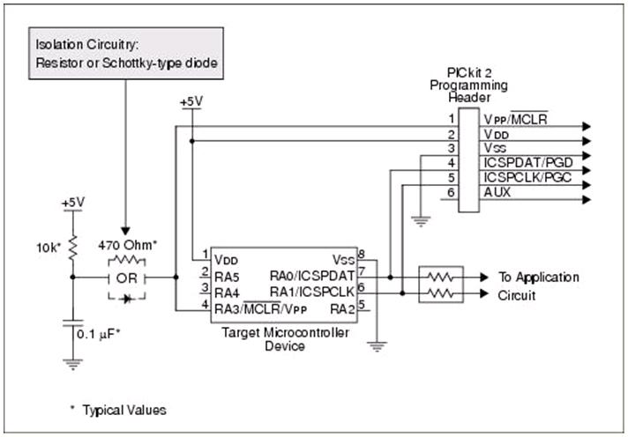
Why ICSP is important?

Slide 23
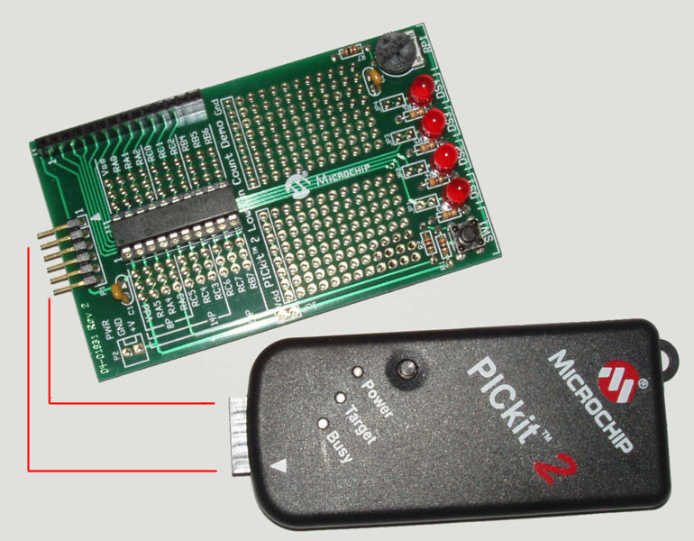
Pick Kit 2

Slide 24
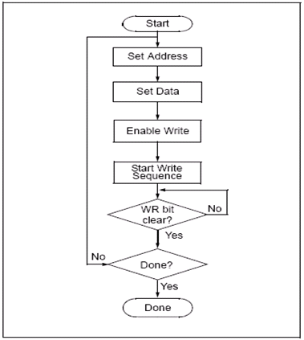
Firmware
MPlab IDE
No cost
Microsoft Compatible Editor
Linker puts together all .obj files
Simulator for source Code
Debugger Interface
Internal C Compiler
Either Assembly or C
Notes:
Where does this section fits better?

Slide 25
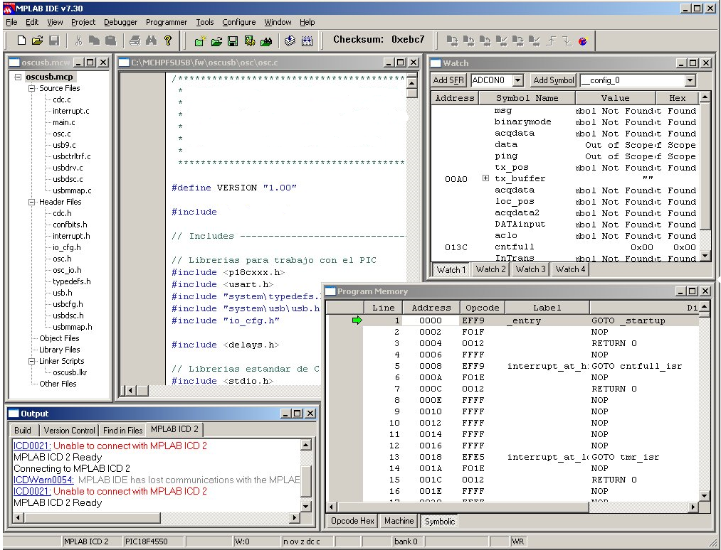
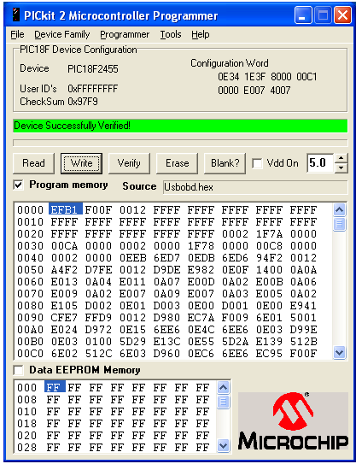
MPlab IDE

Slide 26
MCU Interactive Design
Bar Code : MCU
Customer Enters ID
LCD:MCU
LCD Information
Key Pad:MCU
Key Pad Interface
Xbee:MCU
LCD Information

Slide 27
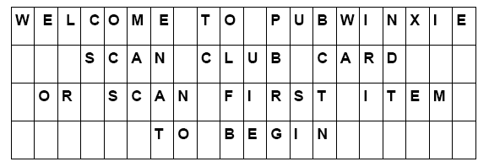
Bar Code Reader- MCU
Customer Scan ID bar code
Transmission to XBee module at 2.4 GHz, data rate 250 Kbps

Slide 28
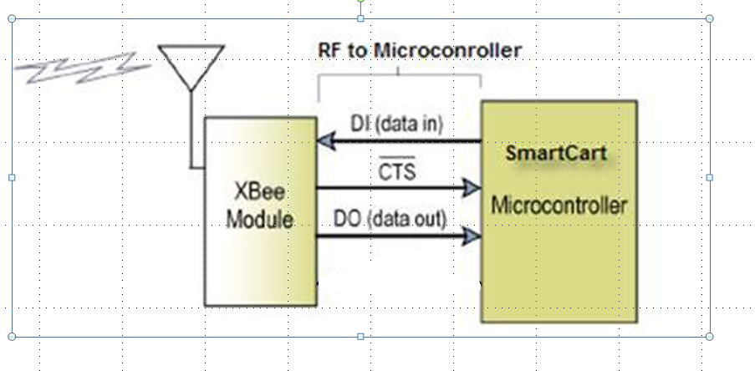
Xbee MCU

Slide 29
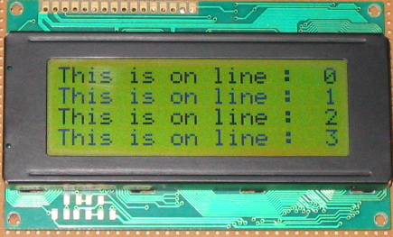
LCD module-MCU
LCD20X4BL
+5 V (5% +/-) power supply. Min (2.7v)
Standard HD 44780 Controller
1/16 duty cycle
Alphanumeric only Backlight feature
High Speed MCU bus interface: 2 MHz

Slide 30
Smart Cart Hardware Specifications
Dimensions: 10” x 7” x 3” max.
Power: 2 W max.
Power Source: Solar Panel plus Internal Battery, rechargeable
Bar Code Reader Port: USB
User Input: Keypad and Bar Code Reader
Display: LCD: 20 characters x 4 lines
Wireless Transceiver:
Frequency: Within Industrial, Scientific, and Medical (ISM) band
Operating Range: At least 10 meters
Bar Code Reader:
Symbology: UPC / EAN
Interface: Decoded data via USB port
Power Source: USB 5 volt source

Slide 31
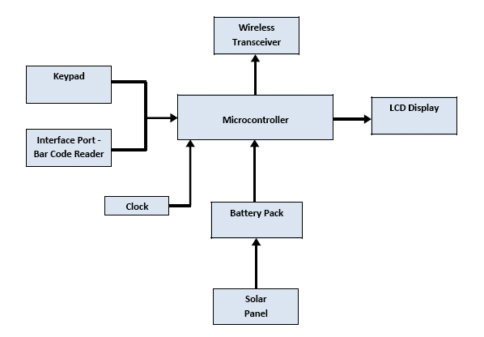
Smart Cart Block Diagram

Slide 32
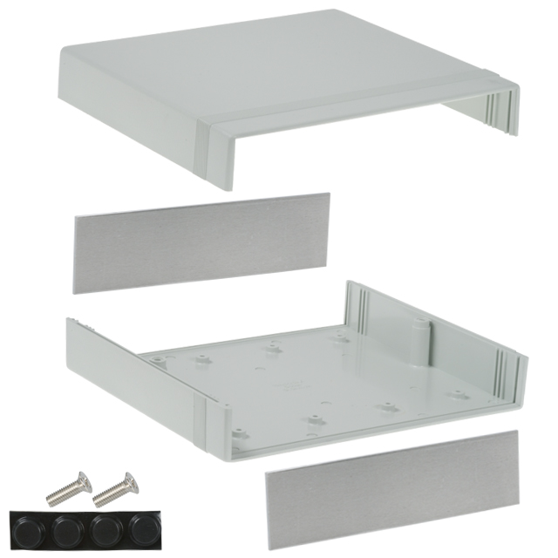
Smart Cart Enclosure
Hammond Manufacturing: 1598DGY 7.1" x 8.1" x 2.5“
Plastic – allows RF transmission – able
to keep RF antenna hidden inside.
Top panel large enough for Solar Panel,
LCD display, and Keypad.
Split sides allows easy access to internal
parts – PCB assembly mounted in
bottom half, Solar Panel, LCD, and
Keypad mounted on top half.

Slide 33
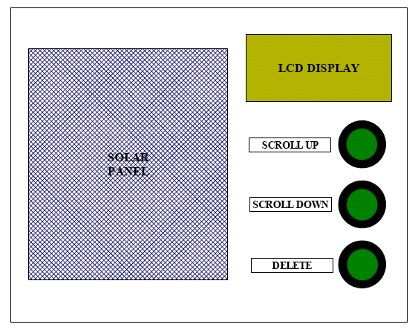
Smart Cart Top Panel Layout

Slide 34
Power Budget
Bar Code Reader: 85mA @ 5v
Battery Charging : 30mA @ 5v
Battery Relay: 30mA @ 5v
LCD Display: 4mA @ 5v
XBee Wireless: 50mA @ 3.3v
Microcontroller: 10mA @ 3.3v
Miscellaneous: 10mA @ 3.3v
Total power = 976 mW = 271mA @ 3.6v

Slide 35
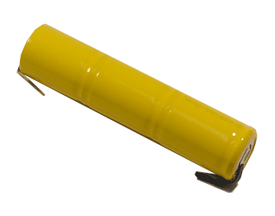
NiCad Battery Pack
Powerizer: CD-4/5Sc3iWT
Also considered NiMH and L-ion
NiCad withstands overcharging
3.6 Volts
Consists of three 1.2 volt cells
1200 mAH Capacity (1200 mAH / 271 mA = 4.43 hours)
Dia 0.93" (24mm) x Length 4" (102 mm)

Slide 36
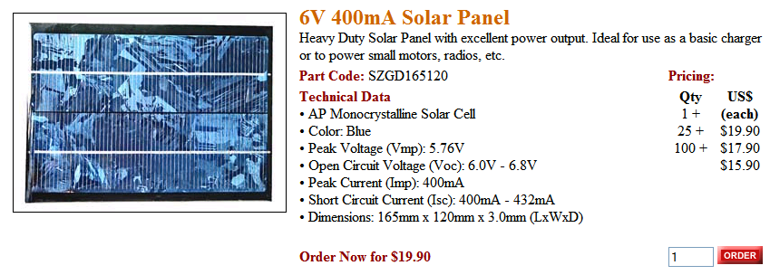
Solar Panel
Ningbo Shenzhou: SZGD165120
Size = 6.5” x 4.7”
Peak Voltage = 5.76 v
Peak Current = 400 mA
Max. power output = 5.76 v x 400mA = 2.3 W
(Smart Cart power consumption = 0.976 W)

Slide 37
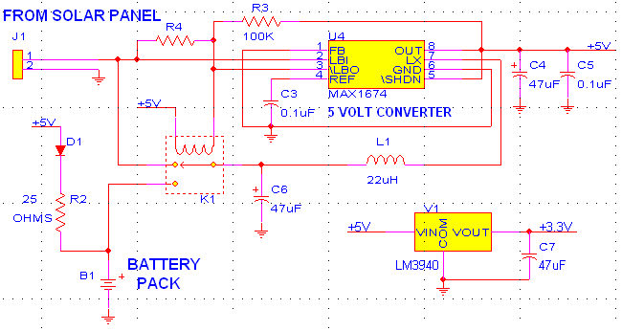
Power Circuit Diagram

Slide 38
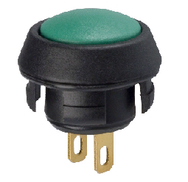
Keypad Pushbutton Switches
(3) Grayhill: 30-102
Momentary Pushbutton Contact
Easy Snap-in Assembly
Solder Tabs for wire attachment

Slide 39
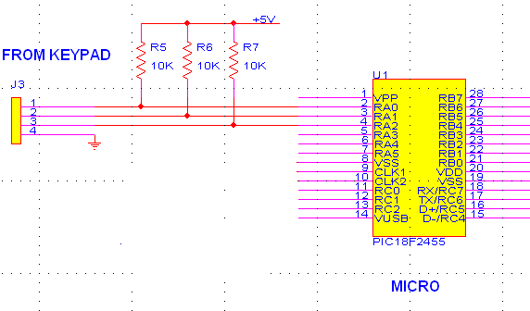
Keypad Circuit Diagram

Slide 40
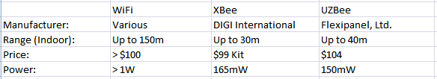
Wireless Transceivers
Looked at 3 options:
WiFi
XBee
UZBee
XBee chosen for low power and domestic manufacturer

Slide 41
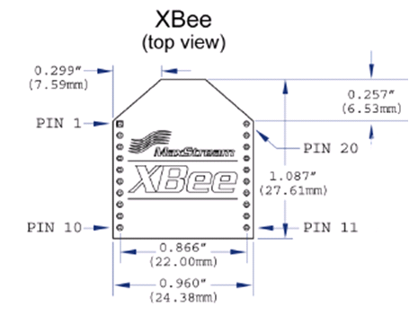
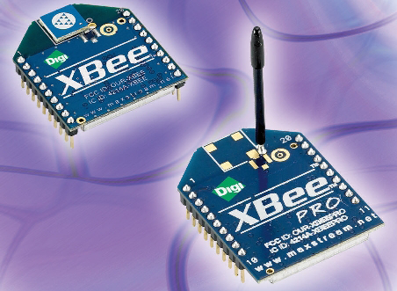
Wireless Module Digi International: XBee
Uses 802.15.4 Standard (Zigbee)
Frequency = 2.4 GHz Band
Range up to 30 meters indoors
50mA peak current consumption Transmit or Receive
Available USB Interface Card
Starter Kit includes 2 XBee modules and 2 interface cards for $99
(Reprinted with permission from Digi International)

Slide 42
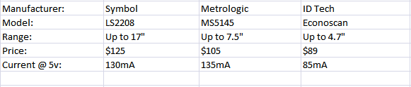
Bar Code Readers
Looked at 3 options:
Symbol: LS2208
Metrologic: MS5145
ID Tech: Econoscan
ID Tech Econoscan chosen for low power and low cost

Slide 43
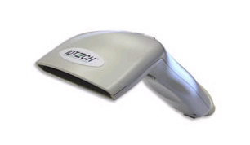
Bar Code Reader ID Tech: EconoScanTM
Features:
Handheld Trigger for Easy, Intuitive Activation
USB Interface Port with Integral Power Source
Operating Current Only 85 mA
Scanning Distance up to 4.7”
Reads all Standard Bar Codes, including UPC/EAN
Cost = $89
(Reprinted with permission from ID Tech)

Slide 44
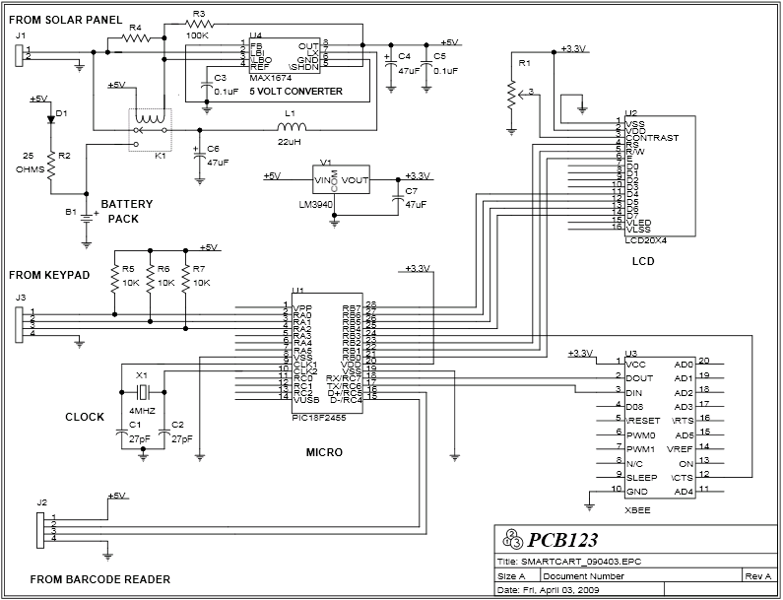
Circuit Schematic Diagram

Slide 45
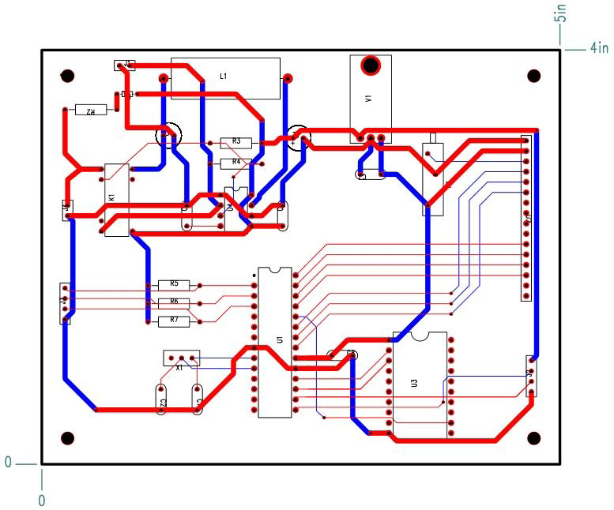
Circuit Board Layout
Generated using PCB123 free layout software from Sunstone Circuits.
Will likely order from Advanced Circuits (4PCB.com) using $33 student special.

Slide 46
Successes and Challenges of Smart Cart
XBee wireless transceiver tested.
Strong signal over 10 meter range.
Weaker signal above 10 meters.
Power supply circuit tested.
Works with solar panel or battery input.
5 volt and 3.3 volt regulation works.
Battery charging with solar panel input works.
The relay for switching from solar to battery not yet working.
MAX1674 chip LBO output cannot sink 30mA for relay.
Need to add a transistor to drive the relay.

Slide 47
Task Completion for Project

Slide 48
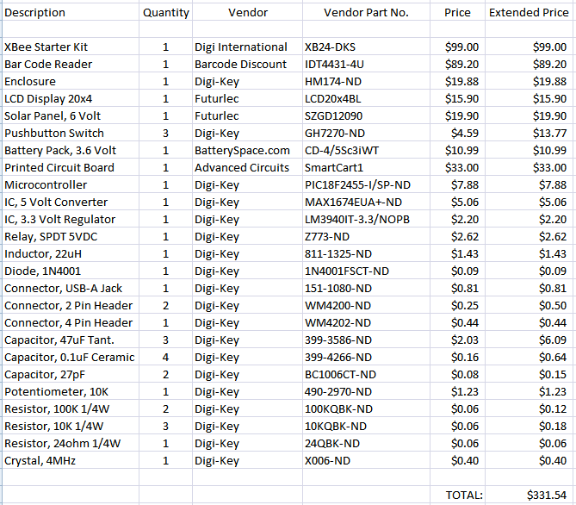
Bill of Material

Slide 49
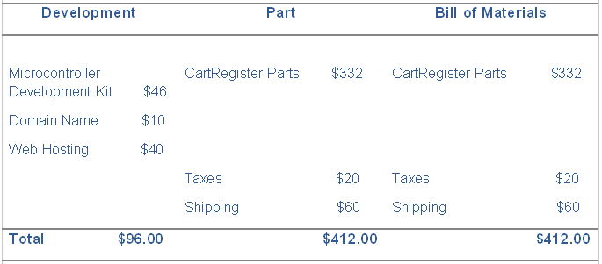
Project Budget
Total Project Cost Estimate = $508.00

Slide 50
Conclusion
The project is on track.
Need to work on Server interface software.
Still need to order PCB, finish coding software, build and test final prototype.

Slide 51
The End

