Slide 1
CartRegister
Group 11
Heath Hensley
Oscar Salas
Mike Sieben

Slide 2
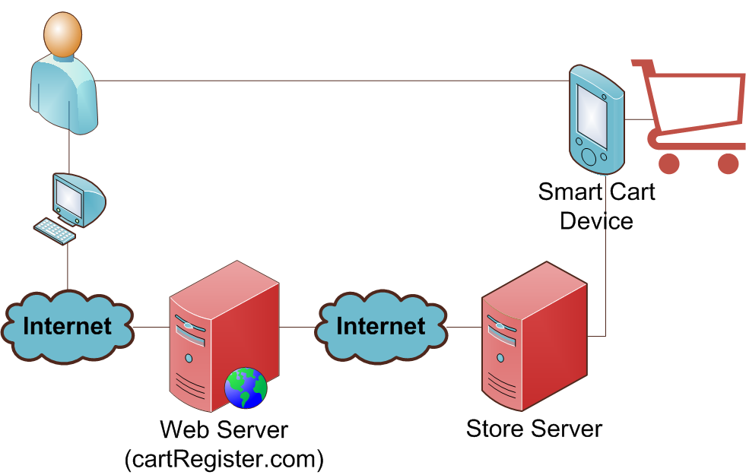
Our Project in Plain English

Slide 3
Motivation and Goals
Facilitate Grocery Shopping
Provide Online Interface to Create Grocery Lists
Reduce Labor Costs
Provide Customer Convenience
Increase Customer Loyalty

Slide 4
Block Diagram & Work Distribution
Web Application
(cartRegister.com)
Store Server Software
Smart Cart Device
Heath
All Members
Oscar - MCU, Firmware
Mike - Hardware

Slide 5
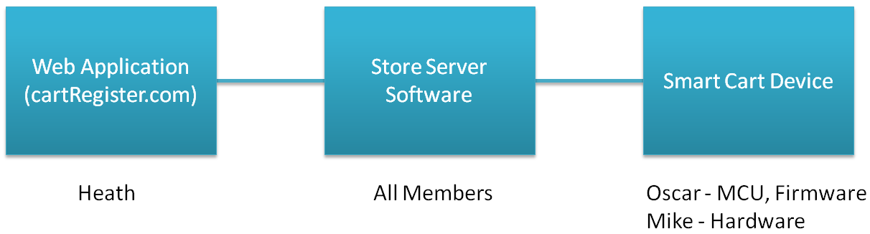
Web Application
Web Application
(cartRegister.com)
Heath

Slide 6
Web Application Goals
Online web interface that is accessible from any computer that has access to the Internet.
Standard Membership based system that will link with store membership card ID’s
Ability to browse through a large inventory of products and easily add and remove them to and from an online shopping list.
Ability to search a database of recipes and easily add all needed ingredients to the shopping list.

Slide 7
Web Application Specifications
Compatibility with all major web browsers (Firefox, IE7, IE8, Chrome, and Safari)
Database storage (minimum requirements for demo purposes):
Items table will contain at least 500 rows (.641 MB)
for production: 650,000 grocery records @ 833.3 MB
10 users in the system
10 lists containing approximately 20 items each
At least 10 recipes, each containing at least 5 items

Slide 8
Web Application Development Environment and Technology Used
Visual Studio 2008 (IDE)
Microsoft Visual SourceSafe 2005 (version control)
SQL Server 2008 (database)
C# and ASP.NET 3.5
JavaScript and the JQuery Library
AJAX (asynchronous JavaScript + XML)
HTML and CSS

Slide 9
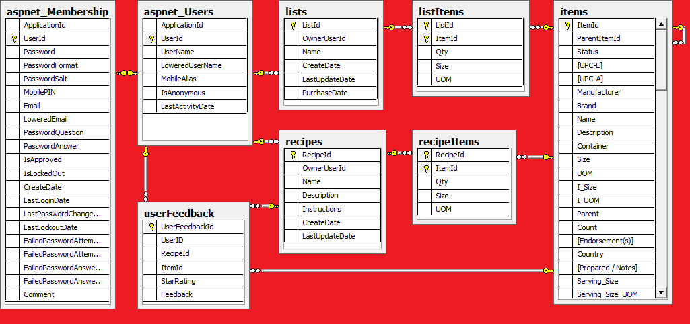
Database Structure

Slide 10
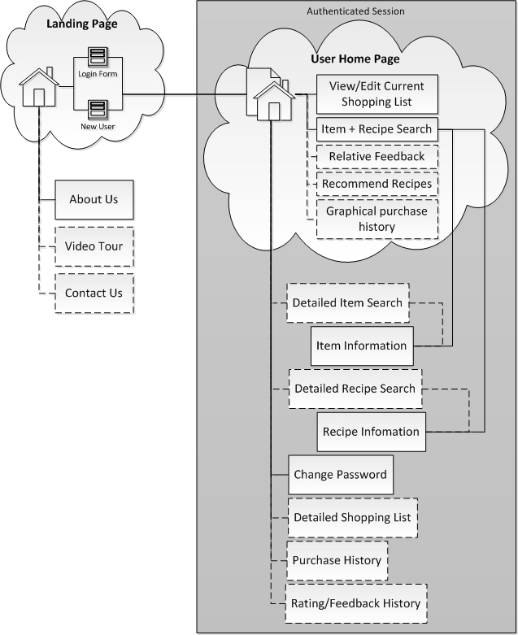
Site Map
Main Landing Page
Information about the website
Login Form
Sign up form
Authenticated Section
User home page
Edit grocery lists
Item & recipe browsing
Account management

Slide 11
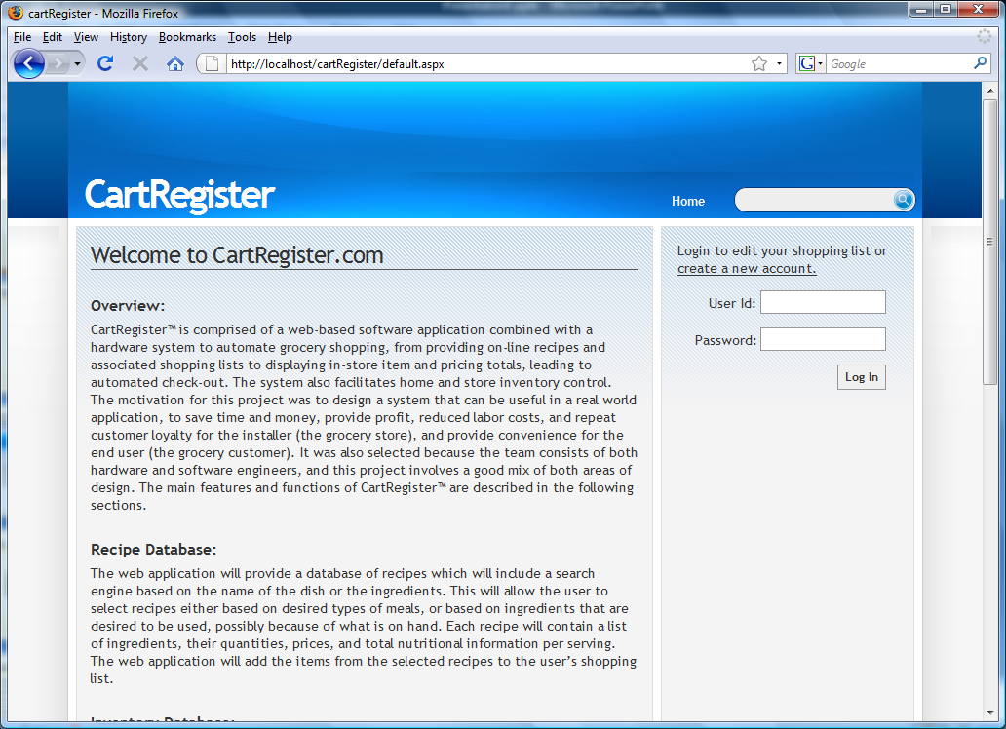
Main Landing Page

Slide 12
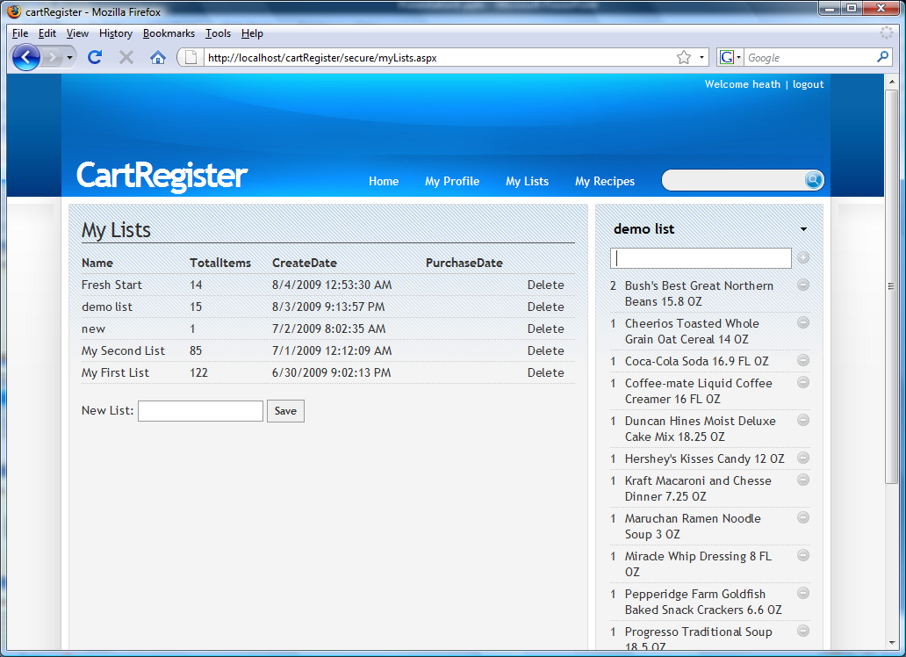
My Lists Page

Slide 13
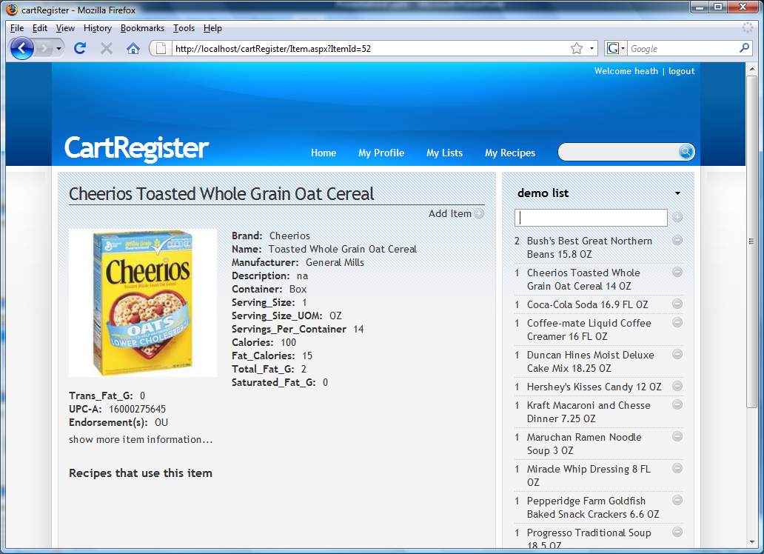
Item Information Page

Slide 14
Store Server
Store Server Software
All Members

Slide 15
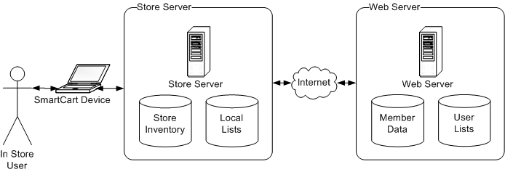
Server Interaction
Objectives of the Store Server
Retrieve and maintain users grocery list
accomplished with the use of a web service
Maintain a list of items in the users cart
Continual communication with the Cart Register Device providing requested information

Slide 16
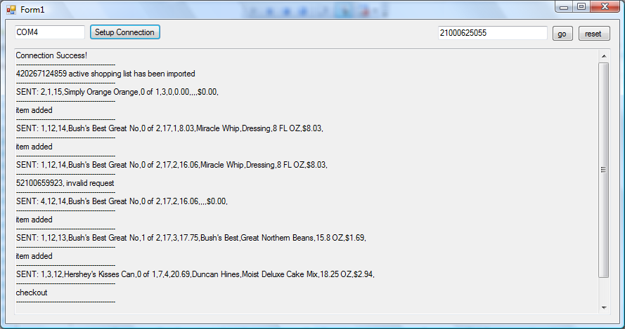
Store Server Testing environment

Slide 17
Smart Cart Device
Smart Cart Device
Oscar - MCU, Firmware
Mike - Hardware

Slide 18
MCU Design Approach
Ability to interface with several peripherals
Relative Easy Programming
Low or no Cost IDE
In Circuit Serial Programming (ICSP)
Reliability
UART interface
Abundant Tech information

Slide 19
MCU Selection
 | PIC 18F2455 | Atmel - AT89C1051U | RCM2100 RabbitCore
Pin Count | 28 | 20 | 34
Comp Speed | 48MHz | 24MHz | 24Mhz
Communication | 2.0 USB, UART | UART | RJ-45
Cost | $3.96 | $3.45 | $89 (full module)
EE Prom | 256 Bytes | 0 | 0
RAM | 2048 K | 512K | 512K
Power | 2V - 5.5V | 2.7 to 6V | 4.75-5.25 V
Development Kit | $46 | $99 | $279

Slide 20
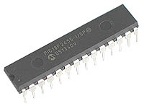
Microcontroller
Microchip PIC18f2455
Low power Consumption: Clocking the Controller from Timer1 or RC oscillator reduced Op. Power by as much as 90%
High computational performance
48 MHz (Smart Cart runs at 8MHz)
Total of 28 pins
Affordable Development Kit $46 (PICkit 2)
1K byte Dual Port RAM + 1K byte GP RAM
16 Endpoints (IN/OUT)

Slide 21
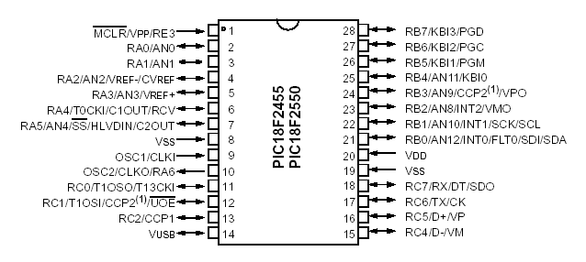
PIC 18F2455 Pin Assignment

Slide 22
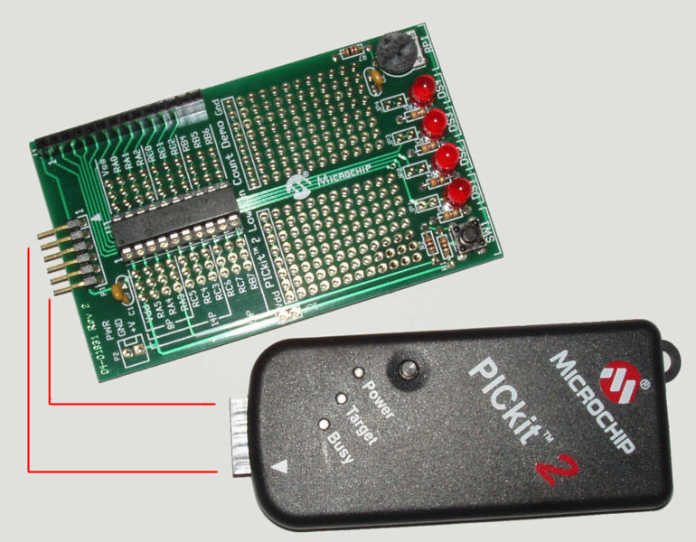
Pic Kit 2

Slide 23
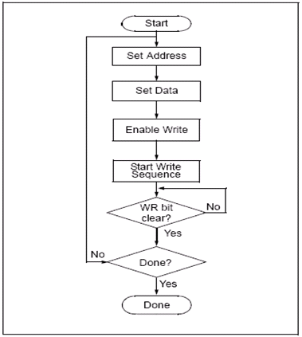
Firmware
MPlab IDE
No cost
Microsoft Compatible Editor
Linker puts together all .obj files
Simulator for source Code
Debugger Interface
Internal C Compiler
Either Assembly or C
Notes:
Where does this section fits better?

Slide 24
MCU firmware sequence
Power Up
Welcome Screen
Bar Code Reader Input
Send Data to Server
Receive Data From Server
5
Mode
4
2
Display “Invalid Barcode”
Display Last Item Scanned
3
1
Display “Invalid Delete Item”
Display Splash Screen
0
Display Next Item on List

Slide 25
Firmware operation
Main Program: Welcome Screen is displayed, then the 3 Pushbutton digital inputs on Port A are polled in a continuous loop.
UART Input from Bar Code Reader results in an interrupt service routine:
1. Bar Code data is received from the UART and stored in internal RAM.
2. Bar Code data is output on UART to XBee for wireless transmission to Store Server.
3. UART input port (RX) is switched to XBee to receive shopping list data from Store Server.
4. Data from server received, and displayed on LCD.
Mode number tells Smart Cart what data to display and in what format.
5. UART input port (RX) switched to Bar Code Reader.
6. Program goes back into polling loop.
If Scroll Up (↑) or Scroll Down (↓) is pressed, a message is sent to the Server. Server sends previous or next item data.
If Delete (X) is pressed, the Delete Message is displayed, waits for Bar Code.
1. If Bar Code is received, the data is sent to Server with a minus sign to tell it to delete.
2. Server sends new data with item removed.
OR
3. User presses Delete again, and previous shopping data is displayed.

Slide 26
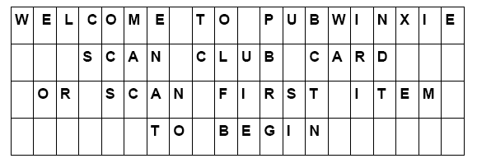
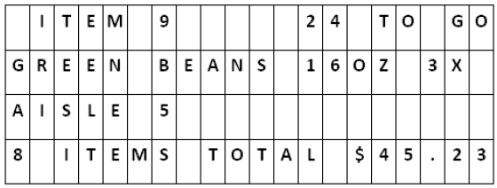
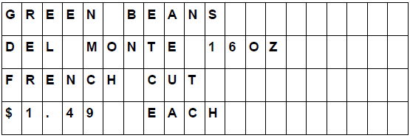
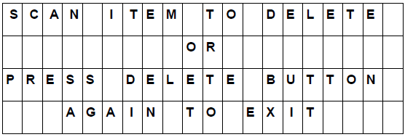
Smart cart display screens
Welcome Screen
Normal Mode Screen
Splash Screen
Delete Mode Screen

Slide 27
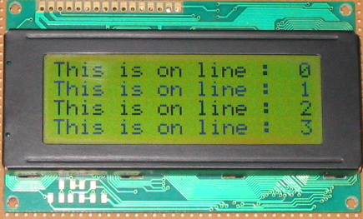
LCD module
LCD20X4BL
+5 V (5% +/-) power supply. Min (2.7v)
Standard HD 44780 Controller
Alphanumeric only
High Speed MCU bus interface: 2 MHz

Slide 28
Smart Cart Hardware Specifications
Dimensions: 7.1” x 8.1” x 2.5”
Power: Less than 1 Watt
Power Source: Solar Panel plus rechargeable Internal Battery
Bar Code Reader Port: RS-232 (9 Pin Connector)
User Inputs: Bar Code Reader and Pushbutton Keypad
Display: LCD, 20 characters x 4 lines
Wireless Transceiver:
Frequency: Within Industrial, Scientific, and Medical (ISM) band
Operating Range: At least 10 meters
Bar Code Reader:
Symbology: UPC
Interface: RS-232 port
Power Source: 5 volts on RS-232 connector pin 9

Slide 29
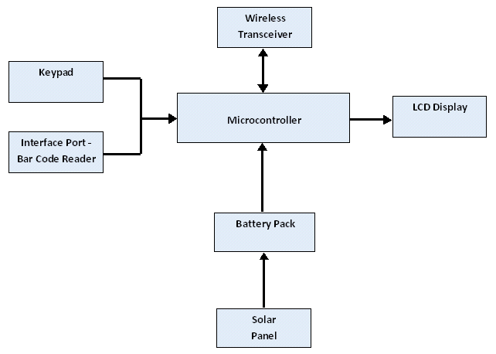
Smart Cart Block Diagram

Slide 30
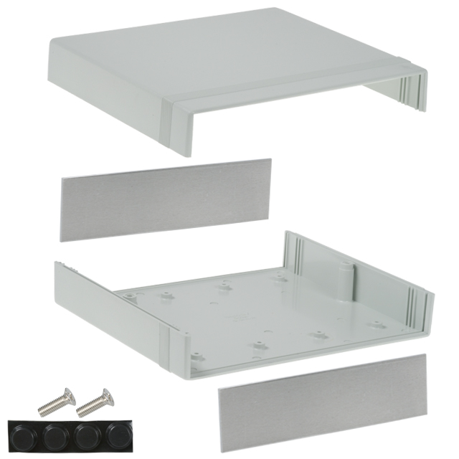
Smart Cart Enclosure
Hammond Manufacturing: 1598DGY 7.1" x 8.1" x 2.5“
Plastic – allows RF transmission – able
to keep RF antenna hidden inside.
Top panel large enough for Solar Panel,
LCD display, and Keypad.
Split sides allows easy assembly –
PCB and batteries in bottom half.
Solar Panel, LCD, and Keypad
mounted on top half.

Slide 31
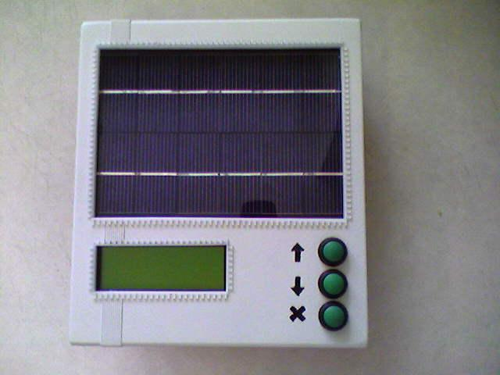
Top Panel Layout

Slide 32
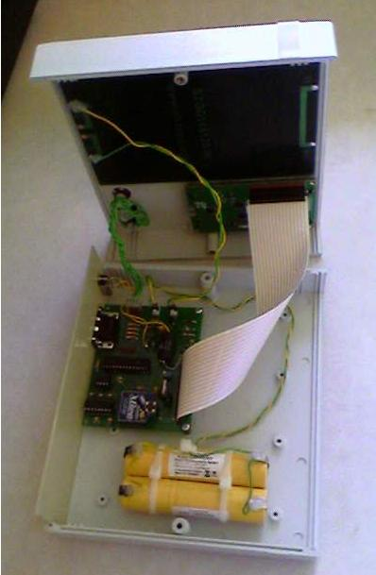
What’s inside
PUSHBUTTONS
SOLAR PANEL
POWER SWITCH
LCD DISPLAY
RS-232 CONNECTOR
CIRCUIT BOARD
BATTERY PACKS

Slide 33
Power Budget
Bar Code Reader: 85mA @ 5v
Microcontroller: 10mA @ 5v
Miscellaneous: 10mA @ 5v
LCD Display: 4mA @ 5v
XBee Wireless: 40mA @ 5v (Before 3.3v Regulator)
Total: 149mA @ 5v
Conversion Efficiency ~ 90% ► 149mA / 0.90 = 166mA @ 5v
Total power = 830mW = 230mA @ 3.6v (Battery voltage)

Slide 34
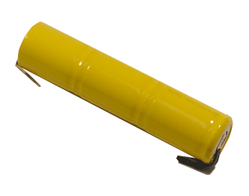
NiCad Battery Pack
Powerizer: CD-4/5Sc3iWT
Also considered NiMH and L-ion
NiCad withstands overcharging
3.6 Volts
Consists of three 1.2 volt cells
Smart Cart uses 2 Battery Packs in parallel
2x 1200 mAH Capacity (2400 mAH / 230 mA = 10.4 hours)
Dia 0.93" (24mm) x Length 4" (102 mm)

Slide 35
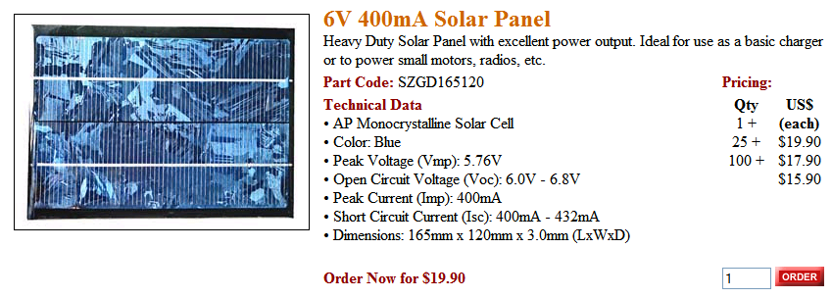
Solar Panel
Ningbo Shenzhou: SZGD165120
Size = 6.5” x 4.7”
Peak Voltage = 5.76 v
Peak Current = 400 mA
Max. power output = 5.76 v x 400mA = 2.3 W
(Smart Cart power consumption = 0.830 W)

Slide 36
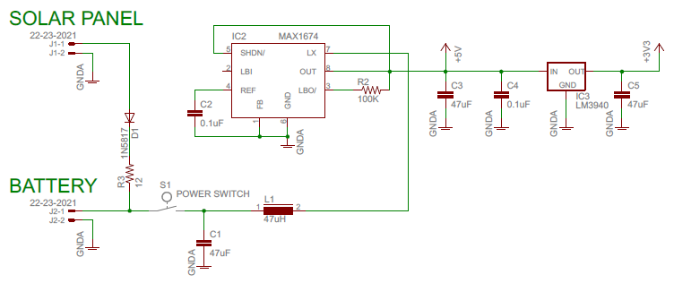
Power Circuit Diagram

Slide 37
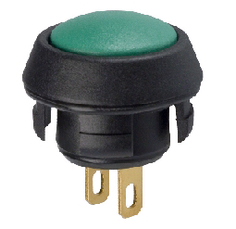
Keypad Pushbutton Switches
(3) Grayhill: 30-102
Momentary Pushbutton Contact
Snap-in Assembly

Slide 38
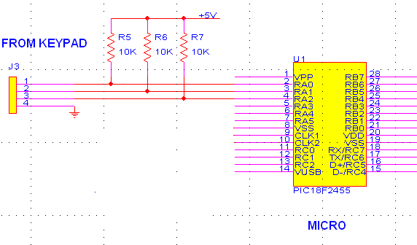
Keypad Circuit Diagram

Slide 39
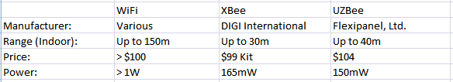
Wireless Transceivers
Looked at 3 options:
WiFi
XBee
UZBee
XBee chosen for low power and domestic manufacturer

Slide 40
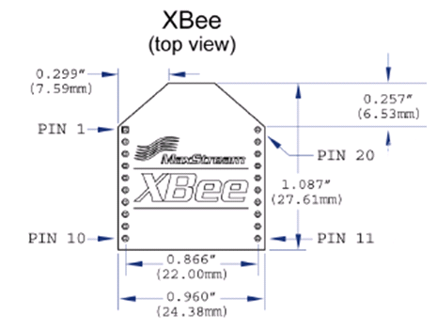
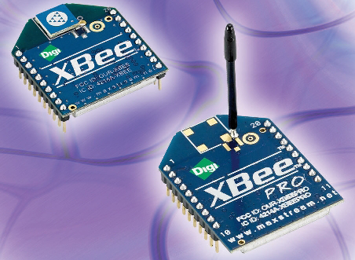
Wireless Module Digi International: XBee
Uses 802.15.4 Standard (Zigbee)
Frequency = 2.4 GHz Band
Range up to 30 meters indoors
40mA peak current consumption Transmit or Receive
Available USB Interface Card
Starter Kit includes 2 XBee modules and 2 interface cards for $99
(Reprinted with permission from Digi International)

Slide 41
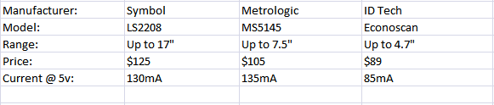
Bar Code Readers
Looked at 3 options:
Symbol: LS2208
Metrologic: MS5145
ID Tech: Econoscan
ID Tech Econoscan chosen for low power and low cost

Slide 42
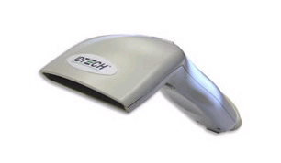
Bar Code Reader ID Tech: EconoScanTM
Features:
Handheld Trigger for Easy, Intuitive Activation
USB or RS-232 Interface Port with Integral Power Source
Operating Current Only 85 mA at 5 Vdc
Scanning Distance up to 4.7”
Reads all Standard Bar Codes, including UPC/EAN
Cost = $89
(Reprinted with permission from ID Tech)

Slide 43
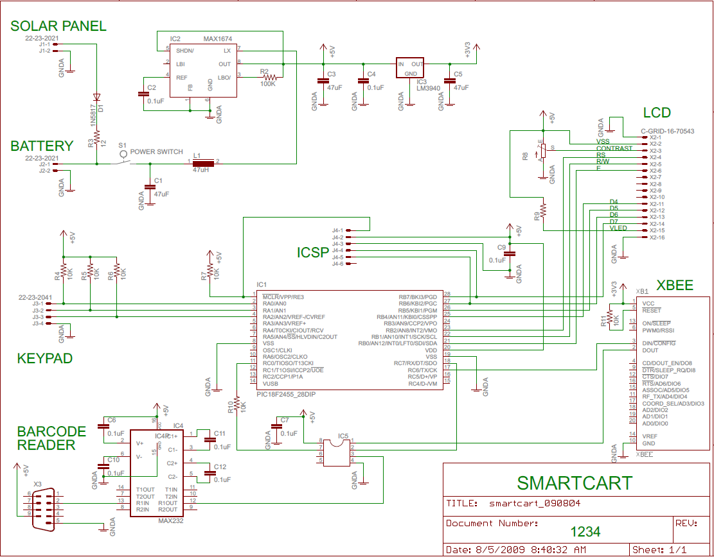
Circuit Schematic Diagram

Slide 44
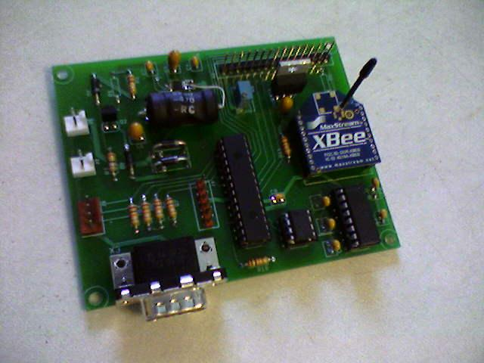
Circuit Board
Generated using free version of Eagle layout software from CadSoft.
Ordered from Advanced Circuits (4PCB.com) using $33 student special.

Slide 45
Testing of Smart Cart
XBee wireless transceiver tested.
Strong signal over 10 meter range.
Weaker signal above 10 meters.
Power supply circuit tested.
Works with battery input.
5 volt and 3.3 volt regulation works.
Battery charging with solar panel input works.
LCD, RS-232 port, Pushbuttons, and XBee all tested during microcontroller programming phase.
Analog Switch tested to switch the UART input between bar code reader and XBee.
Final testing of Smart Cart performed with complete system.

Slide 46
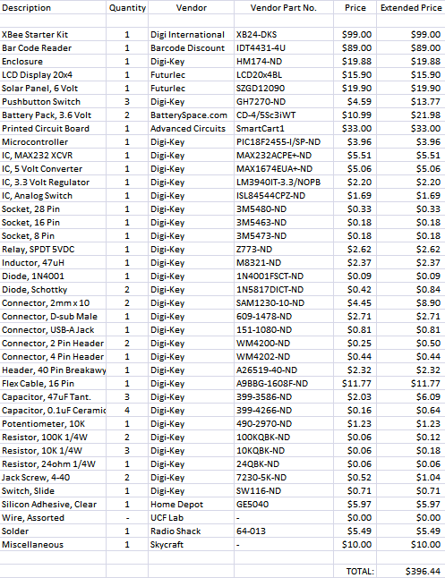
Bill of Material
$396.44

Slide 47
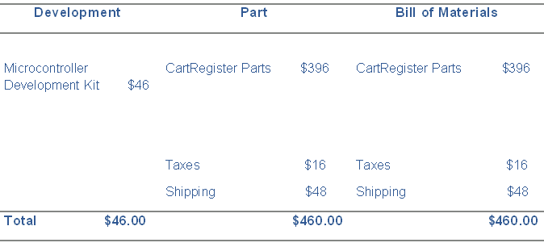
Project Budget
Total Project Cost = $506.00

Slide 48
Conclusion
The project works substantially as planned.
Hardware and software development complete.
Lessons learned and experience gained designing and building a “real world” system.

Slide 49
The End

