Slide 1
Pool Boy
Group 3
Paul Setlak Ivan Latorre Mitch Lienau Robert Sers
Sponsored by CEI

Slide 2
Motivation
Relieve the burden of pool maintenance on the owner
Unchecked pools require more resources to recover
Reduce dependence on harsh chemicals like chlorine
Low cost consumer solution

Slide 3
Project Desription
A system that will automatically monitor and adjust chemicals to the pool daily
Early identification of pool water imbalances
Two basic elements of pool maintenance
Saturation Index
Water Purification

Slide 4
Requirements and Specifications
Requirements | Specifications
Low power maintenance | Low power components
Component longevity | Lalinger Saturation Index
Water purification | Ionizer and chlorine
Easy user access | Remote interface unit

Slide 5
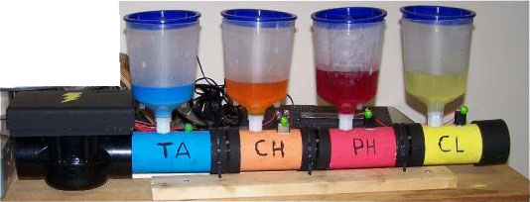
Chemical adjustment reservoir
Electronic Valve
Chemical Sensor
Ionizer and
Microcontroller
unit
To Pool
From Filter
Total Alkalinity
Calcium hardness
pH
Chlorine
Filter
Pool
Pump

Slide 6
1
Unit self-check
Start
2
Water Validation
3
Water Purification
1
Check System Levels
Fail
Reorder Notification
Sleep
To Start
Fail
Low
Pass
Low
2
Test Water
Adjust Levels
Chemical Dispersion Sleep
To Start
Fail
Pass
3
Ion scheduler
Run Ionizer Period
To Start
Yes
No
To Start

Slide 7
1
Unit self-check
1
Check System Levels
Fail
Reorder Notification
Sleep
To Start
Fail
Low
Pass
Low
2

Slide 8
Water Validation
2
1
Pass
Low
2
Test Water
Adjust Levels
Chemical Dispersion Sleep
To Start
Fail
Pass
3

Slide 9
3
Water Purification
2
Pass
3
Ion scheduler
Run Ionizer Period
To Start
Yes
No
To Start

Slide 10
Pool Maintenance

Slide 11
Two main components
Langelier Saturation Index for component longevity
Water Sanitation for safe human use

Slide 12
Langelier Saturation Index
Saturation Index = pH + calchd + totak + temp - 12.1
 | To Lower | To Raise
Ph | Muriatic acid | Soda ash
TA | Hydrochloric acid | Sodium bicarbonate
Calcium hardness | Replace water (backwash) | Calcium Chloride
Decrease TA | GALLONS IN POOL
(ppm) | 1,000 | 5,000 | 10,000 | 15,000 | 20,000 | 25,000 | 50,000
10 | 2.56 oz. | 0.8 pts. | 0.8 qts. | 1.2 qts. | 1.6 qts. | 2.0 qts. | 1 gal.
20 | 5.12 oz. | 1.60 pts. | 1.6 qts. | 2.4 qts. | 3.2 qts. | 1.0 gal. | 2 gal.
30 | 7.68 oz. | 1.2 qts. | 2.4 qts. | 3.6 qts. | 1.2 gal. | 1.5 gal. | 3 gal.
40 | 10.24 oz. | 1.6 qts. | 3.2 qts. | 1.2 gal. | 1.6 gal. | 2.0 gal. | 4 gal.
50 | 12.80 oz. | 2.0 qts. | 1.0 gal. | 1.5 gal. | 2.0 gal. | 2.5 gal. | 5 gal.

Slide 13
Water Sanitation
Traditional chlorine
Salt to chlorine generator
Ionization

Slide 14
Sanitation Methods
 | Copper Ionization | Salt Water | Chlorine
Free Chlorine, ppm | .4-.8 | 2.0-4.0 | 1.0-3.0
pH | 7.2-7.6 | 7.2-7.6 | 7.4-7.6
Total Alkalinity, ppm | 80-120 | 80-100 | 80-100
Total Dissolved Solids, ppm | 750-1500 | 1000-2000 | 1000-2000
Calcium Hardness, ppm | 225-375 | 200-400 | 200-400
Copper Ions, ppm | .3-.4 | N/A | N/A
Cyanuric Acid, ppm | N/A | 60-80 | 60-80
Salinity, ppm | N/A | 2500-4000 | N/A
Notes:
Fix slide to compare chemicals that change

Slide 15
Component Overview
Ionizer
Sensors
Reservoirs / Valves
Microcontroller
Wireless Communication
Control Panel
Power
PCB

Slide 16
Ionizer

Slide 17
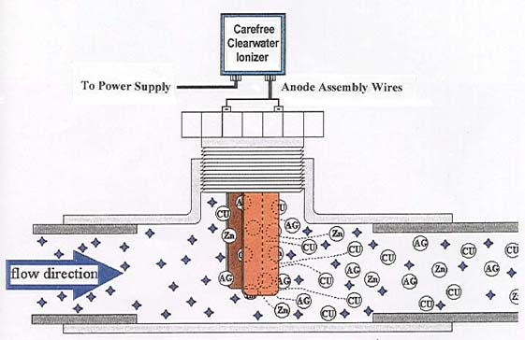
Ionizer
Input Voltage: 120 V AC
Output Voltage: 3-10 V DC
Output Current: 8 A
Electrode Lifetime: 3-5 years

Slide 18
Sensors
The nervous system of the Pool Boy

Slide 19
Components for Pool Measurements
Pressure Switch
Temperature Sensor
Calcium Ion-Selective Electrode
ORP Sensor
Conductivity Sensor
Copper Ion-Selective Electrode
pH Sensor

Slide 20
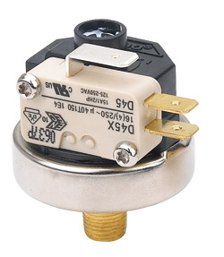
Pressure Switch
Media: gas, liquid or steam
Operating Pressure: 21.5-58 PSI
Differential: 3+- 1.5PSI
Switch Type: single pole double throw (SPDT)
Operating Temperature: 0 °-125 °C
(reprinted pending permission of ueonline.com)

Slide 21
LM35 Temperature Sensor
Scale: Linear 10 mV/ °C
Accuracy: .5 °C
Temperature Range: -55 °-150 °
Current Drain: less Than 60 µA
Operating Voltage: 4-30 V
Terminals: 3 V+, Vout, GND

Slide 22
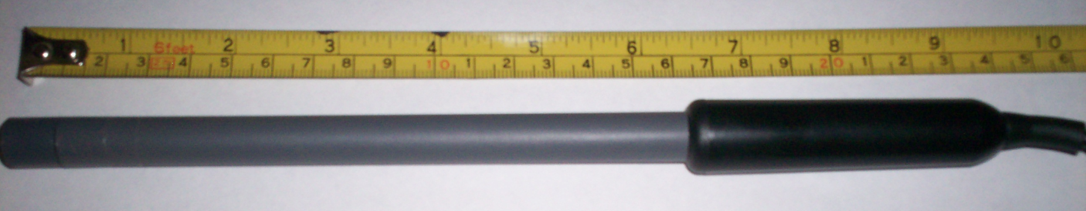
Vernier Calcium Ion-Selective Electrode
Range: 0.20 to 40,000 ppm
pH Range: 3 to 10
Interfering Ions: Pb2+, Hg2+, Sr2+, Cu2+, Ni2+
Electrode Slope: +28 mV/decade
Approximate Calibration Voltages: High (1000 mg/L) 1.9 V Low (10 mg/L) 1.5V
Electrode Resistance: 1 to 4 MΩ
Temperature range (can be placed in): 0 to 50°C (no temperature compensation)
Minimum immersion: 1 inch
Electrode Length: 155 mm
Body Diameter: 12 mm
Cap Diameter: 16 mm
Cable Length: 100 cm

Slide 23
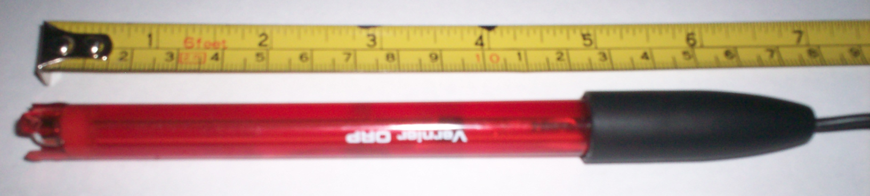
Vernier ORP Sensor
Type: Sealed, gel-filled, epoxy body, Ag/AgCl reference
Storage solution: pH-4/KCl solution (10 g KCl in 100 mL buffer pH-4 solution)
Cable: 1 meter coaxial cable
Temperature range: 0-60ºC
Dimensions: 12 mm OD
Impedance: ~20 kΩ at 25ºC
ORP element: 99% pure platinum band sealed on a glass stem
Calibration (mV): slope 466.875, intercept –559.793
Power: 7 mA @ 5VDC
Output Range: –450 to 1100 mV

Slide 24
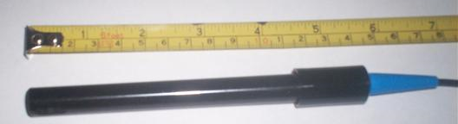
Conductivity Sensor
Electrode Height: 6“
Maximum Pressure: 150 psig
Top Threads: ¾" MPT
Connector Type: Spade Lugs
Cell Constants: 1.0

Slide 25
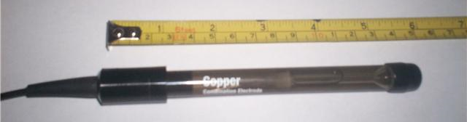
Van London Copper Ion-Selective Electrode
Slope: 27 + / - 2 mV/decade
InterferencesAg+, Hg+2, Cl-, Br-, Fe+2, Cd+2
Temperature Range: 0 to 80° C
Pressure Range: 0 to 70 psi
Response Time: 95% response in 30 seconds
Concentration Range: 0.0006 ppm to 6350 ppm
pH Range: 2 to 12 pH
Temperature Compensation: Not recommended

Slide 26
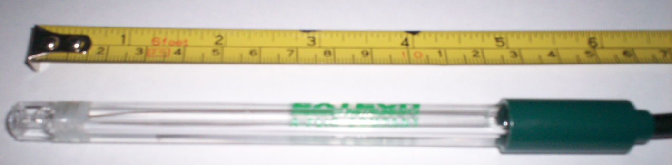
Extech pH Sensor
pH 0.00 to 14.00pH
mV -999 to 999mV
Temperature 32 to 212°F (0 to 99.9°C)
Resolution 0.01pH,1mV, 0.1°
Accuracy ±0.01pH, ±2mV, ±0.8°F/±0.5°C
Dimensions 4.4 x 3.1 x 1.5" (111 x 79 x 39mm)

Slide 27


Circuit Design to Minimize Sensor Noise
(amplifier for the pH sensor)
Summing amplifier:
Inverting amplifier:
Non-inverting amplifier:

Slide 28
National’s LMP7721 Op-amp
Input bias current: Vcm = 1 V
max@25°C: ±20 fA
max@85°C: ±900 fA
Offset voltage ± µV
Offset voltage drift: -1.5µV/°C
DC Open loop gain: 120 dB
DC CMRR: 100 dB
Input voltage noise @ f = kHz: 6.5 nV/Hz
Supply current: 1.3mA
Slew rate (falling edge): 12.76 V/µs
Supply voltage: 1.8 V- 5.5 V

Slide 29
Reservoirs
The stomach of the Pool Boy

Slide 30
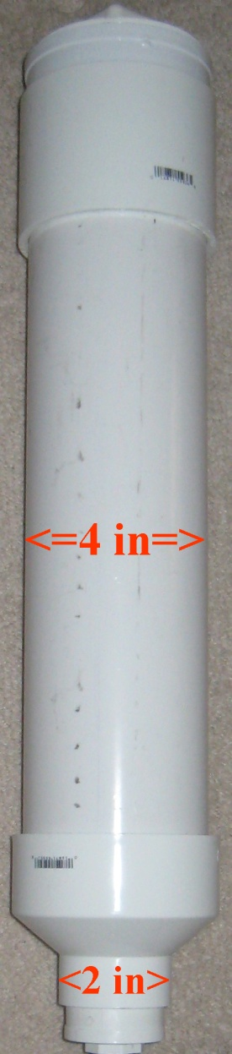
Reservoirs
Reservoirs
Standard PVC pipe
4 inch pipe with height of 18 inches yields a volume of 3.7 liters
Addition of chemicals through threaded cap
Chemical Level Monitoring Methods
Pressure Sensor
Optical Sensor
Float Switch

Slide 31
Chemical Level Monitoring
Method | Disadvantages | Advantages
Pressure Sensor | Potential for inaccuracy Mounting Difficulties | Price - $27 Good Documentation
Optical Sensor | Price - $64 Only “on” and “off” readings | Accurate Easy to install
Float Switch | Only “on” and “off” readings | Price - $24

Slide 32
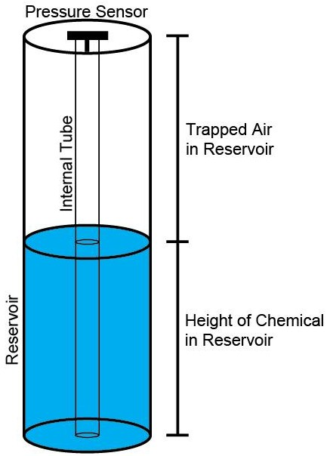
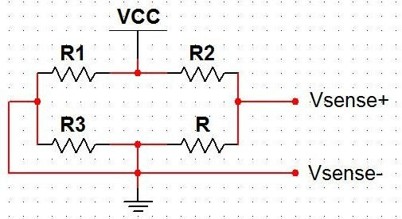
Pressure Sensor
GE NovaSensor’s NPC-1210
Measures the air pressure
10 inches changes output by
50 mV

Slide 33
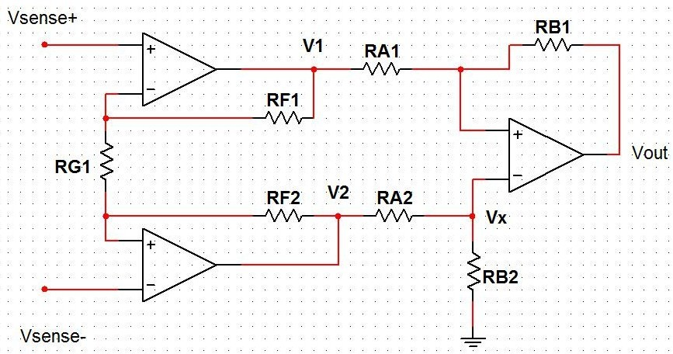





Pressure Sensor

Slide 34
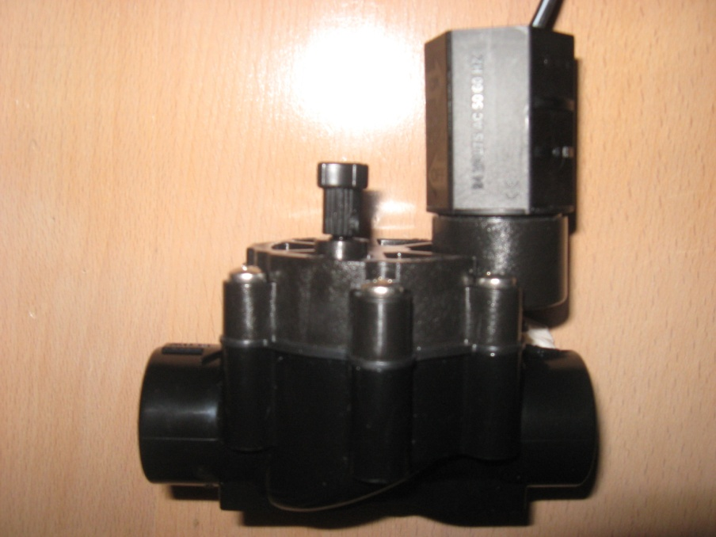
Valves
Solenoid Valve
RainBird CP-075 : ¾" In-Line Solenoid Valve
Input Voltage - 24 VAC
Inrush Current - .3 Amps (7.2 VA)
Holding Current - .23 Amps (5.5 VA)

Slide 35
Microcontrollers
The Brain of the Pool Boy

Slide 36
Objective
Interpret sensor information
Control valves to dispense specified amounts of chemicals based on sensor values and the predefined amounts located on tables.
Interface with wireless peripherals which will connect to another microcontroller located on the control panel.

Slide 37
Microcontroller Requirements
8-bit
Low Cost
Low power consumption
Real-time Clock and Timer Capabilities
Multiple Channel A/D Convertor
SPI/UART Communication capabilities
Speed and memory storage not a big necessity

Slide 38
Microcontroller Manufacturers
Manufacturer | Product Series | Architecture | Advantages | Disadvantages
Microchip | PIC (8-bit) | Harvard Architecture | nanoWatt Extreme Low Power (XLP), IDE environment, widely used in industry for years | Slower compared to others, limited memory for program/data
Atmel | AVR (8-bit) | Harvard Architecture | IDE environment, cross platform support | RF integration not supported on smaller chips
Texas Instruments | MSP430 (16-bit) | Von Neumann Architecture | Low power Consumption, Great Documentation | Learning curve with particular processor, not as much work done with particular processor.

Slide 39
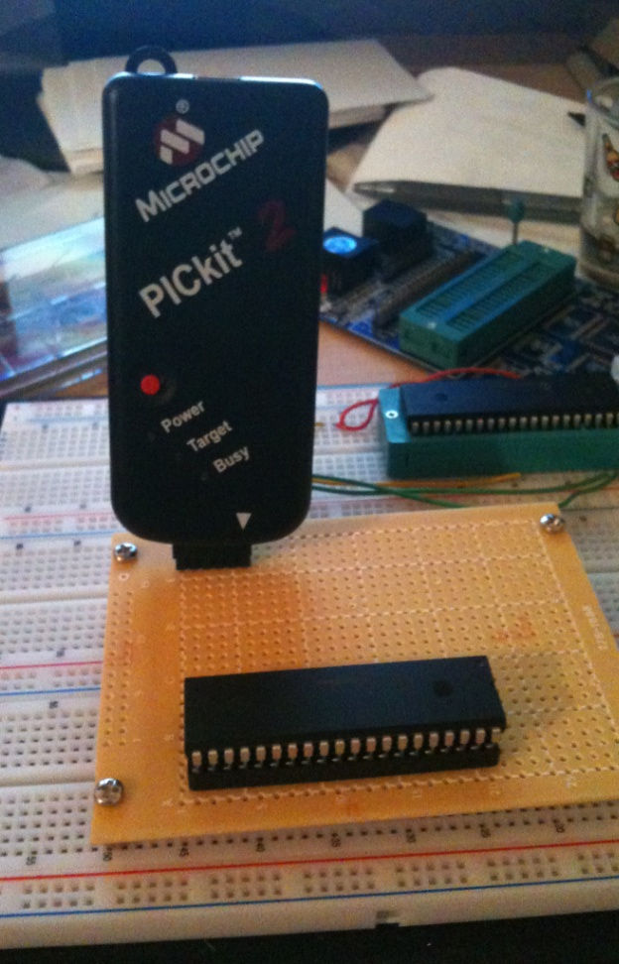
Microchip
Widely used and well known in industry
Low-power PIC® microcontroller (MCU) families with nanoWatt XLP™ eXtreme Low Power Technology with sleep currents as low as 20 nA
MPLAB IDE
HI-TECH C Compiler
PICkit3

Slide 40
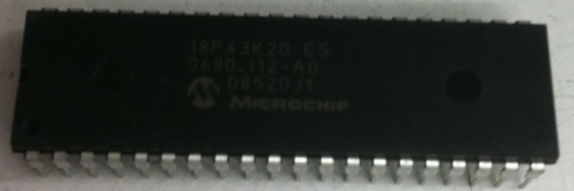
Microcontroller Specs
Parameter Name | PIC16F1823
Pin Count | 14
Program Memory Type | Flash
Program Memory (KB) | 3.5
CPU Speed (MIPS) | 8
Digital Communication Peripherals | 1 – A/E/USART, 1 - MSSP(SPI/I2C)
Timers | 2 x 8-bit, 1 x 16-bit
Temperature (C) | -40 to 125
Operating Voltage Range (V) | 1.8-5.5
Parameter Name | PIC18F45K20
Pin Count | 40
Program Memory Type | Flash
Program Memory (KB) | 32
CPU Speed (MIPS) | 16
Digital Communication Peripherals | 1 – A/E/USART, 1-MSSP(SPI/I2C)
Timers | 1 x 8-bit, 3 x 16-bit
ADC | 13 Ch, 10-bit
Temperature (C) | -40 to 125
Operating Voltage Range (V) | 1.8 to 3.6
XLP | Yes
2”

Slide 41
Block Diagram
Sensors
Master
PIC 18F45K20
PIC18F45K20
Control Panel
Slave
PIC16F1823
Valves

Slide 42
Routines
Sensor reading – ADC
Calculation of chemicals to be dispersed by predefined lookup tables and calculations
Communicate to microcontroller to dispense chemicals by turning on valves
Transmit sensor information to control panel via wireless communication

Slide 43
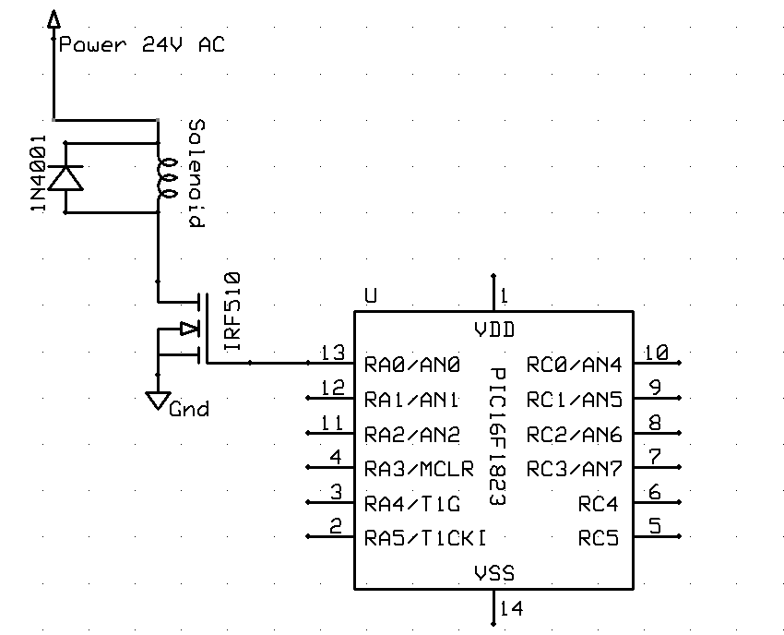
Valve Control

Slide 44
Wireless Communication
The Mouth and Ears of Pool Boy

Slide 45
Wireless Objective
Communicate with user away from the pool system
Set data based on specific pool specifications
Transmit sensor data to Control Panel so the user can see the current state of the pool
Transmit warning indicators when chemical levels are low and the system needs to be checked

Slide 46
Wireless Module Requirements
Transceiver
Interface directly with PIC microcontroller
Communicate with a direct Line-of-Sight
Low power consumption

Slide 47
Wireless Options
Market Name Standard | ZigBee 802.15.4 | Wi-Fi 802.11b | Bluetooth 802.15.1
Application Focus | Monitoring & Control | Web, Email, Video | Cable Replacement
System Resources | 4KB-32KB | 1MB+ | 250KB+
Battery Life (days) | 100-1000+ | .5-5 | 1-7
Network Size | Unlimited | 32 | 7
Maximum Data Rate (KB/s) | 20-252 | 11,000+ | 720
Transmission Range (meters) | 1-100+ | 1-100 | 1-10+
Success Metrics | Reliability, Power, Cost | Speed, Flexibility | Cost, Convenience

Slide 48
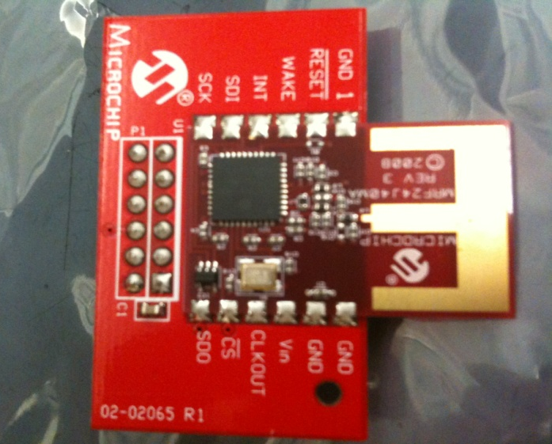
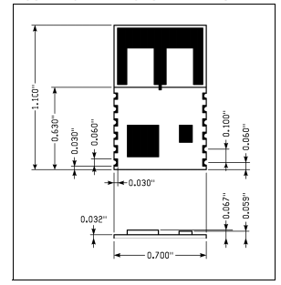
Wireless Module Specs
Module | MRF24J40MA
Range – Indoor | 100 ft (30m)
Range – Outdoor | 300 ft (100m)
Operating Voltage | 2.4-3.6V (3.3V typical)
Operating Temperature | -40°C to +85°C
Dimensions | 0.7” x 1.1” (17.8 mm x 27.9 mm)
Transmit Power | +0 dBm
Receiver Sensitivity | -94 dBm
Tx Current | 23 mA
Rx Current | 19 mA
Sleep Current | 2 μA

Slide 49
Block Diagram
Pool Filter System
Pool Filter System
Control
Panel
Pool System
Signal
PIC 18F45K20
PIC 18F45K20
MRF24J40MA
Transceiver
Coordinator
MRF24J40MA
Transceiver
End Device

Slide 50
802.15.4 Wireless Protocol
ZigBee
More Features than we really need
MiWI / MiWi P2P
Microchip’s 802.15.4 solution
Same capabilities more user defined

Slide 51
Control Panel
The girlfriend of the Pool Boy

Slide 52
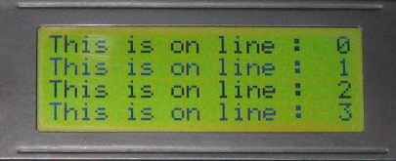
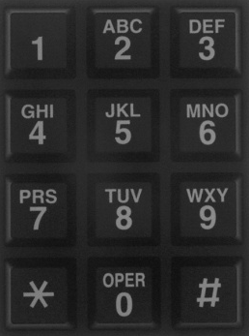
User interface device requirements
Easy user monitoring and access
Number pas input for pool size
Low power consumption
Wireless capabilities
User input unit
8’
Chlorine
Total Alkalinity
Calcium Hardness
pH
Pressure
9’

Slide 53
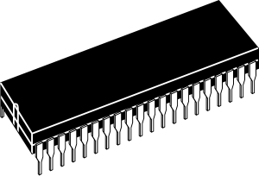
Microcontroller
Drive 4 chemical status LEDs
One pressure sensor LED
One Number pad
One wireless RF module
One LCD display

Slide 54
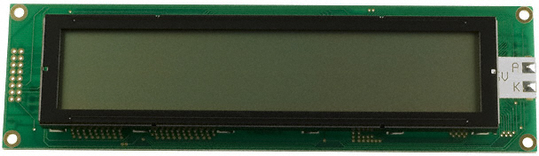
HD44780 compatible LCD-display
Outline L x W x H: 190.00mm x 54.00mm x 14.50mm
Viewing Area: 149.00mm L x 29.50mm W
Backlight: LED - Yellow/Green
Display Format: 40 x 4
Character Size: 4.89mm H x 2.78mm W
Character Format: 5 x 8 Dots
Voltage – Supply: 5.0V

Slide 55
Two main menus
Please input the size of your pool in
Pool size input screen
Pool status screen
4
Gallons:
40
TA :
60%
Temp:
80 F
4
pH :
60%
CL :
60%
CH :
60%
40

Slide 56

Swordfish complier to program PIC
PIC Basic compiler
Auto generates optimized code for the 18f
LCD support libraries
LCD.WriteAt(1,1,"Hello World")

Slide 57
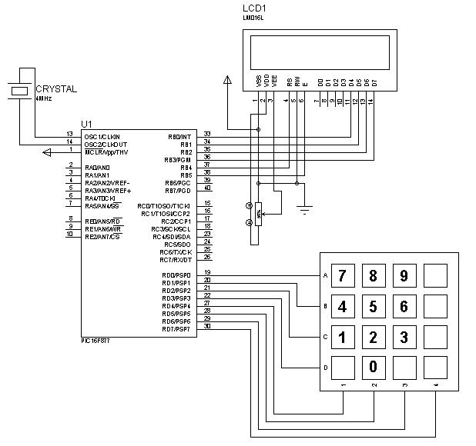
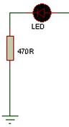
PIC 18F, num pad, LCD, status LEDs

Slide 58
Power – Main System
The heart of the Pool Boy

Slide 59
Requirements
The system must receive enough power for every component

Slide 60
Component Measurements
Component | Input Voltage | Output Voltage | Holding Current
Valve | 24 VAC | N/A | .23 A
Microcontroller | 3.3 – 5 VDC | N/A | .5mA
Pressure Switch | 1 VDC | 1 VDC | N/A
Temperature Sensor | 5 VDC | .2mV-.5mV | 60 µA
Conductivity Sensor | 5 VDC | .4mV-.9mV | 73µA
Ionizer | 12 VDC | N/A | 8 A
ORP Sensor | 5 VDC | -450 – 1100 mV | 7 mA

Slide 61
Power Supply Selection
NFM-15-12 from TRC Electronics
12 Volt DC Power Supply
1.25 Max Current Output
15 Watts @ 120 VAC input
Price: $16.89

Slide 62
24 Volt Transformer
Solenoid valves run on AC
Steps wall outlet down to 24 VAC
Model 57040 from Orbit
Input: 120 VAC 60 Hz
Output Voltage: 24 VAC 60 Hz
Current Output: 750 mA

Slide 63
Voltage Regulators
LM7805 – Fairchild Semiconductor
5 VDC Output
1 A current output
Will power pressure switch, temperature sensor, and the ORP sensor
Not concerned with efficiency in main system
LM2937-3.3 – National Semiconductor
3.3 VDC Output
.5 A current output
Will power microcontroller and transceiver

Slide 64
Schematic and PCB
The skeleton of the Pool Boy

Slide 65
PCB
ExpressPCB is the software chose for this project. Easy to use and it is free to download.
Large library with hundred of components symbols
Error checking connection, which alert the designer of any miss connection or error in the schematic.
ExpressPCB offers a cheap price for PCBs: $51 for three 2-layer boards, $98 for three 4-layer boards

Slide 66
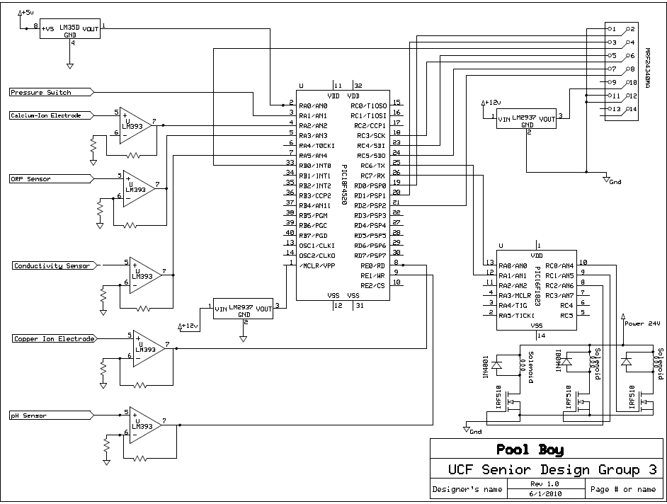

Slide 67
Testing

Slide 68
Testing and Calibration
First an amplifier circuit will be made for each of the sensors and electrodes.
Then water samples will be made for each of the parameter being tested with varying chemical levels within the ideal range of the system.
Each water sample will be tested with appropriate water test strips for accuarcy.
Then the sensors will be placed in the solutions and the voltages will be measured.
Finally the voltages will be related to the different chemical values after the signals have gone through the A/D converter.

Slide 69
Administrative Content

Slide 70
Index | Quantity | Description | Unit Price | Extended Price
 |  |  | USD | USD
1 | 10 | SENSOR HALL EFFECT BIPOLAR SMD | 1.042 | $10.42
2 | 4 | FLEX SENSOR 10K OHM 112.24MM | 12.95 | $51.80
3 | 2 | SENSOR MAGNET BAR HALL EFFECT | 10.76 | $21.52
4 | 1 | SOLDER STATION ANALOG 50W | 124.95 | $124.95
5 | 3 | SOLDER WIRE NO-CLEAN 63/37 1OZ. | 4.16 | $12.48
6 | 1 | HEATSHRINK KIT RFL 1/8" BLK 28PC | 1.42 | $1.42
7 | 1 | SLOTTED ELECTRONIC HARDWARE KIT | 17.95 | $17.95
8 | 2 | BREADBOARD W/140PC WIRE/GND POST | 37.45 | $74.90
9 | 1 | M SERIES TOGGLE KIT | 35 | $35.00
Development
10 | 1 | CABLE TIE PAN-TY ASSORTED | 18.75 | $18.75
11 | 2 | KIT STARTER PICKIT 3 | 69.99 | $139.98
12 | 2 | LCD MODULE 16X2 CHARACTER | 5.88 | $11.76
13 | 3 | IC MCU FLASH 1KX14 EE 18DIP | 4.9 | $14.70
14 | 1 | LCD MOD CHAR 4X20 Y/G TRANSFL | 17.7 | $17.70
15 | 1 | KEYPAD 4 KEY MEMBRANE SW BLACK | 18.9 | $18.90
16 | 1 | KEYPAD 12 KEY BLK REAR PNL MNT | 12.26 | $12.26
17 | 1 | KIT DEMO PICDEM Z MRF24J40 | 269.99 | $269.99
18 | 1 | LCD MOD CHAR 2X20 Y/G TRANSFL | 24 | $24.00
 |  |  | Subtotal | $878.48

Slide 71
Pool Boy Status

Slide 72
Project Milestones

