Slide 1

Group 3
Paul Setlak Ivan Latorre Mitch Lienau Robert Sers
Sponsored by CEI

Slide 2
Motivation
Relieve the burden of pool maintenance on the owner
Unchecked pools require more resources to recover
Reduce dependence on harsh chemicals like chlorine
Low cost consumer solution

Slide 3
Project Desription
A system that will automatically monitor and adjust chemicals to the pool daily
Early identification of pool water imbalances
Two basic elements of pool maintenance
Saturation Index
Water Purification

Slide 4
1
Unit self-check
Start
2
Water Validation
3
Water Purification
1
Check System Levels
Fail
Reorder Notification
Sleep
To Start
Fail
Low
Pass
Low
2
Test Water
Adjust Levels
Chemical Dispersion Sleep
To Start
Fail
Pass
3
Ion scheduler
Run Ionizer Period
To Start
Yes
No
To Start

Slide 5
1
Unit self-check
1
Check System Levels
Fail
Reorder Notification
Sleep
To Start
Fail
Low
Pass
Low
2

Slide 6
Water Validation
2
1
Pass
Low
2
Test Water
Adjust Levels
Chemical Dispersion Sleep
To Start
Fail
Pass
3

Slide 7
3
Water Purification
2
Pass
3
Ion scheduler
Run Ionizer Period
To Start
Yes
No
To Start

Slide 8
Pool Maintenance

Slide 9
Two main components
Langelier Saturation Index for component longevity
Water Sanitation for safe human use

Slide 10
Langelier Saturation Index
Saturation Index = pH + calchd + totak + temp - 12.1
 | To Lower | To Raise
Ph | Muriatic acid | Soda ash
TA | Hydrochloric acid | Sodium bicarbonate
Calcium hardness | Replace water (backwash) | Calcium Chloride
Decrease pH | GALLONS IN POOL
(ppm) | 1,000 | 5,000 | 10,000 | 15,000 | 20,000 | 25,000 | 50,000
10 | 2.56 oz. | 0.8 pts. | 0.8 qts. | 1.2 qts. | 1.6 qts. | 2.0 qts. | 1 gal.
20 | 5.12 oz. | 1.60 pts. | 1.6 qts. | 2.4 qts. | 3.2 qts. | 1.0 gal. | 2 gal.
30 | 7.68 oz. | 1.2 qts. | 2.4 qts. | 3.6 qts. | 1.2 gal. | 1.5 gal. | 3 gal.
40 | 10.24 oz. | 1.6 qts. | 3.2 qts. | 1.2 gal. | 1.6 gal. | 2.0 gal. | 4 gal.
50 | 12.80 oz. | 2.0 qts. | 1.0 gal. | 1.5 gal. | 2.0 gal. | 2.5 gal. | 5 gal.

Slide 11
Water Sanitation
Traditional chlorine
Salt to chlorine generator
Ionization

Slide 12
Sanitation Methods
 | Copper Ionization | Salt Water | Chlorine
Free Chlorine ppm | 0.4 - 0.8 | 2.0 – 4.0 | 1.0 – 3.0
Ph | 7.2 – 7.6 | 7.2 – 7.6 | 7.2 – 7.6
Total Alkalinity ppm | 80 -120 | 80 – 100 | 80 – 100
Total Dissolved Solids ppm | 750 – 1500 | 1000 – 2000 | 1000 – 2000
Calcium Hardness | 225 – 375 | 200 – 400 | 200 – 400
Copper Ions | 0.3 – 0.4 | N/A | N/A
Cvanuric Acid ppm | N/A | 60 – 80 | 60 – 80
Salinity ppm | N /A | 2500 – 4000 | N/A

Slide 13
Component Overview
Ionizer
Sensors
Reservoirs / Valves
Microcontroller
Control Panel
Power
PCB

Slide 14
Ionizer

Slide 15
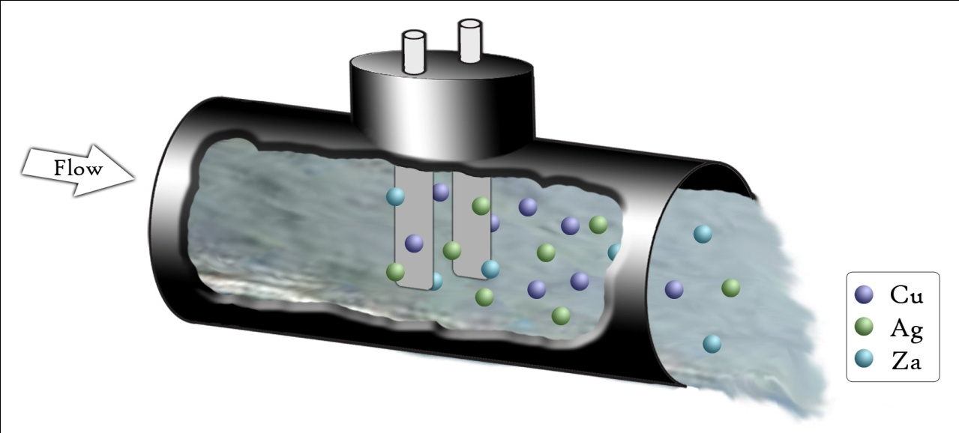
Ionizer
Input Voltage: 120 V AC
Output Voltage: 16.3 V DC
Current Draw: 1 A
Electrode Lifetime: 3-5 years

Slide 16
Sensors
The nervous system of the Pool Boy

Slide 17
Components for Pool Measurements
Temperature Sensor
Calcium Ion-Selective Electrode
ORP Sensor
Copper Ion-Selective Electrode
pH Sensor

Slide 18
LM35 Temperature Sensor
Scale: Linear 10 mV/ °C
Accuracy: .5 °C
Temperature Range: -55 °-150 °
Current Drain: less Than 60 µA
Operating Voltage: 4-30 V
Terminals: 3 : V+, Vout, GND
Notes:
Add picture

Slide 19
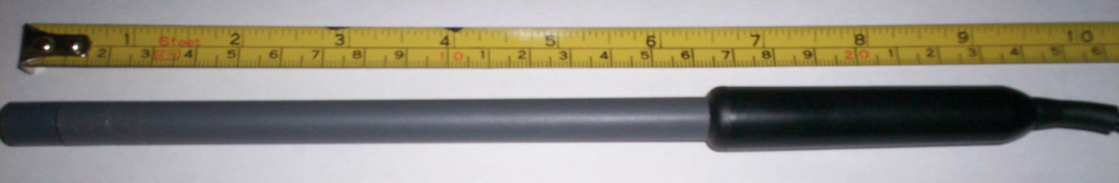
Vernier Calcium Ion-Selective Electrode
Range: 0.20 to 40,000 ppm
pH Range: 3 to 10
Interfering Ions: Pb2+, Hg2+, Sr2+, Cu2+, Ni2+
Electrode Slope: +28 mV/decade
Approximate Calibration Voltages: High (1000 mg/L) 1.9 V Low (10 mg/L) 1.5V
Electrode Resistance: 1 to 4 MΩ
Temperature range (can be placed in): 0 to 50°C (no temperature compensation)
Minimum immersion: 1 inch
Electrode Length: 155 mm
Body Diameter: 12 mm
Cap Diameter: 16 mm
Cable Length: 100 cm

Slide 20
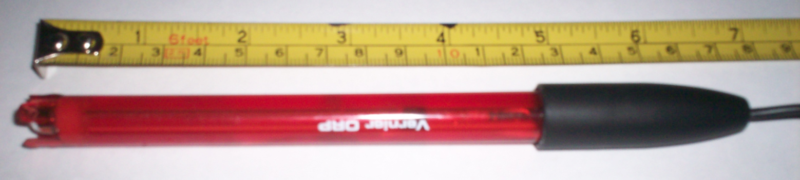
Vernier ORP Sensor
Type: Sealed, gel-filled, epoxy body, Ag/AgCl reference
Storage solution: pH-4/KCl solution (10 g KCl in 100 mL buffer pH-4 solution)
Cable: 1 meter coaxial cable
Temperature range: 0-60ºC
Dimensions: 12 mm OD
Impedance: ~20 kΩ at 25ºC
ORP element: 99% pure platinum band sealed on a glass stem
Calibration (mV): slope 466.875, intercept –559.793
Power: 7 mA @ 5VDC
Output Range: –450 to 1100 mV

Slide 21

Van London Copper Ion-Selective Electrode
Slope: 27 + / - 2 mV/decade
InterferencesAg+, Hg+2, Cl-, Br-, Fe+2, Cd+2
Temperature Range: 0 to 80° C
Pressure Range: 0 to 70 psi
Response Time: 95% response in 30 seconds
Concentration Range: 0.0006 ppm to 6350 ppm
pH Range: 2 to 12 pH
Temperature Compensation: Not recommended

Slide 22
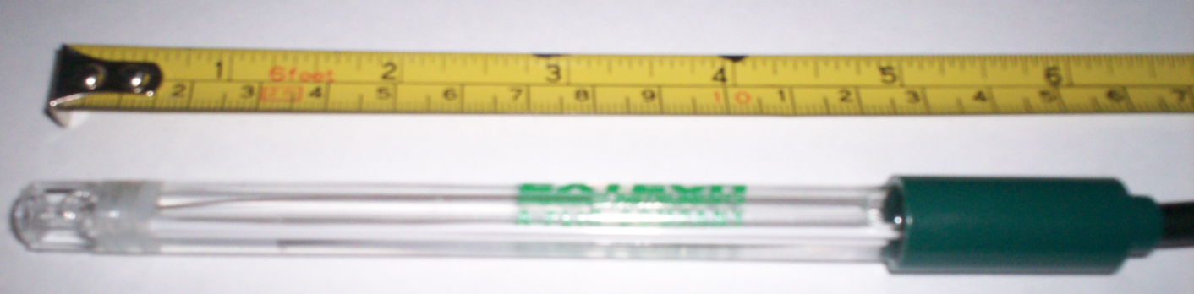
Extech pH Sensor
pH 0.00 to 14.00pH
mV -999 to 999mV
Temperature 32 to 212°F (0 to 99.9°C)
Resolution 0.01pH,1mV, 0.1°
Accuracy ±0.01pH, ±2mV, ±0.8°F/±0.5°C
Dimensions 4.4 x 3.1 x 1.5" (111 x 79 x 39mm)

Slide 23
Amplifier circuit for pH sensor

Slide 24
National’s LMP7721 Op-amp
Input bias current: Vcm = 1 V
max@25°C: ±20 fA
max@85°C: ±900 fA
Offset voltage ± µV
Offset voltage drift: -1.5µV/°C
DC Open loop gain: 120 dB
DC CMRR: 100 dB
Input voltage noise @ f = kHz: 6.5 nV/Hz
Supply current: 1.3mA
Slew rate (falling edge): 12.76 V/µs
Supply voltage: 1.8 V- 5.5 V

Slide 25
Reservoirs
The stomach of the Pool Boy

Slide 26
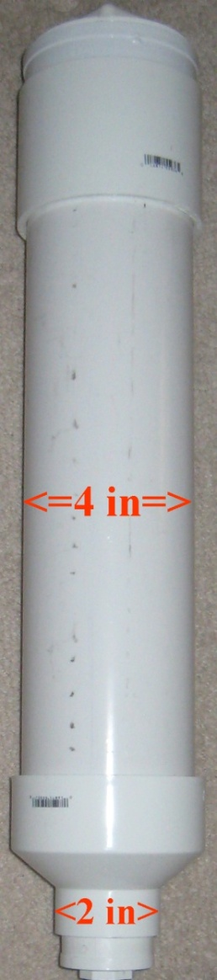
Reservoirs
Standard Schedule 40 PVC pipe
4 inch pipe with height of 18 inches yields a volume of 3.7 liters or 1 gallon
Addition of chemicals through threaded cap
Level measurement mounted near the bottom

Slide 27
Chemical Level Monitoring
Method | Disadvantages | Advantages
Pressure Sensor | Potential for inaccuracy Mounting Difficulties | Price - $27 Good Documentation
Optical Sensor | Price - $64 Only “on” and “off” readings | Accurate Easy to install
Float Switch | Only “on” and “off” readings | Price - $24 Straightforward

Slide 28
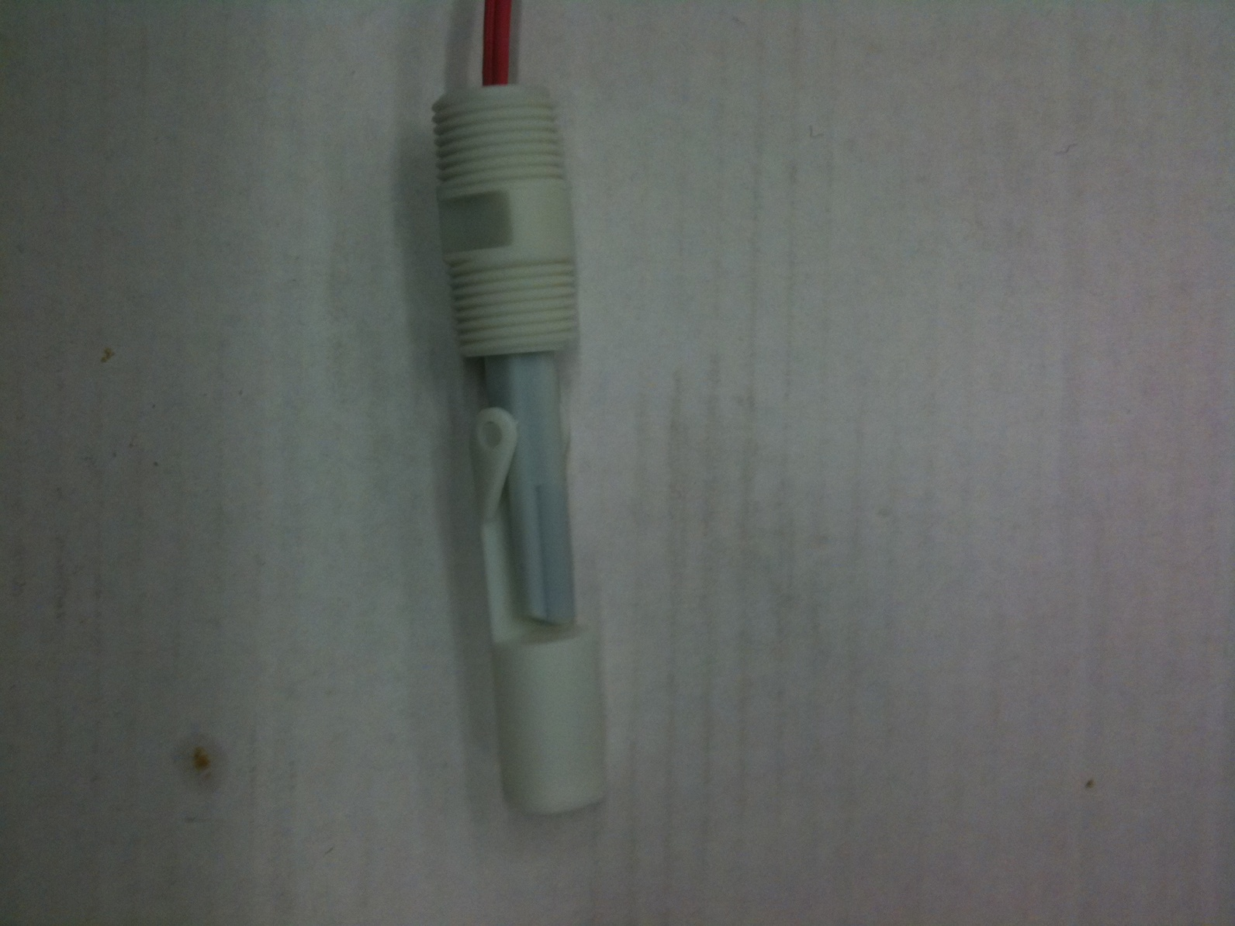
Float Switch
Activates when the float arm is raised to the switch housing.
Internal pull-up resistors enable successful implementation
Switch can be normally open or normally closed depending on orientation

Slide 29
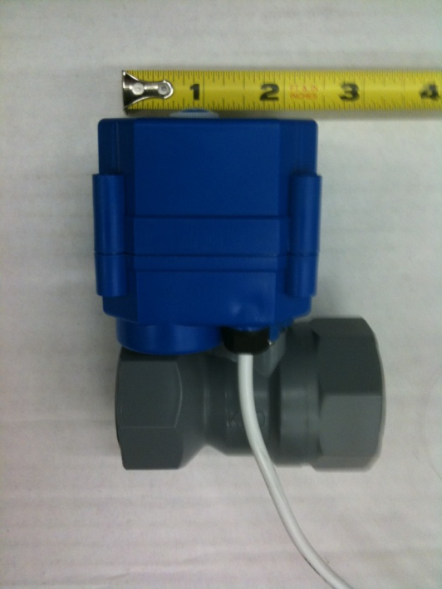
Valves
Motorized DC Ball Valve
KLD20S – Tianjin Kailida Control Technology Development Co. – China
Input Voltage – 5V
Holding Current – 60 mA
5 V to open, - 5V to close
Need a relay and transistor
to operate

Slide 30
Valves cont.
Flow rate through the valve important to know for accurate dispersion of chemicals.
5 – 7 seconds opening time
3 gallons per minute fully open
1 gallon per minute after opening the valve for 2 seconds
One-way valve ensures back pressure will not contaminate reservoir contents

Slide 31
Microcontrollers
The Brain of the Pool Boy

Slide 32
Objective
Interpret sensor information
Control valves to dispense specified amounts of chemicals based on sensor values and the predefined amounts located on tables.
Interface with another microcontroller located on the control panel.

Slide 33
Microcontroller Requirements
8-bit
Low Cost
Low power consumption
Real-time Clock and Timer Capabilities
Multiple Channel A/D Convertor
SPI/UART Communication capabilities
Speed and memory storage not a big necessity

Slide 34
Microcontroller Manufacturers
Manufacturer | Product Series | Architecture | Advantages | Disadvantages
Microchip | PIC (8-bit) | Harvard Architecture | nanoWatt Extreme Low Power (XLP), IDE environment, widely used in industry for years | Slower compared to others, limited memory for program/data
Atmel | AVR (8-bit) | Harvard Architecture | IDE environment, cross platform support | RF integration not supported on smaller chips
Texas Instruments | MSP430 (16-bit) | Von Neumann Architecture | Low power Consumption, Great Documentation | Learning curve with particular processor, not as much work done with particular processor.

Slide 35
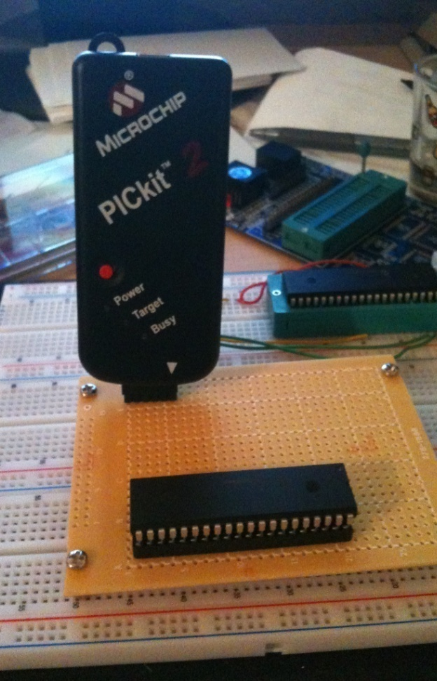
Microchip
Widely used and well known in industry
Low-power PIC® microcontroller (MCU) families with nanoWatt XLP™ eXtreme Low Power Technology with sleep currents as low as 20 nA
MPLAB IDE
HI-TECH C Compiler
PICkit3

Slide 36
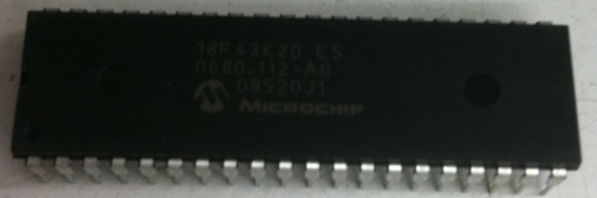
Microcontroller Specs
Parameter Name | PIC18F4K20
Pin Count | 40
Program Memory Type | Flash
Program Memory (KB) | 32
CPU Speed (MIPS) | 16
Digital Communication Peripherals | 1 – A/E/USART, 1-MSSP(SPI/I2C)
Timers | 1 x 8-bit, 3 x 16-bit
ADC | 13 Ch, 10-bit
Temperature (C) | -40 to 125
Operating Voltage Range (V) | 1.8 to 3.6
XLP | Yes
2”

Slide 37
Routines
Sensor reading – ADC
Calculation of chemicals to be dispersed by predefined lookup tables and calculations
Communicate to valves to dispense chemicals by turning on valves
Transmit sensor information to control panel

Slide 38
Sensor reading – ADC
void ReadSensors()
{
set_adc_channel(4);
delay_us(100);
Temp_Value = read_adc(); set_adc_channel(4);
delay_us(100);
Temp_Value = read_adc();
//Temperature Conversion
Temp_Value = Temp_Value / 11;
Temp_Value = Temp_Value - .01;
Temp_Value = Temp_Value * 100;
Temp_Value = Temp_Value * 9/5 + 32;
return;
}

Slide 39
Control Panel
The girlfriend of the Pool Boy

Slide 40
Objective
Communicate with user.
Set data based on specific pool specifications
Transmit sensor data to Control Panel so the user can see the current state of the pool
Transmit warning indicators when chemical levels are low and the system needs to be checked

Slide 41
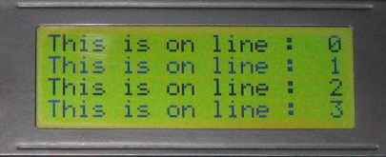
User interface device requirements
Easy user monitoring and access
Key input for pool size
Battery powered
Low power consumption
User input unit
8’
Chlorine
Calcium Hardness
pH
9’

Slide 42
Microcontroller
PIC18F4520
Drive 4 chemical status LEDs
Four push buttons
One LCD display
Receive info from main processor
2”

Slide 43
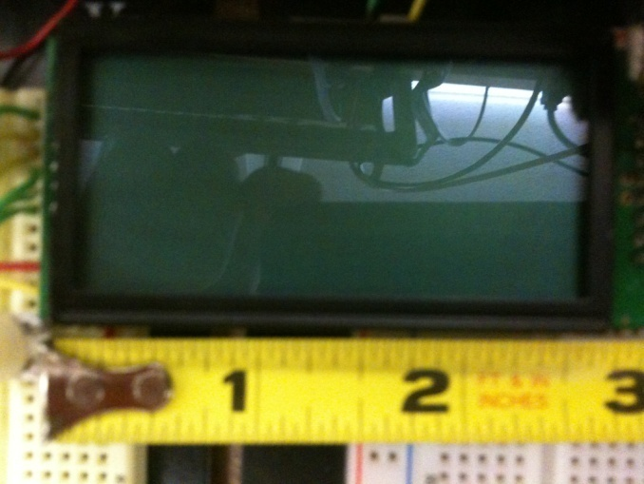
HD44780 compatible LCD-display
Viewing Area: 149.00mm L x 29.50mm W
Backlight: LED - Yellow/Green
Display Format: 20 x 4
Character Size: 4.89mm H x 2.78mm W
Character Format: 5 x 8 Dots
Voltage – Supply: 5.0V

Slide 44
Two main menus
Pool size input screen
Pool status screen
Welcome to PoolBoy
Interface
Press Menu to
continue
4
20
PoolBoy
Ph - Ideal
Chl – Ideal
Temp - 78
4
20

Slide 45
CCS complier to program PIC
PIC – C compiler
Auto generates optimized code for the 18f
LCD support libraries
lcd_gotoxy(1,2);
printf(lcd_putc,“hello world");

Slide 46
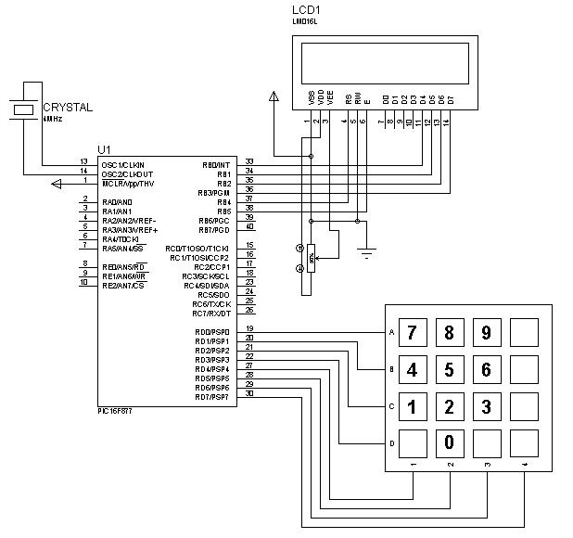
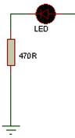
PIC 18F, buttons, LCD, status LEDs

Slide 47
Power – Main System
The heart of the Pool Boy

Slide 48
Requirements
DC Power
Supply sufficient current to all components
Component | Max. Current Draw | Operating Voltage | Power Consumption
PIC18F4520 | 200mA | 5V | 1 Watt
Valve | 100mA | 5V | .5 Watts
Sensors | 7mA | 0-5V | .035 Watts
Relays | 124mA | 5V | .62 Watts
Total | 431 mA | 0-5V | 2.155 Watts

Slide 49
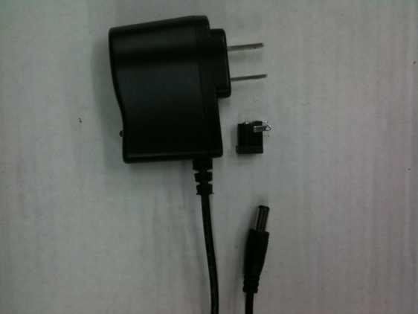
Power Supply Selection
TOL-00298 from SparkFun
Switched-mode power supply
Input: 100 – 210 VAC
Output: 9 V
650 mA current output
Center-positive 5.5x2.1mm barrel connector.
Price: $5.95

Slide 50
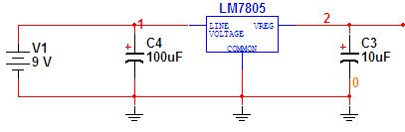
Voltage Regulators
LM7805 – National Semiconductor
5 VDC Output
Max 1 A current output
Will supply power to almost all the components
Not concerned with efficiency in main system

Slide 51
Schematic and PCB
The skeleton of the Pool Boy

Slide 52
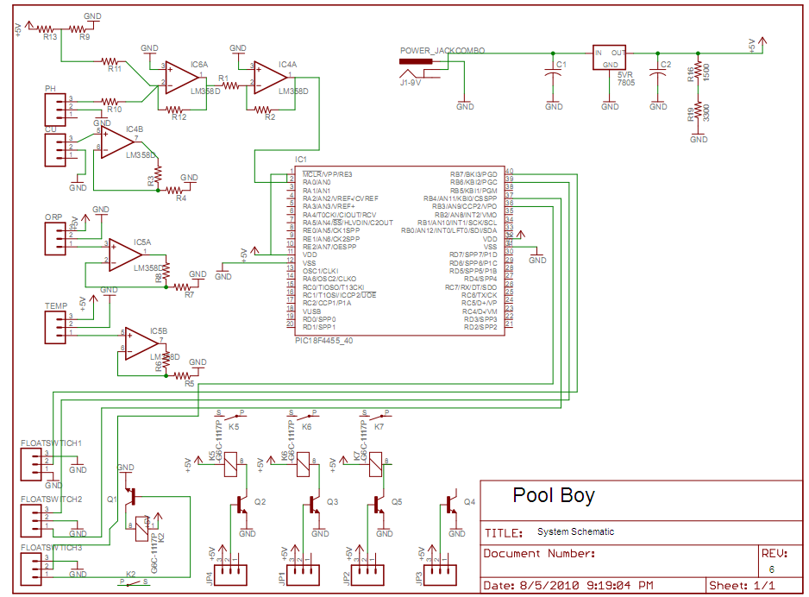

Slide 53
PCB
Eagle CAD PCB Layout Software
Ease of use
Large library with hundred of components symbols
Error checking connection, which alert the designer of any miss connection or error in the schematic
4PCB - $33 2 - Layer Boards

Slide 54
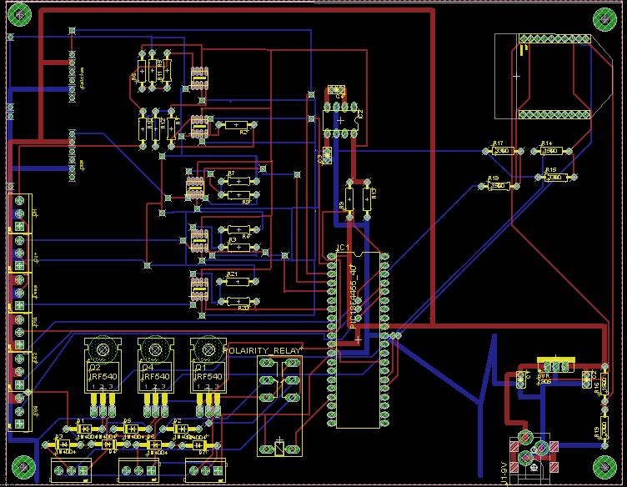

Slide 55
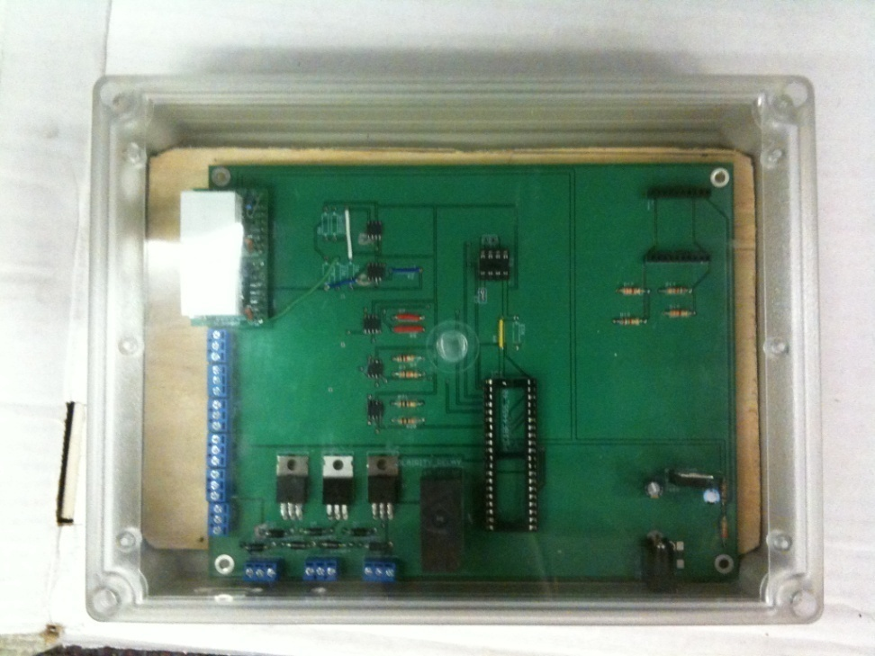
Electronics PCB Enclosure
HAMMOND - RP1455C - Enclosure
Designed to meet IP 65 Specifications
Meets NEMA 4x rating

Slide 56
Testing

Slide 57
Testing and Calibration
Tested in a control environment, at a constant temperature of 80˚ F
Pool Test Strips

Slide 58
Administrative Content

Slide 59
Budget and Financing
Center of Entrepreneurship and Innovation at UCF
Pool Boy Cost = $1441.18
Component | Qty | Cost ($)
Ph Sensor | 1 | 80
Cu+ Sensor | 1 | 249
Ca Sensor | 1 | 179
LM35 | 1 | 1.13
Ionizer | 1 | 100
ORP Sensor | 1 | 79
Float Switch | 4 | 24
LMP7721 | 5 | 4.95
9V Power Supply | 1 | 5.95
PIC Microcontroller | 2 | 7.95
PCB | 2 | 33
LM7805 | 2 | 1
Sensor Proto Board | 2 | 20
PVC Pipe | 30 | 5
Wood | 5 | 6
5V Ball Valve | 3 | 50
Relay | 5 | 4.49
Misc. | 1 | 150
Total | 68 | 1441.18

Slide 60
Work Distribution
Component | Ivan | Mitch | Paul | Rob
PCB Design | %30 | %10 | %30 | %30
Structure |  | %50 |  | %50
Sensors | %10 |  |  | %90
Circuit Design | %20 | %10 | %40 | %30
Code | %33 | %33 | %33

Slide 61
Project Milestones

Slide 62
Questions?
Pool Boy

Slide 63
Demonstration

