Slide 1
Transformer Monitoring System
Group 8
Bradley Tanner Charles Payne Jon Rowe Robert Howard

Slide 2
Project Description
  The Transformer Monitoring System (TMS) is a device that connects to a pole mounted transformer and monitors:
    Voltages and Currents coming into and out of the transformer
    Overall temperature of the transformer
    The phase angle of the voltage and current

Slide 3
Motivation
Government wants Smart Grid by 2030
Need for technologies to counter prolonged downtime of electrical power lines
Tired of power companies relying on the public for important notifications when power is out
No inexpensive method out on the market today that monitors everyday pole mounted transformers

Slide 4
Block Diagram
Power
Voltage Sensor
Brad
Brad
Current Sensor
Microprocessor
Wireless
Central Hub
Brad
Charles
Jon
Robert
Heat Sensor
Robert

Slide 5
Overall Goals and Objectives
Effectively and accurately read and record valuable information about the transformer
Transfer the data wirelessly without any loss in accuracy to a central hub
Store the data in a database for future use
Display the data in a nice, neat, organized fashion for the user to analyze

Slide 6
Hardware Goals and Objectives
Should be weather proof
Must meet Government regulations
Must be small and lightweight
Easy to install and replace
Non-Intrusive to existing power lines
Must be cost effective

Slide 7
Hardware Specifications
No more than 20 pounds
Less than $200 per unit
Able to handle 50kVA to 100kVA
Able to handle temperatures up to 150⁰C
Able to withstand hurricane like storms

Slide 8
Power

Slide 9
Power Supply
Considerations for the power supply
Must be isolated from the grid
Be able to adapt to changes in the power line
Have the ability to power the system in a power outage

Slide 10
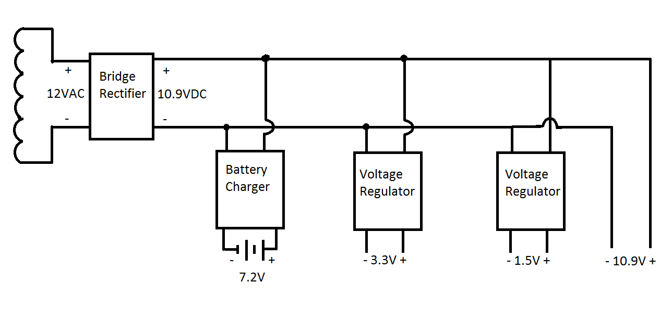
Power supply – Block Diagram

Slide 11

Power supply – Inductive Pickup
The power will be supplied by an inductive coil with the power line running through the center. This will allow the system to be electrically isolated and allow for a wide variety of currents present in the power line.
Voltage induced on coil equation

Slide 12
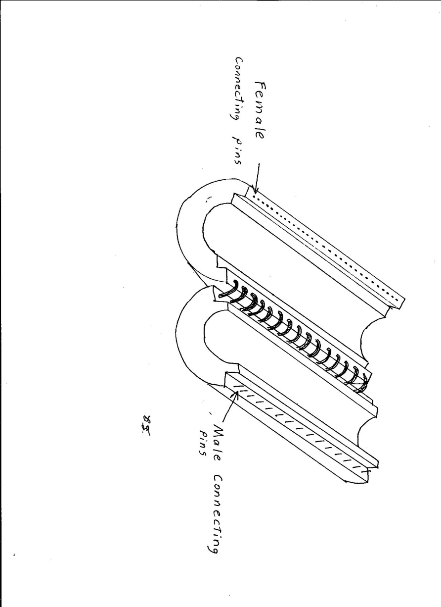
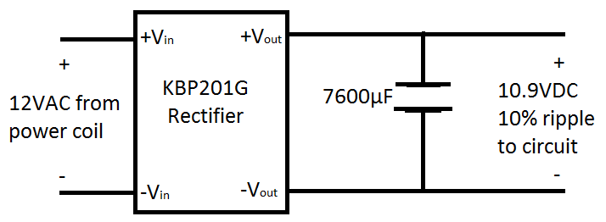
Power Supply – Rectifier Schematic

Slide 13
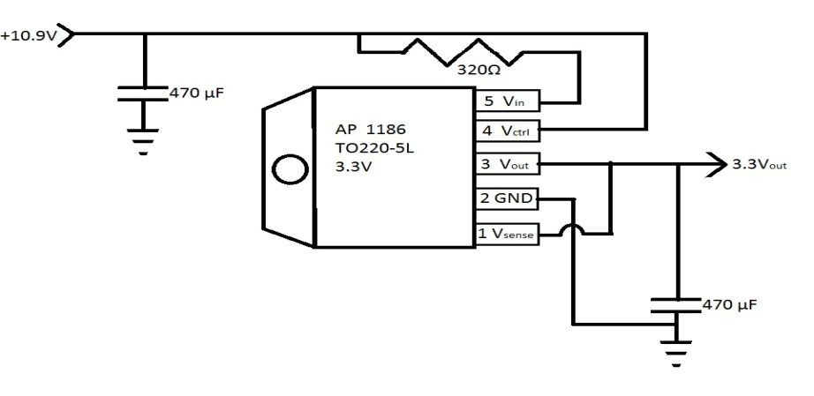
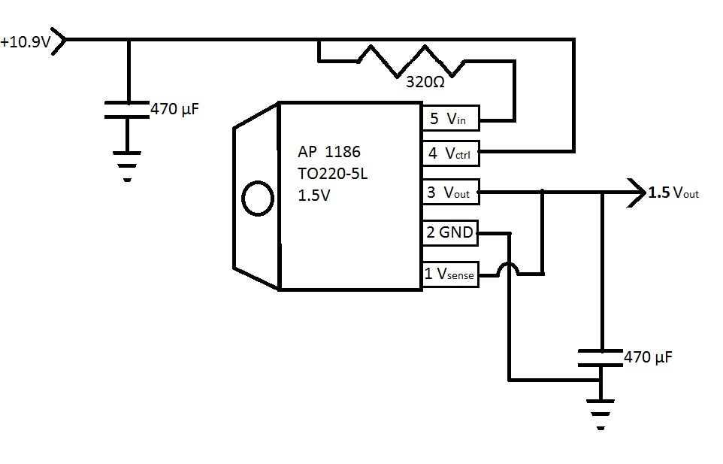
Power Supply – Voltage Regulators
Use of two Diodes Incorporated regulators
3.3v for microcontroller, Xbee,
1.5v for supplying DC offset voltage to sensors
10.9v for supplying power as Vcc to IC’s

Slide 14
Sensors

Slide 15
Voltage Sensors
The problem with commercially available sensors is they measure RMS values or the cost is too great.
The solution to the problem is building our own. This keeps costs down and within budget.

Slide 16

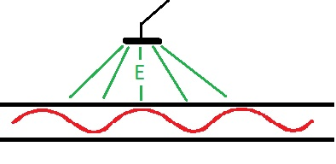
Voltage Sensor Theory
Electric field created by the line charge at point r
Integrating will give an approximation of electric field at the plate

Slide 17
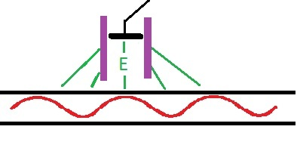
Voltage Sensor Theory
Since the enclosure will be made of material with low electric permittivity. The stray capacitance can be negated, leading to the detection of the electric field directly under the sensor.

Slide 18
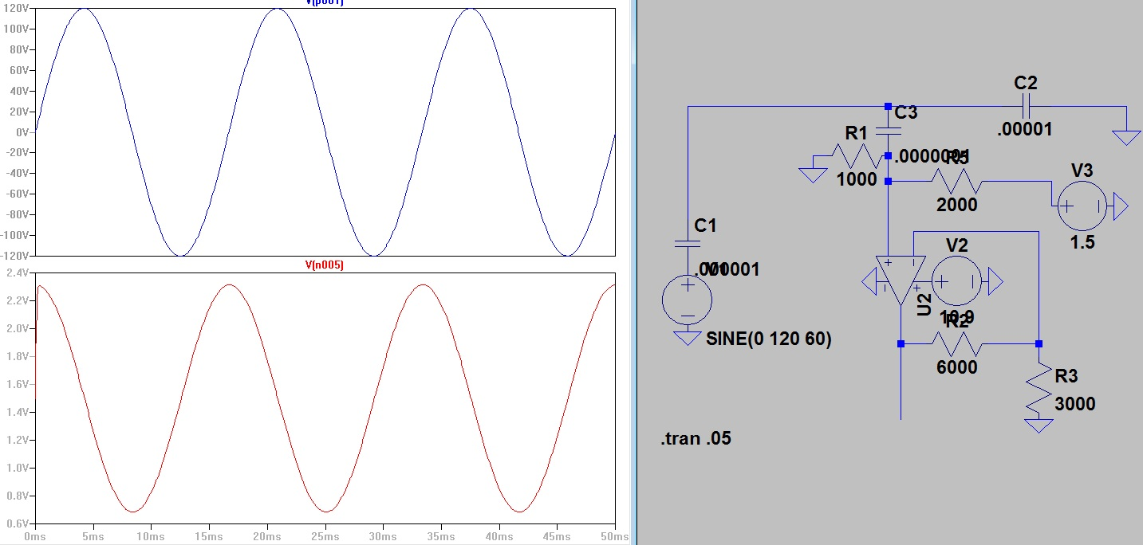
Voltage Sensor Schematic

Slide 19
Current Sensors
The problem with commercially available sensors either too bulky or too expensive.
The solution is to make a Rogowski coil type sensor.

Slide 20

Current Sensor
The voltage induced on the coil for a given current can be found using
The construction of this sensor is a simple long coil insulated by a inner and outer sheath

Slide 21
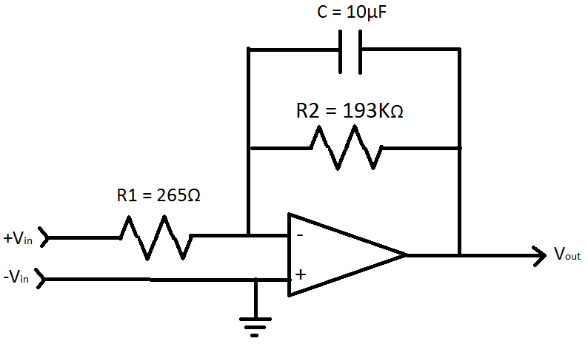
Current Sensor Schematic
Since the coil is an air core toroid, the induced voltage will be in the +/- uA range, leading to the need to add a DC offset and leaky integrator op-amp for the micro-controller to sample properly

Slide 22
Temperature Sensor
MLX90614ESF-AAA Infrared Temperature Sensor
Non-Contact: therefore, non intrusive
90° Field of view
Temperature ranges of -70 to 380°C
Small and compact

Slide 23
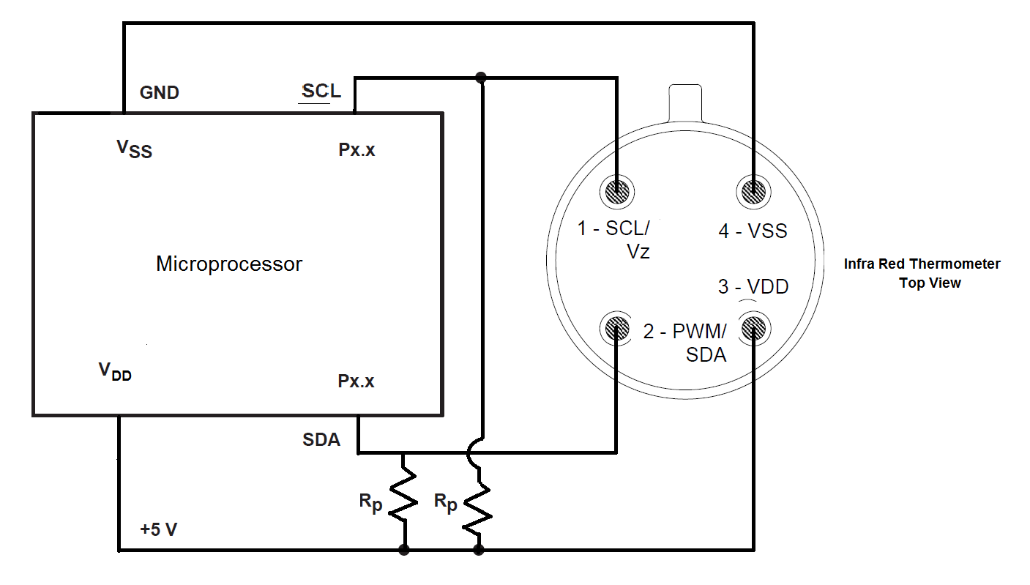
Temperature Sensor Schematic

Slide 24
Microprocessor

Slide 25
Texas Instruments MSP 430
Model F2013
Why MSP 430 F2013?
  Low Power
    Active Mode: 220 μA at 1 MHz, 2.2 V
    Standby Mode: 0.5 μA
    Off Mode (RAM Retention): 0.1 μA
  Ease of Development
    USB Stick Development Tool
    GRACE Development Software
    Code Composer Studio
  8 Onboard Analog to Digital Converters
    No need for PCB mounted ADCs
  10 General Purpose Digital I/O Pins

Slide 26
Microprocessor Pin Assignments
PIN ASSIGNMENTS
Pin | Device
2 | Transformer Low Line Current Sensor
3 | Transformer Low Line Voltage Sensor
4 | Transformer High Line Current Sensor
5 | Transformer High Line Voltage Sensor
6 | Infrared Temperature Sensor Serial Clock Line (SCL)
7 | Infrared Temperature Sensor Serial Data Line (SDA)
12 | Xbee Clear To Send (CTS)
8 | Xbee Ready To Send (RTS)
9 | Xbee Data Out (DO)
13 | Xbee Data In (DI)
1 | Infrared Temperature Sensor Supply Voltage (3V)
14 | Infrared Temperature Sensor Ground (0V)
10 | Not Connected
11 | Not Connected

Slide 27
Microprocessor Tasks
Monitor:
  Transformer Input and Output Voltage
  Transformer Input and Output Current
  Transformer Surface Temperature
Data:
  Receive and store caution and threshold updates
  Transmit transformer line sensor and temperature sensor data
  Transmit transformer state

Slide 28
Microprocessor Tasks
Functionality
  Transmit data at frequency based on transformer state
    Normal State: 30 minutes
    Caution State: 30 seconds
    Warning State: 5 seconds
  Transmit data when requested by central hub

Slide 29
Transformer States
Warning State
  At least one of the sensors is reporting data outside of the normal and caution ranges
Caution State
  No sensors are reporting data in the warning range and at least one sensor is reporting data inside of the caution range
Normal State
  All sensors are reporting data inside of the normal range

Slide 30
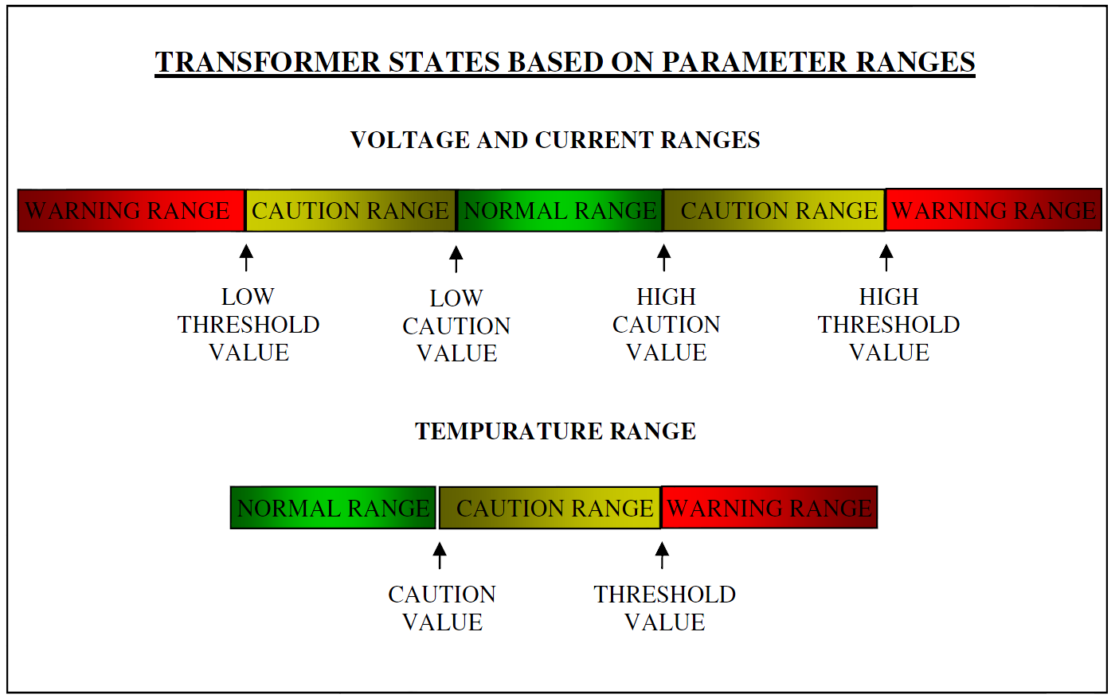
Transformer States

Slide 31
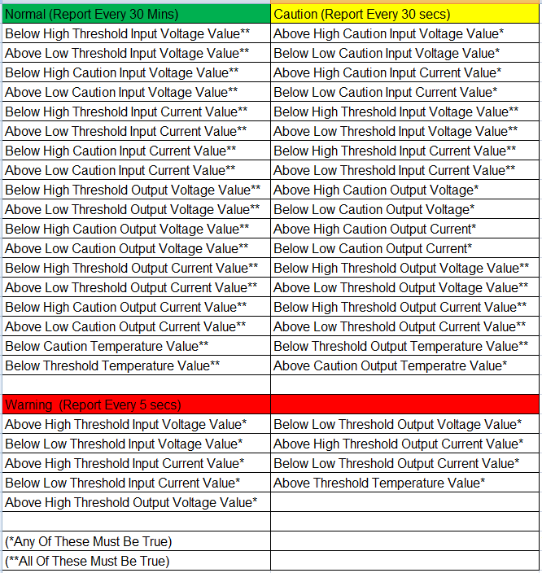
Transformer States

Slide 32
Wireless
Communication

Slide 33
Network Requirements
System must have potential to handle several Monitoring Boxes.
Hub station must be able to directly communicate to Monitoring Boxes about 1 mile away.
Monitoring Boxes farther than 1 mile must indirectly communicate to the hub station.

Slide 34
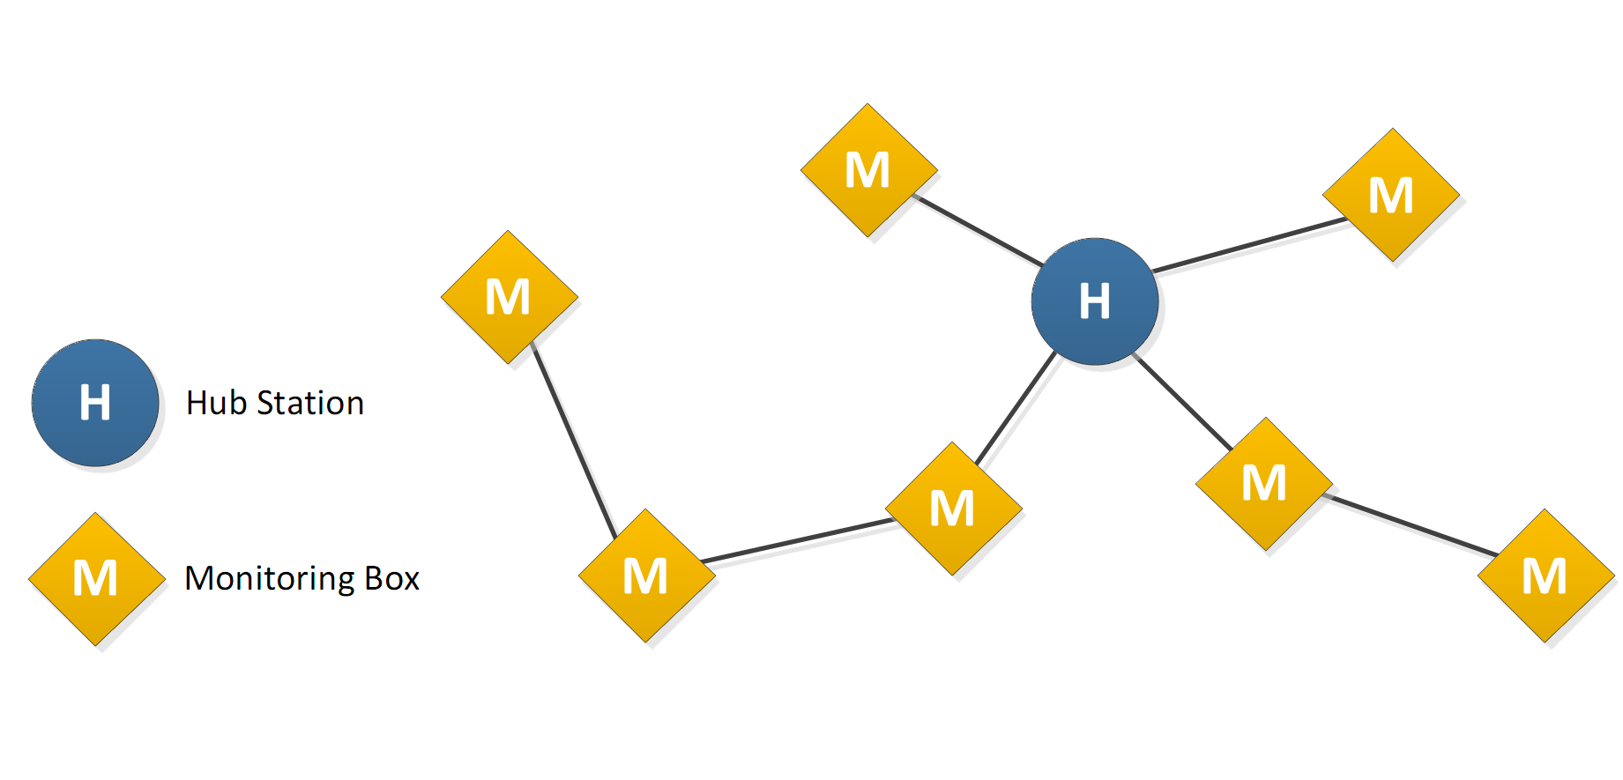
Sample Network Diagram
Hub station communicates with multiple boxes.
Boxes closer to the hub station send relay information from boxes farther away.

Slide 35
Zigbee Advantages
Based on the IEEE 802.15.4 specification.
Designed for mesh networks.
Self-healing network.
ex. If a Monitoring System goes down, others that relied on it will reroute through other Systems to get in touch with the hub station.

Slide 36
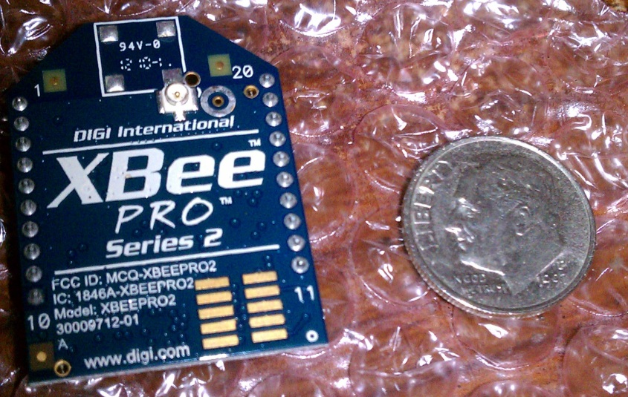
XBee-Pro ZB Zigbee
XBee modules are simple to work with.
RF line-of-sight range up to 2 miles (63mW transmit power)
3.3V CMOS Logic
Frequency: 2.4 GHz
Will use a Yagi antenna

Slide 37
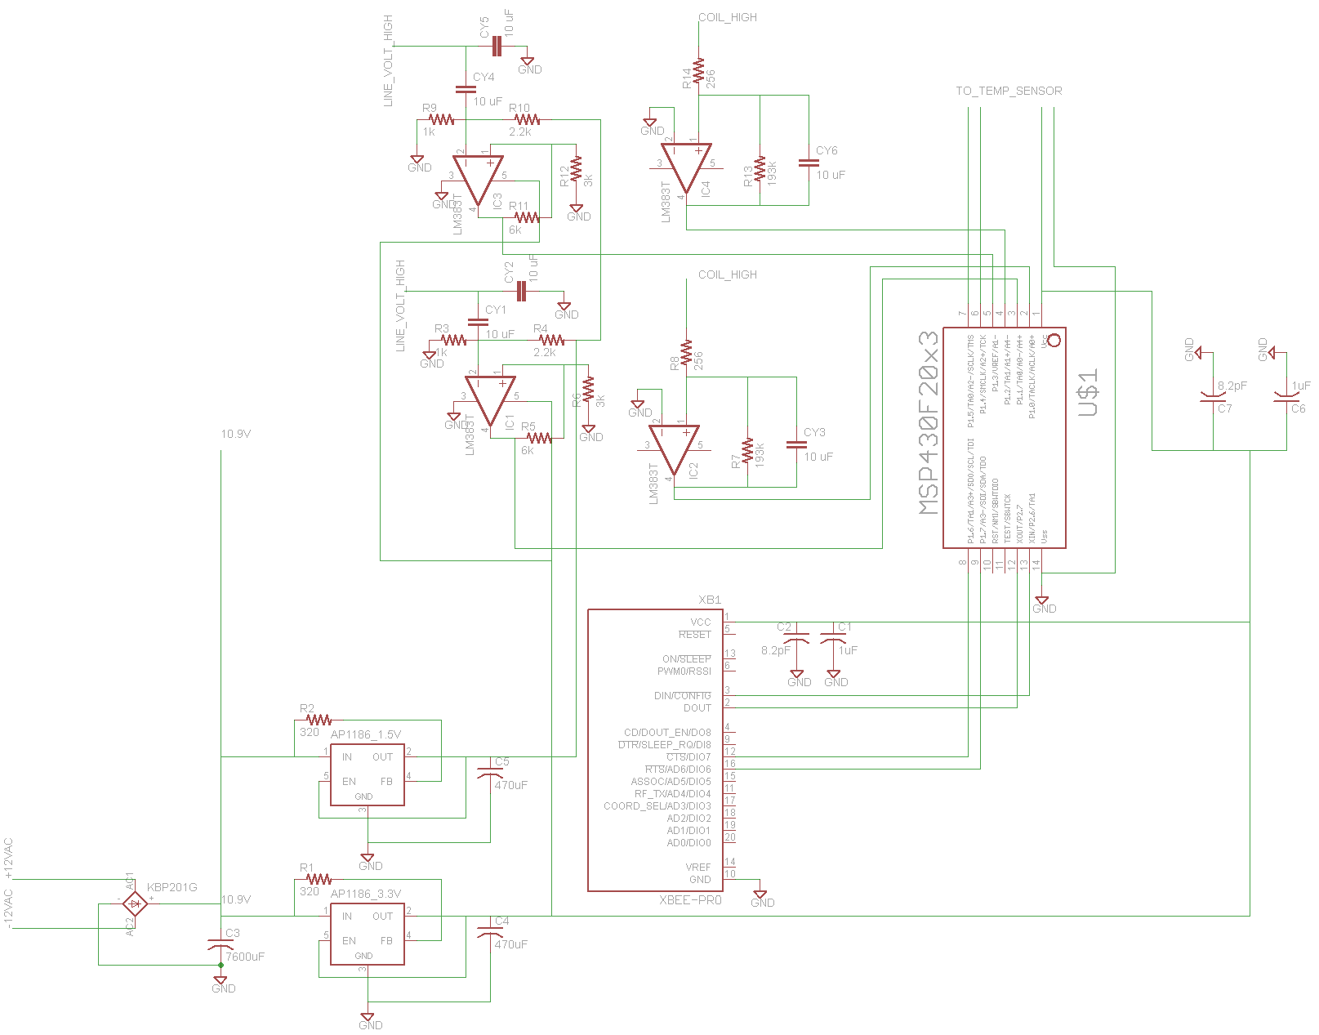
XBee Schematic
Vcc
to MSP430

Slide 38
Full Schematic

Slide 39
Central Hub Program

Slide 40
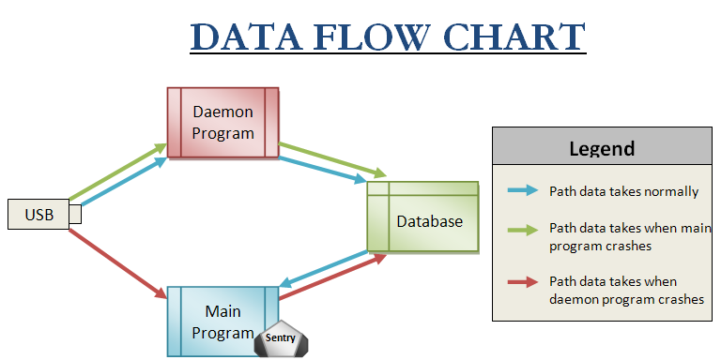

Slide 41
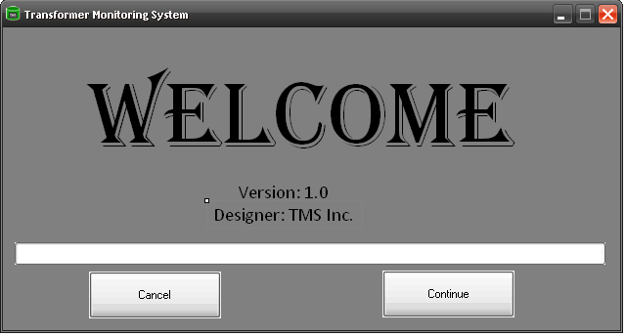
Welcome Splash Screen

Slide 42
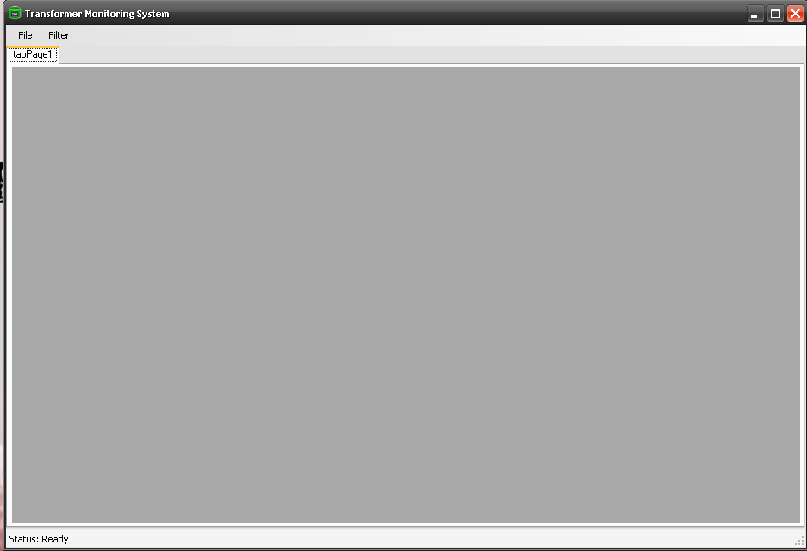
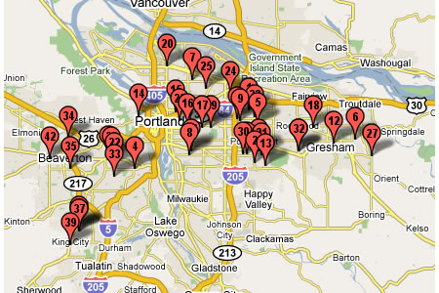
Main Program Interface

Slide 43
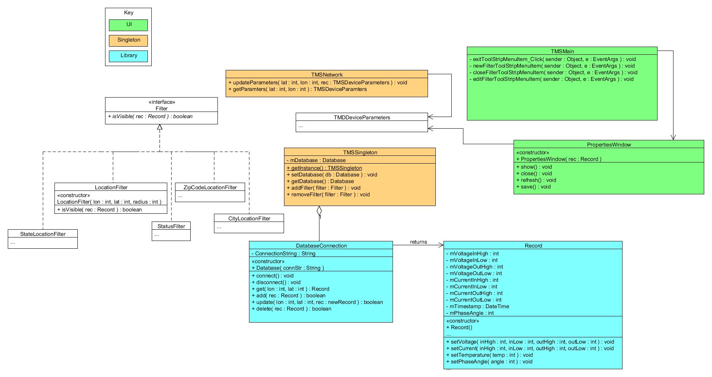
Program UML

Slide 44
Problems Thus Far
Don’t know how to implement Google API yet
Haven’t figured out how to communicate with wireless USB port in order to send and receive data
Don’t know if the Daemon program will be a window service or just a stand alone process

Slide 45
Administrative Content

Slide 46
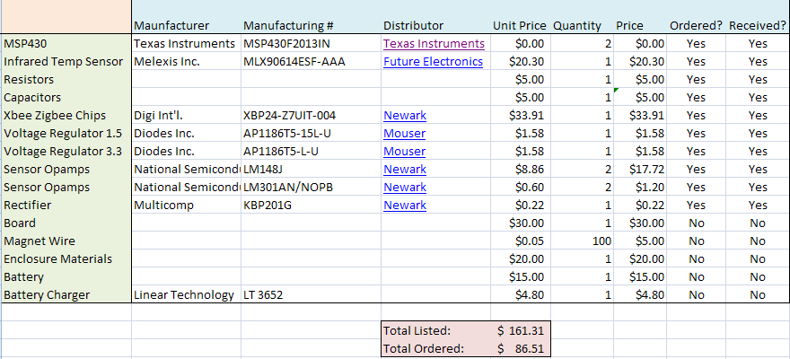
Budget & Finances

Slide 47
Progress Report

