Slide 1
Transformer Monitoring System
Group 8
Bradley Tanner Charles Payne Jon Rowe Robert Howard

Slide 2
Project Description
  The Transformer Monitoring System (TMS) is a device that connects to a pole mounted transformer and monitors:
    Voltages and Currents coming into and out of the transformer
    Overall temperature of the transformer
    The phase angle of the voltage and current

Slide 3
Motivation
Government wants Smart Grid by 2030
Need for technologies to counter prolonged downtime of electrical power lines
Tired of power companies relying on the public for important notifications when power is out
No inexpensive method out on the market today that monitors everyday pole mounted transformers

Slide 4
Block Diagram
Power
Voltage Sensor
Brad
Brad
Current Sensor
Microprocessor
Wireless
Central Hub
Brad
Charles
Jon
Robert
Heat Sensor
Robert

Slide 5
Overall Goals and Objectives
Effectively and accurately read and record valuable information about the transformer
Transfer the data wirelessly without any loss in accuracy to a central hub
Store the data in a database for future use
Display the data in a nice, neat, organized fashion for the user to analyze

Slide 6
Hardware Goals and Objectives
Should be weather proof
Must meet Government regulations
Must be small and lightweight
Easy to install and replace
Non-Intrusive to existing power lines
Must be cost effective

Slide 7
Hardware Specifications
No more than 20 pounds
Less than $200 per unit
Able to handle 50kVA to 100kVA
Able to handle temperatures up to 150⁰C
Able to withstand hurricane like storms

Slide 8
Power

Slide 9
Power Supply
Considerations for the power supply
Be able to adapt to changes in the power line
Have the ability to power the system in a power outage

Slide 10
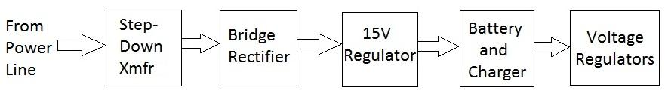
Power supply – Block Diagram

Slide 11
Power supply – Power Tap
The power is supplied by two power line taps. These are connected to the 120 volt and ground lines. The wires are then connected to a 120v to 24v step down transformer.

Slide 12
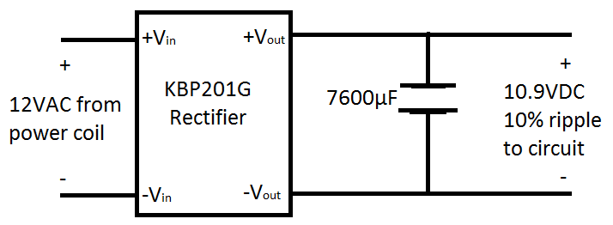
Power Supply – Rectifier Schematic
The KBP201G rectifier is used to convert
the AC power to DC. The rippled output
is then smoothed by a capacitor.

Slide 13
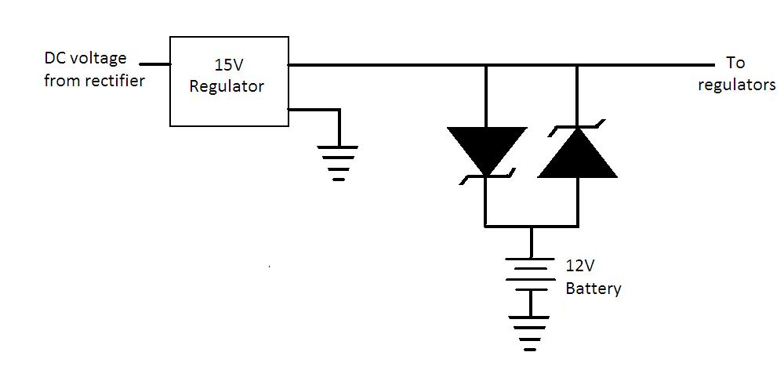
Power Supply – Battery & Charger
Two 15 volt regulators are placed at the rectifier output to maintain a constant voltage. Two Schottky diodes are then used to form the simple charging and low power detection circuit.

Slide 14
Power Supply – Voltage Regulators
Use of two Diodes Incorporated regulators
3.3v for microcontroller, Xbee,
3.1v for supplying DC offset voltage to sensors

Slide 15
Sensors

Slide 16
Voltage Sensors
The problem with commercially available sensors is they measure RMS values or the cost is too great.
The solution to the problem was building our own. This kept costs down and within budget.

Slide 17
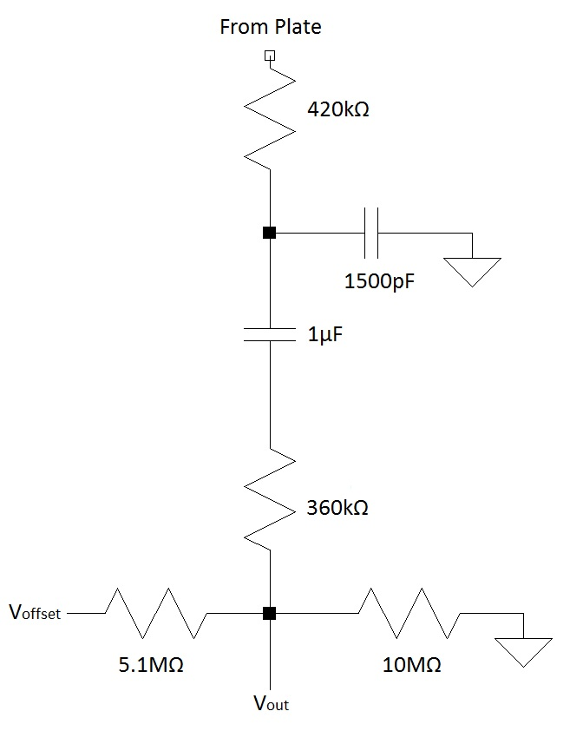
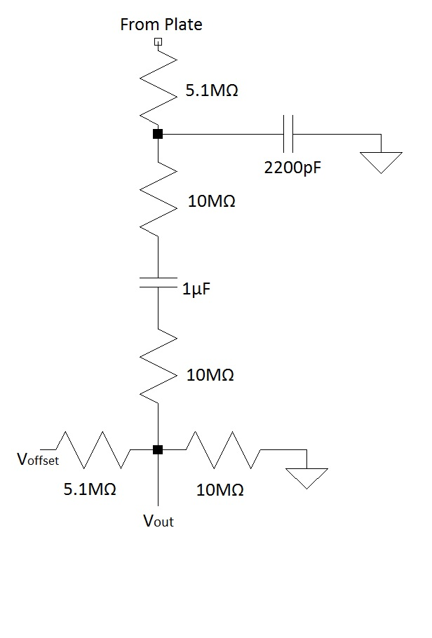
Voltage Sensor Schematic

Slide 18
Current Sensors
The problem with commercially available sensors either too bulky or too expensive.
The solution was to make a current transducer type sensor.

Slide 19
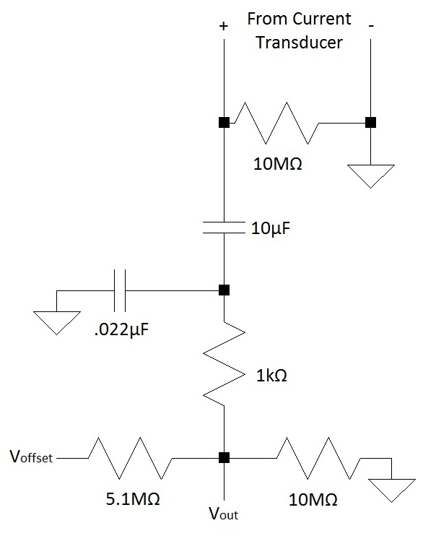
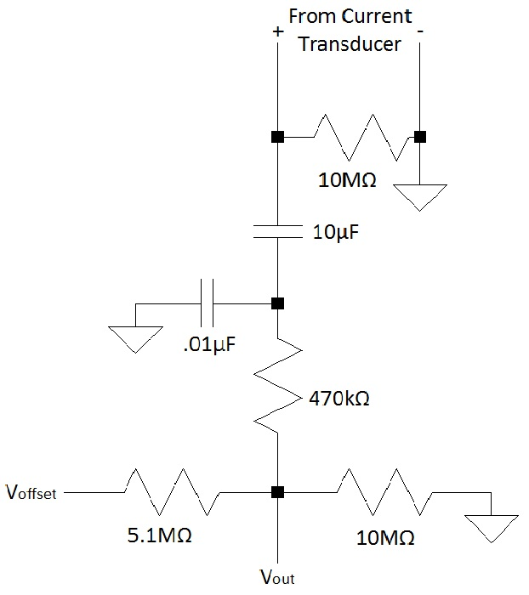
Current Sensor Schematic

Slide 20
Temperature Sensor
MLX90614ESF-AAA Infrared Temperature Sensor
Non-Contact: therefore, non intrusive
90° Field of view
Temperature ranges of -70 to 380°C
Small and compact

Slide 21
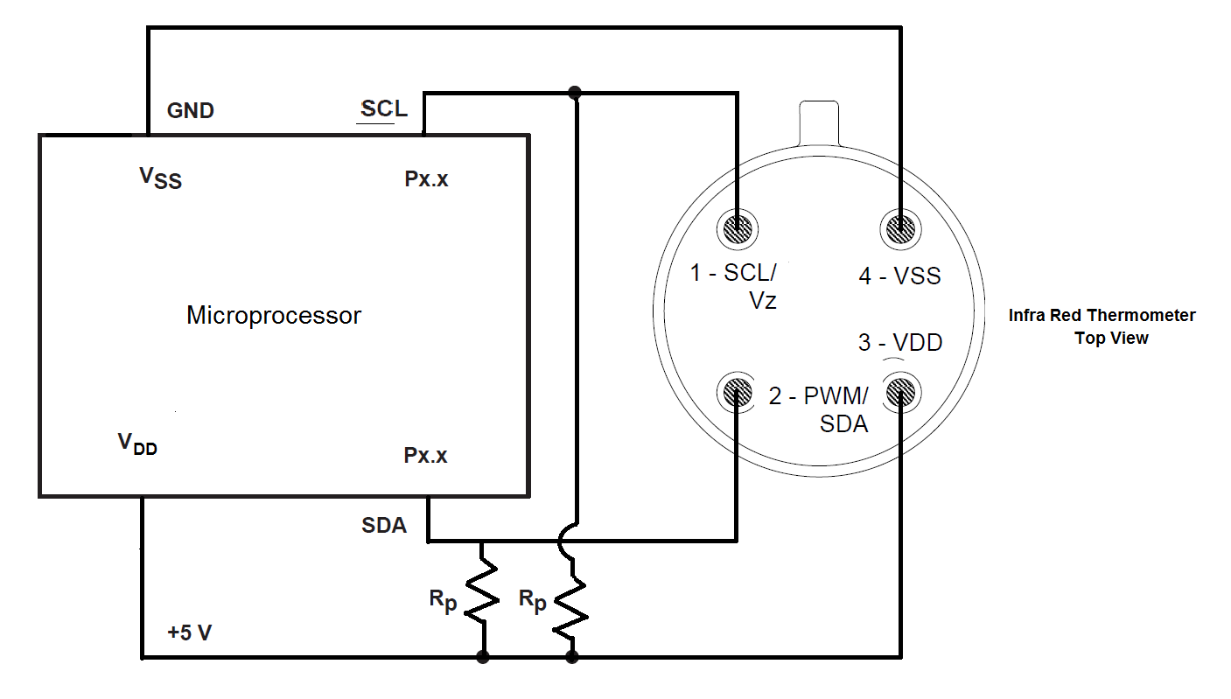
Temperature Sensor Schematic

Slide 22
Microprocessor

Slide 23
ATMEL ATMEGA328
Why ATMEGA328?
  Ease of Development
    Arduino Development Board
    Simple Straightforward Programming Code
    Ability To Remove From Development Board and Insert Directly onto our PCB
  6 Onboard Analog to Digital Converters
    No need for PCB mounted ADCs
  SCL AND SDC capability to Interface with Infrared Temperature Sensor
  Serial Transmit and Receive Capability to Interface with the XBEE Wireless Transceiver

Slide 24
Microprocessor Pin Assignments
PIN ASSIGNMENTS
Pin | Device
26 | Transformer Low Line Current Sensor
25 | Transformer Low Line Voltage Sensor
24 | Transformer High Line Current Sensor
23 | Transformer High Line Voltage Sensor
28 | Infrared Temperature Sensor Serial Clock Line (SCL)
27 | Infrared Temperature Sensor Serial Data Line (SDA)
3 | Xbee Data Out (DO)
2 | Xbee Data In (DI)
7 | VCC (3.3V)
8, 22 | Earth Ground (0V)

Slide 25
Microprocessor Tasks
Monitor:
  Transformer Input and Output Voltage
  Transformer Input and Output Current
  Transformer Surface Temperature
Data:
  Receive and store caution and threshold updates
  Transmit transformer line sensor and temperature sensor data
  Transmit transformer state

Slide 26
Microprocessor Tasks
Functionality
  Transmit data at frequency based on transformer state
    Example:
      Normal State: 30 minutes
      Caution State: 30 seconds
      Warning State: 5 seconds
  Transmit data when requested by central hub
  Transmit threshold values when requested by central hub
  Receive threshold value updates when sent from central hub

Slide 27
Transformer States
Critical State
  At least one of the sensors is reporting data outside of the normal and warning ranges
Warning State
  No sensors are reporting data in the critical range and at least one sensor is reporting data inside of the warning range
Normal State
  All sensors are reporting data inside of the normal range

Slide 28
Transformer States Determination
Example Code:
if (VOLT1>V1_LOW_WARNING && VOLT1<V1_HIGH_WARNING){
V1_STATE = NORMAL_STATE;
}
else if (VOLT1>V1_LOW_CRITICAL && VOLT1<V1_HIGH_CRITICAL){
V1_STATE = WARNING_STATE;
}
else{
V1_STATE = CRITICAL_STATE;
}
if (VOLT2>V2_LOW_WARNING && VOLT2<V2_HIGH_WARNING){
V2_STATE = NORMAL_STATE;
}
else if (VOLT2>V2_LOW_CRITICAL && VOLT2<V2_HIGH_CRITICAL){
V2_STATE = WARNING_STATE;
}
else{
V2_STATE = CRITICAL_STATE;
}

Slide 29
Transformer States Determination
Example Code:
overall_state=0;
if (V1_STATE == NORMAL_STATE && V2_STATE == NORMAL_STATE && V3_STATE == NORMAL_STATE && V4_STATE == NORMAL_STATE && TEMP_STATE == NORMAL_STATE && PHASE1_STATE == NORMAL_STATE && PHASE2_STATE == NORMAL_STATE){
overall_state = 1;
}
if (overall_state == 0){
if (V1_STATE != CRITICAL_STATE && V2_STATE != CRITICAL_STATE && V3_STATE != CRITICAL_STATE && V4_STATE != CRITICAL_STATE && TEMP_STATE != CRITICAL_STATE && PHASE1_STATE != CRITICAL_STATE && PHASE2_STATE != CRITICAL_STATE){
overall_state=2;
}
}
if (overall_state==0) {
overall_state = 3;
}

Slide 30
Reception of Threshold Updates:
Example Update String:
@ 201 901 201 901 201 901 201 901 101 51 51 401 701 401 701 401 701 401 701 91 31 31%
A character (@) is sent at start of update string notifying the microprocessor that it is about to receive a threshold update string of chars
Threshold values are sent in a predetermined order with spaces to separate each value
Chars are read from right to left
The chars are converted to integers
Each char of each threshold is multiplied by a multiple of ten and added together
Each threshold is then stored in the processor’s memory

Slide 31
Wireless
Communication

Slide 32
Network Requirements
System must have potential to handle several Monitoring Boxes.
Hub station must be able to directly communicate to Monitoring Boxes.
Monitoring Boxes out of Hub Station range must use closer monitoring boxes to communicate with Station.

Slide 33
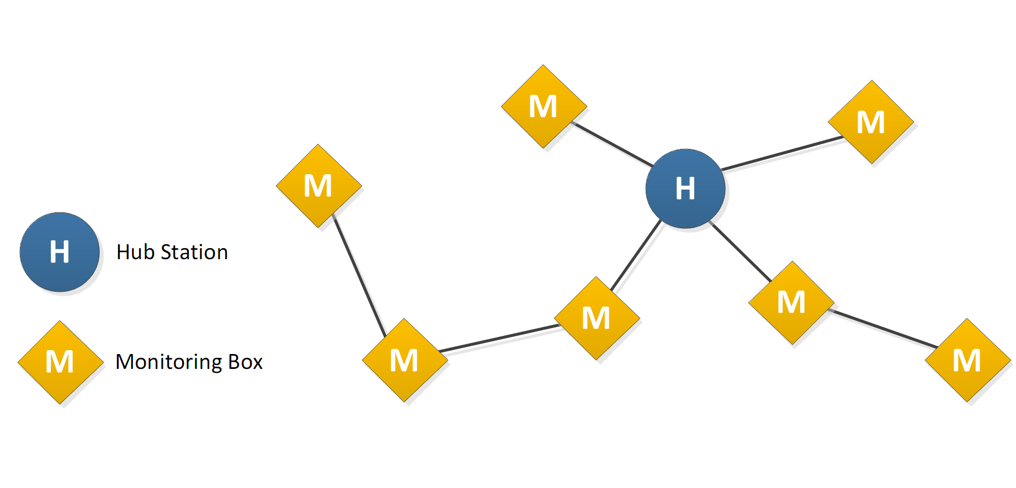
Sample Network Diagram
Hub station communicates with multiple boxes.
Boxes closer to the hub station send relay information from boxes farther away.

Slide 34
Zigbee Advantages
Based on the IEEE 802.15.4 specification.
Designed for mesh networks.
Self-healing network.
ex. If a Monitoring System goes down, others that relied on it will reroute through other Systems to get in touch with the hub station.

Slide 35
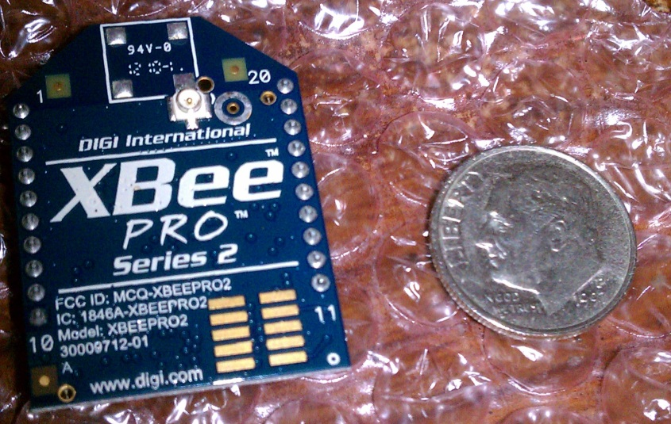
XBee-Pro ZB Zigbee
XBee modules are simple to work with.
RF line-of-sight range up to 2 miles (63mW transmit power)
3.3V CMOS Logic
(direct communication
with microcontroller)
Frequency: 2.4 GHz

Slide 36
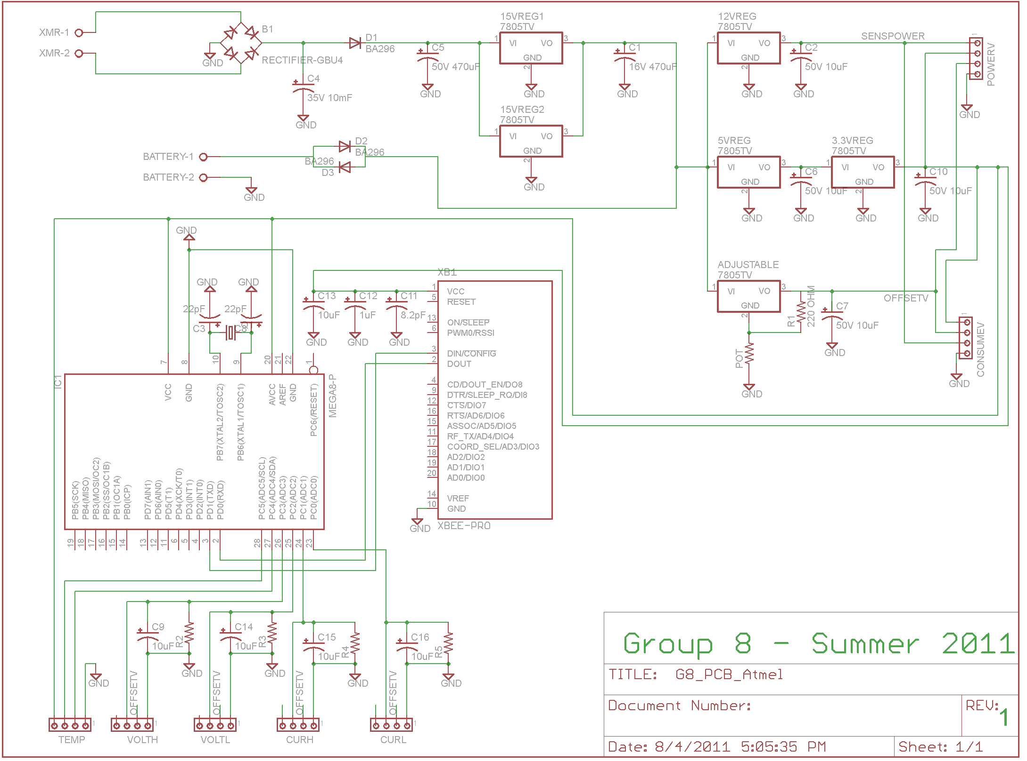
Full Schematic

Slide 37
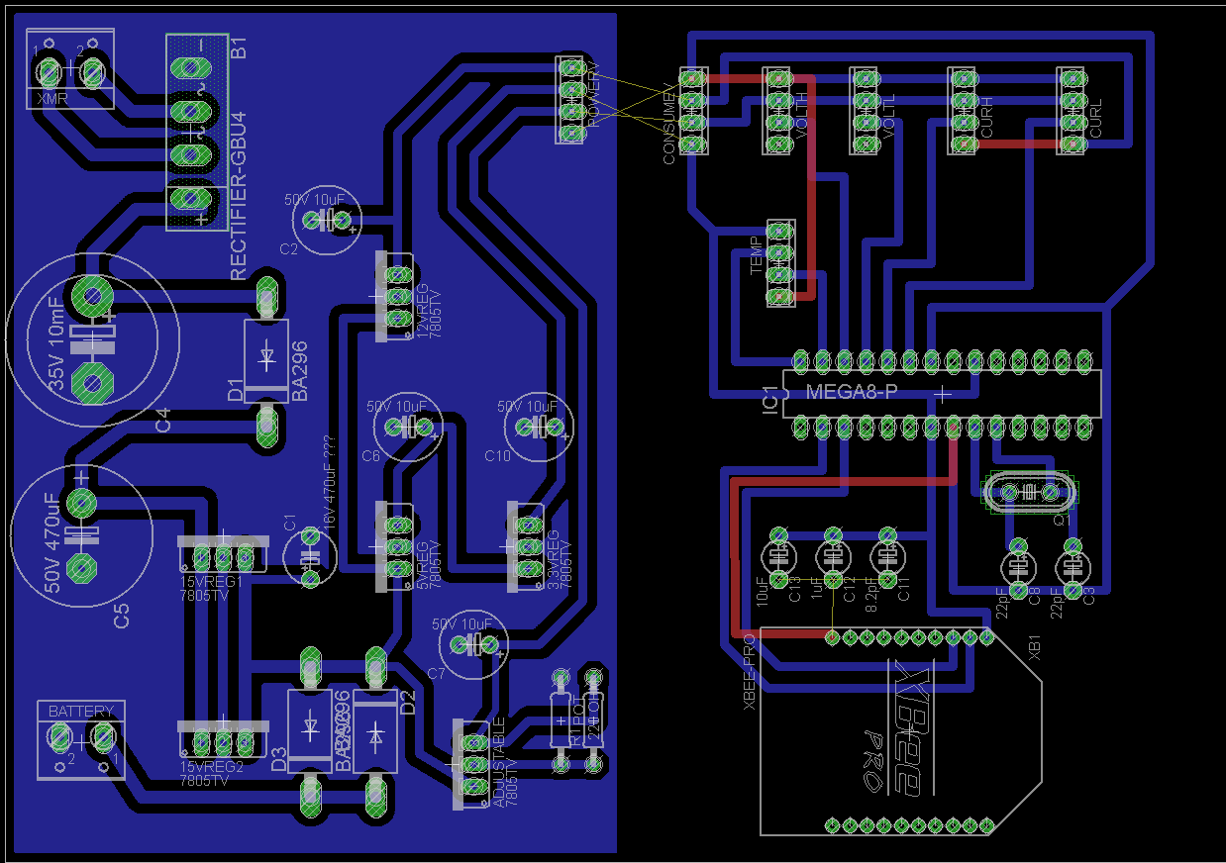
Full Schematic

Slide 38
Central Hub Program

Slide 39
Software Data Flow
Data flows from serial port to:
  Daemon program: parses string input data
  MySQL Database: stores data for future use
  Web application: displays data, allows user input
Data Flow Chart
Daemon
Program
Legend
Path data takes ideally
Path data takes when web application crashes
Web
Application
Database
USB

Slide 40
Daemon Program
  Handles the connection between the USB port and the database while running in background
  Made to be resilient to faults by using try-catch statements.
    Tries code until exception is thrown
    Tries to deal with exception on its own
    If it cannot, falls out of try-catch statement
    and returns to ready state

Slide 41
Daemon Program
  Parses the input data from the Xbee serial port
  Input string will take on the form of either:
@(±)##.##(±)##.## ##_ ##_ ##_ ##_ ##_ ##_ ##_%
  for receive status updates or:
  @(±)#.#(±)#.# # # # # # # # # # # # # # # # # # # # # # #%
  for receive parameter updates
Serial Number | Voltage | Current | Temperature | Phase Angle

Slide 42
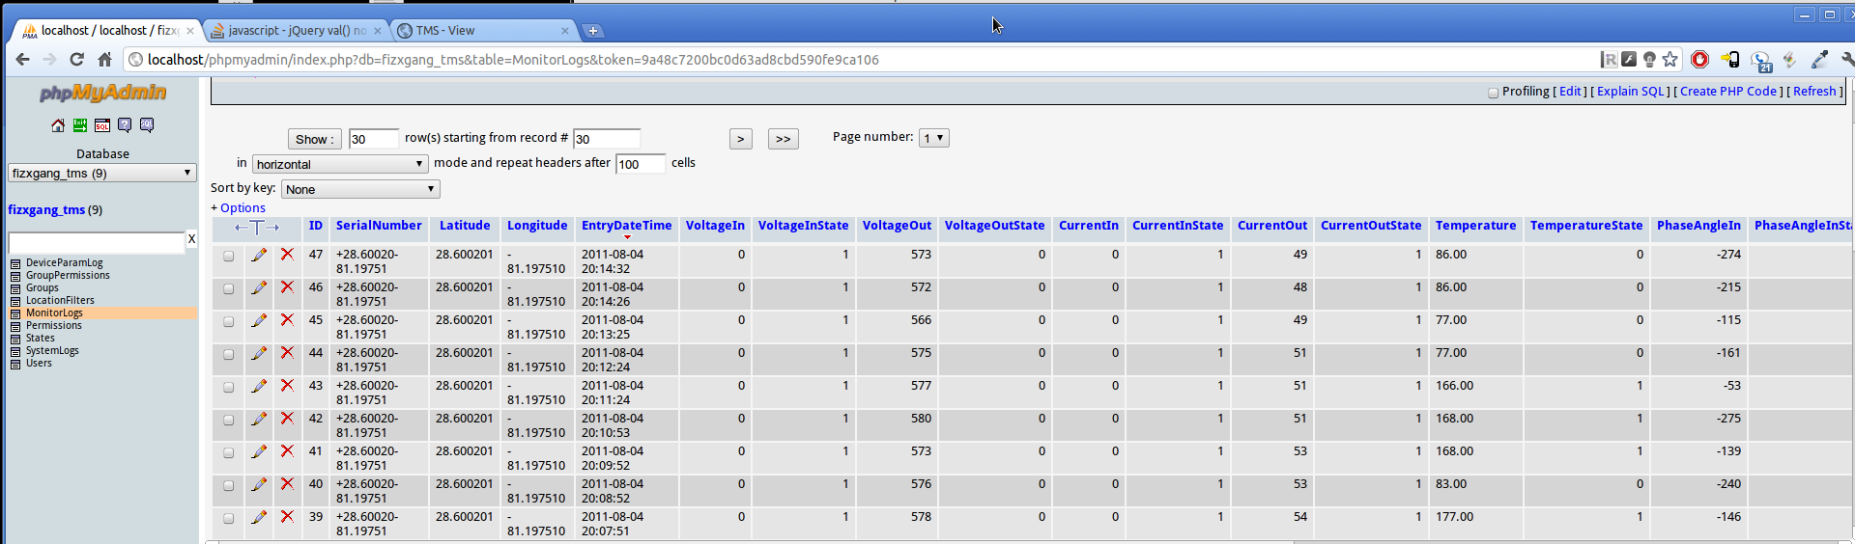
MySQL Database
Stores all device status logs
Can be located off-site from both daemon and web server
Stores location filter settings

Slide 43
Web Application
Displays latest node information from database
Allows user to request a new update from a node
Allows user to set new parameters on a particular node
Customizable views

Slide 44
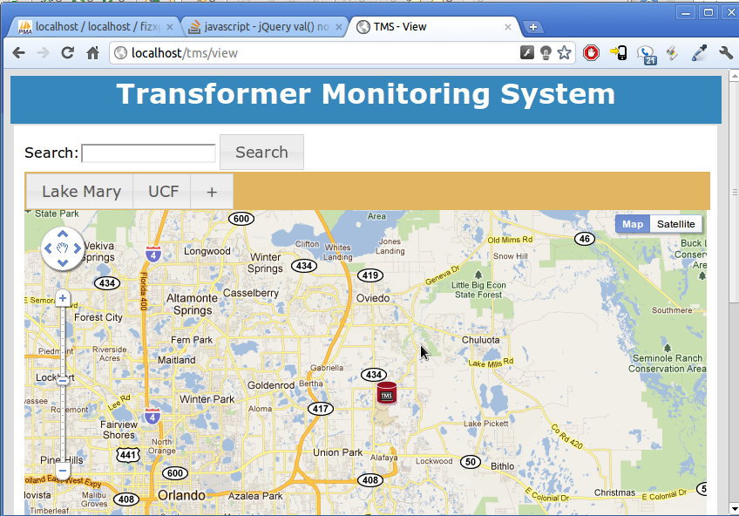
Web Application

Slide 45
Administrative Content

Slide 46
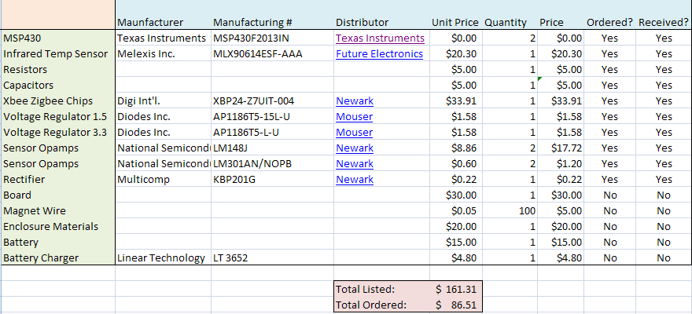
Budget & Finances

