Slide 1

On Board Droid
Vehicle Monitor Control System

Slide 2
Group Members
Josh Estes CpE
Matthew Huereca CpE
Alex Powell EE
Firoz Umran CpE
Group 9

Slide 3
What is On Board Droid?
A system that allows users to view critical vehicle data as well as control certain aspects of a vehicle via Android application and On-Board Diagnostics port (OBD-II)
A means to communicate with a Vehicle’s Engine Control Unit (ECU)
A cheaper and more comprehensive version of existing systems

Slide 4
Objectives
Using Android 2.1 or later:
Allow user to view OBD data
Include capabilities to log data such as gas mileage, speed and air pressure
Allow user to turn vehicle on, turn accessories on and start vehicle engine
Allow user to lock and unlock car, roll windows up and down and pop trunk
Allow user to clear error codes

Slide 5
Timing Advance
Engine RPM
Coolant Temperature
Throttle Position
Fuel Level
Time Since Engine Start
Air Intake Temperature
Speed/ Average Speed
Mass Air Flow
Intake Manifold Pressure
Fuel Pressure
Engine Load
Fuel Economy/ Average Fuel Economy/ Miles to Empty
Battery Voltage
Error Codes
Unlock/Lock
Start Engine
Open Trunk
Panic
Roll up/down Windows
OBD Functions
Physical Functions

Slide 6
Specifications
Feature Spec
Starting Car 10 Seconds
Window Control 3 Seconds
Lock Control 3 Seconds
Alarm Control 3 Seconds
Trunk Control 3 Seconds
OBD-II Reading 3 Seconds
Bluetooth Connect 10 Seconds

Slide 7
Specs Continued
Feature Spec
Range 100 meters
Price, project 300 dollars
Price, system 100 dollars

Slide 8
High Level Design

Slide 9
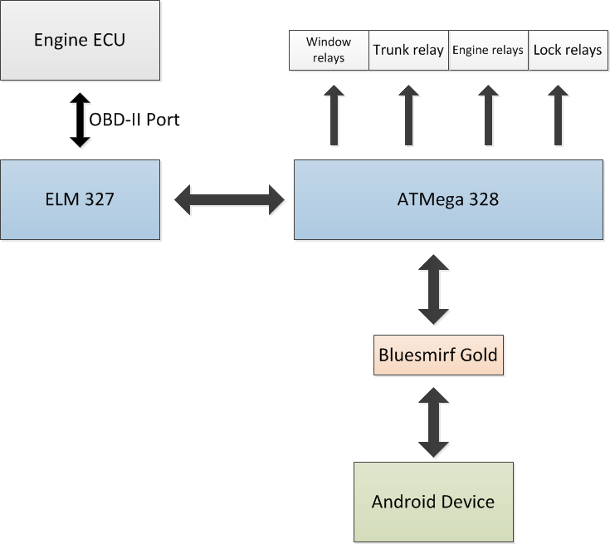
High Level Design

Slide 10
Wireless Communication
Bluetooth or WiFi?
 | Bluetooth | WiFi (a) | WiFi (b) | WiFi (g)
Standard | 802.15 | 802.11a | 802.11b | 802.11g
Frequency(Ghz) | 2.45 | 5 | 2.4 | 2.4
Speed(Mbps) | 0.72 | 54 | 11 | 54
Range | 10 - 100m | 50m | 100m | 100m
Advantage | Low Cost | Speed | Low Cost | Speed
Disadvantage | Range | Cost | Speed | Cost, Range

Slide 11
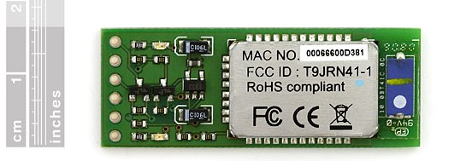
BlueSMiRF Gold
Class 1 Radio Bluetooth Modem
Low Power Consumption: 25mA
Operates on 3.3 Volts – 6 Volts
Operates in harsh RF environments like WiFi, 802.11g, and Zigbee
Encrypted Connection
Frequency: 2.4 GHz – 2.524 GHz

Slide 12
Arduino UNO
C based programming
Large community of developers
Open source hardware
Well documented programming help
Price: $30

Slide 13
ATmega328 Microcontroller
Compatible with Arduino development board
16 input/output pins
Operates on 5 Volts
6 Volt – 20 Volt input Limits
32Kbytes of flash memory
Price: $9.51

Slide 14
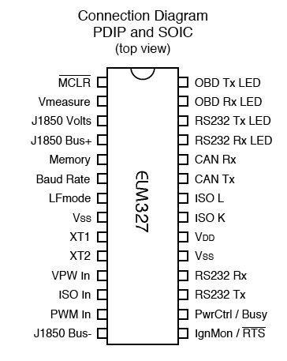
ELM 327
Supports all OBD-II protocols and automatically selects correct type
Configurable command set
Power Control with standby mode
28 pin chip

Slide 15
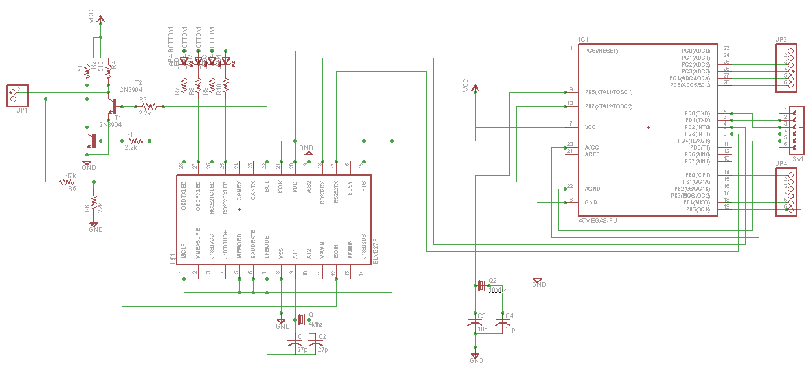
Schematic Diagram

Slide 16
MCU Software
Receives serial data from bluetooth chip
Compare data header
If OBD-II data, pass to ELM 327 and listen for response
Else, compare data further and turn on corresponding relay

Slide 17
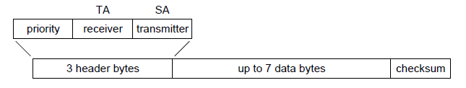
OBD-II Data
Data requests are sent in a standard format from the diagnostics tool (Android) to the OBD-II port.
The first 3 bytes sent are the header. Then, 1 to 7 data bytes follow.
Lastly, there is a check sum byte

Slide 18
Data Bytes
First data byte is mode – 9 modes, determines the type of data being requested
Second data byte is the parameter identification (PID) which specifies the data being requested
Any additional bytes are used to further specify

Slide 19
OBD-II Response
The response sent from the vehicle’s ECU back to the OBD-II port, has a similar structure as the request message
3 header bytes, 7 data bytes
The first of the data bytes represents the mode, second represents PID, and remaining bytes represent actual data
Conversions take place in Android application, not MCU

Slide 20
Response Conversion
PID | Description | # Bytes | Calculation
04 | Load value percent. | 1, A | A*100/255 = engine load%
05 | Coolant temperature in degrees C | 1, A | Deg = A – 40
06 | Short term fuel percent | 1, A | .7812 * (Byte A – 128)
0A | Fuel pressure in kPa | 1, A | Pressure = A * 3
0B | Intake manifold pressure kPa | 1, A | Pressure = A
0C | Engine RPM | 2, A and B | RPM = .25 * (A*256 + B)
0D | Vehicle speed, in km/h | 1, A | Speed = A
0E | Timing advance in degrees | 1, A | Advance = (.5 * A) – 64
0F | Intake air temperature in degrees Celsius | 1, A | Degrees = A - 40
10 | MAF air flow | 2, A and B | Air flow = .01*(256*A+B)
11 | Throttle position | 1, A | Position % = .3922 * A

Slide 21
Software

Slide 22
Connecting Via Bluetooth
Create bluetooth device with name of Device
Create bluetooth socket object and connect()
OutputStream out
out.write()
InputStream in
in.read()
Clear buffer after every read

Slide 23
Reading Issues
Problem
The reader would get command but program would not get the response.
Application would sit in an infinite loop.
Reason
The data would have already been sent before the thread begins to listen for response.
Since read() is a blocking command it did not allow the program to continue

Slide 24
Solution
Create a thread whose sole purpose is to listen for response.
Have that thread start before any data is sent to the Bluetooth Device.
Have a boolean variable to tell when the thread has read data so it may clear the buffer.

Slide 25
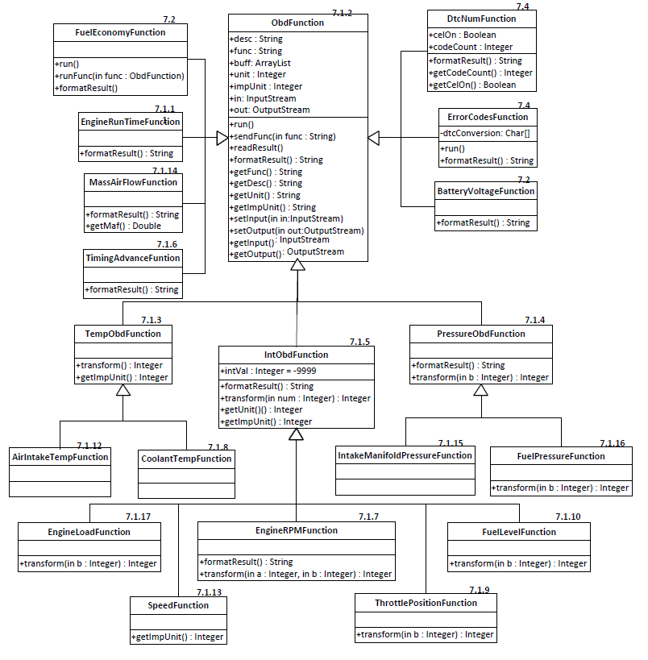

Slide 26
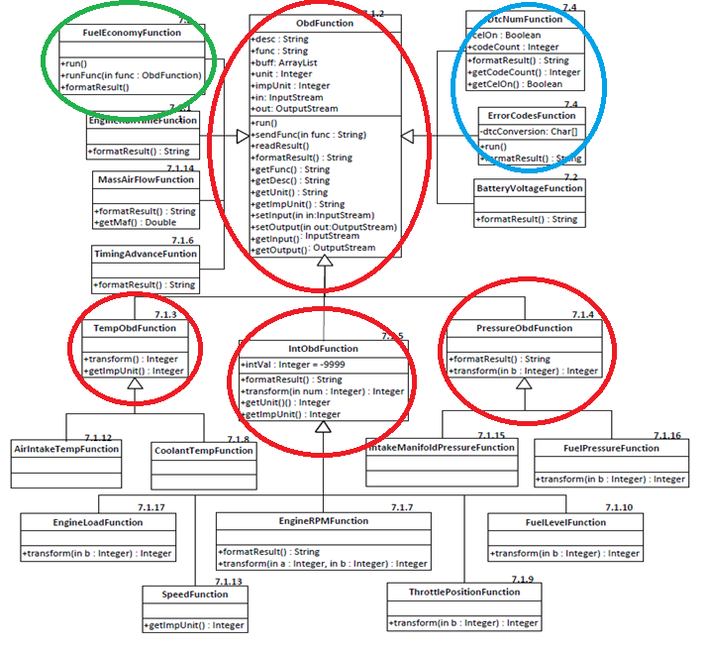

Slide 27
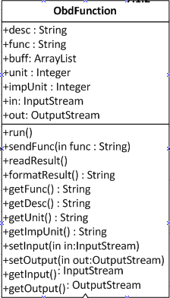
ObdFunction
sendFunc(String func)
Sends command to bluetooth chip described by func.
setInput(InputStream in)
Sets inputStream from bluetooth socket
Overloaded
formatResult()
getUnit()
getImpUnit()
run()

Slide 28
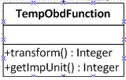
TempObdFunction
.
transform()
Used for all obd functions that deal with temperature:
- 40 used to offset data for negative temperature
getImpUnit()

Slide 29
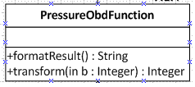
PressureObdFunction
formatResult()
Calls transform(int b)
Data that comes in is the exact amount except in hex.
transform(int b)
Just convert hex value to decimal except for fuel pressure

Slide 30
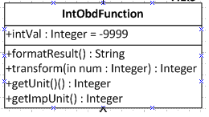
IntObdFunction
Used for functions with Integer values such as RPM and Speed
Each has its own transform and formatResult method.
Also has its own getImpUnit() method based on what the imperial units are

Slide 31
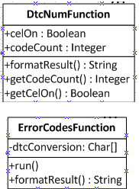
Error Codes
First have to run DtcNumFunction() to see if the CEL is on and to see how many error codes.
Gives 3 error codes per line:
numLines = (num+2)/3
When error codes are received they must be decoded.
Clearing error codes must be done with caution

Slide 32
Error Code Conversion
1ST Digit | Replace w/ | Description
0 | P0 | Power Train Code – SAE defined
1 | P1 | “ “ – Manufacturer Defined
2 | P2 | “ “ – SAE Defined
3 | P3 | “ “ – Jointly Defined
4 | C0 | Chassis Code – SAE defined
5 | C1 | “ “ – Manufacturer Defined
6 | C2 | “ “ – Manufacturer Defined
7 | C3 | “ “ – Reserved for Future
8 | B0 | Body Code – SAE defined
9 | B1 | “ “ – Manufacturer Defined
A | B2 | “ “ – Manufacturer Defined
B | B3 | “ “ – Reserved for Future
C | U0 | Network Code – SAE defined
D | U1 | “ “ – Manufacturer Defined
E | U2 | “ “ – Manufacturer Defined
F | U3 | “ “ – Reserved for Future

Slide 33
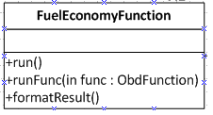
Fuel Economy
Instantaneous data
14.7 = grams of air to 1 gram of gasoline, which is the ideal air/fuel ratio of most vehicles
6.17 = density of gasoline in pounds per gallon (lb/gal)
4.54 = convert pounds per gallon (lb/gal) to grams per pound (g/lb)
.621361 = conversion of kilometers per hour (KPH) to miles per hour (mph)
3600 = seconds per hour
100 = grams per second (g/sec) for mass air flow (Maf)
Speed = speed of vehicle, from OBD
Maf = mass air flow of vehicle from OBD

Slide 34
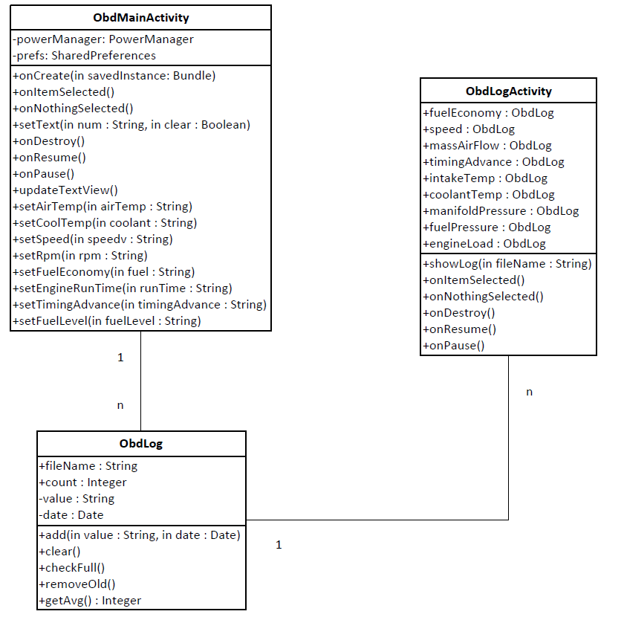
Logging
Ability to review data that has been obtained previously and calculate average values.
Create a log object every time data is updated from main activity, with time/date, name and value.
Put that value in a file with “functionname”_log as title.
Use file to calculate average value
Delete older values from file if file gets too big.

Slide 35
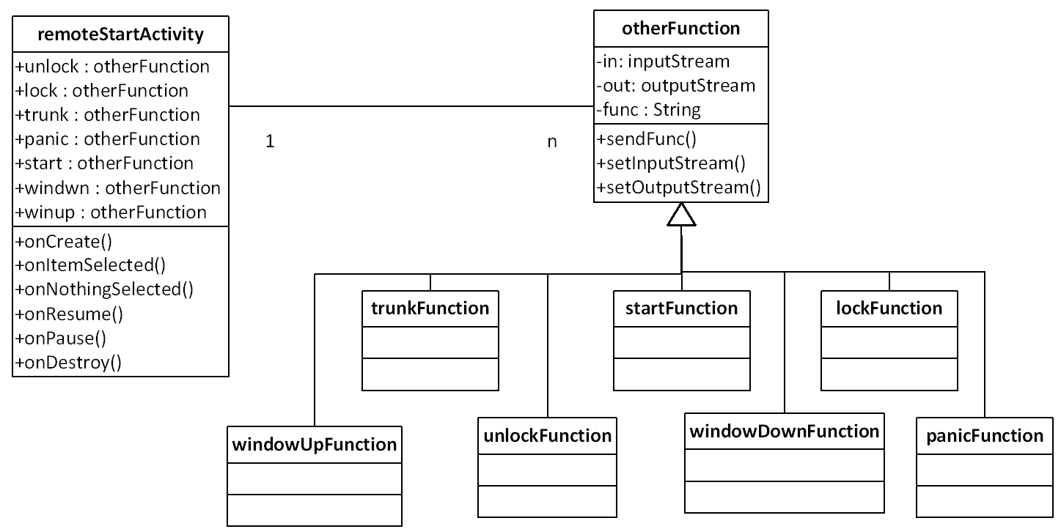
Physical Functions
Function | Header | Data
Unlock | FC | 01
Lock | FC | 02
Pop Trunk | FC | 03
Panic | FC | 04
Windows Down | FC | 05
Windows Up | FC | 06
Start | FC | 07
Will not need to listen for a response from the chip.
Send Header byte along with data to perform desired function using sendFunc() method.

Slide 36
User Interface

Slide 37
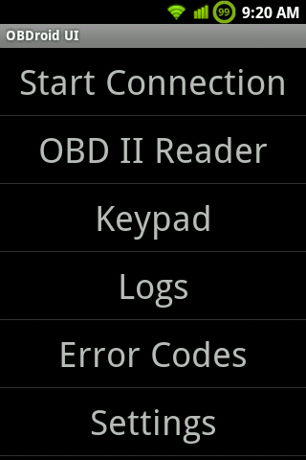
Main Menu
Can manually start connection
Choose the function desired
Simple, easy to understand

Slide 38
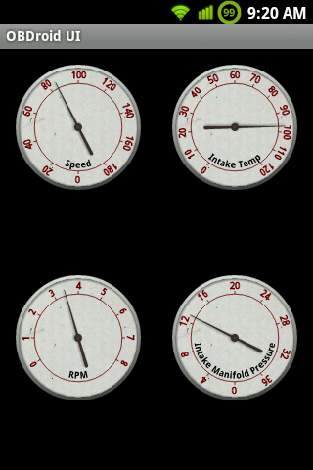
OBD Reader Gauge View
Custom view had to be written for gauges
Uses Canvas object like traditional Java
Draw circle, use image for background
Scale, numbers and label drawn using rotate() on canvas
Other functions call setHandTarget(float input) to change the value of the gauge

Slide 39
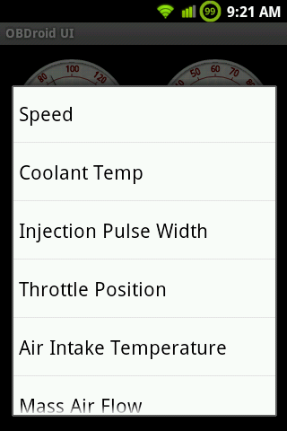
Customizing The Layout
Long-press on any gauge to change its function
Challenge to be able to update each gauge individually
Had to ensure that each gauge had a proper range of values and label

Slide 40
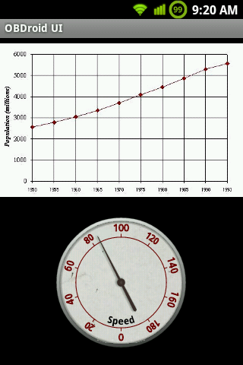
OBD Reader Graph View
Single-press any gauge to pull up this screen
Real-time graph and larger gauge

Slide 41
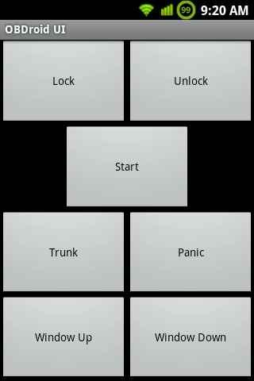
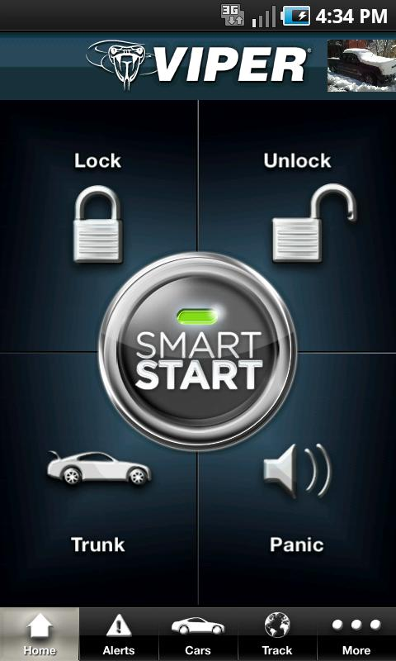
Keypad
Current layout:
Eventually similar to this:

Slide 42
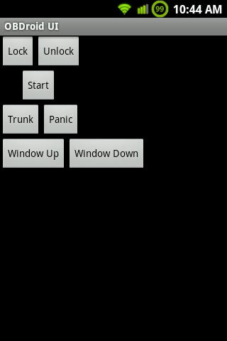
Issues With Layout
General layout correct but still looked wrong
Had to fill out the screen. Could hard-code dimensions in pixels, but needs to be resolution independent
Set width to 0, use layout_weight parameter
<Button android:id="@+id/unlock“
android:layout_width="0dip“
android:layout_height="fill_parent"
android:layout_weight="1"
android:text="Unlock"/>

Slide 43
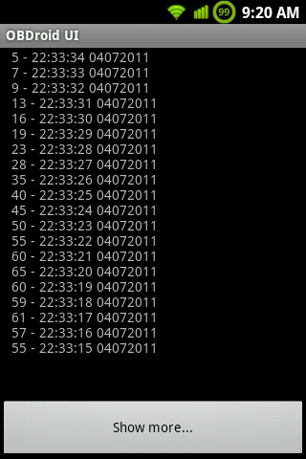
Logs
Logs will be recorded of each function from the OBD and stored in text files on the user’s SD Card
Values can be averaged or shown on a graph

Slide 44
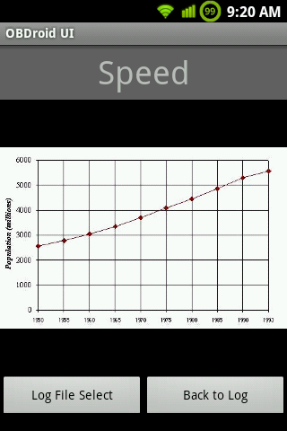
Log Graphing
Static graph of the selected log
Only graphs the most recent set of data
Buttons to return to log select screen

Slide 45
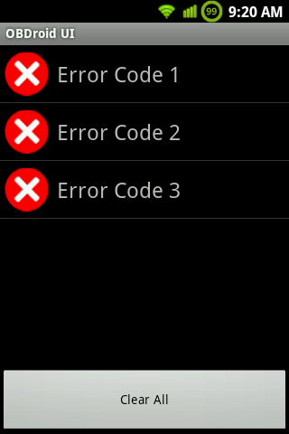
Error Codes
Read error codes from OBD
Able to clear errors from the program
Long-press individual error to find out more information online

Slide 46
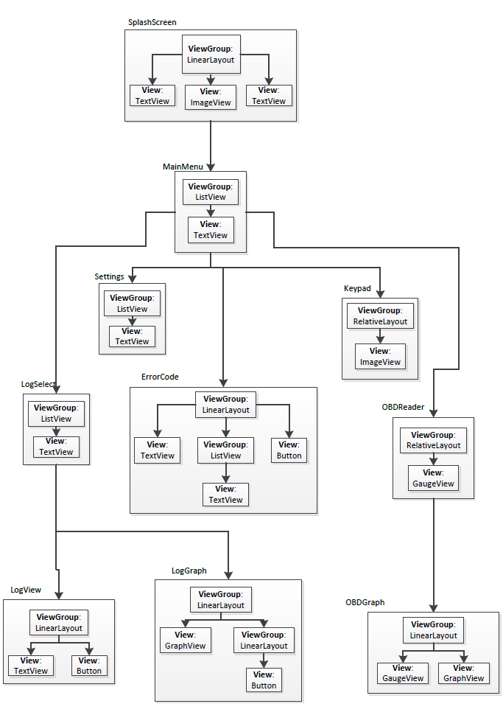
View Design Layout
Design separated into Views and ViewGroups
ViewGroups can be embedded
Sometimes custom Views necessary (gauges, graphs)

Slide 47
Administrative

Slide 48
Budget
Subsystem | Percent Acquired | Current Total | Projected Total
Hardware Development | 92% | $232 | $252
Software Development | 100% | $0.00 | $0.00
PCB Board | 0% | $0.00 | $150.00
‘98 Honda Accord | 100% | $0.00 | $0.00
Smart Phone | 100% | $0.00 | $0.00
Total | 78% | $232 | $402

Slide 49
Progress Graph

Slide 50
Next Step
Test on Breadboard
Order PCB
Test starting car and rolling windows
Implement logging and graphing
Error handling
Test handling of multiple gauges
UI tweaks
Hardware
Software

