Slide 1
Reconnaissance and Demolition Super Attack Tank A.K.A RADSAT
Jeff Hildebrandt
Dylan Lambe
Mick Muzac
Bradley Raley

Slide 2
About RADSAT
RADSAT is a semi-autonomous tank designed to find, lock onto, and shoot a target specified by its color.
The base is an RC tank with sensors mounted on top of it
A camera and air-soft gun (simulated by a laser) are aimed at the target with servos.
RADSAT can be controlled by a laptop as well as voice commands delivered over WiFi.
The user has the option to move the tank manually or have it autonomously roam around.
The user will also be able to view the video stream from the camera within a GUI.
Notes:
Dylan

Slide 3
Project Requirements
One battery to power the tank and circuit board for a least 4 hours
Ability to quickly move in a straight line and turn while moving
Sufficient sensors to avoid real-world obstacles
WiFi camera able to relay video information
Ability to aim and fire a laser at the target
Shoot rapidly and accurately
Appropriately sized
Operate in various types of terrain
Notes:
Dylan

Slide 4
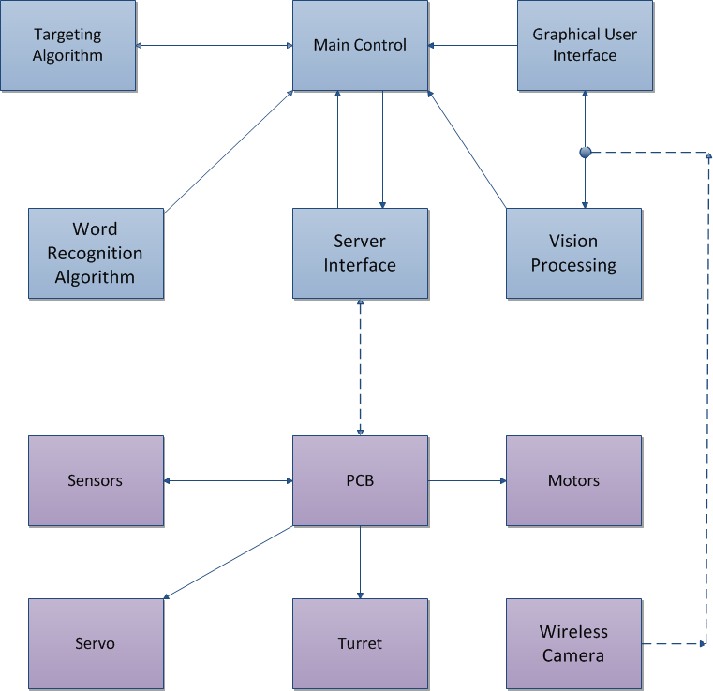
Block Diagram
Notes:
Dylan

Slide 5
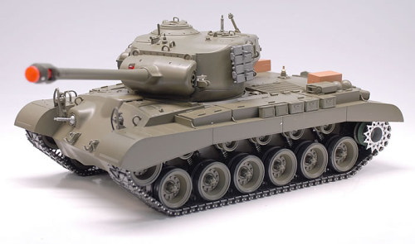

Slide 6
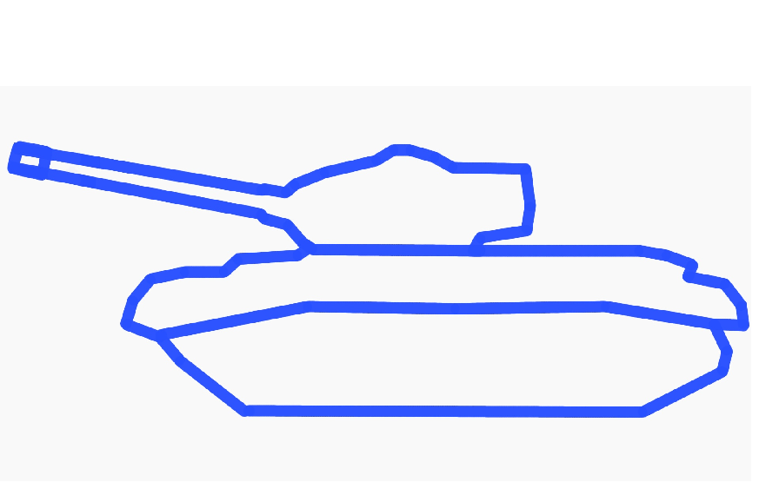

Slide 7
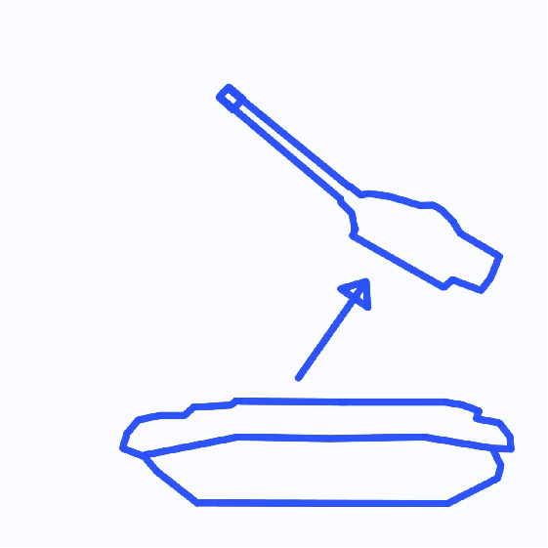

Slide 8
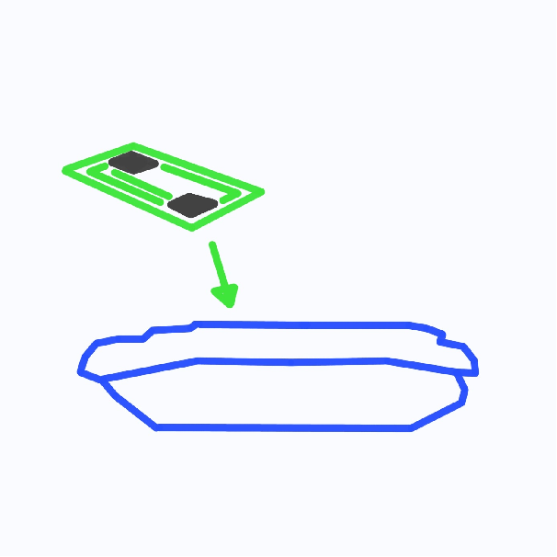

Slide 9
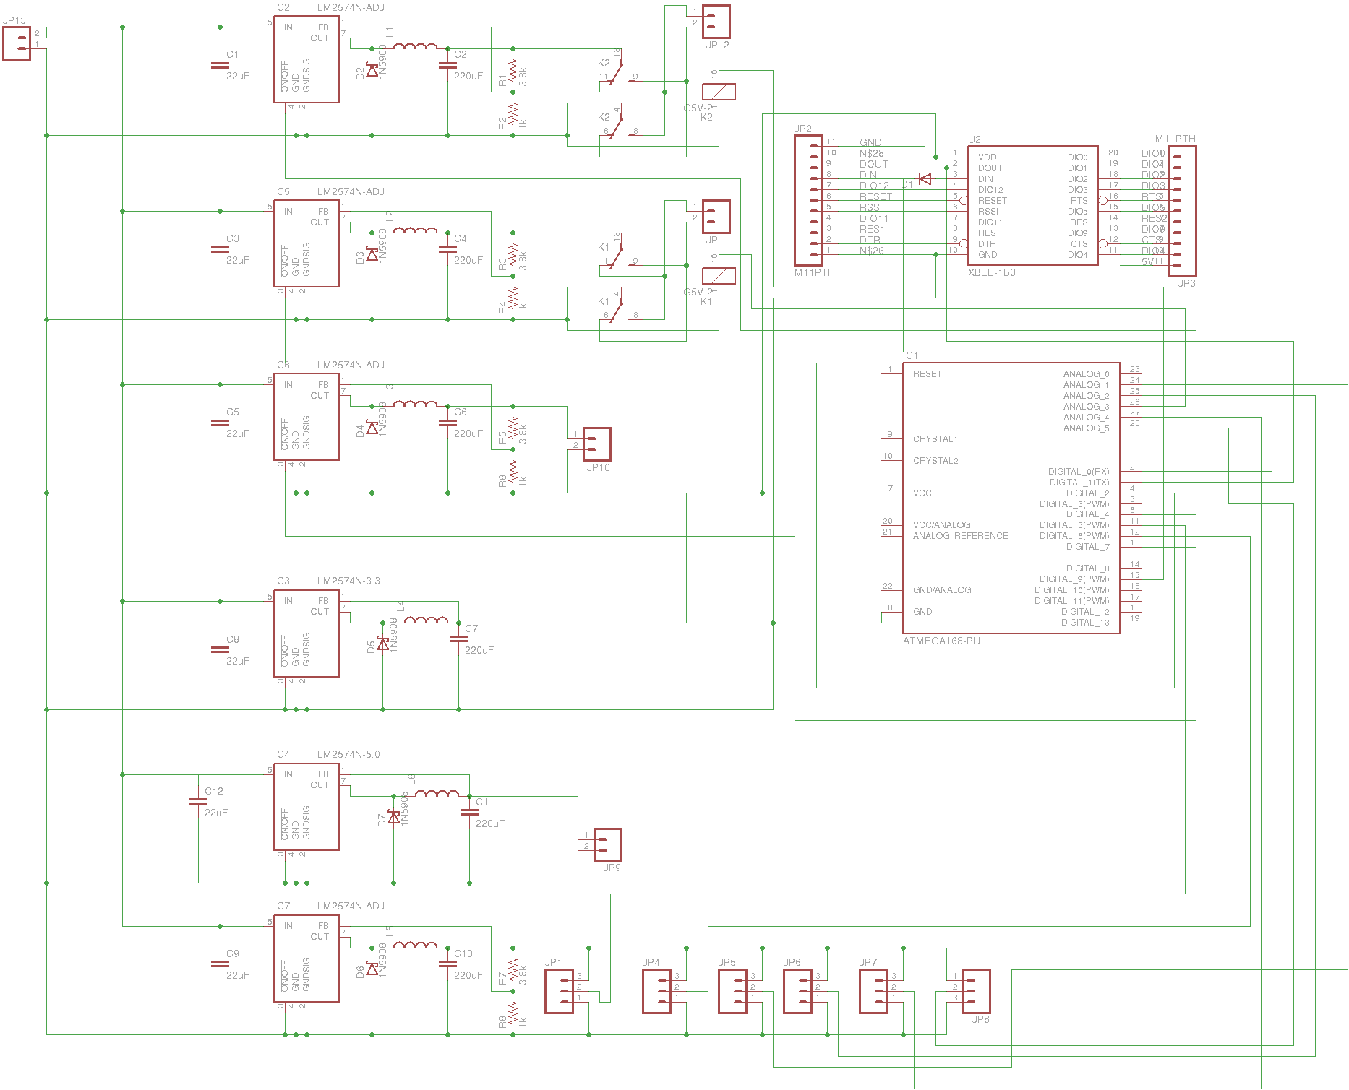
Power & Control Signal Diagram

Slide 10
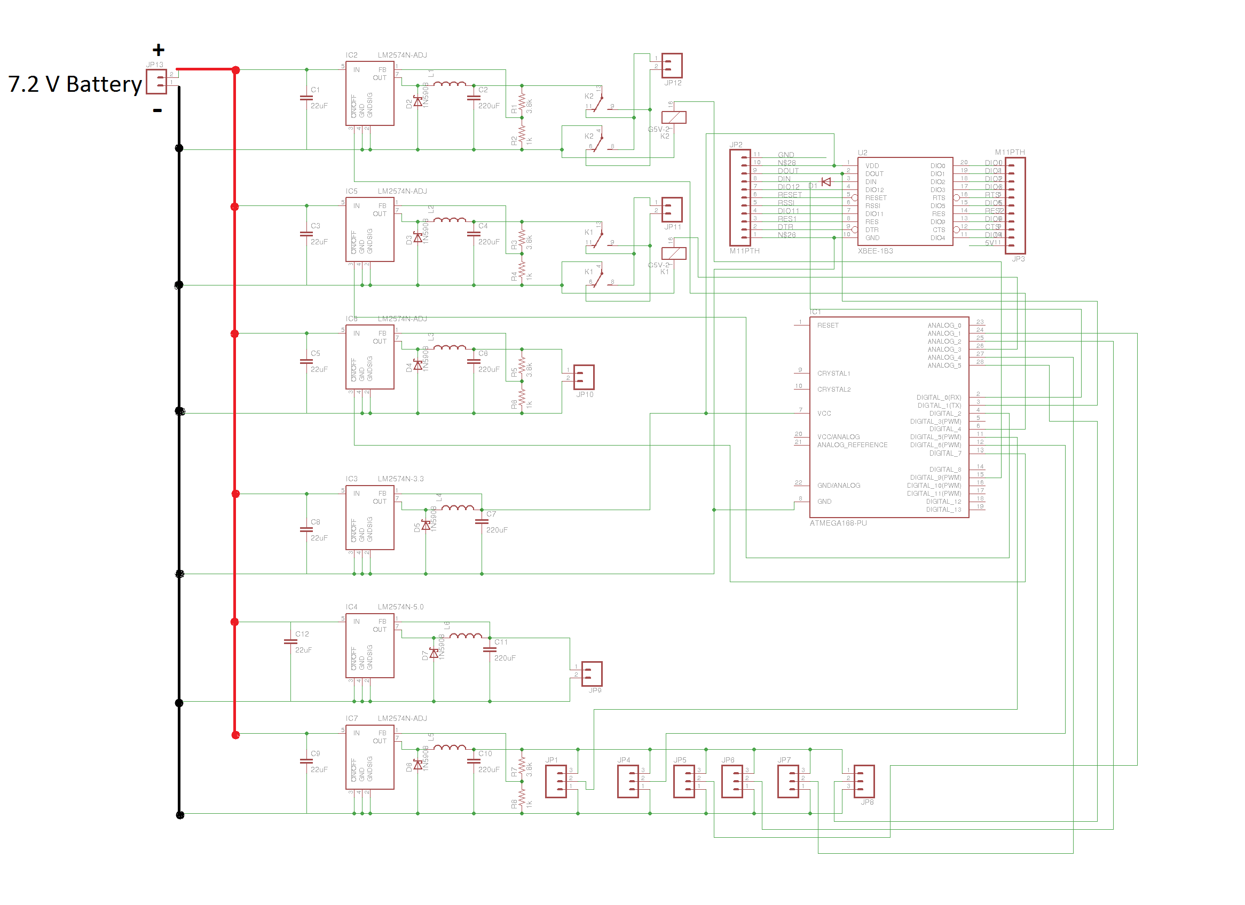
Power & Control Signal Diagram
Notes:
10

Slide 11
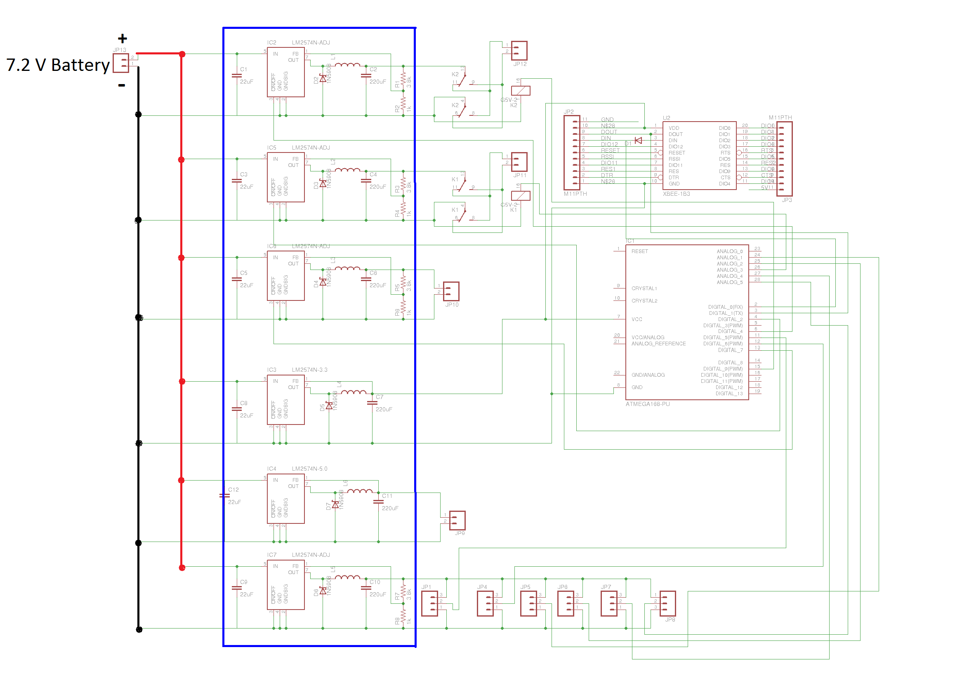
Power & Control Signal Diagram
Notes:
11

Slide 12
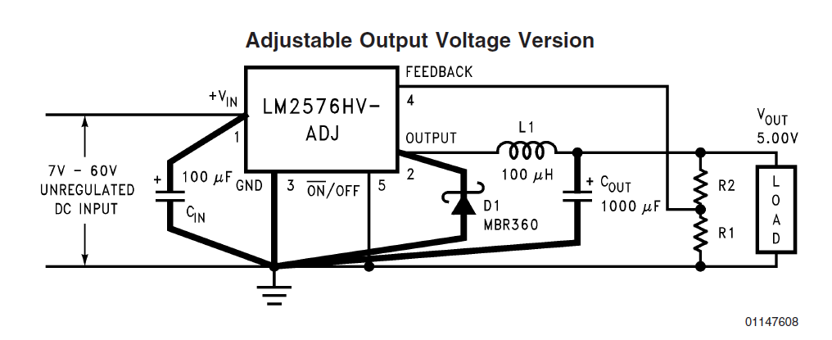
LM 2574
Notes:
12

Slide 13
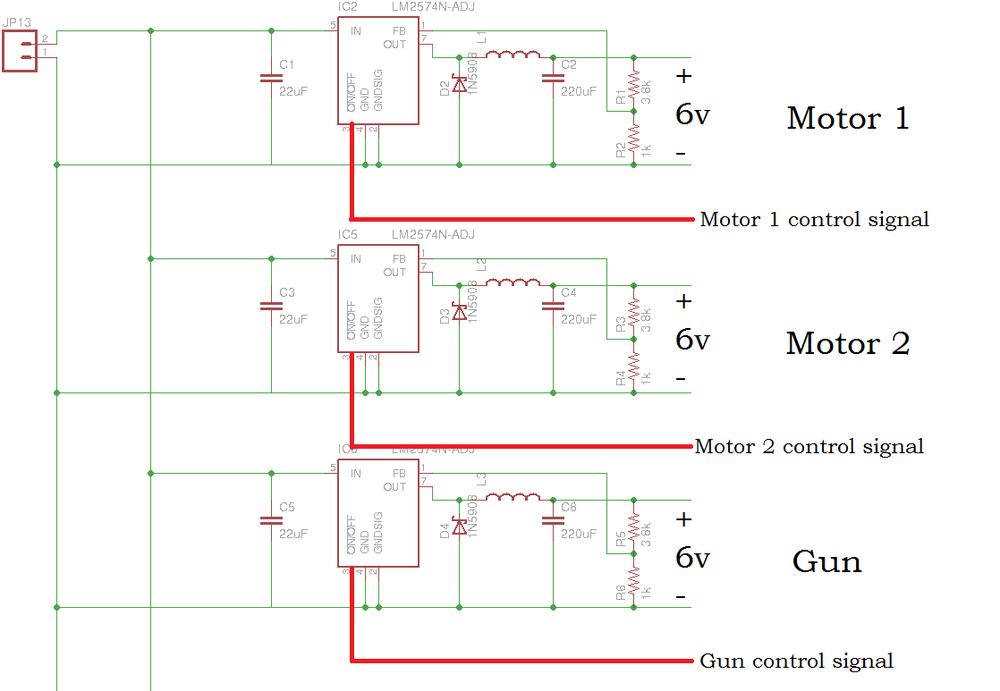
Notes:
13

Slide 14
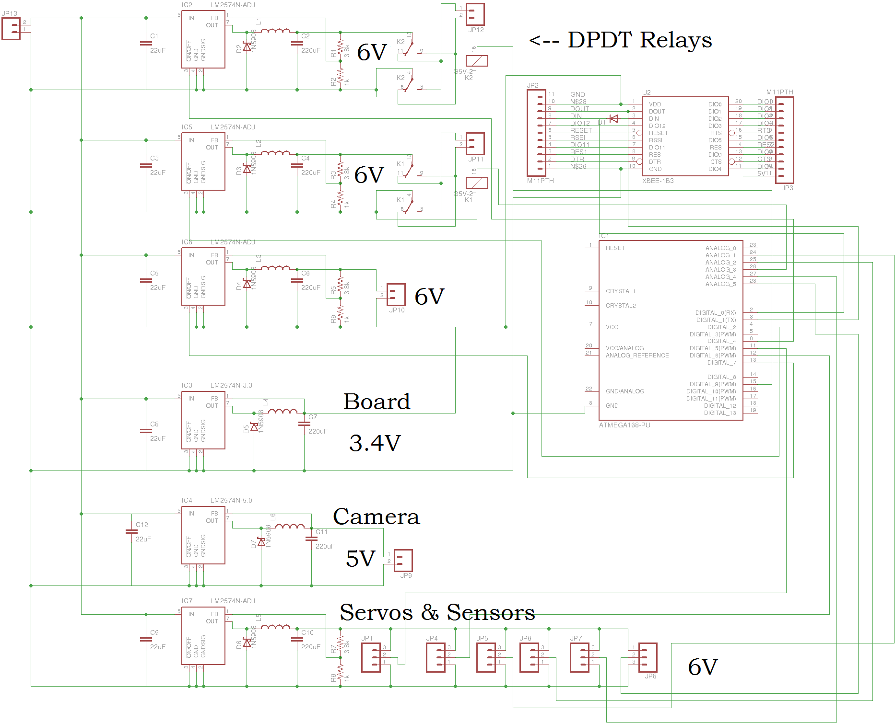
Notes:
14

Slide 15
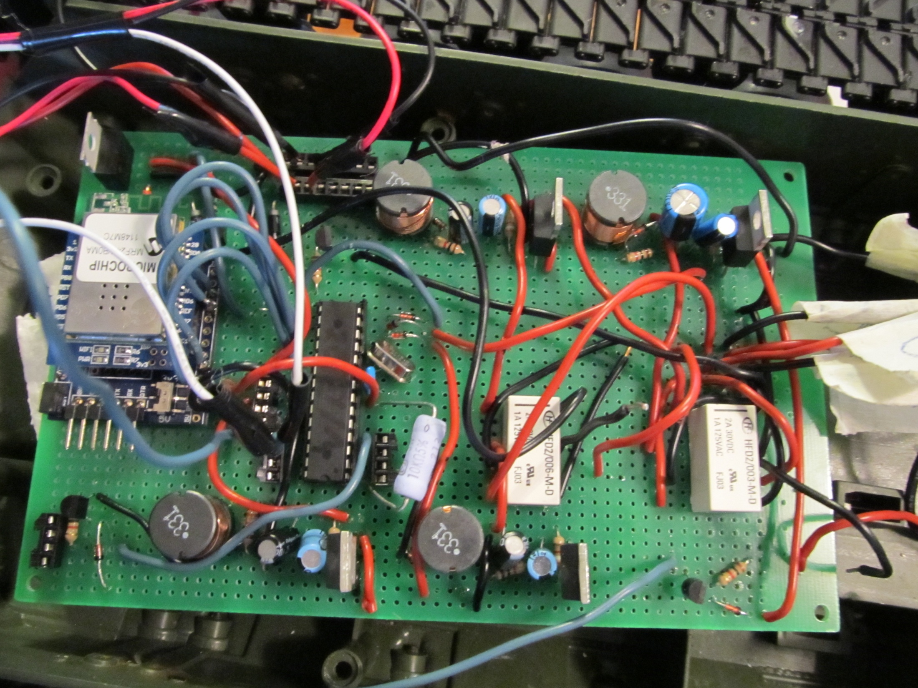

Slide 16
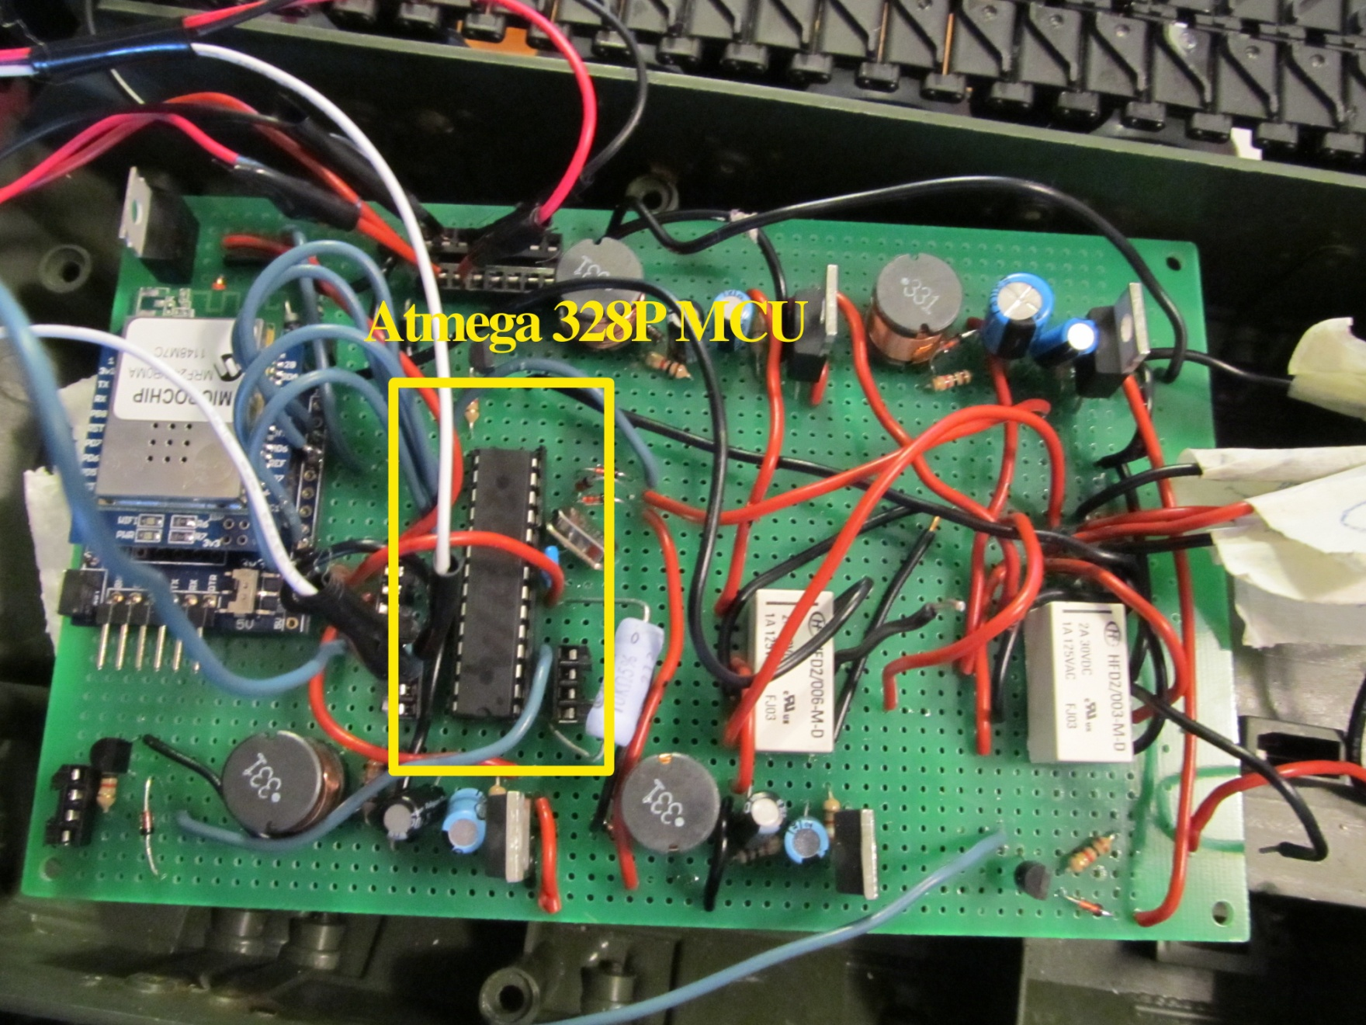

Slide 17
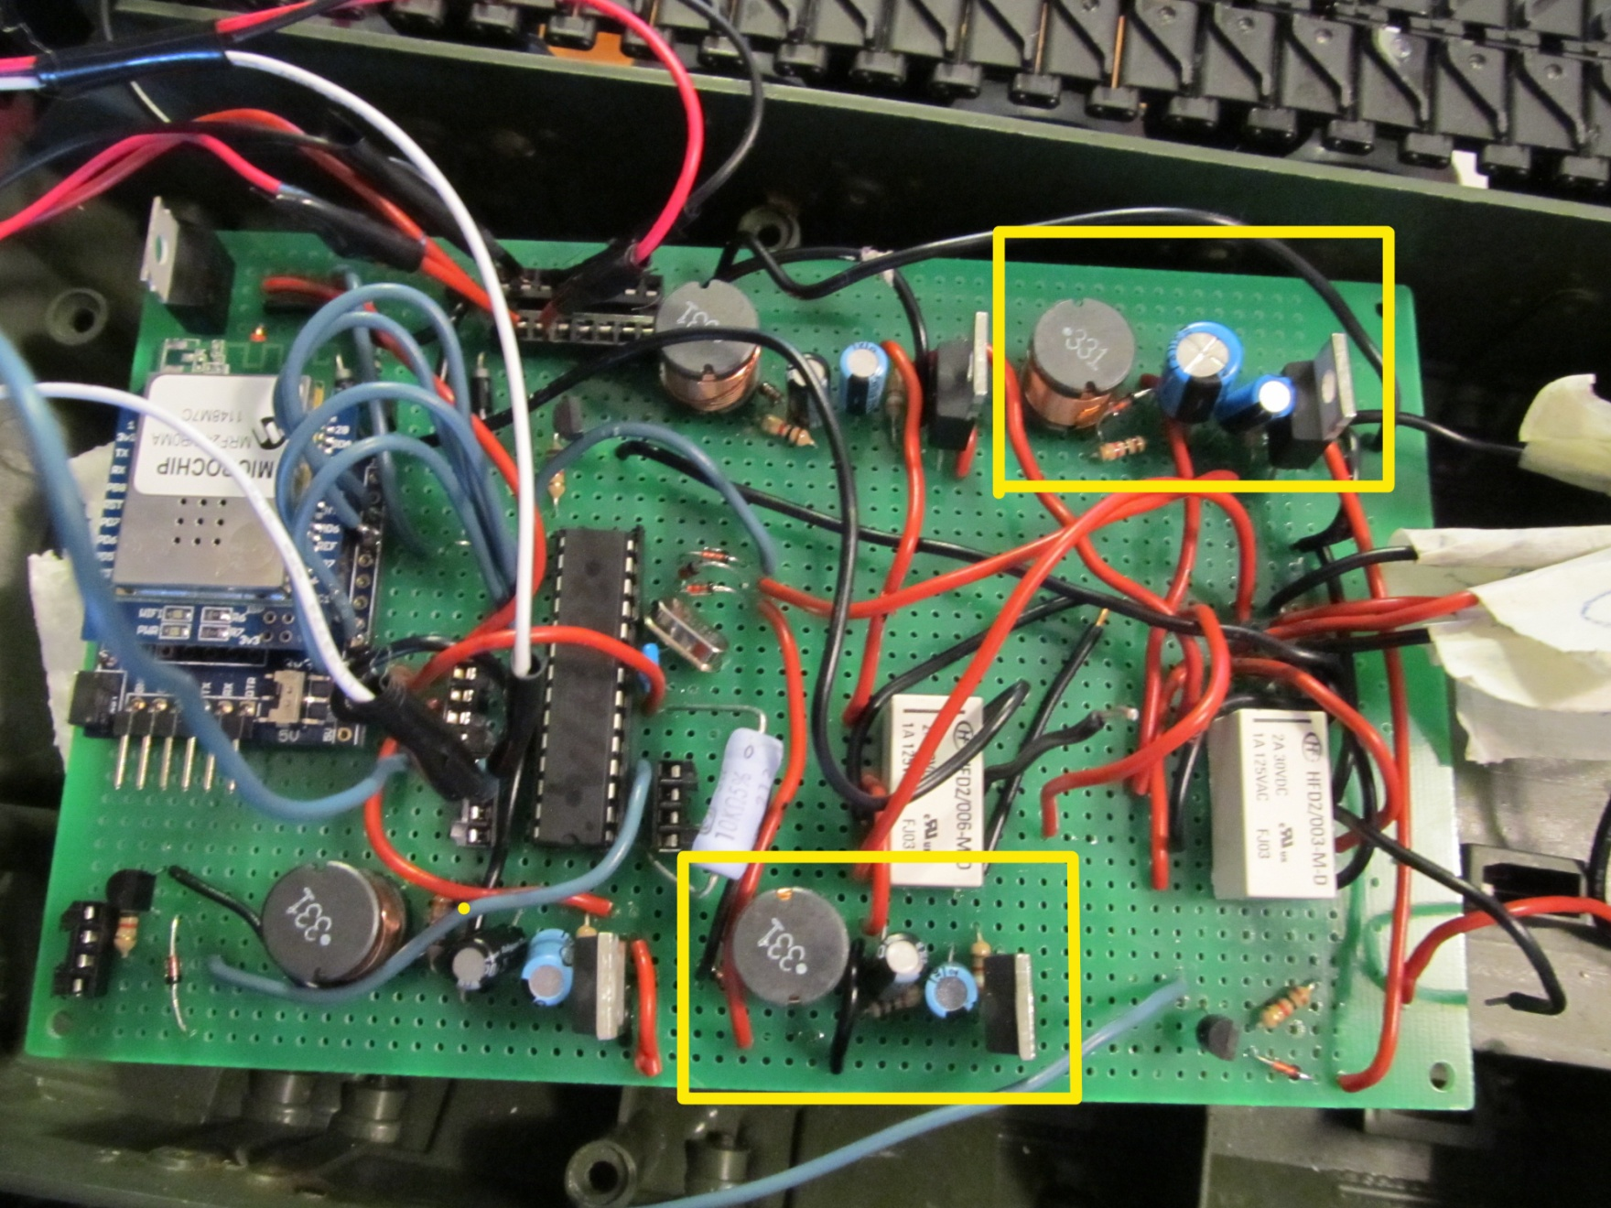

Slide 18
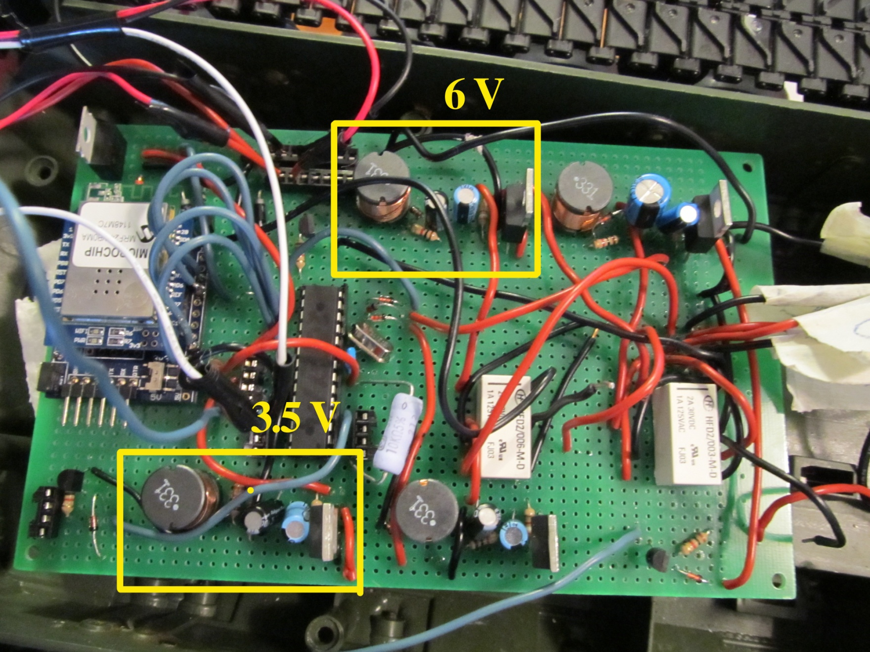

Slide 19
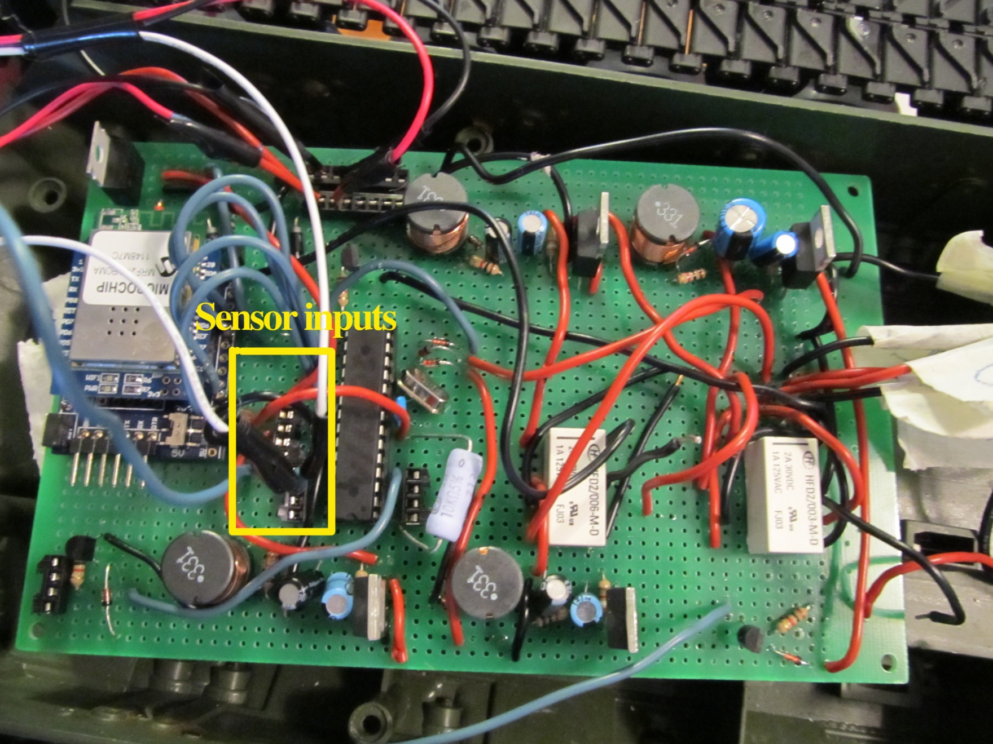

Slide 20
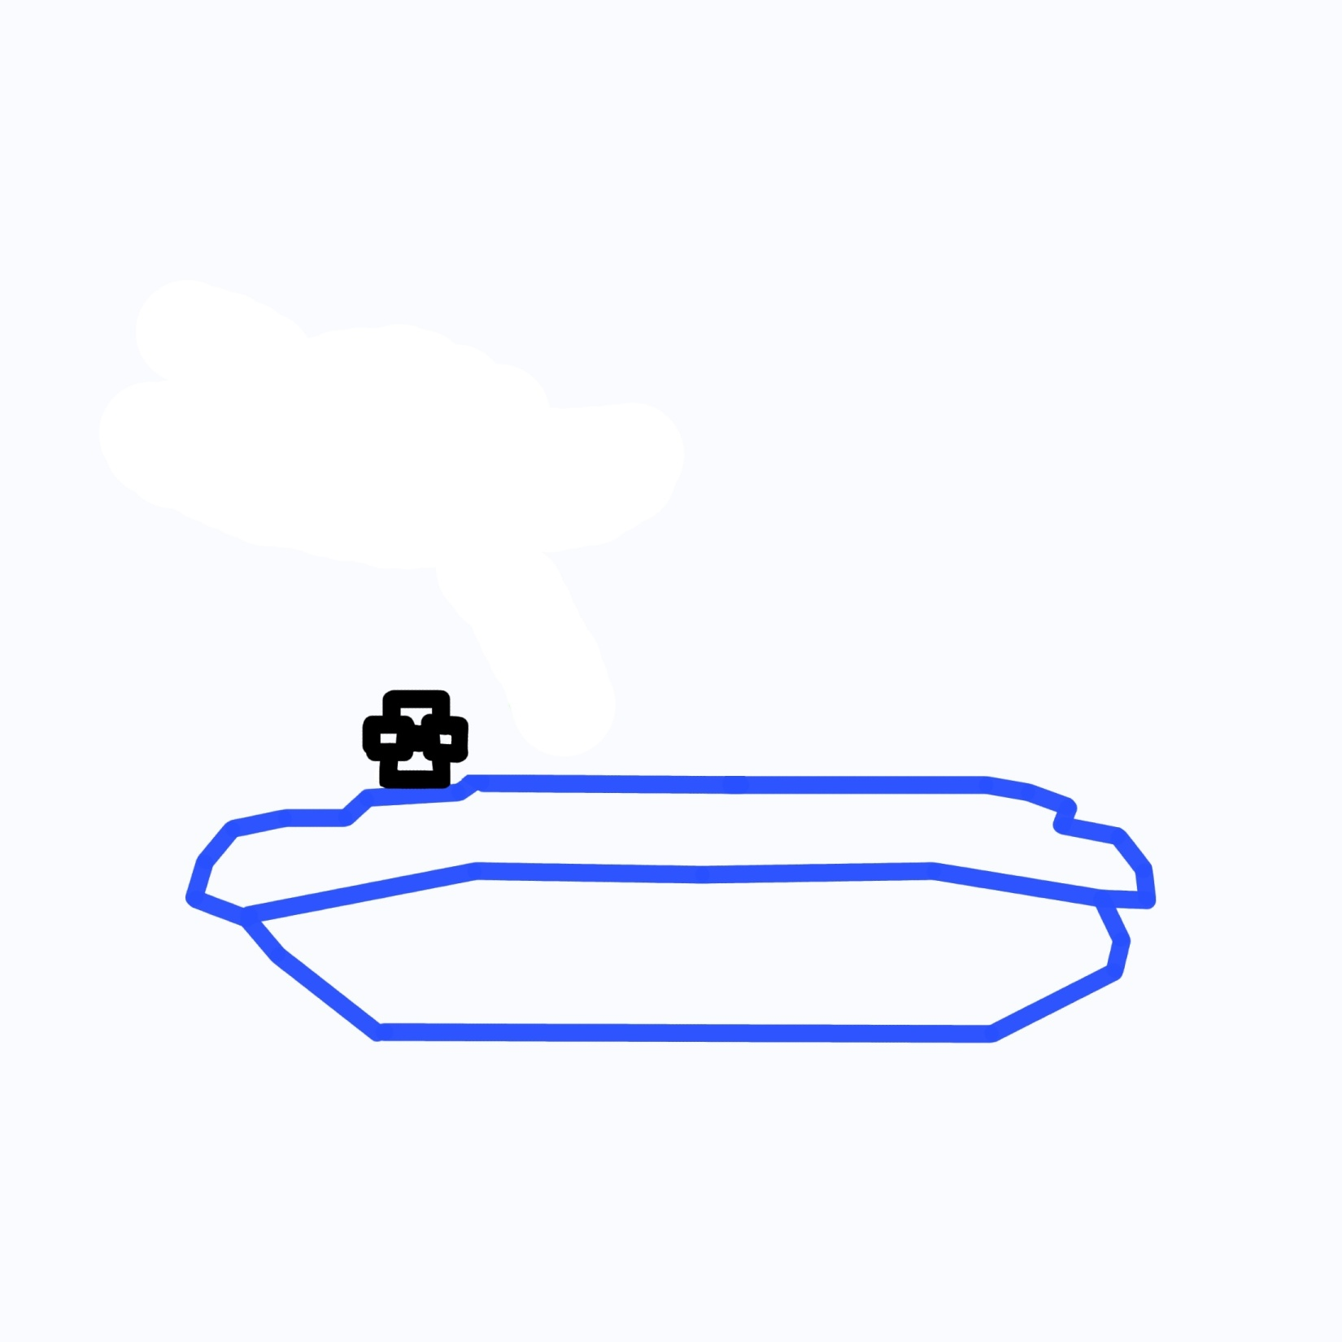

Slide 21
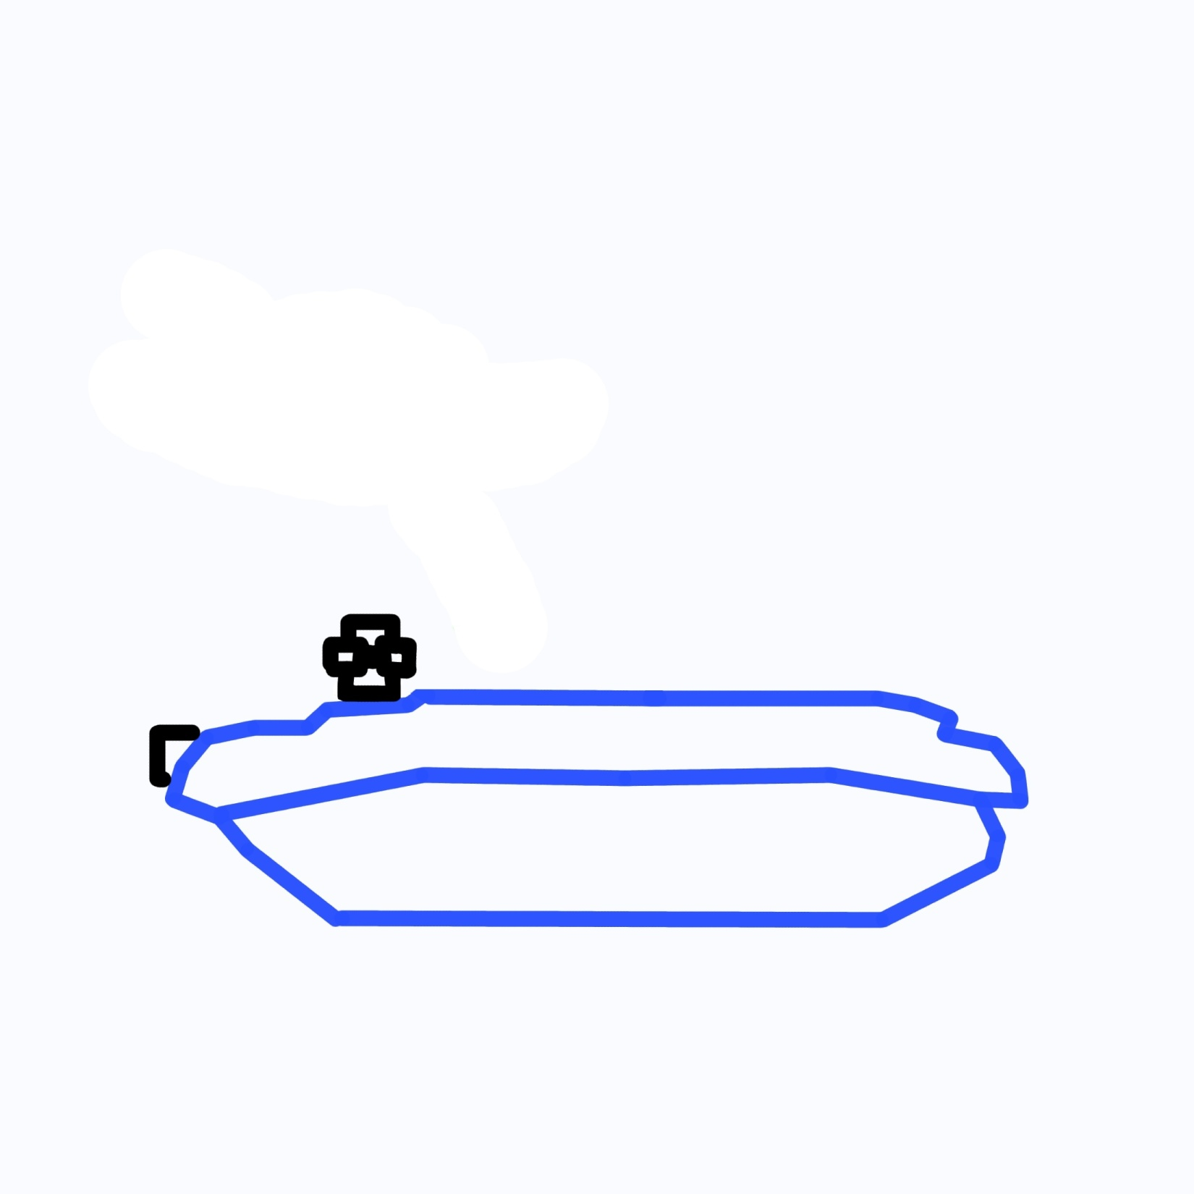

Slide 22


Slide 23


Slide 24


Slide 25
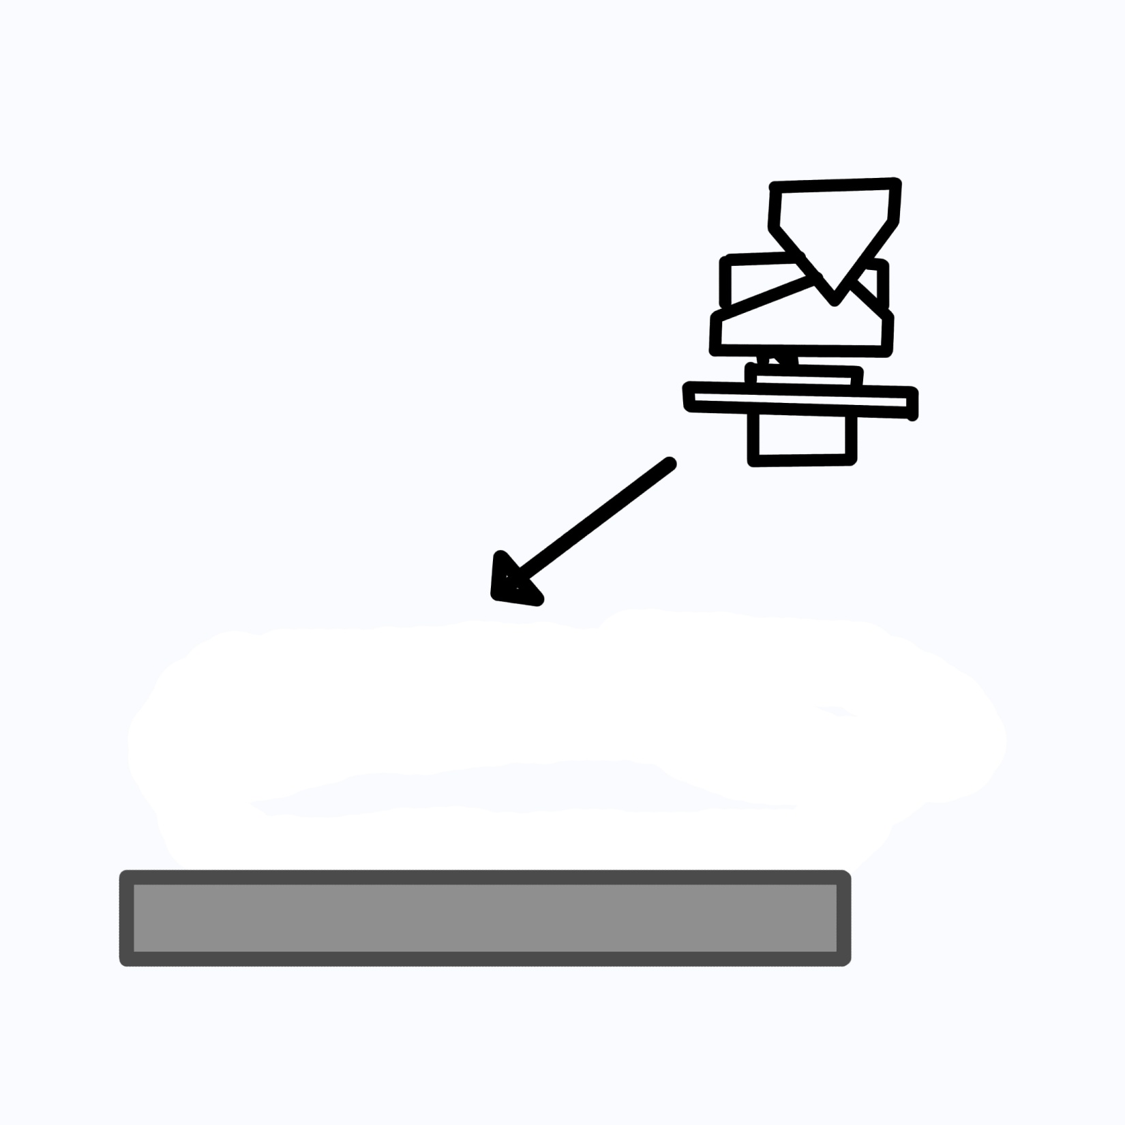

Slide 26
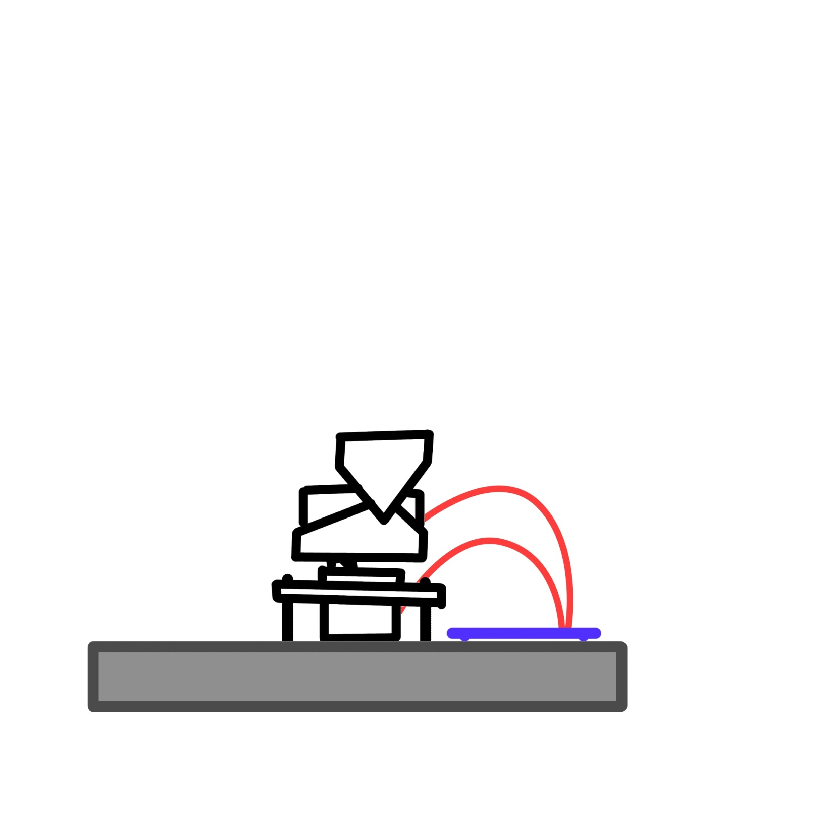

Slide 27
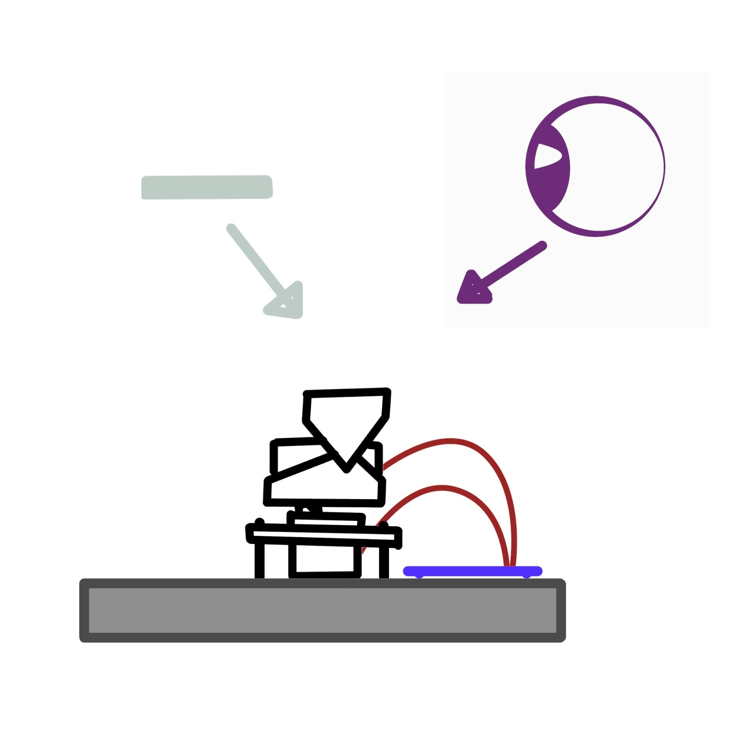

Slide 28
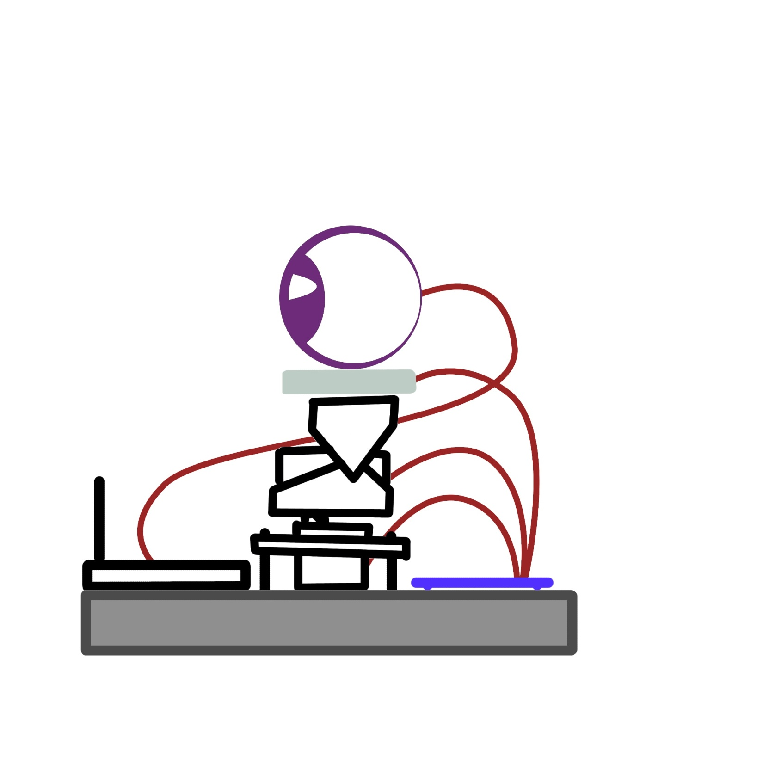

Slide 29
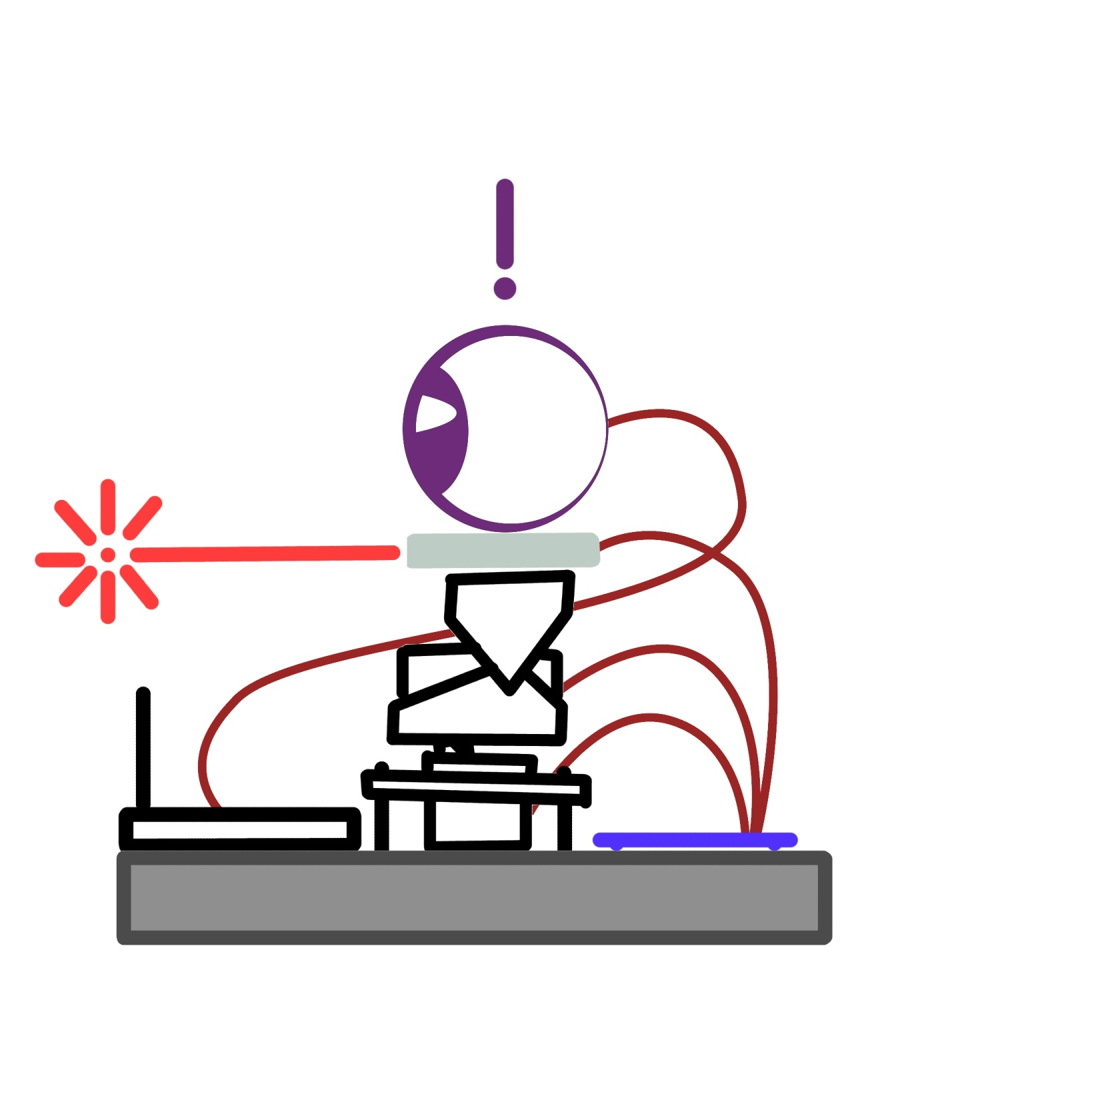

Slide 30
Sensor Selection
 | GP2Y0D02YK | GP2Y0A02YK | MB1210 | FSL0095103ST
Method | Infrared | Infrared | Ultrasonic | Physical Contact
Output | Digital Voltage | Analog Voltage | Multiple | Variable Resistance
Real Distance | No | Yes | Yes | Yes
Range (Min) | 20cm | 20cm | 20cm | 0cm
Range (Max) | 150cm | 150cm | 765cm | 11.43cm
V_{cc} (V) | 4.5 to 5.5V | 4.5 to 5.5V | 3.3 to 5V | N/A
V_{o} (V) | -0.3 to (V_{cc} + 0.3) | -0.3 to (V_{cc} + 0.3) | 0 to 3V | N/A
Approx. Price | $12 | $15 | $45 | $15

Slide 31
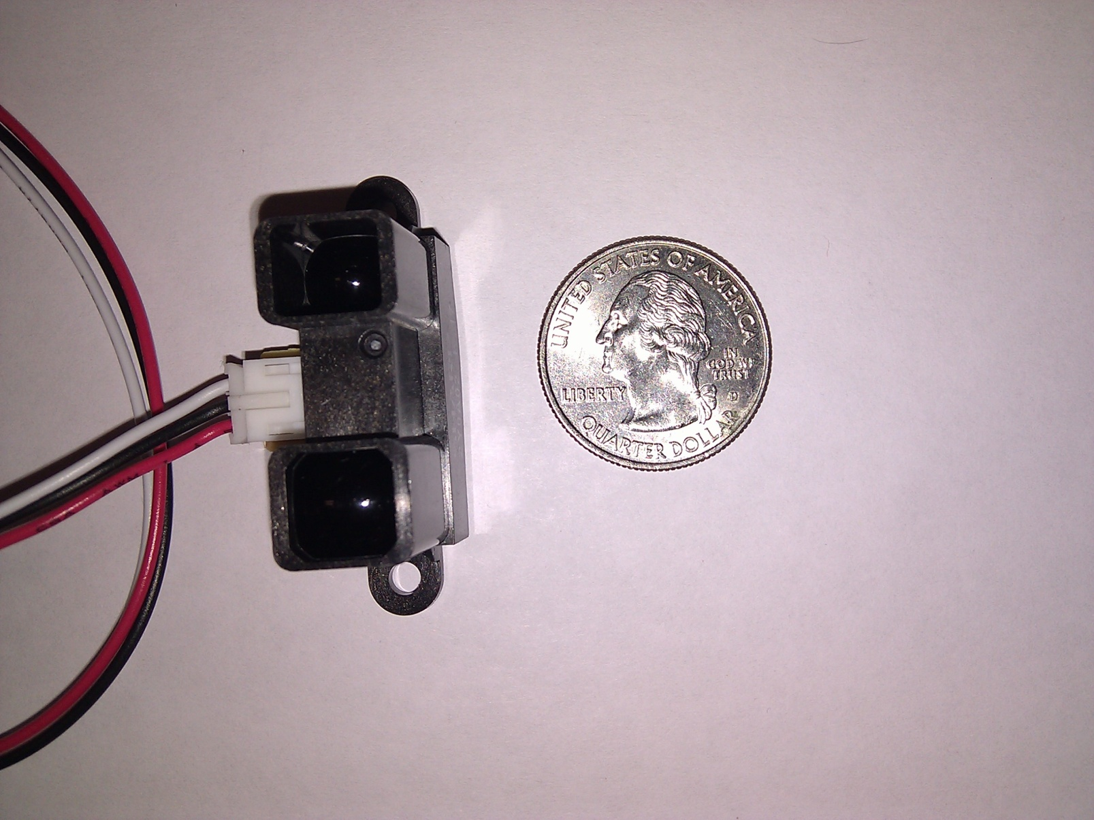
Sony GP2Y0A02YK

Slide 32
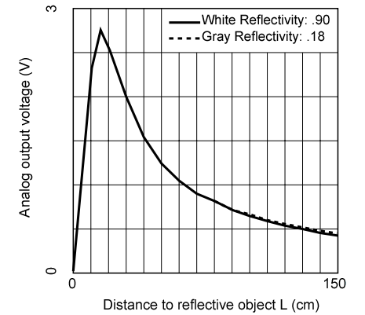
Infrared Advantages
Sony GP2Y0A02YK infrared is very inexpensive
Not susceptible to interference
Easy to mount and comes with JST connector
Will be used as side sensors to detect side obstructions

Slide 33
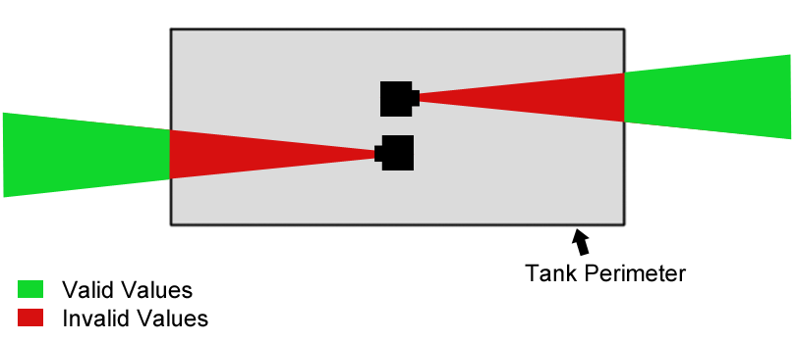
Infrared Placement
20 cm invalid range means sensor needs 20 cm buffer
Duplicate Vo values are impossible

Slide 34
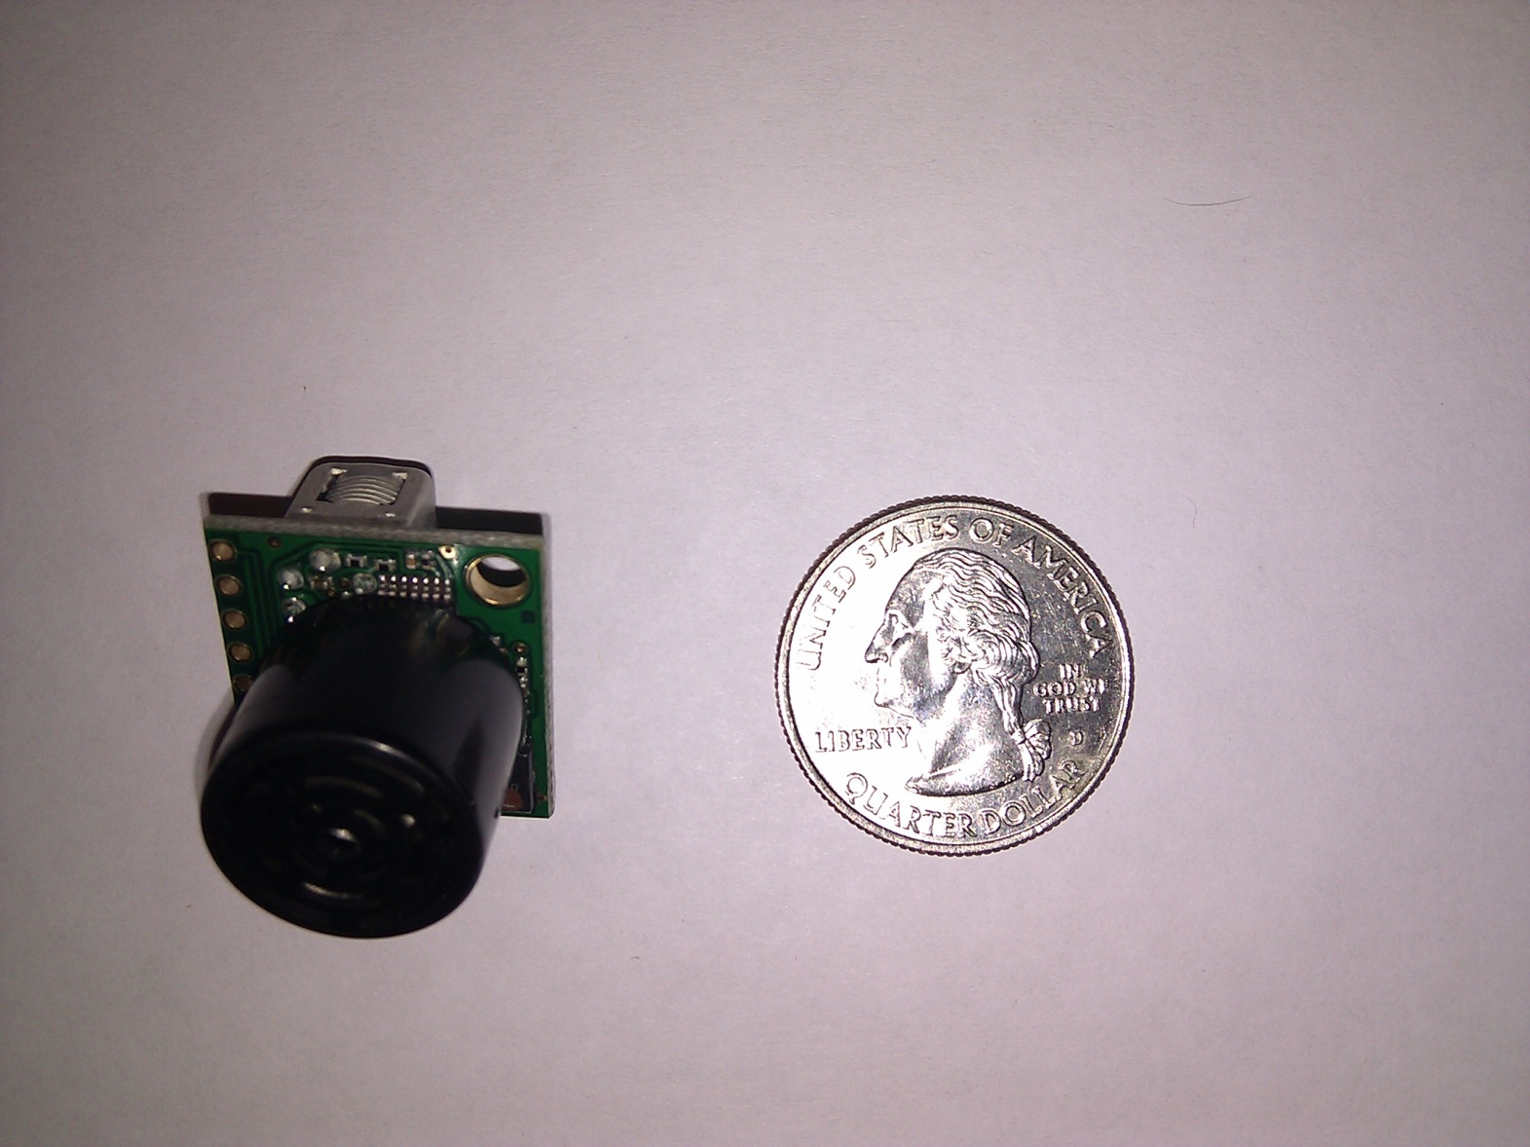
Maxbotix MB1210

Slide 35
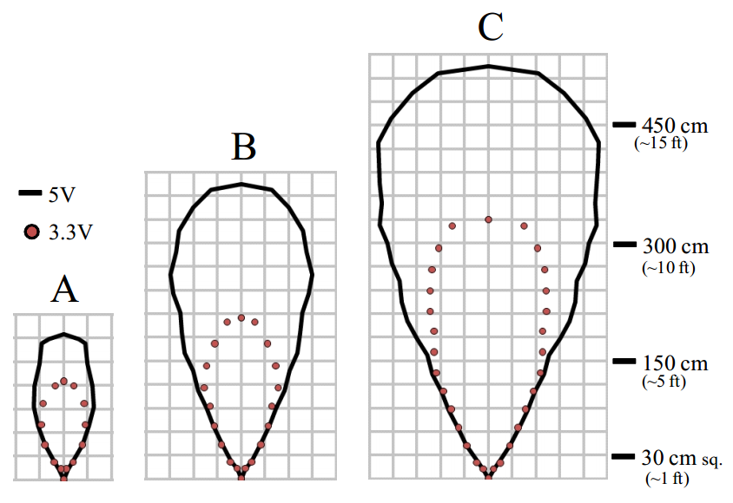
Ultrasonic Advantages
Doesn’t suffer from duplicate Vo problem
Used as front sensor due to range (25ft)
Different modes of operation: 5V > 3.3V
Single speaker Multiple interfaces for measurements
Analog, Serial, Pulse Width

Slide 36
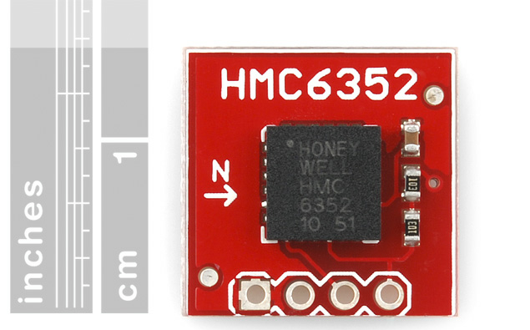
Compass Module
Honeywell HMC6352
0.5 degree heading resolution
I²C interface allows for easy integration
Used to facilitate accurate turning
Biggest drawback: prone to magnetic field interference

Slide 37
Sound Library
Library | Android SDK | Port Audio | Windows API/.NET | Sphinx-4
Platform | Android (Linux based) | Cross Platform | Windows | Cross Platform
Language | Java | C/C++ | .NET | Java
Integrability | Low | High | High | High
Difficulty | Low | Medium | Medium | Low
Recognition | Yes | No | No | Yes

Slide 38
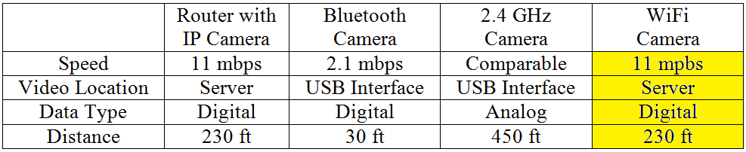
Camera Selection
Needs to stream a live video feed from RADSAT to the computer screen.
Needs to be in color.

Slide 39
Camera Selection
Find a way to stream a live video feed from RADSAT to the computer screen.
Needs to be in color.

Slide 40
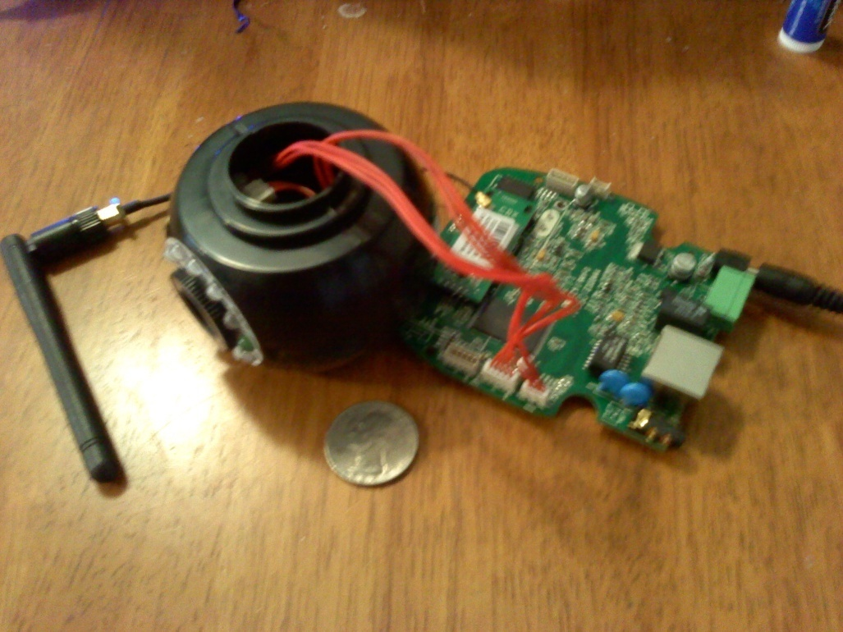
Video Processing
The WiFi camera automatically
puts a video stream onto a server.
Using AForge.net video libraries
for C# - going to retrieve an
MJPEG video stream from the
server.
Parse the MJPEG frames into
individual JPEG images then convert
them to Bitmap.
Each time a new frame is loaded, an event occurs and the program receives a new Bitmap image.
Once the Bitmap image is received the targeting system can occur.

Slide 41
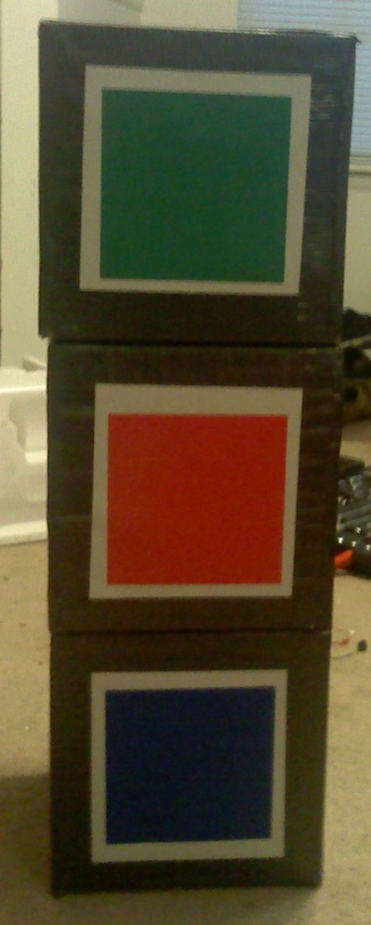
Targeting
The target which RADSAT will be shooting at will be a 10”x10”
cardboard cube which will be colored either red, blue, or
green.
The program will identify the target using the Bitmap image of the camera’s view.
It can differentiate the target from different objects using color recognition as well as shape recognition.

Slide 42
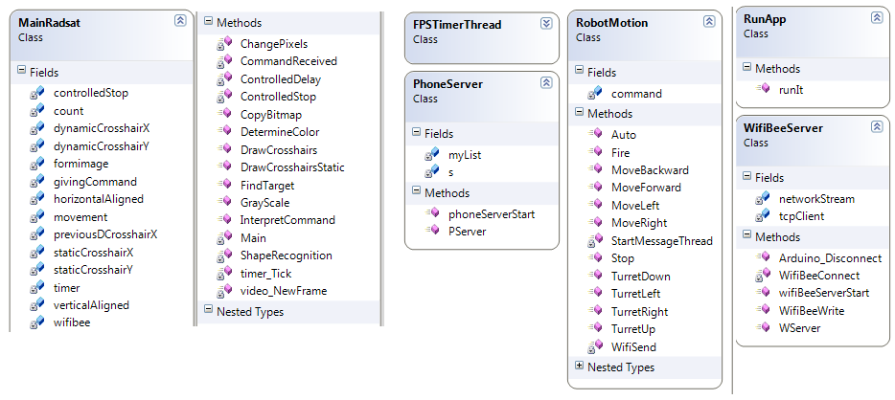
Class Diagram
Notes:
Mention how all the classes implement each other so the image doesn’t have to be passed around

Slide 43

Color Recognition
A variation of this equation will be applied to
every pixel, starting at the top left and moving
right until the target is found (This is the
equation for finding green).
D = sqrt((R - 0)^2 + (G - 255)^2 + (B - 0)^2),
where R represents red within the RGB color scheme, G represents green, and B represents blue. The result D will be compared against a variable.
The larger “D” is then the farther the pixel is from the desired color.
Depending on which color is desired the 255 will replace the zero for either red or blue.
Any pixel that does not meet the specifications will be colored black, making it easier for the user, and program to see exactly what the robot is seeing. There is a button to turn this feature on or off.

Slide 44
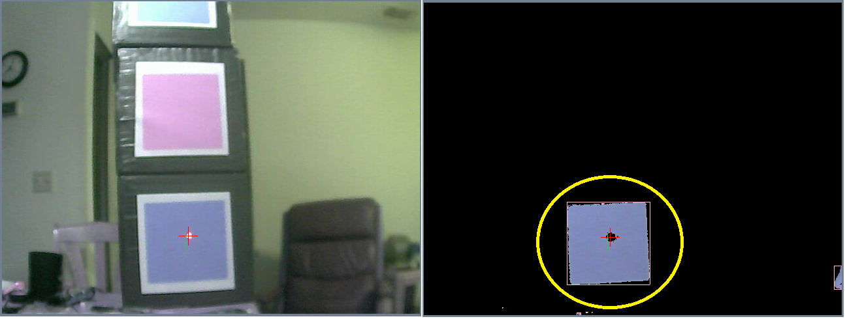
Color Recognition

Slide 45
Shape Recognition
This function uses
AForge.net blob library.
This library is able to cluster together pixels based on their contrast to the black background.
The program takes these clusters and draws a pink rectangle around them.
They are viewable in Robot Vision Mode

Slide 46
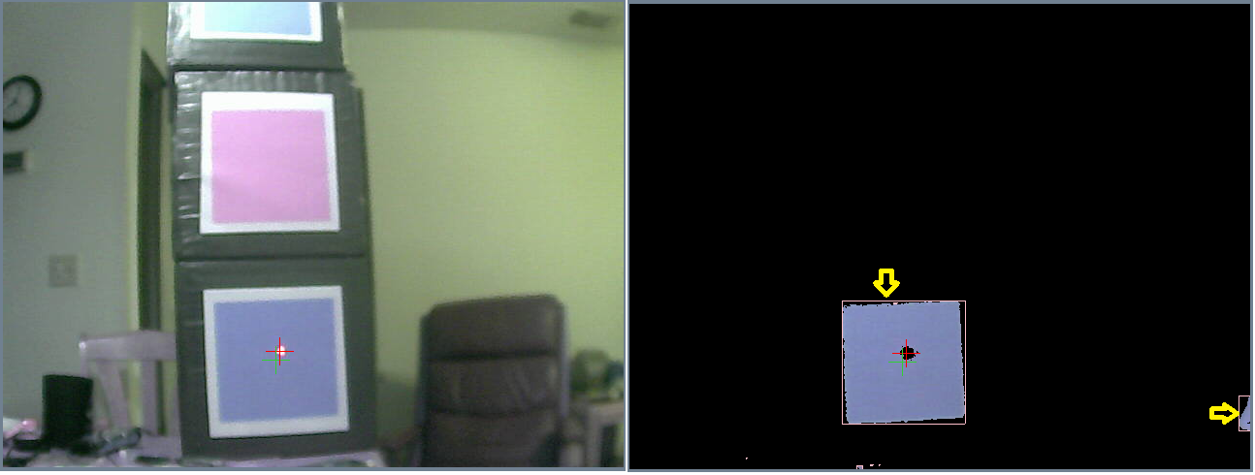
Shape Recognition

Slide 47
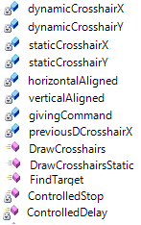
Targeting
This is called after the target
has been found.
It will first draw crosshairs at
the center point of the target.
The program will check where
the target is in relation to the
firing point.
It will first move the turret into the correct horizontal position, then when that has been achieved it will move into the correct vertical position both in relation to the firing point.
Notes:
Explain what the firing point is.

Slide 48
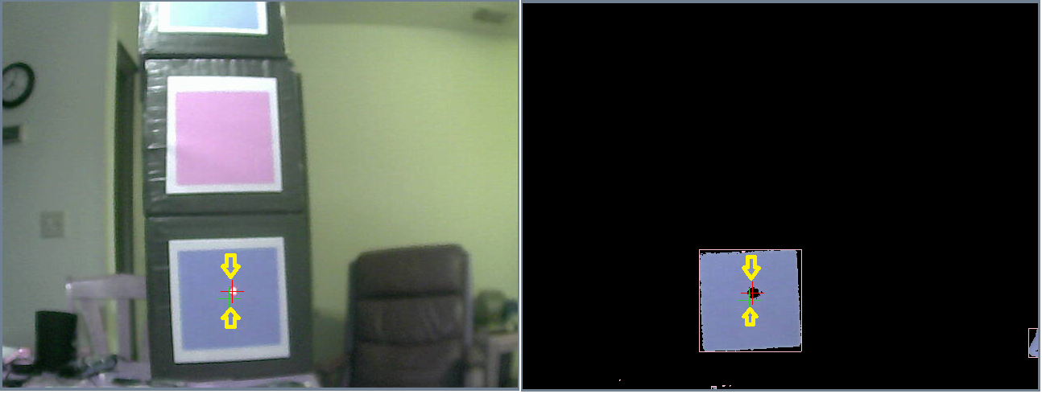
Targeting

Slide 49
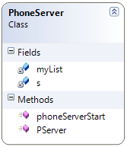
Phone Server
Creates a server which communicates with the phone via a TCP connection.
It will receive a string and use logic to send the appropriate commands to RADSAT.

Slide 50
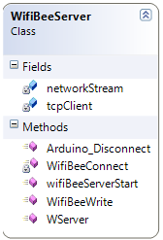
Wifi Bee Client
A TCP client which connects to the server on the Wifi bee
It sends character bytes which RADSAT interprets as commands.
This enables back and forth communication between the computer and RADSAT.

Slide 51
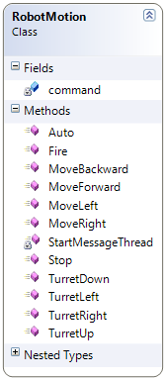
Robot Motion
Sends the movement commands to RADSAT’s server via the TCP connection.
Sends bytes to RADSAT which is then interpreted as commands.

Slide 52
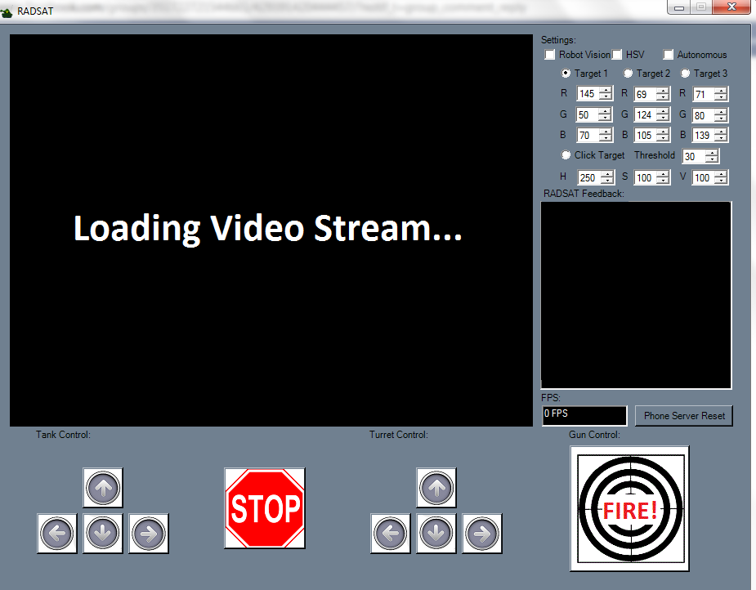
GUI Design
Written in C#
Allows for wireless connection and complete control of the tank
Provides video feedback from the WiFi camera
Can set the tank to autonomous mode
Notes:
Dylan

Slide 53
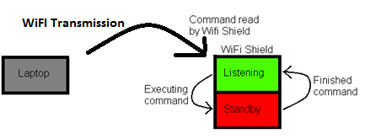
Wireless Communication
Arduino Diamondback used for prototyping
WiFi Bee, included on the board, used on final circuit board
Video stream sent over a separate server
Notes:
Dylan

Slide 54
Financing
Original budget: $800
Part Purchased | Price
WiFi Camera | $56.10
Arduino Diamondback Board | $76.45
Arduino Uno Board | $19.95
R/C Tank | $91.19
Servos | $33.97
Batteries + charger | $66.04
Breadboard + relays | $21.30
Infrared Sensors | $58.84
Ultrasonic Sensor | $38.59
Compass Sensor | $53.59
ATMega Microcontroller | $2.88
WiFi Bee | $89.49
Miscellaneous | ~$100.00
Total | $708.39
Notes:
Dylan

Slide 55
Thank you! Questions?
Notes:
Dylan

