Slide 1
ManScaper
Autonomous Lawnmower
Group 2
Andrew Cochrum
Joseph Corteo
Jason Oppel
Matthew Seth

Slide 2
Project Goals & Motivation
Remove the chore of mowing your lawn
Create a lawnmower that runs with little to no user interaction
Eliminate the need to detect boundaries using buried cable lines
Create a safe system that avoids obstacles that may be in the path of the mower

Slide 3
ManScaper Features
Fully electric, rechargeable lawnmower
Boundary and location detection using computer vision
Cutting area mapped and stored for future reference
Object detection to avoid obstacles
AI navigation with no user interaction required

Slide 4
ManScaper Specifications
Project Specs
Lawnmower size | 26”x35”x12.5”
Mower location accuracy | ≤ 12”
Forward speed | 1 mph
Obstacle detection distance | 2 cm to 3 m
Battery life | ≈ 30 min
Battery charge time | 4 hrs

Slide 5
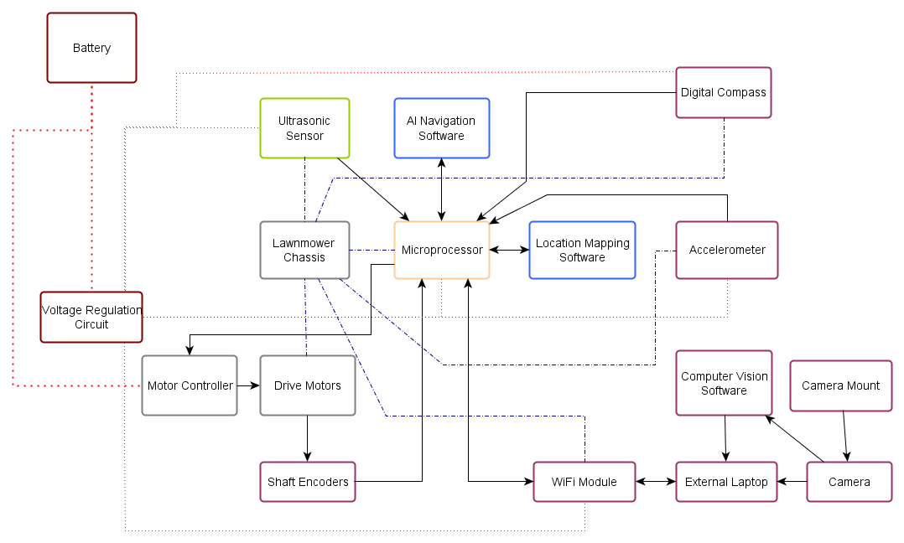
Overall Block Diagram

Slide 6
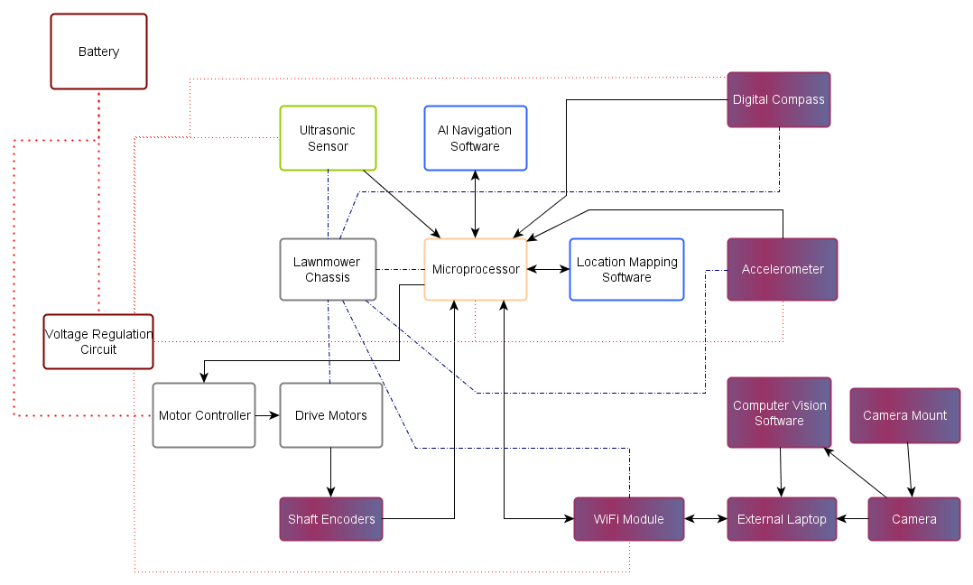
Location Subsystem
Notes:
Bigger font on block diagrams

Slide 7
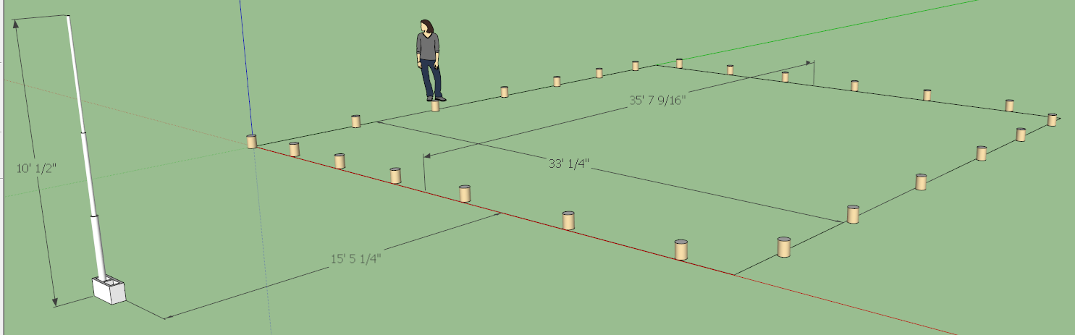
Computer Vision: General Setup
Webcam will be mounted on top of support structure to provide a high enough elevation to survey the entire area
Increasing the elevation of the webcam reduces the distortion between the pixel distances measured by the webcam and the distances actually travelled by the lawn mower – can be rectified using data from encoders

Slide 8
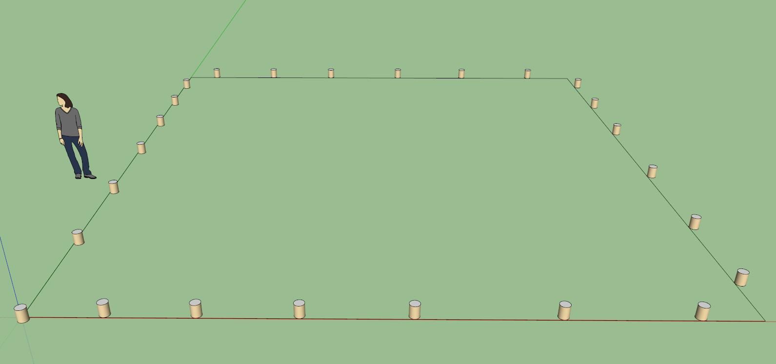
Computer Vision Software: SimpleCV framework for Python
Blah
Webcam view from atop the support structure

Slide 9
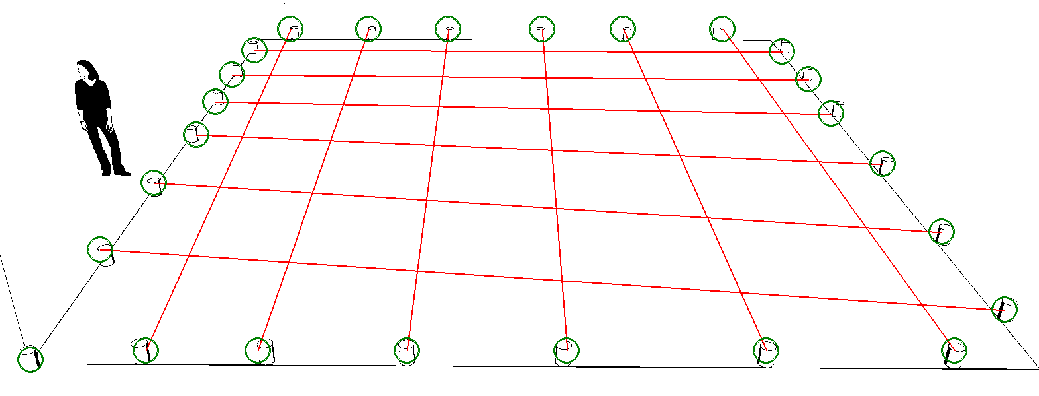
Computer Vision Software: SimpleCV framework for Python
Blah
Python program takes raw image file from the webcam and performs the following functions:
  Crop and binarize
  Find blobs that satisfy criteria (color, size, shape, etc.)
  Create virtual grid based upon these blobs

Slide 10
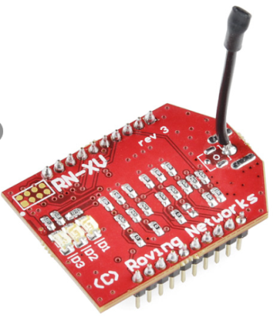
RN-XV WiFly Wireless Module
Onboard TCP/IP stack includes DHCP, UDP, DNS, ARP, ICMP, HTTP client, FTP client and TCP
Requires only two pins to communicate with the ATMega328P (RX and TX)
Both the laptop and WiFly module connect to a wireless access point
Once on the same network, a Telnet session will allow for the transfer of coordinates to the WiFly module

Slide 11
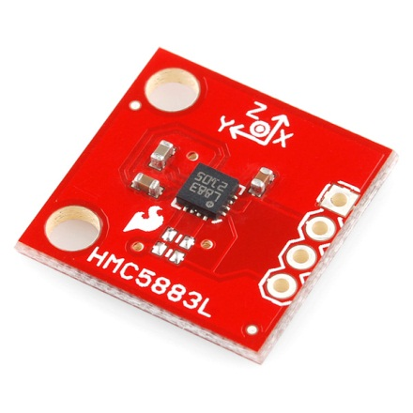
HMC5883L Triple Axis Magnetometer
Used to measure the heading of the lawnmower during operation
Internal measurement scale can be modified via software in case local interference saturates the magnetometer
Disadvantages:
  Highly inaccurate when tilted by more than a few degrees from the horizontal
  Highly sensitive to ferrous materials – must be either shielded or placed at a suitable distance

Slide 12
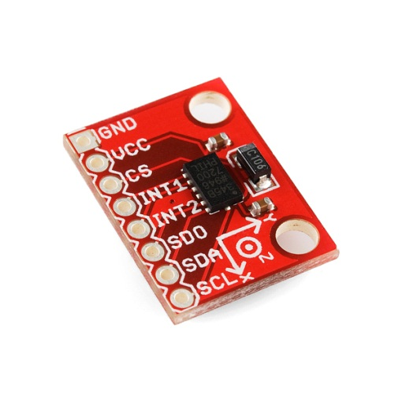
ADXL345 Triple-Axis Accelerometer
High resolution -- able to detect inclination changes of less than 1.0 degree
  Used to add tilt compensation to the digital compass
Ultra low power consumption (40 µA in measurement mode)
Built-in profiles to filter out small vibrations, reducing noise in measurements

Slide 13
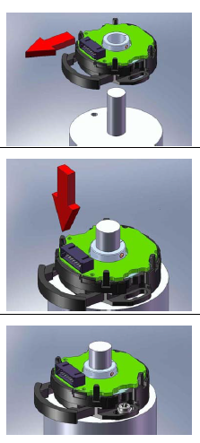
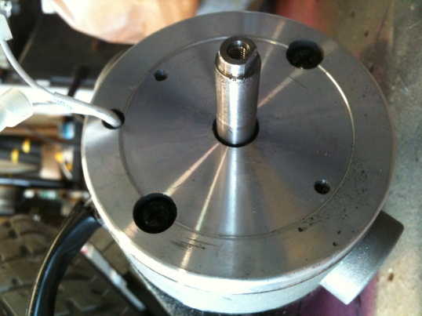
R35i Incremental Encoders
Two data channels in quadrature
1000 PPR (Pulses Per Revolution) resolution
  ~2 ft. travelled per revolution (9 in. wheel diameter) yields an ideal resolution of ~0.024 inches
  Will not exceed ATMega328P clock frequency (16Mhz) since wheels will be rotating at relatively slow speeds
Easy installation

Slide 14
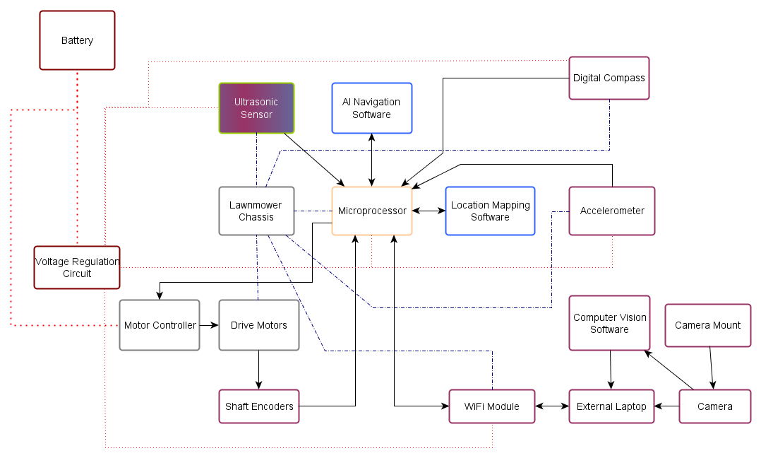
Obstacle Avoidance Subsystem

Slide 15
Infrared vs. Ultrasonic Sensors
Infrared Sensors
  Cheap: $10-$15
  Narrow beam width
  Problems in direct sunlight
Ultrasonic Sensors
  About double the price of infrared
  Poor detection of absorbent materials
  Wider beam width
  Detects items as close as 2 cm
Notes:
Table for discussion between different types of sensors

Slide 16
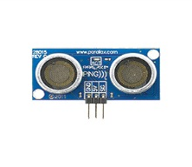
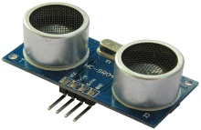
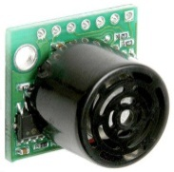
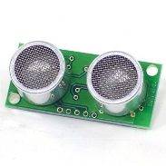
Ultrasonic Sensor Comparison
Sensor | Parallax PING))) Ultrasonic Sensor | HC-SR04 | Maxbotix LV-EZ1 | SRF04
Supply Voltage | 5 V | 5 V | 2.5-5 V | 5 V
Supply Current | 30 mA | 2 mA | 3 mA | 30 mA
Range | 2cm-3m | 2cm-0.5m | 0cm-6.45m | 3cm-3m
Frequency | 40 kHz | 40 kHz | 42 kHz | 40 kHz
Size (mm) | 22x46x16 | 20x43x15 | 20x22x16 | 20x43x17
Price | $29.99 | $5.99 | $29.95 | $29.50

Slide 17
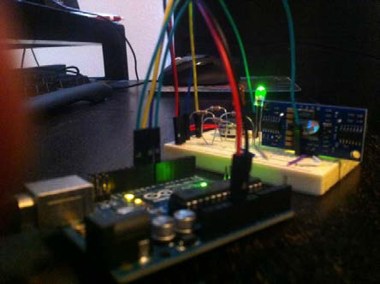
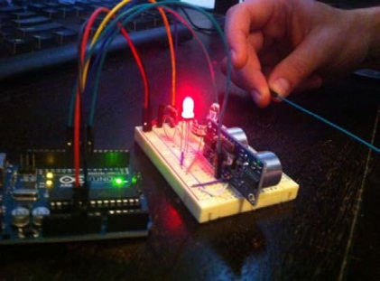
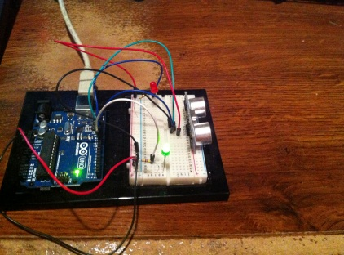
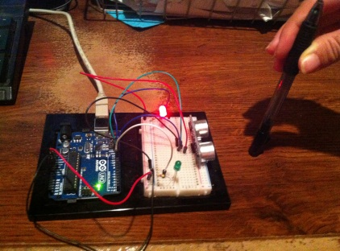
Ultrasonic Sensor Testing
Parallax PING)))
  Detects as close as 2 cm
  Detects 22 gauge jumper wire
HC-SR04
  Detects as close as 2 cm
  Item needs to be thicker
  Occasional issues locating object

Slide 18
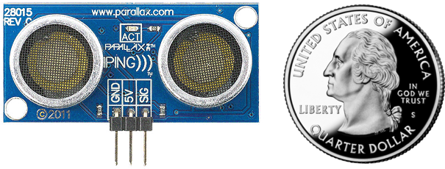
PING))) Ultrasonic Sensor
5V, 30 mA
Ample open source coding available
Available at RadioShack - $29.99

Slide 19
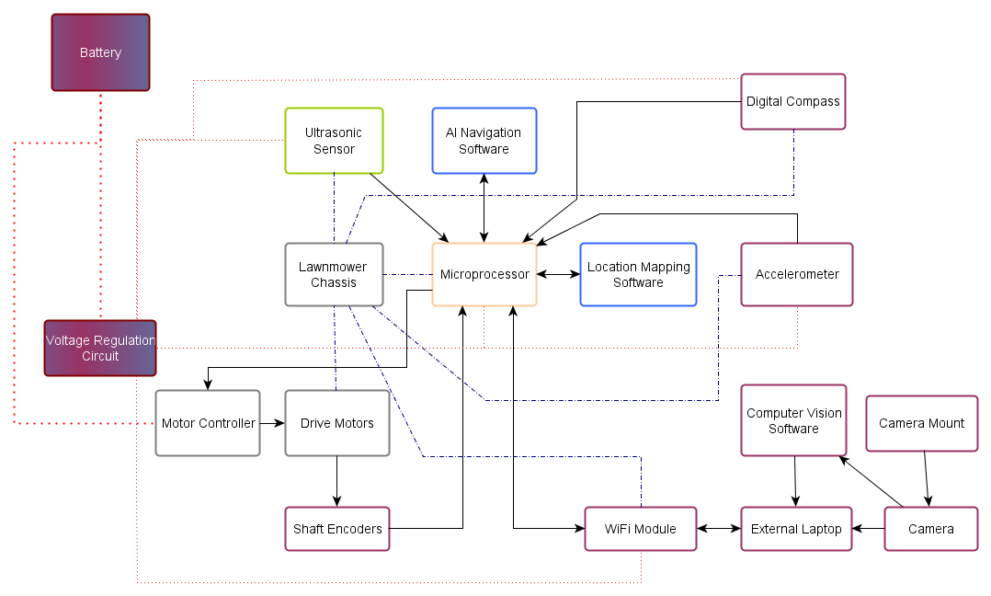
Power Subsystem

Slide 20
Component Power Requirements
Component | Voltage | Max Current Draw
Drive motors | 24 V | 50 A
Shaft encoders | 5 V | 40 mA
Microprocessor | 5 V | 12 mA
Ultrasonic sensor | 5 V | 35 mA
Wi-Fi module | 3.3 V | 38 mA
Digital compass | 3.3 V | 100 μA
Accelerometer | 3.3 V | 145 μA
Total maximum current draw of ≈ 50.13 A

Slide 21
Battery Selection
Existing battery used for blades
Lead acid - rechargeable
½ hr cutting time – at least 26 Ah battery
Two 12V batteries in series
Notes:
More details on battery selection

Slide 22
Voltage Regulation
5 V
  Microprocessor
  Ultrasonic sensor
  Shaft encoders
3.3 V
  Wi-Fi module
  Digital compass
  Accelerometer
Notes:
More details and discussion

Slide 23
Linear vs. Switching Regulators
127 mA regulated current draw
P_{out} = 5V * 127mA = 635mW
Linear Regulator
  Efficiency, η ≈ 41.7%
  P_{d} = P_{out} / η - P_{out} = 635/0.417 – 635 = 0.89 W
Switching Regulator (Buck Converter)
  Efficiency , η ≈ 80%
  P_{d} = P_{out} / η - P_{out} = 635/0.8 – 635 = 0.16 W
Notes:
Tables, tables, tables

Slide 24
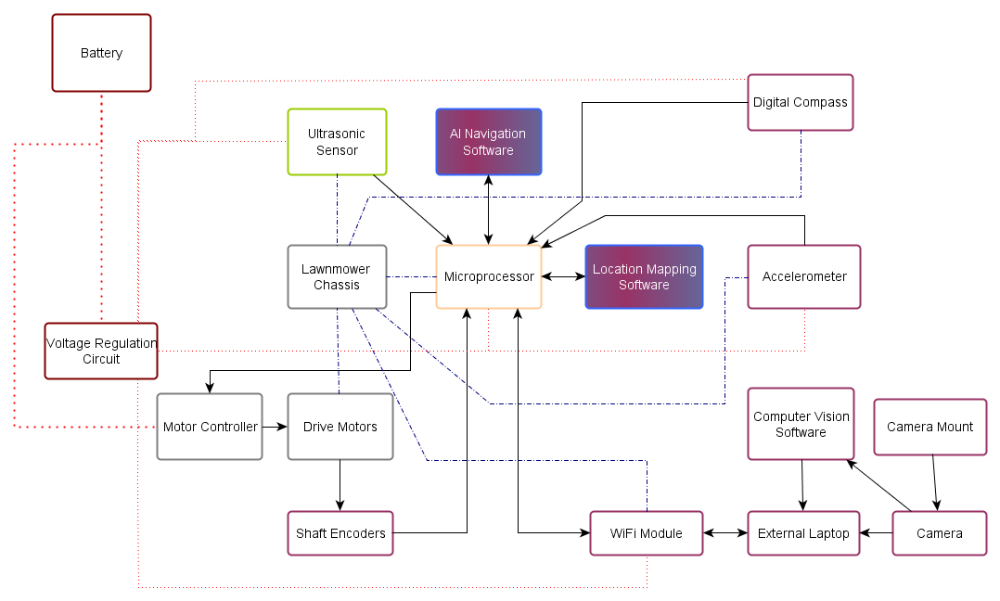
Software Subsystem

Slide 25
Data Storage and Reference
Arduino Atmega-328 EEPROM library for data storage and Metro library for timing.
Necessary for storing coordinate values of the lawn to avoid duplication and missed areas.
As mower moves, the coordinate area is marked and stored.
When the mower encounters an obstacle, the mower will maneuver in a direction not already covered

Slide 26
Data Storage and Reference
EEPROM has 1kbyte of memory available for storage. – 8192 bits
Two coordinate values are needed (4bits for one coordinate, 4bits for the other)
One bit for status (0 or 1)
Total of 16 x-coordinate points and 16 y-coordinate points. – 256 total points
4 + 4 + 1 = 9 bits for each point – 2304 total bits used

Slide 27
Initializing points
First set the 2304 bits that will be used
8 bits used for each point, plus 1
Loop through and increment from 0 to 256
Make next bit 0 (to indicate not covered)
First four bits represent x-coordinates
Right most bits represent y-coordinates
x y
0 0000 0000 – (0,0)
…
0 0000 1111 – (0, 15)
0 0001 0000 – (1, 0)
…
0 1111 1111 – (15, 15)
Notes:
Extraneous

Slide 28
Checking statuses/searching memory
Out of the 9 bits used for each coordinate point, one is used as a status bit.
Since there are 2304 total bits, it’s inefficient to search entire memory for a particular coordinate
Mapping memory location addresses to each status bit for a coordinate is more efficient

Slide 29
Checking statuses/searching memory
Ex. There are 16 points in an axis – 256 total
If we want to search status of coordinate (13, 11)
Coordinate 13 is at the 14th x point
Coordinate 11 is at the 12th y point
14 * 16 = 224 = if all x axes up to 13 are covered
224 – (16-12) = subtracting y components not already covered = 219
9 bits used for each coordinate -> 219 * 9 = 1971

Slide 30
_ _ _ _ _ _ _ _ 1 _ _ _ _ _ _ _ _ 1 _ _ _ _ _ _ _ _0
9th bit will be replaced with value 1 from left to right or right to left.
Initially, mower is moving left to right.
Mower will have coordinate value based on compass and positioning components.
The matching coordinate should be searched for in memory, but to eliminate inefficiency, the microcontroller can be set to write towards the right direction or left direction.
For example, even x values should search memory to the right, and odd x-values should search memory to the left
Uncovered area
Covered area
Mower

Slide 31
00011101 0
00011110 1
00011111 1
In this case, mower is moving to the left.
Searching in memory should switch direction
Best way
Once x- value reaches 15, skip to 144th bit to the right to start at the coordinate above – then enter values in memory going toward opposite direction.
Then switch direction once x-value reaches 0.
Uncovered area
Covered area
Mower

Slide 32
Maneuvering from Obstacles
One method – mark obstacle with a 1 in the status bit when initializing memory
(may occupy one or more “coordinates”)
0 _ _ _ _ _ _ _ _
1 _ _ _ _ _ _ _ _
0 _ _ _ _ _ _ _ _
Mower should not maneuver toward a point already covered
Uncovered area
Obstacle
Covered area
Mower

Slide 33
Maneuvering from Obstacles
Before the mower moves, the memory will be searched for the status of the next coordinate – timer can be used
Because the mower is moving left to right in this case, the mower’s motor controller will maneuver it to the left of the obstacle, then to the right, then to the right
(ie if there is an obstacle in the left or right direction, it will be marked as covered)
If both left and right direction is covered, mower should reverse
Uncovered area
Obstacle
Covered area
Mower

Slide 34
Maneuvering from Obstacles
0 _ _ _ _ _ _ _ _
1 _ _ _ _ _ _ _ _
1 _ _ _ _ _ _ _ _
Now that mower is back on its track, the program resumes writing to memory
Even though the yellow area is actually covered, it is not necessary to mark it as covered since it would complicate the memory writing process
Uncovered area
Obstacle
Covered area
Mower

Slide 35
Maneuvering from Obstacles
If obstacle occupies more than one coordinate
Check status of left or right coordinate
Move mower (either left or right or reverse)
Do not change status of maneuver points
If mower had to be reversed, check status of left or right point again
Uncovered area
Obstacle
Covered area
Mower

Slide 36
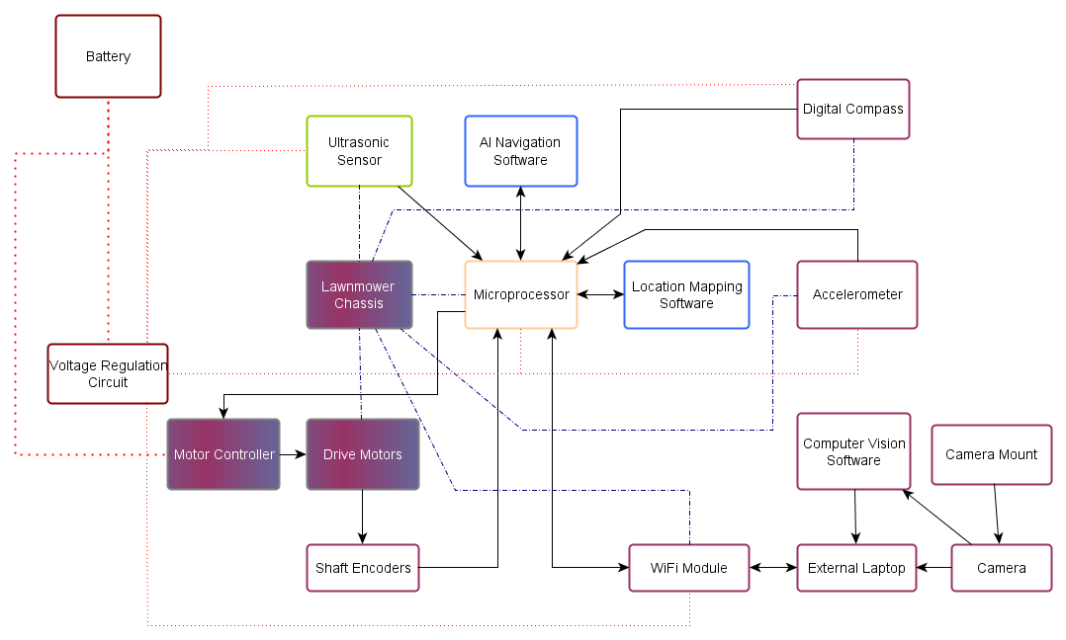
Drive Subsystem

Slide 37
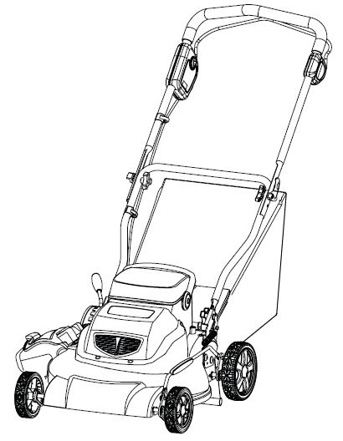
Lawnmower Integration into existing Chassis
Original Greenworks 24 Volt 3-in-1 Cordless Mower

Slide 38
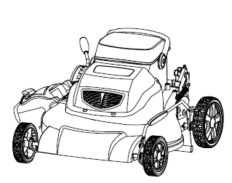
Lawnmower Integration into existing Chassis
We then removed the bag, handle, and wiring harness

Slide 39
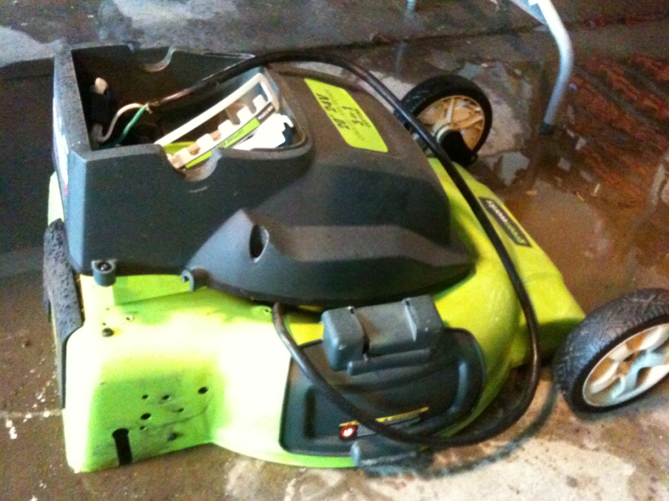
Lawnmower Integration into existing Chassis
Second we removed the rear wheels along with the ride height adjustment

Slide 40
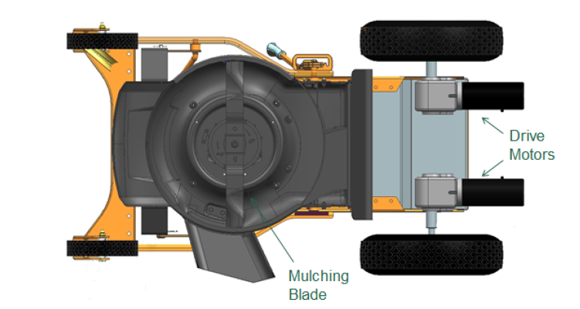
Lawnmower Integration into existing Chassis
We are in the process of fabricating the mount for the motors to attach to. The same mount will hold our batteries and electronics housing

Slide 41
Lawnmower Integration into existing Chassis
The mower turns and navigates via differential steering achieved by using each motor independently as well as free castoring wheels on the front of the chassis
The mower blade is turned on and off by a simple 25 amp relay via the microcontroller

Slide 42
Drive Motors/Motor Controller Selection
Since the electric motors were loaned to us by the UCF Robotics Club, motor selection was simple and the motors that were loaned to us provide more than enough power for our application
The motors each require a maximum of 25 amps
After looking at various manufacturers, the most highly rated and widely used motor controller was the Sabertooth 2x25 motor controller
  The Sabertooth 2x25 is able to handle control of both motors
  The Sabertooth accepts simple serial commands from a microcontroller to individually control the motors
  The Sabertooth has built in overcurrent and thermal protection

Slide 43
Overall Schematic

Slide 44
Responsibility Distribution
 | Andrew | Jason | Joe | Matt
Chassis fabrication | X
Drive subsystem | X
Location detection |  |  | X
Computer vision |  |  | X | X
Obstacle avoidance |  | X
Power subsystem | X | X
Smart Navigation |  | X | X | X

Slide 45
Milestone Chart

Slide 46
Budget
Part | Manufacturer | Quantity | Unit Price | Net Price
25222 20-Inch 24-Volt Cordless Lawn Mower | Greenworks | 1 | $369.00 | $150.00 (used)
Inspiron Laptop | Dell | 1 | $381.00 | $0.00 (used)
DC brushed motor | NPC | 2 | $181.64 | $0.00 (donated)
ATmega328 with development board for testing | Atmel | 1 | $29.99 | $29.99
PING))) Ultrasonic Distance Sensor | Parallax Inc. | 1 | $29.99 | $29.99
Sabertooth 2x25 V2 motor controller | Sabertooth | 1 | $124.99 | $124.99
HMC5883L Triple Axis Magnetometer | Sparkfun | 1 | $14.95 | $14.95
R35i (Quadrature) 1000PPR Rotary Encoder | Renco | 2 | $16.75 | $33.50
Lifecam HD-5000 Webcam | Microsoft | 1 | $24.99 | $24.99
Battery Charger | Battery Mart | 1 | $28.95 | $28.95
12V Battery 26Ah | Battery Mart | 2 | $61.95 | $123.90
LM22670-5.0 fixed output switching regulator | TI | 1 | Free sample | $0.00
LM22670-ADJ fixed output switching regulator | TI | 1 | Free sample | $0.00
ADXL345 Triple Axis Accelerometer | Sparkfun | 1 | $27.95 | $27.95
Breakout board for XBee module | Sparkfun | 1 | $2.95 | $2.95
RN-XV WiFly Module Wiring Antenna | Roving Netwks | 1 | $34.95 | $34.95
PCB 2 Layer Full Spec | Adv Circuits | 2 | $33.00 | $66.00
DIR-655 Wireless-N Router | D-Link | 1 | $94.99 | $0.00 (donated)
Drive subsystem fabrication supplies | Home Depot | X | $20.00 | $20.00
Webcam telescopic platform building supplies | Home Depot | X | $20.00 | $20.00
 |  |  | Total Price | $733.11

Slide 47
Issues
Drive motor specs are unknown due to no identifying marks on the motors at all (they were donated)
  Additional testing of the motors is needed in order that the fuse size be correct to protect the motor from stalling
Original angle iron purchased from Home Depot for the motor/battery mount was not strong enough
  Complete Mobile Boat Repair donated marine-grade aluminum for our project and we are re-designing our bracket

Slide 48
Questions

