Slide 1
Multi-Functional Hexahedron: An Interactive LED Cube
Group 5 Team Members:
Roberto Amaya
Luis Ferrer
Eury Reynoso
Julio Romero

Slide 2
Overview
Project Description
Design Details
Administrative Content
Software Details

Slide 3
Project Description

Slide 4
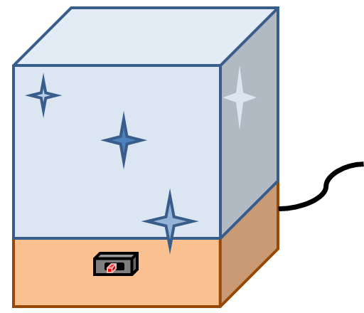

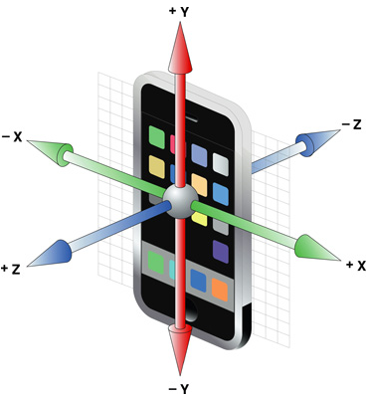
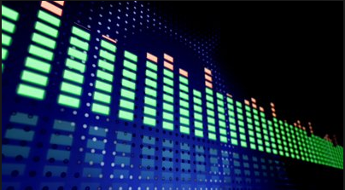
Project Description
An LED cube is basically an LED screen but in three dimensions. Instead of packing the LEDs as close together, one wants to leave space in-between to create depth.
Notes:
Insert picture of actual LED CUBE!

Slide 5
Motivation
A project that would be more programing intensive than electrical due to our group’s skill set
3 CpE and 1 EE
Failed attempt to create a 16x16x16 LED cube by a previous senior design group last summer.
Also to top the non-impressive LED cube that was picked up and showcased this spring.
Monetarily feasible project.
No funding
Fun project to take on as we spend our final semesters.

Slide 6
Requirements & Specifications
The LED resolution will be 8x8x8 = 512 minimum. Having five visible faces
The size will be approximately one cubic foot
RGB light emitting diodes will be used
Total mass should be approximately 10 lbs. or less
Electronics will be housed underneath the LED cube structure
Casing will be made from transparent acrylic/Plexiglas
PCB encasing should be made out of a light weight material
Mini-USB cable connection should be accessible from the outside
Three position switch accessible to the user

Slide 7
Design Details

Slide 8
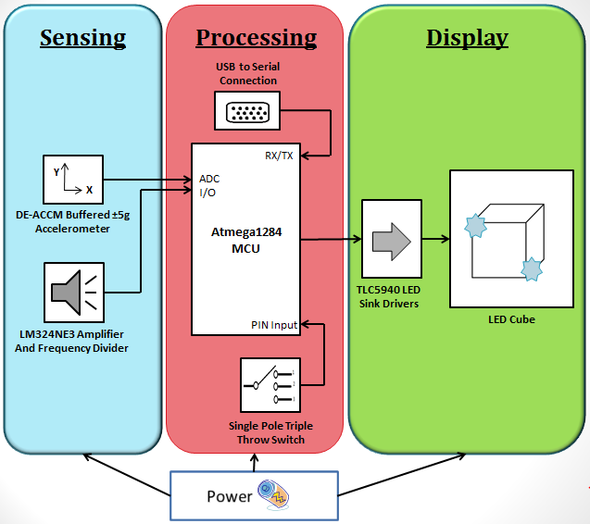
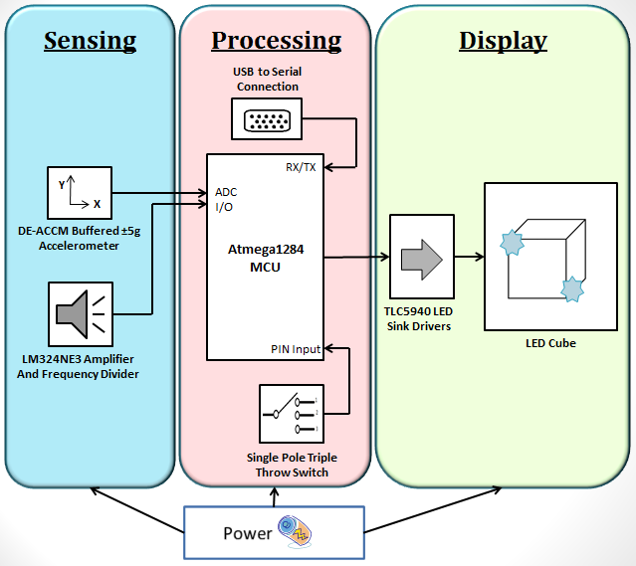
Block Diagram

Slide 9
Processing Subsystem

Slide 10
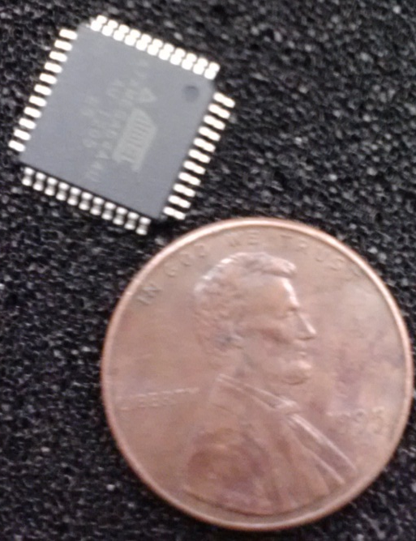
Microcontrollers
 | MSP430 | ATXmega64 | ATmega328P | ATmega1284P
Flash (Kbytes): | 2 | 64 | 32 | 128
Pin Count | 14 | 44 | 32 | 44
Max I/O Pins | 10 | 34 | 23 | 32
ADC Channels | 8 | 12 | 8 | 8
CPU | 16-Bit RISC | 8-bit AVR | 8-bit AVR | 8-bit AVR
EEPROM (Bytes) | 0 | 2048 | 1024 | 4096
Max Op. Frequency (MHz) | 16 | 32 | 20 | 20
SPI | 1 | 2 | 2 | 3
Power Supply | 1.8 – 3.6 | 1.6 – 3.6 | 1.8 – 5.5 | 1.8 – 5.5
Cost | 0 | 0 | 0 | 0
TQFP Pin Packaged
Notes:
In terms of selecting a microcontroller for our project we decided to chose the ATmega1284P for obvious reasons. When we initially started testing the animations of the single-color LED cube, we used the Arduino Uno with the ATmega328p microcontroller. We realized that by the fourth type of animation in just the main animations mode, we had coded about 10KBs of code. The total amount of flash memory on the ATmega328P as you can see here on the specs comparison table, is only 32KBs. We clearly needed to find a microcontroller with more flash memory. Fortunately, Roberto had previously acquired the ATmega1284P which has four times the amount of flash memory that the ATmega328P has and at no cost so we decided to change our microcontroller to the ATmega1284P. (~43 to 47 seconds)

Slide 11
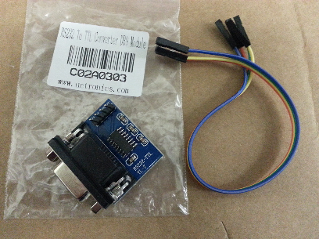
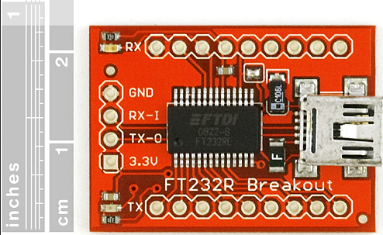
USB to Serial Converter
Originally going to use the USB to SPI converter using MAX3232 IC (USB to DB9)
Works the same as MAX232 but at a lower voltage
Switched to the FT232R Breakout board (USB to miniUSB)
Notes:
http://www.avrfreaks.net/index.php?name=PNphpBB2&file=viewtopic&t=115190&postdays=0&postorder=asc&start=20&sid=4c10c3c2ca9f5ee7e3638645e8835b13

Slide 12
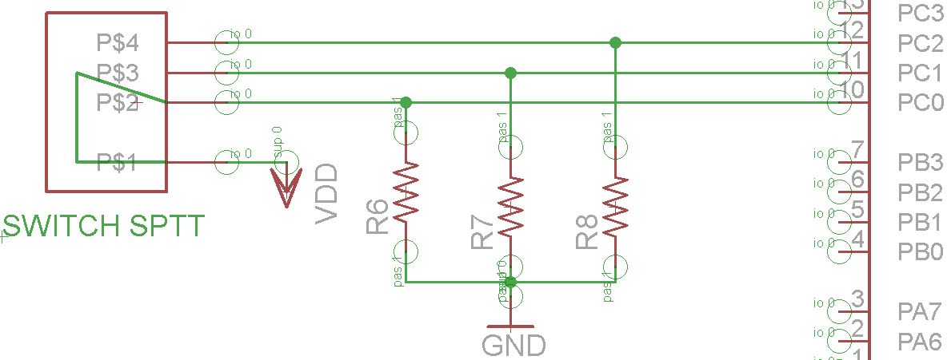
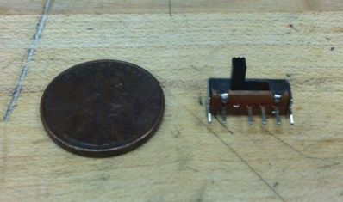
SPTT Switch
Single Pole Triple Throw
Simple method for switching between the three different modes
Picture of switch with coin for size comparison

Slide 13
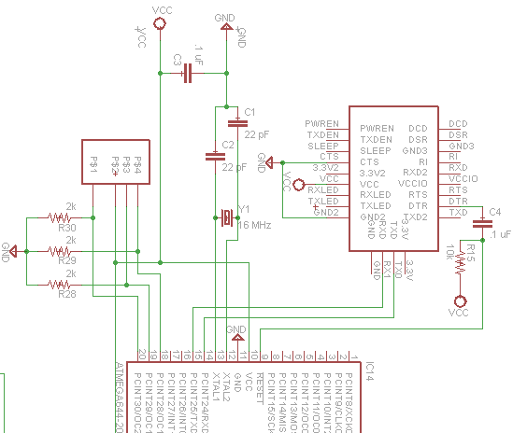
Schematic of Processing Subst.

Slide 14
Sensing Subsystem

Slide 15
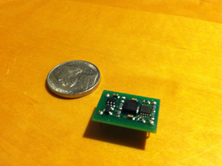
Accelerometer
DE-ACCM5G
Axes | 2
Range | ± 5g
Sensitivity | Up to 312 mV/g
Operating Voltage | 3 to 5 volts
Current Draw | Under 2mA
Advantages:
- 2 axes accelerometers are sufficient for tilting applications
- Sensitivity and range are desirable for our goals
- Component already available to group
Also in consideration: DE-ACCM3D

Slide 16
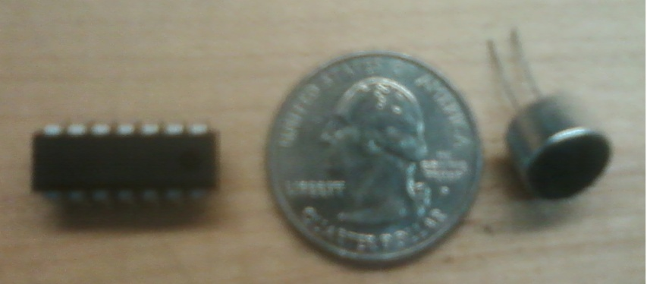
VU Meter
LM324NE3
Single Supply | 3V to 32V
Number of Op-amp | 4
Current Draw | 50 mA
Power Dissipation | 570 mW
Condenser Microphone
Supply voltage | 1V to 10V
Sensitivity | -64 ± 2 dB
Current drain | 0.3 mA (max)
Signal /noise | 60 dB (min)
Frequency response | 50 to 10 KHz
Advantages:
- Minimal parts are need to be implemented in the design
-High-gain frequency-compensated
Component is available as free sample and also at RadioShack

Slide 17
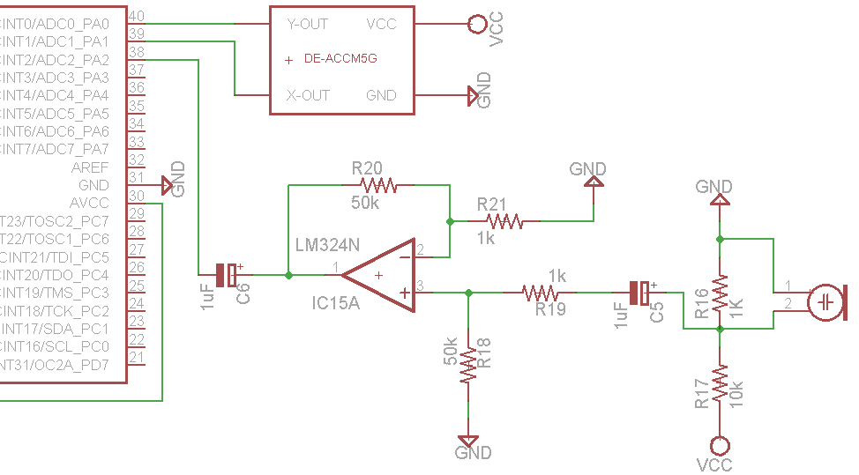
Schematic of Sensing Subst.

Slide 18
Display Subsystem

Slide 19
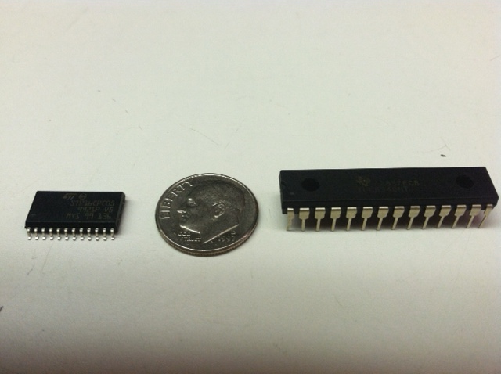
LED Sink Drivers
 | STP16CPS05MTR | TLC5940
Channels | 16 | 16
12-bit PWM Control | No | Yes
Data Transfer Rate | 30 MHz | 30 MHz
Operating Voltage | 3V | 3 to 5.5V
Package Type | SOIC | DIP
Cost | $1 - $2 | $0
Notes:
Now for the LED drivers, it was a similar scenario. When we researched past projects, we came across two widely used LED drivers for this type of project, the STP16C and the TLC5940. The main difference between the two of these in terms of performance is that the TLC5940 contains a 4096-step grayscale PWM brightness control and the STP16CPS05MTR does not. The grayscale brightness control allows us to do smoother lighting transitions on the LEDs which is necessary in some of the animations for this project. As we continued to research the TLC5940, we realized that we could acquire the TLC5940's at no cost, which ultimately helped us solidify our decision in selecting it as our LED driver. (~38 seconds)

Slide 20
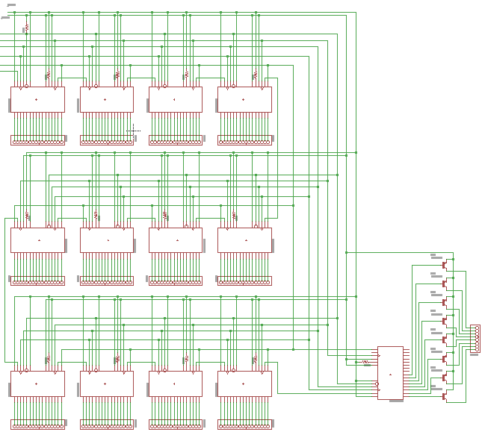

Slide 21
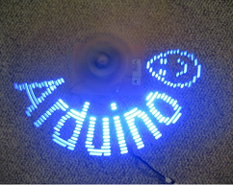
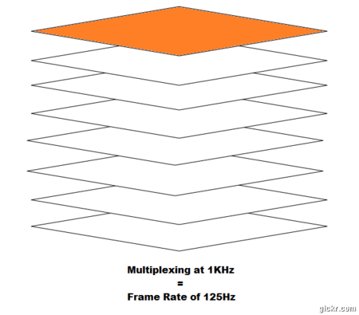
Cube Mechanics
Persistence of vision:
Phenomenon of the eye where afterimage persists for a fraction of a second
Multiplexing:
Control the cube one layer at a time, creating the illusion of a 3D image
Greatly reduce the number of LEDs controlled from 512 to 72 (64 columns + 8 layers)

Slide 22
Power Subsystem

Slide 23
Voltage
 | Part number | Voltage range
Microprocessor | ATxmega1284P | 1.6 to 3.6 V
LED driver | TLC5940NT | 3 to 5.5 V
Accelerometer | DE-ACCM5G | 3 to 5 V
Op-Amp | LM324N | 3 to 30 V
LED’s | 5 mm, RGB | 3 to 3.4
Choose 3.3 Volts as the operating voltage

Slide 24
Current
 | Part number | Max load current | Max load current using POV
Microprocessor | ATxmega128D4 | 200 mA | 200 mA
LED driver | TLC5940NT | 1.56 A | 120 mA
Accelerometer | DE-ACCM5G | 2 mA | 2 mA
Op-Amp | LM324N | 50 mA | 50 mA
LED’s | 5 mm, RGB | 30.72 A | 20 mA
SERIAL CONVERTOR | FT232RL | 15 mA | 15 mA
Total Current |  | 32.55 A | 587 mA

Slide 25
Power Dissipated
Without POV
V=3.3 Volts, I=32.5 Amp., Power = 107 Watts.
With POV
V=3.3 Volts, I=587 mA, Power = 1.94 Watts.
Power dissipated by regulator
P_{D}= (V_{in} –V _{out} ) x I_{L} = (5.5 V – 3.3 V) x 0.587mA = 0.998 W
Maximum allowable temperature rise.
T_{R(MAX)}= T_{J(MAX)} – T_{A(MAX)} =125 ºC – 25ºC = 100ºC
Maximum allowable value for the junction-to-ambient thermal resistance
θJA = T_{R(MAX)} / P_{D} = 100.21 ºC
Not heat sink or fan are need

Slide 26
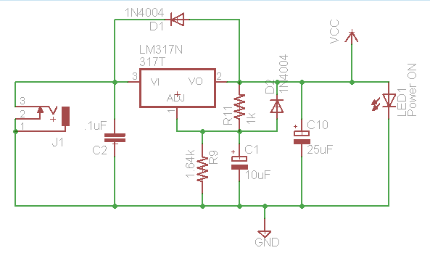
Schematic of Power Subst.

Slide 27
Software Details

Slide 28
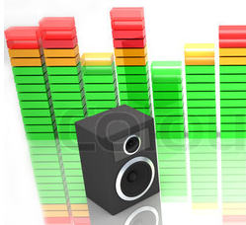
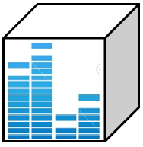
Sound Mode
This mode will allow the cube to react to ambient sound
VU meter provides frequency data
Data is divided by eight, to reflect 8 LED layers
Code will consist of lighting up layer after layer, depending on sound intensity

Slide 29
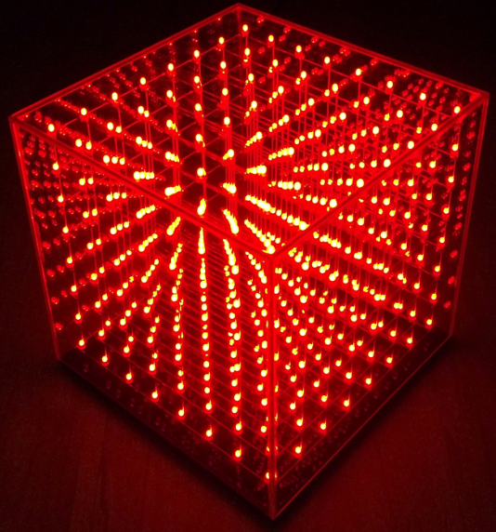
Animation Mode
This mode will display three-dimensional animations
3D array will represent individual LED coordinates
Code to animate cube will be comprised mainly of nested loops

Slide 30
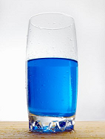
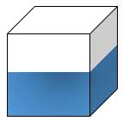
Accelerometer Mode
This mode will simulate the behavior of liquid in a container
Accelerometer provides coordinate data
Running average of coordinate data is calculated in order to account for noise
Code will consist of a dot product of Accelerometer[X][Y][Z] and LEDCube[X][Y][Z] vectors to turn on respective LEDs

Slide 31
Programming Techniques
Direct calls to TLC Library.
This allowed for a more stable lighting mode for the LEDs
Redundant code for more complex animation
Not enough space on flash memory of ATMega1284
LED Function containing following parameters:
X coordinate, Y coordinate, Z coordinate, PWM value
This layout allows us to control all values of the function through sub loops in the main loop
Bit wise control of the LEDs
Each bit was used for each LED on every row, each row on every layer, and each layer on the cube
Allows for P.O.V

Slide 32
Administrative Content

Slide 33
Current Progress
Single-color LED Cube Body completed
Single-color circuitry completed
Atmega1284 MCU boot loaded, hooked up, and ready to be programmed with Arduino IDE
Accelerometer fully tested
VU meter fully tested
Some animations have been implemented

Slide 34

Concerns/Issues
FT232RL Breakout board seems unstable at times
Implementation of persistence of vision concept more involved than expected.
Construction of RGB LED Cube will be more complex, as it requires three times as much wiring.
Time constraint

Slide 35
Budget
Part | Price | Quantity | Cost
5mm RGB LEDs | $0.12 | 512 | $61.44
Capacitors | $0.25 | 8 | $2.00
Transistor | $1.49 | 8 | $11.92
Resistors | $0.30 | 20 | Lab Supply
Wire | $30.00 | 1 | $30.00
TLC5940 | $5.52 | 13 | Free Sample
LM324 Operational Amplifier | $0.48 | 1 | Free Sample
LM317 Voltage Regulator | $0.71 | 1 | Free Sample
Microphone | $2.99 | 1 | $2.99
Plexiglas | $12.99 | 1 | $12.99
Miscellaneous | $20 | 1 | $20
PCB | $40 | 1 | $40
Total |  |  | $181.34

Slide 36
Milestones

Slide 37

Questions/Comments?

Slide 38
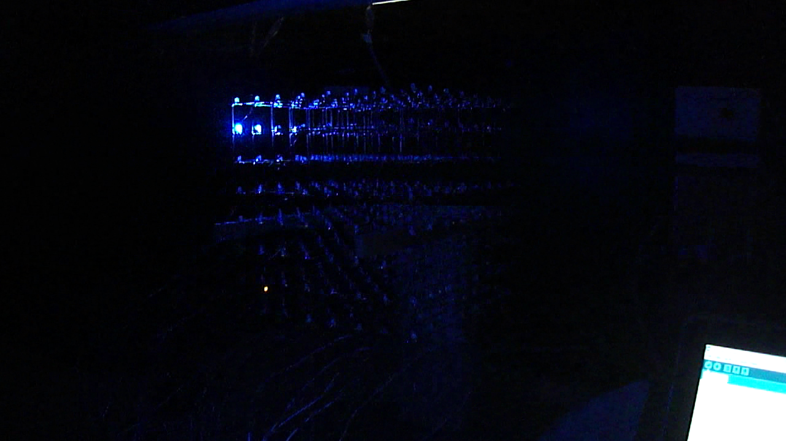
Prototype

