Slide 1
Multi-Functional Hexahedron: An Interactive LED Cube
Group 5 Team Members:
Roberto Amaya
Luis Ferrer
Eury Reynoso
Julio Romero

Slide 2
Overview
Project Description
Design Details
Administrative Content
Firmware Details
Questions / Demonstration

Slide 3
Project Description

Slide 4
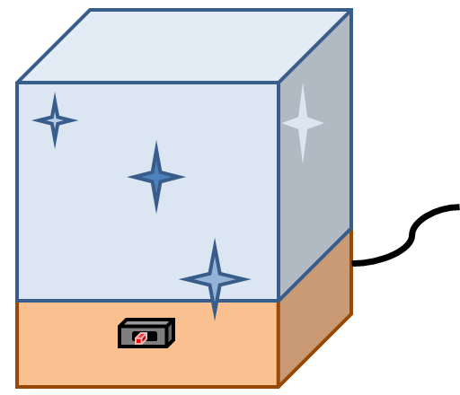

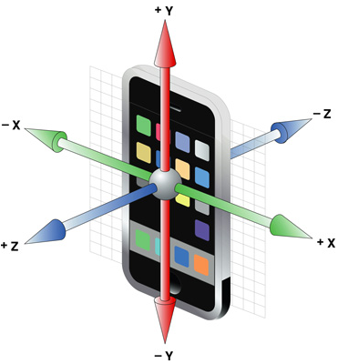
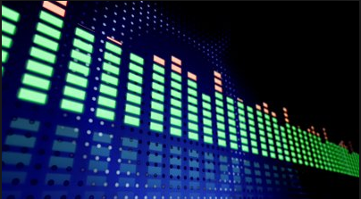
Project Description
An LED cube is basically an LED screen but in three dimensions. Instead of packing the LEDs as close together, one wants to leave space in-between to create depth.
Notes:
Insert picture of actual LED CUBE!

Slide 5
Motivation
A project that would be more programing intensive than electrical due to our group’s skill set
3 CpE and 1 EE
Low cost project.
No funding available
Fun project to take on as we spend our final semesters.

Slide 6
Requirements & Specifications
The LED resolution will be 8x8x8 = 512 minimum. Having five visible faces
The size will be approximately one cubic foot
RGB light emitting diodes will be used
Total mass should be approximately 10 lbs. or less
Electronics will be housed underneath the LED cube structure
Casing will be made from transparent acrylic/Plexiglas
Mini-USB cable connection should be accessible from the outside
Three position switch accessible to the user
Connect to wall socket for power

Slide 7
Design Details

Slide 8
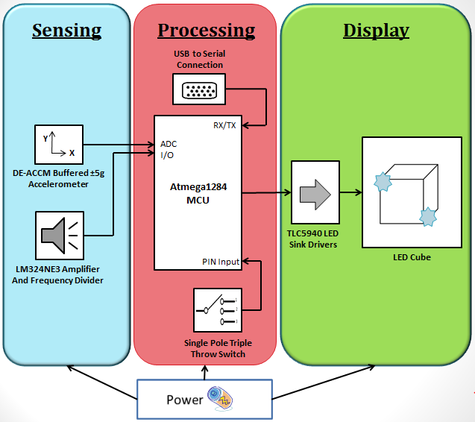
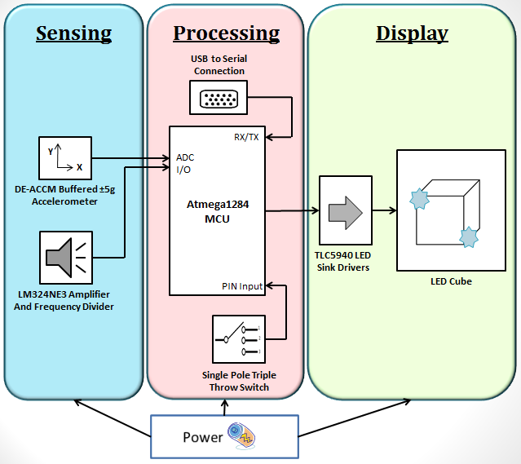
Block Diagram

Slide 9
Processing Subsystem

Slide 10
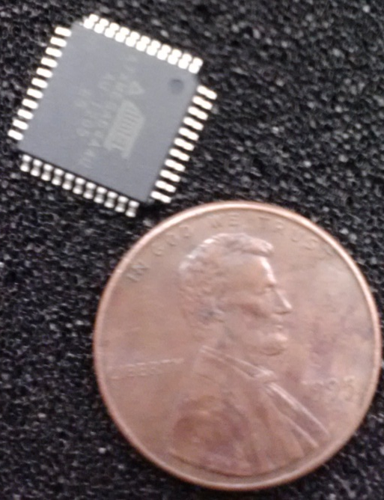
Microcontrollers
 | MSP430 | ATXmega64 | ATmega328P | ATmega1284P
Flash (Kbytes): | 2 – 235 | 64 | 32 | 128
Pin Count | 4 – 90 | 44 | 32 | 44
Max I/O Pins | 10 | 34 | 23 | 32
ADC Channels | 0-16 | 12 | 8 | 8
CPU | 16-Bit RISC | 8-bit AVR | 8-bit AVR | 8-bit AVR
SRAM (Kbytes): | .125 – 16 | 4 | 2 | 16
Max Op. Frequency (MHz) | 4 – 25 | 32 | 20 | 20
SPI | 1 – 4 | 2 | 2 | 3
Power Supply | 1.8 – 3.6 | 1.6 – 3.6 | 1.8 – 5.5 | 1.8 – 5.5
Cost | 0 | 0 | 0 | 0
TQFP Pin Packaged
Notes:
In terms of selecting a microcontroller for our project we decided to chose the ATmega1284P for obvious reasons. When we initially started testing the animations of the single-color LED cube, we used the Arduino Uno with the ATmega328p microcontroller. We realized that by the fourth type of animation in just the main animations mode, we had coded about 10KBs of code. The total amount of flash memory on the ATmega328P as you can see here on the specs comparison table, is only 32KBs. We clearly needed to find a microcontroller with more flash memory. Fortunately, Roberto had previously acquired the ATmega1284P which has four times the amount of flash memory that the ATmega328P has and at no cost so we decided to change our microcontroller to the ATmega1284P. (~43 to 47 seconds)

Slide 11
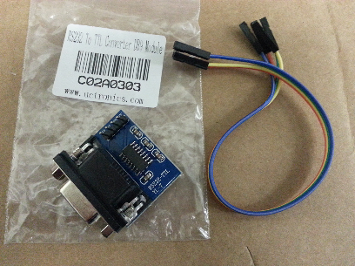
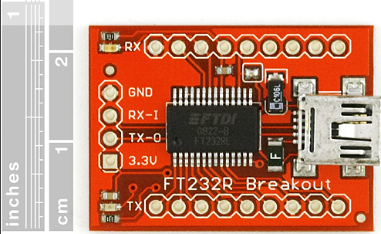
USB to Serial Converter
Originally going to use the USB to SPI converter using MAX3232 IC (USB to DB9)
Works the same as MAX232 but at a lower voltage
Switched to the FT232R Breakout board (USB to miniUSB)
Notes:
http://www.avrfreaks.net/index.php?name=PNphpBB2&file=viewtopic&t=115190&postdays=0&postorder=asc&start=20&sid=4c10c3c2ca9f5ee7e3638645e8835b13
The FT232 Breakout board was already available to the group so for the sake of cost, we decided to progress using it.

Slide 12
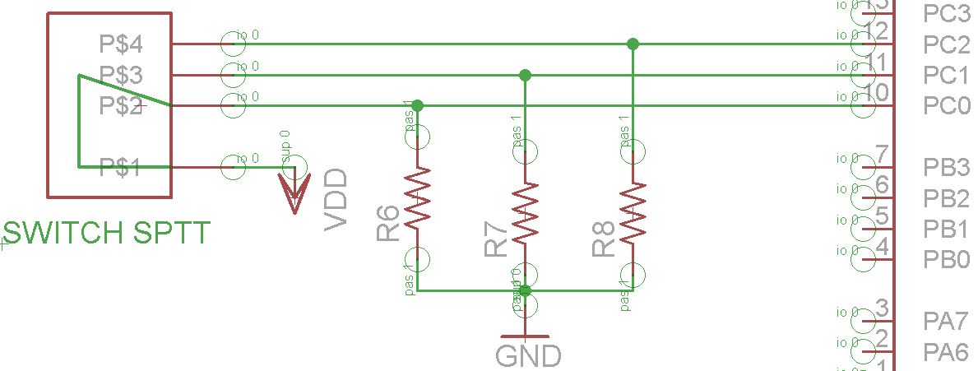
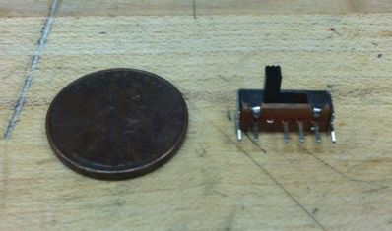
SPTT Switch
Single Pole Triple Throw
Simple method for switching between the three different modes
Picture of switch with coin for size comparison

Slide 13
Sensing Subsystem

Slide 14
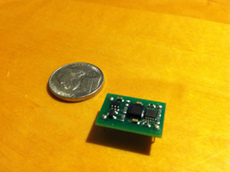
Accelerometer
DE-ACCM5G
Axes | 2
Range | ± 5g
Sensitivity | Up to 312 mV/g
Operating Voltage | 3 to 5 volts
Current Draw | Under 2mA
Advantages:
- 2 axes accelerometers are sufficient for tilting applications
- Sensitivity and range are desirable for our goals
- Component already available to group
Also in consideration: DE-ACCM3D

Slide 15
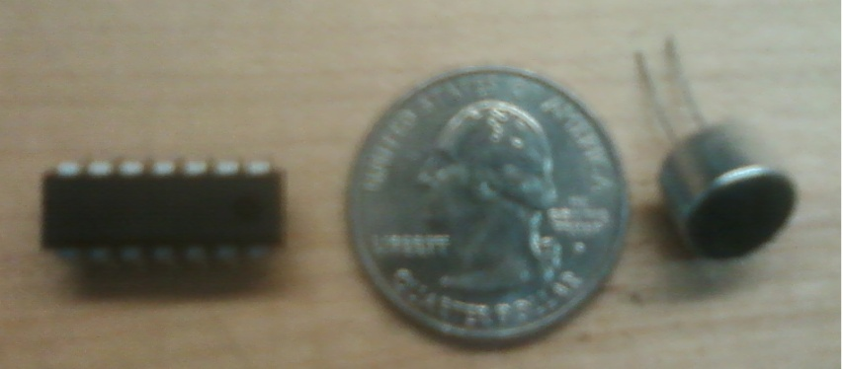
VU Meter
LM324NE3
Single Supply | 3V to 32V
Number of Op-amp | 4
Current Draw | 50 mA
Power Dissipation | 570 mW
Condenser Microphone
Supply voltage | 1V to 10V
Sensitivity | -64 ± 2 dB
Current drain | 0.3 mA (max)
Signal /noise | 60 dB (min)
Frequency response | 50 to 10 KHz
Advantages:
- Minimal parts are needed to be implemented in the design
-High-gain frequency-compensated
Component is available as free sample and also at RadioShack

Slide 16
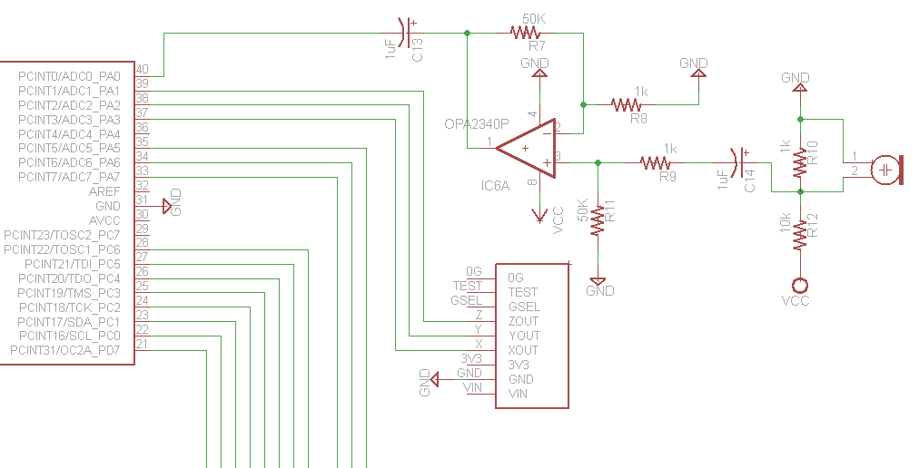
Schematic of Sensing Subst.

Slide 17
Display Subsystem

Slide 18
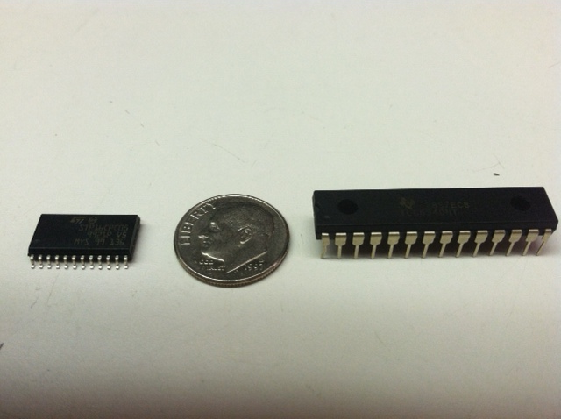
LED Sink Drivers
 | STP16CPS05MTR | TLC5940
Channels | 16 | 16
12-bit PWM Control | No | Yes
Data Transfer Rate | 30 MHz | 30 MHz
Operating Voltage | 3V | 3 to 5.5V
Package Type | SOIC | DIP
Cost | $1 - $2 | $0
Notes:
Now for the LED drivers, it was a similar scenario. When we researched past projects, we came across two widely used LED drivers for this type of project, the STP16C and the TLC5940. The main difference between the two of these in terms of performance is that the TLC5940 contains a 4096-step grayscale PWM brightness control and the STP16CPS05MTR does not. The grayscale brightness control allows us to do smoother lighting transitions on the LEDs which is necessary in some of the animations for this project. As we continued to research the TLC5940, we realized that we could acquire the TLC5940's at no cost, which ultimately helped us solidify our decision in selecting it as our LED driver. (~38 seconds)

Slide 19
Schematic of LED drivers (Pending)
Has to be changed from next slide

Slide 20
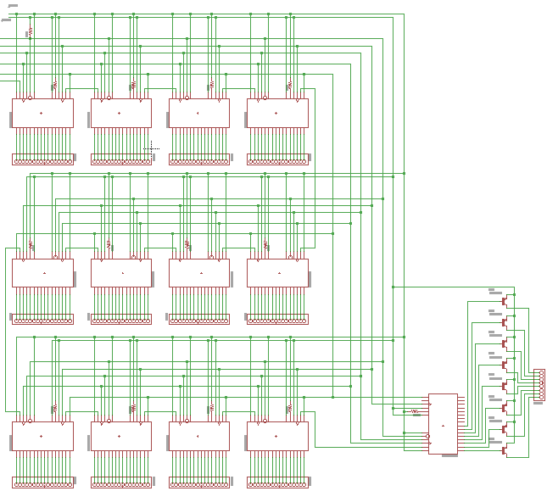

Slide 21
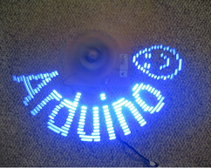
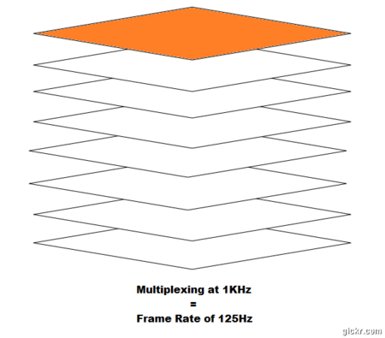
Cube Mechanics
Persistence of vision:
Phenomenon of the eye where afterimage persists for a fraction of a second
Multiplexing:
Control the cube one layer at a time, creating the illusion of a 3D image
Greatly reduce the number of LEDs controlled from 512 to 72 (64 columns + 8 layers)

Slide 22
Power Subsystem

Slide 23
Voltage & Current
 | Part number | Voltage range | Max load current | Max load current using POV
Microprocessor | ATxmega128D4 | 1.8 to 5.5 V | 200 mA | 200 mA
LED driver | TLC5940NT | 3 to 5.5 V | 1.56 A | 120 mA
Accelerometer | DE-ACCM5G | 2.2 to 3.6 V | 2 mA | 2 mA
Op-Amp | LM324N | 2.7 to 5.5 V | 50 mA | 50 mA
LED’s | 5 mm, RGB | 3 to 3.4V | 30.72 A | 20 mA
Serial Converter | FT232RL | 3.3 to 5.25 | 15 mA | 15 mA
Total Current |  |  | 32.55 A | 587 mA
*Choose 5 Volts as the operating voltage

Slide 24
Power Dissipated
Without POV
V=3.3 Volts, I=32.5 Amp., Power = 107 Watts.
With POV
V=3.3 Volts, I=587 mA, Power = 1.94 Watts.
Power dissipated by regulator
P_{D}= (V_{in} –V _{out} ) x I_{L} = (5.5 V – 3.3 V) x 0.587mA = 0.998 W
Maximum allowable temperature rise.
T_{R(MAX)}= T_{J(MAX)} – T_{A(MAX)} =125 ºC – 25ºC = 100ºC
Maximum allowable value for the junction-to-ambient thermal resistance
θJA = T_{R(MAX)} / P_{D} = 100.21 ºC
Not heat sink or fan are need

Slide 25
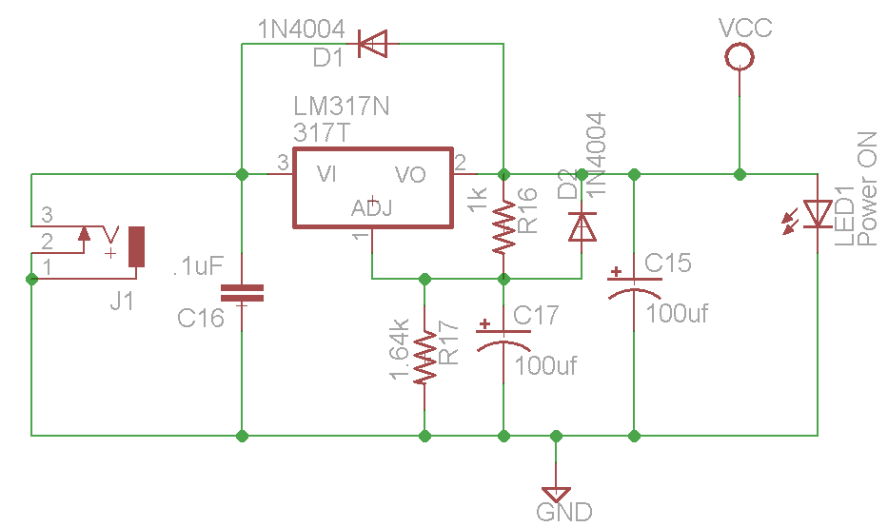
Schematic of Power Subst.

Slide 26
Firmware Details

Slide 27
Bit Manipulation
1st Byte
0XF0
0X00
0X0F
0XFF
0XFF
2nd Byte
3rd Byte
4th Byte
5th Byte
6th Byte
0X00
Channel 16
Channel 16
Channel 15
Channel 14
Channel 13
Channel 13
Grayscale data packet format consist of 12 bits x 16 channels, totaling 192 bits (24 Bytes) for one TLC
format is Big-Endian format. This means that the MSB is transmitted first, followed by the MSB-1, etc.
RGB → 10 TLCs = 240 bytes Single → 4TLCs =96 bytes
Notes:
When VPRG is set to GND, the TLC5940 enters the grayscale data input mode. The device switches the input
shift register to 192-bit width. After all data is clocked in, a rising edge of the XLAT signal latches the data into
the grayscale register New grayscale data immediately becomes valid at the rising edge of the
XLAT signal; therefore, new grayscale data should be latched at the end of a grayscale cycle when BLANK is
high.The first GS data input cycle after dot correction requires an additional SCLK pulse after the XLAT signal to
complete the grayscale update cycle. All GS data in the input shift register is replaced with status information
data (SID) after updated the grayscale register.
Feed in Gslck info at 8Mhz (0-4095)
125 ns every pulse x 4096 -> 512 ms (PWM cycle)
1.95 kHz switching frequency
Blank
Pulse it to restart GSclk counter
Set High, pull channels low
The rising edge of SCLK signalshifts the data from the SIN pin to the internal register. After all data is clocked in, a high-level pulse of XLAT signal latches the serial data to the internal registers.
Clock data at 4MHz

Slide 28
Bit Manipulation Continued
1920 byte array → 240 bytes per layer ( x 8 )
The Cube is actually treated as a 2D 8 x 64 matrix within the code. Coordinate (0,0,7) is translated as (64,0)
An array of pointers is created to keep track of the starting positions within the 1920 byte array. The Single long array is treated like a 2D array in the Multiplexing code.
Call the “Set” function to set the PWM value to the desired spot
Then we load the buffer, one layer at a time passing it to the TLCs
Notes:
The Cube is actually treated as a 2D 8 x 64 matrix within the code. Cordinate (0,0,7) is translated as (64,0)
An array of pointers is created to keep track of the starting positions within the 1920 byte array. The Single long array is treated like a 2D array in the Multiplexing code.
Call the “Set” function to set the PWM value to the desired spot
Then we load the buffer, one layer at a time passing it to the TLCs

Slide 29
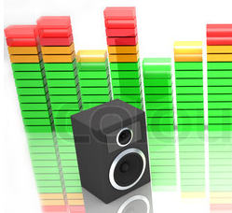
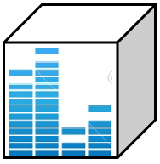
Sound Mode
This mode will allow the cube to react to sound
VU meter provides frequency data
Code will consist of lighting up layer after layer, depending on sound intensity

Slide 30
Sound Mode
Cube is exposed to ambient sound
Vu meter sends frequency data to analog pin on atmega1284p
pollVuMeter(): will take an average of 30 samples and store result in a variable
computeSound(): will divide average data by eight and use remainder (1 - 8) as number of layers to be turned on.
setLED(x,y,z,color): will turn on respective LEDs

Slide 31
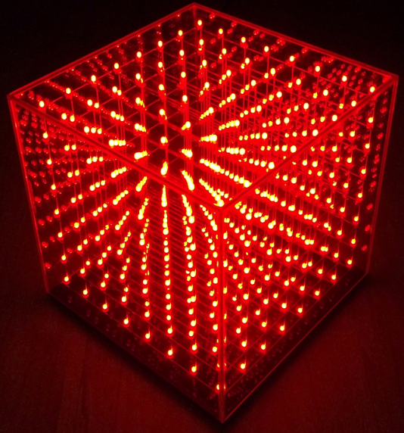
Animation Mode
This mode will display three-dimensional animations
3D array will represent individual LED coordinates
Code to animate cube will be comprised mainly of nested loops
setLED(x,y,z,color): This function will be the main method to light up LEDs

Slide 32
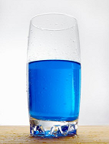

Accelerometer Mode
This mode will simulate the behavior of liquid in a container
Accelerometer provides coordinate data
Running average of coordinate data is calculated in order to account for noise

Slide 33
Accelerometer Mode
Cube is exposed to movement
Accelerometer sends (X,Y,Z) coordinate data to analog pins on atmega1284p
setLED(x,y,z,color): will turn on respective LEDs
computeAccel(): will perform a dot product of accelerometer[3] and LEDCube[3] arrays. Result will determine which LEDs to light up.
pollAccelerometer(): will take an average of 30 samples per axis and store results in an array

Slide 34
Software Metrics

Slide 35
Administrative Content

Slide 36
Current State of Completion
Single-color LED Cube Complete (Animations, circuitry and body)
RGB LED Cube animations and circuitry complete
Accelerometer fully working with both RGB and Single color LED cube
VU meter fully working with both RGB and Single color LED cube

Slide 37
Percent Completion

Slide 38
Budget
Part | Price | Quantity | Cost
5mm RGB LEDs | $0.12 | 512 | $61.44
Capacitors | $0.25 | 8 | $2.00
Transistor | $1.49 | 8 | $11.92
Resistors | $0.30 | 20 | Lab Supply
Wire | $30.00 | 1 | $30.00
TLC5940 | $5.52 | 13 | Free Sample
LM324 Operational Amplifier | $0.48 | 1 | Free Sample
LM317 Voltage Regulator | $0.71 | 1 | Free Sample
Microphone | $2.99 | 1 | $2.99
Plexiglas | $12.99 | 1 | $12.99
Miscellaneous | $20 | 1 | $20
PCB | $40 | 1 | $40
Total |  |  | $181.34

Slide 39
Work Distribution

Slide 40

Questions/Comments?

Slide 41
Demonstration Time

