Slide 1
Knight Gear
Group 6
Rene A. Gajardo
Do Kim
Jorge L. Morales
Siddharth Padhi

Slide 2
Motivation
Heavy course work would require more materials.
Posture is affected by the larger amount of things that a student carries.
Knight Gear would allow for easier moving of school materials and more.

Slide 3
Goals and Objectives
Easy to use robot that follows the user using tracking algorithm.
Carry a limited load of materials for the user.
Limit determined by weight sensor.
Object avoidance system to prevent crashing into other people or walls.
Onboard ultrasound sensors

Slide 4
Specifications
Component | Design Specification
Chasis | 24 inches tall / at most 6 inches off the ground
Maximum Payload | 30 pounds
Ultrasound Detection | 10 feet
Battery Life | 1 hour
Battery Charge Rate | 1.5 hours (electrically)
Wireless Connectivity | 10 feet

Slide 5
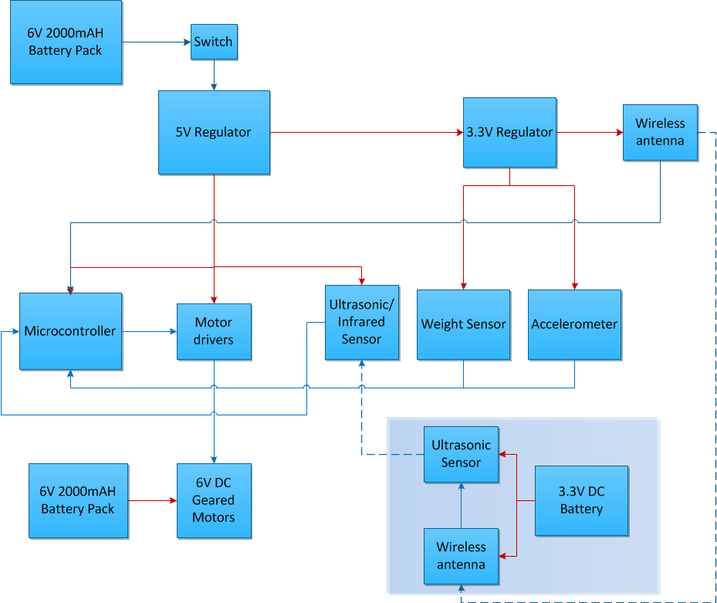
Block Diagram
Notes:
White text and make font larger

Slide 6
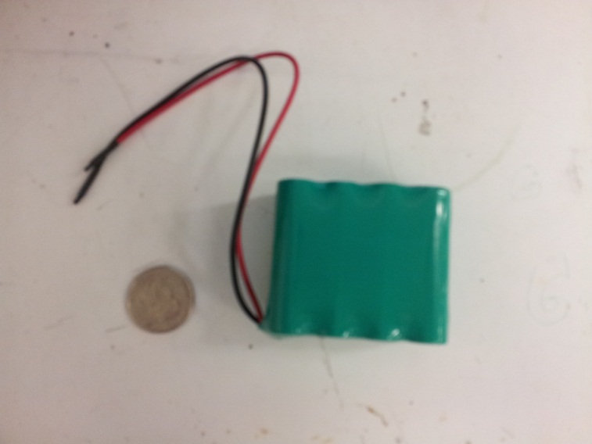
Power system Battery
6V 2000mAh rechargeable Ni-MH battery pack (x2)
Voltage(V) | 1.25 per cell
Capacity (mAh) | 1200~2600 (depend on brands)
recharge cycle | 500~1000
Charging time | 1~2hrs
charge/discharge efficiency (%) | 66
memory effect | no
price | $7~10 for 6V battery pack
High capacity and good current output
No ‘memory effect’
Environmentally friendly
Inexpensive

Slide 7
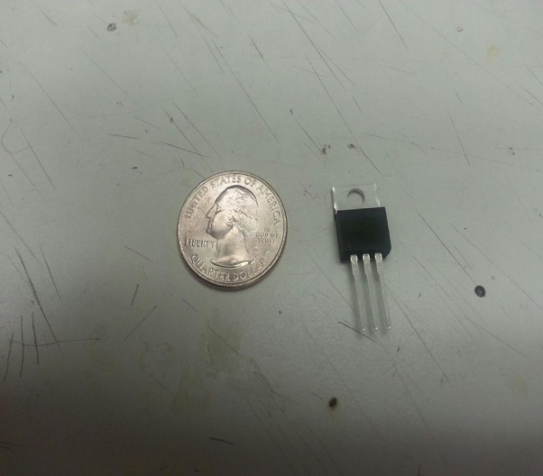
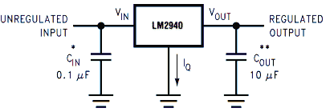
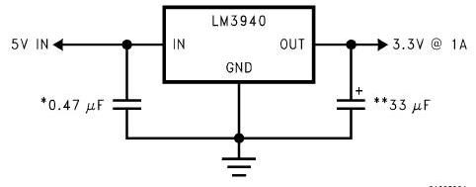
Power System Power Regulation
Motors draw too much of currents - > separate power source for motors
Power dissipation of other electronic devices :
(6V– 5V) * 380mA = 0.38W
->Low dropout linear voltage regulators will be used.
LM2940 LDO regulator for 6V to 5V @ Io =1A
LM3940 LDO voltage regulator for 5V to 3.3V@ Io =1A

Slide 8
Power System Power Regulation cont.
6V 2000mAh NiMH battery pack
6V DC geared Motors
Block diagram of power system
6V 2000mAH battery pack
Switch
6V -> 5V LDO regulator (LM2940)
5V -> 3.3V LDO regulator (LM3940)
Microcontroller
Motor driver IC
Ultrasonic / Infrared proximity sensors
Weight sensor
Accelerometer
Wireless antenna

Slide 9
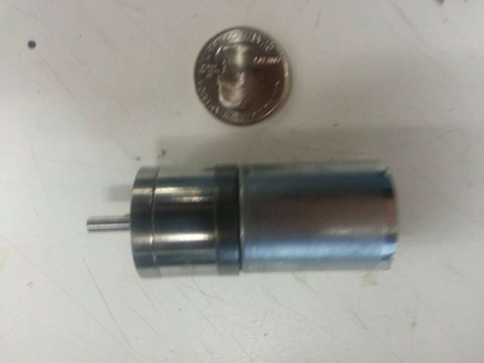
Motor Controller Motors
Spur DC geared motors (x4)
DC motor combined with a gearbox that work to decrease the motor’s speed but increase the torque
Pololu’s metal gear motor:
operating voltage | 6V
Free speed | 210 RPM
Current | 450mA
stall current | 4A
Torque | 12.8 lb*Cm
Notes:
Check specs and have a column of measurements

Slide 10
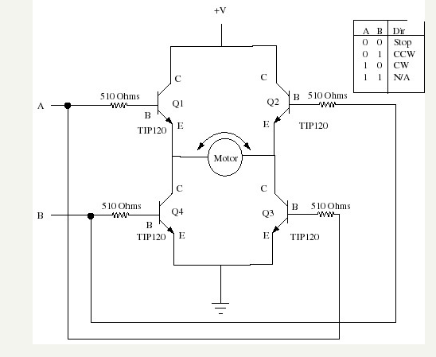
Motor controller cont.
H-bridge
H-bridge circuit is commonly used in robotics and other applications to allow DC motors to run forwards and backwards

Slide 11
Motor controller cont.
H-bridge
H-bridge circuit is commonly used in robotics and other applications to allow DC motors to run forwards and backwards
0
1
Notes:
Less time

Slide 12
Motor controller cont.
H-bridge
H-bridge circuit is commonly used in robotics and other applications to allow DC motors to run forwards and backwards
1
0

Slide 13
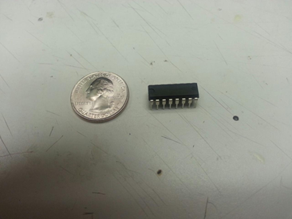
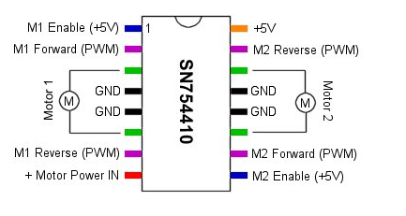
Motor controller cont. motor driver ICs
Texas instrument’s model SN754410 (x2)
Quad Half H-bridge
built-in protection diodes
supply voltage | 4.5V to 36V
Continuous output current per each channel | 1A
Peak output current per each channel | 2A

Slide 14
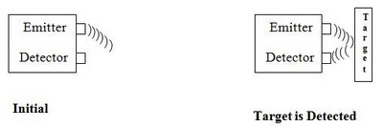
Ultrasonic Proximity Sensor
Ultrasonic sensor plays an indispensable role in Knight Gear.
It engenders high frequency sound waves (above 20,000 Hz), which is incorporated in these sensors, to measure the echo encountered by the detector, and is then received after reflecting back from the target.
This is the basic concept of how Knight Gear will detect and follow its user.

Slide 15
Products | Resolution | Reading Rate | Maximum Range | Required Voltage | Required Current | Operational Temperature | Price
XL-MaxSonar-EZ | 1cm | 10Hz | 300in-420in | 3.5V-5.5V | 3.4mA | 0C – 65C | $27.95
XL-MaxSonar-AE | 1 cm | 10Hz | 300in-420in | 3.5V-5.5V | 3.4mA | - 40C – 70C | $29.95
LV-MaxSonar-EZ | 1 cm | 20Hz | 254in | 2.5V-5.5V | 2.0mA | - | $21.95
HRLV MaxSonar-EZ | 1 mm | 10Hz | 195in | 2.5V-5.5V | 3.1mA | 0C – 65C | $28.95
HRXL MaxSonar-WR | 1 mm | 6Hz-7.5Hz | 196in-393in | 2.7V-5.5V | 3.1mA | -40C – 65C | $97.95

Slide 16
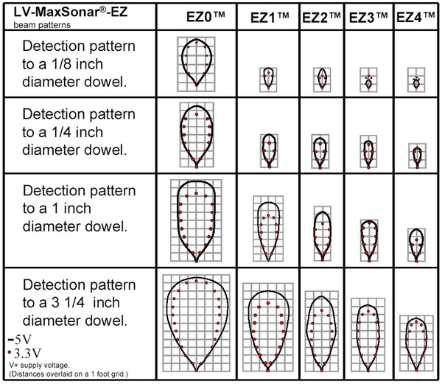
Why LV Max Sonar EZ2 ?
Beam gets narrower and sensitivity gets lower from EZ0 to EZ4
Wider beam width is better for detection but provides more noise and ghost echoes
EZ2 is a sensible pick to get good beam width while also avoiding noise and ghost echoes.

Slide 17
Infrared Proximity Sensor
Infrared proximity sensors send out beams of infrared light and then analyze the returning light.
The photo-detector inside the sensor detects any incoming reflection of this light.
These reflections allow the sensor to determine the location of the object.
In Knight Gear, infrared light will be emitted from this sensor which will be reflected back by the person/object to the proximity sensor.

Slide 18
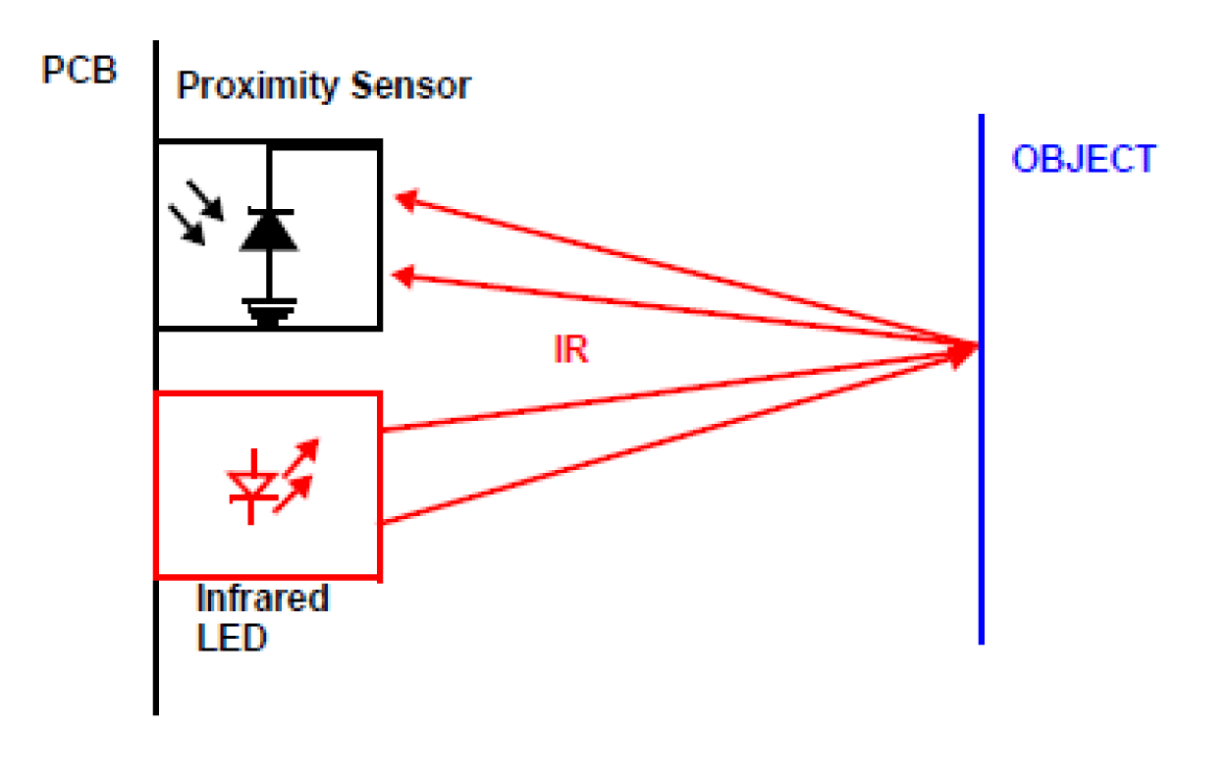
Infrared proximity sensor works as a triangulation.
The sensor will evaluate the time taken and returning angle with modulation to assay the distance.

Slide 19
Products | Voltage Operational Range | Distance | Price
GP2Y0A02YK0F | 2.7V - 6.2V | 150cm | $14.95
GP3Y0A21YK | 2.7V - 5.5V | 10cm-80cm | $13.95
GP2D12 | 4.5V - 5.5V | 10cm-80cm | $9.95
Pololu | 2.7V – 5.5V | 60cm | $5.95
GP2Y0A02YK0F is the best choice
Range of 150 cm is ideal for Knight Gear
Notes:
GP2Y0A02YK0F is the best choice among all the Infrared Proximity Sensors we have looked into.

Slide 20
Accelerometer
An accelerometer is used in Knight Gear to detect
Velocity
Position
Shock
Vibration or acceleration of gravity
It will determine the localization and positioning of Knight Gear by evaluating the inertial measurement of velocity and position.
Accelerometer can measure acceleration in one, two or three orthogonal axis
2-axis accelerometer is sufficient enough for the purpose of Knight Gear and costs more than 3-axis accelerometer which provides more accurate data of x, y and z axis of Knight Gear without supplementing extra weight.

Slide 21
Products | Range | Interface | Axes | Voltage Requirements | Current Requirements | Price
ADXL 193 | ± 250g | Analog | 1 | 3.5 – 6 V | 1.5 – 2 mA | $29.95
ADXL335 | ±3g | Analog | 3 | 1.8 – 3.6 V | 350µA | $24.95
BMA180 | ±1, 1.5, 2, 3, 4, 8, 16g | SPI and I2C | 3 | 2 – 3.6 V | 650 - 975µA | This product is retired.
LIS331 | ±6, 12, 24g | SPI and I2C | 3 | 2.16 – 3.6 V | 250µA | $27.95
MMA7361 | ±1.5, 6g | Analog | 3 | 2.2 – 6V | 400-600µA | $11.95
MMA8452Q | ±2, 4, 8g | I2C | 3 | 1.95 – 3.6 V | 165µA | $9.95
MMA7341L | ±3, 11g | Analog | 3 | 2.2 – 3.6 V | - | $9.95
Notes:
ADXL335, fits the best need of Knight Gear.It costs $24.95 from sparkfun when compared to double axis accelerometer. ADXL-335 provides very low noise and uses very low power to offer sensing range of ± 3g.
This sensing range of ± 3g should be very accurate in a limited range and should maximize sensitivity without losing any of Knight Gear’s functionalities

Slide 22
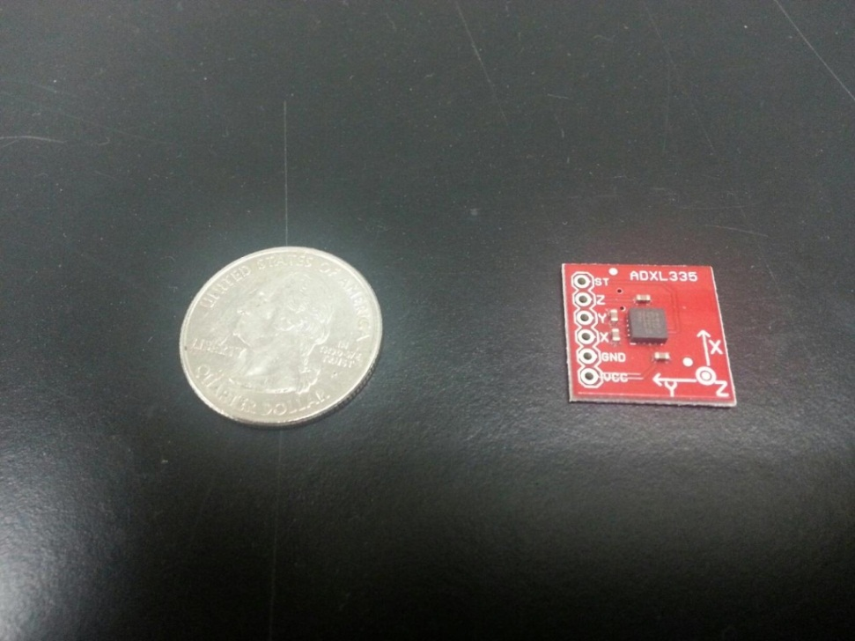
ADXL-335 has ratiometric output.
At Vs = 3.6V, the output sensitivity is typically 360m V/g. At Vs = 2V, the output sensitivity is typically 195 m V/g.
The bandwidth of ADXL-335 ranges from 0.5Hz to 1600Hz for X and Y axis and 0.5Hz to 550Hz for Z axis.
Notes:
the output sensitivity varies proportionally to the supply voltage

Slide 23
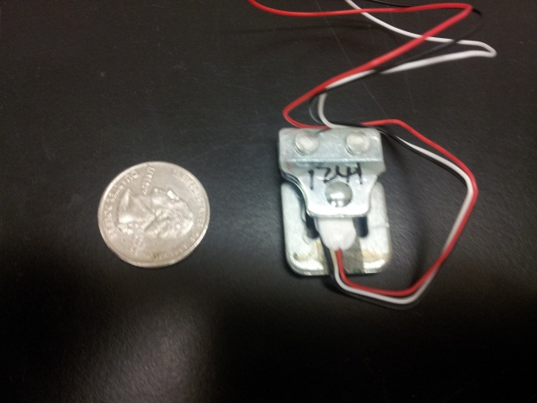
Weight Sensor
Knight Gear works when the weight of the backpack is less than or equal to 30lbs.
The weight sensor works as a Wheatstone Bridge Network, where 4 strain gauges are connected with 4 separate resistors. When a force or load is applied, resistance changes and results in change in output.
This small change in output voltage is measured and augmented carefully from low amplitude to high amplitude and then examine to calculate the weight of the load.
SEN-10245 load cell will be used for the execution of weight sensor.
This sensor costs $9.95 and is not complicated to implement.

Slide 24
Wheels Configuration
Mechanisms to provide locomotion that is required for the Knight Gear
Differential Drive
Ackerman Drive
Synchronous Drive, and
Omnidirectional Drive

Slide 25
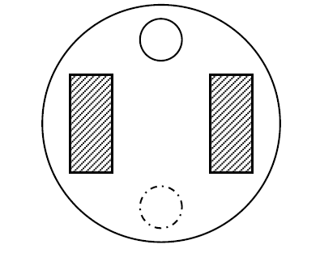
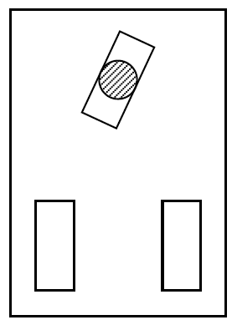
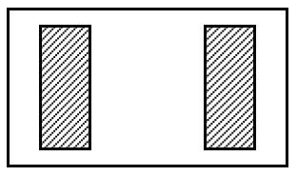
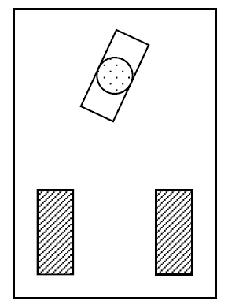
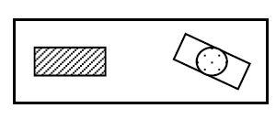
Characteristics of Wheel Configuration
Wheel Configuration | Illustration | Description
Static unstable two-wheeled |  | The front wheel allows controlling the orientation i.e. steering and the rear wheel drives the vehicle.
Static stable two-wheeled |  | If the center of mass is below the wheel axle, this type of wheel achieves stability. The desired speed is achieved by changing the speeds and directions of the wheels.
Differential drive with a castor wheel |  | The center of gravity should be maintained within the triangle formed by the ground contact points of the wheels.
Tri-cycle drive, front/rear steering and rear/front driving |  | The drive wheels are at the rear of the robot. A differential allows the vehicle to avoid the mechanical destruction.
Tri-cycle drive combined steering and driving. |  | The front wheel is used for both driving and steering. The two wheels in the rear keep the stability of the robot.

Slide 26
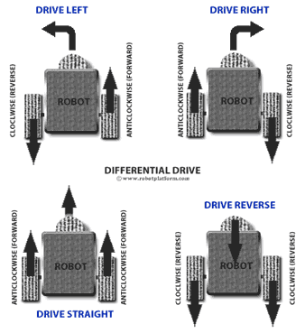
Differential Drive
Wheels rotate at different speeds when turning around the corners
It controls the speed of individual wheels to provide directionality in robot
Correction Factor may be needed to fix the excess number of rotations
Notes:
This is the most common control mechanism for robot builders, especially for beginners. The concept is simple; Velocity difference between two motors drive the robot in any required path and direction. Hence the name “Differential” drive. Differential wheeled robot can have two independently driven wheels fixed on a common horizontal axis or three wheels where two independently driven wheels and a roller ball or a castor attached to maintain equilibrium.

Slide 27
Localization
Knight Gear needs to accurately identify its position at all times, regardless if it is situated outdoor or indoor.
it needs to avoid colliding with walls, hitting people and come to sudden stop if someone comes in front of it.
There are two ways in which awareness of locality can be achieved
Absolute Localization
Relative Localization (Dead Reckoning System)
Notes:
Determining where Knight Gear is, at a random point of time in extremely necessary because while navigating,

Slide 28
Localization
Absolute
Relative
Absolute localization locates the robot using the coordinate system.
No approximate estimation is required to initiate the localization process
Uses sensors to provide information on the surroundings of the robot and the information can be interpreted to determine its position based upon the coordinate landmarks.
Current position of the robot can be determined incrementally by evaluating displacement, initial positioning, speed the robot is travelling, and direction it is travelling
Sensors like gyroscope, accelerometer, and inertial measurement units help in calculating the relative localization of the robot.
However, this technique incorporates a lot of minute errors that add up.
Notes:
However, this technique incorporates a lot of minute errors that add up. These errors are wheel slippage, uneven floors, and lot of incremental errors that accumulate to give localization with accumulated errors.

Slide 29
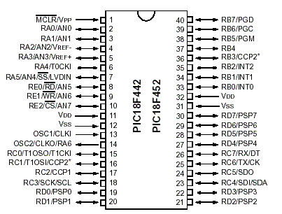
Microcontroller
PIC 18F452
Low cost
Programmable in C
Enough memory for our needs
Notes:
Show all the comparisons between all controllers

Slide 30
Chassis
Custom made chassis designed out of high density polyethylene (HDPE).
Most chassis found where either too small or too big for our needs.
Withstands heat
Waterproof
length | 2 feet
width | 1.5 feet
height | 2 feet
Notes:
Show a diagram of the final design drawings or more

Slide 31
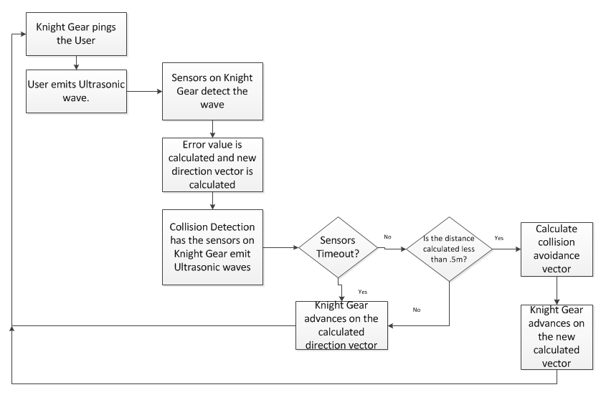
Code Flow

Slide 32
Overall code
The robot turns in the direction of the of the sensor which detected the signal first.
The magnitude of the turn and the speed of the robot is calculated by the difference in time in which the sensors detect the user.
It will use the echo of the sensors on the robot for avoidance detection.
Notes:
More flow charts

Slide 33
Proportional-Integral Controller
We implement a PI controller instead of a PID controller to save memory.
Runs only on current error and integral of previous errors.
Using small constant multipliers to lower the deviation on Knight Gear.
The error is determined by the time it takes for the signal in the users transmitter to reach both sensors on Knight Gear.
After the calculating the movement vector, the Collision Detection is called.

Slide 34
Collision Detection
The code makes the two ultrasonic sensors on the robot send a signal and wait for an echo.
If an echo is not heard or if the distance is greater than half a meter, Knight Gear does not need to do collision avoidance and pings the user
If an echo is heard and the distance calculated is less than one meter, the accelerometer data is gathered and Knight Gear determines if it will collide with the object at its current velocity.

Slide 35
Collision Detection Continued
If Knight Gear calculates that it will collide it takes one of three actions:
If the left sensor detects an obstacle, then Knight Gear turns right.
If the right sensor detects an obstacle, Knight Gear turns left.
If both sensors detect an obstacle around the same time Knight Gear comes to a stop

Slide 36
Collision Detection Continued
From here Knight Gear waits for a second or two then if the obstacle is no longer in the way it pings the user again.
If the obstacle is still in the way it will rotate left and run collision detection again.

Slide 37
Work Distribution
Subsystem | Group Member
Main Software | Rene Gajardo
Linear Control System | Siddharth Padhi
Frame | Do Kim
Motors | Do Kim
Power Supply | Do Kim
Microcontroller | Jorge Morales
Sensors | Siddharth Padhi
Wheel Configuration | Siddharth Padhi
Wireless Communication | Rene Gajardo
PCB Board | Jorge Morales
Autonomous Algorithms | Rene Gajardo

Slide 38
Budget
Part | Cost
Ultrasound Sensor | $83.85
Infrared Sensor | $13.95
Weight Sensor | $9.95
Accelerometer | $24.95
Battery | $5
Motor | $48
Motor Controller | $1.87
Chassis | $54.60
Microcontroller | $4.68
GPS Module | $29.99
Total | $276.84

Slide 39
Progress

Slide 40
Issues
Problem with microcontroller decision.
Not enough PWM lines (only have 2, need 4)
Solar panel.
Problems with implementation into our circuit
Over budget
Localization.
No way of implementing indoor localization.

Slide 41
Questions?

