Slide 1

Motorcycle tracking security system
(M.T.S system)
Group 8
Andres F. Suarez (EE)
Brian Maldonado (EE)
Rígel Jiménez (EE)

Slide 2
Motivation
According to the National Highway Traffic Safety Administration (NHTSA), there were over 9 million motorcycles registered in 2012 in the US.
Unfortunately, the basic motorcycle lacks securities and technological features available in some other transportation vehicles.
The MTS system is about to change this because it will significantly enhance the motorcycle riding experience, by adding:
MTS
Security
Features
Bluetooth
capabilities
Ability to text an emergency contact
Tracking motorcycle location 24/7

Slide 3

Goals and Objectives
Adding electrical components to the helmet without significantly increasing the weight.
Keeping the helmet as spacious as it was originally, even though it will now have all the electronic components.
Being able to synchronize the helmet to a cell phone.
Providing security features to the helmet and the bike.
Implementing an accelerometer to the bike and helmet.
The system should be able to send text messages.

Slide 4
Specifications
COMPONENT | PARAMETER | DESIGN SPECIFICATION
Motorcycle battery | Current Draw | Less than 100 mA
Bluetooth | Minimum Range | 3 meters
GPS | Accuracy | 10 meters
GPS | Acquisition time | Less than 35 sec
Accelerometer | Sensitivity | Less than 20 mg/LSB
GSM | Frequency Band | 800 MHz or greater
GSM | SMS length | More than 90 characters
RF | Minimum Range | 10 meters
Helmet | Additional Weight | Less than 300 grams

Slide 5
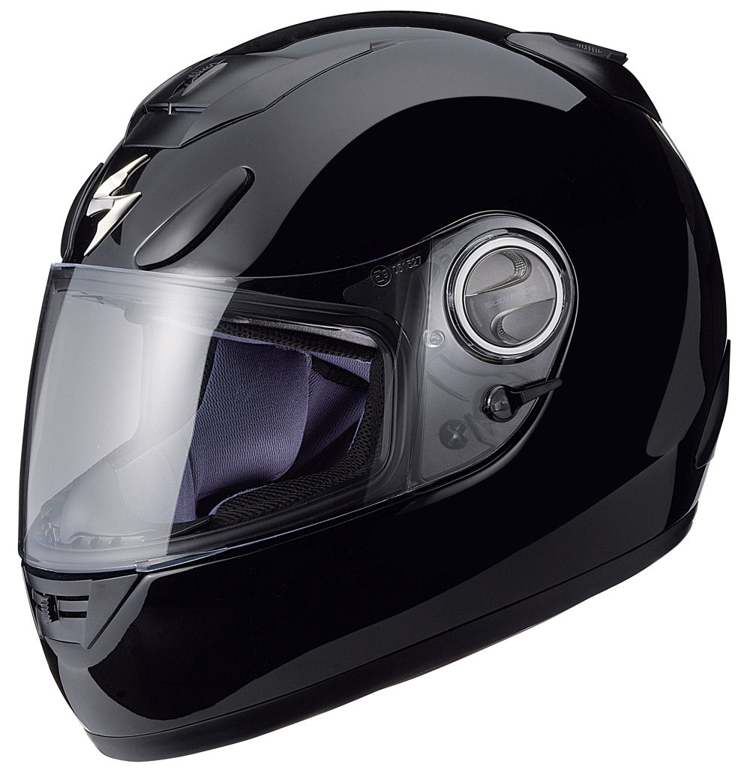
MTS SYSTEM
Helmet
Subsystem
Motorcycle
Subsystem

Slide 6
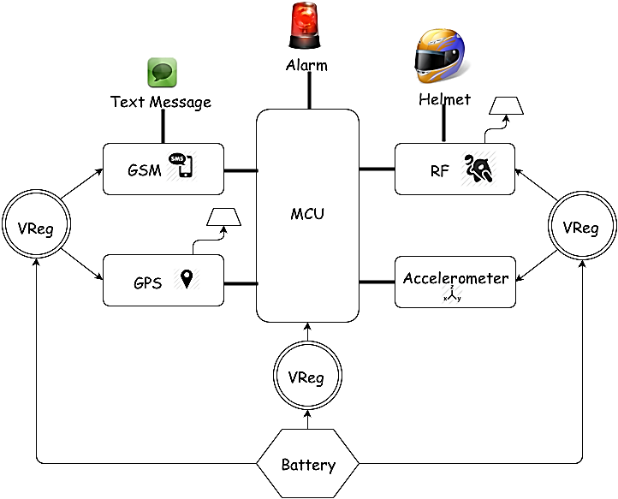
Motorcycle Subsystem

Slide 7
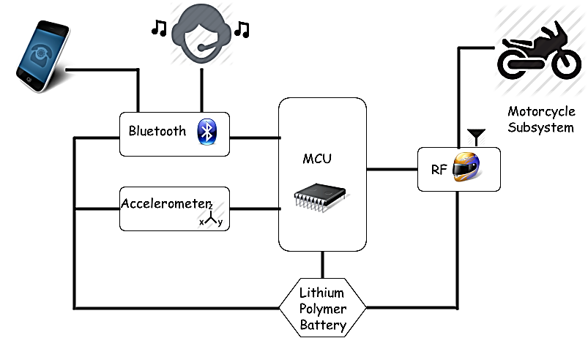
Helmet Subsystem

Slide 8
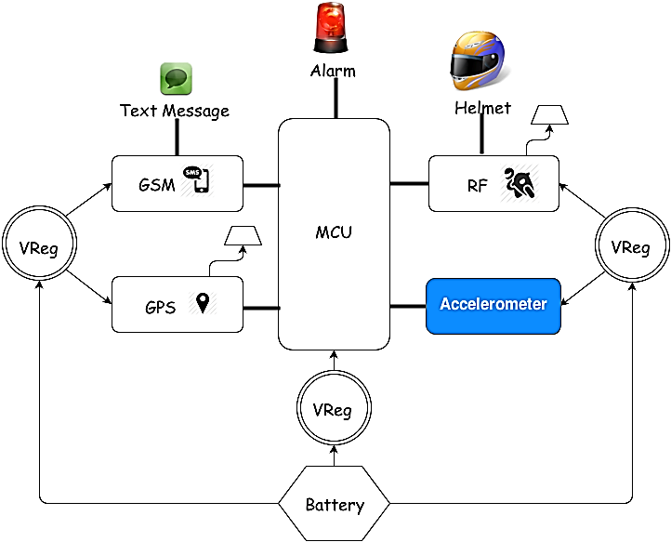
Motorcycle Accelerometer Module

Slide 9
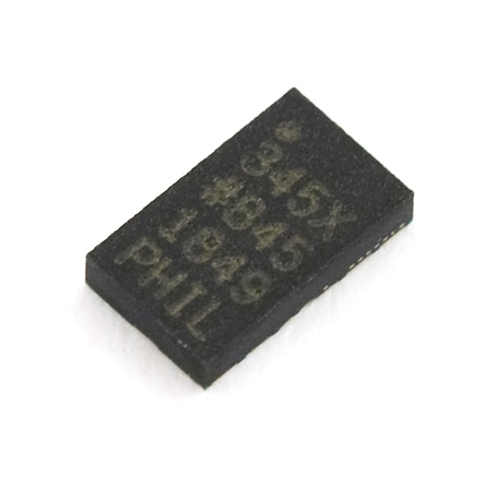
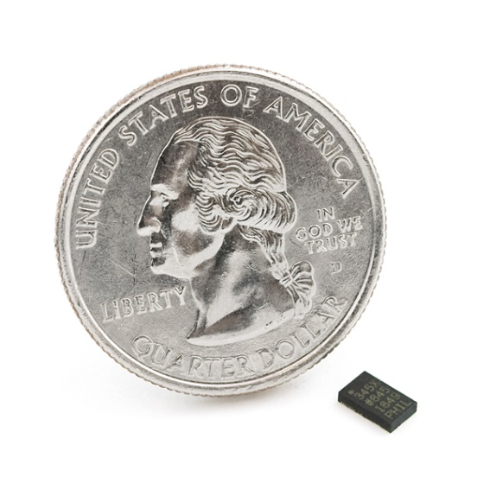
ADXL345 Accelerometer
FEATURES
Voltage Supply | 1.8V to 3.6V
Current Consumption | 25 to 130µA at 2.5V
Resolution | 10-bit at every g-range
Serial Communication | SPI or I²C
Sensitivity | ±2g 3.9mg/LSB, ±4g 7.8mg/LSB, ±8g 15.6mg/LSB, ±16g 31.2mg/LSB
Number of Axes | 3-Axis
Dimension | 3mm x 5mm x 1mm

Slide 10
ADXL345 Functions
ALARM ENGAGED | MOTORCYCLE ON
Functions as a Motion Sensor | Senses for high g-force readings that indicate a possible accident
Has a preset threshold for detecting activity | Has a different set threshold that monitors high g-forces
If threshold is passed, an interrupt signal is then sent to the microcontroller | Sends an interrupt signal once threshold is passed

Slide 11
Accelerometer Registers and Functions
Registers
8-bit register addresses ranging from 0x00 to 0x39
Sets the specs for the interrupts and contains serial, and bandwidth selection.
Contains a total of 14 different interrupt functions.
Interrupt functions used
Self Test | Tests the electrical and mechanical parts for proper function
Single Tap | Interrupt is set when a single acceleration event passes acceleration and time threshold.
Activity | Interrupt is set when acceleration is greater than threshold.

Slide 12
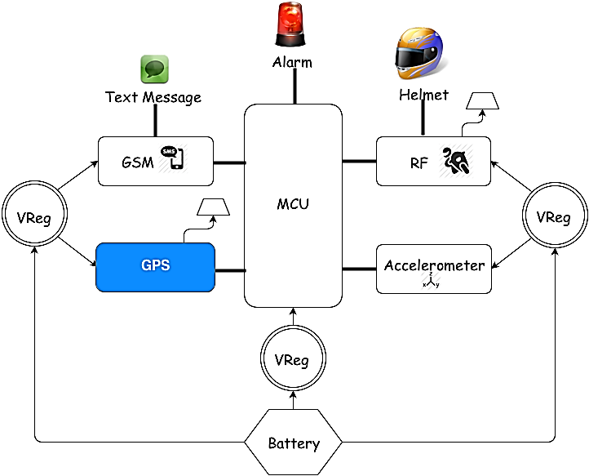
GPS Module

Slide 13
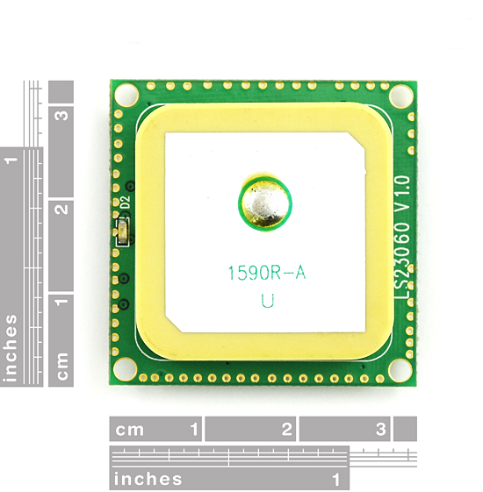
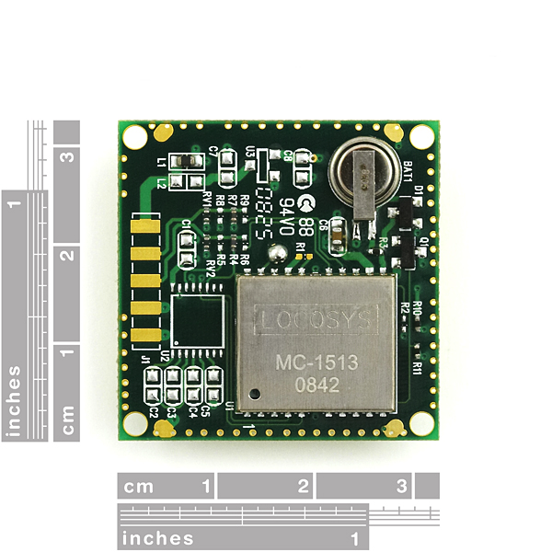
LS20031 GPS Module
FEATURES
66 Channel – 5 Hz GPS Receiver
57600 bps TTL serial interface
3.3 V at 41 mA
Fast Time to first fix at low signals
LED indicator for fix or no fix
Acquisition Time : Cold Start 35 s Hot Start < 2s
Dimensions: 30 x 30 mm
Position Accuracy: 2.5 to 3 m
Uses NMEA protocol
Built-in micro battery to preserve system data for fast satellite acquisition
Built-in Antenna

Slide 14
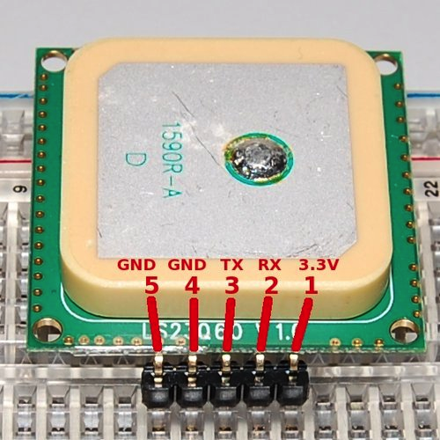
LS20031 GPS
Pin Assignment and Descriptions
Pin # | Name | Type | Description
1 | VCC | P | Power input
2 | RX | I | Data Input (TTL level)
3 | TX | O | Data Output (TTL level)
4 | GND | P | Ground
5 | GND | P | Ground

Slide 15
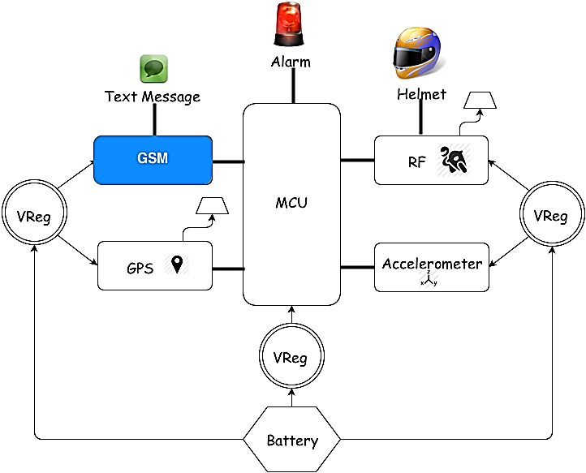
GSM Module

Slide 16
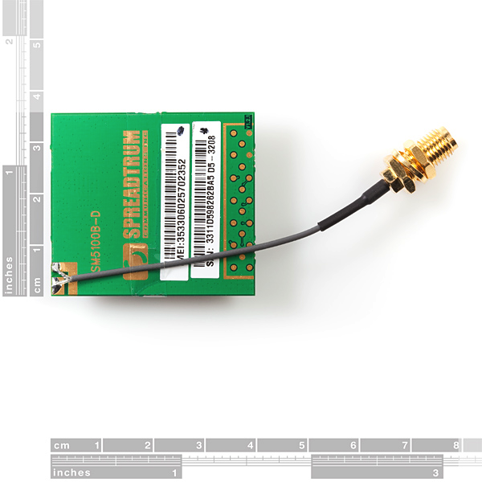
SM5100B GSM Module
APPLICATION:
Sends SMS text messages with corresponding GPS coordinates.
FEATURES:
Dimensions: 35.0 x 39.0 x 2.9mm.
Power: 3.3 – 4.2 V. Nominal 3.6 V.
Current consumption: <100μA when module is off; and 2 mA in Sleep mode.
Quad-band GSM.
Frequency Bands: 900,850,1800,1900 MHz.
Supports UART interfaces.
Supports SIM (Auto Recognize).
Soldered connection for antenna.
LED to notify network status.

Slide 17
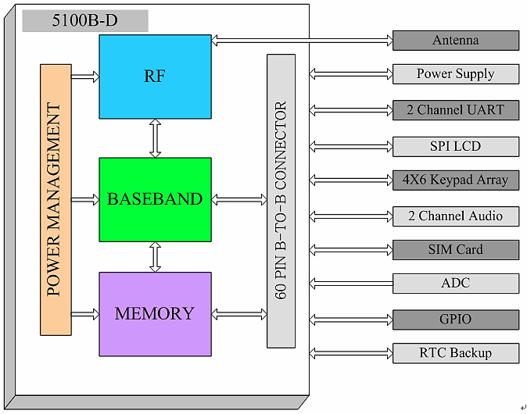
SM5100B Functional Block Diagram

Slide 18
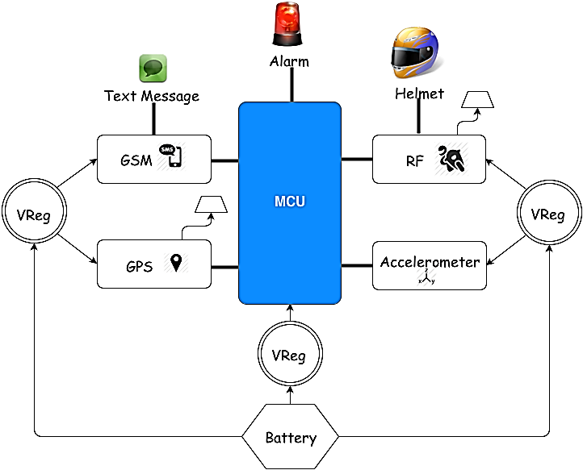
MCU

Slide 19
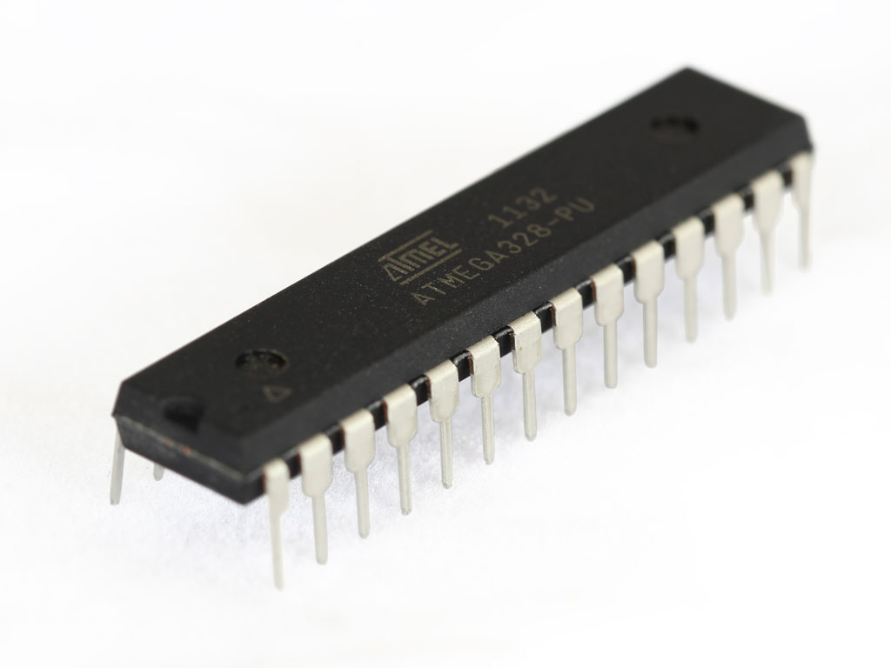
Microcontroller Selection
Primary means of control between system and subsystem peripherals.
Soft Serial Library included to communicate with multiple devices.
Features
1.8-5.5V Operating Range
Up to 20MHz processing speed
32kB Flash Memory & 1kB EEPROM
2kB Internal SRAM
8 Channel 10-bit ADC
Serial USART/SPI/2-wire I2C Interface
23 IO lines
ATMEL ATmega328

Slide 20
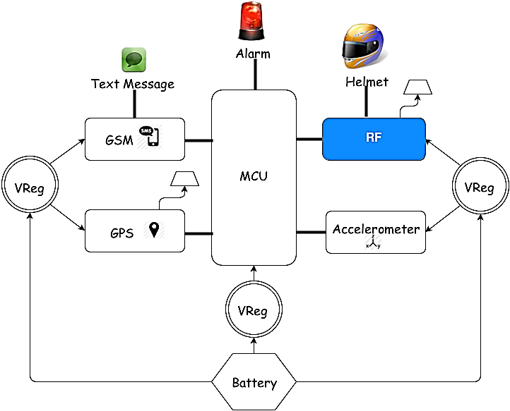
RF Module

Slide 21



RF Device Selection
Specification | Wi-Fi | Bluetooth | ZigBee
Data rate | 54Mb/s | 3Mb/s | 240 Kb/s
Range | 100m | 100m (class 1) 10m (class 2) 1m (class 3) | 100m
Networking Topology | Point to Hub | Ad-Hoc | Ad-Hoc/PTP/Mesh
Operating Frequency | 2.4GHz | 2.4GHz | 2.4GHz
Power Consumption | High | Medium | Very Low
Network Acquisition Time | 3-5s | <10s | 30ms

Slide 22
Further Selection
Specification | Xbee 802.15.4 | Xbee ZB | Xbee Digi Mesh 24
Topology | Point-to-Multipoint | Mesh | Mesh
Frequency | 2.4GHz | 2.4GHz | 2.4GHz
RF Line of sight Range | 90m | 120m | 90m
Transmission Power | 0 dBm | 3 dBm | 0 dBm
Receiver Sensitivity | -92 dBm | -96 dBm | -92 dBm
RF Data Rate | 250 kB/s | 230 kB/s | 250Kb/s
Cost | $19.00 | $17.00 | $19.00

Slide 23
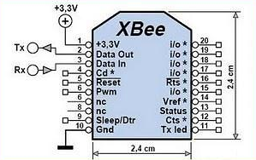
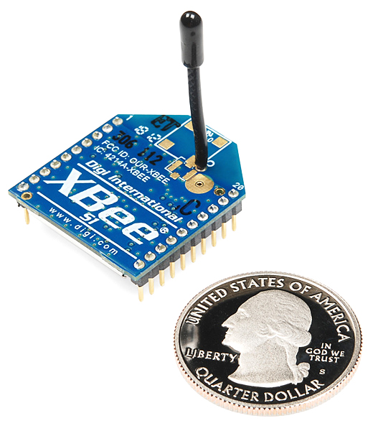
XBee 2.4 GHz RF Module
Specification | Performance
Operating voltage | 3.3V @ 50mA
RF data rate | 250kbps Max data rate
Power output | 1mW output (+0dBm)
Outdoor/RF line-of-sight range | 300ft (100m) range
Antenna type | Wire
Certifications | FCC certified
Analog to Digital pins | 6 10-bit ADC input pins
Security | 128-bit encryption
Digital IO | 8
Configuration | Local or over-air
Command set | AT or API

Slide 24
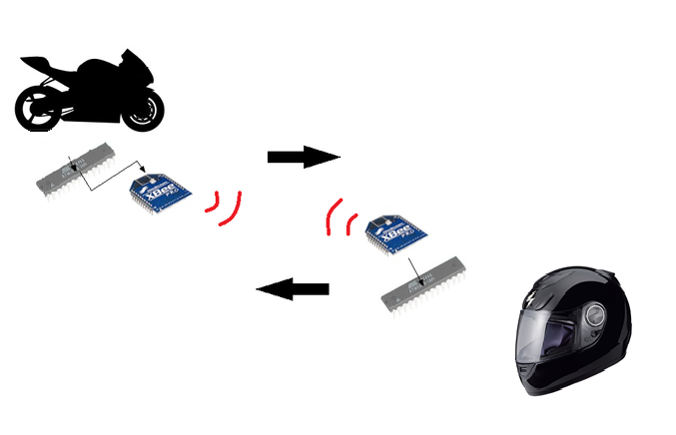
XBee Functionality
Point-to-point communication between the motorcycle system and the helmet system.

Slide 25
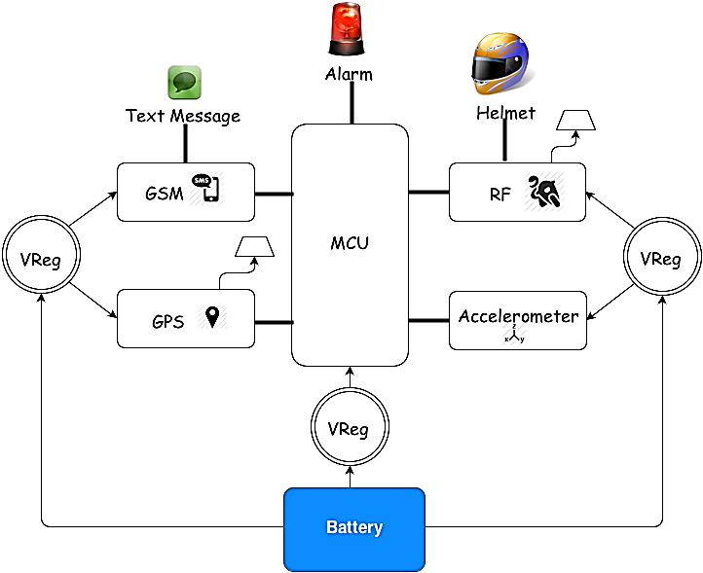
Motorcycle Battery

Slide 26
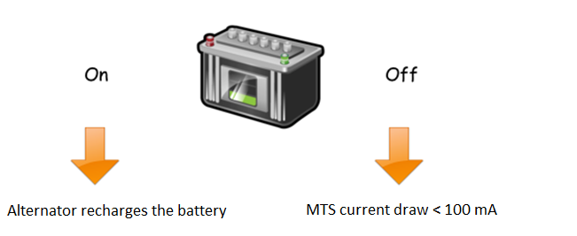
Motorcycle Power Source
The stock 12V battery will be used to power the motorcycle subsystem.
Two different states of power consumption.

Slide 27
Motorcycle Power Source
Motorcycle Module Power Consumption
Modules | Active mode | Sleep mode
ADXL345 | 145 µA | 40 µA
SM5100B GSM/GPRS | 400 mA | 2mA
LS20031 GPS | 29 mA | 2mA
ATmega328p | 0.3 mA | 0.8 µA
XBee RF | 45 mA | 10 µA
Motorcycle off: power consumption < 100mA
No parasitic draw!

Slide 28
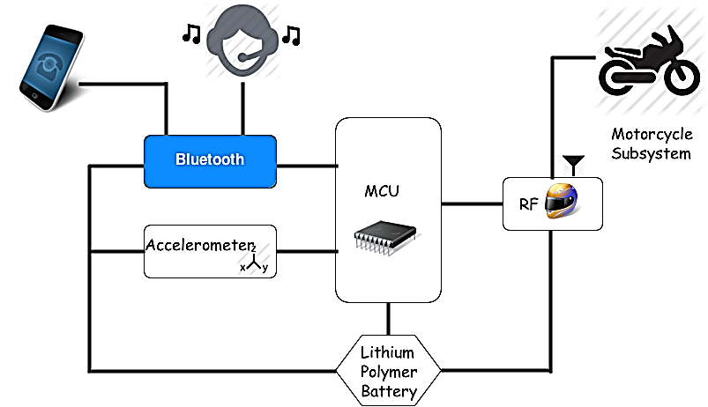
Bluetooth Module

Slide 29
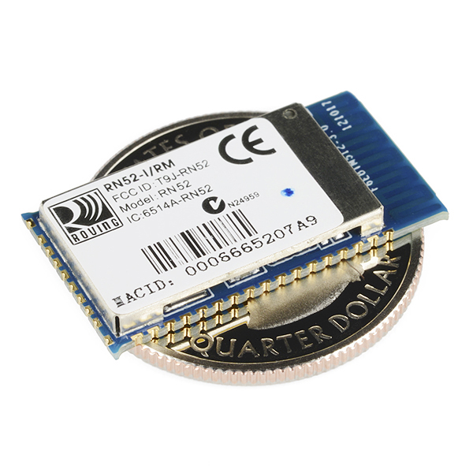
RN-52 Bluetooth Audio Module
Wireless communication used to connect the MTS system to a cell phone (Supports iAP profile)
Bluetooth 3.0
class 2 Audio Module
UART console interfaces
Operation range: 10 meters (33 feet)
Supplied voltage: 3.0 ~ 3.6 V DC
Dimensions: 26.0 x 13.5 x 2.7 mm
Frequency band: 2.4 ~ 2.48 GHz
Maximum Data Rate: 3Mbps
Embedded Stack Profiles: A2DP, AVRCP
Built-in Antenna

Slide 30
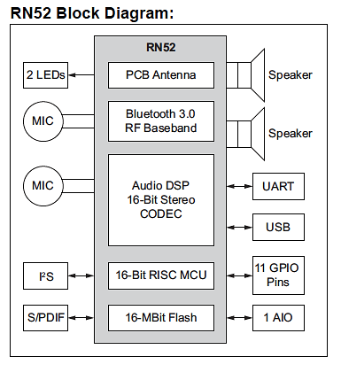
RN-52
APPLICATIONS
High-quality, 2-channel audio streaming.
Wireless stereo headsets.
Wireless speakers.
Intercom push-to-talk audio connection
Automotive hands free audio
Remote control for media player.
Computer accessories

Slide 31
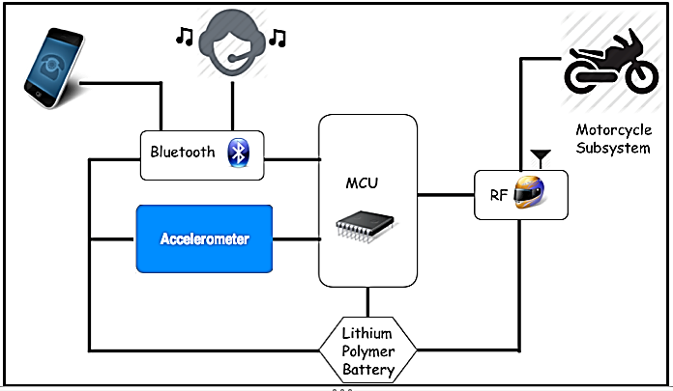
Accelerometer Module

Slide 32
Helmet Accelerometer
Alarm Engaged
Functions as a motion sensor for the helmet.
Has a set threshold for detecting Activity.
When threshold passed, interrupt signal is sent to the microcontroller.

Slide 33
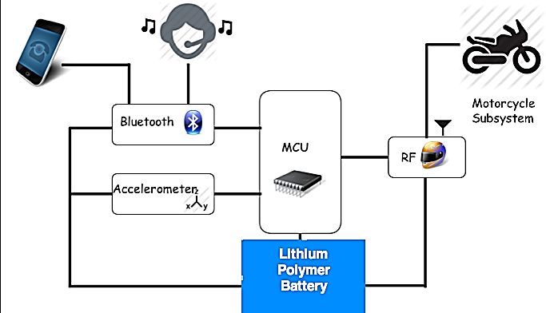
Helmet Battery

Slide 34
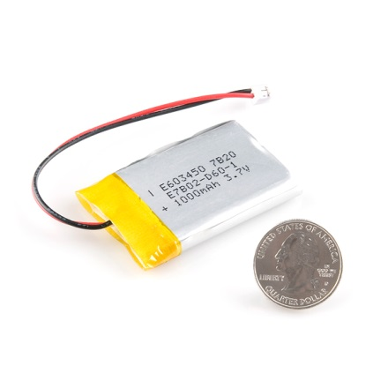
Helmet Power Source
Polymer Lithium Ion Battery- 1000 mAh
Cell outputs at a nominal 3.7V.
Standard discharge current of 200 mA to 2000 mA and Charge current of 200 mA to 1000 mA.
Battery includes built-in protection against over voltage, over current, and minimum voltage.
Requires a specialized lithium polymer charger.

Slide 35
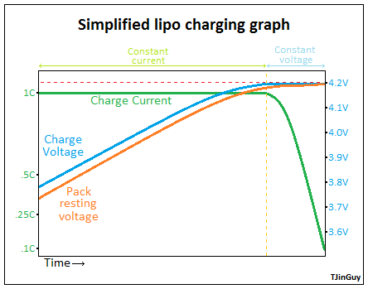
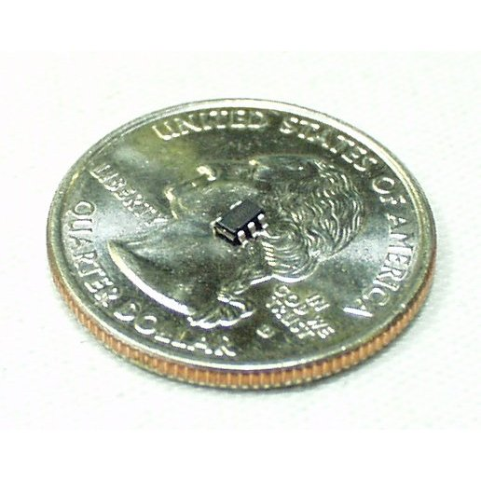
Helmet Recharge Circuit
Lithium Polymer Batteries require special charging
If not charged the proper way it could ruin the battery
Lithium Ion/Polymer USB Battery Charger IC - MAX1555
External Supply of 3.7V to 7V
Will recharge battery through USB connection
Max current charge of 300 mA

Slide 36
Scenario 1-Motorcycle Theft
Accelerometer
Threshold passed
Microcontroller
Wakes up GPS, GSM to full active mode
GPS
Retrieves location and sent to the microcontroller.
GSM
Sends Interrupt to Microcontroller
Decode
Micro decodes NMAE packet into latitude and Longitude
Receives coordinates with message
Sends SMS to owner

Slide 37
Scenario 2-Accident
This Scenario follows the same steps as scenario 1 with added functions.
Emergency Response
Receives emergency text from MTS.
Bluetooth
Can receive Phone Call, kind of like OnStar
Assess
If able to receive call can inform situation, if not WCS assumed.

Slide 38
Scenario 3-Helmet Theft
H. Accelerometer
Threshold passed
H. Microcontroller
GPS
Retrieves location and sent to the microcontroller.
GSM
Sends Interrupt to Microcontroller
Decode
Micro decodes NMAE packet into latitude and Longitude
Receives coordinates with message
Sends SMS to owner
Sends signal to main Micro through RF
M. Microcontroller
Receives RF signal
Wakes up GPS, GSM to full active mode

Slide 39
Distribution of Work Load
 | Rígel | Andres | Brian
MCU | X
RF Module | X
Software | X
Bluetooth Module |  | X
GPS Module |  | X
GSM Module |  | X
Accelerometer Module |  |  | X
Alarm |  |  | X
Battery and Recharge |  |  | X

Slide 40
Milestone

Slide 41
Budget
Item Description | Supplier | # Units | Cost
66 Channel LS20031 GPS 5Hz Receiver | Sparkfun | 1 | $59.95
XBee 1mW Wire Antenna - Series | Sparkfun | 2 | $45.90
SIM Socket | Sparkfun | 1 | $0.95
SM5100B Mating Connector | Sparkfun | 1 | $2.95
Cellular Shield with SM5100B | Sparkfun | 1 | $99.95
Quad-band Cellular Duck Antenna SMA | Sparkfun | 1 | $7.95
Arduino Uno - R3 | Sparkfun | 1 | $29.95
Rn-52 Bluetooth Audio Module | Sparkfun | 1 | $24.95
Max1555 Lithium Ion/Polymer USB Battery Charger | Sparkfun | 1 | $1.95
Lithium Polymer Battery 1000 mAh | Sparkfun | 1 | $11.95
USB Mini-B connection | Sparkfun | 1 | $1.50
USB Mini-B Cable | Sparkfun | 1 | $3.95
ON/OFF switches | Sparkfun | 2 | $1.00
LED’s | Sparkfun | 3 | $1.20
Serial Port Multiplexer | Atlas Scientific | 1 | $5.00
Atmega328p | Microcontroller Pros | 2 | $9.00
RN-52 Evaluation Board | Microchip Technology | 1 | $186.93
Total |  |  | $495.03

Slide 42
Difficulties
Selecting modules very hard to solder and availability of parts.
Interfacing multiple serial devices to our microcontroller.

Slide 43
Questions?

