Slide 1

HELMET tracking system (HTS)
Group 8
Andrés F. Suárez (EE)
Brian Maldonado (EE)
Rígel Jiménez (EE)

Slide 2
Motivation
HTS
HTS
HTS
According to the National Highway Traffic Safety Administration (NHTSA), there were over 9 million motorcycles registered in 2012 in the US.
Unfortunately, the basic motorcycle lacks some technological features available in other transportation vehicles.
The HTS system is about to change this because it will significantly enhance the motorcycle riding experience, by adding:

Slide 3
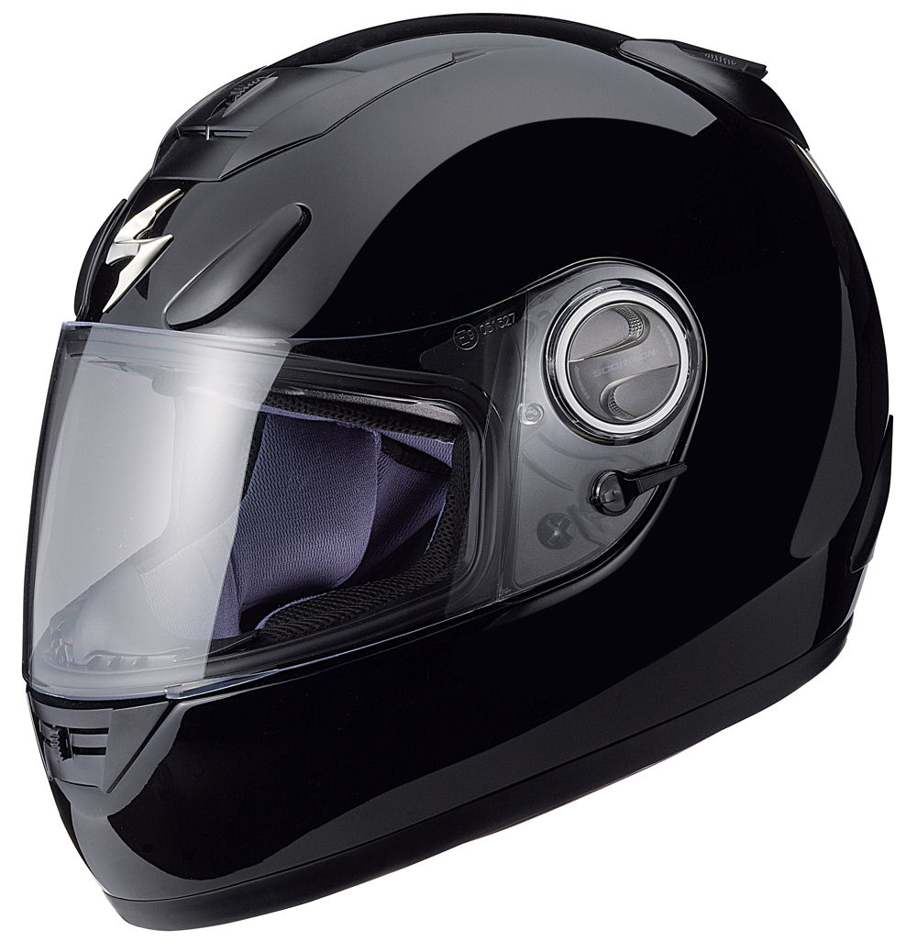
Bluetooth
Capabilities
Tracking Helmet location 24/7
Ability to text an emergency contact
HTS

Slide 4

Goals and Objectives
Adding electrical components to the helmet without significantly increasing the weight.
Keeping the helmet as spacious as it was originally, even though it will now have the electronic components.
Being able to synchronize the helmet to a cell phone.
Implementing an accelerometer to the helmet.
The system will be able to send text messages.

Slide 5
Specifications
COMPONENT | PARAMETER | DESIGN SPECIFICATION
Battery | Current Draw | Less than 100 mA
Bluetooth | Minimum Range | 3 meters
GPS | Accuracy | 10 meters
GPS | Acquisition time | Less than 35 sec
Accelerometer | Sensitivity | Less than 20 mg/LSB
GSM | Frequency Band | 800 MHz or greater
GSM | SMS length | More than 90 characters
Helmet | Additional Weight | Less than 300 grams

Slide 6
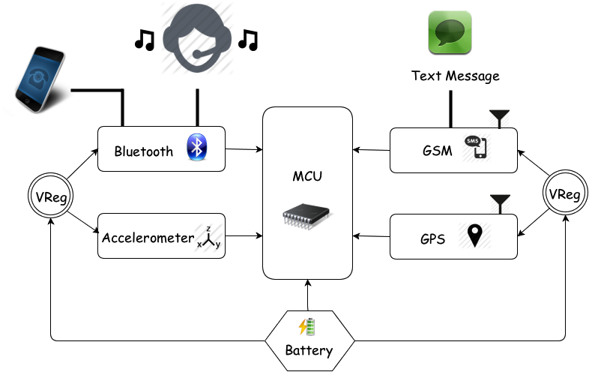
Helmet Tracking System (HTS)

Slide 7
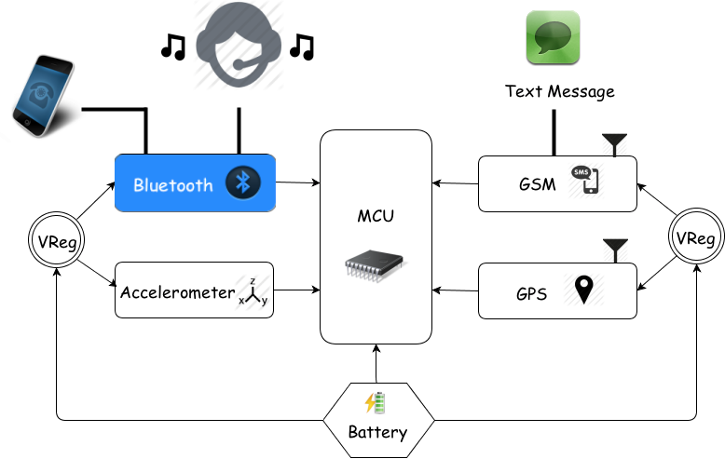
Bluetooth Module

Slide 8
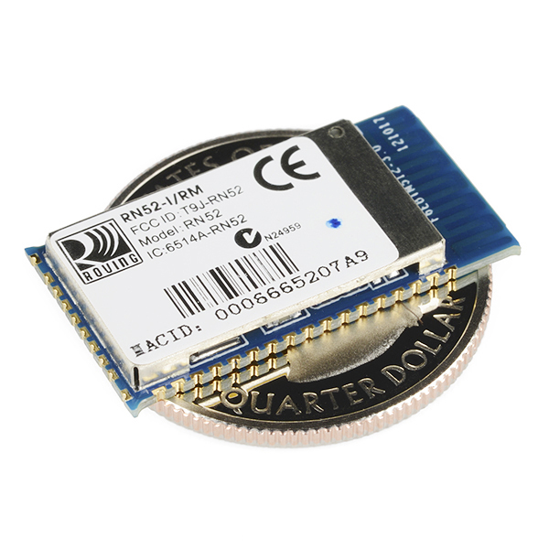
RN-52 Bluetooth Audio Module
Wireless communication used to connect the HTS system to a cell phone (Supports iAP profile)
Bluetooth 3.0
class 2 Audio Module
UART console interfaces
Operation range: 10 meters (33 feet)
Supplied voltage: 3.0 ~ 3.6 V DC
Dimensions: 26.0 x 13.5 x 2.7 mm
Frequency band: 2.4 ~ 2.48 GHz
Maximum Data Rate: 3Mbps
Embedded Stack Profiles: A2DP, AVRCP
Built-in Antenna
Price: $ 24.95

Slide 9
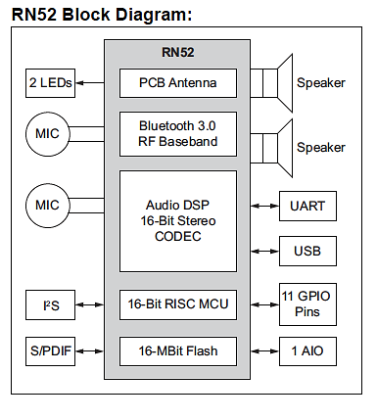
RN-52
APPLICATIONS
High-quality, 2-channel audio streaming.
Wireless stereo headsets.
Wireless speakers.
Intercom push-to-talk audio connection
Automotive hands free audio
Remote control for media player.
Computer accessories

Slide 10
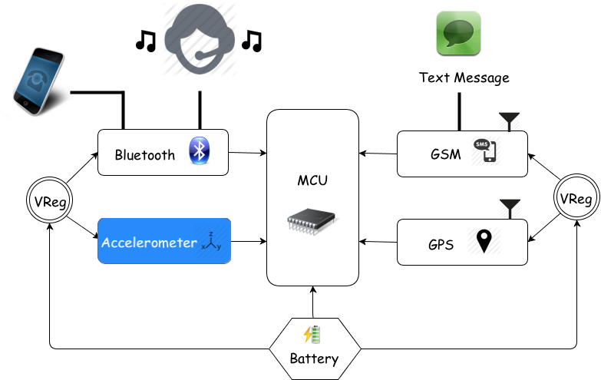
Accelerometer Module

Slide 11
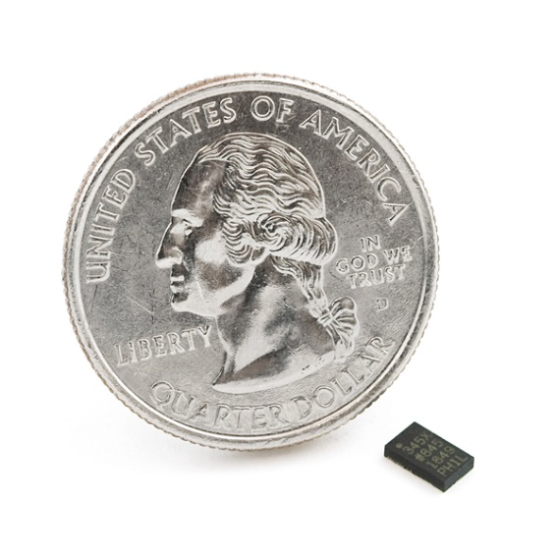
ADXL345 Accelerometer
FEATURES
Voltage Supply | 1.8V to 3.6V
Current Consumption | 25 to 130µA at 2.5V
Resolution | 10-bit at every g-range
Serial Communication | SPI or I²C
Sensitivity | ±2g 3.9mg/LSB, ±4g 7.8mg/LSB, ±8g 15.6mg/LSB, ±16g 31.2mg/LSB
Number of Axes | 3-Axis
Dimension | 3mm x 5mm x 1mm
Price | $ 14.95

Slide 12
Accelerometer Registers and Functions
Registers
8-bit register addresses ranging from 0x00 to 0x39
Sets the specs for the interrupts and contains serial, and bandwidth selection.
Contains a total of 14 different interrupt functions.
Interrupt functions used
Self Test | Tests the electrical and mechanical parts for proper function
Single Tap | Interrupt is set when a single acceleration event passes acceleration and time threshold.

Slide 13
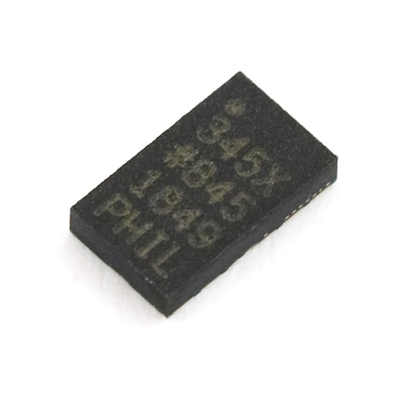

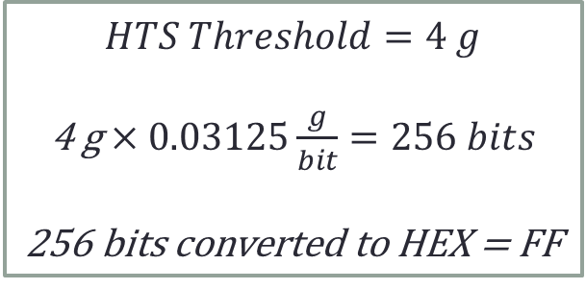
ADXL345 Accelerometer
Threshold Calculation:
$$Scale= \frac{2(g_force)}{2^{8} bits}→\frac{8g}{256 bits}=0.03125 g/bit$$
$$HTS Threshold=4 g$$
4 g$×0.03125\frac{g}{bit}=256 bits$
256 bits converted to HEX = FF

Slide 14
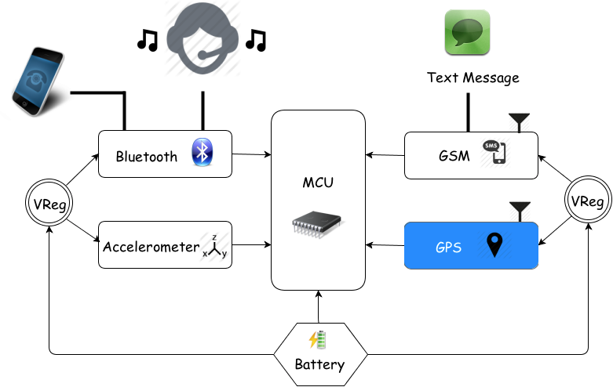
GPS Module

Slide 15
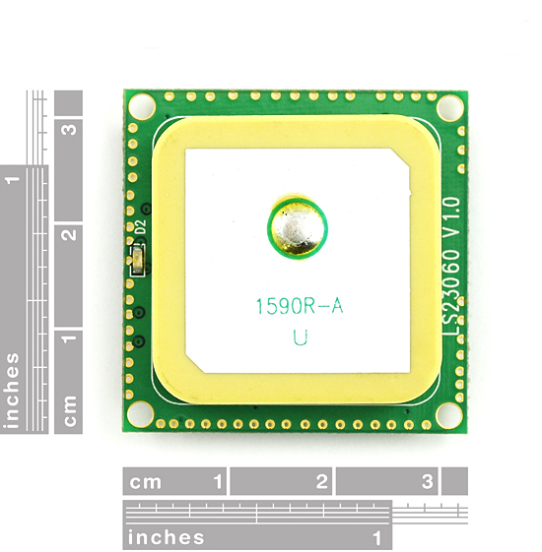
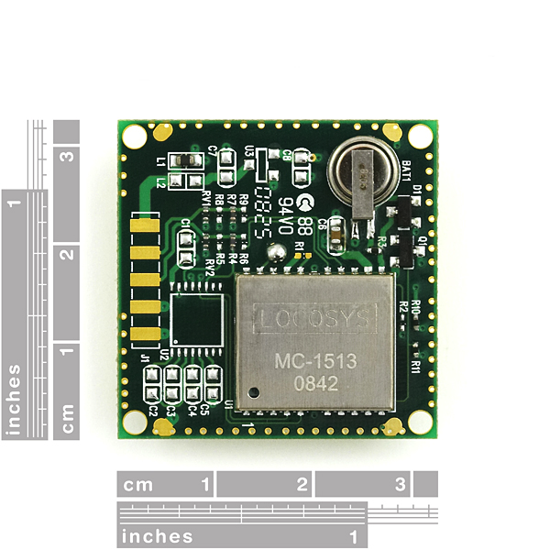
LS20031 GPS Module
FEATURES
66 Channel – 5 Hz GPS Receiver
57600 bps TTL serial interface
3.3 V at 41 mA
Fast Time to first fix at low signals
LED indicator for fix or no fix
Acquisition Time : Cold Start 35 s Hot Start < 2s
Dimensions: 30 x 30 mm
Position Accuracy: 2.5 to 3 m
Uses NMEA protocol
Built-in micro battery to preserve system data for fast satellite acquisition
Built-in Antenna
Price: $ 59.95

Slide 16
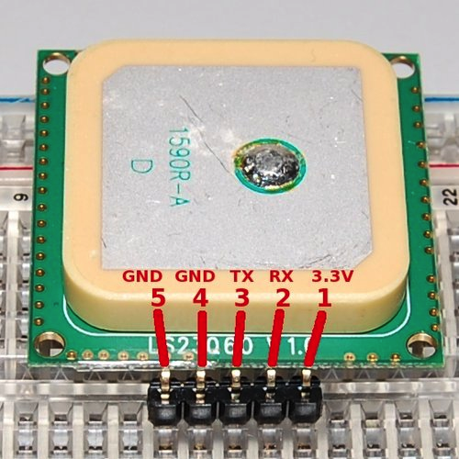
LS20031 GPS Pin Assignment and Descriptions
Pin # | Name | Type | Description
1 | VCC | P | Power input
2 | RX | I | Data Input (TTL level)
3 | TX | O | Data Output (TTL level)
4 | GND | P | Ground
5 | GND | P | Ground

Slide 17
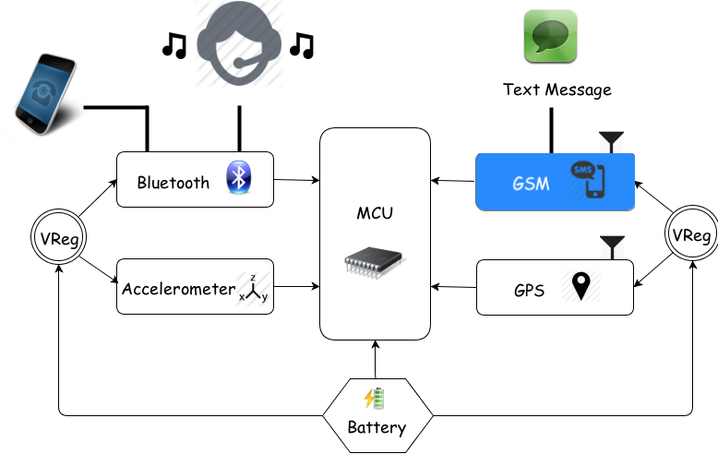
GSM Module

Slide 18
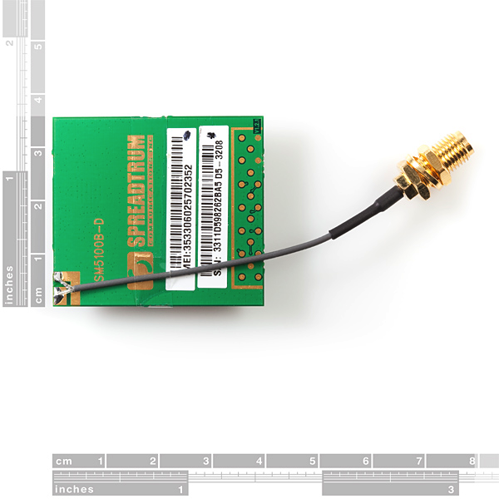
SM5100B GSM Module
APPLICATION:
Sends SMS messages with corresponding GPS coordinates.
FEATURES:
Dimensions: 35.0 x 39.0 x 2.9mm.
Power: 3.3 – 4.2 V. Nominal 3.6 V.
Current consumption: <100 μA when module is off; and 2 mA in Sleep mode.
Quad-band GSM.
Frequency Bands: 900,850,1800,1900 MHz.
Supports UART interfaces.
Supports SIM (Auto Recognize).
Soldered connection for antenna.
LED to notify network status.
Price: $59.95

Slide 19
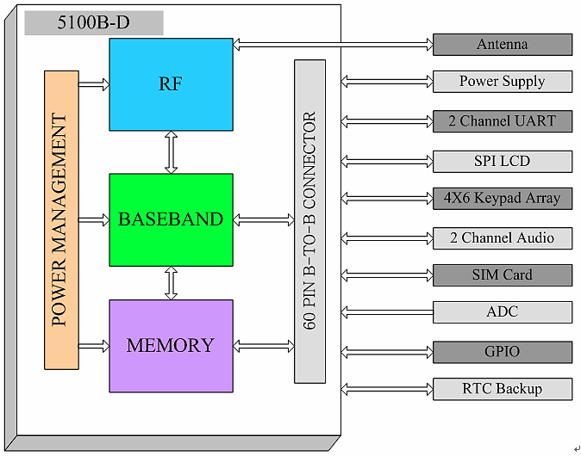
SM5100B Functional Block Diagram

Slide 20
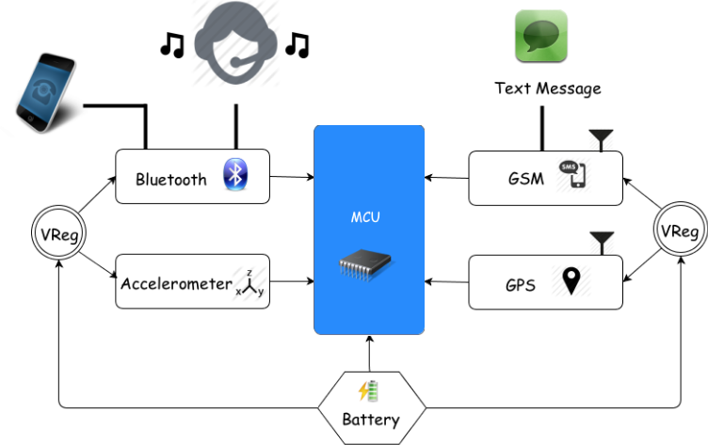
MCU

Slide 21
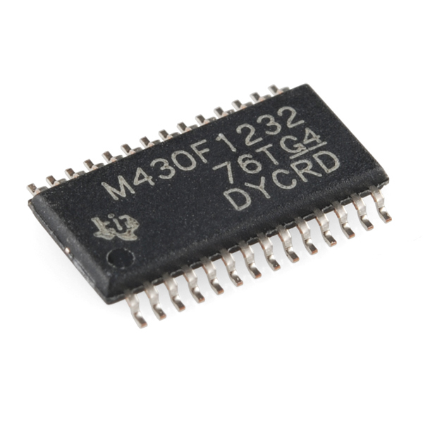
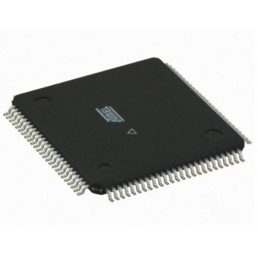
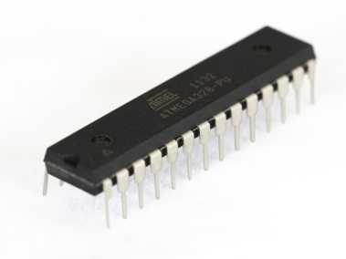
Microcontroller Selection
Microcontroller | MSP430 | ATmega1280 | Atmega328
Operating Voltage | 3.3 V | 5 V | 5 V
Digital I/O Pins | 14 | 54 (15 being PWM) | 14 (6 being PWM output)
Analog Input Pins | 6 | 16 | 6
Flash Memory | 16 KB | 128 KB | 32 KB
SRAM | 1 KB | 8 KB | 2 KB
EEPROM | N/A | 4 KB | 1 KB
Clock Speed | 16 MHz | 16 MHz | 16 MHz

Slide 22
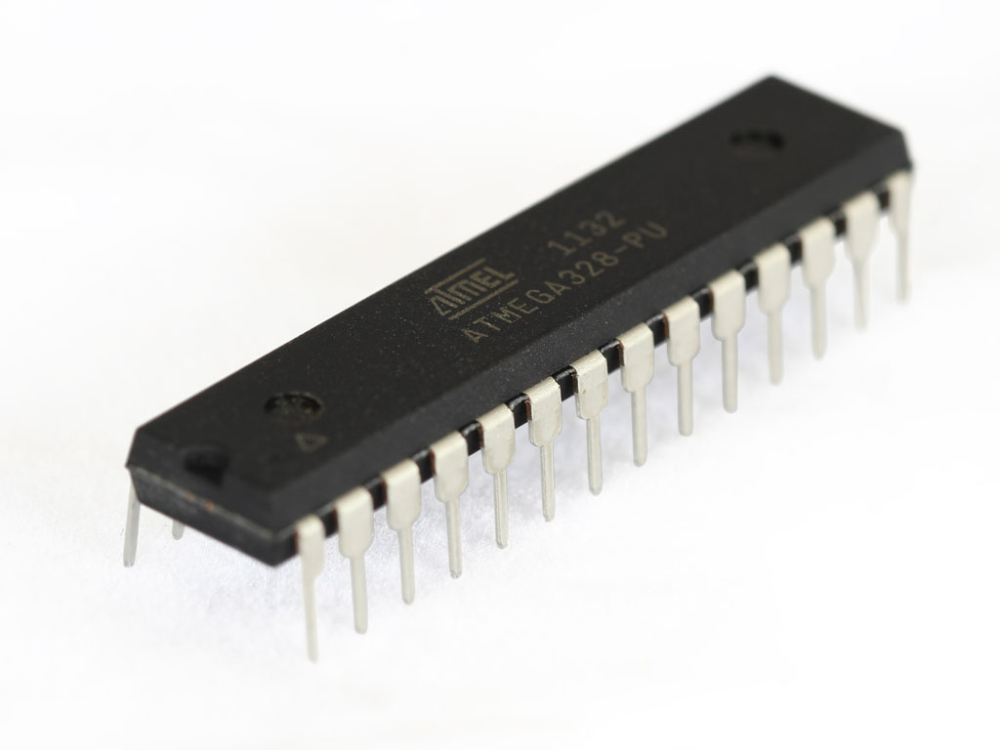
ATMEL ATmega328
Primary means of control between system and subsystem peripherals.
Soft Serial Library included to communicate with multiple devices.
SPECIFICATIONS
1.8-5.5V Operating Range
Up to 20MHz processing speed
32kB Flash Memory & 1kB EEPROM
2kB Internal SRAM
8 Channel 10-bit ADC
Serial USART/SPI/2-wire I2C Interface
23 IO lines
Price: $ 4.50
ATMEL ATmega328

Slide 23
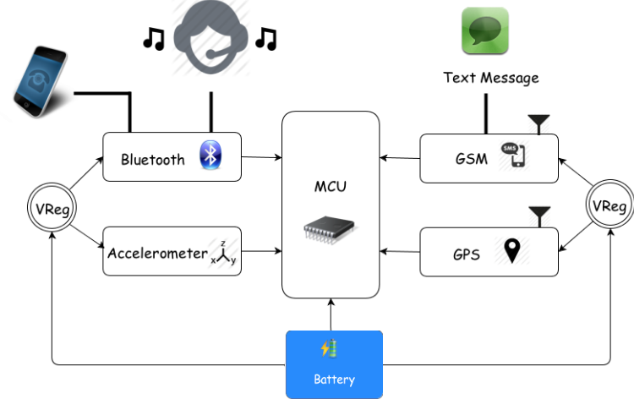
Battery

Slide 24
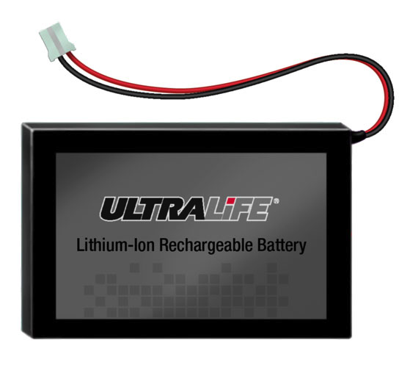
HTS Power Source
SPECIFICATIONS
Voltage Range between 3.0 to 4.2V
Average Voltage of 3.7 V
Capacity of 1.8Ah @ C/5 Rate @ 23°C±2°C
Energy Density 146Wh/kg, 317Wh/l
Weight 46 grams
Recommended charge rate is 900mA to 4.2V in a temperature range of 0°C to 45°C
Price: $ 29.95
Ultralife Lithium-Ion Battery 1800 mAh

Slide 25

HTS Power Source
Helmet Modules Power Consumption
Modules | Active mode | Sleep mode
ADXL345 | 145 µA | 40 µA
SM5100B GSM/GPRS | 200 mA | 2mA
LS20031 GPS | 29 mA | 2mA
Bluetooth | 30 mA | --
ATmega328 | 0.3 mA | 0.8 µA
All devices will be in sleep mode during operation except for the Bluetooth.
$$Average Power Consumption=40 mA$$
$$1800 mAh÷40 mA=40 plus hours‼$$

Slide 26
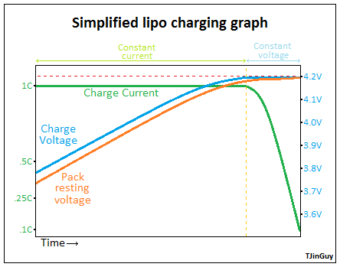
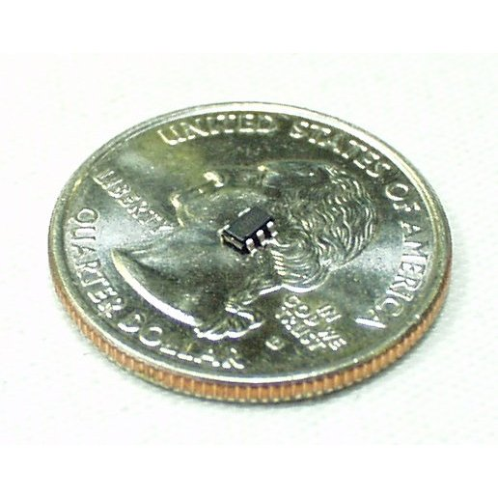
HTS Recharge Circuit
Lithium Ion/Polymer Batteries require special charging
If not charged the proper way it could ruin the battery
Lithium Ion/Polymer USB Battery Charger IC - MAX1555
External Supply of 3.7V to 7V
Will recharge battery through USB connection
Max current charge of 300 mA

Slide 27
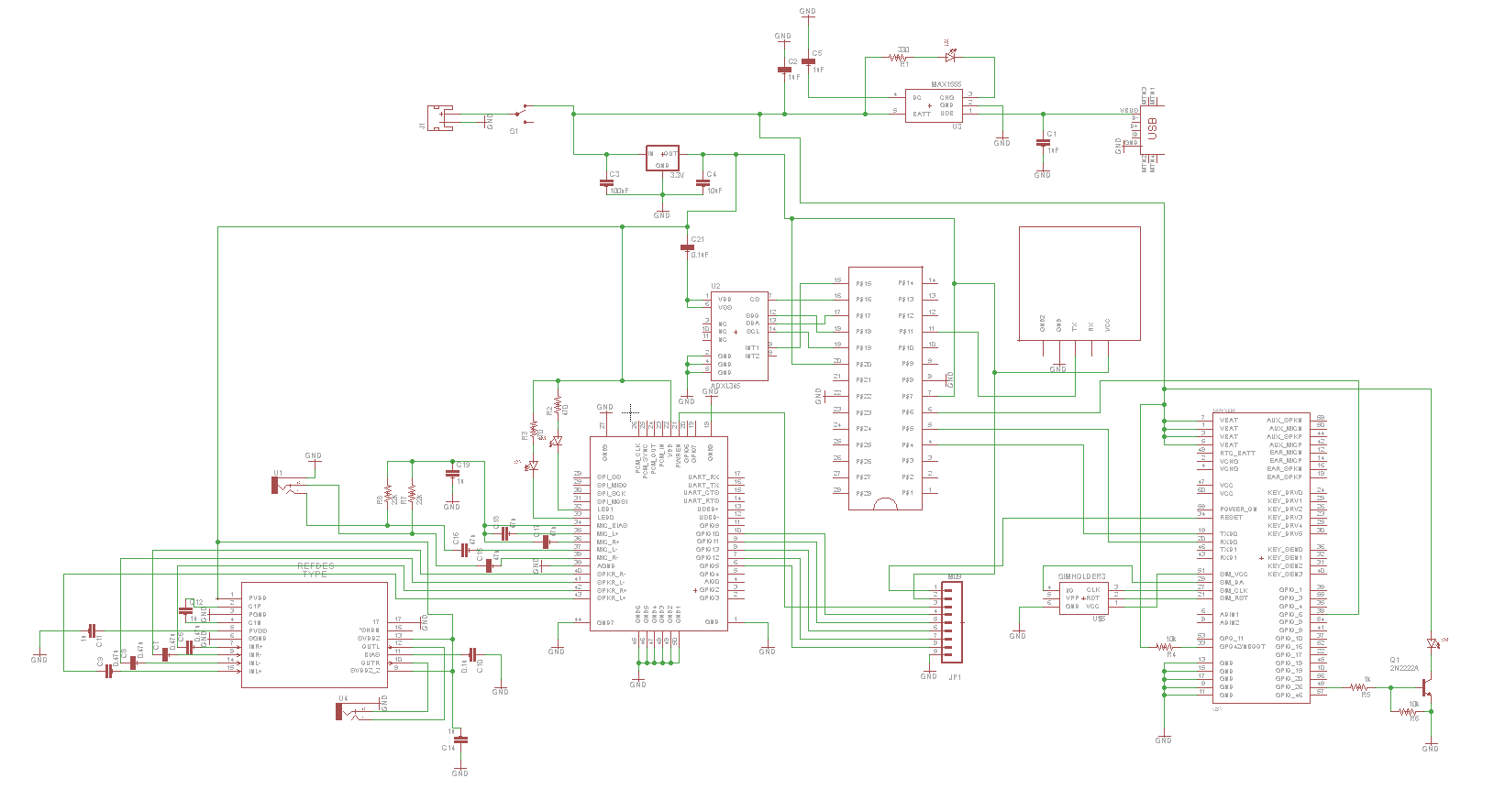
HTS EagleCAD Schematic

Slide 28
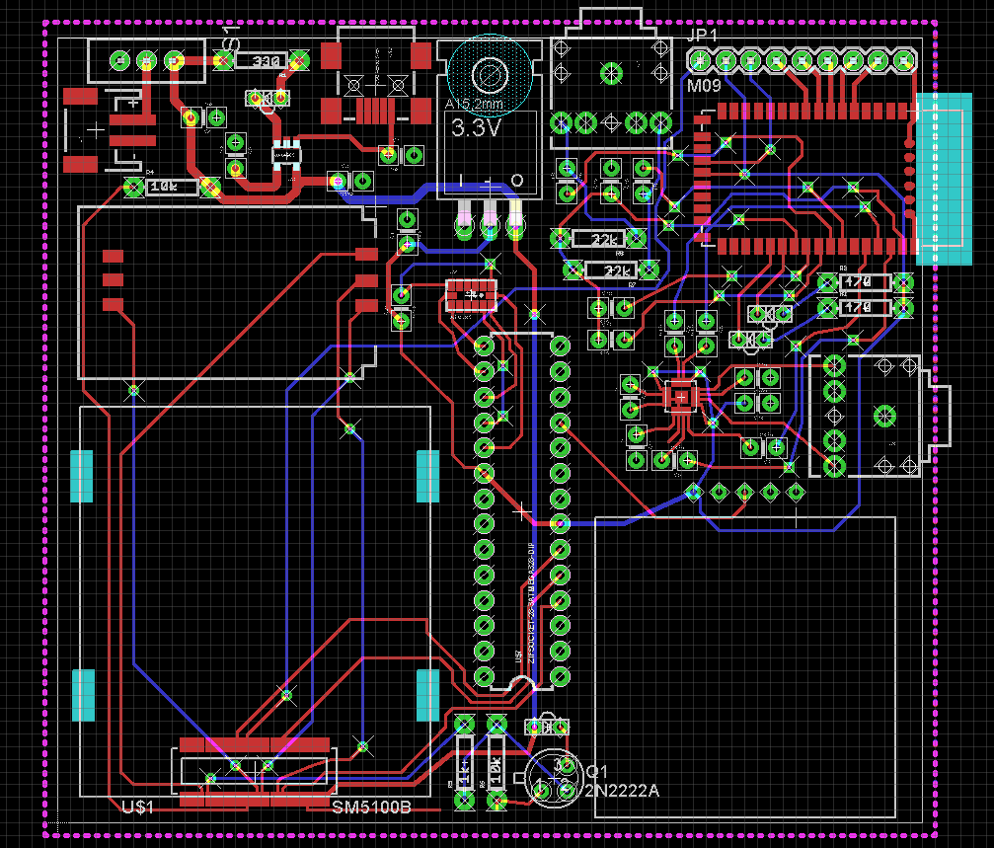
HTS PCB Design
Dimensions: 3.39 in X 3.08 in Price: $37.5

Slide 29
Scenario 1- Reporting an Accident
Accelerometer
Threshold passed
Microcontroller
Wakes up GPS, GSM to full active mode
GPS
Retrieves location and sent to the microcontroller.
GSM
Sends Interrupt to Microcontroller
Decode
Micro decodes NMAE packet into latitude and Longitude
Receives coordinates with message
Sends SMS to Emergency Contact

Slide 30
Scenario 2 – Respond from Emergency Contact
This Scenario follows the same steps as scenario 1 with added functions.
Emergency Response
Receives emergency text from HTS.
Bluetooth
Can receive Phone Call, like OnStar
Assess
If able to receive call can inform situation, if not WCS assumed.

Slide 31
Distribution of Work Load
 | Rígel | Andres | Brian
MCU | X
Software | X |  | X
Bluetooth Module |  | X
GPS Module |  | X
GSM Module | X | X
Accelerometer Module |  |  | X
Battery and Recharge |  |  | X

Slide 32
Milestone

Slide 33
Budget
Item Description | Supplier | # Units | Cost
66 Channel LS20031 GPS 5Hz Receiver | Sparkfun | 1 | $59.95
SIM Socket | Sparkfun | 1 | $0.95
SM5100B Mating Connector | Sparkfun | 1 | $2.95
Cellular Shield with SM5100B | Sparkfun | 1 | $99.95
Quad-band Cellular Duck Antenna SMA | Sparkfun | 1 | $7.95
Arduino Uno - R3 | Sparkfun | 1 | $29.95
Rn-52 Bluetooth Audio Module | Sparkfun | 1 | $24.95
Battery Charger | Sparkfun | 1 | $1.95
Lithium Ion Battery 1800 mAh | Sparkfun | 1 | $11.95
USB Mini-B connection | Sparkfun | 1 | $1.50
USB Mini-B Cable | Sparkfun | 1 | $3.95
ON/OFF switches | Sparkfun | 2 | $1.00
LEDs | Sparkfun | 3 | $1.20
ADXL345 | Sparkfun | 1 | $14.95
Atmega328p | Microcontroller Pros | 2 | $9.00
RN-52 Evaluation Board | Microchip Technology | 1 | $186.93
PCB | 4pcb.com | 1 | $37.50
Total |  |  | $519.58

Slide 34
Difficulties
Getting both audio input and output from the Bluetooth module.
Getting proper voltage to all the modules.
Soldering very small components.

Slide 35
Questions?

