Slide 1

Music In Motion

Slide 2
What is Music in Motion?
Running device that generates music while you exercise
Music matches your run
Digital control system synchronizes the music to your foot-falls
Tracks milestones and personal bests to be viewed on Android Application

Slide 3
Project Motivation
Exploring our collective interest
Biofeedback
Music
Control Systems
Creating something completely unique
Experimenting with product design

Slide 4
Objectives
Reactive audio environment based on the control system in sync with the runner
Predictive tempo control system anticipates the runner’s next footfall
Music playback changes on runner’s metrics
Compiles run data as a user development tracker via Android application
Lightweight, Customizable, and Intuitive

Slide 5
Device Specifications
Size of Device
Category | Requirement
Height | 5 in.
Width | 2.5 in.
Depth | 0.5 in.
Weight | 5 oz.
Strap | Re-adjustable cloth strap or clip
Material | Sturdy, compact plastic enclosure
0.5 in

Slide 6
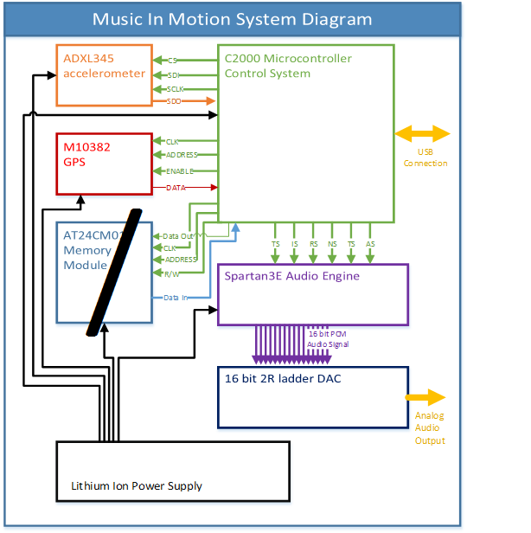

Slide 7
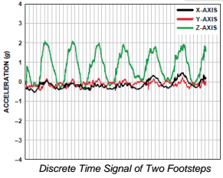
Accelerometer
Problem: The need to detect the runner’s foot-falls in real time with precision and accuracy
Solution: Accelerometer (ADXL345)
Digital Output for DSP
Accelerometer
Category | Requirement
Number of Axes | 3
Resolution | 10 - 13 bits
Maximum Swing | ±16g
Dimensions | 15 mm x 15 mm x 5 mm (max)

Slide 8
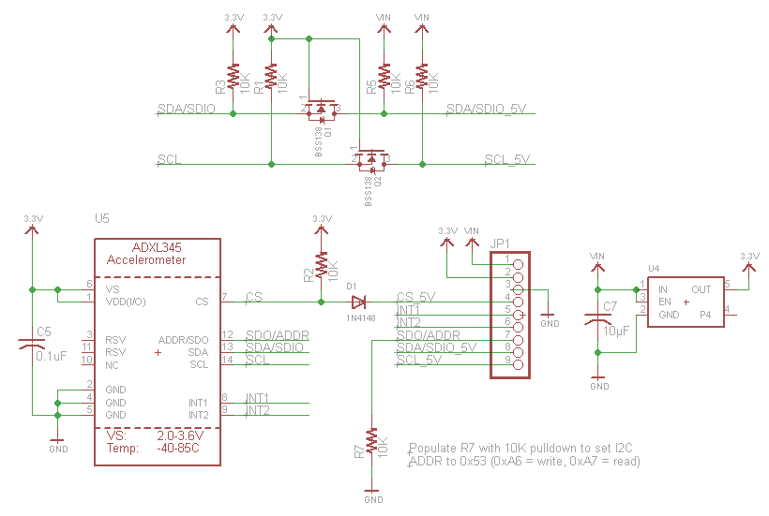
Accelerometer (ADXL345)

Slide 9
GPS – Antenova M10382
UART (SCI) Interfacing
Frequency: 1.575 GHz
MCU sample GPS coordinates at 1 Hz Purposes:
Full breakdown of run stored in Android application after workout
Milestones configured through Application
Default milestones of 1 mi., 2 mi., etc.
$GPGGA,235317.000,4003.9039,N,10512.5793,W,1,08,1.6,1577.9,M,-20.7,M,,0000*5F

Slide 10
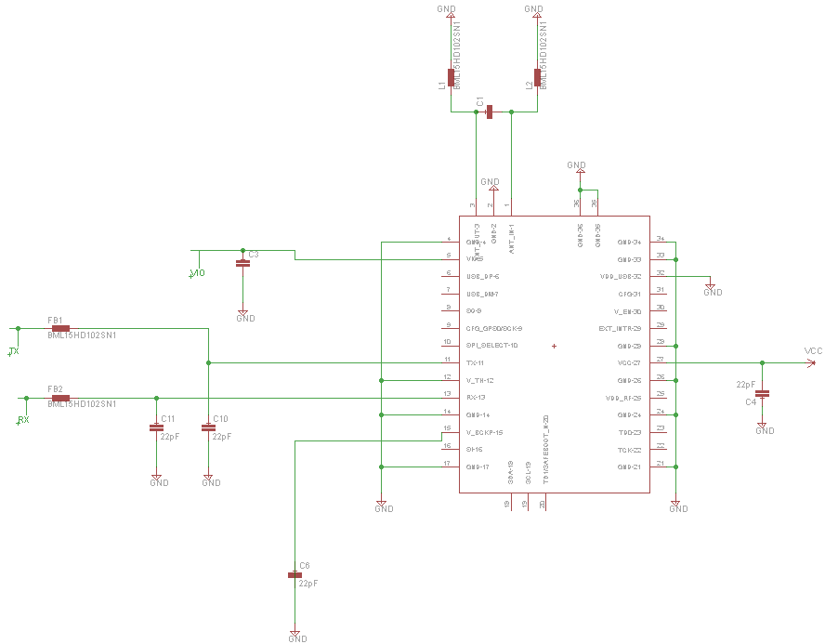
GPS (Antenova M10382)

Slide 11
MCU – TMS320F28027
Retrieve and filter data from the accelerometer and GPS
Program accelerometer data (footfalls) as control lines for the FPGA audio engine
Parse GPS data used for the application and motivation milestones
Create other control lines for the audio engine
Via Accelerometer, GPS, Application Data
Code Composer Studio using C
On-chip memory for program with available Boot ROM
Large TI Support via Control Suite
I/O Interface
Accelerometer | GPS | FPGA
SPI | SCI | GPIO

Slide 12
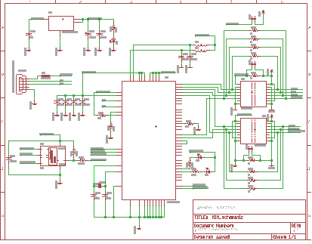
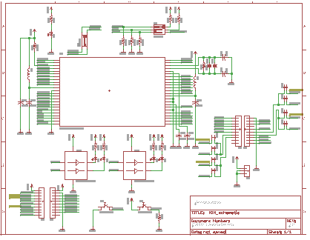
Microcontroller (C2000 Series Piccolo)

Slide 13
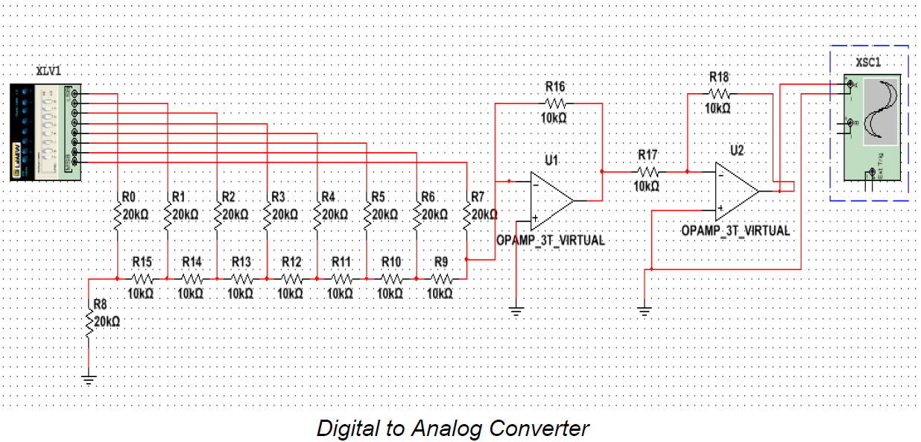
Audio Engine and Control System Design
Hardware
Xilinx Spartan XC3S500E-4pqg208i
Chosen due to familiarity with Spartan architecture and Xilinx development tools
Prototyping done on a Digilent Basys2 is easily transferrable
FPGA design allows for Parallel processing of Control Inputs and Audio Signal Outputs for optimal real time performance
Digital Audio Converter (DAC)
2R Ladder type design
16 bit PCM audio signal input
Analog audio signal output

Slide 14
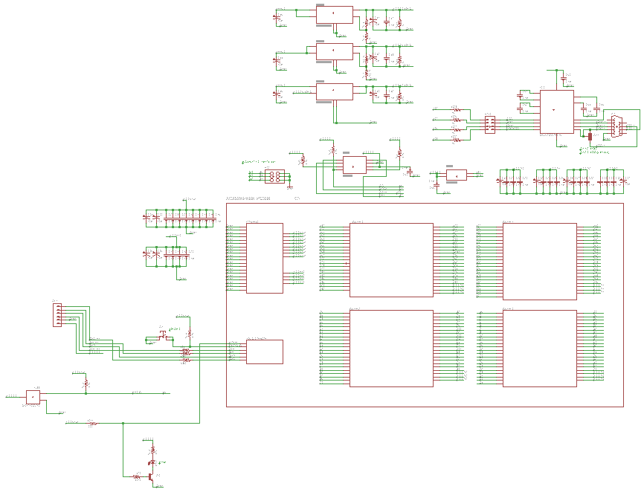
FPGA (XC3S500e-4PQG208i)

Slide 15
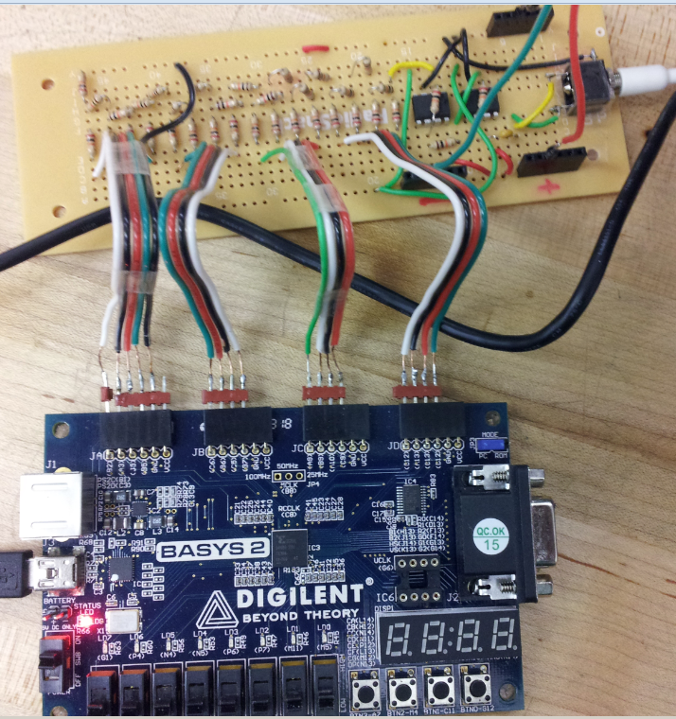
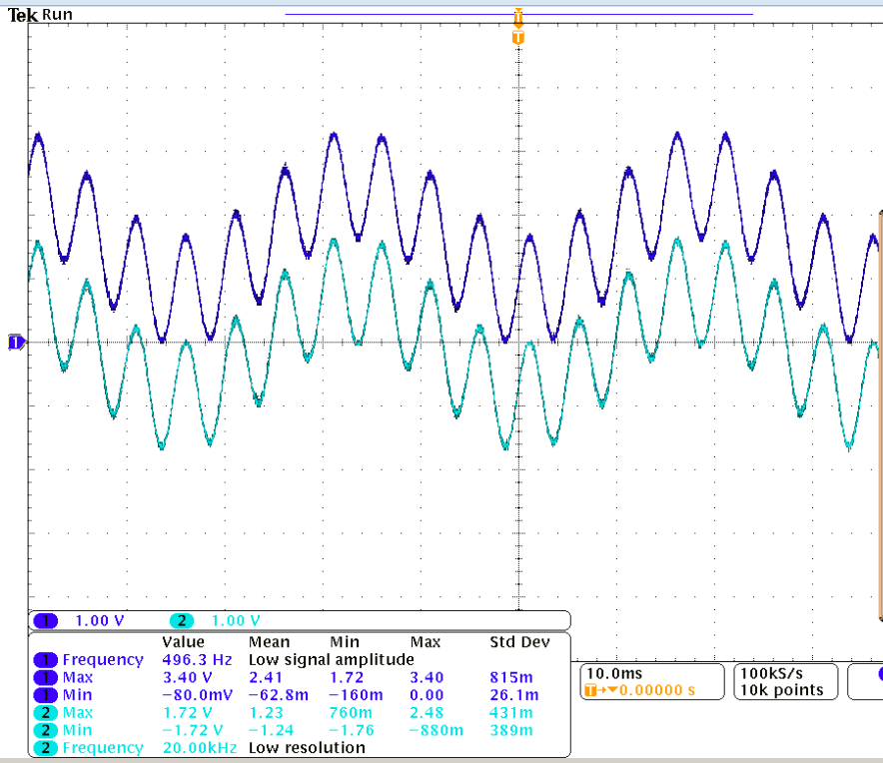
Audio Engine and Control System Design
DAC Hardware Prototype
Simple two oscillator additive synthesis wave

Slide 16
DAC Hardware Prototype Problems
Underestimation of Oscillator resource use lead to limited instrumentation capabilities
Limited polyphony
More than three notes outputs simultaneously leads to excessive digital noise in signal
Solution
VLSI VS1053B
Class D audio amplifier and MIDI synthesizer
Eliminates the need for a custom DAC and audio amplifier thereby reducing the PCB size
Has 50 note MIDI polyphony

Slide 17
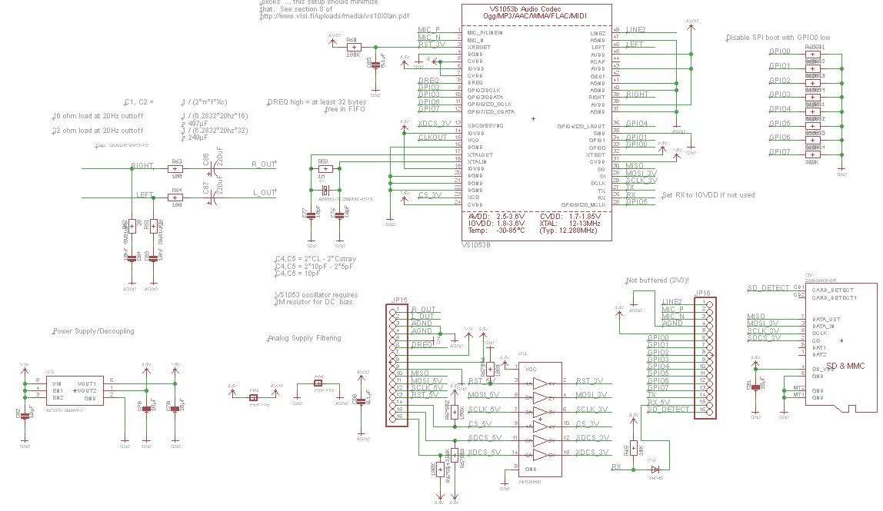
Audio Codec (VLSI1053B)

Slide 18
Power System
Power Source – non-rechargeable 9 volt alkaline battery
Voltage regulation for control units – SPX29302
Adjustable
Low dropout voltage linear regulator
Protect against over-current, reverse battery, and positive and negative voltage transients
Control units (MCU and FPGA) will then power slaves (accelerometer, GPS, and audio codec)

Slide 19
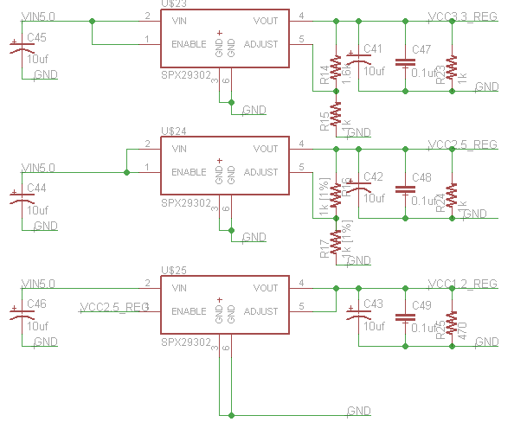

Slide 20
Audio Engine and Control System Design
Software
Audio Signal Generation
Generated using Xilinx Ipcore Oscillator Modules
Coded in Verilog
16bit 44.1KHz signal output
Tempo Maps
Generated from Pulses received from C2000 microcontroller
Pulses represent the runners footfall
Map generated by an Instantaneous Tempo Function and an Average Tempo Function
Map is utilized by the Control System to place downbeat at runners footfall
Control System
Contains Song Rhythmic and Melodic Structure
Utilizes the Tempo Map to output Song data in time with the runners pace

Slide 21
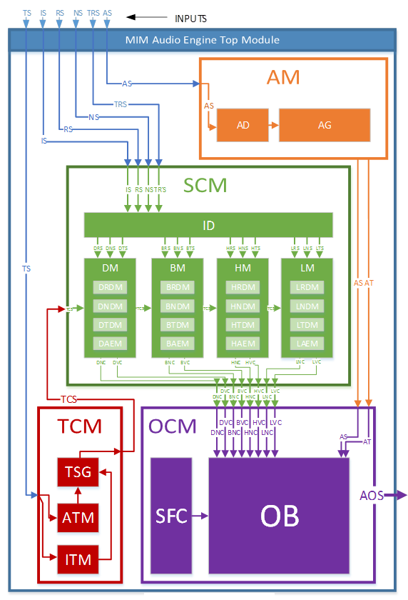
Audio Engine Overview
Six control inputs
Tempo Signal (TS)
Instrument Select(IS)
Rhythm Select(RS)
Note Select(NS)
Timbre Select(TRS)
Alert Select(AS)
Four Modules
Alert Module(AM)
Tempo Control Module(TCM)
Soundtrack Control Module(SCM)
Output Control Module(OCM)

Slide 22
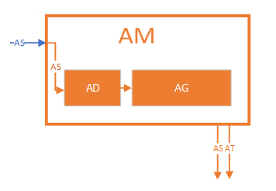
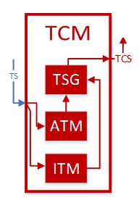
Alerts Module and Tempo Control Module
Alert Module(AM)
Receives AS and the Alert Decoder (AD) determines the type of alert depending upon whether a milestone has been achieved or failed
AS is passed to the oscillator section and the Alert Tone(AT) signal determines the type of tone generated
Tempo Control Module(TCM)
Instantaneous Tempo Module(ITM) measures time between footfalls
Average Tempo Module(ATM) takes the average of the time between the last eight footfalls
Tempo Signal Generator(TSG) predicts the position of the next foot fall based on the signals from the ITM and ATM and generates the Tempo Control Signal(TCS)

Slide 23
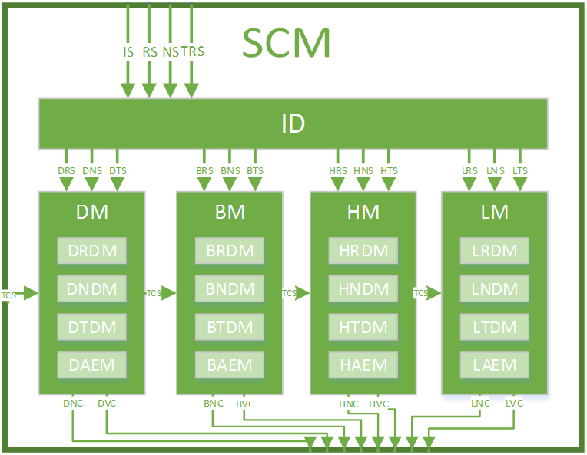
Soundtrack Control Module(SCM)
Generates control signals for the oscillators and MIDI synth
Instrument Decoder(ID)
Receives the control signals from microcontroller and routes them to the correct control module for each instrument
Four Instrument Modules generate oscillator and MIDI note and velocity control signals
Drum Module(DM)-replaced by VS1053
Bass Module(BM)
Harmony Module(HM)
Lead Module(LM)

Slide 24
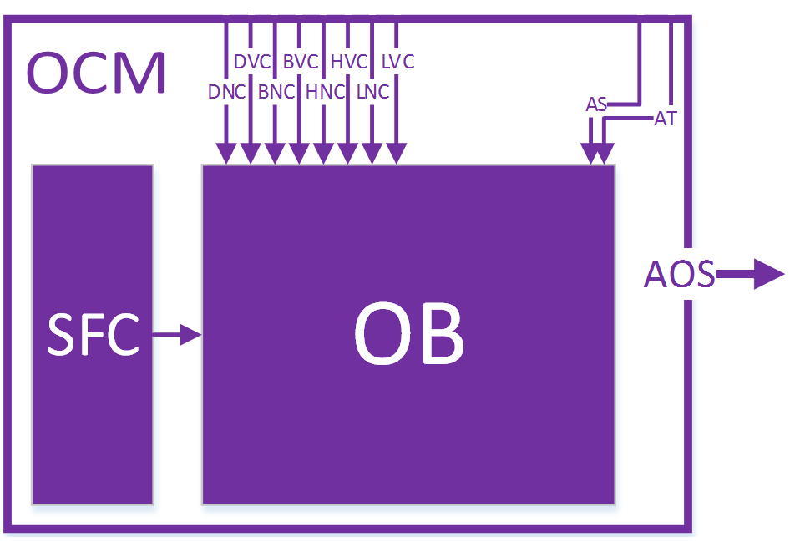
Output Control Module(OCM)
Generates 16bit PCM signal from Ipcore oscillator banks
Sample Frequency Clock(SFC) generates 44.1kHz clock to drive Oscillators
Oscillator Block (OB) generates a set of sine waves at various frequencies and sums and processes them into a PCM Audio Output Signal

Slide 25
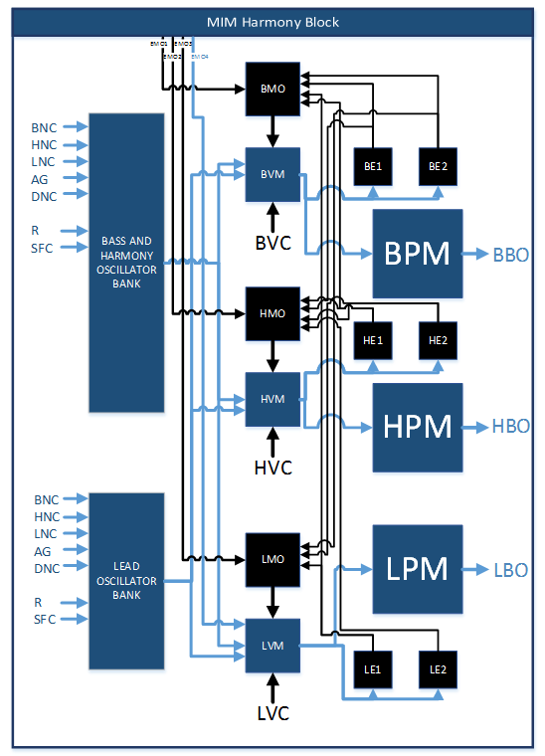
Harmony Block
Contains Oscillators and Control Modules
Oscillator Bank
Generates digital sine wave outputs
Velocity Modules
Create the amplitude envelopes for each instrument
Bass Velocity Module(BVM)
Harmony Velocity Module(HVM)
Lead Velocity Module(LVM)
Modulation Oscillators
Modulate the amplitude envelope to create a more natural sound
Bass Modulation Oscillator (BMO)
Harmony Modulation Oscillator(HMO)
Lead Modulation Oscillator(LMO)
Effect Modules
Granular Audio Effects
Bass Effect 1&2(BE1,BE2)
Harmony Effect 1&2(HE1,HE2)
Lead Effect1&2(LE1,LE2)
Processor Modules
Sum and compress signals to ensure the signal does not clip
Bass Processor Module(BPM)
Harmony Processor Module(HPM)
Lead Processor Module(LPM)

Slide 26
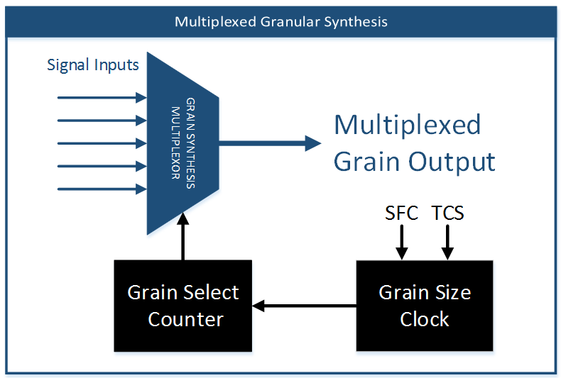
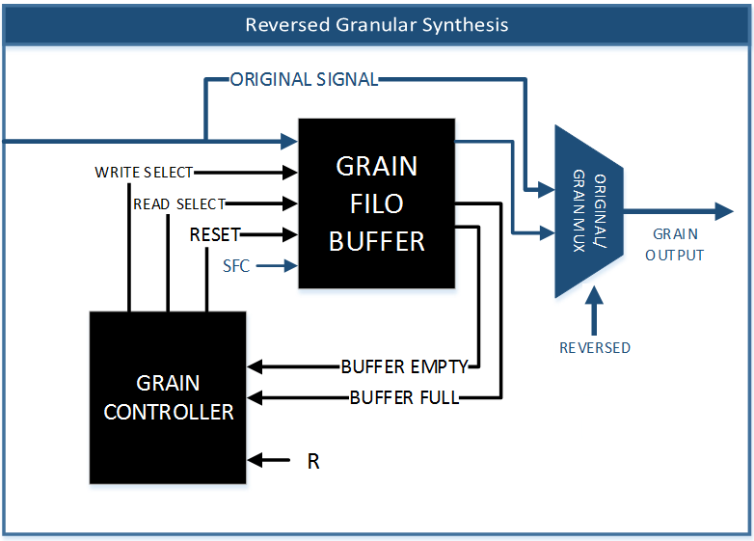
Effect Block Functions
Multiplexed Granular Synthesis
Multiple signals are routed into a MUX
Sizes of the grains are selected as a function of the sample frequency and tempo clock signals
A complex audio signal can be generated from a set of sine waves
Reversed Granular Synthesis
A signal is routed into a FILO buffer
When the buffer is full the signal is output in reverse sample order
When the buffer is empty the original signal is played while the buffer fills
Grain size is determined by the buffer size

Slide 27

Android Application
Input
Select Variables to alter run individually for user:
Height, Weight, Age
Difficulty
Run Settings
Alerts
Output
Track up to 5 runs
Run results broken down into different categories:
Total Distance
Total Time
Average Distance
Average Time
Each mile time
Transferred via USB
Run statistics compiled from algorithms using GPS data

Slide 28
Android over Apple
Familiarity
Java vs. Objective C
Android/Java Documentation and Support
PC development compatibility
Eclipse + ADT Bundle + Subversion
Android Application
Category | Requirement
API | Android 2.2 or higher
Application Size | Less than 20 MB
Splash Screen Wait time | 5 seconds
Number of Run Settings | 10
Number of Saved Runs | 5
Transfer Time | No more than 8 seconds

Slide 29
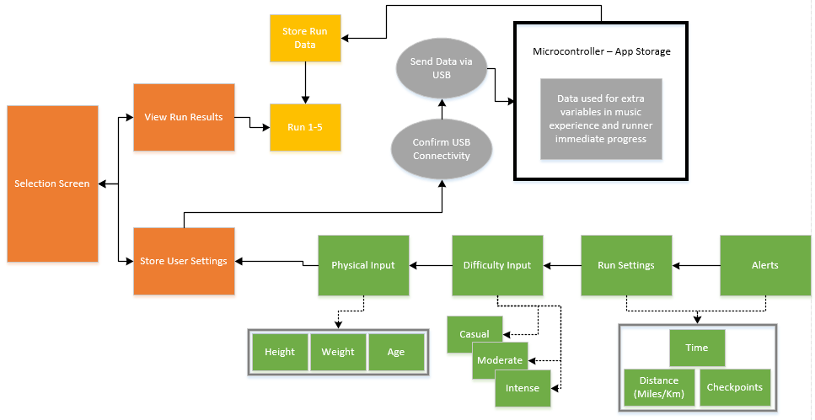

Slide 31
Issues
IC communication
Size of Design – Accelerometer + GPS + FPGA + MCU + Power + USB
Tempo Feedback Control

Slide 32
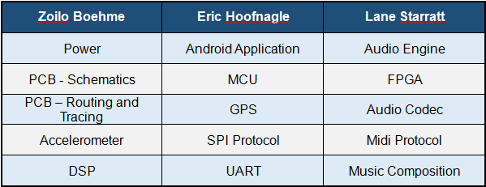
Work Distribution

Slide 33
Music In Motion Budget
ITEM | FUNCTION | OBTAINED | UNITS | PRICE/UNIT | ITEM COST
Digilent Basys2 -250 | FPGA development board | In stock | 1 | $0.00 | $0.00
TI MSP430 LaunchPad | Microprocessor development board for modular prototyping | In stock | 3 | $0.00 | $0.00
TI C2000 Piccolo Development Board | Microprocessor development board for final product integration testing | TI | 1 | $22.00 | $22.00
ADXL345 Accelerometer Development Board | Prototyping and testing the input control system | Adafruit | 1 | $22.00 | $22.00
DAC prototype | Testing and developing the digital audio converter | Built from parts in stock and a blank PCB | 1 | $30.00 | $30.00
C2000 IC | Final product microprocessor | Texas Instruments | 2 | $12.00 | $24.00
Antenova M10382 GPS IC | Final product GPS chip | Adafruit | 2 | $30.00 | $60.00
Spartan3E-XC3S250E | On board FPGA for the Audio Engine | Newark | 2 | $25.00 | $50.00
PCB printing and assembly | Final product assembly | TBD | N/A | N/A | $200.00
Misc. Parts | N/A | N/A | N/A | N/A | $75.00
Total Budget |  |  |  |  | $483.00

Slide 34
Progress

Slide 35

Questions?

