Slide 1

Music In Motion
Notes:
Zoilo

Slide 2
What is Music in Motion?
Running device that synchronizes music to the user’s run
Digital control system synchronizes the music to your foot-falls
Tracks the user’s running distance and generates alerts so they know how they are doing in real time
Notes:
Zoilo

Slide 3
Project Motivation
Exploring our collective interest
  Biofeedback
  Music
  Control Systems
Creating something completely unique
Experimenting with product design

Slide 4
Device Specifications
Original Size of Device
Height | 5 in.
Width | 2.5 in.
Depth | 0.5 in.
Weight | 5 oz.
Strap | Re-adjustable cloth strap or clip
Material | Sturdy, compact plastic enclosure
Final Size of Device
Height | 5 in.
Width | 5 in.
Depth | 1.25 in.
Weight | 5 oz.
Strap | Elastic wide-width belt
Material | Sturdy, compact plastic enclosure w/ wooden frame
Notes:
Zoilo

Slide 5
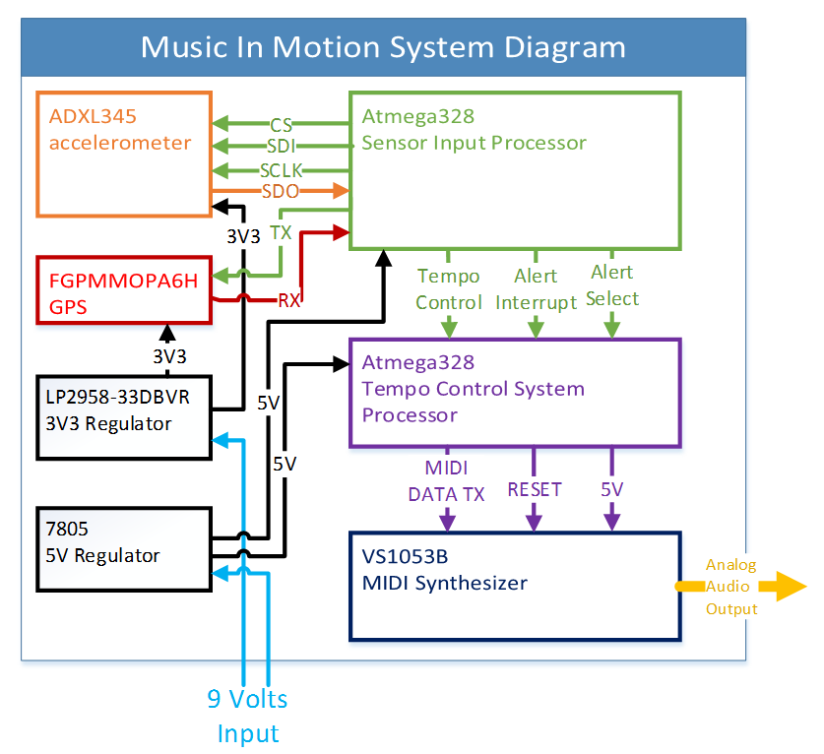
Notes:
Zoilo

Slide 6
Sensor Input Control
Retrieve and filter data from the accelerometer
Parse GSC strings gathered from GPS module
Program accelerometer data (footfalls) and distance computation (milestones) as control lines for the audio engine
Transmit signals in an ordered fashion to avoid signal delay for the accelerometer
C language
I/O Interface
Accelerometer | GPS | Audio System
SPI 4-wire | SCI (UART) | GPIO
Notes:
Eric

Slide 7
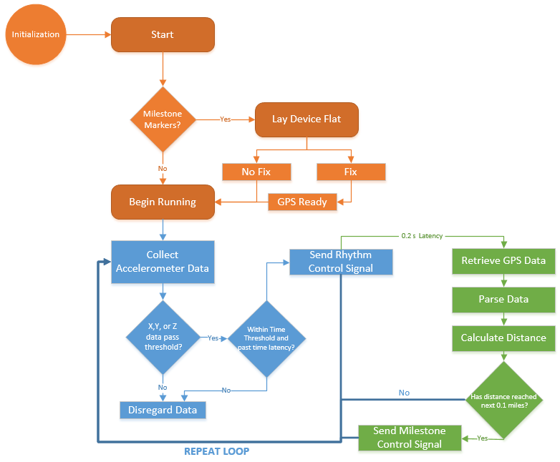
Loop Cycle for Sensor Control
Initialization
GPS
Accelerometer
Notes:
Eric

Slide 8
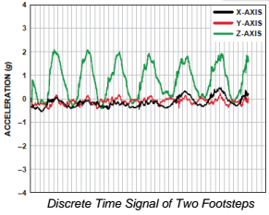
Accelerometer
Problem: The need to detect the runner’s foot-falls in real time with precision and accuracy
Solution: Accelerometer (ADXL345)
  Digital Output for DSP
Accelerometer
Category | Requirement
Number of Axes | 3
Resolution | 10 - 13 bits
Maximum Swing | ±16g
Dimensions | 15 mm x 15 mm x 5 mm (max)

Slide 9
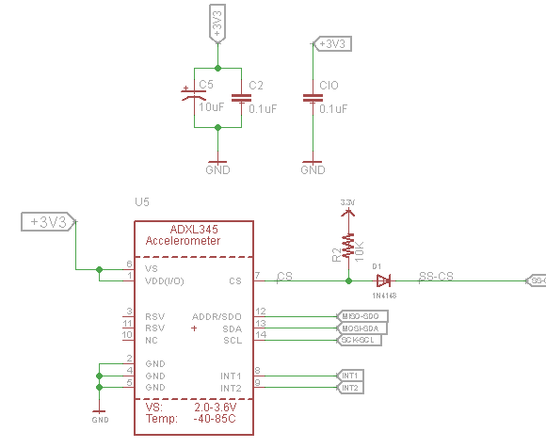
ADXL345 Schematic
Notes:
Eric

Slide 10
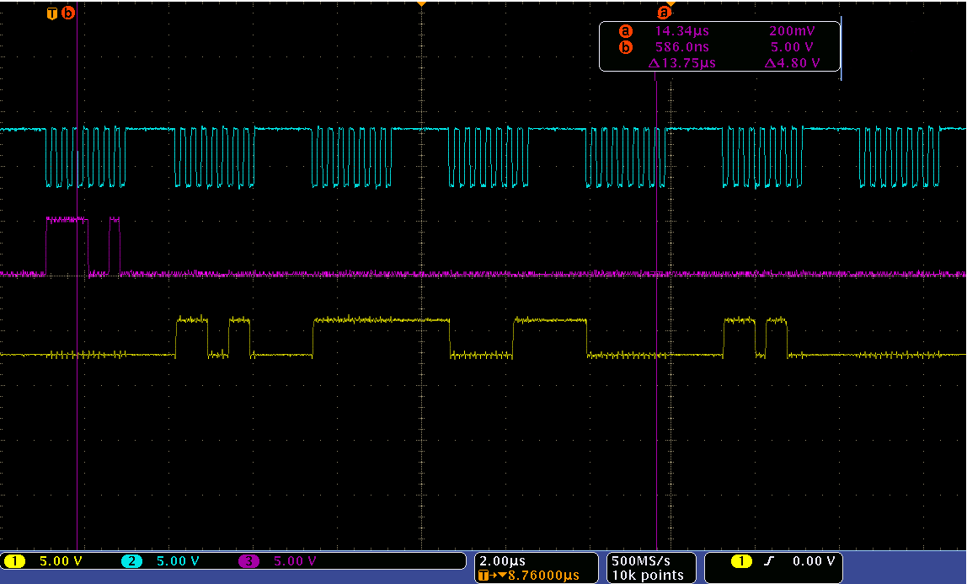
Accelerometer Data Output
Address Sent
16-bit x-axis data
16-bit y-axis data
16-bit z-axis data
Notes:
Eric

Slide 11
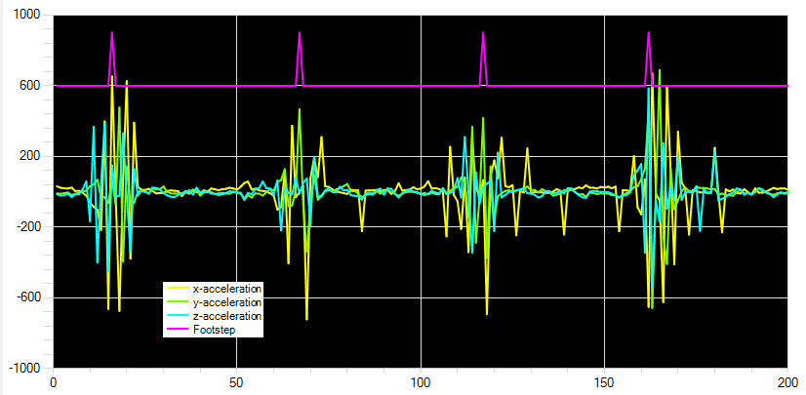
Raw Accelerometer Data
Notes:
Eric

Slide 12
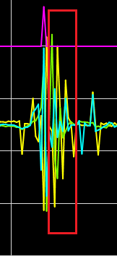
Accelerometer Filtering
FIR digital filter of 4 recorded footsteps
  Establishes threshold for rolling averages
  Threshold for false positives
    In case longer than latency
  False positives non-existent
Latency check to avoid jitter
  Low-pass filter
  0.2 sec after every step
  Time period for GPS check
0.2 sec
Latency
Notes:
Eric

Slide 13
GPS – FGPMMOPA6H
UART (SCI) Interfacing
Frequency: 1.575 GHz
MCU sample GPS coordinates at 1 Hz Refresh Rate
Milestones set on distance calculations
    Distance
      Every 0.1 mile, a unique sound plays to notify the distance
Fix confirmation via audio output
Notes:
Eric
Talk about fix and how it also sends a sound to notify the GPS is ready

Slide 14
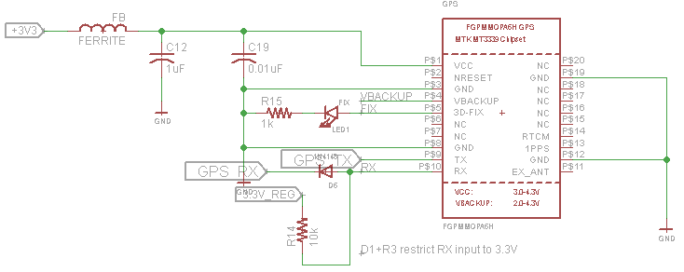
GPS Schematic

Slide 15
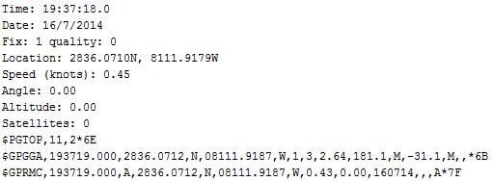
GPS Calculations
Parse data from strings sent through RMC and GGA
Two distance calculation
  Haversine (Using Earth’s radius and altitude)
  Kinematic Equation with speed and time
Notes:
Eric

Slide 16


GPS Calculations
Haversine
Kinematic Equation
Pros:
  More accurate
  Versatile by using more data from GPS
Cons:
  Convoluted algorithms in relation to data provided
  More for large scale applications
Pros:
  Simple
  Less code to execute
  Good for small-scale application
Cons:
  Not as accurate as Haversine
Notes:
Eric

Slide 17
GPS Temporary Issues
Stand-still jitter calculation
  Location precision not concise
Distance offset
  Speed precision off as well
Notes:
Eric

Slide 18
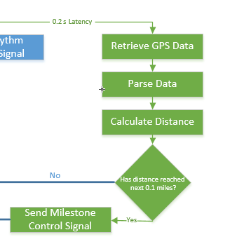
GPS/Accelerometer Software Sync
GPS secondary to Accelerometer
Avoids lag time created when focused on GPS
Update Rate originally congruent with Check Rate
0.2 sec
Latency
Notes:
Eric

Slide 19
Audio Engine and
Control System Design
Tempo Control System
  Processes the Tempo pulses received from the Sensor Microcontroller to output Song data in time with the runners pace
  Utilizes interrupts to mark pulse input timing
  Pulses represent the runners footfall
Audio Control System
  Contains Song Rhythmic and Melodic Structure
  Converts Digital Information to Analog audio signals
  Standard CD quality audio
  16bit 44.1KHz signal output
Notes:
Lane

Slide 20
Tempo Control System
Hardware
Implemented on an Atmega328 microcontroller
Software
Converts the impulse train received from the sensor processor into a dynamic and musically useful tempo map
Coded in C Language
Utilizes instantaneous and average tempo measurements to implement both Finite Impulse and Infinite Impulse response processing
Predictive processing estimates the placement of the next down beat
Quantizes each impulse into quarter note values and further subdivides these into both sixteenth note and triplet subdivisions
Notes:
Lane

Slide 21

Tempo Control System
Instantaneous Tempo Measurement
Discrete Time Diagram
Software Implementation
Finite Impulse response where
T(n)=X(n-1) – X(n)
Notes:
Lane

Slide 22
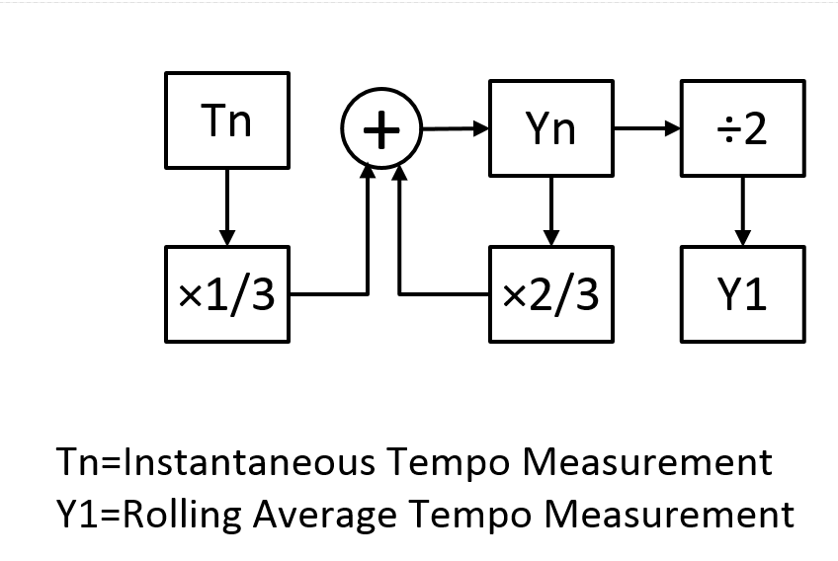
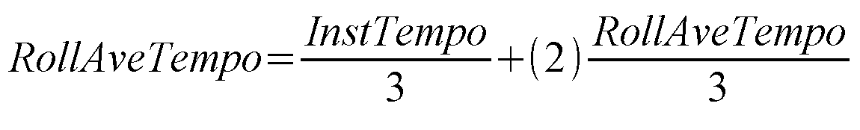
Tempo Control System
Rolling Average Tempo Measurement
Discrete Time Diagram
Software Implementation
Infinite Impulse response where
Y(n)=T(n)×1÷3 + Y(n-1)×2÷3
Notes:
Lane

Slide 23
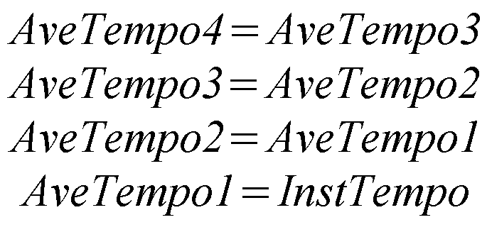
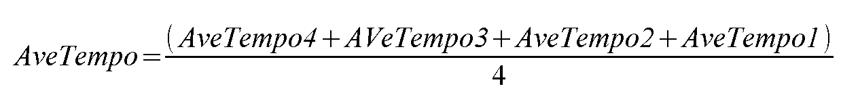
Tempo Control System
Average Tempo Measurement
Discrete Time Diagram
Software Implementation
Finite Impulse response where
Y2=[T(n) + T(n-1) + T(n-2) + T(n-3)] ÷ 4
Notes:
Lane

Slide 24
Tempo Control System Discrete-Time Diagram
Notes:
Lane

Slide 25
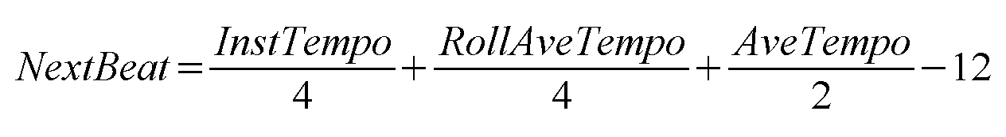
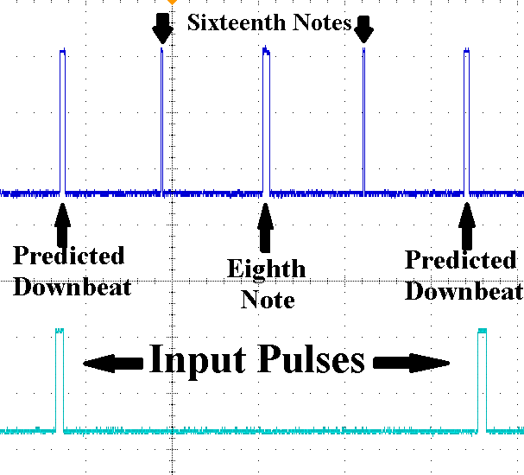
Tempo Control System
Tempo Map Output
The next down beat position is then finally estimated by using a weighted average of each measurement and subtracting a twelve millisecond offset
Input pulses are shown on the lower signal and the Tempo map output sixteenth note subdivisions are shown on the upper signal.
Notes:
Lane

Slide 26
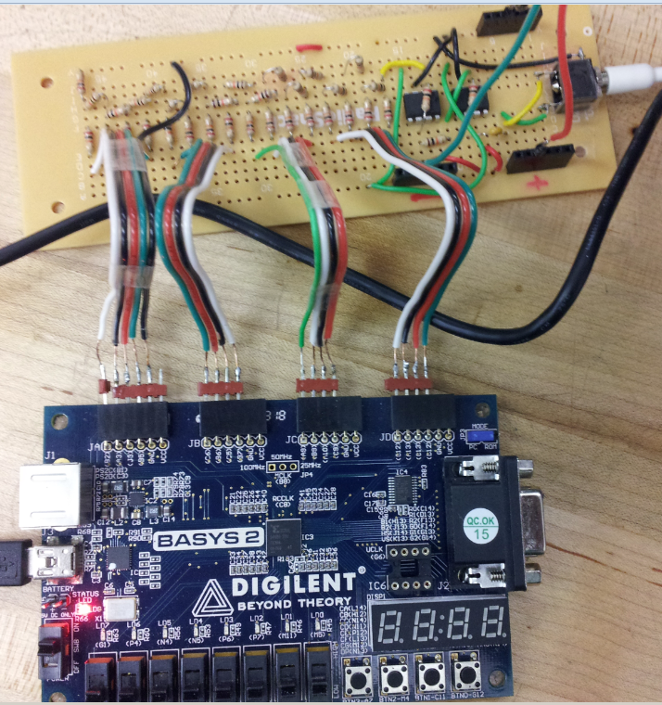
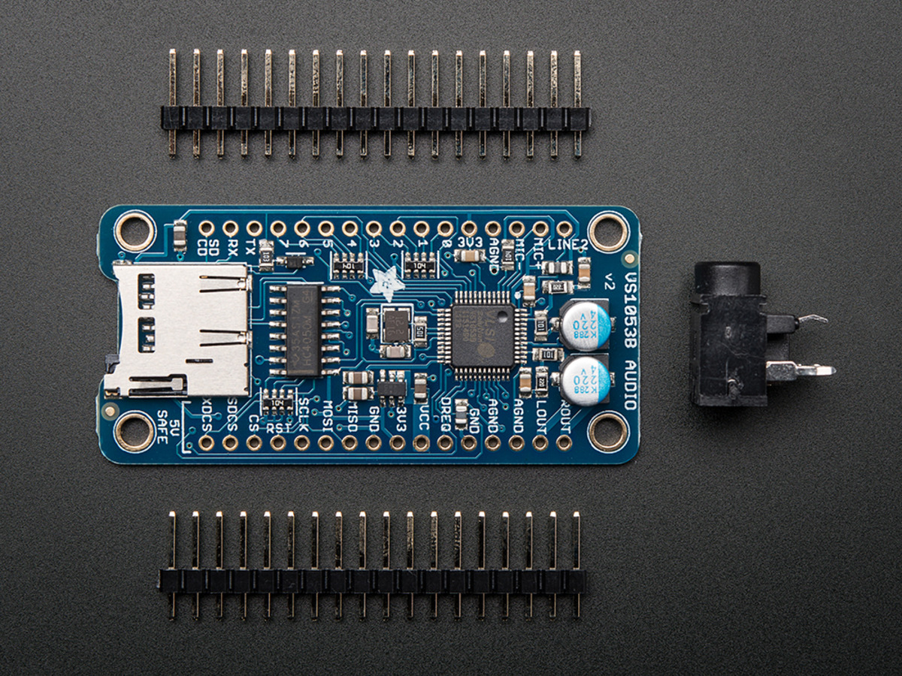
Audio Engine and Control System Design - Two Hardware Options
Additive Synthesis on FPGA
MIDI controlled Synthesizer
Notes:
Lane

Slide 27
Additive Synthesis on FPGA
Advantages
Disadvantages
Familiarity with Spartan architecture and Xilinx development tools
Prototyping done on a Digilent Basys2 is easily transferrable
FPGA design allows for Parallel processing of Control Inputs and Audio Signal Outputs for optimal real time performance on a single IC
Allows for fully customizable Sampling Rate and Bit Depth
Experience designing additive synthesis audio
Requires external or custom designed Digital Audio Converter
Labor Intensive – extensive coding required to design the entire audio engine and control system from scratch
Custom Digital Audio Converter pushes the limit of the PCB size design requirements
Notes:
Lane

Slide 28
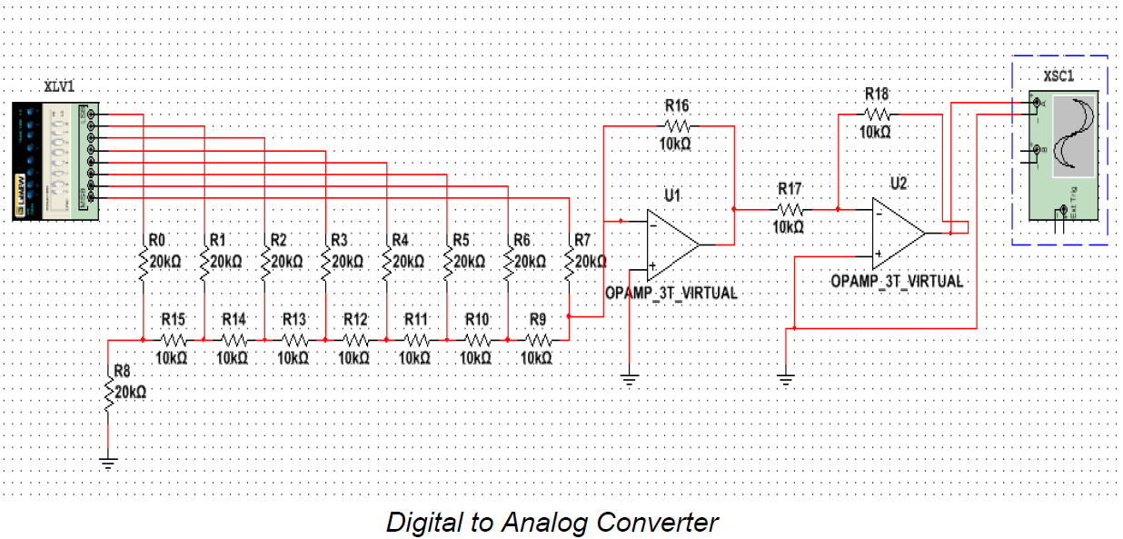
Additive Synthesis Design
Xilinx Spartan3 FPGA
Xilinx integrated IpCore digital oscillators are sufficient for audio signal generation
Oscillators can be Amplitude and Phase Modulated
Extensive Input and Output options
Digital Audio Converter (DAC)
2R Ladder type design
16 bit PCM audio signal input
Analog audio signal output
Notes:
Lane

Slide 29
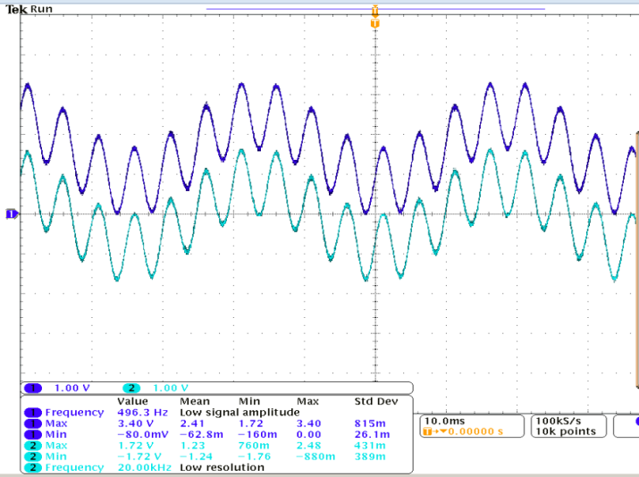
Audio Engine and Control System Design
Oscillator and DAC Hardware Prototype
Simple two oscillator additive synthesis wave
DAC Hardware Prototype Problems
Overestimation of Oscillator resource use lead to limited instrumentation capabilities
Limited polyphony
  More than three notes outputs simultaneously leads to excessive digital noise in signal
Notes:
Lane

Slide 30
MIDI Controlled Synthesizer
VLSI VS1053B
Class D audio amplifier and MIDI synthesizer IC
Advantages
Disadvantages
Outputs stereo analog audio signal
Eliminates the need for a custom DAC and audio amplifier thereby reducing the PCB size
Predesigned instrument sounds save design time
Has 50 note polyphony
MIDI control is easily implemented and can be quickly designed
Requires a separate microcontroller for Tempo processing
UART communication protocol between Tempo Control system and Audio Engine can increase system lag time
Notes:
Lane

Slide 31
Audio Engine and Control System Design - Two Hardware Options
Additive Synthesis on FPGA
MIDI Controlled Synthesizer
Given the time requirements this was determined to be the better option and has been implemented in this project
Notes:
Lane

Slide 32
Audio Control System
MIDI mode and Instrument Initialization
In order to run as a MIDI synth the Audio control system sets the VS1053 GPIO3 pin high and then sends power to the device
MIDI protocol includes 16 control channels and each instrument consists of a two channel layer
Control signals are sent along each channel to the desired sound bank
Note on messages must then be followed by a note off message
MIDI signals include a thee byte word and is transmitted big endian byte wise but little endian bitwise
  Byte 1 – 4 bit channel select and 4 bit command signal
  Byte 2 – 8 bit note number
  Byte 3 – 8 bit velocity value
Notes:
Lane

Slide 33
Audio Control System
Alert Control
Triggered from alert interrupt signal
Alert select input allows for two alert types
  First alert triggered when GPS has a satellite fix
  Following alerts triggered at distance milestones
Notes:
Lane

Slide 34
Audio Control System
Song storage and Generation
Two structure types store instrument note and velocity values
  Rhythmic Instruments – store note lengths and velocity arrays, pointers to those arrays, and an ON variable
  Melodic Instruments – store note values, lengths, and velocity arrays, pointers to those arrays, and an ON variable
Two counters as a song position pointer
  Beat – incremented every down beat
  Measure – incremented every four beats and counts 128 measures
Six functions – Down, Six1, Trip1, Eight, Trip2, and Six2 contain conditional statements that check against song position and turn the desired notes on and off along the required channels
Notes:
Lane

Slide 35
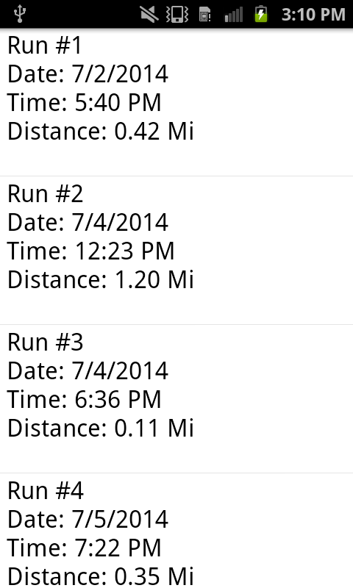
Original Android App Design
Design originally included Android App
  Record statistics of run
    Total Distance
    Total Time
    Milestone times and speeds
  Records up to 5 runs
  User Variable Input
    Distance Markers
    Alerts
  Uploaded via USB after run
  Separate mode when powered on
  USB connectivity issues on final design
Notes:
Eric

Slide 36
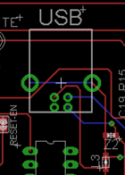
Application Implementation Issues
Prototype communication
Input design obstacles
USB inactivity on PCB
Not enough time
USB I/O
Notes:
Eric
Difficulty during prototyping to communicate USB with Application / Focused on other design issues
Managing sending data through USB without it being powered by a master device
Didn’t function on the PCB itself / Focused on other issues on PCB
More time we could have focused on it

Slide 37
Power System
Power Source – non-rechargeable 9 volt alkaline battery
9V to 3.3V & 1.8V: SPX29302 & AP7312
  Adjustable
  Low dropout voltage linear regulator
  Protect against over-current, reverse battery, and positive and negative voltage transients
9V to 5V: 7508
  Linear regulator
  Very easy to use and understand
  Already have experience with it
Audio dedicated Atmel powers VS1053B audio codec for MIDI mode initialization
Notes:
Zoilo

Slide 38
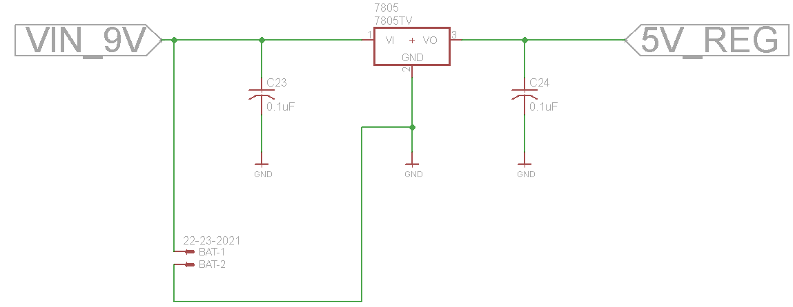
9V to 5V Regulation
Notes:
Zoilo

Slide 39
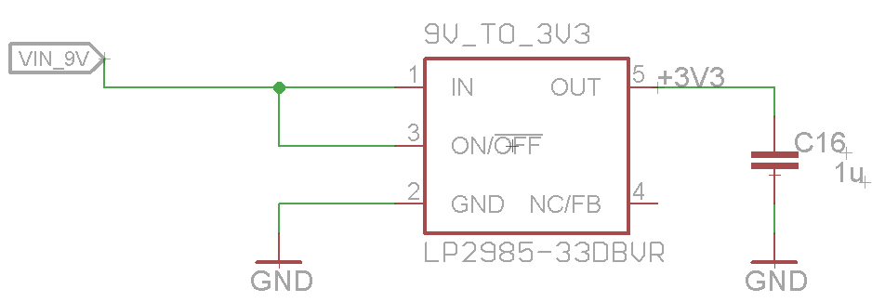
9V to 3.3V Regulation
Notes:
Zoilo

Slide 40
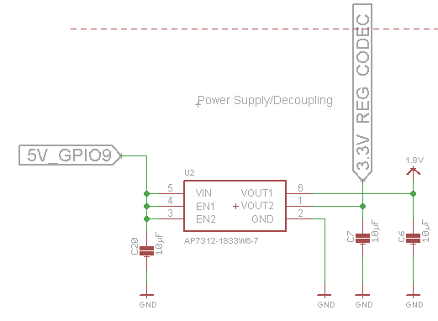
5V to 3.3V and 1.8V Regulation
Notes:
Zoilo

Slide 41
PCB Design
Reference designs were used for the peripheral subsystems which were then reverse engineered in order to meet the design specifications
The MIM PCB is a four-layer board
  One-sided surface mount and through hole parts
  Top Layer: Signal and Power
  Middle Two Layers: Signal
  Bottom Layer: Signal and Ground Plane
Dimensions: 3.920” x 3.423”
Parts on board
  Active: 10
  Passive: 75
Notes:
Zoilo

Slide 42
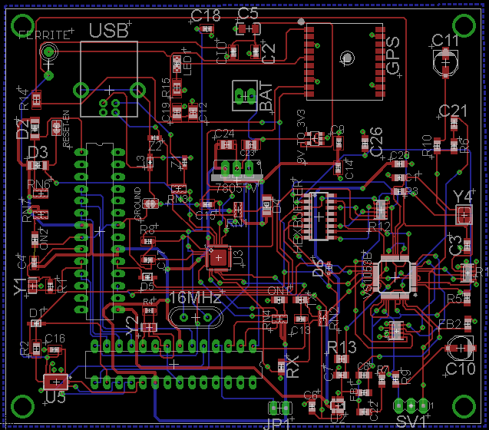
PCB Design
Notes:
Zoilo

Slide 43
PCB Manufacturing & Assembly
The PCB was manufactured by Advanced Circuits using the $66 student special
No electrical errors, one cosmetic error: silkscreen did not show up
Certain parts were inconsistent with footprints
The board was assembled by Quality Manufacturing Services (QMS)
Notes:
Zoilo

Slide 44
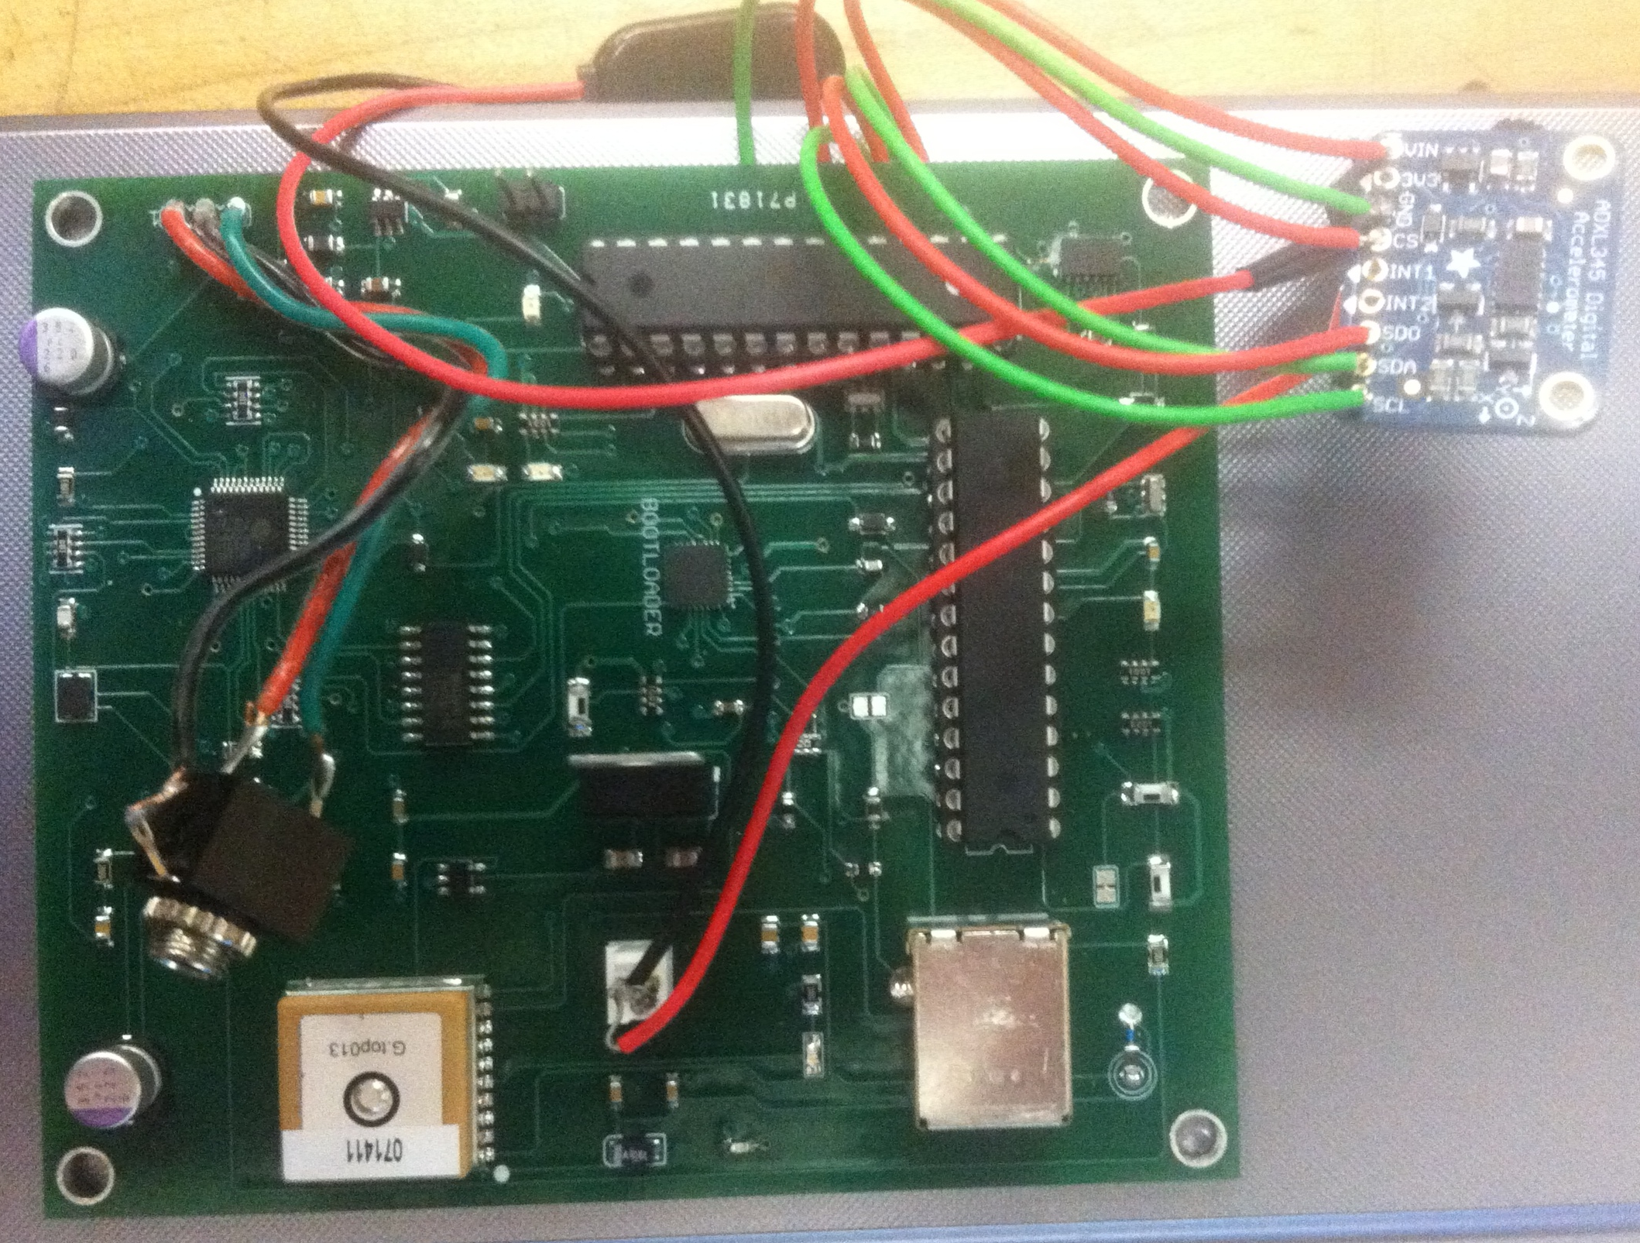
PCB Manufacturing & Assembly
Notes:
Zoilo

Slide 45
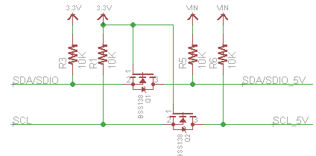
ADXL 345 Problem and Resolution
Problem
  I/O pins take in 1.7V to VS
  VS ranges from 2.0V to 3.6V
  The Atmega328 processor outputs 5V
  Simply missed that when designing the PCB
Solution
  Scratched out the traces that communicate with on board ADXL345
  Soldered jumpers to the sensor Atmel and the ADXL345 development board and interfaced with it
Notes:
Zoilo

Slide 46
Design Drawbacks
Size larger than anticipated
Microcontroller limitations vs TI C2000 and FPGA
Power supply separate from design
Separate accelerometer setup
Notes:
Zoilo

Slide 47
ITEM | DESCRIPTION | PURPOSE | OBTAINED | UNITS | PRICE/UNIT | COST
Digilent Basys2 | FPGA Dev | Prototyping | In stock | 1 | $0.00 | $0.00
TI MSP430 LaunchPad | Microprocessor Dev | Prototyping | In stock | 3 | $0.00 | $0.00
TI C2000 Piccolo Development Board | MCU Dev | Prototyping | TI | 1 | $22.00 | $22.00
ADXL345 Development Board | Accelerometer Dev | Prototyping & Final | Adafruit | 1 | $22.00 | $22.00
ADXL345 IC | Accelerometer IC | Final | SparkFun | 2 | $9.95 | $19.90
Antenova m10382 Development Board | GPS Dev | Prototyping | Mouser | 1 | $24.35 | $24.35
Ultimate GPS Development Board | GPS Dev | Prototyping | Adafruit | 1 | $39.95 | $39.95
FGPMMOPA6H IC | GPS IC | Final | Adafruit | 1 | $29.95 | $29.95
VS1053B Development Board | Audio Codec Dev | Prototyping | Adafruit | 1 | $24.95 | $24.95
VS1053B IC | Audio Codec IC | Final | Adafruit | 1 | $12.50 | $12.50
Arduino Uno Rev3 | MCU Dev | Prototyping | RadioShack | 3 | $29.99 | $89.97
USB Wire A to B | Connector | Prototyping | RadioShack | 2 | 5.89 | $11.78
PCB Manufacturing | Board Printing | Final | Advanced Circuits | 1 | $107.49 | $107.49
PCB Stencil | Assembly Tool | Final | Advanced Circuits | 1 | $134.00 | $134.00
PCB Parts | Circuit Components | Final | Newark/Digikey | 80 | N/A | $43.32
Total |  |  |  |  |  | $582.16
Notes:
Zoilo

Slide 48

Questions?
Notes:
Zoilo

