Slide 1
Puppy Pal
Group 11
Marshall Smith
Afzal Shafi
Cameron Riesen
Anson Contreras

Slide 2
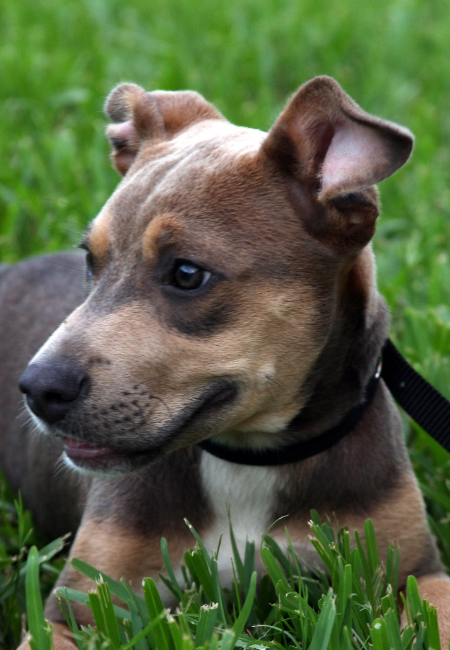
The face of innocence?

Slide 3
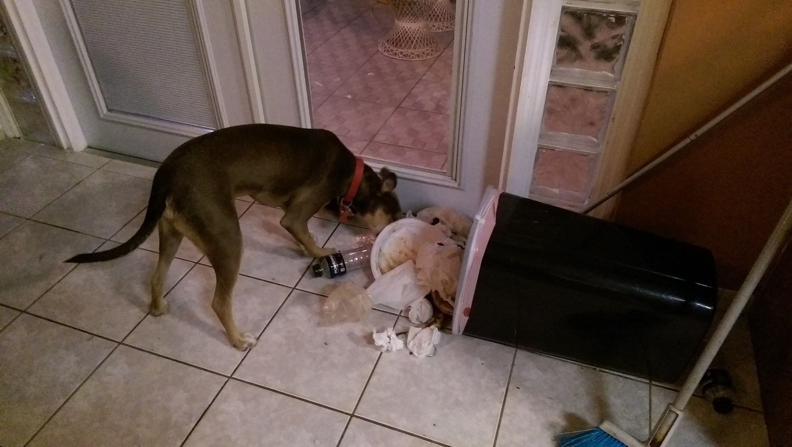
The face of destruction

Slide 4
Causes and Solutions
Causes
Teething stage
Boredom
Nervous energy
Solutions
Toy Doesn’t move, Dog loses interest ✗
Another pet May be bad a influence ✗
Puppy Pal Mimics the ideal playmate ✓

Slide 5
Puppy Pal’s Job
Should prevent destructive behavior while the owner is away
Should not introduce unsafe situations
Should not be a nuisance to people or the dog
Should allow the dog to sleep without interruption
Should not scare timid dogs or lose interest of hyperactive dogs
Should be durable
Should be capable of autonomous operation and user controlled modes

Slide 6
Accomplishing the job
Detect motion and presence from dog to activate the ball to allow the dog to sleep
Use a ball with replaceable fabric cover to create a distraction with physical and audible interactive play mimicking real animals
Ball design minimizes points of failure that could be chewed off
Replaceable fabric cover mimics appearance of real animals
Audio system mimics nonthreatening but playful sounds made by real animals to accommodate all dogs from timid to hyperactive or aggressive
Keep ball within user defined play area to keep the dog safe and out of trouble

Slide 7
Subsystems
Mechanical Housing (ball)
Mechanical Drive
Communications
Android Interface
Autonomous Control
User Control
Motion and Proximity Sensing (of the dog)
Power and Charging

Slide 8
Puppy Pal’s Three Main Components
Ball
The moving piece housing the motor control, autonomous control, and audio subsystems, as well as communications connecting to an Android device, the Collar, and the Base Charging Station.
Base Charging Station
The stationary piece housing the location, proximity, and wireless charging subsystems, as well as communications connecting to the Ball.
Collar
The piece attached to the dog’s collar, housing the motion detection subsystem as well as communications connecting to the Ball.

Slide 9
Specifications
10 hour battery life (including time spent in low power)
A typical work day in America requires 10 hours away from home
8 hours of work, 1 hour of lunch, 1 hour total commute time
Wireless Charging
The ball should be fully enclosed to maximize durability
Wireless charging eliminates cords and connectors that could be chewed
Autonomous Control
The ball should be capable of distracting the dog without human assistance
Will require a locating subsystem

Slide 10
Mechanical Housing
Spherical Shape
Dogs like playing with balls
Shape brings about problems different from traditional robots
Internal structure being turned upside down
Measure of distance traveled is not as straight-forward

Slide 11
Housing Materials
Plastic
Light
Transparent
Easy to drill holes
Sturdy enough for dogs to play with

Slide 12

Internal Structure
Buying a Chassis
No product suiting our requirements was found
Buying Sphero
Similar project
Only has 3 inch diameter
Doesn’t leave us with much to expand on
Purchase is not an option, so we have to build it ourselves

Slide 13
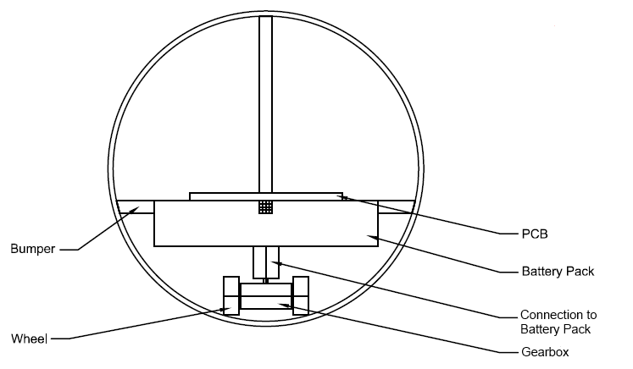
Internal Structure

Slide 14
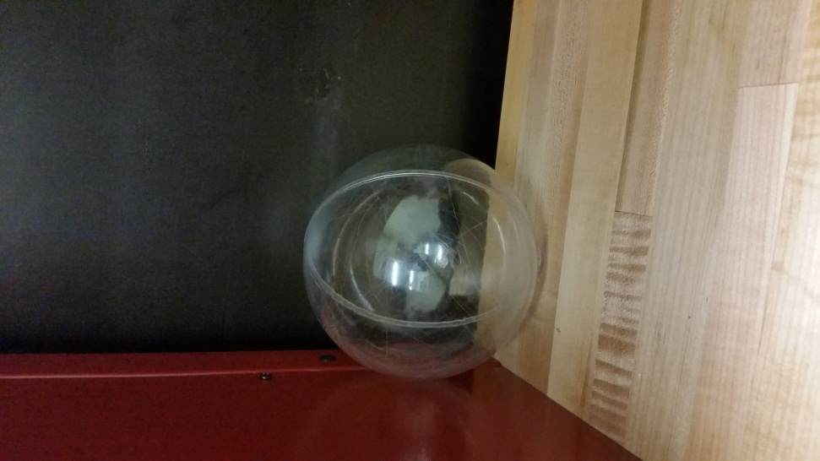
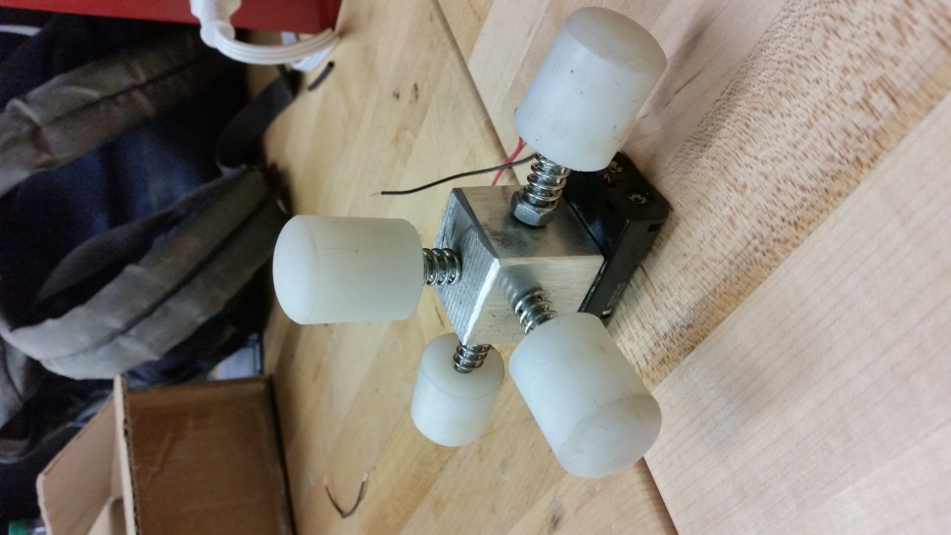
Internal Structure

Slide 15
Internal Structure
Materials
Aluminum
Light
Able to withstand powerful forces from a dog
Plastic
Light
Consistent with rest of the design

Slide 16
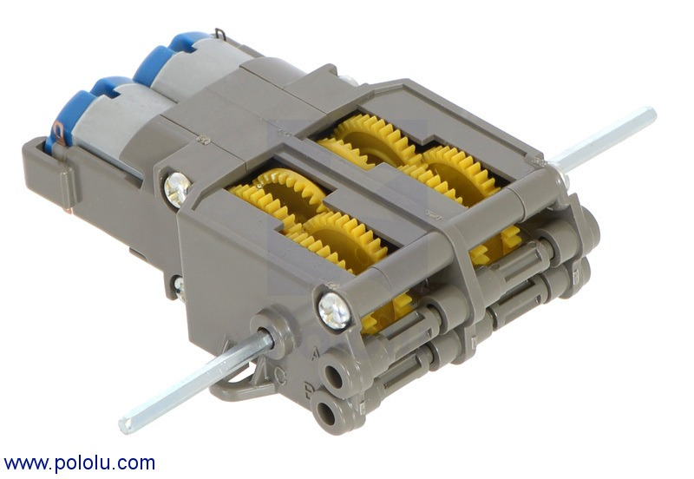
Internal Structure
Tamiya gearbox controls two motors
Gear ratio of 58:1
Shaft gave us options for different wheels throughout the prototyping stage

Slide 17
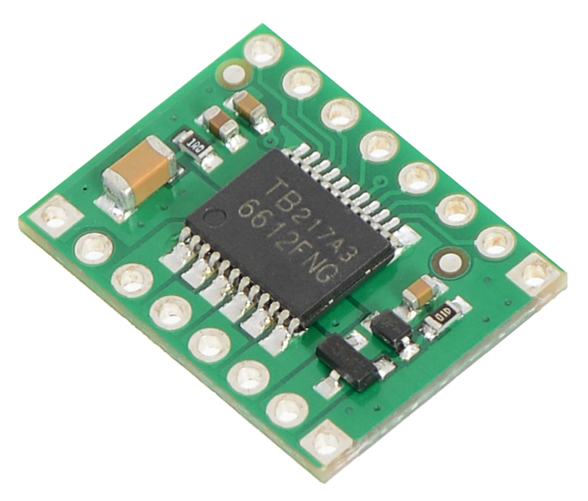
Driving System
The TB6612FNG, a full bridge driver, drives both motors at once.
Change direction of rotation or apply brakes with digital pins.
Able to operate 6V or 12V motors

Slide 18
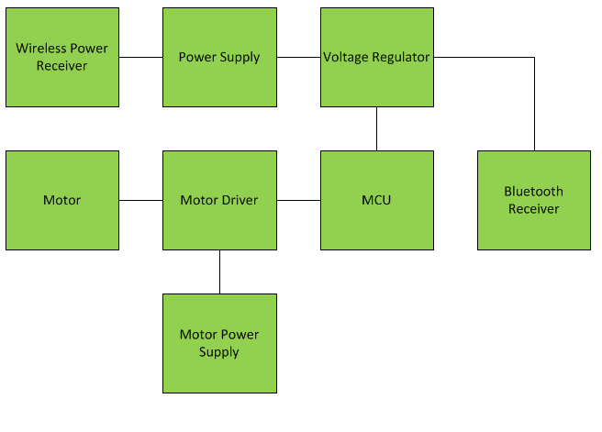
Hardware Block Diagram - Ball
Notes:
Change Block diagram

Slide 19
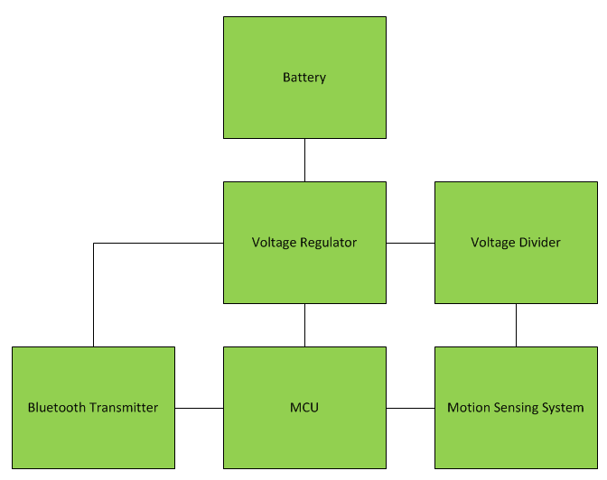
Hardware Block Diagram – Dog Collar

Slide 20
Bluetooth Communications
Simple to connect and configure (Pairing, Searching, Switching Roles)
Range is adequate for project application
Reliable connection
Will be used to send commands to the ball from mobile device and dog collar.
Multiple modules will be used for simplicity and in addition so incoming commands will not be disrupted.

Slide 21
Bluetooth Communications
Collar to ball communications will constantly be updating commands with respect to the dog’s activity (wakes up device)
Mobile device to ball communications will send user commands in RC mode (mode switching, manual control, speed control)
Slave devices on the ball, master devices on collar and mobile phone

Slide 22
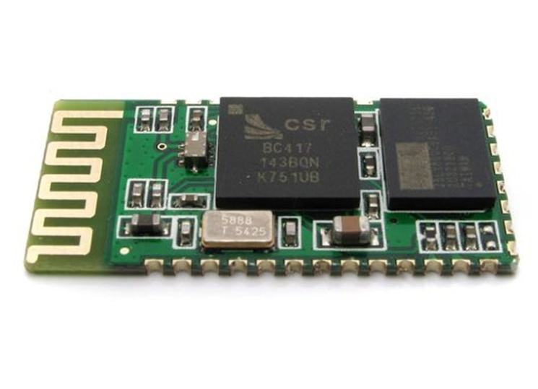
HC-05 Bluetooth Module
Class 2 – 2.5 mW, *approx. 30 feet range
Bluetooth Specification v2.0+EDR
2.4 Ghz ISM band
Bluetooth Serial (Master/Slave)
Operating Voltage : 3.3 to 5 VDC
Integrated antenna
Size : 27mm x 13mm x 2mm
Baud rate : 9600 bps
Auto-connects to last device on power as default
Simple to use ATcommands to configure the module

Slide 23
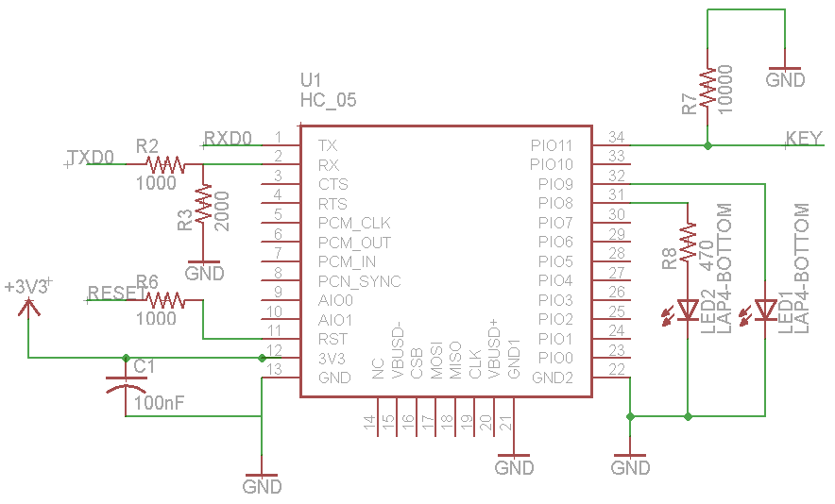
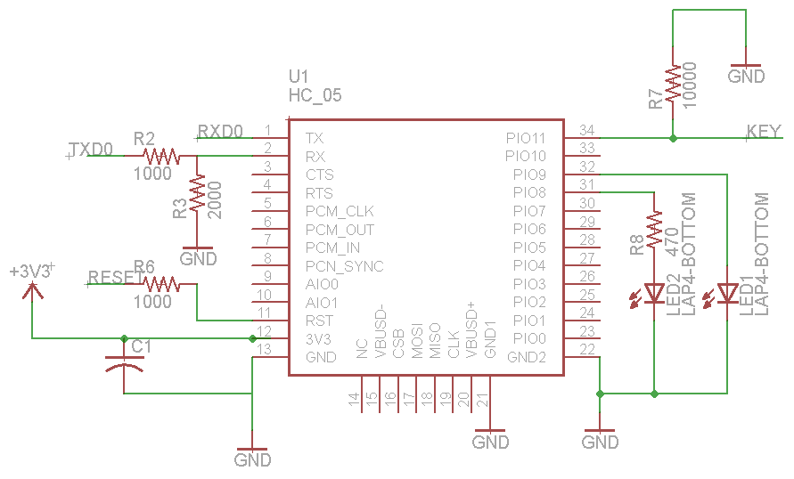
HC-05 Bluetooth Module

Slide 24
Dog Collar
Detects motion from the dog
Sends to “Autonomous Mode “when active threshold has been met, sends system to “Waiting” if not.
Broken down into 3 main components
Bluetooth Module - HC-05
Microcontroller – ATmega328P
Accelerometer - ADXL 345

Slide 25
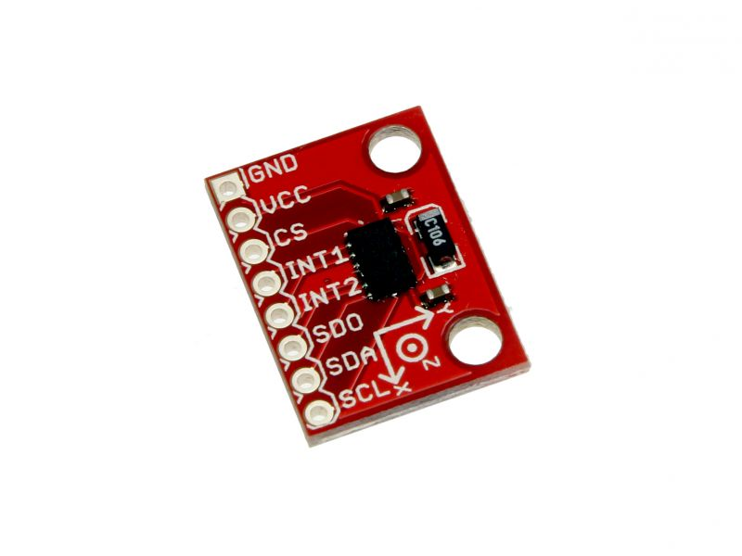
ADXL 345
3 –axis (X and Y axis input)
SPI Communications – Acts as slave
2g, 4g, 8g, and 16g ranges
Used 4g , gave us the most accurate readings and 4g is significantly higher than threshold needed
Supply voltage – 3.3 V

Slide 26
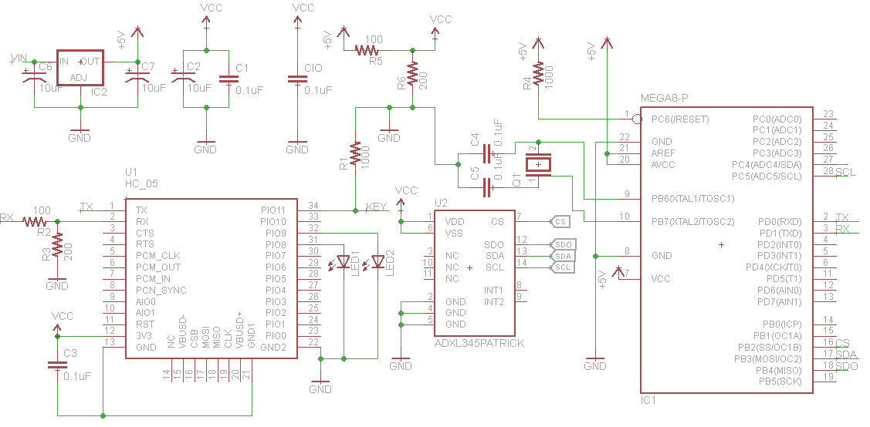
Dog Collar Schematic

Slide 27
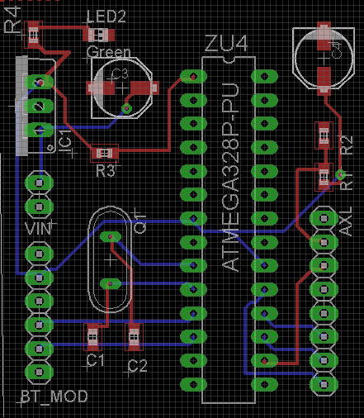
Dog Collar PCB
Dimensions – 1.58 x 1.79 inches
Advanced Circuits – 4pcb.com
Power Supply – 2 CR2032 Coin Cell Battery ( 3 volts each in series)
5 V - LM7805 voltage regulator (Atmega328P and HC-05)
3.3 V – Voltage Divider (ADXL 345)

Slide 28
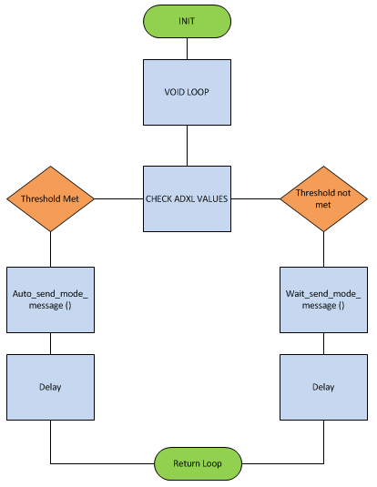
Dog Collar Flow Diagram

Slide 29
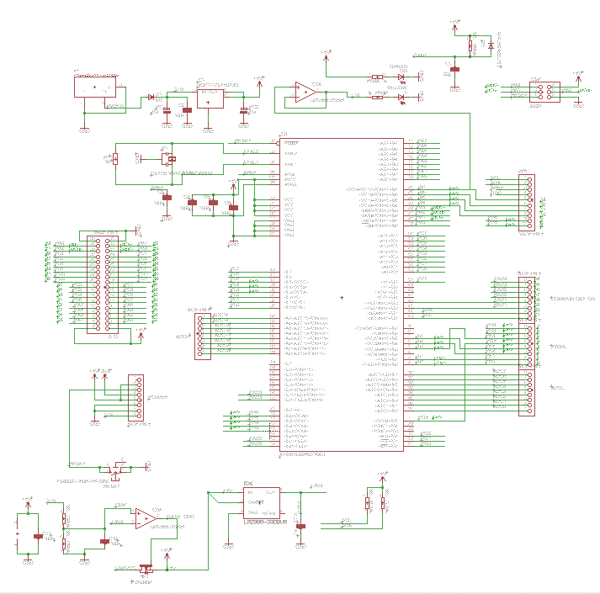
Ball Schematic - MCU

Slide 30
Ball Schematic - MCU
ATmega2560

Slide 31
Ball Schematic - MCU
UART Ports

Slide 32
Microcontroller
Name | Atmega2560
Clockspeed | 16 MHz
Flash | 256KB
GPIO | 54 Digital, 16 Analog
6 pins for serial (3 total interfaces)
11 channels for 8-bit PWM

Slide 33
Puppy Pal Software
C++
GNU Make / avr-g++ / avrdude
No STL
Limited DMA

Slide 34
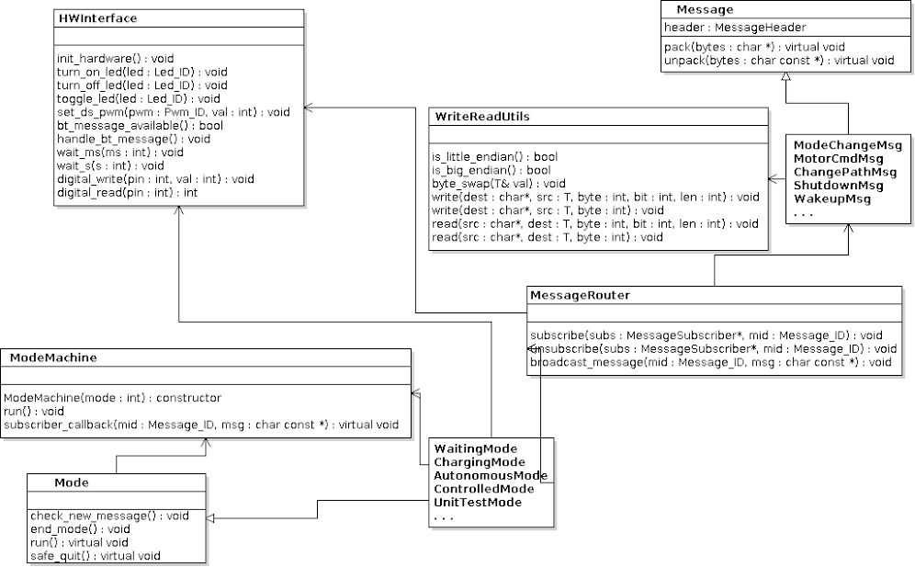

Slide 35
Puppy Pal Software
3 Major aspects
Messaging
Modeing
Interfacing hardware

Slide 36
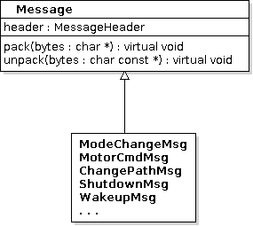
Puppy Pal Software - Messaging
Not specific to Puppy Pal
How all components communicate with each other
Contain data fields specific to the message
Each message knows how to pack/unpack itself
Directed to appropriate module through the MessageRouter

Slide 37
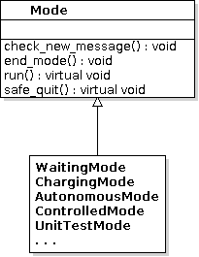
Puppy Pal Software - Modeing
Modes define how the system is operating
controlled by phone, autonomous, waiting for input, ...
Essentially the “forever” loop of the software
The ModeMachine starts, runs and ends modes
subscribes to mode change messages

Slide 38
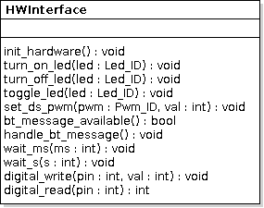
Puppy Pal Software – Interfacing Hardware
Singleton that provides a global access point to all the hardware
turning LEDs on and off
setting duty cycle for PWM pins
writing to GPIO pins
checking for and handling incoming Bluetooth messages

Slide 39
Dog Collar Software
Continuously checks accelerometer values
When values are past a threshold, sends a message to the Puppy Pal that it should turn on

Slide 40
Autonomous Control
Preliminary Ideas
Location sensing and pathfinding with IR, WiFi, GPS
Not enough information, unreliable, large error margins
Image recognition on the Puppy Pal
Physical space constraints, code size constraints

Slide 41
Power and Charging
Ball will be powered by a 12V NiMH Battery, not yet selected
Depends upon testing, use measured power consumption to calculate battery requirements to meet battery life specification
The Base Charging Station will be powered by a standard 120V outlet
Stepped down to 5V and transmitted wirelessly from base station to ball
Transmitter:
Input 5V DC at 2A maximum
Receiver:
Output 5V DC at 1A maximum
Wireless power transfer efficiency of approximately 60%

Slide 42
PCB
2 Layer Design Required
Utilize existing designs from Arduino to minimize design work
Design using Eagle freeware
Using 4PCB’s $33.00 2 layer student deal

Slide 43
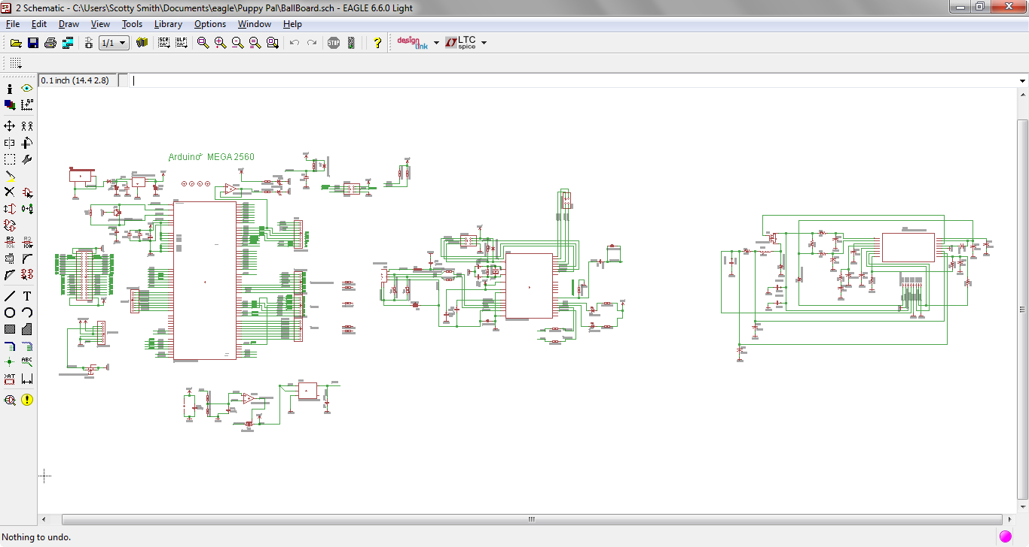
PCB Schematic

Slide 44
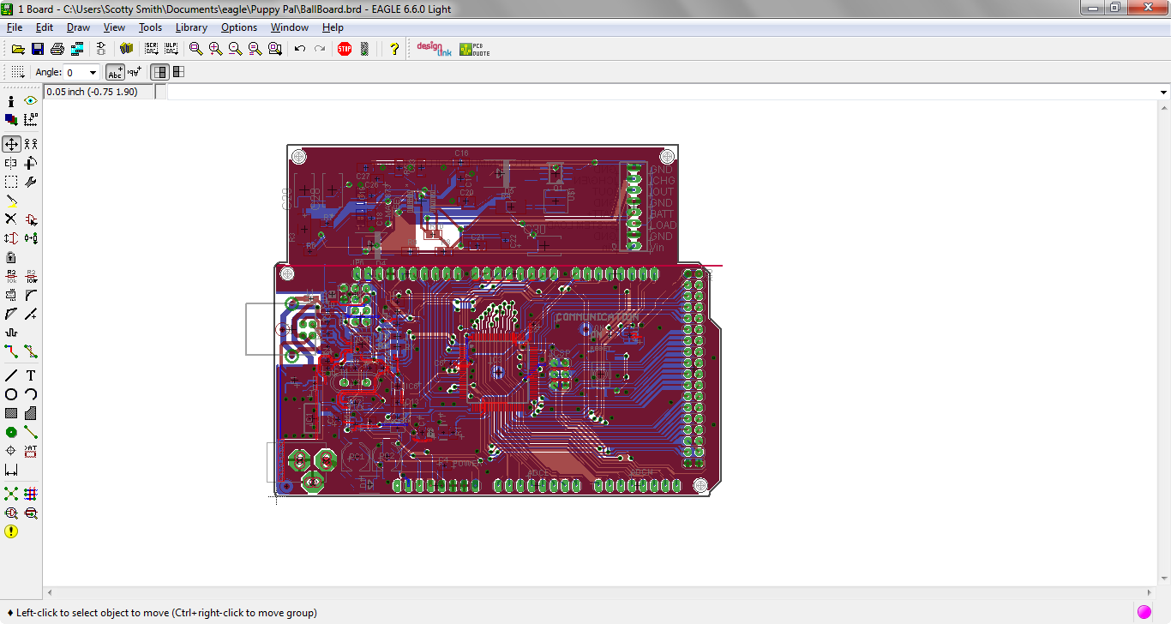
PCB Board

Slide 45
Work Distribution
 | Marshall Smith | Cameron Riesen | Afzal Shafi | Anson Contreras
Mechanical Design | x |  | x | ●
Motor Control |  | x |  | ●
Android Application |  | ● | x
Communication |  | x | ●
Location Detection | x | ●
Motion/Proximity Sensing | ● | x |  | x
PCB | x |  | ●
Power System | ● |  |  | x
Embedded Software |  | ●
● - Key Responsibility | x – Contribution

Slide 46
Budget – Total
Component | Quantity | Price
Ball Enclosure | 1 | 10.99
Arduino Mega 2560 | 1 | 15.00
Bluetooth Module(s) | 5 | 20.00
DC Motors | 2 | 10.00
Android Device | 1 | Owned
PCB Ball | 1 | 316.00
PCB Dog Collar | 1 | 50.00
Accelerometer | 1 | 5.00
Gear Box | 2 | 12.00
Misc. Mechanical Parts | 1 | 30.00
Misc. Electrical Parts | 1 | 20.00
12 V Battery | 1 | 40.00
Dog Collar Battery | 1 | 20.00
Total | 19 | 548.99

