Slide 1
Puppy Pal
Group 11
Marshall Smith
Afzal Shafi
Cameron Riesen
Anson Contreras

Slide 2
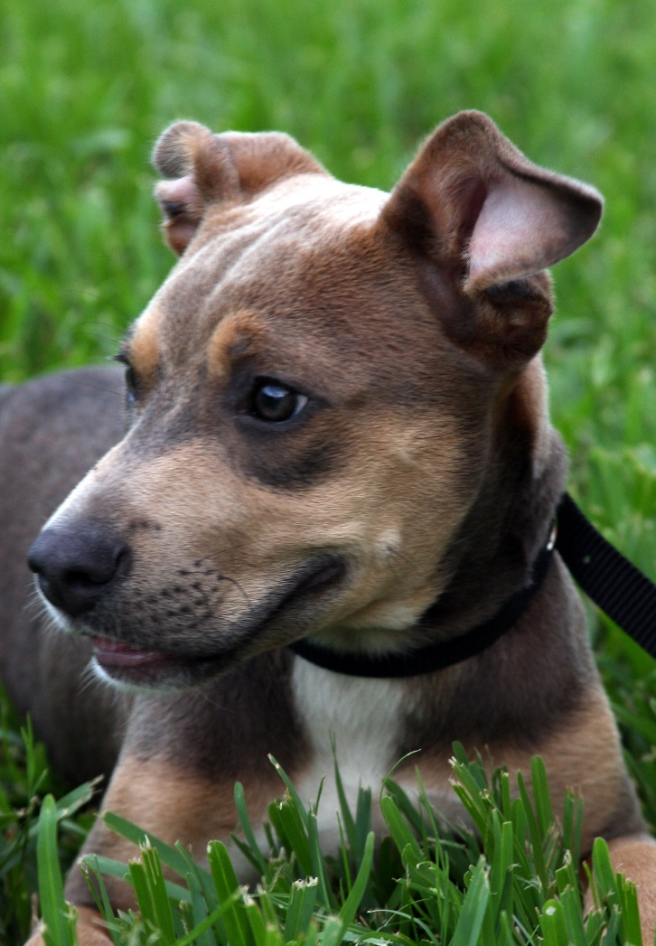
The face of innocence?

Slide 3
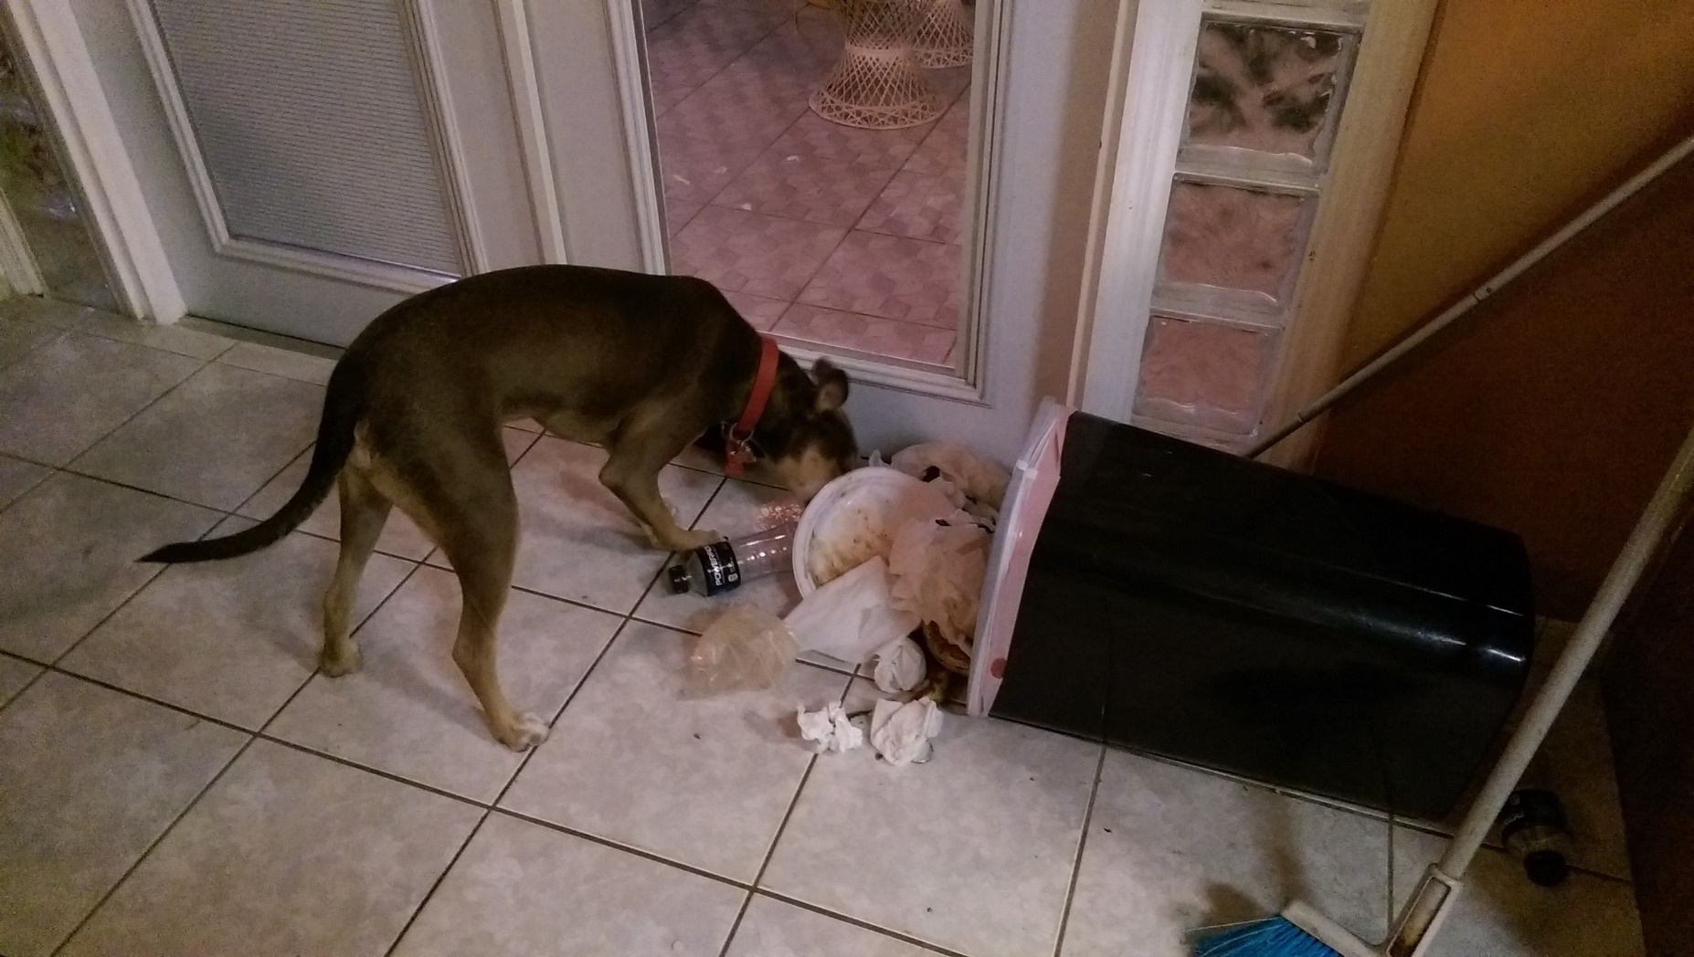
The face of destruction

Slide 4
Causes and Solutions
Causes
Teething stage
Boredom
Nervous energy
Solutions
Toy Doesn’t move, Dog loses interest ✗
Another pet May be bad a influence ✗
Puppy Pal Mimics the ideal playmate ✓

Slide 5
Puppy Pal’s Job
Should prevent destructive behavior while the owner is away
Should not introduce unsafe situations
Should not be a nuisance to people or the dog
Should allow the dog to sleep without interruption
Should not scare timid dogs or lose interest of hyperactive dogs
Should be durable
Should be capable of autonomous operation and user controlled modes

Slide 6
Accomplishing the job
Detect motion and presence from dog to activate the ball to allow the dog to sleep
Use a ball with replaceable fabric cover to create a distraction with physical and audible interactive play mimicking real animals
Ball design minimizes points of failure that could be chewed off
Replaceable fabric cover mimics appearance of real animals
Audio system mimics nonthreatening but playful sounds made by real animals to accommodate all dogs from timid to hyperactive or aggressive
Keep ball within user defined play area to keep the dog safe and out of trouble

Slide 7
Subsystems
Mechanical Housing (ball)
Mechanical Drive
Communications
Android Interface
Autonomous Control
User Control
Location Detection (of the ball)
Motion and Proximity Sensing (of the dog)
Power and Charging

Slide 8
Puppy Pal’s Three Main Components
Ball
The moving piece housing the motor control, autonomous control, and audio subsystems, as well as communications connecting to an Android device, the Collar, and the Base Charging Station.
Base Charging Station
The stationary piece housing the location, proximity, and wireless charging subsystems, as well as communications connecting to the Ball.
Collar
The piece attached to the dog’s collar, housing the motion detection subsystem as well as communications connecting to the Ball.

Slide 9
Specifications
10 hour battery life (including time spent in low power)
A typical work day in America requires 10 hours away from home
8 hours of work, 1 hour of lunch, 1 hour total commute time
Wireless Charging
The ball should be fully enclosed to maximize durability
Wireless charging eliminates cords and connectors that could be chewed
Autonomous Control
The ball should be capable of distracting the dog without human assistance
Will require a locating subsystem

Slide 10
Mechanical Housing
Spherical Shape
Dogs like playing with balls
Enclosure keeps dog away from the motor and the electronics that would be exposed if we use a rectangular chassis
Shape brings about problems different from traditional robots
Internal structure being turned upside down
Measure of distance traveled is not as straight-forward

Slide 11
Housing Materials
Plastic
Light
Comes in variety of colors
Transparent or oblique
Easy to drill holes
Sturdy enough for dogs to play with
Custom ordered or taken from other products

Slide 12
Housing Materials
3D printed ABS
3D printer available on-campus
Strong
Impact-resistant
Gives us the option to print out the internal structure already inside
Expensive: $7 per cm³
Acryllic
Can be ordered in any size
Only comes in hemispheres or as a solid piece with a single opening
Once hemispheres are sealed closed, we won’t have access to the inside of the robot

Slide 13
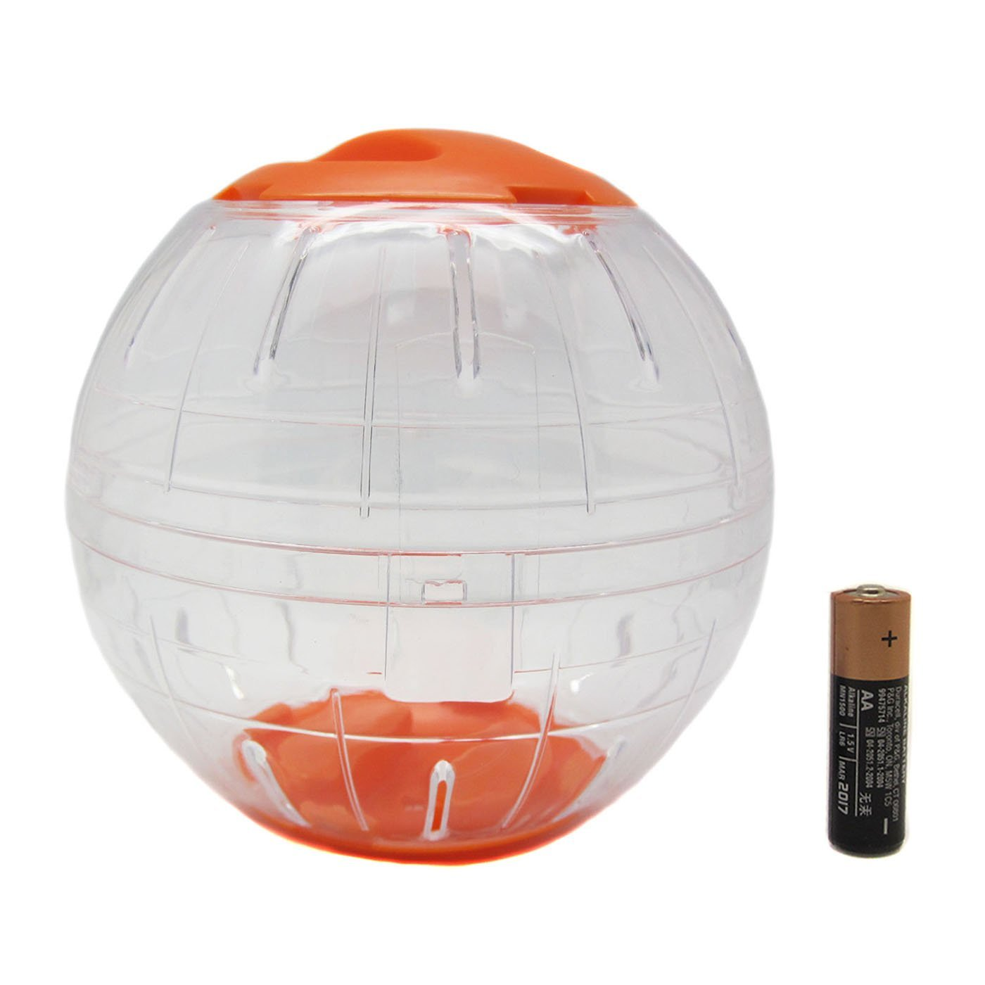
Housing Materials
Alfie Hamster Ball
Plastic
Hemispheres can be connected and separated easily
6 inch diameter
Two openings with 3 inch diameters
Allows us to take apart the ball to troubleshoot during testing and construction

Slide 14

Internal Structure
Buying a Chassis
No product suiting our requirements was found
Buying Sphero
Similar project
Only has 3 inch diameter
Doesn’t leave us with much to expand on
Purchase is not ideal, so we have to build it ourselves

Slide 15
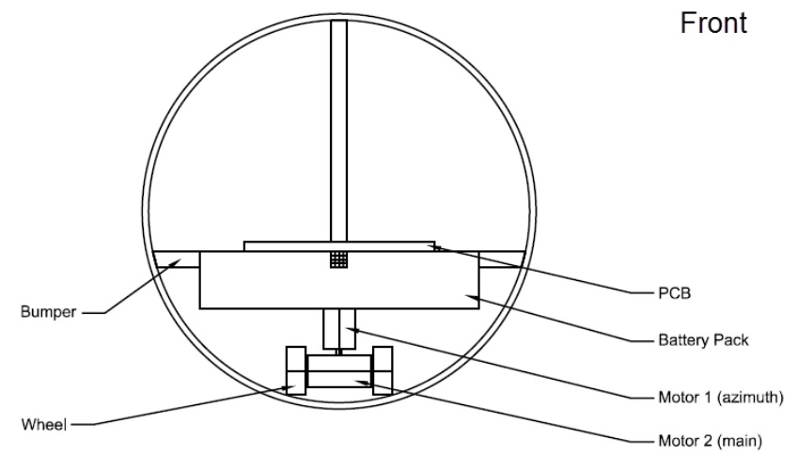
Internal Structure

Slide 16
Internal Structure
Materials
Aluminum
Light
Plenty available in Home Depot and Skycraft
Wood
Insulator
Bulky if not purchased with correct thickness
Home Depot can cut the wood for us
Cheap
Plastic
Light
Consistent with rest of the design
Different colors can give the project more personality
Constructed with salvaged plastic
Produced with a 3D printer with mounts for motors, PCB, and batteries already built-in

Slide 17
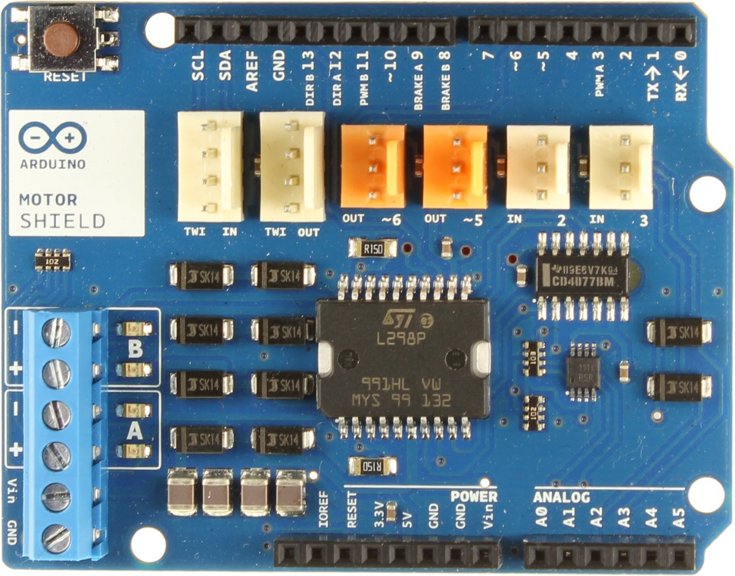
Driving System
We are using the Arduino Motor Shield to drive our motors
It uses the L298P, a full bridge driver, to drive both motors at once
Able to operate our 12V and 6V motors

Slide 18
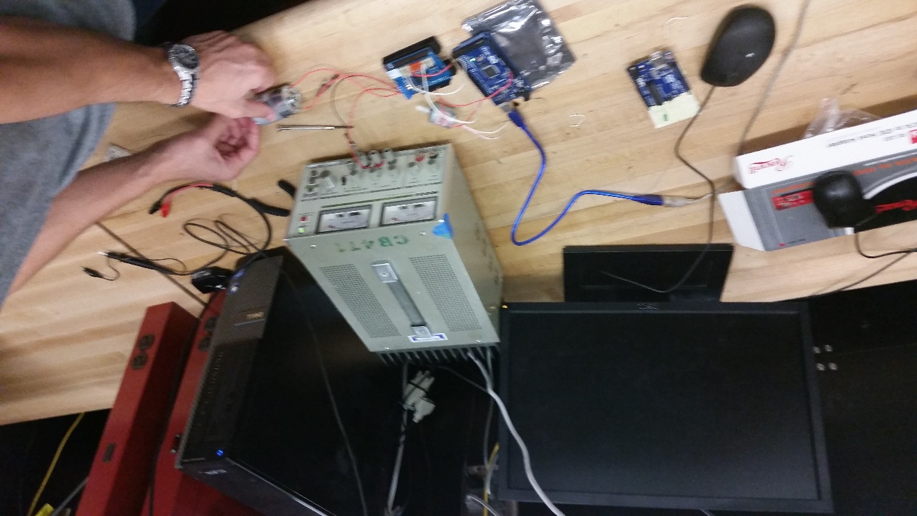
Progress
We have tested mechanical output of our motors and the amount of current required
Test also showed the effectiveness of the motor shield

Slide 19
Hardware Block Diagram - Ball

Slide 20
Bluetooth Communications
Simple to connect and configure (Pairing, Searching, Switching Roles)
Range is adequate for project application
Connection to mobile device
Will be used to send commands to the ball from mobile device and dog collar.
Potentially may be used to receive commands from charging station
Multiple modules will be used so incoming commands will not be disrupted

Slide 21
Bluetooth Communications
Collar to ball communications will constantly be updating commands with respect to the dog’s activity
Mobile device to ball communications will send user commands in RC mode
Charging Station will update commands with respect to location

Slide 22
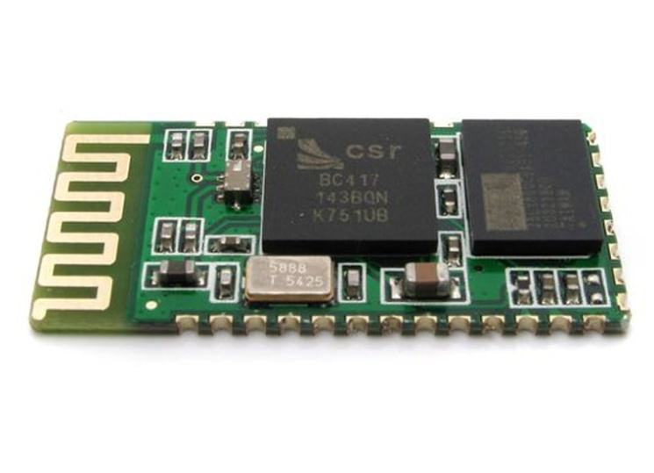
HC-05 Bluetooth Module
Class 2 – 2.5 mW, *approx. 30 feet range
Bluetooth Specification v2.0+EDR
2.4 Ghz ISM band
Bluetooth Serial (Master/Slave)
Operating Voltage : 3.3 VDC
Integrated antenna
Size : 27mm x 13mm x 2mm
Baud rate : 9600 bps
Auto-connects to last device on power as default
Simple to use ATcommands to configure the module

Slide 23
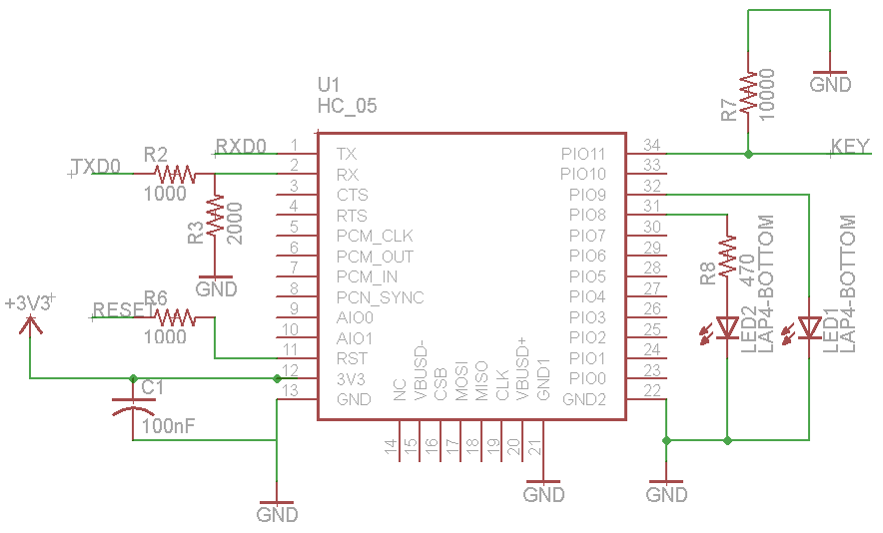
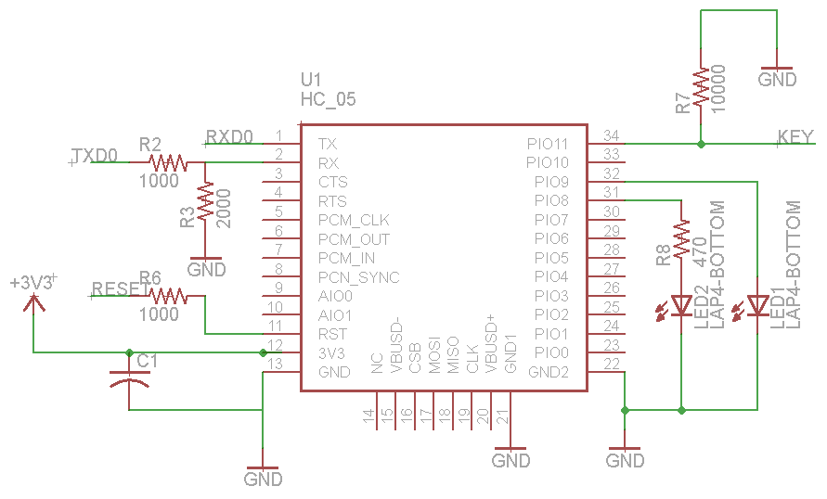
HC-05 Bluetooth Module

Slide 24
Mobile Application
User Input
Movement and Speed Control
Button
Tilt
Switching Modes
Configure boundaries
Settings

Slide 25
Audio Output
Ideally will be used to attract the dog to the system
Will play short sound clips
Triggered by the commands received by the collar via Bluetooth (Autonomous Mode)
Triggered by the user in RC mode via mobile application
Potential methods for sound generation
Modified MP3 Clip Player – cheap, doesn't add too much hardware, not a lot of information.
VS1053b - References available, Libraries available, requires more hardware

Slide 26
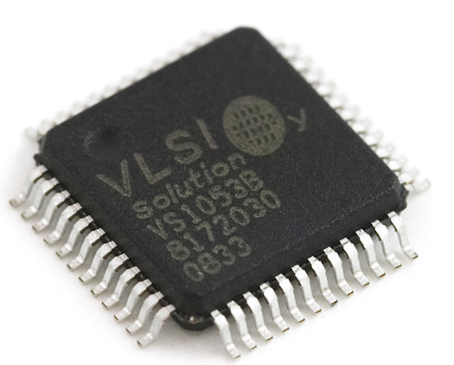
Audio Decoder - VS1053B
High Performance DSP processor core
MP3, AAC, WMA,MIDI files
Low power operation
Receives input bitstream through the SPI bus
Bass ,treble, and volume controls
Shield available for testing

Slide 27
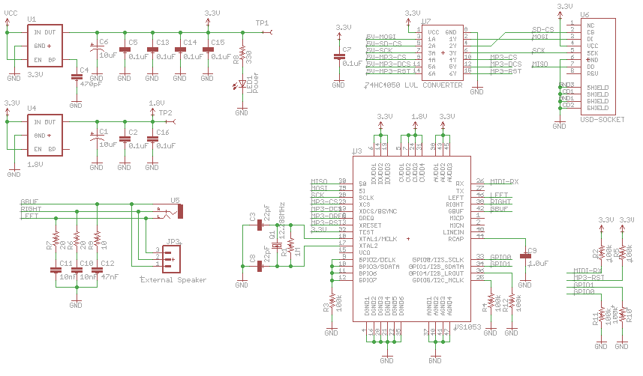
Audio Output – Schematic

Slide 28
Audio Output – Schematic
VS1053B – Audio Decoder

Slide 29
Audio Output – Schematic
MicroSD card

Slide 30
Audio Output – Schematic
External
Speaker
Connection

Slide 31
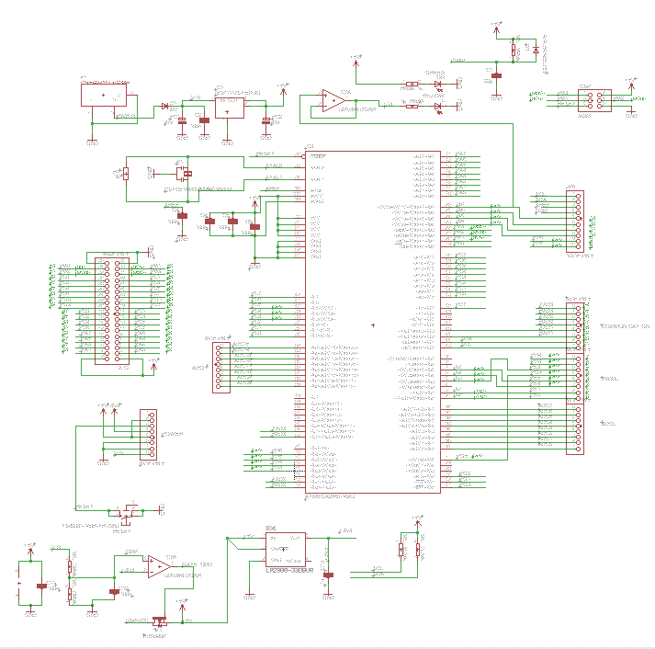
Ball Schematic - MCU

Slide 32
Ball Schematic - MCU
ATmega2560

Slide 33
Ball Schematic - MCU
UART Ports

Slide 34
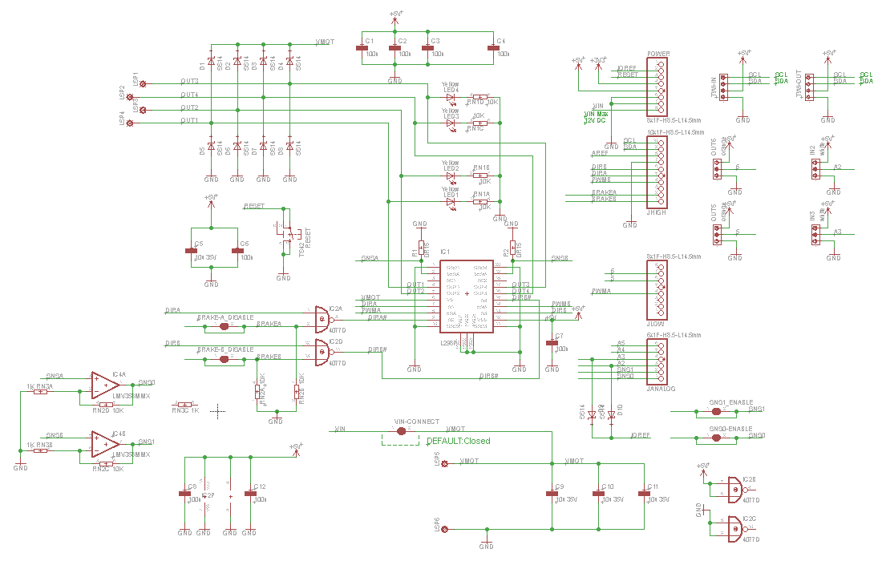
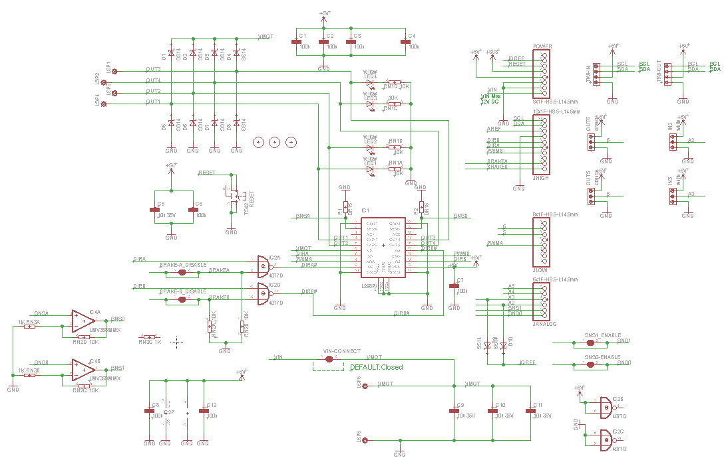
Ball Schematic – Motor Driver

Slide 35
Ball Schematic – Motor Driver
L298P – Motor Driver

Slide 36
Ball Schematic – Motor Driver
MCU Input Ports

Slide 37
Ball Schematic – Motor Driver
12 Volt Battery

Slide 38
Microcontroller
Name | Atmega2560
Clockspeed | 16 MHz
Flash | 256KB
GPIO | 54 Digital, 16 Analog
6 pins for serial (3 total interfaces)
11 channels for 8-bit PWM

Slide 39
Puppy Pal Software
C++
GNU Make / avr-g++ / avrdude
No STL
Limited DMA

Slide 40
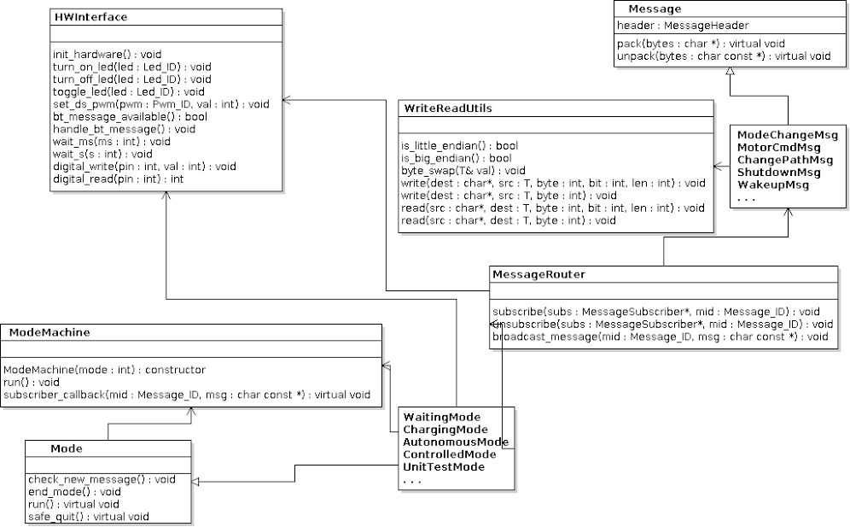

Slide 41
Puppy Pal Software
3 Major aspects
Messaging
Modeing
Interfacing hardware

Slide 42
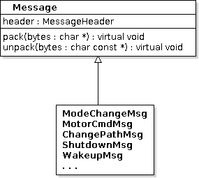
Puppy Pal Software
Messaging
Not specific to Puppy Pal
How all components communicate with each other
Contain data fields specific to the message
Each message knows how to pack/unpack itself
Directed to appropriate module through the MessageRouter

Slide 43
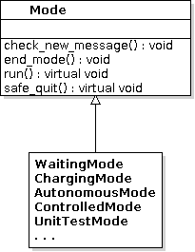
Puppy Pal Software
Modeing
Modes define how the system is operating
controlled by phone, autonomous, waiting for input, ...
Essentially the “forever” loop of the software
The ModeMachine starts, runs and ends modes
subscribes to mode change messages

Slide 44
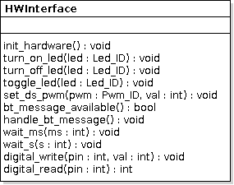
Puppy Pal Software
Interfacing Hardware
Singleton that provides a global access point to all the hardware
turning LEDs on and off
setting duty cycle for PWM pins
writing to GPIO pins
checking for and handling incoming Bluetooth messages

Slide 45
Dog Collar Software
Continuously checks accelerometer values
When values are past a threshold, sends a message to the Puppy Pal that it should turn on
moar

Slide 46
Autonomous Control
A few different ideas tossed around
Location sensing and pathfinding with IR, WiFi, GPS
Not enough information, unreliable, large error margins
Image recognition on the Puppy Pal
Physical space constraints, code size constraints

Slide 47
Autonomous Control
Finally settled with Xbox Kinect
Pros
Powerful, easy to use, acts as an overseer,
Cons
Requires the Kinect, requires Windows machine

Slide 48
User Control
Finally settled with Xbox Kinect
Pros
Powerful, easy to use, acts as an overseer,
Cons
Requires Windows machine, NEED OTHERS

Slide 49
Location Detection
Kinect
Additional Hardware
Strong Performance
Limited Range
Embedded or Desktop OpenCV
Both require additional hardware
Embedded requires more processing power
Desktop requires additional hardware
GPS
Signal strength and accuracy issues when in buildings and urban areas
Limited accuracy

Slide 50
Motion and Proximity Sensing of the Dog
The motion and proximity sensing will be handled separately
Motion detection will be accomplished by a collar worn by the dog containing an accelerometer and Bluetooth communications system.
This allows us to determine if the dog wakes up outside of the play area and will signal the ball to attempt to bring the dog into the play area using sounds.
ADXL362 digital 3-axis accelerometer for ease of prototyping using an available breakout board
Proximity sensing will be accomplished by the Kinect and a laptop on the Base Charging Station and locations transmitted from to the ball via Bluetooth.

Slide 51
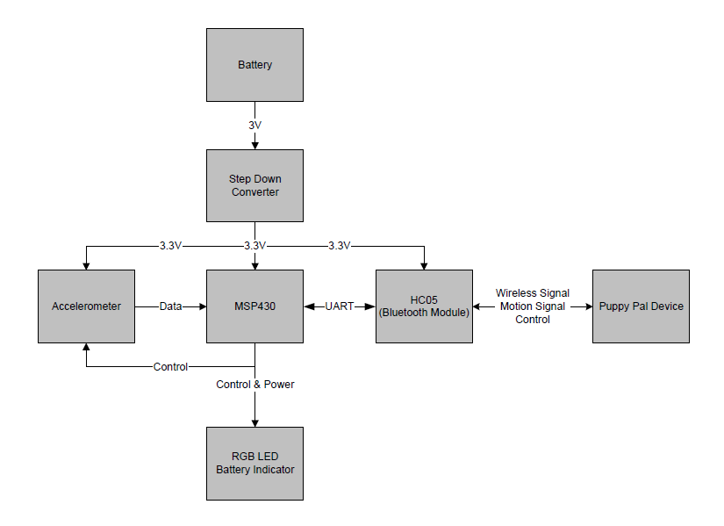
Collar Block Diagram

Slide 52
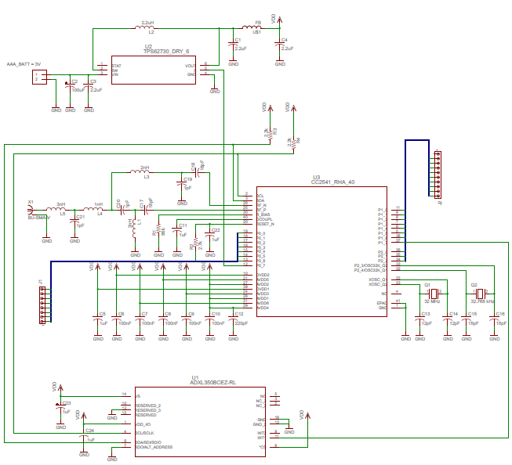
Collar Schematic
Passive: 33
Active: 3

Slide 53
Power and Charging
Ball will be powered by a 12V NiMH Battery, not yet selected
Depends upon testing, use measured power consumption to calculate battery requirements to meet battery life specification
The Base Charging Station will be powered by a standard 120V outlet
Stepped down to 5V and transmitted wirelessly from base station to ball
Transmitter: BQ500211A
Input 5V DC at 2A maximum
Receiver: BQ51013B
Output 5V DC at 1A maximum
Expected wireless power transfer efficiency of 60%

Slide 54
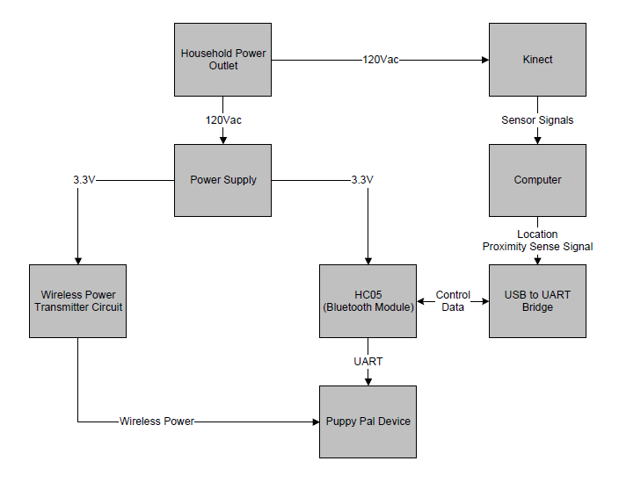
Base Charging Station Block Diagram

Slide 55
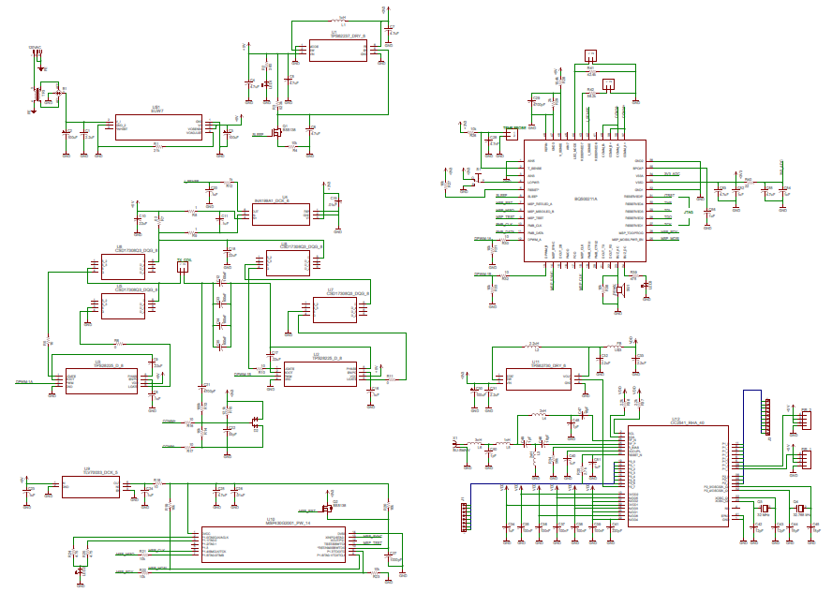
Base Charging Schematic
Passive: 120
Active: 18

Slide 56
PCB
4 Layer Design Required
Component Layer, Ground Layer, Routing Layer, Ground Layer
Utilize existing designs from Arduino to minimize design work
Design using Altium, Eagle freeware board size too small
Using 4PCB’s $66.00 4 layer student deal
Try to fit full project on the maximum 30 square inch board

Slide 57
Work Distribution
 | Marshall Smith | Cameron Riesen | Afzal Shafi | Anson Contreras
Mechanical Design | x |  | x | ●
Motor Control |  | x |  | ●
Android Application |  | ● | x
Communication |  | x | ●
Location Detection | x | ●
Motion/Proximity Sensing | ● | x |  | x
PCB | x |  | ●
Power System | ● |  |  | x
Embedded Software |  | ●
● - Key Responsibility | x – Contribution

Slide 58
Project Progress

Slide 59
Budget – Total
Component | Quantity | Price
Arduino Motor Shield | 1 | 26.56
Ball Enclosure | 1 | 10.99
Arduino Mega 2560 | 1 | 15.00
Bluetooth Module(s) | 5 | 20.00
DC Motor | 1 | 5.95
DC Motor2 | 1 | Owned
Kinect | 1 | Owned
Android Device | 1 | Owned
PC | 1 | Owned
PCB | 1 | 66.00
Accelerometer | 1 | 14.95
Audio System | 1 | 10.00
Misc. Mechanical Parts | 1 | 30.00
Misc. Electrical Parts | 1 | 20.00
12 V Battery | 1 | 40.00
Total | 17 | 259.45
Total Spent | 11 | 78.50

Slide 60
Issues
Location subsystem
Kinect greatly increases the hardware requirements for this project (Kinect and Computer)
GPS signal will suffer greatly indoors, and may completely lose connection
OpenCV also greatly increases the hardware requirements (Camera and Computer or high performance microcontroller)
Mechanical subsystem
Minimal experience, minimal documentation on similar projects

