Slide 1
Secured-E-Key
Group 11
Sheldon Johnson EE – Enjolie Morales EE
Shawn Gangasingh EE – Saint-Surin Paul EE
UNIVERSITY OF CENTRAL FLORIDA

Slide 2
Projects Goals
Global accessibility to a device
Wireless communication controls restricted to user and device
Ensure complete reliability of all components without any instances of failure
Create at least two separate methods for user entry
Overall low maintenance for the long term

Slide 3
Motivation for the Project
Device applicable to the current market place
A project people can instantly relate to but be improved
Focus on hardware and software security
Modes of secure communication not easily infiltrated by outsiders
To graduate

Slide 4
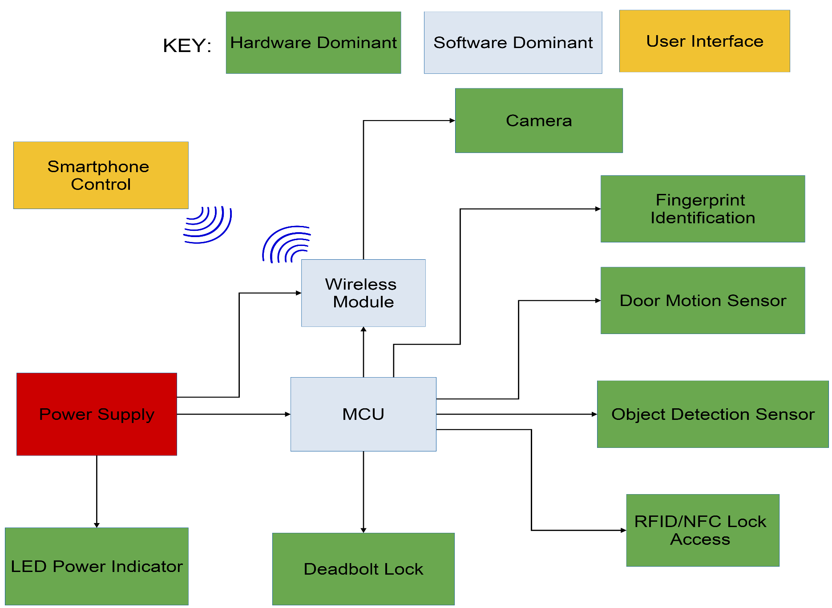
Project Block Diagram

Slide 5
Specifications and Requirements
RFID/NFC technology for easy entry
Sensors to detect presence of moving objects
Detect objects only within 6 feet
Snap a picture to send to user
Lock and unlock the device from any location wirelessly with a smartphone
An isolated power source to last at least 3 months
Easy and simple user interface

Slide 6
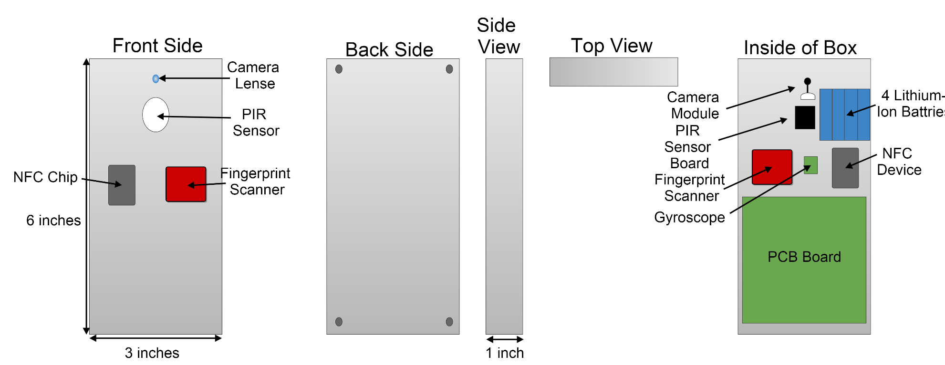
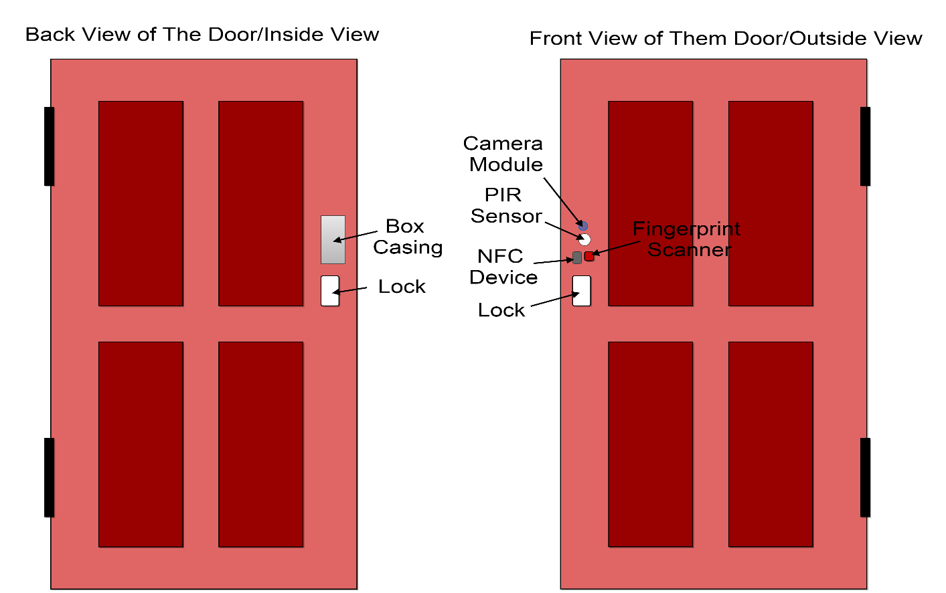
Secured-E-Key Design Model

Slide 7
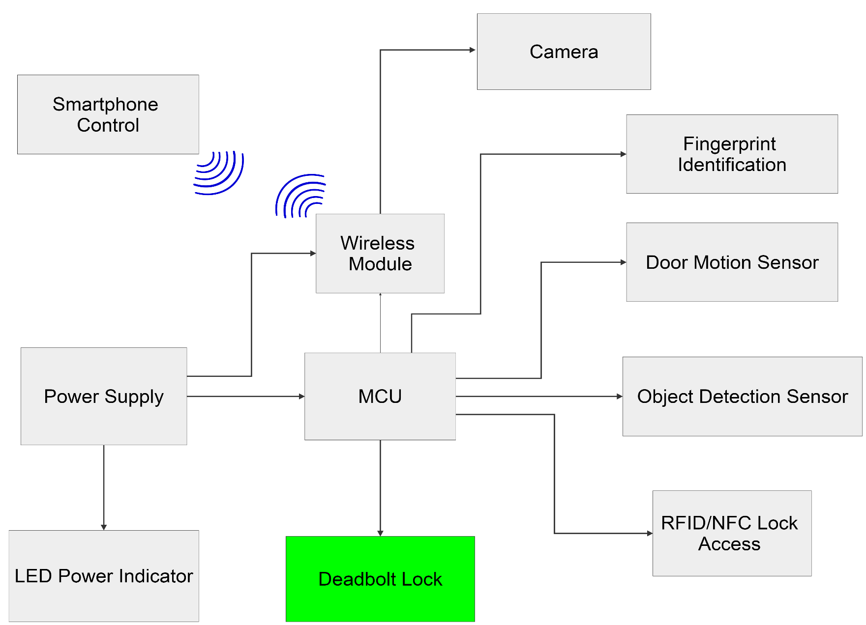
Motorized Electric Deadbolt

Slide 8
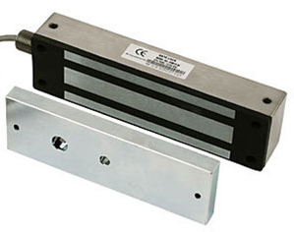
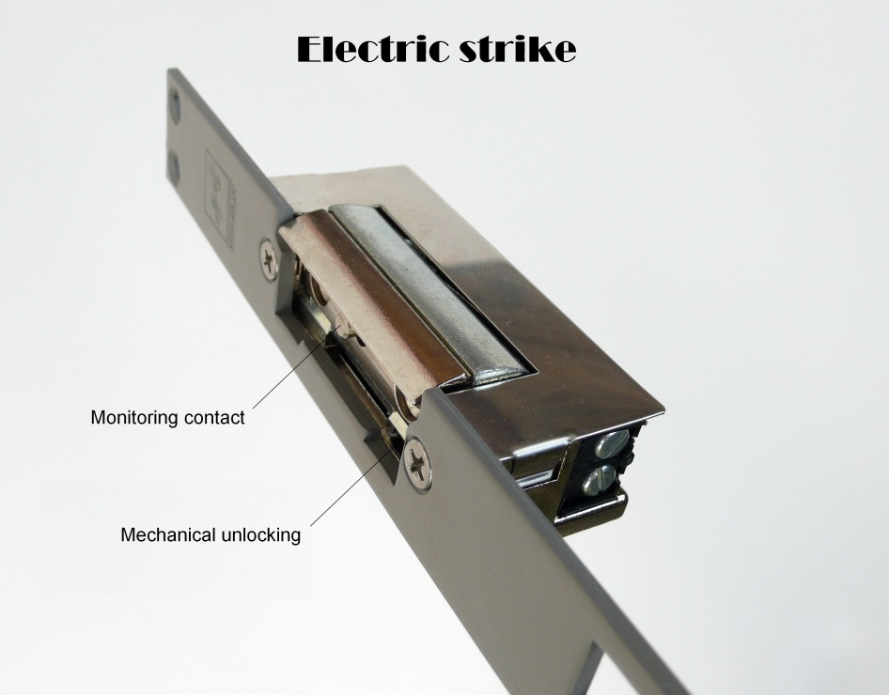
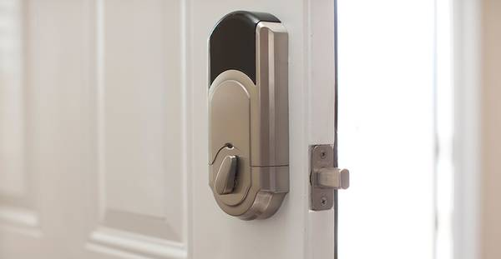
Types Of Electric Door Lock
Magnetic lock
Electric Strike
Motorized Electric Deadbolt
Magnetic lock Electric Strike Motorized Electric Deadbolt

Slide 9
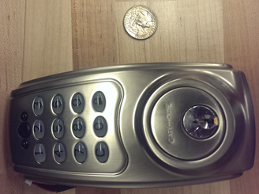
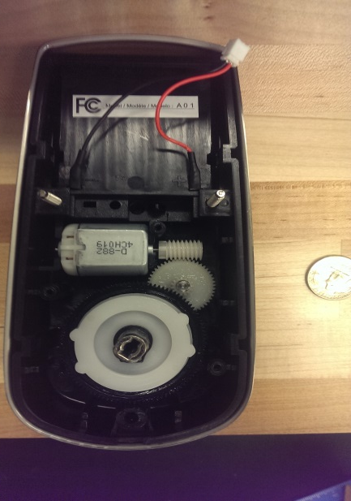
Door Lock System
Specifications | Morning Industry Remote Electronic Deadbolt-QF-01P | Diax MVM Motorized Electric Rim Lock | The Gatehouse Electronic Motorized Deadbolt
Outer Size | 5.75’’Hx3.25’’Wx0.25’’D | 2.75’’Hx4.5’’Wx1.25’’D | 6.75’’Hx3.5’’Wx1.15’’D
Inner Size | 5.75’’Hx3.25’’Wx1.75’’D | 3.78’’Hx4.95’’Wx1.65’’D | 8.25’’Hx4.0’’Wx1.4’’D
Operating Voltage | 6 V | 12 V | 6 V
Bolt Type | Sgl Cyl Deadbolt | Sgl Cyl Deadbolt | Sgl Cyl Deadbolt
Height | 5.25’’ | 3.78’’ | 8.25’’
Door Thickness | 1-3/8’’ to 1-3/4’’ | 1-3/5’’ to 1-2/5’’ | 1-3/8’’ to 1-3/4’’
Projection | 1.25’’ | 0.72’’ | 1.4’’
Price | $ 169.99 | $ 65.88 | $ 64.00

Slide 10
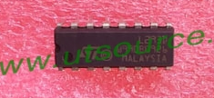
Lock system implementation
The lock will operate to lock and to unlock the door.
The microcontroller will send the appropriate command to operate the lock.
To lock or unlock the door, we will use a driver that can turn the motor clockwise or counterclockwise.
The driver that will be utilized is the L293 D.
Specifications of L293D Driver
Operating voltage | 4.5 V to 36V
Op. Temperature | 0 C to 70 C
Power Dissipation | 2.075 W
Output Voltage | 2.3 V to 7V

Slide 11
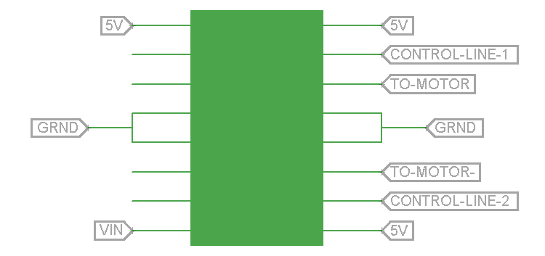
Lock system Implementation
Pins 1, 9 and 16 will be connected to a 5V pin from the microcontroller
Pins 4, 5, 12 and 13 will b e connected to the ground.
Pin 8 will receive 5 V directly from the power source.
Pins 10 and 15 are the control line from the microcontroller.
Pins 11 and 14 will be connected to the motor.

Slide 12
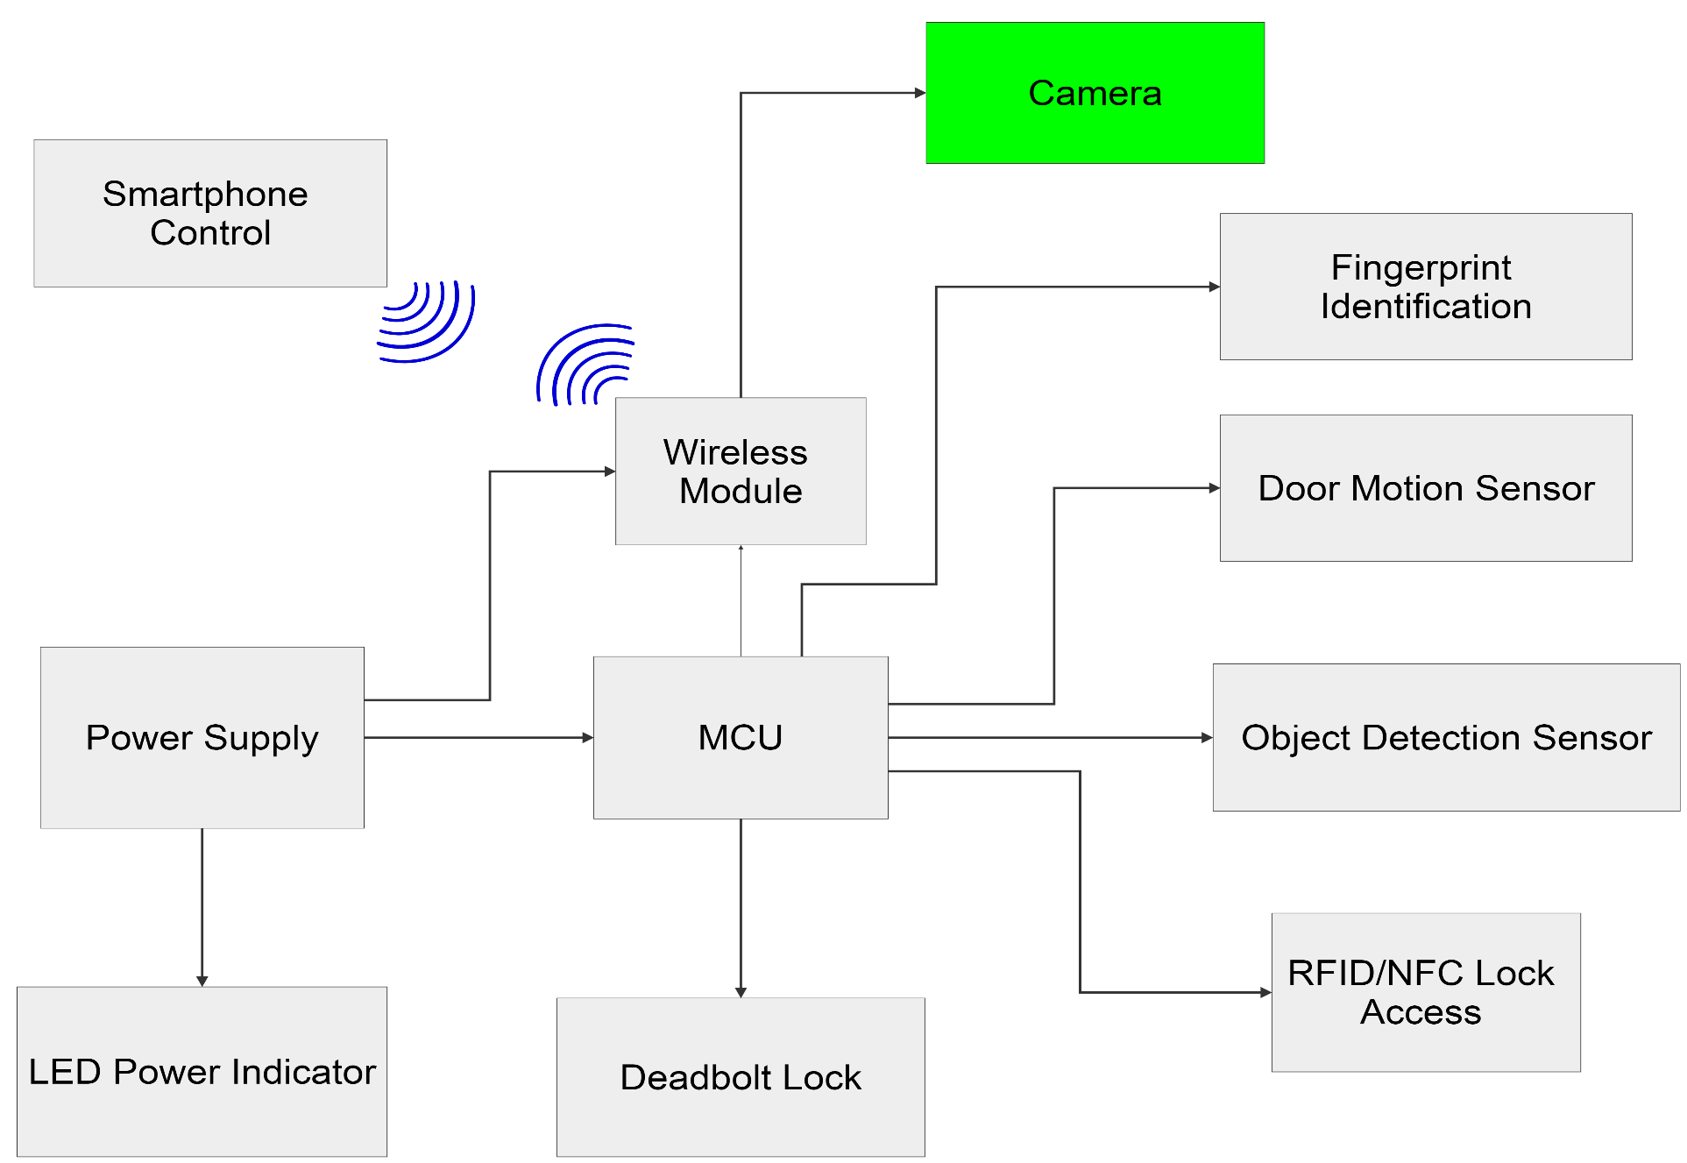
Motorized Electric Deadbolt

Slide 13
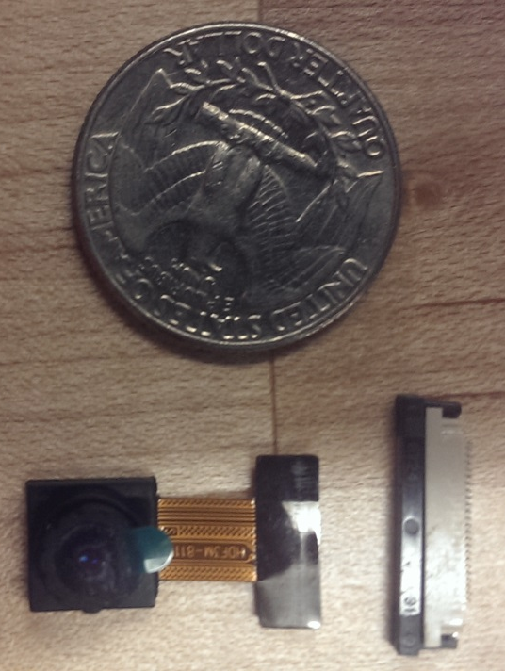
Camera Module
Specifications | TTL Serial JPEG Camera with NTSC Video | LW-MINI110 | OV2640FSL 2MP MegapixelUXGA
Resolution | 640 x 480 | 520 TV Lines | 2 MP UXGA
Operating Voltage | 5 V | 3.3 to 6 V | 3.0 V
Operating Current | 75 mA | 75mA | 46mA
Pixel size | 5.6 um x 5.6 um | 3.4 um x 3.4 um | 2.2um x 2.2um
Op. Temperature | -10 C to 45 C | -20 C to 50 C | -30 C to 70 C
Lens Size | ¼’’ | 1/3’’ | ¼’’
SNR | 45 dB | 48 dB | 40 dB
Price | $ 39.95 | $ 28.80 | $ 20.00

Slide 14
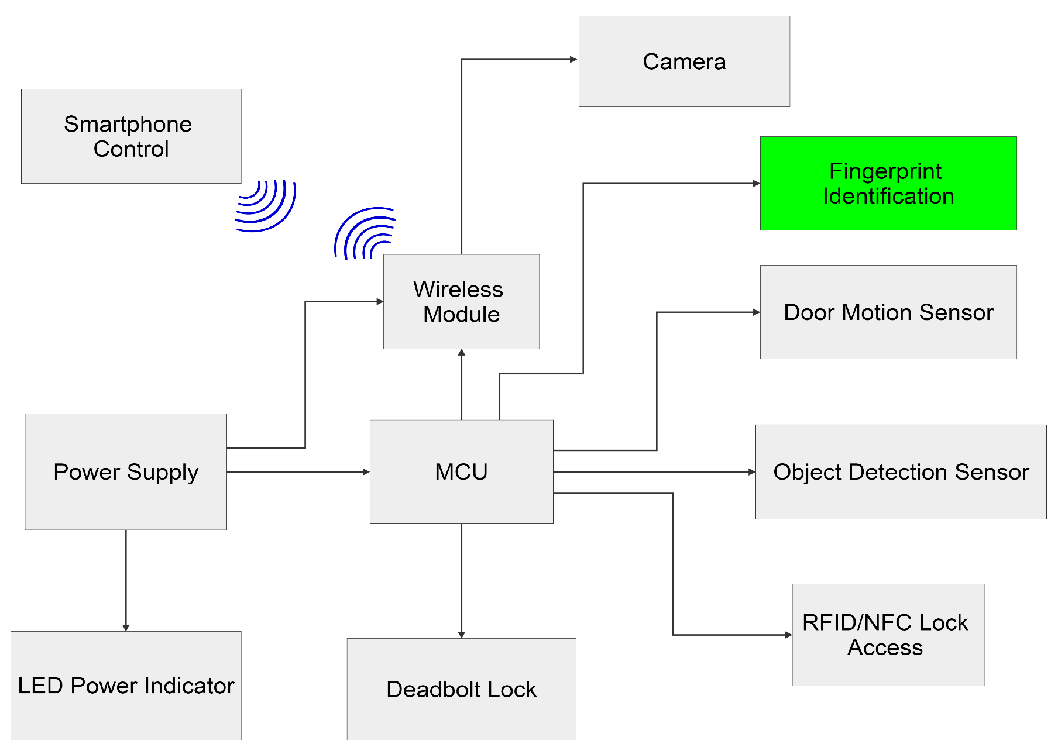
Fingerprint Scanner

Slide 15
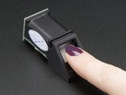
Fingerprint scanner
Specifications | Adafruit Fingerprint sensor | GT-511C1R | EikonTouch 710
Size | 56 x 20 x 21.5mm | 37 x 17 x 9.5 mm | 84 x 34 x 14 mm
Operating Voltage | 3.6 to 6.0 V | 3.3 to 6.0 V | 5 V
Operating Current | 120 mA | < 130mA | 120 mA
Fingerprint time | <1.0 second | <1.5 second | <1.0 second
False Acceptance Rate | <0.001% | <0.001% | <0.001%
Security Level | 3 | 3 | 3
Working Temperature | -20 C to 50 C | -20 C to 60 C | 0 C to 40 C
Price | $ 49.95 | $ 31.95 | $ 119.00

Slide 16
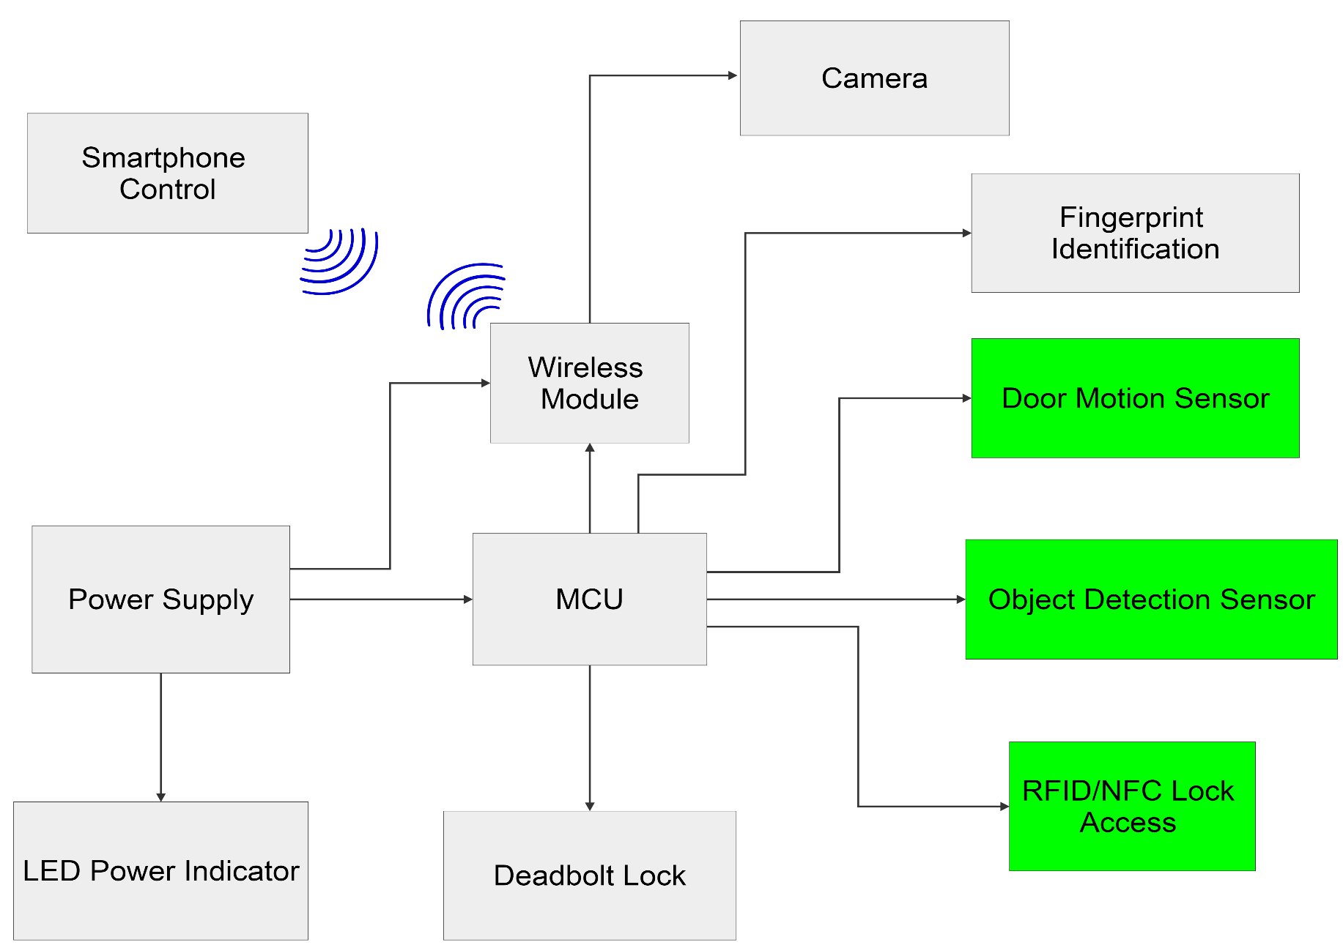
Other Sensors

Slide 17
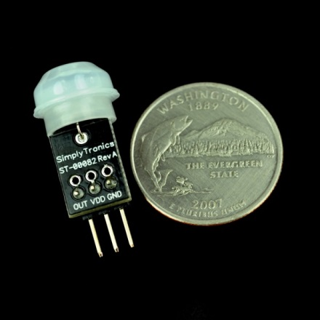
PIR SENSOR
Product | Parallax PIR Mini Sensor
Size | 29.5 x 12.5 x 12.5 mm
Detection Range | 100°
Operating Voltage | 3.3 V
Operating Current | 28 μA
Price | $9.99
Commonly used in security applications (i.e. burglar alarms, outdoor lights)
Single bit high/low output
Detects IR source up to 3.65 m (12 ft)
Sends signal to 3G module to activate the camera to take picture

Slide 18
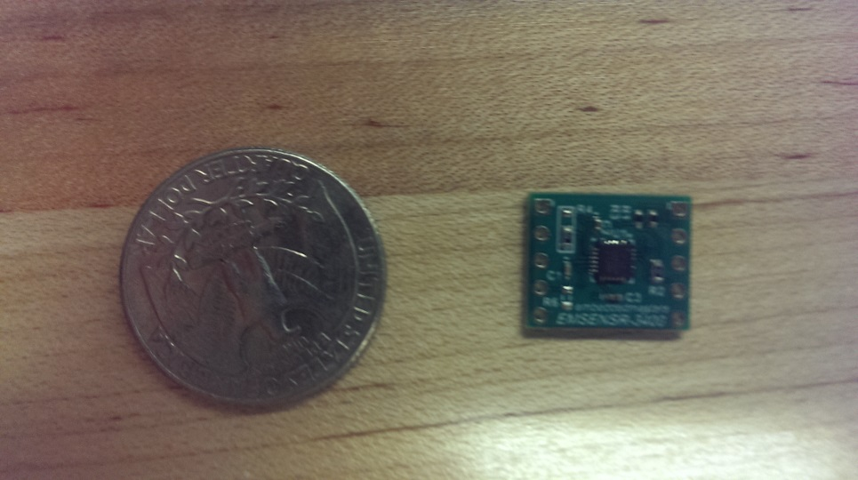
Gyroscope
3 axis Gyroscope
Programmable in Arduino
Used to detect when door is open and unlocked
It would send a signal to microprocessor to determine when to lock again
Product | InvenSense ITG-3400 EB
Size | 1.52 x 1.27 cm
Range | +/- 250 - 2000
Operating Voltage | 1.8 V
Operating Current | 3.2 mA
Price | $19.95

Slide 19
RFID & NFC COMPARISON
Characteristics | RFID | NFC
Frequency | 13.56 MHz in HF (varies in LF, UHF) | 13.56 MHz
Range | Up to 1 m | Up to 10 cm
Communication Modes | Read/write | Read/write Peer 2 Peer Card emulation
Security | Mid | High
Application | Item tracking | Mobile payments, access control
System Components | Reader, Antenna, Tag | May act as both reader and tag

Slide 20
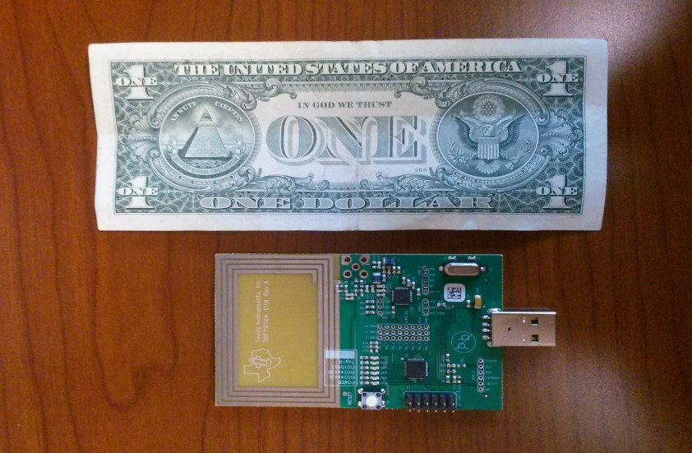
Near Field Communication (NFC)
Product | TRF7970A EVM
Frequency | 13.56 MHz
Modes | reader/writer Peer 2 Peer card emulation
Operating Voltage | 5 V
Range | up to 5 cm
Size | 9 x 5.5 cm
Price | $99.00
Built in Antenna
USB powered to allow interoperability with different devices and applications
Module uses C programming language
Phone use NFC reader/writer App
Offers AES Authentication BoosterPack Plug in Module for secure level encryption

Slide 21
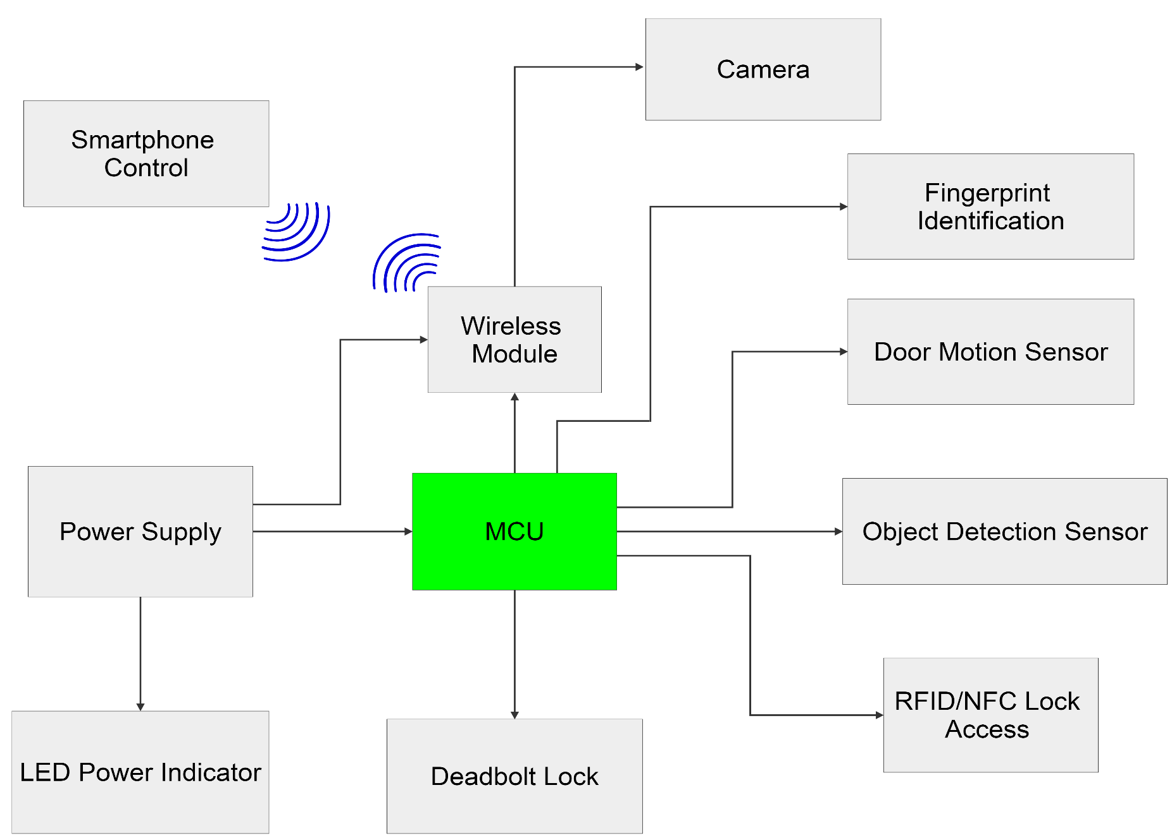
Micro Controller

Slide 22
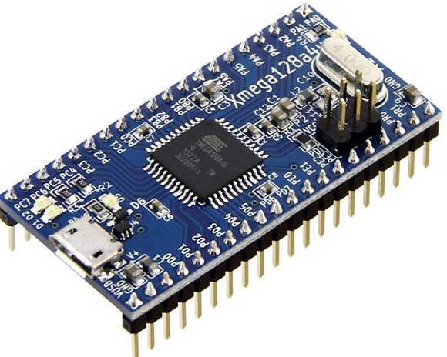
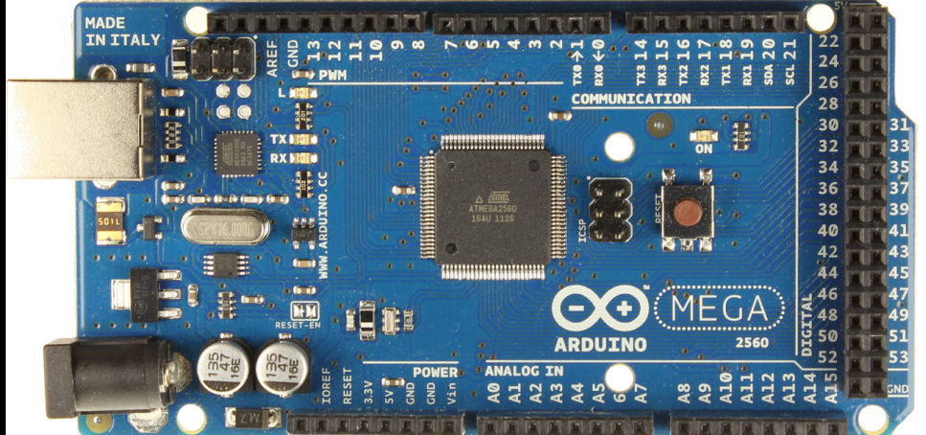
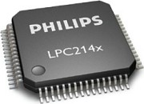
Microcontroller
Microcontroller | CPU Frequency | I/O Pins | UART | SPI | I2C | ADC Channels | Price | Store
ATxmega128A4U | 32MHz | 34 | 5 | 7 | 2 | 12 | $5.16 | Atmel
ATxmega2560 | 16MHz | 86 | 4 | 5 | 1 | 16 | $5.65 | Ebay
LPC2148 | 60MHz | 64 | 2 | 2 | 2 | 14 | $12.50 | Ebay

Slide 23
Software Environment
Software: Arduino Integrated Development Environment(IDE)
Uses “Sketch” for programming the code
Includes a software library called “wiring”
-AVR Power
-AVR Sleep
-AVR IO
Open-source hardware capability
-XmegaDuino
Programming language: C

Slide 24
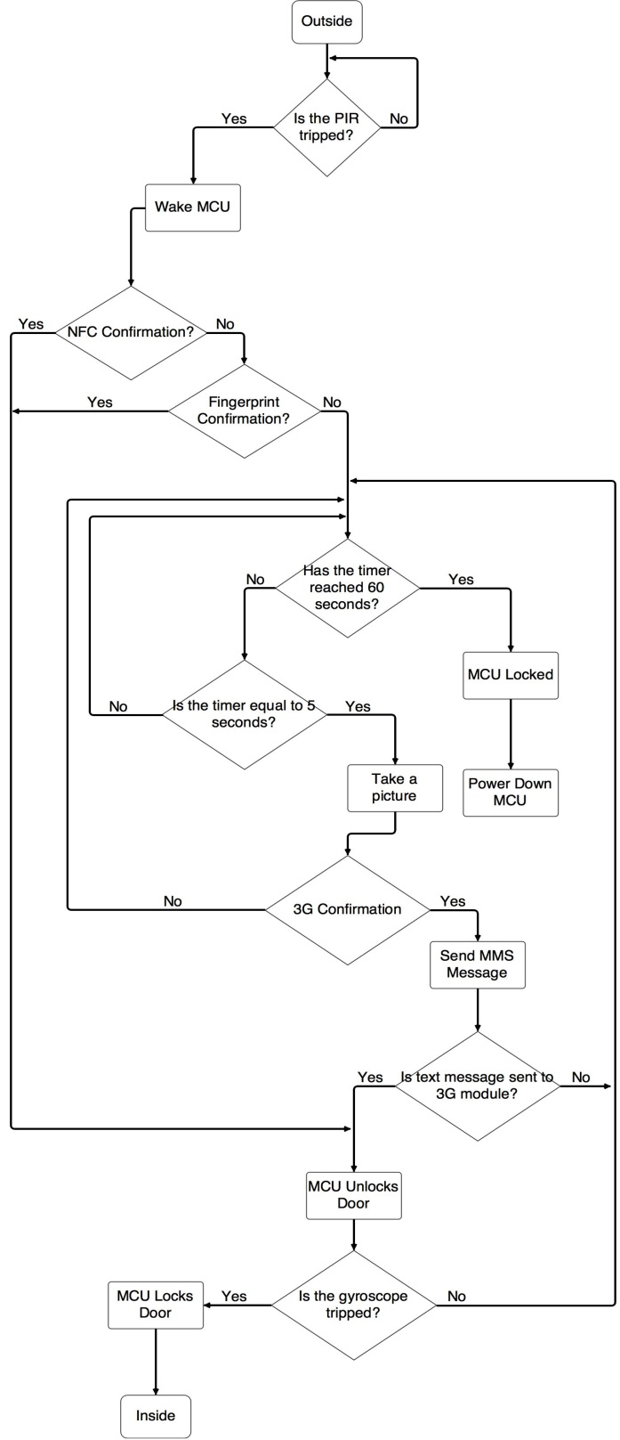
Microcontroller Flow Chart
Uses the PIR sensor to determine if there is a presence
Uses the Gyroscope sensor to determine whether the door is open
A timer is implemented to optimize power consumption.
NFC, 3G and fingerprint scanner are used to determine whether to unlock or keep the door locked.

Slide 25
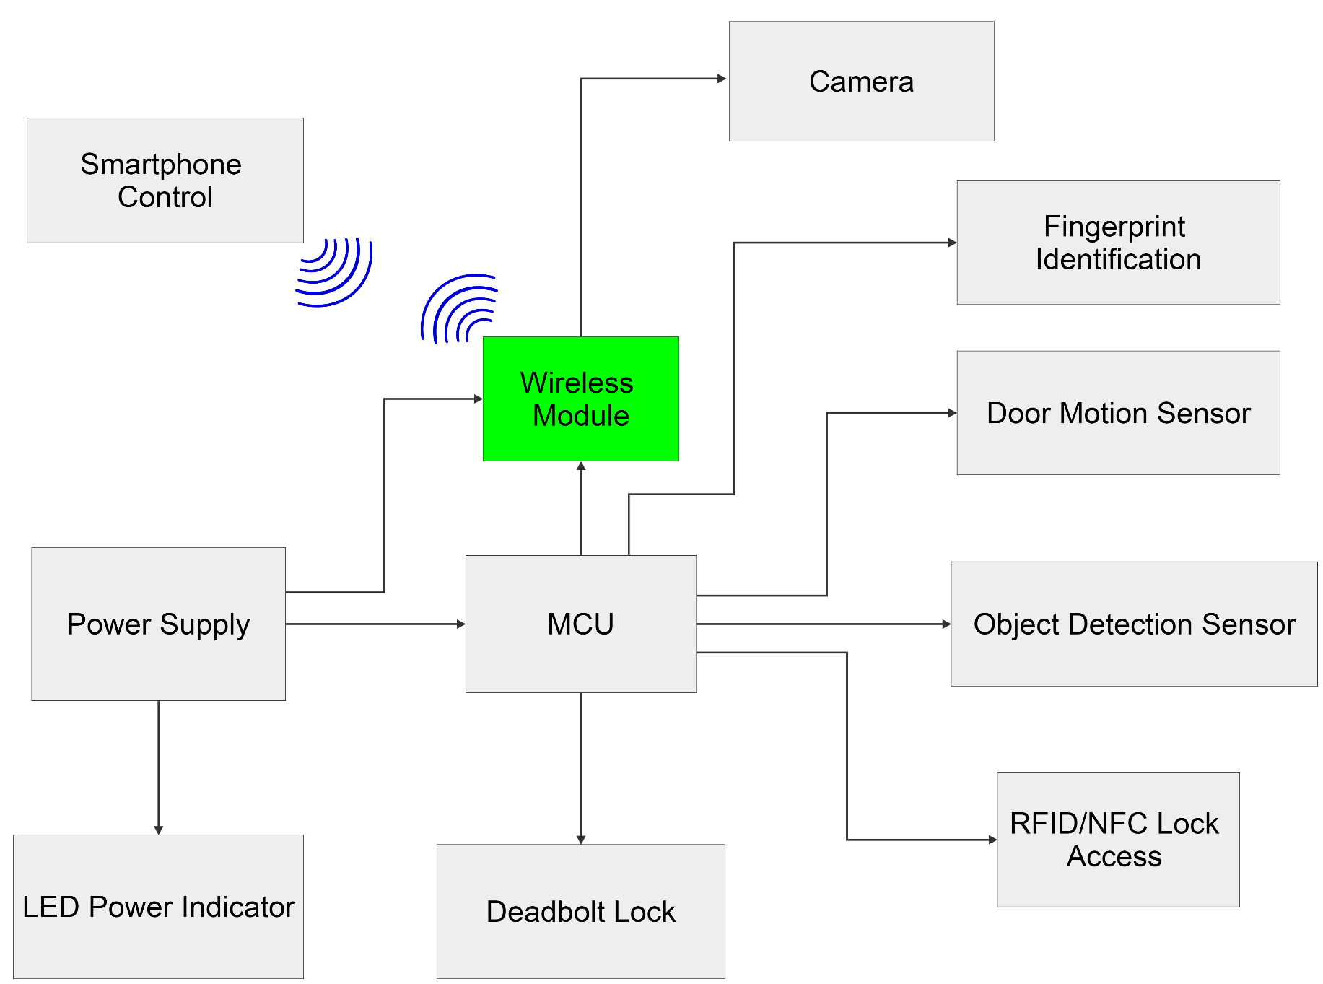
Wireless Module

Slide 26
Wireless Communication Types
Specification | Bluetooth | Wi-Fi | 3G Cellular Network
Data Rate | 2-25 Mbps | 100 Mbps | 3.6 Mbps (DL) / 384 Kbps (UL)
Range | 10cm-100m | 20m-100m | Where Service Permits
Baud Rate | 115200 bps | 115200 bps | 115200 bps
Operating Frequency | 2.4-2.48 GHz | 2.4 GHz | 2.4GHz
Complexity | Medium | High | Medium
Power Consumption | 2.5 mW | 500 mW | 250 mW
Interfacing Method | UART, SPI, I²C | UART, SPI, SDIO, I²C, USB | UART

Slide 27
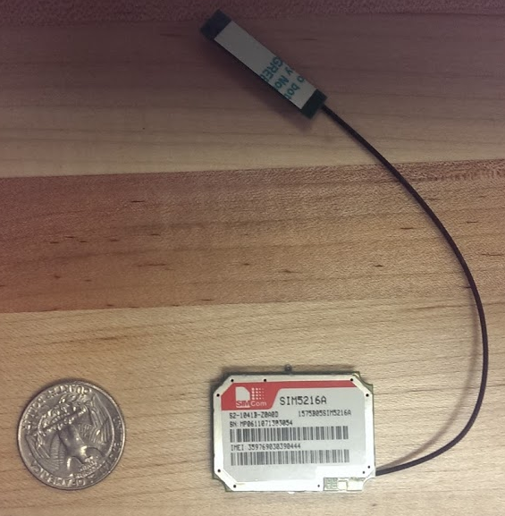
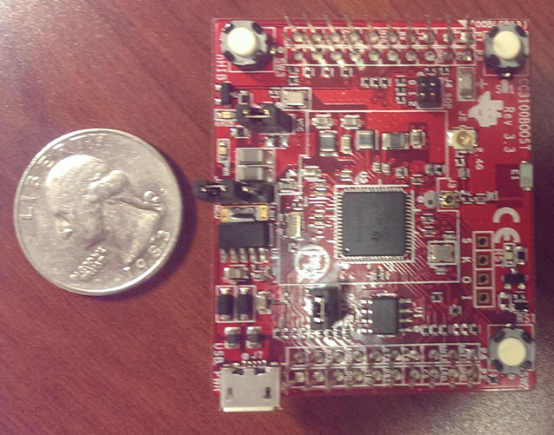
TI CC3100 Wi-Fi Module vs SIM5216A Module
Features | TI CC3100 Wi-Fi Module | SIM5216A Module
Wireless Communication | Wi-Fi | 3G
Supply Voltage | 2.1 to 3.6 V | 3.3 to 4.2 V
Active Current | 450 mA (Maximum) | Typical 580 mA
Hibernation Current (With RTC) | 4 µA | 10 µA
Size & Pin Count | 9 x 9 (mm) – 64 pins | 36 x 26 (mm) – 70 pins
Hardware Sub-Features | None | USIM Card, Audio Interface, 1 I²C, SCCB Interface, 2 GPIO, 4 PCM
Cost | $14.07 (TI.com) | $32.00 (Aliexpress.com)
Applications | Cloud Connectivity Security Systems Home Automation | Telematics Security Solution Tracking Solution
Software | C Programming | AT Commands
IDE | Code Composer Studio | Online AT Command Tester, Arduino IDE

Slide 28
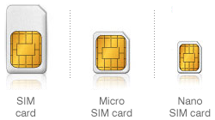
Pros and Cons of 3G over Wi-Fi
Pros
Cons
No need for cloud connectivity software services like IBM Bluemix, Xlively, or Microsoft Azure
Allows for direct communication by SMS and MMS between the SIM5216 module and user’s smartphone
SMS and MMS messages automatically save to hard drive of smartphone instead of cloud database
Automatically archives and organizes SMS and MMS messages in order by date
Simpler interfacing for user
Stops intruders from acquiring user login information to an app as to gain lock access
Supports a TCP/IP network for:
FTP/HTTP/SMTP/POP3
Access to door lock is limited to user’s registered smartphone device
System requires its own SIM card to connect with 3G network
Available 3G service to Secured-E-Key is limited to mobile provider that use same operating frequency bands of the SIM5216A

Slide 29

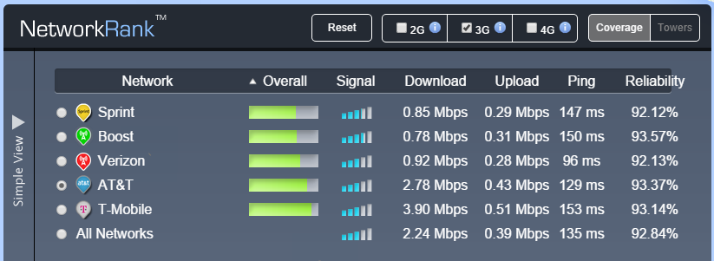


3G Coverage Maps and Provider Comparison
T-Mobile Coverage
AT&T Coverage
Dual-Band: UMTS/HSDPA 850/1900 MHz
Quad-Band: EDGE 1900 MHz
Courtesy of OpenSignal.com

Slide 30
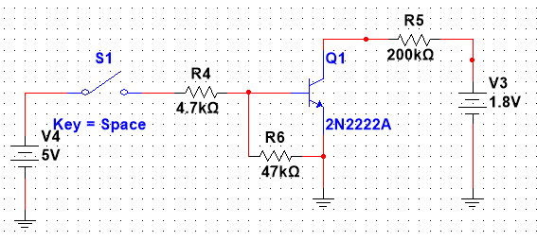
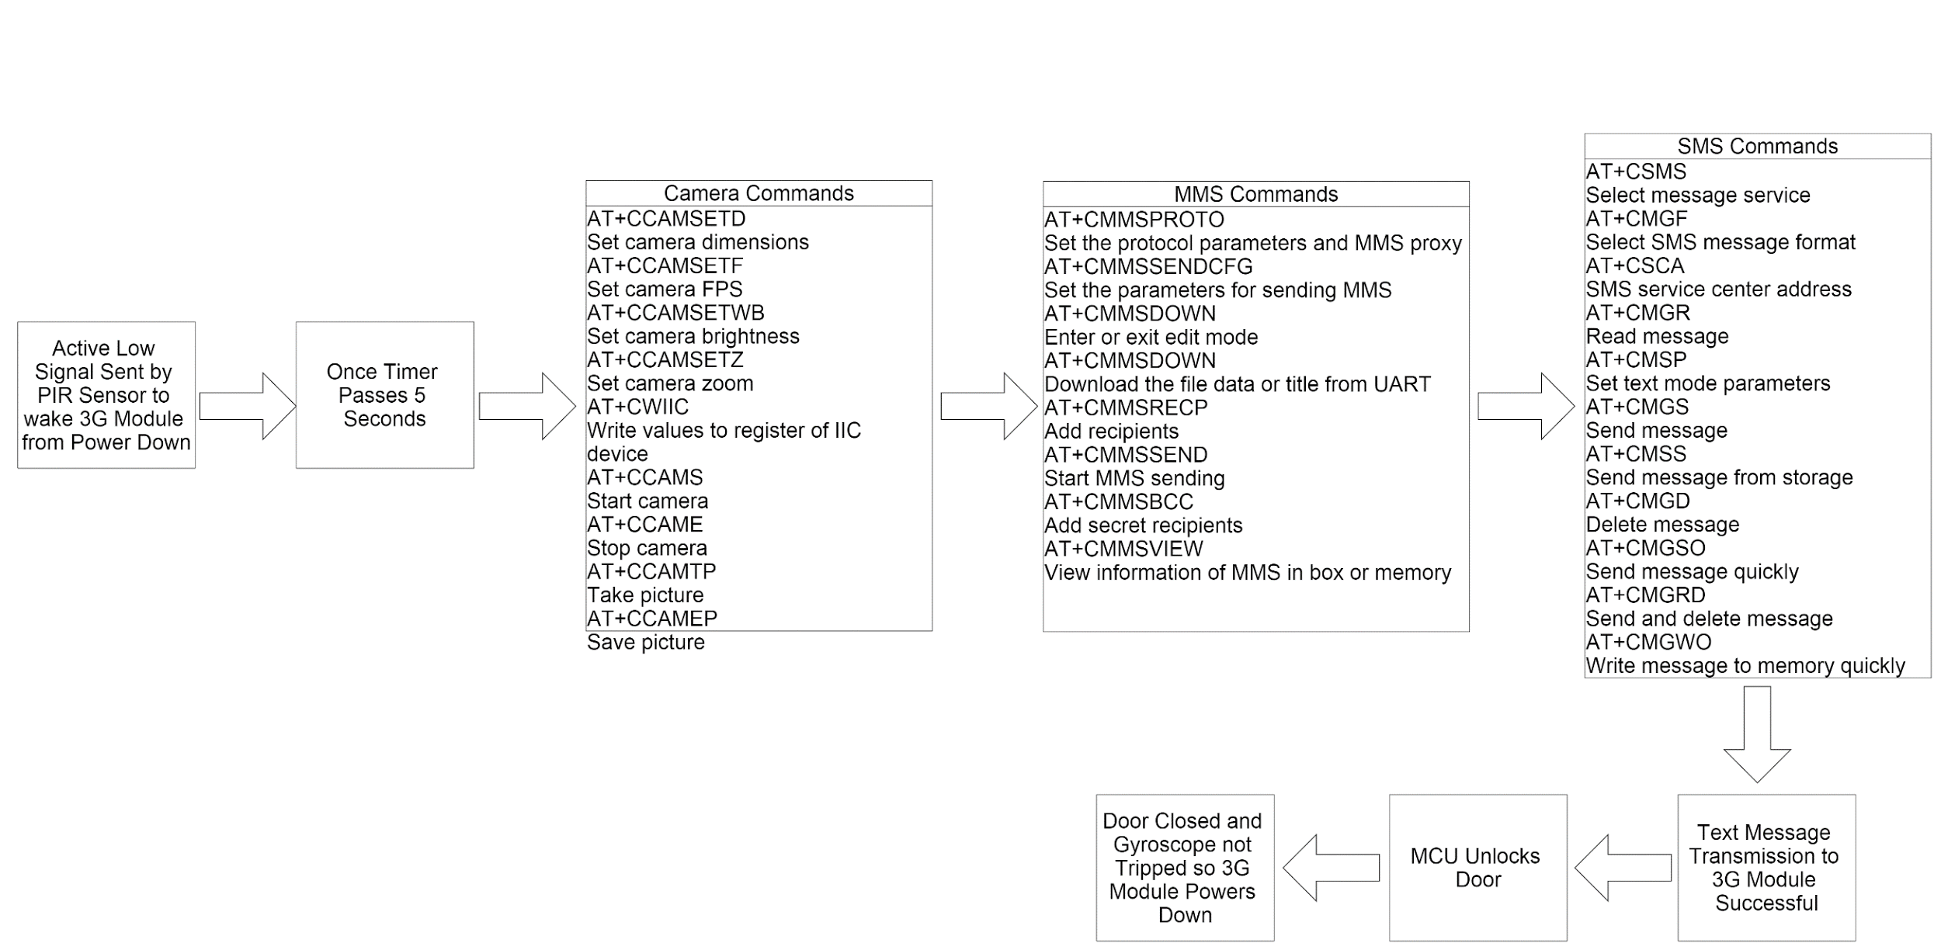
3G Module Software Diagram

Slide 31
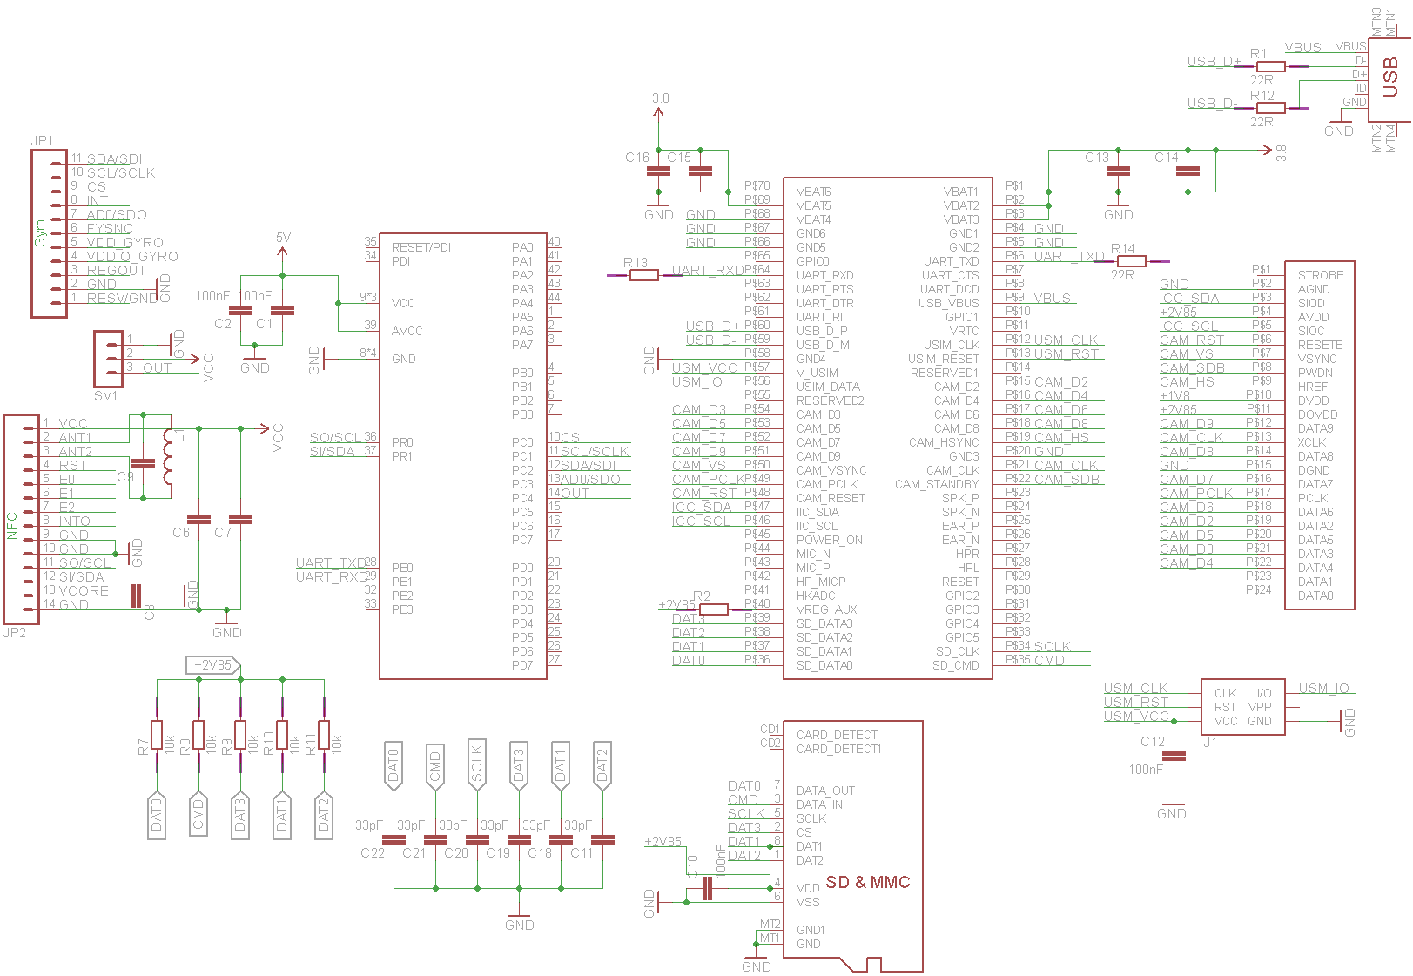
Secured-E-Key Schematic

Slide 32
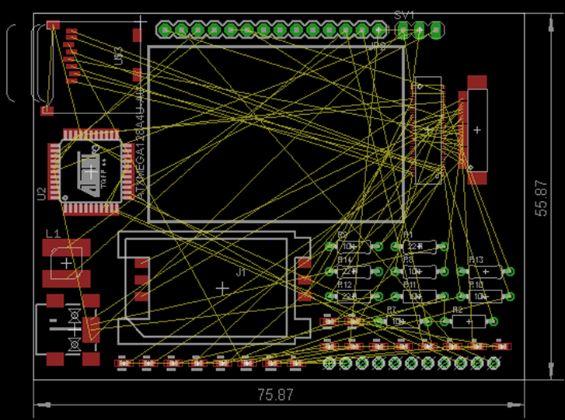
Secured-E-Key PCB Layout

Slide 33
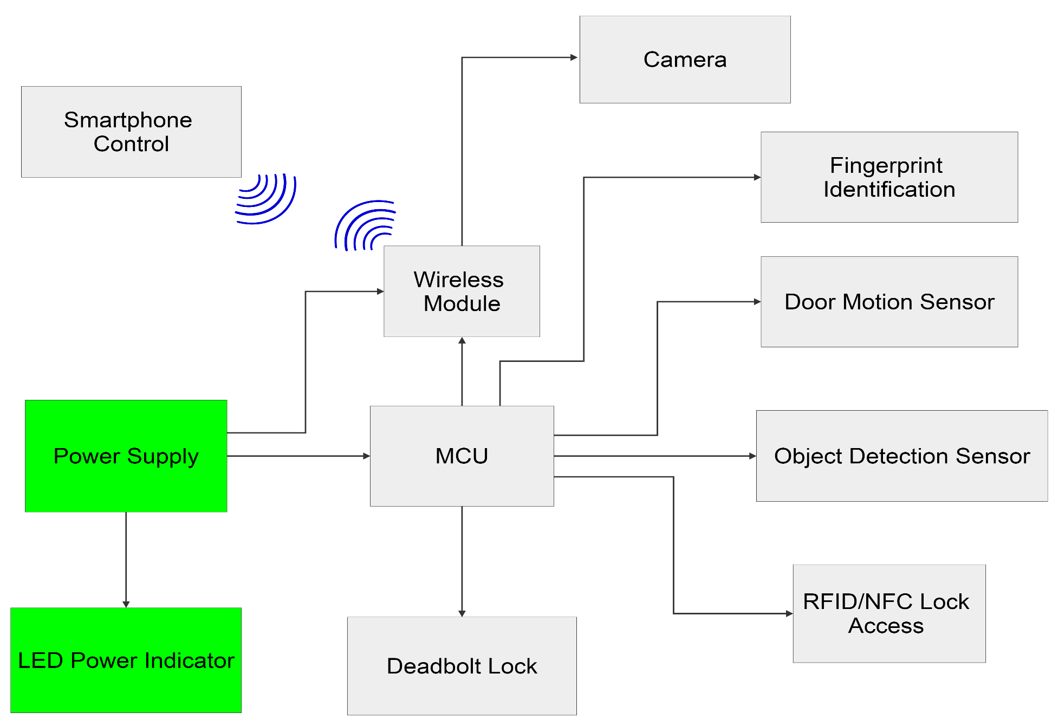
Power Supply

Slide 34
Power Diagram
Battery
5V Regulator
Electric Lock
NFC Module
3.3V Regulator
MCU
PIR
Gyroscope
3G module
Finger Print Scanner
SD module

Slide 35
Power Requirements
Device | Model | Min Input Voltage | Max Input Voltage | Standby Current | Operating Current
Microcontroller | ATxmega128A4U | 1.6V | 3.6V | 4.5uA | 9.6mA
NFC | TRF7970A | 1.8V | 5.5V | .5uA | 130mA
Finger Print Scanner | Adafruit Fingerprint Sensor | 3.6V | 6V | 1mA | 120mA
Gyroscope | ITG-3400 | 1.8V | 3.3V | 1.6uA | 3.2mA
PIR | Parallax | 3V | 15V | 110uA | 28uA
Camera | OV2640FSL 2MP MegapixelUXGA | 1.7V | 3.3V | .6mA | 46mA
Lock | Gatehouse | 5V | 6V | 0 | 500mA
3G | SIM5216e | 3.3V | 4.2V | 10uA | 580mA
Motor Driver | DRV8832 | 2.7V | 6.8V | .3uA | 1.4mA

Slide 36
DC-DC step-down
Two DC-DC will be used to step down the voltage to 3.3V
The regulators must be efficient to optimize power consumption
The maximum output current must be greater than 1A
Voltage Regulator | Regulator Type | Min Input Voltage | Max Input Voltage | Output voltage | Output Current | Price | Store
LM109QML | Linear | 7 | 35V | 6V | 2A | $24.97 | Arrow
TPS62140 | Switching | 3 | 17V | .9V-6V | 2A | $21.40 | Ebay
TPS62173 | Switching | 3 | 17V | .9-6V | .5A | $9.97 | Mouser

Slide 37
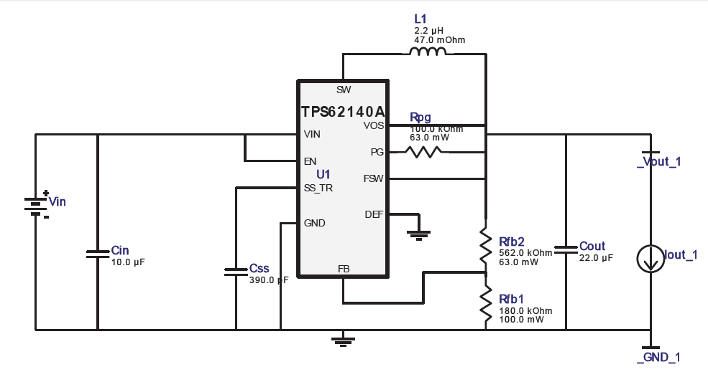
TPS62140A
Referenced from WEBENCH

Slide 38
Battery Types
NiMH “Nickel metal hydride” SunLabz 14500 AA
Pros | Cons
Rechargeable Little memory Loss High drain applications 400-2000 life cycle $3.75 p.u at Amazon Able to produce high currents 2500mAh | Has a memory Effect Toxic chemicals 1.2V cell voltage
Li-ion “Lithium ion” UltraFire TR14500 AA
Pros | Cons
No Memory effect 3.7 cell voltage Quick charge No discharge required | Lower Current drain applications Toxic chemicals 1200mAh $2.25 p.u at Amazon

Slide 39
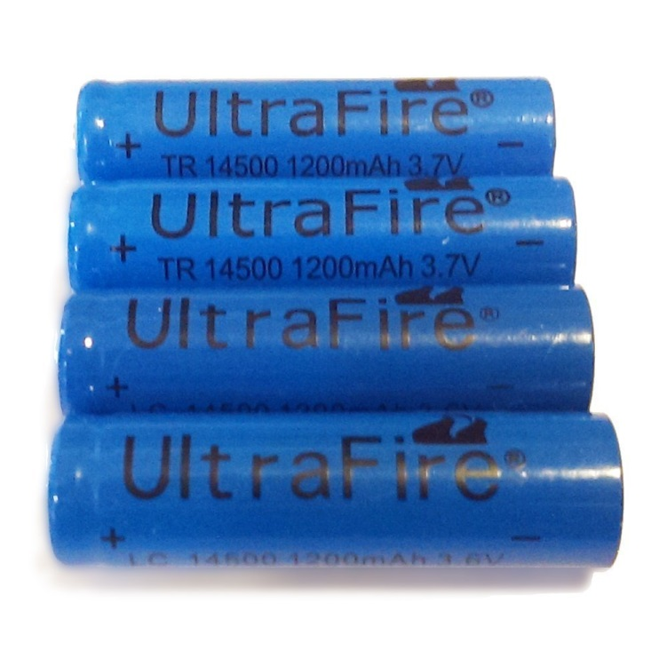
Battery Power Supply
UltraFire TR14500 1200 mAh 3.7V batteries will be used as the power source
Lithium ion batteries were chosen since they have 3 times the charging power compared to NiMH batteries
Using the Gatehouse battery holder, 4 of these batteries will be used
The batteries will be configured in Parallel which will effectively quadruple the Energy Capacity to 4800 mAh

Slide 40
DC-DC step-up
TPS61232DRC
The TPS6127 will be used as the DC-DC step up converter
The 3.7V battery supply will be stepped up to 5V
The booster converter with lithium ion batter will effectively increase the power supply capacity by 33% if 2400 mAh NiMH batteries were used.
Voltage Regulator | Regulator Type | Min Input Voltage | Max Input Voltage | Output voltage | Output Current | Average Efficiency | Price | Store
TPS61232DRC | Switching | .9V | 6.5V | 5 | 1.5A | 91% | $3.30 | TI

Slide 41
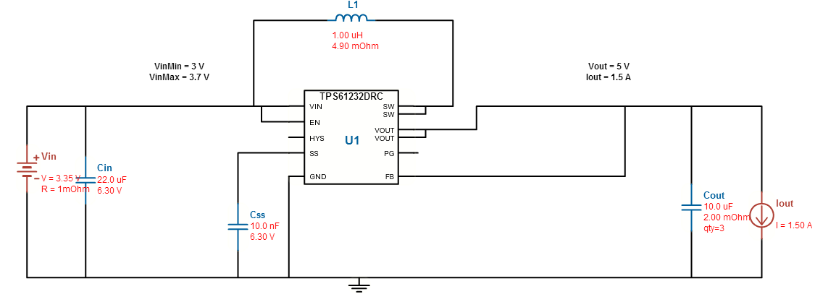
TPS61232DRC Schematic
Referenced from WEBENCH

Slide 42
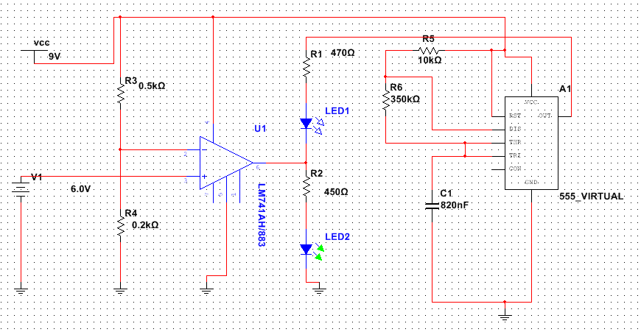
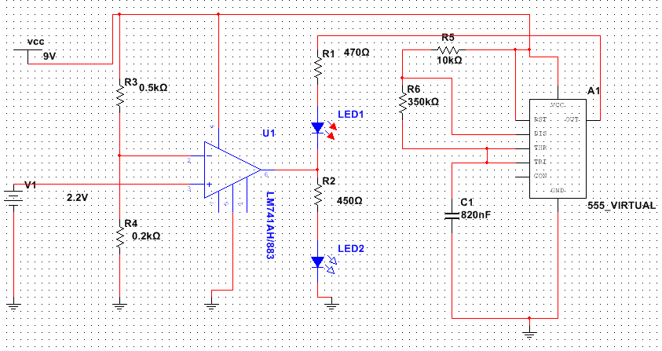
Battery Status
Primarily we were using The LTC2148, and to monitor the battery we were having a voltage comparator with 2 LEDs and a timer.
LM741
CS555

Slide 43
Standards
NFC | ISO/IEC 18092 ISO/IEC 21481
3G | - International Mobile Telecommunications- 2000 (IMT-2000) - TDMA Single‑Carrier (IMT‑SC) - CDMA Multi‑Carrier (IMT‑MC - CDMA Direct Spread (IMT‑DS) - CDMA TDD (IMT‑TC) - FDMA/TDMA (IMT‑FT) - IP‑OFDMA
Gatehouse Electronic Motorized Deadbolt | Graded 2 from ANSI

Slide 44
Work Distribution
Category | Enjolie | Shawn | Paul | Sheldon
PCB Design |  | O |  | X
Wireless Communication | O |  |  | X
Micro Controller | O | X
Power System |  | X | O
Sensors | X |  | O
Project Assembly |  |  | X | O
Primary X | Secondary O

Slide 45
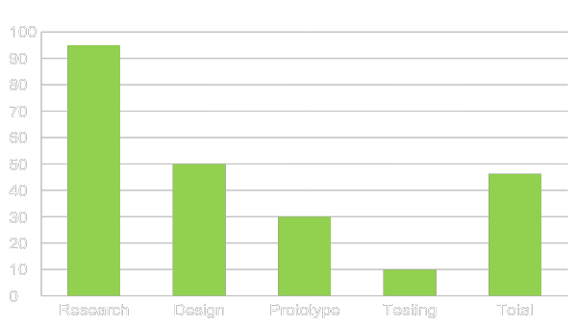
Progress

Slide 46
Immediate Plans
Finish prototyping
Finalize and submit PCB design for manufacturing
Have project casing made
Begin software implementation
Begin project construction

Slide 47
Budget
Parts | Cost
Gatehouse lock | $64.95
Driver L 293D | $2.99
Adafruit Fingerprint scanner | $49.95
LED | $2.99
Gyroscope | $19.95
NFC Module | $99.00
PIR Sensor | $9.99
Micro SD Card | $4.00
Camera 2Mp UXGA | $20.00
TPS 61232 DRC | $3.30
LITHIUM ION BAT. | 4*($ 2.25) = $ 9.00
TPS 62140 A | $21.40
ATxmega 128A4U | $5.16
SIM5216A | $32.00
Wooden Door and Frame | Free
Total | $344.68

Slide 48
Issues
Problem having the NFC to work
Software problem to have the 3G module to work in conjunction with the camera
Transmitting data from 3G modules is good, receiving data is a working progress.

Slide 49

QUESTIONS?

