Slide 1
Secured-E-Key
Group 11
Sheldon Johnson EE – Enjolie Morales EE
Shawn Gangasingh EE – Saint-Surin Paul EE
UNIVERSITY OF CENTRAL FLORIDA

Slide 2
Goals and Objectives
Secured home surveillance via camera and sensors
Secured Identity authentication for user to access home
Wireless communication controls restricted to user phone and lock device
Have two secured methods for home entry
Have minimal maintenance for long term use

Slide 3
Motivation for the Project
Device applicable to the current market place
Create a project that incorporates Home Automation/Access Control
Learn applications on hardware and software security
To graduate

Slide 4
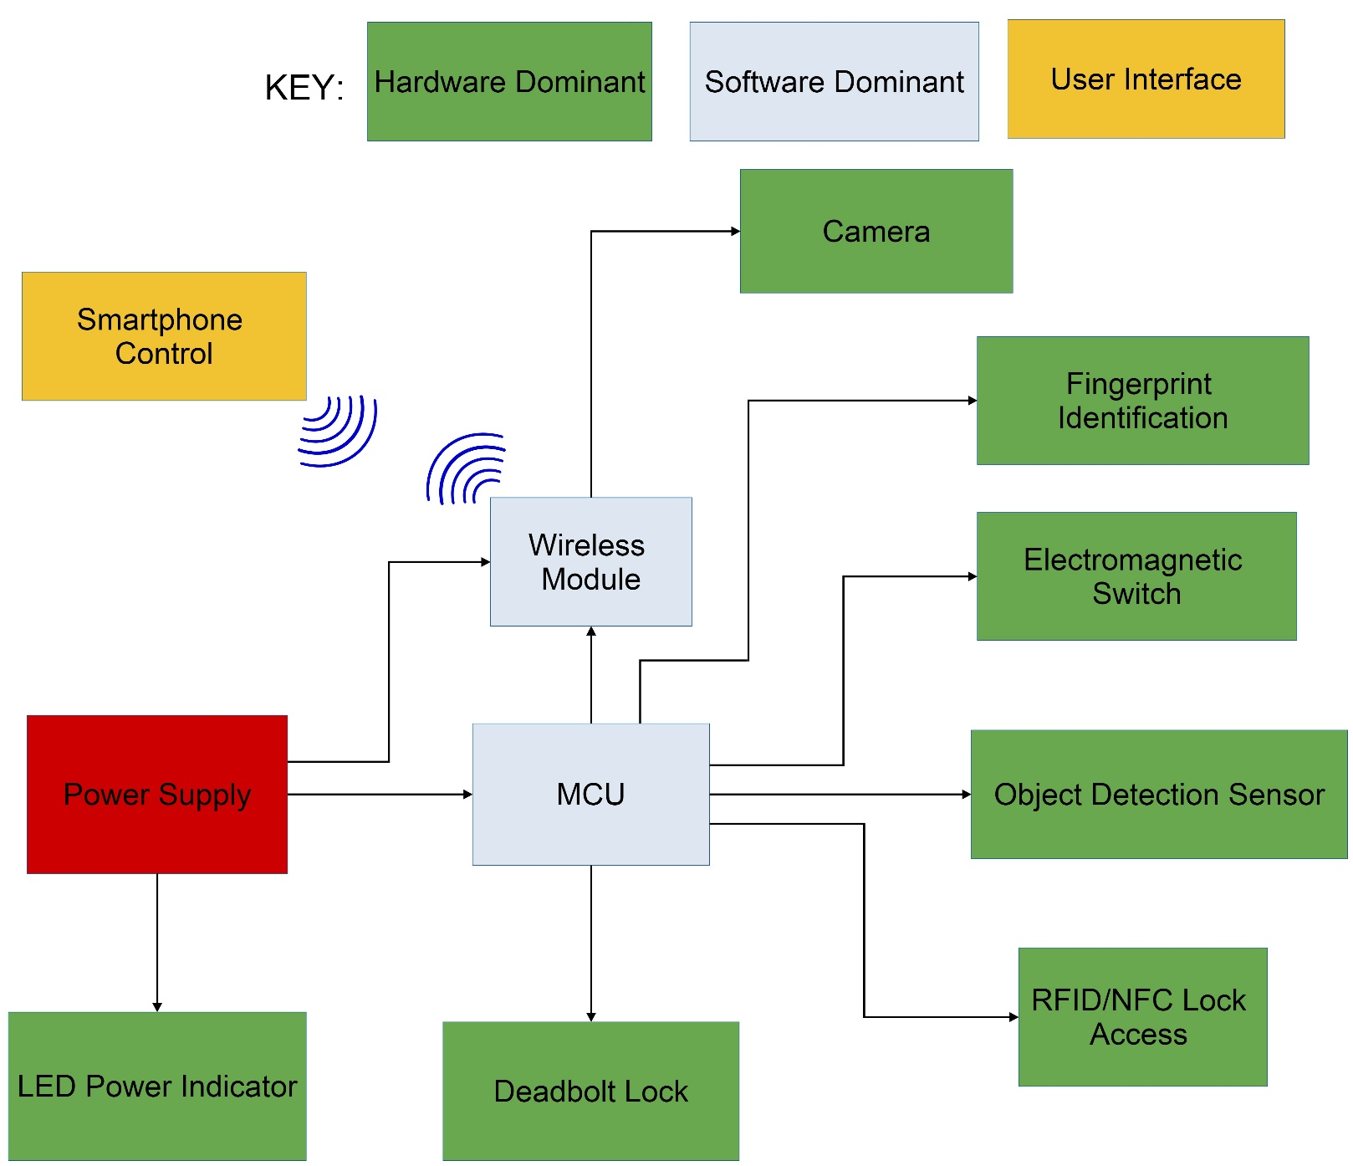
Project Block Diagram

Slide 5
Specifications and Requirements
Door unlocks/locks with NFC within 4cm range
Fingerprint scanner scans within 3 sec
PIR sensor detects within 6ft range
Camera takes picture within 3 sec
User obtains text message within 10 sec
Unlocked door returns to locked state within 5 sec
Power source lasts up to 3 months

Slide 6
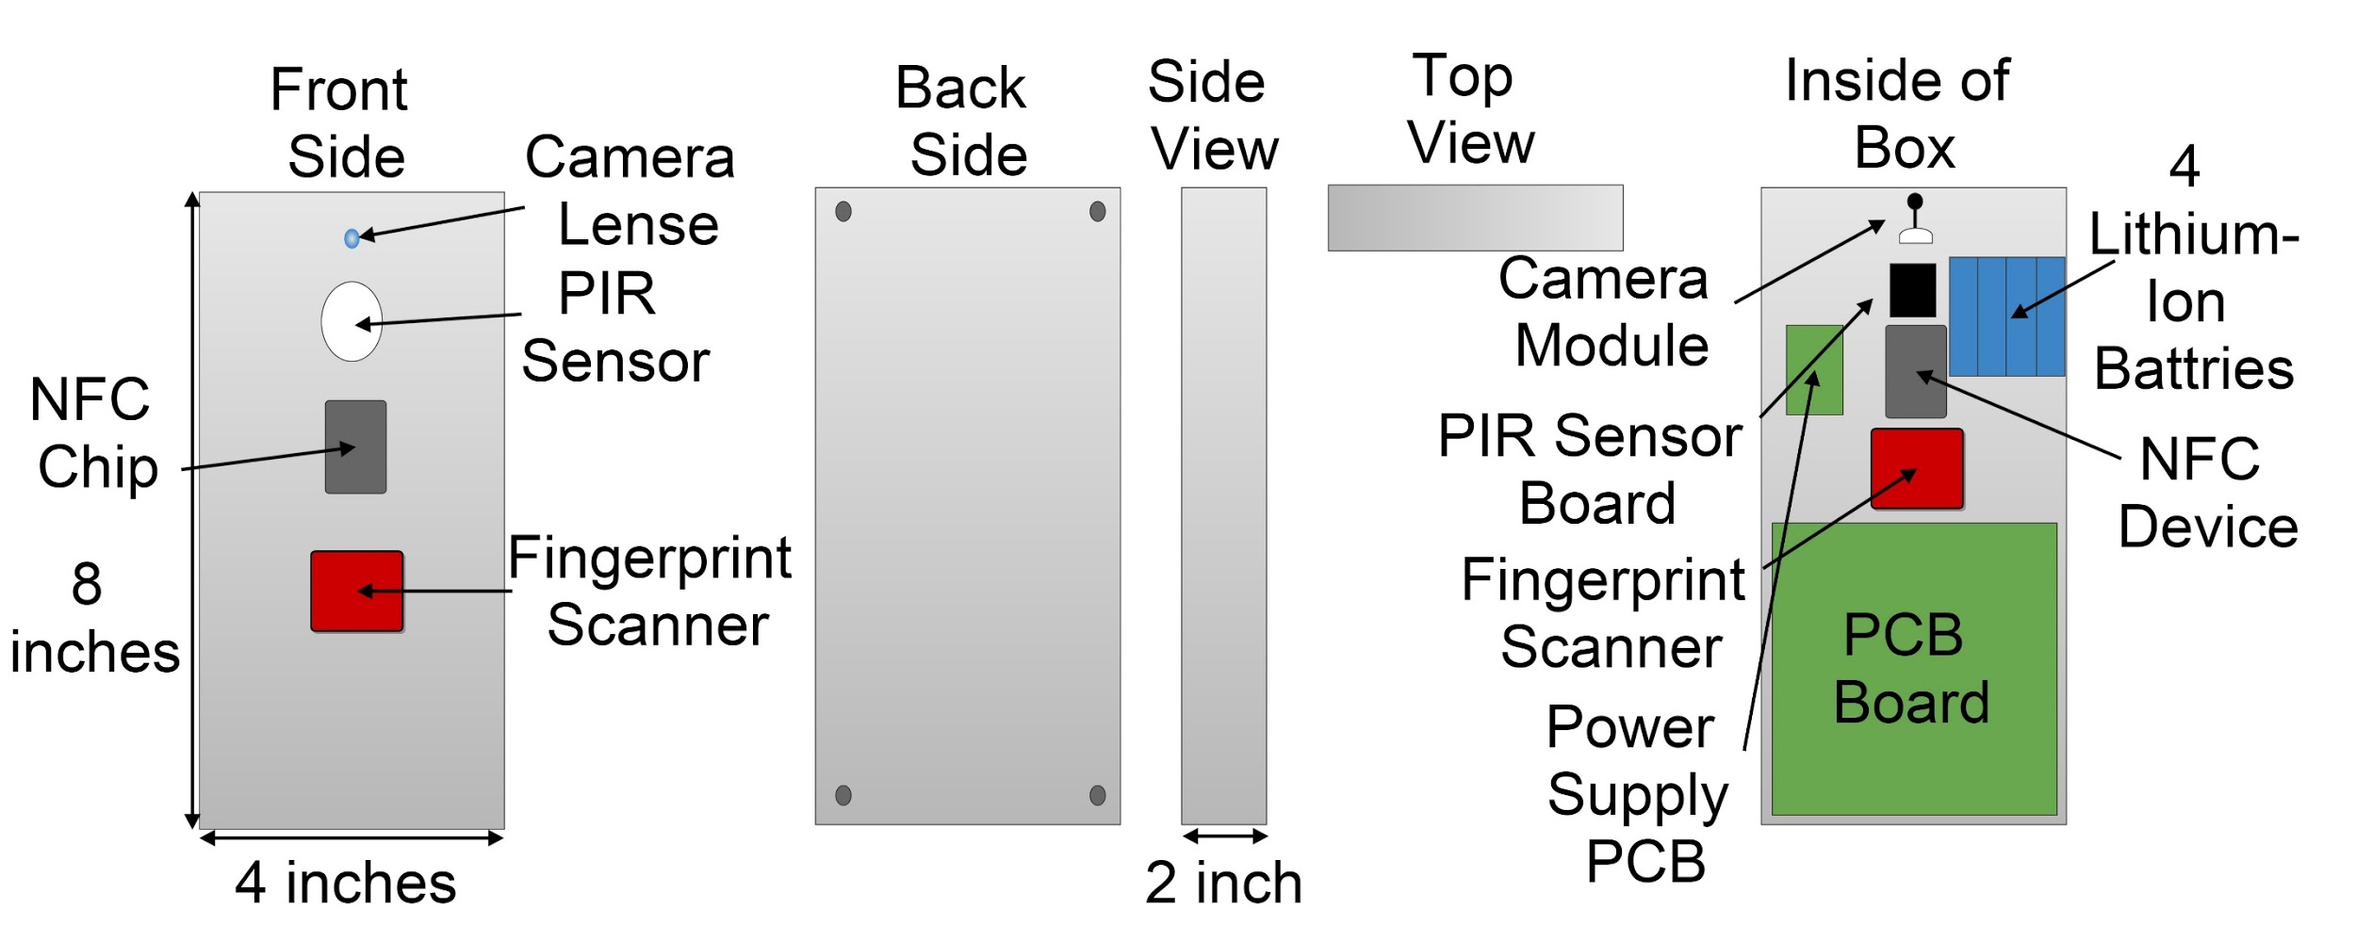
Lock Case Model

Slide 7
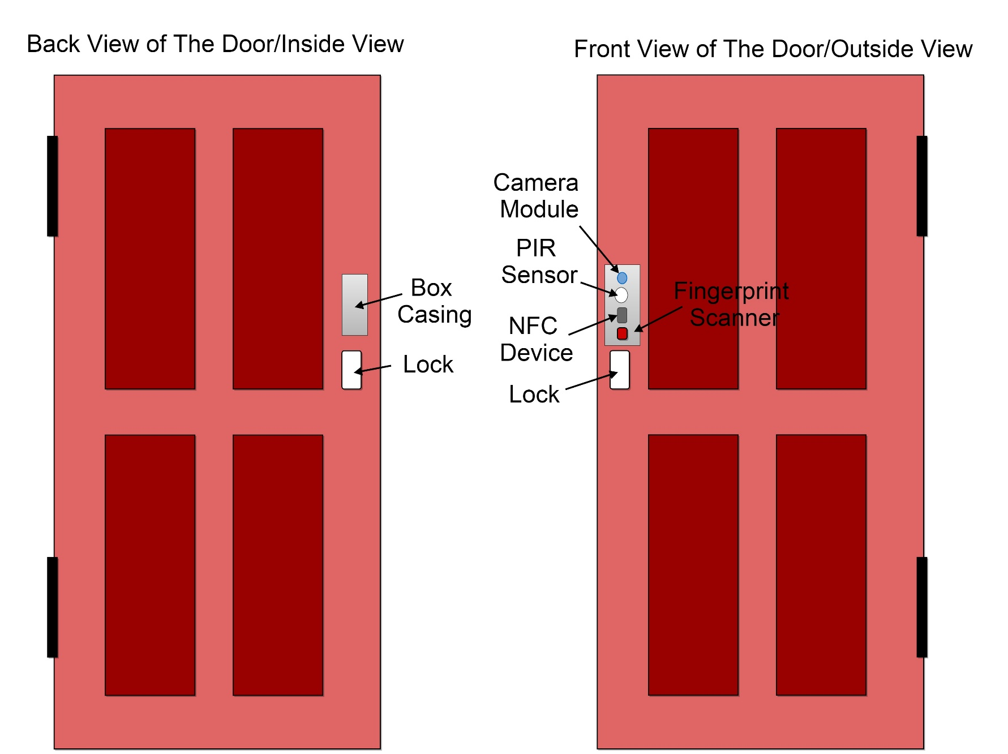
Door Model

Slide 8
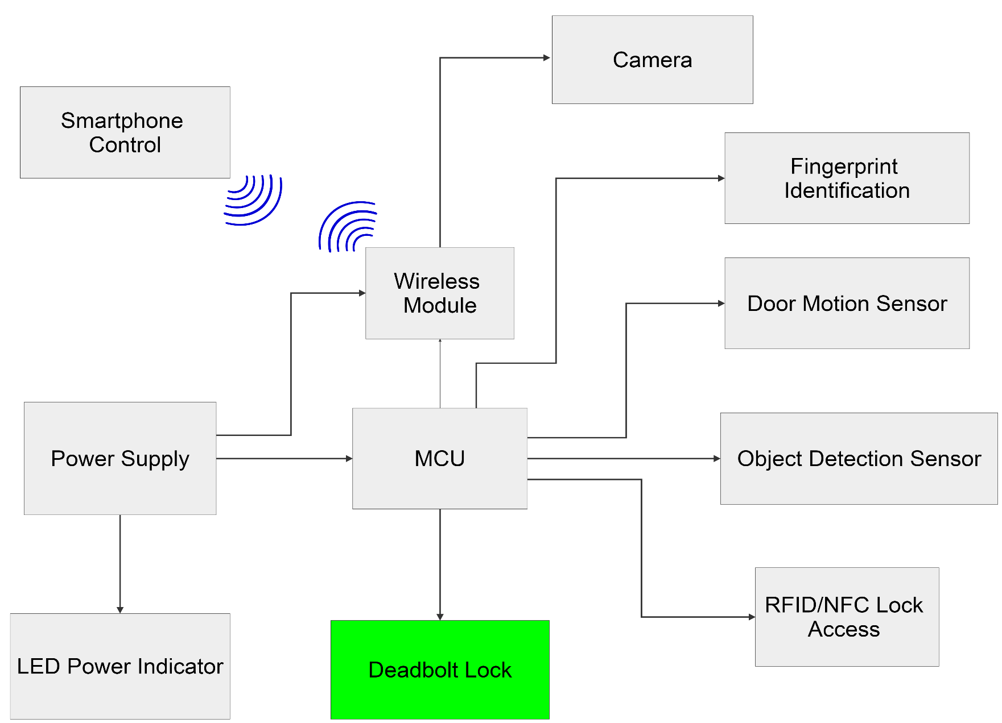
Motorized Electric Deadbolt

Slide 9
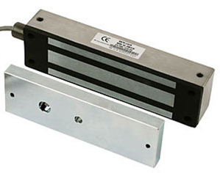
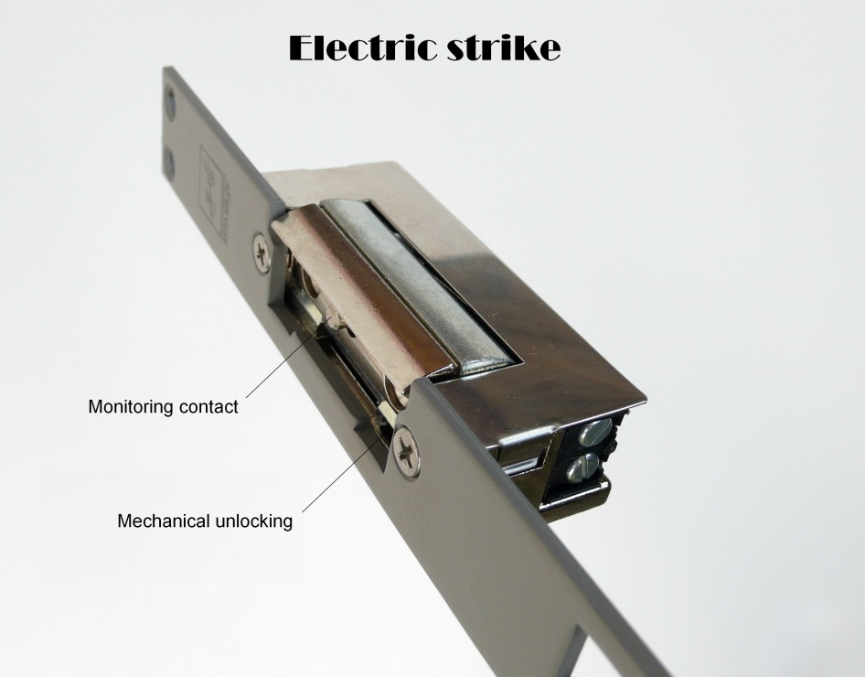
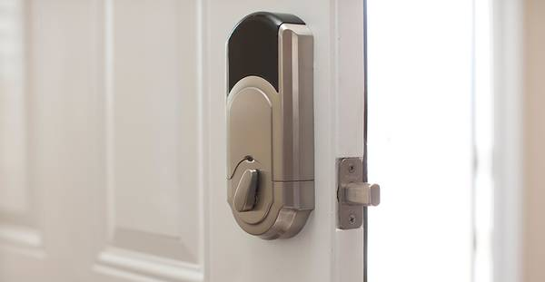
Types Of Electric Door Lock
Magnetic lock
Electric Strike
Motorized Electric deadbolt
Magnetic lock Electric Strike Motorized Electric Deadbolt

Slide 10
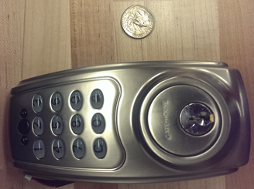
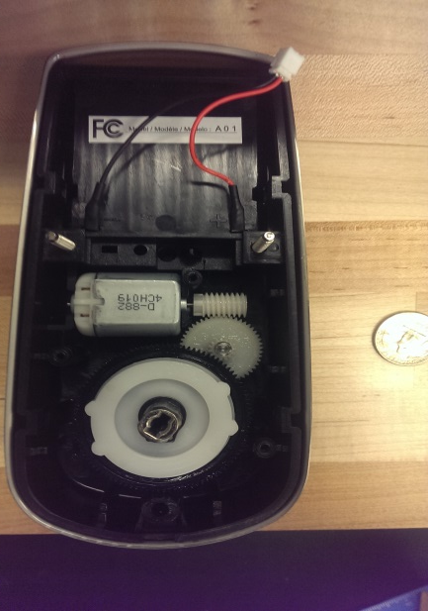
Door Lock System
Specifications | Morning Industry Remote Electronic Deadbolt-QF-01P | Diax MVM Motorized Electric Rim Lock | The Gatehouse Electronic Motorized Deadbolt
Outer Size | 5.75’’Hx3.25’’Wx0.25’’D | 6.0’’Hx4.25’’Wx1.25’’D | 6.75’’Hx3.5’’Wx1.15’’D
Inner Size | 5.75’’Hx3.25’’Wx1.75’’D | 3.78’’Hx4.95’’Wx1.65’’D | 8.25’’Hx4.0’’Wx1.4’’D
Operating Voltage | 6 V | 12 V | 6 V
Bolt Type | Sgl Cyl Deadbolt | Sgl Cyl Deadbolt | Sgl Cyl Deadbolt
Height | 5.25’’ | 3.78’’ | 8.25’’
Door Thickness | 1-3/8’’ to 1-3/4’’ | 1-3/5’’ to 1-2/5’’ | 1-3/8’’ to 1-3/4’’
Projection | 1.25’’ | 0.72’’ | 1.4’’
Price | $ 169.99 | $ 65.88 | $ 64.00

Slide 11
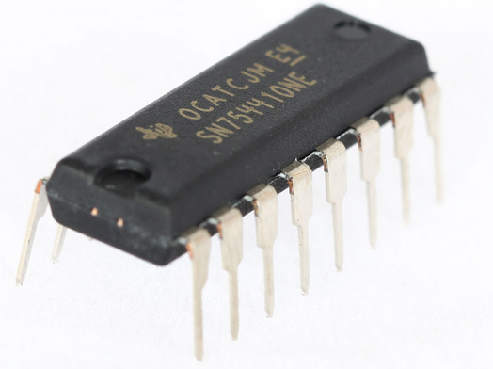
Lock System Implementation
The lock will operate to lock and to unlock the door.
The microcontroller will send the appropriate command to operate the lock.
To lock or unlock the door, a driver will be utilized to turn the motor clockwise or counterclockwise.
The driver that will be used is the SN754410
Specifications | L293D Driver | SN754410
Operating voltage | 4.5 V to 36V | 4.5V to 36V
Op. Temperature | 0 C to 70 C | -40 °C to 85 °C
Current Drawn | 0.65 A | 1 A
Output Voltage | 2.3 V to 7V | -3 to Vcc+3

Slide 12
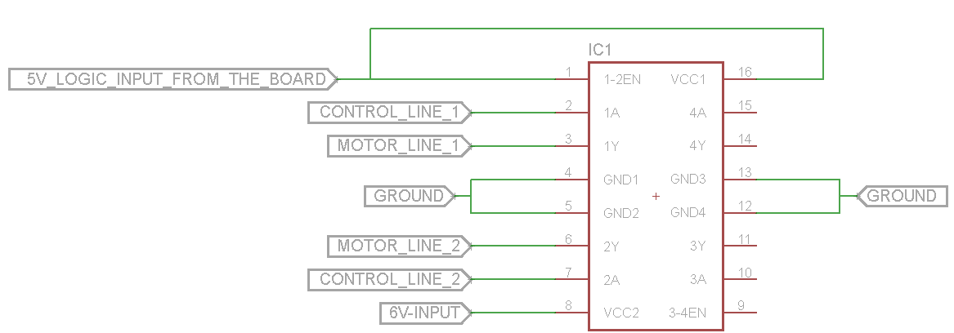
Lock System Implementation
Pins 1, 9 and 16 will be connected to a 5V pin from the microcontroller
Pins 4, 5, 12 and 13 will be connected to the ground.
Pin 8 will receive 5 V directly from the power source.
Pins 10 and 15 are the control line from the microcontroller.
Pins 11 and 14 will be connected to the motor.

Slide 13
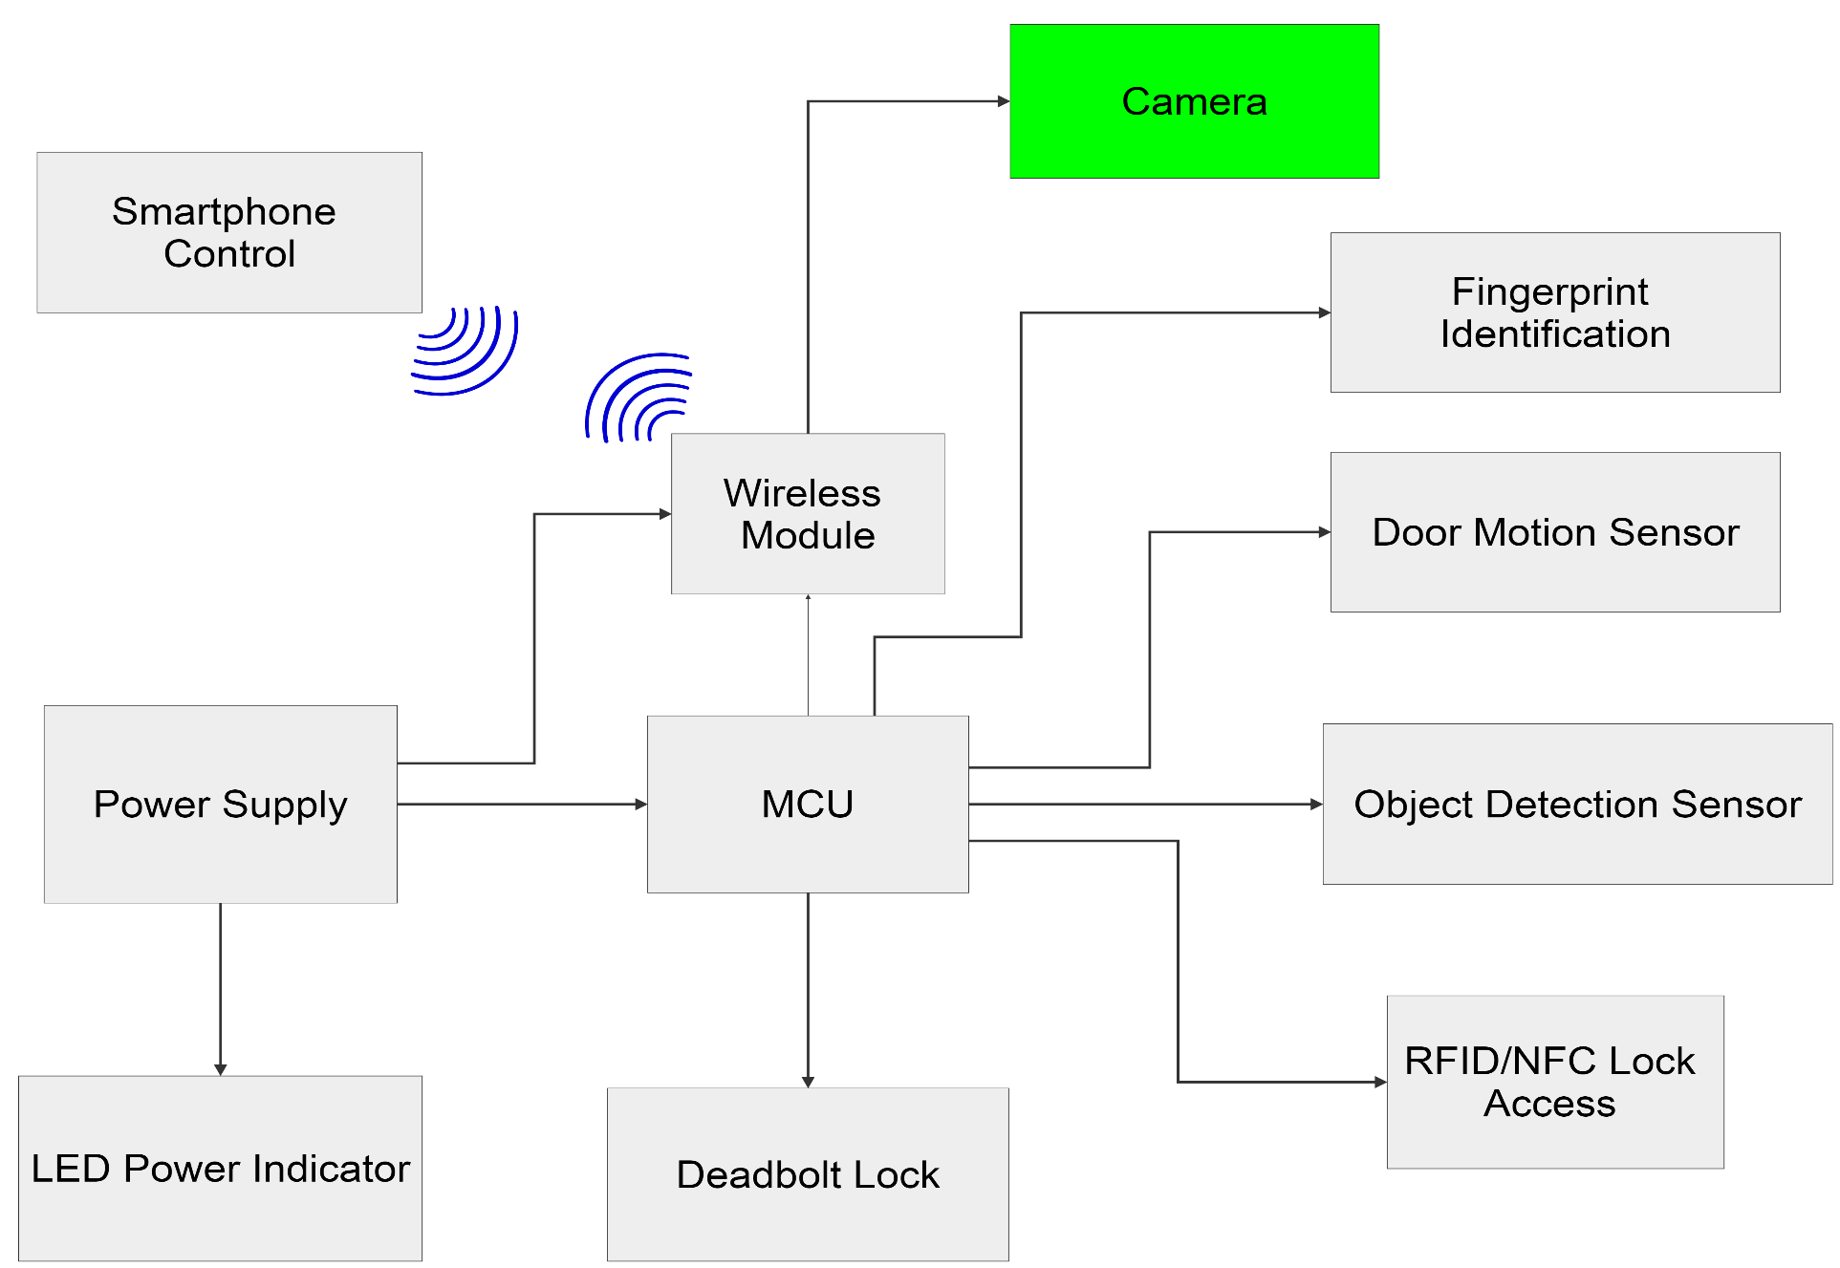
Camera Module

Slide 14
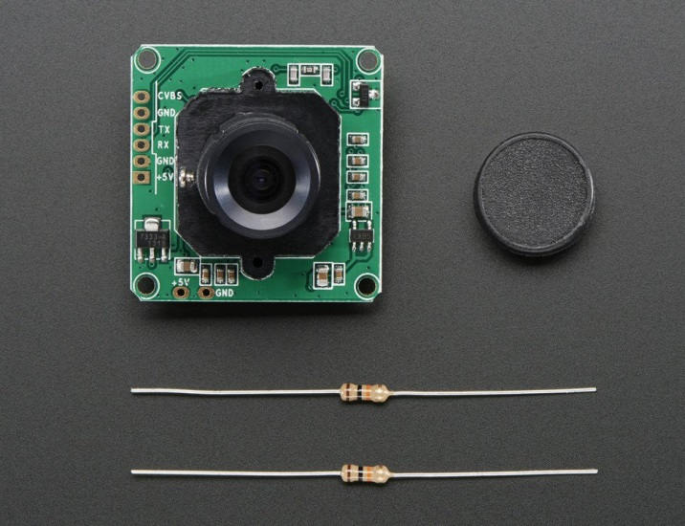
Camera Module
Specifications | TTL Serial JPEG Camera with NTSC Video | LW-MINI110 | Camera 2Mp UXGA
Resolution | 640 x 480 | 520 TV Lines | 2 MP UXGA
Sensitivity | 0.6 V/Lux-sec | 0.6 V/Lux-sec | 0.6 V/Lux-sec
Operating Voltage | 5 V | 3.3 to 6 V | 3.0 V
Current Draw | 75 mA | 75mA | 46mA
Pixel size | 5.6 um x 5.6 um | 4.5 um x 2.6 um | 2.2um x 2.2um
Op. Temperature | -10 C to 45 C | -20 C to 50 C | -30 C to 70 C
Lens Size | ¼’’ | 1/3’’ | ¼’’
SNR | 45 dB | 48 dB | 40 dB
Price | $ 39.95 | $45.85 | $ 20.00

Slide 15
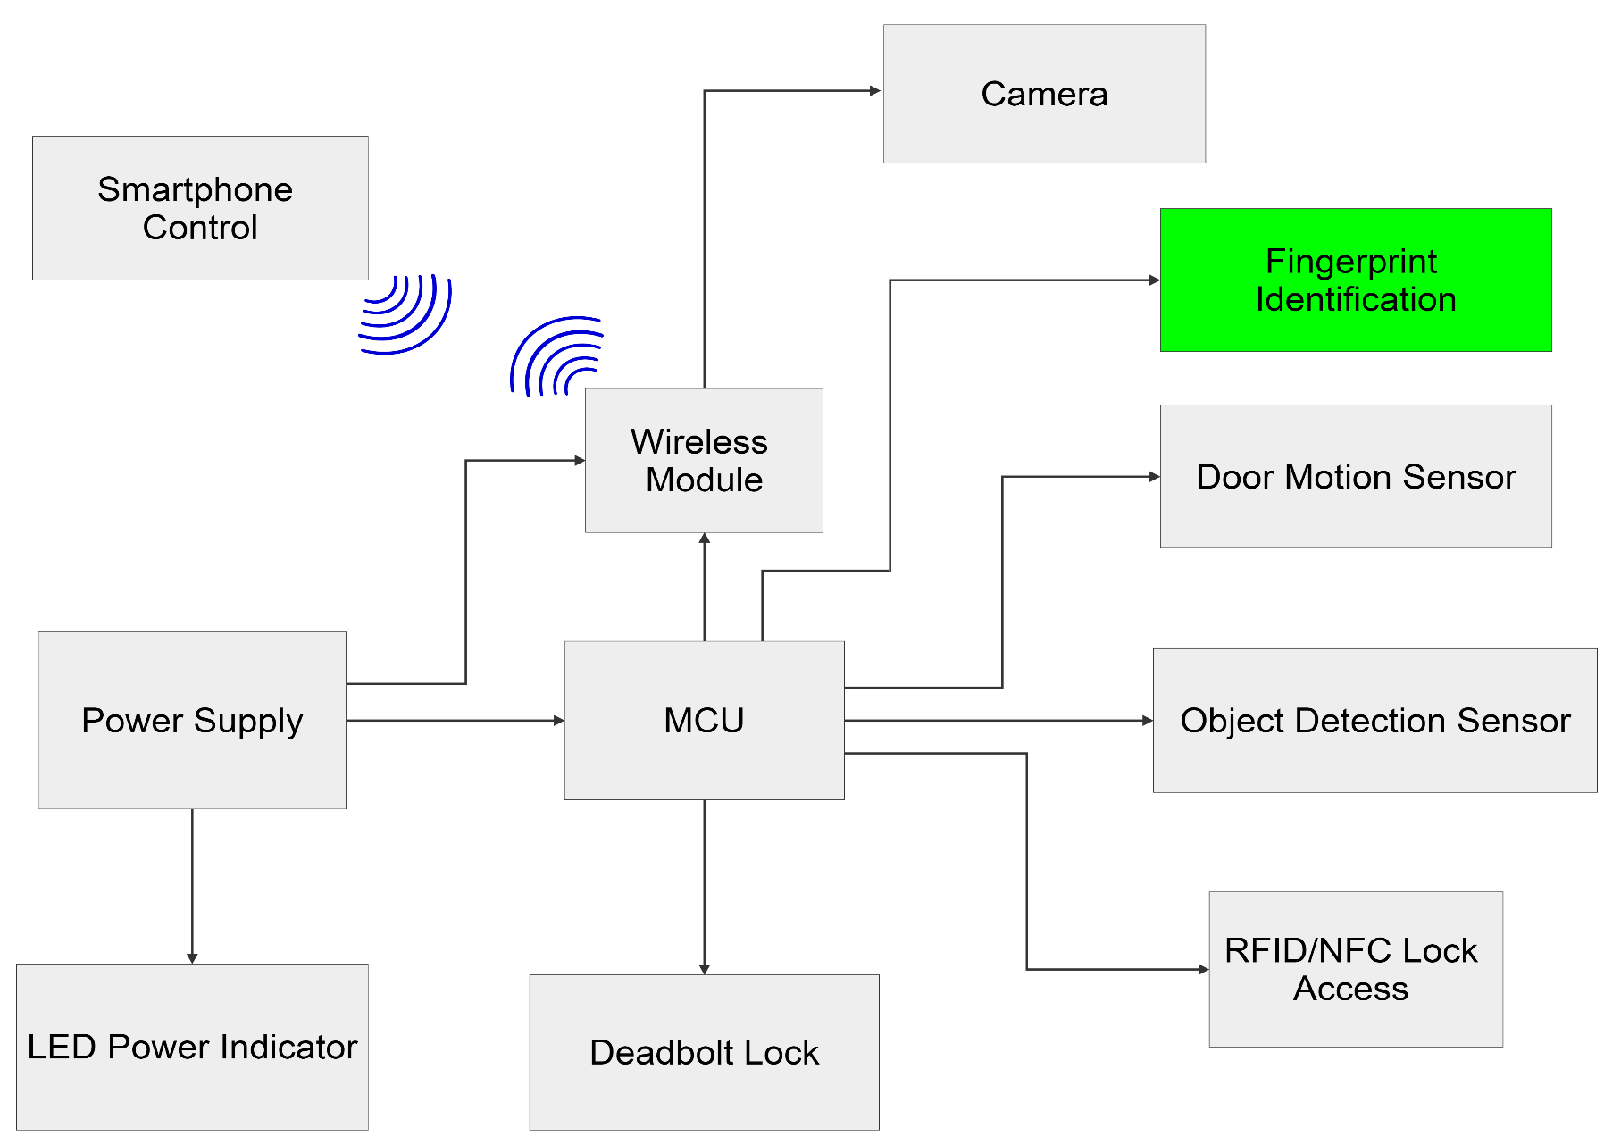
Fingerprint Scanner

Slide 16
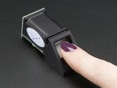
Fingerprint Scanner
Specifications | Adafruit Fingerprint sensor | GT-511C1R | EikonTouch 710
Size | 56 x 20 x 21.5mm | 37 x 17 x 9.5 mm | 84 x 34 x 14 mm
Operating Voltage | 3.6 to 6.0 V | 3.3 to 6.0 V | 5 V
Operating current | 120 mA | < 130mA | 120 mA
Fingerprint time | <1.0 second | <1.5 second | <1.0 second
False Acceptance rate | <0.001% | <0.001% | <0.001%
Security Level | 3 | 3 | 3
Working temperature | -20 C to 50 C | -20 C to 60 C | 0 C to 40 C
Price | $ 49.95 | $ 31.95 | $ 119.00

Slide 17
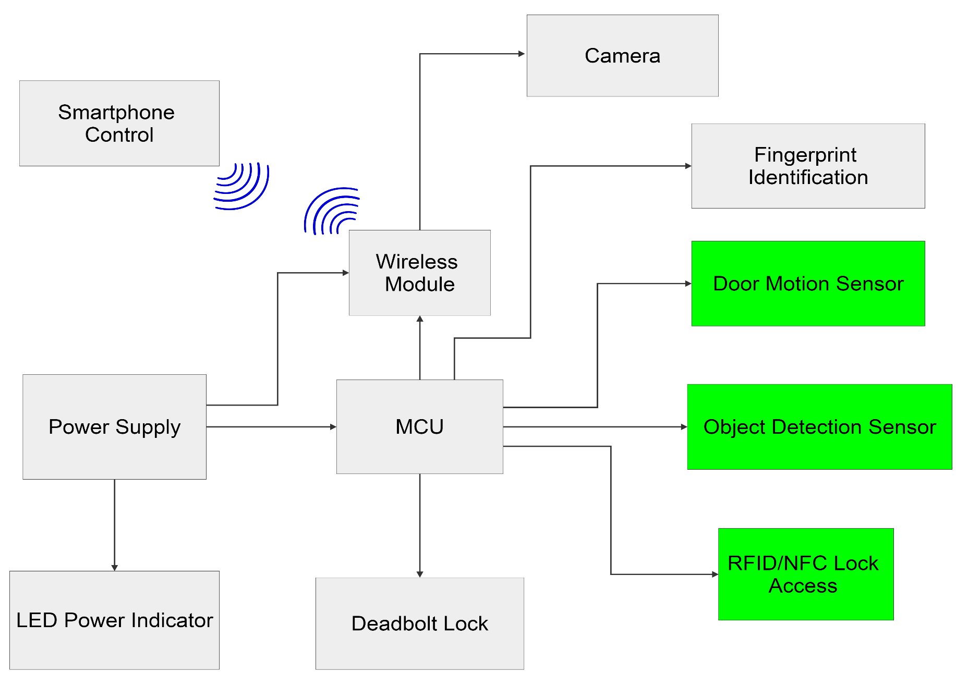
Other Sensors

Slide 18
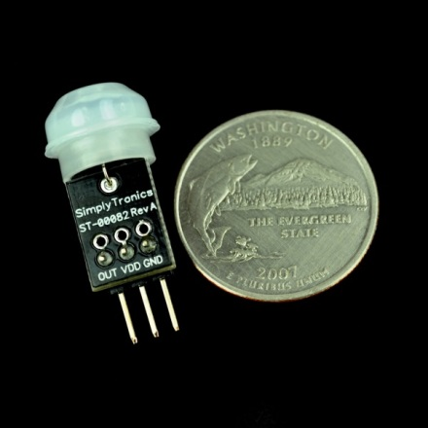
PIR SENSOR
Product | Parallax PIR Mini Sensor
Size | 29.5 x 12.5 x 12.5 mm
Detection Range | 100°
Operating Voltage | 3.3 V
Operating Current | 28 μA
Price | $9.99
Features:
Commonly used in security applications (i.e. burglar alarms, outdoor lights)
Single bit high/low output
Detects IR source up to 3.65 m (12 ft)
3 pin package

Slide 19
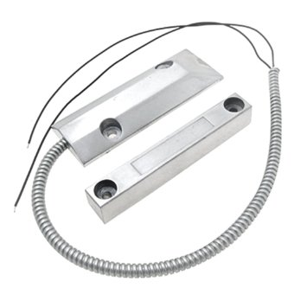
Magnetic Reed Switch
Used to automate the locking mechanism of the door
Easy installation
Already connected to an alarm security system
Product | Zinc Alloy Security Garage Door Rolling Gate Magnet Alarm
Size | 8.1 x 5 x 0.8 inches
Cord Length | 45 cm
Weight | 9.1 ounces
Operating Distance | 45 – 60 mm
Operating Voltage | 100 V
Price | $10.59

Slide 20
RFID & NFC COMPARISON
Characteristics | RFID | NFC
Frequency | 13.56 MHz in HF (varies in LF, UHF) | 13.56 MHz (standard)
Range | Up to 1 m | Up to 10 cm
Communication Modes | Read/write | Read/write Peer 2 Peer Card emulation
Scan Ability | Multiple at once | Only one at a time
Application | Item tracking | Mobile payments, access control
System Components | Reader, Antenna, Tag | May act as both reader and tag

Slide 21
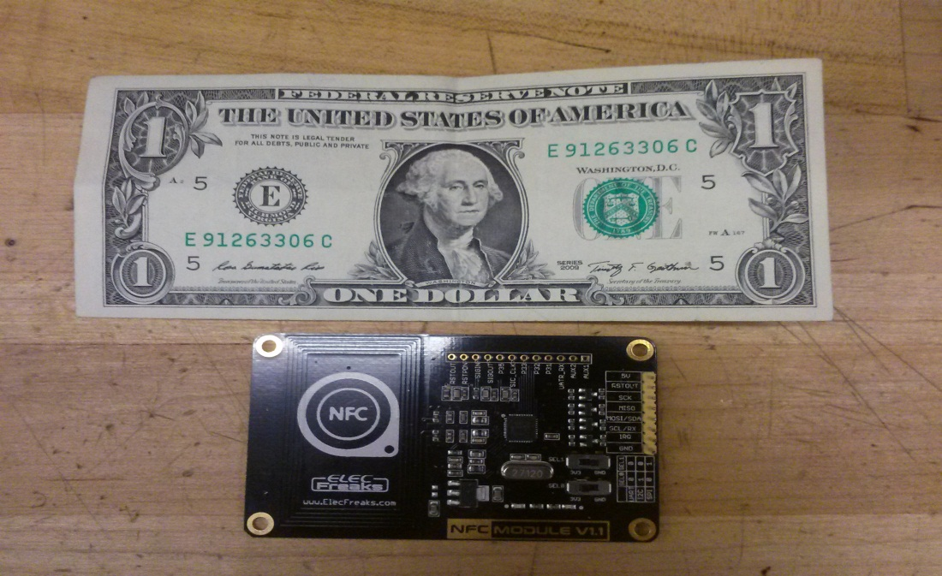
Near Field Communication (NFC)
Product | ElecFreaks NFC Module V1.1
Frequency | 13.56 MHz
Modes | reader/writer Peer 2 Peer card emulation
Operating Voltage | 5 V
Range | up to 5 cm
Size | 85mm x 52mm
Price | $24.00
Features:
PN532 NFC Chip
Built in Antenna
Arduino/AVR/ARM compatible
UART/SPI/I2C interface select switch

Slide 22
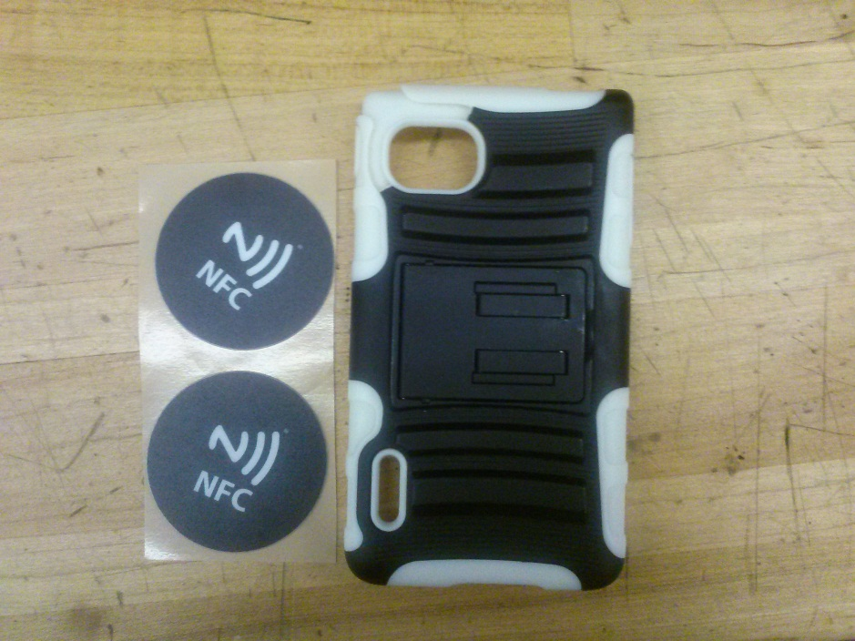
NFC STICKER TAGS
To establish communication between the phone and the NFC module
Module will read the unique Tag ID number to grant home access
Placed inside phone case / on phone itself
Format | NFC Chip | Tag Size | Antenna Size | Scan Strength | Price
White round Sticker | NTAG213 | 22 mm | 22 mm | 7 out of 10 | $ 0.71
On – Metal round Sticker | NTAG203 | 45 mm | 25 mm | 3 out of 10 | $ 3.90

Slide 23
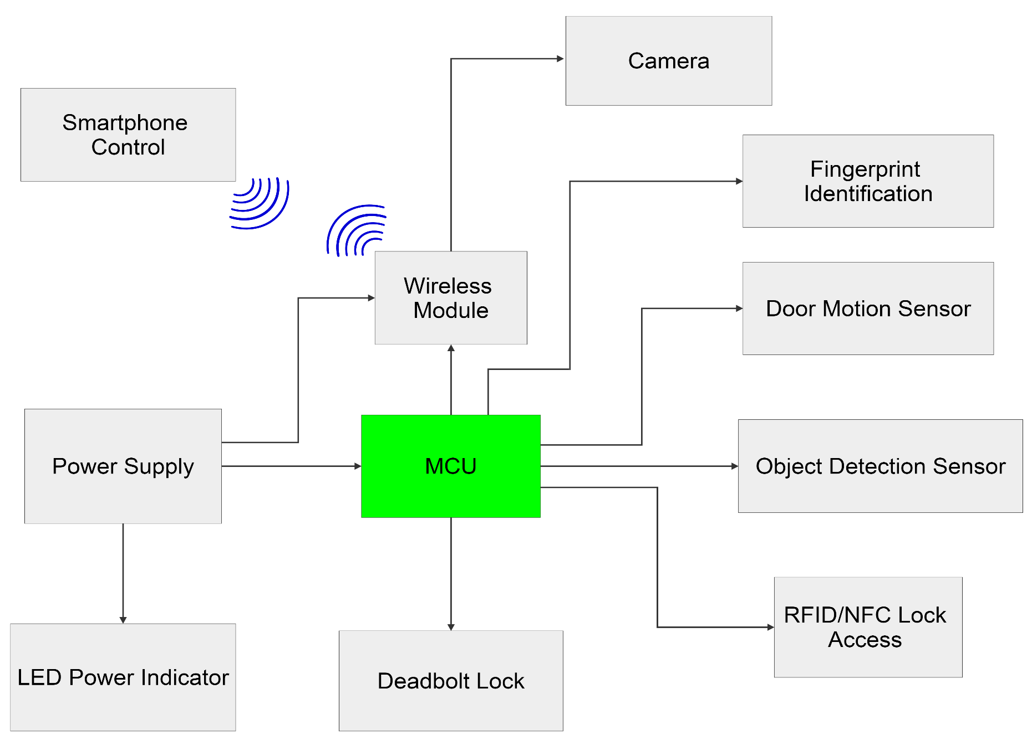
Micro Controller

Slide 24
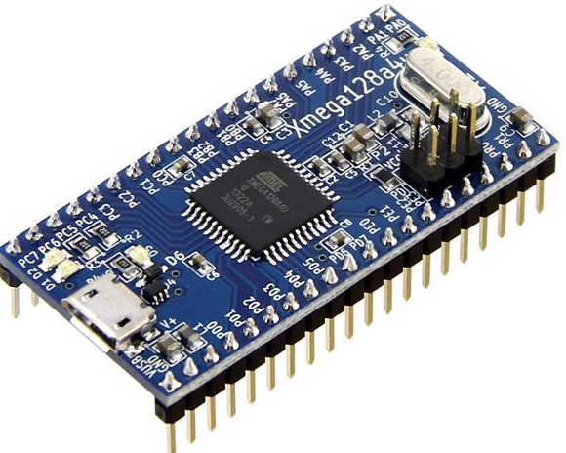
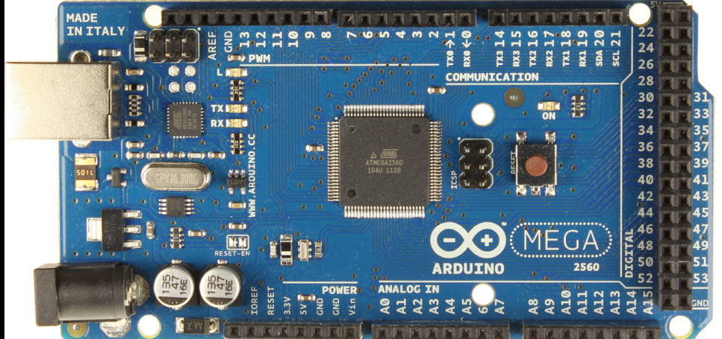
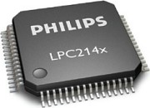
Microcontroller
Microcontroller | CPU Frequency | I/O Pins | UART | SPI | I2C | ADC Channels | Price | Store
ATxmega128A4U | 32MHz | 34 | 5 | 7 | 2 | 12 | $5.16 | Atmel
ATmega2560 | 16MHz | 86 | 4 | 5 | 1 | 16 | $5.65 | Ebay
LPC2148 | 60MHz | 64 | 2 | 2 | 2 | 14 | $12.50 | Ebay

Slide 25
Software Environment
Software: Arduino Integrated Development Environment(IDE)
Uses “Sketch” for programming the code
Includes a software library called “wiring”
-AVR Power
-AVR Sleep
-AVR IO
Open-source software capability
Programming language: C

Slide 26
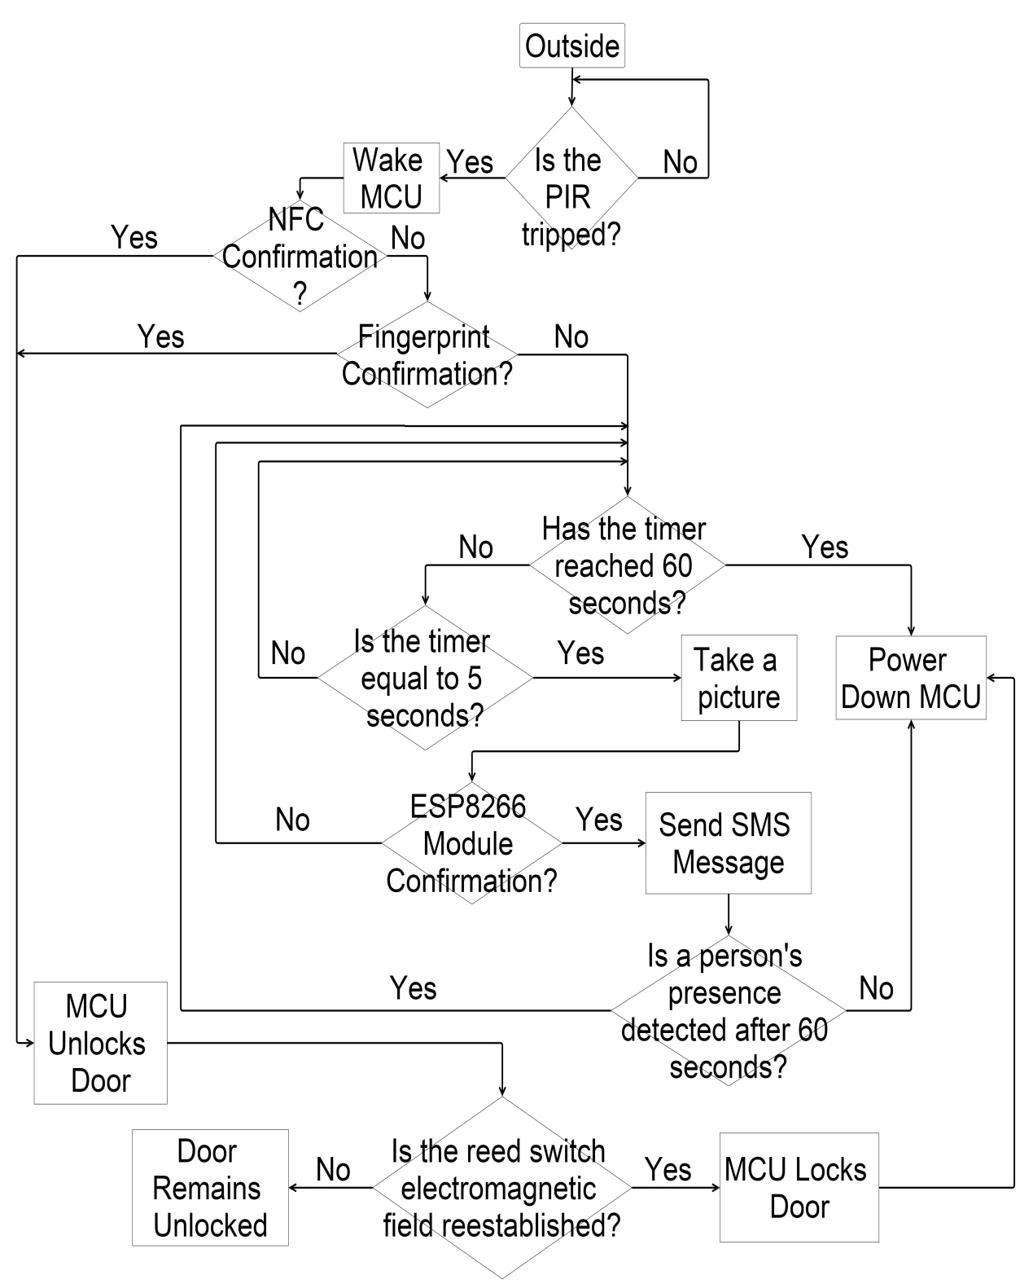
Microcontroller Flow Chart
Uses the PIR sensor to determine if there is a presence
Uses the magnetic reed switch to determine whether the door is open
A timer is implemented to optimize power consumption.
NFC and fingerprint scanner are used to determine whether to unlock or keep the door locked.
Uses WiFI to send a SMS message if there is a presence

Slide 27
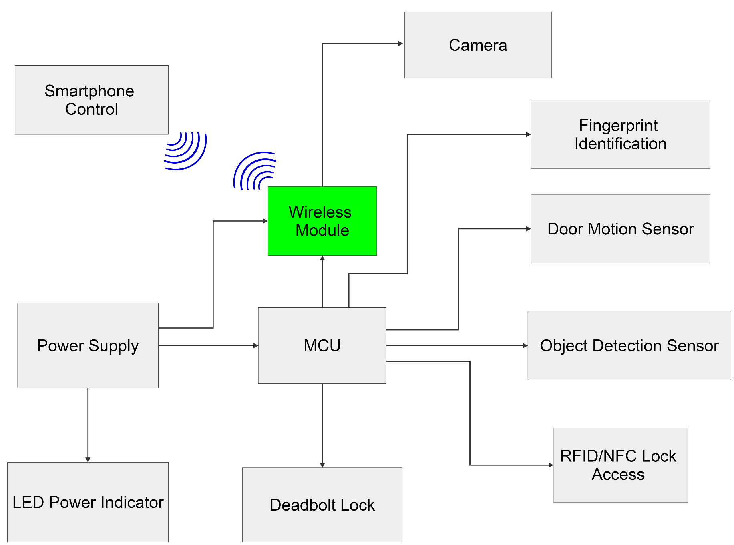
Wireless Module

Slide 28
Wireless Communication Types
Specification | Bluetooth | Wi-Fi | 3G Cellular Network
Data Rate | 2-25 Mbps | 100 Mbps | 3.6 Mbps (DL) / 384 Kbps (UL)
Range | 10cm-100m | 20m-100m | Where Service Permits
Baud Rate | 115200 bps | 115200 bps | 115200 bps
Operating Frequency | 2.4-2.48 GHz | 2.4 GHz | 2.4GHz
Complexity | Medium | High | Medium
Power Consumption | 2.5 mW | 500 mW | 250 mW
Interfacing Method | UART, SPI, I²C | UART, SPI, SDIO, I²C, USB | UART

Slide 29
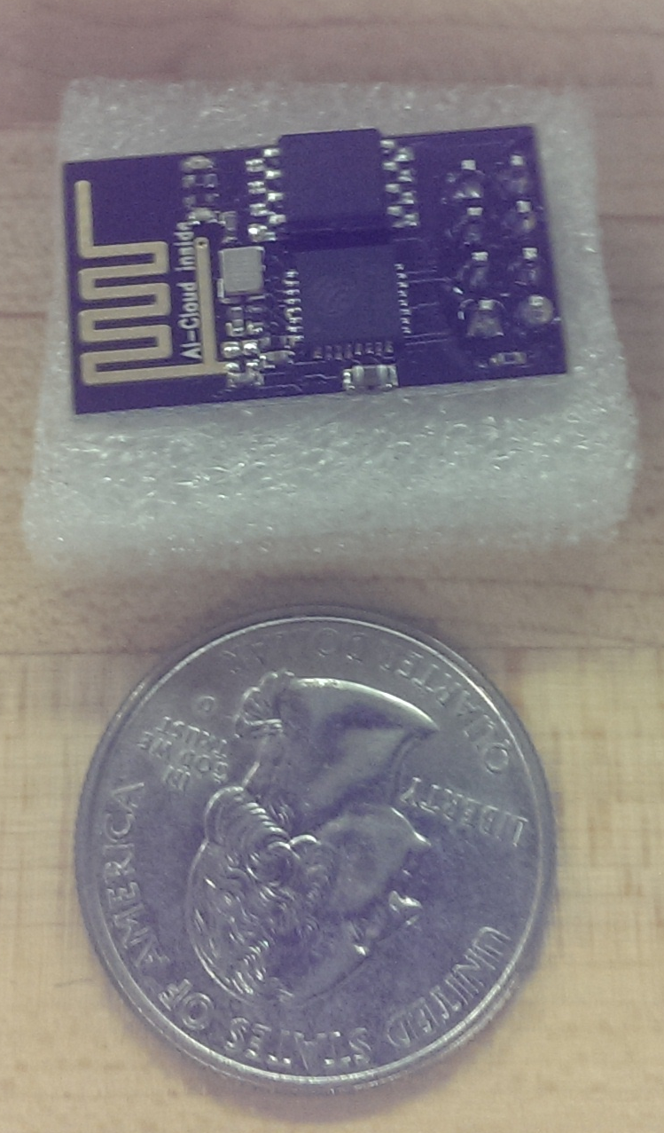
ESP8266 Wi-Fi Module
Features | ESP8266 Wi-Fi Module
Wireless Communication | Wi-Fi
Supply Voltage | 3.3 V
Operating Current | 100 mA (Max)
Shutdown Current | 5 µA
Size & Pin Count | 13.2 x 21 (mm) – 8 pins
Hardware Sub-Features | 2 GPIO pins
Cost | $7
Applications | WPA/WPA2 (AP) networks, P2P
Software | C Programming AT Commands
IDE | Arduino IDE
Interfacing | UART

Slide 30
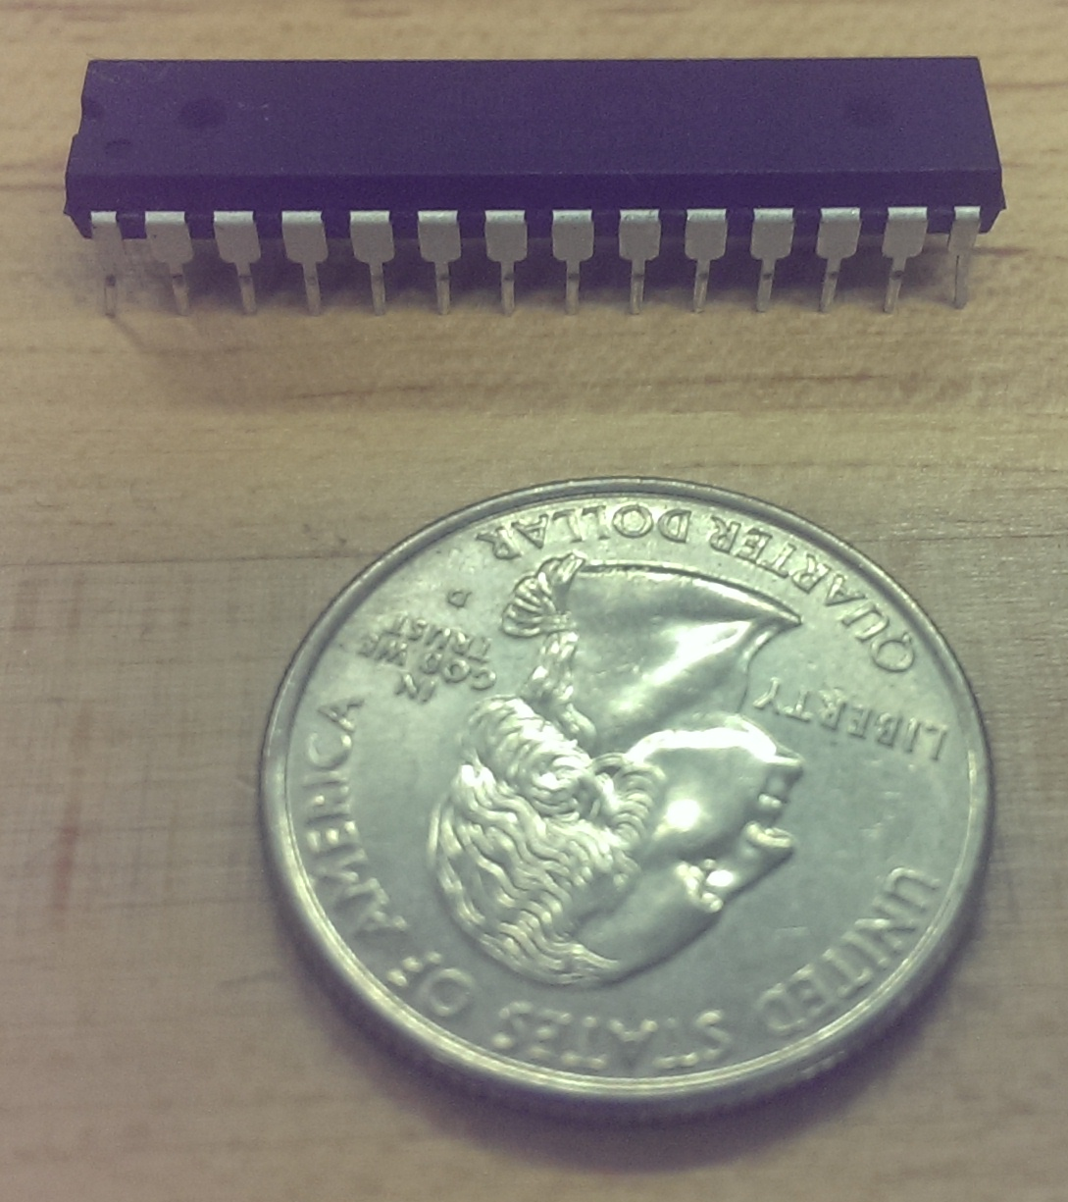
Special Case Micro Controller
Compatible with ESP8266 software code
Software communication between ATmega2560 and ESP8266 is buggy
Wi-Fi module and ATmega328P act as one unit
Simplistic in design and execution
Features | Atmega.328P
Supply Voltage | 1.8 – 5.5 V
Operating Current | 200 mA (Max)
Shutdown Current | 100 nA
Size & Pin Count | 0.8 x 34 (mm) – 28 pins
Cost | $4
Interfacing | UART

Slide 31
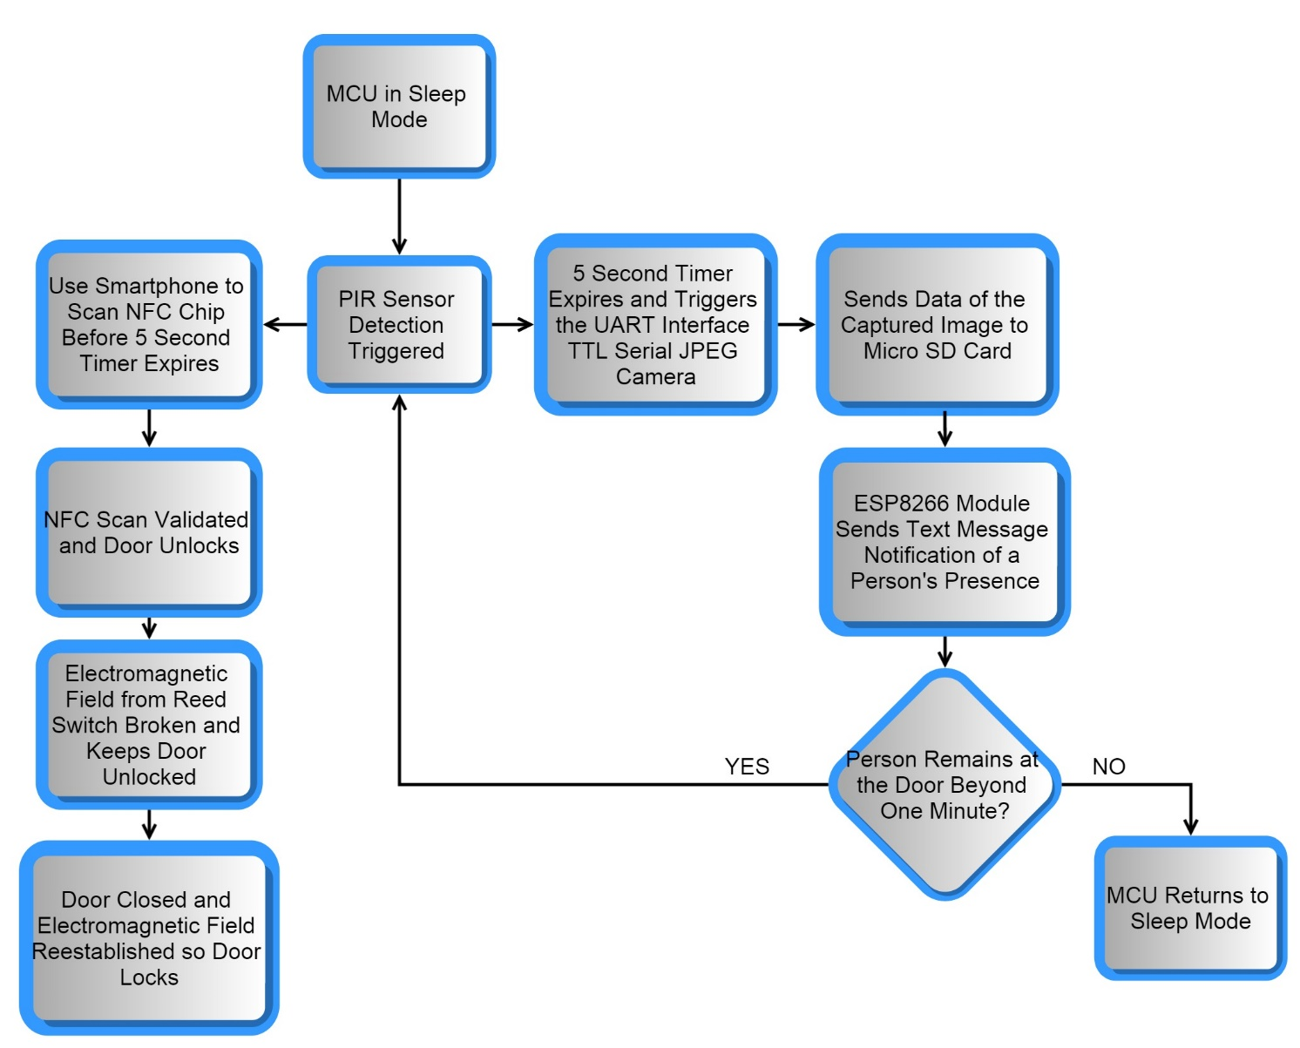
Twilio API SMS and Wireless Software Communication
Twilio Characteristics
Sends a text message to notify of motion detection
Only communicates with the specified user
Secure communication through Twilio assigned SID and TOKEN ID
ESP8266 Twilio Virtual Communication
Assigned a pre-determined AP with SSID and password
Uses Twilio account phone number to contact user’s smartphone number
ESP8266 connects to AP, communicates with Twilio, and sends text message averaging at 30 seconds

Slide 32
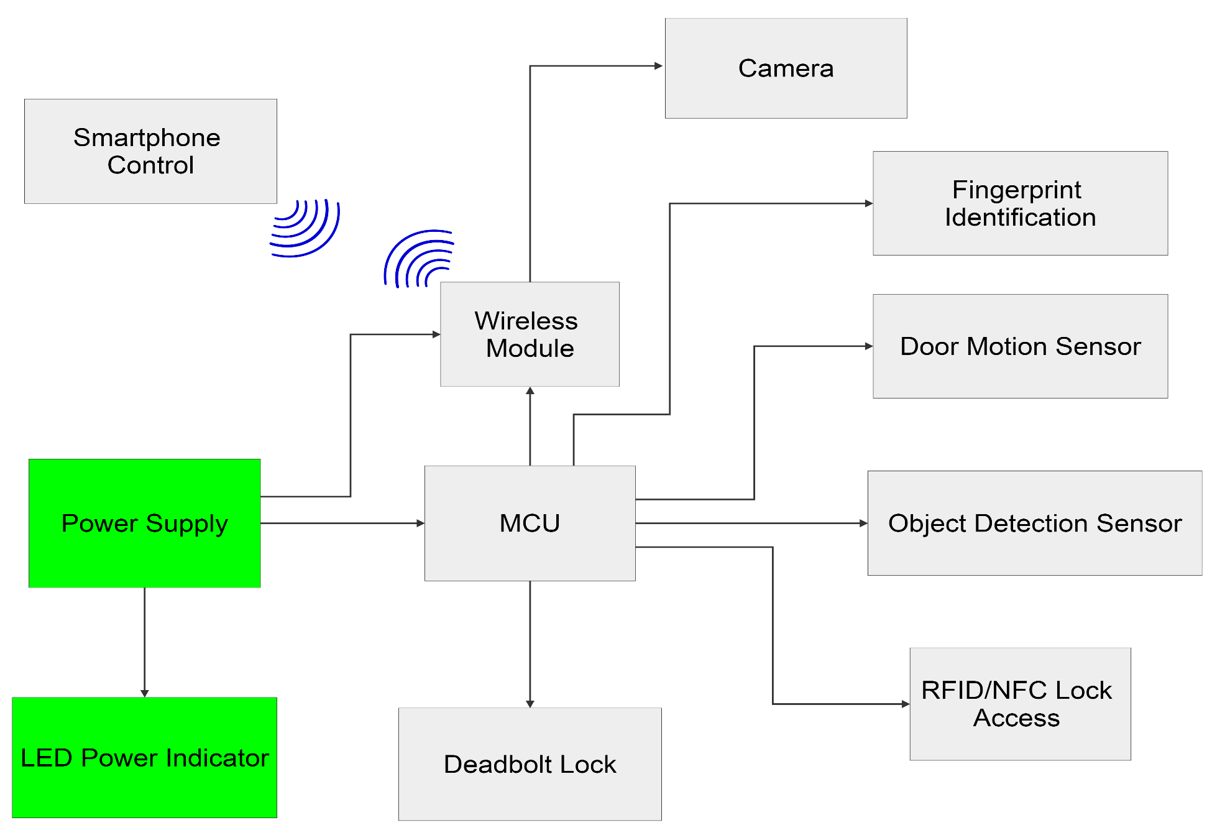
Power Supply

Slide 33
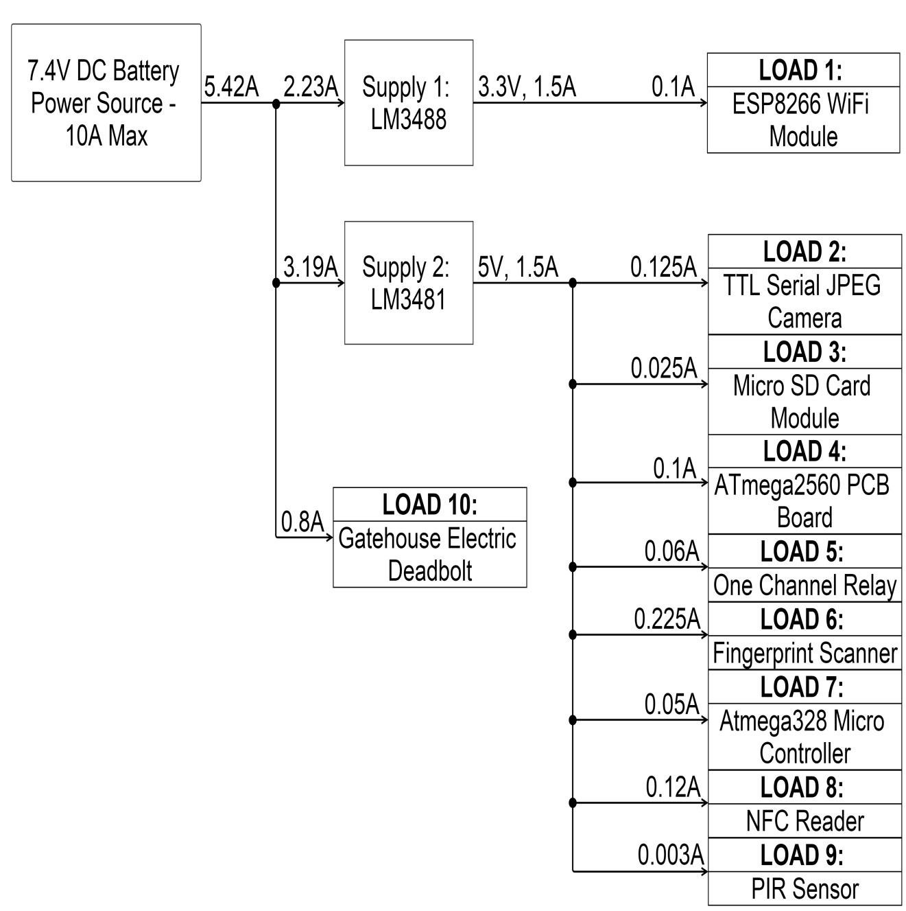
Power Diagram

Slide 34
Power Requirements
Device | Model | Min Input Voltage | Max Input Voltage | Standby Current | Operating Current
Microcontroller | ATmega2560 | 1.6V | 3.6V | 4.5uA | 9.6mA
NFC | TRF7970A | 1.8V | 5.5V | .5uA | 130mA
Finger Print Scanner | GT-511C1R | 3.6V | 6V | 1mA | 120mA
PIR | Parallax PIR Sensor | 3V | 15V | 110uA | 110uA
Camera | TTL Serial Camera | 1.7V | 3.3V | .6mA | 30mA
Lock | Gatehouse | 5V | 6V | 0 | 500mA
Wi-Fi | ESP8266 Module | 3.3V | 4.2V | 10uA | 300mA
Motor Driver | DRV8832 | 2.7V | 6.8V | .3uA | 1.4mA

Slide 35
DC-DC step-down
Two DC-DC will be used to step down the voltage to 3.3V and 5V
The regulators must be efficient to optimize power consumption
The maximum output current must be greater than 1A
Voltage Regulator | Regulator Type | Min Input Voltage | Max Input Voltage | Output voltage | Output Current | Price | Store
LM109QML | Linear | 7 | 35V | 6V | 2A | $24.97 | Arrow
LM3488 | Switching | 3 | 17V | 5V | 1.5A | $21.40 | Ebay
LM3481 | Switching | 3 | 17V | 3.3V | 1.5A | $9.97 | Mouser

Slide 36
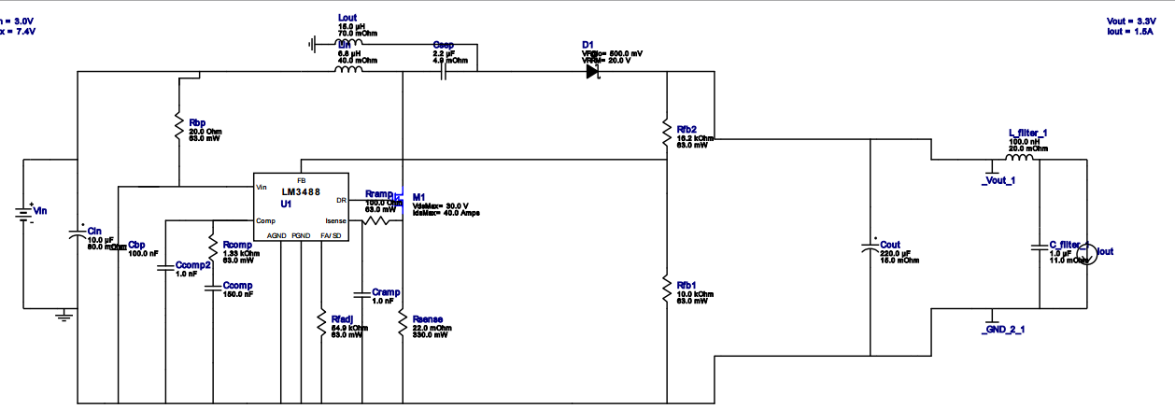
LM3488
Produced by WEBENCH

Slide 37
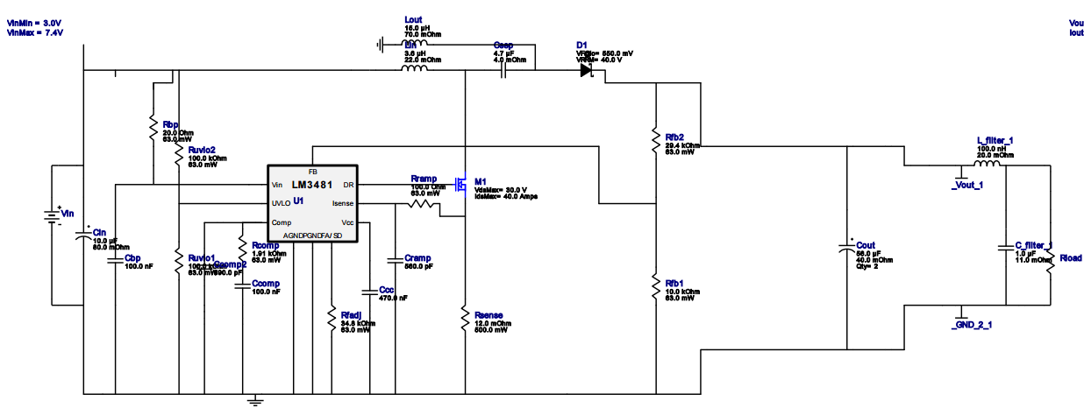
LM3481
Produced by WEBENCH

Slide 38
Battery Types
NiMH “Nickel metal hydride” SunLabz 14500 AA
Pros | Cons
Rechargeable Little memory Loss High drain applications 400-2000 life cycle $3.75 p.u at Amazon Able to produce high currents 2500mA | Toxic chemicals 1.2V cell voltage
Li-ion “Lithium ion” UltraFire 18650
Pros | Cons
No Memory effect 3.7 cell voltage Quick charge No discharge required | Lower Current drain applications Toxic chemicals $2.25 p.u at Amazon

Slide 39
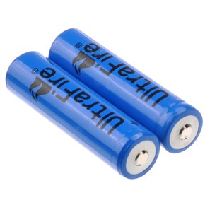
Battery Power Supply
UltraFire 18650 4200 mAh 3.7V batteries will be used as the power source
Lithium ion batteries were chosen since they have 2 times the capacity compared to NiMH batteries
Two batteries are implemented
The batteries will be configured in series which will double the voltage to 7.4V.

Slide 40
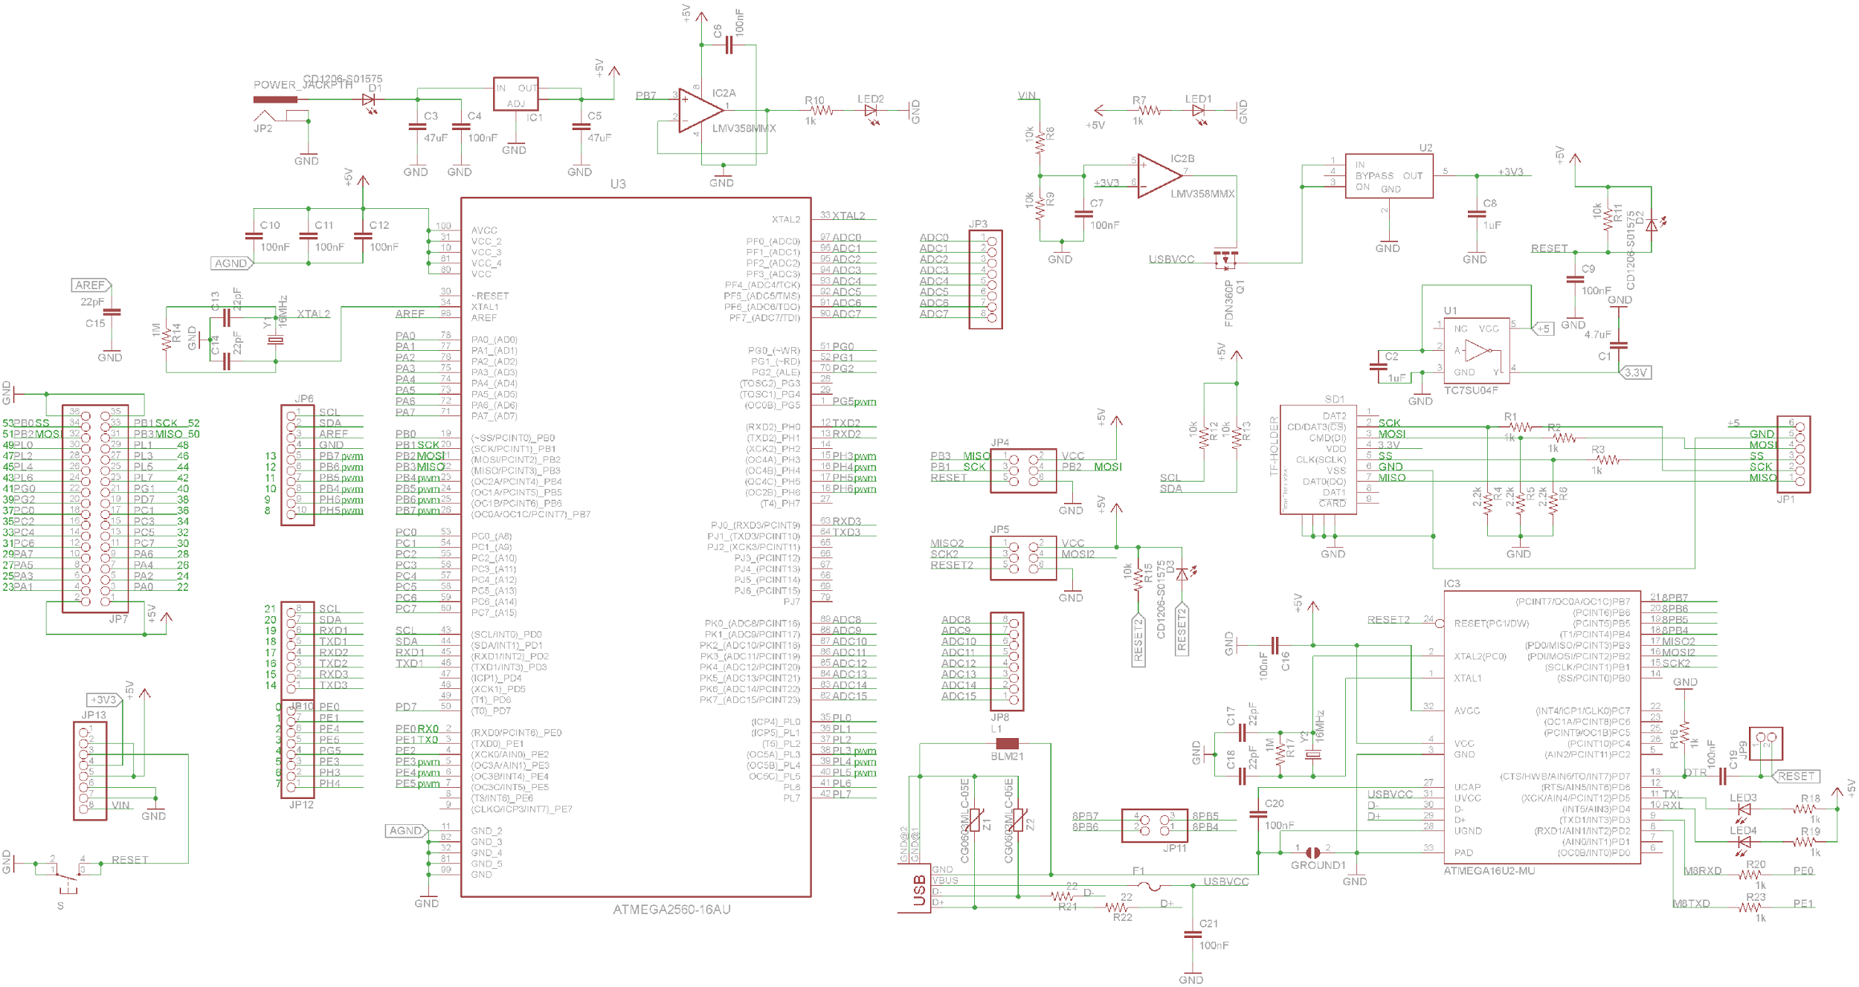
Micro-Controller Schematic

Slide 41
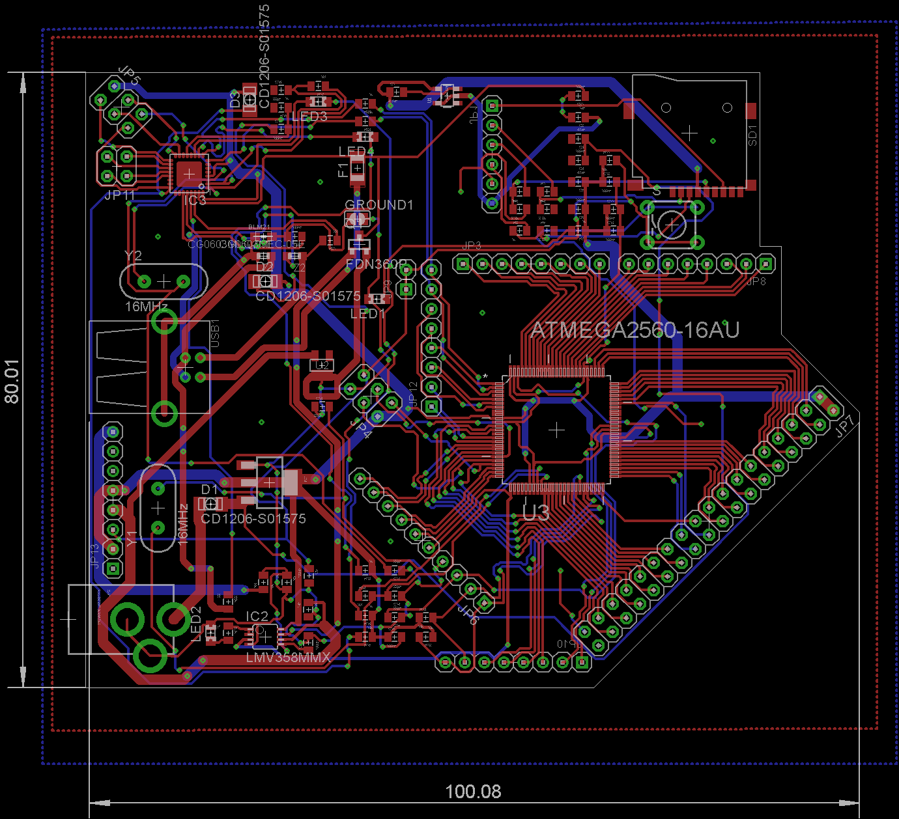
Micro-Controller PCB Layout

Slide 42
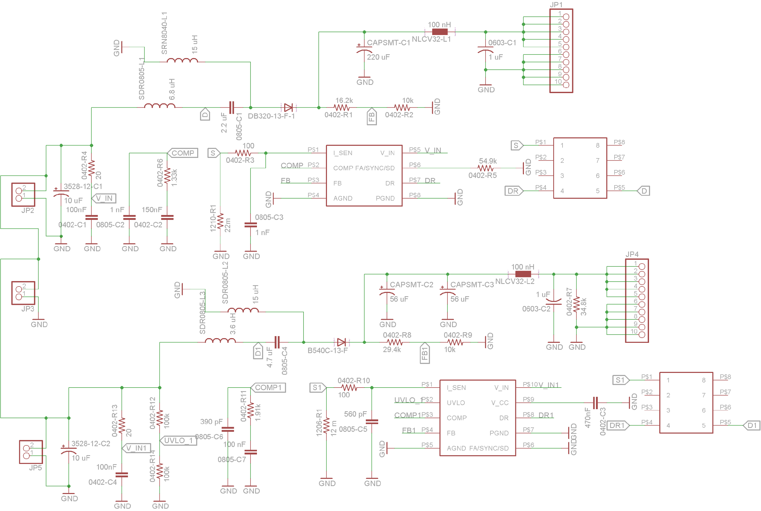
Micro-Power Schematic

Slide 43
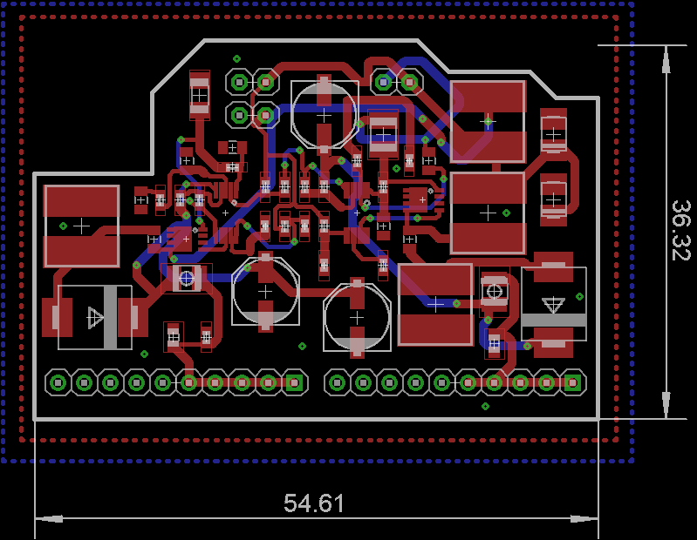
Power PCB Layout

Slide 44
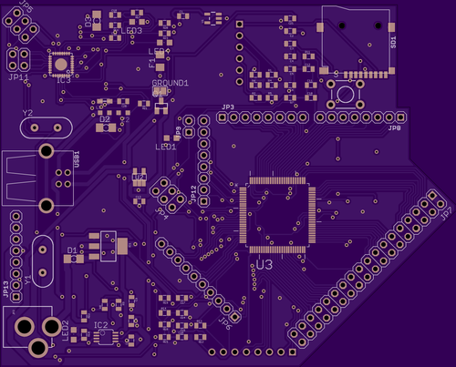
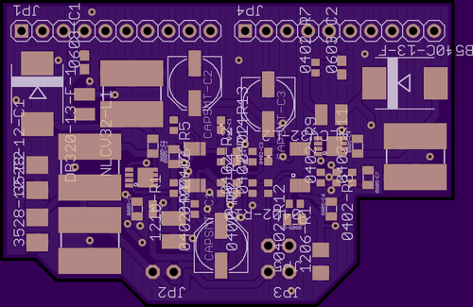
OSH Park Fabricated Boards
Micro-Controller Board
Power Board

Slide 45
Standards
NFC | ISO 14443A / MIFARE (for read/write capabilities) ISO 14443B (for read capabilities) ISO 18000-3 (13.56 MHz)
Wi-Fi | 802.11 b/g/n
Gatehouse Electronic Motorized Deadbolt | Graded 2 from ANSI
Peripheral Communications | I2C , SPI, and UART for the micro controller

Slide 46
Work Distribution
Category | Enjolie | Shawn | Paul | Sheldon
PCB Design |  | O |  | X
Wireless Communication | O |  |  | X
Micro Controller | O | X
Power System |  | X | O
Sensors | X |  | O
Project Assembly |  |  | X | O
Primary X | Secondary O

Slide 47
Budget
Parts | Cost
Gatehouse lock | $64.95
Driver SN754410 | $2.99
Adafruit Fingerprint scanner | $49.95
LED | $2.99
Magnetic Reed Switch | $10.59
NFC Module | $24.00
PIR Sensor | $9.99
Micro SD Card | $4.00
TTL Serial JPEG Camera | $39.95
Parts | Cost
LM3488 | $3.30
LITHIUM ION BAT. | 4*($ 2.25) = $ 9.00
LM3481 | $2.40
ATmega 2560 | $5.65
ESP8266 Module | $7.00
Wooden Door and Frame | Free
PCB Board Fabrications | $84.45
Total | $317.57

Slide 48
Issues
Couldn’t use NFC in phone due to encryption, had to resort to using NFC sticker tags
PCB boards currently not working

Slide 49


