Slide 1


Hydroponics with Automated Reporting and Monitoring
Sponsored by Duke Energy
Group 15
David Mascenik (Electrical Engineer)
Jon Spychalsky (Electrical Engineer)
James Tooles (Electrical Engineer)

Slide 2
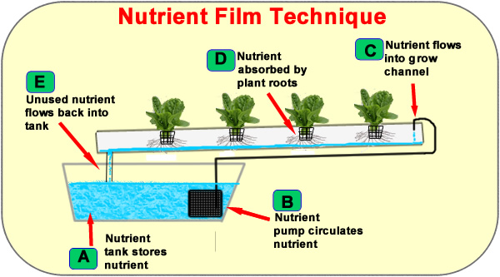
What is Hydroponics?
"Growing plants in the absence of soil."
Nutrients and air dissolved in the water, directly absorbed by the plant roots
Sensitive to:
  pH
  Dissolved Oxygen
  Temperature (water and air)
  Contamination (fungi and molds)
Design Choice: Implement the Nutrient Film Technique to cultivate the test plant (tomatoes) for the project.
Figure 1

Slide 3
Project Motivations And Goal
Motivation 1: Investigate hydroponic science, which has the potential to be:
  Resource Efficient (Nutrients)
  Space efficient (Vertical Growing)
  More Controllable
Motivation 2: Develop skills that will be desirable in the job market:
  Embedded Programming
  PCB Layout Design
Project Goal: Automate the care and maintenance of a hydroponic system.
  Design boards for the MCU, Automation, and Solar Charge Controller.
  Analyze sensor data to on/off control automation subsystems
  Post data to a local server

Slide 4
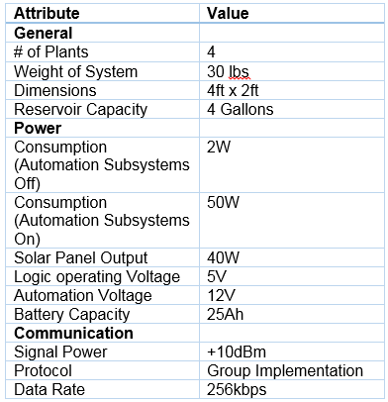
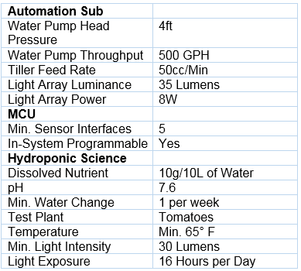
Specifications and Requirements
Table 2
Table 1

Slide 5
Standards and Specifications
RS232 UART
Inter-Integrated Circuit (I2C)
802.11 b/g/n
JTAG Interface (IEEE 1149.1)
C Programming Language (ISO 9899)
Chip Package Types

Slide 6
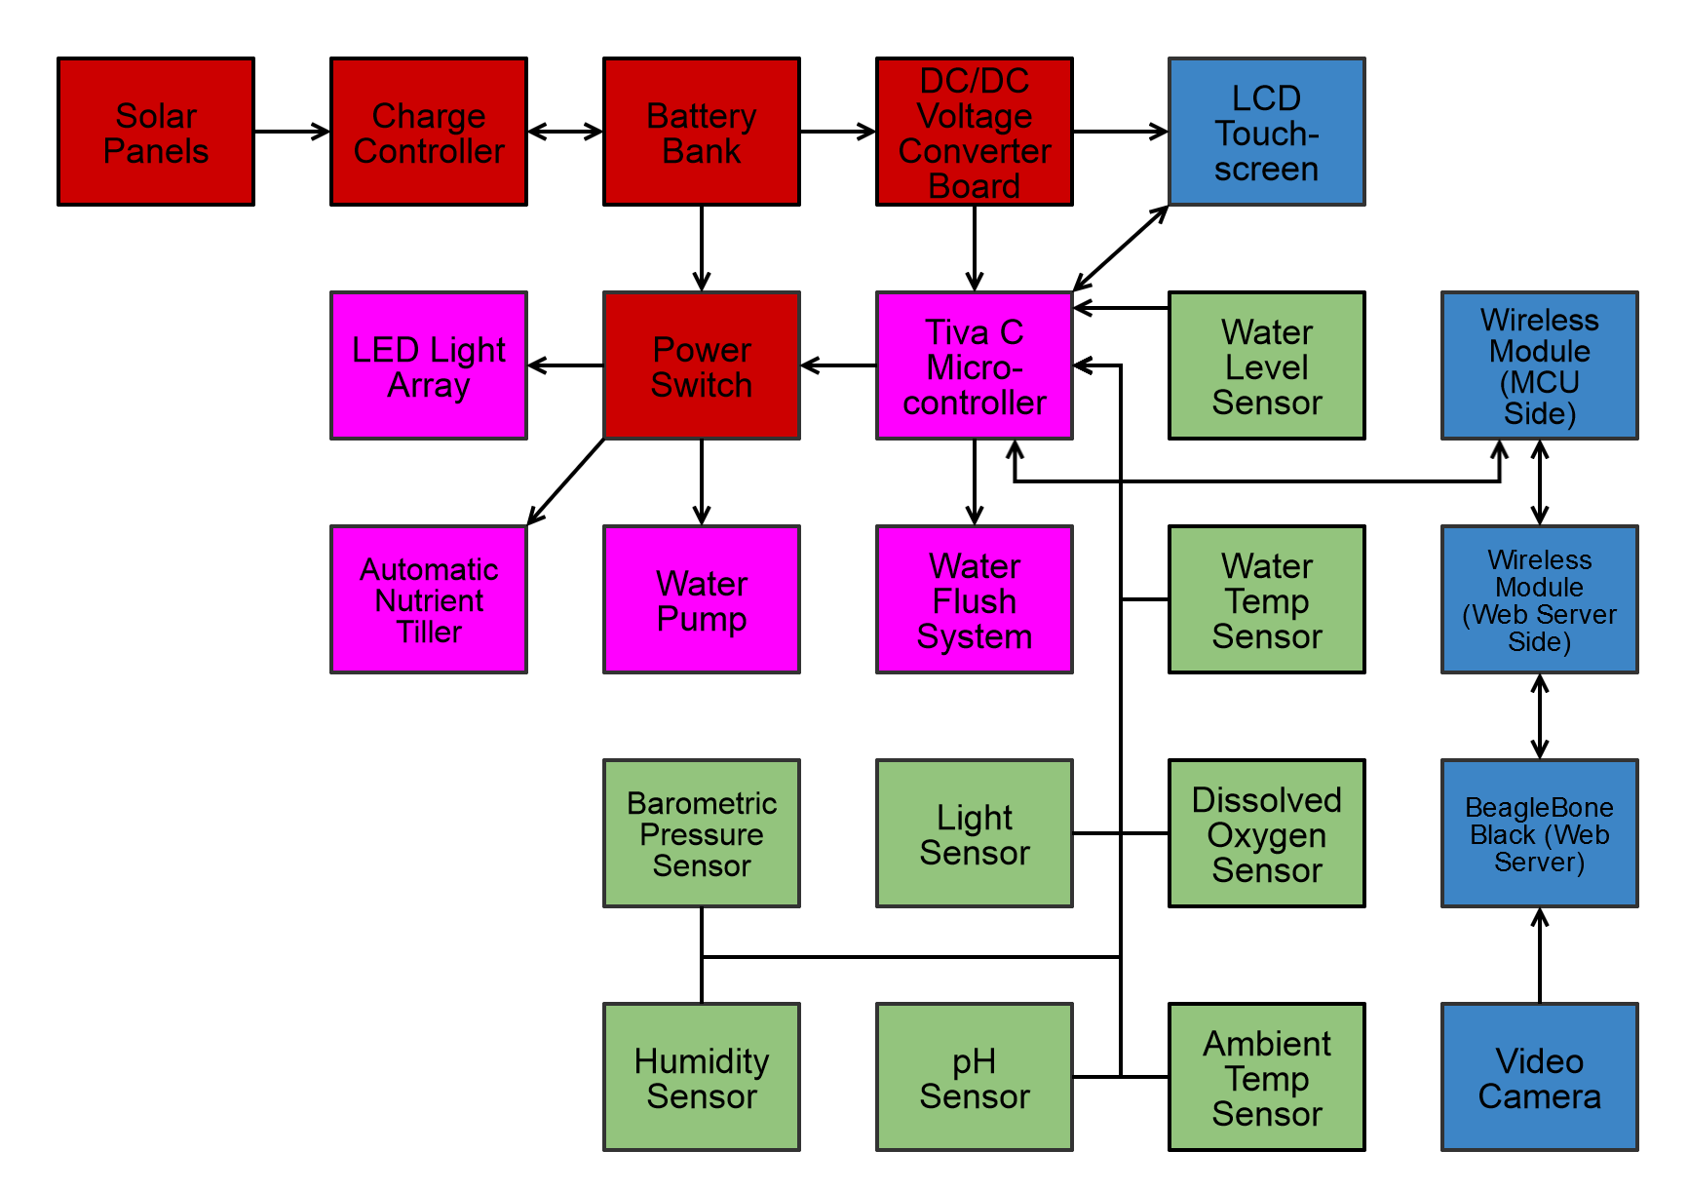
Hardware Block Diagram

Slide 7
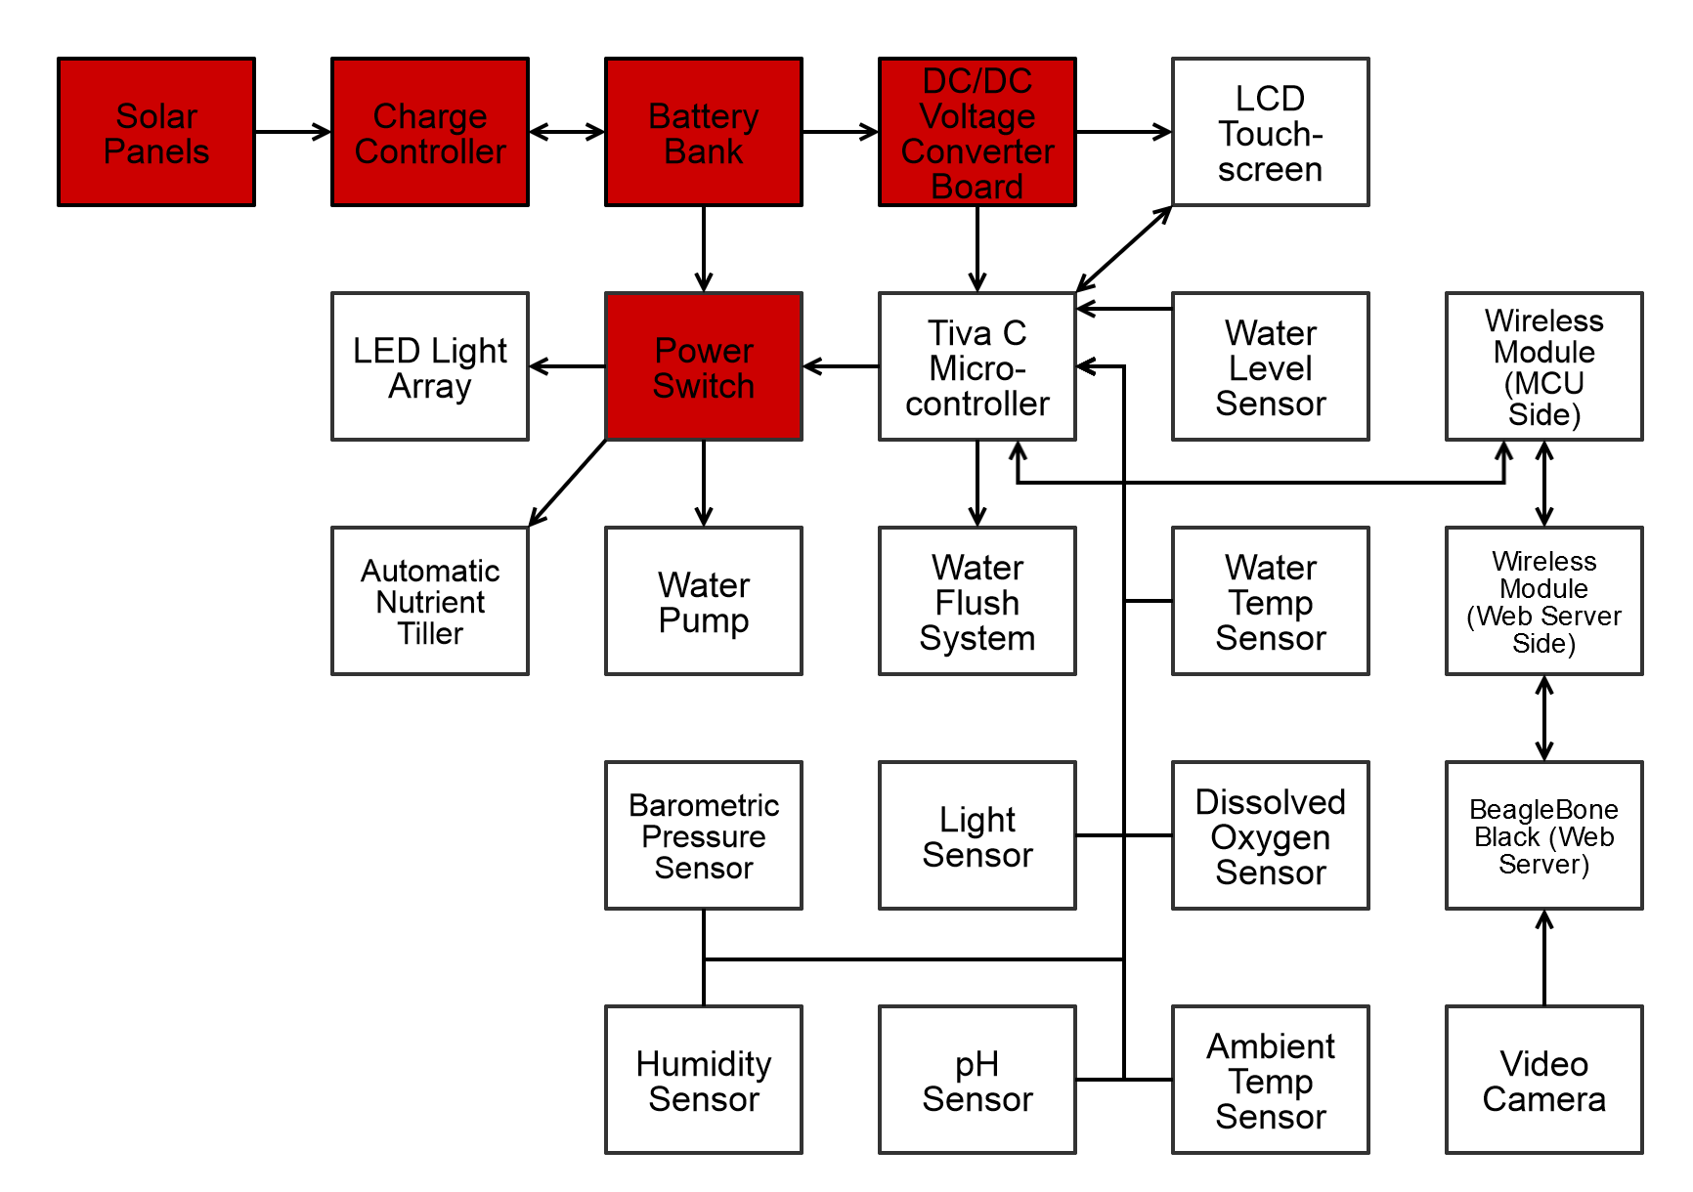
Power Distribution

Slide 8
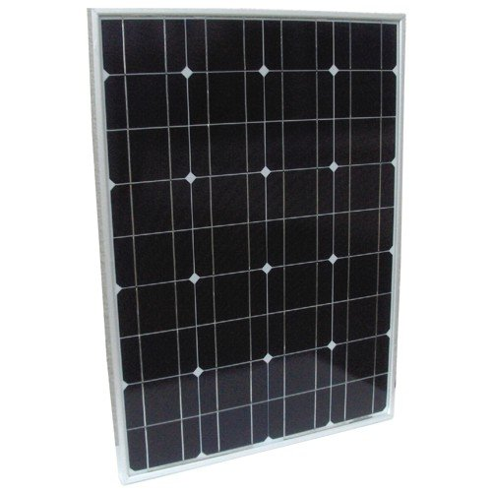
Solar Panel
HQRP Mono-Crystalline Solar Panel
  50 Watt Power Rating
  12V Operating Voltage
  Mono-Crystalline Solar Panel
  6.07kg (13.4lb) Weight
  53.3cm x 73..66cm x 3.81cm (21in x 29in x 1.5in) Dimensions
Figure 2

Slide 9
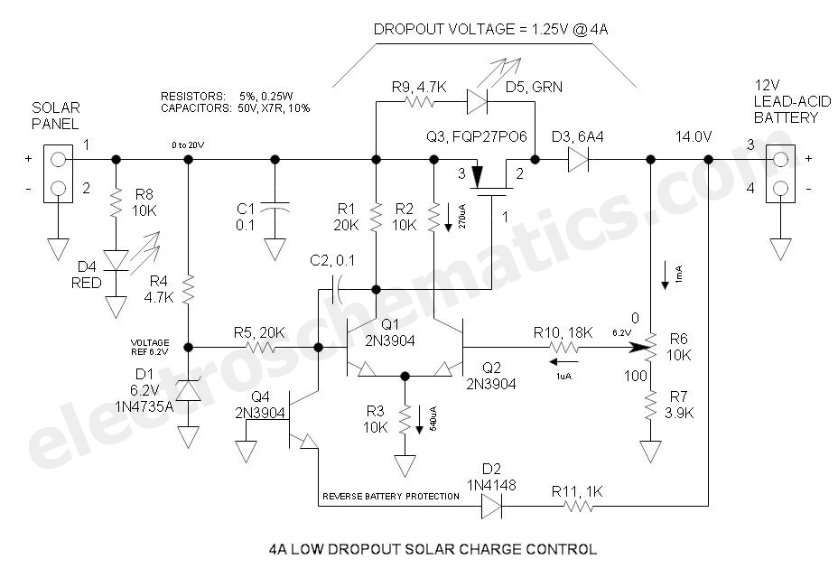
Solar Charge Controller
Specifications
  50W Solar Panel Input
  7V - 14V Adjustable Output
  Dropout Voltage of 1.25V @4A
  4A Maximum Current
  Charging of Sealed Lead Acid
  Reverse Battery Protection
Figure 3
Reference Design: Electroschematics

Slide 10
Selecting Battery Chemistery
Sealed Lead Acid
(SLA)
Lithium Iron Phosphate
(LiFePO4)
20% The Cost of LiFePO4
Low Charging and Discharging Complexity
Wide Operation Temperature Range -40C - 45C
No Battery Memory
Minimal Self Discharge
75% The Weight of SLA
Higher Charge Density
65% The Volume of SLA
7 Times The Life Cycle of SLA
No Harmful Elements
Minimal Voltage Sag

Slide 11
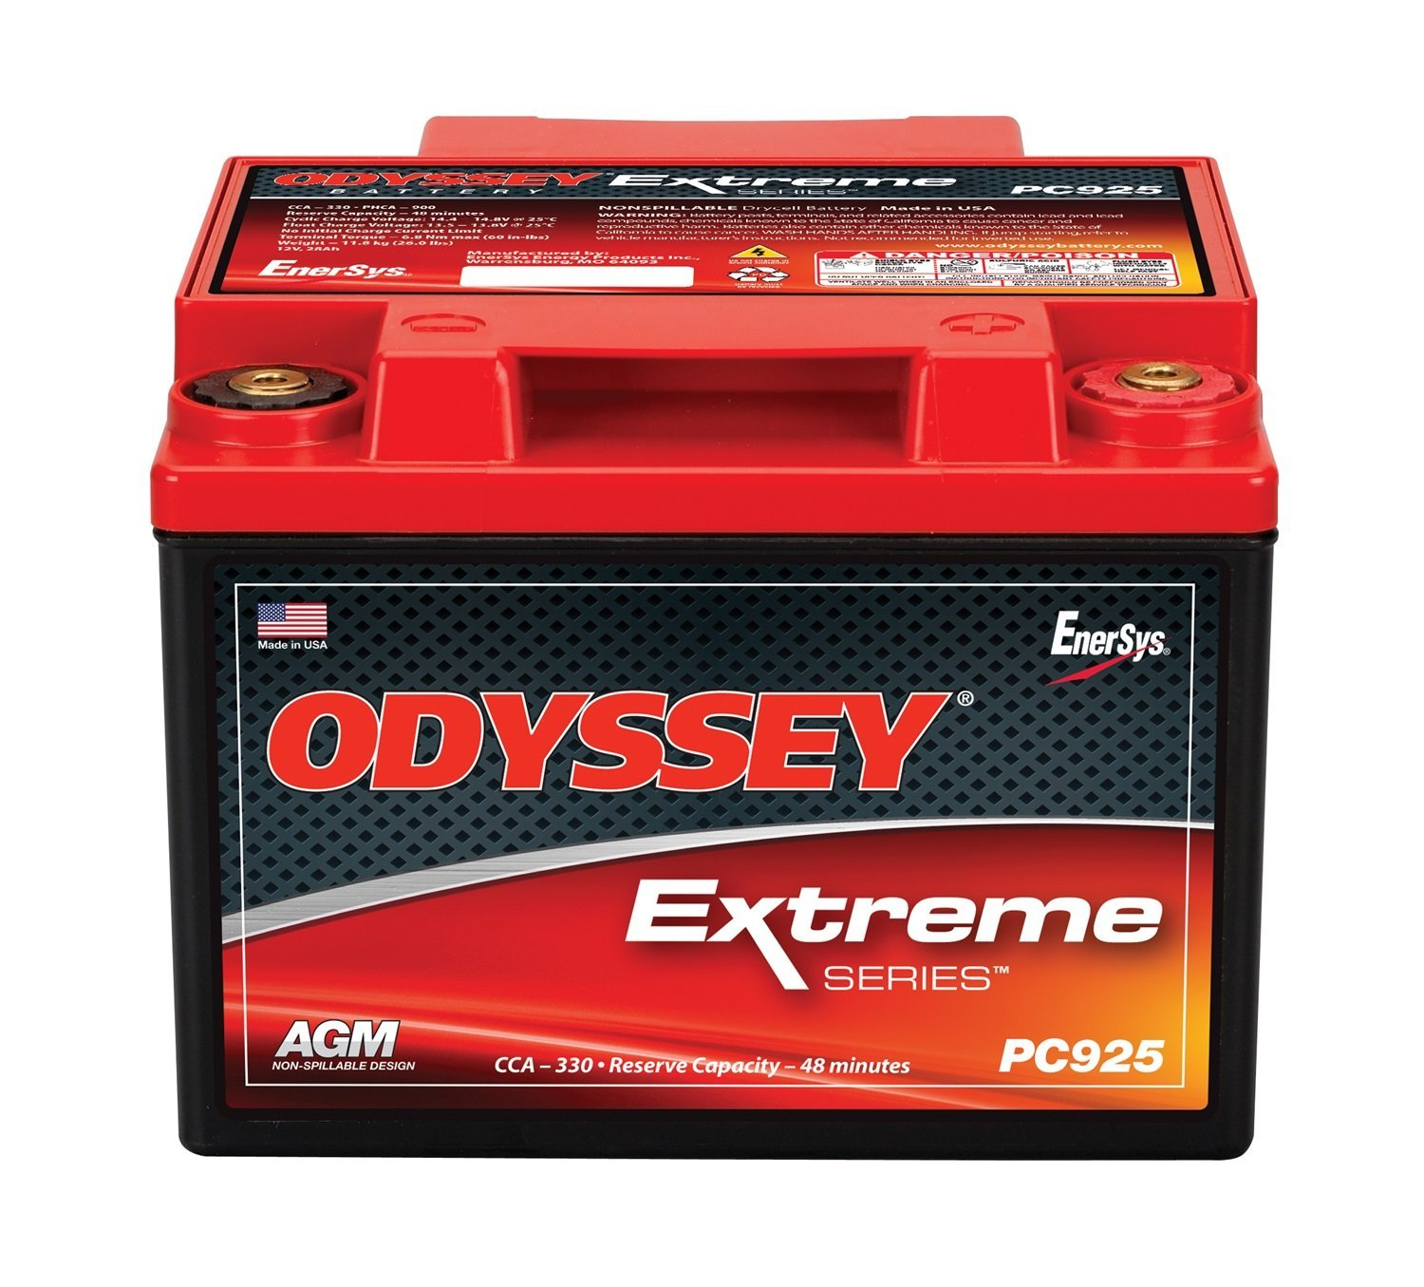
Sealed Lead Acid Battery
Odyssey PC925
  12V Nominal Voltage
  28Ah Capacity
  11.8kg (26lb) Weight
  M6 or SAE 3/8" Receptacle Terminals
Figure 4

Slide 12
Voltage Regulation
Goals
Need to Reduce the Voltage from the Battery.
Need to Output Multiple Voltages.
Since linear regulators are inefficient, and efficiency is important for our project, we decided to use switching voltage regulators.
An efficiency of 85% or greater for the regulators is a minimum, but a >90% efficiency is ideal.

Slide 13
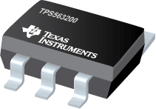
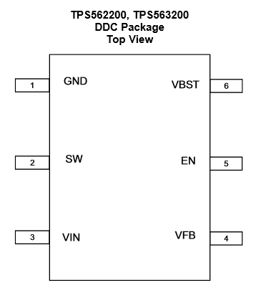
TPS563200 Switching Voltage Regulator
Overview
Description | Value
Input Voltage Range | 4.5V – 17V
Output Voltage Range | 0.76V – 7V
Feedback Voltage Accuracy | 1%
Operating Temperature | -40°C – 85°C
Efficiency | Varies (graph on next slide)
Table 3
Figure 5

Slide 14
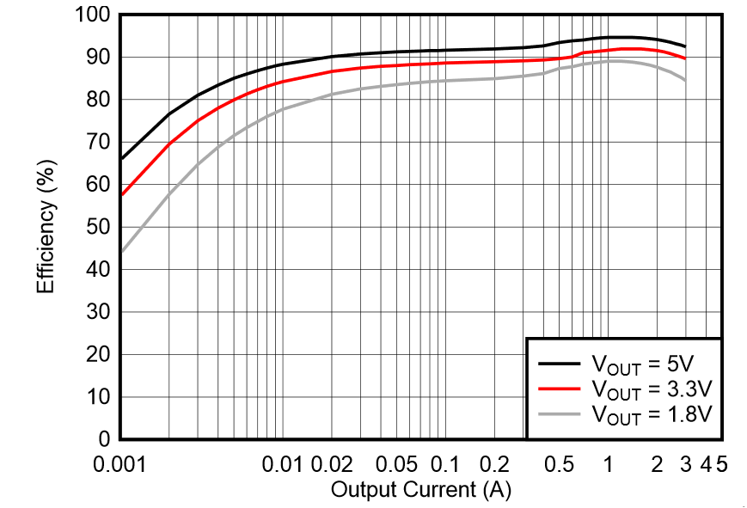
TPS563200 Switching Voltage Regulator Efficiency Graph
For 5V Output, Greater than
85% Efficiency at ~5mA,
Greater than 90% Efficiency
at ~20mA.
For 3.3V Output, Greater
than 85% Efficiency at
~15mA, Greater than 90%
Efficiency at ~600mA.
Figure 6

Slide 15
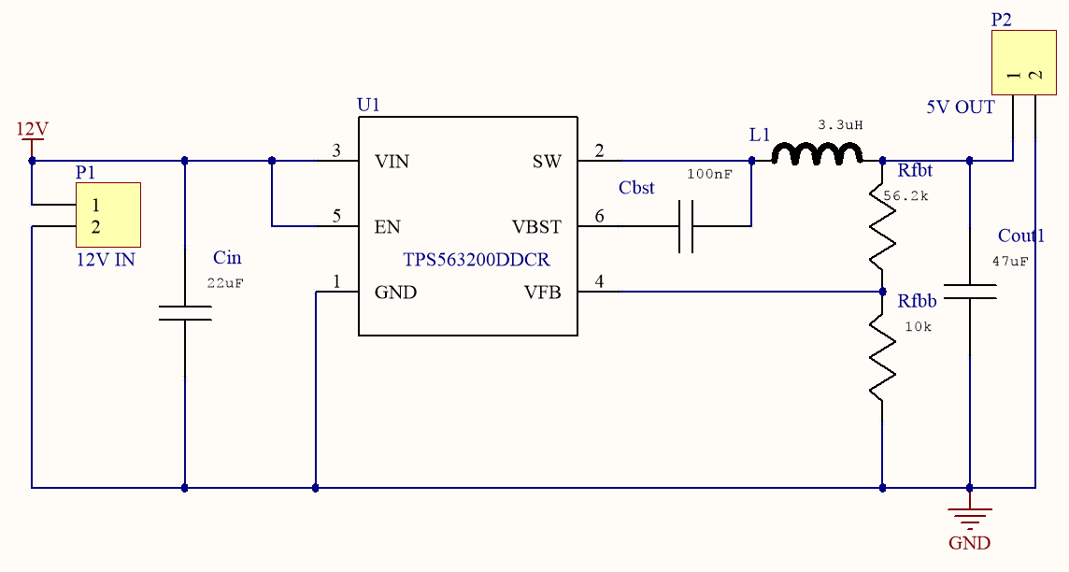
12V Input to 5V Output
Schematic Design
Figure 7
Based on Reference Design: Texas Instruments

Slide 16
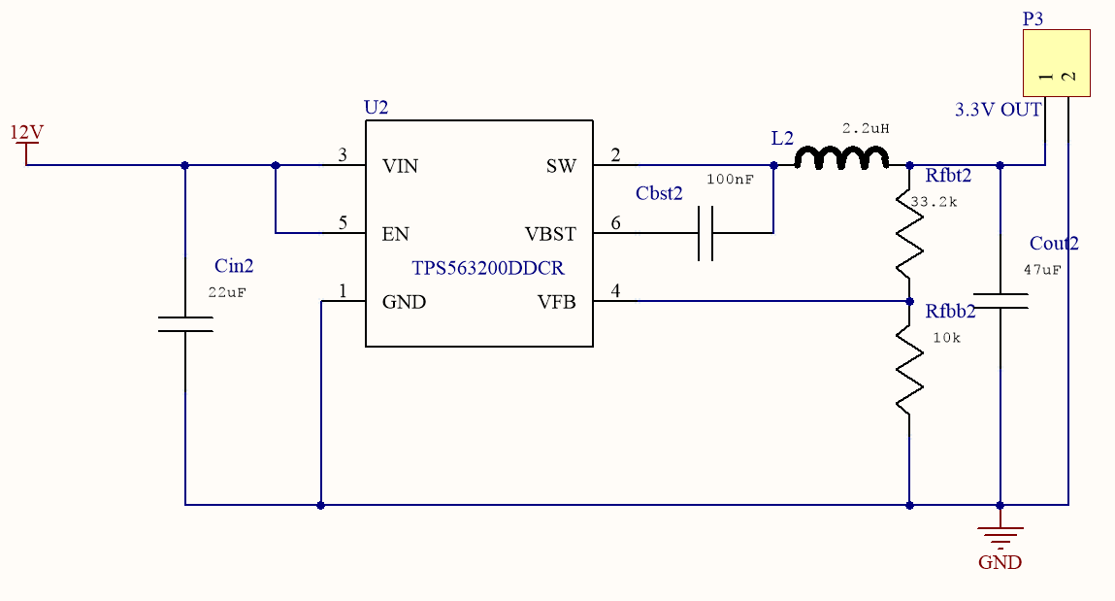
12V Input to 3.3V Output
Schematic Design
Figure 8
Based on Reference Design: Texas Instruments

Slide 17
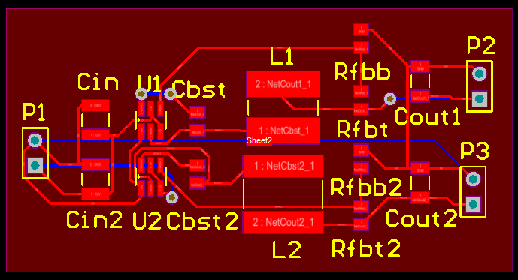
Complete Voltage Regulator
PCB Design
Figure 9

Slide 18
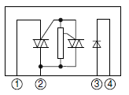
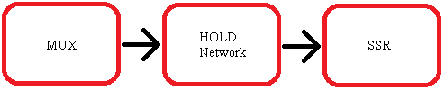
Power Switch
Receive TTL Commands to Selectively Engage
Hydroponic Automation Subsystems.
Multiplexor to Solid State Relays
  Hold Circuit to Hold MUX Output
  MUX = CD74HC4067
  SSR = S108T02
Modulate
  Water Pump
  LED Light Array
  Solenoid Valves
  Nutrient Tiller
Solid State Relay - SHARP Datasheet
Figure 10a
Figure 10b

Slide 19
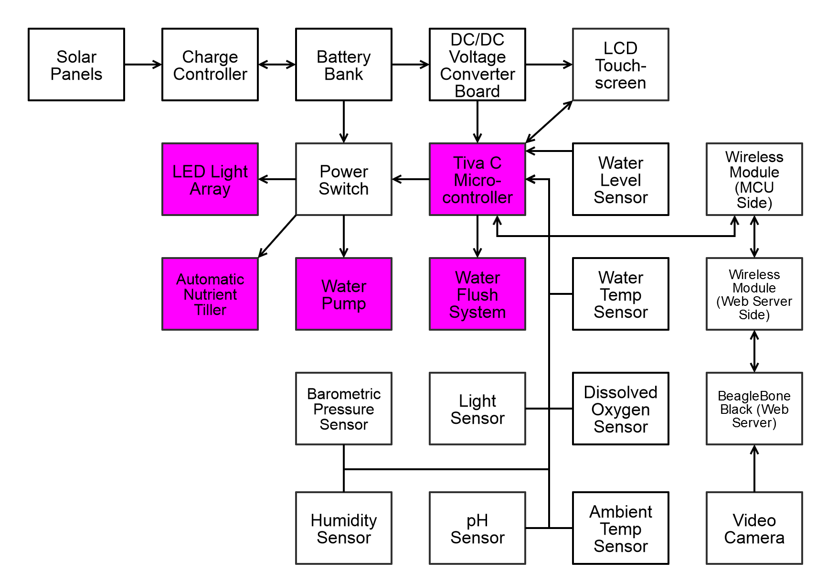
Power Switch Control

Slide 20
The Microcontroller
Project Requirements:
  Take Sensor Readings From 5 Separate Devices
  At Least 4 GPIO Necessary For Automation Subsystems
  Communicate to Web Server Wirelessly
  Display Sensor Readings Locally on an LCD Display
Summary:
  At Least 1 I2C And 2 SPI Ports
  At Least 1 UART For Debugging Over Serial
  Min. 32kB of Space For User Code

Slide 21
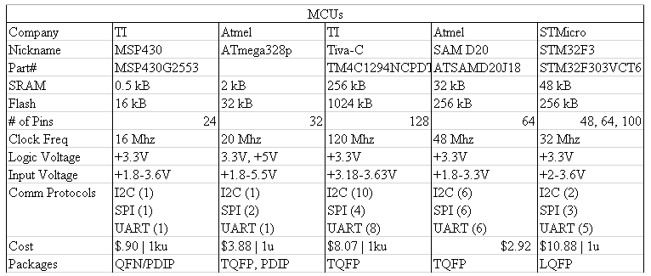
Microcontroller - Comparisons
Table 4

Slide 22
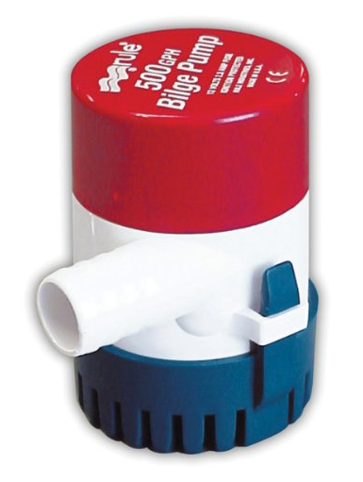
Automation Subsystems - Water Pump
Boat Bilge Pump
  500 Gallons per Hour
  12VDC @ 2Amps
  Submersible
  MSRP $30 - Donated to Project
Figure 11

Slide 23
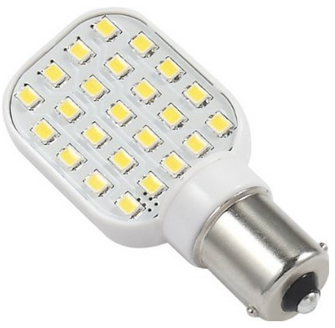
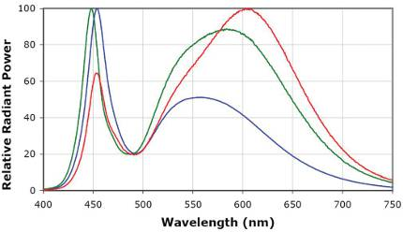
Automation Subsystems - LED Array
RV LED Lights
  250 Lumens
  12VDC @ 200mA
  Sufficient Spectrum for Plants
  MSRP $8 per Bulb
Figure 12
Figure 13

Slide 24
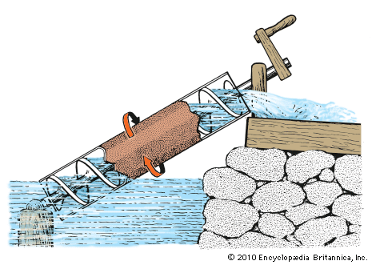
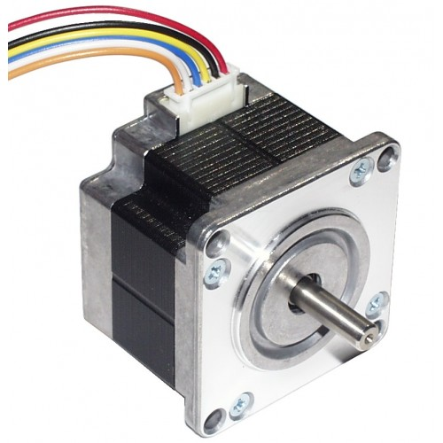
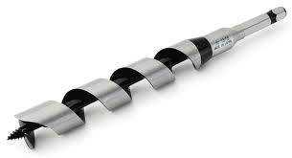
Automation Subsystem - Nutrient Tiller
"Archimedes Water Screw" Design
Stepper Motor
  Step Angle = 3.6 deg
  12VDC @ 150mA per Phase
  Auger Bit Mounted to Till Nutrient Solute
Figure 16
Figure 15
Figure 14

Slide 25
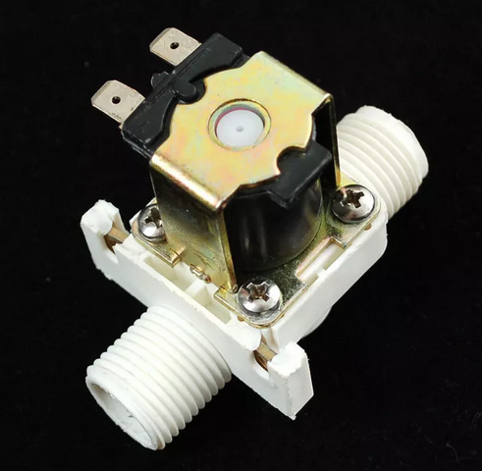
Automation Subsystem - Water Flush
Solenoid Valves Between Water Pump and Hydroponic System Intake
Flush Water Reservoir
  Out of Range Ph Value
  Watchdog Limit: 1 Week
Solenoid Valves
  12V @ 400mA
  Off-State = Valve Closed
  One Valve Active At A Time
Figure 17

Slide 26
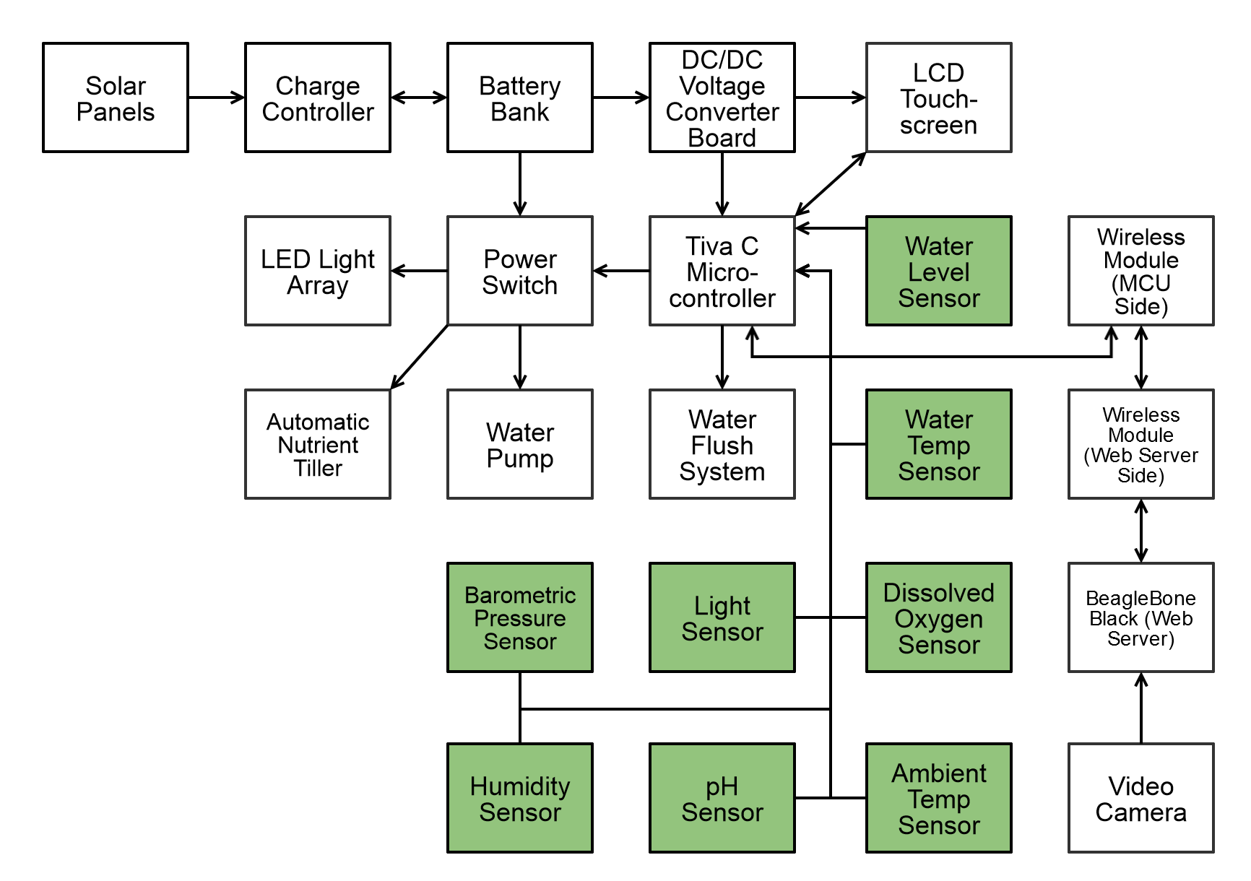
Sensors

Slide 27
Types of Sensors
Ambient Light Sensor
Ambient Temperature Sensor
Ambient Humidity Sensor
Barometric Pressure Sensor
Water Level Sensor
Water Temperature Sensor
pH Sensor
Dissolved Oxygen Sensor

Slide 28
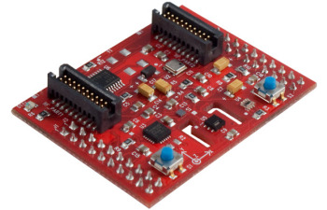
Texas Instruments Sensor Hub
Sensirion SHT21
  Humidity Sensor
  Ambient Temperature Sensor
Intersil ISL29023
  Ambient Light Sensor
  Infrared Light Sensor
TMP006
  Non-Contact Infrared Temperature Sensor
Bosh Sensortec BMP180
  Barometric Pressure Sensor
Figure 18

Slide 29
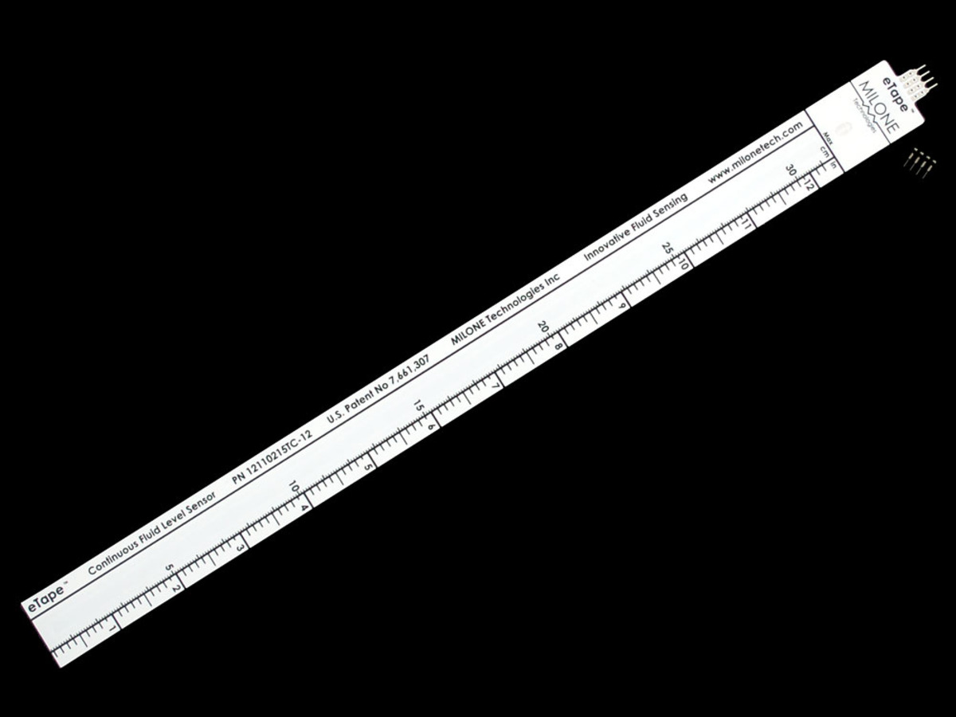
Water Level Sensor
eTape Continuous Fluid Level Sensor PN-12
  12" Long
  Resistive Output
  0.25mm (0.01") Resolution
  1500Ω (Empty) - 300Ω (Full)
  0.5W Power Rating
  -9C - 65C Temperature Range
Figure 19

Slide 30
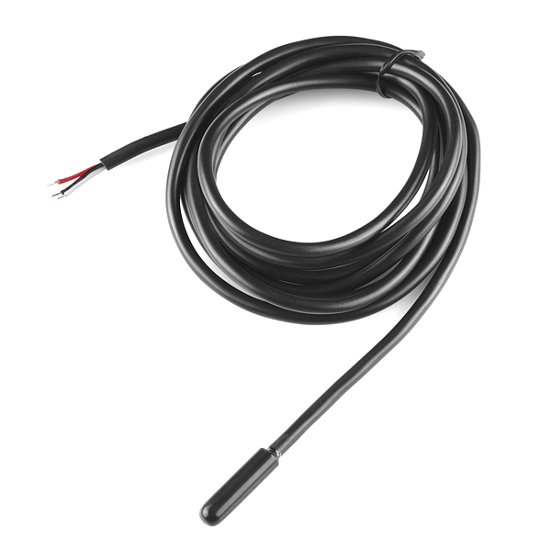
Water Temperature Sensor
Waterproof DS18B20
  Digital Water Temperature Sensor
  3V - 5V Operating Voltage
  9 - 12 bit Selectable Resolution
  0.5C Accuracy
  -10C - 85C Temperature Range
Figure 20

Slide 31
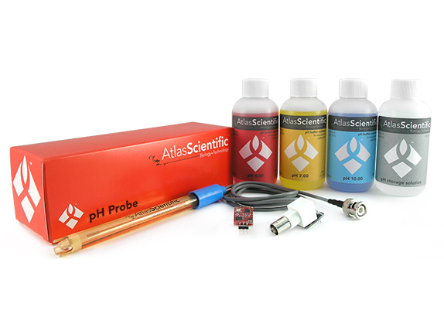
pH Sensor
Atlas Scientific EZO Embedded pH Sensor
  UART or I2C Protocol
  3.3V - 5V Operating Voltage
  0.001 - 14 pH Range Readings
  0.02pH Resolution
  Waterproof Probe
  0.995mA at 3.3V Sleep Mode
Figure 21

Slide 32
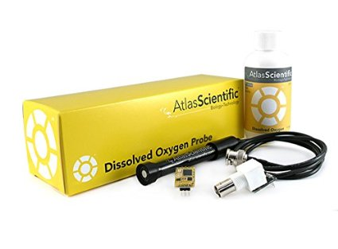
Dissolved Oxygen Sensor
Atlas Scientific EZO Embedded Dissolved Oxygen Sensor
  UART or I2C Protocol
  3.3V - 5V Operating Voltage
  0 - 20 mg/L Readings
  0.1 mg/L Resolution
  Waterproof Probe
  0.995mA at 3.3V Sleep Mode
Figure 22

Slide 33
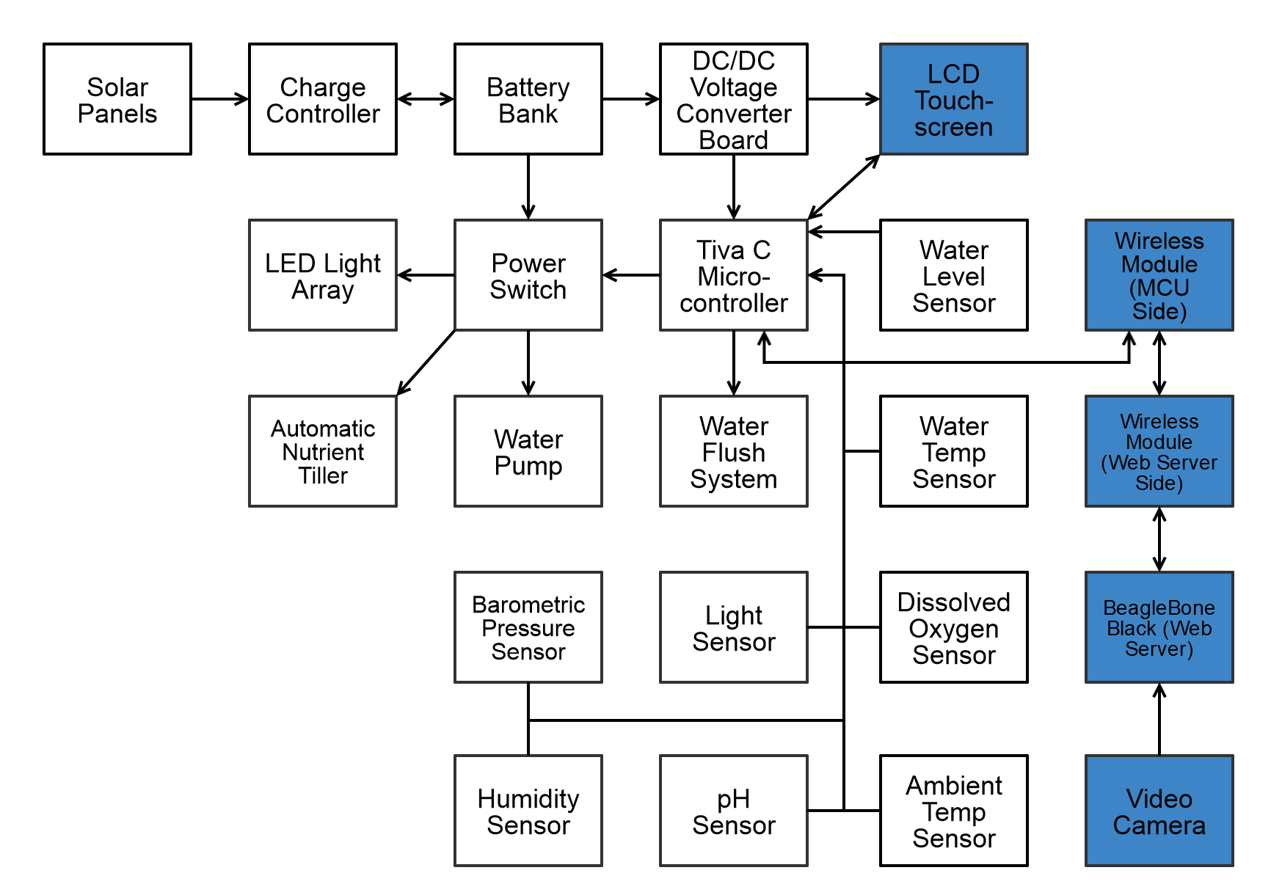
User Interface

Slide 34
User Interface
Specifications
A Web-Based and LCD Touchscreen Based Interface.
View Current Sensor Readings and Threshold Alerts.
Ability to Manipulate Alert Thresholds.
Manually Activate Numerous Parts of the System.
  A Resistive Touch LCD Screen for Control at the Site.
  Beaglebone Black Web Server for Remote Viewing and Control.
Around 5 Minute Sensor Refresh
Ability to Manually Refresh Sensors.
Straightforward and Simple to Use UI.

Slide 35
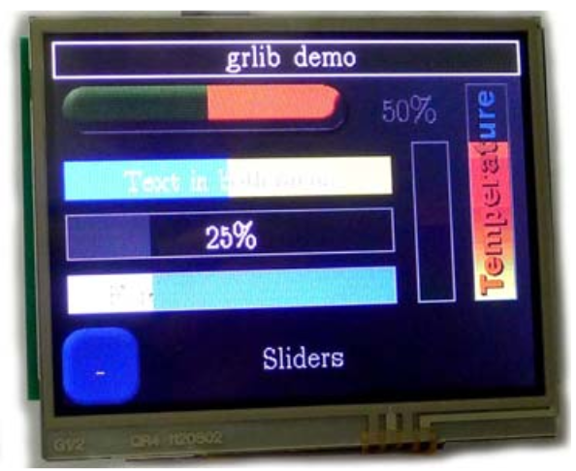
Kentec 3.5” LCD Touchscreen
Overview
Decent Size.
Can Fit Multiple Elements on Screen Easily.
Touchscreen Allows Ease of Use of Control
of the System.
Supported by Texas Instruments’ Graphics
Library.
Parallel Data Connection.
Figure 23

Slide 36
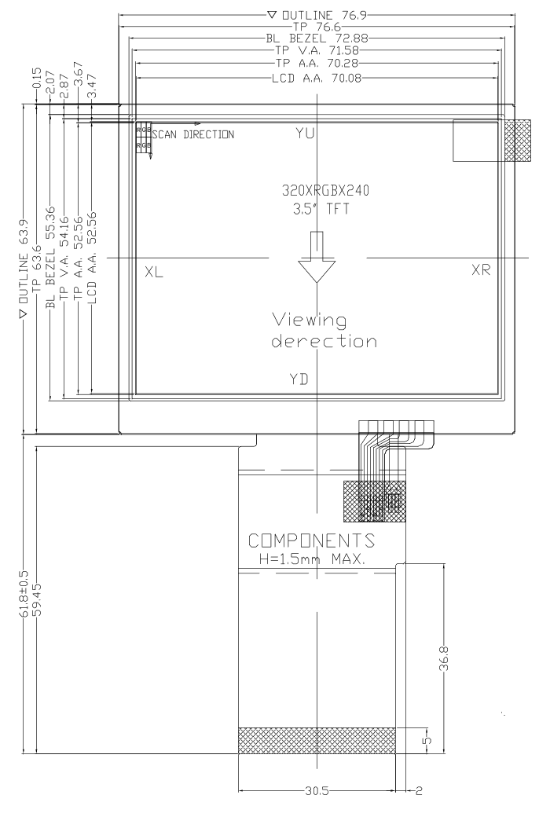
Kentec 3.5” LCD Touchscreen
Specifications
 | Value
Operating Voltage | 3.3V & 5V
Resolution | 320 x 240
Interface | 16-bit parallel
Operating Temp. | -20 – 70°C
Table 5
Figure 24

Slide 37
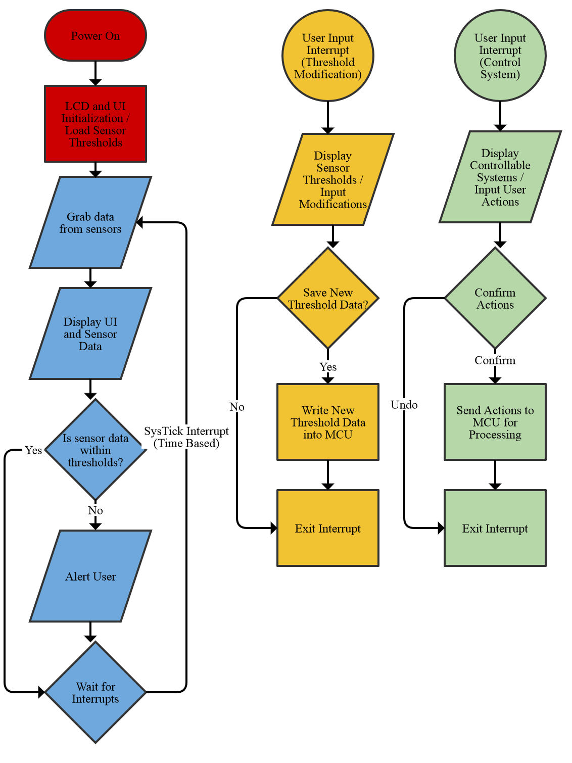
LCD Touchscreen Flowchart

Slide 38
Web-based Interface
Goals
In Addition, a Similar Featured Web Interface to the LCD Interface.
Adds a Database for History.
Manipulate Alert Thresholds and Control Subsystems.
Can Access the System Remotely, No Need to Be at the Location.

Slide 39
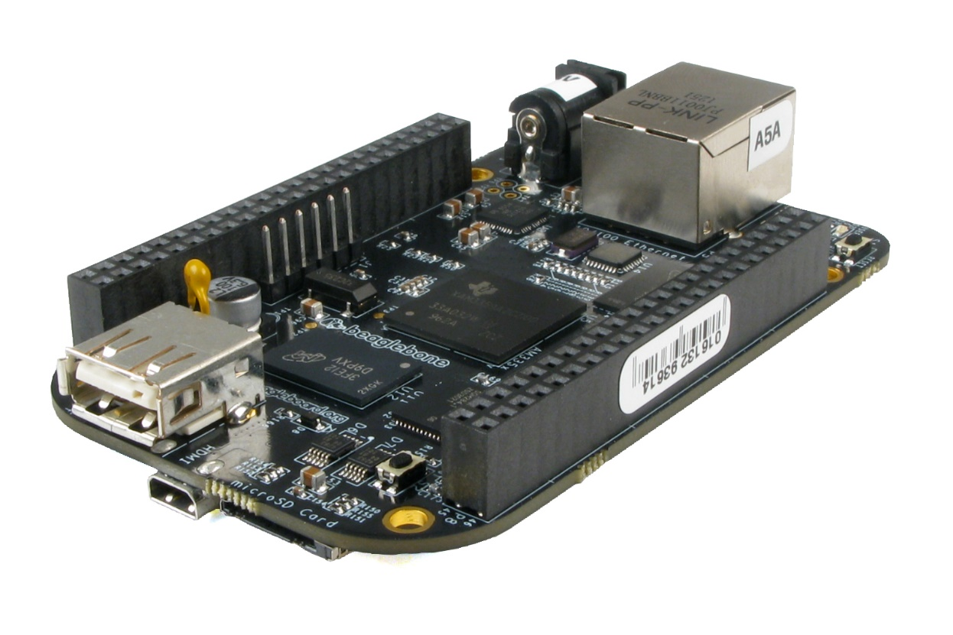
BeagleBone Black
Overview
Open Source Hardware and Tons of Documentation.
69 GPIO Pins, Easy to Interface With.
4GB On-Board eMMC, No Need for a microSD Card.
Low Power Consumption
(between 1-2W).
Free from the Innovation Lab.
Large Community.
Built-in Simple to Use Node.js Web Server.
Figure 25

Slide 40
Wireless Module
Goals
Needed a Longer Range Communication Device Between MCU and BeagleBone Black.
Wires Not Practical, a Wireless Approach is Needed.
Should Use Low Power
Should Have 10-15 Meter Range
Should Be Less Than $20
Should Be Easy to Implement

Slide 41
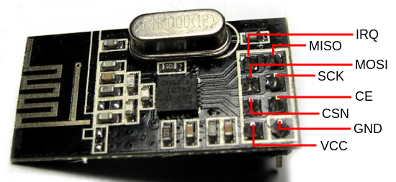
NRF24L01+ Wireless Transceiver
Overview
Uses 2.4 – 2.525 GHz RF
Can Use up to 126 Channels
Range of About 30 Meters
Powered by 3.3V (Same as
MCU and Beaglebone Pins)
Uses SPI for Communication
Has an Interrupt Pin
Has an Ultra Low Power Mode
Only About $7 for a Pair
Figure 26

Slide 42
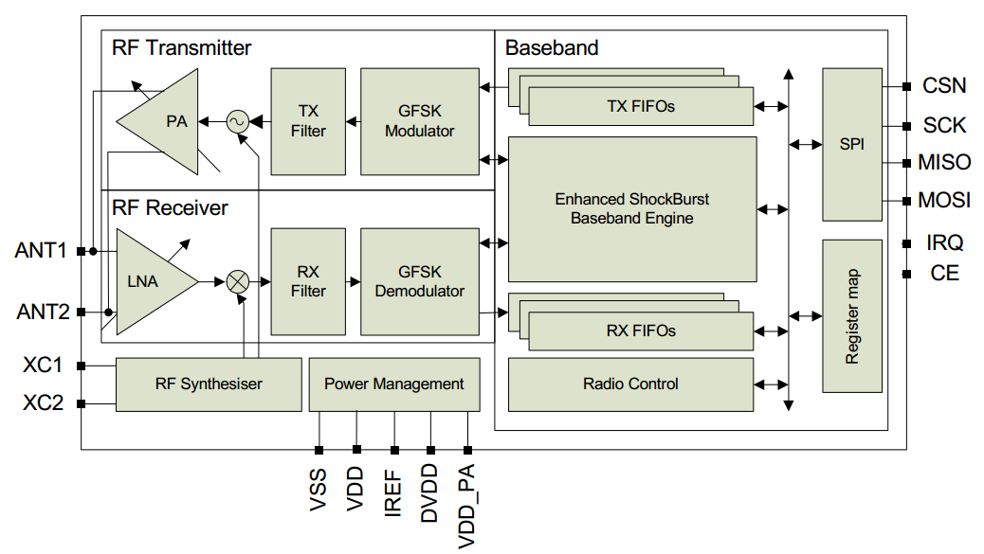
NRF24L01+ Wireless Transceiver
Specifications & Block Diagram
 | Value
Operating Voltage | 1.9 – 3.6V
Maximum Current Draw | 13.5mA
Standby Current Draw | 26µA
Data Rates | 250kbps, 1Mbps, 2Mbps
Operating Temp. | -40 – 125 °C
Figure 27
Table 6

Slide 43
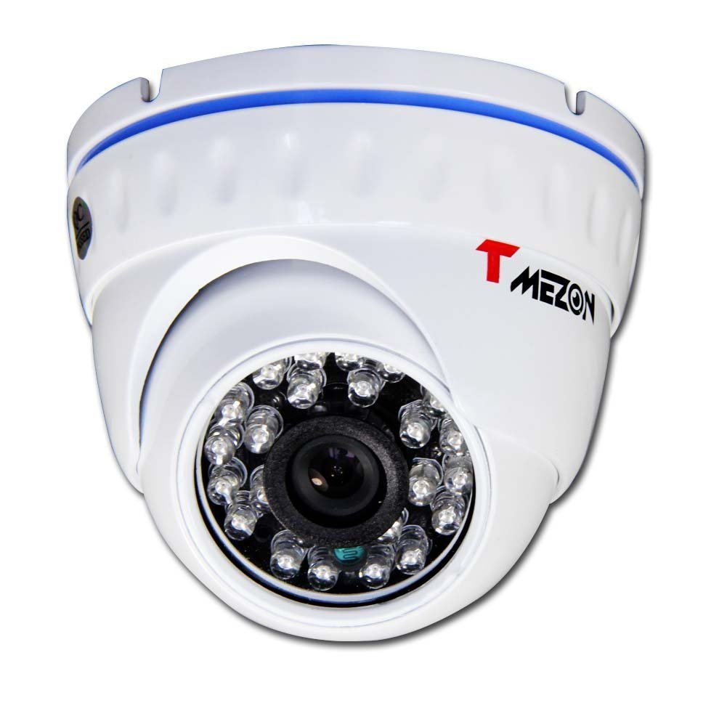
Camera
TMEZON Outdoor IP Camera
  1.0 Mega Pixels
  720p
  24 IR LEDs
  Night Vision
  Power Over Ethernet (POE)
  Weatherproof
  IP66 Water Resistance
  Self Hosting IP Camera Stream
  WiFi 802.11 b/g/n Compliant
Figure 28

Slide 44
Administrative Content
Progress Chart

Slide 45
Administrative Content
Work Distribution
 | David | James | Jon
PCB Design | X | X | X
Web Server | X
Sensor Integration |  | X
Control Signals Integration |  |  | X
LCD Screen | X
Power Distribution | X | X | X
Pump, Tiller, Hydroponics System |  |  | X
Table

Slide 46
Administrative Content
Budget
Device | Device Type | # of Units | Price per Unit
Solar Panel | Power Distribution | 1 | $103.95
Battery | Power Distribution | 1 | $152.95
Sensor Hub | Sensor | 1 | Free (TI Innovation Lab)
Water Level Sensor | Sensor | 1 | $39.99
Water Temperature Sensor | Sensor | 1 | $9.95
pH Sensor | Sensor | 1 | $105.95
Dissolved Oxygen Sensor | Sensor | 1 | $199.95
Camera | User Interface | 1 | $43.99

Slide 47
Administrative Content
Budget (cont)
Device | Device Type | # of Units | Price per Unit
LCD Touch Screen | User Interface | 1 | $33.25
BeagleBone Black | User Interface | 1 | Free (TI Innovation Lab)
Tiva C TM4C1294 | Microcontroller | 1 | Free (TI Sample)
TPS563200 | Voltage Regulator | 2 | Free (TI Sample)
Various passive devices | Passives for Regulator | Multiple | $1.43 for all
Wires | Wires | 1 set of 120 | $9.99 per set
Bilge Pump | Water Pump | 1 | $33.99
nRF24L01+ | Wireless Module | 2 | $3.42
Solid-State Relays | Active Device | 4 | $4.99
LED Bulbs | Light | 2 | $30.99

Slide 48
Administrative Content
Budget (cont)
Device | Device Type | # of Units | Price per Unit
Auger Bit | Hardware | 1 | $11.99
Stepper Motor | Motor | 1 | Free
Solenoids | Active Devices | 2 | $12.99
3/4" Hosing | Hardware | 4 | $3.95
 |  | Total | $803.72
 |  | Duke Funding | $1250.00
 |  | Remaining Funds | $446.28
Table 7

Slide 49
Constraints
Time (Shorter Semester)
Money (Cost vs Performance)
Practical Experience
Mechanical Design Knowledge
Manufacturing
  No Low Cost Pick and Place
  No Low Cost Reflow Station
  No Low Cost and High Quality PCB Design Software Package

Slide 50
Difficulties and Successes
Difficulties
  Software Development With Only Electrical Engineers
Successes
  Wireless Communication Between the MCU and BeagleBone Black
  Completed Hydroponic System
  Learning a Large Amount of Practical Design Applications

Slide 51
Immediate Plans
Finish PCB Designs
Order PCB Designs
Complete Sensor Interfacing
Develop Code for Subsystem Integration
Develop Code for Web Server
Develop Code for LCD Interface

Slide 52
Figure Sources
Figure 1 - http://hydroponie.fr/mendota-hydroponie-production-local-solution-global/
Figure 2 - http://www.amazon.com/HQRP-Mono-crystalline-Anodized-Aluminum-Warranty/dp/B002OSAB28
Figure 3 - http://www.electroschematics.com/6899/12v-ldo-solar-charge-control/
Figure 4 - http://www.amazon.com/Odyssey-PC925-Automotive-LTV-Battery/dp/B0002ILK72
Figure 5 - http://www.ti.com/product/TPS563200/datasheet
Figure 6 - http://www.ti.com/product/TPS563200/datasheet
Figure 10a - http://cdn.sparkfun.com/datasheets/Components/General%20IC/S108,208T02%20Series.pdf
Figure 11 - www.amazon.com
Figure 12 - www.amazon.com
Figure 13 - http://www.electronicsweekly.com/
Figure 14 - http://www.robosoftsystems.co
Figure 15 - www.fine-tools.com
Figure 16 -
Figure 17 - www.adafruit.com
Figure 18 - http://www.ti.com/tool/boostxl-senshub
Figure 19 - http://www.adafruit.com/products/464
Figure 20 - https://www.sparkfun.com/products/11050
Figure 21 - http://atlas-scientific.com/product_pages/kits/ph-kit.html
Figure 22 - http://atlas-scientific.com/product_pages/kits/do_kit.html
Figure 23 - http://www.kentecdisplay.com/uploads/soft/Products_spec/EB-LM4F120-L35_UserGuide_04.pdf
Figure 24 - http://www.kentec.com.hk/images/UploadFile/20111115190922-7.pdf
Figure 25 - http://www.logicsupply.com/blog/2013/05/23/beaglebone/
Figure 26 - http://web.uvic.ca/~andpol/project5.html
Figure 27 - https://www.nordicsemi.com/eng/content/download/2726/34069/file/nRF24L01P_Product_Specification_1_0.pdf
Figure 28 - www.amazon.com

Slide 53

QUESTIONS?

