Slide 1

The
Diabetic
Breathalyzer
Group 13
Jon Brown EE
Christine Sleppy EE
Noah Spenser EE
Edert Geffrard EE

Slide 2
Project Motivation
29.1 million Americans have diabetes
Proper management of this disease requires picking the finger many times per day
The Diabetic Breathalyzer will be a noninvasive option

Slide 3
Project Goals
The typical breathalyzer we are familiar with takes measurements of ones blood alcohol concentration
Our goal is to create a breathalyzer that can measure ones blood glucose concentration

Slide 4
Breath Analysis
The majority of breath is made up of nitrogen, oxygen, carbon dioxide, water, and inert gases
The rest of the content found in one’s breath is a small fraction consisting of thousands of volatile organic compounds (VOC) with concentrations in unit of ppm (parts per million)
These VOC’s provide the link between breath analysis and clinical diagnosis

Slide 5
Objectives
Hand-held design
Accurate VOC Sensor
Status LED
Wireless Communication
Rechargeable Battery

Slide 6
Specifications
Component | Parameter | Specification
Enclosure | Unit Dimensions | 140x80x30 mm
TGS822 Sensor | High Concentration | 50-1000 ppm
 | Volts | 5 V
WSP2110 Sensor | Low Concentration | 1-50 ppm
 | Volts | 5 V
DHT22 Sensor | Temperature | -40-80° Celsius (+/-0.5°)
 | Humidity | 0-100% RH (+/- 5%)
 | Volts | 3.3 V
Bluetooth | Volts | 3.3/5 V
 | Frequency | 2.4GHz
 | Range | 0-30 meters
Battery | Rechargeable lithium ion polymer | >3400 mAh

Slide 7
Project Hardware Design

Slide 8
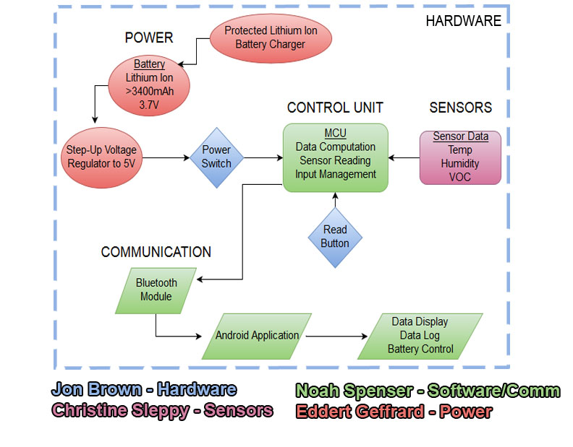
Overall Block Diagram

Slide 9
Power
Our device must be relatively lightweight
It must be portable
The battery must be rechargeable with the ability to last an entire day
These requirements create a specific need for the type of power system our device has
Goes along the lines of standard use for a cell phone type device

Slide 10
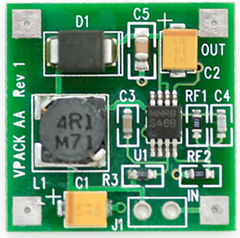
Power
Lithium ion batteries come in increments of 3.7 V for each cell
The sensor heaters run on 5V
DC to DC step up Vpack
These can be built by hand on the PCB with various components

Slide 11
Step-up vs. Step-down
Step-up | Step-down
Lower efficiency with respect to the step-down regulator, but still >90% | Higher efficiency for the step down regulator over the step up.
More space efficient for the component and with being able to use a single cell battery instead of two. | Component itself is larger and would require 2 cells to power.
Overall costs will be lower since we only have to use a single cell. | Overall costs would be higher having to use multiple cells to reach the needed voltage.

Slide 12
Power
Simple 5V power source from Bodhilabs
This PCB uses a source of 1.1V to 4.5V and generates 5V using a DC to DC step up circuit
Perfect for all those 5V applications that need to be small
Run on less than 300mA from a variety of power cells

Slide 13
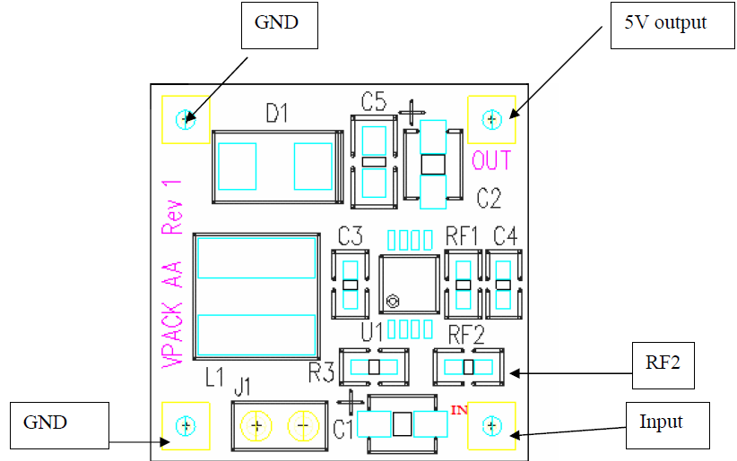
Power

Slide 14
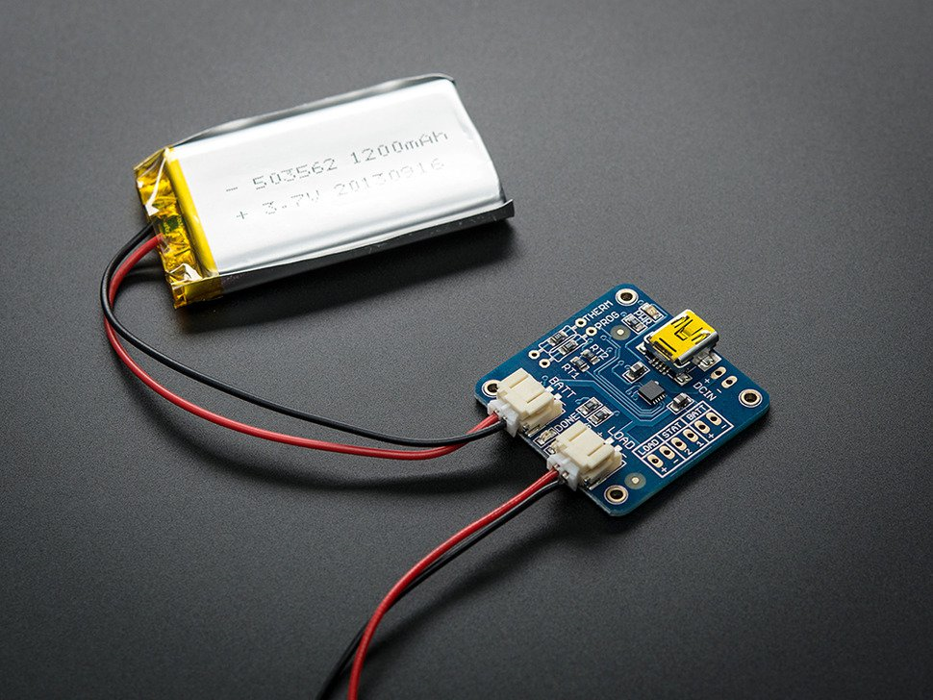
Power Recharge
This is a Lithium Ion and Lithium Polymer battery charger based on the MCP73833.
Uses a USB mini-B for connection to any computer or 'USB wall adapter'.
Three stages of charging: first a preconditioning charge, then a constant-current fast charge and finally, constant-voltage trickle charge.
Automatic End-of-Charge Control

Slide 15
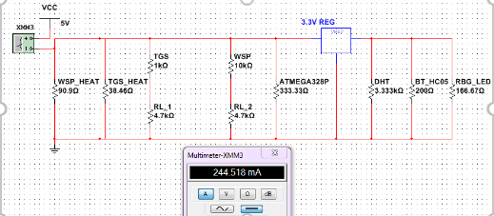
Current Draw
Once we have the regulated 5V, the use of basic linear regulators can be used when 3.3V is required. With lower current demand, it is sufficient.
Overall estimated current draw is about 250mA.

Slide 16
Control Unit
 | ATtiny85 | ATMega328p | ATSAMB11
Cost ($) | 0.77 | 1.80 | 9.81
Flash (kB) | 8 | 32 | 256
Pin Count | 8 | 32 | 58
Max I/O Pins | 6 | 23 | 30
Built-in Bluetooth Support | No | No | Yes

Slide 17
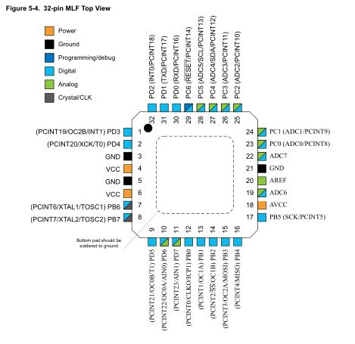
ATMega328p
Has digital and analog pins, both of which needed
Large enough (32kB) flash memory to store code and any data logged
32-pin MLF package takes up minimal room (~5mmx5mm)
Easily programmable with Arduino IDE and ISP configuration

Slide 18


WiFi vs. Bluetooth
WiFi Bluetooth
High power consumption
Distance between devices ranges up to 100 meters
Designed to connect devices to a network
Readily available in many areas
Consumes less power
Distance between devices ranges up to 30 meters
Designed for devices to interact with each other
Bluetooth is on every smartphone

Slide 19
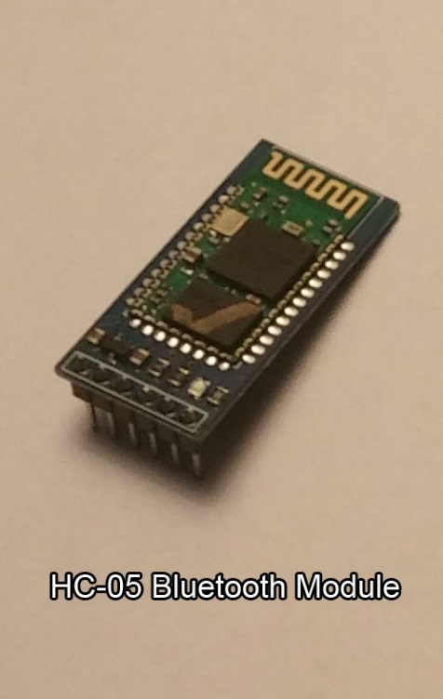
Communication
HC-05 BT Module:
Can run on 3.3V or 5V od DC power.
Communication over RX and TX serial pins.
During communication draws up to 40mA of current.
Can make easy connection to any Bluetooth enabled device.

Slide 20
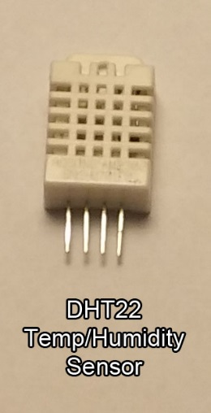
Temperature/Humidity Sensor
DHT22:
VOC sensors dependent on current temperature and humidity values.
Uses digital pin to transmit data.
Range of -40-80 degrees Celsius.
Runs on 3.3V and draws minimal current, (<1mA)
Functions properly in high humidity.

Slide 21
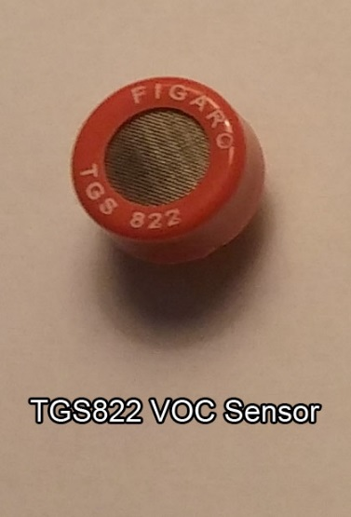
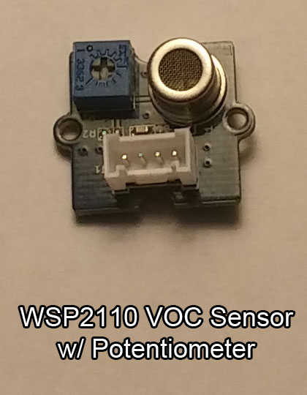
VOC Sensors
TGS822: 50-1000 ppm detection range. ~600mA current draw at 5V Uses voltage divider circuit on PCB to monitor resistance change. | WSP2110: 1-50 ppm detection range. ~300mA current draw at 5V Uses built in voltage divider on module with adjustable potentiometer.

Slide 22
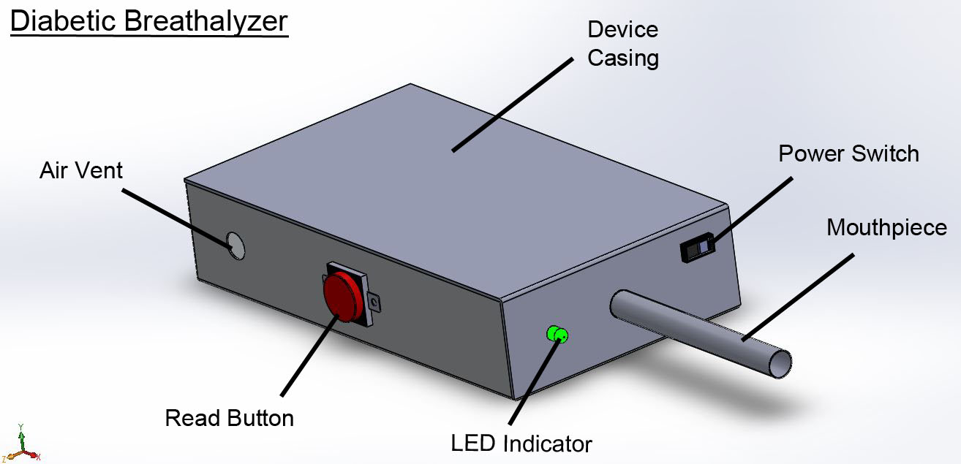
Physical Design
Dimensions: | 140mm x 80mm x 40mm
Material: | Heavy Duty Plastic Box (air tight)
Components: | Push button, slide switch, tri-color LED, and mouth piece

Slide 23
Project Software
Design

Slide 24
Code Block Layout
The code was organized into three major blocks
  Arduino Device Code
  Android Application Framework
  Sensor Calibration Code
The Application Framework and Device Code are the basics required for the device to function passably
The Sensor Calibration is the result of testing and experimentation on the functionality of the device’s concept

Slide 25
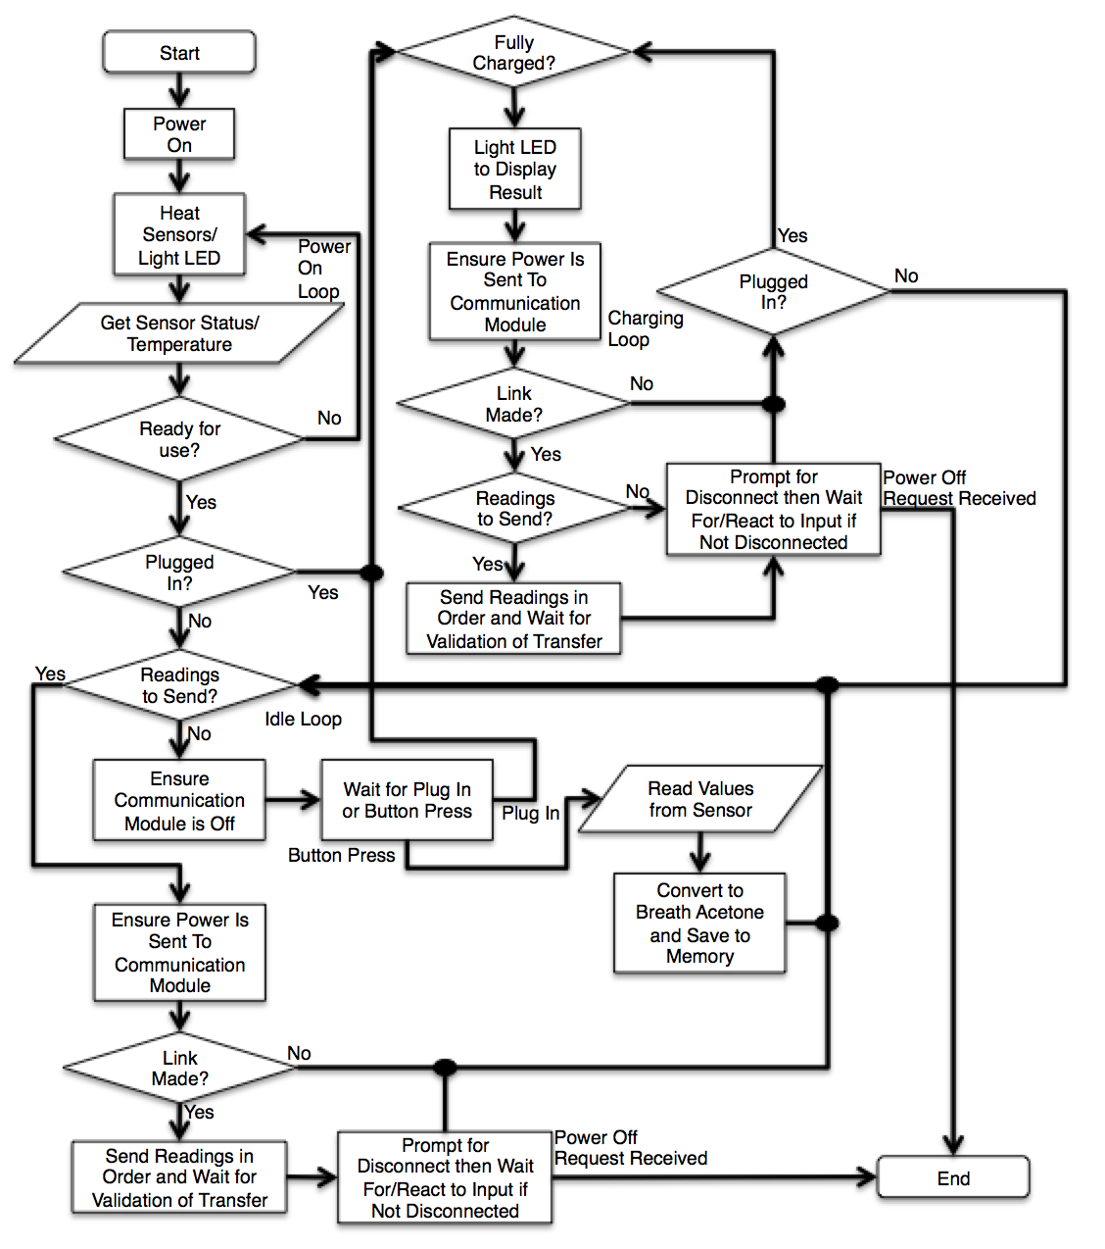
Device/Input Code
Using Arduino IDE and writing in C
Initial code framework has to be adjusted a bit to correct for small changes in device design and coding requirements
Ensures functionality and power management of device as well as communication of values to user

Slide 26
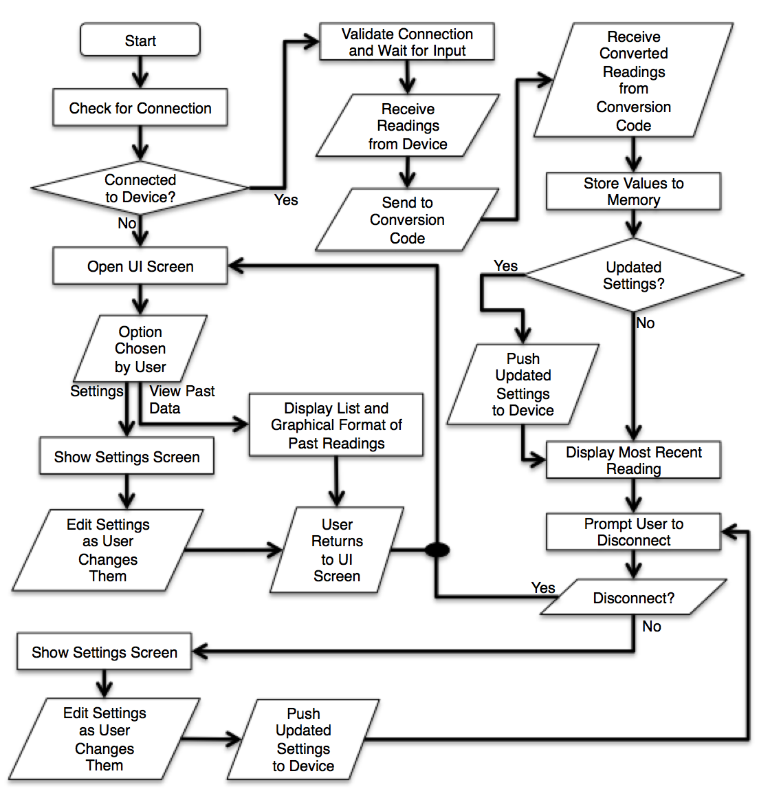
Phone Application Code
Initial design ideas changed a bit for the functionality and organization of the application
Instead of initially trying to connect, has a button to engage connection
A lot of open-ended expansion potential for phone application functionality given time

Slide 27
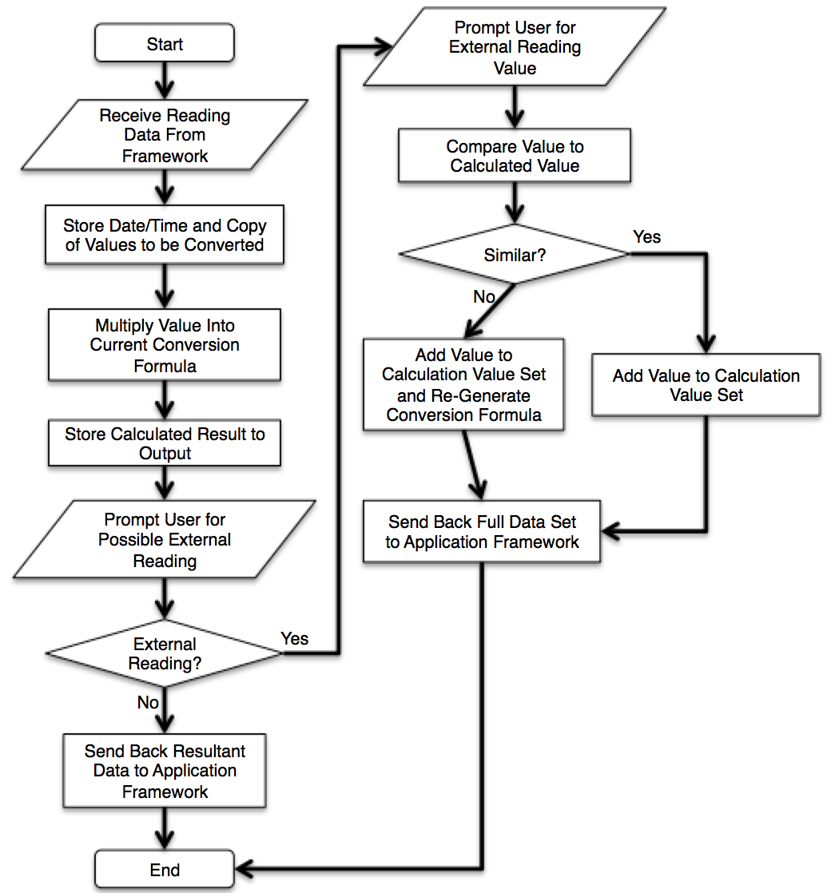
Sensor Calibration Coding
The function relationship between blood glucose and breath acetone is still unknown
Will develop an algorithm and the method of algorithm generation per user based on initial tests and value input

Slide 28
Prototype Construction

Slide 29
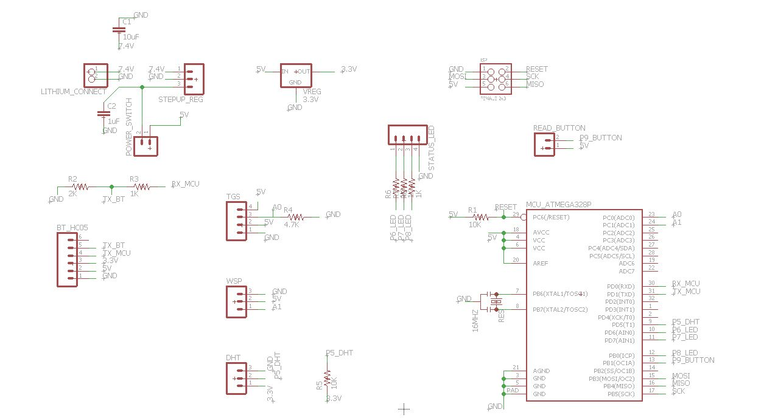
PCB Design-Schematic
Power

Slide 30
PCB Design-Schematic
Control Unit

Slide 31
PCB Design-Schematic
Communication

Slide 32
PCB Design-Schematic
Sensors

Slide 33
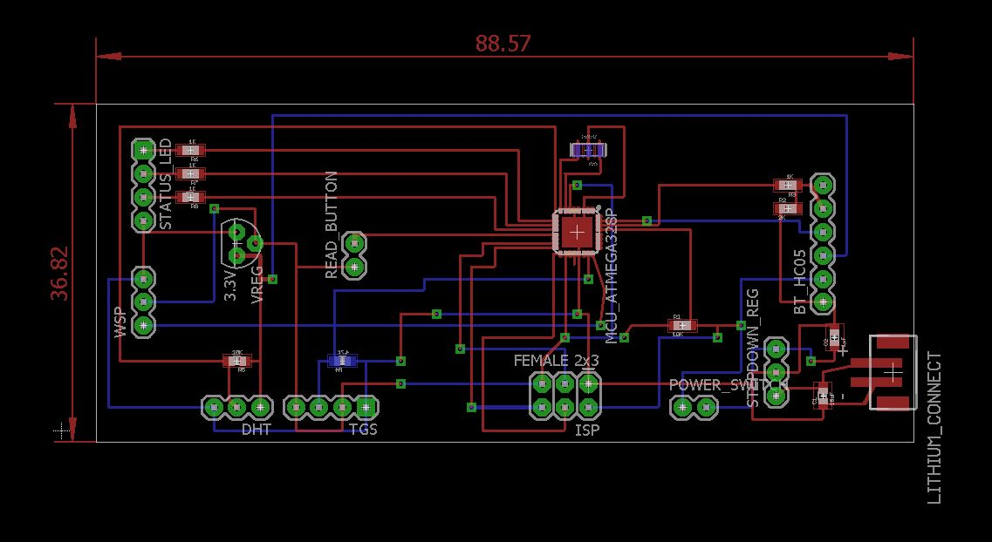
PCB Design-Board

Slide 34
Prototype Testing

Slide 35
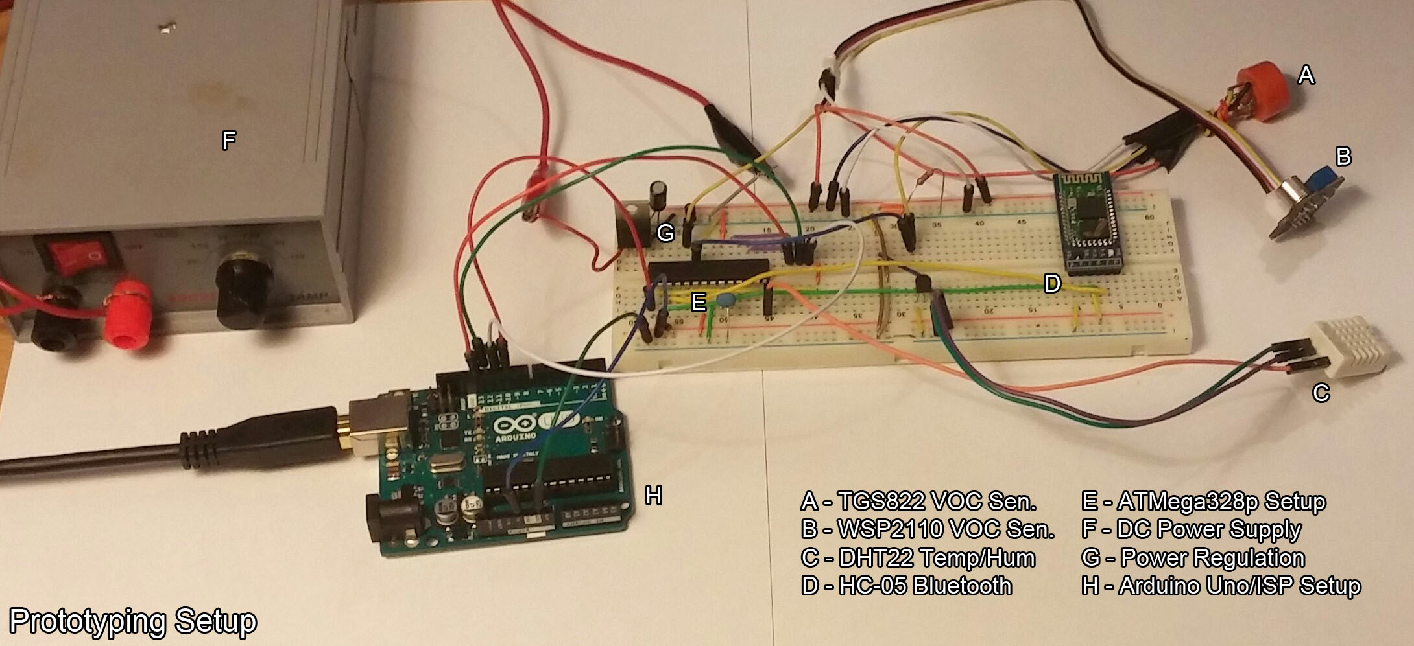
Breadboard Design

Slide 36
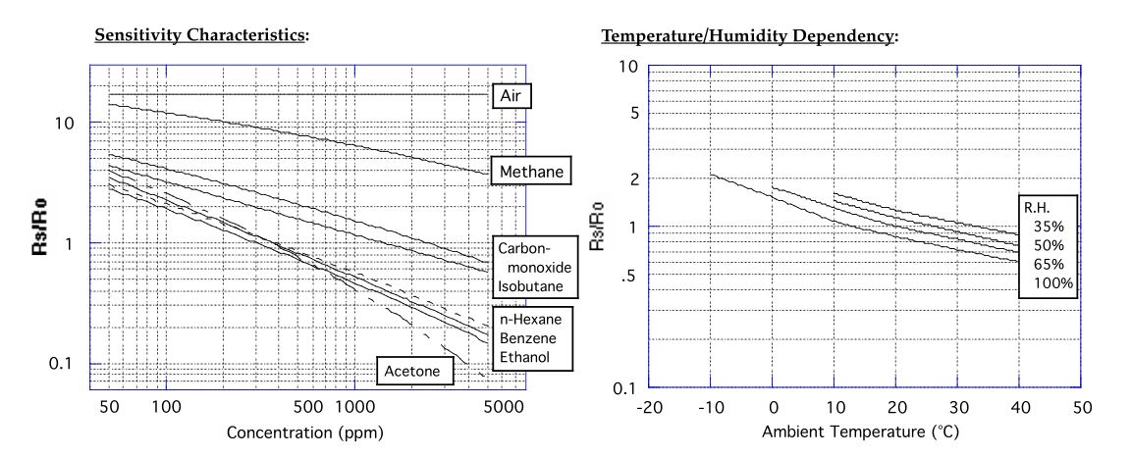
Concentration Relationship
TGS822 VOC Sensor

Slide 37
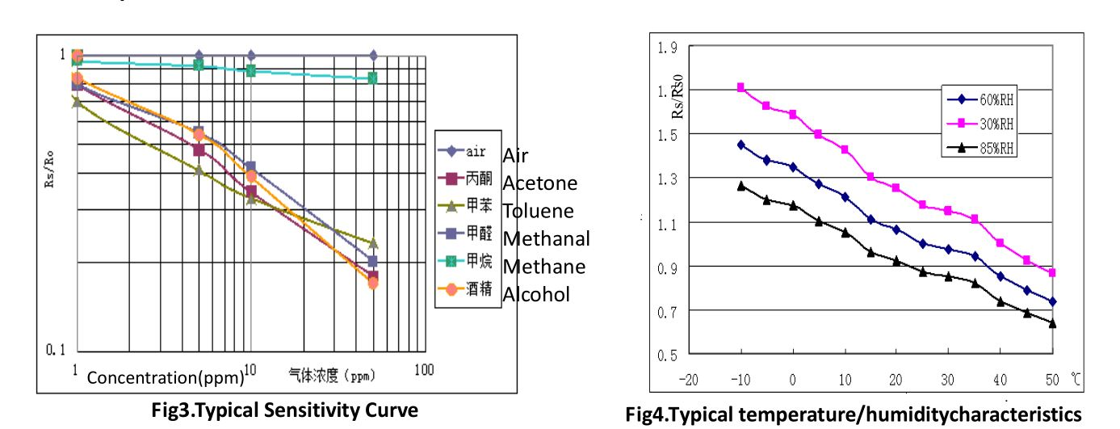
Concentration Relationship
WSP2110 VOC Sensor

Slide 38
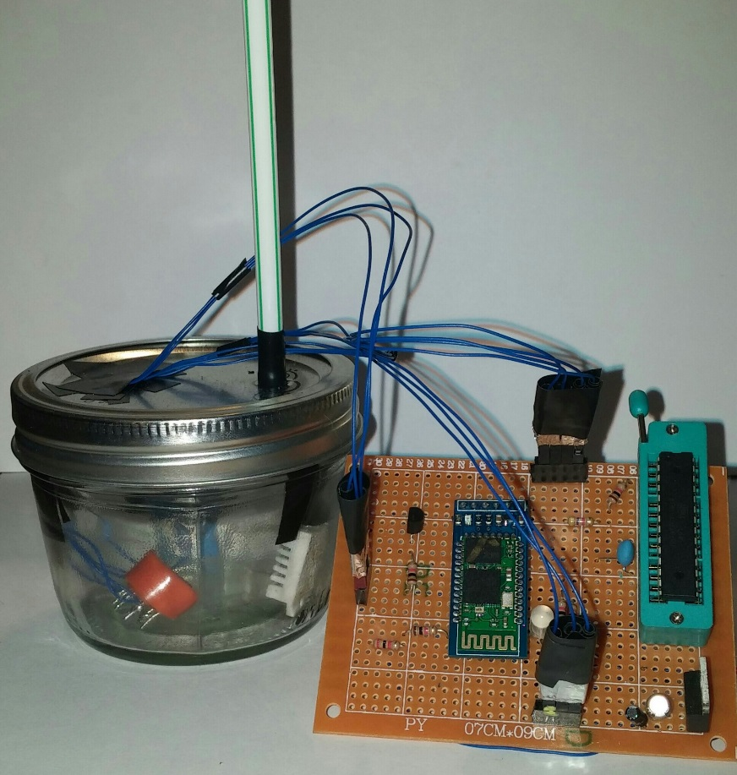
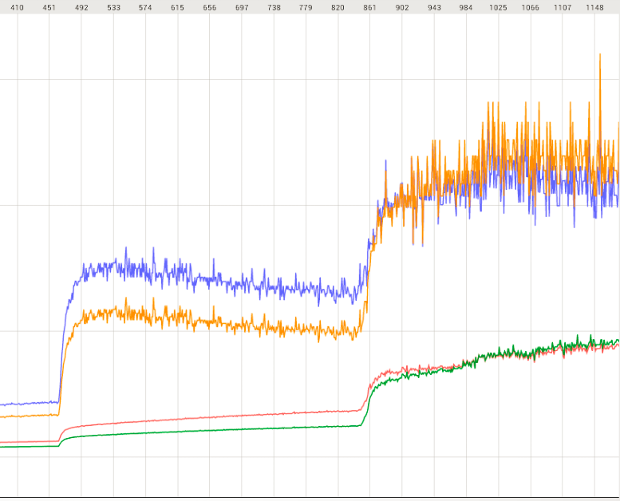
Testing Procedure
Current testing set up with real-time response

Slide 39
Successes and Difficulties
Successes:
We have a working prototype that sends data via Bluetooth to another device
  Sensors are working as planned
  Bluetooth is communicating between devices
  Showing correlation between resistance and concentration
Difficulties:
All four group members are EE
Our project is based upon ideas that are still under extensive research
Relating the acetone concentration found in the breath to the corresponding blood glucose concentration

Slide 40
Project Budget
Description | Name | Quantity | Price
Temp/Humidity Sensor | DHT22/AM2302 | 1 | $7.84
High Concentration VOC Sensor | TGS822 | 2 | $11.88
Low Concentration VOC Sensor | WSP2110 | 1 | $16.80
Bluetooth Module | HC-05 | 2 | $17.60
Microcontroller | ATMEGA328P | 4 | $14.80
PCB |  | 2 | $60
Battery | Lithium Ion Polymer Battery | 2 | $19.90
Charger | LiPoly Charger | 1 | $12.50
Physical Design Components | Outside container, buttons, switches, etc. | 1 | ~$15.00
 |  | Total | <$180

Slide 41
Work Distribution
 | PCB Design | Software | Sensor Management | Power Management
Jon Brown | Primary | Secondary
Christine Sleppy | Secondary |  | Primary | Secondary
Noah Spenser | Secondary | Primary
Edert Geffrard | Secondary |  | Secondary | Primary

Slide 42
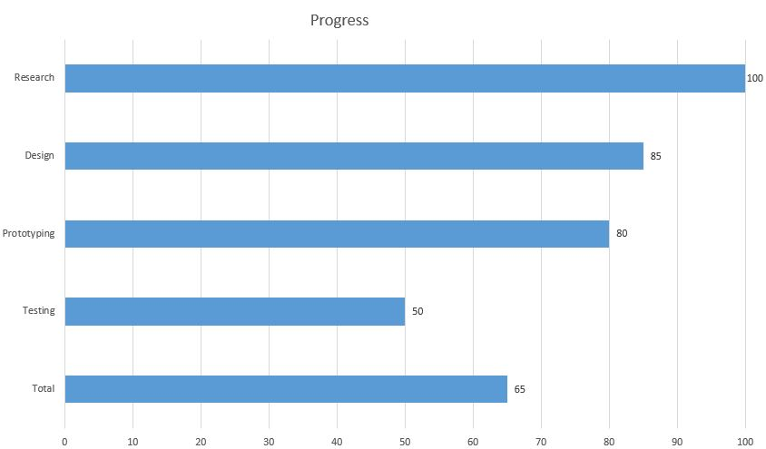
Current Progress

Slide 43
Questions?

