Slide 1

The
Diabetic
Breathalyzer
Group 13
Jon Brown EE
Christine Sleppy EE
Noah Spenser EE
Edert Geffrard EE

Slide 2
Project Motivation
29.1 million Americans have diabetes.
Proper management of this disease requires pricking the finger many times per day.
The Diabetic Breathalyzer will be a non-invasive option for daily monitoring.

Slide 3
Project Goals
The typical breathalyzer we are familiar with takes measurements of ones blood alcohol concentration.
Our long-term goal is to create a breathalyzer that can measure ones blood glucose concentration.
Our short-term goal is to provide an easy and noninvasive way to determine whether ones diabetes is under control.

Slide 4
Breath Analysis
The majority of breath is made up of nitrogen, oxygen, carbon dioxide, water, and inert gases.
The rest of the content found in one’s breath is a small fraction consisting of thousands of volatile organic compounds (VOC) with concentrations in unit of parts per million (ppm).
These VOC’s provide the link between breath analysis and clinical diagnosis.

Slide 5
Clinical Diagnosis for Diabetes
Acetone is the VOC that is present in the breath for diabetics.
If there is an immense amount of acetone found in the breath, the user is in a very unhealthy state.

Slide 6
Acetone/Ketone Relationship
Ketones are present in diabetics when their body goes into a state where it starts to burn fat for energy instead of glucose.
  Normally from high blood glucose level
  Also present in extremely low-carb dieters
When the user has high blood sugar levels, their ketone levels are also high, and so is the concentration of acetone levels in the breath.

Slide 7
Objectives
Hand-held design
  Small enough to carry around for daily use
VOC Sensors
  Must be able to detect acetone levels in breath
Status LED
  Displays stability of the sensors
Wireless Communication
  Bluetooth connection to smartphone where the final value will be displayed
Rechargeable Battery
  Must last an entire day before needing a recharge

Slide 8
Specifications
Component | Parameter | Specification
Enclosure | Unit Dimensions | 119.4x66x40.6 mm
TGS822 Sensor | High Concentration | 50-1000 ppm
 | Volts | 5 V
WSP2110 Sensor | Low Concentration | 1-50 ppm
 | Volts | 5 V
DHT22 Sensor | Temperature | -40-80° Celsius (+/-0.5°)
 | Humidity | 0-100% RH (+/- 5%)
 | Volts | 3.3 V
Bluetooth | Volts | 3.3/5 V
 | Frequency | 2.4GHz
 | Range | 0-30 meters
Battery | Rechargeable lithium ion polymer | >3100 mAh

Slide 9
Project Hardware Design

Slide 10
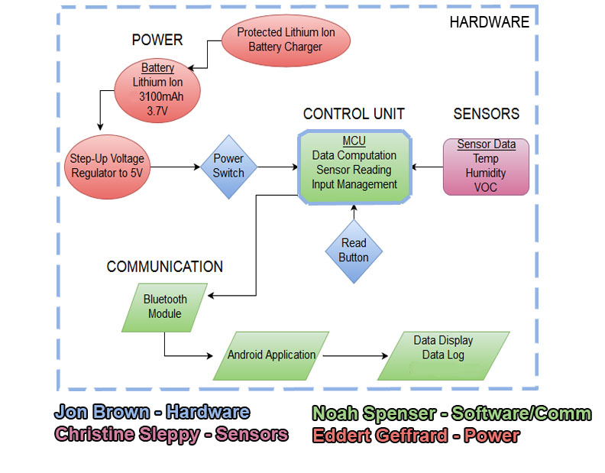
Overall Block Diagram

Slide 11
Power
Relatively lightweight and portable.
Rechargeable with the ability to last an entire day (12-14 hours).
3100 mAh lithium ion polymer battery

Slide 12
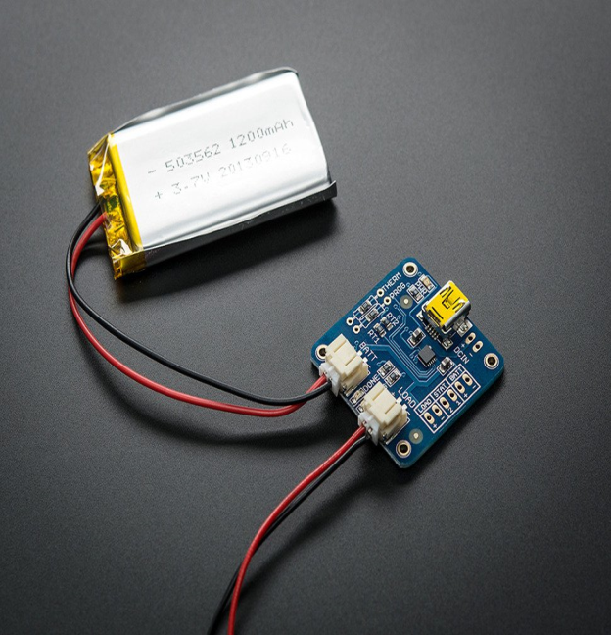
Power Recharge
Lithium Ion and Lithium Polymer battery charger based on the MCP73833 (shown left).
USB mini-B for connection to any computer or USB wall adapter.
Three stages of charging:
  1. Preconditioning charge
  2. Constant-current fast charge
  3. Constant-voltage trickle charge
Automatic End-of-Charge Control

Slide 13
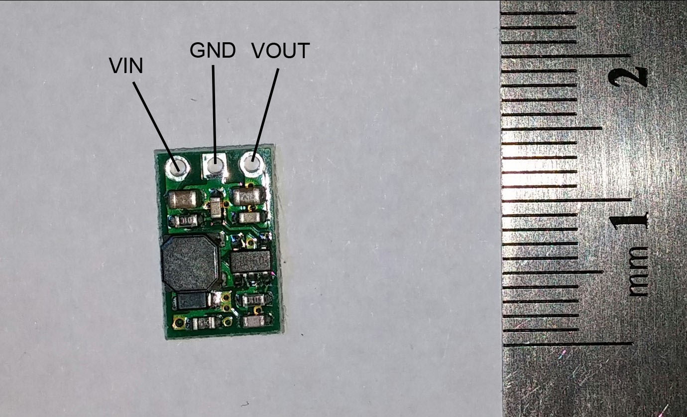
Step-up Regulator
Lower efficiency but still >90%
Space efficient
Overall costs will decrease

Slide 14
Power
Once we have the regulated 5V, the use of basic linear regulators is used when 3.3V is required.
Since the current draw on those 3.3V applications is small, the concern for energy loss is mitigated.
Device utilizes simple rocker switch to provide power to entire device.

Slide 15
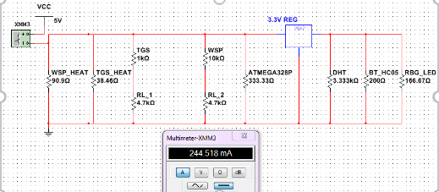
Power
Overall max current draw is under 250 mA, during peak usage.
Majority of time, current draw is about 180 mA to just power sensors.

Slide 16
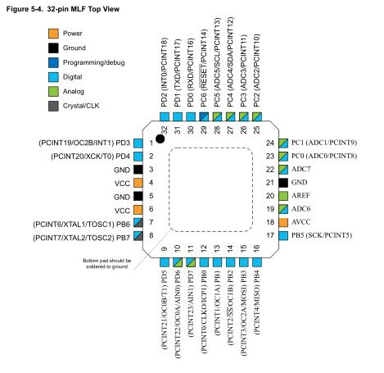
ATMega328p
Has digital and analog pins, both of which are needed.
Large enough (32kB) flash memory to store code and any data logged.
32-pin MLF package takes up minimal room (~5mmx5mm).
Easily programmable with Arduino IDE and ISP configuration.

Slide 17
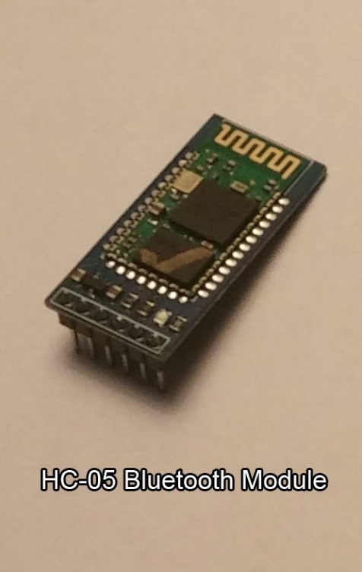
Bluetooth Communication
HC-05 BT Module:
Can run on 3.3V or 5V od DC power.
Communication over RX and TX serial pins.
During communication draws up to 40mA of current.
Can make easy connection to any Bluetooth enabled device.

Slide 18
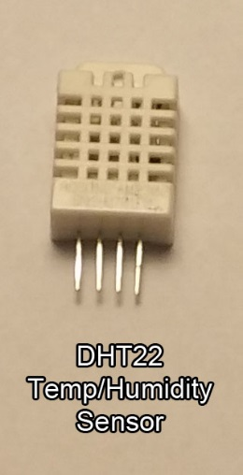
Temperature/Humidity Sensor
DHT22:
VOC sensors dependent on current temperature and humidity values.
Uses digital pin to transmit data.
Range of -40-80 degrees Celsius.
Runs on 3.3V and draws minimal current. (<1mA)
Functions properly in high humidity.

Slide 19
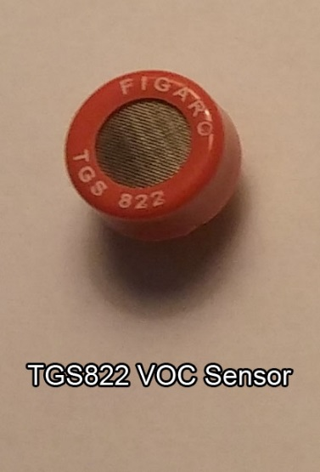
VOC Sensors
TGS822:
High concentration sensor.
50-1000 ppm detection range.
~600mA current draw at 5V.
Uses voltage divider circuit on PCB to monitor resistance change.

Slide 20
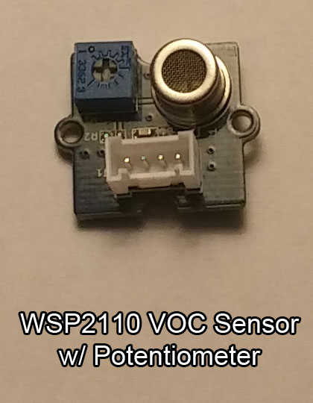
VOC Sensors
WSP2110:
Low concentration sensor.
1-50 ppm detection range.
~300mA current draw at 5V.
Uses built in voltage divider on module with adjustable potentiometer.

Slide 21
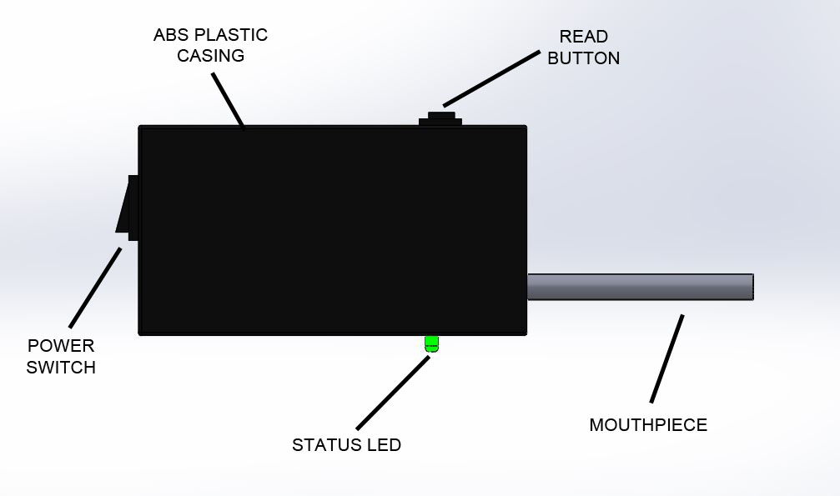
Physical Design
Dimensions: | 119.4mm x 66.0mm x 40.6mm
Material: | Heavy Duty Plastic Box (air tight)
Components: | Push button, rocker switch, tri-color LED, and mouth piece

Slide 22
Project Software
Design

Slide 23
Device/Input Code
Using Arduino IDE and writing in C
Utilizes push button to check stability and read sensor values.
Tri-color LED shows device status.

Slide 24
Phone Application Code Plan
Basic Requirements
Receive values and display them to the user
Store readings and display previous readings to user on demand
Handle errors and bad communication
Handle any necessary data management
Remain open-ended and rapidly testable as project moves forward
Have potential for easily transferrable and usable data based on changing device parameters

Slide 25
Phone Application Code Plan
Expansion/Refinement
Potential to convert readings into glucose values
Save values in easily transferrable/manageable fashion; potential online expansion/merging with physician status
Multiple device support and security features as well as setting and user profile management

Slide 26
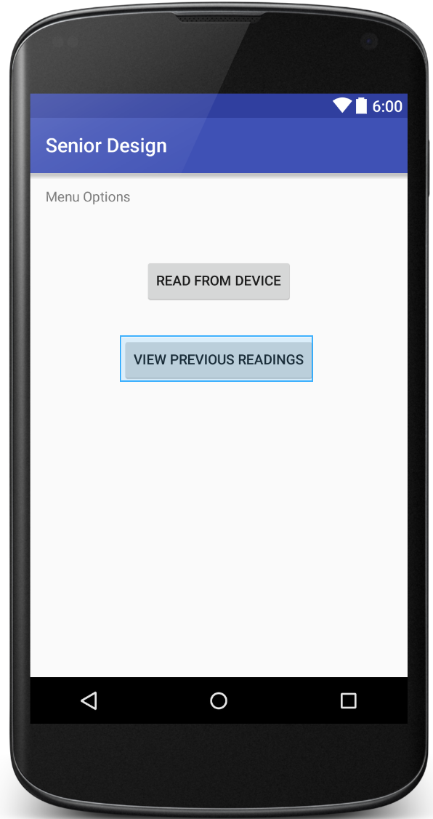
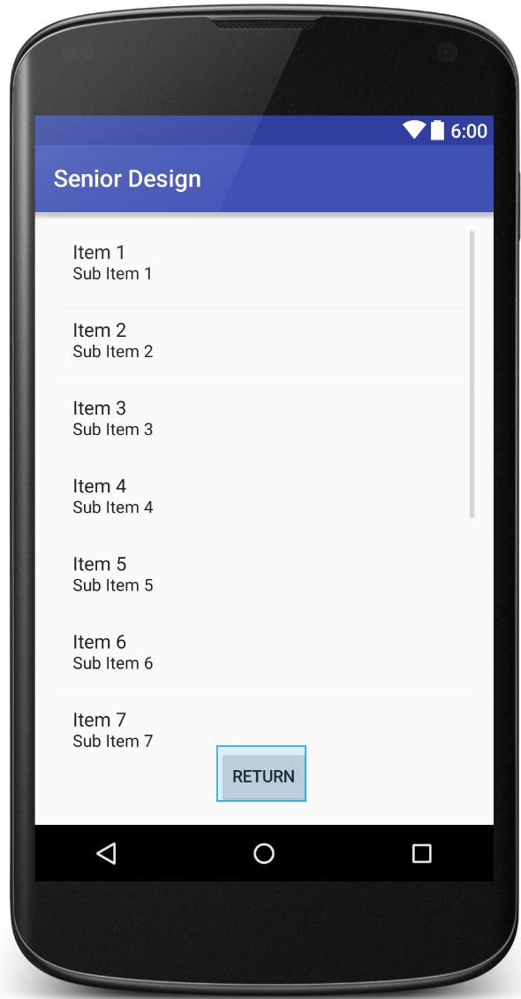
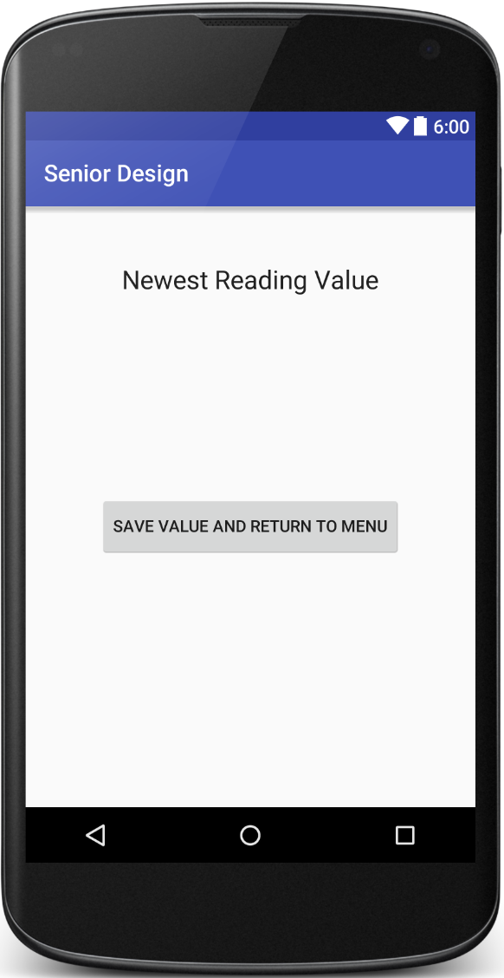
Phone Application Code Pictures

Slide 27
PCB Construction

Slide 28
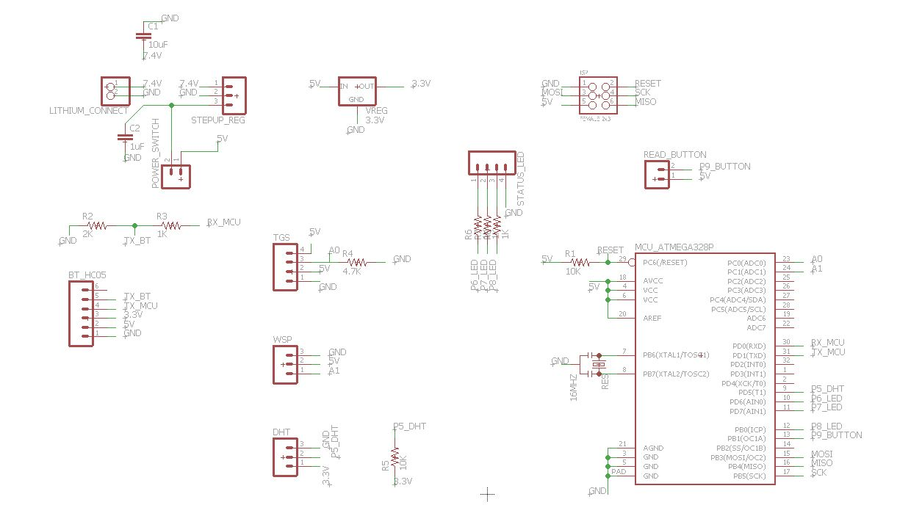
PCB Design-Schematic
Power

Slide 29
PCB Design-Schematic
Control Unit

Slide 30
PCB Design-Schematic
Communication

Slide 31
PCB Design-Schematic
Sensors

Slide 32
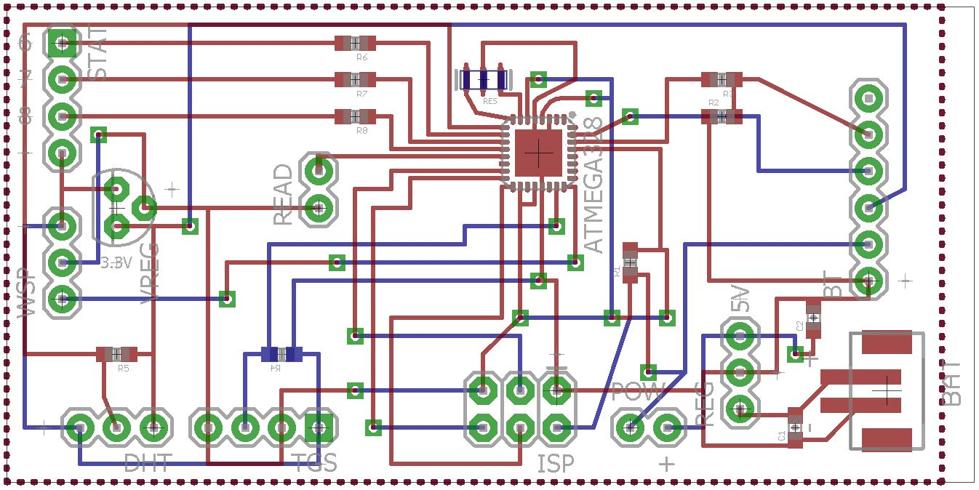
PCB Design-Board

Slide 33
Prototype Testing

Slide 34
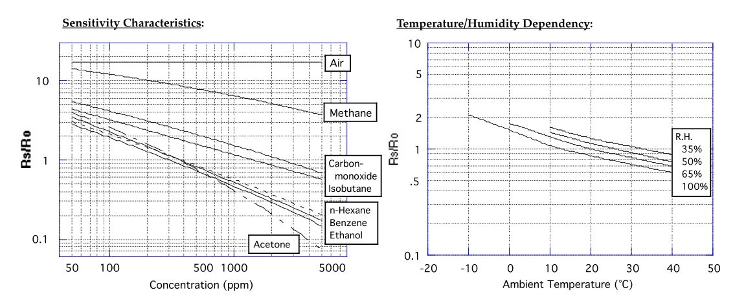
Concentration Relationship
TGS822 VOC Sensor

Slide 35
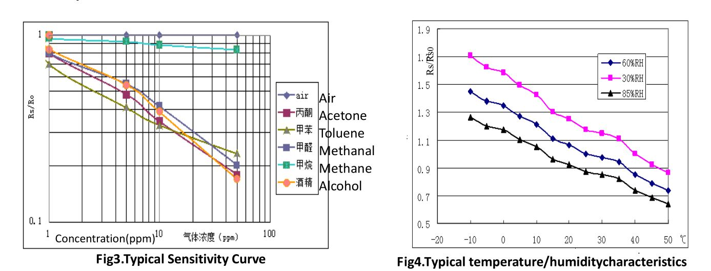
Concentration Relationship
WSP2110 VOC Sensor

Slide 36
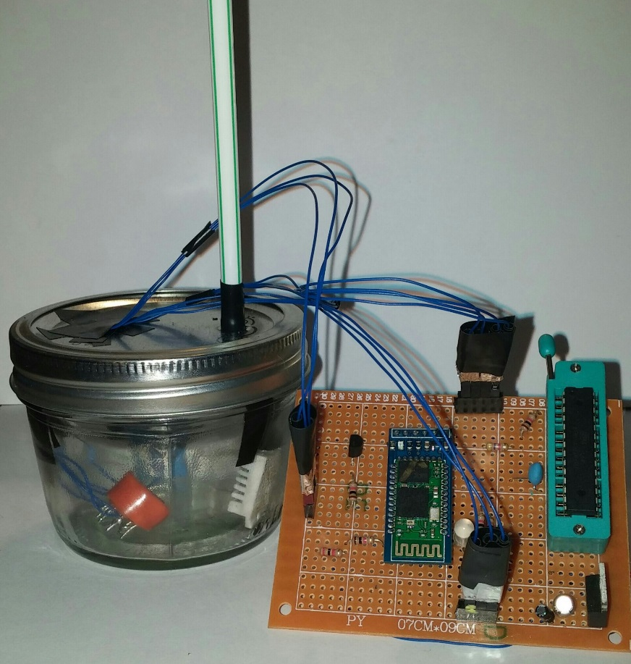
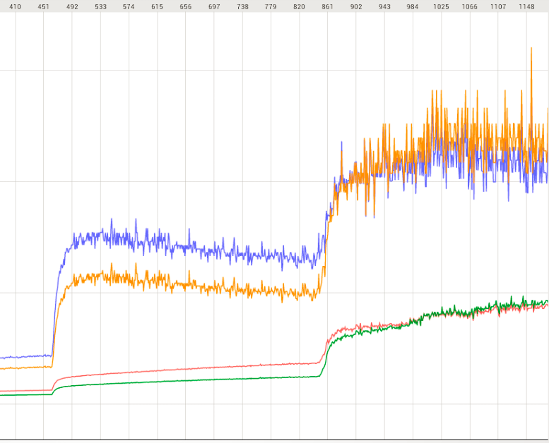
Prototype Testing Procedure
Testing set up and real-time response

Slide 37
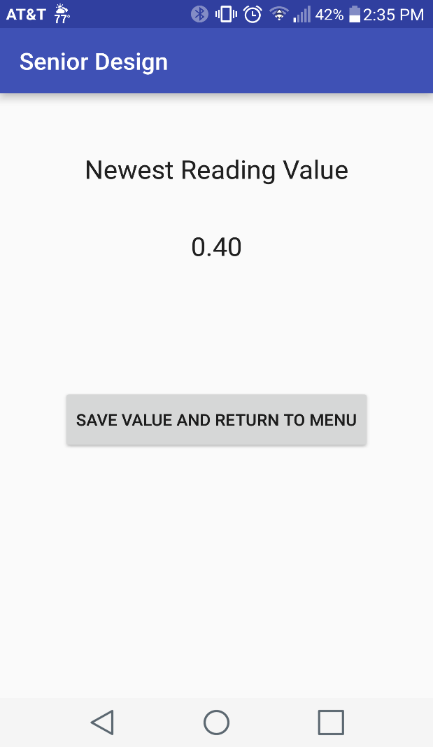
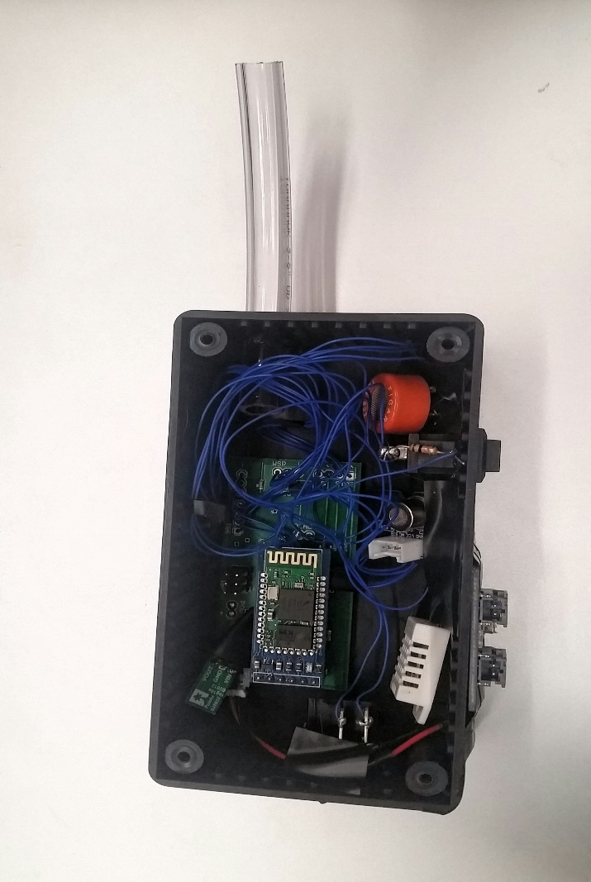
Device Testing Procedure
Device Interior and App Readout

Slide 38
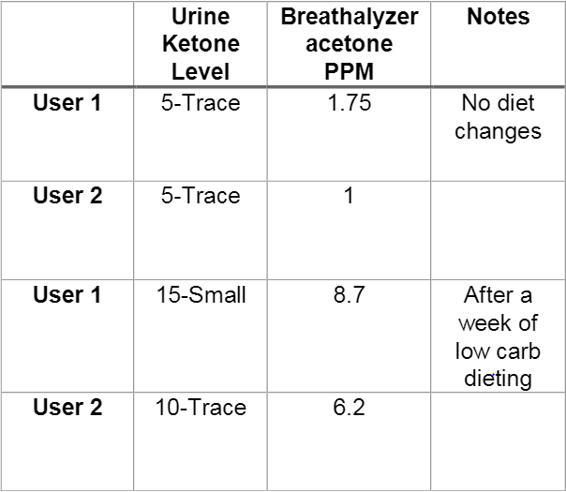
Healthy Experimental Results
Breathalyzer readings correspond to the ketone urine test.
(Readings vary from person to person)

Slide 39
Diabetic Experimental Results
 | Urine Ketone Level | Breathalyzer Acetone PPM | Notes
User 1 | 5-Trace | 1.2 | No diet change
User 2 | 5-Trace | 0.8 | Small breath
User 1 | 15-Small | 5 | After drinking a soda
User 2 | 15-Small | 8.83 | Larger breath
Breathalyzer readings still correspond to the ketone urine test.
Expected the difference between healthy and diabetic results to be more drastic.

Slide 40
Project Budget

Slide 41
Work Distribution
 | PCB Design | Software | Sensor Management | Power Management
Jon Brown | Primary | Secondary
Christine Sleppy | Secondary |  | Primary | Secondary
Noah Spenser | Secondary | Primary
Edert Geffrard | Secondary |  | Secondary | Primary

Slide 42
Project Difficulties
Our project is based upon ideas that are still under extensive research.
  We do not have access to the resources that make for more accurate results.
Relating the acetone concentration found in the breath to the exact corresponding blood glucose concentration is not attainable with the given resources.
The VOC sensors are sensitive to open air causing varied baseline resistances, making it difficult to keep the results consistent.
All four group members are EE.

Slide 43
Project Successes
Our device works to give the user a range of healthy versus unhealthy values using the Acetone-Ketone relationship.
  A diabetic user can infer their approximate blood glucose level and health status from this range.
  This provides a noninvasive option for diabetic health management.
Sensors detect acetone in the breath.
Bluetooth is communicating between devices and sends a value to the smartphone.
Able to show the correlation between resistance and concentration.
Low cost, low power, battery efficient, and hand-held.

Slide 44
Questions?

Slide 45
Demo 1
Our first demonstration will show how our device intakes breath from a normal healthy person.
  Determines value in ppm (a healthy result)
  Sends value to phone via Bluetooth
  Displays value on phone app

Slide 46
Demo 2
Our second demonstration will show how our device intakes acetone heavy air.
  Mimics an unhealthy person with high acetone levels in their breath
  Shows the difference in value from Demo 1 (an unhealthy result)
  Sends value to phone via Bluetooth
  Displays value on phone app

