Slide 1
W.E.A.R
Wireless Energy Autonomous Robot
Trent Smith | EE
Dimitri Wilks | EE
W. Olivier Laleau | EE
Blake Emerton | CpE

Slide 2
Motivation
We wanted to significantly increase the operational range of an electric vehicle while still in motion by using wireless energy to charge the battery on the vehicle.
The main limitation to current electric vehicles is the range. We aimed to scale this down to a robot size vehicle to show that it is a viable option. Since many EVs are moving to autonomous navigation, we wanted to integrate that into the robot as well.

Slide 3
Goals and Objectives
Design a wireless charging system
Good representation of charging system between car and track.
Implement safety features for charging system for practical use.
Design navigation system through robotic vision.
Robot car must be able to drive itself along track.

Slide 4
Requirements and Specifications
Oscillator
  Achieve a oscillating frequency of 200kHZ
Receiver
  Charge current range between 2-3 Amps
Transmitter/Receiver Coils
  Copper coils must mounted safely and for optimum usage.
Charge Controller
  Obtain a battery charging efficiency of > 50%
Robot car
  Small but able to fit the necessary materials
Autonomous Camera System
  Detect lines and keep the robot within the specified deflection angle
Track
  Design a track that models a road and protects system

Slide 5
Design Constraints
Use wireless energy to charge the robot within ¾’’inch
Charge controller supply constant charge current to battery and implementing MCU to record readings.
Robot must be small enough to move around a track no larger than 3ft x 4ft
Robot must navigate autonomously without user control

Slide 6
Wireless Energy

Slide 7

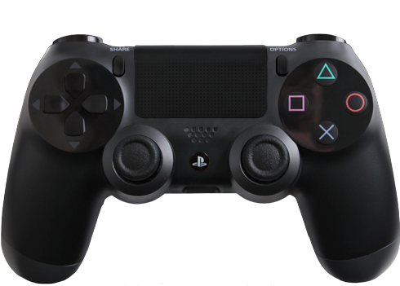
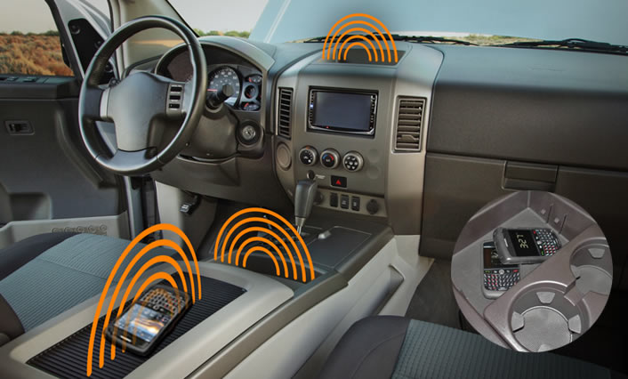
Why Go wireless?
Popular
No more broken wires
Senior design worthy

Slide 8
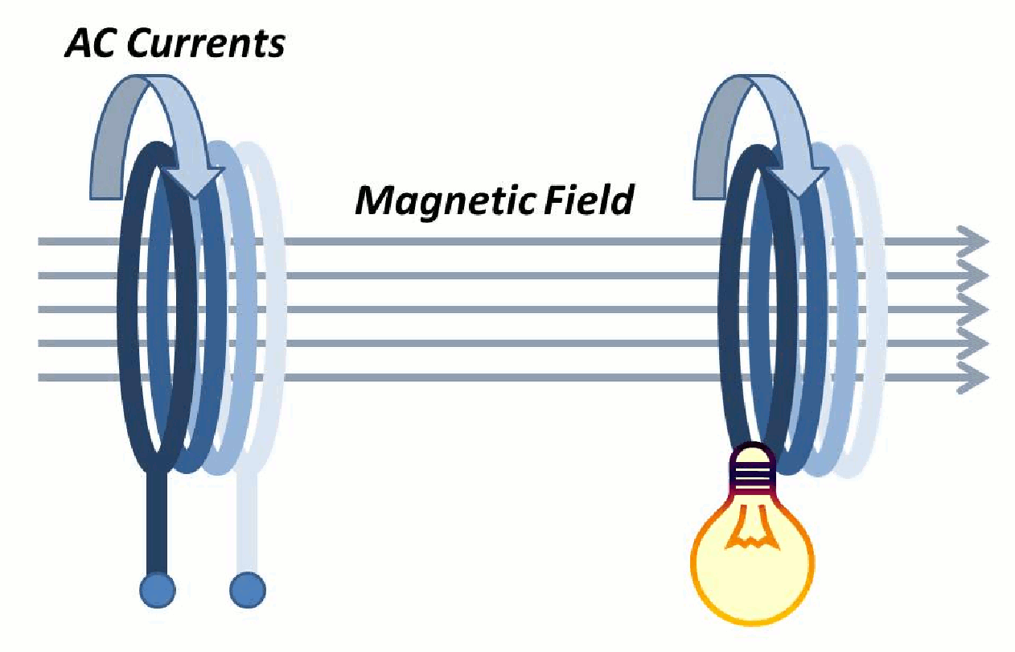
Magnetic Resonance
Why not Lasers, Magnetron(Microwaves)
Inductive Coupling
Magnetic Resonance
  Larger range between transfer
  Doesn’t require precised alignment for transfer

Slide 9
Transmitter
Ground system
Oscillator Circuit
  Zero Voltage Switching Driver (ZVS)
  Colpitts, Hartley

Slide 10
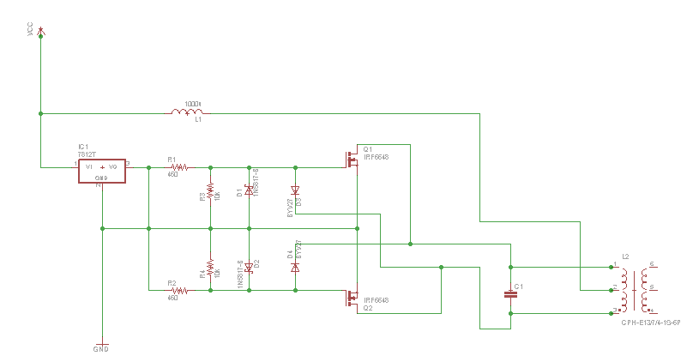
Oscillator

Slide 11
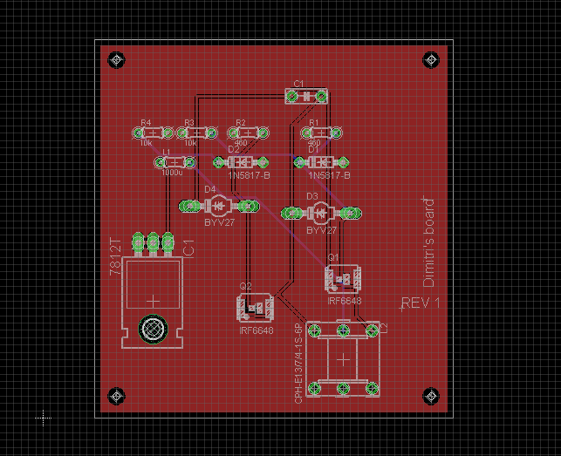
PCB Design

Slide 12
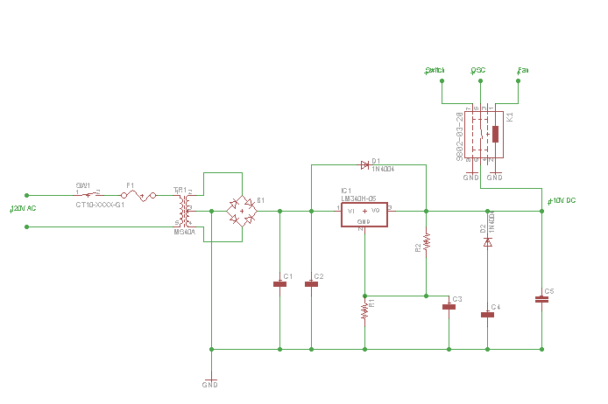
Power Distribution

Slide 13
Receiver
Consists of:
Car coil
Thermal detection
Charge controller

Slide 14
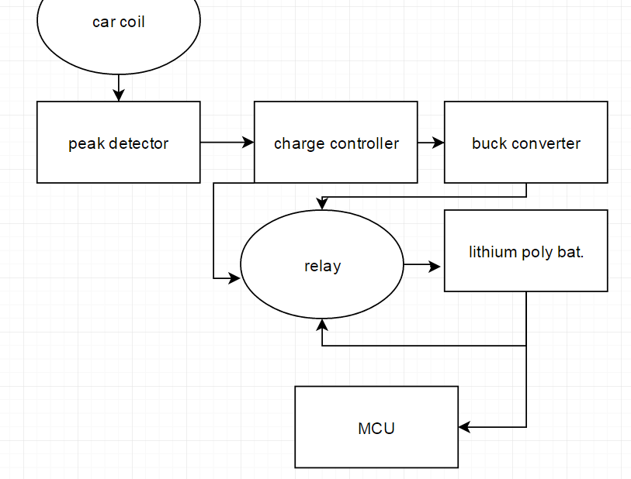
Body Diagram

Slide 15
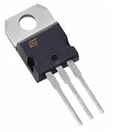

Voltage Regulator
Lm7805
When the input is 7-12 V the output will be around 4.2-5V.

Slide 16
Charge Controller
Consists
Peak detector
Voltage regulator
Buck converter

Slide 17
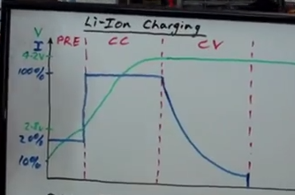
Charge Controller
Used to control the charging of the lithium polymer battery
Will switch between the buck converter and the voltage regulators
Special way to charge lithium polymer batteries

Slide 18
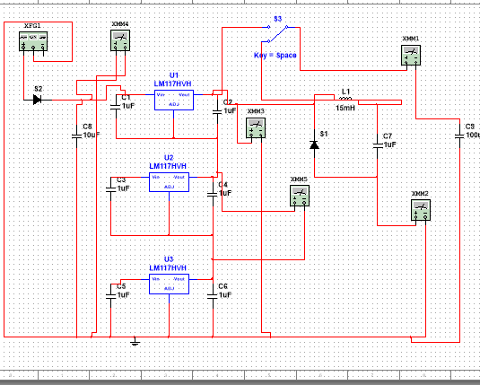
Charge Controller

Slide 19
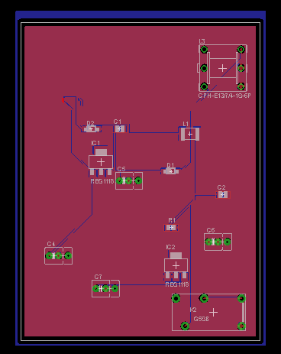
PCB

Slide 20
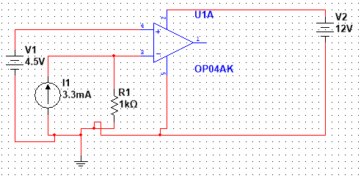
Thermal Detection
Used to detect if the battery is overheating
V2 - battery
V1 - reference voltage
Constant current source
Thermistor - R1
0 C - 75C
273.15 K - 372.15 k

Slide 21
Robot Hardware

Slide 22
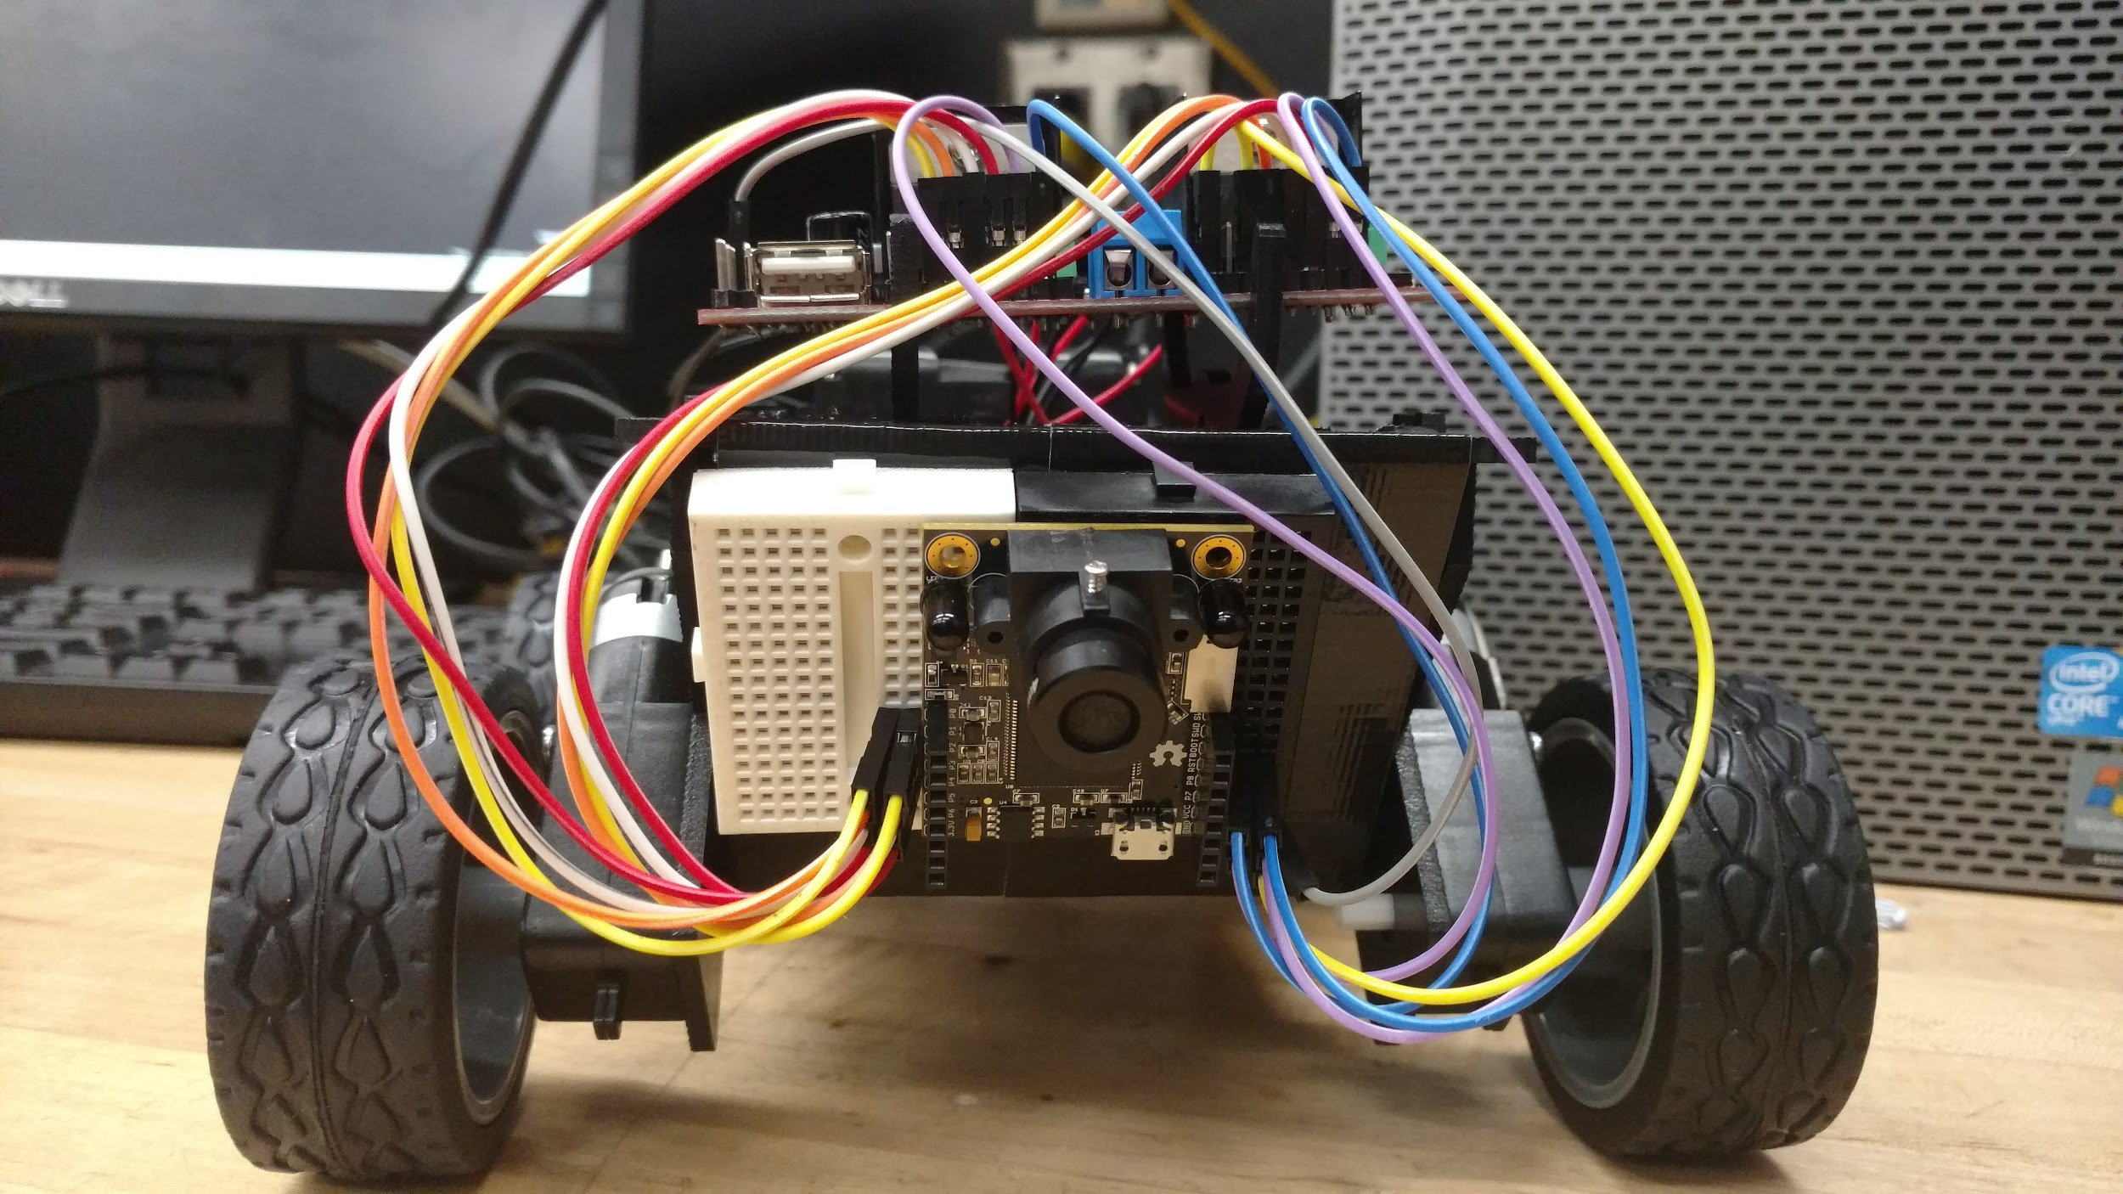

Slide 23
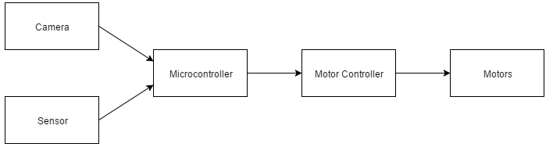
Autonomous control

Slide 24
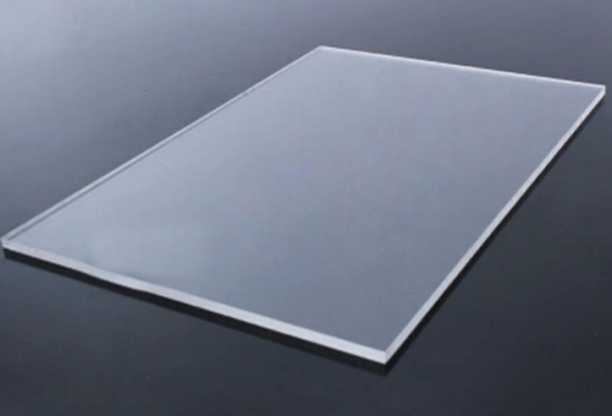
Track
The track will consist of a 36 x 48 plexiglass sheet.
The sheet will have lines that the robot should continuously follow.
Our goal is for the materials to not weigh too much to ensure a smooth ride

Slide 26

Track
Traced out on a large acrylic sheet
Clear so the components under the track can be seen
Multiple curves to show autonomous navigation

Slide 27
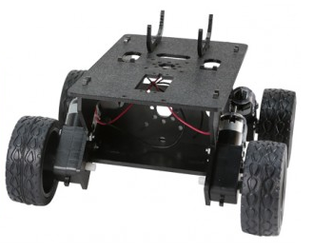
Robot chassis
Whippersnapper Runt Rover
Small enough to easily drive on the track
Weight 0.97 lbs
Stable and adjustable
4 wheels and 4 DC motors

Slide 28
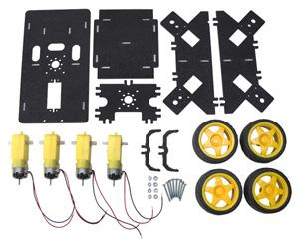
DC motor
DC MOTOR SPECIFICATIONS
4 DC motor will be in charge of controlling the wheels
Recommended Voltage: 4.5VDC
No Load Speed: 140RPM
No Load Current: 190mA
Max. Load Current: 250mA
Torque: 800 gf-cm

Slide 29
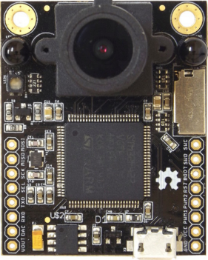
Microcontroller / Camera
OpenMV
Keypoint tracking, marker tracking
Adaptable to any hardware like Arduino
Cortex M4 processor
Micro python interpreter
3.7V to operate

Slide 30
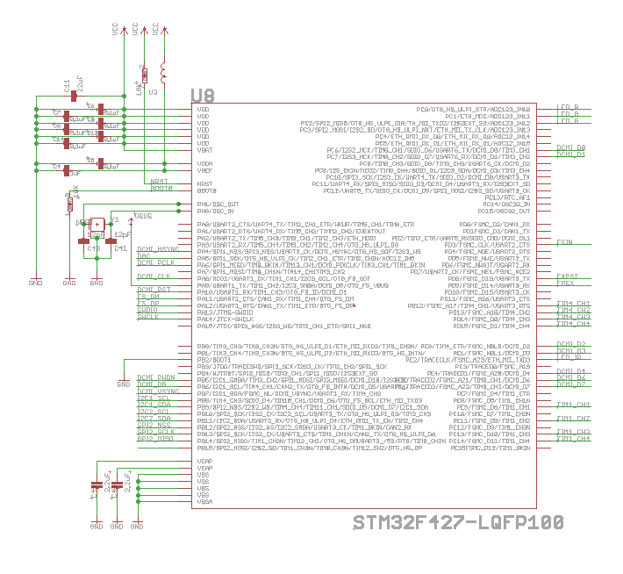
Schematic MCU

Slide 31
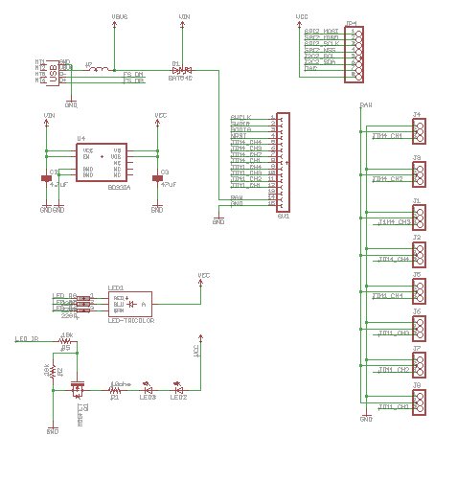
Schematic USB PORT, HEADERS, VOLTAGE REGULATORS

Slide 32
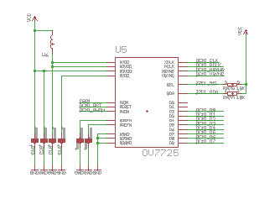
SCHEMATIC IMAGE SENSOR

Slide 33
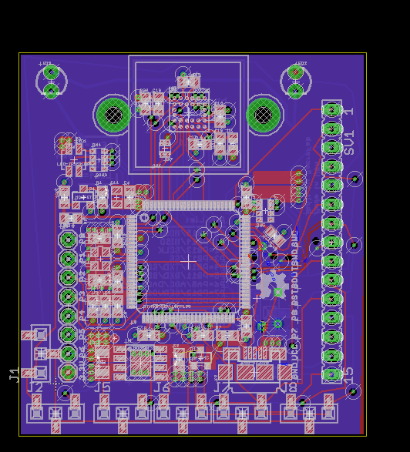
Board design

Slide 34
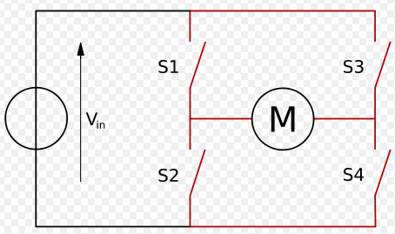
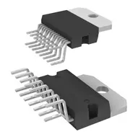
Motion control H-bridge
Forwards/Backwards movement
Left or Right turns
Only motors on the same side are always in sync
L298n H-bridge Driver

Slide 35
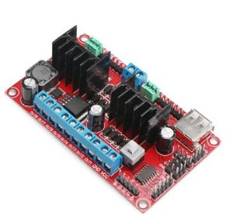
Motor Driver
Driver Chip: L298N dual H-bridge motor driver
It can directly drive two 3-30V DC motor.
5V output for to power for a 5V single-chip circuit
Driving Terminal can supply from + 5V to+ 30V
Peak Current of the Driving Part: 2A
Size:90 * 55 * 33mm

Slide 36
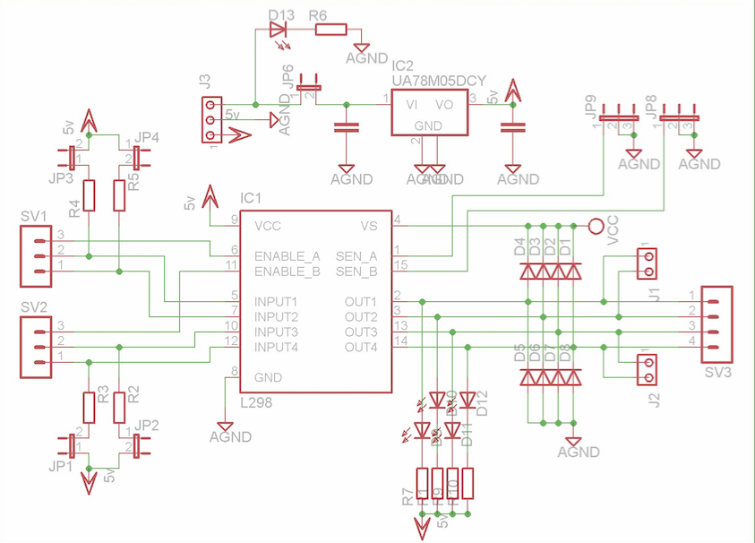
Motor driver schematic

Slide 37
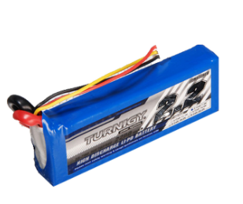
Battery
LiPo Battery 11.1V 2200mAh
Long cycle life
Excellent discharge performance
Capable of operating under very high current
Ideal for use in high power applications
Voltage: 11.1V
Capacity: 2200mAh(3S)
Rate of maximum discharge: 25-35C
Light-weight:185g Size : 103mm x 33mm x 24mm

Slide 38
Battery charging requirements
Even though they are really efficient and they can store a lot of power, There are certain issues that lithium batteries have. Certain cell can be hazardous. And if it is treated improperly by being mishandled, over-charged, or abused LiPo , It can cause a small explosion.
Therefore, there are certain charging requirements.
11.1 V LiPo batteries need to be charged ideally between 10.5 V and 11.7 V

Slide 39
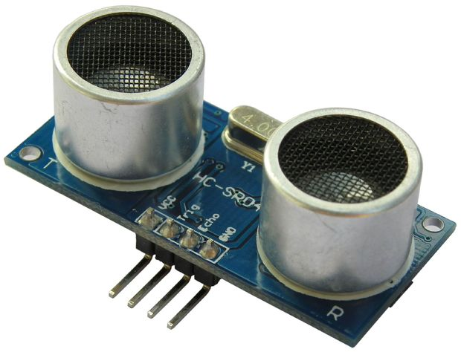
Ultrasonic Sensor
HC - SR04
5V operating voltage
15mA operating current
2cm minimum range
4m maximum range
15 degree measuring angle

Slide 40
Software Design

Slide 41
High Level

Slide 42
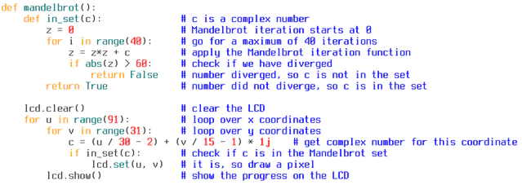
MicroPython
Python for microcontrollers!
Implementation of Python 3
Released in 2013

Slide 43
How It Works
Camera captures an image
Finds connected pixel regions that pass a threshold test
  X, Y position of bounding rectangle
  Number of pixels that passed threshold
  X, Y position for center of mass
  Angle of rotation
Region of Interest (ROI)
  x, y, z, h values
  Detects 3 regions
  Lowest region holds most weight, highest holds least weight
Deflection angle created from ROI data

Slide 44
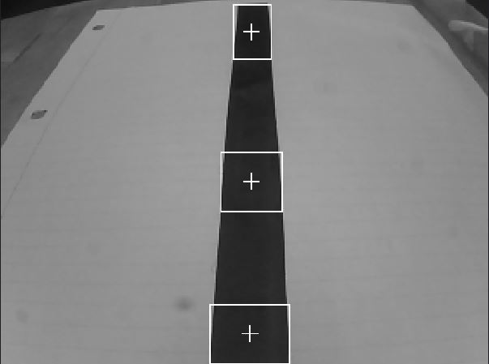
What the Robot Sees

Slide 45
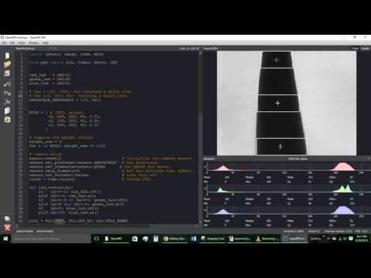
Robot Vision

Slide 46
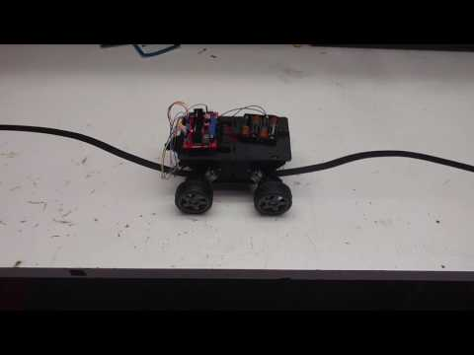
Robot Prototype

Slide 47
Administrative Content

Slide 48
Work Distribution
Name | Transmitter | Receiver | Robot Hardware | Robot Software | Track Construction
Trent | S | P |  |  | S
Dimitri | P | S |  |  | S
W. Olivier |  | S | P |  | S
Blake |  |  | S | P | S

Slide 49
Budget
Components | Cost | Budget | Difference
Track | $109.67 | $30 | $4.33
Power Distribution | $38.92 | $35 | -$3.92
Fan | $5.78 | $5 | -$0.22
Oscillator | $9.56 | $15 | $6.44
Temperature Sensor | $12.32 | $10 | -$2.32
Microcontroller | $75 | $75 | $0.00
Wires,Mounting | $42.46 | $50 | $7.54
Battery | 23.95 | $30 | $6.05
Services | $90 | $200 | $110
Motor driver | $17.98 | $30 | $12.02
Robot Chassis | $28.99 | $50 | $21.01
Copper Wire | $0.60/ft | $60 | $0.00
Total | $514.63 | $610 | $95.37

Slide 50

Financing
Sponsored by Quartus Engineering

Slide 51
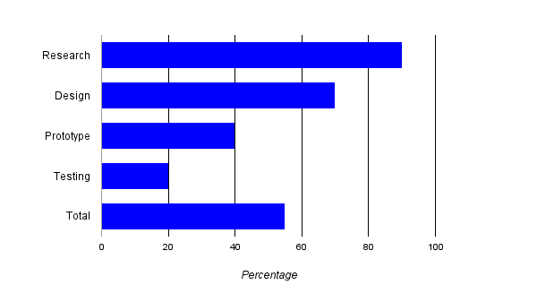
Progress

Slide 52
Plans for Completion
Meet 3 times weekly
  1 meeting for progress check
  2 meetings for build time
Send out PCB designs by 10/2
Complete prototype by 10/27
Complete conference paper by 11/11
Complete final prototype by 11/25

Slide 53
Issues
Making sure the wireless energy transfer will not affect robot components.
Finding the perfect size coils for our design constraints due to the track design.
Power Distribution design
  Need to incorporate MCU
  Supply sufficient power to other components (sensors,fans,etc.)
Robot MCU design change
Kickstarter ship dates

Slide 54
Questions

