Slide 1
W.E.A.R
Wireless Energy Autonomous Robot
Group L
Trent Smith | EE
Dimitri Wilks | EE
W. Olivier Laleau | EE
Blake Emerton | CpE

Slide 2
Motivation
We wanted to significantly increase the operational range of an electric vehicle while still in motion by using wireless energy to charge the battery on the vehicle.
The main limitation to current electric vehicles is the range. We aimed to scale this down to a robot size vehicle to show that it is a viable option. Since many EVs are moving to autonomous navigation, we wanted to integrate that into the robot as well.

Slide 3
Goals and Objectives
Design a wireless charging system
Good representation of charging system between car and track.
Implement safety features for charging system for practical use.
Design navigation system through robotic vision.
Robot car must be able to drive itself along track.

Slide 4
Requirements and Specifications
Oscillator
Achieve a oscillating frequency of 70kHZ
Receiver
Charge current range between 200-600 mAmps
Transmitter/Receiver Coils
Copper coils must mounted safely and for optimum usage.
Charge Controller
Obtain a battery charging efficiency of > 50%
Robot car
Small but able to fit the necessary materials
Autonomous Camera System
Detect lines and keep the robot within the specified deflection angle
Track
Design a track that models a road and with an charging lane.

Slide 5
Design Constraints
Use wireless energy to charge the robot within ¾’’inch
Charging car battery while in motion.
Charge controller supply constant charge current to battery and implementing MCU to record readings.
Robot must be small enough to move around a track no larger than 3ft x 4ft
Robot must navigate autonomously without user control

Slide 6
Wireless Energy

Slide 7

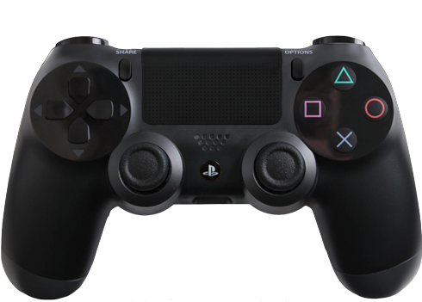
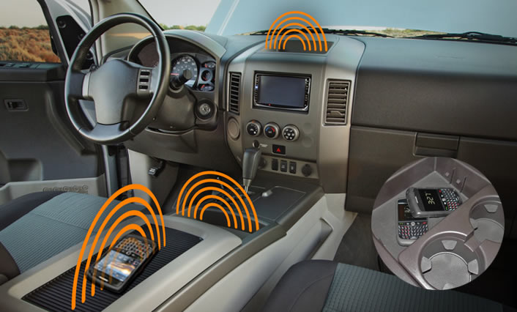
Why Go wireless?
Popular
No more broken wires
Senior design worthy

Slide 8
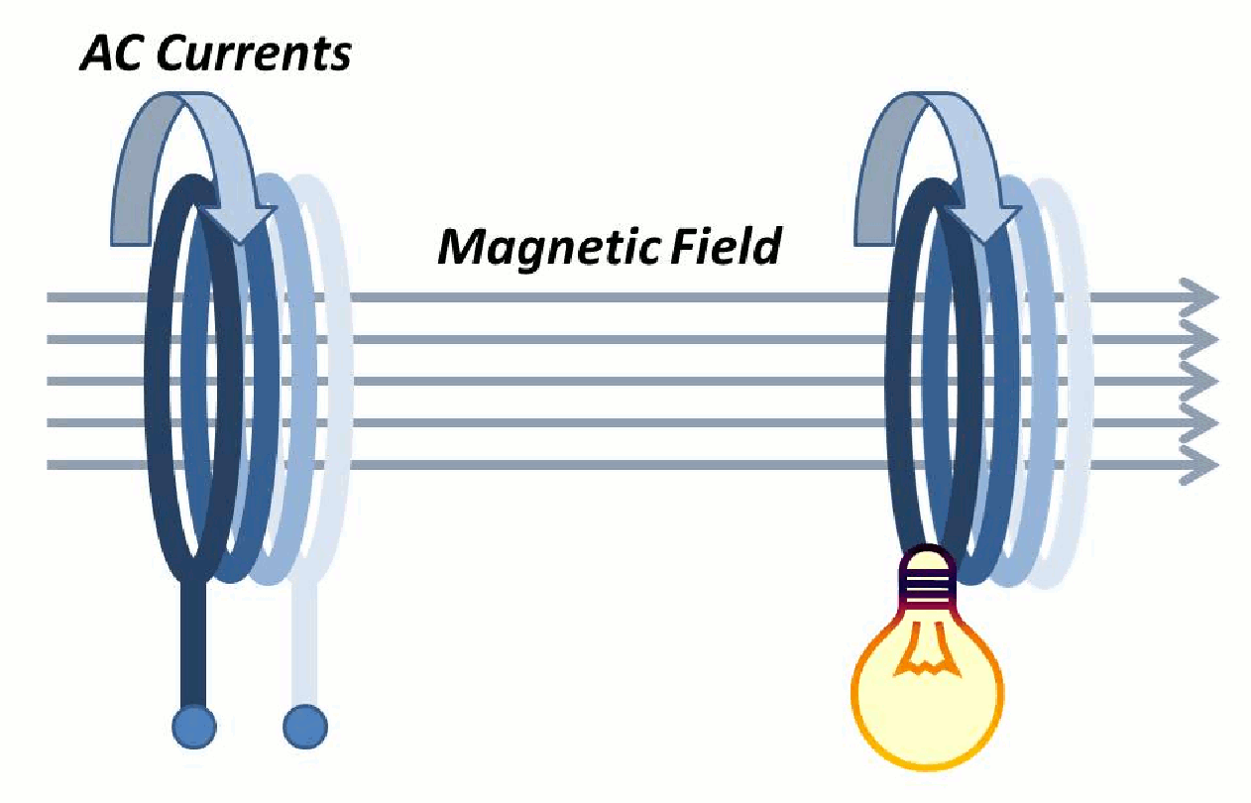
Magnetic Resonance
Why not Lasers, Magnetron(Microwaves)
Inductive Coupling
Magnetic Resonance
Larger range between transfer
Doesn’t require precised alignment for transfer

Slide 9
Transmitter
Ground system
Track apparatus
Oscillator Circuit
Zero Voltage Switching Driver (ZVS)
Colpitts

Slide 10
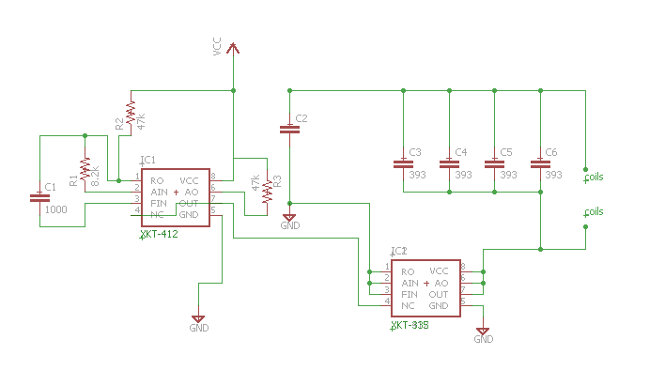
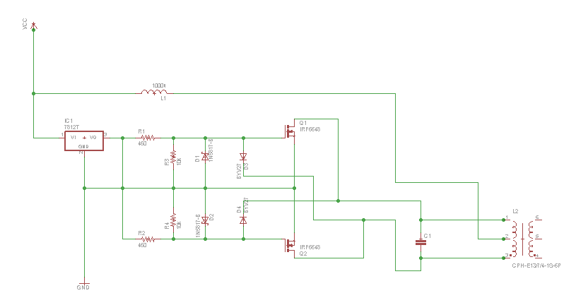
Oscillator
CMOS IC Oscillator
ZVS Oscillator

Slide 11
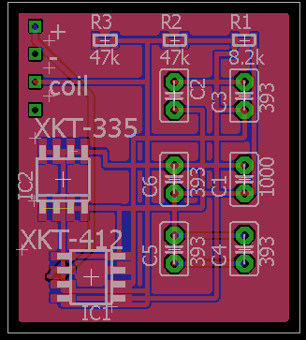
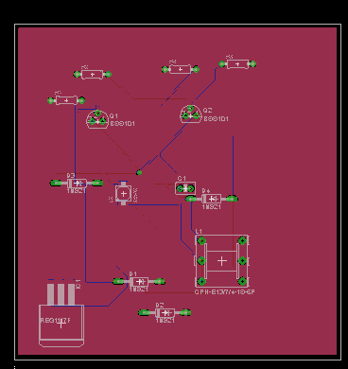
PCB Design
ZVS Oscillator
CMOS Oscillator

Slide 12
Oscillator System
PCB Design smaller and space friendly.
Elecrow
Designer help make the pcb small.
Two- layers with components soldered to the top and bottom.

Slide 13
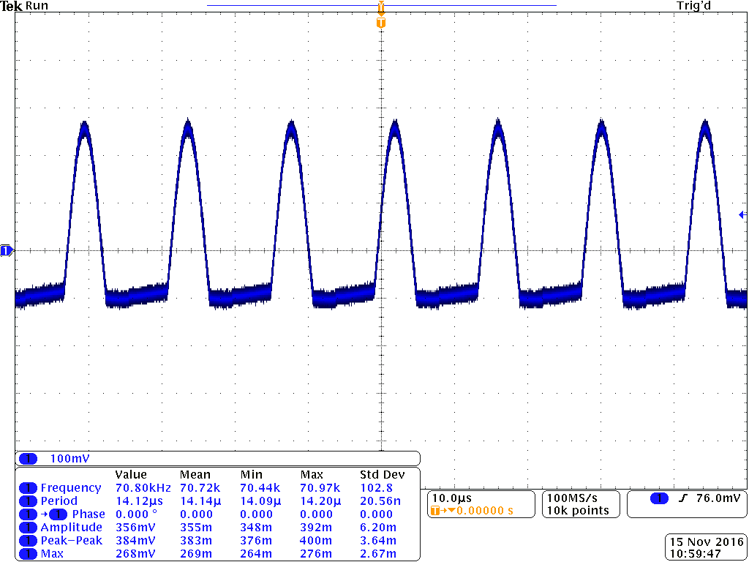
XKT-335 IC
CMOS Technology
nMOSFETs & pMOSFETs
Higher accuracy and stability
Dissipates very low heat
XKT-412
IC chip that helps regulate
Adjust to different LC tanks for resonant frequency.

Slide 14
Oscillator Circuit Continued...
18 AWG Copper Coils
Coil inductance 33uH.
Resonance frequency of 70kHz
Case to protect Oscillator
Light indicator to know when the oscillator is on.

Slide 15
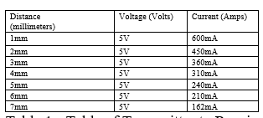
Receiver
Consists of:
Car coil
Charge controller

Slide 16
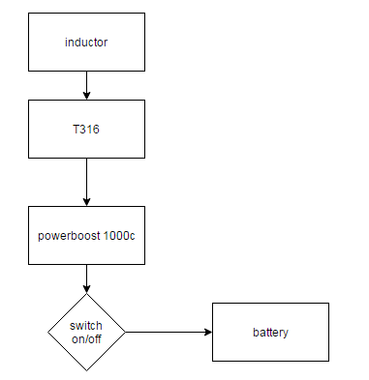
Parts of the Charge controller
T316 IC
Powerboost 1000c

Slide 17
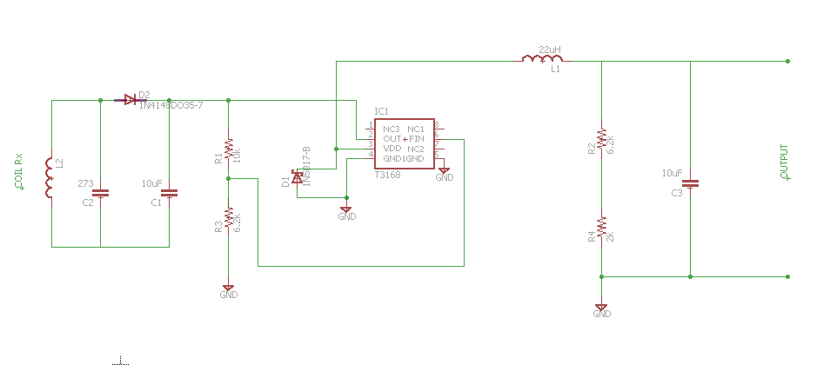
Receiver Circuit

Slide 18
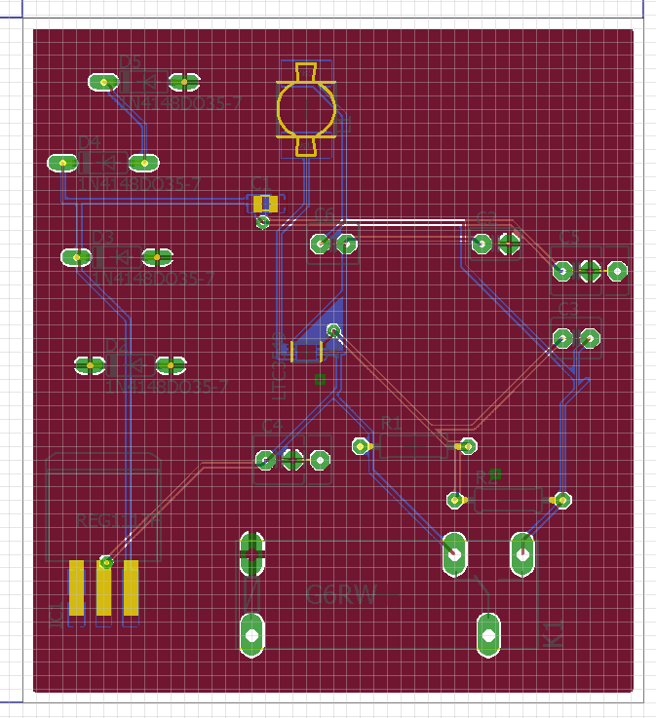
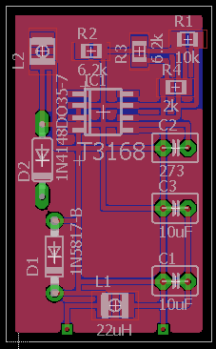
Receiver PCB

Slide 19
Receiver PCBs
Receiver with T316 IC
Receiver with buck converter

Slide 20
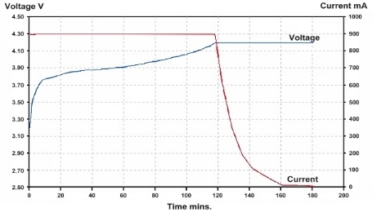
Charge Controller
Used to control the charging of the lithium polymer battery
Special way to charge lithium polymer batteries

Slide 21
T316 IC
Used to change AC to DC/peak detector
Also steps down voltage to help with sending it to the powerboost which is similar to the lm 27313
Step down from 8V to a more usable voltage around 4V.

Slide 22
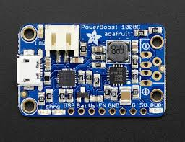
Power boost 1000c
Temperature sensor to detect overheating
Determines when to charge and when not to charge switching between the constant current and constant voltage sources.
Green means done
Orange means charging

Slide 23
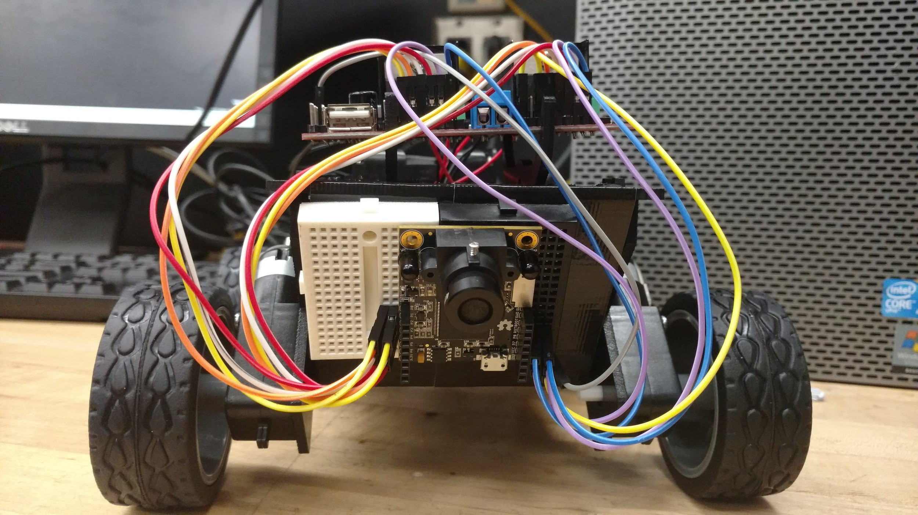

Slide 24
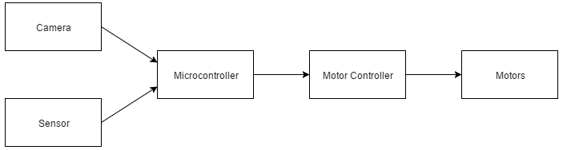
Autonomous control

Slide 25
Robot Hardware

Slide 26

Track
Traced out on a large acrylic sheet
Clear so the components under the track can be seen
Multiple curves to show autonomous navigation

Slide 27
Track (W.E.A.R System)
4 inch PVC couplings for stability and clearance (Height: 5 inches)
¾ inches of clearance (Transmitter Coil to Receiver Coil)
12 Volt Battery
Parallel Connections to oscillators
Transmitter LED
Green when ON.

Slide 28
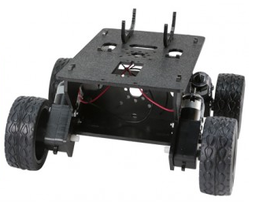
Robot chassis
Whippersnapper Runt Rover
Small enough to easily drive on the track
Weight 0.97 lbs
Stable and adjustable
4 wheels and 4 DC motors

Slide 29
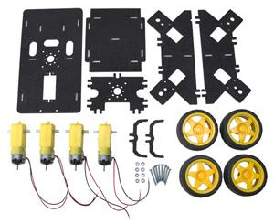
DC motor
DC MOTOR SPECIFICATIONS
4 DC motor will be in charge of controlling the wheels
Recommended Voltage: 4.5VDC
No Load Speed: 140RPM
No Load Current: 190mA
Max. Load Current: 250mA
Torque: 800 gf-cm

Slide 30
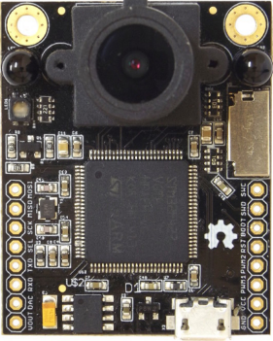
Microcontroller / Camera
OpenMV
Keypoint tracking, marker tracking
Adaptable to any hardware like Arduino
Cortex M4 processor
Micro python interpreter
3.7V to operate

Slide 31
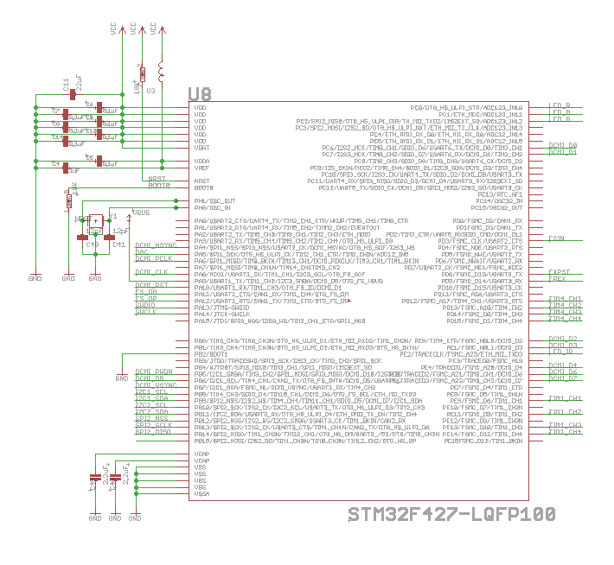
Schematic MCU

Slide 32
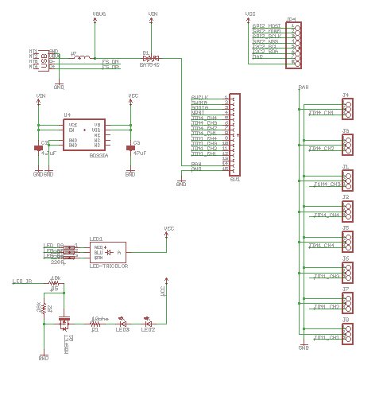
Schematic USB PORT, HEADERS, VOLTAGE REGULATORS

Slide 33
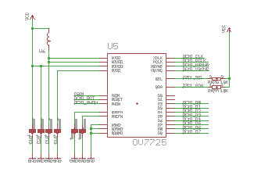
SCHEMATIC IMAGE SENSOR

Slide 34
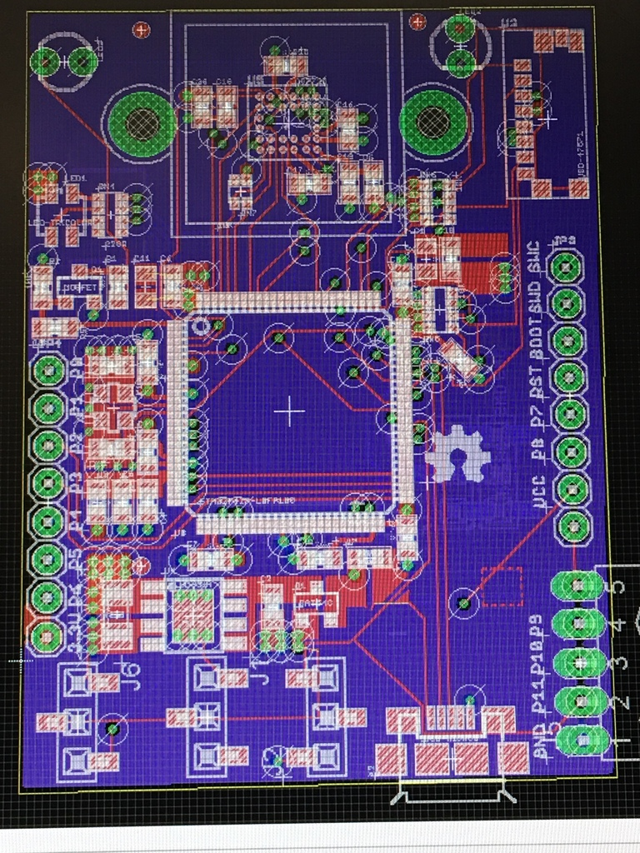
Board design
Size: 39.21mm * 53.05mm

Slide 35
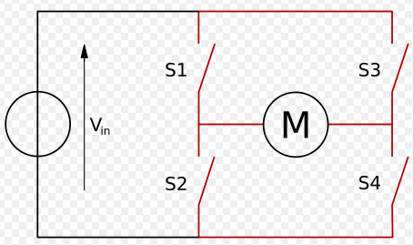
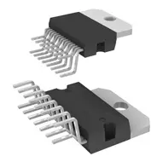
Motion control H-bridge
Forwards/Backwards movement
Left or Right turns
L298n H-bridge Driver

Slide 36
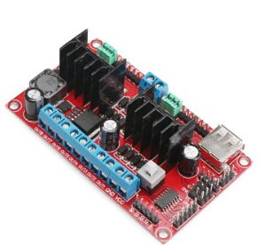
Motor Driver
Driver Chip: L298N dual H-bridge motor driver
It can directly drive two 3-30V DC motor.
5V output for to power for a 5V single-chip circuit
Driving Terminal can supply from + 5V to+ 30V
Peak Current of the Driving Part: 2A
Size:90 * 55 * 33mm

Slide 37
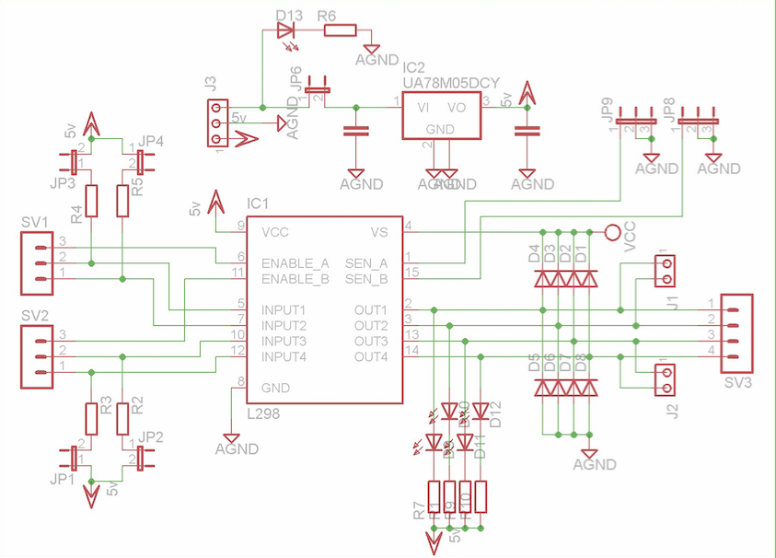
Motor driver schematic

Slide 38
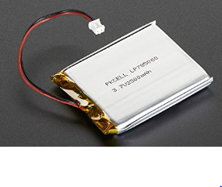
Battery
LiPo Battery
Long cycle life
Excellent discharge performance
Voltage: 3.7V
Capacity: 2500mAh
Light-weight: 0.3 ounces
Size : 2.6 x 2 x 0.3 inches

Slide 39
Battery charging requirements
Even though they are really efficient and they can store a lot of power, There are certain issues that lithium batteries have. Certain cell can be hazardous. And if it is treated improperly by being mishandled, over-charged, or abused LiPo , It can cause a small explosion.
Therefore, there are certain charging requirements.
3.7V LiPo batteries need to be charged ideally with 4.2 V

Slide 40
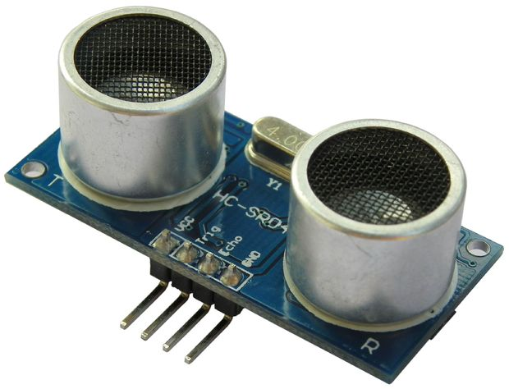
Ultrasonic Sensor
HC - SR04
5V operating voltage
15mA operating current
2cm minimum range
4m maximum range
15 degree measuring angle

Slide 41
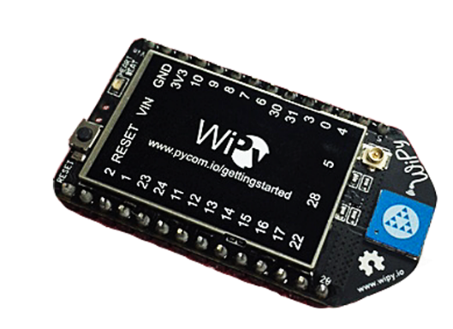
Wipy 1.0
★UART (x2), SPI, I2C, I2S, SD card
★Analog channels: 3×12 bit ADCs
★Timers: 4×16 bit with PWM and input capture.
★3v3 output capable of sourcing up to 250mA
★WiFi: 802.11b/g/n 16Mbps
★RAM: 256 KBytes
★Flash: 2 MBytes Size: 25mm x 45mm (1.0″ x 1.77″)
★GPIO: Up to 25

Slide 42
Software Design

Slide 43
High Level

Slide 44
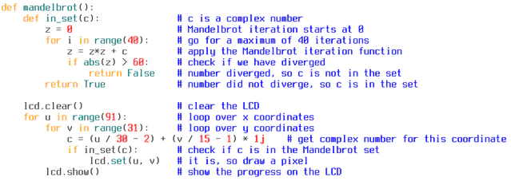
MicroPython
Python for microcontrollers!
Implementation of Python 3
Released in 2013

Slide 45
How It Works
Camera captures an image
Finds connected pixel regions that pass a threshold test
X, Y position of bounding rectangle
Number of pixels that passed threshold
X, Y position for center of mass
Angle of rotation
Region of Interest (ROI)
x, y, z, h values
Detects 3 regions
Lowest region holds most weight, highest holds least weight
Deflection angle created from ROI data

Slide 46
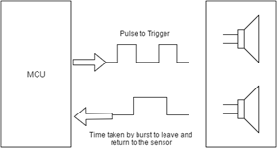
Ultrasonic Detection
The HC-SR04 ultrasonic sensor operates by emitting a sound wave that is greater than human hearing which is above 20 kHz. The distance is then measured using the formula: L = C X T

Slide 47
Wireless Monitoring
The WiPy is used as an access point in order to remotely monitor the battery voltage levels without requiring the robot to stop
It can be accessed using Telnet(Putty) and editing using an FTP client like FileZilla
The 3.7V battery voltage is sent through a voltage divider in order to meet the maximum requirement of 1.4V

Slide 48
Motor Control
Uses two L298N dual H bridge motor drivers
The 140 motors were tested to work reliably down to 70% PWM signal
The deflection angle calculated from the ROIs is then converted to degrees and divided by three to give a turn value. This will ensure that the PWM signal does not drop below 70%

Slide 49
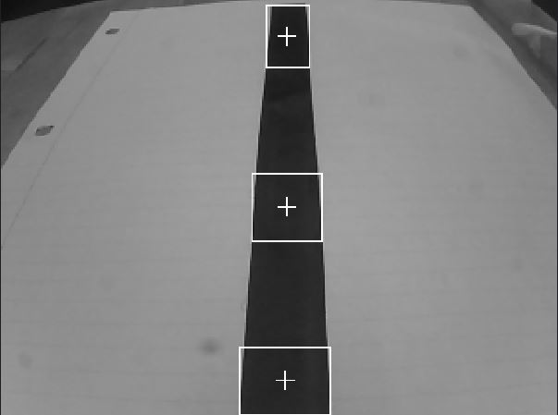
What the Robot Sees

Slide 50
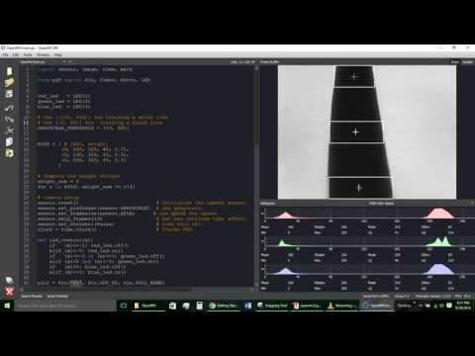
Robot Vision

Slide 51
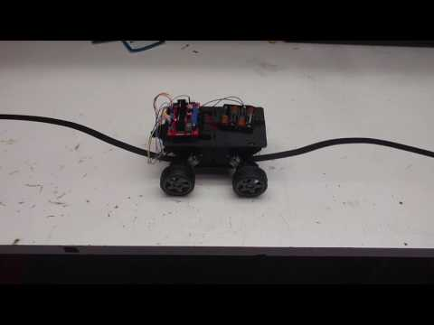
Robot Prototype

Slide 52
Administrative Content

Slide 53
Work Distribution
Name | Transmitter | Receiver | Robot Hardware | Robot Software | Track Construction
Trent | S | P |  |  | S
Dimitri | P | S |  |  | S
W. Olivier |  | S | P |  | S
Blake |  |  | S | P | S

Slide 54
Budget
Components | Cost | Budget | Difference
Track | $109.67 | $30 | $4.33
Power Distribution | $38.92 | $35 | -$3.92
Fan | $5.78 | $5 | -$0.22
Oscillator | $9.56 | $15 | $6.44
Temperature Sensor | $12.32 | $10 | -$2.32
Microcontroller | $75 | $75 | $0.00
Wires,Mounting | $42.46 | $50 | $7.54
Battery | 23.95 | $30 | $6.05
Services | $90 | $200 | $110
Motor driver | $17.98 | $30 | $12.02
Robot Chassis | $28.99 | $50 | $21.01
Copper Wire | $0.60/ft | $60 | $0.00
Total | $514.63 | $610 | $95.37

Slide 55

Financing
Sponsored by Quartus Engineering

Slide 56
Issues
Making sure the wireless energy transfer will not affect robot components.
Finding the perfect size coils for our design constraints due to the track design.
Multiple Coupling to allow energy transfer over a longer distance.
Robot MCU design change
Kickstarter ship dates

Slide 57
Questions?

