Slide 1
Group 7
Adam Kutchak (CPe)
Luis Brum (ee)
Jamie peck (cpe)
Greg Kelso (cpe)

Slide 2
Introduction
The Fire Extinguishing Unmanned Aerial Vehicle or FXUAV for short, is a project that seeks to extinguish fires autonomously.
Using an infrared imager, some clever programming, and a payload release design, the FXUAV will detect the presence of a flame, and put it out.

Slide 3
Motivation
Amount of deaths, injuries, and losses caused by fires
8 fatalities in the first 2 months of 2016
Over 20,000 deaths and injuries in 2011
$11 billion in damages in the United States in 2011
Facilitate a drive towards reducing the number of fatalities, injuries, and losses
Effectively reduce the number of deaths due to structure collapse and smoke inhalation
Satisfy UCF senior design requirements

Slide 4
Goals and Objective
Fire detection using image processing
Autonomous drone navigation toward fire
Autonomous fire extinguishing via chemical payload
Mobile App to operate drone

Slide 5
Specifications and Requirements
Subsystem | Parameter | Specification
Quadcopter | Thrust | 8 lb
Quadcopter | Flight-time | 10 min
Extinguisher | Weight | 1lb
Camera | Fire Detection/Tracking | 500 sq ft. range

Slide 6
System Overview – Block Diagram

Slide 7
Design Approach and Implementation
The FXUAV is composed of 2 major sub-systems:
  Quadcopter
  Linux/Android Application

Slide 8
Multirotor Flight Hardware
Frame: Tarot 650
  Material: Carbon Fiber
  Total Weight: 590 grams
  Base Size: 650 millimeters
Flight Controller Unit: PixHawk
  Processor: 32 bit ARM Cortex® M4
  Software: Mission Planner
  Firmware: APM: Copter V3.3.3 Quad
  Power Requirements: 5 Nominal Volts, < 3 Amps
  Internal Measurement Units:
    ST Micro L3GD20 3-axis 16-bit gyroscope, ST Micro LSM303D 3-axis 14-bit accelerometer / magnetometer, Invensense MPU 6000 3-axis accelerometer/gyroscope, and MEAS MS5611 barometer

Slide 9
Multirotor Flight Hardware
Motors: T-Motor MT3515 400KV (4 units)
  Power Requirement: 22.2 Nominal Volts, 0-20 Amps
  Thrust: 970 grams per motor at 50% throttle 2460 grams per motor at 100% throttle
Propellers: 15” Diameter Carbon Fiber
Electronic Speed Controller: Hobby Wing Xrotor Pro (4 units)
  Power Requirements: 10.8 – 22.2 Nominal Volts, 0-40 Amps
Battery: QuadroPower 6s 35C
  Voltage: 22.2 Nominal Volts
  Capacity: 10,000 mAh
  Maximum Discharge Rate: 350 Amps

Slide 10
Multirotor Flight Hardware
GPS System: 3DR uBlox GPS with Compass Kit
  u-blox NEO-7 module
    Accuracy: 2.5m
    17 mA @ 3 V (Continuous)
    5 Hz update rate
  Maxim Amplifier
    High-Power Gain: 20.5dB
    1.6V to 3.6V, 4.1mA
    Noise Figure 0.8 dB
  Taoglas Antenna
    Center Frequency: 1575MHz, +/-3MHz
    Bandwidth: 10MHz min Return Loss <-10dB

Slide 11
Multirotor Flight Hardware
Telemetry Radio: 3DR RADIO V2
  Operating Frequency: FCC15.47
    Minimum: 902 MHz
    Maximum: 928 MHz
    Channels: 50
  Transmit Current: 100mA at 30 dBm
  Receive Sensitivity: -117 dBm
  Frequency Hopping Spread Spectrum
  Adaptive Time Division Multiplex
  Data Transfer Rate: up to 250 kbps
  Operating Voltage: 3.7-6 V

Slide 12
Multirotor Flight Hardware
Radio Controller: RC Turnigy 9X 9Ch Transmitter w/ Module & 8ch Receiver
Receiver:
  Frequency Hopping Spread Spectrum technology
  2.4GHz 8 channels PPM
  Dipole single wire antenna
  Operating Voltage 4.5V-6V
Transmitter:
  Encoding PCM 9 channel and 8 channel PPM(2.4Ghz)
  8 internal model memories
  11.1v 1700mAh LiPo battery

Slide 13
Multirotor BOM
FIRE EXTINGUISHER UAV BOM
LINE | PART | MODEL NAME | QTY | UNIT PRICE | TOTAL PRICE
1 | FRAME | TAROT 650 | 1 | $129.99 | $129.99
2 | MOTORS | TIGER RC MT3515 400KV | 4 | $49.95 | $199.80
3 | PROPELLERS | Iflight 15x5.5 T-style Carbon Fiber CW&CCW | 4 | $25.00 | $100.00
4 | FLIGHT CONTROL | 3DR PIXHAWK | 1 | $200.00 | $200.00
5 | ESC | 40A | 4 | $25.00 | $100.00
6 | BATTERY | 10000MAH 25C 6S | 1 | $199.99 | $199.99
7 | MINIMOSD | APM MinimOSD | 1 | $49.99 | $49.99
8 | TX/RX | BOSCAM 5.8GHZ RC305 | 1 | $50.00 | $50.00
9 | TELEMETRY | 3DR TELEMETRY RADIO | 1 | $65.99 | $65.99
10 | GIMBALL | FPV Brushless PTZ | 0 | $52.49 | $0.00
11 | CAMERA | TAU | 1 | $0.00 | $0.00
12 | GPS | 3DR uBlox | 1 | $89.99 | $89.99
13 | SENSORS | HC-SR04 Ultrasonic Module | 5 | $2.50 | $12.50
14 | CHARGER | Hitec X1+ | 1 | $75.00 | $75.00
15 | MCU | BEAGLEBBONE BLACK | 1 | $0.00 | $0.00
16 | PDB | OWN DESIGN | 1 | $150.00 | $150.00
17 | FIRE EXTINGUISHER | OWN DESIGN | 1 | $50.00 | $50.00
18 | CABLES |  | 1 | $30.00 | $30.00
19 | BATTERY | 6000 MAH 25C 6S | 1 | $150.00 | $150.00
20 | MISC |  | 1 | $100.00 | $100.00
 |  |  |  | SUBTOTAL | $1,753.25
 |  |  |  | TAX | $113.96
 |  |  |  | EST. S&H | $140.26
 |  |  |  | TOTAL | $2,007.47

Slide 14
Total Weight
FIRE EXTINGUISHER UAV WEIGHT CALCULATION
PART | NAME | UNITS | WEIGHT (G) | WEIGHT (LB)
FRAME | TAROT 650 | 1 | 590 | 1.30
MOTORS | TIGER RC MT3515 400KV | 4 | 752 | 1.65
PROPELLERS | TAROT 1555 | 4 | 100 | 0.22
FLIGHT CONTROL | 3DR PIXHAWK | 1 | 38 | 0.08
ESC | 40A | 1 | 130 | 0.29
BATTERY | 10000MAH 25C 6S | 1 | 1400 | 3.08
MINIMOSD | APM MinimOSD | 1 | 50 | 0.11
TRANSMITTER | BOSCAM 5.8GHZ RC305 | 1 | 40 | 0.09
RECEIVER | BOSCAM 5.8GHZ RC306 | 1 | 0 | 0.00
TELEMETRY | 3DR TELEMETRY RADIO | 1 | 50 | 0.11
GIMBALL | FPV Brushless PTZ | 1 | 200 | 0.44
CAMERA | TAU | 1 | 125 | 0.28
GPS | 3DR uBlox | 1 | 16.8 | 0.04
SENSORS | HC-SR04 Ultrasonic Module | 4 | 44 | 0.10
CHARGER | Hitec X1+ | 1 | 0 | 0.00
MCU | BEAGLEBBONE BLACK | 1 | 40 | 0.09
PDB | OWN DESIGN | 1 | 200 | 0.44
FIRE EXTINGUISHER | OWN DESIGN | 1 | 500 | 1.10
CABLES |  | 1 | 100 | 0.22
MISC. |  | 1 | 50 | 0.11
 |  | TOTAL | 4425.8 | 9.74

Slide 15
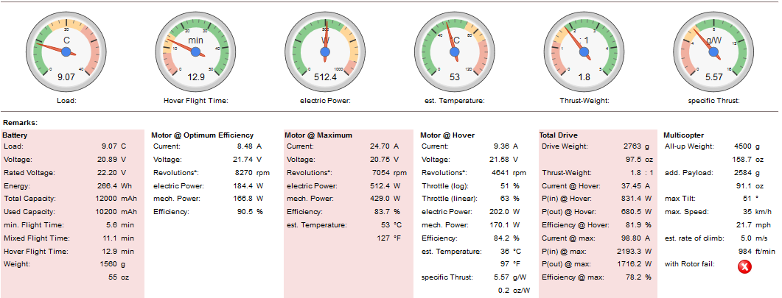
Flight Time Estimation
*THIS IS AN ESTIMATE AS OF FEBRUARY 26TH 2016. FLIGHT TIME IS SUBJECT TO CHANGE DUE TO FINAL PRODUCT DESIGN, FLIGHT TIME DATA HAS AN ACCURACY OF +/-15%.

Slide 16
Power Distribution Diagram

Slide 17
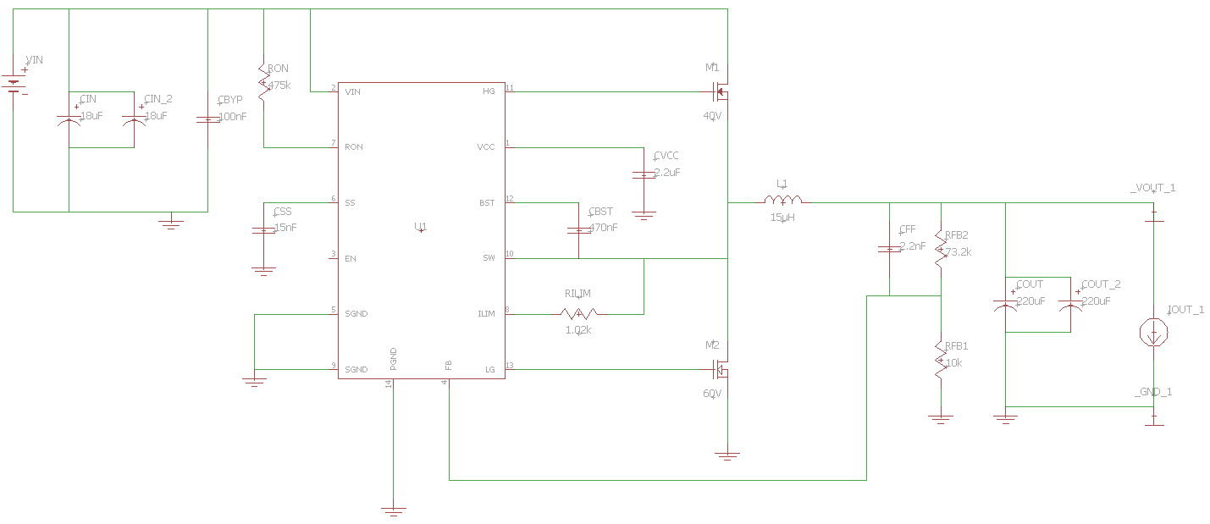
PDB Schematic

Slide 18
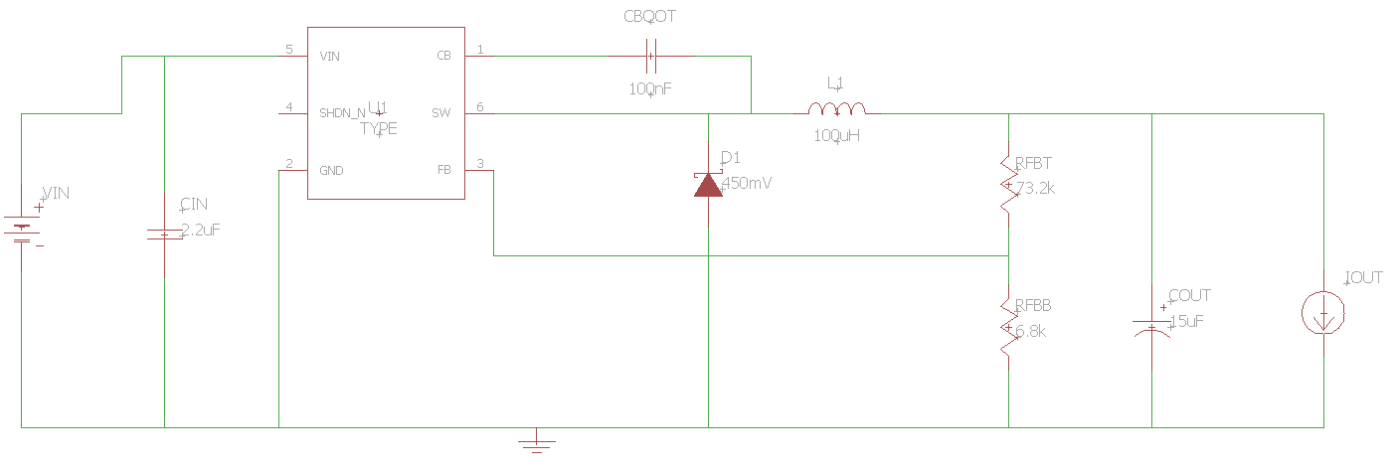
PDB Schematic

Slide 19
Software Architecture
Onboard the quadcopter will be another module that will be doing image processing and will control the Fire Extinguisher.
We will be using a BeagleBone Black for this image processing.
  Native to Python
  More GPIO pins than Raspberry Pi
  Has been done before (don't have to reinvent the wheel)

Slide 20
Software Architecture
PWM
Commands
Pixhawk
Airframe
MAVLink via
USB
MAVLink
Via
Wi-Fi
App
BeagleBone
Black
Ground
Control
Station
MAVLink
Via
Loopback

Slide 21
MAVProxy
MAVProxy is a command-line ground control station written in Python
Each MAVLink command sent to the App/Pixhawk via USB/Wi-Fi from MAVProxy.

Slide 22
MAVLink
MAVLink is a protocol for communicating to UAVs.
Using MAVLink command messages, we will be able to attach ultrasonic sensors and receive data from them.
Using the data we receive from the sensors, we will use MAVLink command messages to control the quadcopter and implement object avoidance.

Slide 23
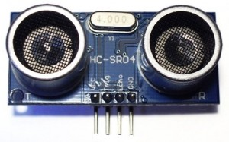
Ultrasonic Sensors
HC – SR04 Ultrasonic Module
  Weighs 10g each
  Sends 40kHz sonar wave
  Detects objects up to 4 meters
5 will be placed on different sides of the FXUAV to be used for collision avoidance

Slide 24
Camera Module
 | GoPro HERO4 Black | Tau2 640
Weight | 5.4oz (152g) | 4.48oz (127g)
Cost | $499.00 | No added cost
Image | Color | Thermal

Slide 25
Camera Module
GoPro HERO4 Black
Advantages:
  Continuous photo capture, Night photo capture
  Exceptional Battery Life; Lithium-ion rechargeable battery
  Wi-Fi communication capabilities
  Up to 64 GB storage capacity
  GoPro Controller Library
Disadvantages:
  Weighs 5.4oz (152g)
  Cost ($499.00)

Slide 26
Camera Module
Tau2 640
Advantages:
  No added cost—camera provided by FLIR Systems Inc.
  Camera Controller GUI
  Low power consumption
  Specifically designed Image Processing Modes
  40,000ft Operational Altitude
Disadvantages:
  Potential ‘blindness’ from its own radiation—decreased sensitivity

Slide 27
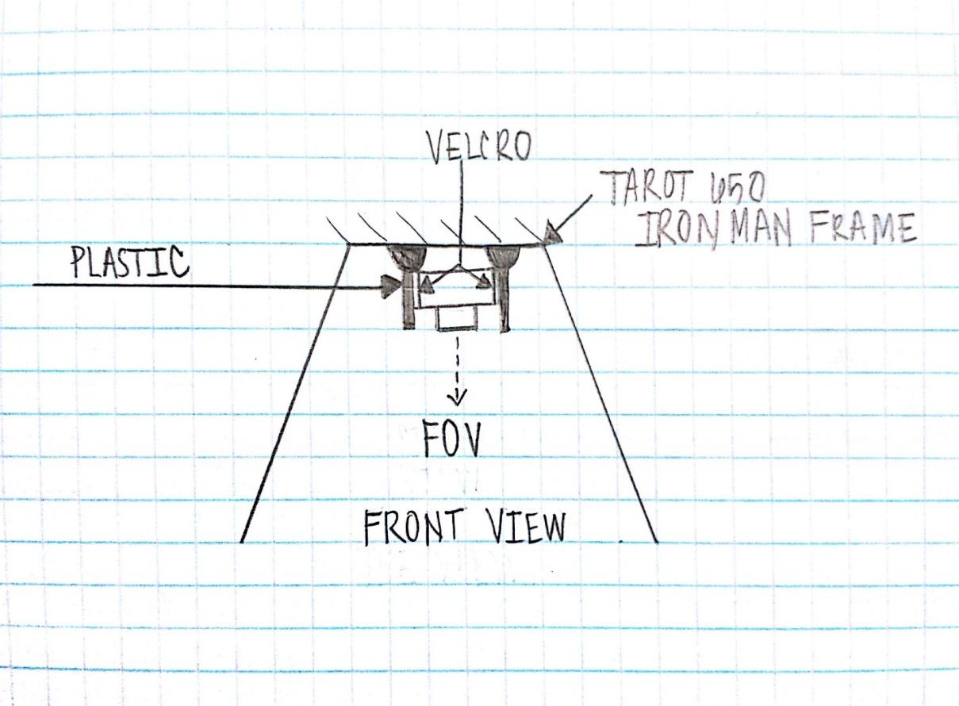
Camera Attachment
Camera Controller GUI
Enables remote command and control of camera functions and features
USB or RS-232 serial interface

Slide 28
Selecting A Lens
Distance d
Lens
Image Sensor
Object
Focal Length f

Slide 29
Lens | FOV-Horizontal (deg) | Pixel Size | Analog Display-Horz | Analog Display-Vert | Detector Size | Focal Length
WIDE FOV
7.5mm | 90 | 1.70E-05 | 640 | 480 | 0.01088 | 0.006926423
9mm | 69 | 1.70E-05 | 640 | 480 | 0.01088 | 0.009034465
13mm | 45 | 1.70E-05 | 640 | 480 | 0.01088 | 0.013852846
19mm | 32 | 1.70E-05 | 640 | 480 | 0.01088 | 0.019480565
NARROW FOV
25mm | 25 | 0.000017 | 640 | 480 | 0.01088 | 0.024935123
35mm | 28 | 1.70E-05 | 640 | 480 | 0.01088 | 0.022263503
50mm | 12.4 | 1.70E-05 | 640 | 480 | 0.01088 | 0.050272426
100mm | 6.2 | 1.70E-05 | 640 | 480 | 0.01088 | 0.100544852

Slide 30
Image Processing
OpenCV libraries
  Classifier Training
  Object Detection
System training via opencv_traincascade application
Positive and negative image samples required
  OpenCV Utility: opencv_createsamples

Slide 31
Image Processing
findcontours( )
drawcontours( )
The function draws contour outlines of filled contours in the image
check( )
The function searches for contours of red pixels
The function retrieves contours from the image
Useful tool for shape analysis and object detection and recognition
Image Prep
GaussianBlur( )
dilate( )
erode( )
convolves the source image
causes bright regions within an image to “grow”
bright areas of the image get thinner, and dark zones get bigger

Slide 32

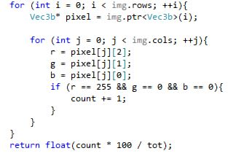

Slide 33
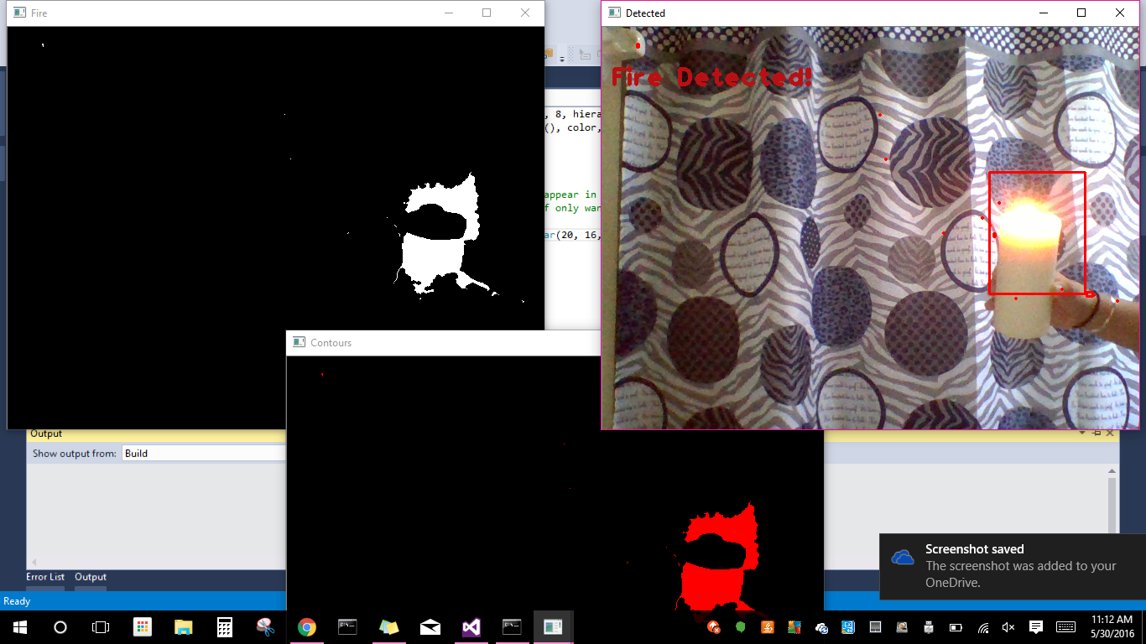
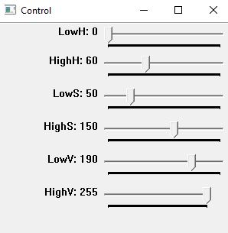

Slide 34
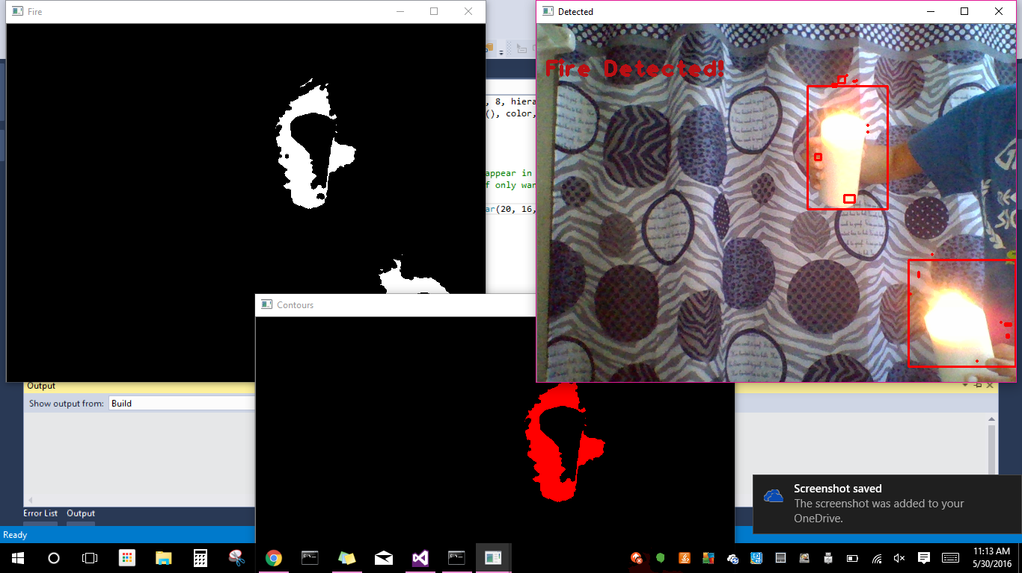

Slide 35
Processing Tasks
Task | Module | Connection
Flight Path Processing | Pixhawk Flight Controller | Onboard; I2C Serial Interface Protocol
Proximity Processing | HC – SR04 Ultrasonic Sensors | Onboard; GPIO Pins
Image Processing | OpenCV Algorithms | Direct Connect to MCU; USB

Slide 36
Processing MCU
 | Arduino ATMega2560 | BeagleBone Black
Cost | $30.00 | $55.00 (free)
Universal Serial Buss | N/A | 1x2.0
ADC | 6 | Internal
I/O Protocols | 14 | 22
RAM | 8 KB | 512 MB
Speed | 16 MHz | 1 GHz
Processor | ATMega2560 | TI Sitara AM3359 ARM Cortex A8
Architecture | 8-bit | 32-bit
Programming Language | Wiring Based (~C++) | C, C++, Java, Python, Perl, Ruby
Integrated Development Environment | Android IDE, Eclipse | Cloud9, Node.JS
Operating System | N/A | Android, Linux, Windows CE, RISC OS
No power conversion or level shifting is needed
  PixHawk Flight Controller operates at the same voltage of 3.3V
Several Connectivity Ports: USB host, USB client (for power and communications), Ethernet, HDMI, and 2x46 pin headers.

Slide 37
Image Processing Sub-System
The BeagleBone Black will receive video streams from the Tau2 640 via a USB port
  Image processing will be done via the BeagleBone
Once the object is detected the BeagleBone Black will signal the PixHawk Flight Controller
  PixHawk will ignore the waypoints it receives from the mission planner software
  It will then navigate the quadcopter to the fire that was detected

Slide 38
Fire Suppression
The fire suppression will be made up of a trap door mechanism that is populated with Sodium Bicarbonate (baking soda), something often used in fire extinguishers.
Once the drone has been positioned accordingly, a signal will be sent to release the contents and extinguish the fire.

Slide 39
Fire Extinguisher
The extinguisher will be operated electronically, via solenoid valve.
As stated previously, once the drone is placed accordingly, a signal is sent from the beaglebone black to the solenoid which will extend/retract and activcate the trap door.

Slide 40
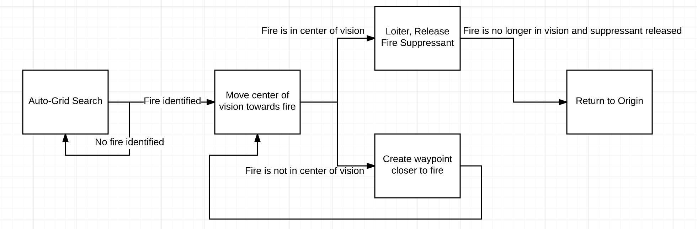
Software Activity Diagram

Slide 41
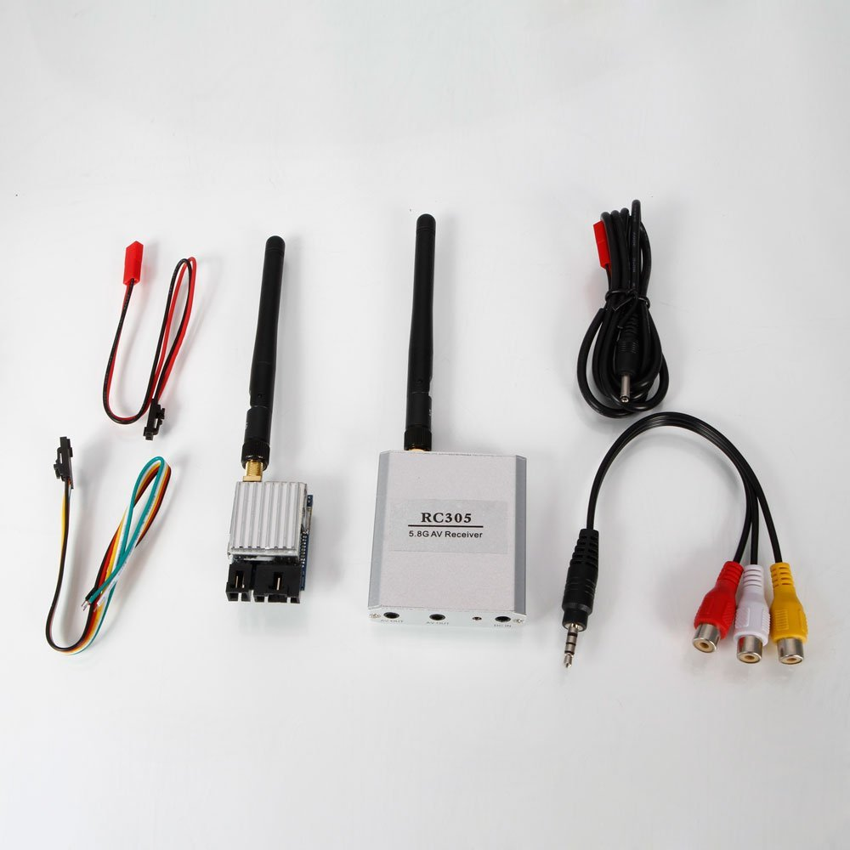
Boscam 5.8GHz TS351 TX and RC305 RX
Operates at 5.8GHz
Supports up to 8 channels
Transmitter weighs 25g
Displays video in NTSC format
Antenna is detachable and upgradeable
Provides direct communication between Linux application and Tau2 camera

Slide 42
Linux Application
Connects to Tau2 IR camera via Boscam 5.8GHz TX/RX
Displays live video feed from the IR camera
Detects the fire using OpenCV libraries
  Also used to display debug data from the image processing
Communicates with quadcopter using the Pixhawk's PyMAVLink libraries
  Uses this to display live telemetry data
Developed in Python with PyQT

Slide 43



Linux Application Development Tools
Overall application will be developed with Python
Application will run on Debian/Ubuntu Linux distributions
GUI for the application will be developed with PyQT
Embedded camera feed will be displayed using libVLC
Image recognition software will be developed with OpenCV libraries

Slide 44
Why Python?
Python is fast, powerful, and easy to use
Python allows development to focus on the higher-level algorithms and architecture of the design, instead of struggling with implementation
Several of the project's requirements offer Python-based libraries, which significantly removes the number of programming languages used overall
  LibVLC
  PyQT

Slide 45
Qt / PyQt
Qt is an incredibly flexible and powerful cross-platform application development tool. It allows developers to create an application with one programming language and one code base, and then distribute it to run natively in any environment (Windows, OS X, Linux)
Qt natively runs on C++, but PyQt binds the application to Python scripts, allowing for development in Python instead of C++
Creating a simple, easy to maintain cross-platform application is imperative for future expansion and use of the FXUAV

Slide 46
LibVLC
The VLC Media Player is a free, open-source, and cross-platform media player that is based on the LibVLC SDK
The FLIR Tau2 transmits data in the NTSC video format, which the VLC media player is capable of displaying
LibVLC offers Python bindings, once again allowing development to occur in the Python language
LibVLC is compatible with Qt / PyQT, which will allow the application to embed a VLC media player to display the Tau2 video stream

Slide 47
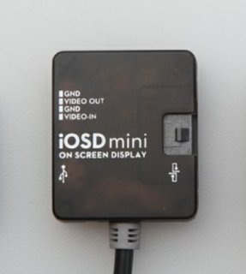
DJI iOSD Mini
Overlays video stream with useful telemetry data
Communicates to the camera with NSTC port
Includes data such as voltage drain, current velocity, distance to origin, and others
Weighs 14g

Slide 48
Work Distribution
 | Adam | Luis | Jamie | Greg
MAVLink Communication/Object Avoidance
Power Distribution Board
Image Processing
App

Slide 50
Issues
Keeping the baking soda from dispersing too heavily before reaching the fire.
Dropping the baking soda has two main issues
  Being too close to the fire may damage components or put out the fire with propeller wind.
  Being too far allows too much time for other factors to interfere with dispersing the baking soda before it can contact the flame.

Slide 51
Issues
Propeller and motor attachment.
Currently, the propeller center bore, is too small for the motor shaft.
We're looking into workarounds to solving these issues without compromising the effectiveness of either the motor the propellors.

Slide 52
Immediate Plans for Success
In order to succeed, our immediate plans include finding a solution to our two main issues, as well as assembling everything so we can start testing.
These steps are the most important and most crucial to the success of the FXUAV.

