Slide 1
GROUP 14: ESSENCE OF MUSIC
Joshua Garber – EE
Baron Dolletski-Lazar – CpE
Nelson Tan - CpE

Slide 2
Motivation
Create a device that allows the user to experience music in multiple ways.
Be able to provide an uplifting atmosphere through the use of sound and lights.
Provide the user with control over how they want to experience the music.
Provide a clear playback of music accompanied by flashing patterns of lights.
There is a growing demand for different types of audio devices.

Slide 3
Specifications and Requirements
Description | Numerical Value or Representation
Able to produce audible sounds from a reasonable distance. | Can produce a clear sound of 80 dB from a distance of 8 meters.
Can be controlled wirelessly from a distance. | Wireless signal capable of reaching 10 meters.
Lightweight and compact for portability. | Overall weight < 2.5 kg Dimensions: 30 cm X 30 cm X 30 cm
Have a long lasting and quick charging power supply. | Battery life from max charge: ~4-5 hours Recharge time: 2 – 3 hours

Slide 4
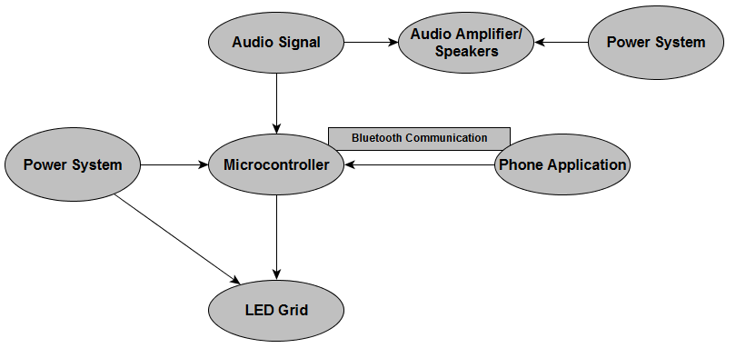
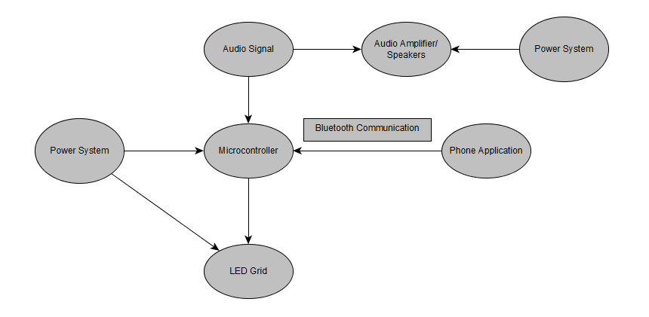
Project Diagram

Slide 5
Microcontroller
Microcontroller | Pros | Cons | Price
Atmega328p | Large community base for assistance, larger power supply, 28 pins, 2kB of RAM | More expensive peripherals, | ~ $5.00 for one unit
MSP430G2553 | Cheap peripherals, 16 MHz internal clock, | Lower Ram, smaller memory | ~ $6.00 for one unit

Slide 6
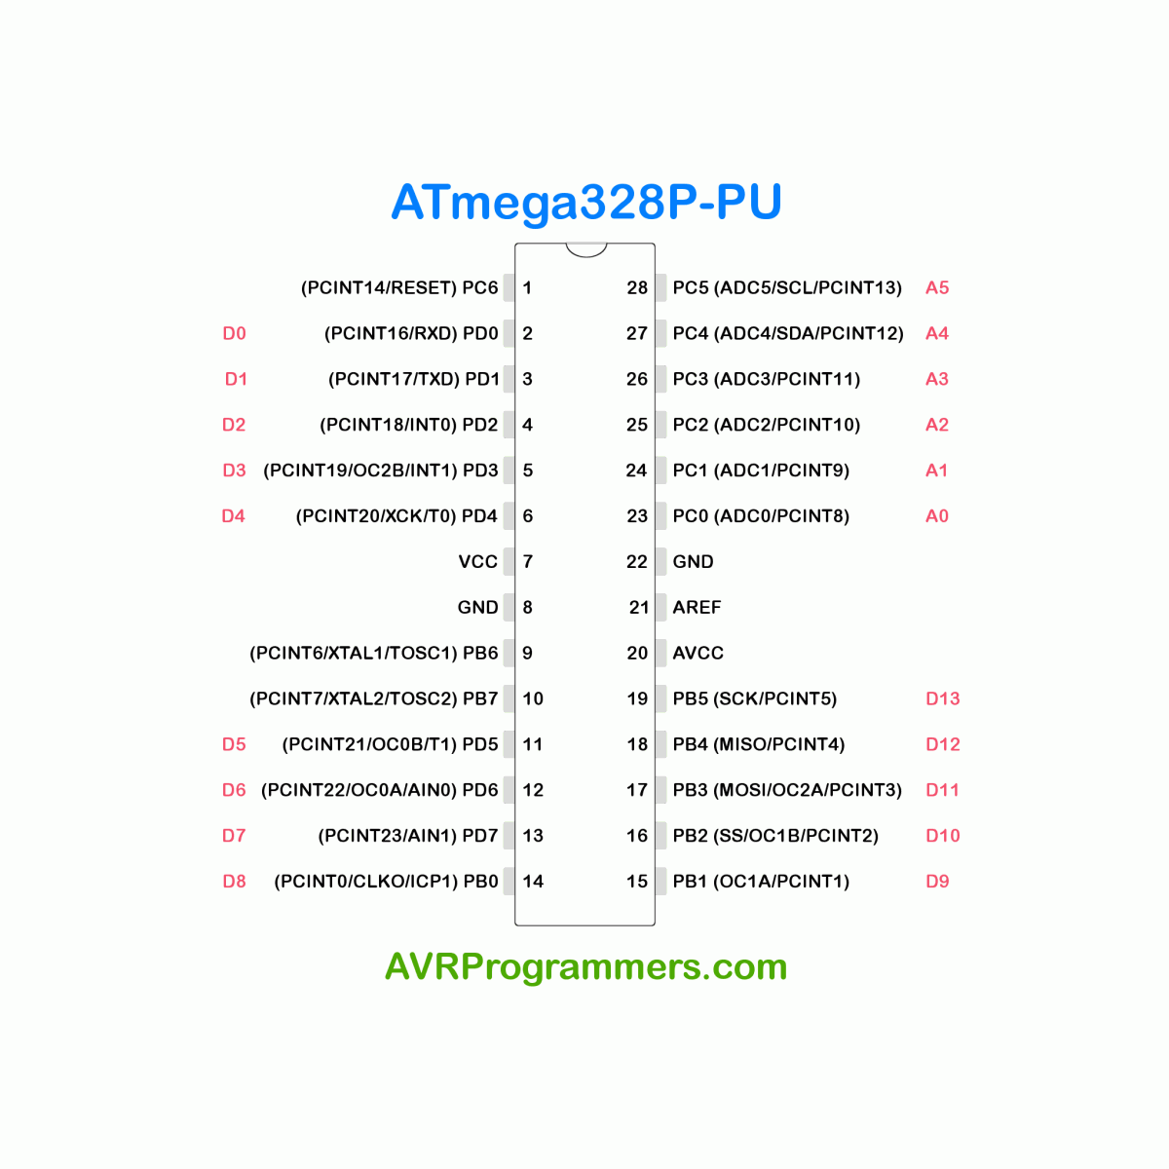
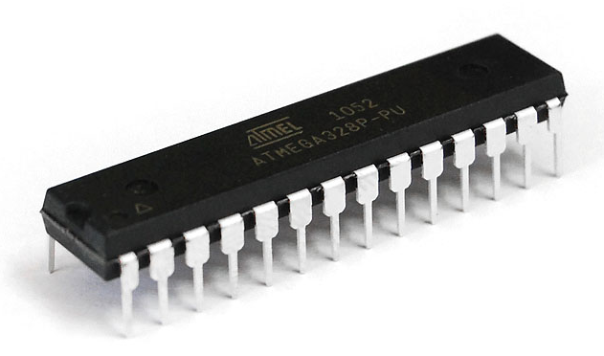
Selected Microcontroller: Atmega328p
Meets the specification requirements.
Able to be programmed using the Arduino for testing and easy to incorporate for the PCB.
Large amount of community support.
Insert Picture of Atmega328p here

Slide 7
LED Set-up
LED Set-up | Price | Color Range | Set-up
4 sets of 8 X 8 LED grids | 35 per grid | Large Spectrum | 4 grid linked in series
16 X 32 LED grid | ~25 | Large Spectrum | 1 single grid with input and output
LED light soldering | 100 at 6.06 | 3 colors | Soldered LEDs connected in parallel.

Slide 8
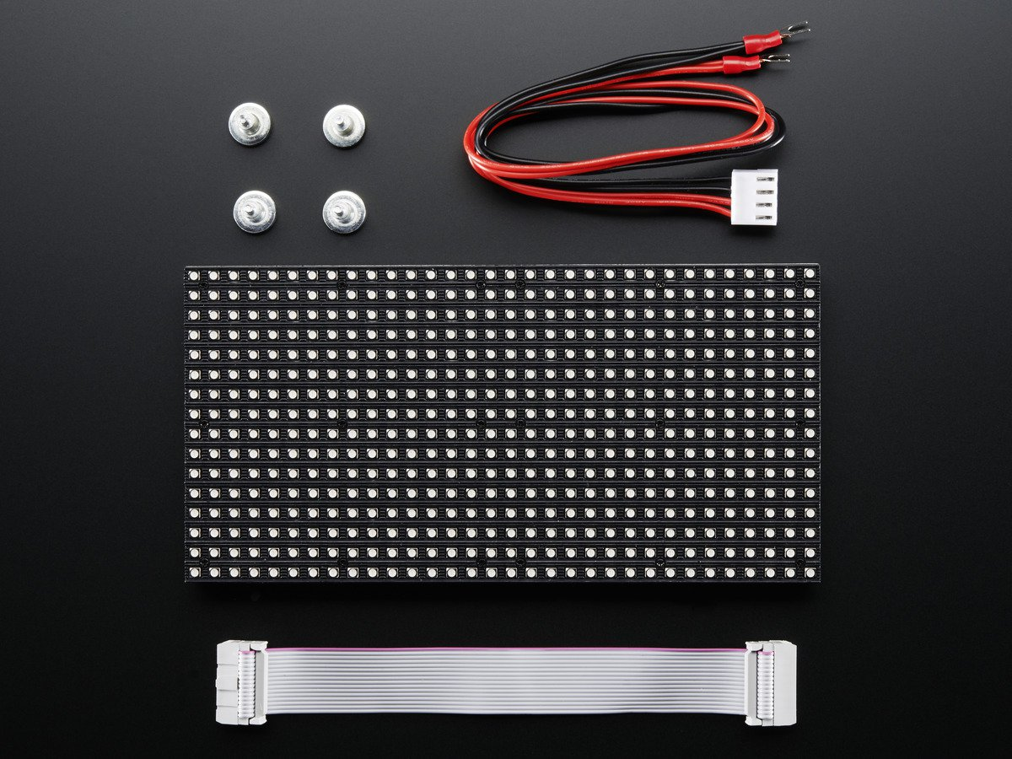
Visual Display: LEDs
LEDs in a grid of size 16 X 32.
Ability to hold a large variety of colors customizable by the user.
Lights blink and flash in various patterns based on the user’s preference.
Overall cheaper and provides an easy way to control the LEDs using output from the PCB.
Include Picture of LED grid here.

Slide 9
LED Programming
Focus primarily on the types of patterns and interpretations of incoming audio signals.
Allow settings for the user to control patterns of lights in various settings as well as the different colors that they want displayed.
C programming language for code due to board and controller compatibility.

Slide 10
Power Source
Power Source | Pros | Cons
Lithium Ion Batteries | Portable, Easy to incorporate into device, cheap. | Suffers from aging.
Lithium Polymer | Portable, smaller, safer. | Slightly more expensive, lower energy density
Wall Mount | Unlimited source of energy while connected. Provides a constant source of energy. | Little to no mobility away from wall outlets, requires wall adapter.

Slide 11
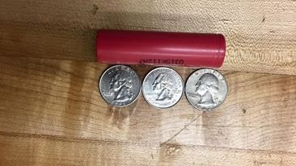
Batteries
Selected Batteries: Lithium Ion 18650 Batteries.
Lightweight batteries for added portability.
Long lasting battery life.
Quick to charge.
Can support relatively high current for mobile device.
One of the highest Energy/Volume ratios for batteries - very efficient
Insert Picture of physical batteries here.

Slide 12
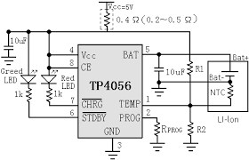
Charging Circuits
Batteries for the device are rechargeable.
Requires a specific circuit in order to perform the charging.
Decided to use the TP4056 circuit due to its ease of use and convenience.
Insert Image of TP4056 circuit here.

Slide 13
Audio Input and Output
Audio comes in as an analog signal and passes through a buffer to two different locations.
One signal goes to the speakers for audio playback.
The second signal is sent to the microcontroller which is passed through an FFT function in order to perform spectrum analysis.
However, our MCU only operates in the voltage range of 0V to 5V - registering the analog voltage as a value between 0 and 1023. The problem is that most auxiliary audio signals have very small voltage ranges (typically in the range of -200mV to +200mV)

Slide 14
Microcontroller and Audio Signals
The MCU is unable to operate at negative voltages. The negative voltages are clipped out since the MCU is unable to process them.
Even past raising the DC offset of the audio signal, the audio signals amplitude is still going to be in the order of 200mV, so it must be amplified.
Because of these facts, it is necessary to have a circuit that upscales and corrects these issues.
The following simulation presents a configuration that converts the audio signal into what can more properly be interpreted by the MCU.
Notes:
To note, first off, the MCU doesn’t even OPERATE at negative voltages, meaning the signal going bare into the MCU would be clipping all the negative parts of the signal.

Slide 15
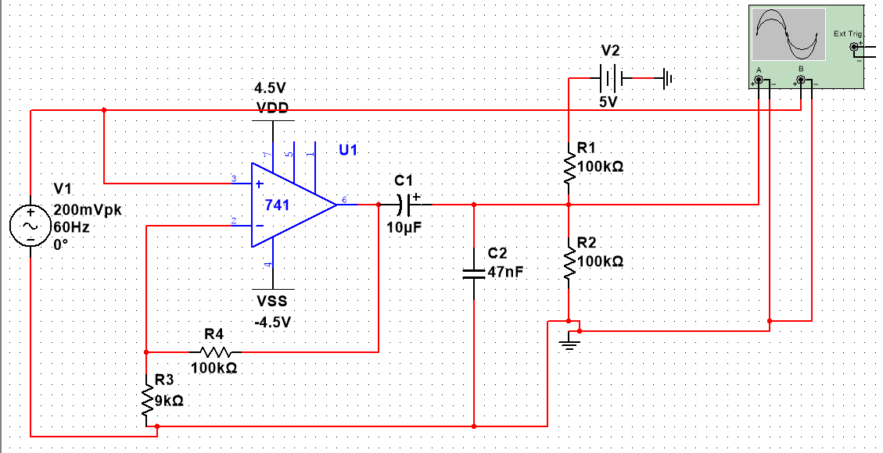
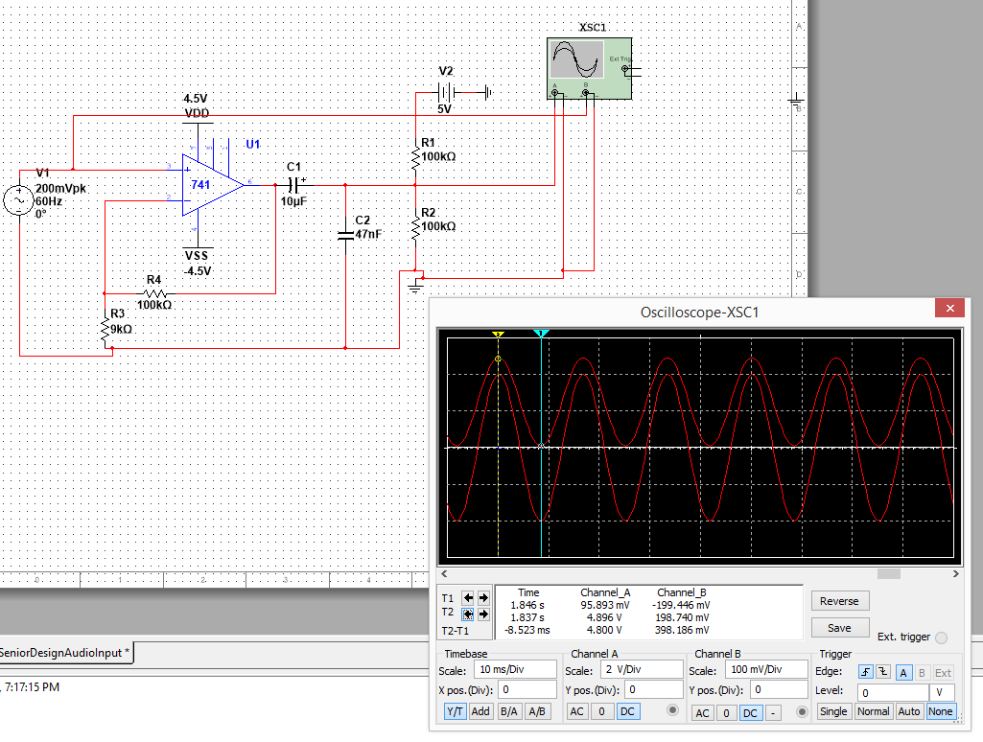
Audio Converter to MCU

Slide 16
Audio Converter to MCU

Slide 17
Audio Converter to MCU

Slide 18
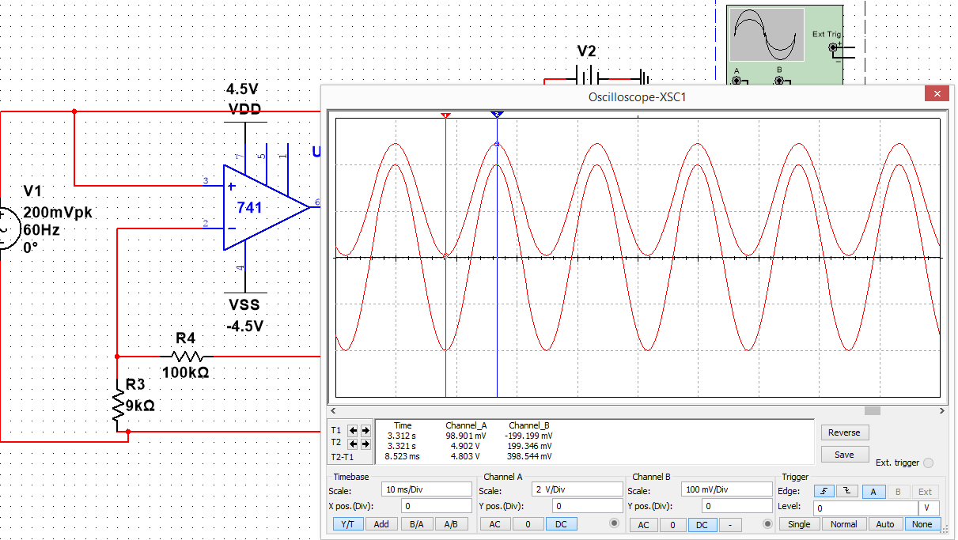
Audio input and output towards MCU

Slide 19
Wireless Communications
Method | Maximum Range | Data Transfer | Pros | Cons
Wi-Fi | 200 meters | 250Mbps | Long distance use | Harder to implement
Bluetooth | Class 1: 100 meters Class 2: 10 meters | 25Mbps | Incorporated into more devices every day, lower power | No easy way to directly connect to Wi-Fi without third party,

Slide 20
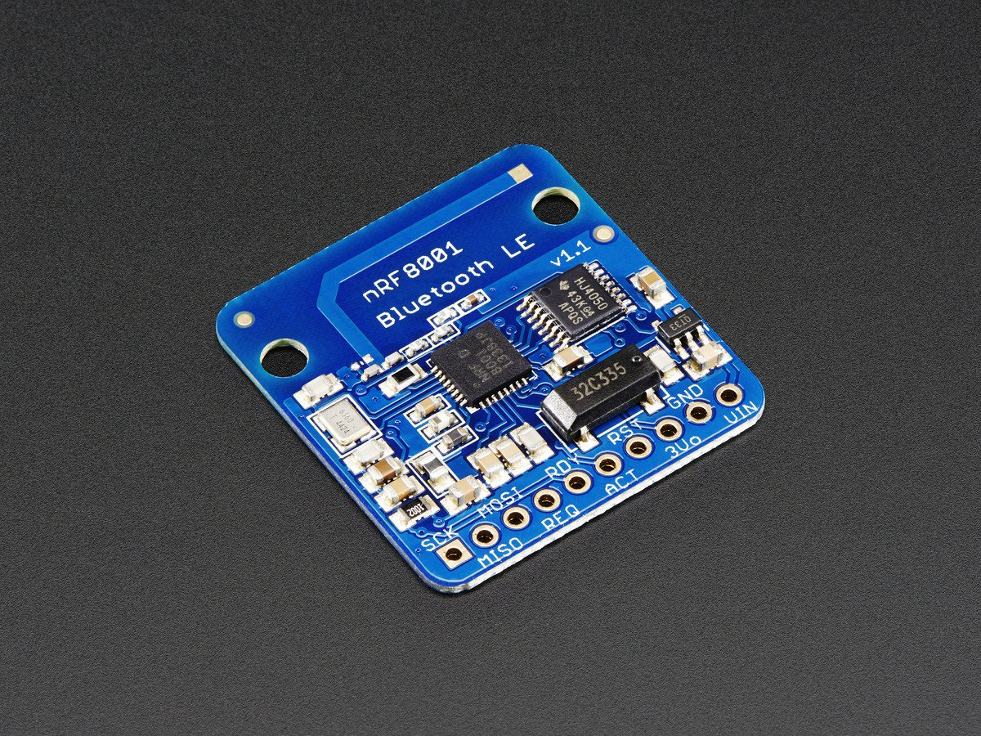
nRF8001 Bluetooth Module
Selected for several reasons:
Publically available datasheet
Cheap Cost ~$20 for breakout board, $4.98 for the standalone chip.
Small size, 1” x .09”
No microcircuit.
Runs for a long time on a coin battery.
Wide range from 10 – 100 meters.

Slide 21
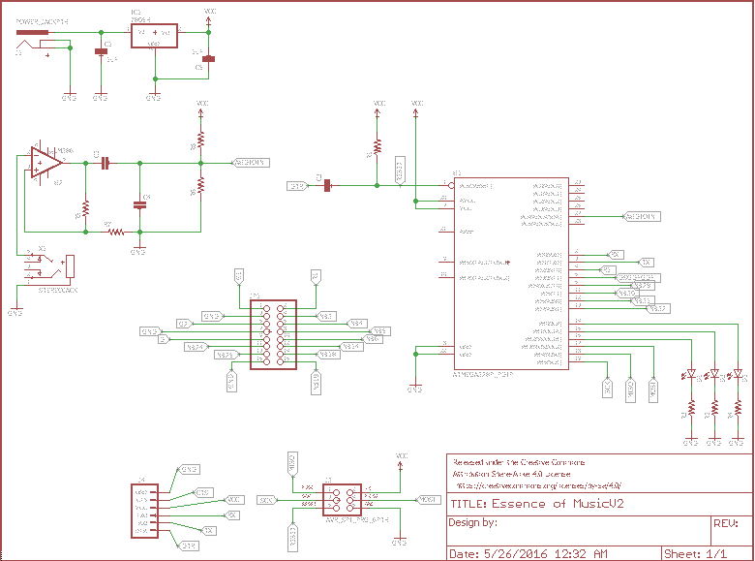
PCB

Slide 22
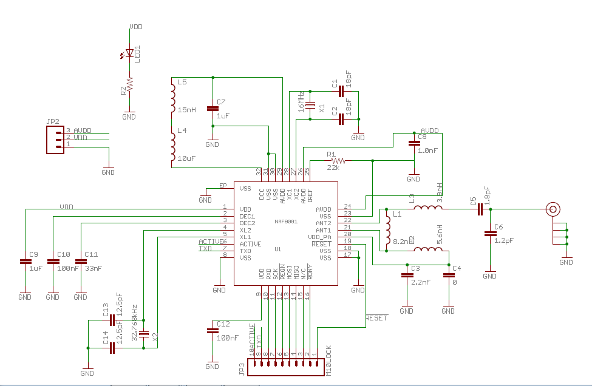
nRF8001 Schematic
Designer: Nabil Tewolde

Slide 23
Phone Application Platform
Android | iOS | Windows Phone
Capable of working with many different types of OS | Simple System integration across series. | Easy integration with other Windows devices.
Open Source | High Level of Security
Cheap development costs
Easier overall development
Easy Access to Source Files

Slide 24
Programming Languages
Will use a combination of JavaScript and C languages.
Arduino will use C to program the microcontroller
Phone Application will use JavaScript to create the interactive screen and control the device through Bluetooth connections.

Slide 25
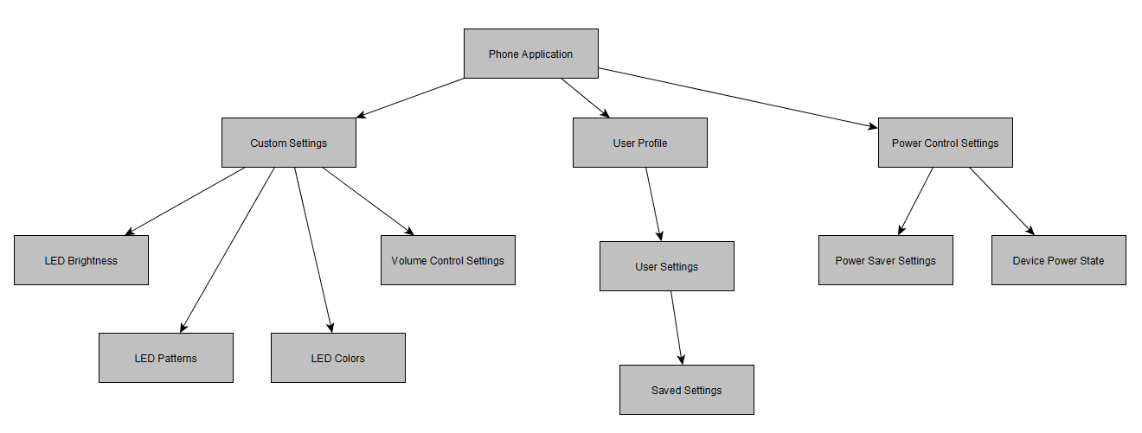
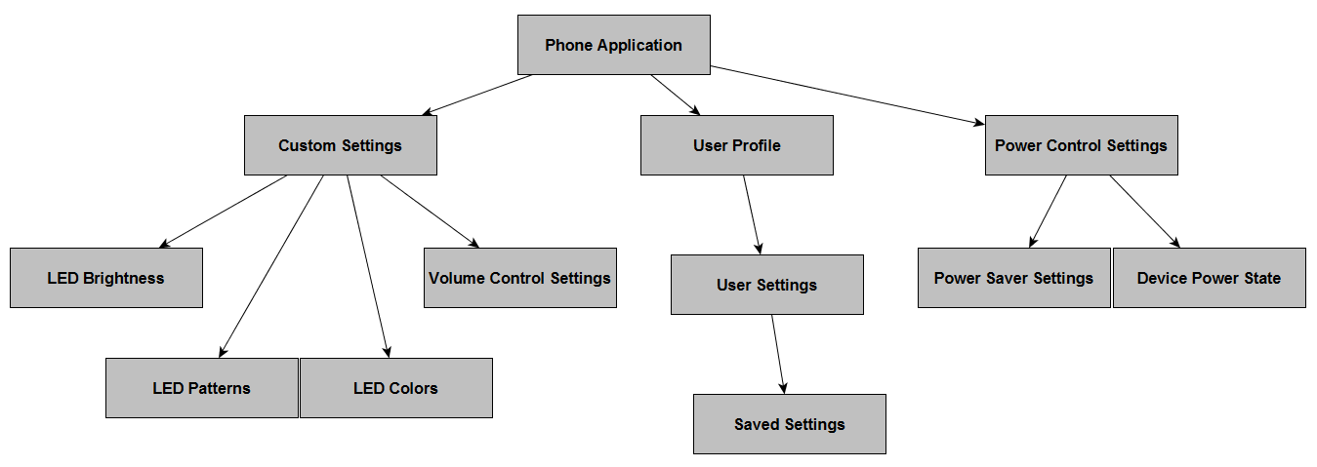
Phone Application Class Diagram

Slide 26
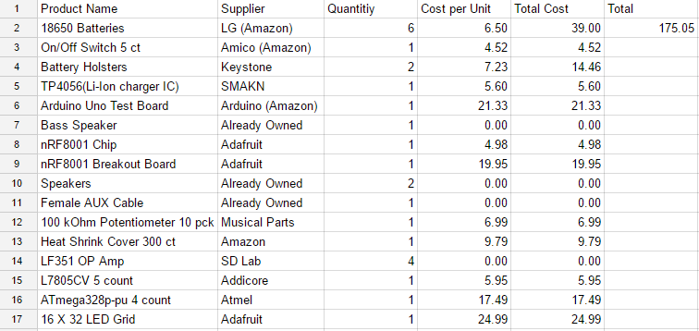
Finances

Slide 27
Division of Work
Work/ Person | Joshua | Baron | Nelson
Hardware: Battery | Primary | Secondary | Secondary
Hardware: Casing | Secondary | Secondary | Secondary
Hardware: PCB design | Secondary | Primary | Secondary
Hardware: Electronics | Primary | Secondary | Secondary
Software: Programming | Secondary | Secondary | Primary
LED Programming | Secondary | Primary | Secondary
Materials Management | Secondary | Secondary | Primary

Slide 28
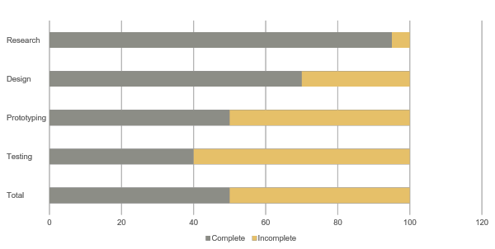
Overall Progress

Slide 29
Possible Changes and Additions
Changing from Battery powered device to Wall mount power source.
Metadata display from active audio files.
Extracting Metadata from external music applications such as Spotify and Pandora.

Slide 30
Questions/Comments?

