Slide 1

Group 11
Presented by:
Marc Burrell EE/CpE
Mario Martinez EE
Geoffrey Mulberry EE
Portable PCR Machine

Slide 2
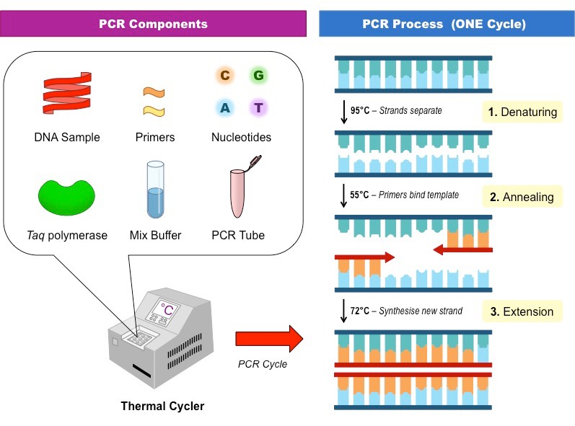
What is PCR?
PCR stands for Polymerase Chain Reaction
A polymerase chain reaction is a technique that is able to amplify a gene or DNA sequence multiple times.
A mixture containing DNA, primers, buffers, taq polymerase, and nucleotides are put into a PCR tube
The process involves:
Splitting the DNA when it reaches an average of 90 degrees Celsius
Primers attach to opposite ends of the DNA Strands and completing their compliments when it reaches a temperature of 60 degrees Celsius
Therefore two new strands are generated
This process can happen occur as many times as the temperature fluctuates and the media will allow

Slide 3
PCR Machines
PCR machines alternate temperatures constantly from 90 degrees Celsius and 60 degrees Celsius
PCR Machines are separated by two different types:
Thermocycler vs Real-time Detectors
Thermocyclers simply alternate in temperature
Real-time Detectors alternate temperatures and take measurements of the sample throughout the process. Providing data and eliminating the need more detection machines

Slide 4
Motivation
Current PCR machines are very large and bulky
Outbreaks occur and in areas without easy access to PCR machines
A portable PCR machine would allow scientist to use the machine in the field
Samples could be processed on sight, preventing contamination and break down of the sample that occurs in transportation to the lab
GPS in portable PCR would allow for automatic geographic tracking of outbreaks
Phone app would allow data taken from portable PCR machine to be uploaded to online database allowing for scientist to better communicate and take action

Slide 5
Overview
The goal of this project was to design a portable PCR machine that can easily be used in the field by scientist to fight disease outbreaks in rural areas.
Two heating Elements at set temperatures; 90 degrees Celsius and 60 degrees Celsius
Servos to move the PCR tube
LED, Emission Filter, and Photodiode - Measuring the Reaction
Touch Screen - Control the device and allows the user to view results.
Rechargeable Battery - operating the device It
GPS - Collect location data
Bluetooth - Connect an Android phone
Phone App for our device
Online Database - Connected to the App

Slide 6
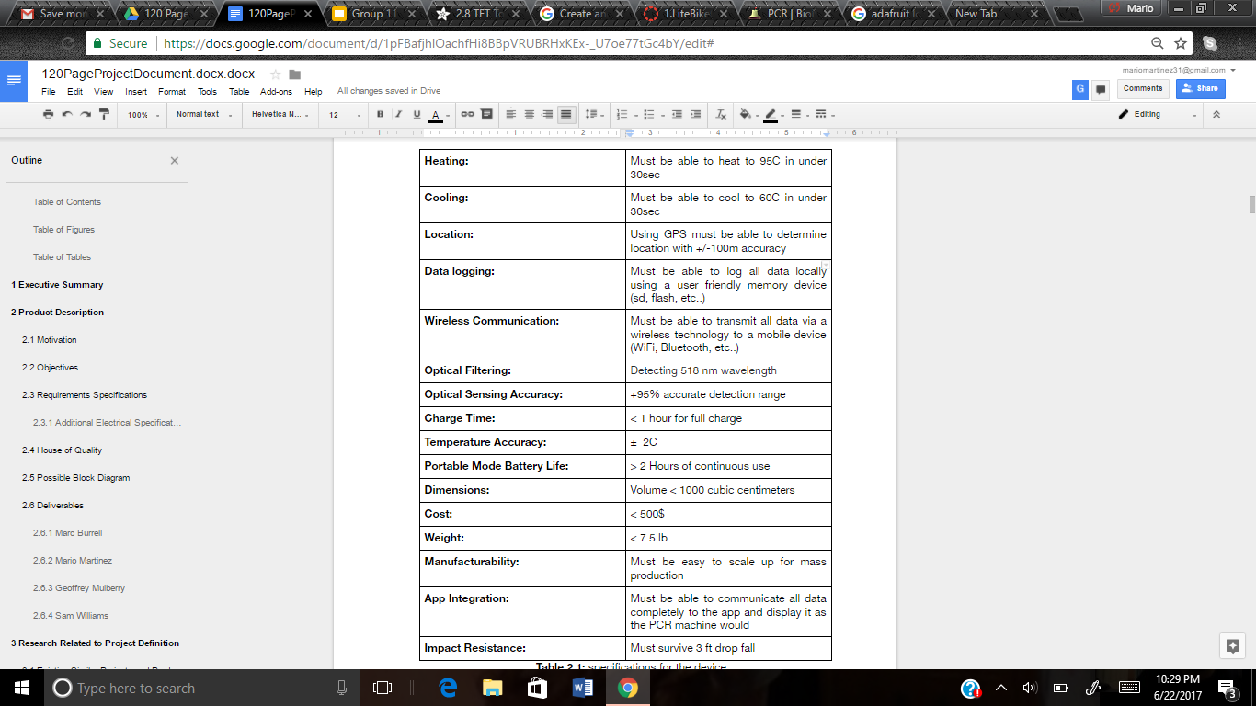
Design Specifications

Slide 7
Safety
Our device is meant to be dealing with different viruses such as HIV and need our machine to be dealt with care
PCR tubes carry the physical content
Therefore the machine itself must support the users who are handling such content
We have designed our device to be operated by someone who is wearing gloves

Slide 8
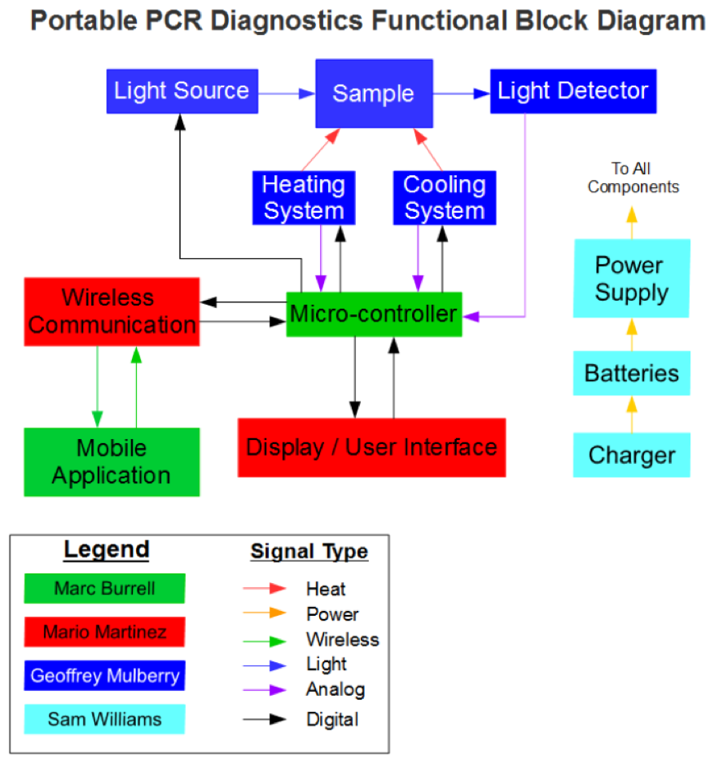
Block Diagram
Mario
Sam Williams has recently left our group and his potion of the project has been divided among the three of us

Slide 9
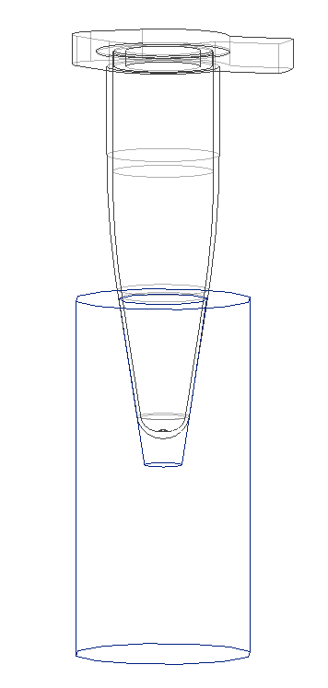
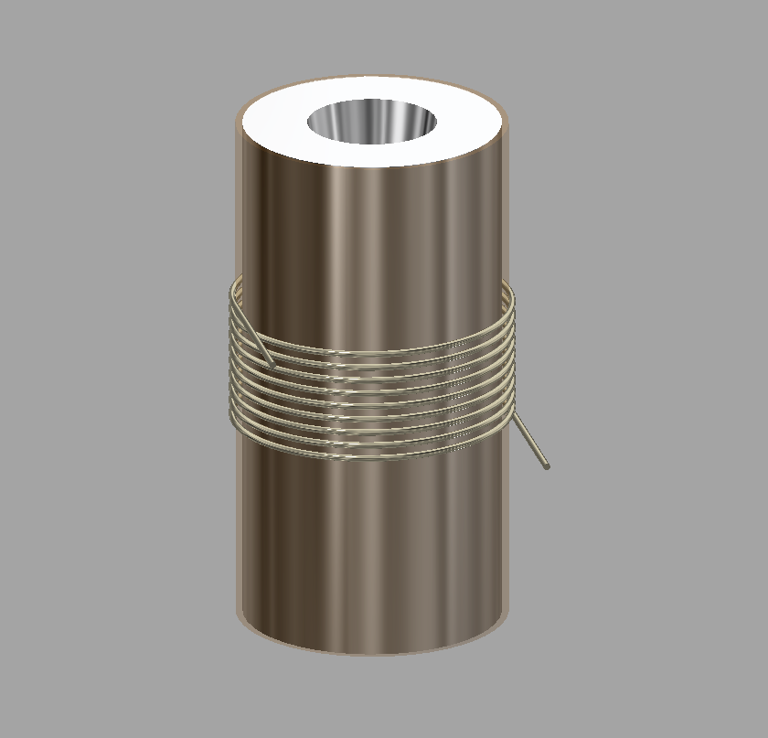
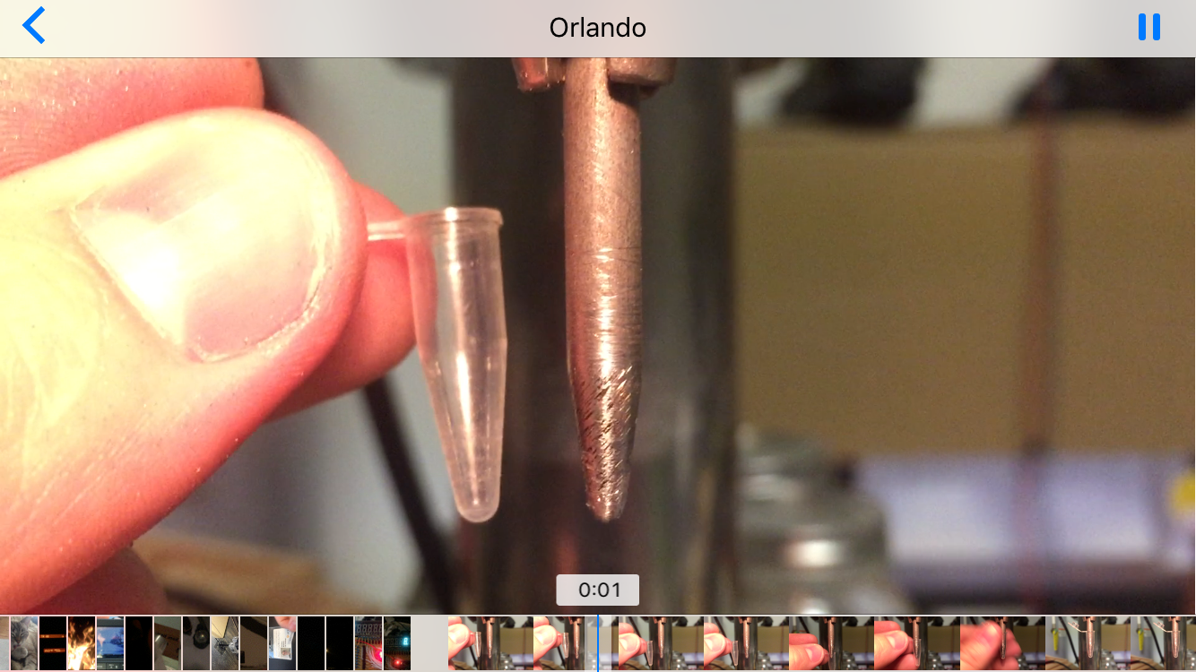
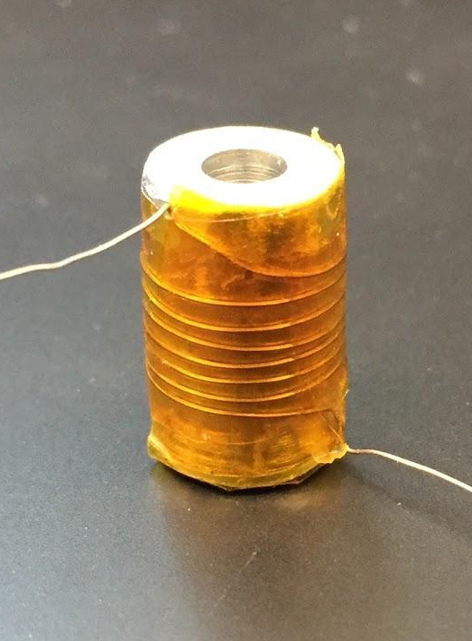
Heating Element
Cross Section
3D CAD
Shaping Tool
1st Prototype

Slide 10
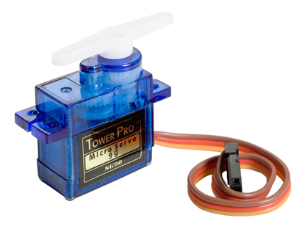
Servos
 | SG90 | SG51R | HS-35HD
Manufacturer | Tower Pro | Tower Pro | Hitec
Size | 23.0 x 12.2 x 29.0 mm | 22.0 x 22.0 x 12.0 mm | 18.6 x 7.6 x 15.5 mm
Rotation Angle | 180 Degree | 180 Degree | 180 Degree
Weight | 9 g | 5 g | 4.5 g
Unit Price | $ 2.38 | $ 5.95 | $ 24.95

Slide 11
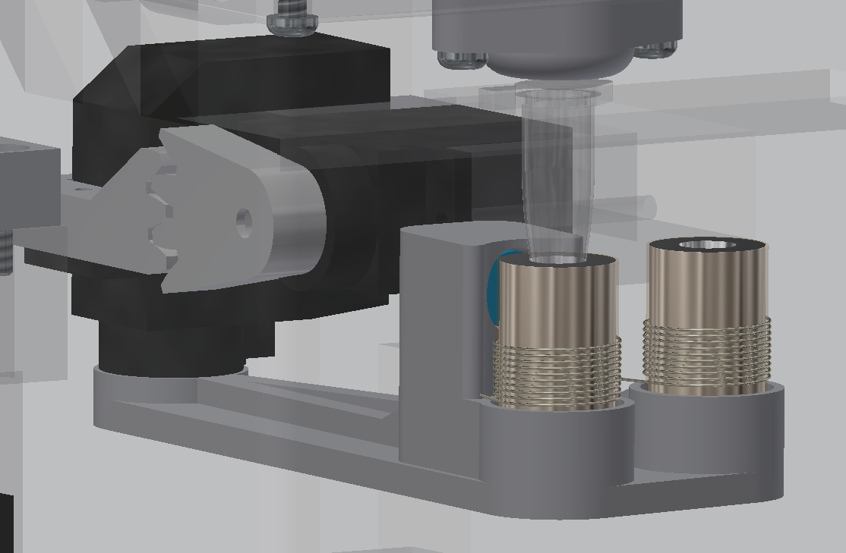
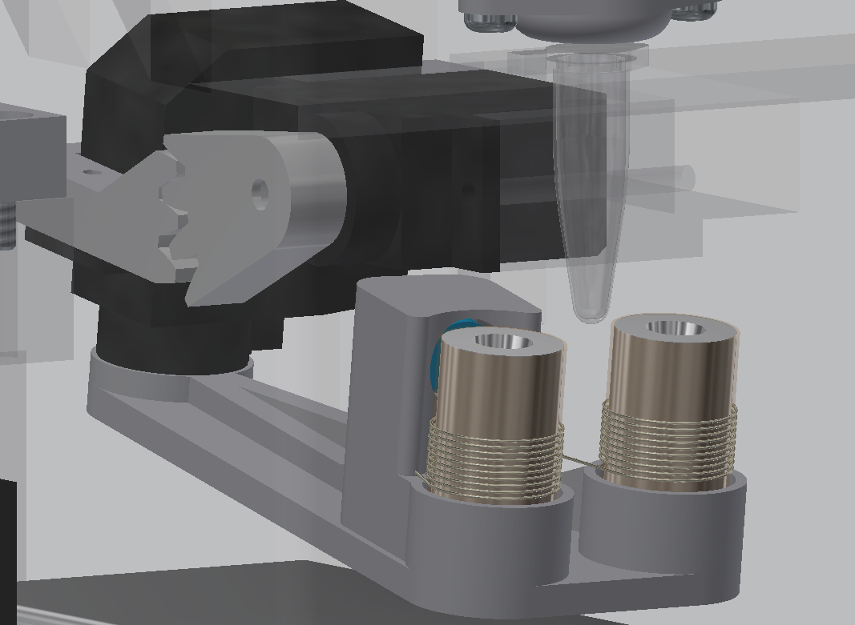
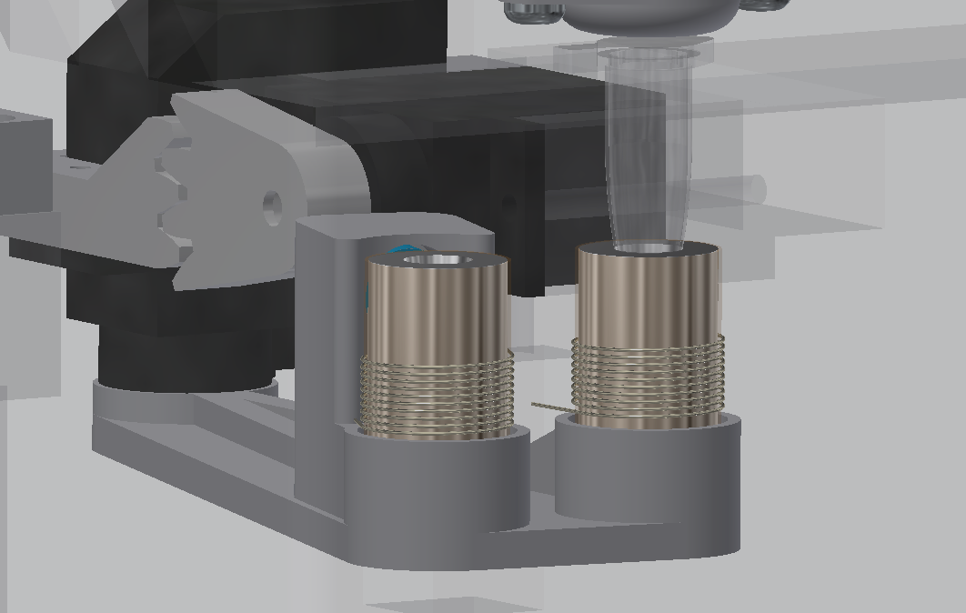
Servo Function
Holding / Measuring
Cooling / Moving
Heating

Slide 12
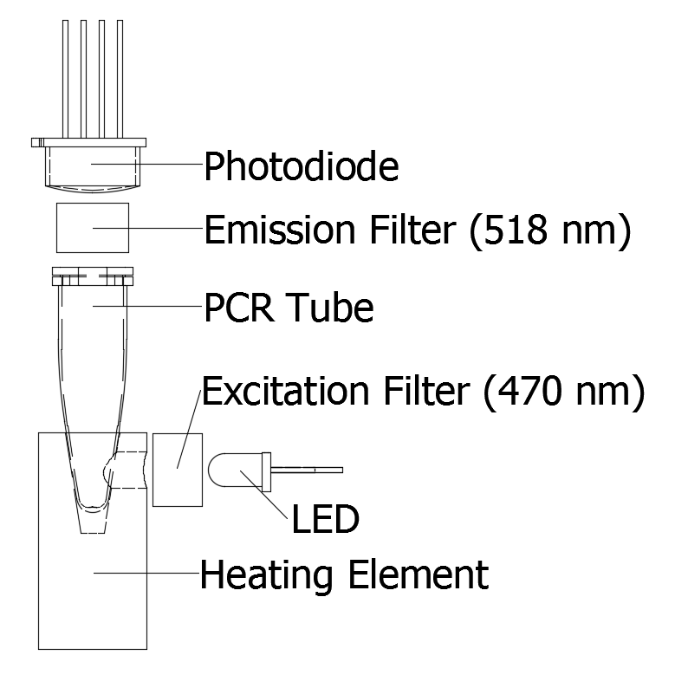
Detection System

Slide 13
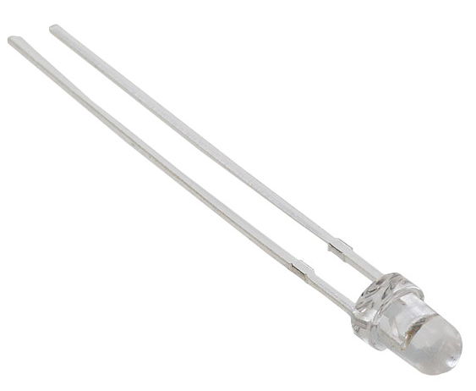
LED
 | MTE4047C5-UB | OD-469L | MTE3047N-UB
Manufacturer | Marktech Optoelectronics | Opto Diode Corp | Marktech Optoelectronics
Size | 3 mm | 9.4 mm | 5mm
Wavelength | 470 nm | 470 nm | 470 nm
Max Current | 30 mA | 350 mA | 50 mA
Unit Price | $ 7.18 | $ 25.13 | $ 11.42

Slide 14
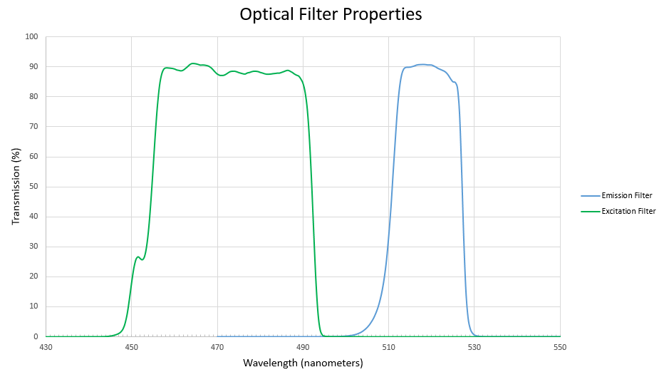
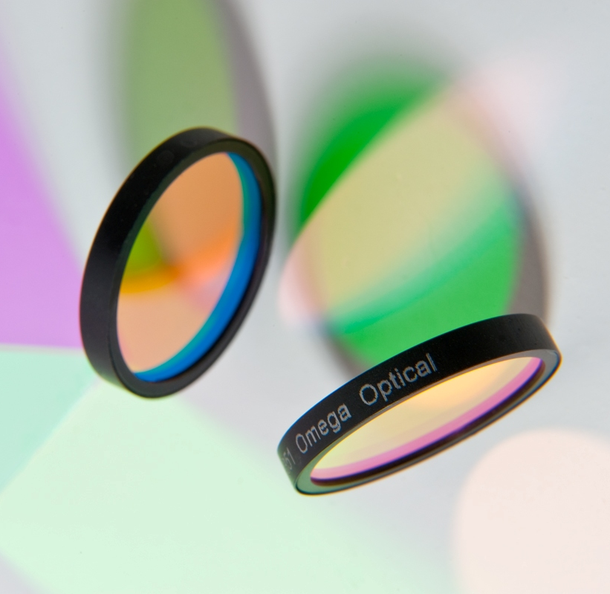
Filters
Image: Omega Optical, Inc.
Omega W5800
Omega W5798

Slide 15
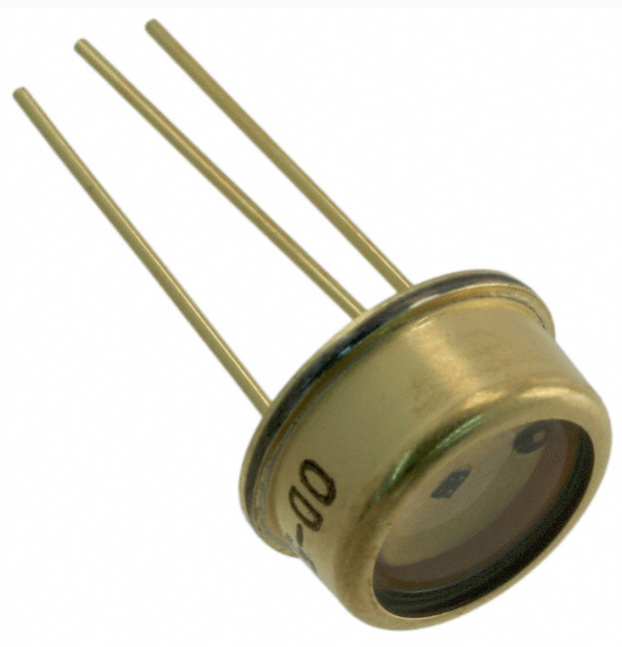
Photodiode
 | ODA-6WB-500M | MTQD5.8PV1-5 | SLD-70BG2A
Manufacturer | Opto Diode Corp | Marktech Optoelectronics | Luna Optoelectronics
Passive / Active | Active | Active | Passive
Gain | 500M | 250M | 0
Enhanced Color | Green | Blue/Green | Blue/Green
Active Area | 6 mm² | 5.7 mm² | 9 mm²
Unit Price | $ 74.42 | $ 24.77 | $ 6.45

Slide 16
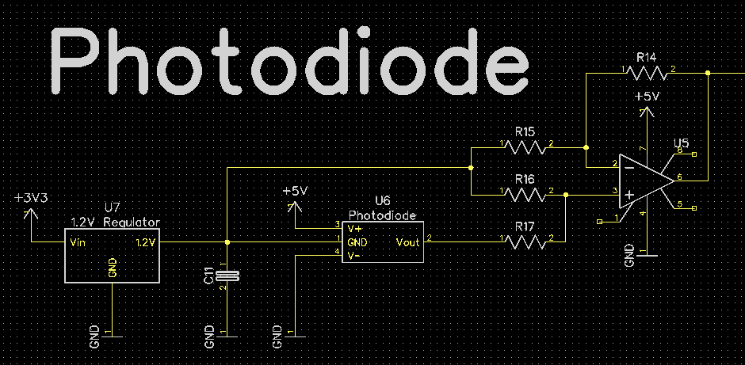
Difference Amplifier

Slide 17
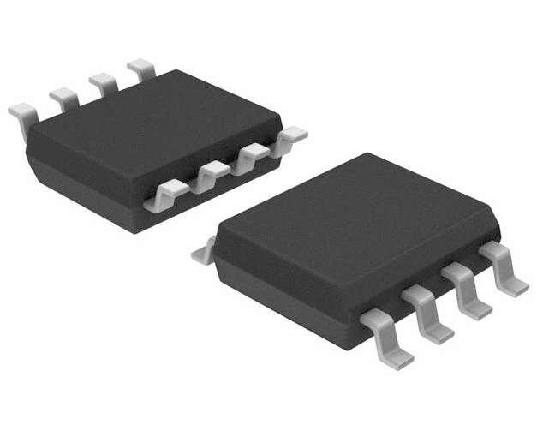
Op-Amp
 | MAX406ACSA+ | OPA317QDBVRQ1 | TSU111IQ1T
SR - Slew Rate: | 20 V/us | 150 mV/us | 2.7 V/ms
Supply Voltage - Min: | 2.5 V | 5.5 V | 5.5 V
Input Voltage Noise Density | 150 nV/sqrt Hz | 55 nV/sqrt Hz | 200 nV/sqrt Hz
Output Type: | Rail to Rail | Rail to Rail | Rail to Rail
Gain Bandwidth Product: | 40 kHz | 300 kHz | 11.5 kHz
Package / Case: | SOIC-8 | SOT-23-5 | DFN-6

Slide 18
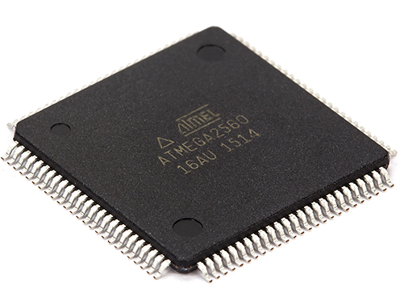
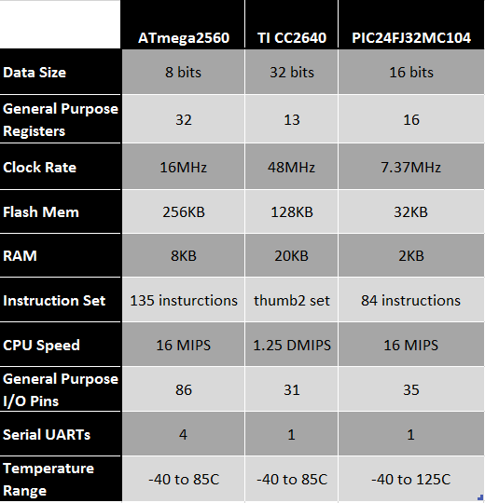
Microcontroller
Atmel ATmega2560
Best MCU for our project.
Reliable
Cost effective
Able to support all features.
Room for more if wanted.
Easy for testing, on Arduino development board with IDE.
Widely supported and large community.

Slide 19
Microcontroller
Needed variety of pins to accommodate our features.
3 Serial Ports and a variety of I/O pins.
General Purpose I/O
Display
Heaters
LED
Battery Charging Stat
Low Battery Indicator
Servos (PWM)
Serial
GPS
Bluetooth
Debug Port
Analog
Temperature Sensors
Photodiode
Battery Level

Slide 20
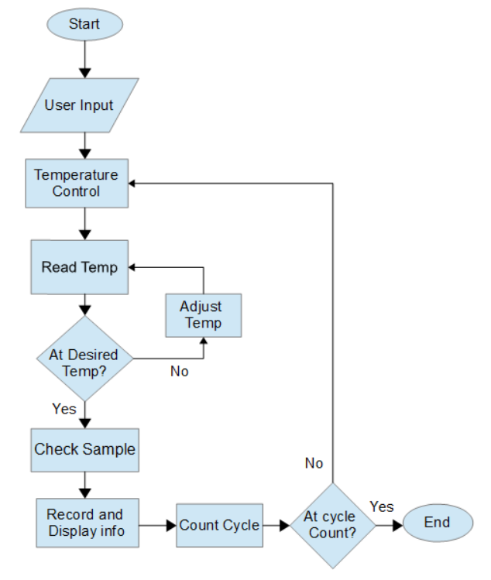
Microcontroller
Responsible for controlling the whole process
User input for settings and start.
Heating blocks heated, thermistors used to read temperature, and servos controlled to move between temperatures.
LED flashed and frequencies recorded through filter.
Results calculated and displayed throughout test
Repeat until end

Slide 21
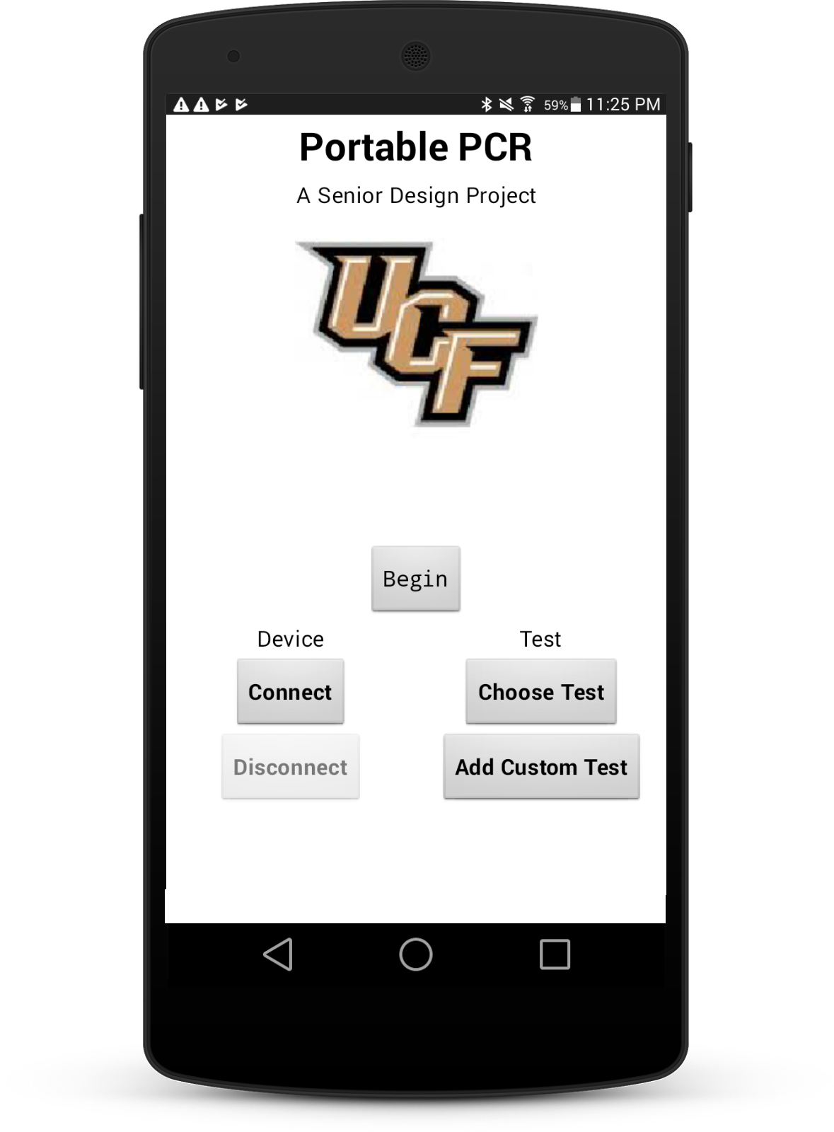

Application
Decided on Android for cheaper development and wide use.
Developed using the android studio IDE.
Testing on a Samsung android tablet and Galaxy S

Slide 22
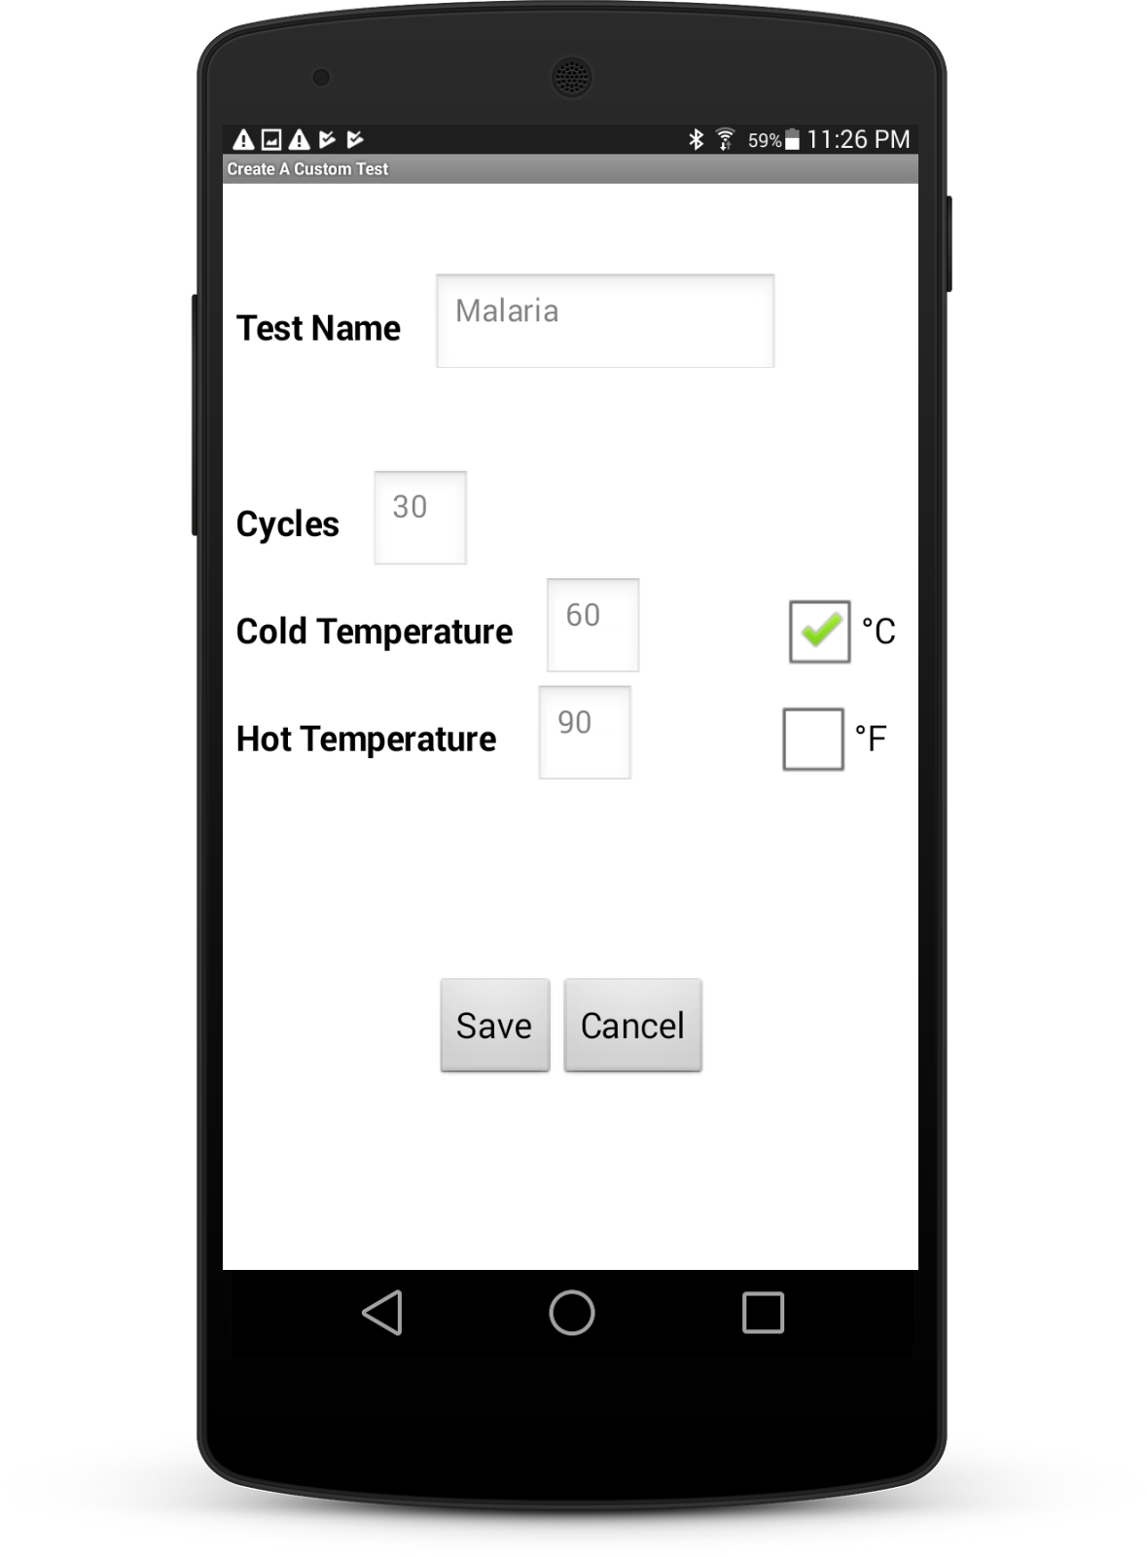
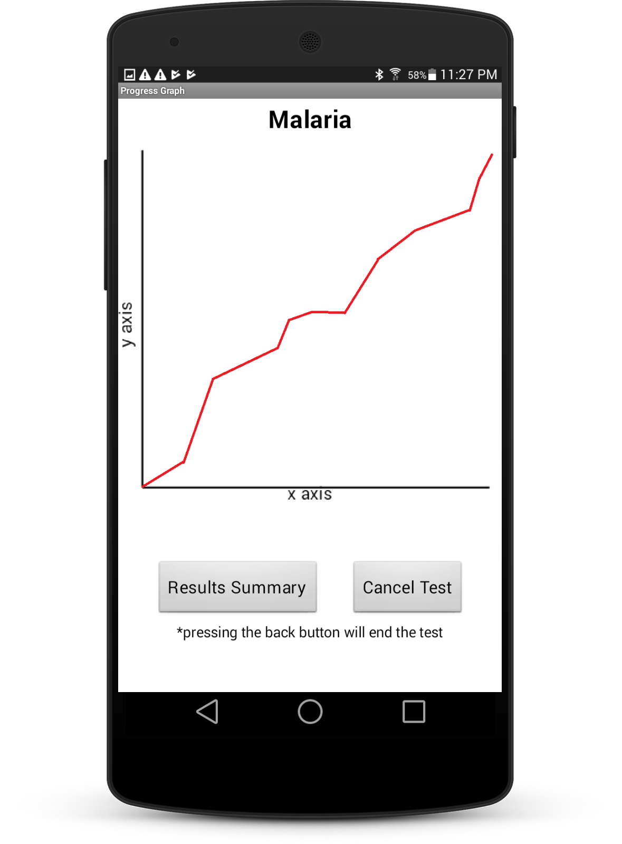
Application
Four simple screens that progress in a linear sequence.
Main Start Screen
Custom Test Screen
Test Running Screen
Result/Submission Page

Slide 23
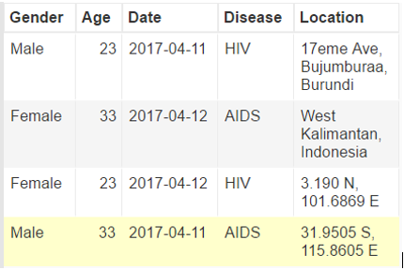
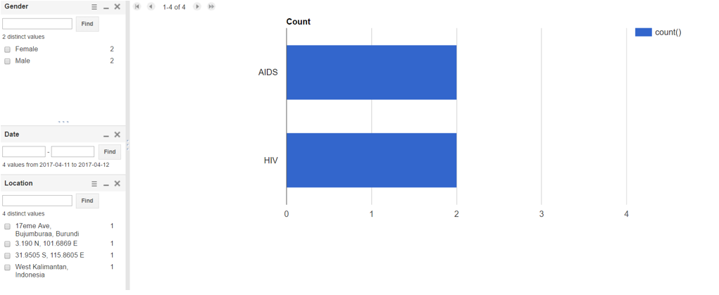
Database
Google Fusion Tables
Much like an excel spreadsheet
Rows can be added by anyone
Only Registered Viewers can see the table
Great for quick overview of info
Works very well with apps
Libraries available to add over internet connections

Slide 24
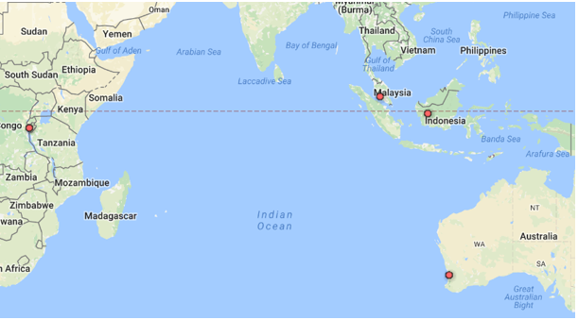
Database
Locations can even be mapped for quick trend views

Slide 25
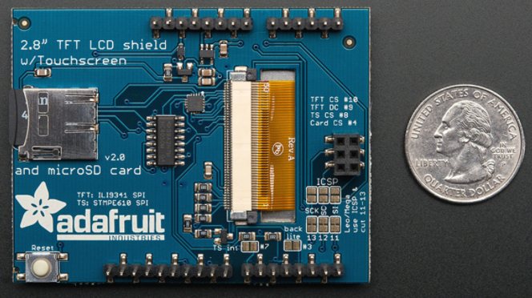
Display
 | Adafruit TFT Touch Shield v2 | Capacitive | With microSD
Voltage Compatibility | Up to 3.3V | Up to 3.3V | Up to 5V
Pins | 13 | 13 | 12
Color | 18-bit | 18-bit | 8-bit
Resolution (pixels) | 240x320 | 240x320 | 240x320
Size (Diagonal) | 2.8” | 2.8” | 2.8”

Slide 26
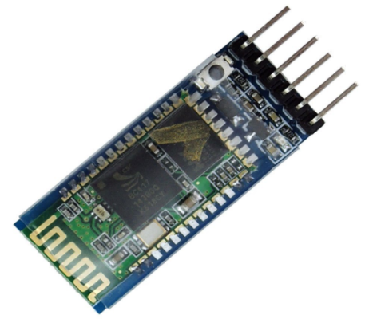
Bluetooth
 | HC - 05 | CC2564 | XS3868
Power supply: | 1.8 - 3.6V | 3.0 - 3.6V | 3.6 - 4.2V
Range: | 10 meters | 10 meters | 10 meters
UART Baud Rate: | 9600~460800bps | 2400~460800bps | 115200bps
Size: | 12.7mmx27mm | 76.2mmx25.4mm | 35mmx15mm
Bluetooth | V2.0+EDR | 4.1(BR/EDR, BLE) | V2.0
Cost | $7.99 | $14.99 | $8.29

Slide 27
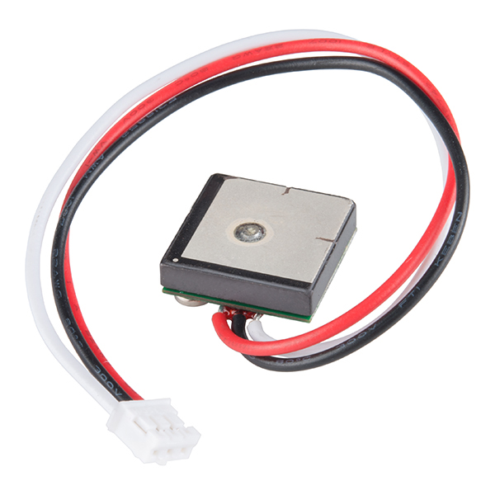
GPS
 | NEO-6M | NEO-7M-C | FeatherWing | GP-20U7
Channels: | 50 Channels | 56 Channels | 66 Channels | 56 Channels
Power Supply: | 3.6 V | 3.6 V | 3.6 V | 3.3 V
Sensitivity | -161dBm | -161 dBm | -145 dBm | -162 dBm
Position Accuracy | 2.5 meters | 2.5 meters | 3 meters | 2.5 meters
Acquisition time (Cold Start) | 27 seconds | 30 seconds | 34 seconds | 29 seconds
Size: | 16.0 x 12.2 x 2.4 mm | 16.0 x 12.2 x 2.4 mm | 22.9 x 51.2 x 6.7 mm | 18.4 x 18.4 x 4 mm
Cost: | $20.99 | $33.32 | $29.50 | $15.95

Slide 28
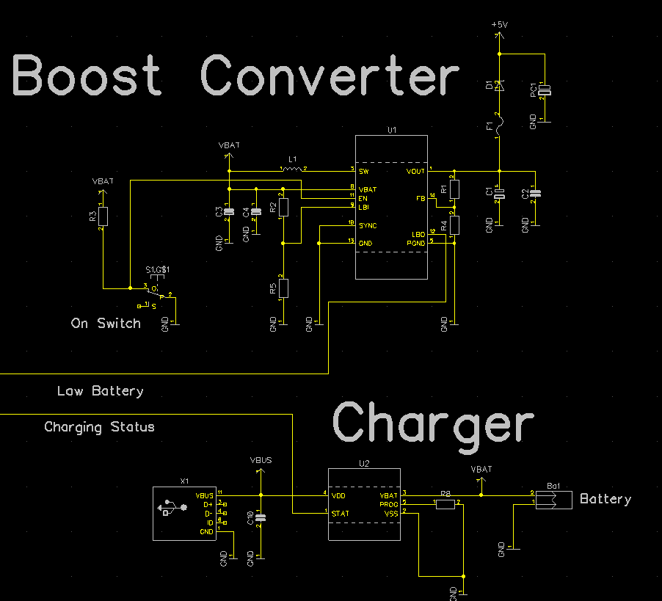
Power
Fourth member responsible for the power supply, charging systems, and PCB layout left the group.
Parts used:
Boost Converter:
TI TPS61030
Charger:
Microchip MCP73831

Slide 29
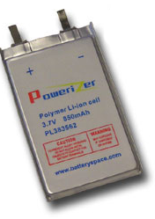
Batteries
 | Li-ion Polymer Flat Pack | 18650 | AA
Make | Battery Space | Panasonic | Duracell
Voltage | 3.7 V | 3.6 V | 1.5V
Capacity | 850 mAh | 3400 mAh | 2400 mAh
Size | 3.3 mm x 35 mm x 62 mm | 18 mm x 65 mm | 14.5 mm x 50 mm
Cost | $5.95 | $15.00 | $0.54
Rechargeable? | Yes | Yes | No

Slide 30
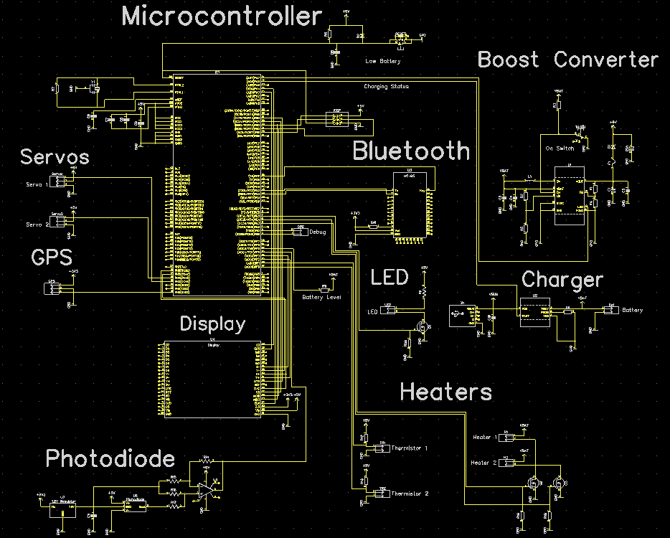
Overall Schematic

Slide 31
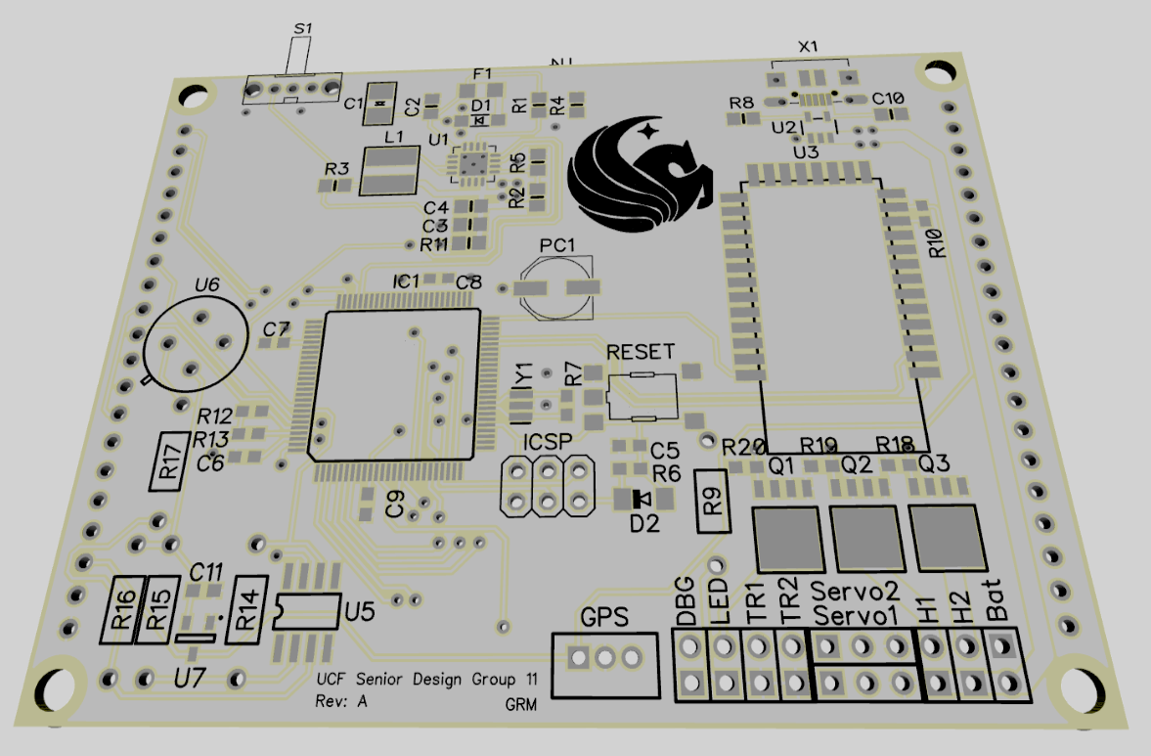
PCB
Designed using DipTrace
Fabricated by PCB Way
Arriving today!

Slide 32
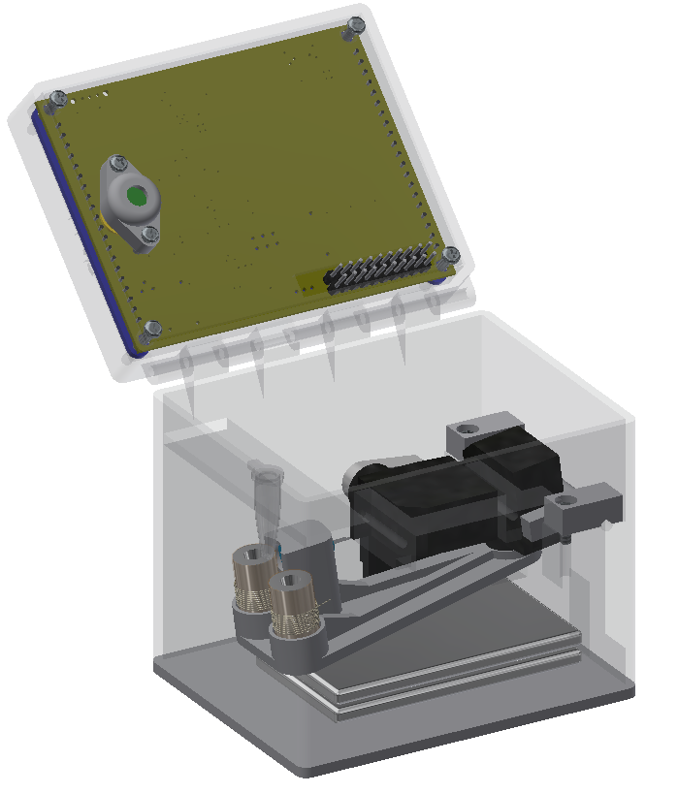
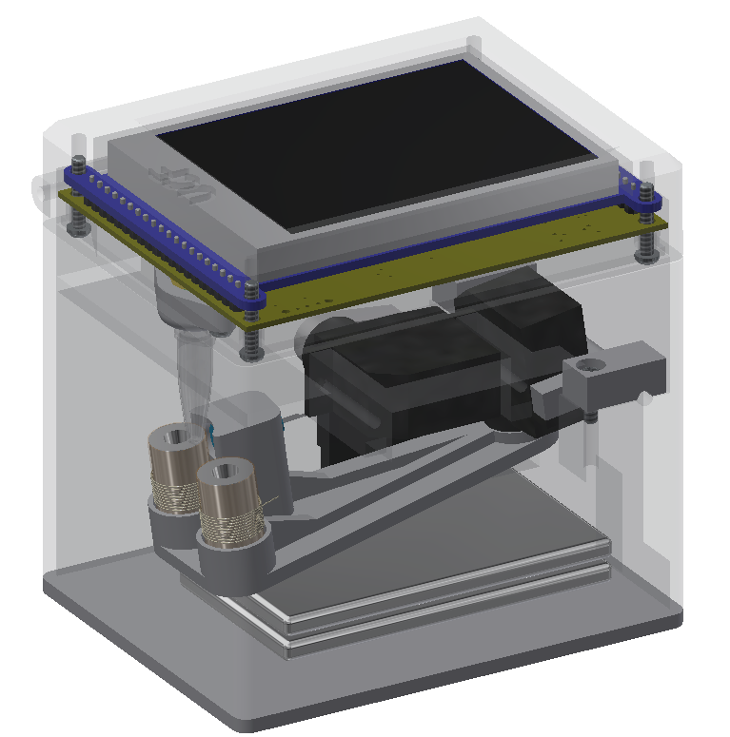
3D CAD
Closed
Open

Slide 33
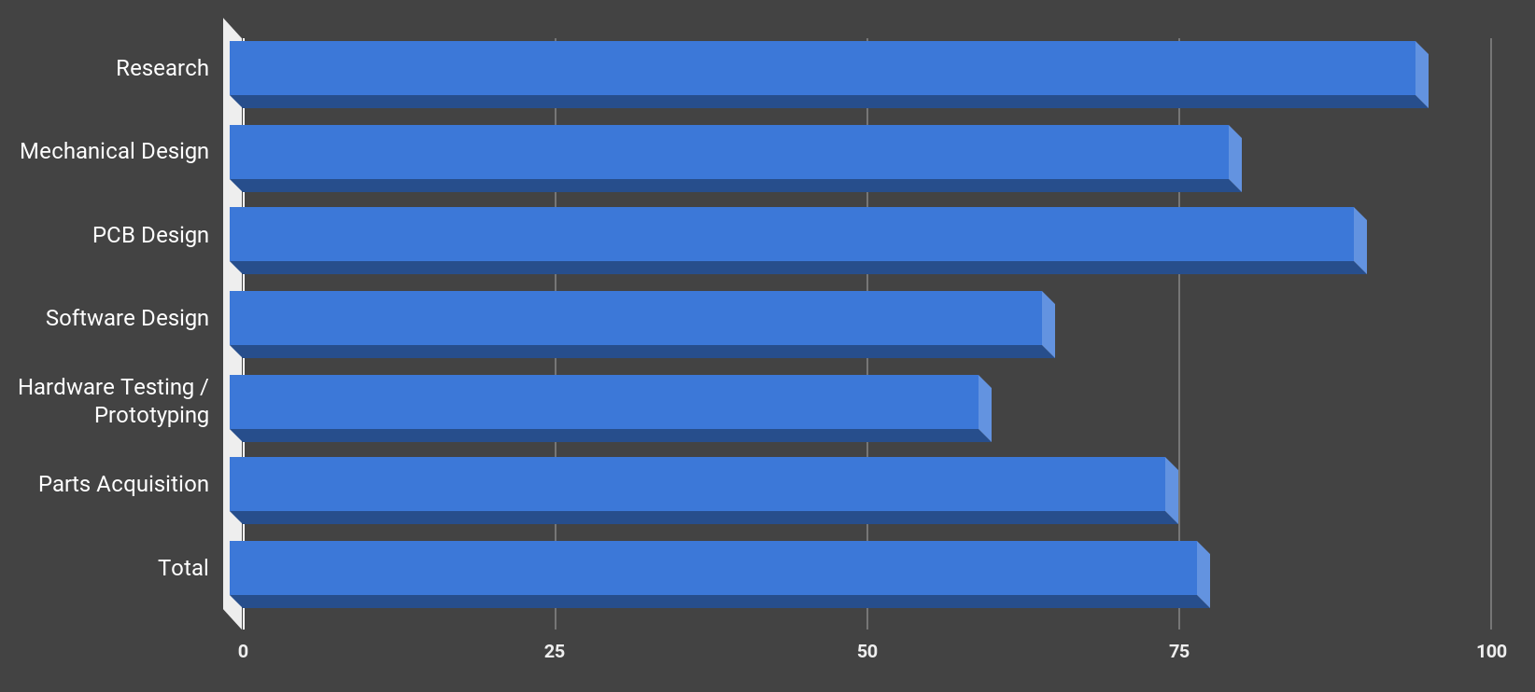
Progress

Slide 34
Budget
Item | Budget | Price Spent | Suppliers
Display | $50 | $29.95 | Adafruit
Electronic Components | $200 | $167.71 | DigiKey
Bluetooth Module | $20 | $7.99 | Amazon
GPS Module | $20 | $19.95 | Amazon
Batteries | $20 | $11.90 | BatterySpace
Mechanical Components | $100 | $82.47 | Amazon, Omega Optical
PCB | $60 | $28.00 | PCB Way
Total | $500 | $347.97
Our Total Budget for our Design is:
$500
As of now we have spent $347.97 and still have extra
We are sponsored by Dr. Kim and all expenses are covered by Dr. Kim

Slide 35
Questions

