Slide 1
Smart Package Lockbox
Group 5
Brandon Dziewior - EE
Michael Light - EE
Daniel Corredor - CpE
Dominic Amalfitano - CpE

Slide 2
Motivation
In recent years, online order services have become increasingly prevalent in the retail industry
The theft of unattended packages has become a common occurrence
Current package theft solutions have various drawbacks including:
  High cost
  Inconvenience
  Minimal security provided

Slide 3
Goals
Design a package theft solution that:
  Is low cost
  Is easy to use/install
  Does not need to be bolted/secured to a surface
  Provides a reasonable level of security

Slide 4
Early Design Decisions
Problem solution would take the form of a lockbox
Avoid redundant features
  Reduce Cost
  Increase reliability and ease of use / installation
No camera included
  Research showed that cameras were typically not effective for catching package thieves
  Value added not worth the trade offs
      Increased system cost / processing requirement
      Reduces ease of use / installation

Slide 5
Requirements
ID | Requirement
E1 | The enclosure interior should contain 4 to 12 cubic feet of storage space.
P1 | The system must be able to run on 120V and 60Hz AC electricity from a standard US power outlet.
P2 | The system will be able to operate for a minimum of 24 hours on secondary power from a rechargeable battery in the case that primary power is lost.
SE1 | The system shall include an alarm with a minimum Sound Pressure Level (SPL) of 85 dB or higher as measured from outside the lockbox while locked.
SE2 | The attempted theft or unauthorized relocation of the system as a whole shall be detectable with a minimum success rate of 95%.
W1 | The system shall include a Wi-Fi module with a minimum range of 100 meters from within the lockbox while closed.
C1 | The costs for developing the system should not exceed $600.
C2 | The total material cost of the system should not exceed $250.

Slide 6
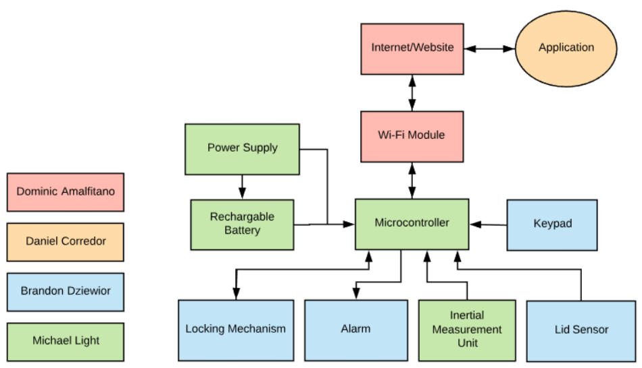
System Block Diagram

Slide 7
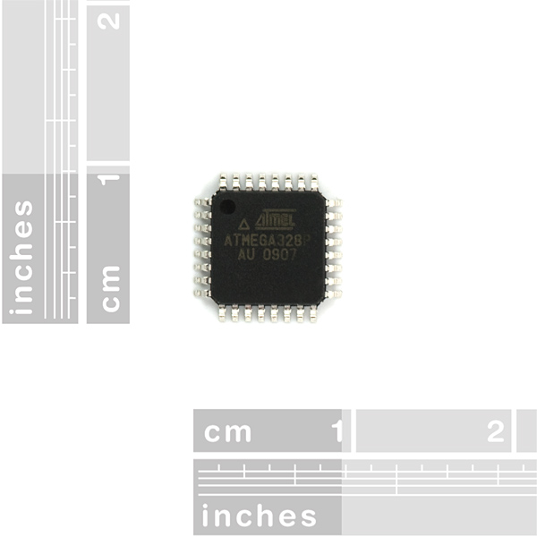
MCU Comparison
Specifications | ATmega328P | ATmega2560 | MSP430G2553
Clock Speed | 16 MHz | 16 MHz | 16 MHz
Flash Memory | 32 KB | 256 KB | 16 KB
RAM Memory | 2 KB | 8 KB | 512 B
Operating Voltage | 1.8 - 5.5 V | 4.5 - 5.5 V | 1.8 - 3.6 V
Power Draw | 200 uA at 1 MHz | 500 uA at 1 MHz | 420 uA at 1 MHz
Number of GPIO Pins | 23 | 86 | 24
Cost | $2.17 | $12.35 | $2.46

Slide 8
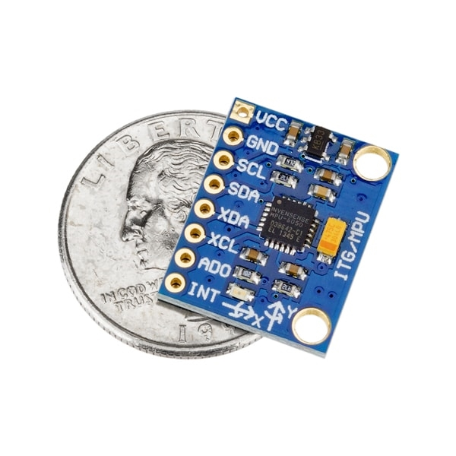
Inertial Measurement Unit (IMU)
IMU selected was MPU-6050:
Breakout board available for breadboard prototyping
High availability of community resources available
Low cost ($2.60 with breakout included)
Low power (3.5mA average draw)
Low power modes available

Slide 9
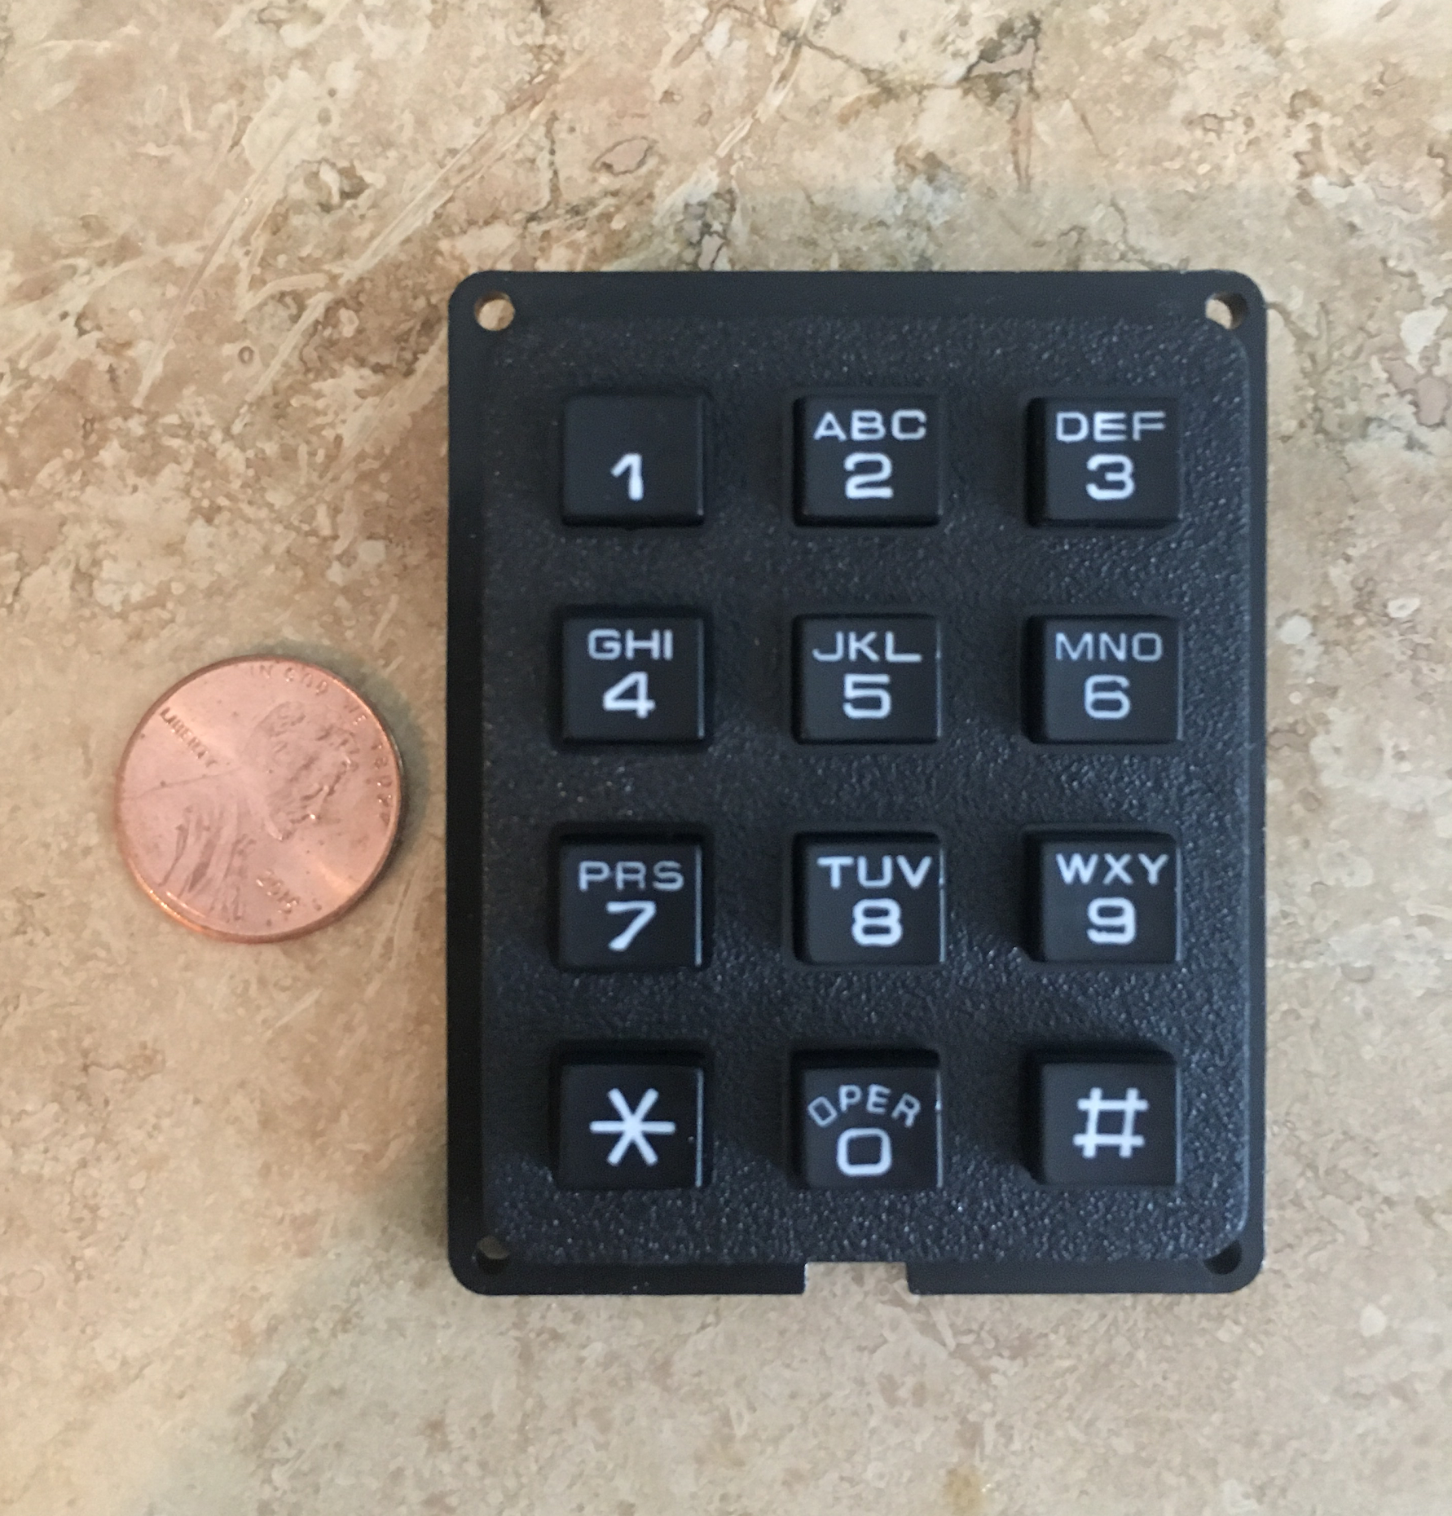
Keypad Selection
Specifications | Grayhill Inc. 96AB2-102-R | Adafruit Industries LLC 1824 | Parallax Inc. 27899
Matrix Size | 3x4 | 3x4 | 4x4
Dimensions | 2.7 x 2 in. | 2.52 x 2 in. | 2.7 x 3 in.
Maximum Rating | 5 mA for .5 s | 5 mA for .5 s | 30 mA for .5 s
Switch Type | Conductive Rubber | Conductive Rubber | Membrane (Snap Dome)
Pins | 7 | 7 | 8
Cost | $17.89 | $7.50 | $6.50

Slide 10
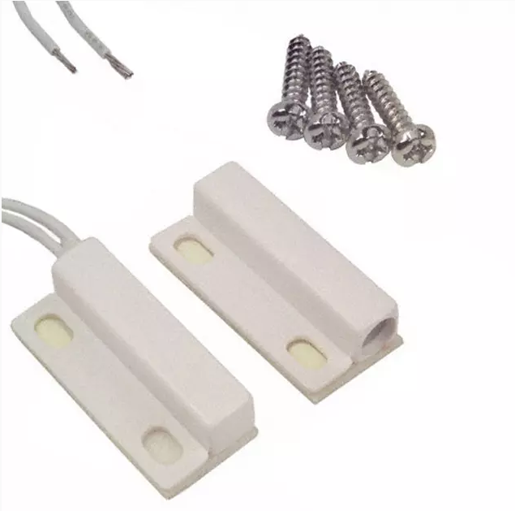
Magnetic Switch Selection
Specifications | SECO-LARM SM-204/W | Amico Magnetic Switch | Magnetic Switch COM-13247
Max Current Draw | 1 A | 500 mA | 250 mA
Mount Type | Adhesive/Screws | Adhesive/Screws | Adhesive/Screws
Wire Length | 15 in. | 10 in. | 12 in.
Operation Gap | 1 in. | 1 in. | 1 in.
Cost | $2.00 | $1.50 | $7.18

Slide 11
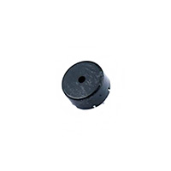
Alarm Selection
Specifications | Soberton Inc. PT-1307 | PUI Audio, Inc. AI-3035-TWT-3V-R | PUI Audio, Inc. AT-1810-T-LW50-R
Voltage Rated | 3V | 3V | 3V
Maximum Current Draw | 1 mA | 9 mA | 3 mA
Sound Pressure Level | 70 dB | 100 dB | 103 dB
Frequency | 4 kHz | 3.5 kHz | 1.5 kHz
Cost | $0.69 | $2.98 | $3.76

Slide 12
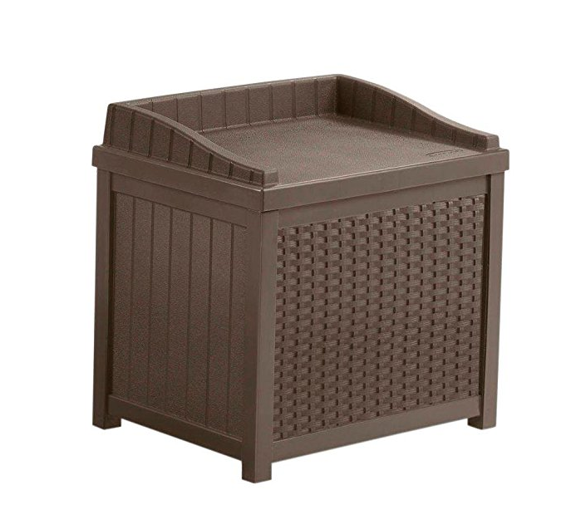
System Enclosure Selection
Specifications | Suncast DBW7300 | Lifetime 60103 | Suncast SSW1200
Dimensions | 46 x 21.6 x 22.5 in | 39 x 26 x 24 in | 17.5 x 22.5 x 22.5 in
Weight | 32 lbs | 37.2 lbs | 14.15 lbs
Capacity | 73-gallons | 80-gallons | 22-gallons
Material | Plastic | Plastic | Plastic
Cost | $79.49 | $136.81 | $39.00

Slide 13
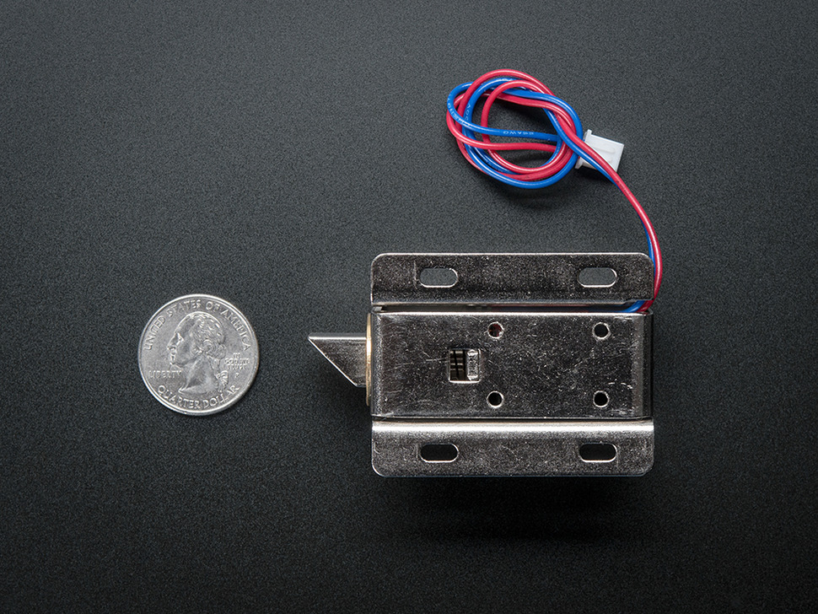
Locking Mechanism Selection
Lock-style Solenoid 12VDC
Fits voltage requirements
Easily installable
Strong and secure
Can close without power

Slide 14
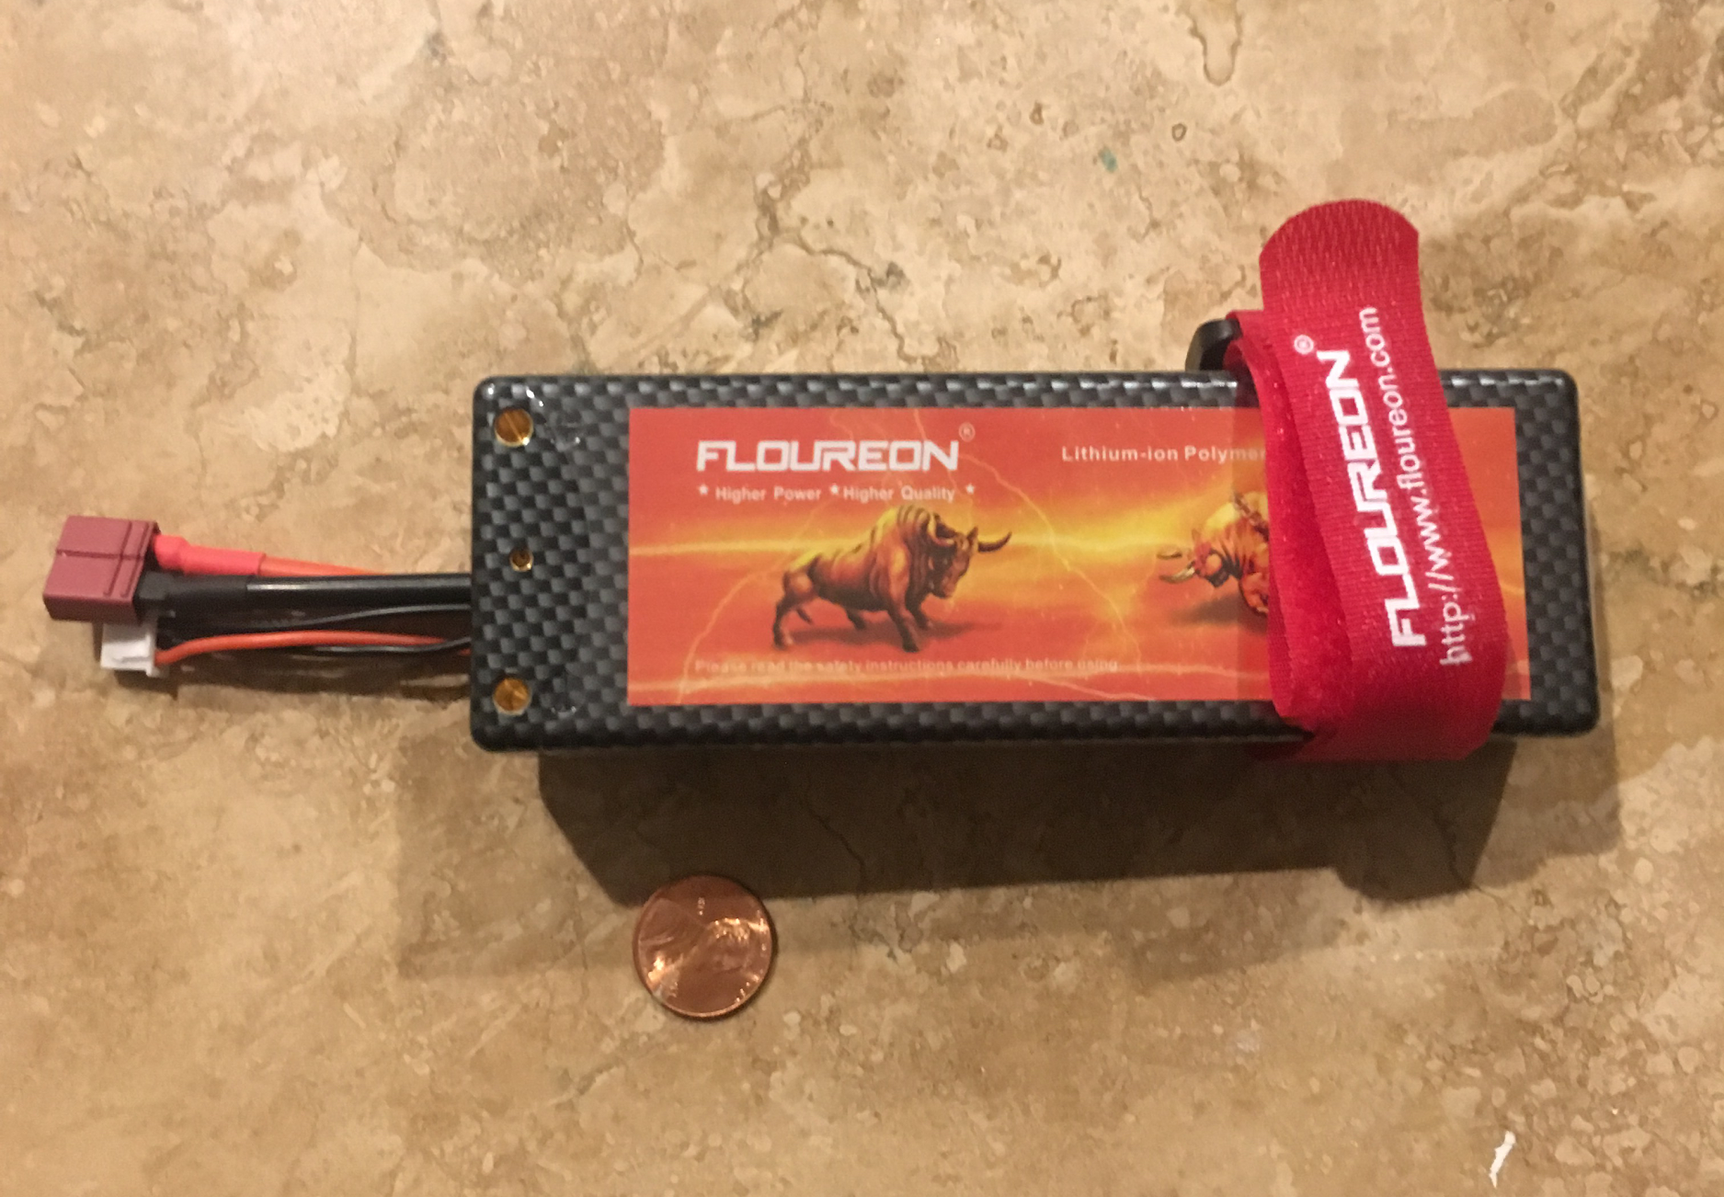
Battery Selection
Floureon 7.4V 5200mAh 30C LIPO Battery
Lithium-ion technology
Offers high capacity
Fast recharge rate
High discharge rate
Low variance from nominal voltage
during discharge cycle

Slide 15
How To Connect?
Connection Type | Cost | Frequency | Speed | Power Consumption | Adaptor | Range | Signal Drop Off
WiFi | Mid-High | 2.4 GHz, 3.6 GHz, 5.0 GHz | 250 Mb/s | High | Yes | 32-100 Meters | Mid
Bluetooth | Low | 868 MHz, 915 MHz, 2.4 MHz | 25 Mb/s | Low | Yes | Up to 100 meters | High
ZigBee | Low | 10 in. | 250 Kb/s | Low | Zigbee Hub | Up to 100 meters | High

Slide 16
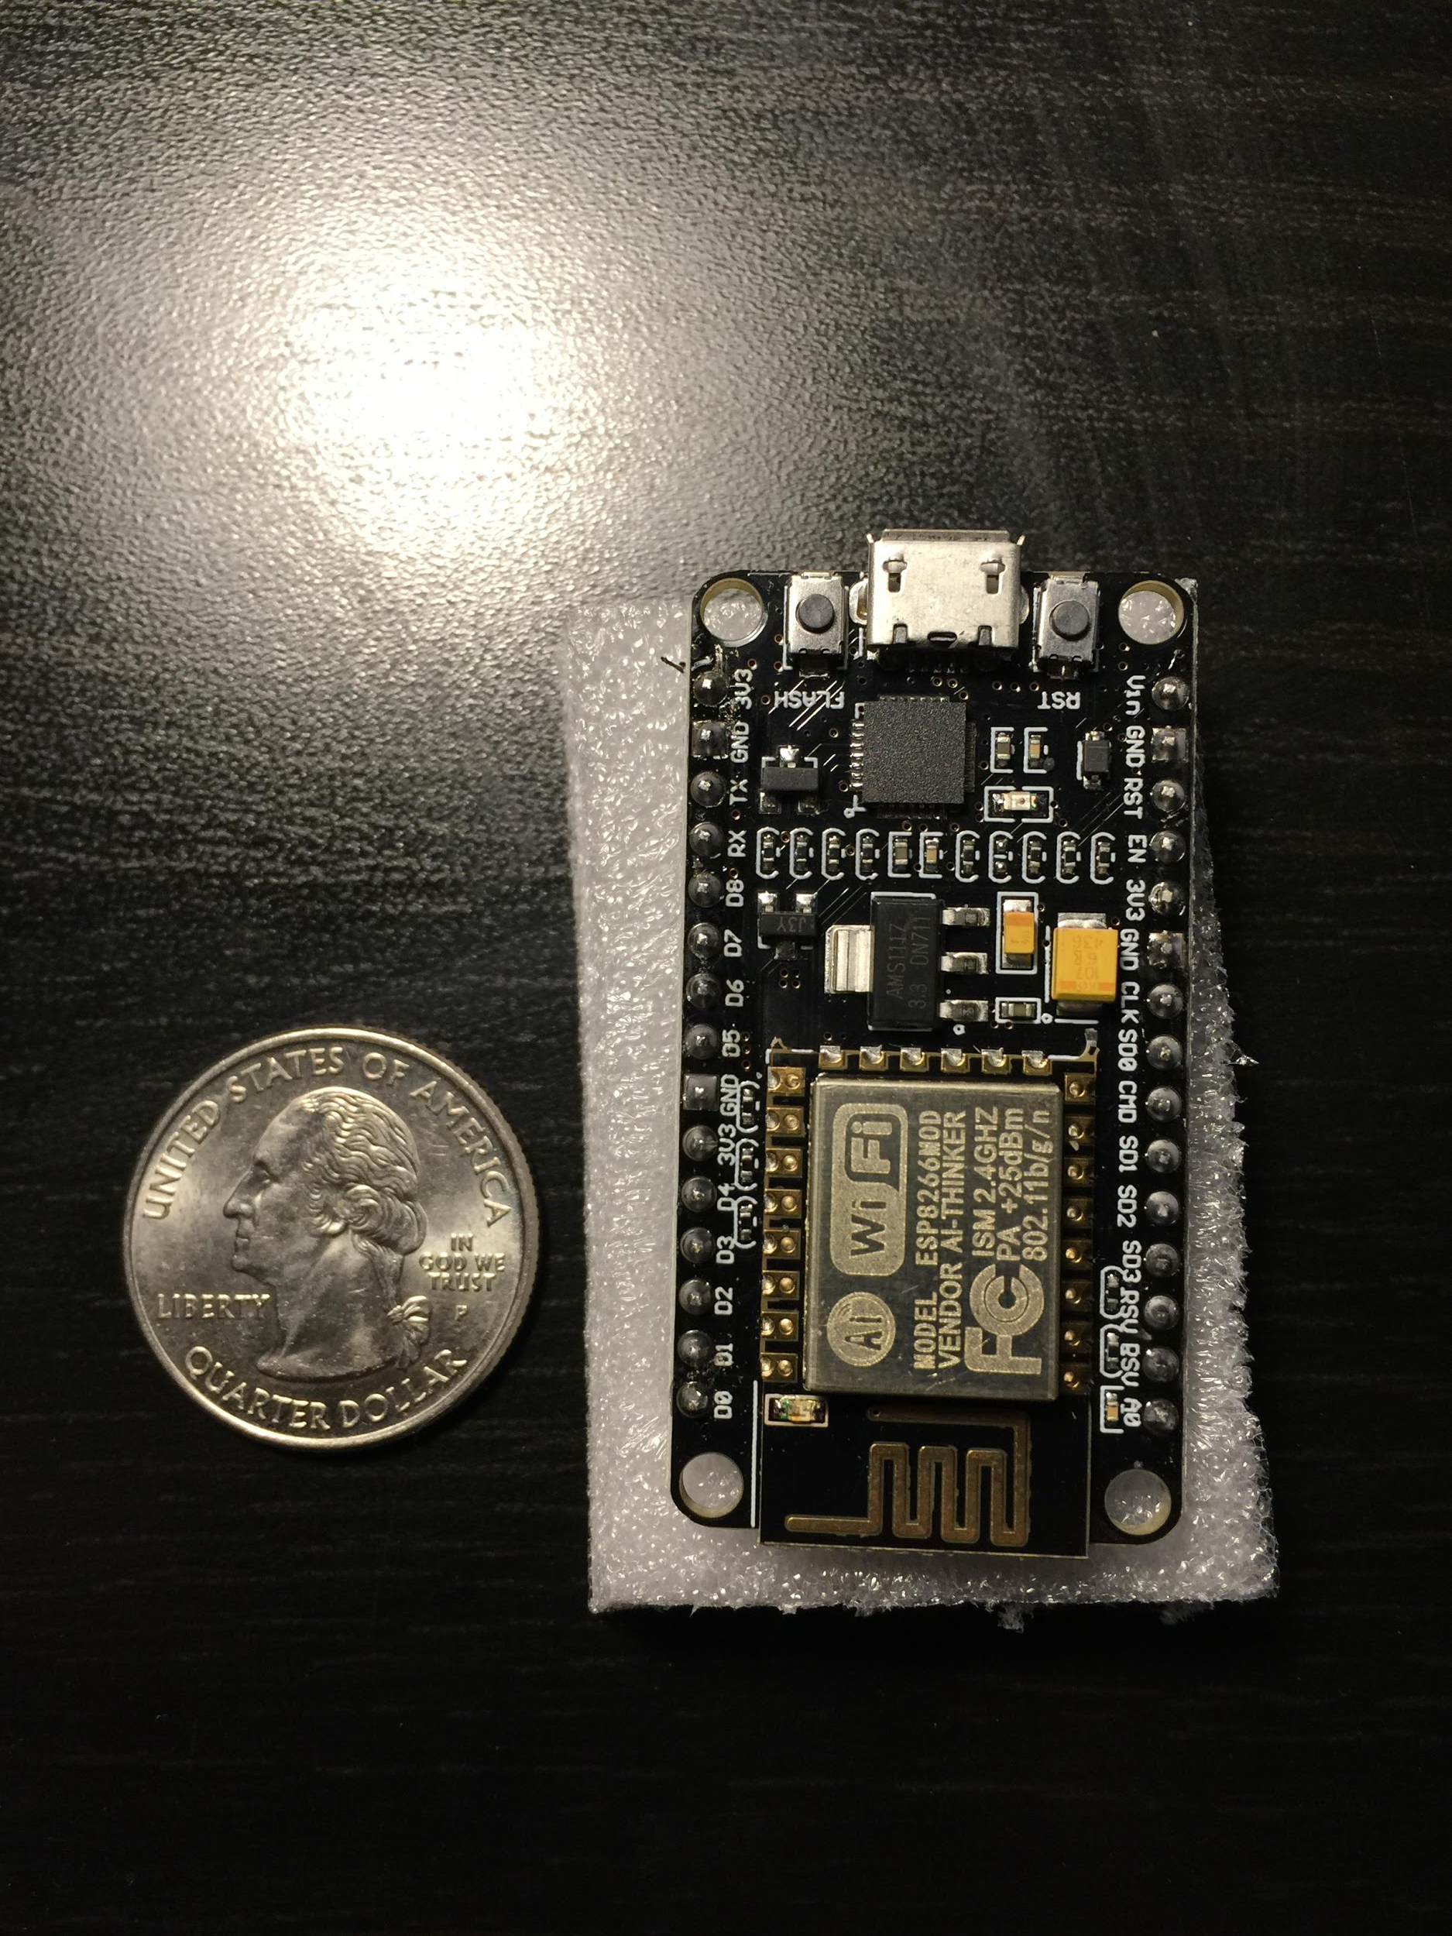
WiFi Module
Specification | (TI) CC3320MODASF12MONR | (TI) CC3120MODRNMMOBR | ESP8266
Size | 63 pin , 20.5 x 17.5 mm | 63 pin , 20.5 x 17.5 mm | 32 pin , 5 x 5 mm
Operating Voltage | 2.3 - 3.6 V | 2.3 - 3.6 V | 2.5 - 3.6 V
Low Power Mode? | Yes | Yes | Yes
Peripherals | SPI, UART, I2C, up to 25 GPIO’s | SPI or UART | UART, SPI, I2C
Operating Temp | -40 to 85 C | -40 to 85 C | -40 to 125 C
Operating Current | 59 mA RX , 229 mA TX | 53 mA RX , 223 mA TX | 80 mA Average
Cost | $ 19.03 | $ 13.66 | $ 6.95

Slide 17
Software Design Goals
Want users to be able to easily connect to and set up their Smart Package Lockbox
Have a profile to add or make changes
Be able to communicate to their Smart Package Lockbox over multiple devices and just about anywhere

Slide 18
Achieving These Goals
Website along with a phone application to aid with communication and connectivity
Easy setup and saving of profile information will be done using a web server (Firebase)

Slide 19
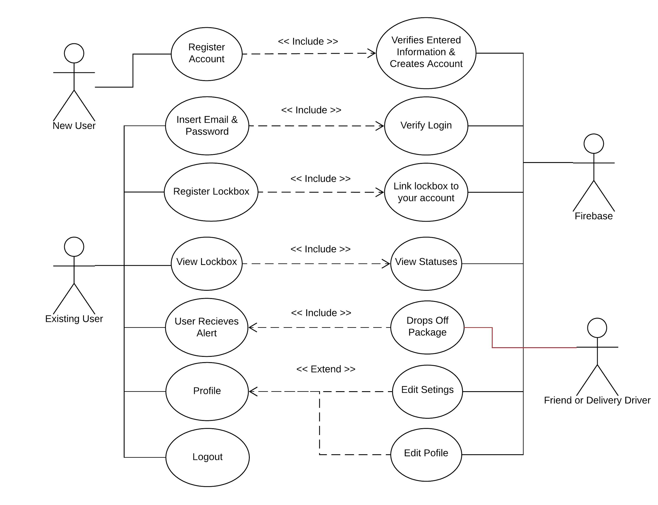
Use Case
Diagram

Slide 20
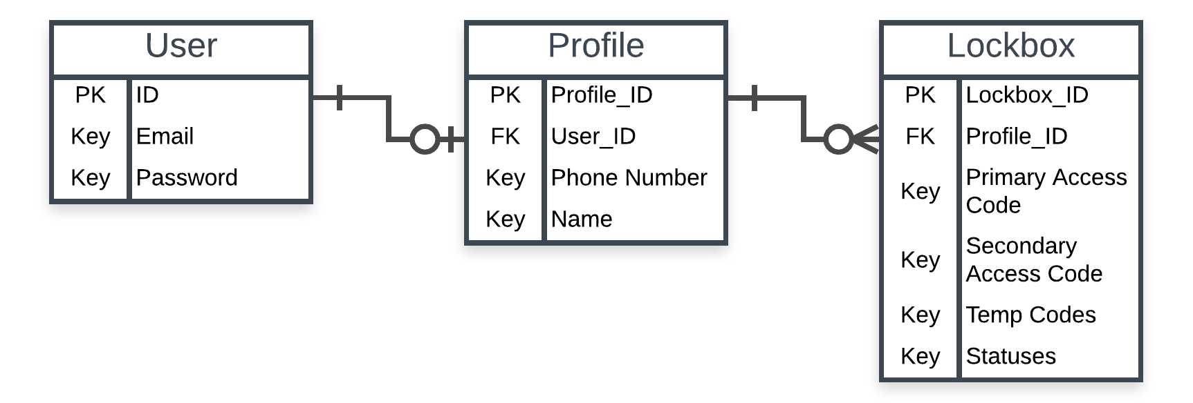
ER Diagram

Slide 21
Firebase
Free
Realtime Database
Built in functionality with WiFi module
Premade functions for JSON communication and API
Provides Hosting as well

Slide 22
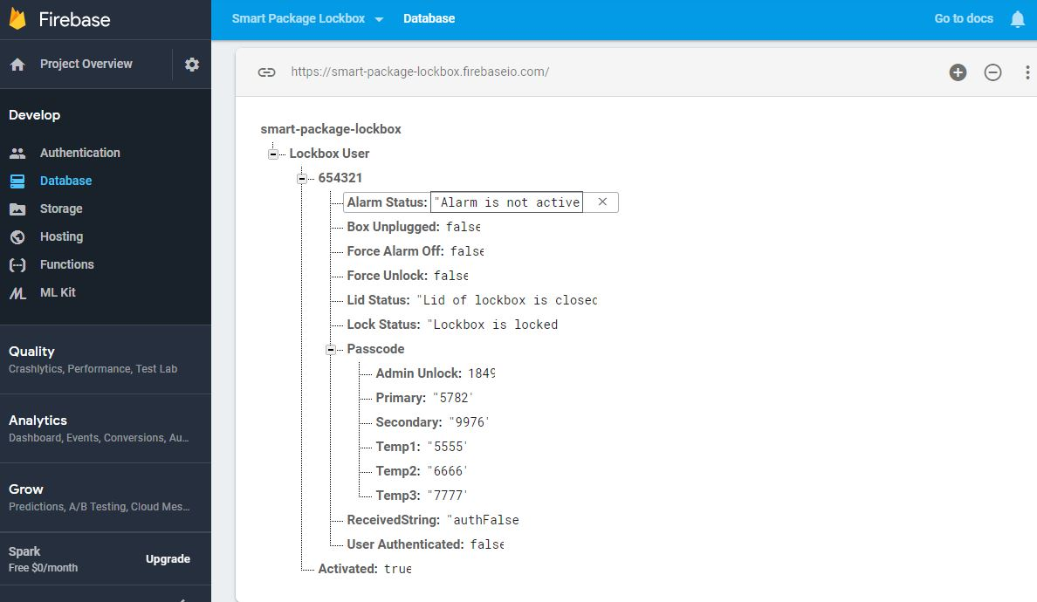
Firebase Database

Slide 23
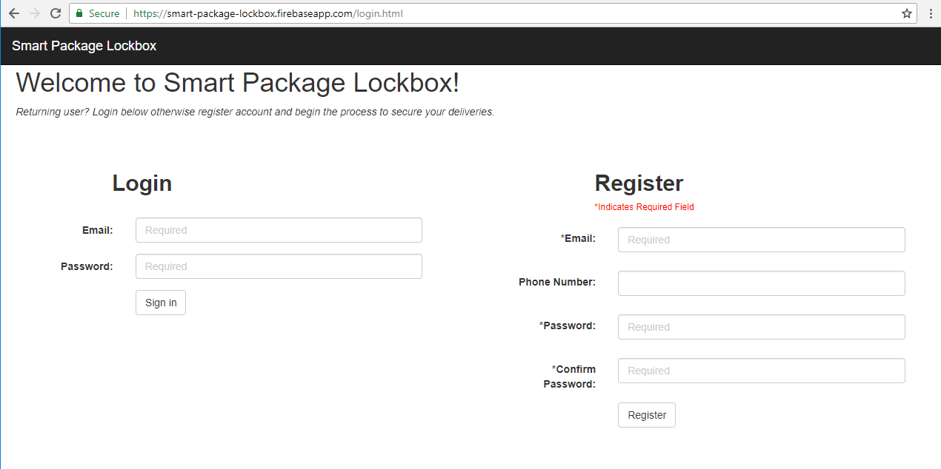
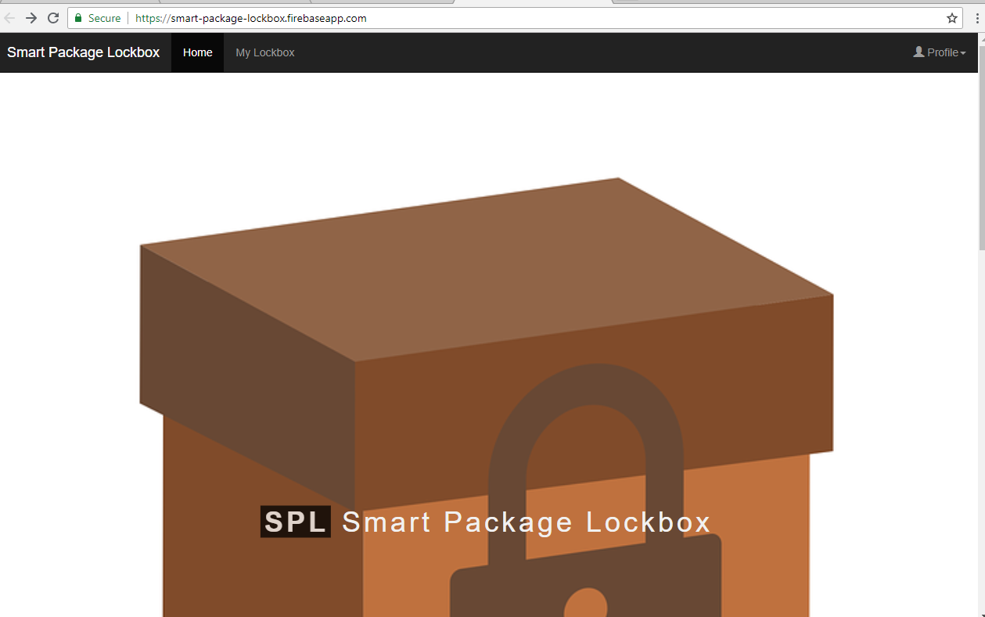
Website

Slide 24


Mobile App Development
iOS Ecosystem
Swift & Objective-C
Only macOS support
US Market Share ~ 56%
Android Ecosystem
Java
Windows & macOS
US Market Share ~ 43%

Slide 25

Cross-Platform Mobile App Development
JavaScript, CSS, HTML
macOS, Linux, Windows
Native Performance
Code Changes instantly refresh
Minimal to no platform-specific code

Slide 26
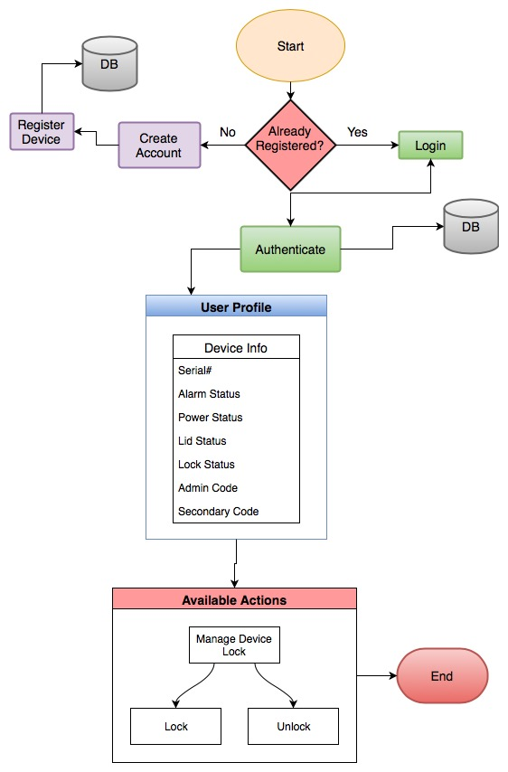
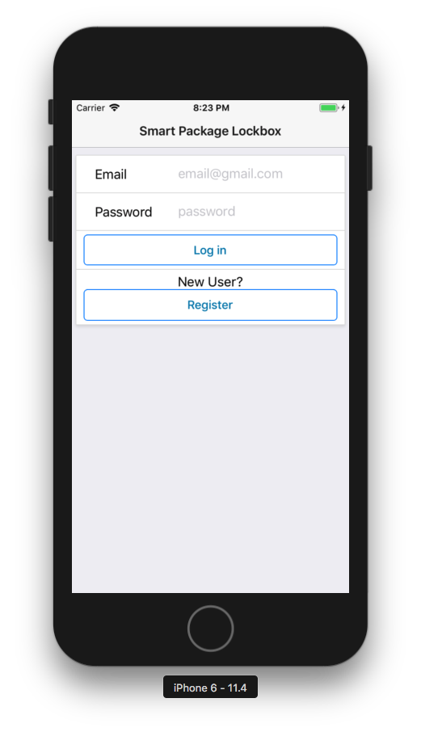
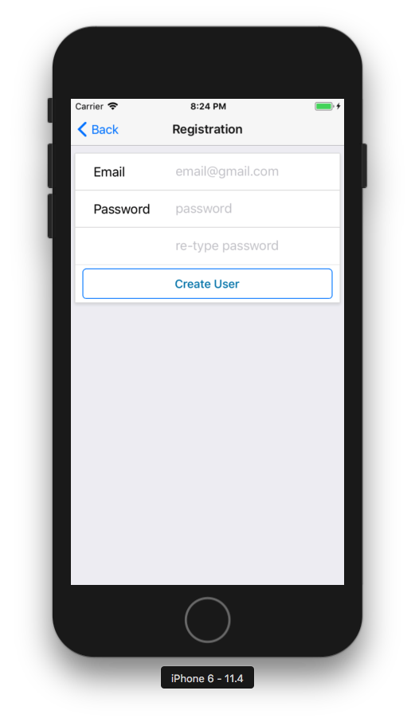
Mobile App Flowchart

Slide 27
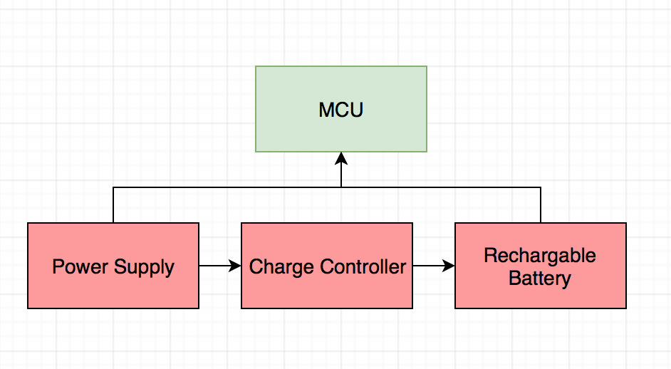
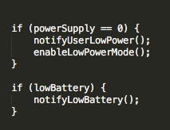
Battery & Low Power Mode

Slide 28
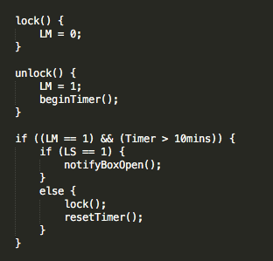
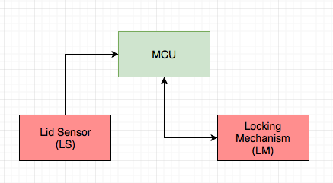
Lid Sensor & Locking Mechanism
*Low power mode disables LM

Slide 29
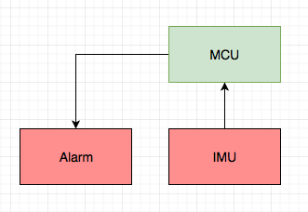
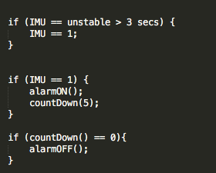
IMU & Tampering Alarm

Slide 30
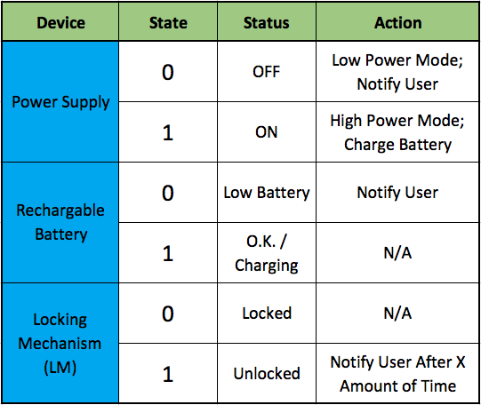
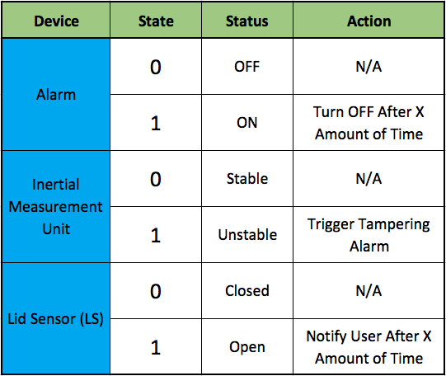
MCU Device States & Actions

Slide 31
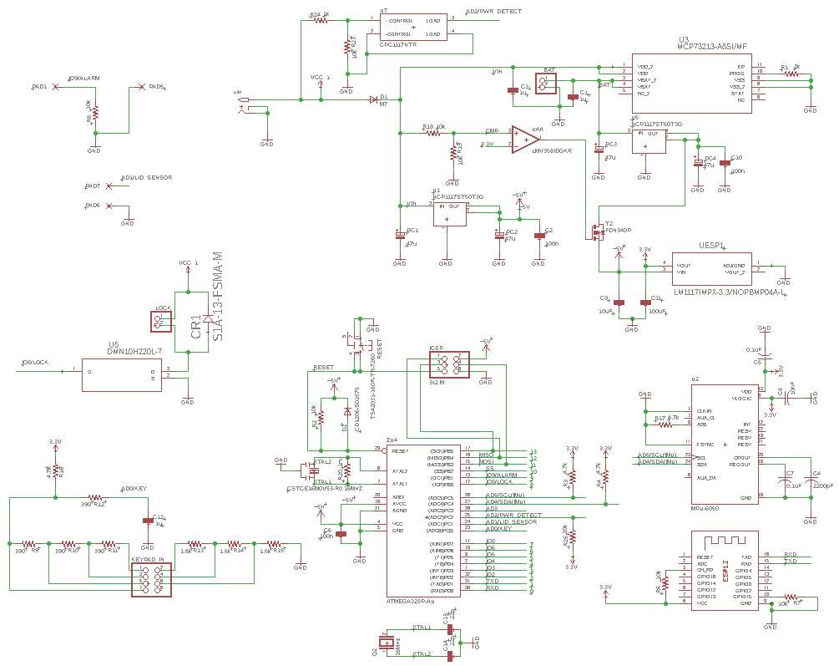

Slide 32
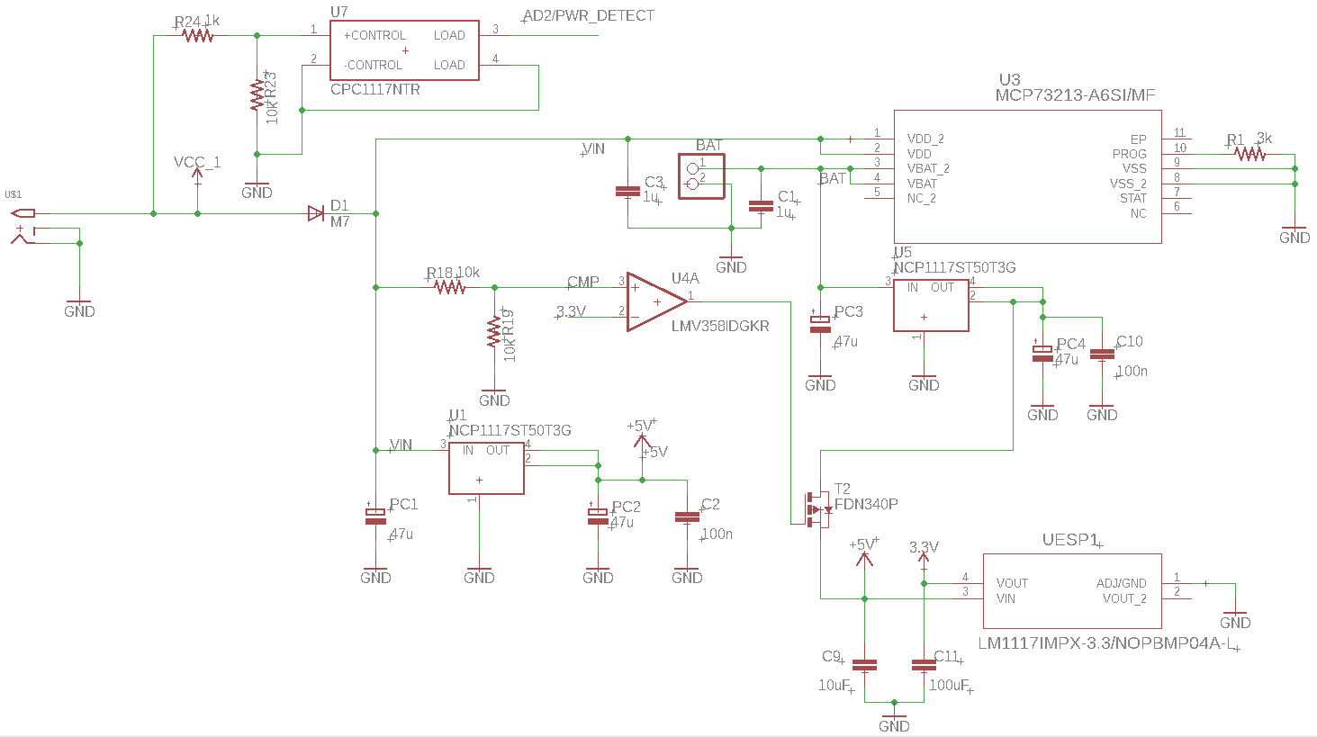

Slide 33
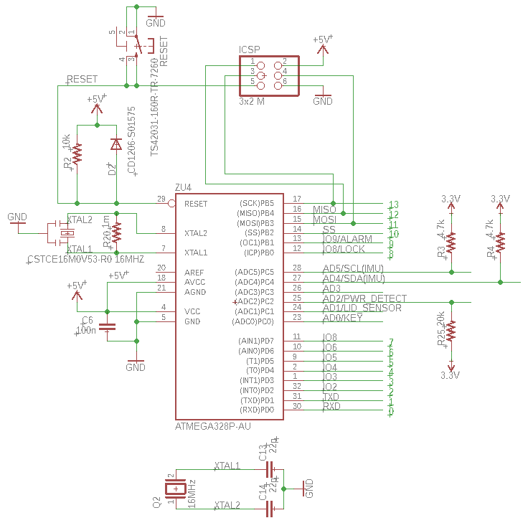

Slide 34
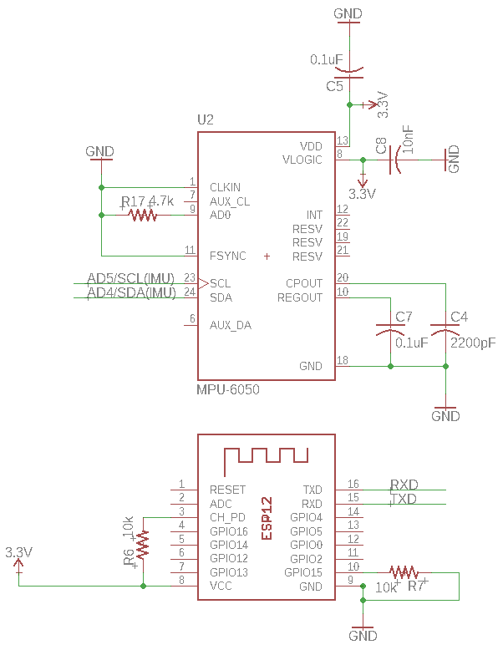

Slide 35
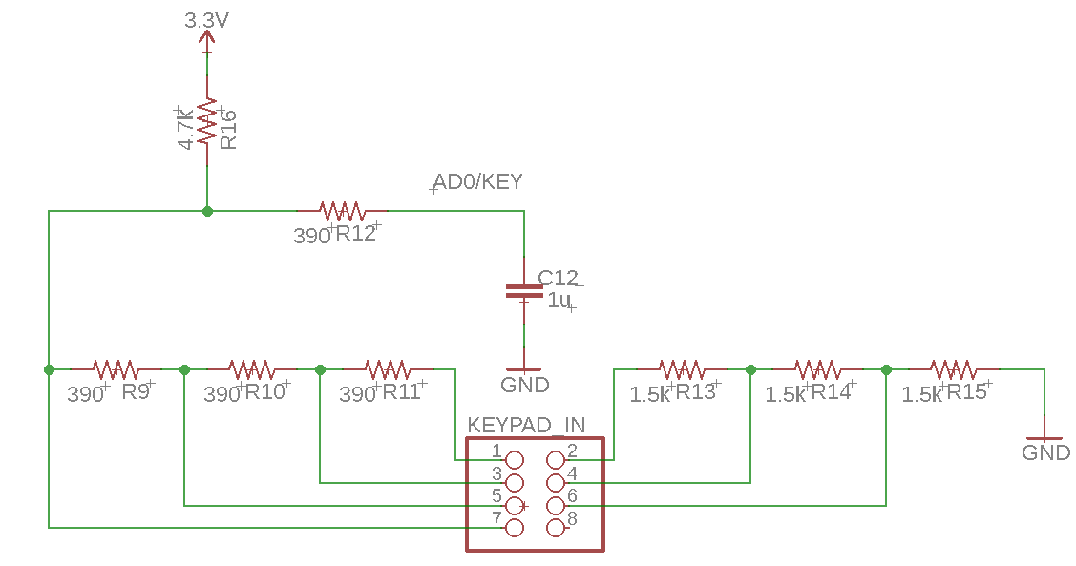

Slide 36
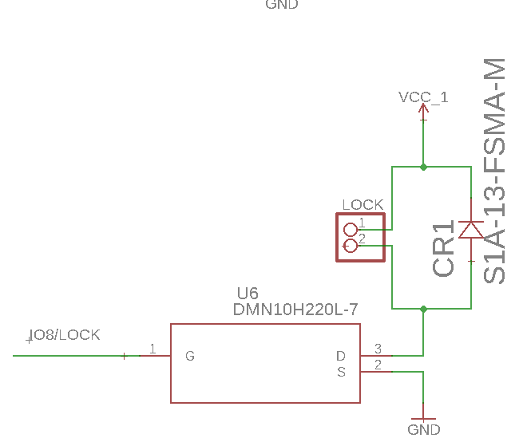

Slide 37
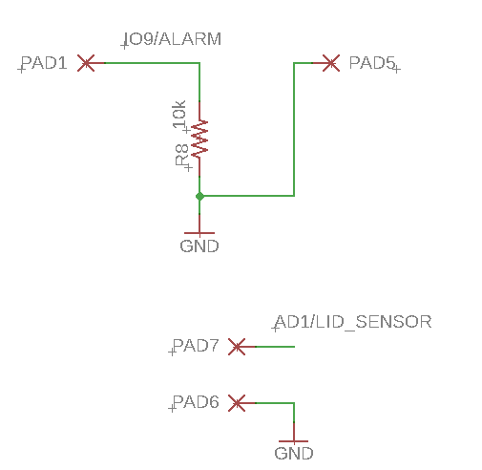

Slide 38
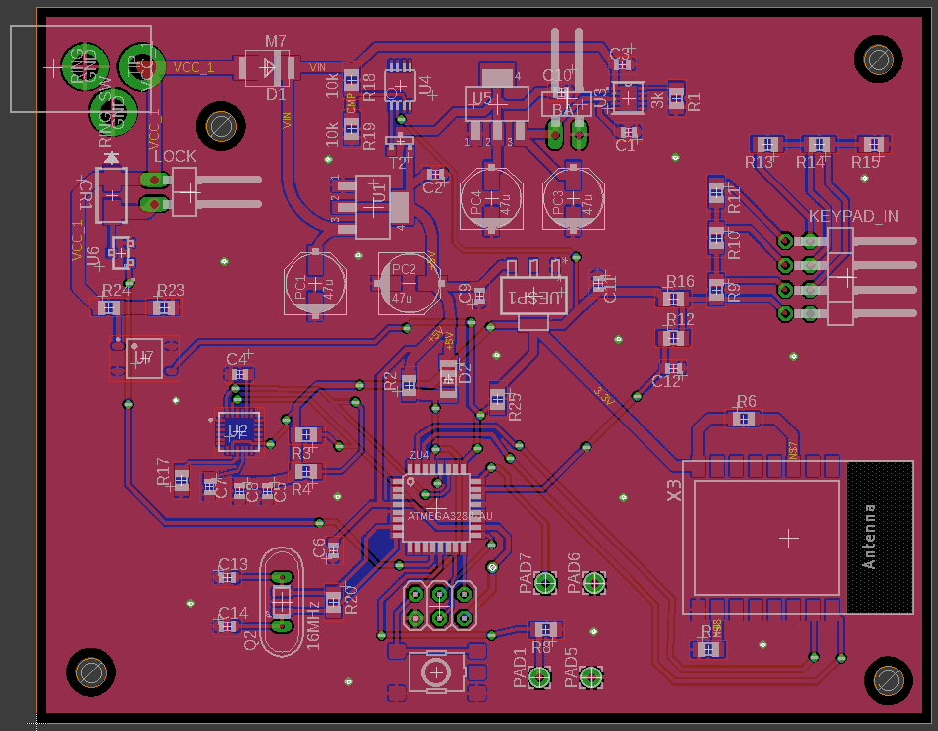
System PCB

Slide 39
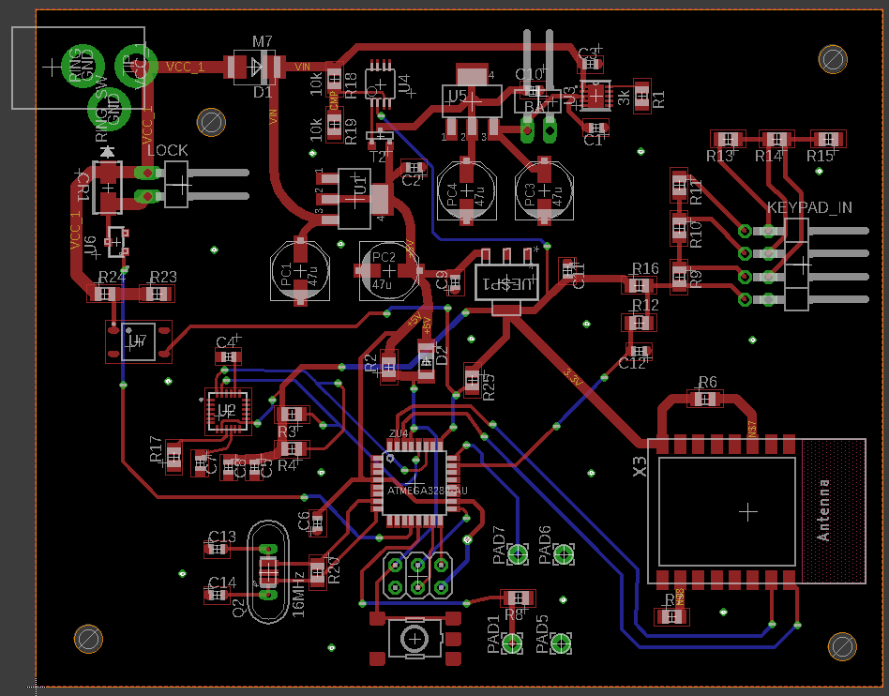
System PCB

Slide 40
Work Distribution
 | Brandon | Michael | Daniel | Dominic
Power Design | S | P
PCB Design / Debugging | S | P
Inertial Measurement Unit | S | P
Hardware Integration | S | P
Keypad / Alarm / Lid Sensor / Locking Mechanism | P | S
Wi-Fi Module |  | S | S | P
Online Database / Website |  |  | S | P
Application |  |  | P | S
MCU Software Integration | S | S | P | S
P = Primary
S = Secondary

Slide 41
Project Material Cost Per Unit
ItemI | Qty | Cost
Suncast Box | 1 | $39.00
IMU | 1 | $2.60
Wi-Fi Module | 1 | $6.95
MCU | 1 | $2.17
Locking Mechanism | 1 | $14.95
Keypad | 1 | $7.50
Alarm | 1 | $2.98
Magnetic Switch | 1 | $7.18
PCB | 1 | $33.00
Backup Battery | 1 | $29.99
Misc. PCB Components |  | $28.40
Power Adapter | 1 | $11.98
Total: |  | $186.70

Slide 42
Overall Project
Budget
ItemI | Qty | Cost
Suncast Box | 1 | $39.00
IMU | 2 | $2.60
Wi-Fi Module | 3 | $6.95
MCU | 2 | $2.17
Locking Mechanism | 1 | $14.95
Keypad | 1 | $7.50
Alarm | 1 | $2.98
Magnetic Switch | 1 | $7.18
PCB (Advanced Circuits) | 3 | $33.00
PCB (PCBWay) | 10 | $2.70
Backup Battery | 1 | $29.99
Misc. Components |  | $89.66
Power Adapter | 1 | $11.98
Arduino Prototype Boards | 4 | $11.86
ItemI | Qty | Cost
Demo Buzzer Pack | 1 | $12.98
Alligator Clip Pack | 1 | $6.99
Breadboard Kit | 2 | $11.99
PCB Shipping (Advanced Circuits) |  | $97.00
Total: |  | $548.02

Slide 43
Questions?

