Slide 1
Ion
Interactive Robot Assistant
Group 11
Dennis Gebken, CpE
David Jaffie, CpE
Mohammad Rizeq, EE

Slide 2
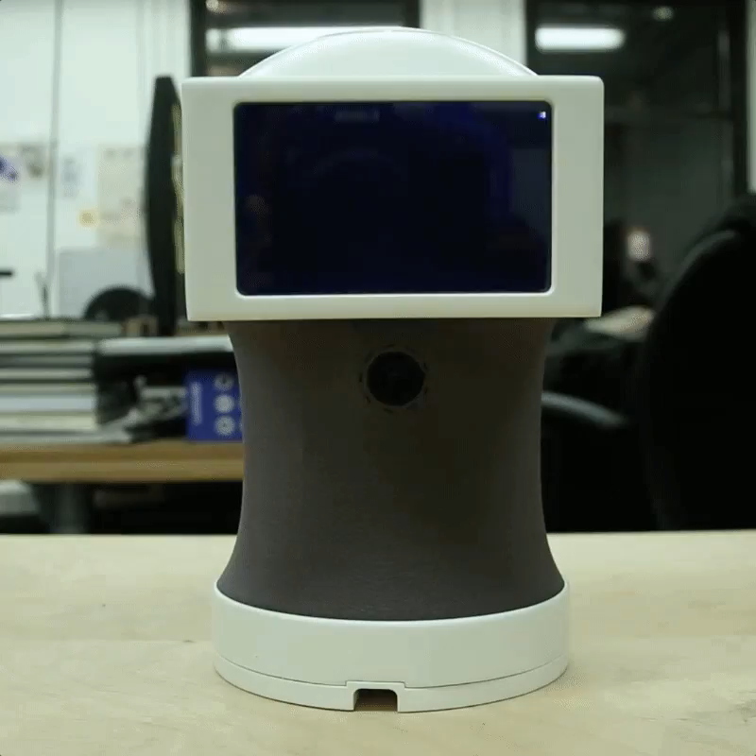
Motivation
Combat boredom at the desk
Provide more interaction and a physical embodiment to personal assistant smart speakers
Objective
Produce an all-in-one robotic assistant
Natural movement and conversation
Small, lightweight for portability
Wirelessly utilize the internet to carry out tasks
Meet Peeqo! Made by Abhishek Singh

Slide 3
Requirements & Specifications
Property | Design Specification
Weight | < 5lb
Size | < 7”x7”x15”
Voice Command Response Time | < 2 seconds
Voice Recognition | 80% of what is spoken
Supported Language | English
Face Recognition | 80% of faces recognized under normal lighting
Power Consumption | < 50W
Development Cost | < $500

Slide 4
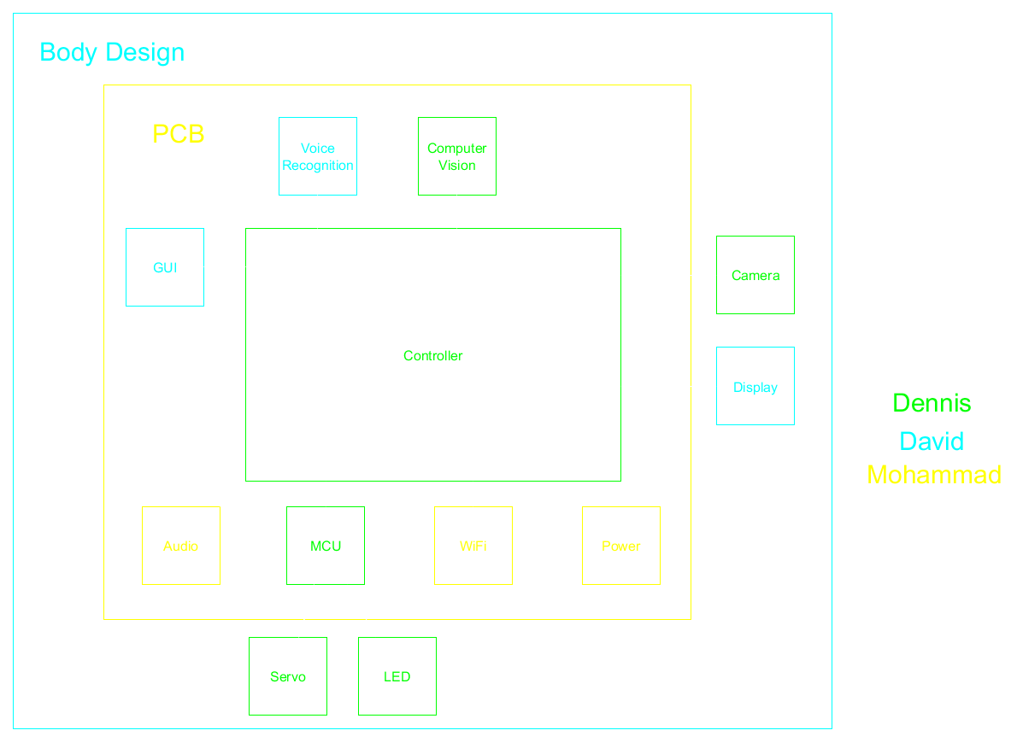
Overall Block Diagram & Tasking
Task | Primary | Secondary
Controller | Dennis | David
Camera & CV | Dennis | David
GUI | David | Dennis
Voice Recognition | David | Dennis
Body Design | David | Dennis
MCU & Servos | Dennis | Mohammad
Power | Mohammad | Dennis
Audio | Mohammad | Dennis
PCB | Mohammad | Dennis
WiFi | Mohammad | Dennis

Slide 5
David’s Responsibilities
Body Design
Display
GUI
Voice Recognition

Slide 6
David’s Responsibilities
Body Design
Display
GUI
Voice Recognition

Slide 7
Body Design
Originally wanted to utilize 3D printing to build a body
Low priority, decided to finish primary tasks related to ECE hardware and software
Basic tubing just to house components while allowing rotation

Slide 8
David’s Responsibilities
Body Design
Display
GUI
Voice Recognition

Slide 9
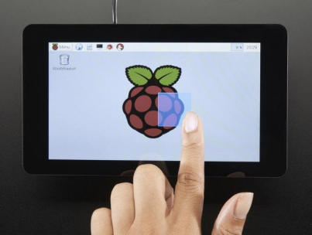
Display
Important factors:
Cost
Touch capability - GUI
Size & Resolution – GUI & multimedia
Built-in adaptor board
Source: Adafruit

Slide 10
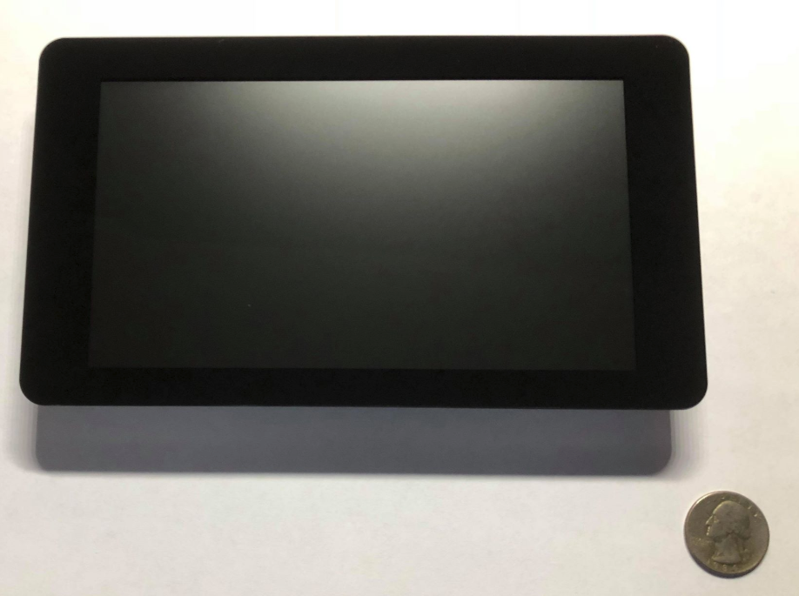
Pi Foundation Display
Size: 7”
Resolution: 800x480
Liquid Crystal Display (LCD)
Cheaper, more energy-efficient compared to TFT
Capacitive touchscreen allowing for multi-touch
Attached driver board that handles power and signal processing
Easily integrates with Raspberry Pi
Cost: $80

Slide 11
David’s Responsibilities
Body Design
Display
GUI
Voice Recognition

Slide 12
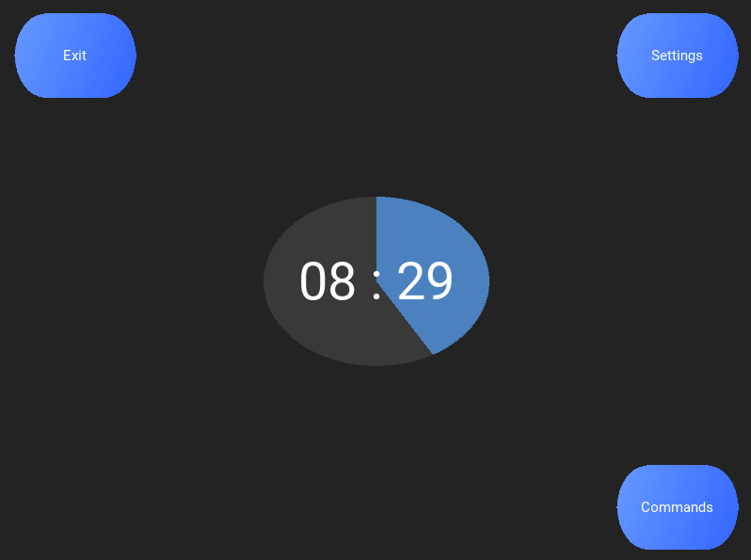
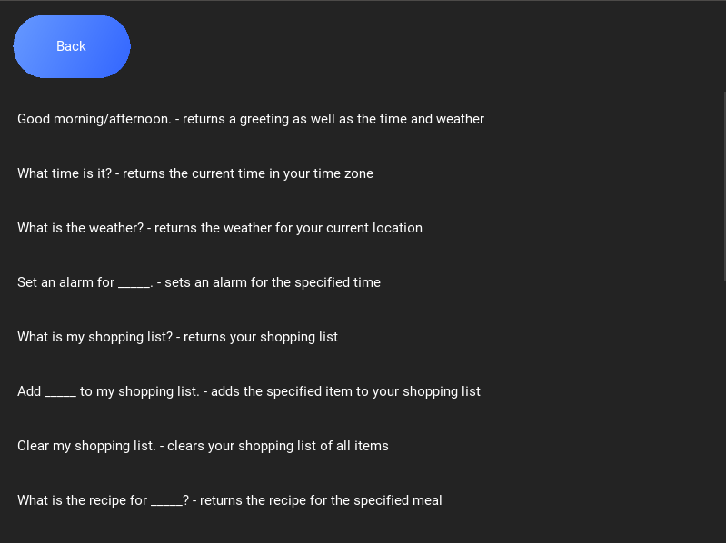
GUI
Secondary means of interaction with the device
Allows the user to:
View available commands
Receive notifications on recognized or unrecognized users
Change various settings
Coded in Python
Included with Raspbian
Event-driven language
Used Kivy library
Open-source
Easily integrates with the Raspberry Pi
Great for multi-touch user interfaces and apps

Slide 13


GUI User Flowchart

Slide 14
David’s Responsibilities
Body Design
Display
GUI
Voice Recognition

Slide 15
Voice Recognition
Primary means of interaction with the device
Works the same as Amazon Echo, Siri, etc.
Looks for a ‘wake-up word’
Records the command that follows the wake up word and utilizes Google Speech API to translate it into a command that Ion can recognize

Slide 16

Voice Recognition Flowchart

Slide 17
Dennis’s Responsibilities
Face Detection
Face-the-User System (name TBD)
Facial Recognition
Main Processor selection
Motor Control Unit (MCU)

Slide 18
Dennis’s Responsibilities
Face Detection
Face-the-User System (name TBD)
Facial Recognition
Main Processor selection
Motor Control Unit (MCU)

Slide 19
Face Detection
Purpose:
Detect faces
Return position of face closest to center (x,y)
Feedback for Face-the-User (name TBD) system
Language: Python
Library: OpenCV

Slide 20

Face Detection Algorithm
Reduces capture size
Transforms to grayscale
Blurs
Detects faces
Returns coordinates

Slide 21
Dennis’s Responsibilities
Face Detection
Face-the-User System (name TBD)
Facial Recognition
Main Processor selection
Motor Control Unit (MCU)

Slide 22
Face-the-User System
Camera
Purpose
Turn Ion so the screen faces the user
Capture image
Image is sent to Raspberry Pi
Raspberry Pi
Detects face
Calculates distance vector to center
Instructs MCU to update position
MCU
Changes servo position

Slide 23
Face-the-User System Challenges
Position vector’s magnitude could be off
Too large
Overshoot
Oscillation
Too small
Many minor adjustments
Both are a waste of power and resources
User may move while position is updated

Slide 24
Face-the-User System Solutions
Dynamic feedback
Position change in increments
Variable buffer rectangle
Slow, continuous adjustments
Position updated until face is centered
Target rectangle while adjusting position.
Buffer rectangle. The center of the face needs to cross one of its borders to initiate movement.

Slide 25
Dennis’s Responsibilities
Face Detection
Face-the-User System (name TBD)
Facial Recognition
Main Processor selection
Motor Control Unit (MCU)

Slide 26
Facial Recognition
Purpose:
To identify saved users and greet them
Notify user when someone else was detected at the desk
Not a true safety feature
Not accurate enough because of lack of processing speed
Accuracy vs. Speed
Eigenfaces – fast but unreliable
Fisherfaces – More reliable but slow
Will only run when a face has not been detected for a while

Slide 27
Dennis’s Responsibilities
Face Detection
Face-the-User System (name TBD)
Facial Recognition
Main Processor selection
Motor Control Unit (MCU)

Slide 28
Processor Load
Facial Recognition
Face Detection
GUI & Multimedia
Voice Recognition
OS (Linux-based)

Slide 29
Single Board Computer (SBC) Choices
Asus Tinkerboard
Beagleboard
Raspberry Pi
Sopine A64

Slide 30
SBC Comparison
 | Raspberry Pi | BeagleBoard | Asus TinkerBoard | Sopine A64
CPU/SOC | 4-core 1.2 GHz | 1-core 1.0 GHz | 4-core 1.8 GHz | 4-core 1.152 Ghz
Memory (RAM) | 1 GB | 512 MB | 2 GB | 2 GB
Price | $35.00 | $49.00 | $55.44 | $35.00
Component Availability | Readily available | Readily available. CPU can be bought directly for $20 | Prototype board available on Amazon. Components for final design not yet found | Readily available
Interfaces | Everything necessary, except 2nd PWM output | All necessary interfaces available | All necessary interfaces available | Everything necessary, except 2nd PWM output
Final Implementation | Connect Raspberry Computer Module 3 via fixed SODIMM connector to PCB | SBC design to be used as reference to add CPU directly to final PCB | Currently not possible because components have not been found | Connect Sopine A64 via fixed SODIMM connector to PCB

Slide 31
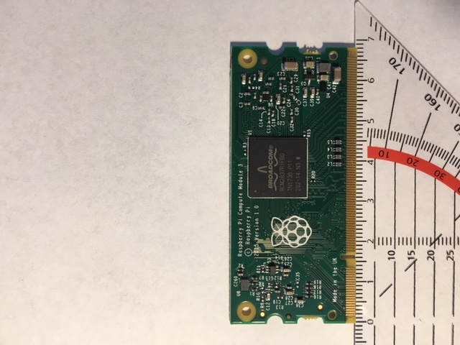
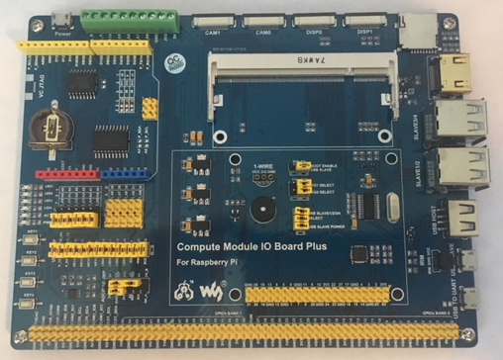
SBC Choice: Raspberry Pi 3 Compute Module Lite
Performance deemed sufficient
Smaller when added to PCB
Lowest cost
Already own development board and SBC (version 3 B)
Abundant information and tutorials online
Most future-proof
Raspberry Pi Compute Module 3 Lite
WaveShare Compute Module IO Board Plus

Slide 32
Dennis’s Responsibilities
Face Detection
Face-the-User System (name TBD)
Facial Recognition
Main Processor selection
Motor Control Unit (MCU)

Slide 33
Motor Control Unit (MCU) Tasks
Rotate servos
RGB LED control

Slide 34
MCU Main Choices and Comparison
 | Atmel Mega328 | Ti M430
Prototyping Board | Arduino Uno | LaunchPad
Operating Voltage | 1.8-5.5V | 2.0-3.6V
Clock Speed | 20 MHZ @ 4.4+ V | 16 MHz
I/O | 23 GPIO 8 10-bit ADC channels | 15 GPIO 8 10-bit ADC channels
Price | $1.30 | $2.48

Slide 35
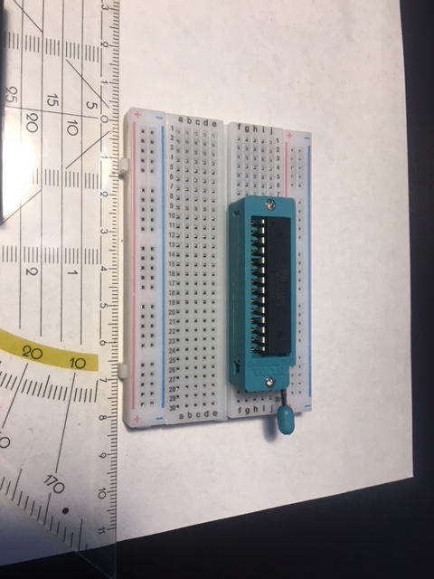
MCU Choice: Atmel mega328
Faster
Cheaper
Can be prototyped on breadboard (see picture)
Already own Arduino Uno and Bootloader

Slide 36
Mohammad’s Responsibilities
Audio Processing
WiFi System
Input Ports
Power Management
PCB

Slide 37
Mohammad’s Responsibilities
Audio Processing
WiFi System
Input Ports
Power Management
PCB

Slide 38

General User-Device Voice Interaction
User issues the device a command; the device responds.
Example:
User: Stream The Beatles from Youtube.
Device: *plays song*

Slide 39
Initial Design Audio Components

Slide 40
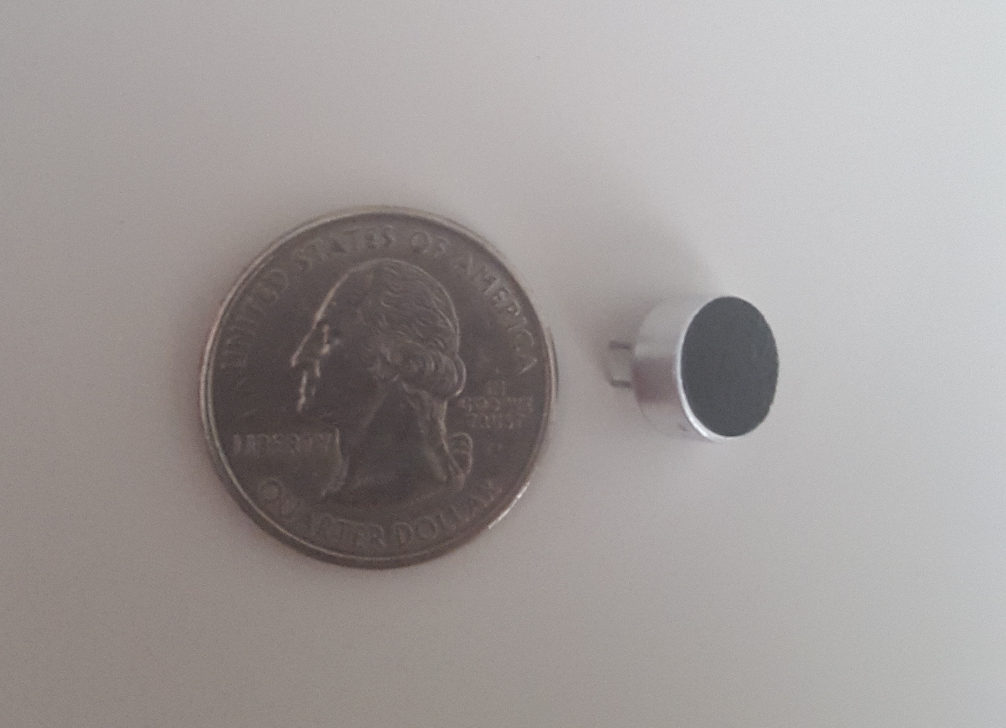
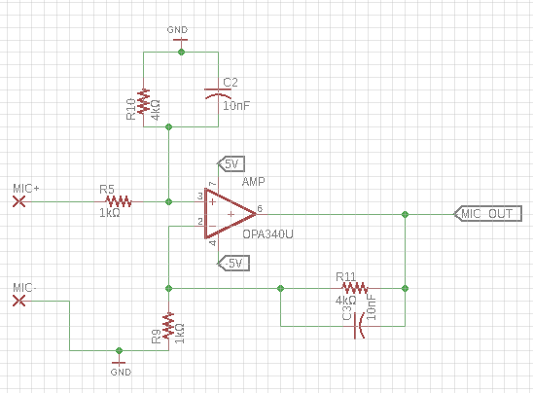
Electret Microphone
Very common in audio projects.
Specs:
-44dB sensitivity
20Hz-20kHz frequency response
Operating voltage range of 1V_{DC}-10V_{DC}
Breadboard-friendly
Downside: Requires filtering and amplifying
Amplifier & Low Pass Filter
Cutoff Frequency: ~4kHz
Gain: 4 V/V

Slide 41
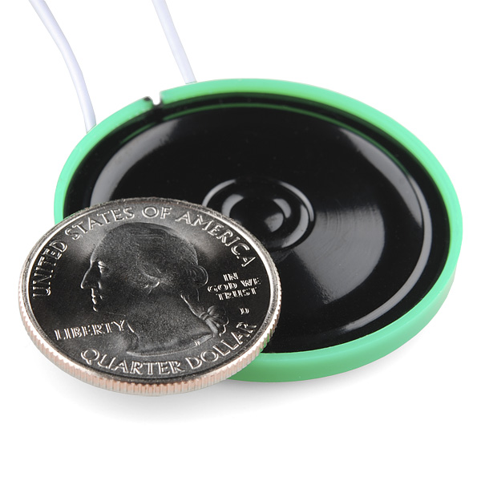
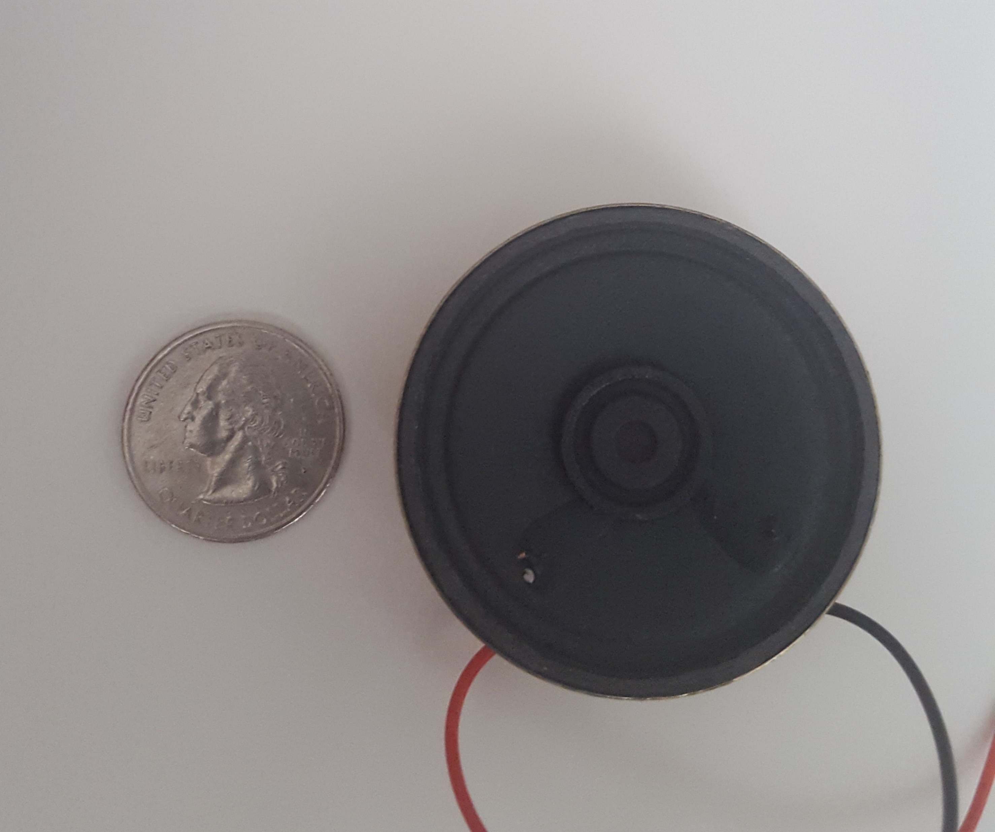
Speakers
Parameter | Regular Speaker | Thin Speaker
Diameter | 50mm | 40mm
Power Rating | 0.5W | 0.25W
Impedance | 8Ω | 8Ω
Price | $1.95 | $0.95
Quality | Much clearer sound | Sound is noisy and unclear
Thin Speaker
Source: SparkFun
Regular Speaker

Slide 42
Final Design Audio Components

Slide 43
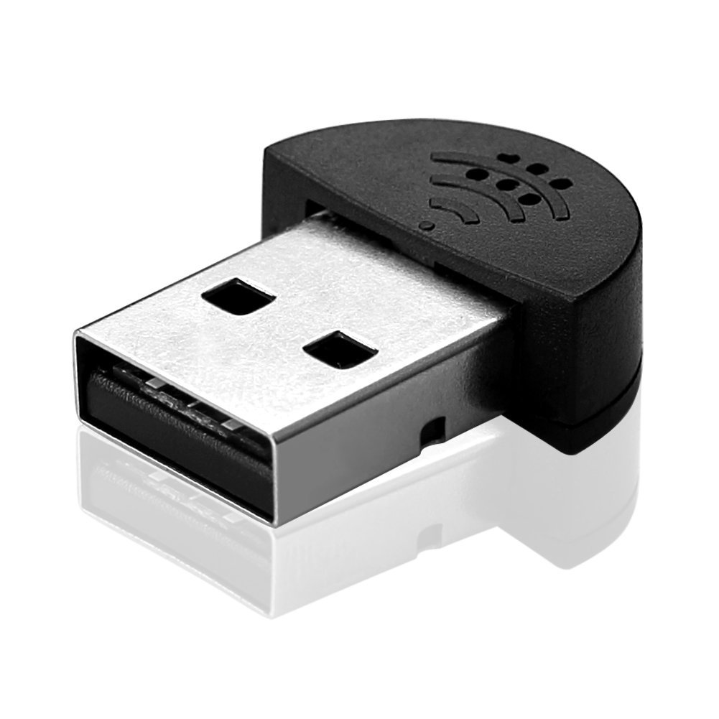
Sienoc Mini USB Microphone
Specs:
Very small: 22.5x18.3x7.1 mm
100Hz-16kHz frequency response
Does not require a driver
Effective distance of 2 meters
Advantages:
Less PCB space & signal noise
Can be switched out
ADC not required
Amplifier & LPF not needed
Source: Amazon

Slide 44
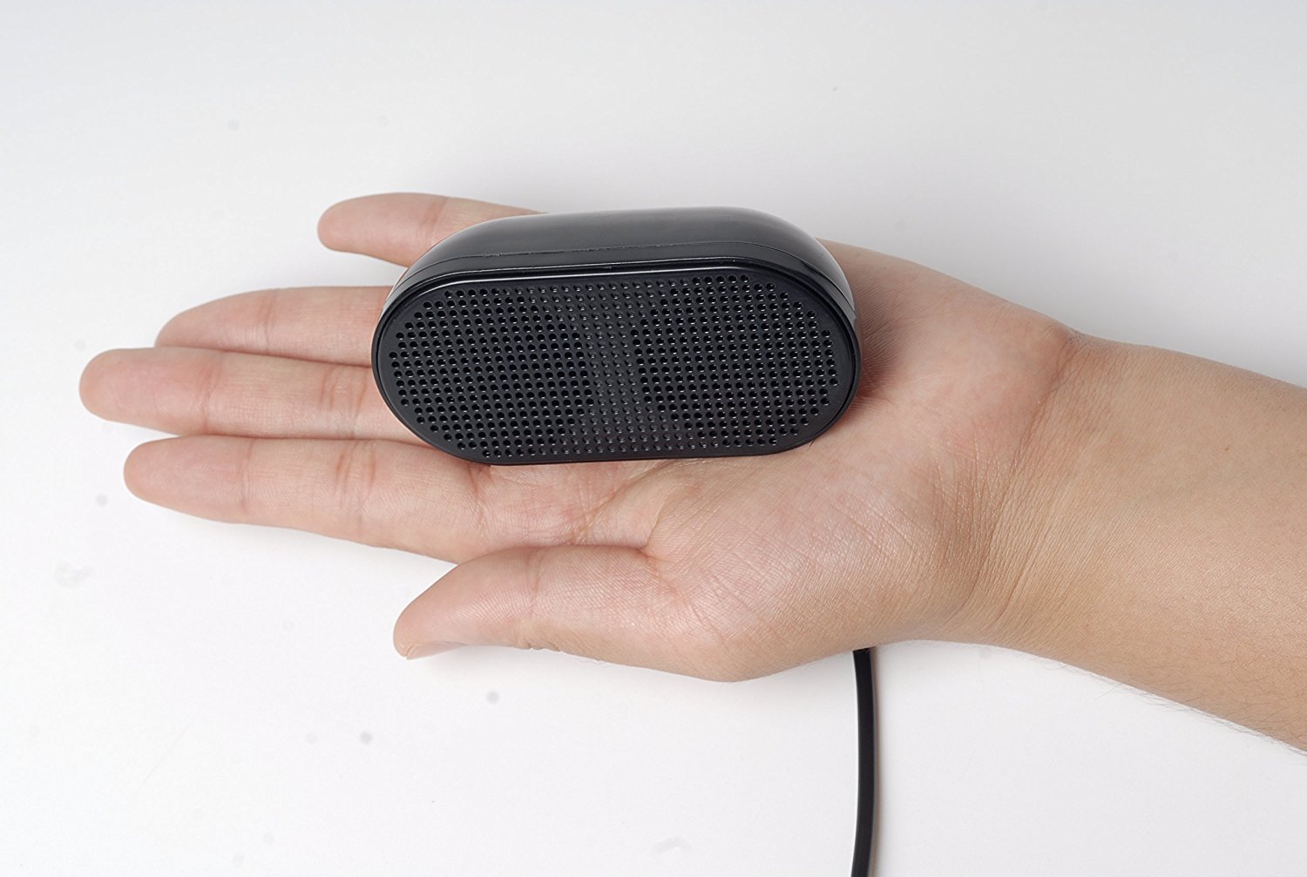
USHONK USB Mini Speakers
Specs:
Small: 79.756x30.48x45.212 mm
Does not require a driver
0.5W per speaker (2)
Advantages:
Less PCB space & signal noise
Can be switched out
DAC no longer needed
Regular Speaker
Source: Amazon

Slide 45
Mohammad’s Responsibilities
Audio Processing
WiFi System
Input Ports
Power Management
PCB

Slide 46
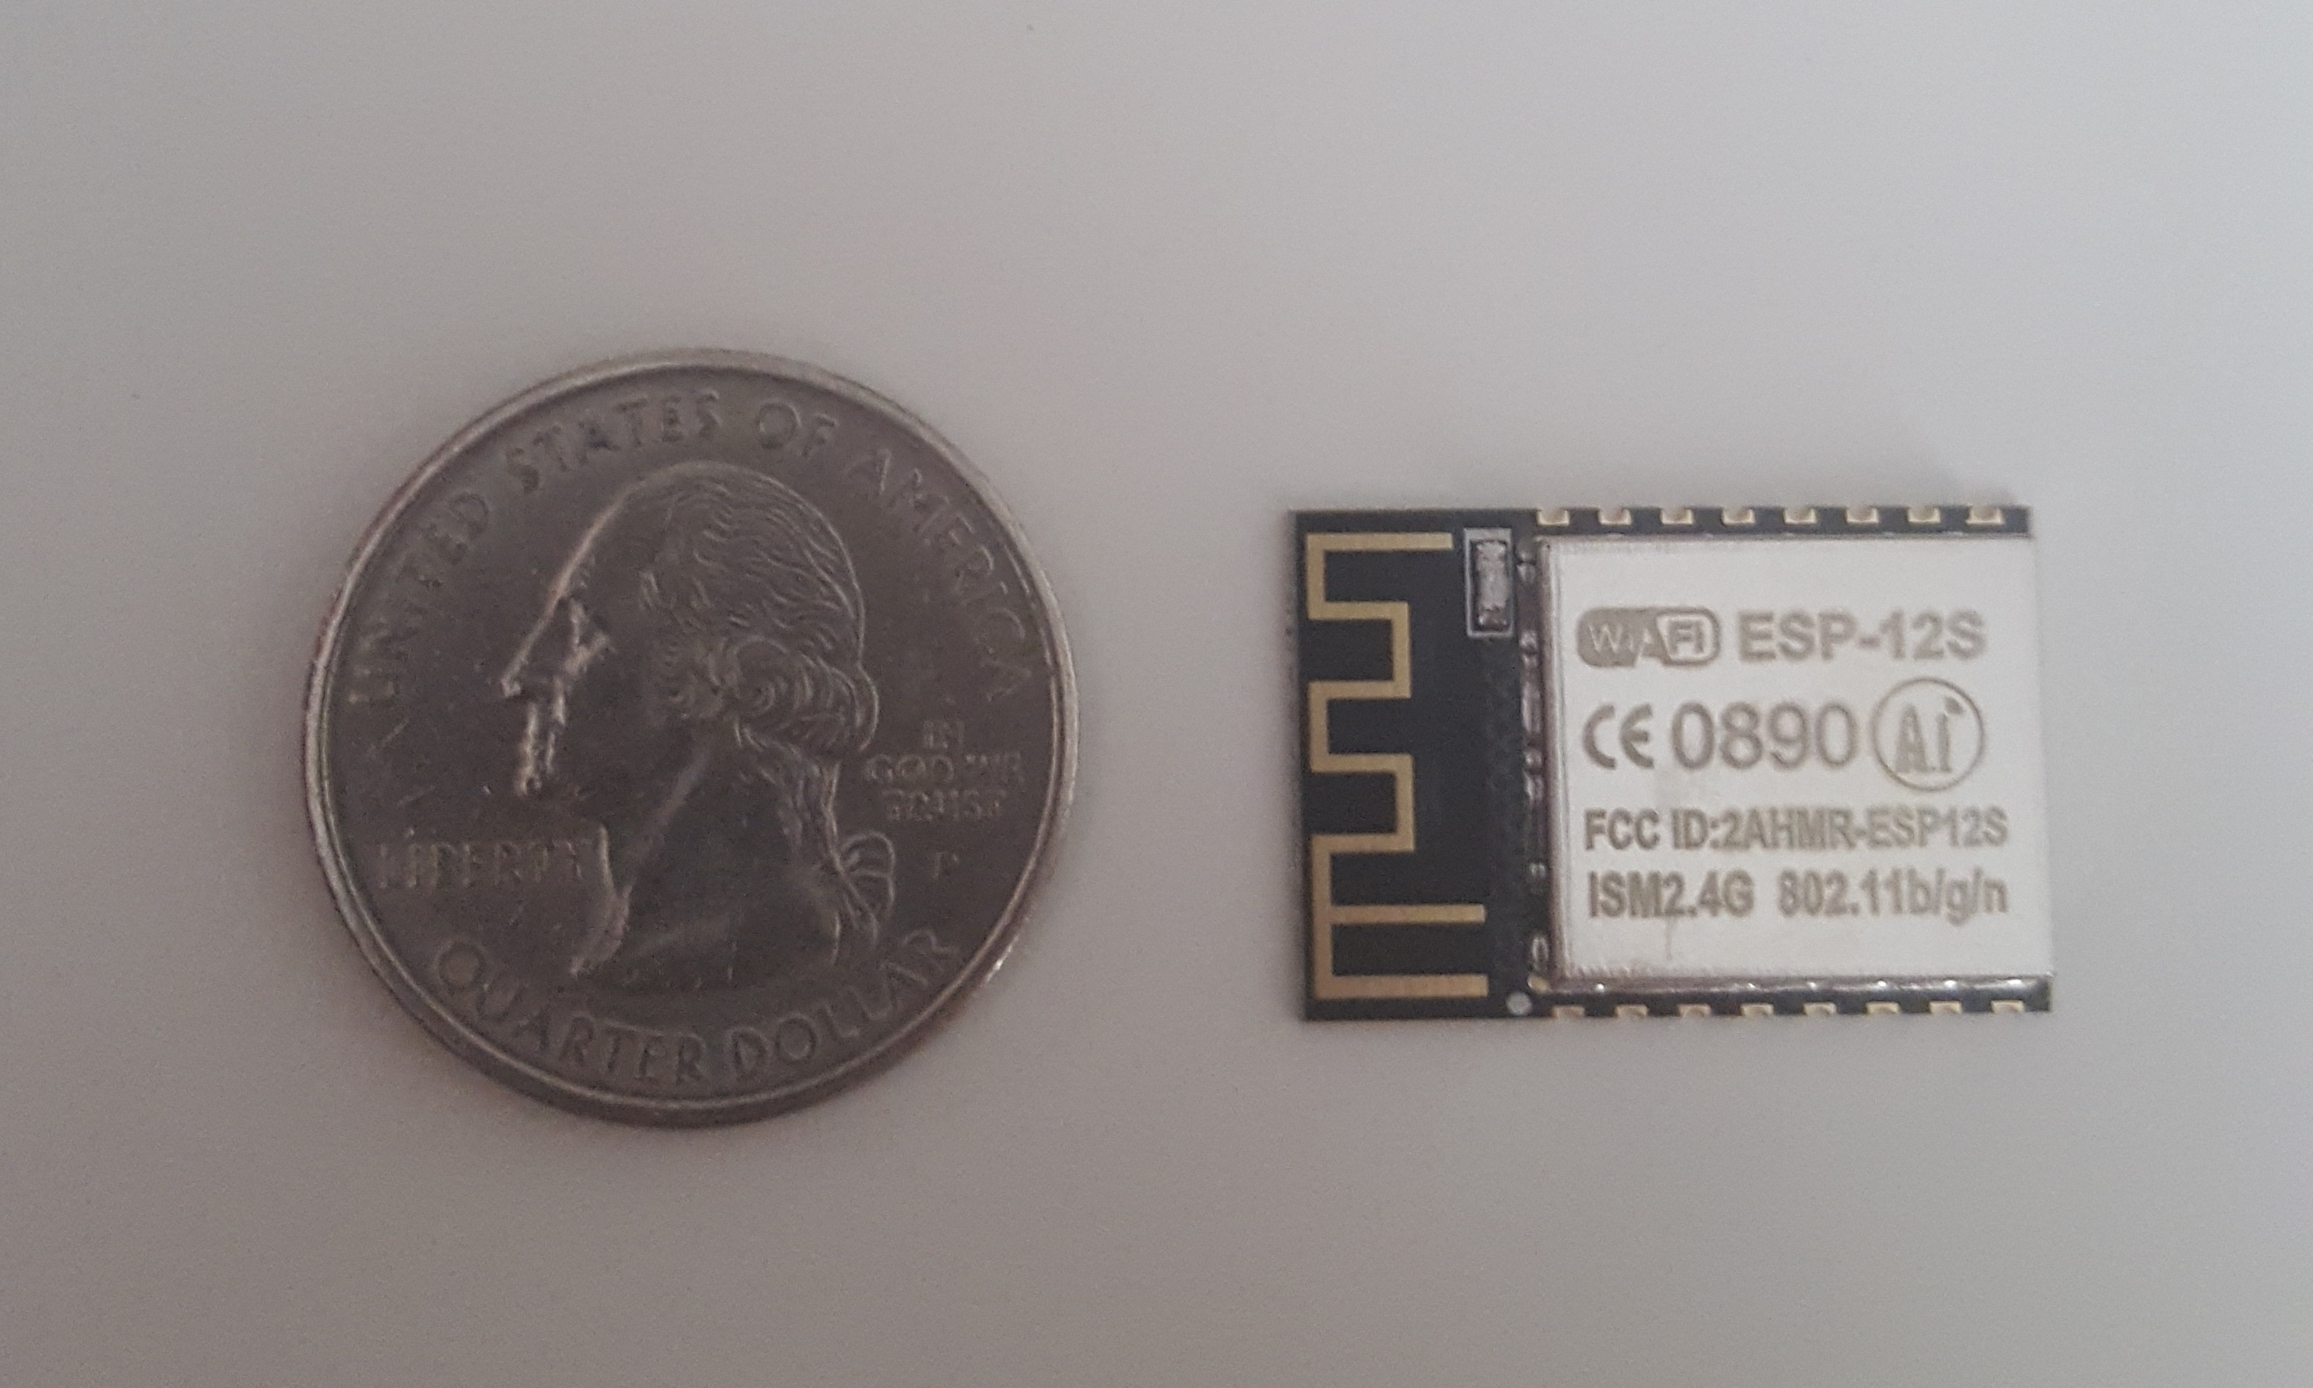
WiFi Chip
Parameter | Xbee S6B | ESP-12E
Standard | 802.11 b/g/n | 802.11 b/g/n
Frequency Band | 2.4GHz | 2.4GHz
Security | WPA/WPA2/WEP | WPA/WPA2/WEP
Interface | SPI/UART | SPI/I2C/UART
Operating Voltage | 3.12V-3.46V | 3.0V-3.6V
Transmit Power | +/- 16 dBm | +/- 20 dBm
Price | $29.00 | $6.95
ESP-12E WiFi Chip

Slide 47
Mohammad’s Responsibilities
Audio Processing
WiFi System
Input Ports
Power Management
PCB

Slide 48
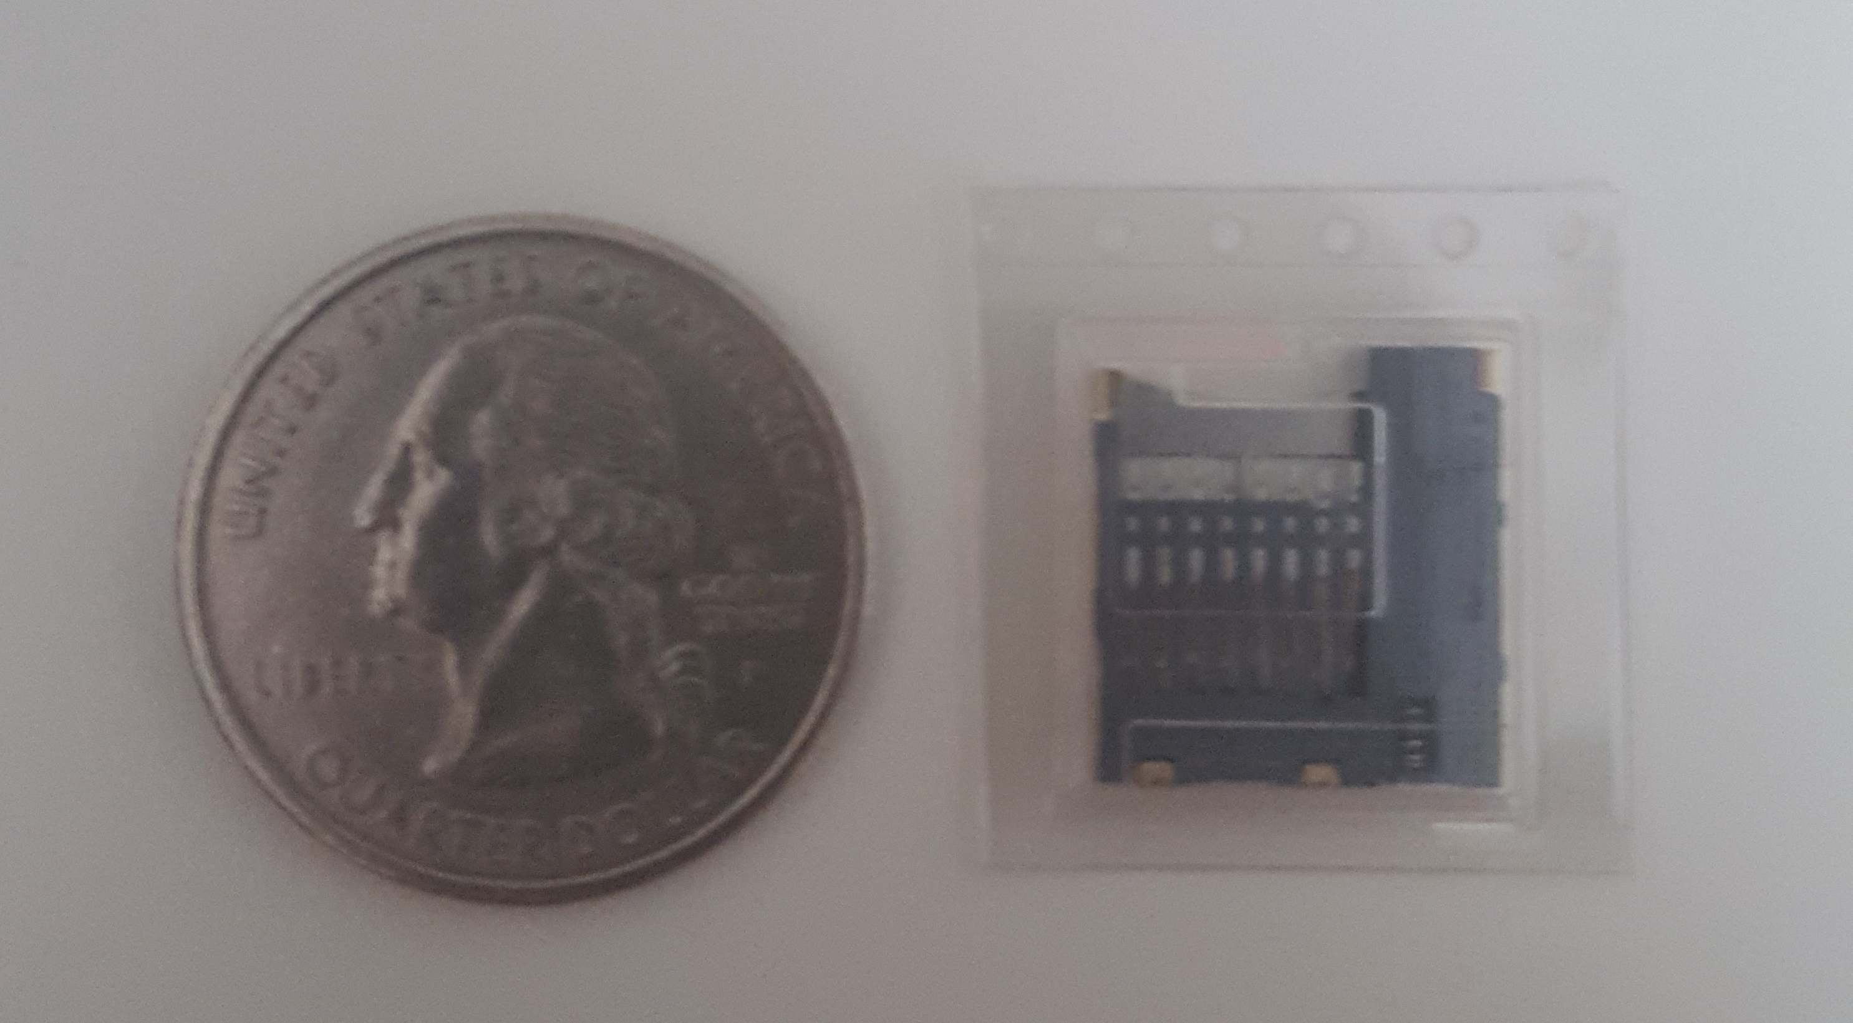
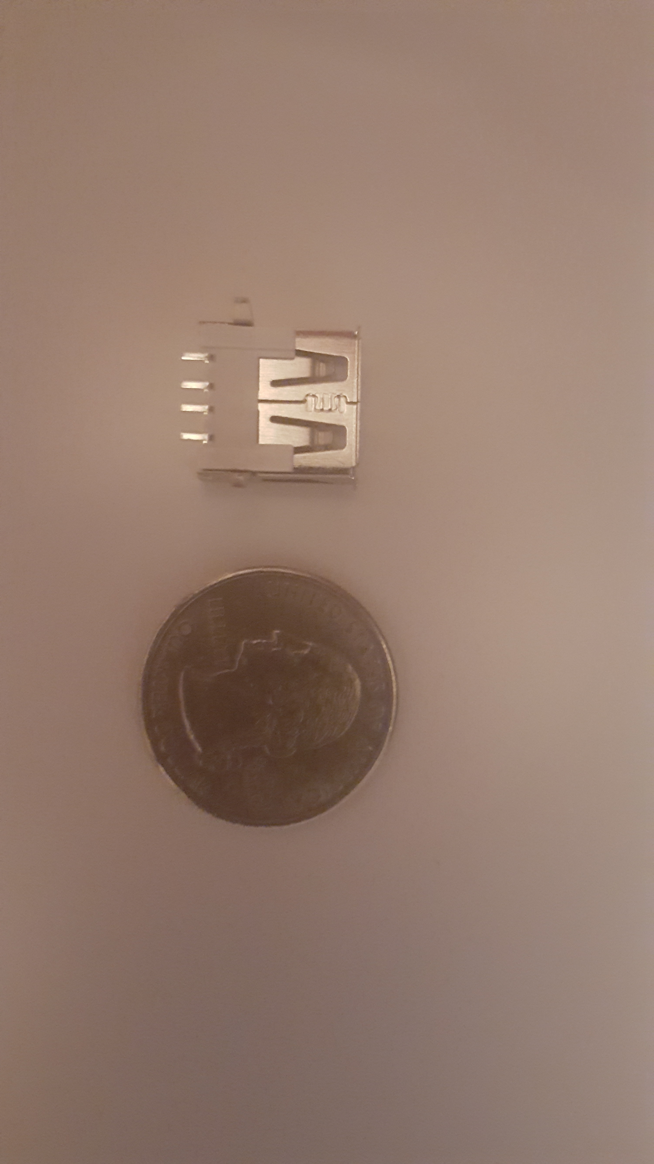
Input Ports
USB Type A
Initial Design: Troubleshooting & Peripherals
Final Design: Mic, Speakers & Peripherals
MicroSD Card Socket
Boot drive
Storage

Slide 49
Mohammad’s Responsibilities
Audio Processing
WiFi System
Input Ports
Power Management
PCB

Slide 50
Final Design Power Consumption
Component | Nominal Input Voltage (V) | Nominal Current Draw (mA) | Power Consumed (mW)
Processor | 5 | 700 | 3,500
LCD | 5 | ~200 | ~1,000
Servo Motors | 5 | 200 | 1,000
Motor Control Unit | 5 | 0.2 | 1
WiFi Chip | 3.3 | 80 | 264
Camera | 5 | 250 | 1,250
LEDs | 3.3 | ~20 | ~66
microSD Card | 3.3 | 100 | 330
USB Peripheral | 5 | ~500 | ~2,500
Total: |  | ~2.05A | ~10W

Slide 51
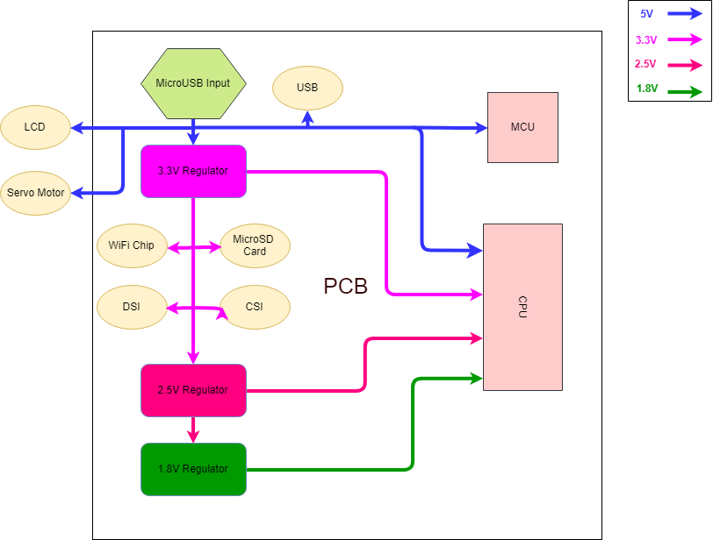
Final Design Power Connections
LED

Slide 52
Mohammad’s Responsibilities
Audio Processing
WiFi System
Input Ports
Power Management
PCB

Slide 53
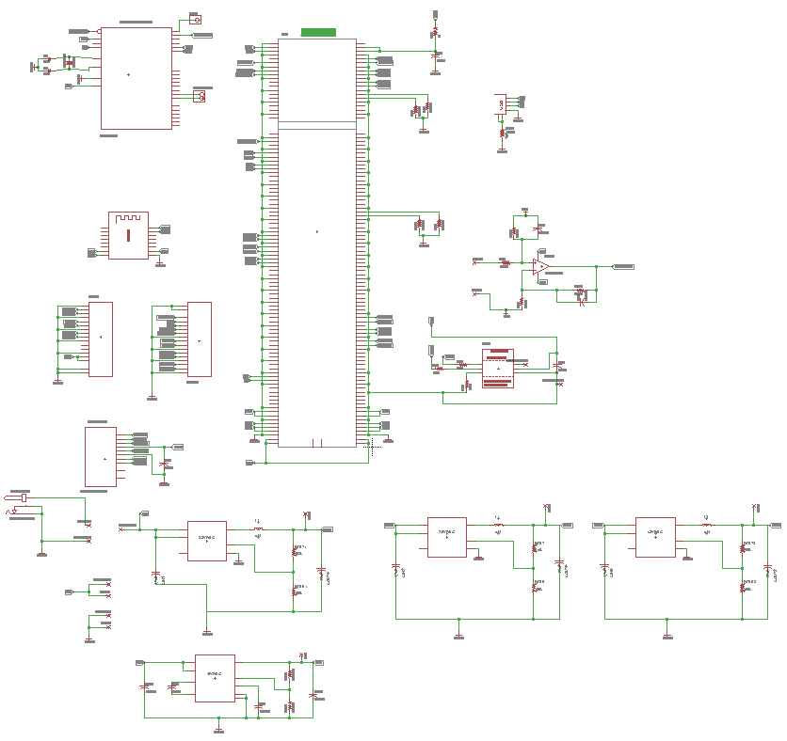
PCB Schematic Overview
CPU
USB
MCU
WiFi
Mic Amp
DSI
&
CSI
Initial Design
DAC
microSD
DC Jack
LCD & Servo
Voltage Regulators

Slide 54
Initial Design Disadvantages
Size & price can be reduced
Very complex
MCU is through-hole
Components are very small

Slide 55
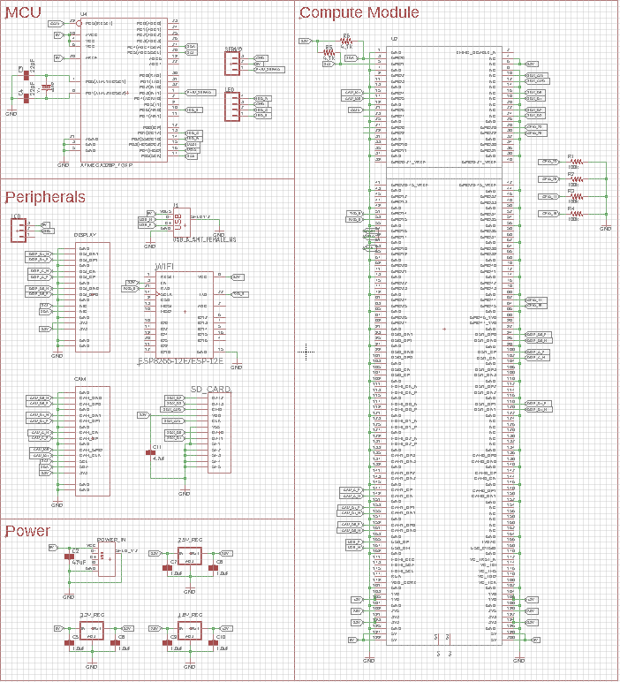
PCB Schematic Overview
Final Design

Slide 56
Administrative Content

Slide 57
Budget
Component | Projected Cost ($) | Actual Cost ($)
Microphones | 3.00 | 7.78
Speakers | 6.00 | 15.90
Display | 60.00 | 80.00
Controller | 35.00 | 26.00
Camera | 15.00 | 10.00
PCB(s) | 50.00 | 60.00
Body | 50.00 | 0
Buttons, switches | 10.00 | 1.50
Resistors, capacitors, etc | 10.00 | 50.00
LEDs | 10.00 | 5.90
MCU | 20.00 | 7.52
Servo(s) | 30.00 | 6.99
WiFi Modules | 32.00 | 11.95
Mono Audio Amplifier | 8.00 | 7.95
DAC Breakout Board | 5.00 | 4.95
Battery | 20.00 | 0
Voltage Regulators | 15.00 | 12.58
Total | 494.00 | 309.02

Slide 58
Ion Unit Cost
Component | Cost ($)
Voltage Regulators | 1.29
Speakers | 12.00
Display | 80.00
Controller | 26.00
Camera | 9.99
PCB | 2
Body | 0
Resistors, capacitors, etc | 13.05
LED | 0.10
MCU | 1.88
Servo | 6.99
WiFi Modules | 5.00
USB Hub | 6.99
Microphone | 5.88
Ball Bearing | 5.95
Total | 177.12

Slide 59
Issues
Kivy and Pi didn’t get along as well as we hoped
Python library to embed browser wasn’t compatible with ARM processors
Window provider for Pi always kept Kivy on top – couldn’t launch browser in front of it
Complex widgets resulted in lag
Final PCB’s USB port is not working:
Error code: “Warning – TX status read failed -71”
Possibly Differential pair (mismatched or wrong impedance)
Could also be hardware driver
But, we had a plan B prepared

Slide 60
Questions?

