Slide 1
Head-Mounted Display (HMD) Mini-map for "Lazer" tag
Group 2
Patrick Burton – Computer Engineering
Bailey Duryea – Photonics Science and Engineering
Nicholas Harris – Photonics Science and Engineering
Aaron True – Computer Engineering

Slide 2
Motivation
"Lazer" Tag is a growing industry, becoming a popular alternative to other forms of entertainment venues like bowling/mini-golf/theme parks/etc.
Looking for ways to improve "Lazer" Tag so the game is more exciting and fun to play
Wanted to make it more like a video game

Slide 3
Goals and Objectives
Head-Mounted Display that shows the user important supplemental information
Shows your approximate position on the map
Shows how many lives you have
Augmented Reality: A Video Game-Like Experience
User friendly, easily recognizable, similar to well-known video game elements

Slide 4
Project Specifications
Description | Value | Unit
HMD HUD Weight | < 5 | lbs
"Lazer" Tag equipment Weight | < 5 | lbs
Receiver, Battery and Board weight | < 10 | lbs
Emitter Functional Range | ≥30 | m
Emitter Accuracy | ±15 | cm (@ 15 m)
Real Time Tracking Accuracy | ±1 | m (@ 15 m )
Real Time Tracking refresh rate | 1 | Hz
Battery Life | ≥4 | Hrs

Slide 5
Real Time Location System
Initially considered RFID, UWB, Wi-Fi, GPS and BLE
Biggest limiting factor for this portion of the project is cost
Most of the RTLS options are very expensive costing thousands of dollars to set up
Most RTLS systems are set up in large companies for employee/asset tracking
Bluetooth Low Energy is the most viable option for our project
Low Cost
Low Power Consumption
Decent Accuracy
Easier to implement than other options
If this project was done a year later, BLE 5.1 with its direction-finding feature would be able to find location with centimeter precision

Slide 6
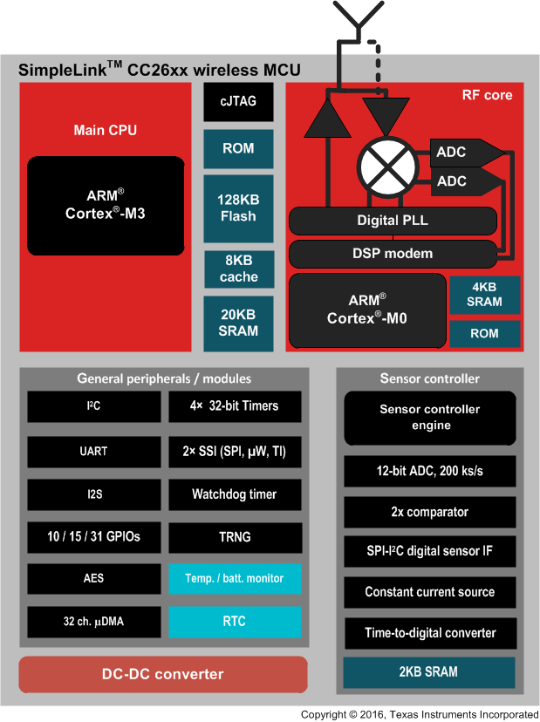
Microcontroller
Need microcontroller to have wireless transmission capabilities in order to read advertisements from BLE peripherals
Texas Instruments Series CC26XX – a line of microcontrollers with built in ZigBee/BLE/6LoWPAN components
Our design uses CC2640R2F which was made specifically for BLE solutions

Slide 7
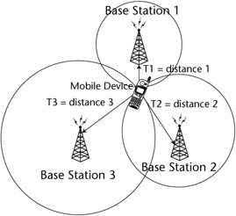
Bluetooth Beacons
Most beacons perform the same basic function: sending out BLE advertisements
Part of the BLE Advertisement is a value called the RSSI (Received Signal Strength Indicator)
RSSI can converted to a distance
This distance is only an approximation, not always accurate
With three distance approximations, trilateration can be used to approximate the location of the user in two-dimensional space
Trilateration Example

Slide 8
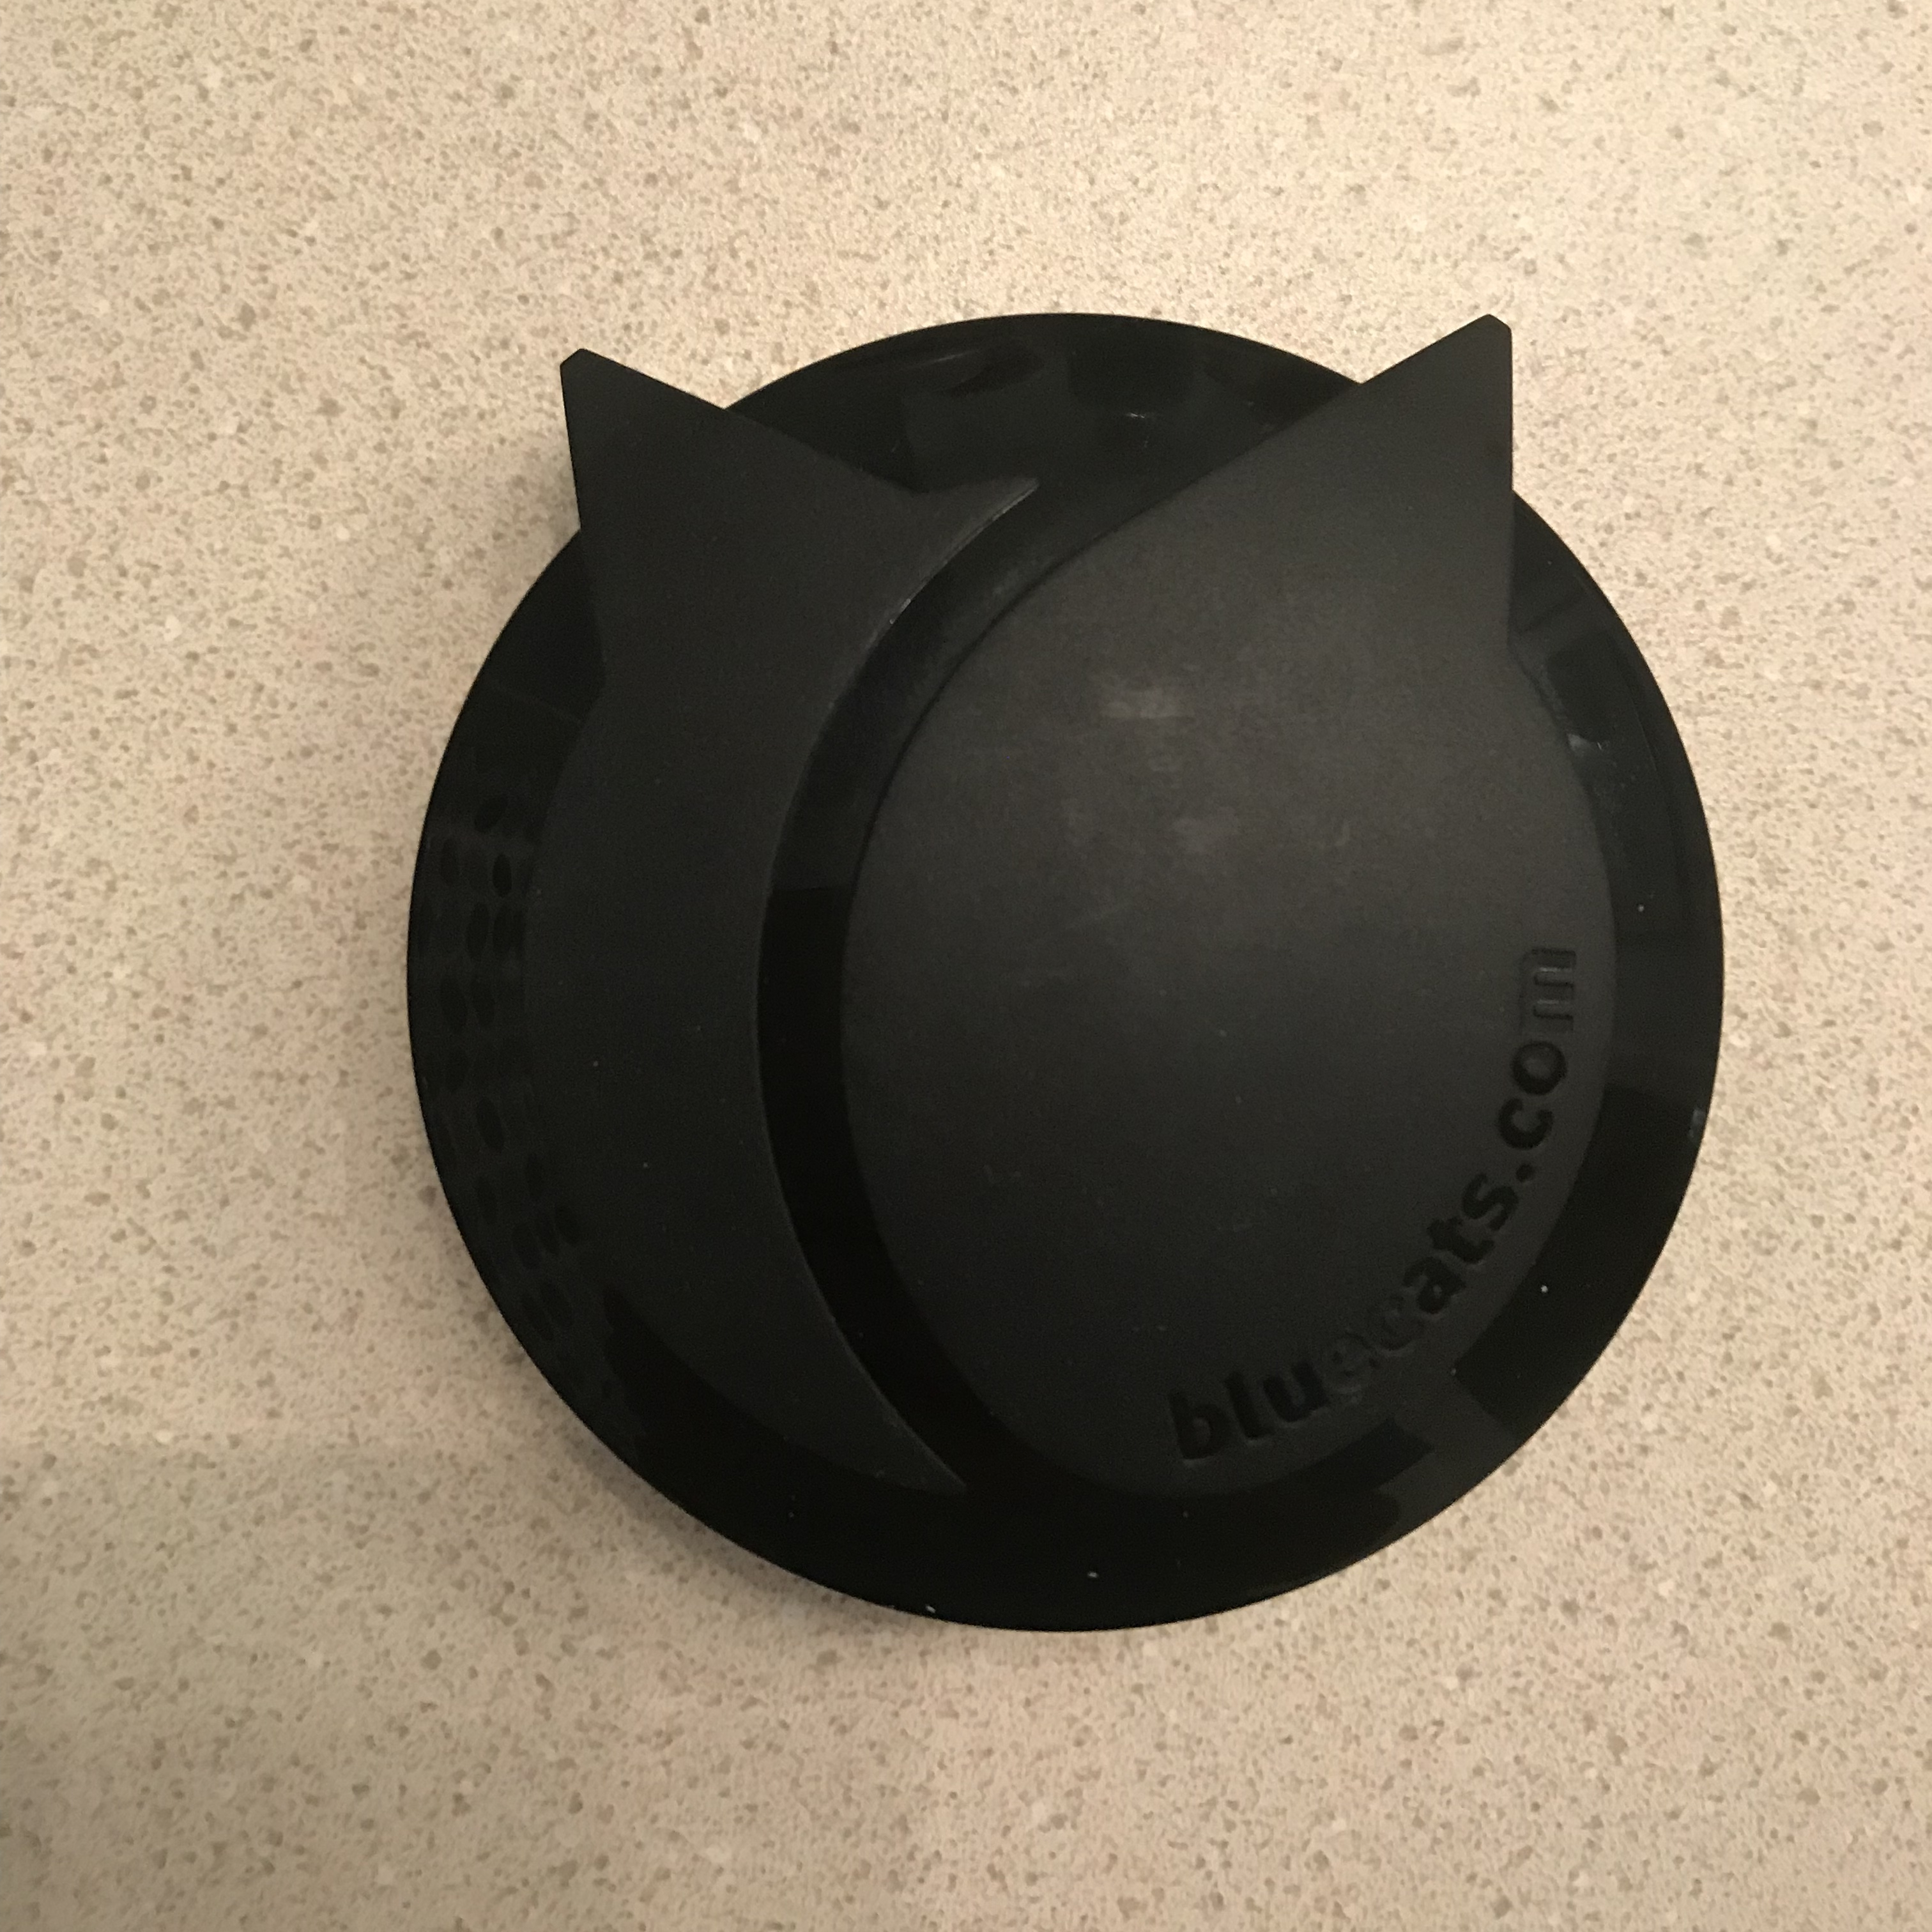
BlueCats AA Beacons
Powered by standard AA batteries
Supports Bluetooth 4.0+
100m Range for normal operation
Supports both Eddystone and iBeacon protocols
Chosen mostly for their low cost
$30 each
76mm
76mm

Slide 9
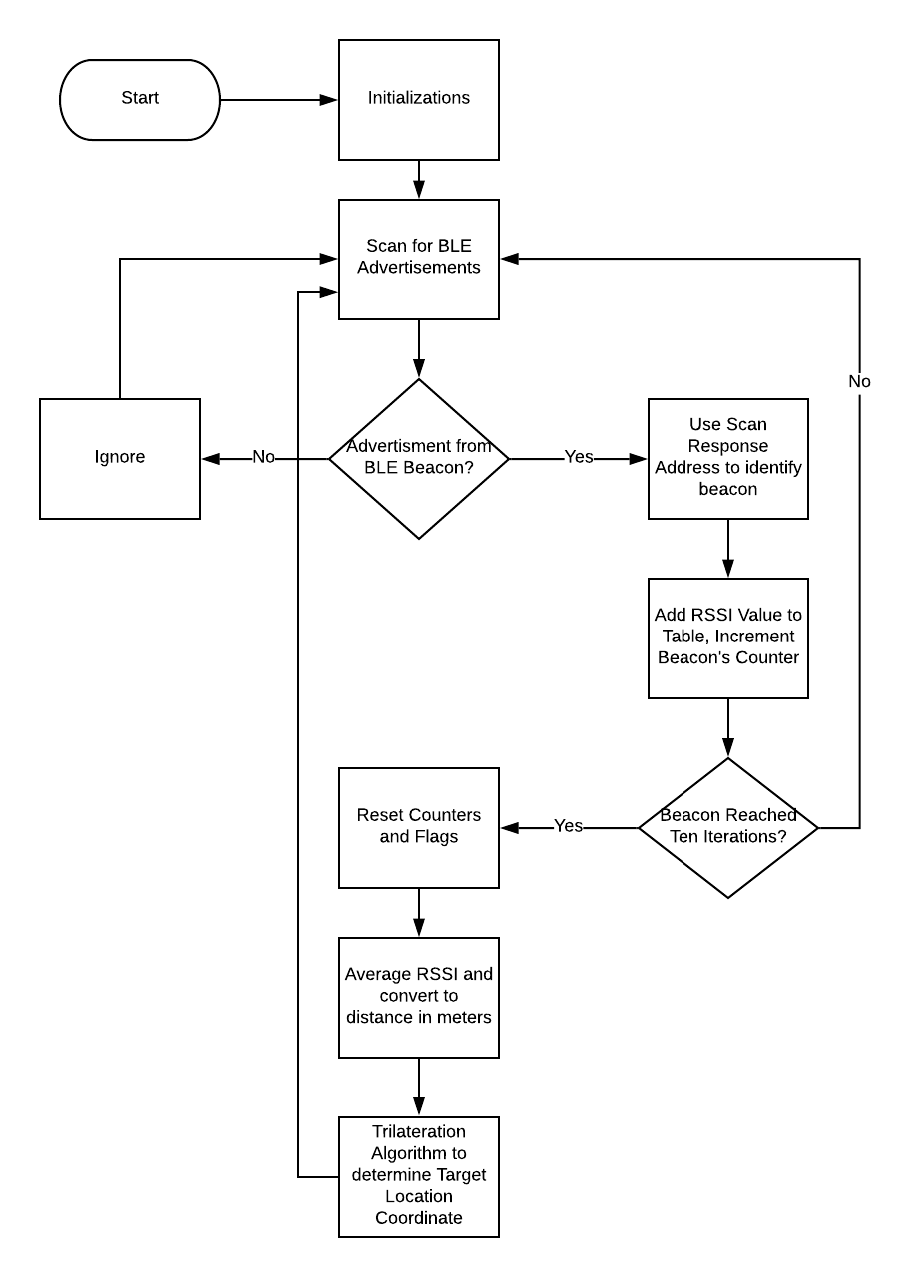
RTLS Software
Upon powering up, the MCU scans for all BLE advertisements within range
Filters advertisements based on known beacon's Bluetooth addresses
Reads RSSI until it has 5 RSSI values from each beacon
Averages RSSI and converts to distance
Uses trilateration algorithm with 3 known beacon locations and 3 measured distances to approximate the user's location
Beacon's location coordinates are hard-coded into the software
Resets and continues infinitely

Slide 10
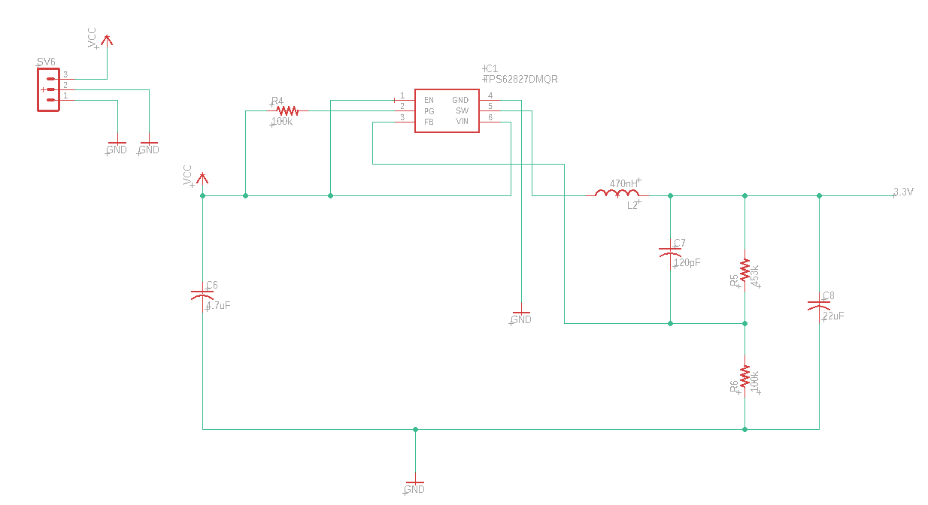
Schematic: DC/DC Converter
DC/DC Converter
Battery Vcc
Output: 3.3V to all circuit elements

Slide 11
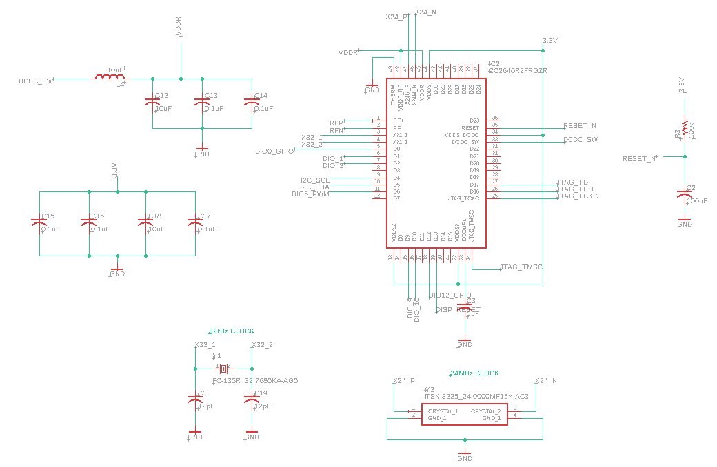
Schematic: MCU
MCU: CC2640R2FRGZR
Decoupling Capacitors
Crystal Oscillators

Slide 12
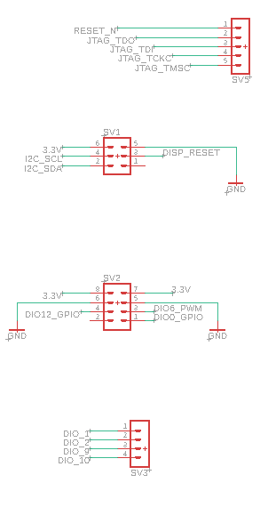
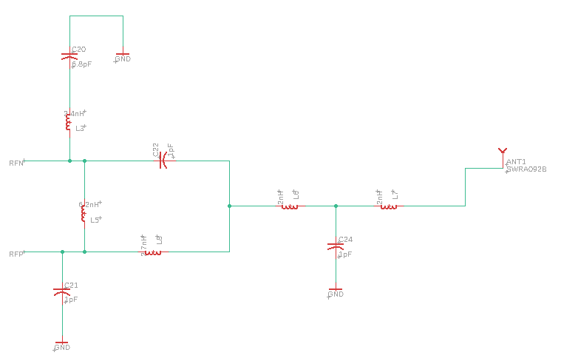
Schematic: Connections
BLE Antenna Connection
JTAG to program MCU
Display Pins
IR/LED Pins
Extra Pins for robustness and future additions

Slide 13
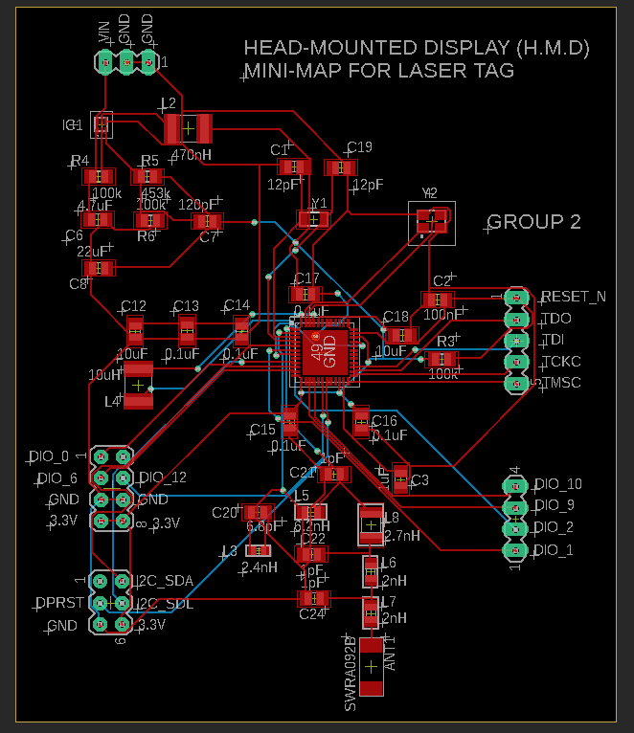
PCB Design
71mm
DC/DC Converter
JTAG
MCU
85mm
Peripheral Connections
Extra GPIO
BLE Antenna

Slide 14
Prototype Housing
Prototype consists of 3 peripherals that required housing
"Lazer" Transmitter
"Lazer" Receiver & Central Unit
HMD
To manufacture these housings, we made use of 3D printing, preexisting harness systems.

Slide 15
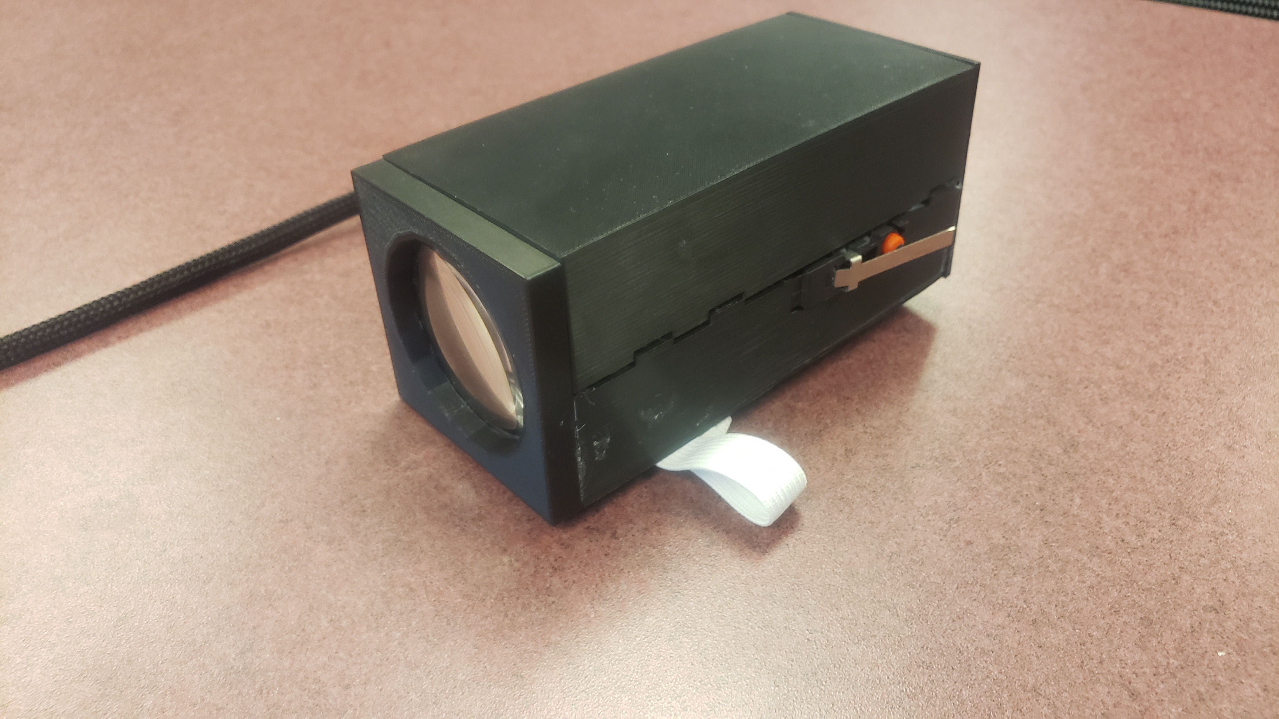
"Lazer" Housing
Arm-mounting inspired by campus gun restrictions
Tethered to the MCU
Wraps around arm with elastic bands
Components made by 3D printing with PLA filament
Button switch incorporated into transmitter box

Slide 16
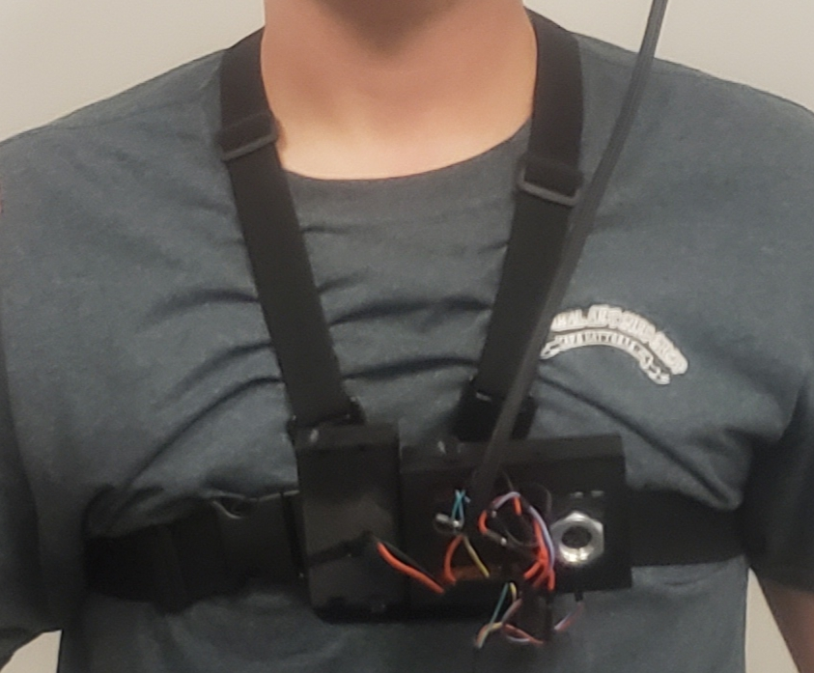
Receiver Housing
Main hub for the prototype
House MCU, "lazer" receiver, and power supply
Made with 3d printed components
Utilizes chest strap for GoPro cameras

Slide 17
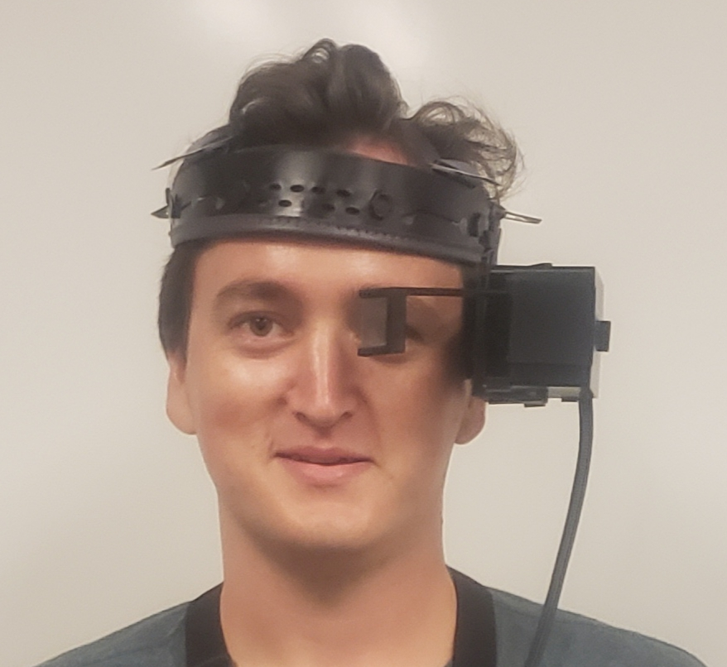
HMD Housing
Most complicated housing
House display, and optical system
Tethered to MCU
Utilizes replacement skull guard insert for a hard hat

Slide 18
Game Design
Each prototype keeps track of it’s own cooldown, life count, and location within the playing field.
Our game follows a “last man standing” model, where each player begins the game with 5 lives.
Once a player has lost all 5 of their lives, their peripheral is disabled and they are out of the game.

Slide 19
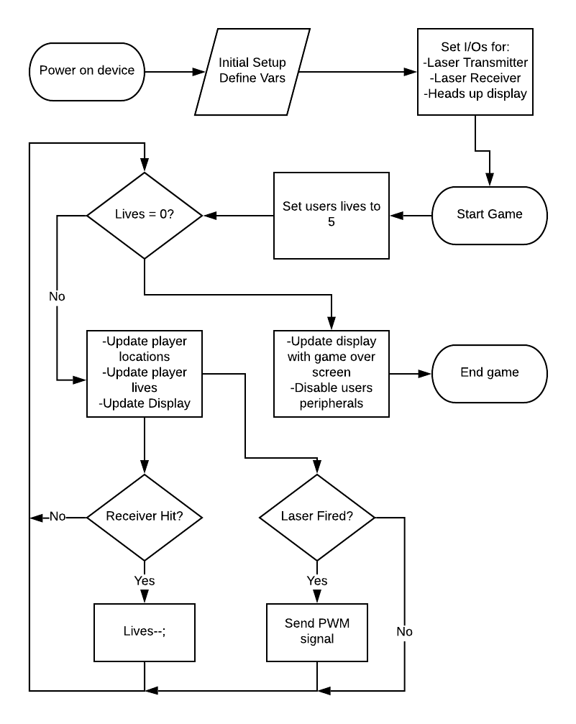
Game Design Flowchart

Slide 20
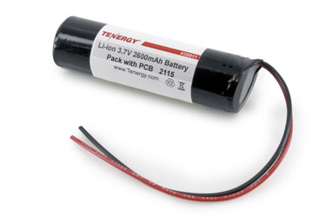
Power Supply
Due to it’s superior power density ratio, our project uses rechargeable lithium-ion batteries.
Each prototype uses two 3.7V batteries connected in parallel to increase our overall battery life.
Tenergy Li-Ion 3.7V 2600mAh rechargeable Batteries

Slide 21
"Lazer" Emitter System Overview
2 arm-mounted IR transmitters (Player 1 and Player 2)
Differentiated by address codes
IR LEDs modulated at 38 kHz following NEC Protocol
Chest-mounted IR receivers
LED Driver
Circuit
LED
IR
Receiver
Optic
μC
μC
Switch

Slide 22
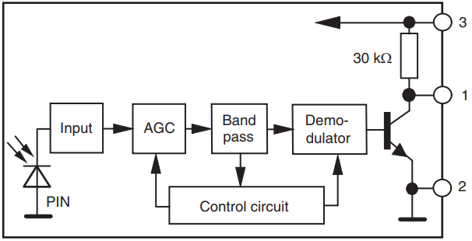
IR Receiver
TSOP34438 Receiver
Includes AGC, 38 kHz bandpass filter, and demodulator
Minimizes effects of background illumination
Ideal for outdoor applications and indoor applications with lights on
High horizontal directivity of ±45˚ limited to smaller acceptance cone by a NIR-reflective aperture
Parameter | Value
Input Current | 0.27-0.45 mA
Input Voltage | 2.5-5.5 V
Output Voltage Low | <100 mV

Slide 23
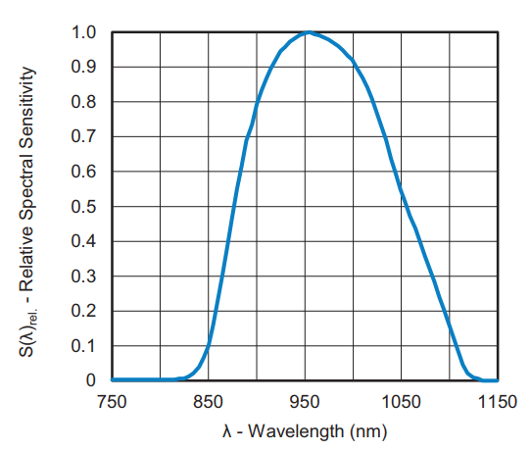
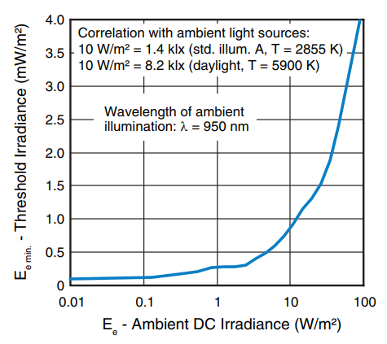
Receiver Sensitivities
950 nm wavelength of max sensitivity
1 mW/m² minimum irradiance needed in bright sunlight

Slide 24
IR Transmitter
TSAL6100 IR LED
Laser diode considered, but not chosen due to difficulty to aim at long range and need for more optics (cylindrical lenses, beam expanders)
940 nm peak wavelength
Angle of half intensity φ=±10˚
Turned on by pulse signal modulated at 38 kHz
Parameter | Value
Radiant Intensity | 1.35-1.6 V (at I_{F}=100 mA, t_{p}=20 ms) 2.2-3 V (at I_{F}=1 A, t_{p}=100μs)
Radiant Power | 40 mW (at I_{F}=100 mA, t_{p}=20 ms)
Rise Time | 15 ns
Fall Time | 15 ns

Slide 25
Focusing Optic Selection
Light focused for long range play with a lens
Choice made between spheric and aspheric lenses
Aspheric optics offer reduced aberration and improved collimation
Spheric optics are less expensive and smaller than aspherics at similar focal lengths
To maximize optical throughput, a lens with NA greater than 0.174 was chosen
This number was derived from the NA = sin(φ) approximation
Large focal length to minimize divergence
Selected a plano convex lens
Parameter | Value
Numerical Aperture | 0.25
Focal Length | 100 mm
Diameter | 50 mm

Slide 26
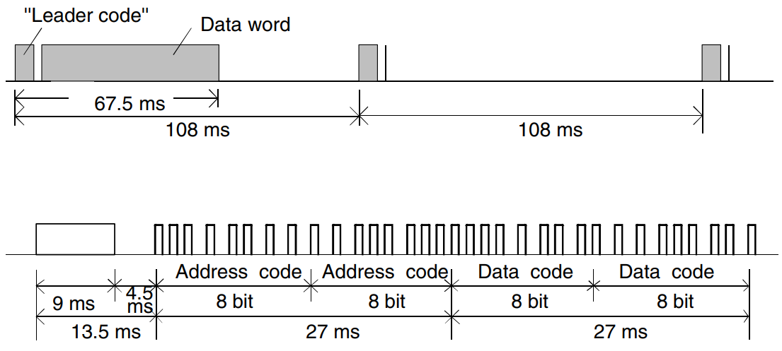
Pulse Signal Generation
NEC IR Transmission protocol industry standard used as a guideline
A 108 ms signal is generated
0 and 1 differentiated by pulse distance
Leader, address, and command codes
Our application only sends 1 command, so only an address code was needed

Slide 27
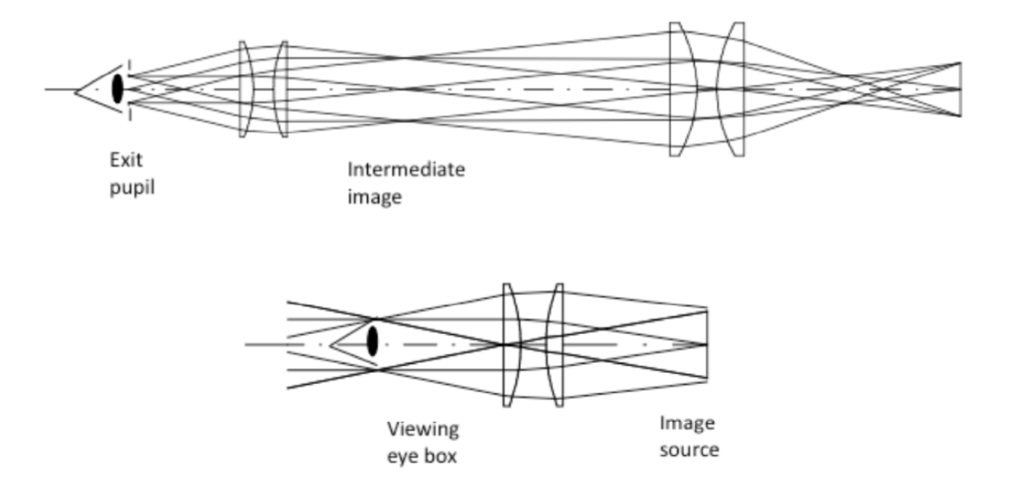
Mixed Reality Basics
Combines Digital and Real Space
Productivity Enhance
Conventional Optics
Pupil Forming
Intermediate Images
Exit Pupil at the Eye
Non-Pupil Forming
Image Formation at Infinity
Direct Scaling of Optical Elements
Kress, Bernard, and Meimei Shin. “Diffractive and Holographic Optics as Optical Combiners in Head Mounted Displays.” Proceedings of the 2013 ACM Conference Pervasive & Ubiquitous Computing Adjunct Publication, Sept. 2013, p. 1479.

Slide 28
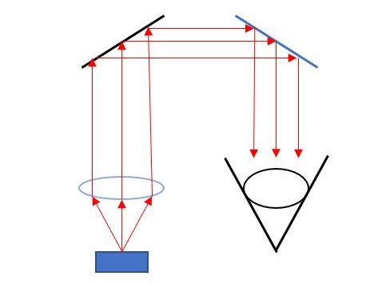
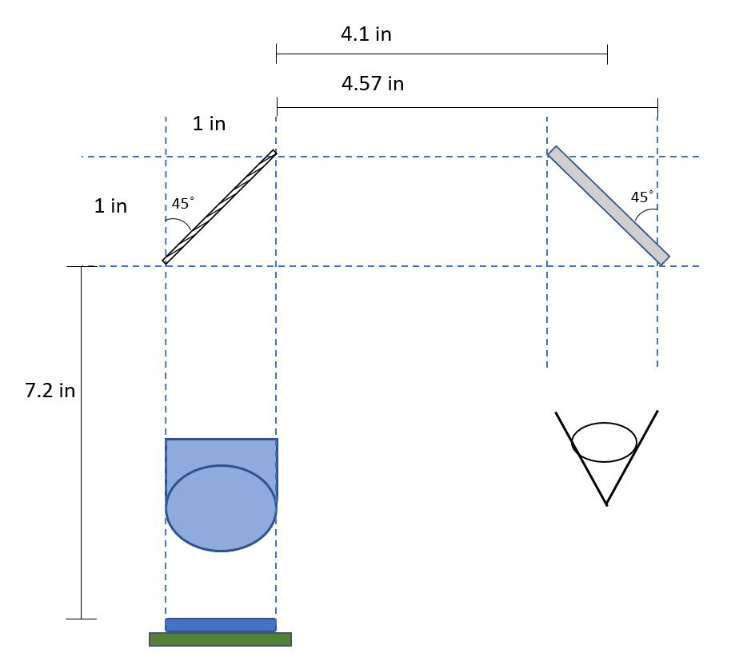
Lens System
Non-Pupil Forming
Plano Convex Lens
Focus at Display for Collimation
Focus image at Infinity
Flat Mirror
Beam splitter
Positioning changed slighty in the development process

Slide 29
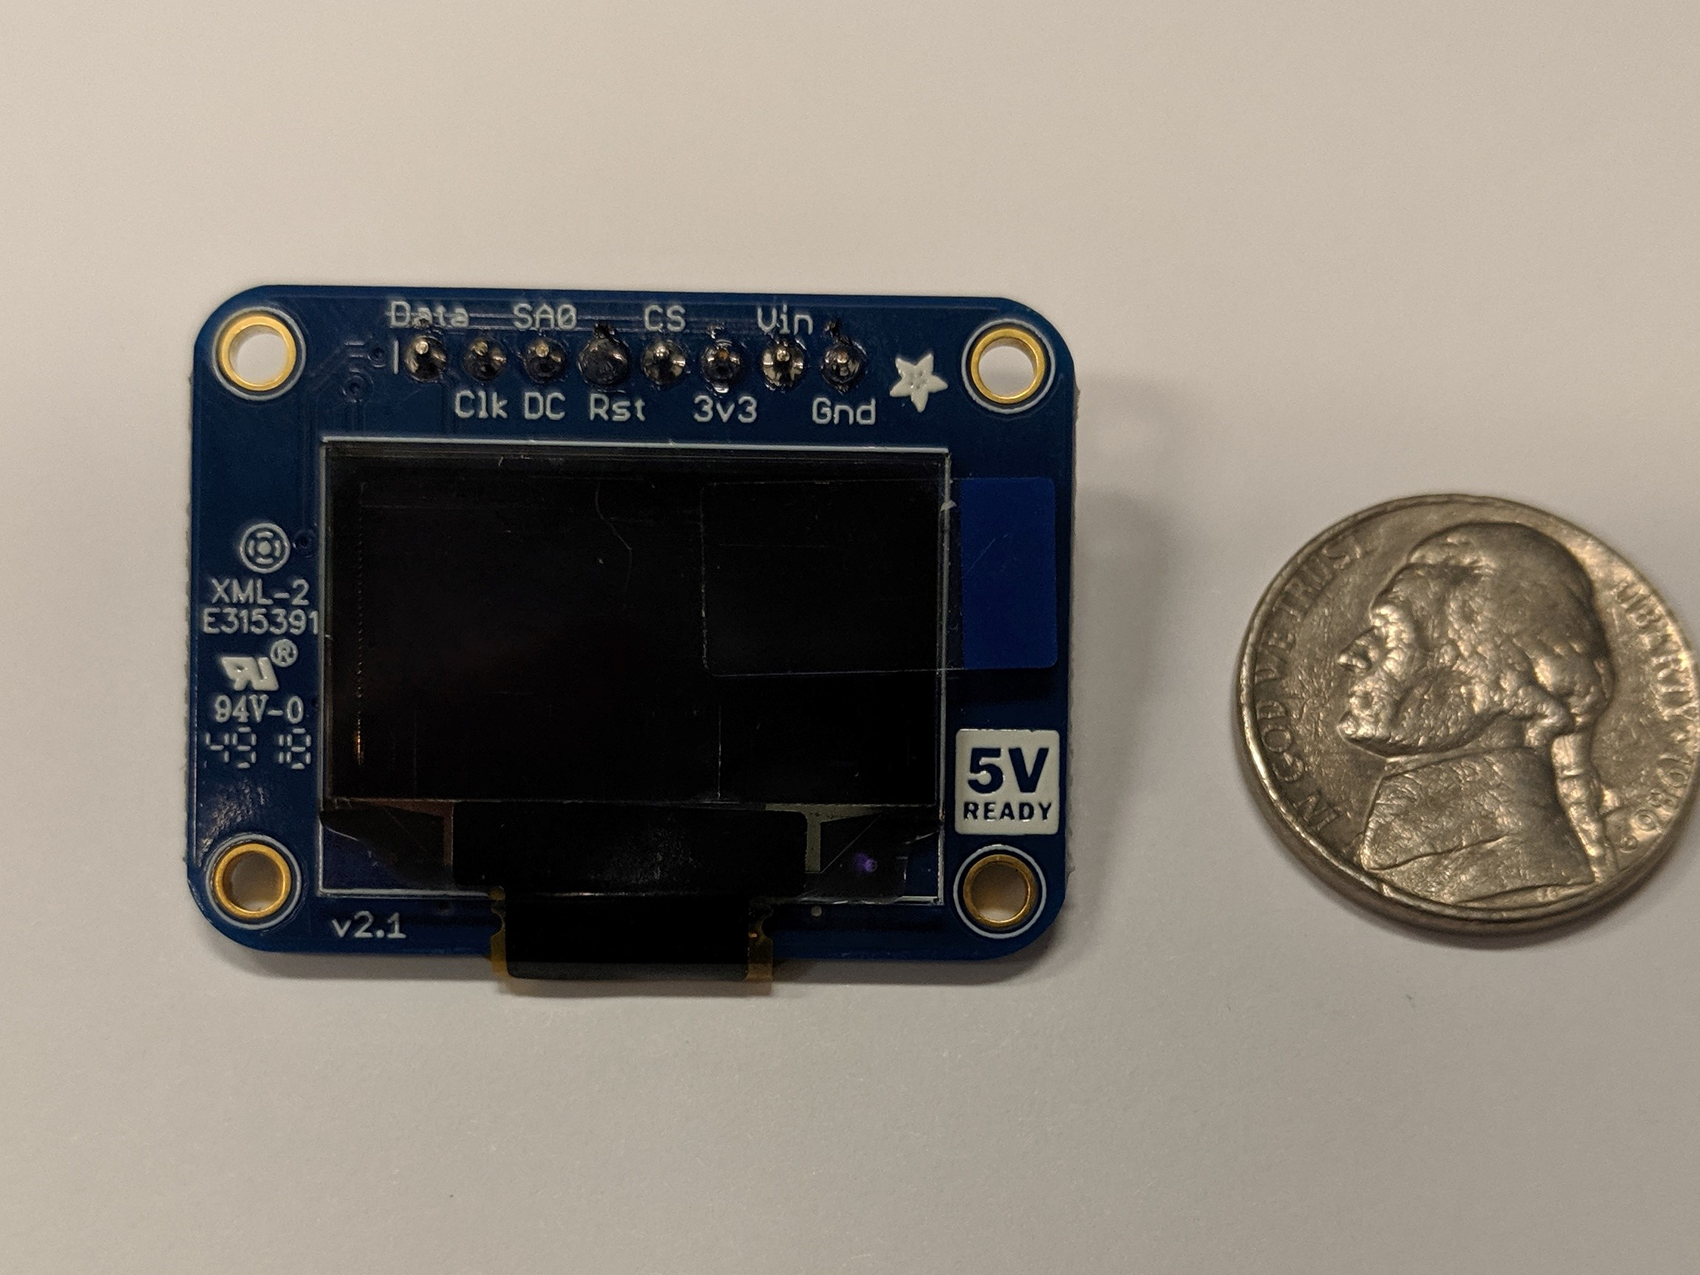
Display Source
OLED
Small and cost effective
Luminance Contrast Biggest concern for Source
Adafruit 0.96” OLED Breakout Board
128 x 64 Pixels
I2C data scheme for accessibility

Slide 30
Display Source Software
Operates on a 1024 byte buffer
Uses I2C for communicating with MCU
No available drivers were available for our TI MCU
Adapted C++ drivers intended for Arduino boards to C drivers, using necessary TI APIs to achieve compatibility
Display uses I2C to either receiver commands, such as “invert display” or “turn on display”, as well as write data commands to manipulate the data displayed on the OLED.

Slide 31
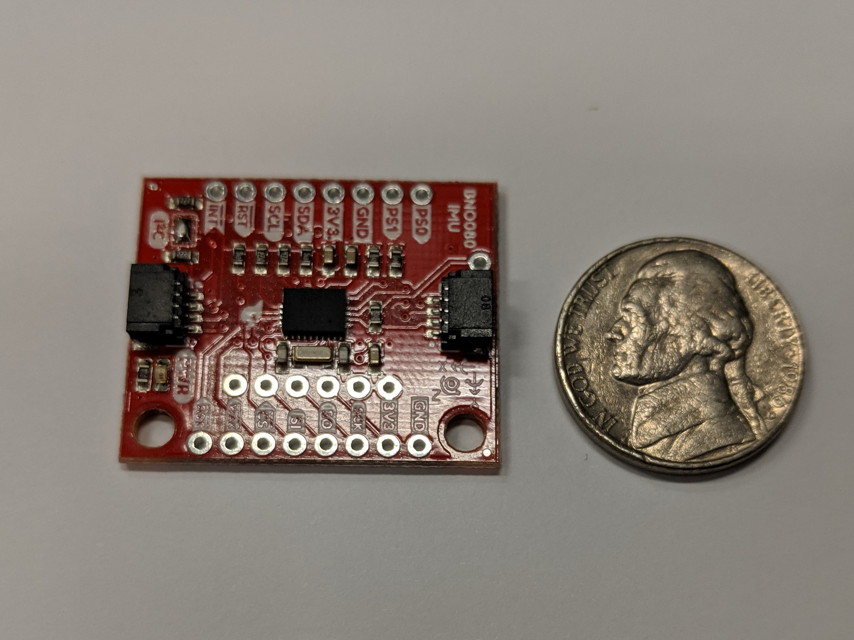
Future Features
Orientation System
Utilizes BNO080 Inertial Measurement Unit
3 Axis Gyroscope, Accelerometer, Magnetometer
Wireless Connectivity
Relay position and game data

Slide 32
Project Cost
Single Unit Cost
Item Type | Cost
HUD Optics | $200
PCB & PCB Components | $400
Power Supply | $40
Housing | $100
“Lazer” Tag Optics | $100
Bluetooth Beacons | $90
Gyroscope | $50
Display Source | $80
Miscellaneous | $140
Total | $1200
Item Type | Cost
HUD Optics | $100
PCB & PCB Components | $30
Power Supply | $15
Housing | $25
“Lazer” Tag Optics | $50
Bluetooth Beacons | $90
Display Source | $35
Total | $345

Slide 33
Work Distribution
Name | Power | IR Transmitter | IR Receiver | Game | RTLS | Display | Mixed Reality Optics | PCB | Housing
Aaron |  |  |  | 2 | 1 |  |  | 1
Bailey |  | 1 | 1 |  |  |  |  |  | 1
Nick |  |  |  |  |  | 2 | 1 |  | 1
Patrick | 1 | 2 | 2 | 1 |  | 1 |  |  | 2
1 – Primary
2 – Secondary

Slide 34
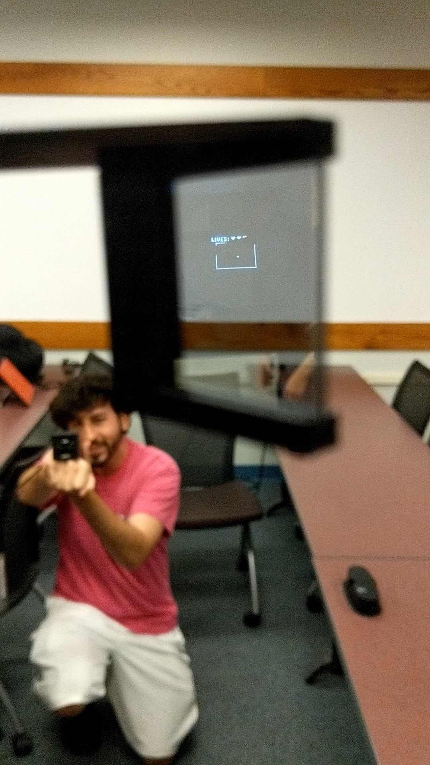
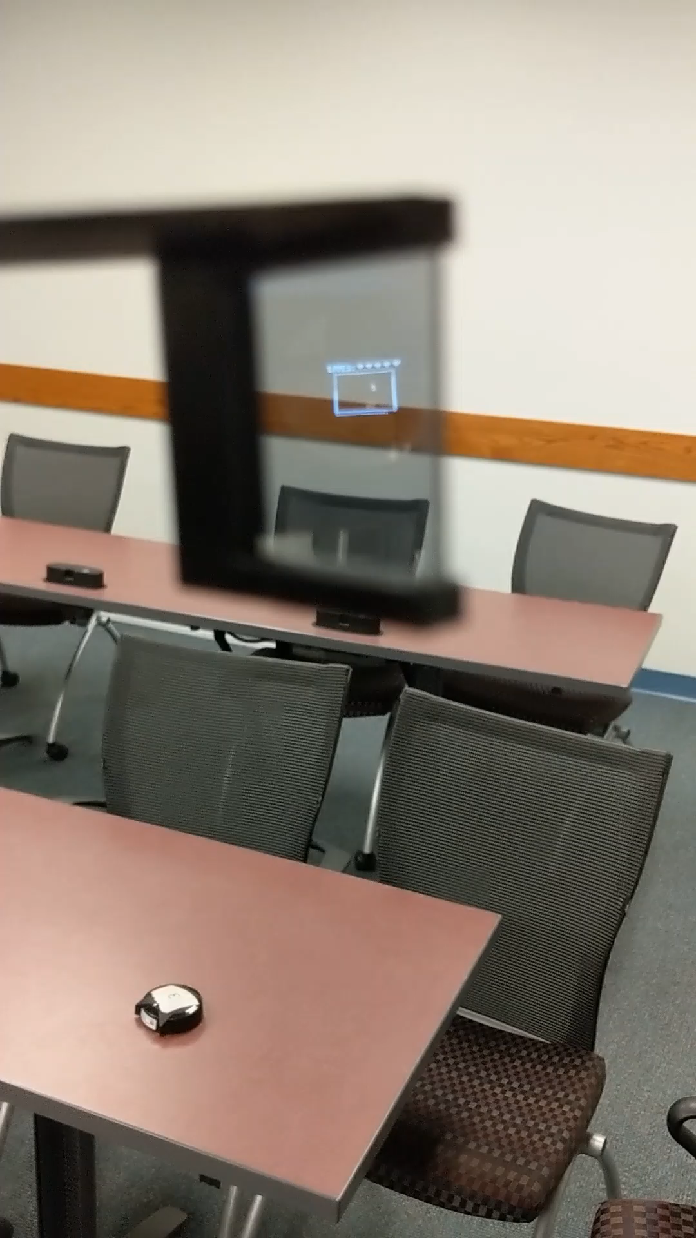
HMD
Heart Reduction
Location Changes

Slide 35
Questions?

