Slide 1

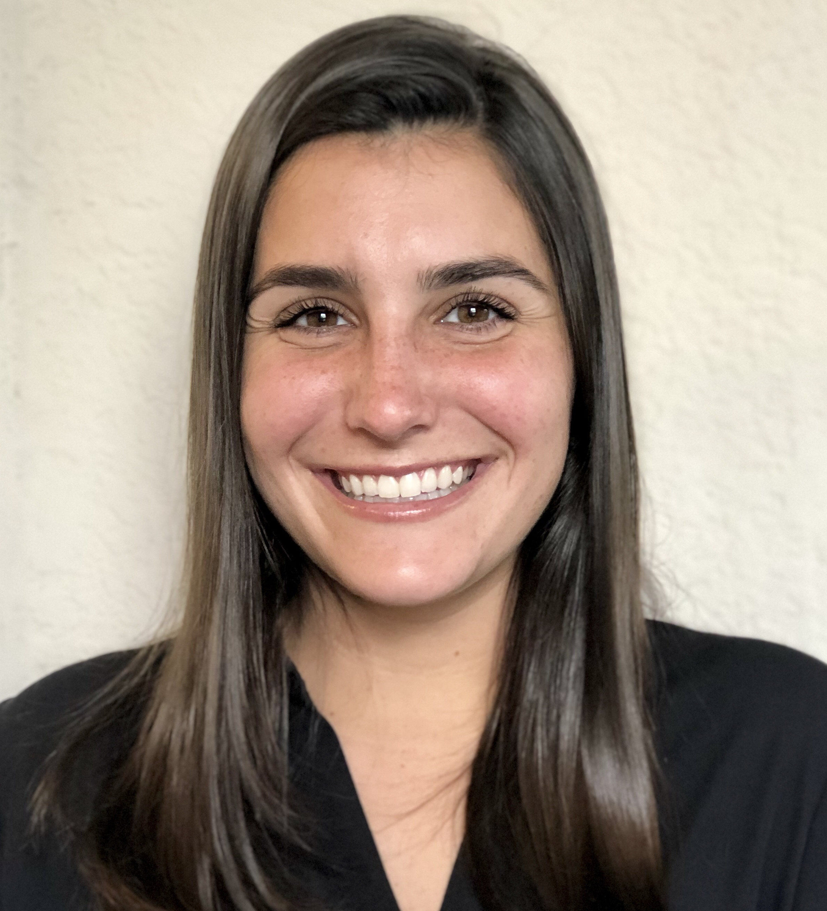
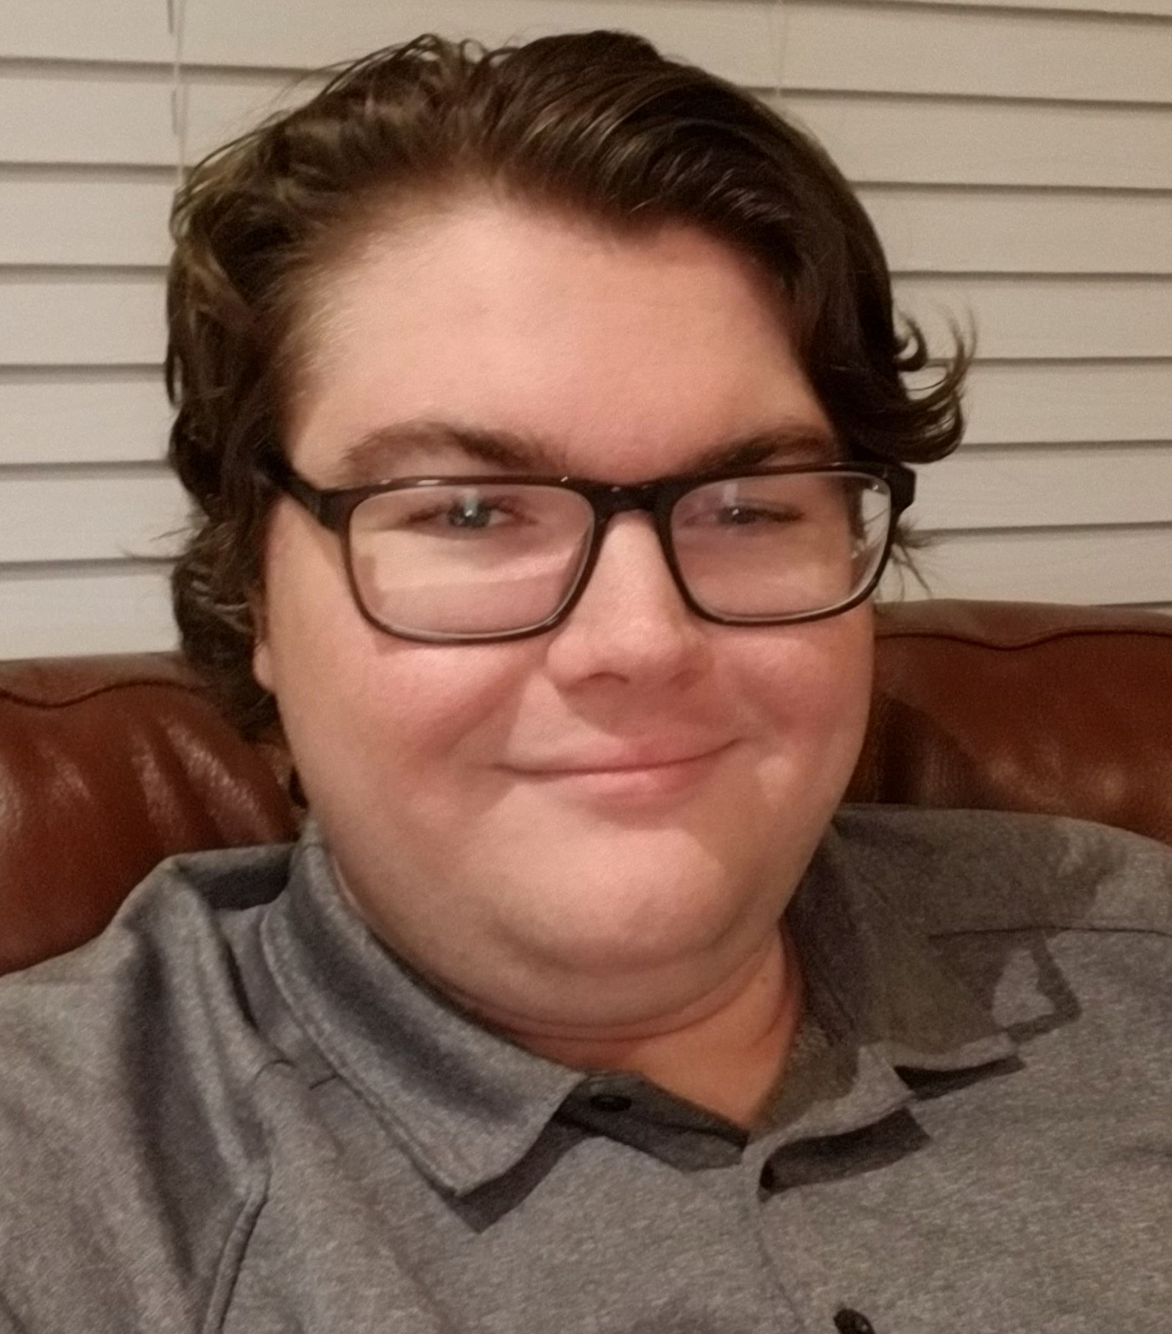




Raman Spectroscopy Using a Concatenated Laser System to Detect Water Content in Fuel
Group 1
RSCL
CDR
Yaelle Olivier (PSE) Tyler Morris (CPE) Austin Collins (CPE)
Sponsored by:
Summer 2021
Senior Design 2

Slide 2
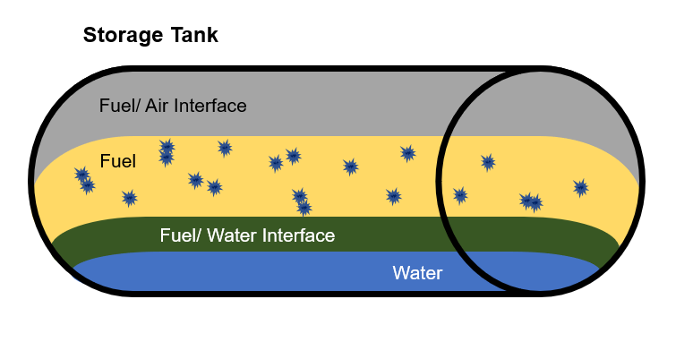
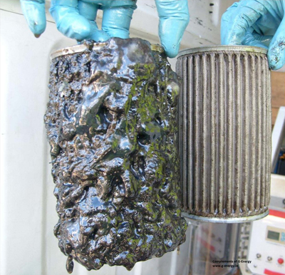
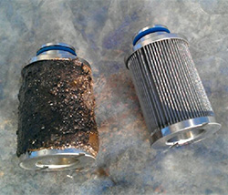
Motivation
Water contamination in fuel is the #1 cause of equipment failure in emergency situations.
  Because the reserve fuel often goes unchecked and is left in storage for too long creating a space for water contamination to occur.
Water contamination causes bacterial and microbe growth this turns into sludge
  This microbial sludge will:
    Destroy surface coatings
    Cause corrosion
    Cause clogging of fuel filtration
    Block fuel supply
    Cause malfunctioning fuel gauges
Currently on the market there is no way to quantitatively measure water content in fuel.
  Kits to test for water contamination include
    Chemical reactions
    Time

Slide 3
Goals and Objectives
The best way to prevent and correct water contamination in fuel is to first detect it quickly and accurately.
Accurate and timely quantitative measurements to measure water content in a chemical or fuel.
A safe way to test fuel in a small amount without interaction of other chemicals.
Be easy to use through the user interface with clear information.

Slide 4
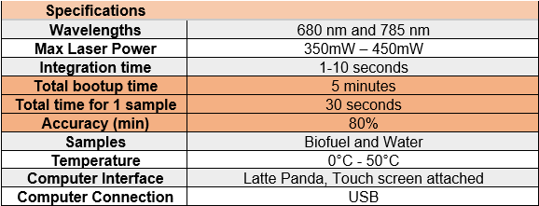
Specifications and Requirements

Slide 5
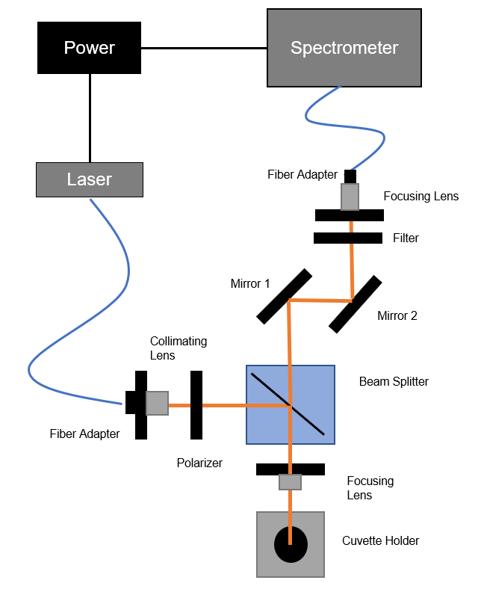
Optical Block Diagram

Slide 6
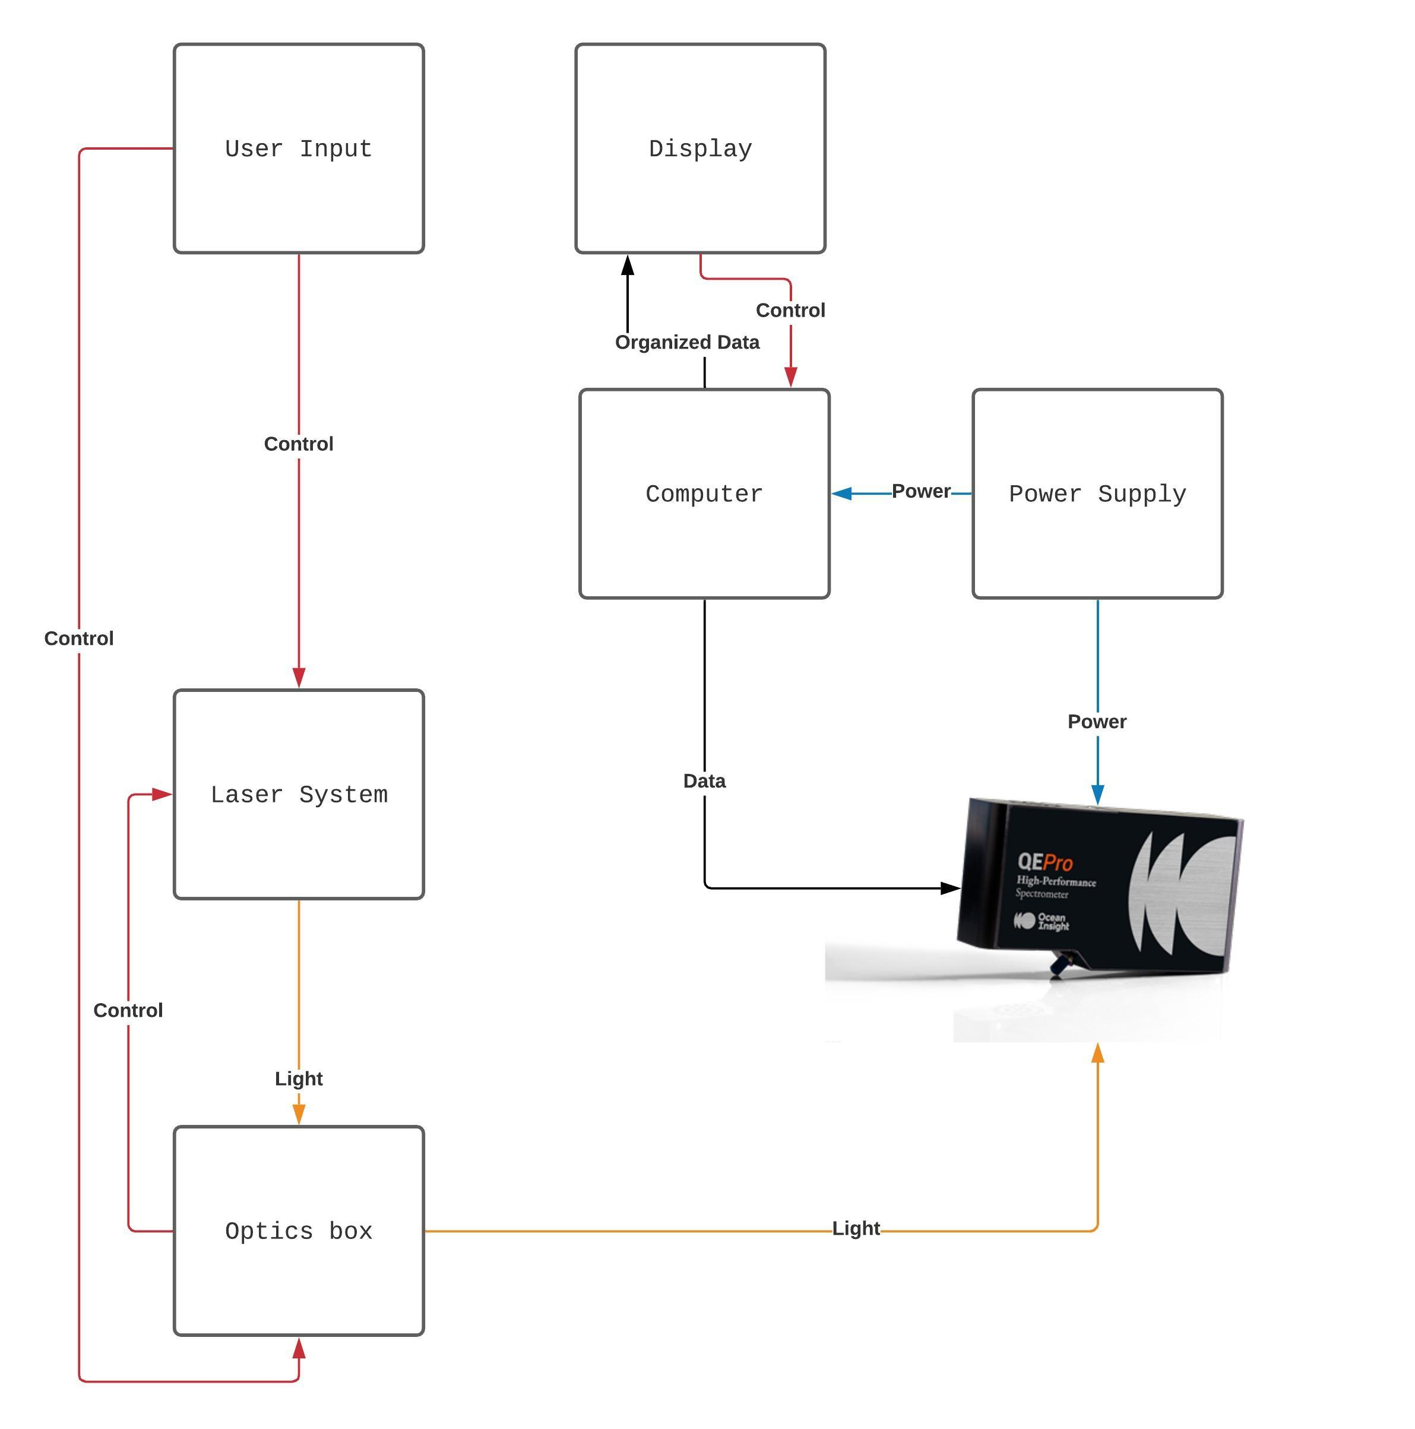
Hardware Diagram

Slide 7
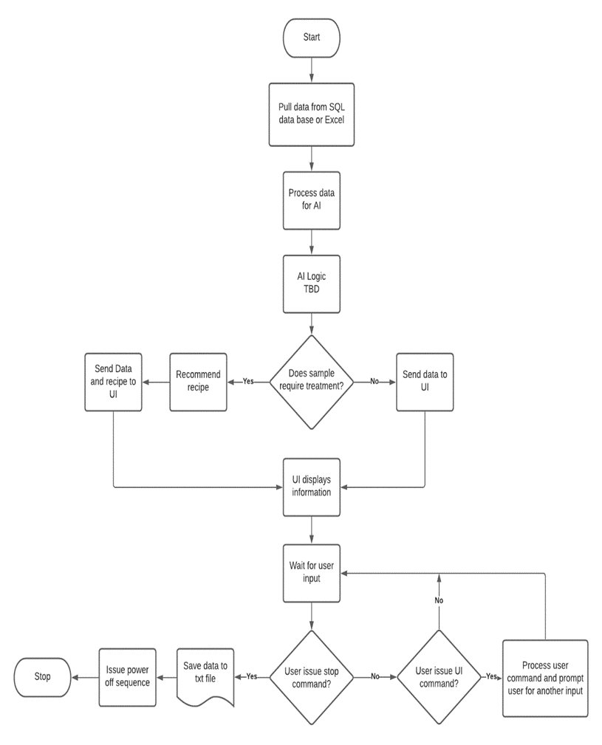
Software Flowchart

Slide 8
A Review on Raman Spectroscopy
Raman spectroscopy uses scattering when light passes through a sample
  The photon will physically scatter the molecule causing an energy shift and create vibrations.
  In scattering the laser will interact with a molecule and distort the electrons around the nuclei to a virtual state. This is what we measure.
  Raman is advantageous because there is minimal preparation, and it provides a fingerprint for each sample.
  It is also nondestructive to the sample
  Usually for finding chemicals in water, here we want to find water content in chemicals.

Slide 9
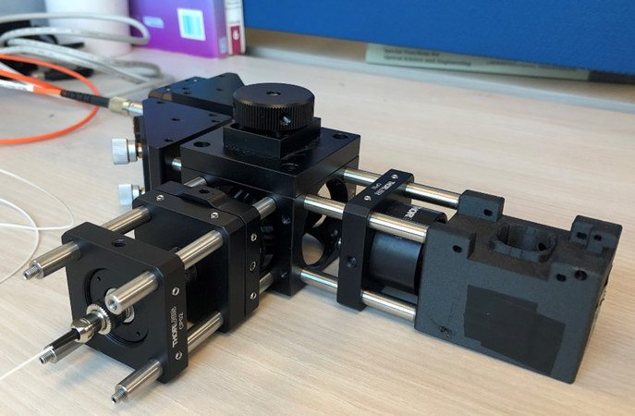
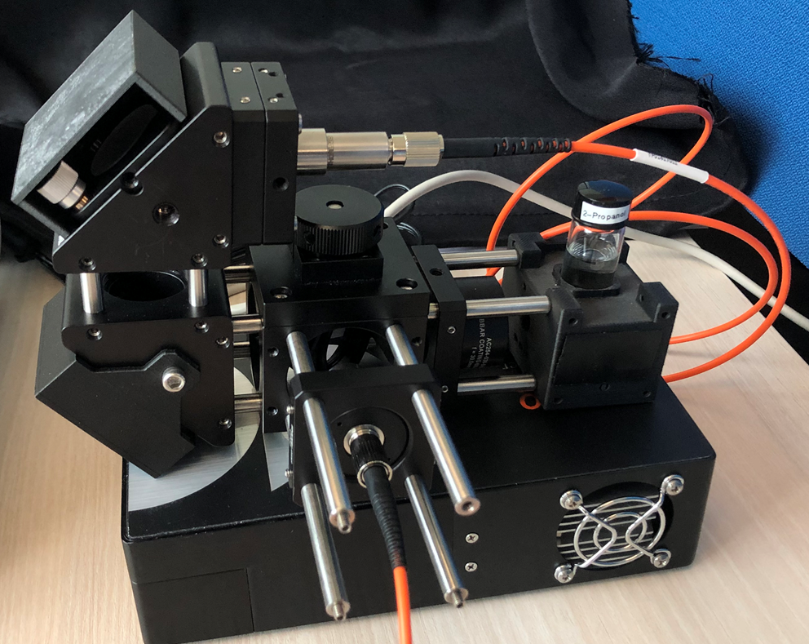
Optical System Design
Original design
Re-design
Was too wide, not suitable for the system to be as compact as possible.
Now the base fits mostly on the spectrometer, it is more compact. Here we just flipped the mirrors to go vertically and turned the vial holder around.

Slide 10
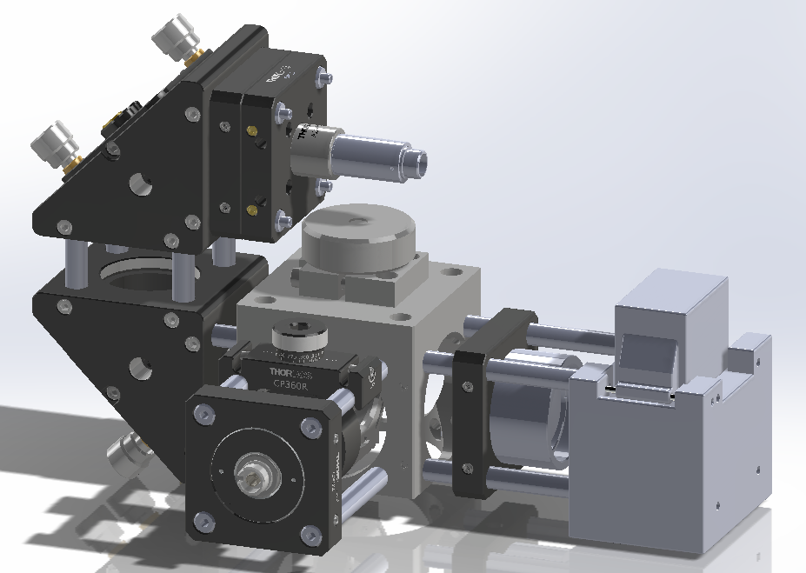
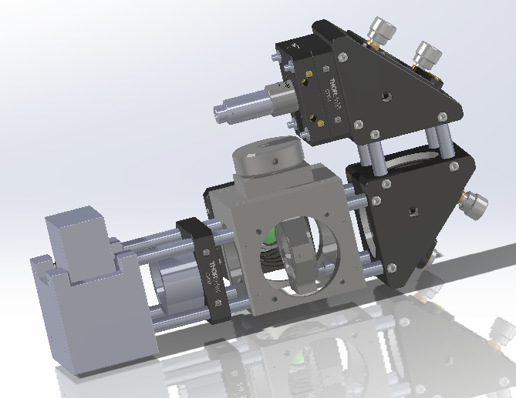
Optical System Design
Back (laser in view)
Front (Where touch screen will be)
Spectrometer Connection
Laser In
Vial Holder

Slide 11
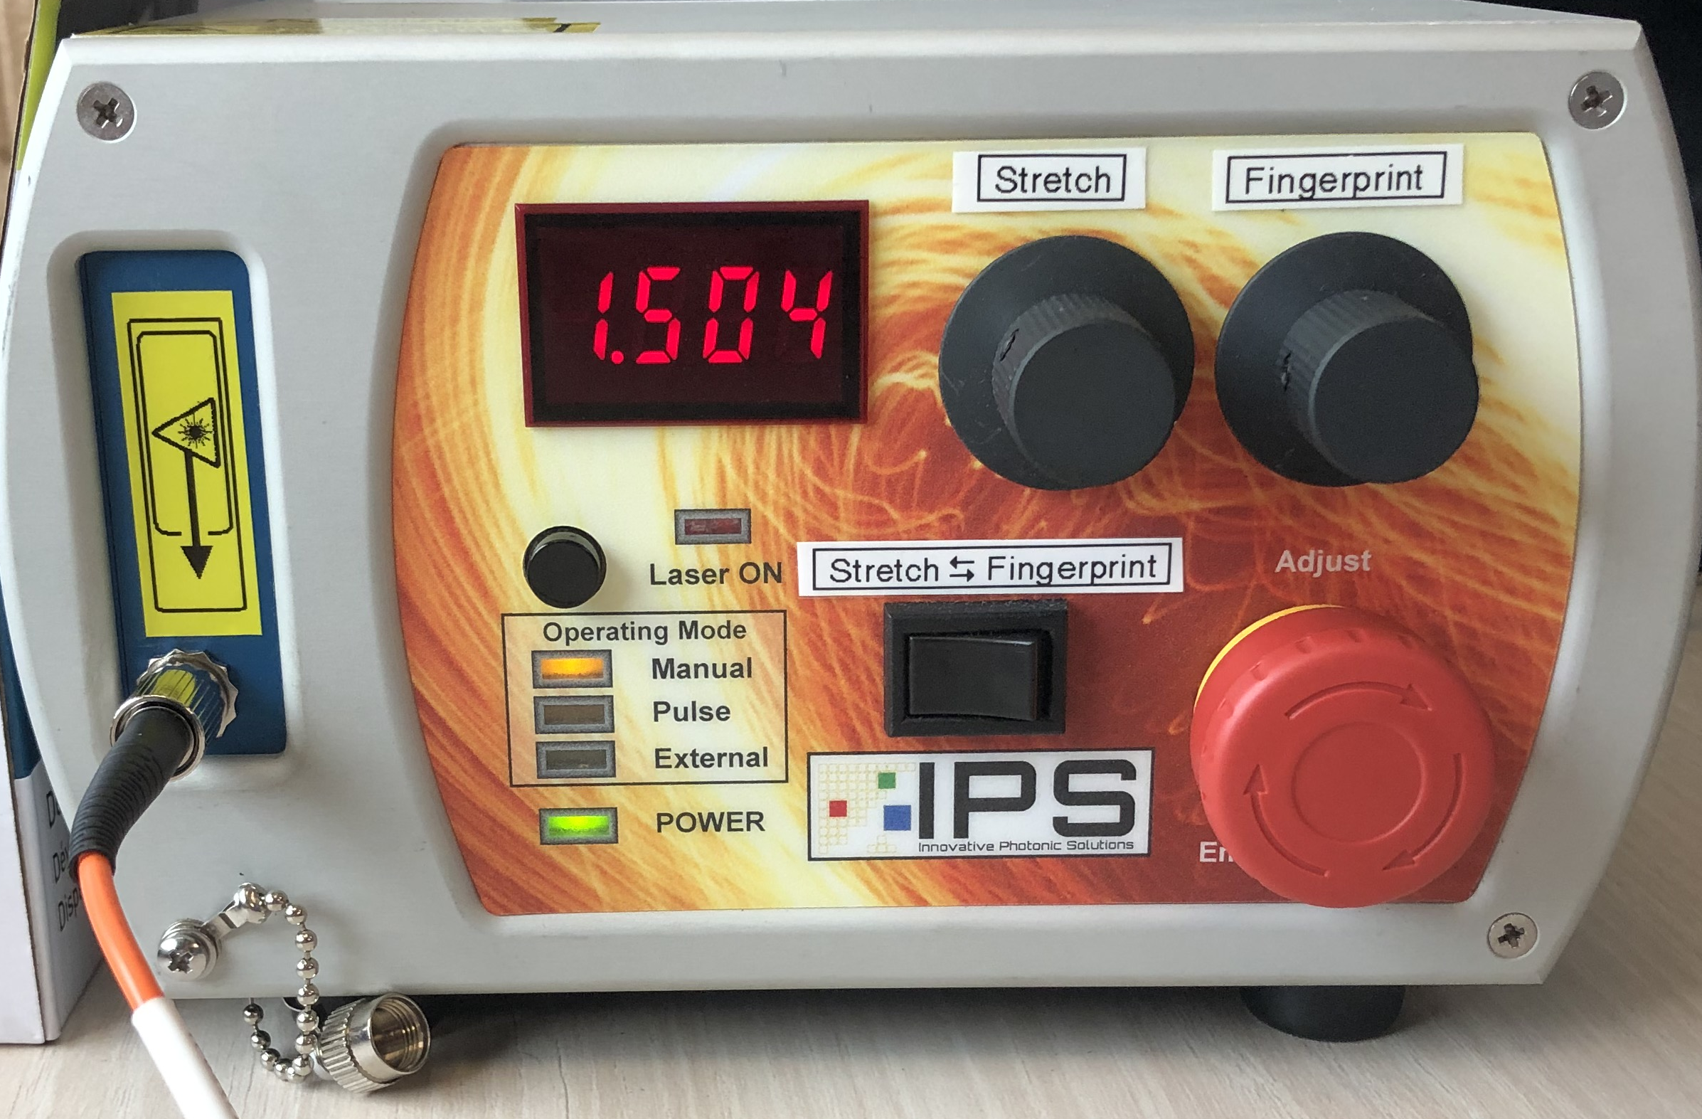
Dual Wavelength Laser
This laser provided by IPS is dual wavelength allowing us to easily switch between 680 nm (Stretch) and 785 nm (Fingerprint). With up to 500 mW power.
It is a manual switch however if we were to buy this laser for actual manufacturing of the RSCL we would request for the laser to be controlled through USB and through the GUI.
To take the data we first take a spectrum of the sample when the laser is set to stretch, without moving the vial we switch the laser to fingerprint and take the data from that spectrum to concatenate later.

Slide 12
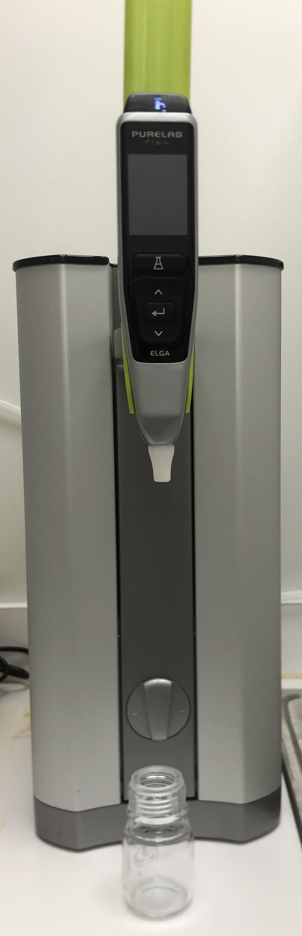
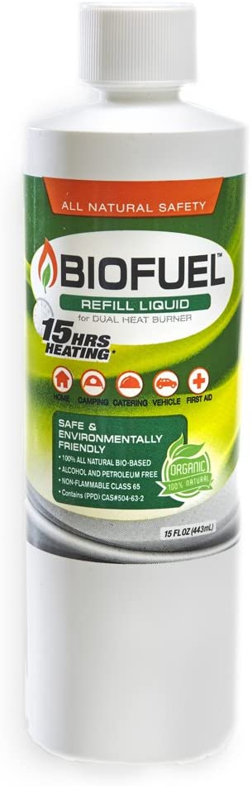
Data collected – Biofuel
We are setting up our system without the 785 nm short pass cutoff filter for now as we wait for it to be sent by Semrock. This just causes saturation around the 785 nm mark.
We started testing both wavelengths with Biofuel and water. Biofuel is water soluble therefore making it easier to be affected by water contamination. For these measurements mixed the biofuel and water in vials at each percent:
The water used to contaminate the biofuel is ultra filtered, purified water from a Pure Lab flex system.
  100% Biofuel
  87.5% Biofuel – 12.5% Water
    (7 ml biofuel, 1 ml water)
  75% Biofuel – 25% Water
    (6 ml biofuel, 2 ml water)
  62.5% Biofuel – 37.5% Water
    (5 ml biofuel, 3 ml water)
  50% Biofuel – 50% Water
    (4 ml biofuel, 4 ml water)
  100% Water
** The 785nm (fingerprint) data is taken at a 2 sec integration time while the 680 nm (stretch) is taken at a 1 sec integration time.

Slide 13
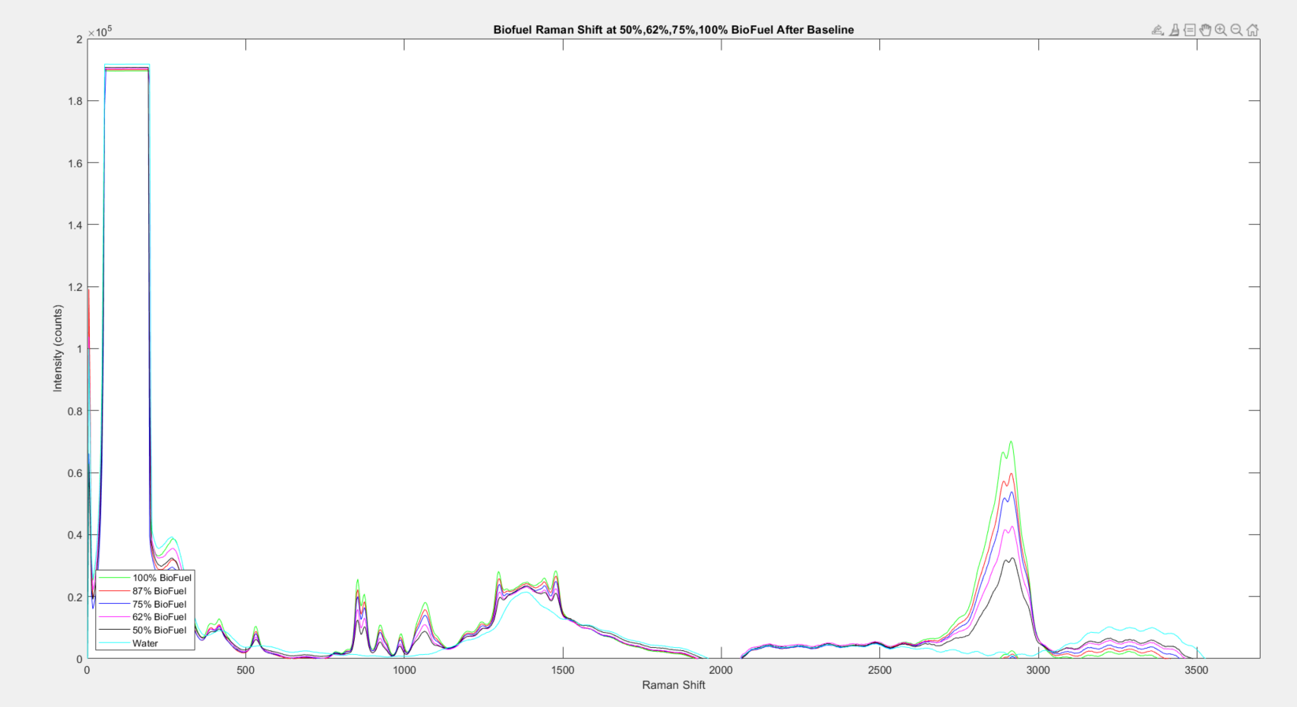
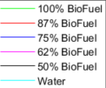
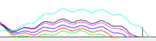
Data collected - Biofuel
Water Peaks
Fingerprint
Stretch

Slide 14
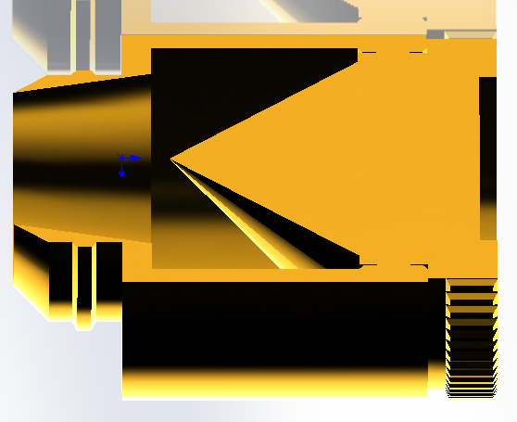
New Vial Holder Creation
Problem 1:
Problem 2:
In the data we can see quite a bit of etaloning. This is due to the vials I was using.
Solution:
  We got new vials, however they are much smaller, so I needed to redesign and reprint a 3D vial holder for the system.
The laser is so high powered, when focused onto the vial it started to burn a hold in the material behind the sample
Solution:
  We are buying a beam dump to attach behind the vial for safety.

Slide 15
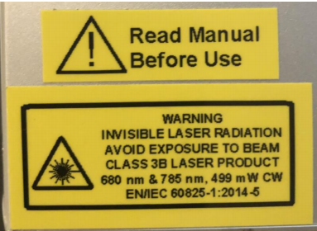
Design Constraints and Standards - Optical
The biggest constraint optically is the safety of the laser system. We are using a class 3B high powered laser.
  Where beam hazards are potential injury to the eye and potential injury to the skin. Non-Beam hazards include electrocution, fire, exposure to air contaminants, hazardous gases, laser dyes, and solvents. To avoid these hazards, they have implied that these lasers must be in protective housing, warning signs, and label requirements.
  We will solve this by using a cap for the vial holder that is connected to an interlock circuit to shut the laser down if the cap is open.
  Standards
  According to the FDA standard d 21 CFR 1040.10 and 1040.11) “requires a warning label on Class IIIa and IIIb products. Class IIIb products must also have a key switch and connector for remote interlock. The products are also required to have identified and certifying labels and instructions for safe use.”

Slide 16
Current Progress – Optical
Physical Cage system and alignment – 90%
Samples – 70%
Building outer shell to hold optical cage – 20%

Slide 17

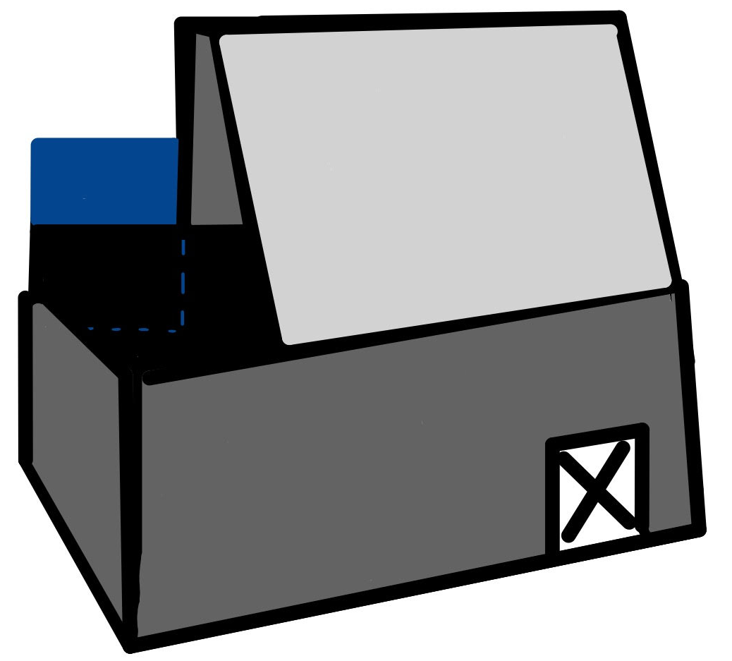
Immediate Plans - Optical
Immediate plan for the next month includes:
  Receiving new filter and beam dump to add to the system
  Gather and test biodiesel samples
  Create an outer shell for the optical cage

Slide 18
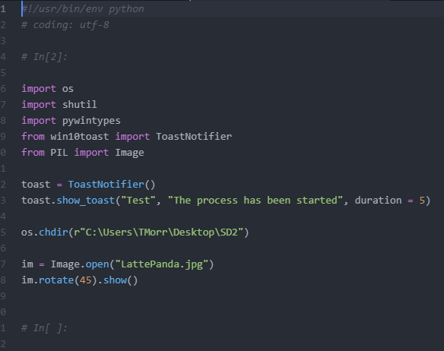
Automation
•Streamline coding process to have program as simple as possible, both for the user and for the designer
•Limit the necessary interactions with the computer (i.e. required inputs from the User)
•Make the program do all background tasks, needing no user intervention (power on, save data, collect data, process data, start GUI)

Slide 19
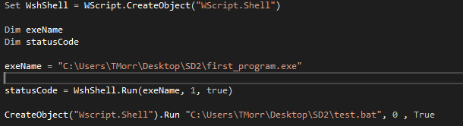
Automation Progress
•Can begin process on start up using a combination of Visual Basic, Batch Scripts, Registry editing, and Python.
•Can save and process data into a usable format (CSV)
•Can plot and display data.

Slide 20
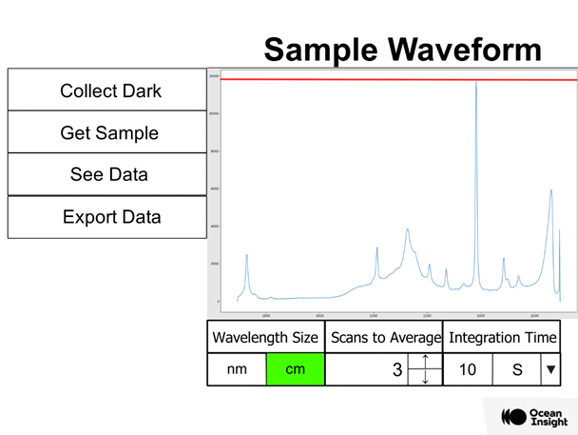
Graphical User Interface
•Want to create a simple user interface, both to reduce design complexity and reduce user confusion
•Want to present data in a palatable and informative way
•Want to design with a graphical design studio with layering abilities
•Convert layers into separate images in order to use them with Python GUI design capabilities

Slide 21
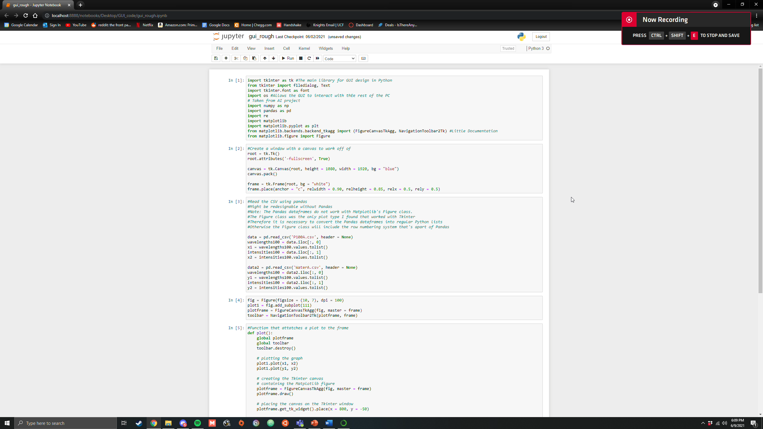
Graphical User Interface

Slide 22
Algorithm Goals
The end goal of the algorithm is to determine the amount of water contamination in fuel
This will take a total of four data sets from the driver portion of the software design. One set will be a dark measurement, and will be used to find a theoretical zero for the rest of our data. The next two will be our control samples, 100% water and 100% fuel. The fourth will be the experimental test which will be an unknown combination of water and fuel.
Based on these four data sets, the algorithm will be able to say with fair confidence what the percentage of water contamination is.

Slide 23
Design Constraints and Standards - Software
  Safety
  Security
  Reliability
  Maintainability
  Portability

Slide 24
Significant Design Decisions (SW)
Decision to move from C++ to C# for the driver software – Internally at the sponsor company more support and professional help is available for C#. C# while being unfamiliar to the designer was easy to transfer due to the similarities of C++ and Java.
Move focus upon beginning the project from a bottom - up to a top – down view. The initial design plan was to create the algorithm to take data, and build a GUI, automation, and determine the drivers around it. However upon taking this route, it became quickly apparent that it will be easier to complete the desired objective by working from the end goal backwards.

Slide 25
Current Progress - Software
Three main software categories
  Spectrometer drivers – 75%
  Graphical User Interface – 40%
  Automation and Algorithm – 25%

Slide 26
Immediate Plans - Software
Immediate plans to complete 1within the next 2-3 weeks.
  Finish configuring and implementing drivers in order to move forward with other parts of software design that are relying on it.
  Flesh out UI more, import/redesign more icons and items from the Krita UI rough draft
  Begin work on determining required mathematics involved for the algorithm and determining how to implement it as simply as possible in order to maximize run time efficiency (Big O notation)

Slide 27
Power Supply Requirements
Part | Vin | Current | Total Power
Single Board CPU | 5 V | 2 A | 10 W
Spectrometer | 5 V | 5 A | 25 W

Slide 28
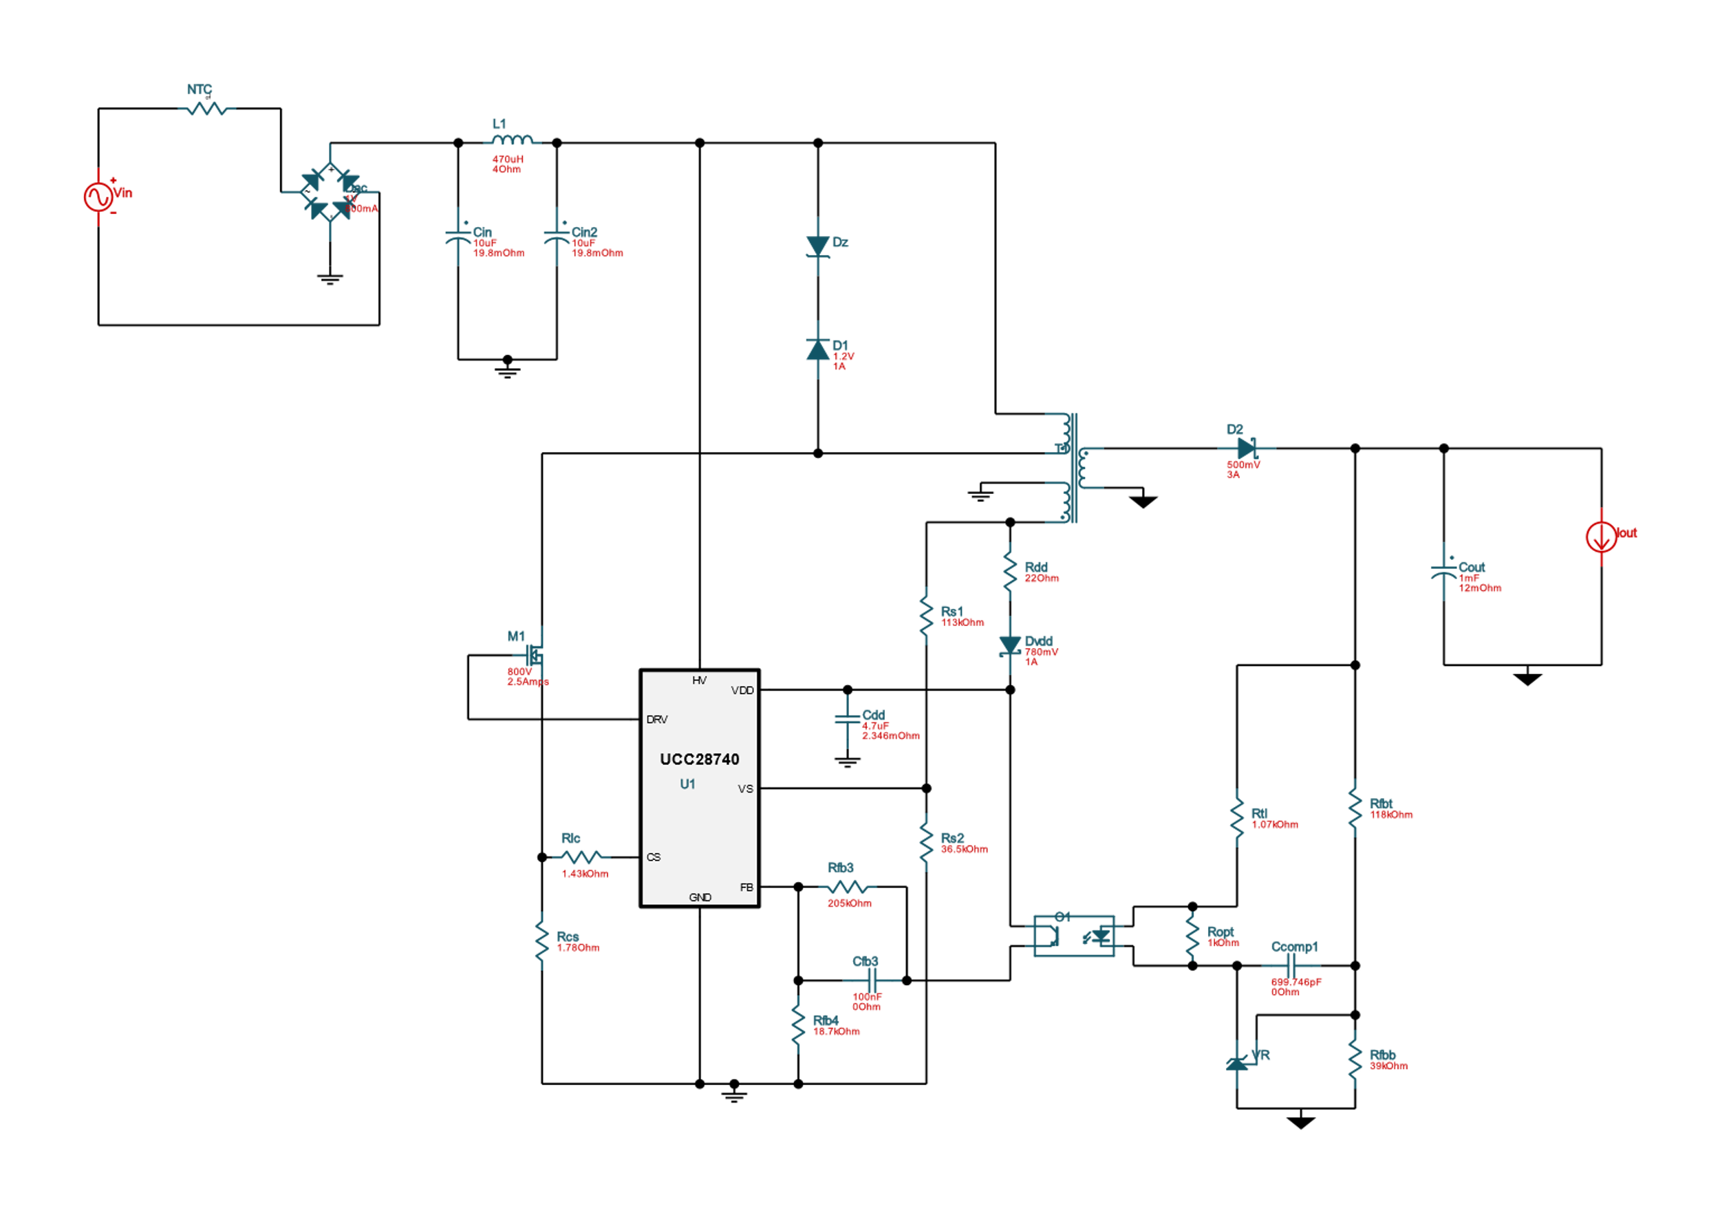
Power Supply Design
The Design for the Single Board CPU Power Supply

Slide 29
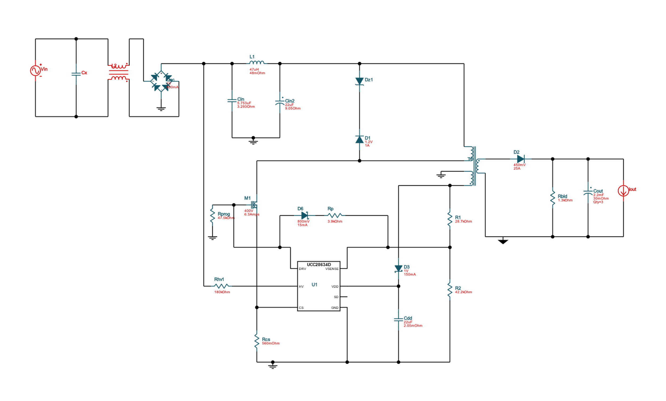
Power Supply Design
The Design for the Spectrometer Power Supply

Slide 30
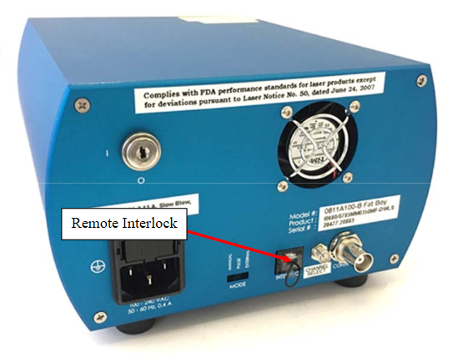
Laser Safety System

Slide 31
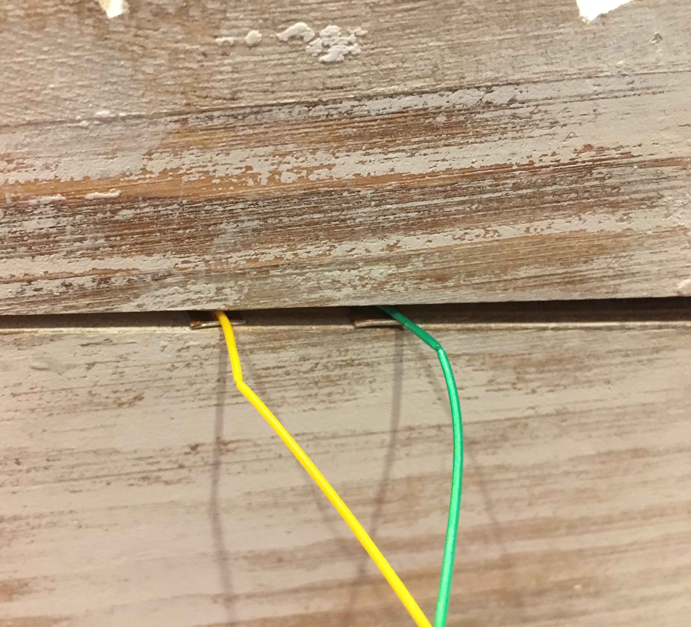
Laser Safety System

Slide 32
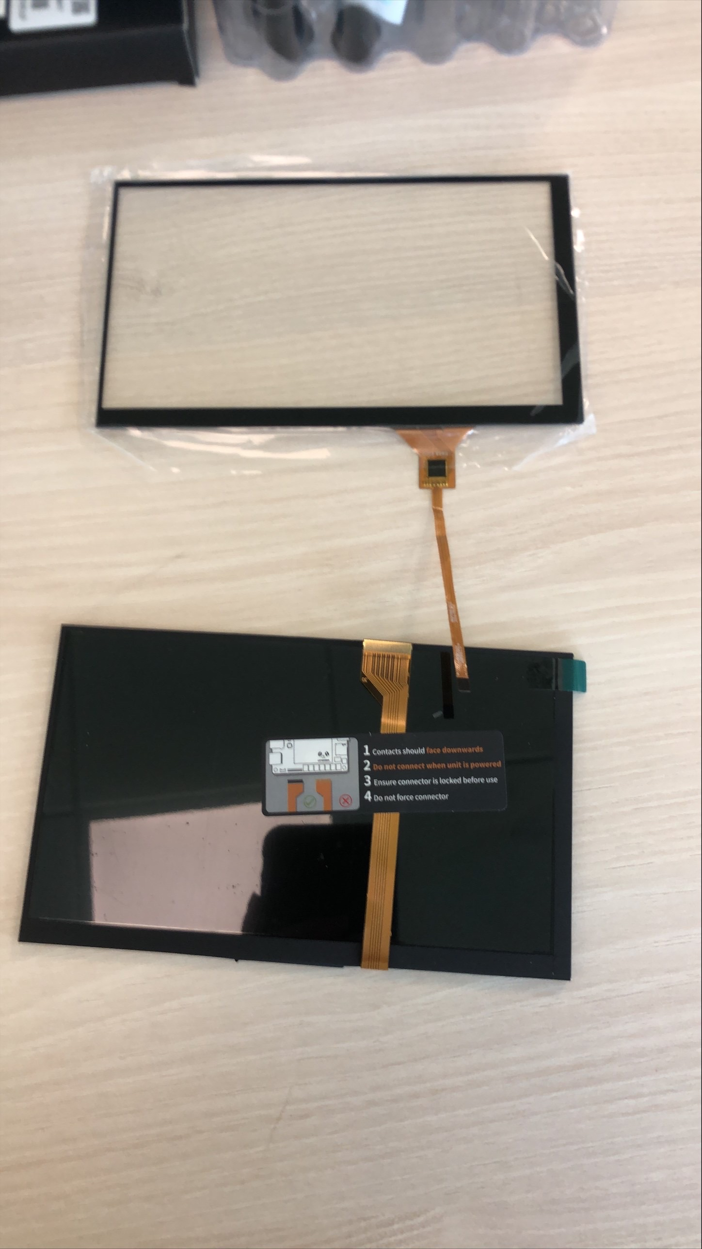
User Interface Components
7" IPS Display
7" Capacitive Touch Panel Overlay

Slide 33

Current Progress – Hardware
There are currently two main Hardware Categories
• Power Supply – 5%
• Laser Safety System – 30%

Slide 34
Immediate Plans - Hardware
To finish 1 of the 2 in the following week
• To make the appropriate changes to the cuvette chamber design in order to fit the copper plates and wiring needed for the laser safety system.
• Make the appropriate adjustment to either of the Power Supply designs to be able to output both power requirements from one pcb.

Slide 35
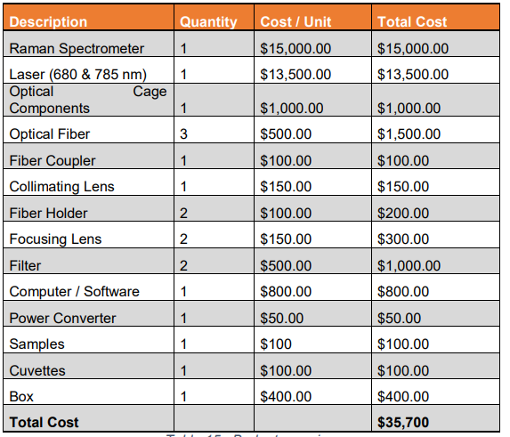
Budget
We can make this happen because of our sponsors Ocean Insight and IPS

