Slide 1

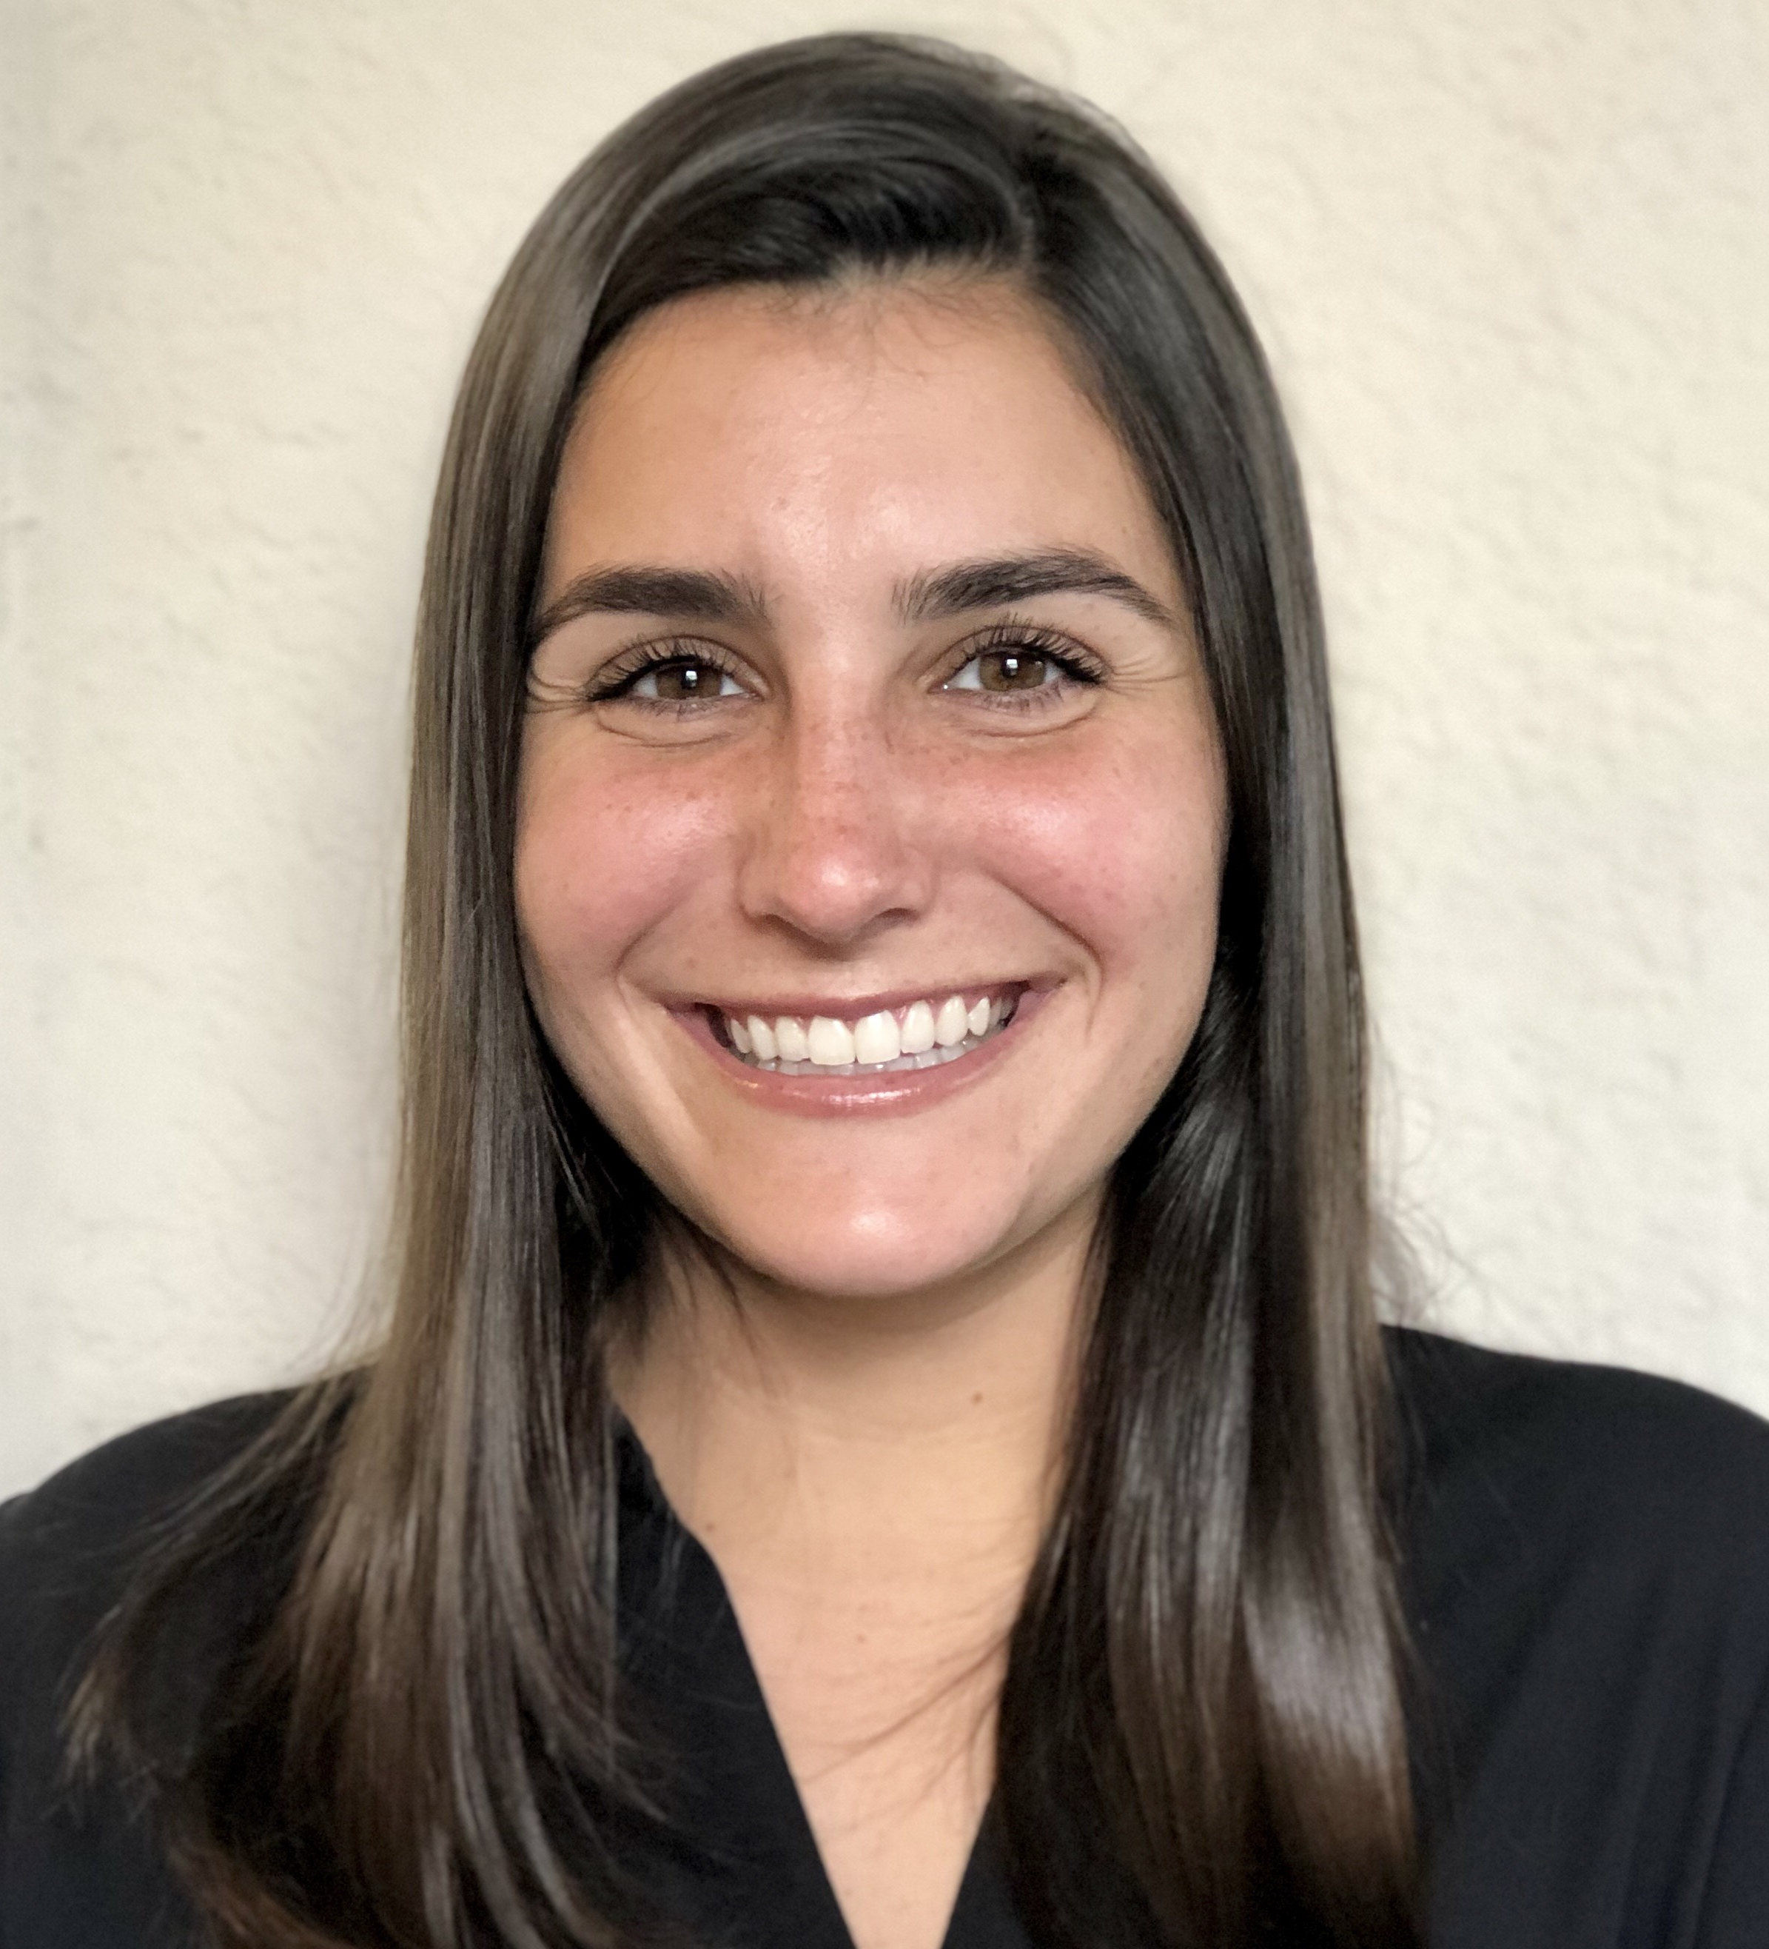
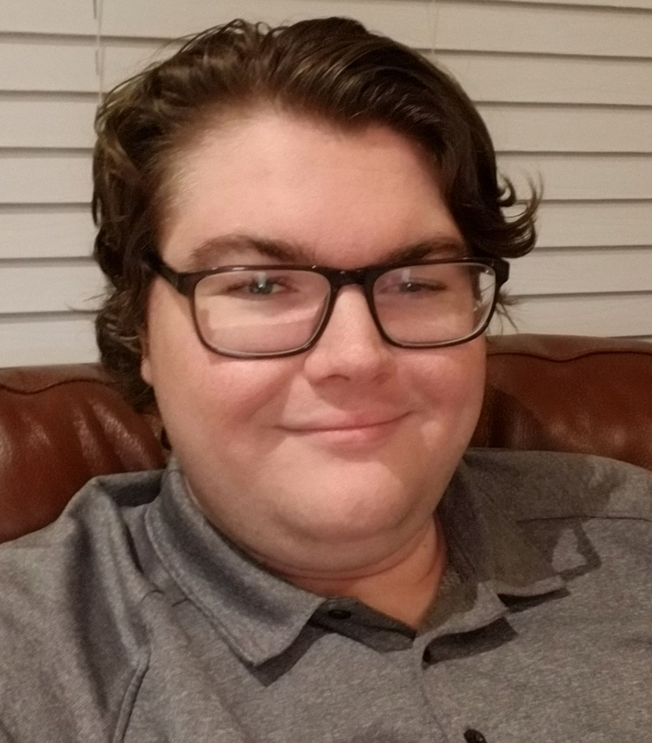



Raman Spectroscopy Using a Concatenated Laser System to Detect Water Content in Fuel
Group 1
RSCL
CDR
Yaelle Olivier (PSE) Tyler Morris (CPE)
Sponsored by:
Summer 2021
Senior Design 2

Slide 2
Goals and Objectives
To help prevent water contamination in fuel by detecting it quickly and accurately.
To get timely quantitative measurements to measure water content in a chemical or fuel.
A safe way to test fuel or chemicals in a small amount without interaction of other chemicals.
Be easy to use through the user interface with clear information presented.
Done by Yaelle Olivier

Slide 3
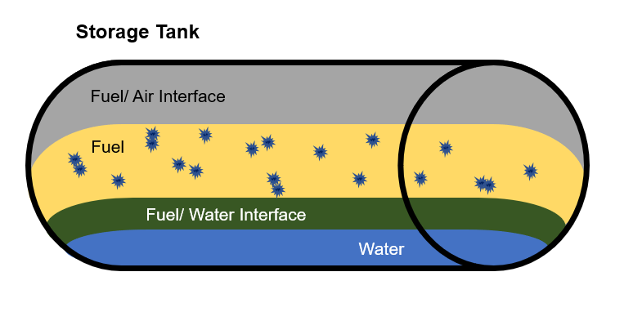
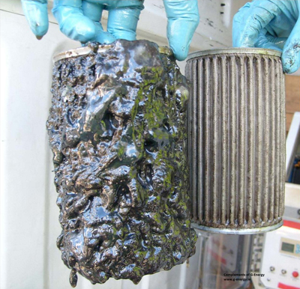
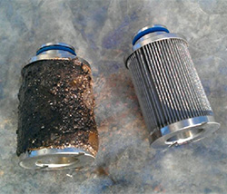
Motivation
Water contamination in fuel is the #1 cause of equipment failure in emergency situations.
  Because the reserve fuel often goes unchecked and is left in storage for too long creating a space for water contamination to occur.
Water contamination causes bacterial and microbe growth this turns into sludge
  This microbial sludge will:
    Destroy surface coatings
    Cause corrosion
    Cause clogging of fuel filtration
    Block fuel supply
    Cause malfunctioning fuel gauges
Currently on the market there is no way to quantitatively measure water content in fuel.
  Kits to test for water contamination include
    Chemical reactions
    Time
Done by Yaelle Olivier

Slide 4
Background on Biofuel/Biodiesel
Biodiesel is a fuel produced from renewable sources, like vegetable oils and animal fats and is a cleaner-burning replacement for petroleum-based diesel fuel. Biodiesel is nontoxic and biodegradable and is produced by combining alcohol with vegetable oil, animal fat, or recycled cooking grease.
Like petroleum-derived diesel, biodiesel is used to fuel compression-ignition (diesel) engines. Biodiesel can be blended with petroleum diesel in any percentage, including B100 (pure biodiesel) and, the most common blend, B20 (a blend containing 20% biodiesel and 80% petroleum diesel).
Biodiesel will cause problems if it isn’t high quality or if it sits too long this is because of the nature of the biofuel, it is water soluble. So, if it is exposed to water it is more likely to combine with it causing engine problems quicker than regular diesel or gasoline. It is contain up to 0 times more water than regular petroleum diesel fuel.
Done by Yaelle Olivier

Slide 5
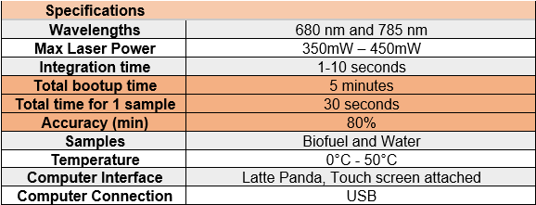
Specifications and Requirements
Done by Tyler Morris

Slide 6
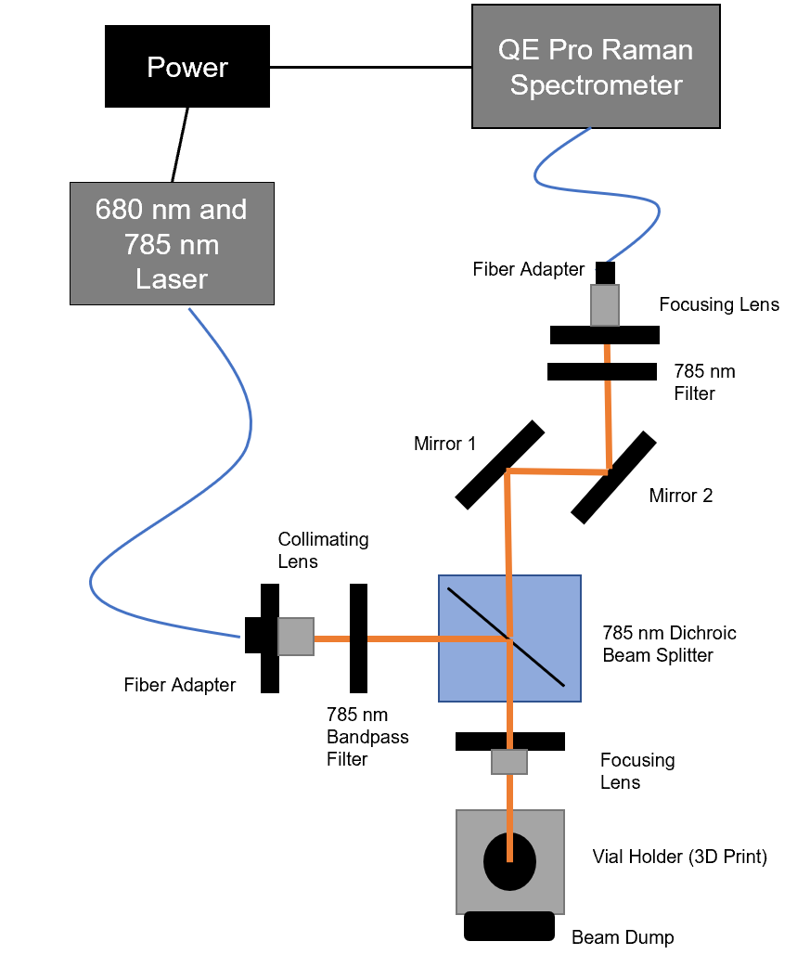
Optical Block Diagram
Done by Yaelle Olivier

Slide 7
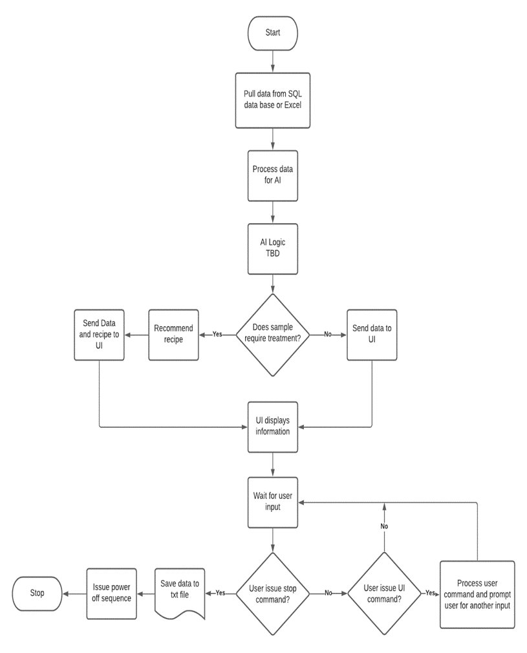
Software Flowchart
Done by Tyler Morris

Slide 8
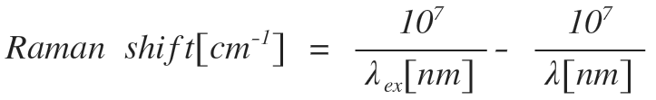
A Review on Raman Spectroscopy
Raman spectroscopy uses scattering.
  The photons from the incident laser will cause an energy shift within the atoms, this is what creates scatter.
  The scattered light is mostly the same as the incident laser light, but a small amount is scattered at different wavelengths depending on what the chemical makeup of your sample is.
  Raman spectroscopy is advantageous because there is minimal preparation, and it provides a nondestructive chemical analysis technique to receive information about the sample.
  A fingerprint and in our case, a stretch for each sample.
Done by Yaelle Olivier

Slide 9
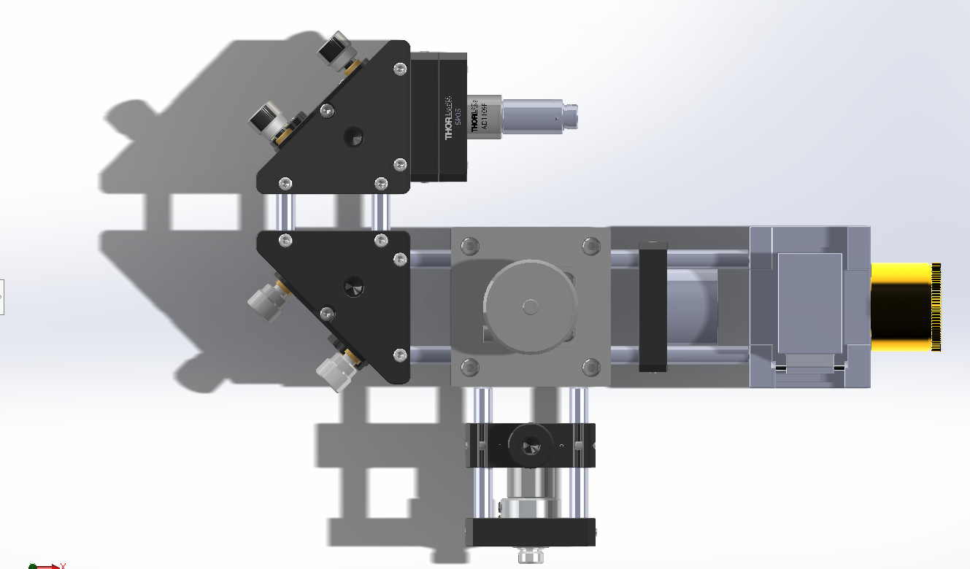
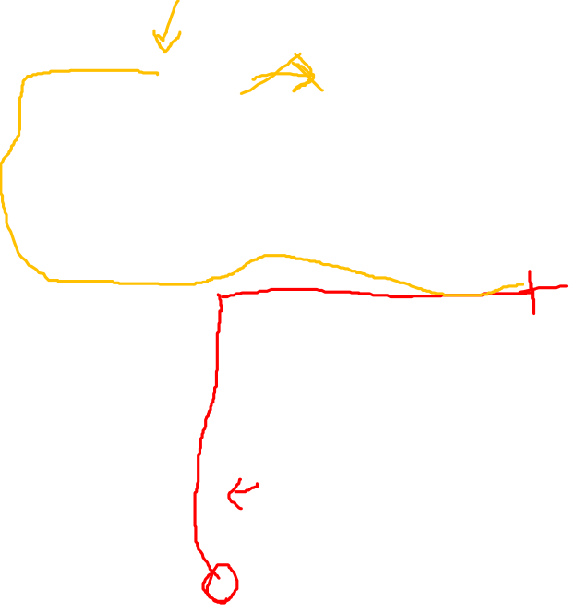
Optical System Design
Spectrometer Fiber Connect
M2
Beam Splitter
M1
Beam Dump
Vial Holder
Laser In
Done by Yaelle Olivier

Slide 10
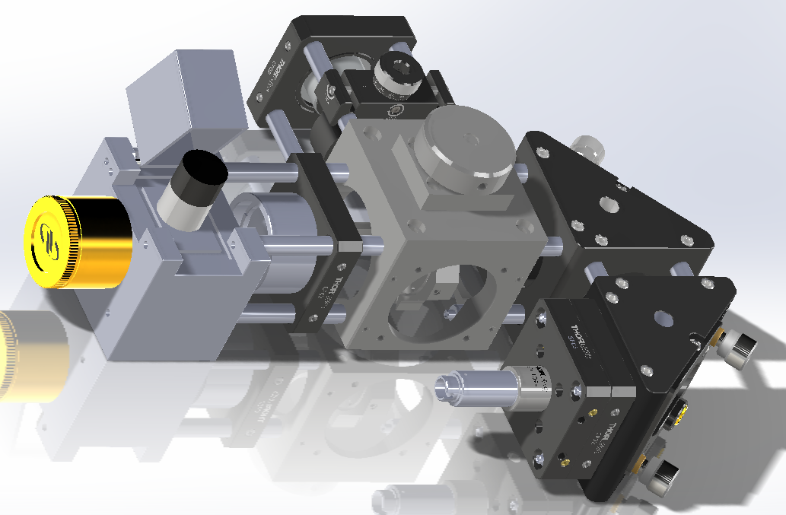
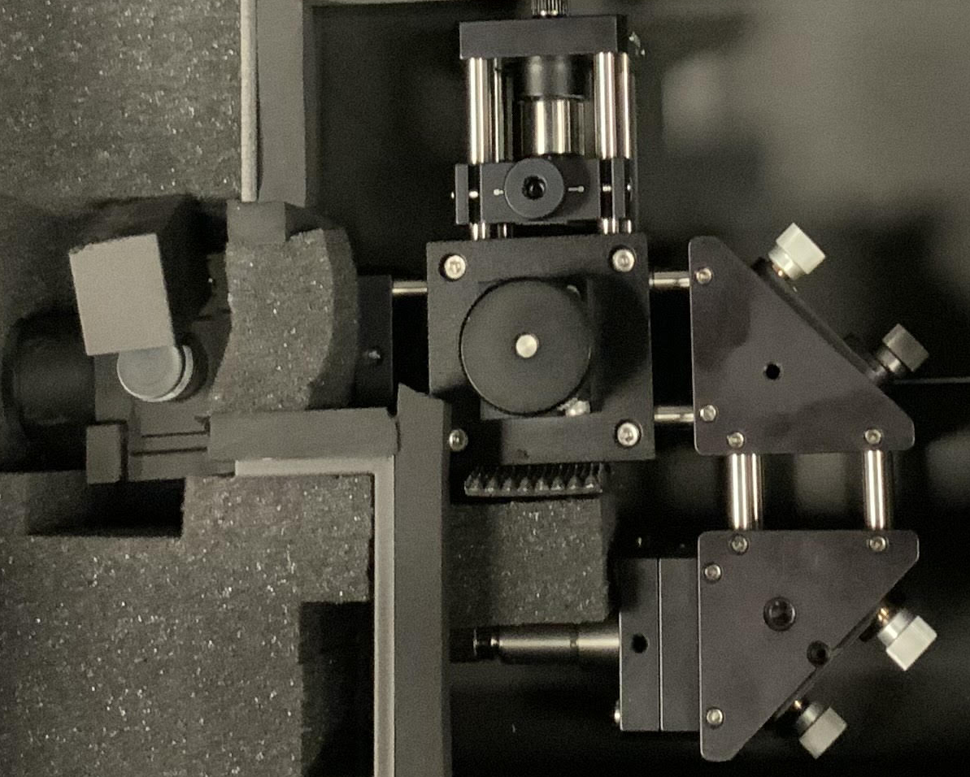

Optical System Design
Laser In
Beam Dump
M1
Beam Splitter
Vial Holder
M2
Spectrometer Fiber Connect
Done by Yaelle Olivier

Slide 11
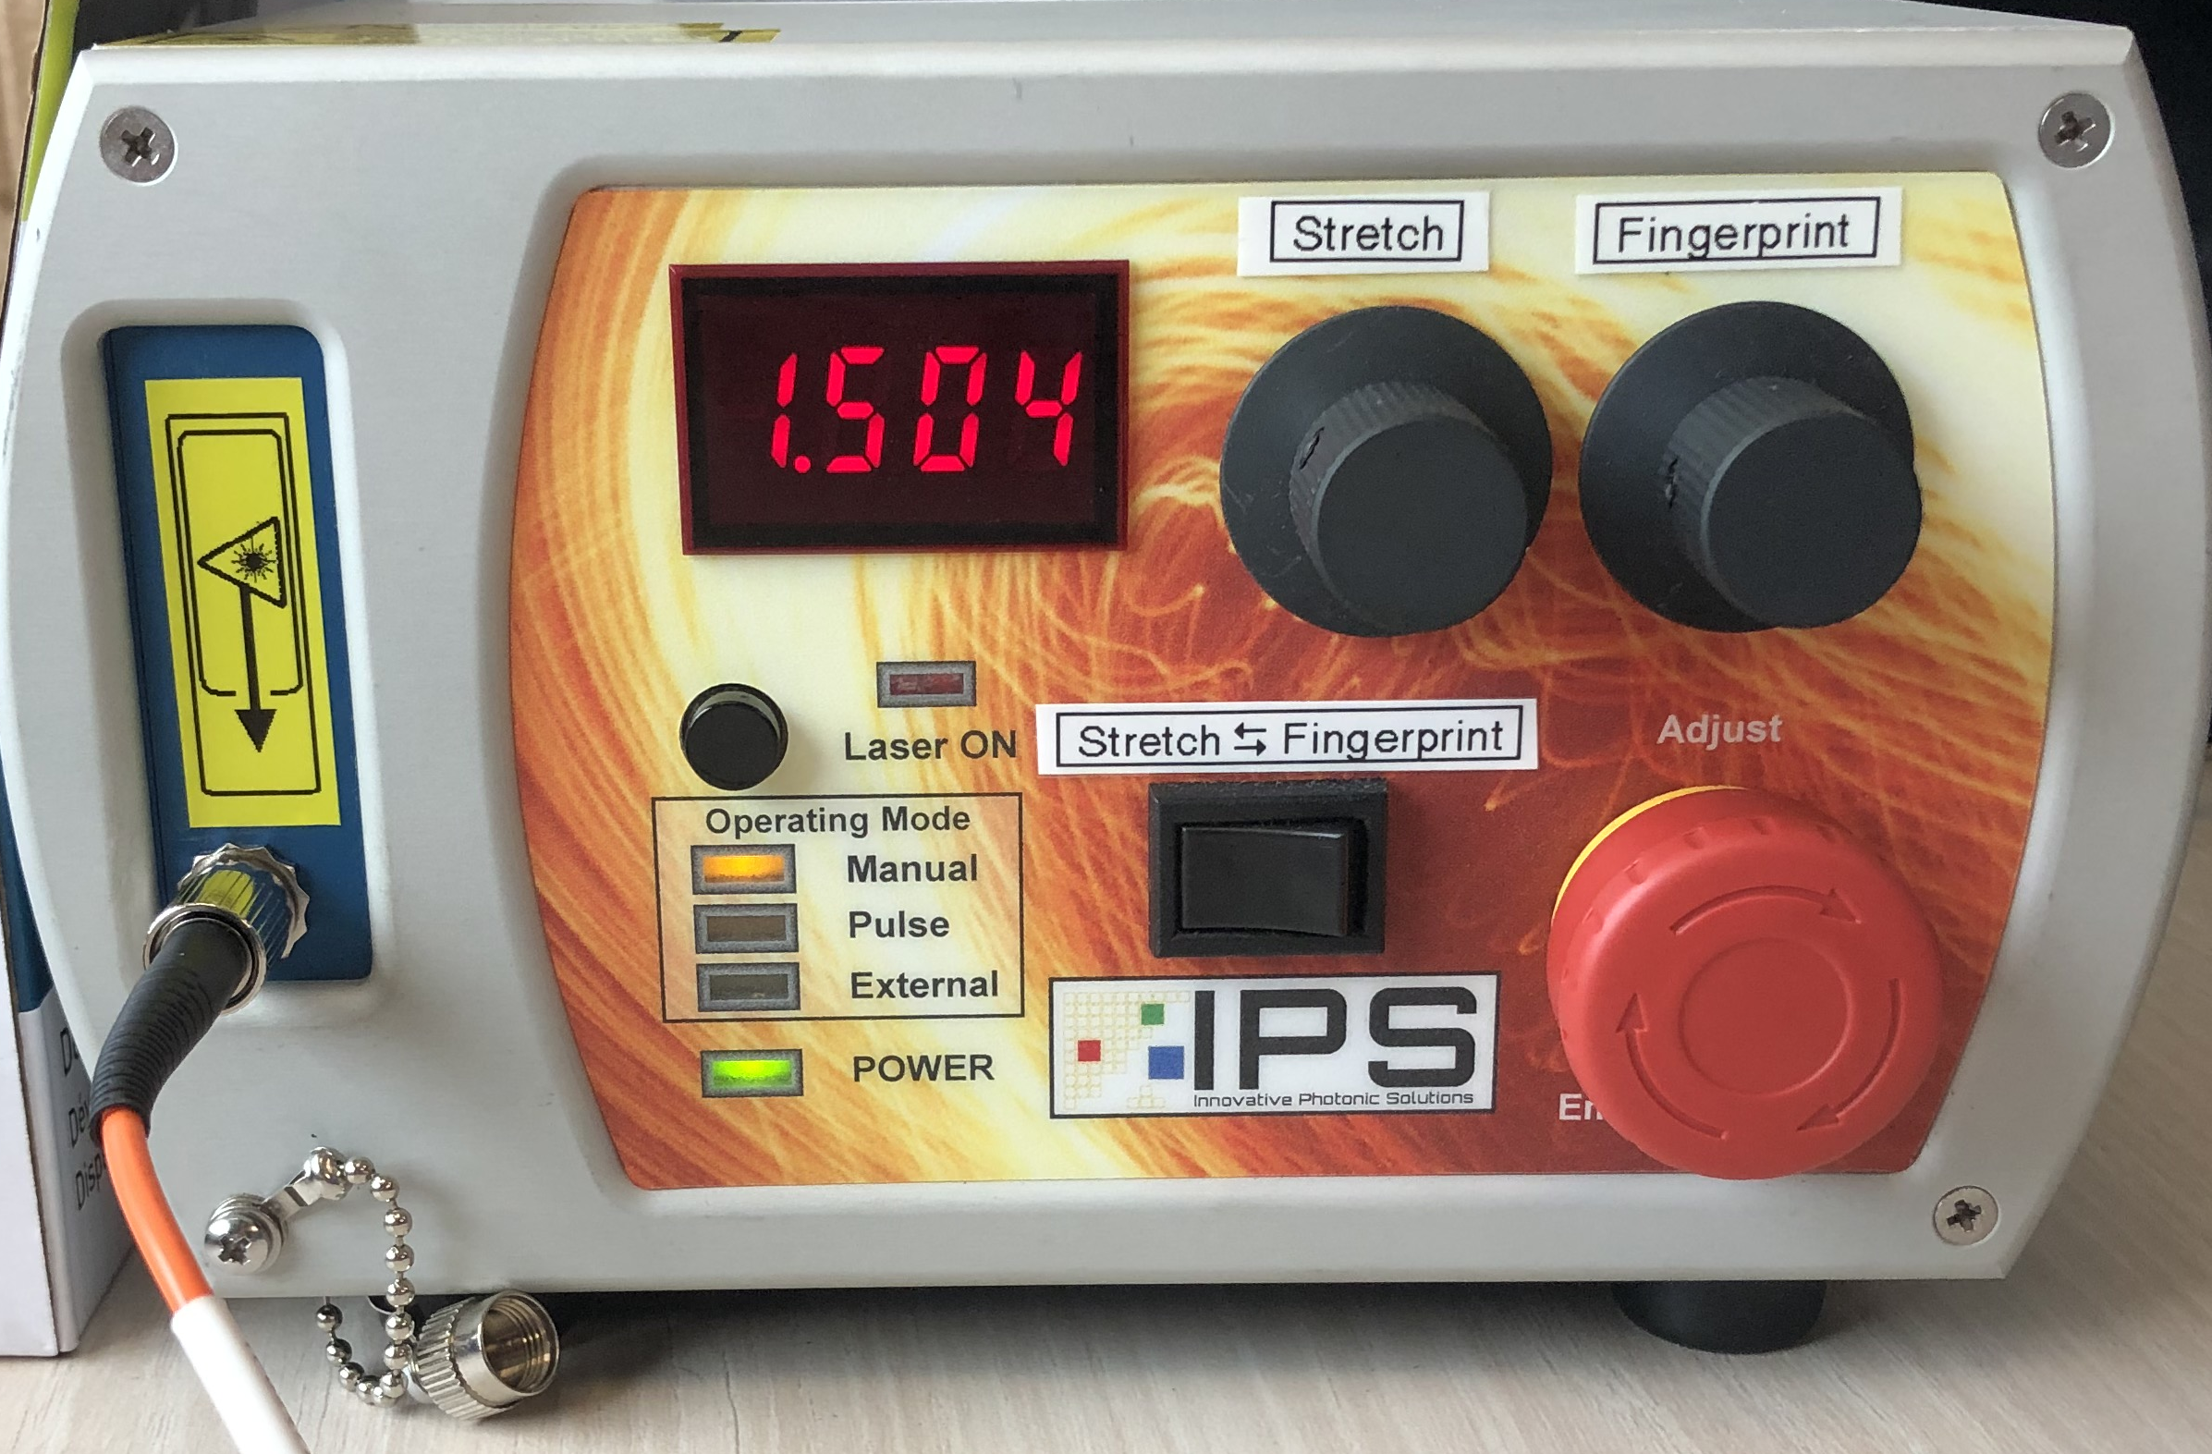

Dual Wavelength Laser
This laser provided by IPS is dual wavelength allowing us to easily switch between 680 nm (Stretch) and 785 nm (Fingerprint). With up to 500 mW power.
To take the data we first take a spectrum of the sample. Without moving the vial, we switch the laser to from stretch to fingerprint and take the data from each excitation wavelength and concatenate the data later.
It is a manual switch however if we were to buy this laser for actual manufacturing of the RSCL we would request for the laser to be controlled through USB and through the GUI
Done by Yaelle Olivier

Slide 12
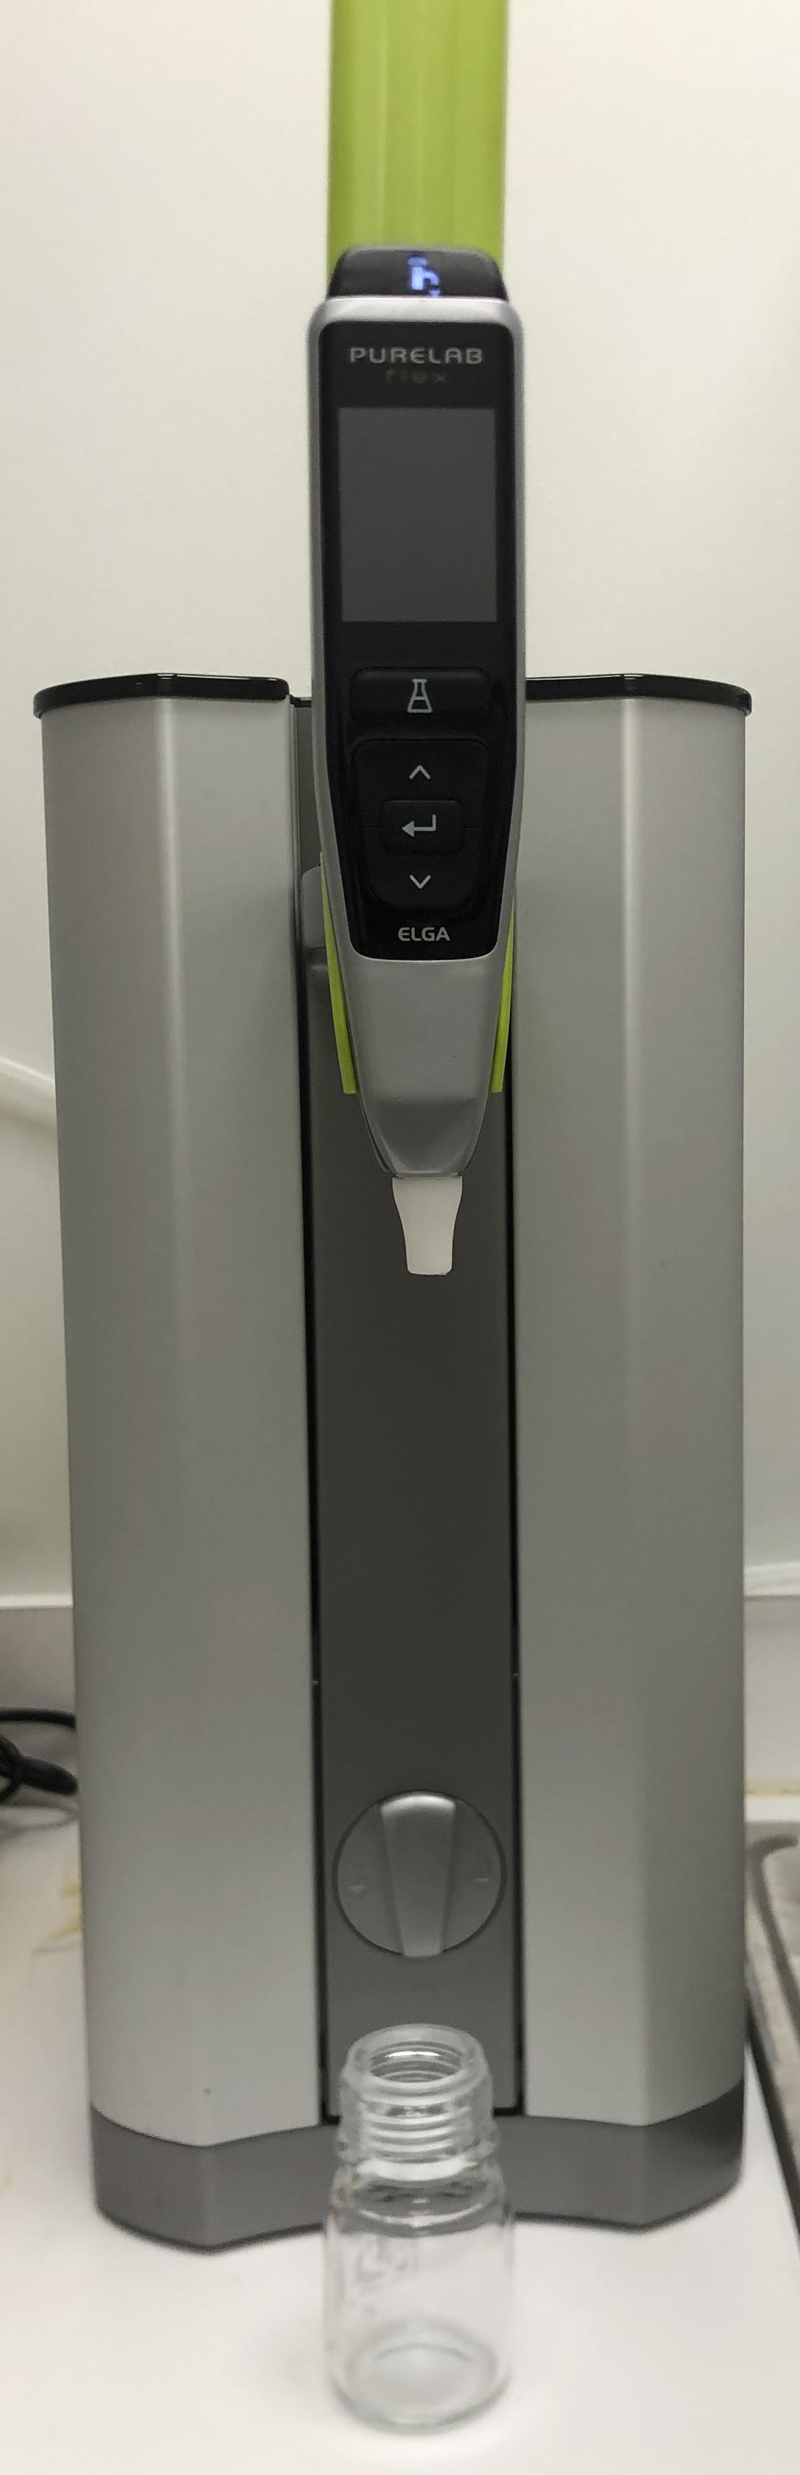
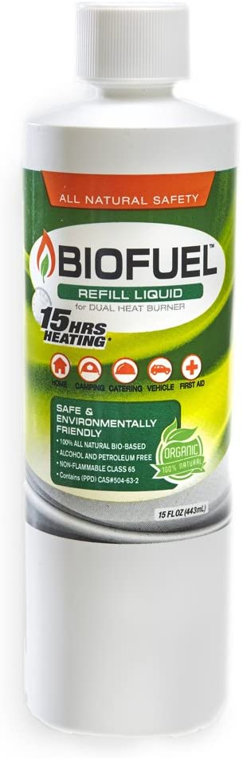
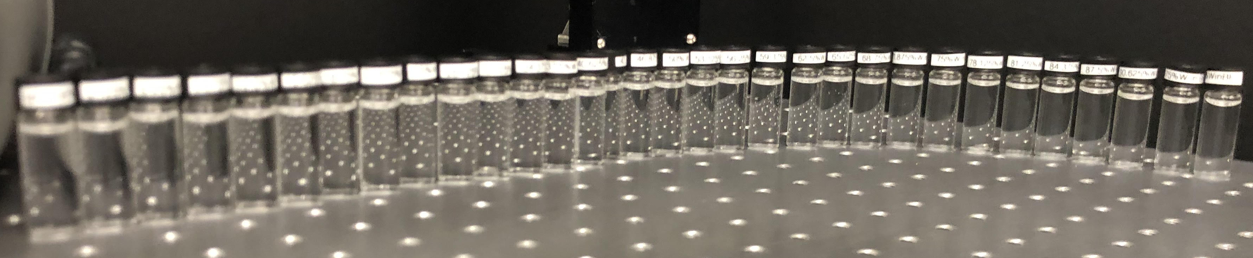
Data collected – Biofuel
We are using both wavelengths (680 nm and 785 nm) with Biofuel and water. Biofuel is water soluble therefore making it easier to be affected by water contamination. For these measurements mixed the biofuel and water in vials every 3.125% percent from 0% water to 100% water.
The water used to contaminate the biofuel is ultra filtered, purified water from a Pure Lab flex system.
Later, this can translate into testing Biodiesel for water content
Done by Yaelle Olivier

Slide 13
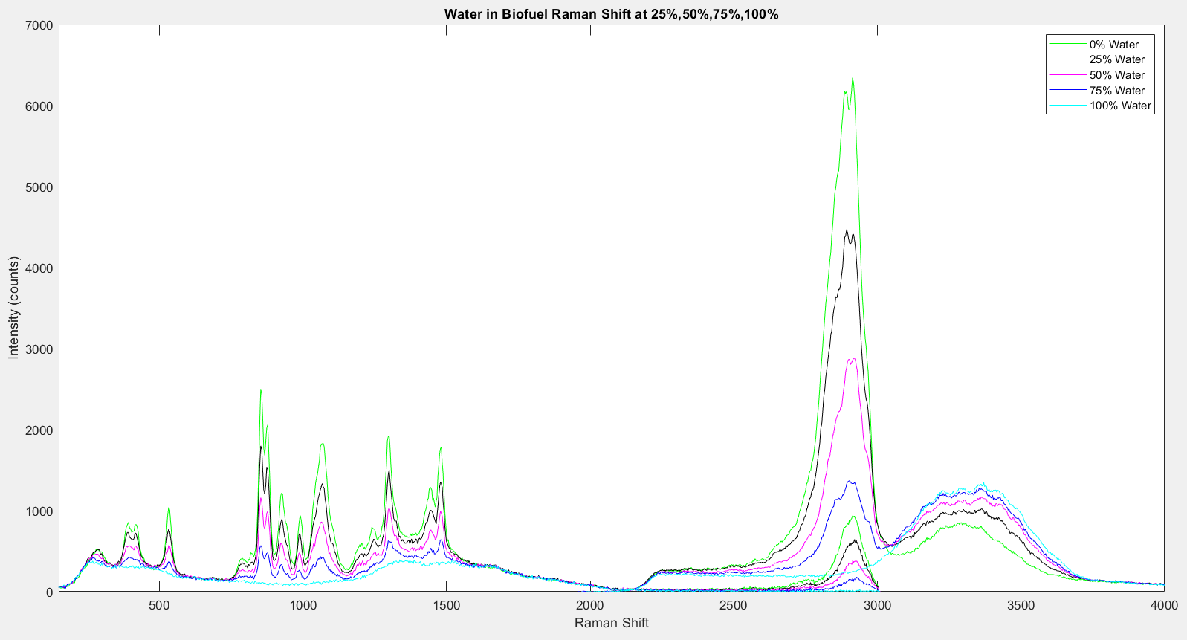
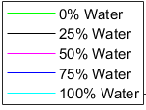
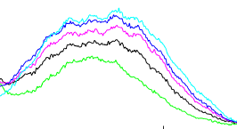

Data collected - Biofuel
Water Peak
Fingerprint
Stretch
Done by Yaelle Olivier

Slide 14
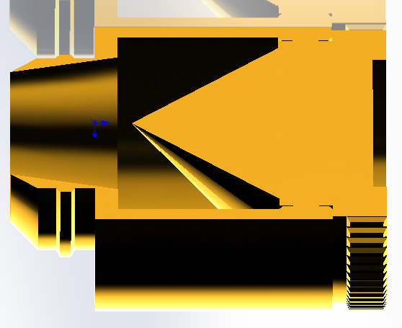

Optical Problems We Ran Into
Problem 1:
Problem 2:
In the data we could see quite a bit of etaloning. This is due to the vials I was using.
Solution:
  We got new vials.
The laser is so high powered, when focused onto the vial it started to burn a hold in the 3D printer material behind the sample
Solution:
  We bought a beam dump to attach behind the vial for safety.
Done by Yaelle Olivier

Slide 15
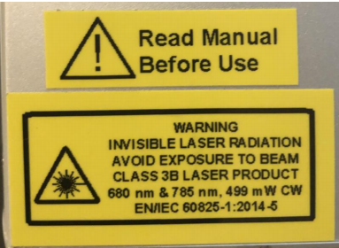
Design Constraints and Standards - Optical
The biggest constraint optically is the safety of the laser system. We are using a class 3B high powered laser.
  Where beam hazards are potential injury to the eye and potential injury to the skin. Non-Beam hazards include electrocution, fire, exposure to air contaminants, hazardous gases, laser dyes, and solvents. To avoid these hazards, they have implied that these lasers must be in protective housing, warning signs, and label requirements.
  We will solve this by using a cap for the vial holder that is connected to an interlock circuit to shut the laser down if the cap is open.
  Standards
  According to the FDA standard d 21 CFR 1040.10 and 1040.11) “requires a warning label on Class IIIa and IIIb products. Class IIIb products must also have a key switch and connector for remote interlock. The products are also required to have identified and certifying labels and instructions for safe use.”
Done by Yaelle Olivier

Slide 16
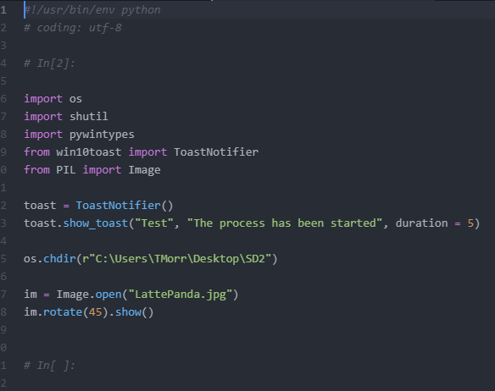
Automation
•Streamline coding process to have program as simple as possible, both for the user and for the designer
•Limit the necessary interactions with the computer (i.e. required inputs from the User)
•Make the program do all background tasks, needing no user intervention (power on, save data, collect data, process data, start GUI)
Done by Tyler Morris

Slide 17
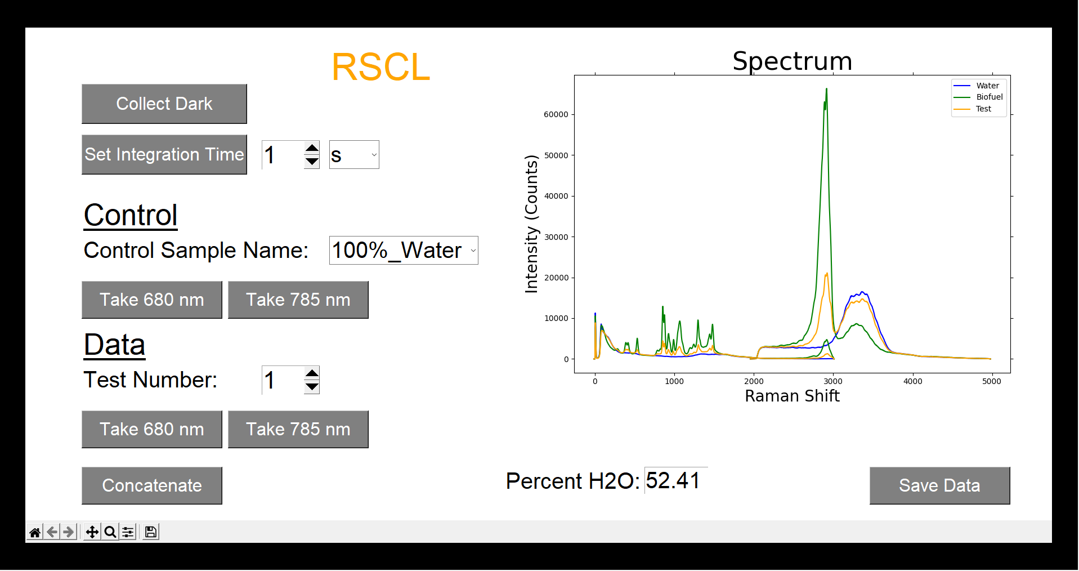
Graphical User Interface
•Want to create a simple user interface, both to reduce design complexity and reduce user confusion
•Want to present data in a palatable and informative way
•Used an intuitive design in order to help the user understand the sequence of options, while also preventing them to accessing options too early
Done by Tyler Morris

Slide 18
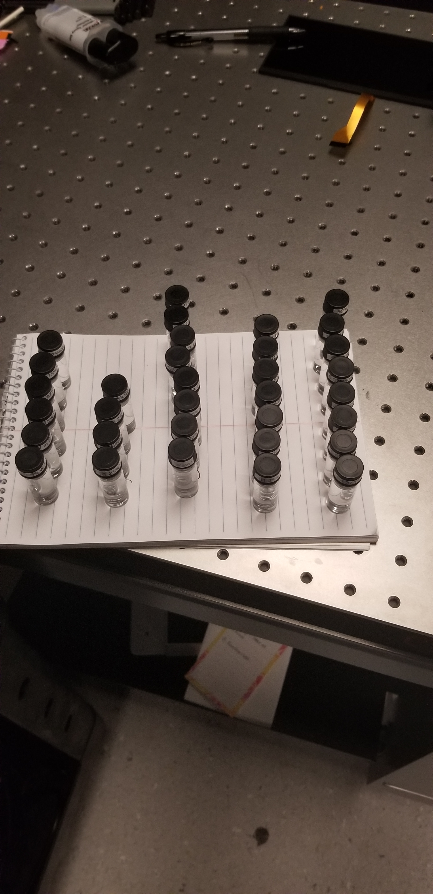
Data Analysis
Create sample mixtures of water and biofuel, incrementing water amounts by 3.125% each time
Use linear regression to find a regression line and the coefficients of said line in order to create an estimator function
Use a combination of random sampling the individual samples, as well as splitting the data into train and test data when creating the estimator
Done by Tyler Morris

Slide 19
Design Constraints and Standards - Software
  Safety
  Security
  Reliability
  Maintainability
  Portability
Done by Tyler Morris

Slide 20
Significant Design Decisions (SW)
Decision to move from C++ to C# for the driver software – Internally at the sponsor company more support and professional help is available for C#. C# while being unfamiliar to the designer was easy to transfer due to the similarities of C++ and Java.
Move focus upon beginning the project from a bottom - up to a top – down view. The initial design plan was to create the algorithm to take data, and build a GUI, automation, and determine the drivers around it. However, upon taking this route, it became quickly apparent that it will be easier to complete the desired objective by working from the end goal backwards.
Done by Tyler Morris

Slide 21
Bug Testing and Troubleshooting
Find as many instances as possible that the user can crash the program, and handle these exceptions (example: accessing samples too early)
Data Variability – The amount of ambient light in the room can significantly affect the readings we are taking, especially with such a small sample size.
Done by Tyler Morris

Slide 22
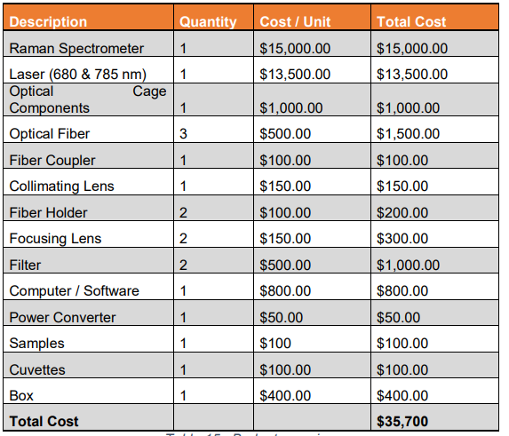
Budget
We can make this happen because of our sponsors Ocean Insight and IPS
Done by Yaelle Olivier

