Slide 1

Photoelectric Wind Instrument
Manuel Correa
Tim Walsh
Andrea Styles

Slide 2
Motivation
People are staying home more often due to the current pandemic.
The need for peace and quiet may discourage musicians from practicing.
The saxophone will feel responsive using light as opposed to sound.

Slide 3
Goals and Objectives
Illumination/Detection system to form and collect note information.
Processing of light to determine which note to play.
Audio jack to connect to headphones or speakers.
Additional lighting for keys for increased responsivity.
Battery power system to power internal functions.

Slide 4
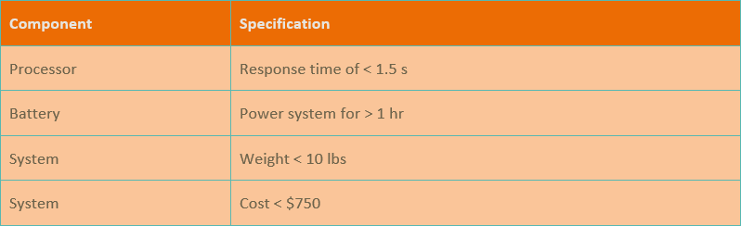
Specifications

Slide 5
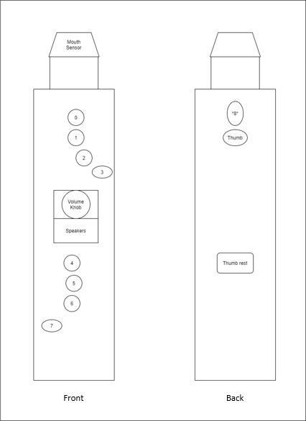
Design Sketch
Keys that mirror the keys of a saxophone.
Mouth sensor to keep track of whether a note is played or not.
Volume knob and speakers to modify sound intensity.
Thumb rests at the back for better support.

Slide 6
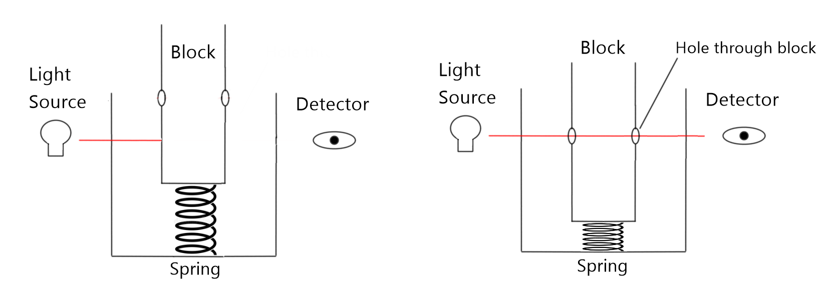
Photonic Subsystem

Slide 7
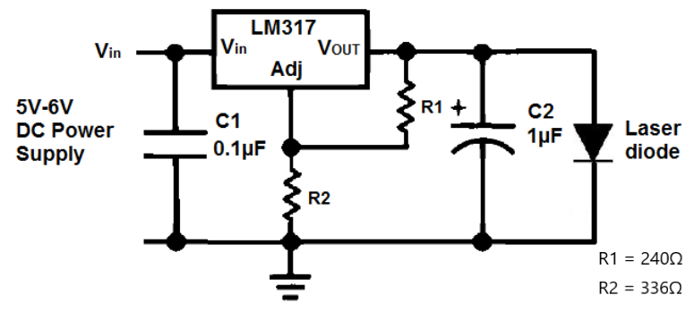
Laser Driver

Slide 8
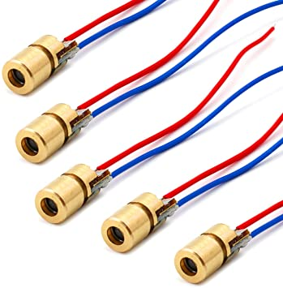
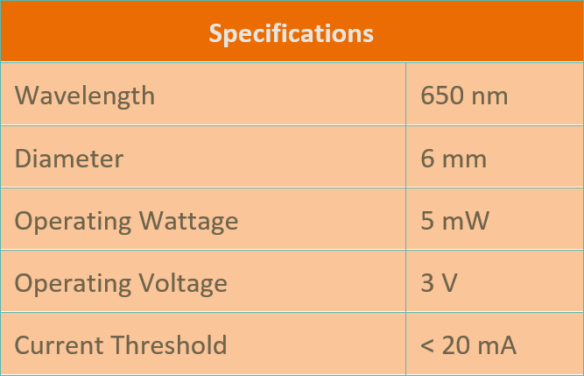
Light Source
Value concentrated light of laser diode over dispersed light of LED.

Slide 9
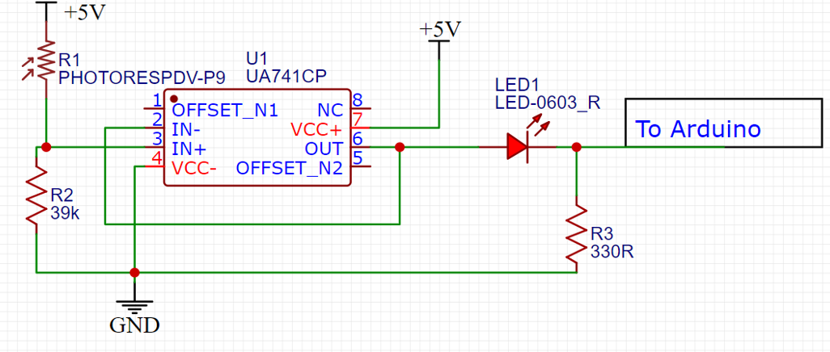
Laser Detector

Slide 10
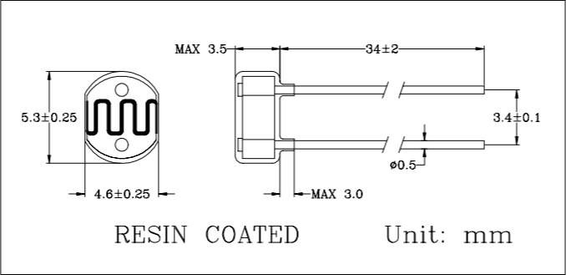
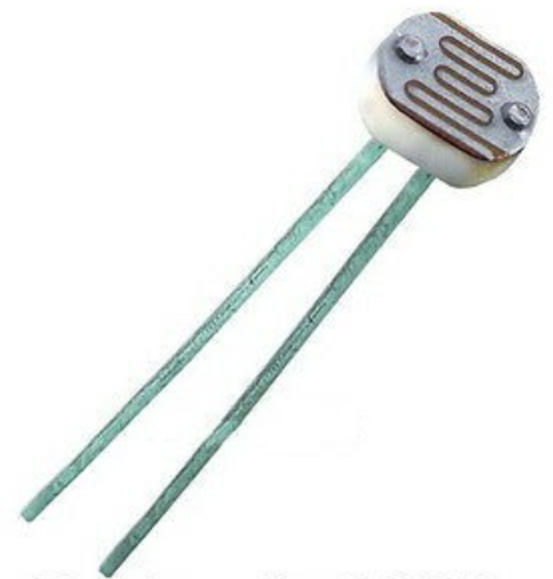
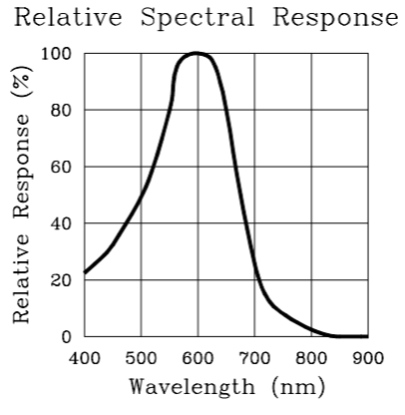
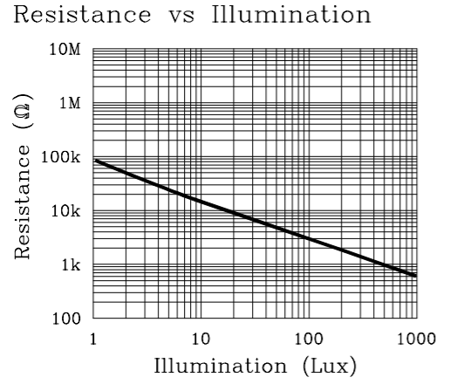
Photoresistor

Slide 11
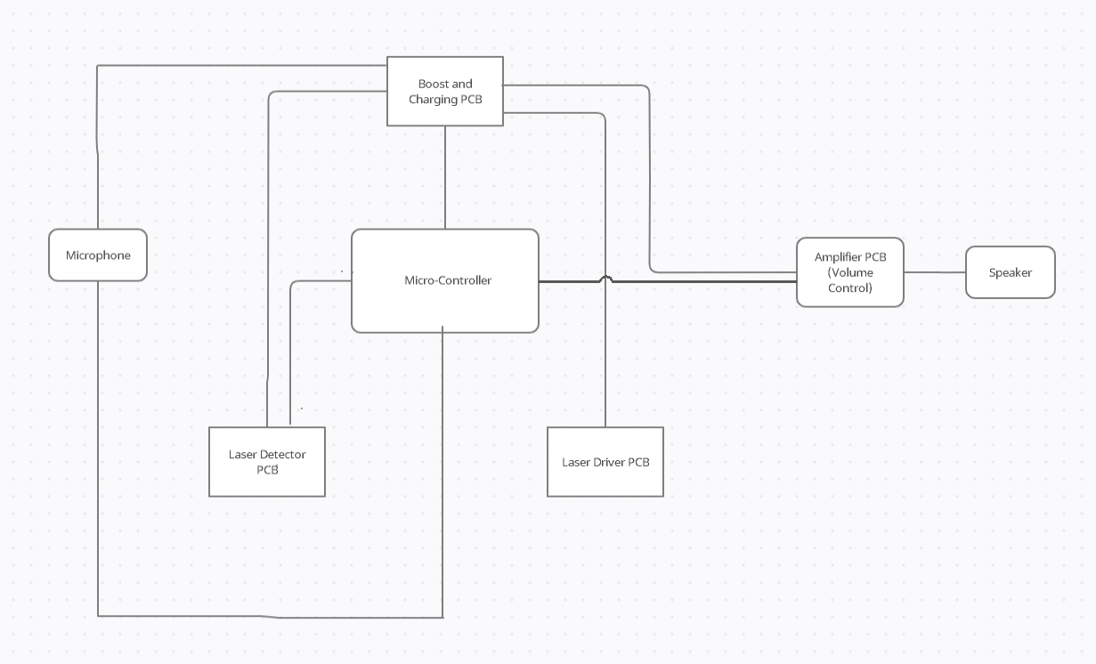

Block Diagram of the Overall Design

Slide 12
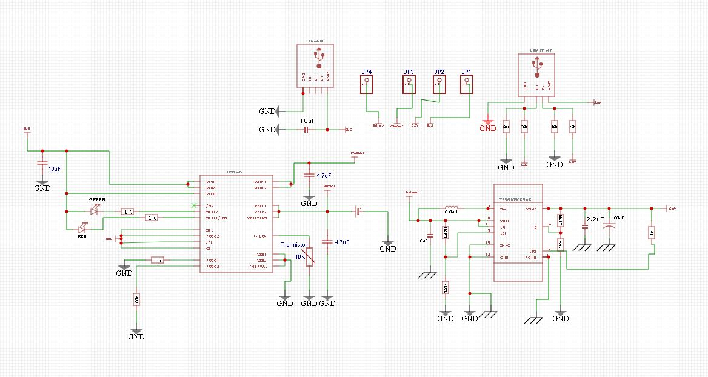
Schematic of Battery Charging Circuit
MCP73871 Battery Charger IC
TPS6109 Boost Converter

Slide 13
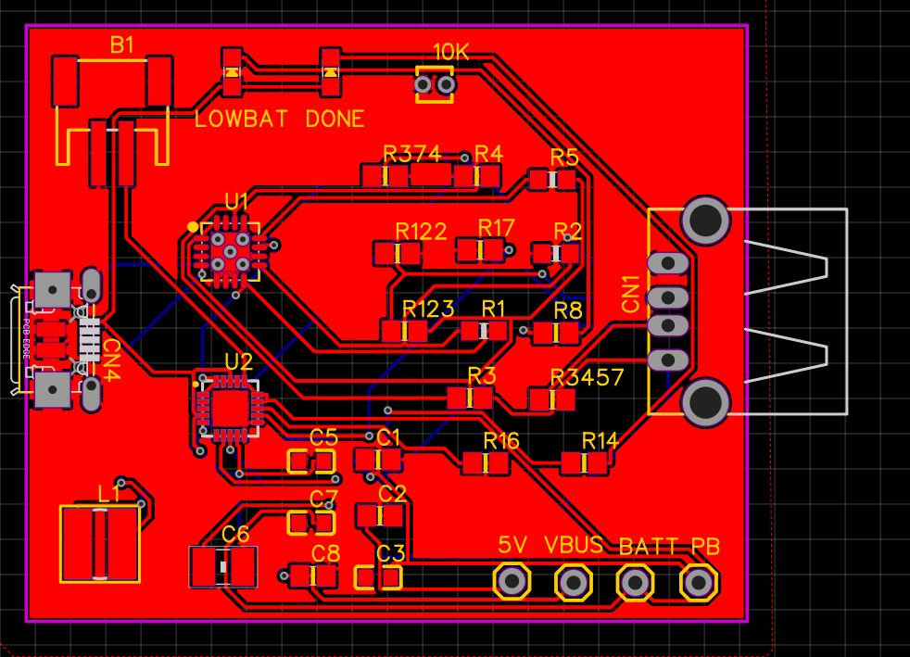
PCB of the Charging Circuit
Micro USB input
USB output
4 Headers for testing
JST plug to connect battery pack

Slide 14
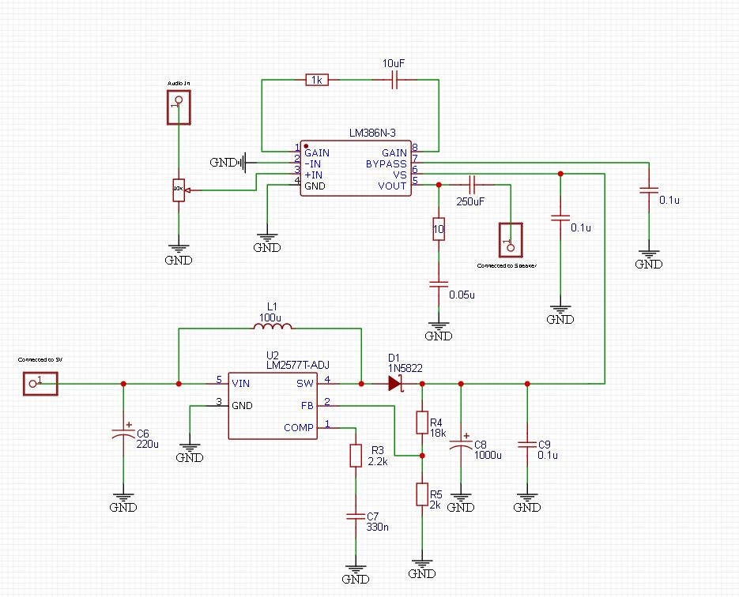
Volume Control Circuit
LM386 Amplifier
LM2577T Step up Regulator

Slide 15
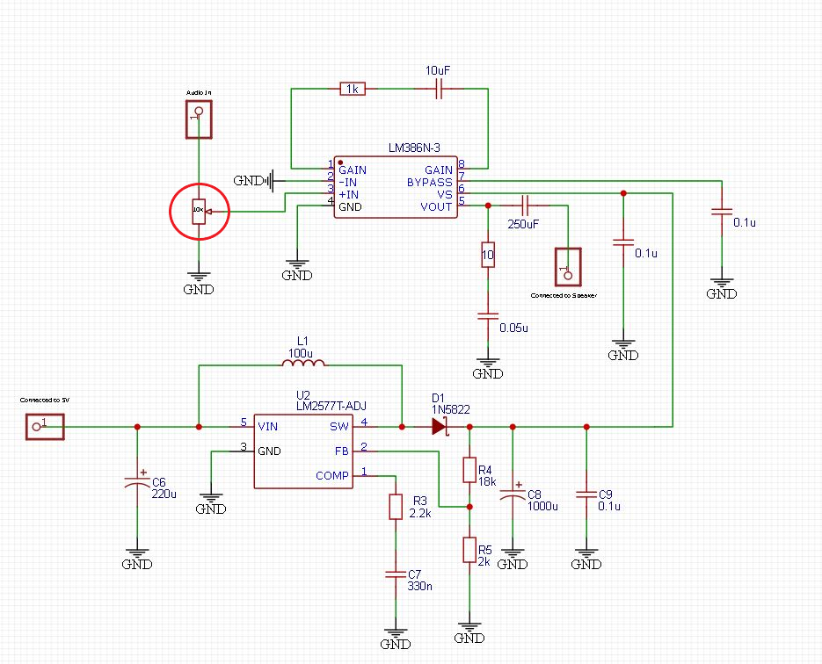
Volume Control Circuit
LM386 Amplifier
LM2577T Step up Regulator

Slide 16
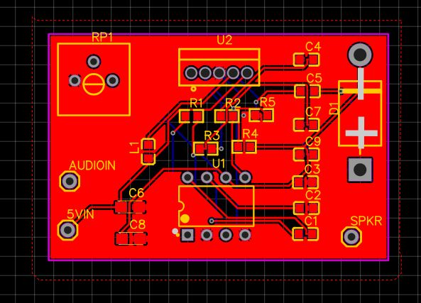
PCB of the Volume Control Circuit
Audio Input Pin
5 Volts Input to Power ICs
SPKR pin outputs boosted audio

Slide 17
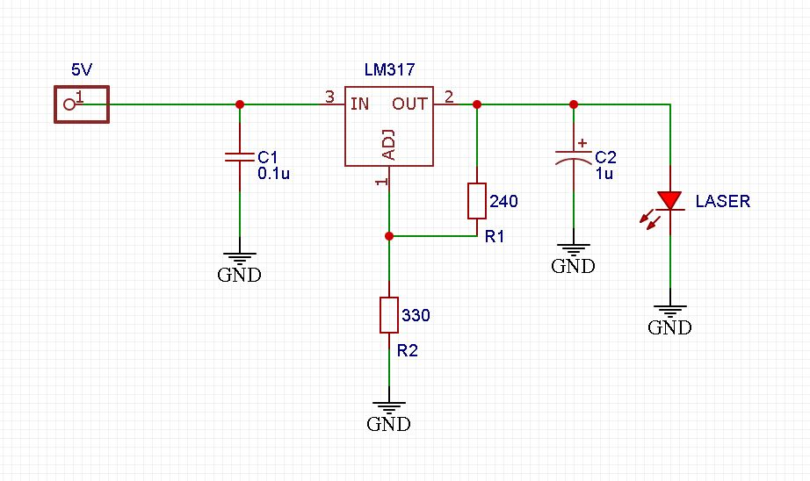
Laser Driver Circuit

Slide 18
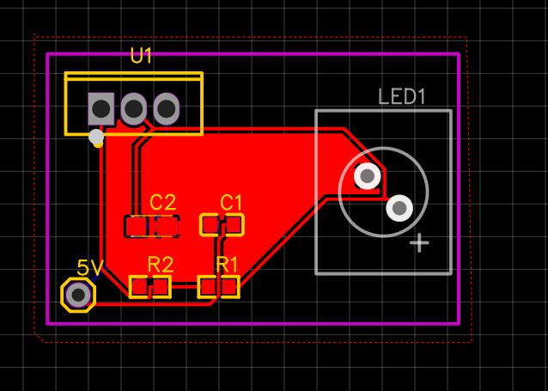
Laser Driver PCB

Slide 19
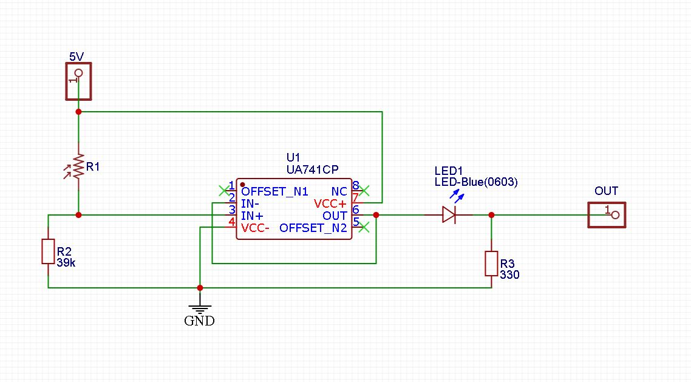
Laser Detector Circuit

Slide 20
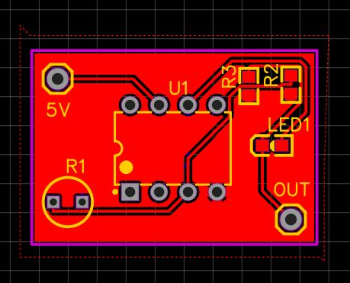
Laser Detector PCB

Slide 21
Current Draw
TPS Boost IC is limited to 2.5A output before chip malfunction
Arduino operates on 200mA via USB
Driver operates at approx. 100mA
Detector Operates at 50-60mA each (we need about 10)
Microphone is powered via the Arduino or directly from power supply PCB.

Slide 22
PCB Fabrication Process
We have ordered our PCBs from JLCPCB, which should arrive very soon.
As a backup, we have also contacted QMSFL as a backup incase the PCBs from JLCPCB do not work as intended or if there is any manufacturing errors.

Slide 23

Note Processing and Software

Slide 24
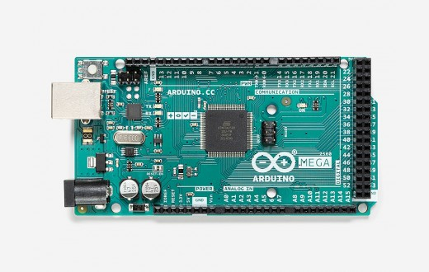
Microcontroller - Arduino Mega 2560
Processor: ATmega2560
Specifications
256KB Flash memory
8KB RAM
16Mhz clock
I/O pins
86 general-purpose
16 Analog/Digital Converter (ADC)
channels
Price: $40.30

Slide 25
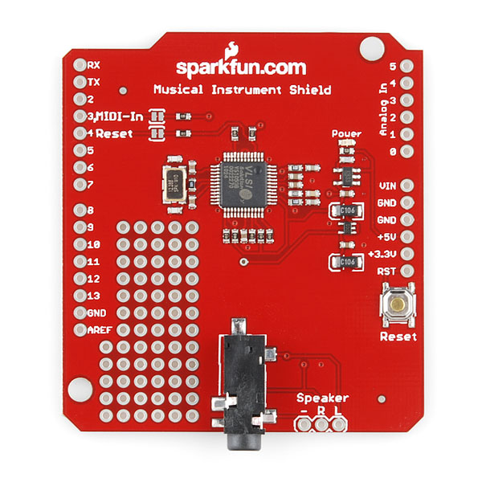
Instrument Shield
MIDI synthesizer
Volume control
Tone bank of 189 instruments
Connects to Arduino through header pins
Connects to speaker/headphones through
AUX cable
Price: $34.95

Slide 26
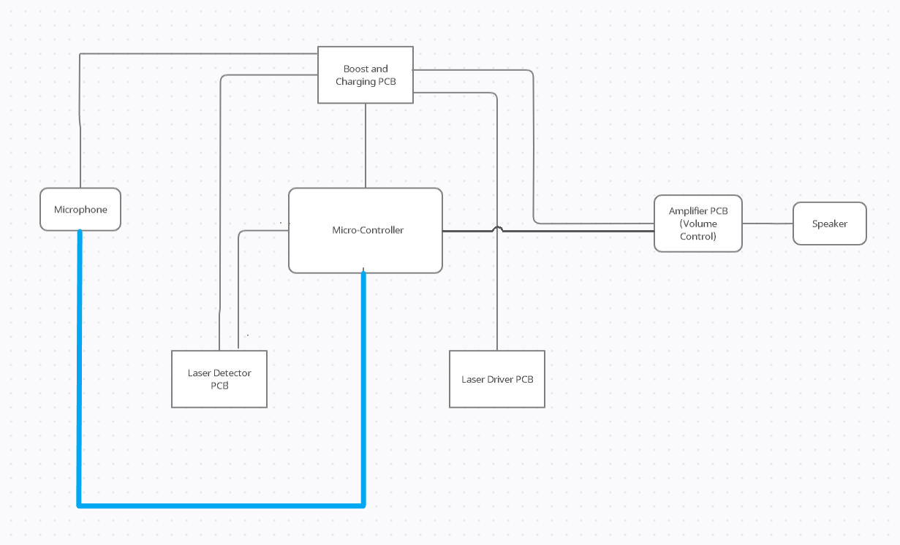
Microphone to Microcontroller
Microphone will transmit the noise level it is receiving in the mouthpiece
Noise level will be used by the Arduino to determine whether the instrument is being played, and if so, at what intensity

Slide 27
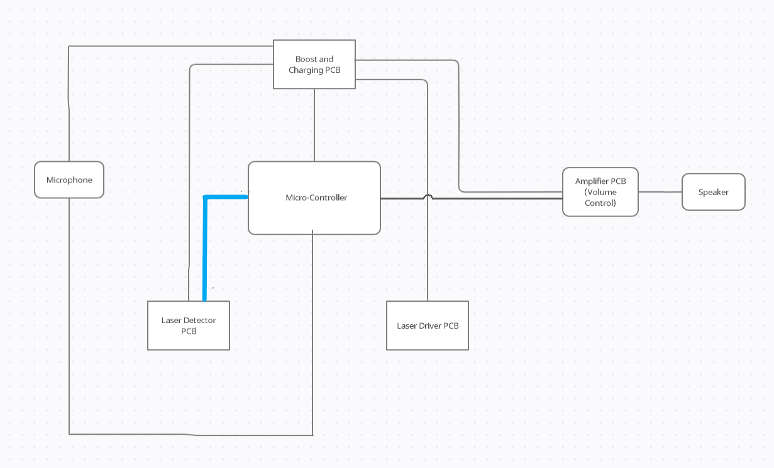
Laser Detectors to Microcontroller
11 laser detectors will be connected to Analog/Digital Converter (ADC) pins of the Arduino
Each detector will transmit whether or not it detects a laser input
Combination of triggered detectors will be used by the Arduino to determine what note is being played

Slide 28
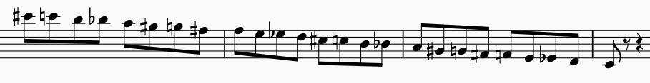
Keys and Note Generation
Each laser detector corresponds to a key of the saxophone
Actual alto saxophone fingering will be matched as closely as possible
With 11 keys, notes range from Low C to High C (25 unique notes)
Stretch goal: 18 keys to match traditional alto sax
Notes range from Low B flat to High F sharp (32 unique notes)

Slide 29
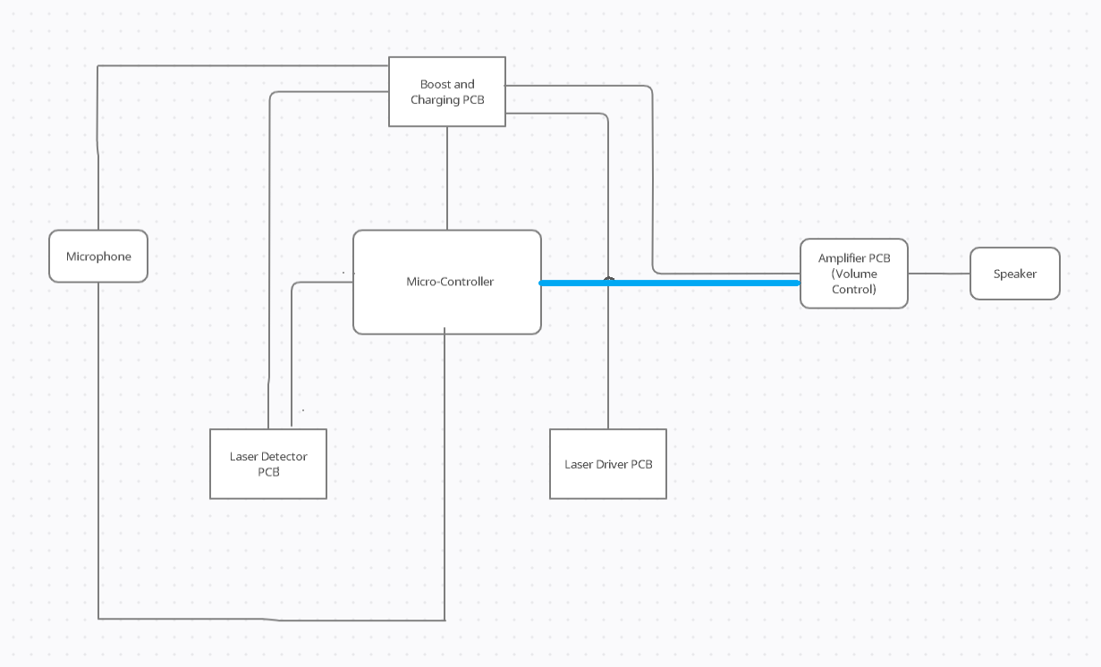
Microcontroller to Amplifier
Using input from the laser detectors and microphone, the Arduino determines which note the synthesizer should send to the amplifier and the intensity with which the note should be played

Slide 30
MIDI Synthesis
Synthesizer will communicate with the speaker using two main messages: Note On and Note Off
noteOn(channel, note, velocity)
Channel determines instrument
Note determined by input from laser detectors
Velocity determined by input from microphone
Master volume determined by volume knob

Slide 31
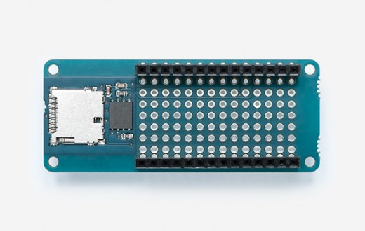
Stretch Goal: Session Recording
Arduino MKR Memory Shield allows a
microSD card to be connected
User would be able to record sound
files to the microSD card and access it
to transfer the files to a local storage

Slide 32
Administrative Content

Slide 33
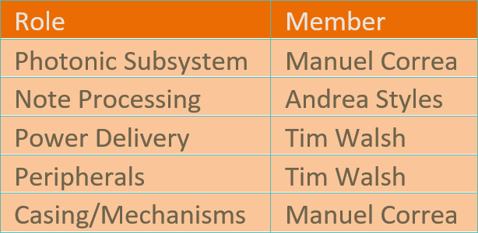
Work Distribution

Slide 34
Budget
Components | Price
PCB, ICs, etc. | $75
Arduino Mega 2560 | $40.30
SparkFun Music Instrument Shield | $34.95
Auxiliary components (volume knob, AUX cable, speaker, etc) | $25
Laser diodes | $17.97
Photoresistors | $7.20
Housing components | $90*
Total | $290.42

Slide 35
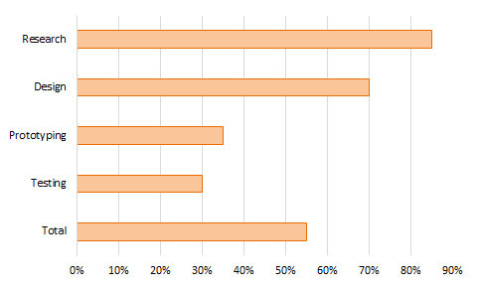
Progress So Far

Slide 36
Challenges
Lack of mechanical knowledge
Down one member
Delay in PCB acquisition

Slide 37
Questions

