Slide 1
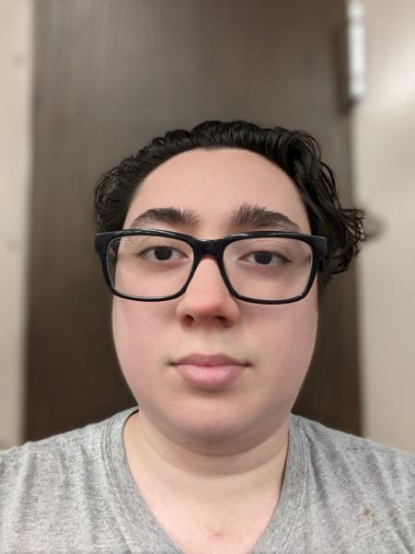
Optoelectronic Saxophone
Group 4
Manuel Correa
Tim Walsh
Andrea Styles

Slide 2
Motivation
People are staying home more often due to the current pandemic.
The need for peace and quiet may discourage musicians from practicing.
The saxophone will feel responsive using light as opposed to wind.

Slide 3
Goals and Objectives
Emitter/Detection system to form and collect note information.
Processing of light to determine which note to play.
Audio jack to connect to headphones or speakers.
Battery power system to power internal functions.

Slide 4
Specifications
Component | Specification
Processor | Response time of < 1.5 s
Battery | Power system for > 1 hr
System | Weight < 10 lbs
System | Width < 6 inches/15 cm
System | Length < 2 feet/60 cm
System | Cost < $750

Slide 5
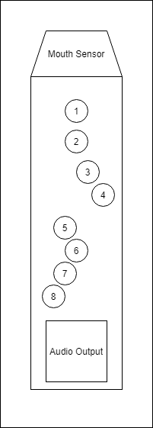
Design Sketch
Keys that mirror the keys of a saxophone.
Mouth sensor to keep track of whether a note is played or not.
Volume knob and speakers to modify sound intensity.
Thumb rests at the back for better support.

Slide 6
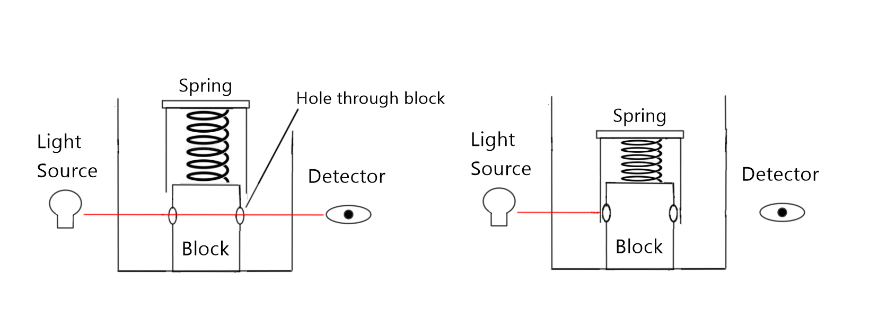
Photonic Subsystem

Slide 7

Radiation Constraints
Optical power rating below dangerous levels (<5 mW).
Want light to be contained within the walls of the system.
Want any extra light to not inconvenience the user.
Prefer to use as much of the optical power of the light source as possible.

Slide 8
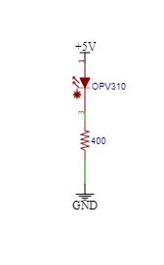
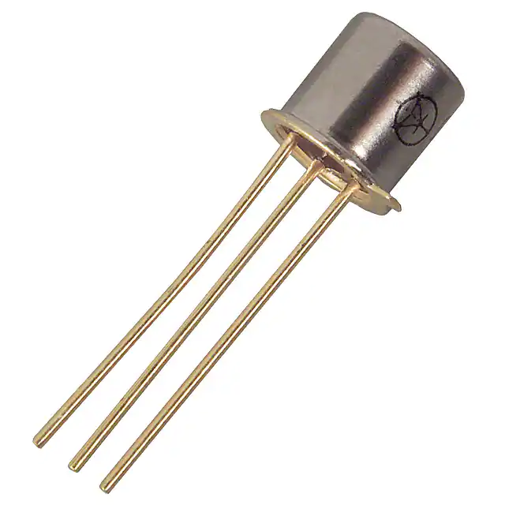
Light Source
OPV310 Vertical Cavity Surface Emitting Laser
Specifications
Wavelength | 850 nm
Optical Power | 1.5 mW
Current Threshold | 3 mA
Operating Voltage | 2.2 V

Slide 9
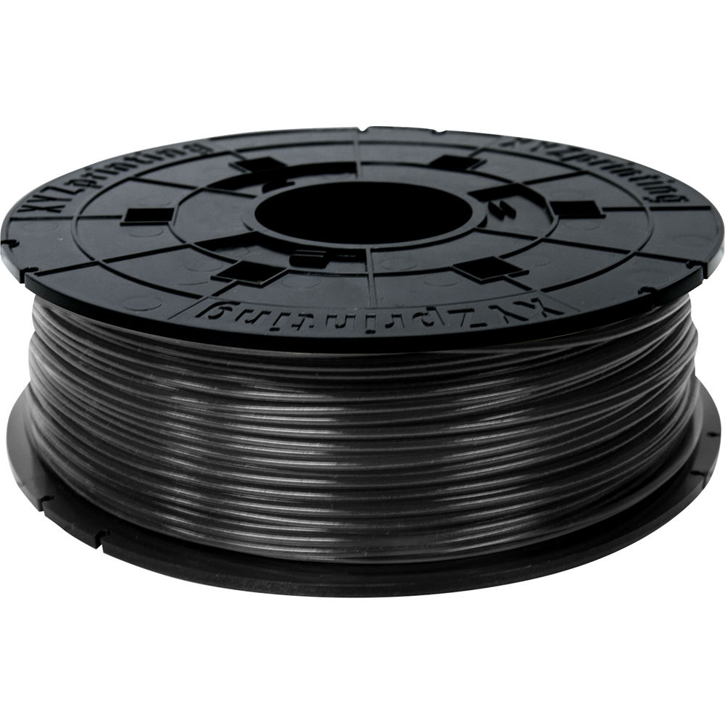
Why 850?
Invisible to human eye
Constrained by material: Black PLA

Slide 10
Detector Constraints
Needs to match the wavelength of the laser diode.
Needs to match the size of the laser diode.
Needs to have a fast response time.

Slide 11
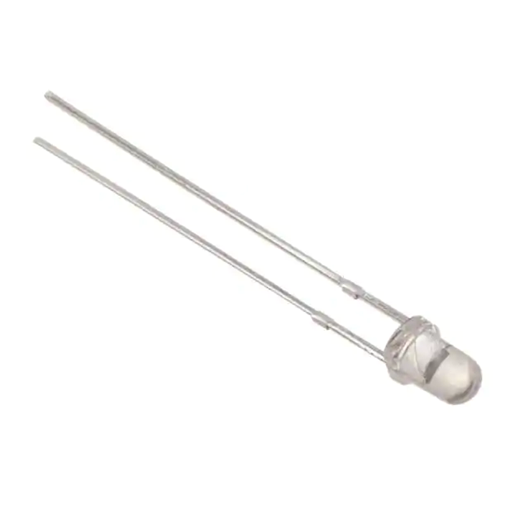
Photodiode
Specifications
Peak Sensitivity | 850 nm
Reverse Current | 35 μA
Dark Current | 5 nA
Fall/Rise Time | 45 μs
INL-5APD80
Comparison | Photodiode | Phototransistor
Sensitivity | Less | More
Output Response | Faster | Slower

Slide 12
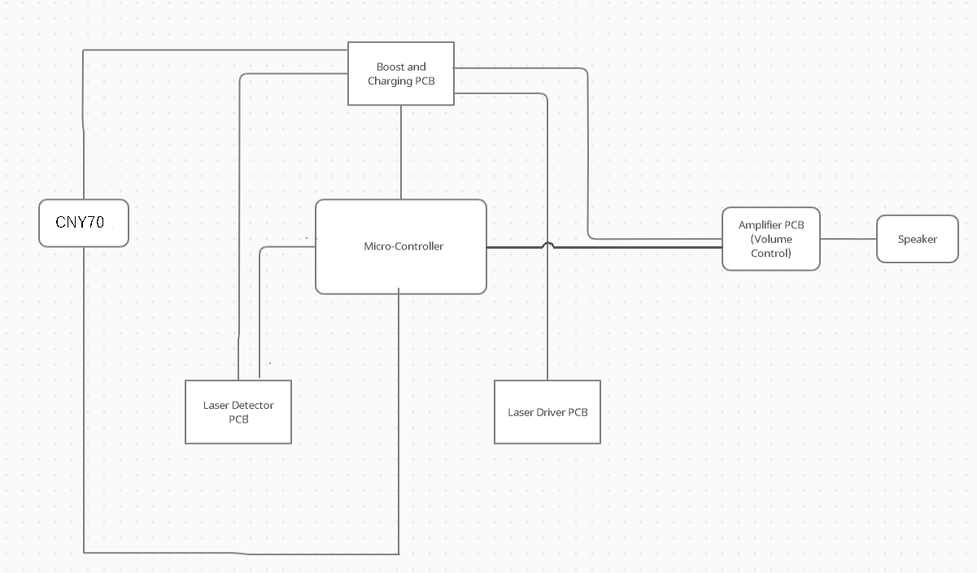

Block Diagram of the Overall Design

Slide 13
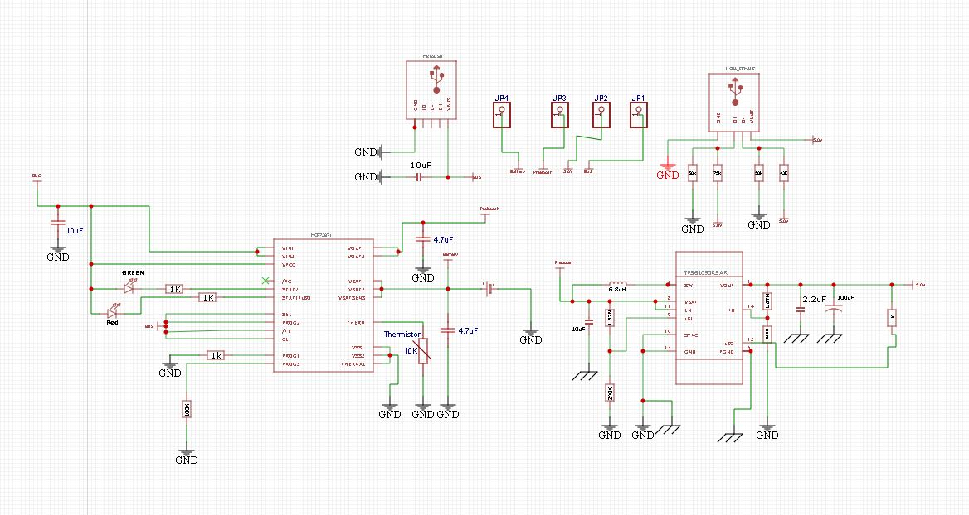
Schematic of Battery Charging Circuit
MCP73871 Battery Charger IC
TPS6109 Boost Converter

Slide 14
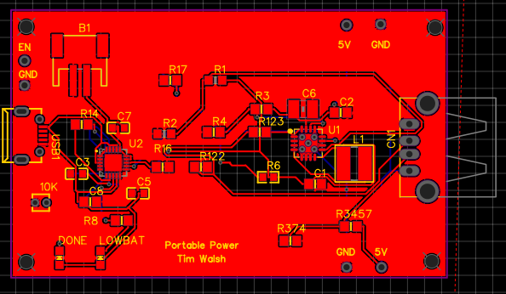
PCB of the Charging Circuit
Micro USB input
USB output
4 Headers for testing
JST plug to connect battery pack

Slide 15
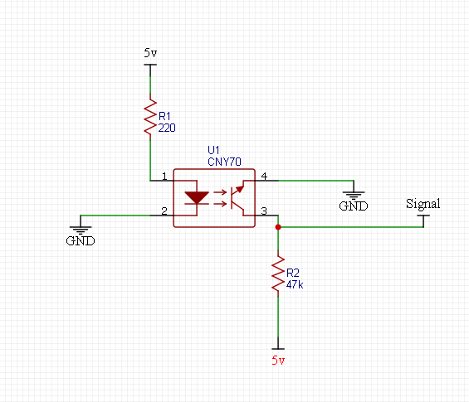
Mouth Sensor
To detect air being blown into the device, a CNY70 proximity sensor is used
Circuitry is very simple and the PCB for this was etched ourselves

Slide 16
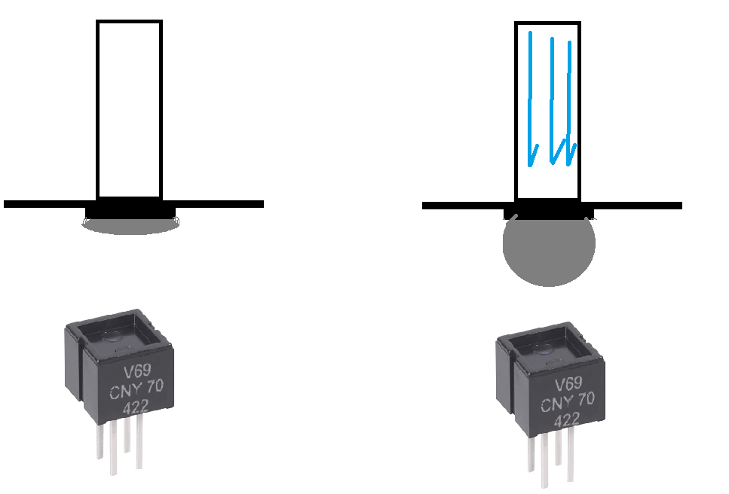
Mouth Sensor

Slide 17
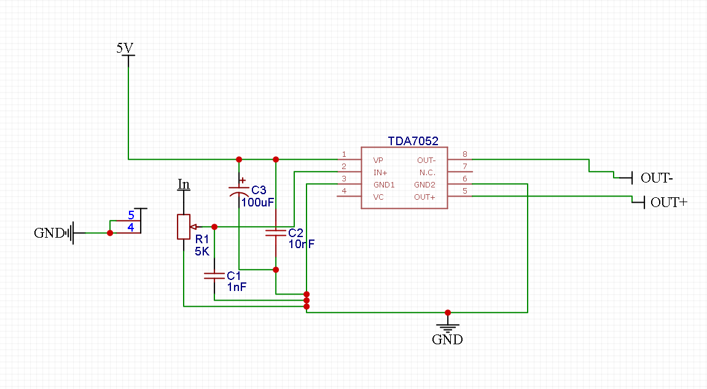
Volume Control Circuit

Slide 18
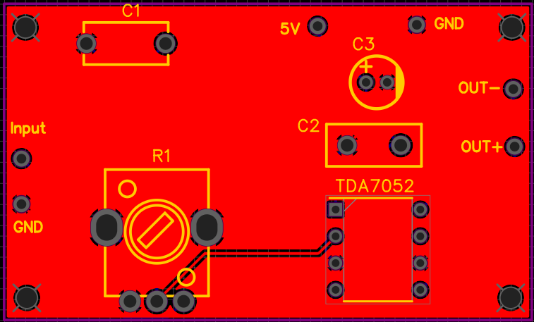
PCB of the Volume Control Circuit
Audio Input Pin
5 Volts Input to Power IC
SPKR pin outputs boosted audio

Slide 19
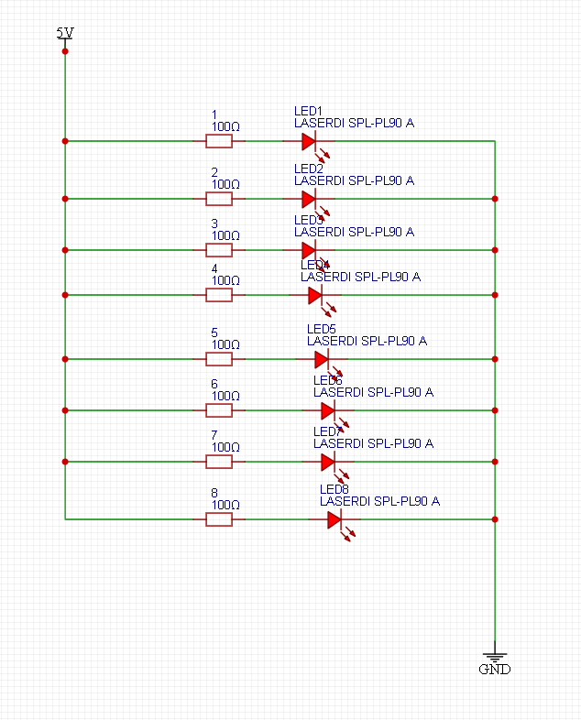
Laser Driver Circuit

Slide 20
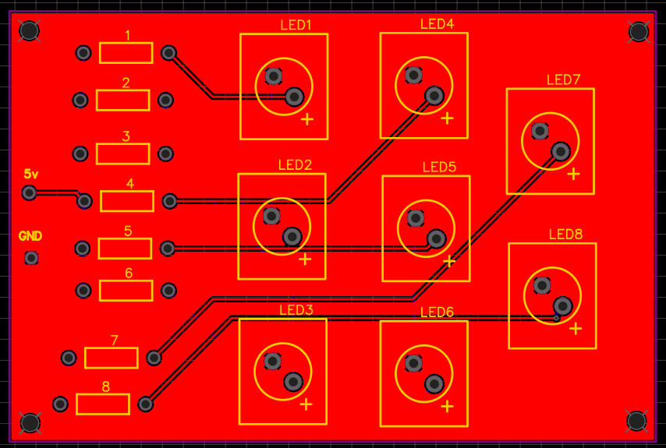
Laser Driver PCB

Slide 21
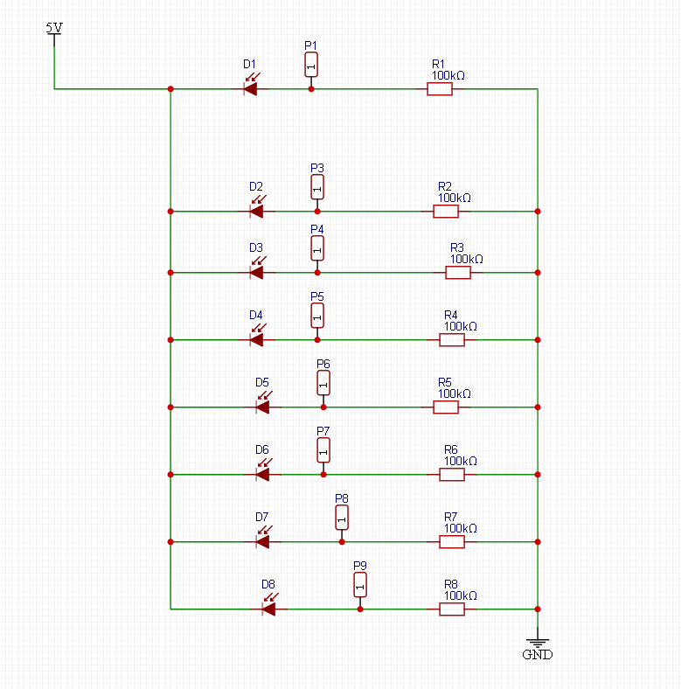
Laser Detector Circuit

Slide 22
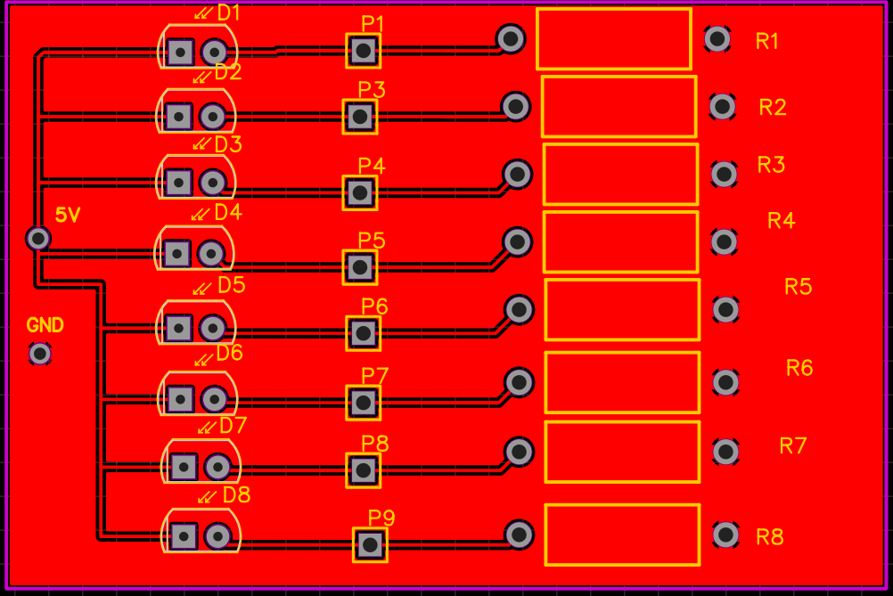
Laser Detector PCB

Slide 23
Current Draw
TPS Boost IC is limited to 1.5A output before chip malfunction
Arduino operates on 200mA via USB
Driver operates at approx. 250mA
Detector Operates at 75-100mA
CNY70 operation current is very low and negligible.

Slide 24
PCB Fabrication Process
We have ordered our PCBs from JLCPCB
The simpler PCBs or those that needed last minute changes were etched at my home using Ferric Chloride etching and hand drilled.

Slide 25

Note Processing and Software

Slide 26
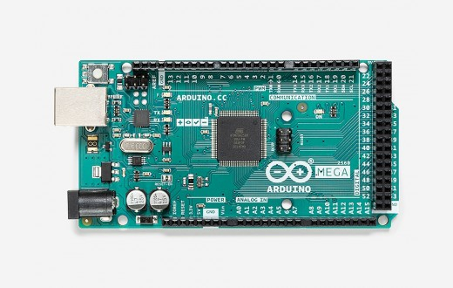
Microcontroller - Arduino Mega 2560
Processor: ATmega2560
Specifications
256KB Flash memory
8KB RAM
16Mhz clock
I/O pins
86 general-purpose
16 Analog/Digital Converter (ADC)
channels
Price: $40.30

Slide 27
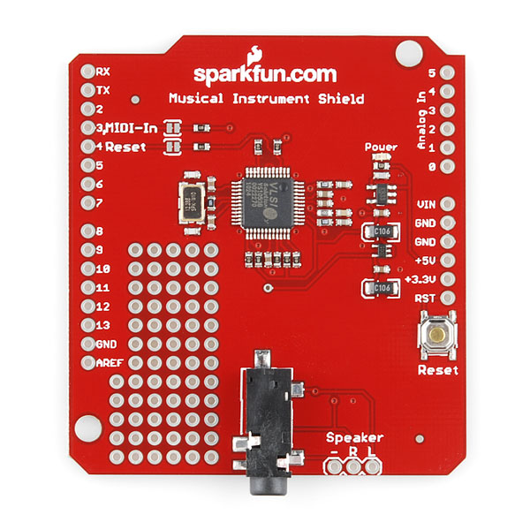
Instrument Shield
MIDI synthesizer
Tone bank of 189 instruments
Connects to Arduino through header pins
Connects to speaker/headphones through
AUX cable
Price: $34.95

Slide 28
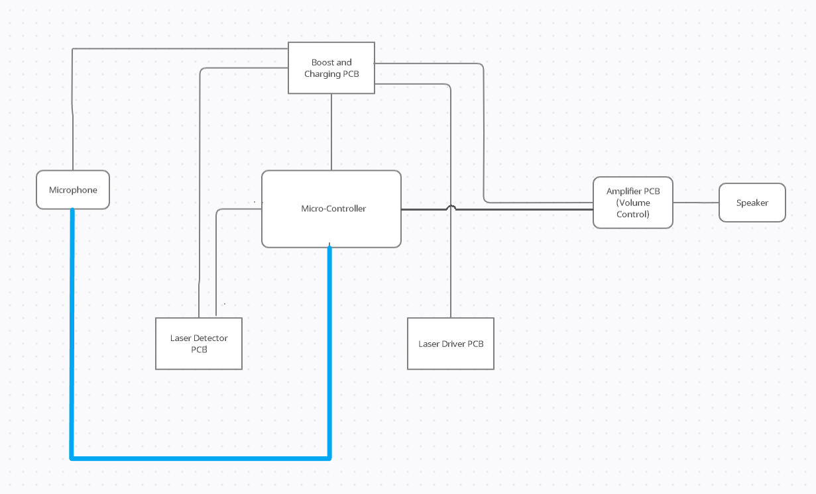
Mouthpiece to Microcontroller
Proximity sensor will detect the distance from the membrane to the mouthpiece
Distance will be used by the Arduino to determine whether the instrument is being played

Slide 29
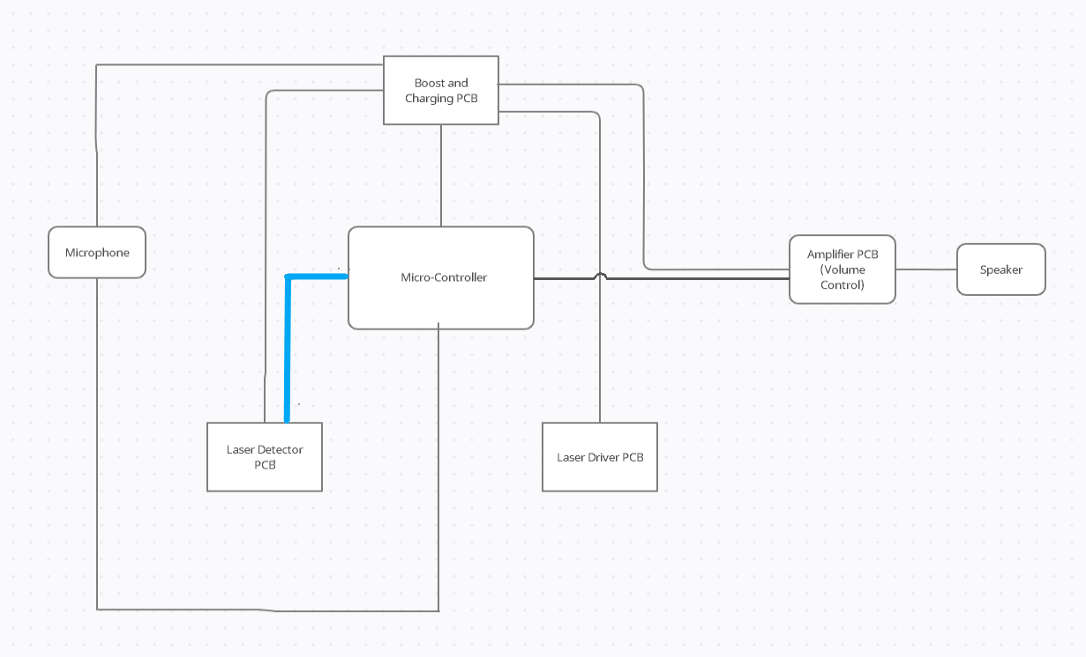
Photodiodes to Microcontroller
8 photodiodes will be connected to Analog/Digital Converter (ADC) pins of the Arduino as laser detectors
Each detector will transmit whether or not it detects a laser input
Combination of triggered detectors will be used by the Arduino to determine what note is being played

Slide 30
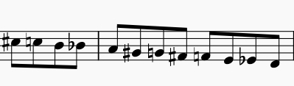
Keys and Note Generation
Each laser detector corresponds to a key of the saxophone
Actual alto saxophone fingering is matched as closely as possible
With 8 keys, notes range from Low D to Mid D (12 unique notes)
Stretch goal: 18 keys to match traditional alto sax
Notes range from Low B flat to High F sharp (32 unique notes)

Slide 31
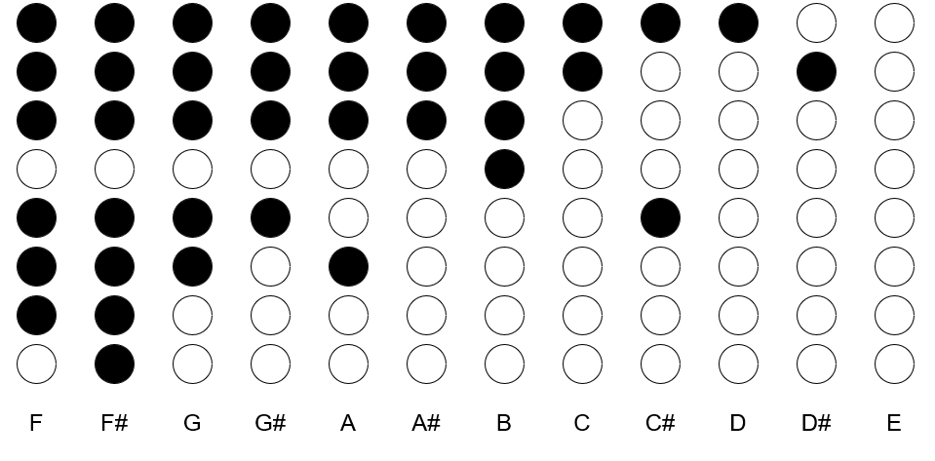
Key Configuration
Notes are determined in
concert scale
Keys 1 - 8 descending
Left hand: top 4 (1 - 4)
Right hand: bottom 4 (5 - 8)
Any key combination not
corresponding to a note as
shown here defaults to an
open note (mid E)

Slide 32
MIDI Synthesis
Synthesizer will communicate with the speaker using four main messages: Note On and Note Off, Control Change, and Program Change
Program Change determines instrument tone to be used on given channel
Note On turns on specified note on given channel
Channel determines instrument
Note determined by input from laser detectors
Velocity determines how forcefully note is played
noteOff(channel, note, velocity)
Same format as noteOn, but turns the note off
Control Change determines controller to be modified and value to be assigned

Slide 33
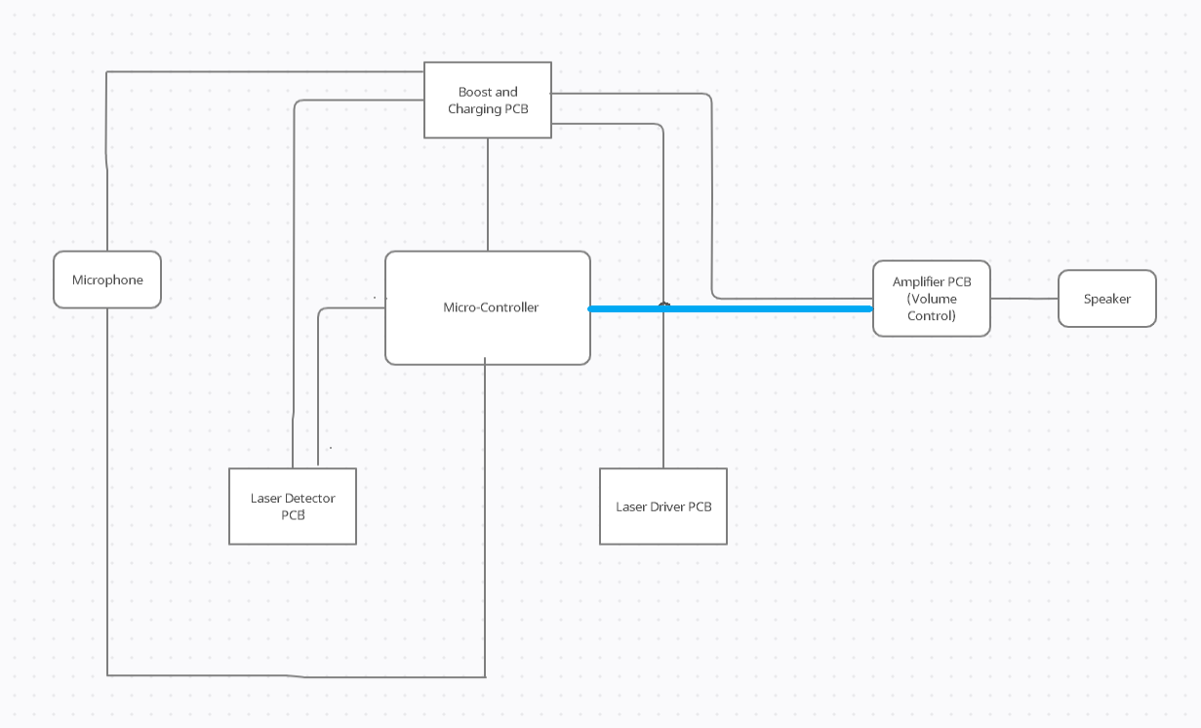
Microcontroller to Amplifier
Using input from the laser detectors and proximity sensor, the Arduino determines whether a tone should be generated and, if so, which note the instrument shield should send to the amplifier

Slide 34
Administrative Content

Slide 35
Work Distribution
Role | Primary | Secondary
Photonic Subsystem | Manuel | Tim
Note Processing | Andrea | Manuel
Power Delivery | Tim | Manuel/Andrea
Peripherals | Tim Walsh | N/A
Casing/Mechanisms | Manuel Correa | N/A

Slide 36
Budget
Components | Price
PCB, ICs, etc. | $75
Arduino Mega 2560 | $40.30
SparkFun Music Instrument Shield | $34.95
Auxiliary components (volume knob, AUX cable, speaker, etc) | $25
Laser diodes | $150
Photoresistors | $20
Housing components | $20*
Total | $365.25

Slide 37
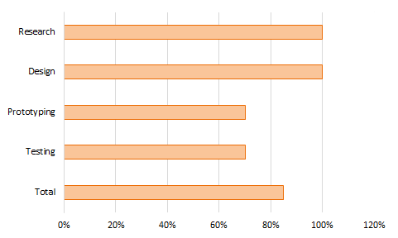
Work Progress

Slide 38
Challenges/Obstacles
Down one member
Lack of mechanical knowledge
Delay in PCB acquisition
Schedule Differences/Unexpected Emergencies

Slide 39
Thank you

