Slide 1

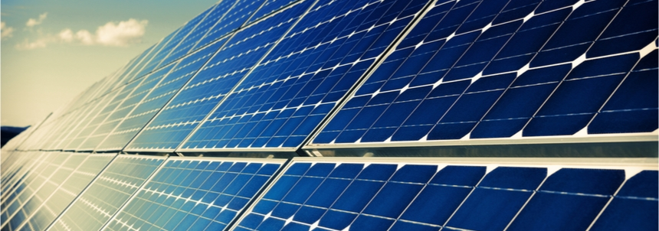

High Capacity Battery Solar Powered System (HCBSPS)
Group 09
Josiah Best
Mike Howell
Eduard Meighan
Jason Rodriguez

Slide 2

Project overview
Lithium Iron Phosphate Battery (LiFePO4)
  Battery composition doesn't risk thermal runaway
  Safe and affordable to assemble via individual cells
User friendly controls and interface
  User friendly BMS with mobile app integration
  Easy to navigate graphs and interface
Touchscreen Capability

Slide 3
The Problem?
How do we set ourselves apart from others who have created Lithium Iron Phosphate battery systems?

Slide 4
Why this system?
OTHER SYSTEMS
  Other systems utilize different, less safe and less optimal chemical compositions in their cells
  Other compositions run the risk of thermal runaway under stress
  Difficult to assemble cell by cell
  No touchscreen capabilities
OUR SYSTEM
  No risk of thermal runaway due to chemical composition
  Touchscreen Solar Charge Controlelr
  Affordable components
  Easy to utilize by the consumer

Slide 5
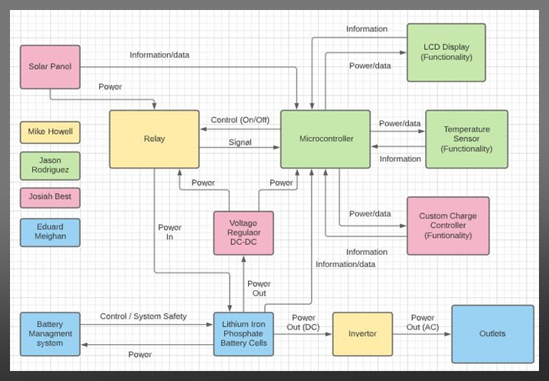
Design approach

Slide 6
Difficulties faced
Shorter period over the summer semester
Group member on a month-long quarantine due to the spread of covid in the household
Extended lead times on shipping due to the impact of covid and Suez Canal
Project scaling from 6A to 20A

Slide 7
Design objectives
High-Capacity Storage
Semi-Portable
Affordable
Safe to operate
Easy and Intuitive to use

Slide 8
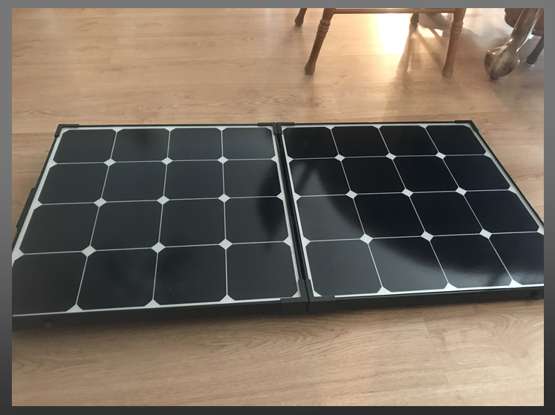
Our chosen solar panel
Renogy 100W 12V Monocrystalline Foldable Suitcase Solar Panel
Donated
Max operating voltage = 18V
Max operating current = 5.56A
Max operating power = 100.08W

Slide 9
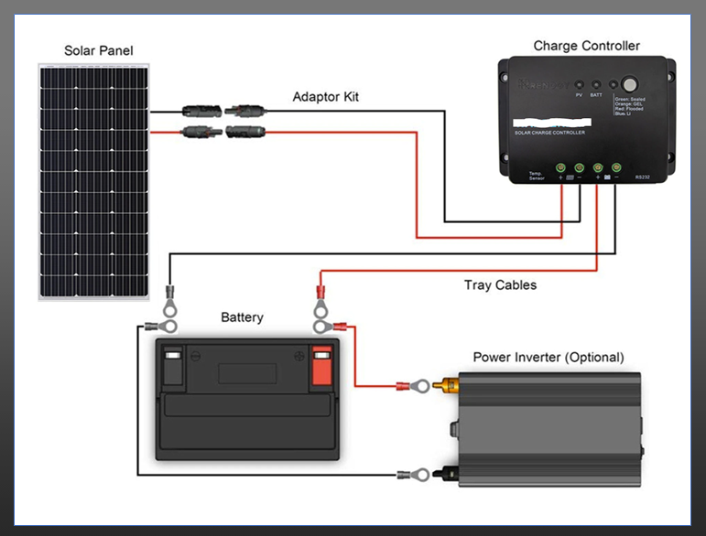
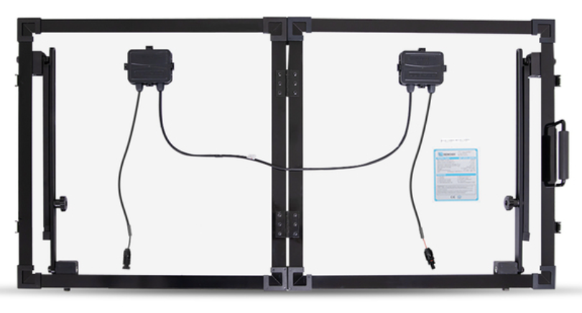
solar panel implementation
Solar panels will be connected to each other as shown in the image below
Solar panel will directly connect to the solar charge controller.
Solar charge controller, Battery Assembly and Inverter should be plugged in prior to connecting solar panel to the assembly

Slide 10
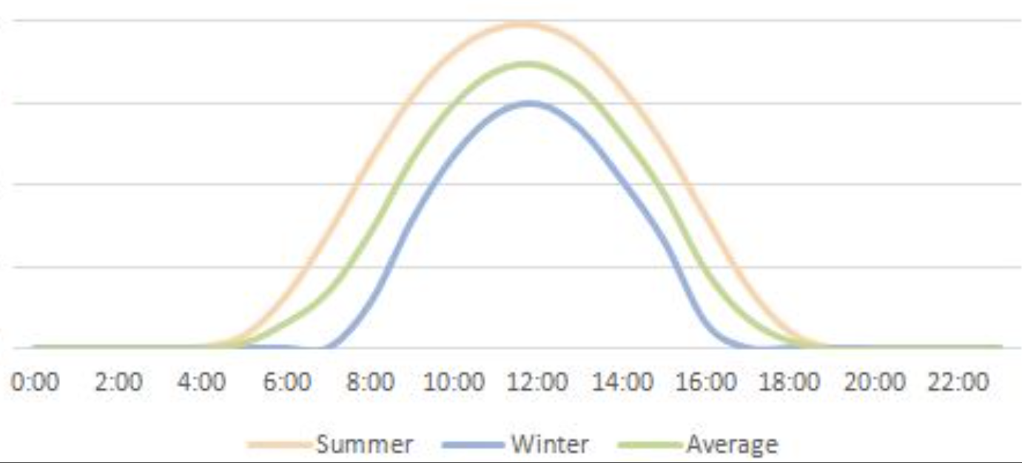

solar panel expected yield
Solar panels are typically the most efficient in the middle of the day due to the amount of sun exposure.
Assuming 80% panel efficiency, and 4 peak sunligt hours, we expect roughly a daily power yield of 400W

Slide 11
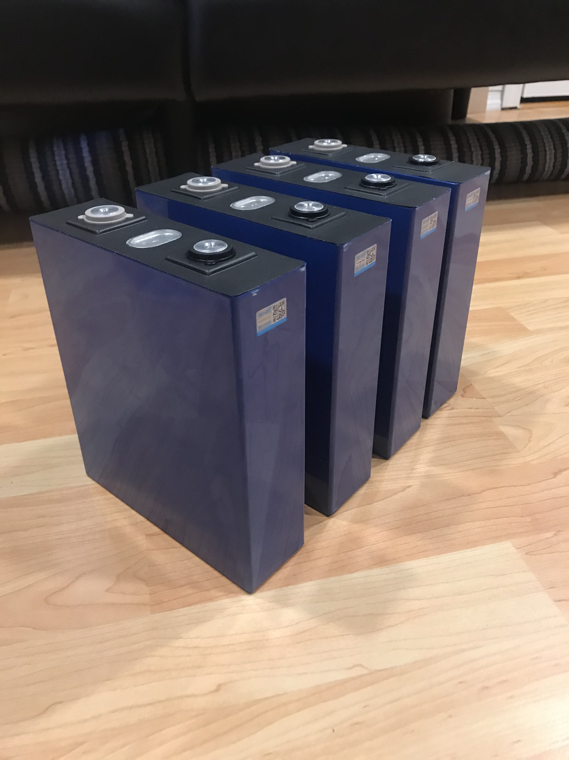
Our chosen Battery
(4) Lithium Iron Phosphate battery cells connected in series
Most cost effective/efficient solution for high-capacity storage
Easily scalable
Lithium Iron Phosphate has the greatest depth of discharge compared to other battery types excluding Lithium Ion
Self-assembly of cells allows for more depth of design and better economy

Slide 12
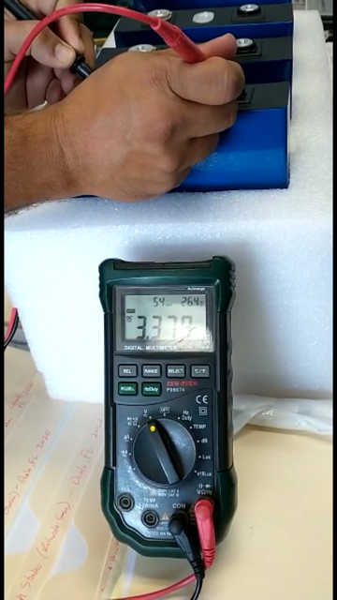
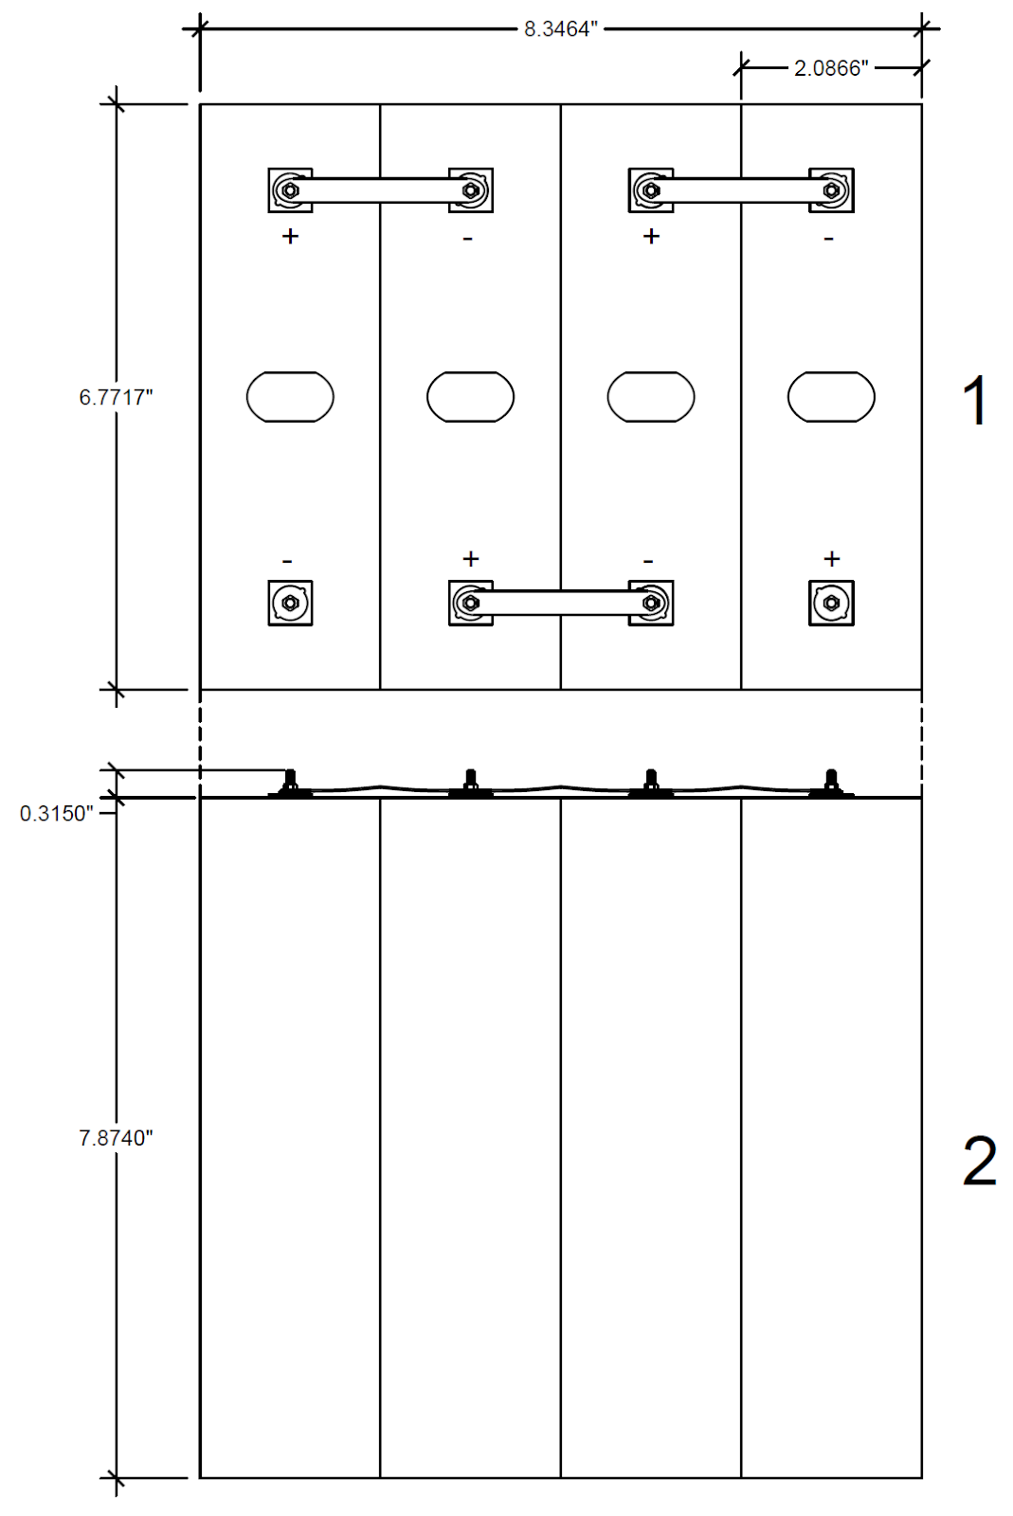
Battery cell testing/assembly
Actual cells tested to be 3.379V each
Maximum cell capacity is 3.65V
Each tested cell has the same voltage meaning we don't have to balance the cells ourselves
All cells will be connected in series using the provided copper bus bars as shown in the image to the left
Connecting each cell in series will provide a 13.5V, 200Ah battery

Slide 13
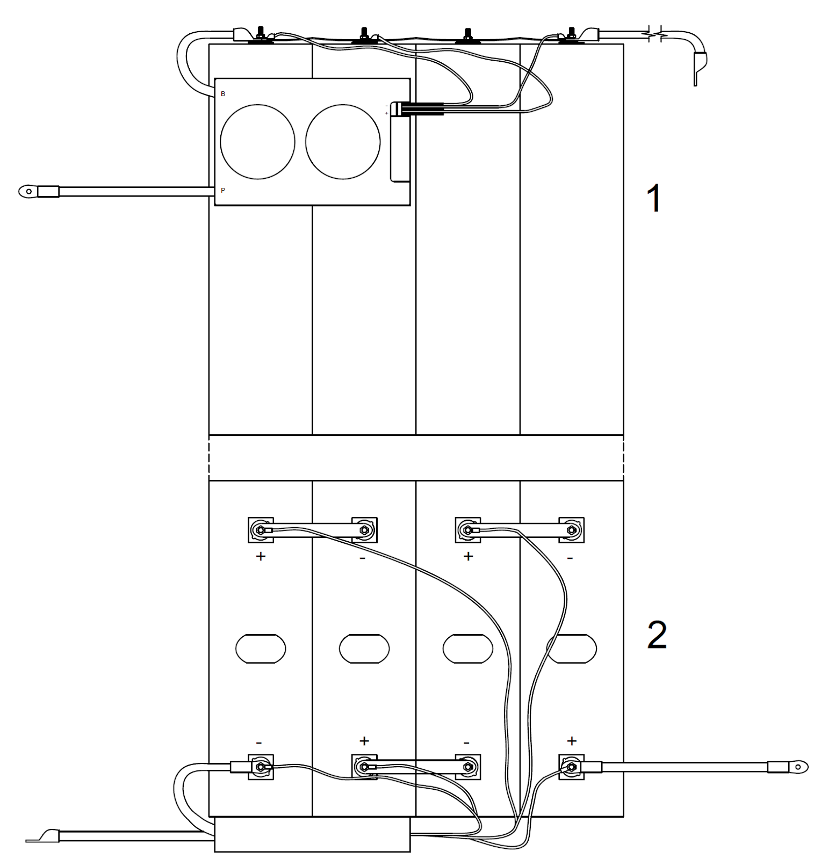
Battery cell Full assembly with cables
4 Gauge wire will be connected to the main positive terminal of the battery
BMS balancing wires will be connected to each positive terminal on the battery
BMS main cables will connect to the main negative terminal of the battery
The BMS and its functionality in our design will be explained later in the presentation

Slide 14
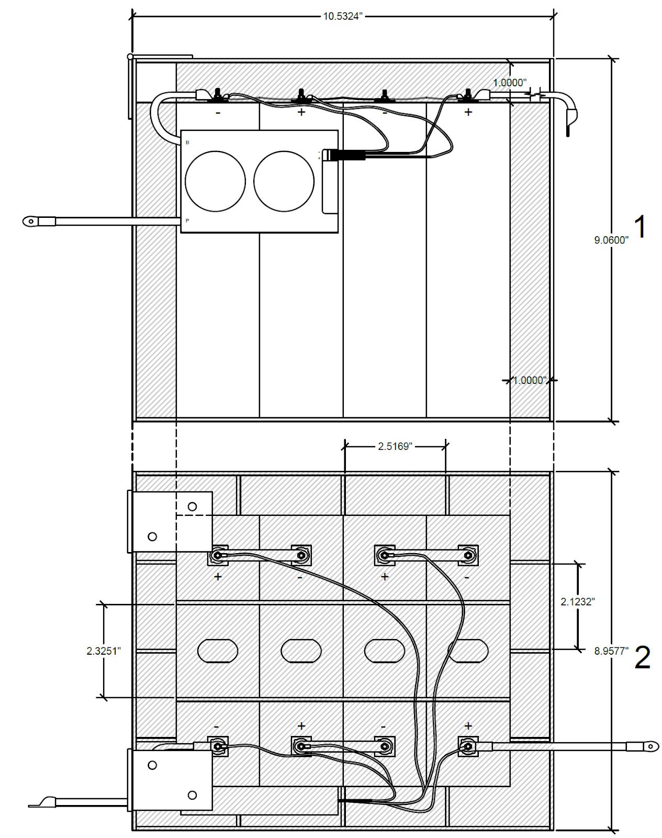
Battery cell Enclosure
Enclosure will be built using plexiglass
Small plexiglass pieces will be cut to use as spacers to provide heat ventiliation as shown in the bottom picture
The plexiglass enclosure will have a plexiglass hinged lid as shown in the image to the left
(2) Horizontal spacers will be attached to the bottom of the lid to isolate the top of the battery from the plexiglass

Slide 15
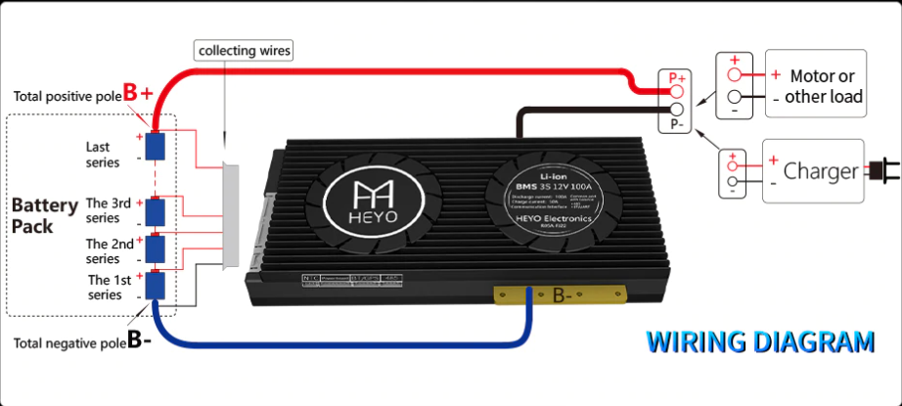
Battery Management System
A Battery Management System is vital to the lifecycle of the battery it manages
The BMS performs a multitude of different functions that include balancing the battery and keeping it at the appropriate temperature
Has the ability to measure the voltage of each individual cell

Slide 16
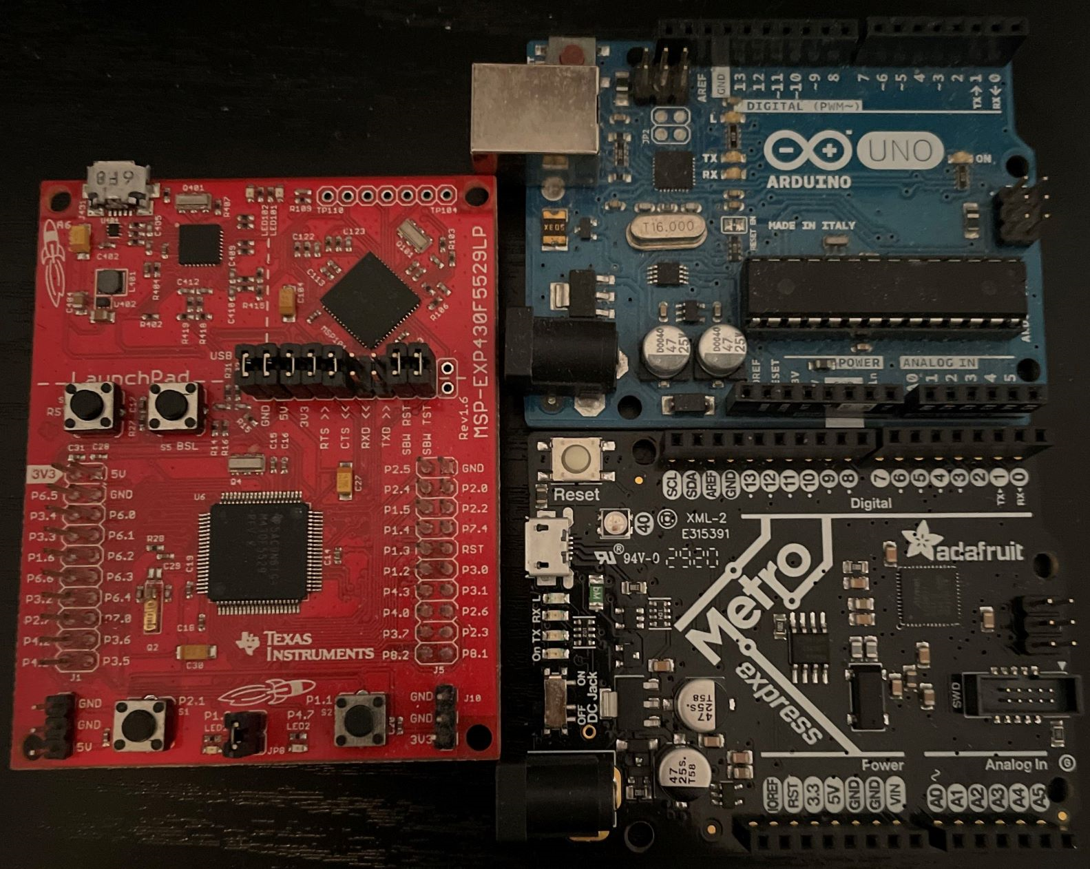
The Microcontroller (MCU)
Why The METRO?
ATSAMD21G18 ARM Cortex M0+
  32-bit architecture
  256 KB flash memory and 32 KB of SRAM
  UART, SPI, I2C.
  48 MHz
  low power consumption
  Internal Real-Time-Clock (RTC)
Used with the Adafruit METRO M0 Express board
  Flashing
  Has regulators and other neat features
  Comes with an additional 2MB flash chip
    Useful for Datalogging

Slide 17
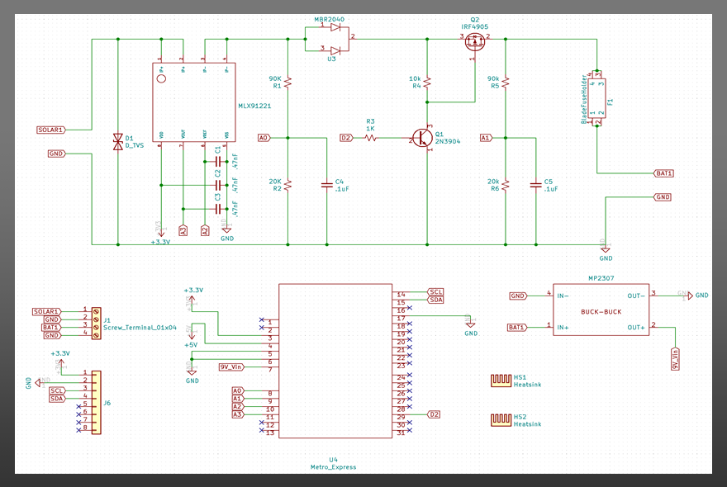
Charge Controller Circuit Diagram

Slide 18
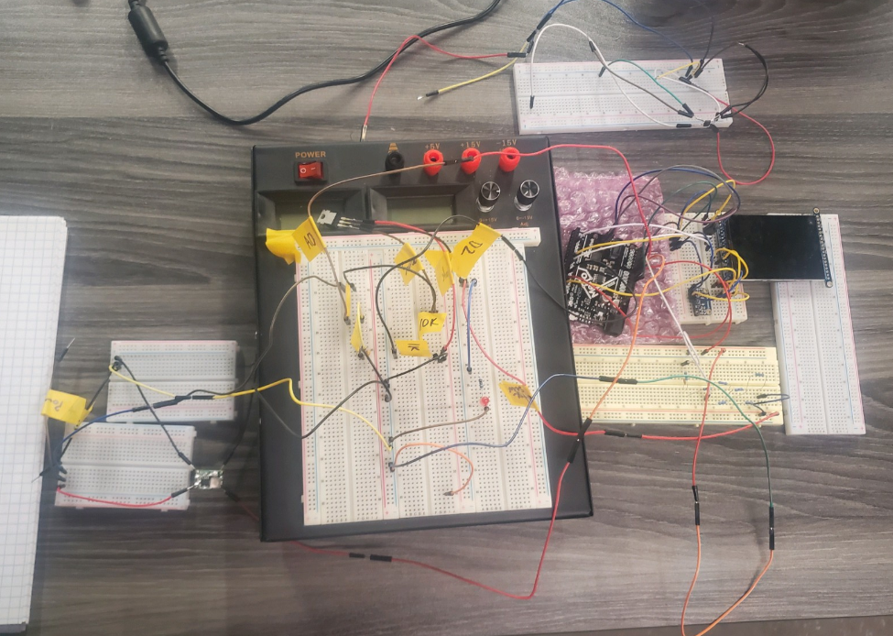
Charge Controller Breadboarded

Slide 19
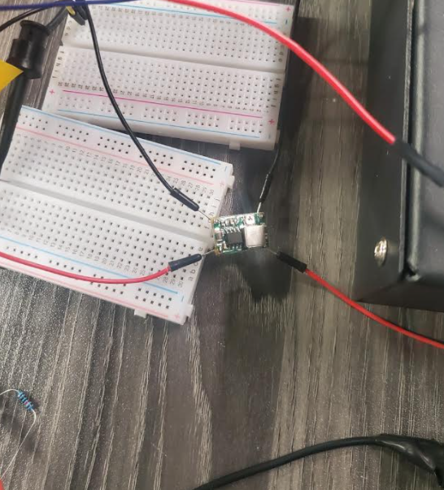
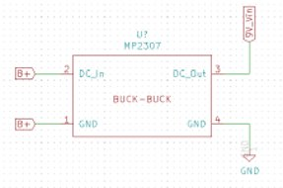
BUCK TO BUCK CONVERTER
Provides stable voltage output
More efficient
Can be toggled for specific output value
Why use it?

Slide 20
Built in Protections
TVS Diodes
Schottky Diodes
Fuse
LiFePO4 Batteries
BMS
Relays
What do they offer?

Slide 21
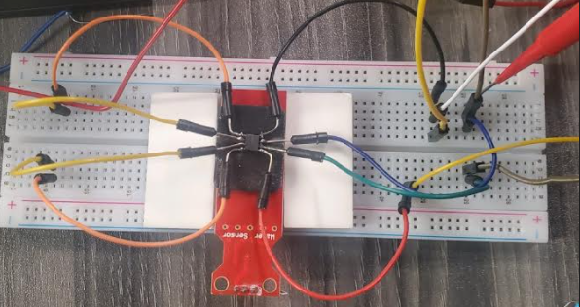
Current Sensor
As current is going through the sensor:
  It returns a voltage value with respect to its supply voltage.
  The Analog-to-Digital converter (ADC) can use that value to calculate the current.
  If the ADC is using a different supply voltage, pin Vref from the sensor can be used.

Slide 22
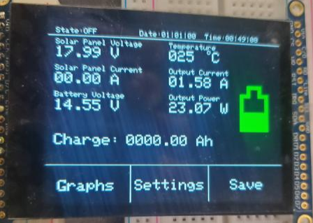
Voltage Dividers
Used to read the voltage from solar panel side and battery side
Divider with A0 pin reads solar panel voltage
Divider with A1 pin reads battery voltage
Supply capacitors?

Slide 23
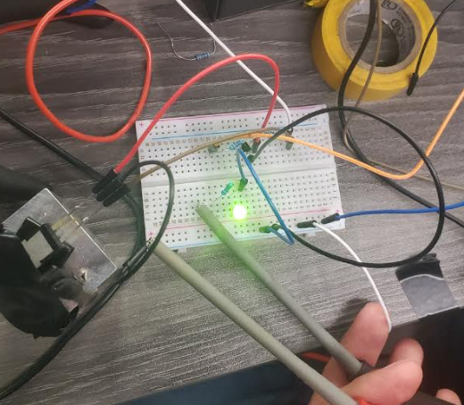
PMOS/BJT Testing
NPN BJT is used as a switch
MOSFET acts as a "variable resistor"
Base current drives collector current
Gate voltage drives the PMOS
LED is our load to indicate when activated

Slide 24
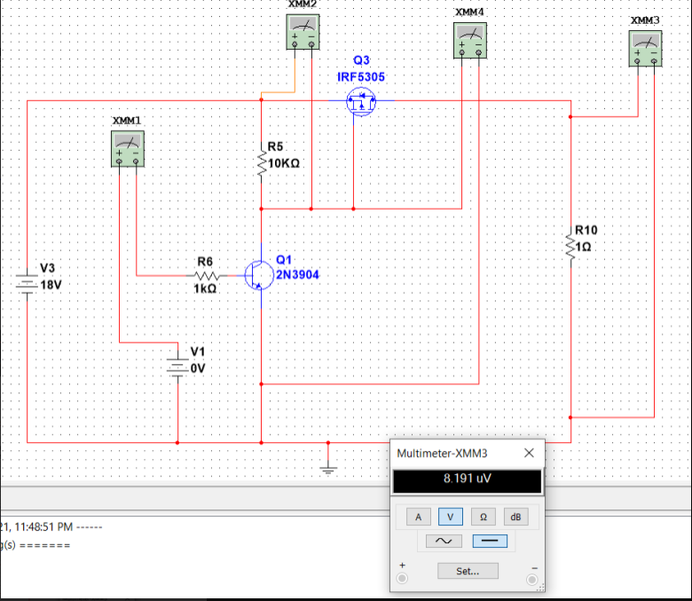
PMOS/BJT Simulation (No pwm sent)

Slide 25
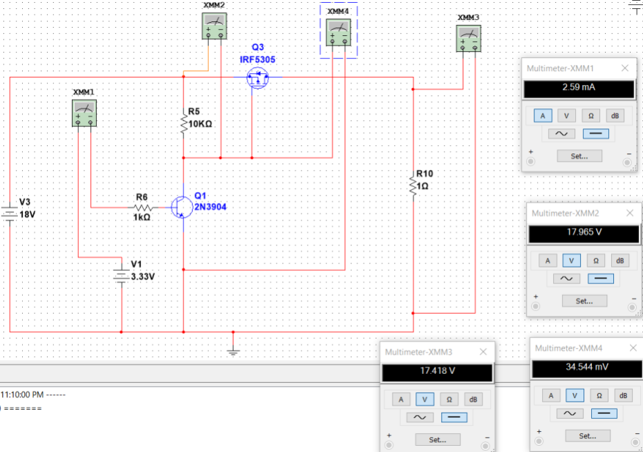
PMOS/BJT Simulation (when pwm applied)

Slide 26
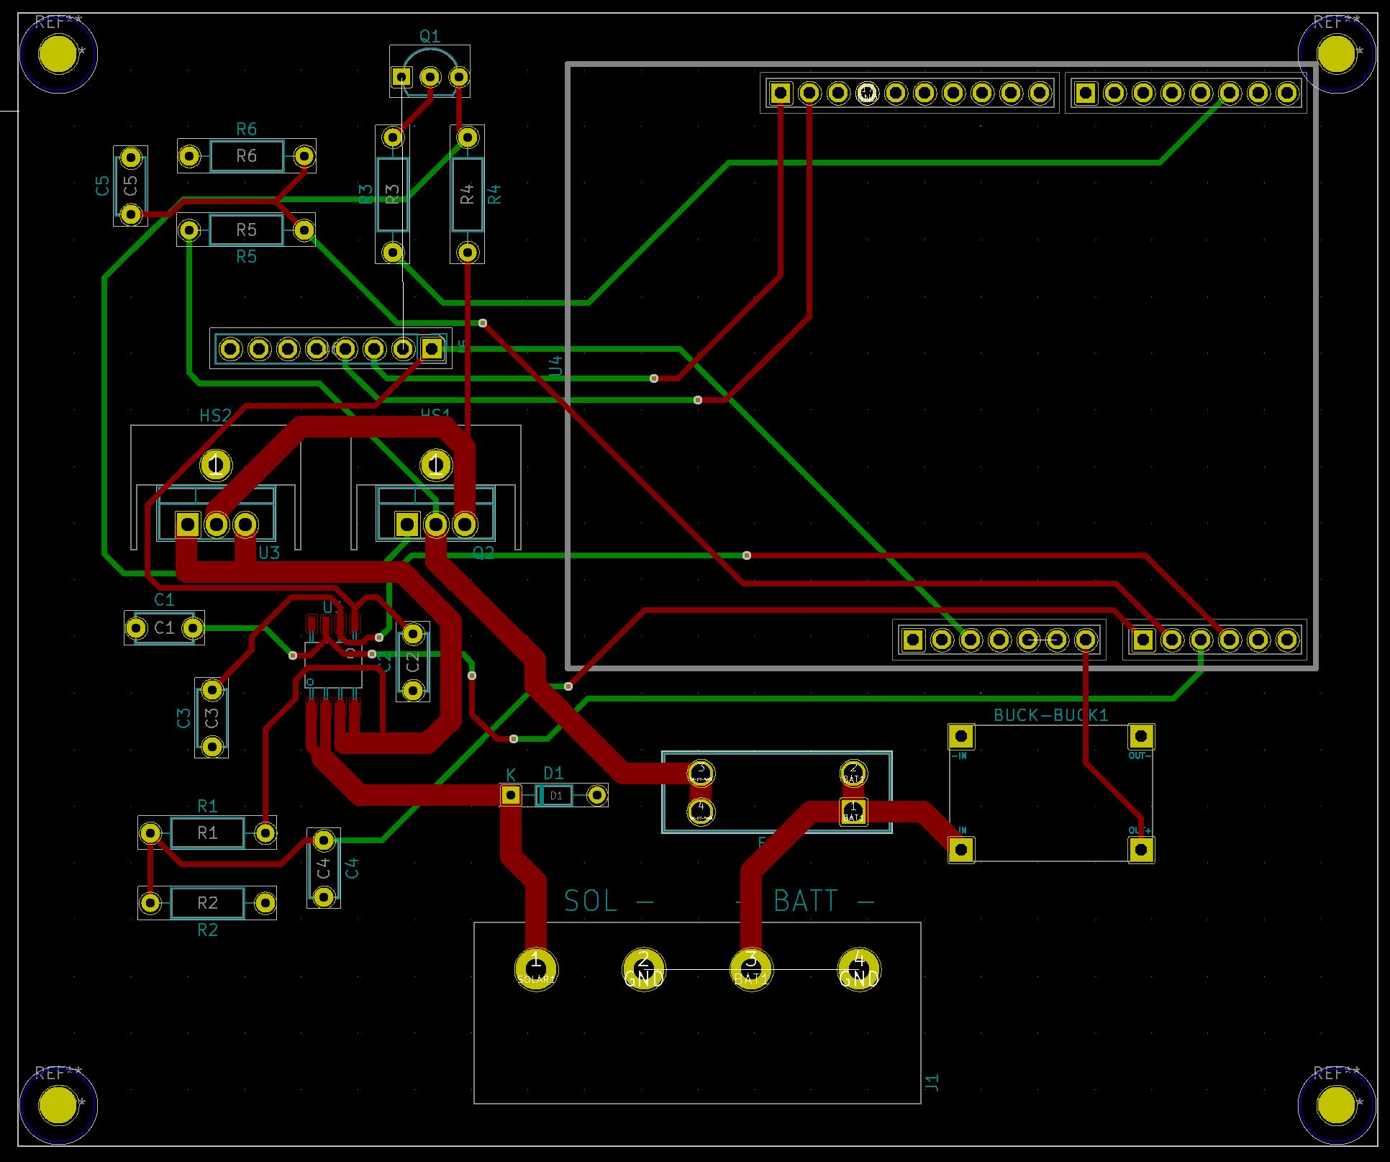
PCb design (ground pours hidden)
Two-layer board design
2oz outer copper weight per layer
Based on testing, each trace width has been calculated to handle the maximum current running through it
120mm x 100mm

Slide 27
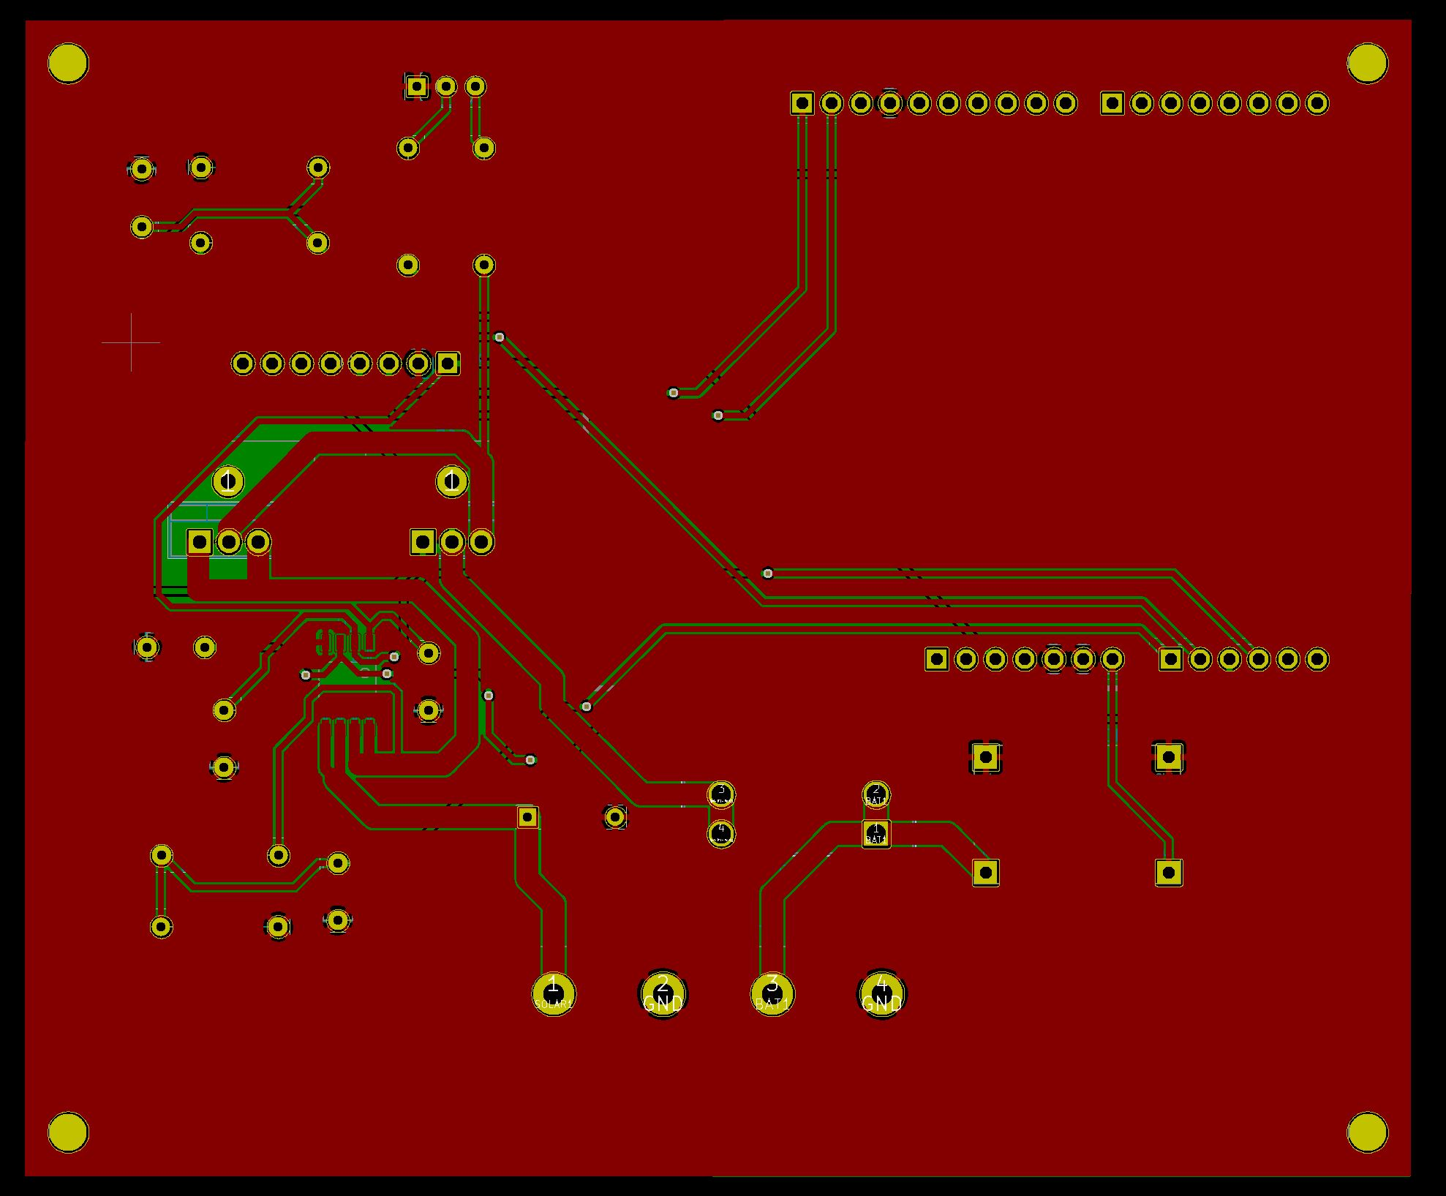
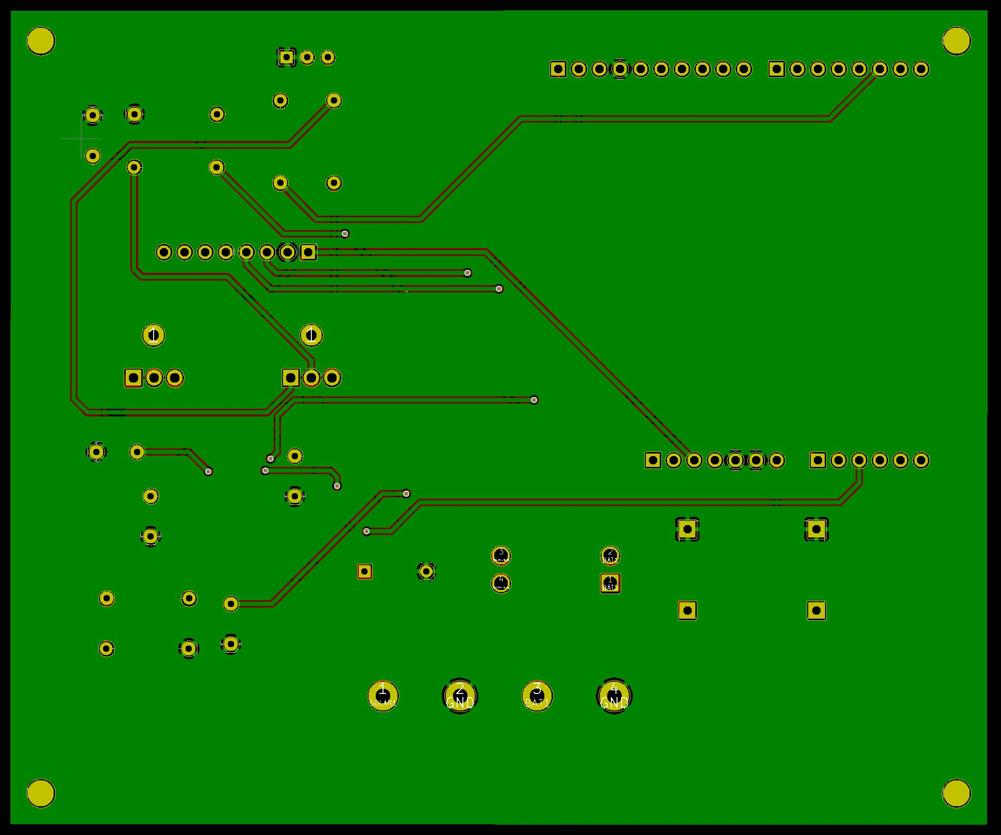
PCb design (front and back copper layers with gnd pour)
Front copper layer with gnd pour
Back copper layer with gnd pour

Slide 28
Software design
There are two components for the software.
  The Graphical user interface (GUI)
    This displays information about each critical component in an easy-to-understand format.
    Gives users many options and features.
    Design decisions based on existing Charge Controllers in the market.
  The charging algorithm
    Charges the battery based on the LIFEPO4 charging profile.

Slide 29
Software design – tHE gUI
Uses Adafruit Graphics Library for graphics
  Extensive documentation
  Many examples on the internet.
uses SPI and I2C libraries to communicate with:
  The Capacitive Touch Controller.
  The METRO's SPI flash chip memory.
  The Temperature Sensor.
  The LCD.
Compatible with many Arduino Zero libraries
  RTCZero was used for example.

Slide 30
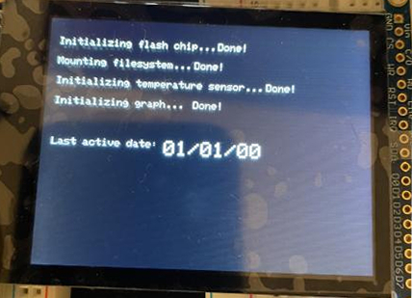
Boot Screen
Boot Screen
  Initializes hardware and software.
    Queues are filled if data is present.
  Gives the user the last active date.
    Date is saved every time new day occurs.
      Including when it first boots.

Slide 31
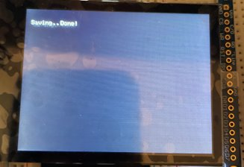
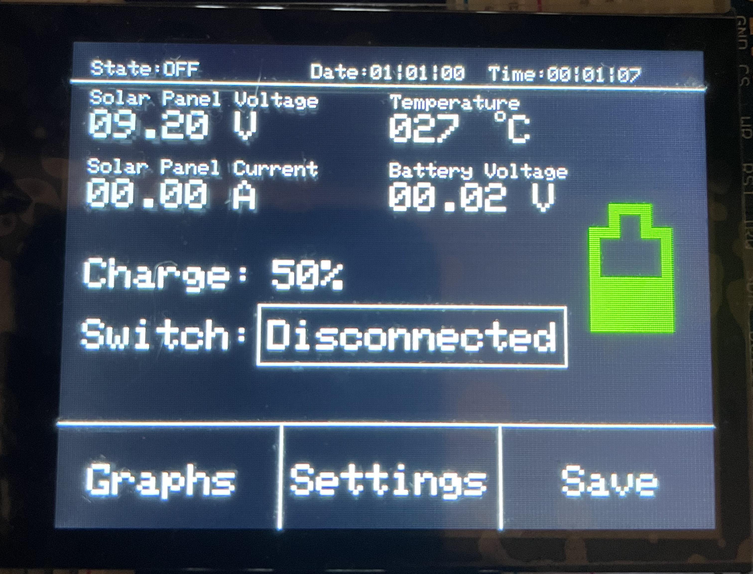
Main screen
Displays Ambient Temperature
Displays date and time
  24-hour time and 2-digit year format
Displays information about the solar panel
  Senses the voltage across the panels.
  Interprets the voltage returned by the current sensor.
Displays information about the battery
  Senses the voltage across the battery.
  Battery's charge determined using a voltage ratio.
    Charge is also illustratively represented.
  Battery's state is displayed on the top left corner
Four buttons
  Button below charge level switches the relay.
  Three buttons below for other functions.
Saving Data

Slide 32
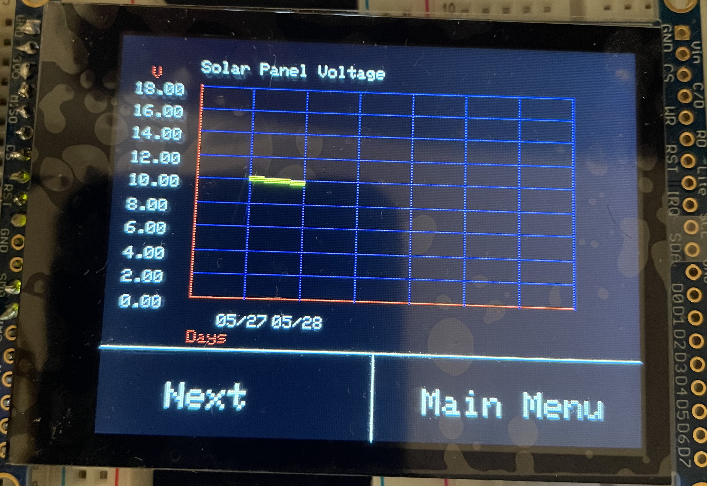
Graph screen
Queues were used to store data for the graph
  Maximum capacity of 7 days.
  Values and dates are stored.
    Dates were converted to floating point values.
      For example, 05/27 corresponds to 5.27
  First In First Out (FIFO)

Slide 33
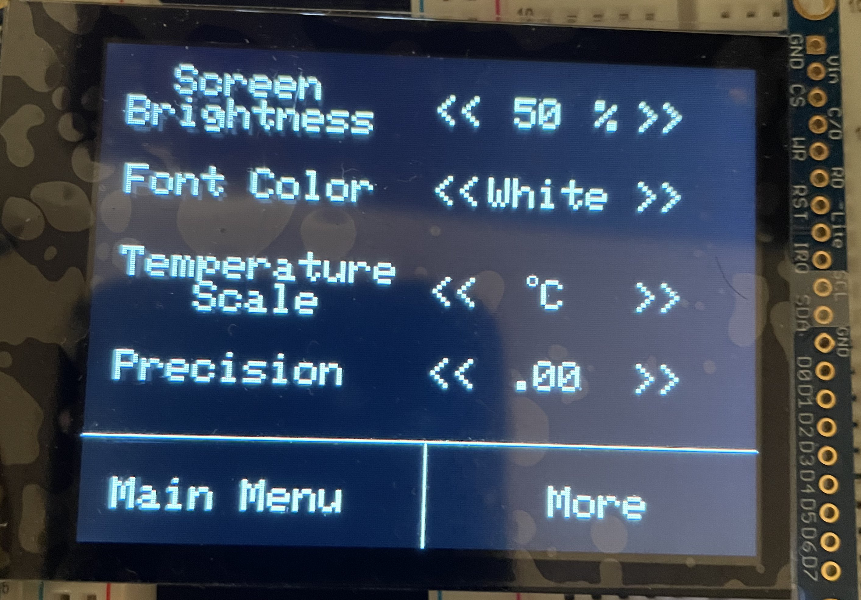
Settings Screen – first screen
Screen Brightiness
  Increases/Decreases screen brightness by 10%.
    Minimum: 10%, Maximum: 100%.
Font Color
  Changes the color of the texts and some graphics.
Temperature Scale
  Switches output to Celsius or Fahrenheit.
Precision
  Increases/Decreases the number of place values.
    Minimum: none, Maximum: Two place values.

Slide 34
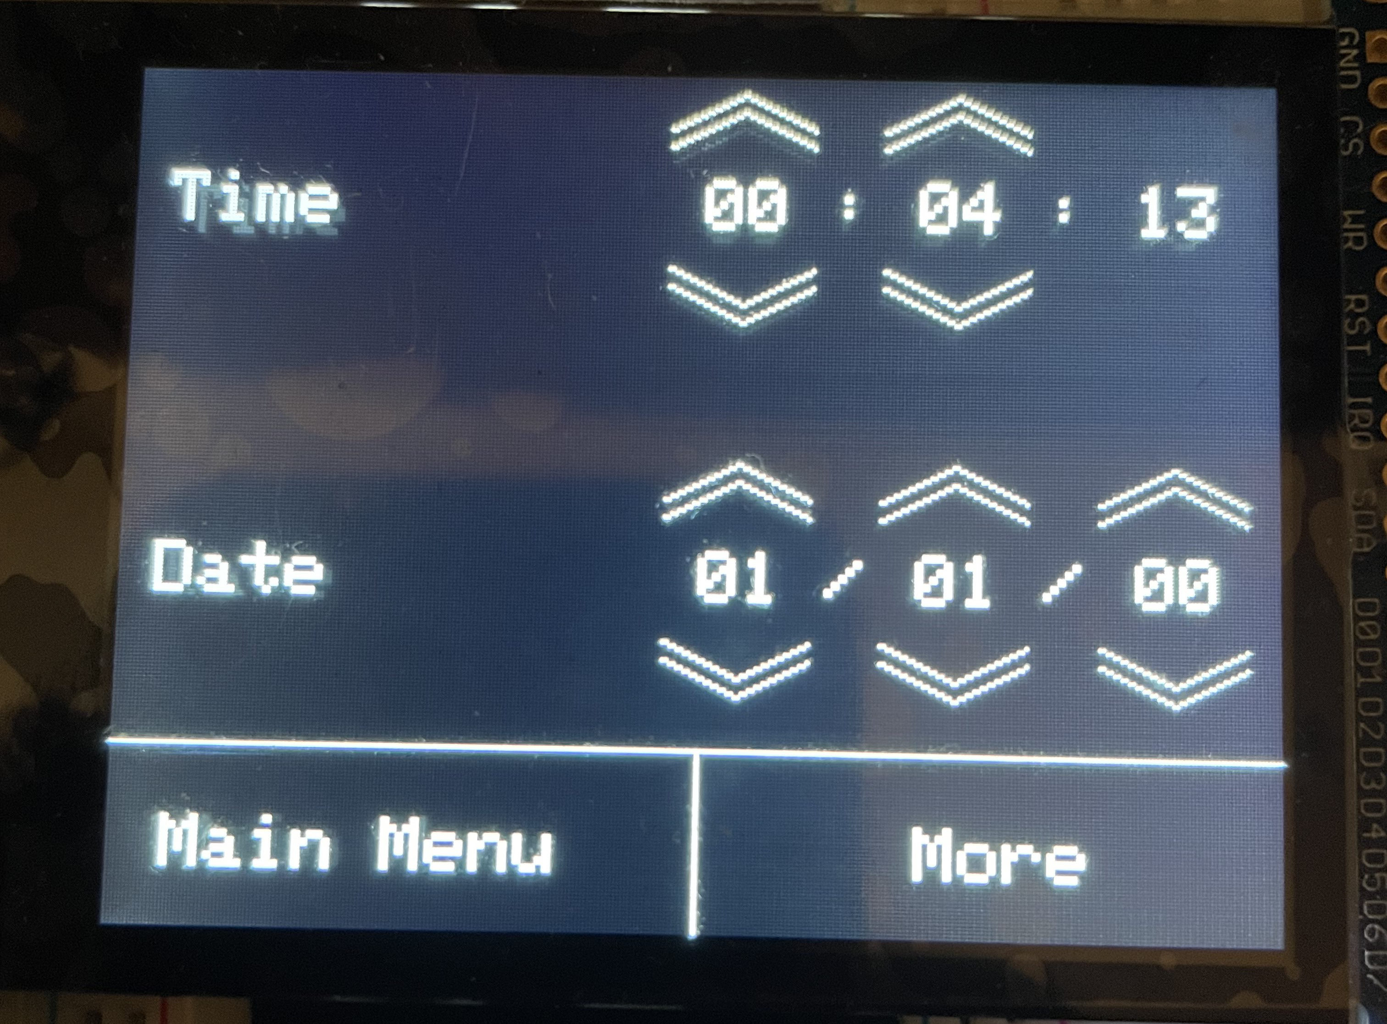
Settings Screen – Second screen
Date and time resets everytime the MCU shuts off
Time
  Hour and minute values can be changed.
  Seconds cannot be changed.
    Helps keep consistency.
Date
  Month/Day/Year format
  Leap years and 30/31-day months are accounted for.
    RTC also accounts for them when it is set.

Slide 35
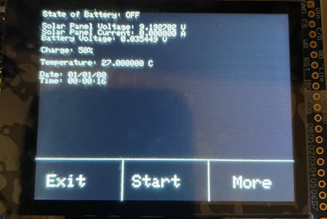
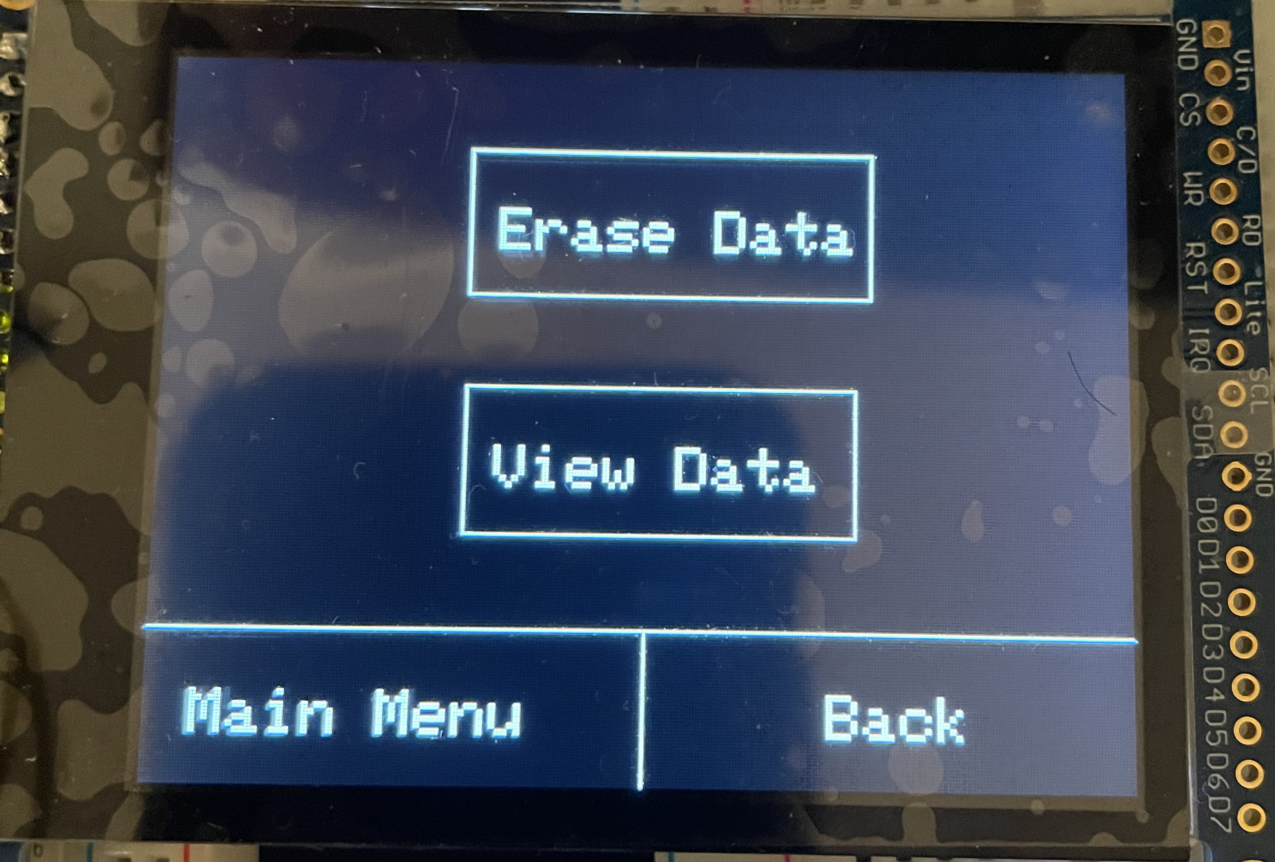
Settings screen – final screen
View Data
  Uses delimeters.
  User is able to cycle through saved data.
Erase Data
  Erases stored text files.
  Clears queues.
Viewing Data

Slide 36
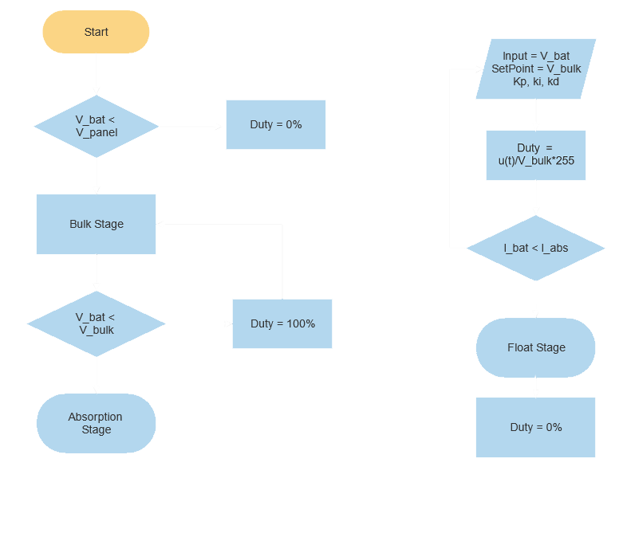
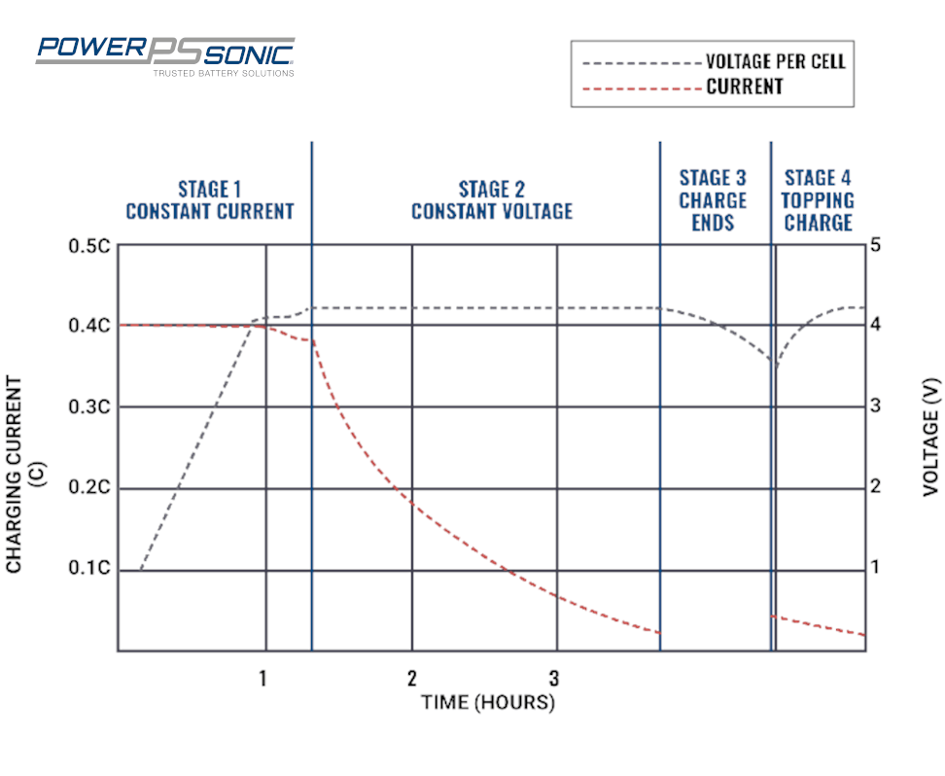
Software design – Charging Algorithm
Charging Profile

Slide 37
Software design – dIFFICULTIES Faced
Getting sporadic values from the sensor
  Length of wires.
  Unsecure connections.
  Excessive Noise.
    Possibly from power supply.
    Decoupling Capacitor did little help.
  Possible solution: Smoothing the result via sampling

Slide 38
Budget
ITEM | QUANTITY | PRICE ESTIMATE | PLACE OF ORIGIN
Solar Panel | 1 | Donated | Friend
Charge Controller | 1 | $80.00 | Custom
Battery Cells | 4 | $312.04 | AliExpress
Microcontroller | 1 | $25.00 | Adafruit
PCB Breakout Board | 1 | $6.47 | JLCPCB
BMS | 1 | $45.92 | AliExpress
Capacitive LCD Display | 1 | $39.95 | Adafruit
Relay | 2 | $12.00 | Amazon
Custom Plexi Enclosure | 1 | $39.44 | Home Depot
Hinge | 3 | $9.98 | Home Depot
Wiring | Varies | $35.00 / Donated | Amazon / Friend
Soldering Materials | Varies | $65 | Amazon / Home Depot
Inverter | 1 | Donated | Friend
Temperature Sensor | 1 | $5.00 | Adafruit
Total | N/A | $675.80 | N/A

Slide 39
Progress so far
Task | Duration | January | February | March | April | May | June | July | August
Research | 110 Days
Hardware Design | 45 Days
Software Design | 30 Days
Ordering Supplies | 60 Days
Solar Panel Integration | 30 Days
Microcontroller Integration | 30 Days
BMS Integration | 10 Days
Testing | 30 Days

Slide 40
Work distribution
Josiah
  Solar Panel
  Battery
  PCB
Mike
  Compiling Data
  CDR
Eduard
  Testing
  Assembling Hardware
Jason
  Microcontroller
  Lcd
  Code

Slide 41
Spring milestone chart
DESCRIPTION | TIMELINE | COMPLETION DATE
Senior Design Grouping | ~1 Week | 1st Week (1/14/2021)
Project Idea Brainstorming | ~1 Week | 2nd Week (1/21/2021)
Divide and Conquer 1.0 | ~1 Week | 3rd Week (1/29/2021)
Divide and Conquer 1.0 Meeting | ~1 Week | 4th Week (2/1/2021)
Divide and Conquer 2.0 | ~1 Week | 5th Week (2/12/2021)
Initial Project Research/ 60 Page Draft Due | ~7 Weeks | 12th Week (4/2/2021)
100 Page Draft Due | ~2 Weeks | 14th Week (4/16/2021)
Final Document Due (120 Pages) | ~2 Weeks | 16th Week (4/27/2021)

Slide 42
Summer milestones chart
DESCRIPTION | TIMELINE | COMPLETION DATE
Project Prototype Build | ~4 Weeks | 4th Week (6/4/2021)
In Class Presentation | ~1 Week | 5th Week (6/11/2021)
Testing and Fixes | ~1 Week | 6th Week (6/18/2021)
Finish Prototype (Based on Fixes) | ~2 Weeks | 8th Week (6/29/2021)
Final Presentation | ~4 Weeks | 12th Week (7/27/2021)
Final Document for Turn-In | ~1 Week | 13th Week (8/3/2021)

Slide 43
More information
Solar Panels
  https://solect.com/the-science-of-solar-how-solar-panels-work/
  https://science.nasa.gov/science-news/science-at-nasa/2002/solarcells
  www.lexology.com/library/detail.aspx?g=10aff4c1-37ba-4d43-a0ca-4154f5bd0473
Lithium Iron Phosphate Batteries
  www.power-sonic.com/blog/how-to-charge-lithium-iron-phosphate-lifepo4-batteries/
  https://ethospower.org/blog/learn-about-lithium-batteries/
  blog.epectec.com/lithium-iron-phosphate-vs-lithium-ion-differences-and-advantages

