Slide 1

Indoor Plant Maintenance System (IPMS)
Summer 2021

Slide 2

Jelawi Alqhtani
Electrical Engineering

Slide 3
SYSTEM SPECIFICATION
Sr. No | Description
01 | No need for the user to manually keep on checking the plants health
02 | Automatically water the plants when the owner is not present
03 | Power consumption of a wireless sensor network should be less so that it can be used for a long period of time.
04 | The user interacts with the android application and the sensors fixed around the plants will update the current condition of the plant environment.
05 | Precision is providing the environment condition of the plant.
06 | Sensors obtain ambient temperature, ambient humidity, soil moisture and illuminance it to the cloud which is then displayed on the UI on the user Android device.
07 | If the user is facing Internet problems, he/she can easily access using Bluetooth.
08 | The application should have an easy-to-use interface and present data with minimal latency.

Slide 4
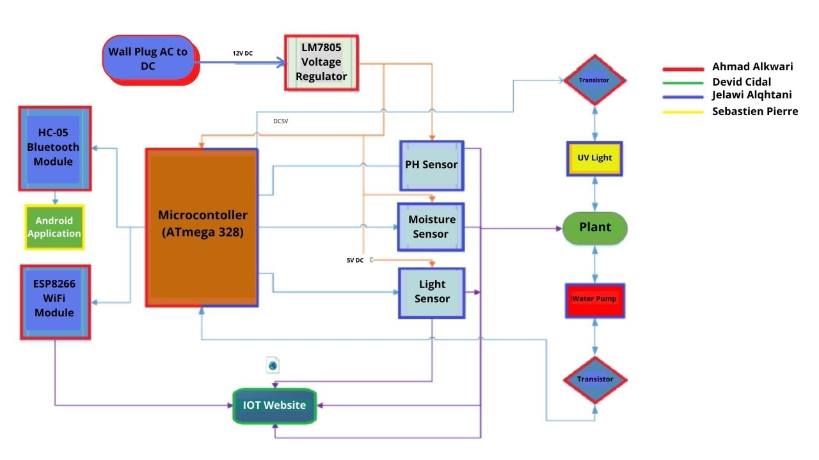
HARDWARE BLOCK DIAGRAM

Slide 5
RESEARCH RELATED TO PROJECT DEFINITION
Microcontroller
Atmega 328
Atmega 168
MSP430G2553
Arduino IDE
Bluetooth Module
Soil Moisture Sensor
WiFi Module
PH Sensor
TIP-122 Transistor
FTDI Convertor
Voltage Regulator
Crystal Oscillator
Light Sensor
Temperature and Humidity Sensor
Grow Light
Water Pump

Slide 6
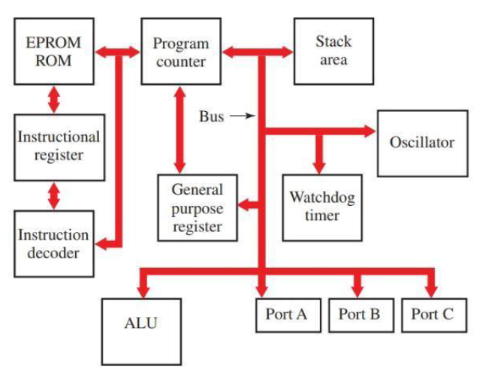
MICROCONTROLLER
It is the brain of the project as it control all the components.
Function of a microcontroller is to receive, process information, and produce the desired output.
Built-in I/O (input/output) capabilities.
Components along the Microcontroller serves as a feedback control system.
A low cost MCU with a large number of digital and analog pins.
The microcontrollers that we considered for this project are the ATMEL ATmega328 and the ATmega168.

Slide 7
ATMEL ATmega 328
The ATMEL ATmega328 is an easy to program 8-bit Microcontroller.
It is a 28-pin chip with an operating voltage ranging from 1.8V to 5.5V and with a 2KB SRAM along with a 32KB flash memory.
It has 13 digital I/O pins with 6 analog I/O pins and 1KB of (EEPROM).
On Ali Express 10 pieces of ATmega328 cost around US $16.
Its 1Kb EEPROM and 2KB SRAM microsystem for quality work.
They are powerful chips that control all over the system exactly the main way to perform well and to do a good performance.

Slide 8
ATmega 168
It’s an 8-bit micro-controller with different AVR controllers.
The memory program is about 16K.
The around the 20-year data retention capability is present.
The ADC system module is the 10-bit initial system.
12C, SPI USART and AT mega are responsible for the different communication system protocol.
The chip contains all the information that is used in the digital system as well.

Slide 9
MSP430G2553
This microcontroller costs around 10$, runs at 16MHz with 16KB of flash and an input voltage 5V.
This Microcontroller needs more coding to properly use an LCD.
Analog inputs, and for the initial setup than the Arduino.
It is not supported for Mac or Linux environments.
It contains 0.5KB of RAM.

Slide 10
COMPARISON
FEATURE | ATmega 328 | ATmega 168 | MSP430G2553
Operating Voltage | 1. 8 − 5. 5𝑉 | 2. 7 − 5. 5𝑉 | 1. 8 − 3. 6 𝑉
Temperature Range | − 40 𝑡𝑜 85℃ | − 40 𝑡𝑜 85℃ | − 40 𝑡𝑜 80℃
Max Clock Frequency | 20𝑀𝐻𝑧 | 16𝑀𝐻𝑧 | 16𝑀𝐻𝑧
Memory | 32KB Flash, 1KB EEPROM, 2KB SRAM | 16KB Flash,512B EEPROM,1K SRAM | 16 𝐾𝐵 𝐹𝑙𝑎𝑠ℎ 0. 5𝑆𝑅𝐴𝑀
Analog I/O | Input only | Input only | Both
Digital I/O | Both | Both | Both
GPIO Pin Count | 23 | 23 | 24
Bit Count | 8 Bit | 8 Bit | 16 Bit
Low Power | Yes | Yes | Yes
Power Consumption Active mode: Off mode: | 200μ𝐴@1𝑀𝐻𝑧 0. 1μ𝐴 | 1. 8𝑚𝐴 𝑎𝑛𝑑 3𝑉@4𝑀𝐻𝑧 5μ𝐴 𝑎𝑡 3𝑉 | 330μ𝐴@1𝑀𝐻𝑧 0. 1μ𝐴
Price | $16. 8/10𝑝𝑐𝑠 | $1. 2 𝑡𝑜 $1. 3/𝑝𝑐 | $19. 83/10𝑝𝑐𝑠
The ATmega 328 module has been chosen to be the Microcontroller module that is to be used in this project.

Slide 11
ARDUINO IDE
Arduino IDE is Open Source Software.
Make it easy to Write, Compile and Verify and Upload the code to the Microcontroller.
Support a lot of Boards.
Arduino IDE supports C, C++ languages.
The Arduino integrated development environment is the best application.
It is specially used for programming upload purposes and also writing purposes too.

Slide 12
BLUETOOTH MODULE COMPARISON
The Purpose of a Bluetooth Module is to communicate with the Microcontroller.
FEATURE | HC-05[2] | HC-06[1] | BLE Link Bee
Transmission Range | 9𝑚 | 9𝑚 | 60𝑚
Voltage Requirement | 3. 3𝑉 𝐷𝐶@50𝑚𝐴 | 3. 3𝑉@40𝑚𝐴 | 3. 3𝑉@10. 6𝑚𝐴
Frequency | 2. 4𝐺𝐻𝑧 | 2. 4𝐺𝐻𝑧 | 2. 4𝐺𝐻𝑧
Slave | Yes | Yes | Yes
Master | Yes | No | Yes
Android Compatible | Yes | Yes | Yes
PRICE | $2. 22 − 2. 7 | $2. 22 − 2. 7 | $9. 90
Speed | 2. 1𝑀𝑏𝑝𝑠 | 2. 1𝑀𝑏𝑝𝑠 | ≤1𝑀𝑏𝑝𝑠
Working Temperature | (− 20℃) 𝑡𝑜 75℃ | (−20℃) 𝑡𝑜 55℃ | −40℃ 𝑡𝑜 85℃
Bluetooth Version | 2. 0 | 2. 0 | 4. 0
The HC-05 module has been chosen to be the Bluetooth module that is to be used in this project.

Slide 13
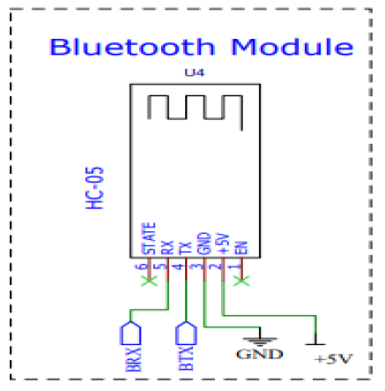
BLUETOOTH MODULE BLOCK

Slide 14
SOIL MOISTURE SENSOR
Soil moisture sensor is used to measure the amount of water/moisture that is present in the soil.
Sensors that measure the resistance of soil:
The soil moisture sensor works on the idea of resistance.
It passes current through the soil and according to the resistance of the soil.
Less water results in less conductivity.
More water contributes to allowing higher current.
The soil moisture sensor is an easy to utilize module.
Sensors that measure the soil capacitance:
This sensor measures the volumetric content of water inside the soil.
It is made of corrosion resisting material.
It measures the moisture content by measuring the change in capacitance.
It is made up of two plates; one is positive and the other is negative.
It is also easy to use because it provides an analog voltage signal.

Slide 15
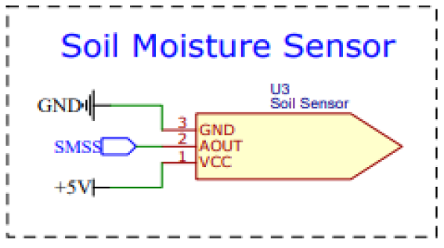
SOIL MOISTURE SENSOR
Feature | Resistive 04 | Capacitive 04
Input Voltage | 3. 3 − 5. 5𝑉 𝐷𝐶 | 3. 3 − 5. 5𝑉 𝐷𝐶
Output Voltage | 0 − 5𝑉 | 0 − 3. 0𝑉 𝐷𝐶
Input current | 15𝑚𝐴 | 5𝑚𝐴
Price | $0. 74[3] | $0. 63 [3]
Resistive 04 is selected for our project

Slide 16

Ahmad Alkwari
Electrical Engineering

Slide 17
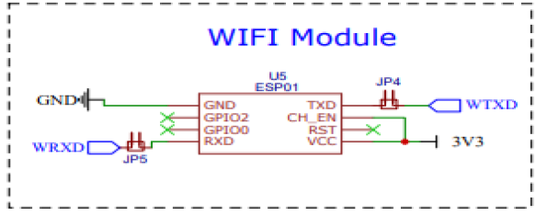
Wi-Fi Module
The Wi-Fi module helps in transferring data from the Microcontroller and displays it on the smartphone app. There are a number of Wi-Fi modules available in the markets which include the ESP-01, and the ESP-05.
Feature | ESP-01 | ESP-05
GPIO Pins | 2 | 0
ADC | No | No
Antenna | PCB | PCB
Breadboard friendly | Medium | Good
Price | $3 | $3
Voltage | 3.3V | 3.3V
ESP-01 does have the advantage of being compact, for this project the ESP-01 is to be used, due to our familiarization with this module.

Slide 18
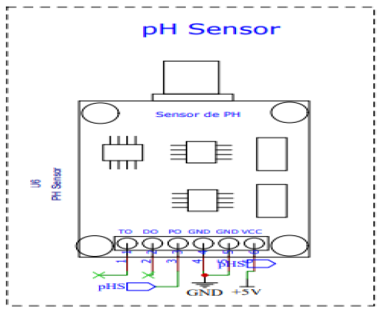
PH SENSOR
PH sensor is used to measure the acidity or alkalinity of any substance.
The scale for PH measurement is 0 to 14.
The negative algorithm of the hydrogen ion (–log10 [H+]) is known as PH.
Vernier pH Sensors are combination electrodes.
The purpose of the PH sensor in this project is to measure the acidity of the soil that is present for the growth of plants.
The PH sensor gives a value from 1 to 14.
Specifications:
Input Power: 5V (Power Indicator LED)
Module Size: 43mm x 32mm
pH Measuring Range: 0 – 14pH
Temperature Measuring: 0 to 60 Degrees
pH Interface: 2.0
Gain Adjustment: Potentiometer

Slide 19
PH Electrodes Characteristics
Voltage (mV) | pH Value | Voltage (mV) | pH Value
414.12 | 0.00 | -414.12 | 8.00
354.96 | 1.00 | -354.96 | 9.00
295.80 | 2.00 | -295.80 | 10.00
236.64 | 3.00 | -236.64 | 11.00
177.48 | 4.00 | -177.48 | 12.00
118.32 | 5.00 | -118.32 | 13.00
59.16 | 6.00 | -59.16 | 14.00
0.00 | 7.00 | 0.00 | 15.00

Slide 20
TIP-122 Transistor
The purpose of the TIP-122 transistor is to switch the pump.
It is a Darlington pair NPN transistor.
The TIP-122 is an NPN transistor of Darlington pair.
It has a good current collector rate
It’s like a collector of 100V.

Slide 21
Why Not Relay
Transistors
Faster
Smaller
Inexpensive

Slide 22
Voltage Regulator
The purpose of the voltage regulator is to provide fixed voltage of a certain value.
This requires either a battery sufficiently large to supply the load on its own for two weeks, or the use of an AC power supply.
A voltage regulator will be used to provide the microprocessor and sensors with a stable operating voltage.
There are two types of voltage regulators: Linear Regulator and the Switching Regulator.

Slide 23
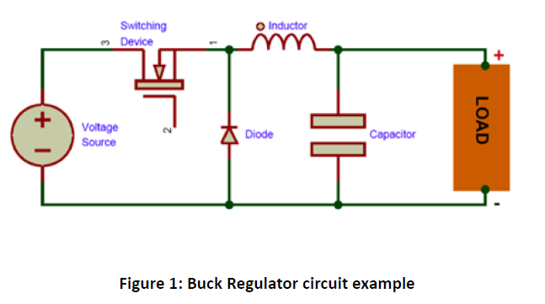
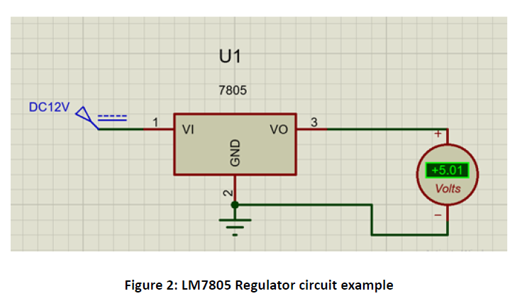
Comparison

Slide 24
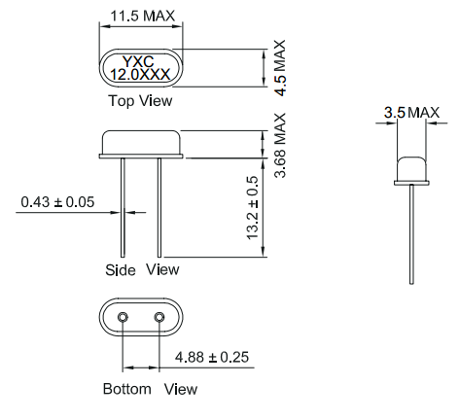
Crystal Oscillator
The crystal oscillator provides the clocking frequency necessary to run the microprocessor.
16MHz is recommended for the chosen microprocessor
The exact timing in not critical for this application
An “HC49S” has been chosen for this part because it is small, cheap, and available from many sources.

Slide 25
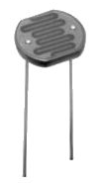
Light Sensor
The amount of ambient light is one of the critical resources for plant health.
Low light levels make all other plant care more critical
The IPMS will augment natural lighting to maintain plant health.
Light of sufficient strength to matter requires a lot of energy
The light sensor will determine when light augmentation is needed.
The light sensor itself is just a light sensitive resistor, which can be sourced very cheaply from many places in various values.

Slide 26
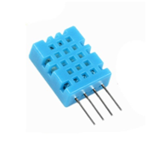
Temperature and Humidity Sensor
IPMS will also monitor temperature and humidity since these can also affect plant health.
A high ambient temperature, or low humidity will increase watering needs.
IPMS can adjust watering schedule based on temperature and humidity.
Temperature and Humidity sensors are frequently combined in a common package.

Slide 27
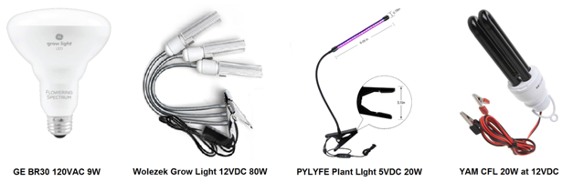
Grow Light
Light is a critical plant need.
IPMS will augment natural light if necessary to maintain plant health
Lighting is costly in terms or energy use. At least 10-20 watts are needed to make a difference.
Lighting is costly in terms of component cost ($10-$20)
The most energy efficient light sources are LEDs, but these are also the most expensive.
A 12VDC 20W CFL has been tentatively selected, but is subject to change if a better option can be found.

Slide 28
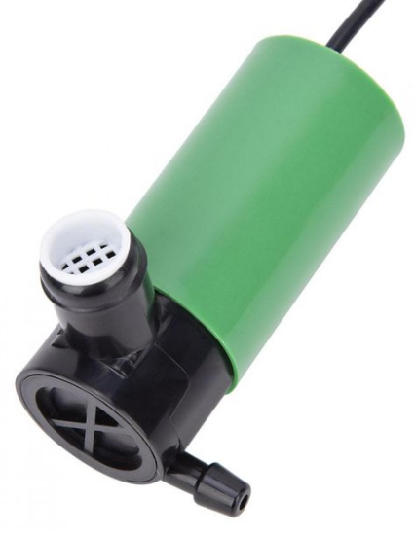
Water Pump
An appropriate supply of water is the most critical function of the IPMS.
Use of household water tap was rejected because of inconvenience and risk of leakage.
A water pump will allow the regulation of water flow.
High lift not needed
High flow rate not needed.
Must be reliable
Of various alternatives, a submersible 12VDC pump is considered most viable.
The Walfront submersible 12VDC pump has been selected because it meets the needs of IPMS at the lowest price point. ($16.29)

Slide 29

David Cidel
Computer Engineering

Slide 30
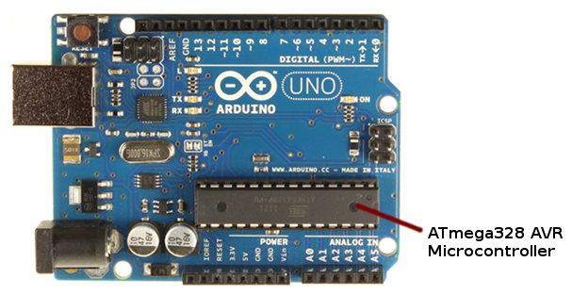
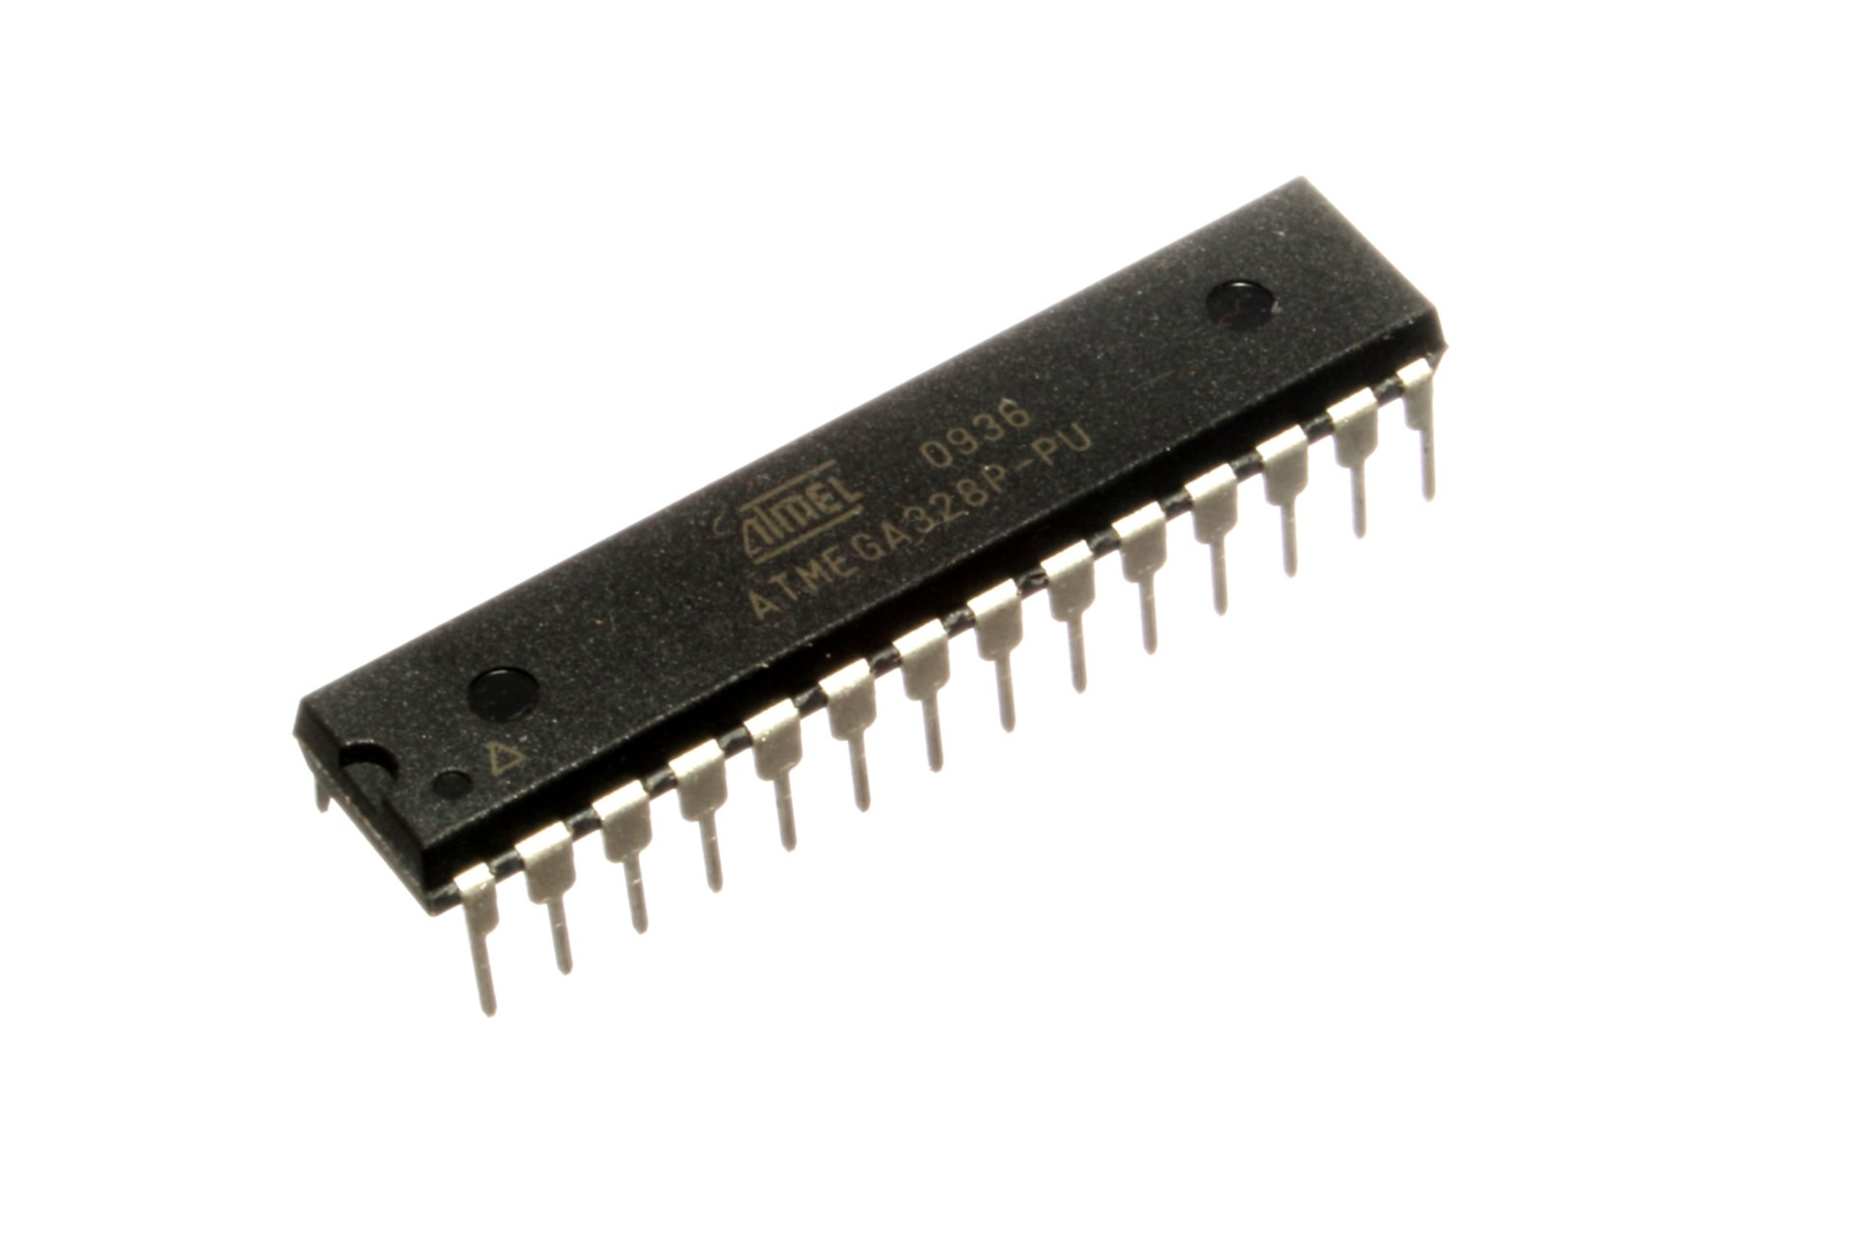
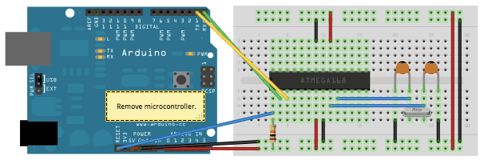
Atmega328 + Arduino (Development)
Arduino as In-System Programmer. (Burning the bootloader)
Upload code to the Atmega328
Use programmed Atmega in the PCB

Slide 31
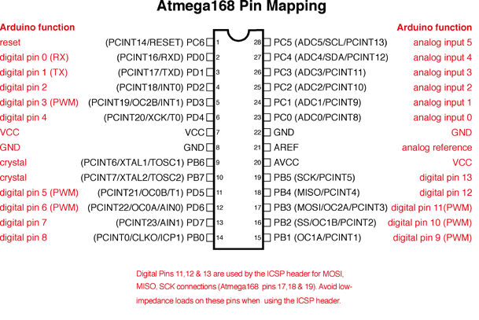
Pin Layout Example

Slide 32
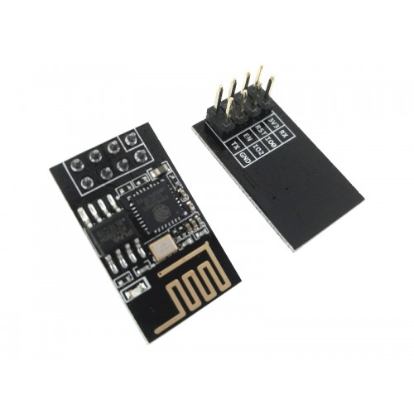
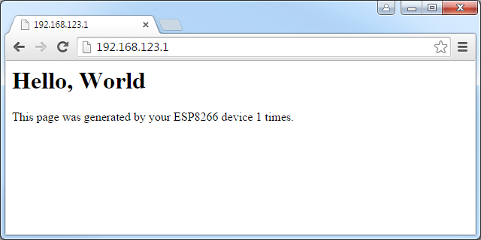
ESP8266
The ESP8266 will be able to use data collected from the Atmega microchip in order to display it to the user via wifi.

Slide 33
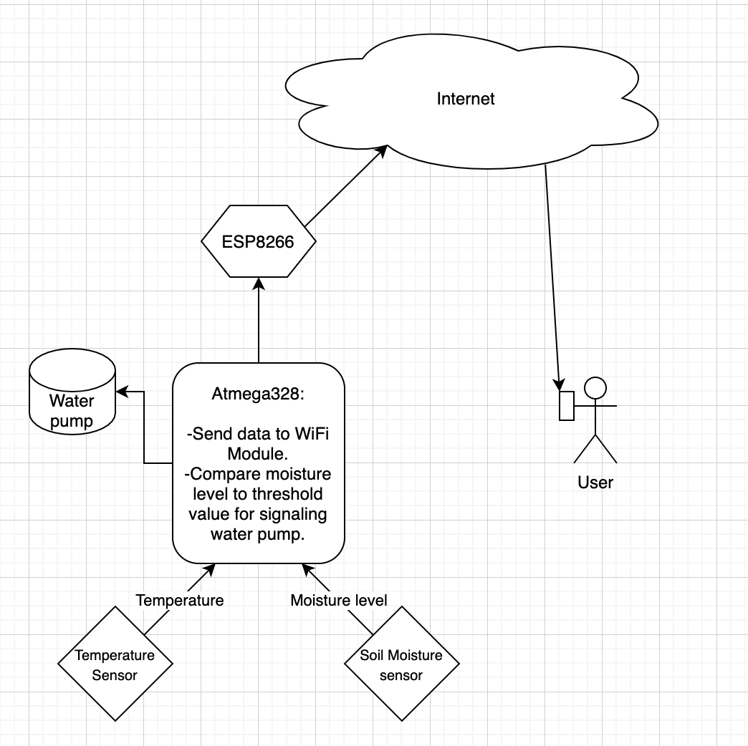
Software Component Data Flow Diagram

Slide 34
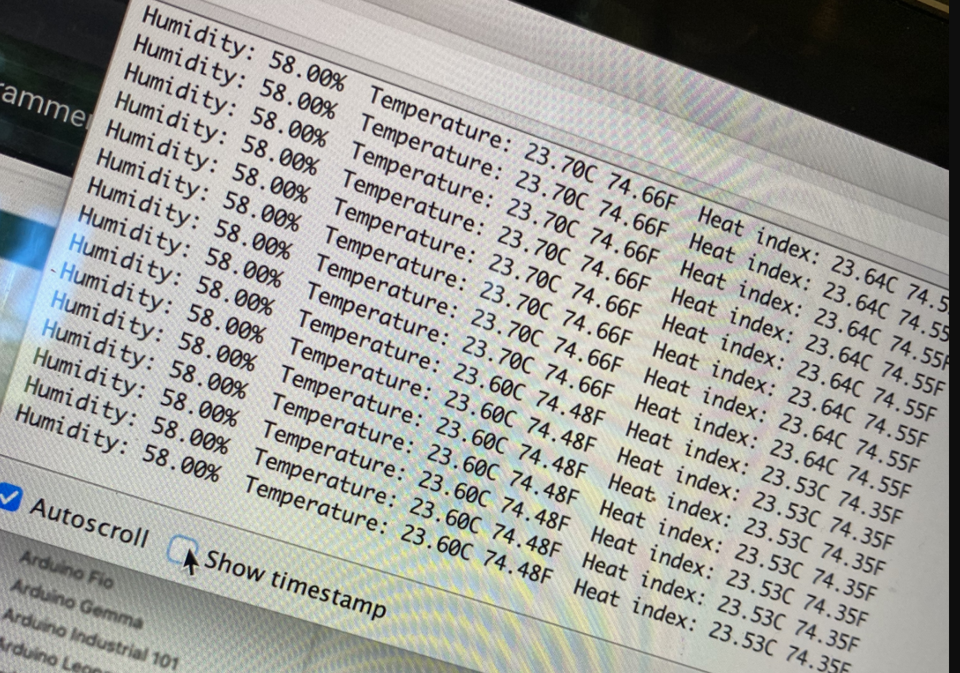
Testing in Arduino IDE
Serial Monitor
Check Dataflow
Check threshold
Check communication with ESP8266

Slide 35

Sebastien Pierre
Computer Engineering

Slide 36
Initial Estimated Project Budget
This project doesn’t have any sponsors or endorsers and is instead fully self financed by the four members of this group
During the initial research and documentation process of this project, we estimated that the budget of this project would be between $150.08 to $487.17 or $37.52 to $121.79 split evenly among the four of us
Our initial project budgets didn’t include shipping costs or potential repurchasing of items due to mistakes or shorts

Slide 37
Device/Part | Approximate Price
SENSORS:
Soil Moisture Sensor | $7.00-$40.00
Temp/Humidity Sensor (DHT11) | $1.50-$7.00
Light Sensor (LDR) | $6.00-$20.00
PH Sensor | $6.00-$30.00
Electronics:
CPU | $10.00-$40.00
Microcontroller | $1.00-$15.00
Bluetooth module(HC-05) | $2.00-$20.00
Development Kit | $30.00-$50.00
Wifi Module(ESP8266) | $2.00-$15.00

Slide 38
Circuit Elements:
Diode(1N5408) | $0.72-$2.12
Diode(1N4007) | $0.06-$1.50
Capacitor (25V) | $0.79-$2.00
Voltage Reg(LM7805) | $0.50-$1.40
Terminal Blocks | $0.99-$1.04
Switch Transistor(BC547) | $0.92-$1.21
Resistors | $0.60-$0.90
PCB | $20.00-$60.00
MISC:
Batteries | $10.00-$20.00
Container | $30.00-$50.00
LED Lights | $20.00-$60.00
Software Expenses | $0-$50.00
Shipping Expenses | TBD
Approximate Total Price Range: | $150.08-$487.17

Slide 39
Current budget spent & updated estimate project budget
As of today we have spent $138.50 on this project
This money was spent on the Pcb, Wifi module, Bluetooth module, voltage regulator, sensor module, atmega bootloader, temperature/humidity sensor, moisture sensor, diodes, and Arduino development board
Based on our initial items list, we are missing now only missing water pump, Led lights, batteries, container, and potential software expenses
After our initial estimated project budget we have update it and are now expected to spend around $60 to $180 in total for the rest of the items.

Slide 40
Current Progress %
Software Side
On the software side of the project we are currently around 50% done with everything that is required for this project. We have coded for the majority of the sensors and have researched how to translate arduino code to atMega code.
Electrical Side
On the electrical side of the project we are currently around 70% of the way done. We have constructed all of the components for the PCB and have done some preliminary tests to make sure it is working correctly.

Slide 41
Current Plans & Schedule
Software Side
On the software side of things, we are currently working on coding the wifi module to send data to a web server. We are also working on sending the data from sensors to the wifi module to the web server. Once we have figured that out, we will begin to create a web server that can store and send data back and forth between IPMS and it.
Electrical Side
On the electrical side of things, we are currently troubleshooting everything to make sure that the pcb working correctly. Once that it is done, we should communicate with the software side of things to make sure everything is able to work together.

