Slide 1
PTZ Camera
Group 26:
Andre Samaroo, Cp.E
Chisom Ikejiani, Cp.E
Michael Serignese, Cp.E
Notes:
andre?

Slide 2
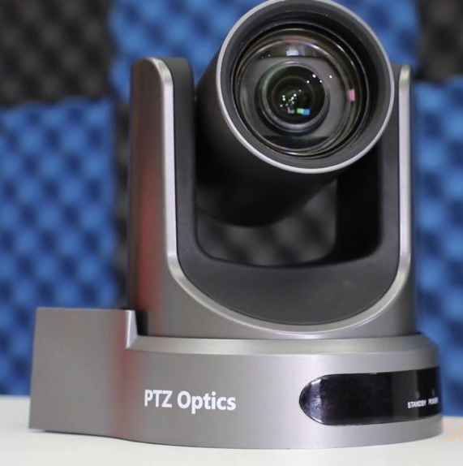
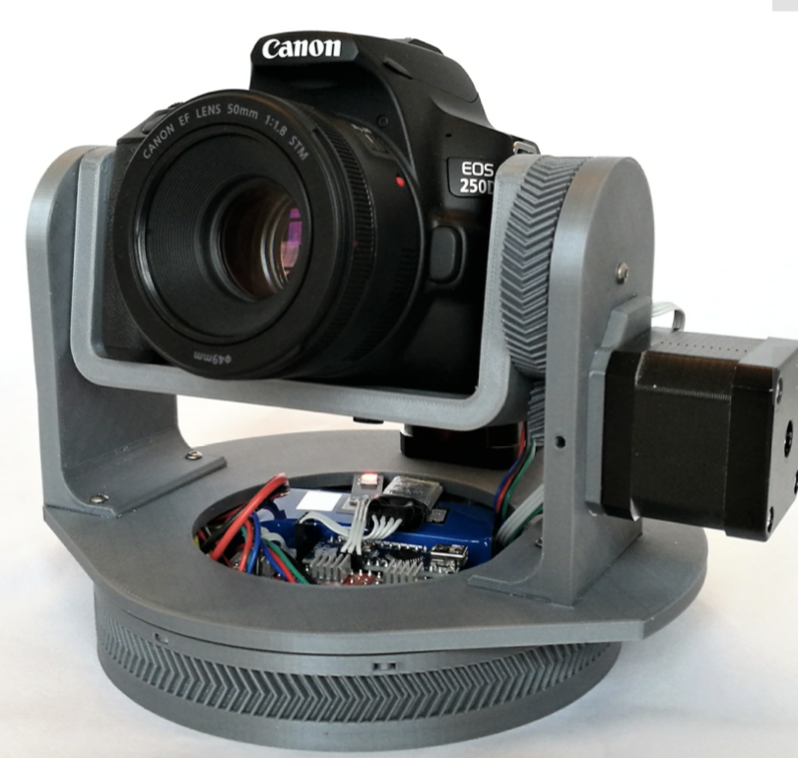
Administrative Introduction
Based on the sponsored QwikCut project, we want to make an inexpensive PTZ camera system that uses as few cables as possible.
There are various PTZ projects that we can look at for reference and we hope to reduce the cables by using WiFi for data transmission so we only need power cables.
Notes:
andre

Slide 3
Project Impacts
Low cost, widely available parts
For sports events, weddings, and many other use cases
Makes professional video angles more accessible to the average person
Notes:
New slide (record audio) Michael

Slide 4
Administrative Overview
Pre-Production considerations
Hardware Subsystems
Software Discussion
Project Assessment
-Goals and Objectives
-Requirements
-Constraints
-Camera
-Motors
-Control Boards
-Case
-Workstation software
-Servo Control software
-Controller software
-Success and Challenges
-Budget and Financing
-Progress
-Plans for Completion
Notes:
andre

Slide 5
Goals and Objectives
Create a tripod-mounted sports action camera
Tripod is 25 ft. tall for ideal camera angling
Controller operates camera for ease of use
Stretch Goal:
Computer-vision assisted tracking
Notes:
Mike

Slide 6
Specifications and Requirements
The camera should meet the standards:
Lightweight at 1 lb. or less
Waterproof in moderate rain (0.10 inches / hour)
Stable in moderate windspeed (15 miles / hour)
Pan-tilt-zoom all accessible through the controller
Notes:
Mike

Slide 7
Design Constraints
Budget | Cables | Group Dynamics
Under $400 | Power/data delivery | 3 members
Self funded | Number of cables | All CPE
Notes:
andre

Slide 8
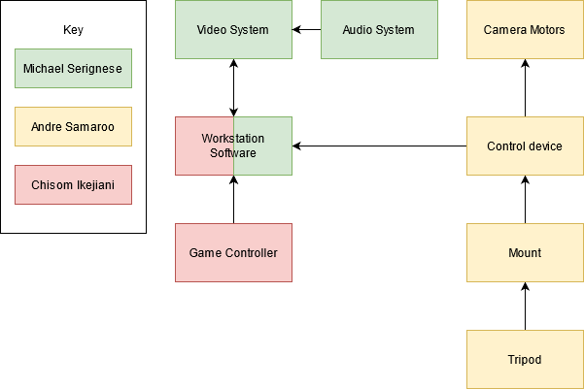
Hardware Block Diagram: Overview
System divided
into key parts:
Audio-video
Controls
Motor
Notes:
Mike

Slide 9
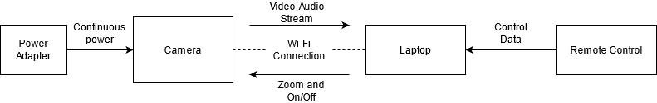
Hardware Block Diagram: Camera-to-Controller
Notes:
Mike

Slide 10
Camera Options: Security Cameras
Many options for premade security cameras
Even tend to include built-in pan-tilt-zoom controls
Include anti-features harmful to the budget
Ruled out in favor of action cameras
Notes:
Mike

Slide 11
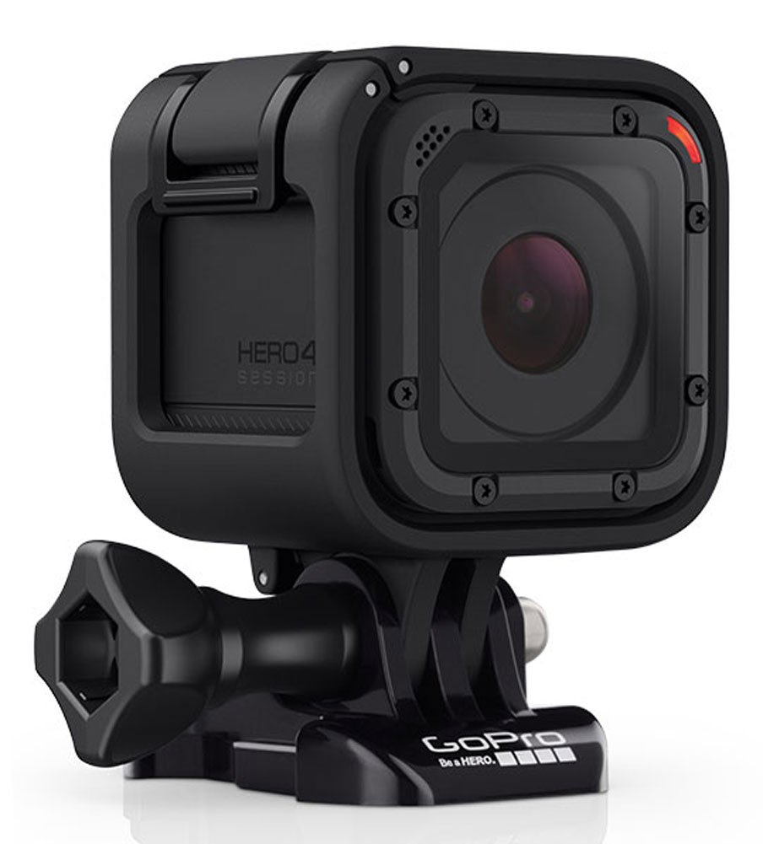
Action Cameras
Intended for capturing sports -- ideal defaults
Overall, the clear prebuilt choice for this design
GoPro Hero 7
Price: $250.00
Resolution: 4k or 1080p
Framerate: 30fps or 60fps modes
WiFi: 5GHz b/g/n
Notes:
Mike

Slide 12
Camera Data Transmission Systems
WiFi: the standard for action cameras, and meets requirements.
GoPro Hero 7:
Supports 5GHz and 2.4GHz frequencies with b/g/n technology
Theoretical top transmission speed of 300Mbit/s
Probable actual speed: 64 Mbit/s
This bitrate is sufficient to transport our stream
Notes:
Mike

Slide 13
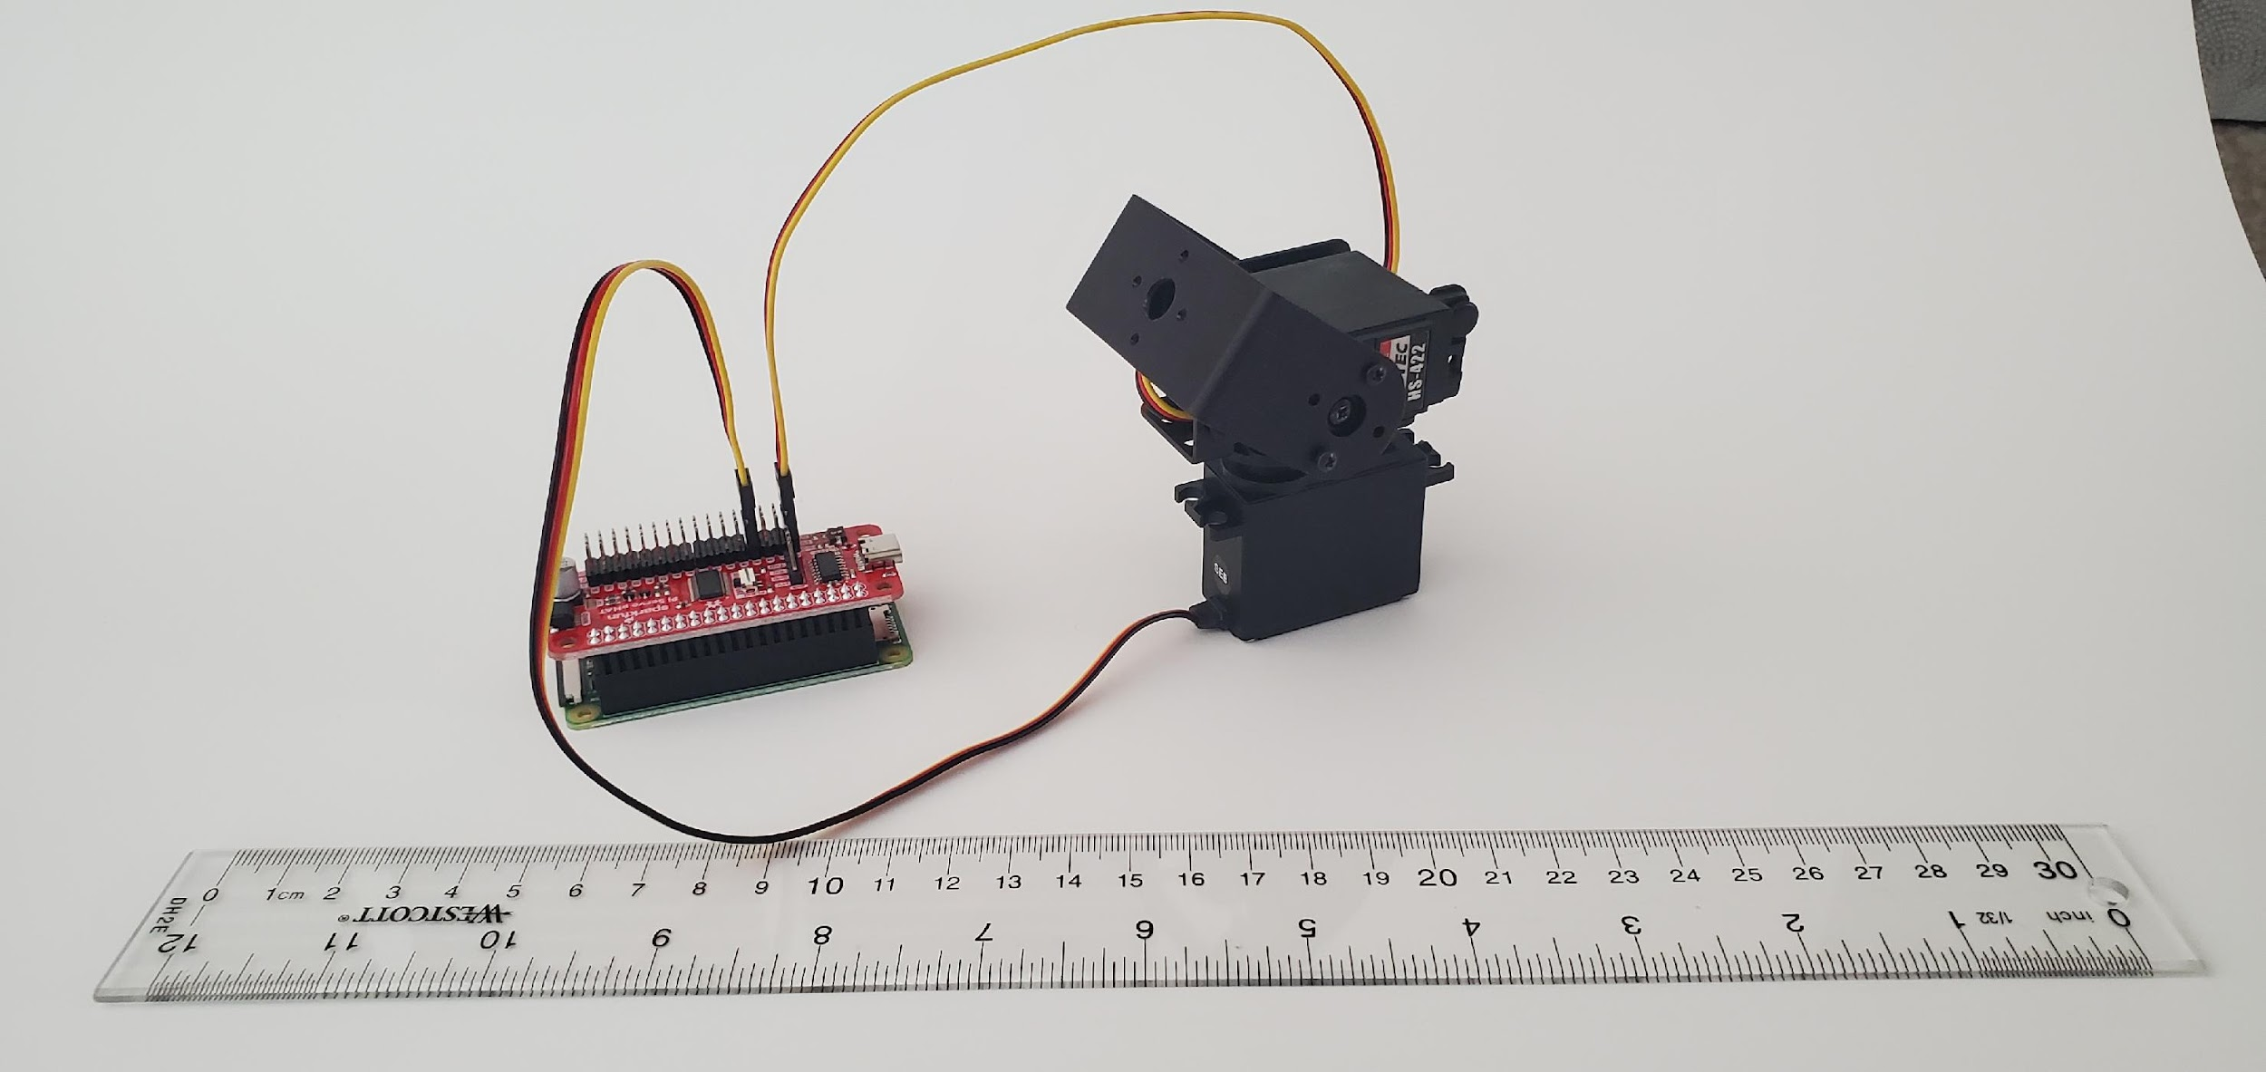
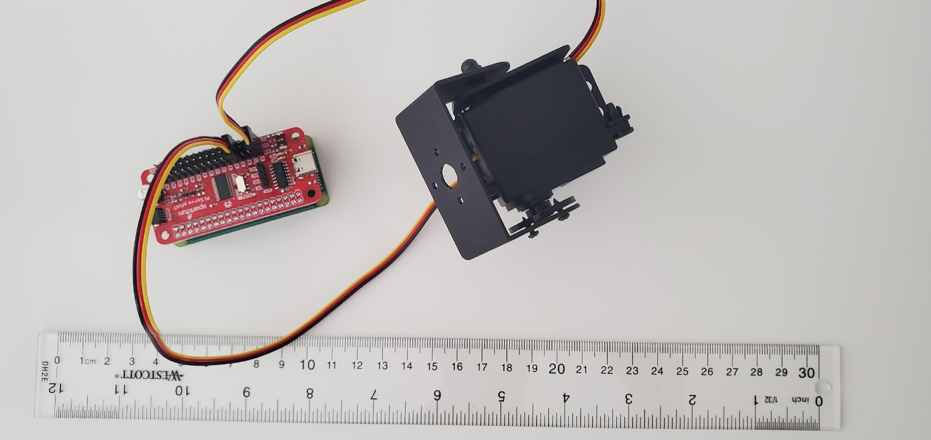
Motor Hardware: Servos and Control boards
2 servos – 1 for panning, 1 for tilt
Servo control board
Main control and communication board
Notes:
andre

Slide 14
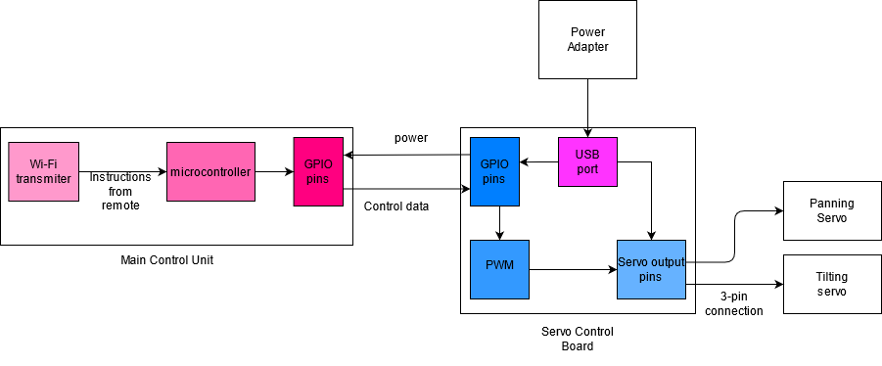
Hardware Block Diagram: Motor-to-MCU interface
Notes:
andre

Slide 15
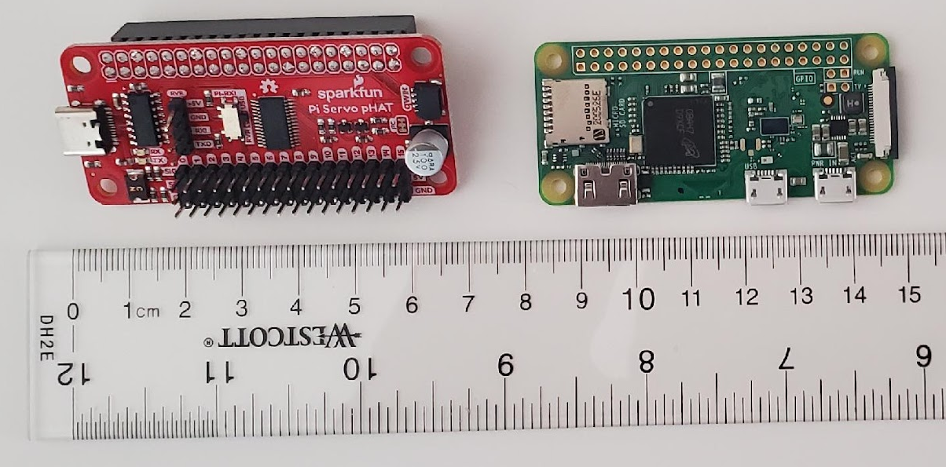
Motor Hardware: Control Boards
Sparkfun servo pHAT
  Uses PCA9685
  PWM control
Raspberry Pi Zero W
Broadcom BCM43438
  Easy to use
Power cables
  Use a barrel plug-to-usb converter
Notes:
andre

Slide 16
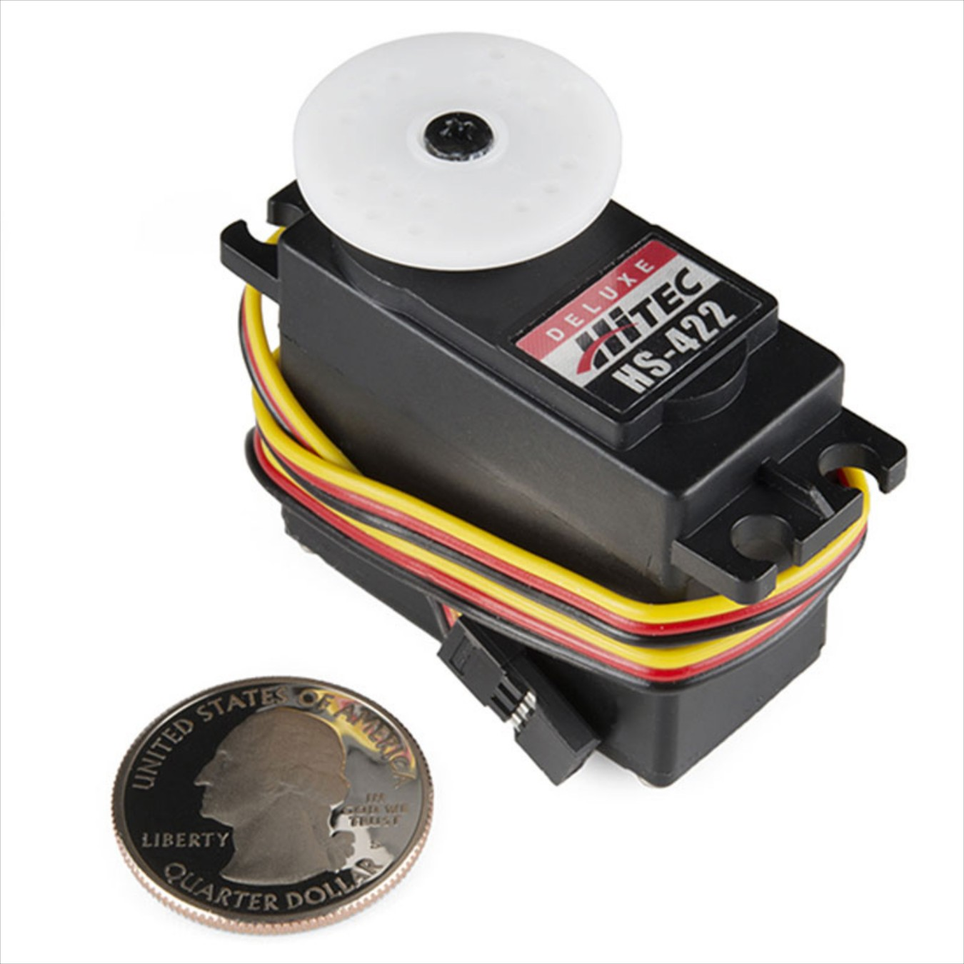
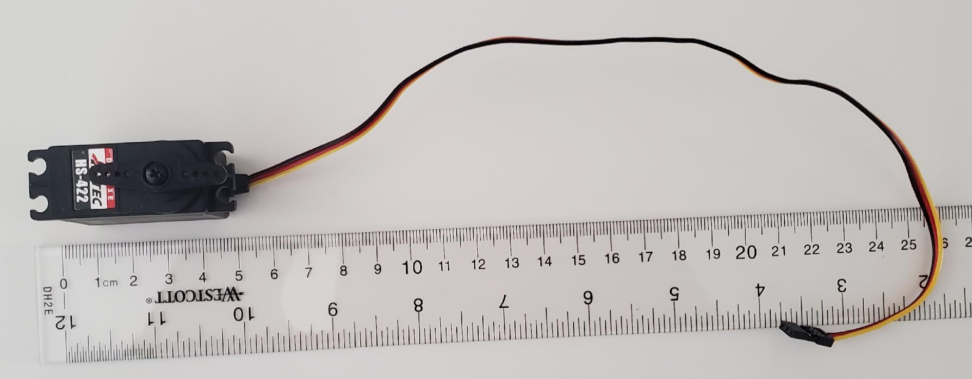
Motor Hardware: Servo Details
Why servo motors?
Precision
Low Power
High torque
Hitec HS-422 servo motor
180 degree motion, 0.16sec/60◦ ~0.5 sec response
3 pin input, voltage, ground, signal
Notes:
andre

Slide 17
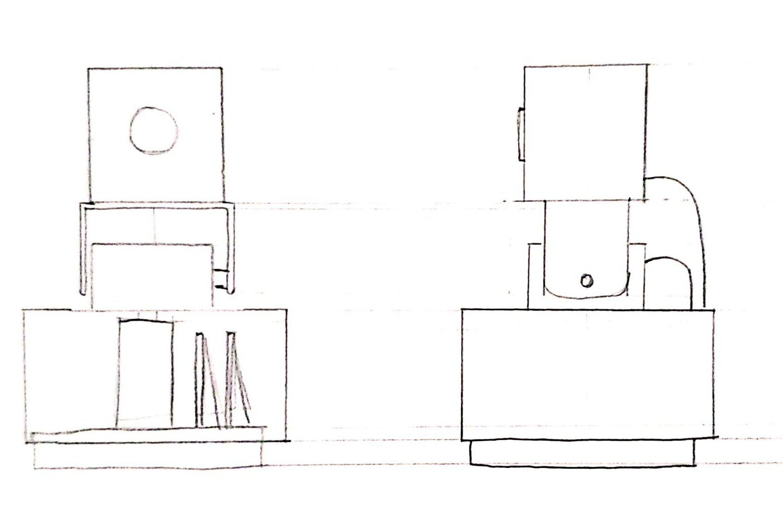
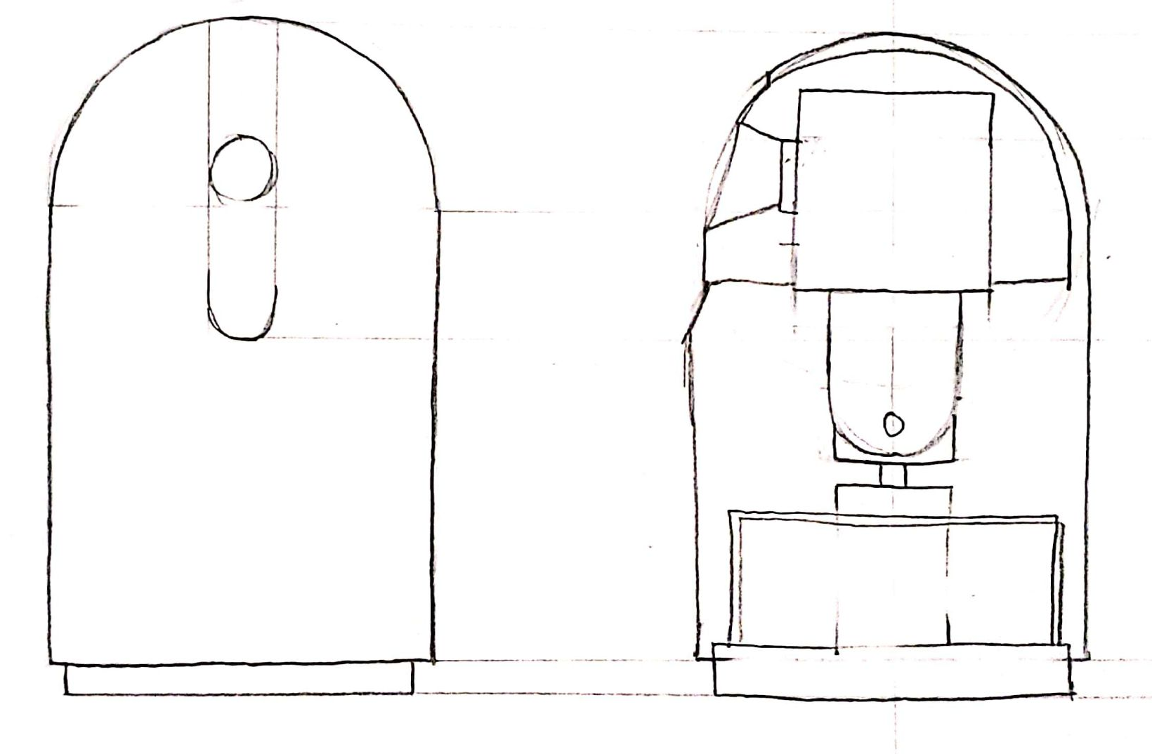
Device Housing: Sample Illustrations
Design 1
Design 2
Notes:
andre

Slide 18
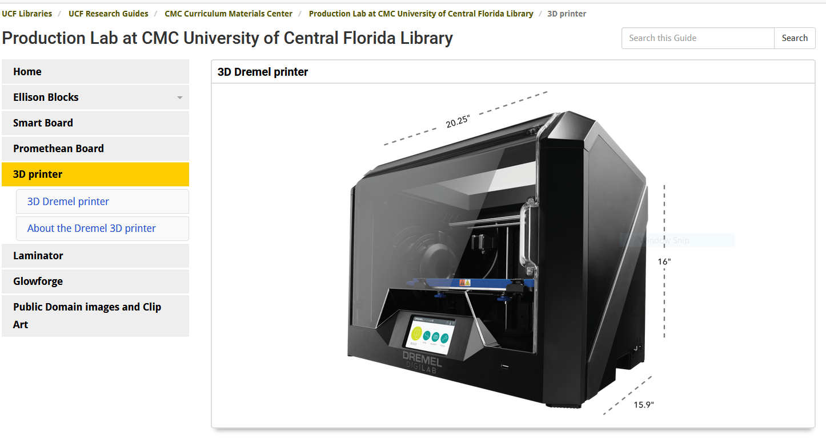

Device Housing: A 3D-printed Case
Using ABS plastic
Print in either TI lab or on Library printer
File made on tinkerCAD
Notes:
andre

Slide 19
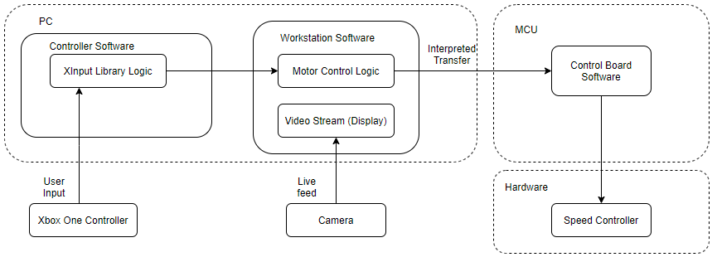
Software Overview
Controller Software
Workstation Software
Control Board Software
Notes:
Chisom

Slide 20
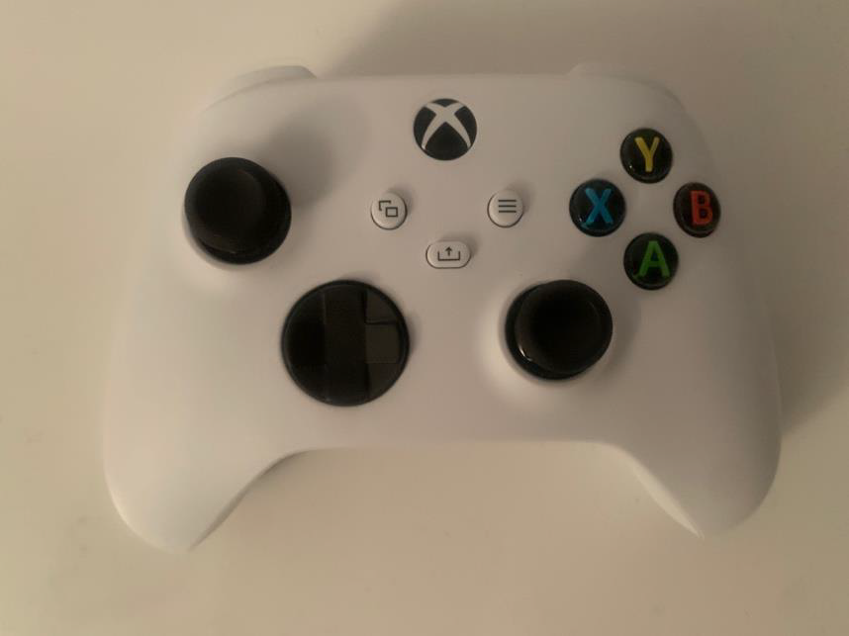
The Controller
Xbox Series X Controller
Interacts well with the Windows native
libraries
Can be used over Bluetooth

Slide 21
Controller Software
Hosted on the computer
Sends input from user via Xbox Controller to computer
Uses the Xinput library to receive byte level information representing the controller's current state
Interprets data and sends user selected command over to the main control board
Notes:
Chisom

Slide 22
Workstation Software: Overview
Features:
  Physical and Digital Control over PTZ camera
  User can control the movement speed of camera
  Live video feed
  Display sensor status such as battery life of camera, recording status, and current action.
  Coordinates controller input
Possible Features:
  Object Tracking (SimpleCV, OpenCV, and Imutils)
Notes:
Chisom
(add more about CV and Object tracking)

Slide 23
Workstation Software: Graphical User Interface
NodeJs
Electron
  Cross platform GUI software
  Minimal memory usage
  Locally packaged
Notes:
Chisom

Slide 24
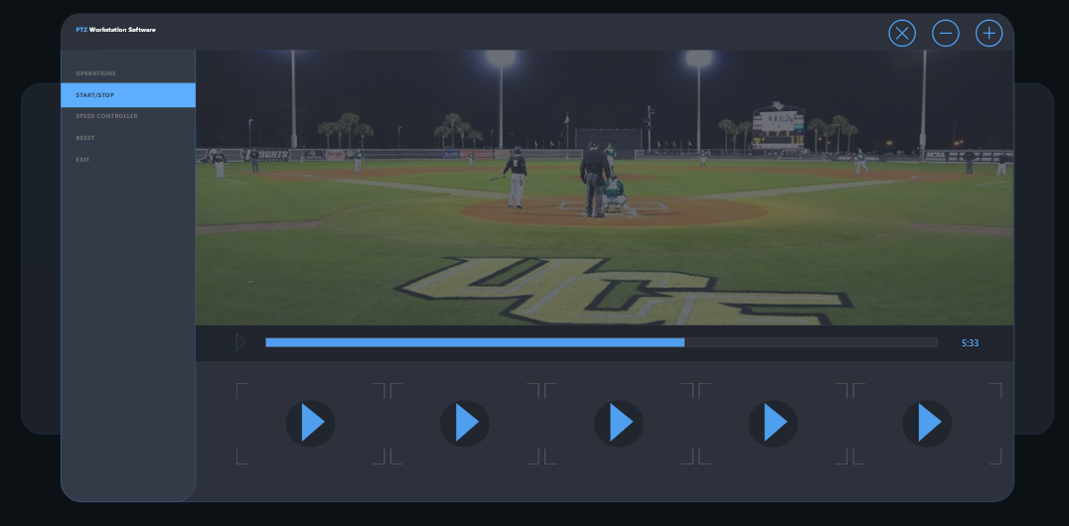
Workstation Software: GUI (Concept Design)
Notes:
Chisom

Slide 25
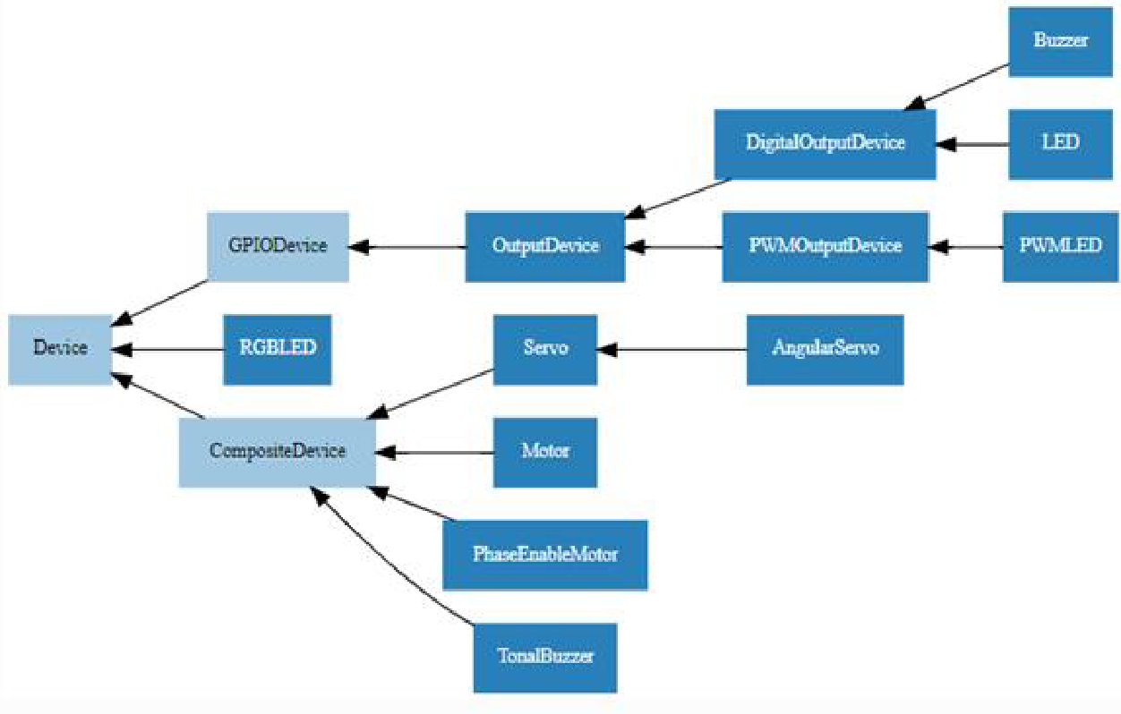
Control Board Software: Servo Control Design
Translates received data into servo controlling commands using the gpizero library
Data is sent to the servos using the GPIO pins on the raspberry Pi
Notes:
Chisom

Slide 26
Project Flow: A Success Story
We desire to deliver a product while minimizing design complexity
We also intend to avoid sacrificing control over our requirements
Premade parts are a success that enabled immediate testing and integration
Notes:
Mike

Slide 27
Project Flow: A Challenge Story
Predesigned cameras include features and anti-features
Predesigned cameras simplify implementation, but are out of our control
Designing our own high-quality camera greatly increases complexity
A difficult choice between project designs with unique consequences
Notes:
Mike

Slide 28
Budget and Financing
Item | amount | status | Cost
Servo PTZ kit | 1 | acquired | $33
PI zero W | 1 | acquired | $10
Sparkfun Servo pHAT | 1 | acquired | $10
GPIO pin header | 1 | needed | $1
USB-to-barrel adapters | 2 | needed | $13
Power cables | 2 | needed | $20
Camera | 1 | needed | $250
Controller | 1 | acquired | $58
total | -- | -- | $395
Notes:
andre

Slide 29
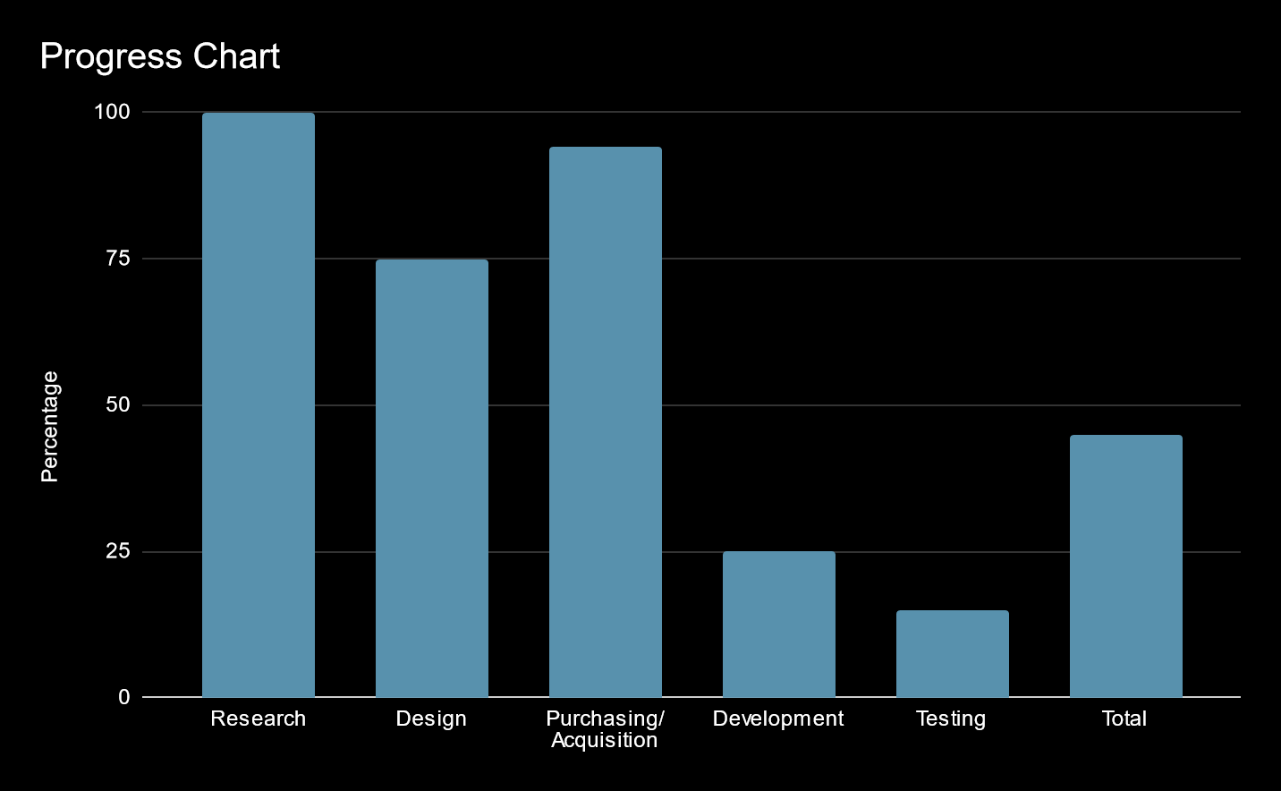
Current Progress
Notes:
Chisom

Slide 30
Plans to complete
Workstation Software
  GUI
  Controller interface
  WiFi Media Stream
Complete Motor Testing
Finish assembly for waterproofing and wind-stability testing

Slide 31
Future Plans
Current Plans
  Fine tune the servos
  Complete the graphical user interface
  Add the remaining workstation functionality
  Add servo speed control
Stretch Goal Plans
  Add automated positioning
  Object identification and tracking
Notes:
Chisom

Slide 32
Thank You For Your Time
Notes:
New slide(record audio) Chisom

