Slide 1

Wearable Optical Biometric Tracking System
Group 2:
Tyrone Morales
Christopher Bormey
Scott Perryman
Cody Showers

Slide 2
Project Goals
Build a lightweight, compact, wearable sensor device that measures and provides information about cardiovascular biometrics.
Design device such that it can wirelessly interfaces with a personal device.
Have biometric data logged via an app for long term health monitoring

Slide 3
Main Specifications
# | Description | Magnitude | Units
1 | Device shall produce predictions for the following biometrics: Heart Rate, Heart Rate Variability, Blood Oxygenation, Temperature. | 4 | Modes
2 | The device size should be compact for the contact design (WxLxH) | ~8x4x4 | Cm
3 | The bias of the distribution of any of the biometric predictions on any single user should not be more than the specified value. | 5 | %
4 | The variance of the distribution of any of the biometric predictions on any single user should be less than the specified value. | 5 | Unit^2

Slide 4
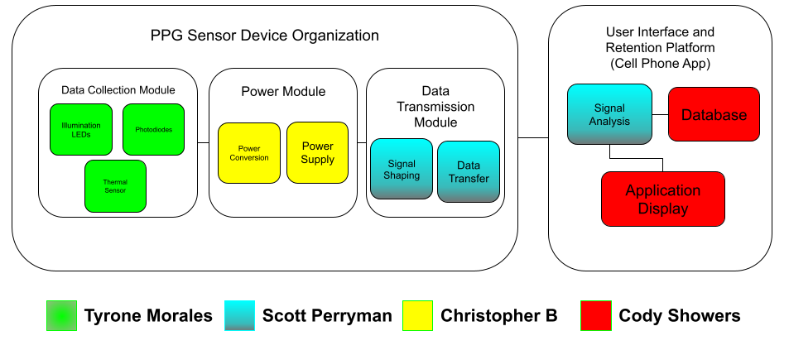
High level overview/block diagram

Slide 5
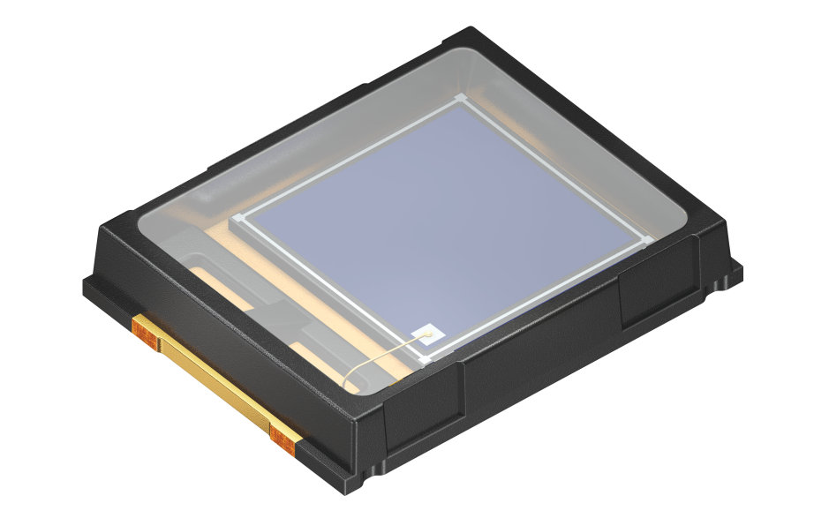
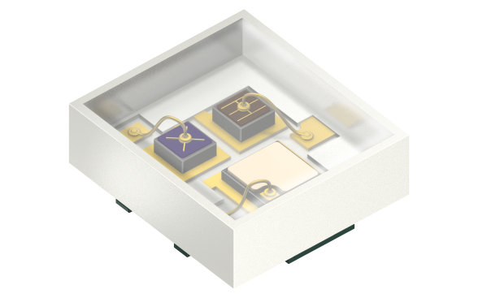
PPG Sensor
SFH7016 by OSRAM
[Spectral Characteristics] Green: 526 nm with FWHM of 32nm Red: 660 nm with FWHM of 17nm Near Infrared: 950 nm with FWHM of 42 nm
[Component Dimensions] L x W x H: 1.65 mm x 1.85 mm x 0.6 mm
[Electrical Characteristics ] Green: I_{F} = 20 mA @ V_{f} = 2.40 V Red: I_{F} = 30 mA @ V_{f} = 1.90 V Near Infrared: I_{F} = 40 mA @ V_{f} = 1.30 V
[Price] $1.42 unit price per 10 units
SFH2200 by OSRAM
[Spectral Characteristics] Green: 0.301 A/W Red: 0.473 A/W Near Infrared: 0.665 A/W
[Component Dimensions] L x W x H: 5.09 mm x 4 mm x 0.85 mm
[Price] $1.09 per unit
Photoplethysmography is an optical method for obtaining cardiovascular information via detecting volumetric blood flow changes in microvascular tissue
For our PPG sensor, we are utilizing a multiwavelength SM-LED chip (SFH7016) and an SM-Photodiode (SFH2200).
These components offer compact dimensions, reasonable forward current requirements, and met our spectral requirements.

Slide 6
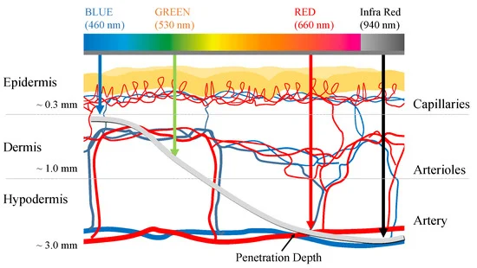
Wavelength Selection
The LED wavelengths were chosen due to their benefits with respect to PPG signal generation
SpO2 measurements require the use of Red and NIR light to resolve amount of oxygenated and deoxygenated hemoglobin in blood.
 | Green PPG | Red and IR PPG
Advantages | Most robust to motion artifacts | Relatively low absorption by skin, Used to determine Sp02 measurements
Disadvantages | Highly absorbed by skin | Subject to motion artifacts

Slide 7
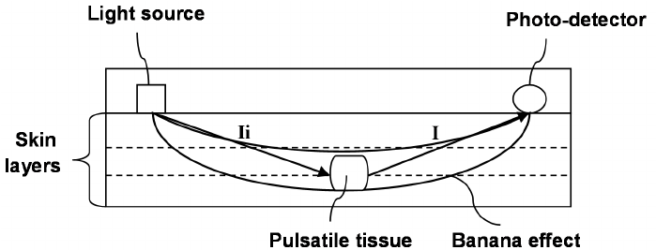
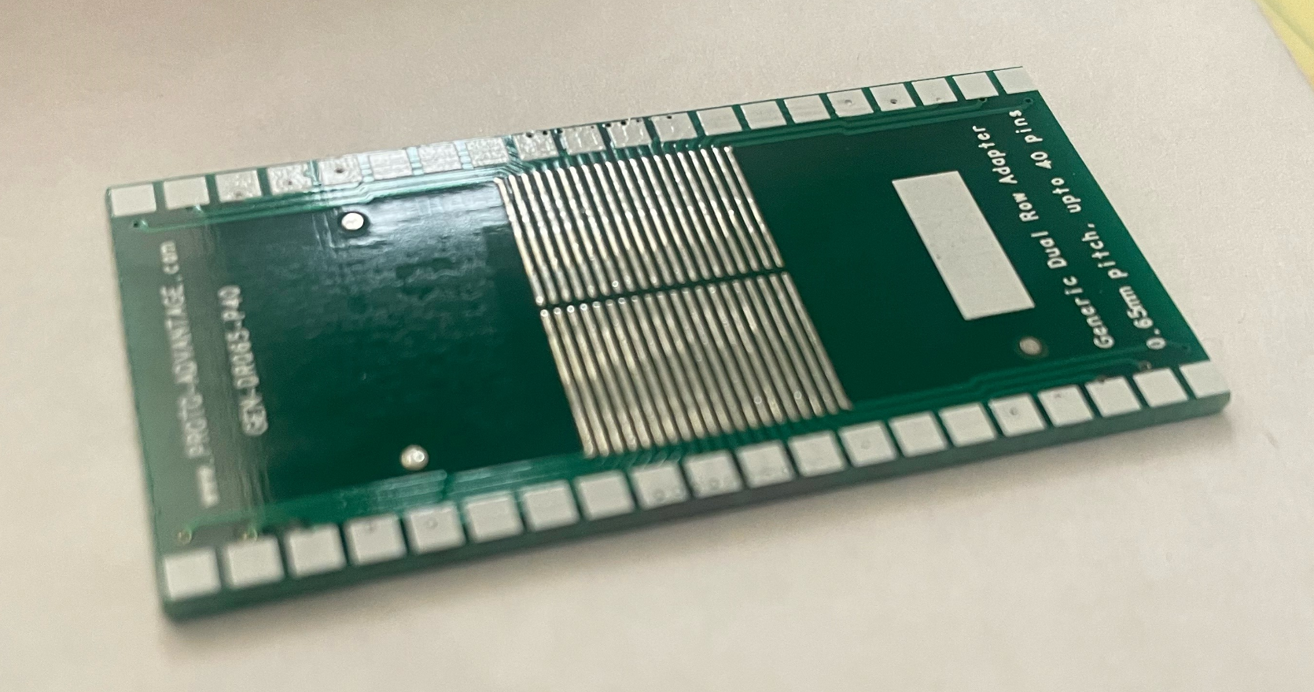
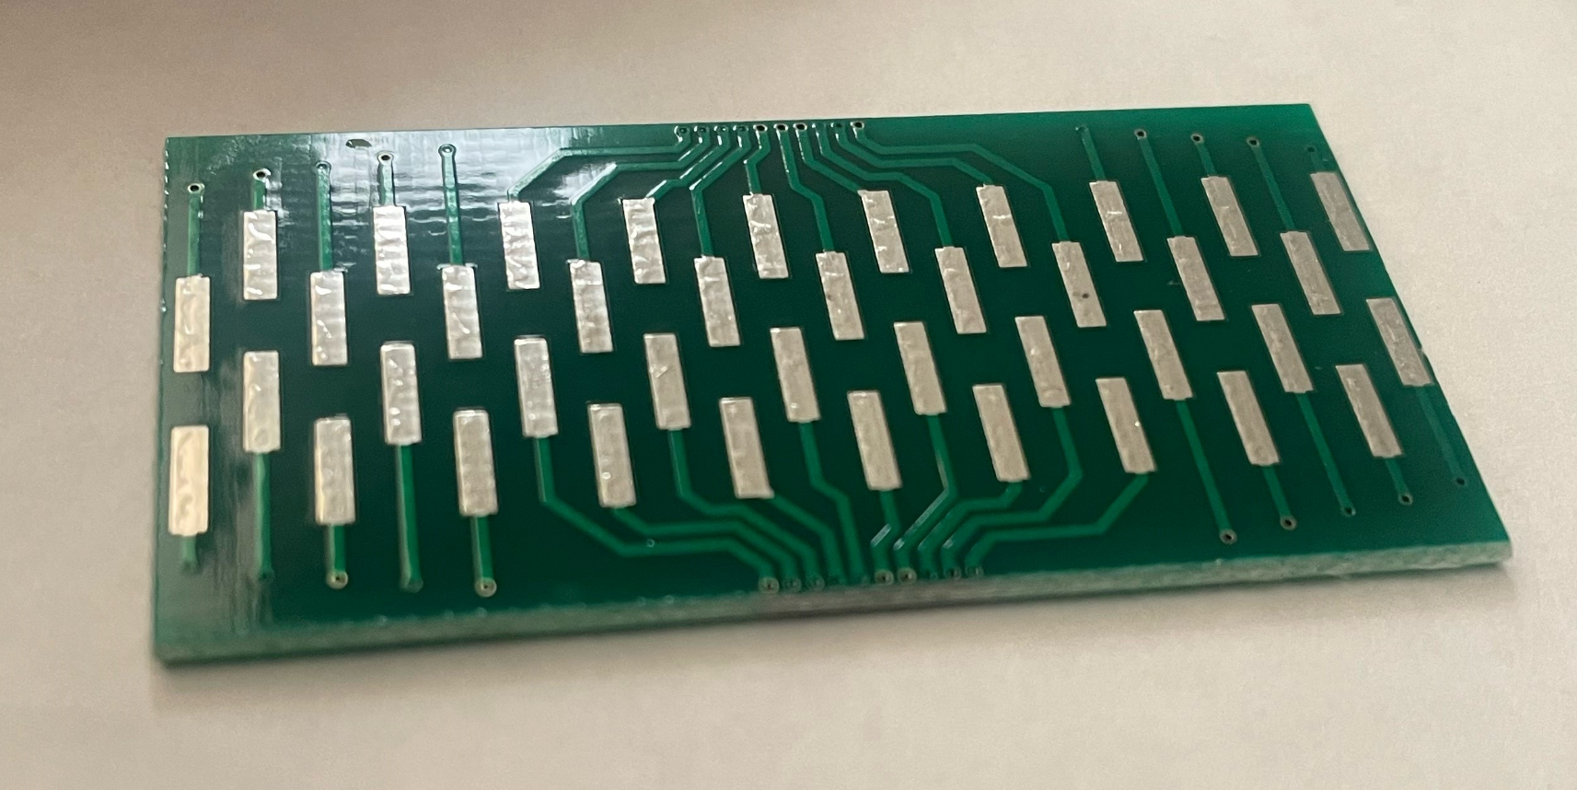
LED to Photodiode separation distance
The reflected diffused light follows a "banana-shaped" path.
Small separation of LED and PD yields collection of non-modulated diffused light.
Large separation of LED and PD yields low to no collection of any light.
Separation of the LED and PD is tentatively set to 1.5mm to 2mm to ensure optimal collection of reflected diffused light that has interacted with modulating medium.
We plan on testing the effects LED to PD separation via a SMD-PCB to DIP adaptor from Proto-Advantage

Slide 8
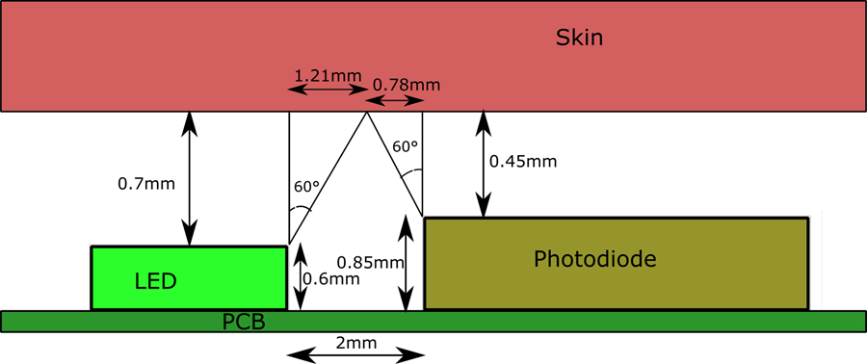
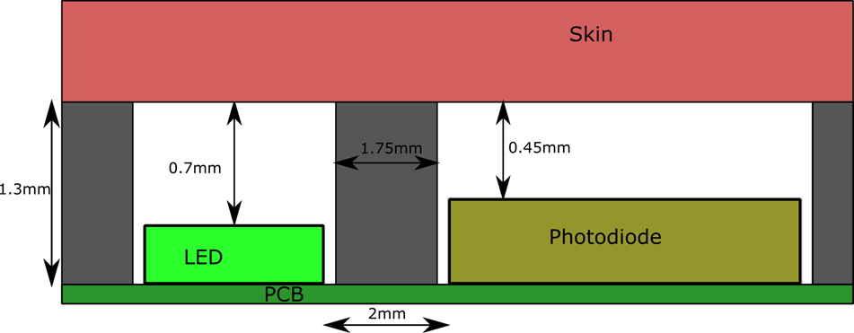
Optical Barriers for Suppressing Crosstalk
Due to the LED's ideal Lambertian emission profile (60-degree half angle) and the PD's acceptance profile, optical crosstalk will occur from specular reflection at the air-to-skin surface.
Introduction of an optical barrier with a tentative thickness of 1.75 mm will greatly reduce the amount of crosstalk negligible levels
The barriers will be implemented in the housing structure for the complete device.
The material used will be a black polycarbonate filament, and the structure will be manufactured via a 3D printer.

Slide 9
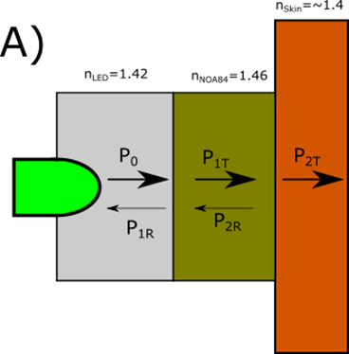
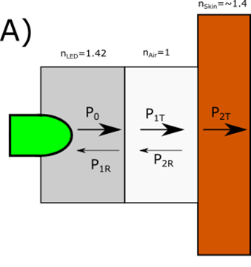
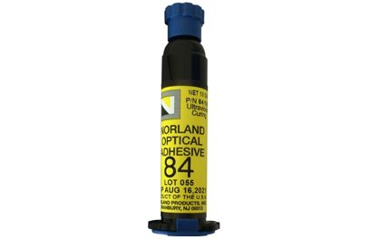
Optical Adhesive for Index matching
To further optimize the collection of the PPG signal, optical adhesive will be used to reduce Fresnel losses.
Optical adhesive provides a transition medium between the sensor and skin which has a similar refractive index.
The optical adhesive to be used is NOA84 by Norland Adhesives
A complication that arises from this is the need of a UV source as UV curing is needed for the adhesive.
NOA84
[Refractive Index] 1.46
[Price] $20.00 per 6 grams, min of $30 per order
[Optimal Curing Wavelengths] 325 nm, 365 nm and 405nm

Slide 10
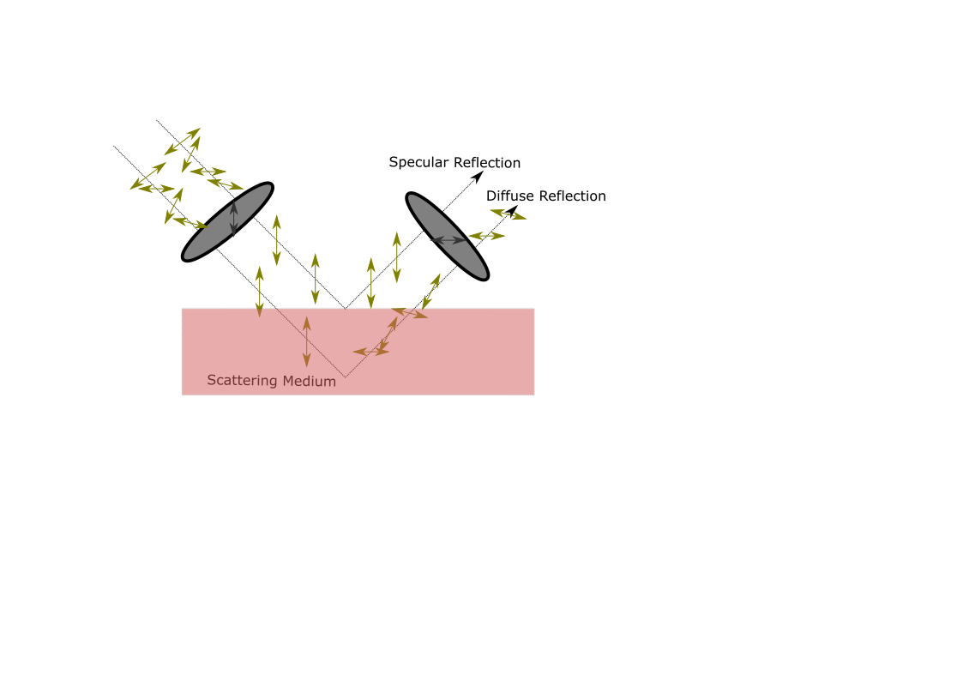
Cross Polarization for Noise suppression
Collection preference for diffuse reflection over specular reflection can be further optimized via a cross-polarization scheme.
Light that is scattered by a target medium is diffusely reflected with random polarization.
Placing linear polarizers in front of the LED and PD with perpendicular axis of transmission virtually eliminates specular reflection.
The polarizer film to be used is the TECHSPEC wire-grid polarizer film available from Edmund Optics.
Difficulties: The dimensions of the LED and PD are very small, therefore the thin-film polarizer must be cut and arranged on the sensor frame structure with considerable care.
TECHSPEC wire-grid polarizer film
[Wavelength range] 400nm-1200nm
[Extinction Ratio] 4,250:1
[Price] $43 for 12.5 mm by 12.5 mm

Slide 11
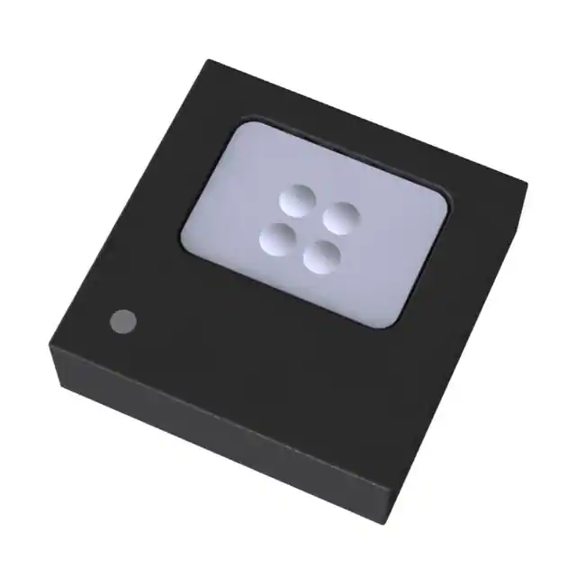
Thermal sensor
MAX30205 | MLX90362
[Sensor Modality] Contact-based sensor | [Sensor Modality] Optical-based sensor
[Measurement Accuracy] 0.1 Celsius | [Measurement Accuracy] 0.01 Celsius
[Price] $4.77 per unit | [Price] $17.98 per unit
[Power consumption] V_{s} = 2.7V - 3.3V @ I_{s} =100 uA | [Power consumption] V_{s} = 3.3V @ I_{S} = 1 mA
For skin temperature sensing, we plan to utilize a thermal sensor module with an I²C interface for system integration.
Complications of contact-based option arise from placement of device within the overall sensor PCB.
The thermal sensor to be used is the MLX90362 available via Mouser.

Slide 12
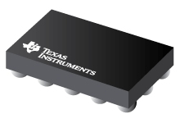
Analog Front End Selection
AFE | Photodiode Support | LED Support | Size | Cost
ADPD4100 | 2 | 8 | 3.11mm x 2.14mm | $14.33
TI AFE4403 | 1 | 3 | 3.07mm x 3.07mm | $3.78
TI AFE4404 | 1 | 3 | 2.60mm x 1.60mm | $1.85
AFE4404
Notes:
To produce the best possible PPG signal we will be utilizing an Analog Front End which facilitates the interactions between the photo diodes, the LEDs and the microcontroller.
When considering the different AFEs the biggest deciding factor was how we would be able to test and implement them. The ADPD front end from analog devices is a more robust choice, able to interface with many more LEDs and has dual channel capability to receive input from two photodiodes simultaneously, however, the development kit for it was not fiscally feasible and sourcing the part proved more difficult than anticipated. The evaluation board alone would have increased our budget by $130 compared to the TI evaluation boards, and would have accounted for ~80% of our planned budget.
We went with the AFE4404 over the 4403 because of its reduced size and cost, at the expense of giving up its fault detecting circuitry.

Slide 13
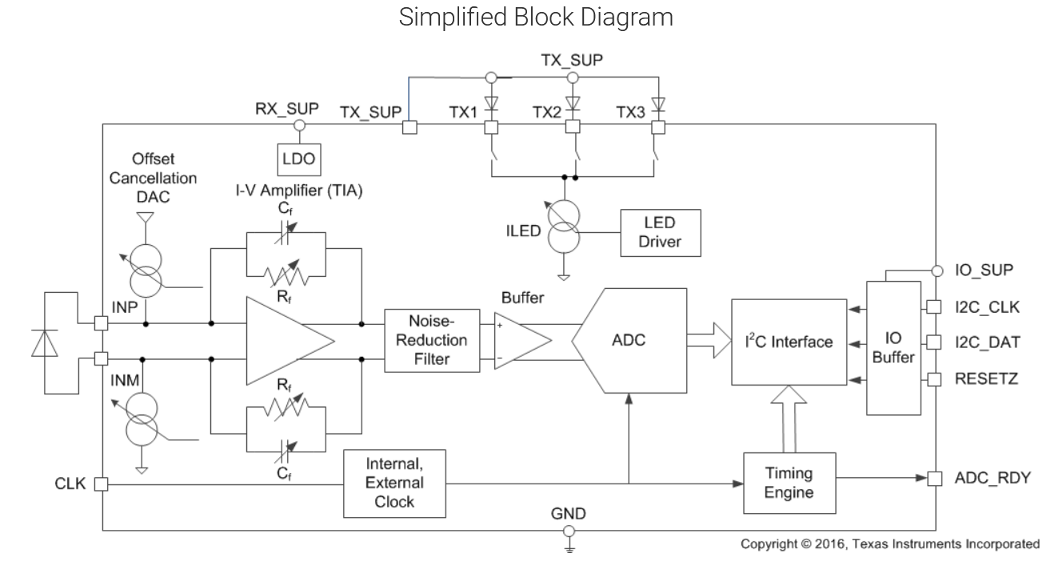
AFE4404
Notes:
As we can see on the left hand side of the block diagram , the AFE takes the current generated by the photo diode and put it into a transimpedance amplifier and then ambient light between LED pulses is captured and subtracted from the signal eliminating noise. The filtered output is then fed to an analog to digital converter where it can be transmitted by I2C. The three LEDs are wired into three separate programmable current sinks with 6 bits of resolution, allowing current from 0 mA to 50 in intervals of 0.8mA

Slide 14
Microcontroller Selection
Microcontroller | Cost | Development tools | Features
TI -MSP430(FR6989) | $5 | Code Composer Studio | 16-Bit processor at 16MHz 2kB RAM LCD Driver
Nordic Semiconductor –nRF52840(NINAB306) | $14.35 | nRF Connect, Arduino IDE | 32-bit processor at 64MHz 256kB RAM Bluetooth Module enabled
Notes:
When approaching the question of what micro controller to use, we prioritized processor speed and bluetooth capability and as a result are using the NINAB306 bluetooth module that houses an nRF52840 microcontroller in conjunction with a pcb trace antenna. Another driving factor in this choice was scarcity, since many other popular microcontrollers, such as the atmega328p on which many arduinos are based on, are not currently available.
Choosing this bluetooth module allows us to test software on the Arduino nano BLE development board before flashing it onto our prototypes.

Slide 15
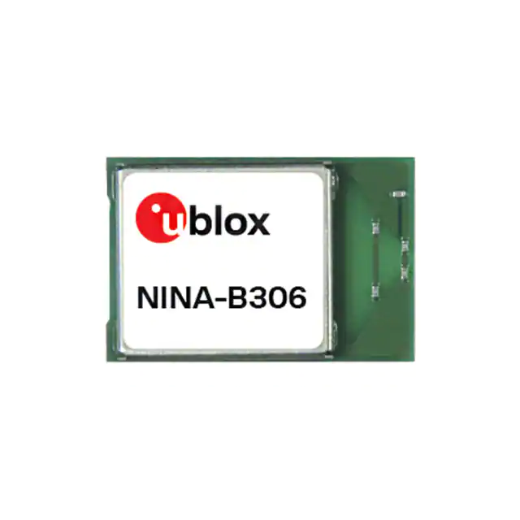
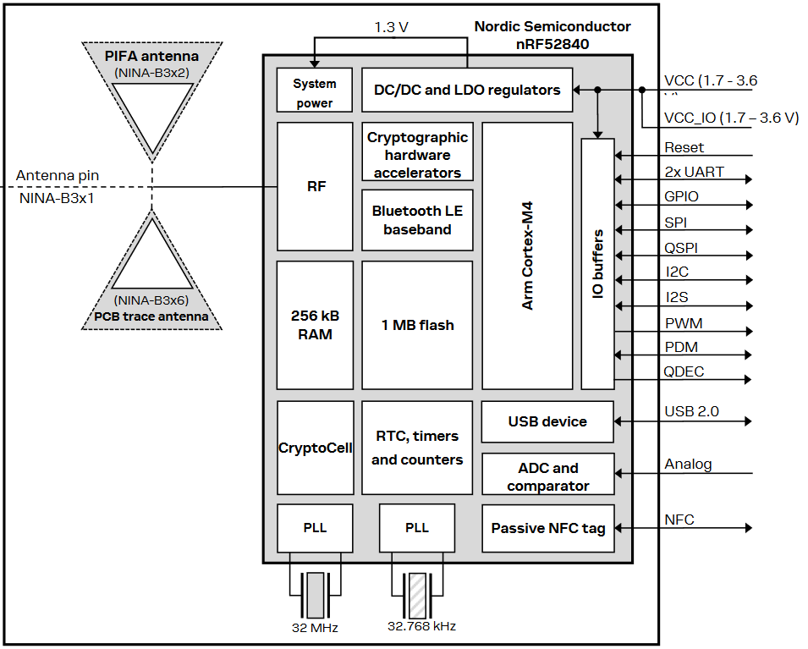
NINA B306
10mm x 15mm
Notes:
The NINA B306 takes a standard voltage of 1.7V to 3.6V, giving the choice of using 1.8V logic or 3.3V logic. Of the two we have chosen to use 3.3V for all of our ICs, since it is a voltage closer to the power supply we will be using.
As seen above the NINA module contains a PCB trace antenna and can drive two different I2C buses which we will be using to communicate with two AFEs concurrently.

Slide 16
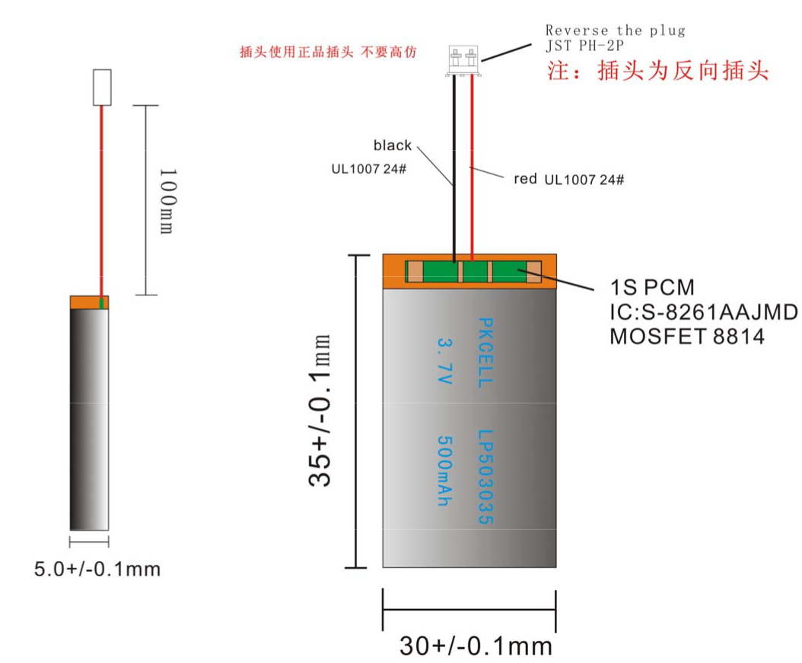
Power Delivery
Our wearable device will be powered solely by a lithium-ion Polymer battery
Nominal voltage of 3.7V, actual range is 3.0V-4.2V
Over-charging and low voltage protection circuitry within
Notes:
The power supply we will be using is a Lithium-ion Polymer battery, its voltage fluctuates from 3.0V at which point it will shut off, and 4.2V when fully charged. We chose this specific battery because it was the compromise between current driving, capacity, and size we felt was most appropriate.

Slide 17
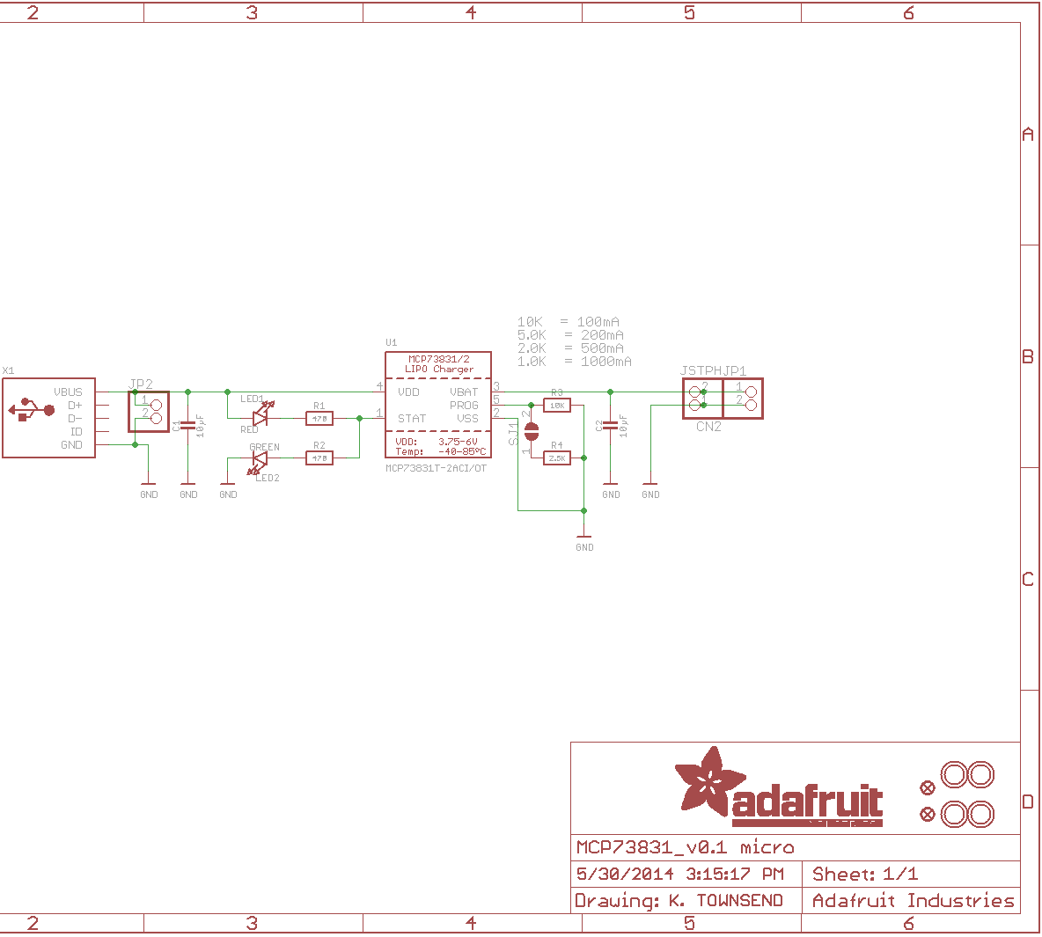
Charging Circuitry
Tentatively kept external to conserve space
Device is not intended to be used while plugged in
Notes:
As of now we do not intend to have this device be used while plugged in, as such we have just kept the charging of the battery external and will make the casing so you can take the battery out for charging.

Slide 18
Power Regulation
Buck-Boost Switching Voltage Regulators
Regulator | Input Voltage Range | Output Voltage Range | Output current (max) | Size | Cost per unit
TPS63001 | 1.8V – 5.5V | 1.2V – 5.5V | 1200mA | 3mm x 3mm | $1.03
TPS63802 | 1.3V – 5.5V | 1.8V – 5.2V | 2000mA | 3mm x 2mm | $0.70
LTC3440 | 2.5V – 5.5V | 2.5V – 5.5V | 600mA | 3mm x 3mm | $7.75
Notes:
The voltage level needed for all of our circuit is 3.3V, which lies in the middle of the range of a Lithium polymer battery. This eliminates the possibility of using a Low drop out regulator on its own and having less components used. One of the most common ways to p​ower a 3.3V device from a battery is to use a Buck-Boost switching regulator, which can dynamically increase or decrease voltage to maintain 3.3V.
We chose the LTC3440 from linear technology because it meets our demands while being one of the few regulators of its class available. The popular offerings from TI such as the TPS63001 which we had originally used in our power design are on backorder.

Slide 19
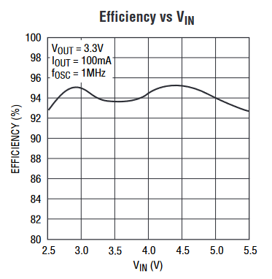
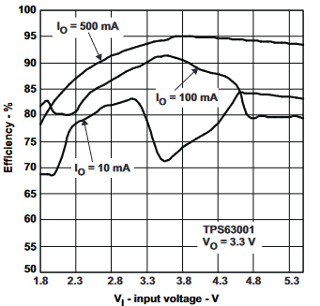
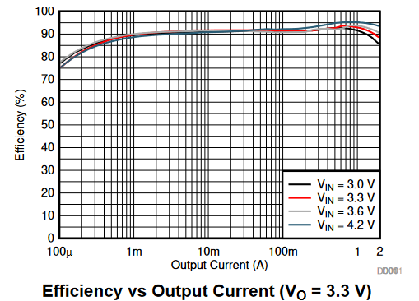
Regulator Efficiency Comparison
LTC3440 TPS63001 TPS63802
Notes:
The LTC3440 provides some of the most efficient voltage regulation available, especially when the device is not drawing a heavy load.
The TPS63001 would provide better efficiency only if using 500 mA on average, whereas the TPS63802 offers good efficiency overall, but once again was not in stock.

Slide 20
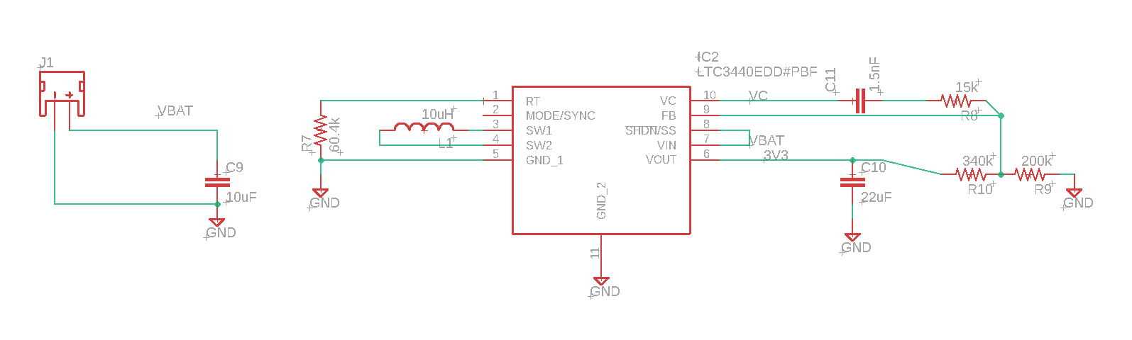
Power Regulation Schematic
Notes:
The battery connects through a JST 2 pin connector to the rest of the circuit, the R7 R10 and R9 resistors set the fixed voltage level for this IC.

Slide 21
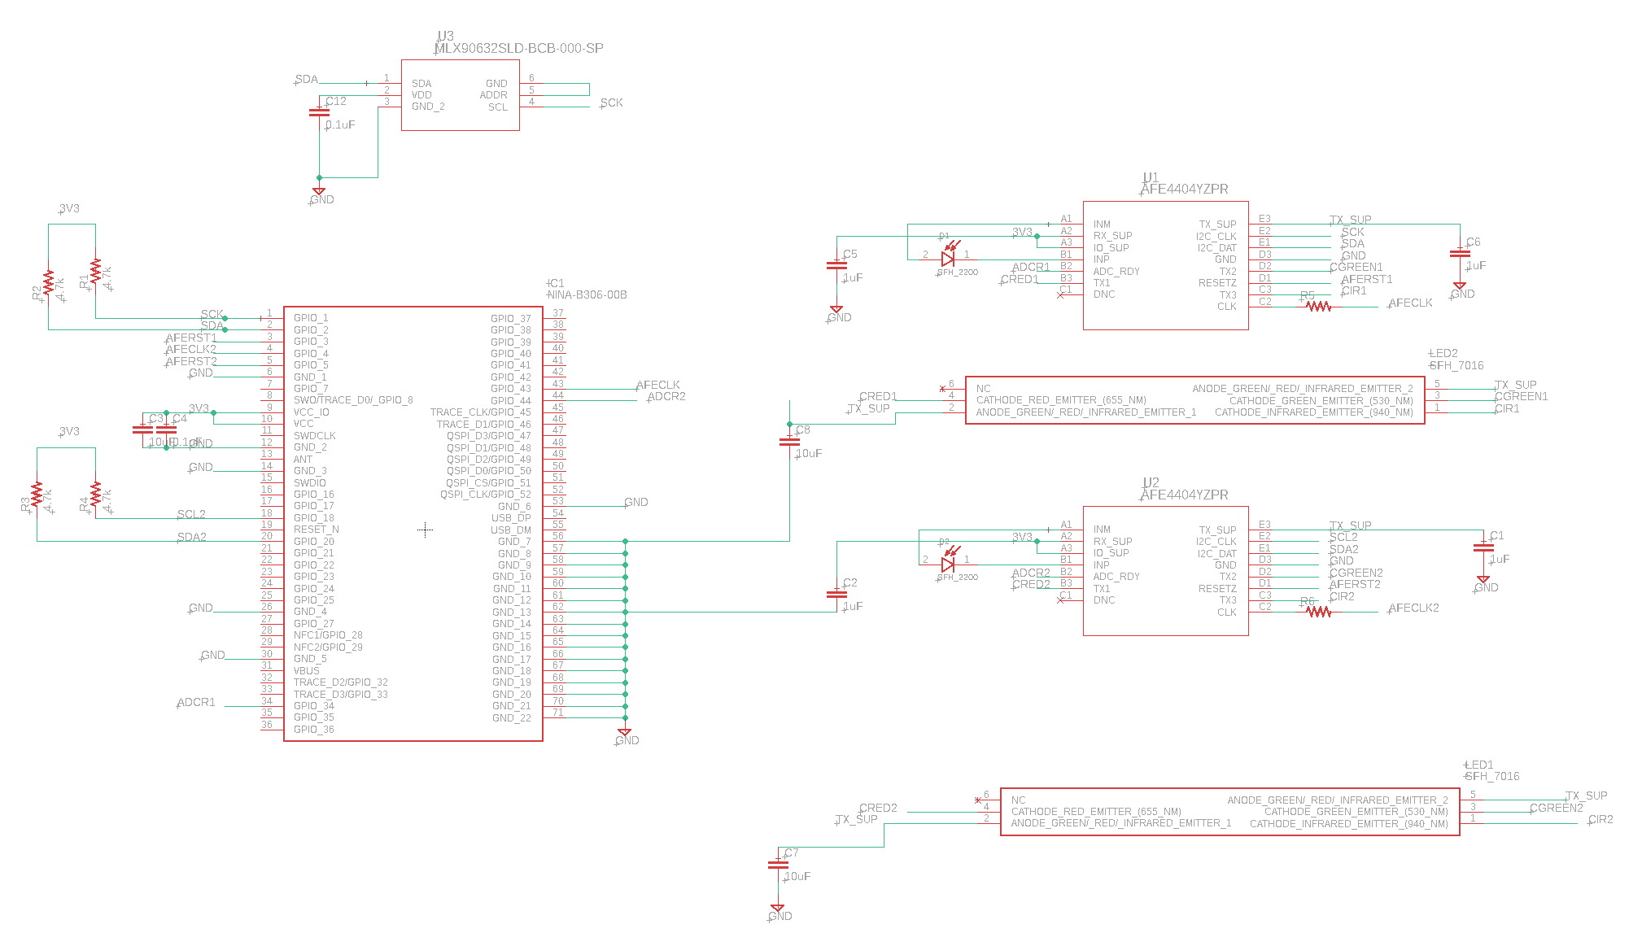
MCU and Sensors Schematic
Notes:
The 3.3V signal is used to power the rest of the board and drives the I2C bus which connects the thermal sensor, and the two AFEs. The LEDs are connected in common anode in their respective AFEs and biased using the same voltage.

Slide 22
Mobile Application Platform Selection Factors
Features
Cost
Hardware Requirements
Learning Curve
Notes:
The heart of our system will be reliant on the mobile application for processing the results measured by our device, presenting that data to the user, and storing those results for future retrieval. When reviewing our options for the solution there were a few stand out metrics.

Slide 23
Platform Selection Comparison
Android
Apple/IOS
Cross Platform
Selective Multithreading Support
Features selectively available and not necessarily supported.
Commonly No Software cost/requirement
In general No Hardware cost
Selective Language Familiarity.
Native Multithreading
Tightly coupled and supported features
No Software Cost
No Hardware Cost
No special HW requirements
Strong Language Familiarity.
Native Multithreading
Tightly coupled and supported features.
Software Development cost starts at $100
Requires IOS computer for development. Must purchase.
Weak Language Familiarity
Notes:
Although an ideal solution would be functional on as many platforms as possible, ultimately, we decided this would not be a good option for our system’s prototype. One of the more important features will be multithreading which will allow processing to happen in the background without necessarily halting user navigation of the application. Many of the cross-platform solutions, Cortona, React Native, Onsen UI, are built on top of languages like Javascript or Lua that do not natively support multithreading or require platform specific implementations. Retooling for multiple platforms could potentailly significantly increasing development time hence our decision to stick to a singular platform.
Although Apple does have guaranteed access to features and support, the cost is not ideal. Despite their development environment having no cost, the licensing to allow their platform specific access to distribute the application is $100, Private only distribution starts at $299 and additional development tools only increase that cost.
Android is the clear winner here. It keeps the features we want, supports languages some of us have already studied while enrolled here, and comes with no additional HW or SW cost or requirements.

Slide 24
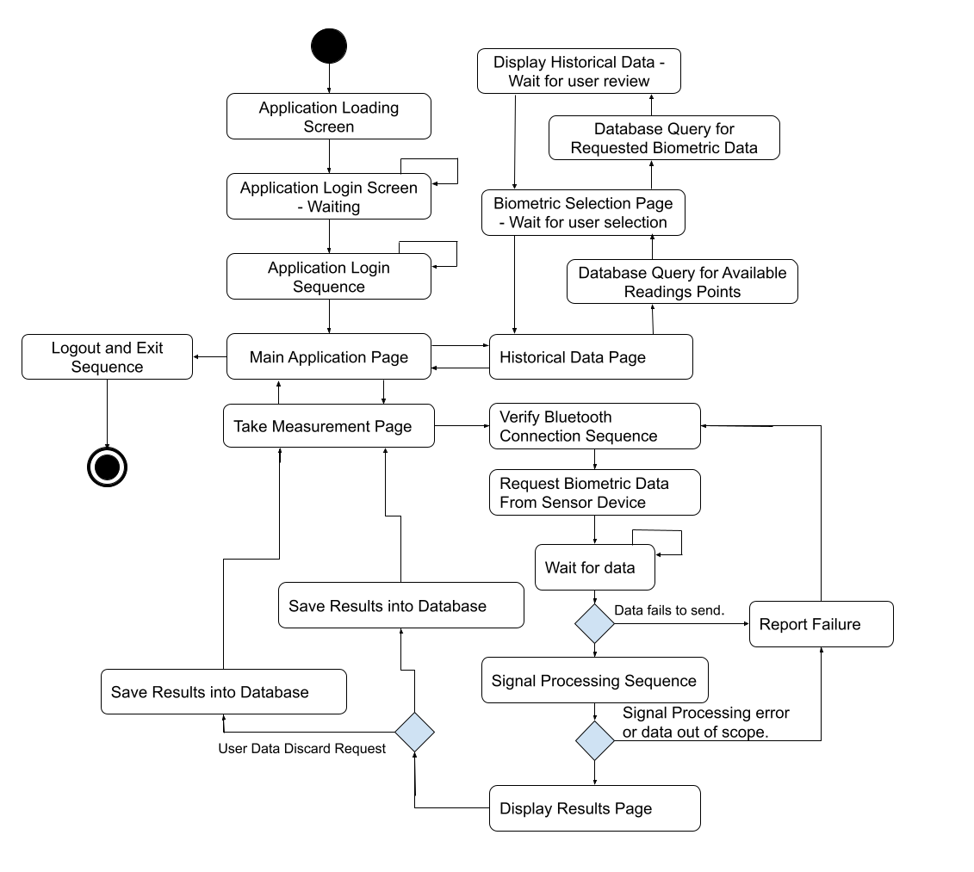
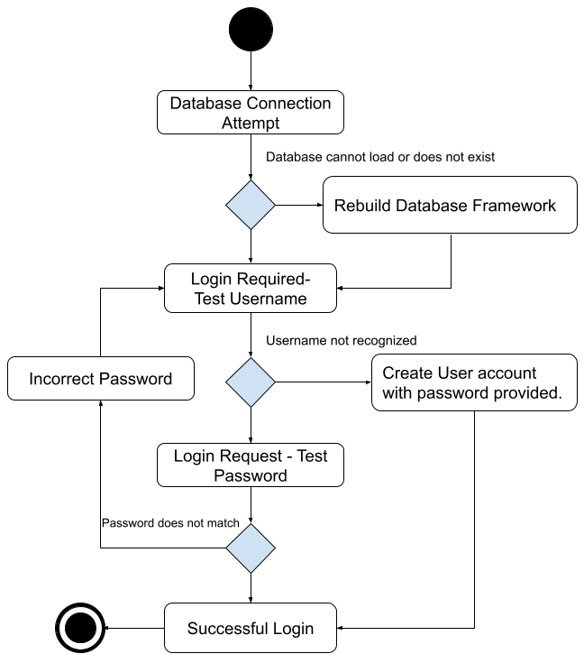
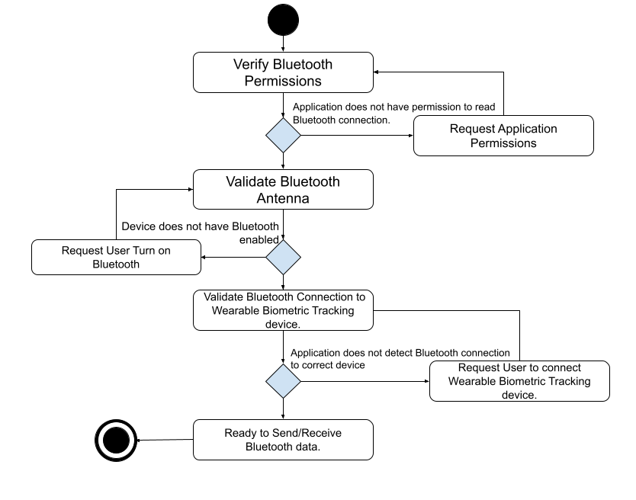
Mobile Application - Overview
BT Validation Sequence
Primary Flow
Login Sequence
Notes:
Our mobile application will have an overall flow which will be clearly defined and broken into 4 main logical pieces.
There will be a login sequence that doubles as an integrity check for the database system.
There will be the primary UI flow which defines the user experience. There will be a Bluetooth validation sequence which verifies communication.
Finally, the signal processing session will take the components of the signals received to convert them into biometrics, this will not have a flow diagram depicted here but is further explained in its own dedicated section.

Slide 25
Mobile Application - Login Sequence

Slide 26
Mobile Application – Primary Flow

Slide 27
Mobile Application – Bluetooth Validation

Slide 28
Data Storage System Selection
SQL
No-SQL
Strong Data structure.
Predictable behavior.
Common Syntax
Vertical Scalability
Optimization through Normalization
Weak Data structure
Structure can be easily changed.
Different use cases can have different syntax.
Horizontal Scalability.
Can be complicated to optimize.
Notes:
For storage an Ad hoc or custom storage solution could potentially result in unconsidered issues or edge cases that cause unwanted App behavior. The industry standard is to utilize some sort of database management system to manage and store user data. There is a standard used to Acid. Atomicity, Consistency, Isolation, and Durability. Most mature database solutions in question whether SQL or No-SQL are ACID compliant.
Although both SQL and NoSQL database systems have advantages to use in this case, we are opting into the SQL database system to store our data. SQL systems require more structure but due to this structure there is a clear methodology for optimizing data storage requirements and query speed through normalization. A relational database will lend itself well to the storage of repeated data such as categorized readings from a particular sensor that are predictable and derived results connected to individual users. Once normalized adding additional data, such as an additional metric becomes trivial removing one of the systems biggest negatives.

Slide 29
Database System Selection - SQLite
Native Android support
Local Data Storage
Full SQL feature support
ACID compliance
Predictable Syntax
Optimizable

Slide 30
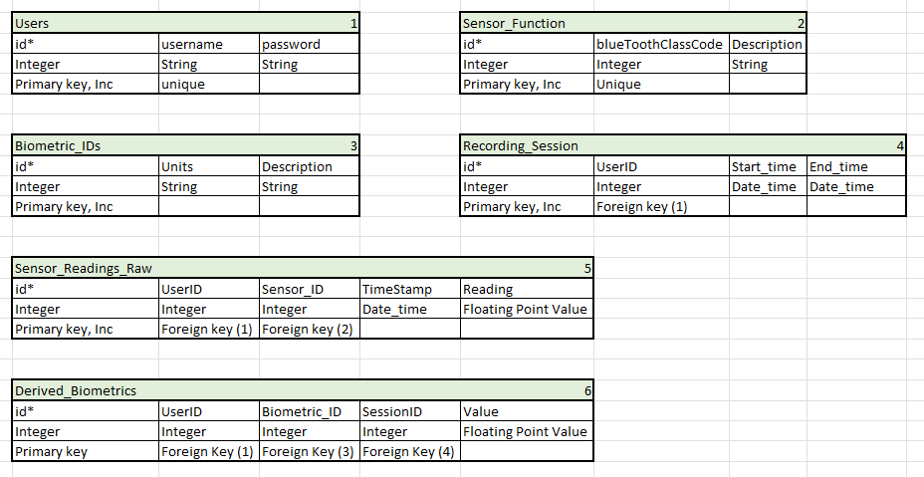
Database Table Structure
Notes:
Although we may find additional database structures convenient. The 6 table design we have created allows for a compact representation of our data, eliminating most data redundancies while still providing the ability to extend the functionality of the application or the data stored with minimal effort. This design should be compliant with at least the 3rd normal form.

Slide 31
Features
Biometrics
Heart Rate
Heart Rate Variation
Blood Oxygenation
Peaks
DC-Component of Red and Infrared wavelengths
AC-Component of Red and Infrared wavelengths

Slide 32
Peak Detection
2 techniques Considered:
First Derivate of signal is equal to 0.
Logically, if both of temporally adjacent samples are less than, than there exists a peak. i.e. s(n-2)<s(n-1)>s(n)
s(n) – s(n-1) = s’(n-1)
s(n-1)
s(n-2)
s(n)
Delay
Delay
C
s(n-1)
0
C
C
s(n)
Delay

Slide 33
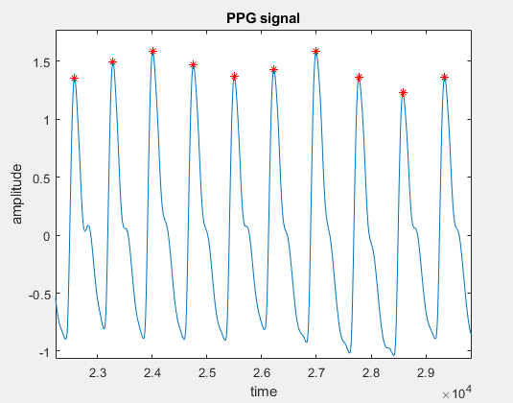
Peak Detection
When applying to the PPG signal, we see that we are detecting multiple peaks in each cycle. To remove these, we add additional criteria such as the sample must be greater than (.75) max value.

Slide 34

Obtaining AC and DC Components in a period signal.
The Fourier Transform of a signal defines the amplitude and phase for all frequencies from 0(DC) to infinity. So, obtaining the AC and DC components is as straight forward as performing a DTFT. Assume we have a discrete signal s(n) of length N.
$$ℱ\left\{s\left(n\right)\right\}= \sum_{n=0}^{N−1}{x\left(n\right)e^{−j2πkn/N}}=S(k)$$
$$S\left(0\right)=DC component \\ S\left(α\right)=AC component$$

Slide 35
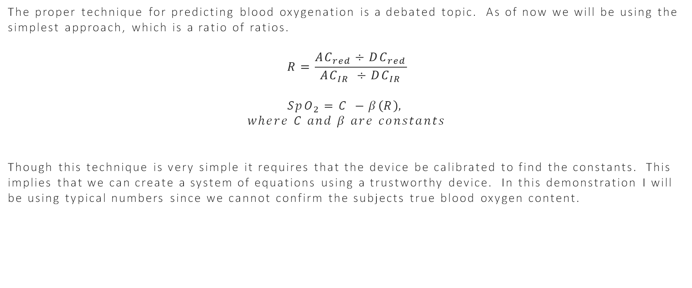
Blood Oxygenation Prediction
The proper technique for predicting blood oxygenation is a debated topic. As of now we will be using the simplest approach, which is a ratio of ratios.
$$R=\frac{AC_{red}÷DC_{red}}{AC_{IR} ÷DC_{IR}}$$
$$SpO_{2}=C −β\left(R\right),$$
$$where C and β are constants$$
Though this technique is very simple it requires that the device be calibrated to find the constants. This implies that we can create a system of equations using a trustworthy device. In this demonstration I will be using typical numbers since we cannot confirm the subjects true blood oxygen content.

Slide 36
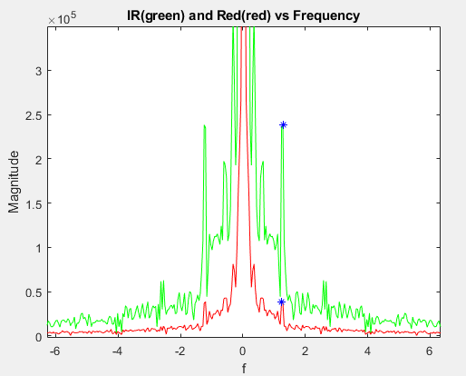
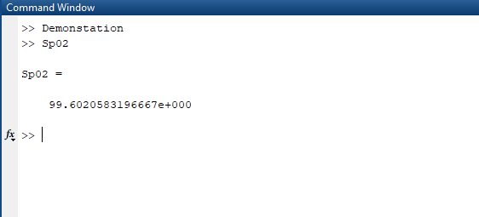
Blood Oxygenation Prediction
redratio = REDFmaxval/REDF(fix(length(REDF)/2)+1);
irratio = IRFmaxval/IRF(fix(length(IRF)/2)+1);
R = redratio/irratio;
Sp02 = 104 - 28*(R);

Slide 37
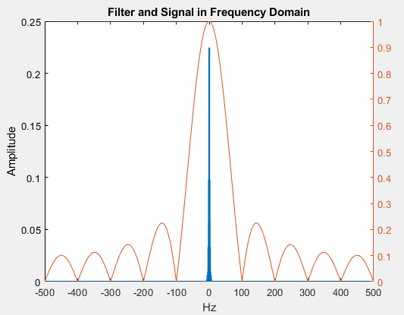
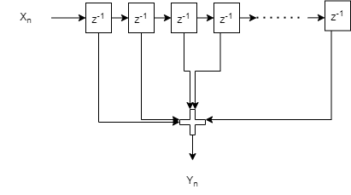
Signal Conditioning
Signal Decimation to increase SNR.
Roughly Speaking Increase SNR by down sampling ratio.
ADC samples at 1kHz
Down sample to 100Hz

Slide 38
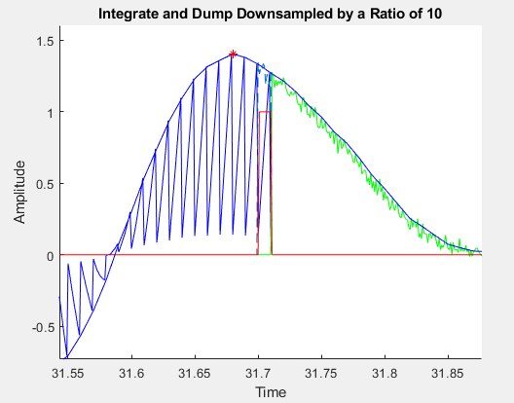
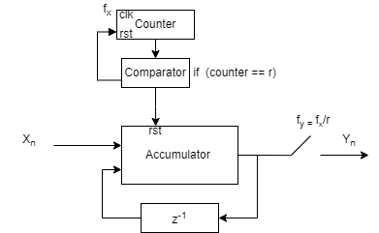
Implementation
Cascaded Integrator-Comb Filter
Lower Hardware Requirements
Achieves Same Result.
Unfiltered Signal(Green)
Filtered Signal(Blue)

Slide 39
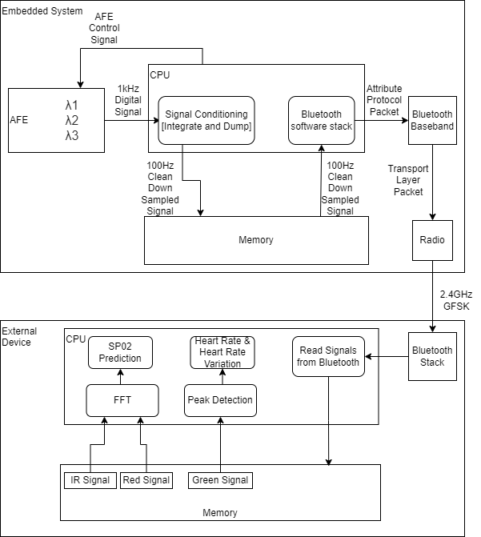
Data Flow Design

Slide 40
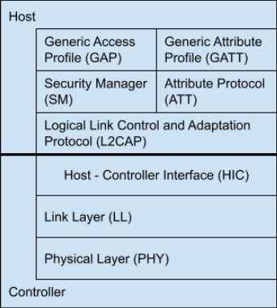
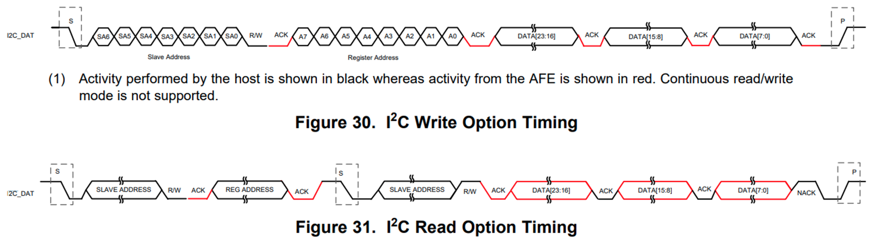
Standards
Bluetooth
Layers Of protocols
I²c
Standard Speeds
Acks and Knacks
Database Normal Forms
Data space optimizations
Query runtime optimizations.

Slide 41
Budget and Finance
Item Number | Item Name | Price per unit | Quantity | Cost
1 | SFH7016 | $1.42 | 20 | $28.40
2 | SFH2200 | $1.09 | 10 | $10.90
3 | Dual Row to DIP Adaptor (0.65mm pitch) w/stencil | $25 | 1 | $25.00
4 | Solder paste | $12 | 1 | $12.00
5 | AFE4404 | $4.33 | 4 | $17.32
6 | 15 BGA to DIP Adaptor (0.65 mm pitch) w/stencil | $45 | 1 | $45.00
7 | MLX90362 | $17.98 | 2 | $35.96
8 | 10 DFN to DIP Adaptor (0.5mm pitch) w/ stencil | $17.29 | 1 | $17.29
9 | NOA84 | $40 | 1 | $40.00
10 | TECHSPEC wire-grid polarizer film | $43 | 1 | $43.00
11 | Arduino Nano BLE with headers | $24.80 | 3 | $74.40
12 | Battery | $20 | 2 | $40.00
13 | SMT JST 2 PIN | $1.00 | 1 | $1.00
14 | Battery Charging Circuitry | $7.00 | 1 | $7.00
15 | Buck Boost Converter | $5.00 | 1 | $5.00
16 | Boost Converter | $5.00 | 1 | $5.00
17 | PCB Boards | $100 | 1 | $100.00
 |  |  | Total Costs | $507.27
Items and Quantities in yellow correspond to additional supplies acquired for module testing.

Slide 42
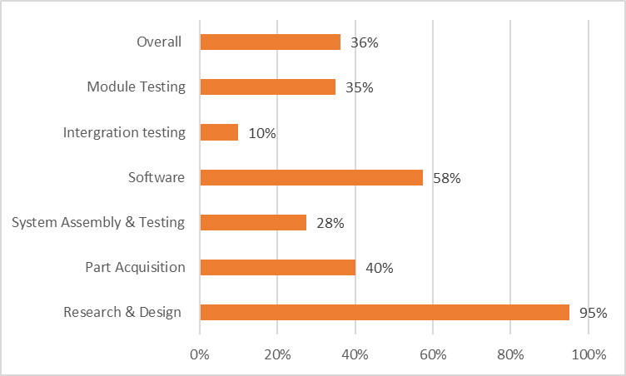
Project Progress

Slide 43
Road Map of Objectives
[6/12-6/18]
Assembled initial PPG sensor prototype (optical barrier and optimal separation)
Integration of PPG sensor and AFE modules
First Draft of UI for app completed
[6/19-6/25]
Assemble refined PPG sensor prototype (Optical adhesive casing and polarizers)
Finalize UI look and feel
[6/26-7/2]
Unit Testing for application logic flow.
[7/3-7/9]
Begin Application Integration Testing with prototype with device communication
[7/10-7/16]
Complete Application Integration Testing with prototype.
[7/17-7/23]
Confirm Demo Sequences of UI for presentation
Finish first draft of wearable housing
Finish final draft of wearable housing
Integrate thermal sensor with bluetooth
Test algorithms for biometric extractions

Slide 44
Thank you!

