Slide 1


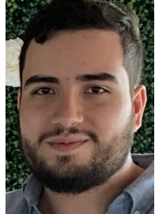


Wearable Optical Biometric Tracking System
Group 2:
Tyrone Morales PSe
Christopher Bormey EE
SCOTT PERRYMAN EE & CPE
Cody Showers CPE

Slide 2
Project Goals
Build a lightweight, compact, wearable sensor device that measures and provides information about cardiovascular biometrics.
Design device such that it can wirelessly interfaces with a personal device.
Have biometric data logged via an app for long term health monitoring

Slide 3
Main Specifications
# | Description | Magnitude | Units
1 | Device shall produce predictions for the following biometrics: Heart Rate, Heart Rate Variability, Blood Oxygenation, Temperature. | 4 | Modes
2 | The device size should be compact for the contact design (WxLxH) | 365 | Measurements Stored
3 | Keep track of at least one year's worth of measurements stored. | ~8x4x4 | Cm
4 | Singular point of contact for measurement. | 1 | contact
Notes:
The main point of the specifications that we selected were that they spoke to a specific functionality or goal that we were trying to implement.
Heart Rate, Heart Rate Variability, SPO2, and Temperature are all metrics that can be obtained through optical design and they are all indicators of overall health. Also, ¾ of them are indicators of cardiovascular health.
Doctors, in particular primary care physicians, are able to help someone trying to be healthier. Given that many people don't see their doctor but maybe once a year, being able to store this data for at least that amount of time was curial to it's development.
The singular point of contact specification was in order to keep this implementation to something which would not impede users too much while potentially recording fitness activities.
Although we did not meet the specific dimensions we originally intended, they were also meant to speak to the portability and convenience for end users of our intended device.

Slide 4
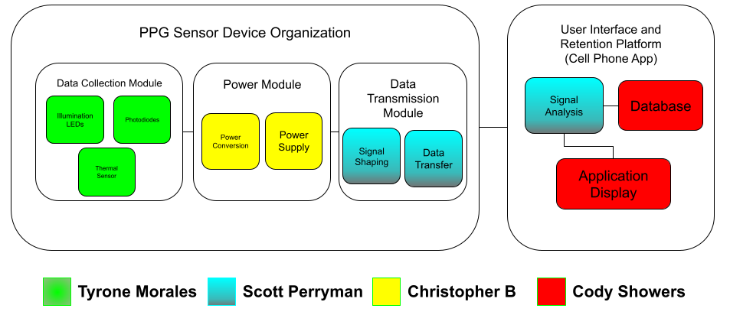
High level overview/block diagram

Slide 5
Fundamental Theory of Photoplethysmography
Photoplethysmography (PPG) is an optoelectronic technique implemented in medical and fitness technologies for obtaining cardiovascular information via optical probing of skin tissues.
PPG technology is based on a fundamental principle of light-skin interactions, absorption.
  Chromophores are biomolecules which have a distinct absorption spectrum.
  The primary chromophores in skin are water, melanin, and hemoglobin.
  Hemoglobin is the oxygen carrying component of blood.
Due to absorption spectrum of hemoglobin and the contraction/relaxation of capillaries, the Beer-Lambert can be used to sense the presence blood flow from microvascular tissue

Slide 6
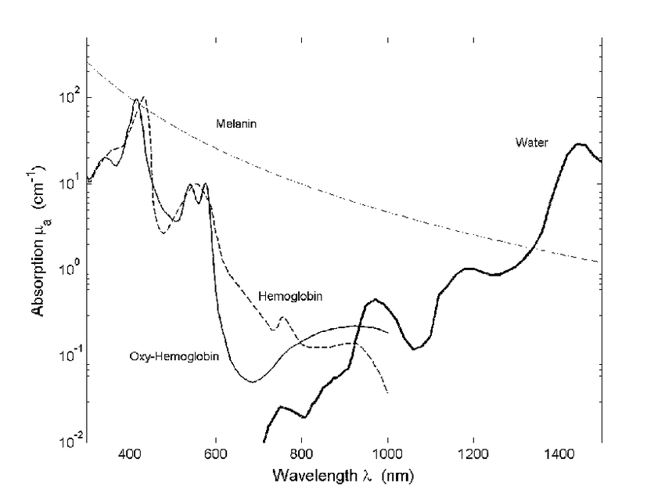
Wavelength Selection
Wavelength of operation is one of the most critical parameters for the implementation of a PPG sensor
Melanin is a strongly absorbing chromophore which spans the visible spectrum but is most absorbent at wavelengths lower than 500 nm.
Water's absorption coefficient becomes large at wavelengths larger than 1000 nm.
For our application, we needed to maximize the absorption of hemoglobin while minimizing losses from unwanted sources.

Slide 7
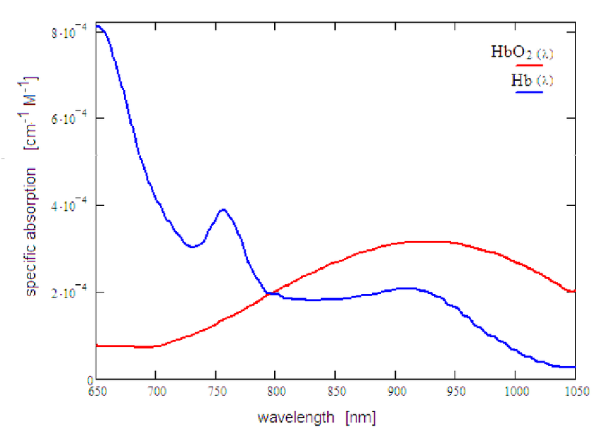
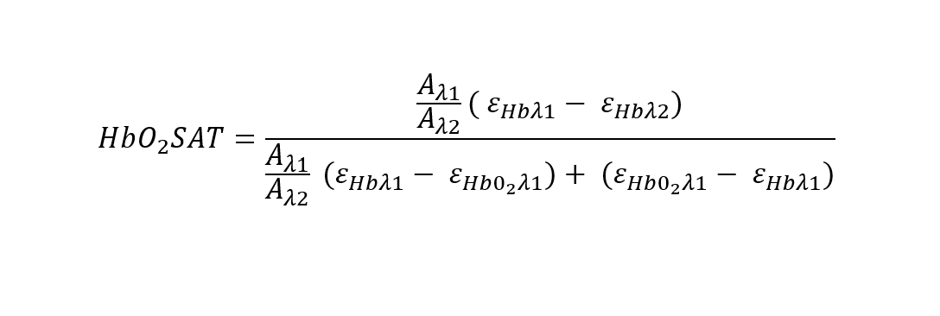
Wavelength selection cont.
Calculation of blood oxygen is dependent difference absorbance of two distinct wavelengths for oxygenated and nonoxygenated blood.
The Beer-Lambert Law relates the absorbance of both wavelengths to the concentration of each variation of the chromophore such that blood oxygen saturation can be calculated.

Slide 8
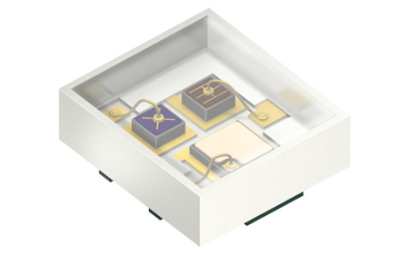
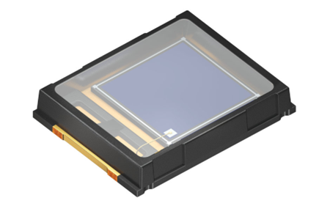
Component Selection
SFH7016 by OSRAM
[Spectral Characteristics] Green: 526 nm with FWHM of 32nm Red: 660 nm with FWHM of 17nm Near Infrared: 950 nm with FWHM of 42 nm
[Component Dimensions] L x W x H: 1.65 mm x 1.85 mm x 0.6 mm
[Electrical Characteristics ] Green: I_{F} = 20 mA @ V_{f} = 2.40 V Red: I_{F} = 30 mA @ V_{f} = 1.90 V Near Infrared: I_{F} = 40 mA @ V_{f} = 1.30 V
For our PPG sensor, we are utilizing a multiwavelength SM-LED chip (SFH7016) and an SM-Photodiode (SFH2200).
These components offer compact dimensions, reasonable forward current requirements, and met our spectral requirements.
SFH2200 by OSRAM
[Spectral Characteristics] Green: 0.301 A/W Red: 0.473 A/W Near Infrared: 0.665 A/W
[Component Dimensions] L x W x H: 5.09 mm x 4 mm x 0.85 mm

Slide 9
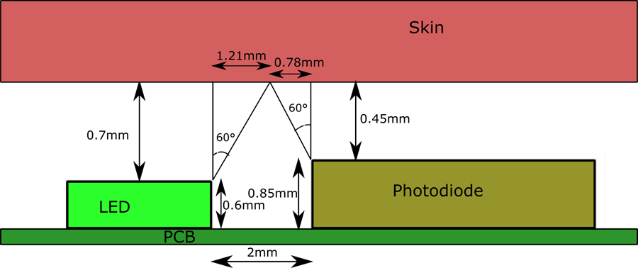
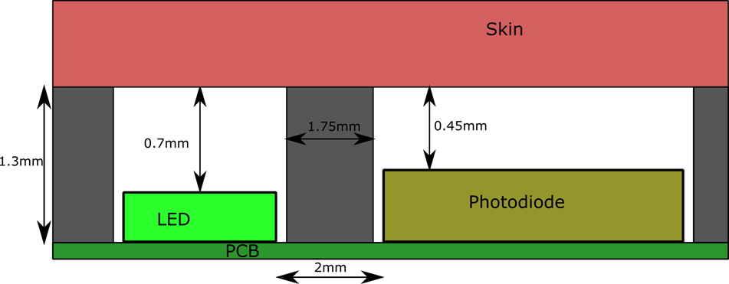
Optical Barriers for Suppressing Crosstalk
Due to the LED's ideal Lambertian emission profile (60-degree half angle) and the PD's acceptance profile, optical crosstalk occurs from specular reflection at the air-to-skin surface.
Introduction of an optical barrier with a tentative thickness of 1.75 mm greatly reduced the amount of crosstalk to negligible levels
The barriers were implemented in the housing structure for the complete device.
The material used was a PETG filament, and the structure will be manufactured via a 3D printer.
  PETG filament have less than 1% transmission for 1 mm thickness at our wavelengths

Slide 10
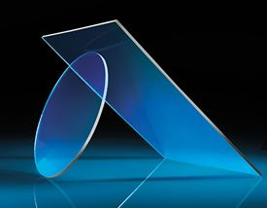
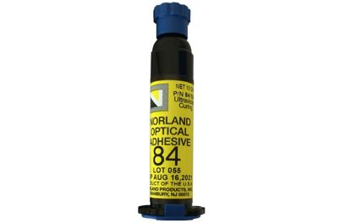
Optical Windows and Adhesives for Index matching
To further optimize the collection of the PPG signal, optical windows and adhesives were used to reduce Fresnel losses.
The optical window and adhesive provided a transition medium between the sensor and skin resulting in a reduction of Fresnel losses of 6.39% to 0.12%
The optical adhesive as the NOA84 by Norland Adhesives
  A complication that arises from this is the need of a UV source as UV curing is needed for the adhesive.
Clear Plastic Optical Windows
[Refractive Index] 1.501
[Transmission] Above 90%
NOA84
[Refractive Index] 1.46
[Optimal Curing Wavelengths] 325 nm, 365 nm and 405nm

Slide 11
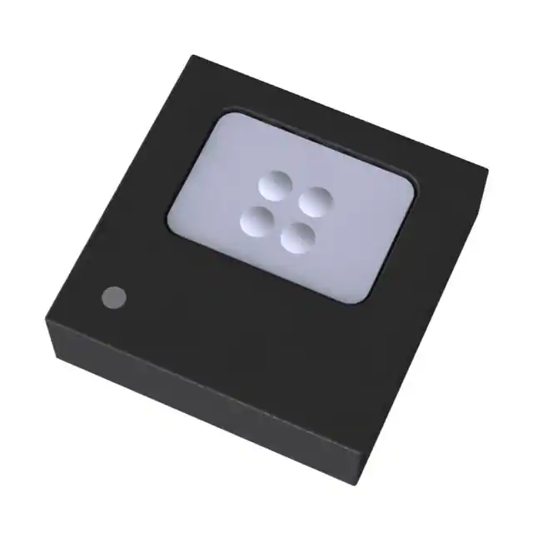
Thermal sensor
MAX30205 | MLX90362
[Sensor Modality] Contact-based sensor | [Sensor Modality] Optical-based sensor
[Measurement Accuracy] 0.1 Celsius | [Measurement Accuracy] 0.01 Celsius
[Price] $4.77 per unit | [Price] $17.98 per unit
[Power consumption] V_{s} = 2.7V - 3.3V @ I_{s} =100 uA | [Power consumption] V_{s} = 3.3V @ I_{S} = 1 mA
For skin temperature sensing, we utilized a thermal sensor module with an I²C interface for system integration.
The thermal sensor to be used is the MLX90362 available via Mouser.

Slide 12
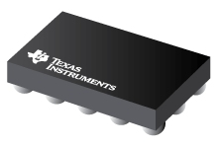
Analog Front End Selection
AFE | Photodiode Support | LED Support | Size | Cost
ADPD4100 | 2 | 8 | 3.11mm x 2.14mm | $14.33
TI AFE4403 | 1 | 3 | 3.07mm x 3.07mm | $3.78
TI AFE4404 | 1 | 3 | 2.60mm x 1.60mm | $1.85
AFE4404
Notes:
To produce the best possible PPG signal we will be utilizing an Analog Front End which facilitates the interactions between the photo diodes, the LEDs and the microcontroller.
When considering the different AFEs the biggest deciding factor was how we would be able to test and implement them. The ADPD front end from analog devices is a more robust choice, able to interface with many more LEDs and has dual channel capability to receive input from two photodiodes simultaneously, however, the development kit for it was not fiscally feasible and sourcing the part proved more difficult than anticipated. The evaluation board alone would have increased our budget by $130 compared to the TI evaluation boards, and would have accounted for ~80% of our planned budget.
We went with the AFE4404 over the 4403 because of its reduced size and cost, at the expense of giving up its fault detecting circuitry.

Slide 13
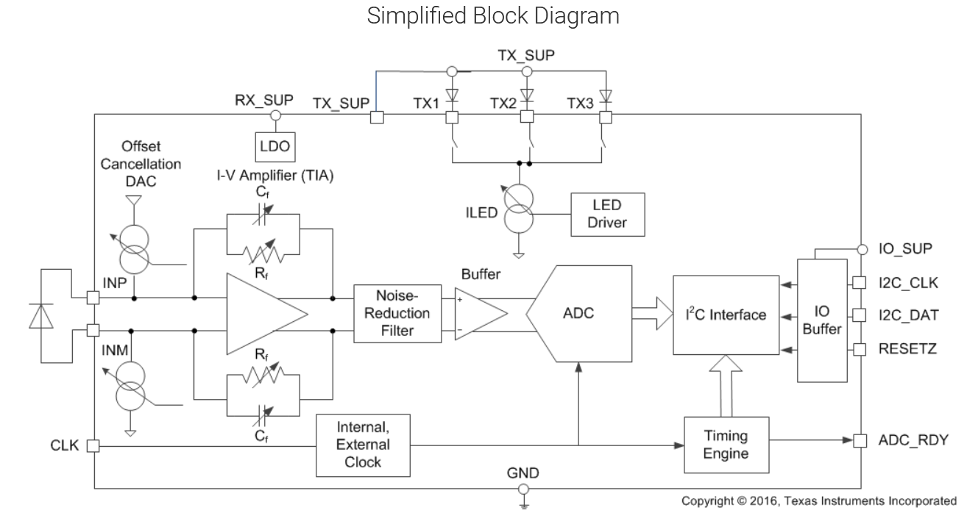
AFE4404
Notes:
As we can see on the left hand side of Analog Front End, the AFE takes the current generated by the photo diode as a result of the time multiplexed LEDs and puts it into a transimpedance amplifier along with our programmed current offset, then the ambient light between LED pulses is captured and subtracted from the signal eliminating noise. The filtered output is then fed to an analog to digital converter where it can be transmitted by I2C. The three LEDs are wired into three separate programmable current sinks with 6 bits of resolution, allowing current from 0 mA to 50 in intervals of 0.8mA

Slide 14
Microcontroller Selection
Microcontroller | Cost | Development tools | Features
TI -MSP430(FR6989) | $5 | Code Composer Studio | 16-Bit processor at 16MHz 2kB RAM LCD Driver
Nordic Semiconductor –nRF52840(NINAB306) | $14.35 | nRF Connect, Arduino IDE | 32-bit processor at 64MHz 256kB RAM Bluetooth Module enabled
Notes:
When approaching the question of what micro controller to use, we prioritized processor speed and bluetooth capability and as a result are using the NINAB306 bluetooth module that houses an nRF52840 microcontroller in conjunction with a pcb trace antenna. Another driving factor in this choice was scarcity, since many other popular microcontrollers, such as the atmega328p on which many arduinos are based on, were not available when we conducted component research.
Choosing this bluetooth module allows us to test software on the Arduino nano BLE development board before flashing it onto our own PCBs.

Slide 15
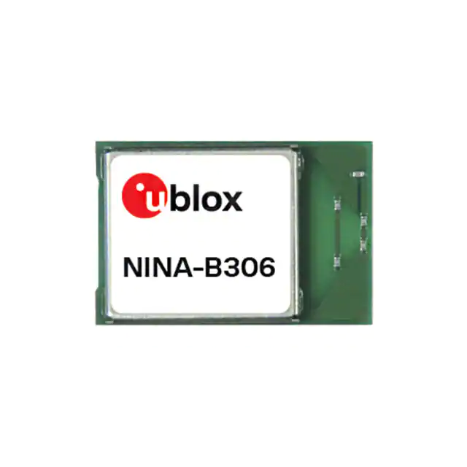
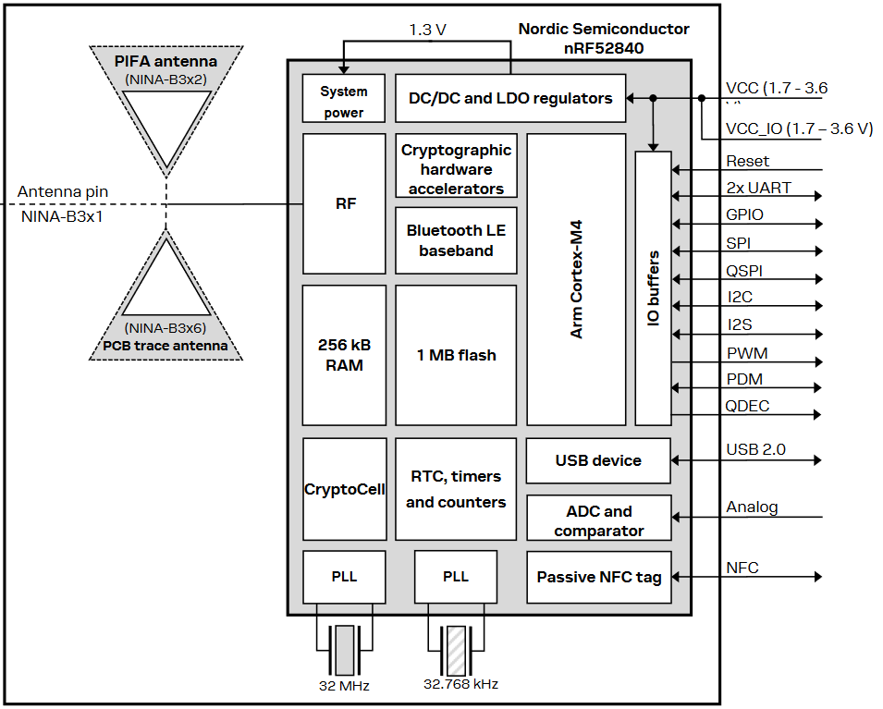
NINA B306
10mm x 15mm
Notes:
The NINA B306 takes a standard voltage of 1.7V to 3.6V, giving the choice of using 1.8V logic or 3.3V logic. Of the two we have chosen to use 3.3V for all of our ICs, since it is a voltage closer to the power supply we will be using.
As seen above the NINA module contains a PCB trace antenna and can drive two different I2C buses which we use to communicate with two AFEs concurrently.

Slide 16
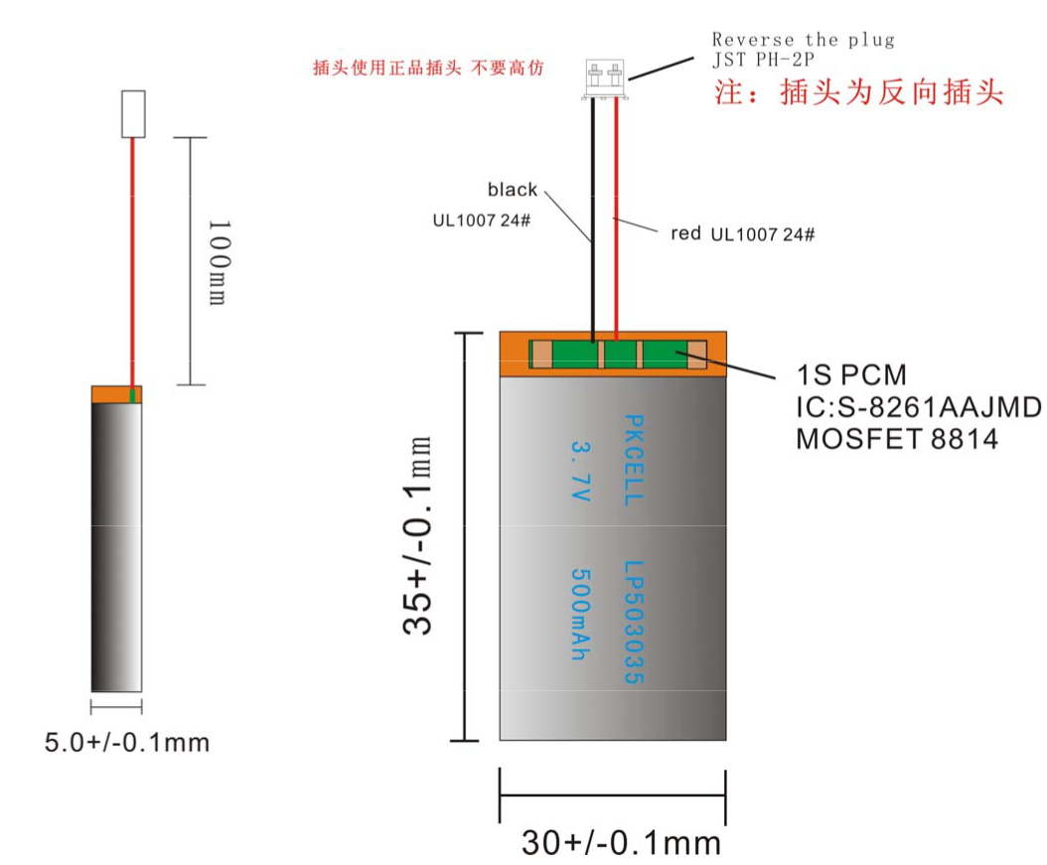
Power Delivery
Our wearable device will be powered solely by a lithium-ion Polymer battery
Nominal voltage of 3.7V, actual range is 3.0V-4.2V
Over-charging and low voltage protection circuitry within
Notes:
The power supply we will be using is a Lithium-ion Polymer battery, its voltage fluctuates from 4.2 Volts when fully charged to 3 Volts when the battery is depleted. We chose this specific battery because it was the compromise between current driving capability, capacity, and size we felt was most appropriate. The small size form factor and 500 milli amp hour capacity allows us to power our device for approximately 10 hours straight running at full capacity.

Slide 17
Power Regulation
Buck-Boost Switching Voltage Regulators
Regulator | Input Voltage Range | Output Voltage Range | Output current (max) | Size | Cost per unit
TPS63001 | 1.8V – 5.5V | 1.2V – 5.5V | 1200mA | 3mm x 3mm | $1.03
TPS63802 | 1.3V – 5.5V | 1.8V – 5.2V | 2000mA | 3mm x 2mm | $0.70
LTC3440 | 2.5V – 5.5V | 2.5V – 5.5V | 600mA | 3mm x 3mm | $7.75
Notes:
The voltage level needed for all of our device is 3.3V, which lies in the middle of the range of a Lithium polymer battery. This eliminates the possibility of using a Low drop out regulator on its own and having less components used. One of the most common ways to p​ower a 3.3V device from a battery is to use a Buck-Boost switching regulator, which can dynamically increase or decrease voltage to maintain 3.3V.
We chose the LTC3440 from linear technology because it meets our demands while being one of the few regulators of its class available. The popular offerings from TI such as the TPS63001 which we had originally used in our power design are on backorder.

Slide 18
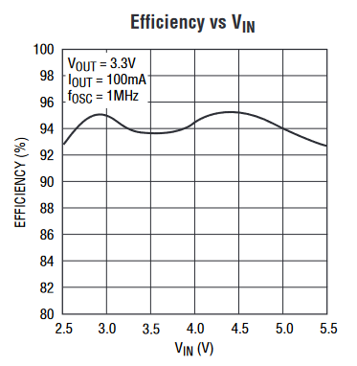
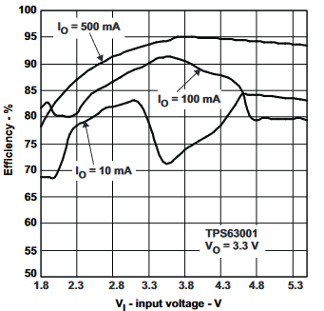
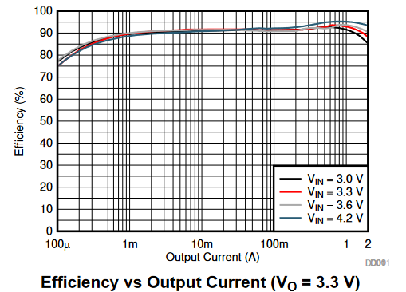
Regulator Efficiency Comparison
LTC3440 TPS63001 TPS63802
Notes:
The LTC3440 provides some of the most efficient voltage regulation available, especially when the device is not drawing a heavy load.
The TPS63001 would provide better efficiency only if using 500 mA on average, whereas the TPS63802 offers good efficiency overall, but once again was not in stock.

Slide 19
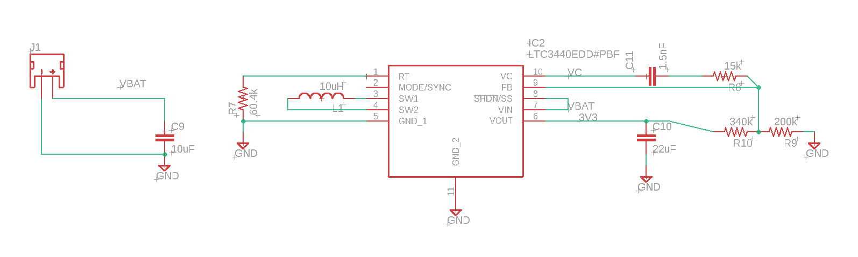
Power Regulation Schematic
Notes:
The battery connects through a JST 2 pin connector to the rest of the circuit, the R7 R10 and R9 resistors set the fixed 3.3V voltage level for this IC.

Slide 20
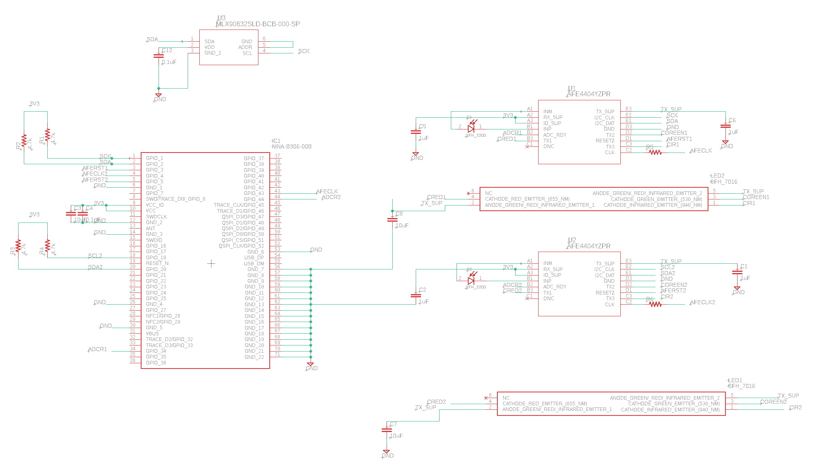
MCU and Sensors Schematic
Notes:
The 3.3V signal is used to power the rest of the board and drives the I2C bus which connects the thermal sensor, and the two AFEs. The LEDs are connected in common anode in their respective AFEs and biased using the same voltage.

Slide 21
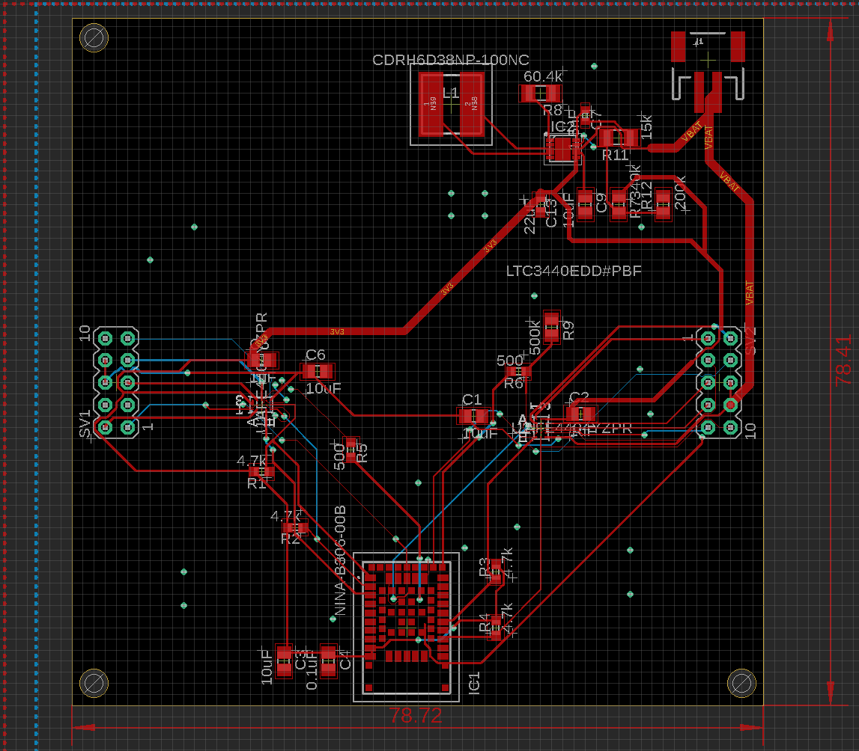

Processing Board
Hosts our microcontroller, battery connecter, and analog front ends.
Notes:
On the left hand side here we have our processing board that hosts the microcontroller, battery connector, voltage regulator, and analog front ends. The board was designed to keep our switching voltage regulator and Bluetooth antenna as far away as possible from the sensitive traces such as the photodiode inputs. Using the total of 20 pins, ten on each side we have a symmetric design where each AFE and photodiode/led pair is routed separately between boards.

Slide 22
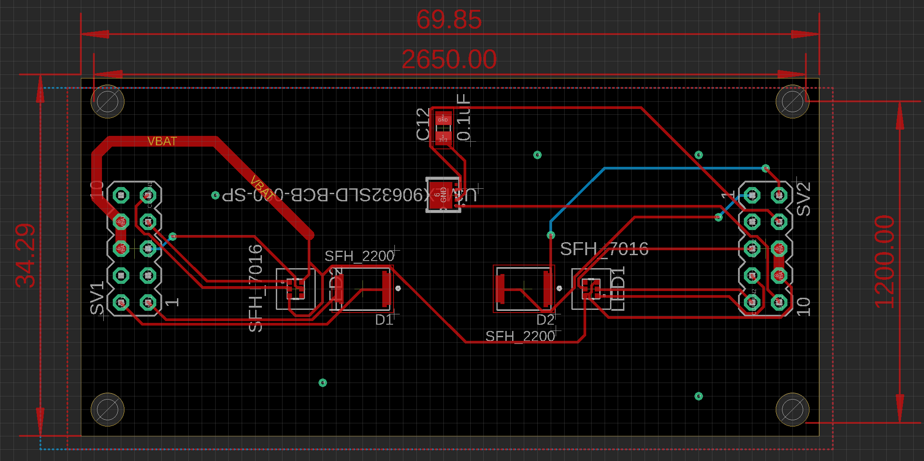
Sensor Board
Two Photo diodes
Two LED arrays, for a total of six LEDS
Notes:
Our sensor board hosts the two Photodiode/ LED pairs with the optimal two millimeter spacing between each photodiode and its corresponding LED array. Above these components sits the thermal sensor with its bypass capacitor. On either sides are the pins that connect all the optical sensors to the processing board where the data will be interpreted and packaged.

Slide 23
Mobile Application Platform Selection Factors
Features
Cost
Hardware Requirements
Learning Curve
Notes:
The heart of our system will be reliant on the mobile application for processing the results measured by our device, presenting that data to the user, and storing those results for future retrieval. When reviewing our options for the solution there were a few factors that we used to select our platform.

Slide 24
Platform Selection Comparison
Android
Apple/IOS
Cross Platform
Selective Multithreading Support
Features selectively available and not necessarily supported.
Commonly No Software cost/requirement
In general No Hardware cost
Selective Language Familiarity.
Native Multithreading
Tightly coupled and supported features
No Software Cost
No Hardware Cost
No special HW requirements
Base Language Familiarity.
Native Multithreading
Tightly coupled and supported features.
Software Development cost starts at $100
Requires IOS computer for development. Must purchase.
Weak Language Familiarity
Notes:
Although an ideal solution would be functional on as many platforms as possible, ultimately, we decided this would not be a good option for our system’s prototype.
One of the more important features will be multithreading which will allow processing to happen in the background without necessarily halting user navigation of the application. Many of the cross-platform solutions, Cortona, React Retooling for multiple platforms would have potentially significantly increase development time, hence our decision to stick to a singular platform. Even with this decision, learning the platform on a time limit increased difficulty.
Although Apple does have guaranteed access to features and support, the cost is not ideal. Despite their development environment having no cost, the licensing to allow their platform specific access to distribute the application is $100, Private only distribution starts at $299 and additional development tools only increase that cost.
Android seemed to be the clear winner. It keeps the features we want, supports languages some of us have already studied while enrolled here, and comes with no additional HW or SW cost or requirements. However it had its own complications.

Slide 25
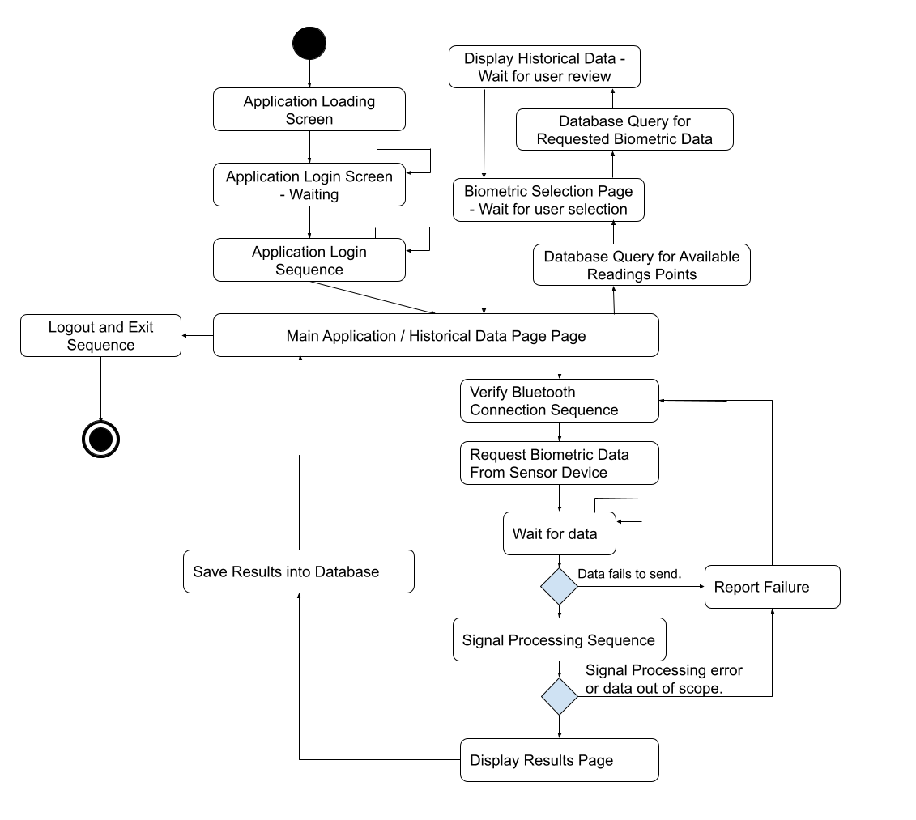
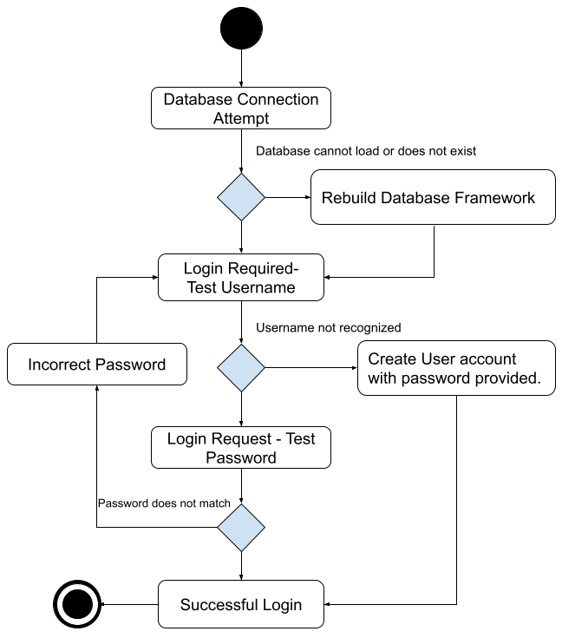
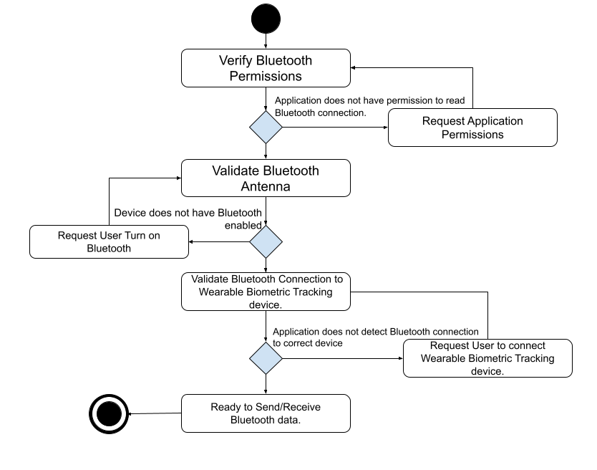
Mobile Application - Overview
BT Validation Sequence
Primary Flow
Login Sequence
Notes:
Our mobile application has a flow which was clearly defined and broken into 4 main logical pieces.
There is a login sequence that doubles as an integrity check for the database system.
Our original planned UI flow ultimately was collapsed. This did not greatly effect the state. Arduino code regularly has to check permissions to allow Bluetooth communication.
Finally, there is a signal processing session which takes the components of the signals received to convert them into biometrics, this is described in detail in its own dedicated section.

Slide 26
Mobile Application - Login Sequence
Notes:
Upon launch the application

Slide 27
Mobile Application – Primary Flow

Slide 28
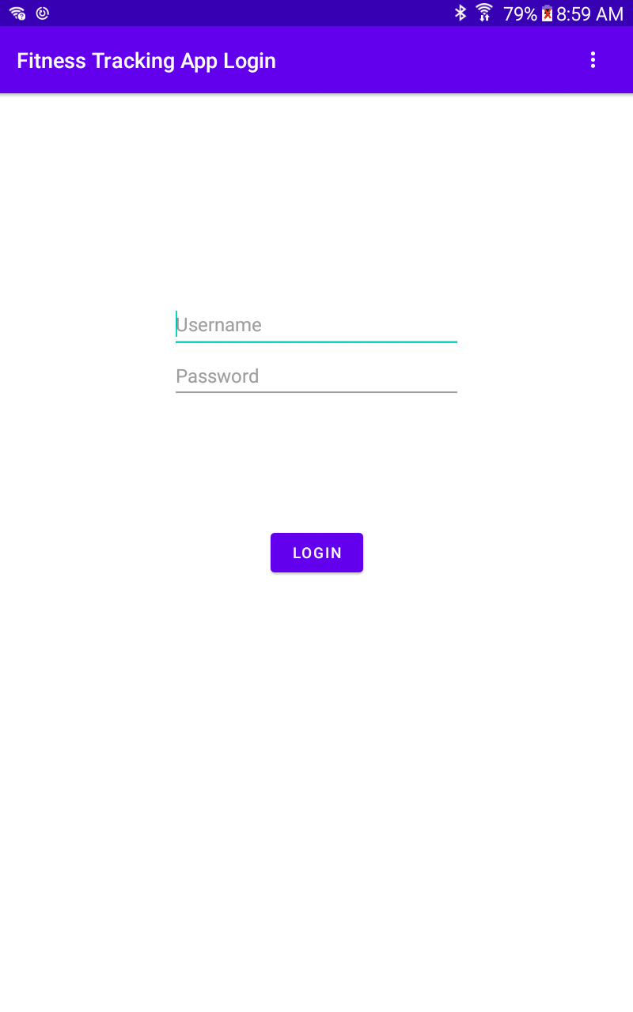
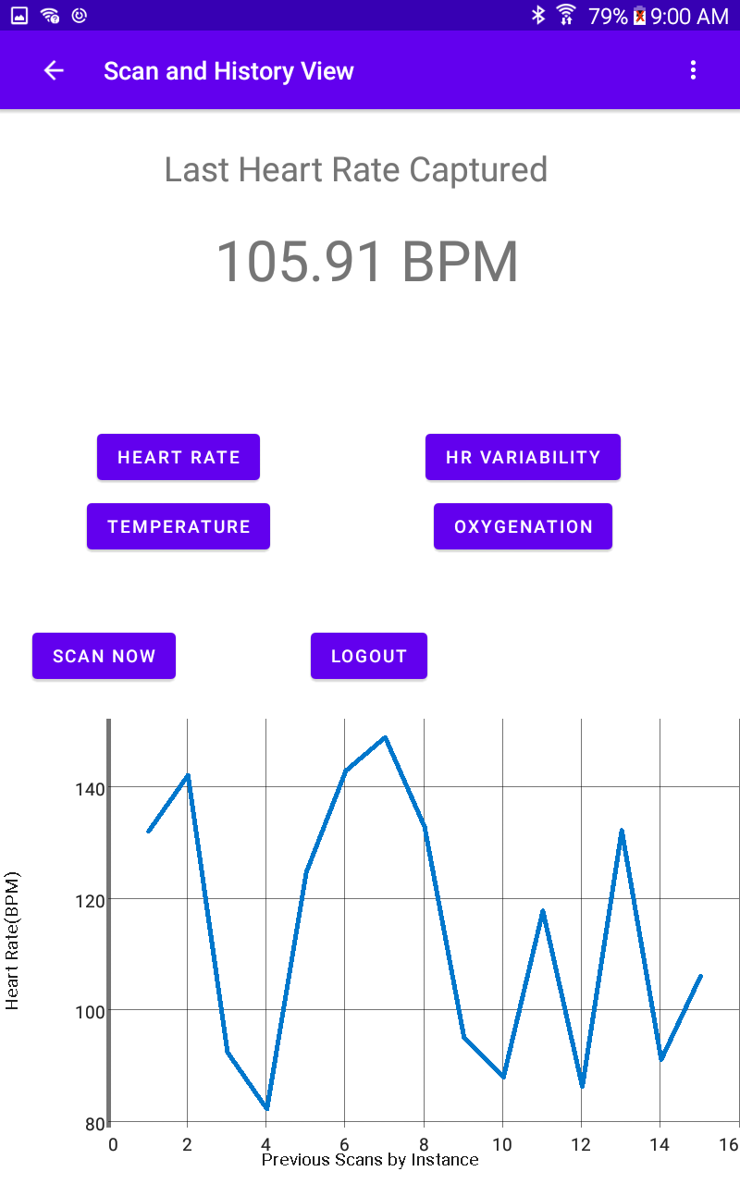
Mobile Application – Simplified Display
Notes:
In order to try to Simplify the design of the app layout we collapsed the multi layout design combining redundant elements, in particular the buttons and UI framework required to link resources.
In an attempt to focus on the importance, labels and values are as large as the space allows. Data is upfront as the intent has always been to capture biometrics on this device.
The GraphView on population bounds its Viewport around the specific data range in question, the last stored metric, and data labels are immediately set to match the biometric button selected.

Slide 29
Mobile Application – Bluetooth Validation
Notes:
On every module access attempt Android activities and services implode if access attempts are made without handling exceptions. Unfortunately this has evolved over time. The particular implementation we targeted was for the demo device selected on API 23. This requires permissions checks and services to be started to function, but not in the same manner required by devices on later APIs.
This is one of a few examples of areas where Android's less apparent nuances proved to only increase the complexity of our task.

Slide 30
Data Storage System Selection
SQL
No-SQL
Strong Data structure.
  Predictable behavior.
  Common Syntax
  Vertical Scalability
  Optimization through Normalization
Weak Data structure
  Structure can be easily changed.
  Different use cases can have different syntax.
  Horizontal Scalability.
  Can be complicated to optimize.
Notes:
For storage an Ad hoc or custom storage solution could potentially result in unconsidered issues or edge cases that cause unwanted App behavior. The industry standard is to utilize some sort of database management system to manage and store user data. There is a standard used to describe database systems, Acid Compliance. Atomicity, Consistency, Isolation, and Durability. Most mature database solutions in question whether SQL or No-SQL are ACID compliant.
Although both SQL and NoSQL database systems have advantages to use in this case, we opted into the SQL database system to store our data. SQL systems require more structure but due to this structure there is a clear methodology for optimizing data storage requirements and query speed through normalization. A relational database lent itself well to the storage of repeated data such as categorized readings from a particular sensor that are predictable and derived results connected to individual users. Normalized tables simplify adding additional data, such as an additional metric making them trivial and removing one of the systems biggest negatives.

Slide 31
Database System Selection - SQLite
Native Android support
Local Data Storage
Full SQL feature support
  ACID compliance
  Predictable Syntax
  Optimizable
Notes:
With Native platform support, optimized speeds, and reliability in the face of possibly having no internet or wireless access were the primary motivators to opting for SQLite.
SQLite queries can also be ported to another system based on the SQL framework due to their fundamental similarities.

Slide 32
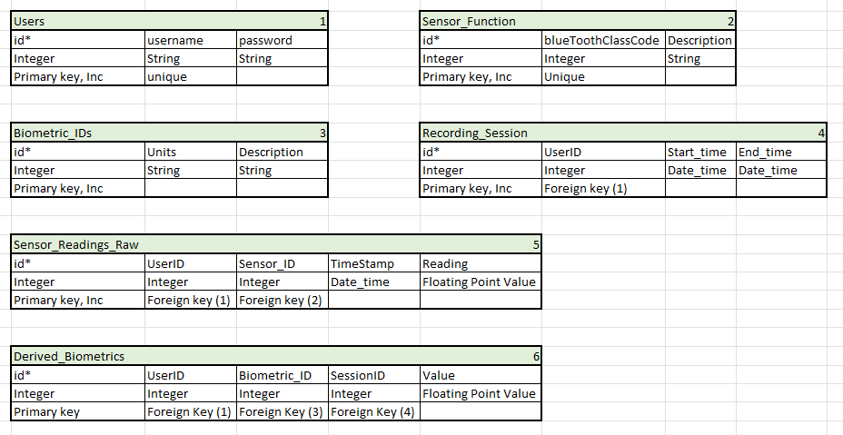
Database Table Structure
Notes:
Although we may find additional database structures convenient. The 6 table design we have created allows for a compact representation of our data, eliminating most data redundancies while still providing the ability to extend the functionality of the application or the data stored with minimal effort. This design should be compliant with at least the 3rd normal form.

Slide 33
Database Performance Testing
Sets of Readings | First Time App Launch (s) | Subsequent App Launch (s) | User Data Load (s) | Graph Swap time (s) | Database Size on Disk
0 | < 1 s | < 1 s | < 0.1 s | < 0.1 s | 44 KB
20 | < 1 s | < 1 s | < 0.1 s | < 0.1 s | 44 KB
400 | 27.5 s | < 1 s | < 0.1 s | < 0.1 s | 92 KB
3000 | 210.4 s | < 1 s | < 0.2 s | < 0.1 s | 412 KB
Fixed amounts of 5 users, 6 sensors, 4 biometrics
Notes:
In performance testing, collected metrics were not heavily impacted by large numbers of data transactions.
In particular larger cases were almost exclusively impacted by large numbers of random samples being generated.
Secondary launches of the application are nearly instantaneous because no outside connections need to be established in order to recreate the framework where data is stored.
Even with thousands of sets of 4 biometrics app launch times were quick usually less than one second. User data loading happened in fractions of a second and graphs updating were very quick. Database normalization played a significant factor in reducing the size on disk.
Since usual recommendations for healthy adults to see a physician are around one year and mobile devices are often limited in storage in comparison to other computing devices, making sure that a years worth of comparisons, would easily fit was important to us. Database normalization helped us to more than reach this goal.

Slide 34
Features
Biometrics
Heart Rate
Heart Rate Variation
Blood Oxygenation
Peaks
DC-Component of Red and Infrared wavelengths
AC-Component of Red and Infrared wavelengths
Notes:
This slide depicts the mapping of signal features to the biometrics they allow us to predict. Its worth noting that although the peaks of any wavelength ppg signal would allow us to predict heart rate, the AC and DC components of exclusively red and ir would allow us to predict blood oxygen content. This is due to the absorption properties of these wavelength as previously stated in the photonics design slides.

Slide 35
Peak Detection
2 techniques Considered:
First Derivate of signal is equal to 0.
Logically, if both of temporally adjacent samples are less than, than there exists a peak. i.e. s(n-2)<s(n-1)>s(n)
s(n) – s(n-1) = s’(n-1)
s(n-1)
s(n-2)
s(n)
Delay
Delay
C
s(n-1)
0
C
C
s(n)
Delay
Notes:
Our design for peak detection was very straight forward. If the two temporily adjecent samples are less than the middle sample than we detect a peak. Not only is this simple it is essentially the only way to estimate the existance of a peak in a discretely defined signal.

Slide 36
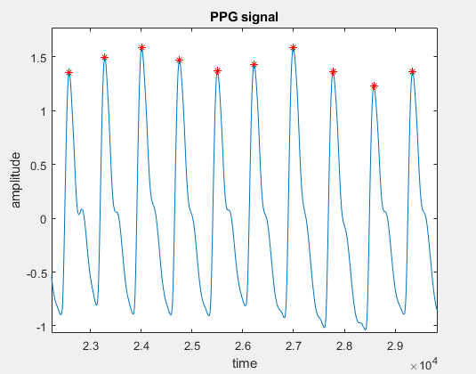
Peak Detection
When applying to the PPG signal, we see that we are detecting multiple peaks in each cycle.
Originally, we wanted to set criteria that filtered out any peaks detected under a designated threshold. (.75)*max_value for example.
Due drift and other motion artifacts this was not possible. max_value was a time varying.
Our solution was to decimate the signal to the point where only 1 peak existed at each cycle.
Notes:
To make use of our peak detection algorithm we had to make sure that we were detecting a peak in the same phase of each heart beat cycle. Due to the heart beat having both a systolic peak and diastolic peak we were forced to addition critiria to filter one of them out. This is where the biggest deviation from the original signal processing plan can be found. The orignal plan was to take the max value of the signal across the sample window and use it to filter out the smaller diastolic peaks. An example of this is in the second bullet point. This proved to be a flawed design as there were severe drifts in the signals due factors like motion artififacts, users unknowingly changing the presures applied to the sensor device, etc. To combat this we filtered the signal down to the bare minimum leaving not much more than a saw tooth wave.

Slide 37
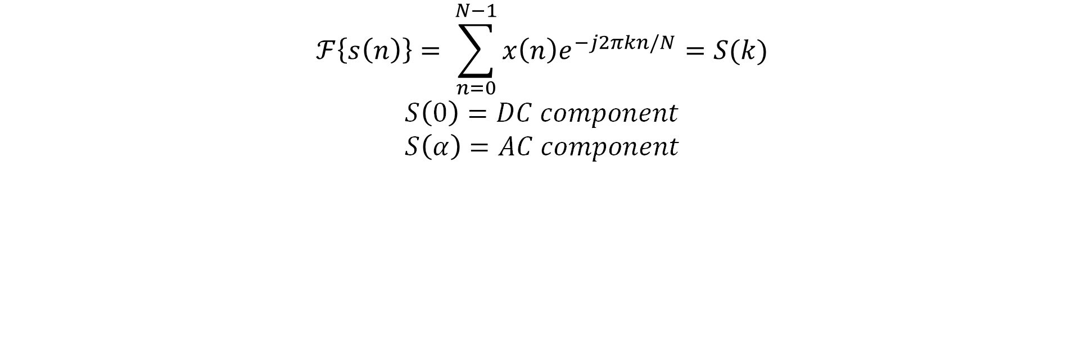
Obtaining AC and DC Components in a period signal.
The Fourier Transform of a signal defines the amplitude and phase for all frequencies from 0(DC) to infinity. So, obtaining the AC and DC components is as straight forward as performing a DTFT. Assume we have a discrete signal s(n) of length N.
$$ℱ\left\{s\left(n\right)\right\}= \sum_{n=0}^{N−1}{x\left(n\right)e^{−j2πkn/N}}=S(k)$$
$$S\left(0\right)=DC component \\ S\left(α\right)=AC component$$
Notes:
FInding the AC and DC components of the Red and IR signals was essentially taking the fourier transform of the signal. Due to issues with implementation we were not able to use the excessive computing power available on a mobile device. To make use of what we had we simplified the transform to essentially find the amplitude of the peaks detected in the decimated signal.

Slide 38
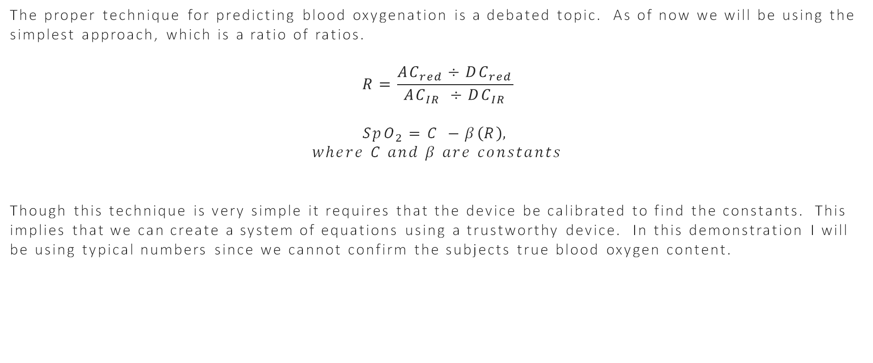
Blood Oxygenation Prediction
The proper technique for predicting blood oxygenation is a debated topic. As of now we will be using the simplest approach, which is a ratio of ratios.
$$R=\frac{AC_{red}÷DC_{red}}{AC_{IR} ÷DC_{IR}}$$
$$SpO_{2}=C −β\left(R\right),$$
$$where C and β are constants$$
Though this technique is very simple it requires that the device be calibrated to find the constants. This implies that we can create a system of equations using a trustworthy device. In this demonstration I will be using typical numbers since we cannot confirm the subjects true blood oxygen content.

Slide 39
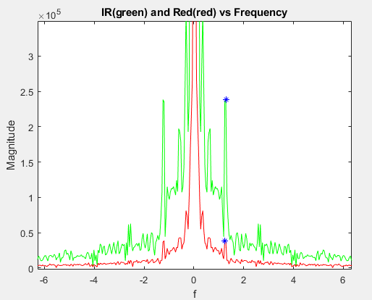
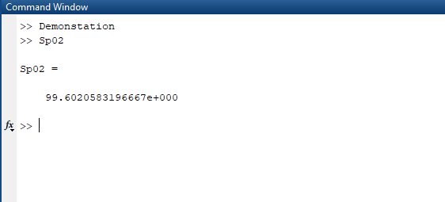
Blood Oxygenation Prediction
redratio = REDFmaxval/REDF(fix(length(REDF)/2)+1);
irratio = IRFmaxval/IRF(fix(length(IRF)/2)+1);
R = redratio/irratio;
Sp02 = 104 - 28*(R);

Slide 40
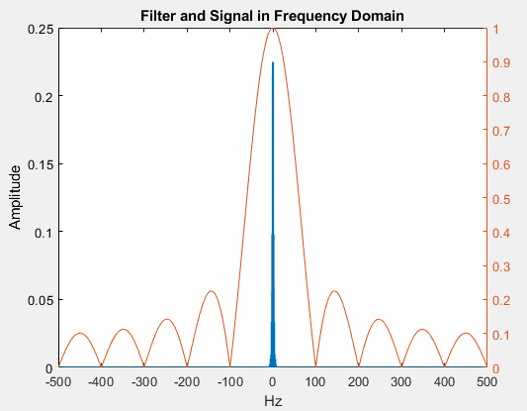
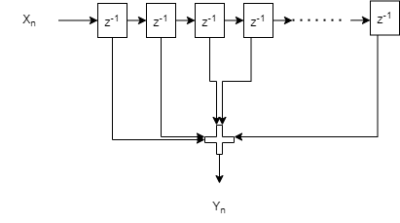
Signal Conditioning
Signal Decimation to increase SNR.
Roughly Speaking Increase SNR by down sampling ratio.
ADC samples at 1kHz
Down sample to 100Hz

Slide 41
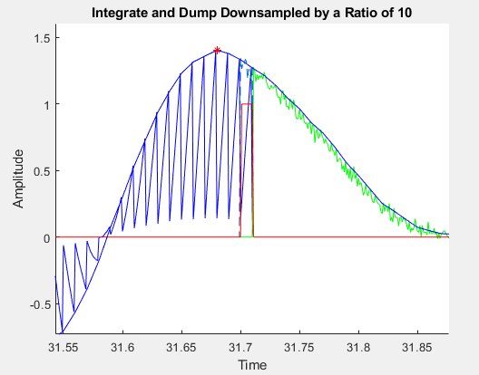
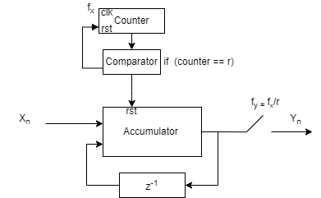
Implementation
Cascaded Integrator-Comb Filter
Lower Hardware Requirements
Achieves Same Result.
Unfiltered Signal(Green)
Filtered Signal(Blue)

Slide 42
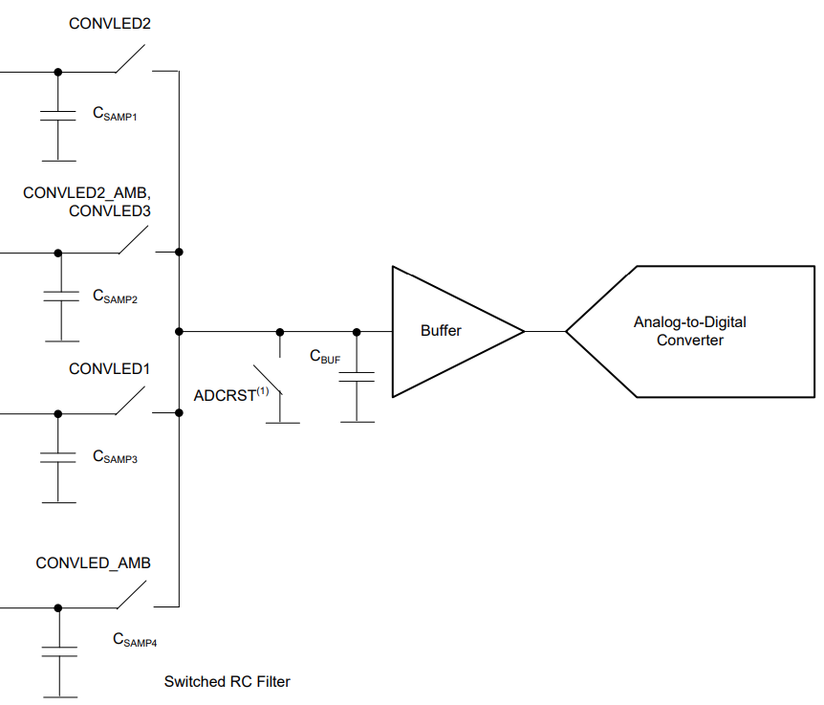
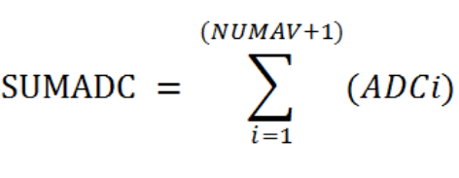
ADC Noise
Not quantization noise.
Hold charge in capacitor and make multiple conversions.

Slide 43
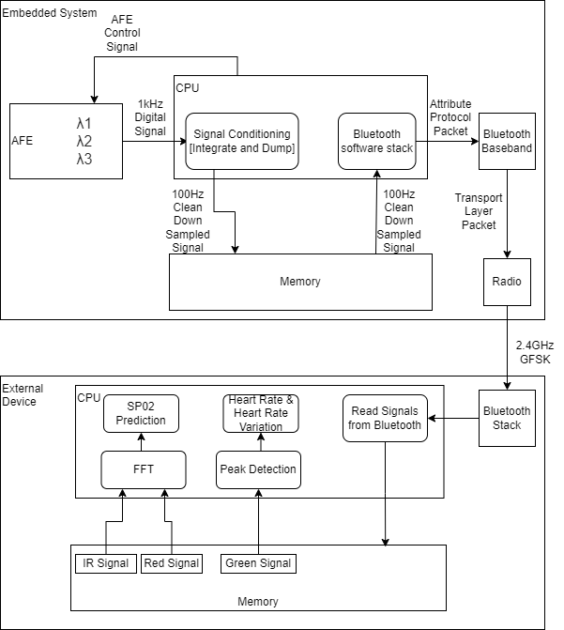
Data Flow Design

Slide 44
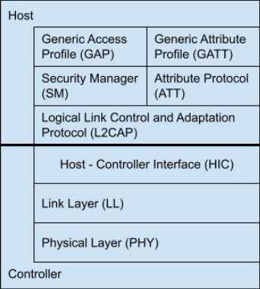
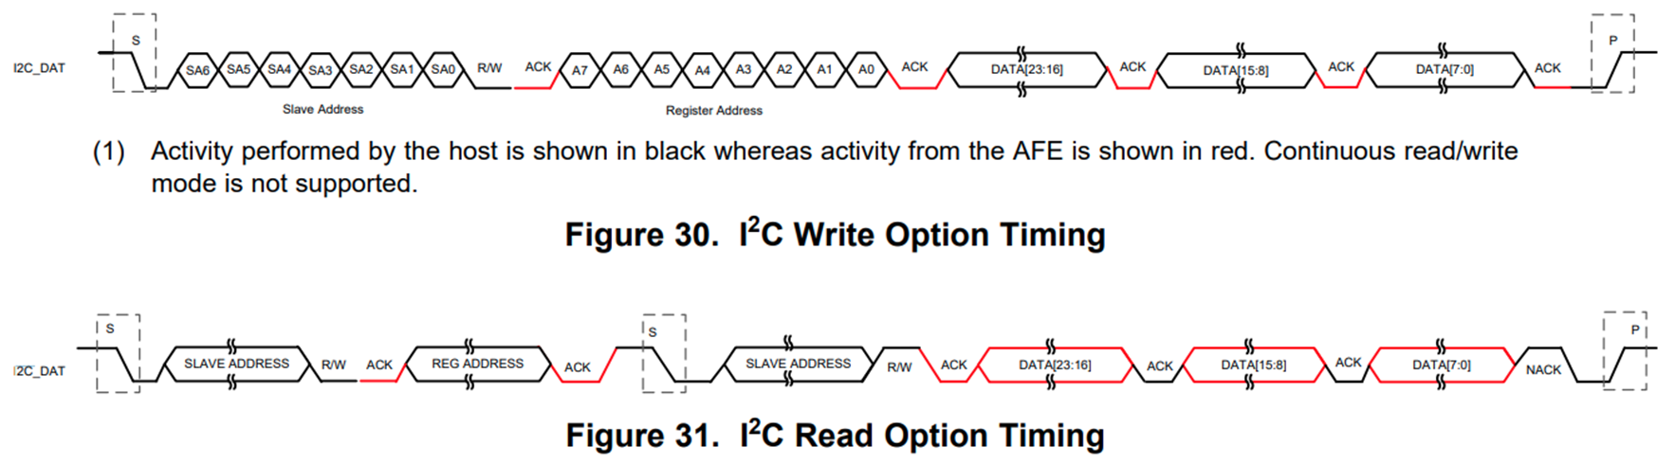
Standards
Bluetooth
  Layers Of protocols
I²C
  Standard Speeds
  Acks and Knacks
Database Normal Forms
  Data space optimizations
  Query runtime optimizations.

Slide 45

Budget and Finance
Item | Money | Nubmer | Est Cost
AFE4404 Evaluation Board | $270.00 | 1 | $270.00
Half mill ball grid array adapters | $20.00 | 3 | $60.00
Ardiuno Nano Ble | $24.00 | 7 | $168.00
Custom PCBs X 2 Large 5 small | $240.00 | 1 | $240.00
Extra Misc Batch RLC components | $60.00 | 1 | $60.00
PLA | $20.00 | 1 | $20.00
Lithium Ion Polymer Battery - 3.7v 500mAh | $8.00 | 1 | $8.00
Battery Charging Circuit, Buck Boost converter | $30.00 | 1 | $30.00
42BGA stencil from Protoboard and Photodiodes | $65.79 | 1 | $65.79
AFE4404 s and Photodiodes | $57.86 | 1 | $57.86
Thorlabs- optics polarizers and adhesive | 73.13 | 1 | $73.13
Edmond optics, glass windows | $141.23 | 1 | $141.23
Electrical Components AFEs/ Adapter boards Sensors/ LEDS / Photodiodes | $271 | 1 | $271.00
 | Sum |  | $1,465.01
Notes:
As the project has gone on we went from an original budget hoping for approximately $400 spent to $507 near the beginning of this term to approximately $ at this point.

Slide 46
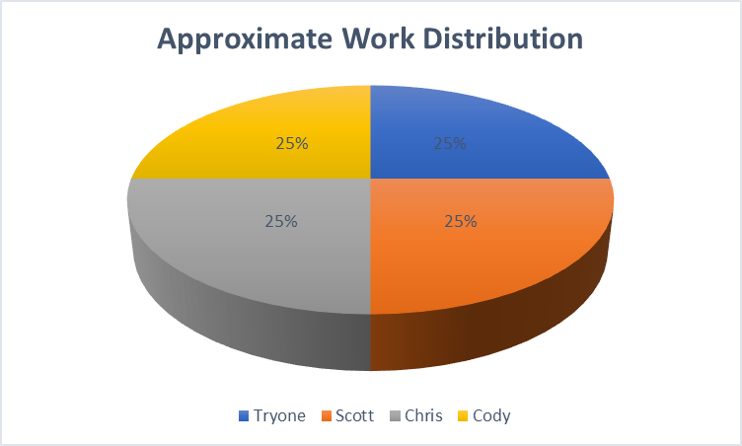
Distribution of Labor
Notes:
During this effort we took effort to assist or facilitate with each other as much as possible spreading the distribution of labor evenly.
Each member work on specific aspects of the project related to their course of study and the skillsets we desired at the end of Senior design.
Extra tasks were split as evenly as possible and when problems arose the group attempted to assist each other where possible.

Slide 47
Series of Complications
Limitations of physical opto-mechanical design
  3D printing
  Optical adhesive
  Size of components
  Reliable Characterization of System
Android Development
  Learning Curve
Circuit diagnostics
  IC sophistication
  BGA ICs
Notes:
Throughout our project we faced a number of challenges which we had to overcome.

Slide 48
Critical Failures
Microprocessor
  Not in Stock
  Not reworkable – Could not desolder successfully
Custom PCB realities – They weren't perfect.
  Foil came off one of our leads
  Shorting small components

Slide 49
Thank you for your time!

