Slide 1
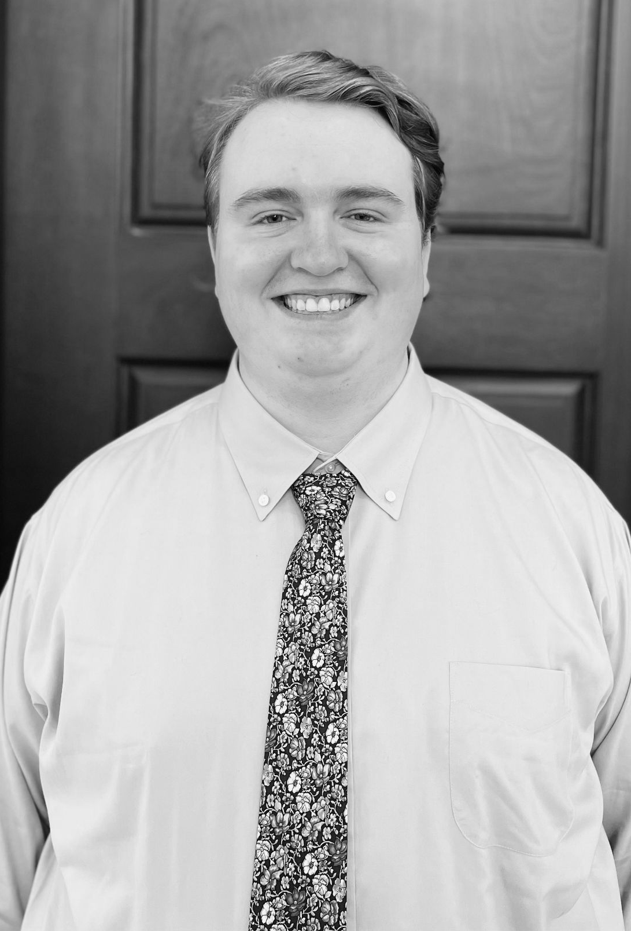

SmartPlant Hub
Group 17
Daniel
Daniel Bohl - Computer Engineering
Hunter Cheung - Computer Engineering
Brendon Hales - Computer Engineering
Kristen Marks - Electrical Engineering
Notes:
Daniel - I can introduce

Slide 2
Project Motivation
Daniel
Many new plant owners don’t know how to take care of their plants
Design a product that helps any user with any amount of knowledge in plant ownership
Provide information on commonly owned plants
Provide live information to a user on the environment its plant is living in currently
Allow users to learn about their plants and create the optimal environment for them
Notes:
Daniel

Slide 3
Goals | Implementation
Cost Effective | Price point so that any individual would be inclined to purchase the item Scalability is to be considered The project’s stretch goal is to create multiple units to work collaboratively Enclosure around electronics could be extremely expensive 3D-printing was considered to be the cheap solution Custom enclosure could be created, with any color or design, while still being cheap in terms of the filament cost
Small in Size | Design should be small enough to work with pre-existing plants Must be able to work with a plant in a pot Must be able to contain all necessary parts while being able to be moved if required
Help Improve User Control | Shows the user the health of the plant when considering various plant health elements Light levels Soil moisture levels Ambient temperature Humidity levels
Ensuring Plant Growth Success | Remote monitoring of the plant status Device will alert user when the plant needs something Allows the user to monitor the plant away from home Receive notifications when the plant’s health is in jeopardy
Daniel
Notes:
Daniel

Slide 4
Description | Technical Values
The system shall run at specified voltage | 3.3V regulated
The system shall be rechargeable using specified method | 3.7V rechargeable battery charged via 5V solar panel
The system shall enter sleep mode after specified time | ≥ 30s after last use, system enters sleep mode
The system shall update monitor information on database in the specified interval | ≥ 1 update per 5s period
The system shall be connected to database/app through specified method | System connected via WiFi, transmits to database and subsequent user
The system shall transmit data to user within specified time after user asks/after wake | ≤ 3s response time
The system shall be self-contained in specified dimensions | 15cm x 15cm x 15cm
The system’s app shall run on specified OS | Application runs on Android OS
The system shall support single or multiple instances of monitoring units on different plants | ≥ 1 monitoring unit
Requirements Specifications
Daniel
Notes:
Daniel

Slide 5
Design Decisions
Component selections were made with the following in mind
  Affordable
  Available
  Reliable in the long term
  Fast transmission capabilities
  Overall impact on device size
Each component also has its own set of decisions relative to its use for the device
  Examples include supply ranges, compatibility and accuracy
Daniel
Notes:
Daniel

Slide 6
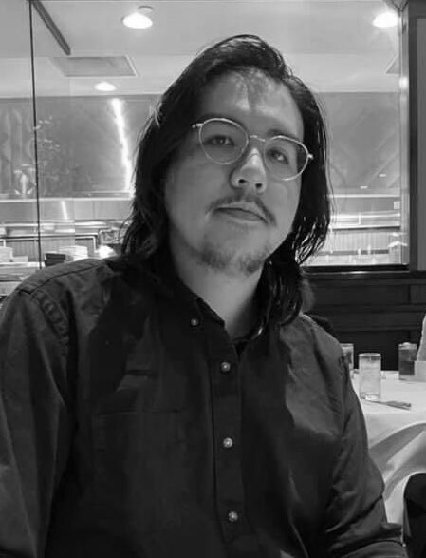
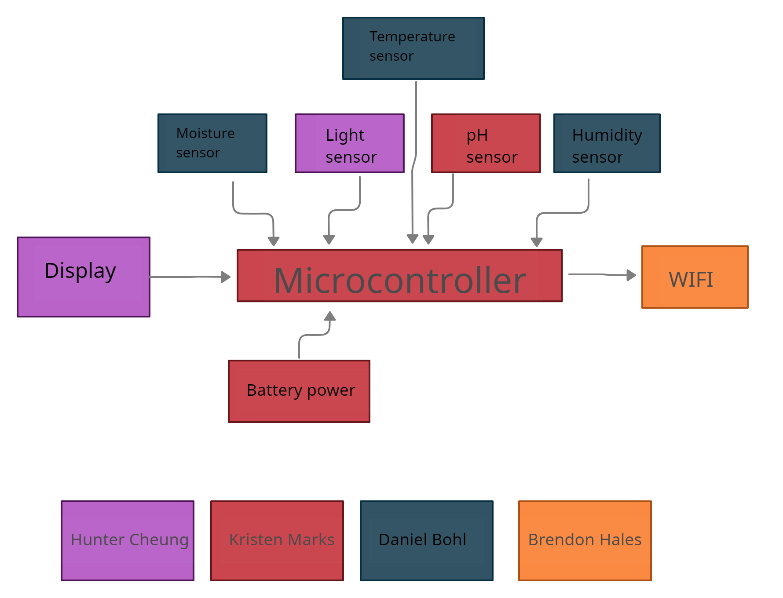
Hunter
Hardware Block Diagram
Notes:
Hunter

Slide 7
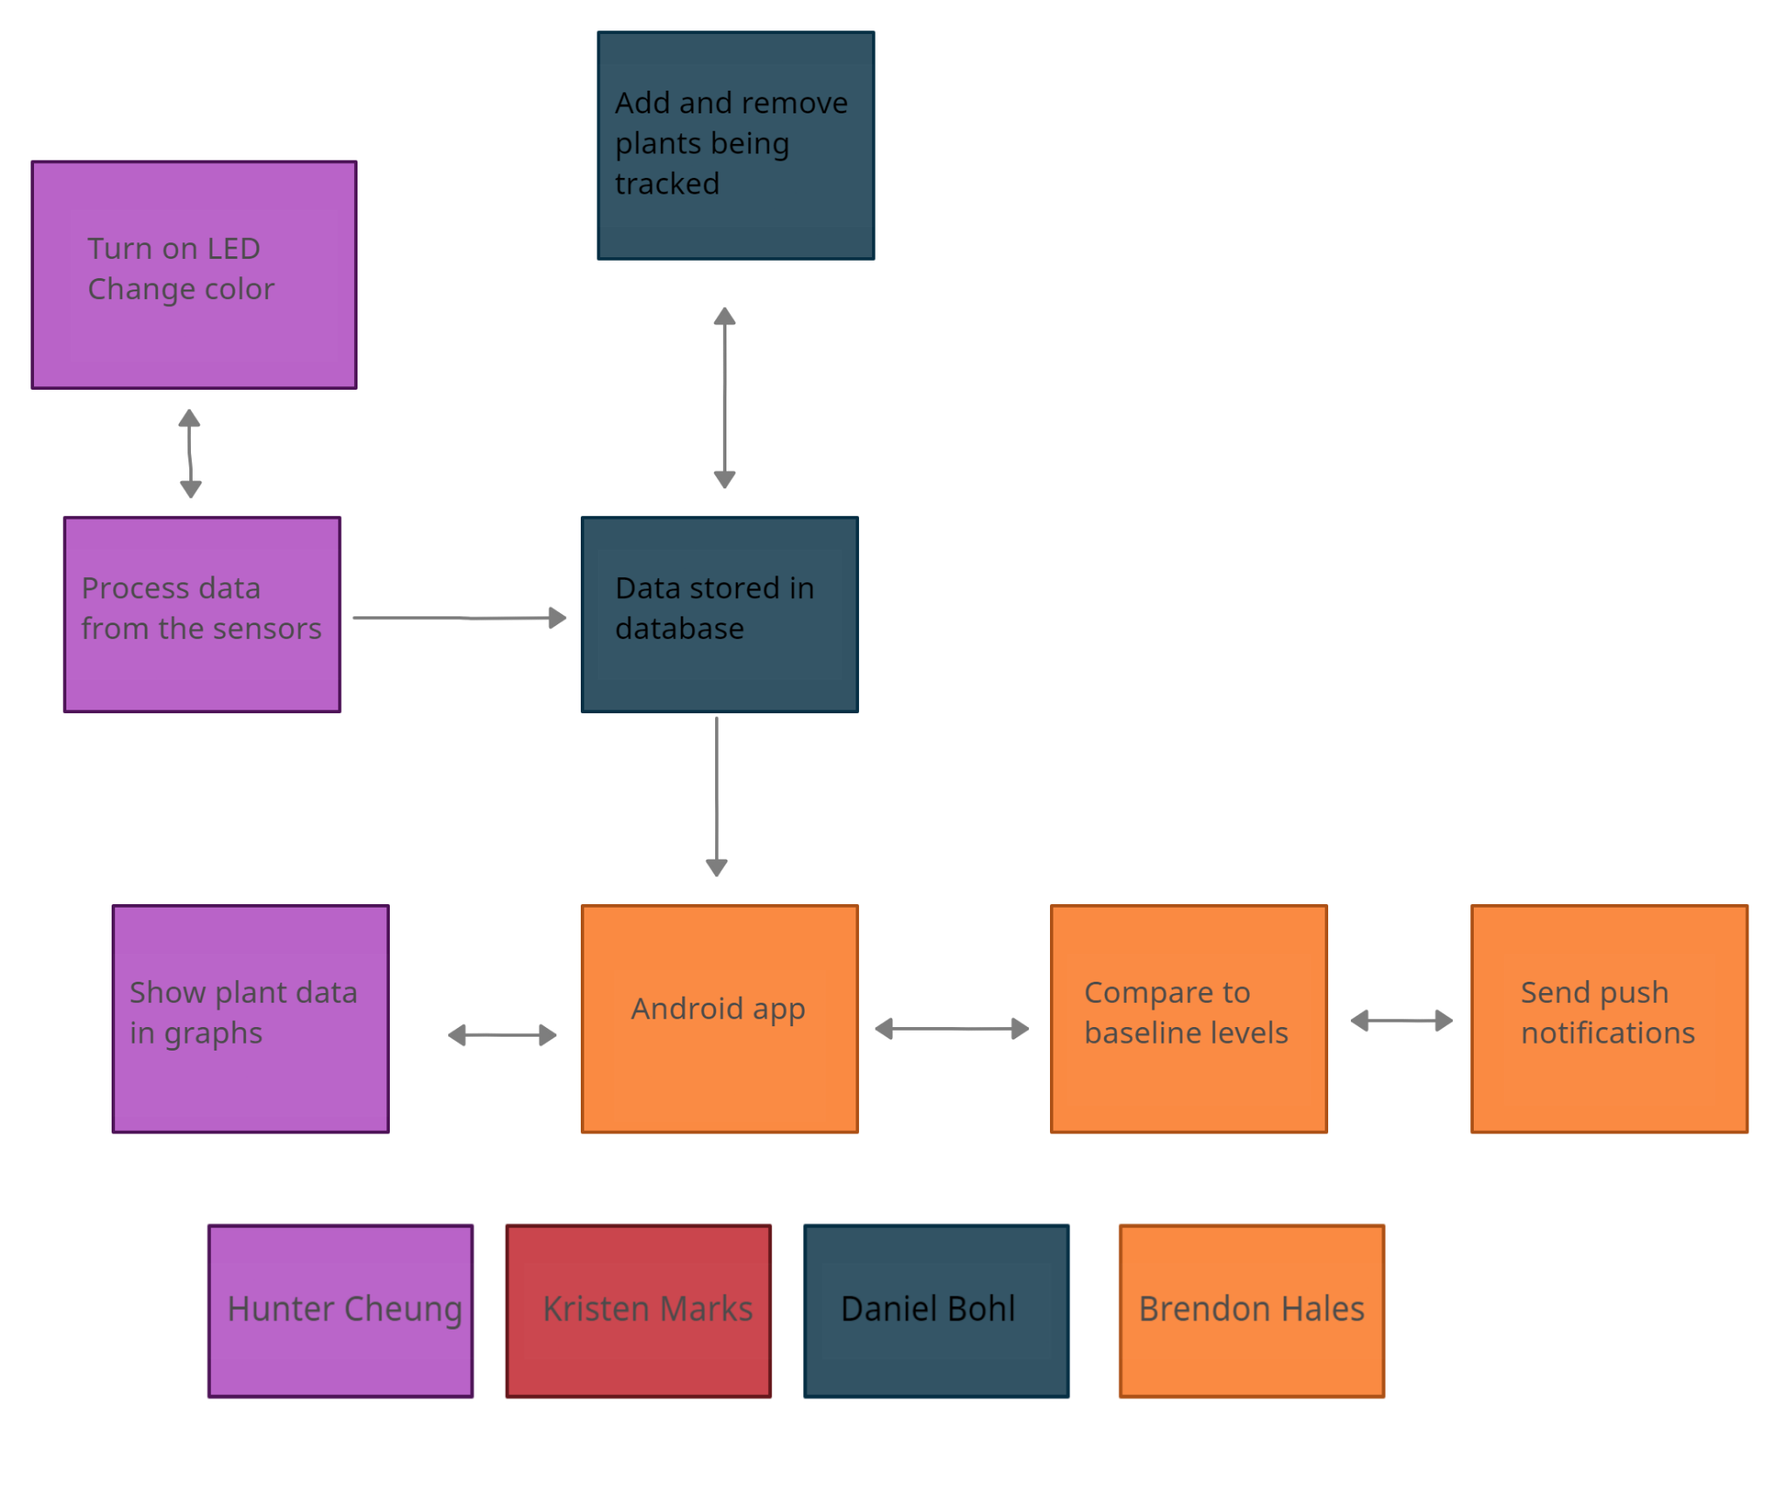
Hunter
Software Block Diagram
Notes:
Hunter

Slide 8
Microprocessor | Arduino MKR WiFi 1010 | Raspberry Pi Zero 2 W | HUZZAH32
Size | 61.5mm x 25mm | 65mm x 30mm | 51mm x 23mm
Interface | 32-bit | 64-bit | 32-bit
Pin Count | 23 | 40 | 21
CPU Speed | 240 MHz | 1 GHz | 240 MHz
Memory | 256 KB | 512 MB | 4 MB
Communication | 1 x UART, 1 x SPI, 1 x I2C, 7 x ADC, 1 x DAC, 8 x Digital I/O | 2 x UART, 11 x SPI, 4 x I2C | 3 x UART, 3 x SPI, 2 x I2C, 12 x ADC, 2 x I2S, 2 x DAC
Operating Voltage | 3.3V | 5V | 3.3V
WiFi | Yes | Yes | Yes
Bluetooth (BLE) | Yes | Yes | Yes
Price | $35 | $55 | $21.95
Microcontroller Comparison Table
Daniel
Notes:
Daniel

Slide 9
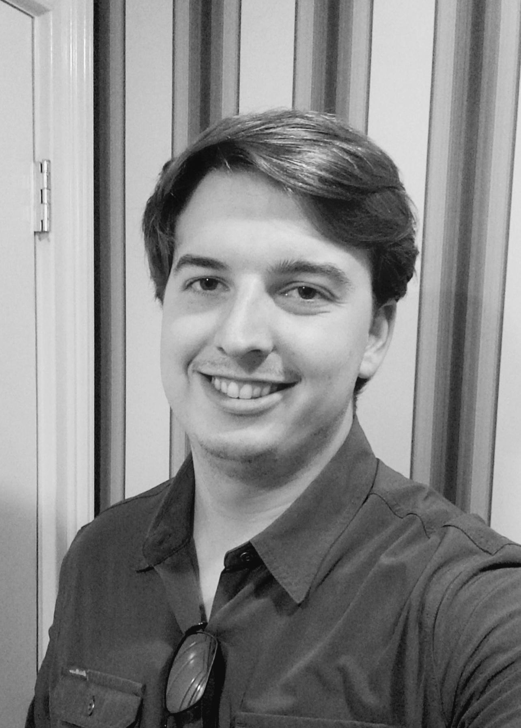
Name | Language Options | Development Environments | Market | Cost of App Development
iOS | Swift | Xcode | Apple Store | $99 per year
Android | Java/ C++ | Android Studio | Google Play Store | Free
Brendon
Language Options
Java and C++ are both languages that can run on any machine, not just Apple specific
Development Environments
Android Studio runs on all machines, not Apple specific, allowing for freedom when it comes to later development
Market
Google Play Store allows for us to quickly and easily upload our app for the end user to download, without the need for verification as with the Apple Store
Cost of App Development
Minimizing cost is KEY for our project
Operating System Comparison Table
Notes:
Brendon

Slide 10
Name | Language Support | Arduino Compatible | OS Support
Code Composer Studio | C | No | Windows, MacOS
Arduino IDE | C/ C++ | Yes | Windows, MacOS, Linux
Brendon
Language Support
C is a language we are all familiar with
C++ allows for more object-oriented programming to be performed
Arduino Compatible
The microcontroller we chose uses an Arduino interface, meaning that our development environment must be able to be program Arduino
OS Support
Arduino IDE allows for development across a variety of operating systems, meaning that the team can program in any environment they choose
Hardware Code Comparison Table
Notes:
Brendon

Slide 11
Name | Relation Type | Data Entry | Data Type Flexibility
MySQL | Structured | Line by line | No
Firestore | Unstructured | As received | Yes
Brendon
Relation Type
A unstructured relation type allows for data that do not have relationships to be input
Structured relationships do not allow flexibility in terms of future data
Data Entry
MySQL must have all of the required relational information input at the time of new data entry
Firestore can have a single piece of data entered, regardless of what it may be
Data Type Flexibility
Flexibility of the input data types is a MUST as development progressed
Database Comparison Table
Notes:
Brendon

Slide 12
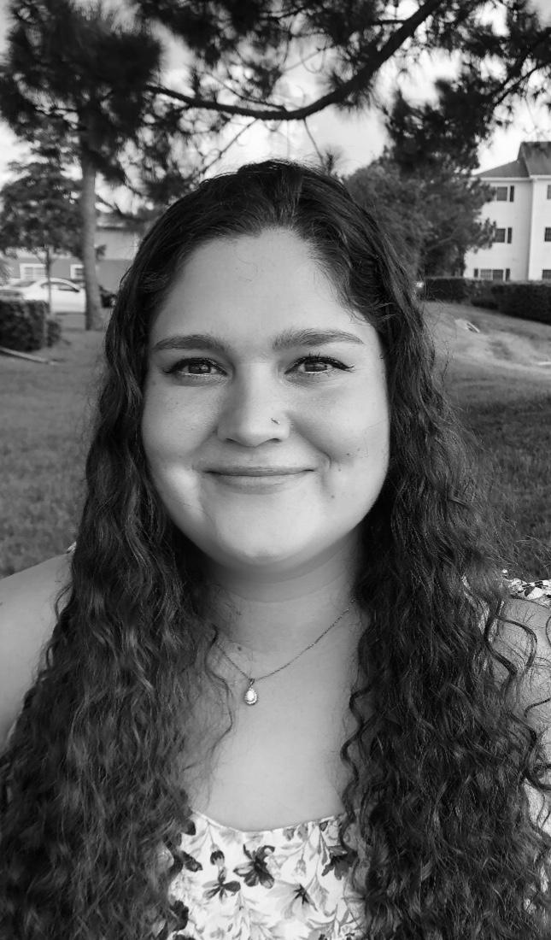
Name | Measurement (% RH) | Accuracy (% RH) | Supply Range (V) | Price ($)
SEN-18364 | 1 to 100 | 3 | 2.2 to 5.5 | 5.95
HS1100 | 0 to 100 | 5 | 10 | 8.99
HR202L | 20 to 90 | 5 | 1.5 | 2.11
Kristen
Measurement
Although the SEN does not have the greatest measurement range, like the HS1100, it will most definitely suffice for our needs, especially as it will never reach below the lower threshold of 1% RH
Accuracy
The SEN is the most accurate of the 3 sensors by having the smallest tolerance of accuracy ranges
Supply Range
SEN has a supply voltage range of 2.2 to 5.5, allowing for versatility when it comes to designs
The other boards would require the voltage to be either stepped up or down, respectively
Price
Although the SEN is not the cheapest, it is in the middle price-wise, making it a viable choice
Humidity Sensor Table
Notes:
kristen

Slide 13
Name | Output | Detection Depth (mm) | Supply Range (V) | Price ($)
VH400 | Analog | 93 | 3.5 to 20 | 41.95
SEN0114 | Analog | 20 | 3.3 to 5 | 2.70
STM32 | Analog | 38 | 2 to 5 | 2.99
Kristen
Output
All of the sensors output in an analog so this is not a notable difference
Detection Depth
The depth on the STM32 is relatively close to the surface (1.5 inches down) as compared to the alternative of 93 mm (3.6 inches) on the VH400
Supply Range
The STM has a range of 2 to 5V, allowing for versatility without the need for significant voltage scaling
Price
STM32 is the middle of the price range with $2.99, but is the best average out of the choices all considered
Moisture Sensor Table
Notes:
kristen

Slide 14
Name | Modes | Supply Range (V) | Price ($)
SEN0097 | multiple | 3 to 5 | 4.50
LM393 | intensity | 3.3 to 5 | 8.99
HW5P-1 | multiple | 3 to 15 | 0.95
Kristen
Modes
While the LM393 is limited in the measurement mode of being light intensity only, this allows for easier programmability as compared to the other choices
Supply Range
The LM has the smallest supply voltage range but it falls perfectly in the expected range of the system
Price
The LM393 is by far the most expensive, but the simplicity makes it the project choice
Light Sensor Table
Notes:
kristen

Slide 15
Name | Voltage | mAh | Price ($)
AA Battery Pack | 6V | 8000 | 2.95
Li-Ion Battery Pack | 3.7V | 6500 | 24.95
Lithium Ion Polymer Battery | 3.7V | 2500 | 15
Hunter
Voltage
The Li-Ion has a supply voltage of 3.7V, meaning that the range requires minimal scaling up or down, as compared to the AA battery back which would require stepping down
mAh
Li-Ion is the middle of the pack in terms of battery capacity
6500 mAh allows for the system to operate for “ideally” multiple days without additional charges
Price
The battery pack choice is by far the most expensive, but the additional capacity without the headache of voltage scaling is worth the cost
Battery Table
Notes:
Hunter

Slide 16
Name | Wavelength (nm) | Supply Range (V) | Price ($)
100F5T-YT-RGB-CC | Red: 620-625 Blue: 450-455 | Red: 3 Blue: 2 | 7.96
0603 SMD | Red: 620-625 Blue: 460-465 | Red: 3 Blue: 2 | 5.99
WS2812BLEDB | Red:620-625 Blue: 465-467 | Red: 3 Blue: 2 | 15.99
Hunter
Wavelength (nm)
All of the LED choices are in the same general realm of output wavelengths, although our choice has a much tighter blue range, meaning that the color will be more accurate and consistent
Supply Range
All the chosen LEDs require the same input voltage of 3V for red and 2V for blue
Price
The WS is the most expensive LED choice, but it allows for RGB colors to be changed on the fly, allowing more freedom with color choices during development
LED Table
Notes:
Hunter

Slide 17
Name | Size | Resolution | Display Type | Price ($)
Monochrome 128x64 OLED | 26.6mm x 19mm | 128 x 64 | OLED | 17.50
Waveshare RGB OLED | 26.8mm x 26.8mm | 128 x 128 | OLED | 16.59
HiLetGO 128x64 LCD | 33mm x 33mm | 128 x 64 | LCD | 9.19
Hunter
Size
The HiLetGo LCD is the largest size, coming in as a square of 33 mm, requiring the largest footprint
Resolution
Although the resolution is not as crisp as the Waveshare, the screen on the HiLetGo is larger
Display Type
The OLED versions would have a much more vibrant color output but it is not necessary as we will only be displaying text
Price
The price of the HiLetGo is almost half the price of the Monochrome, making it an obvious choice
Display Comparison Table
Notes:
Hunter

Slide 18
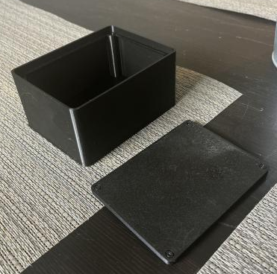
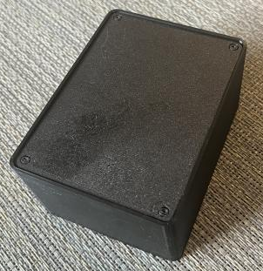
Hunter
3D Printed Enclosure

Slide 19
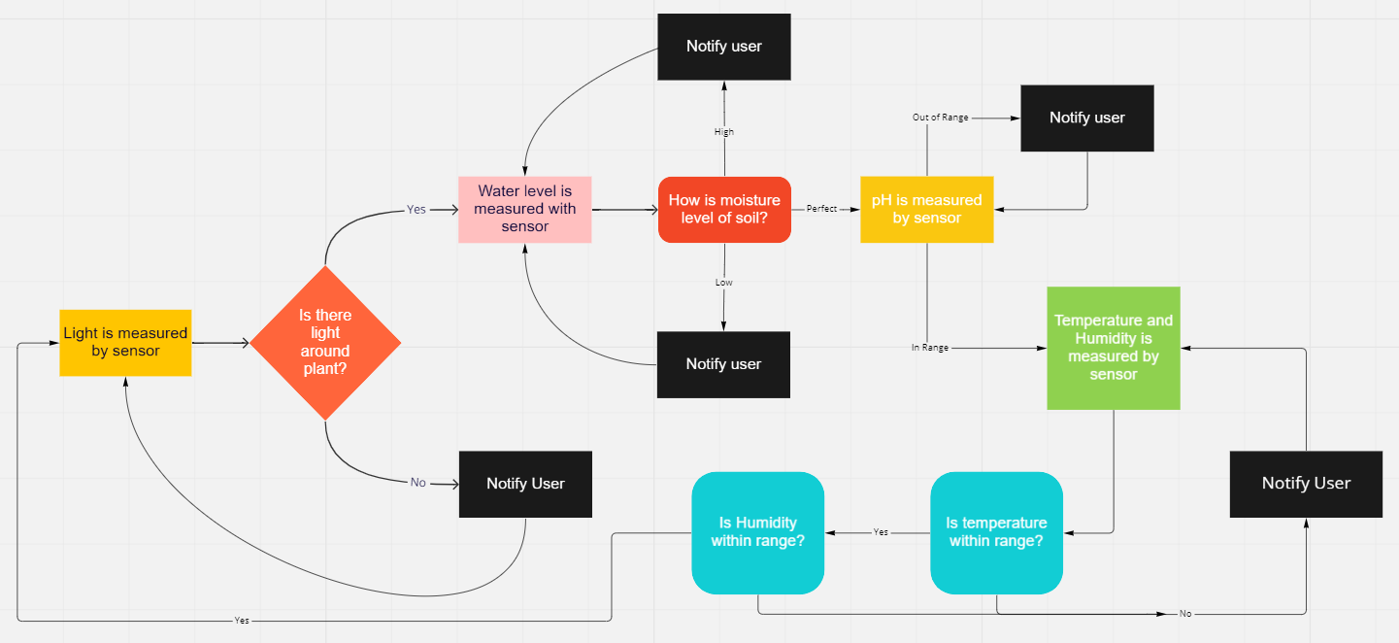
Hunter
Sensor Flowchart
Notes:
Hunter

Slide 20
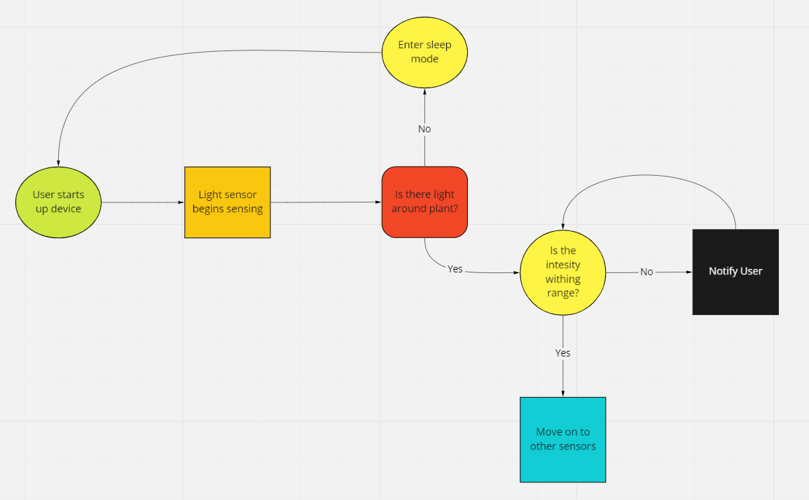
Kristen
Is there light around plant?
Light Sensor Flowchart
Notes:
kristen

Slide 21
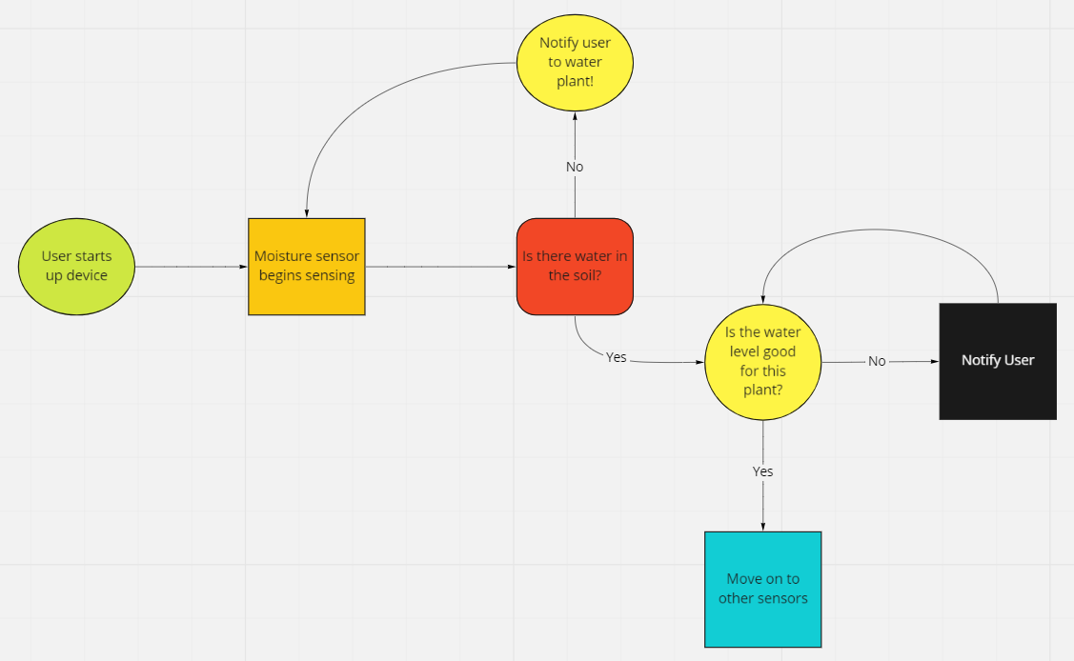
Kristen
Is there water in the soil?
Moisture Sensor Flowchart
Notes:
kristen

Slide 22
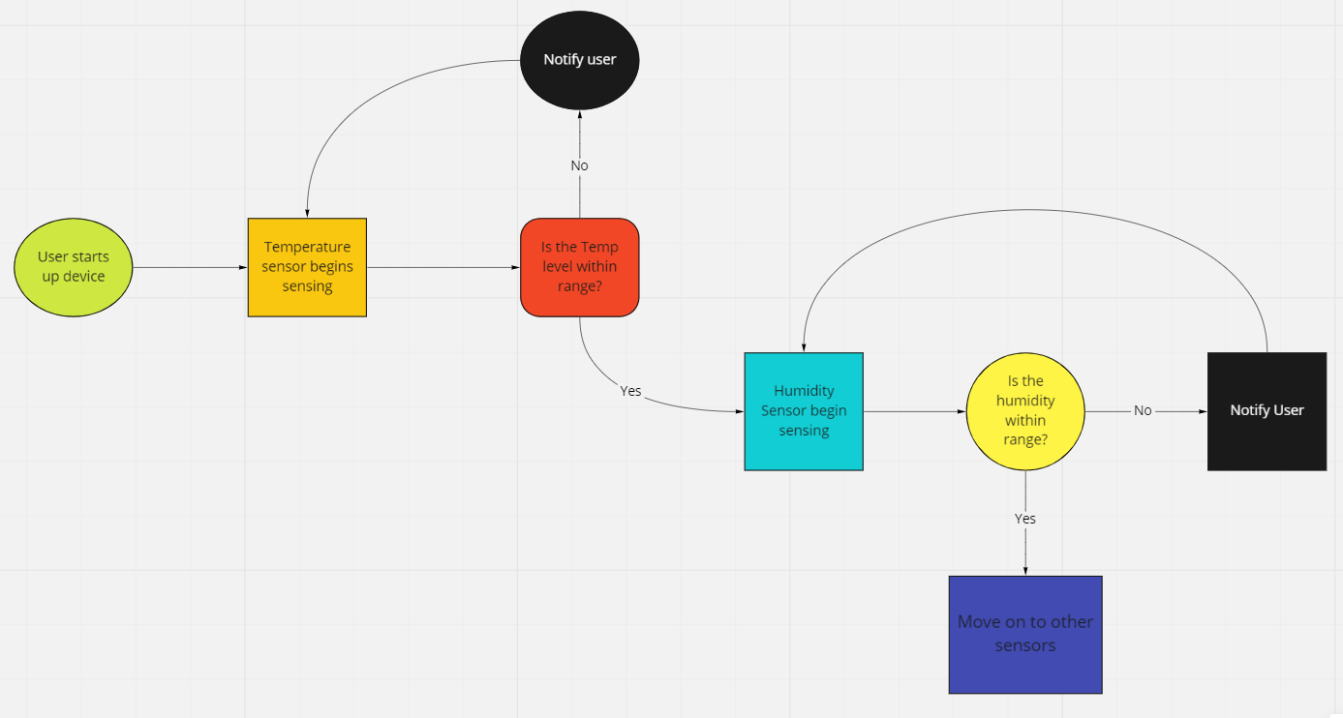
Kristen
Is the temp level within range?
Temperature Sensor and Humidity Sensor Flowchart
Notes:
kristen

Slide 23
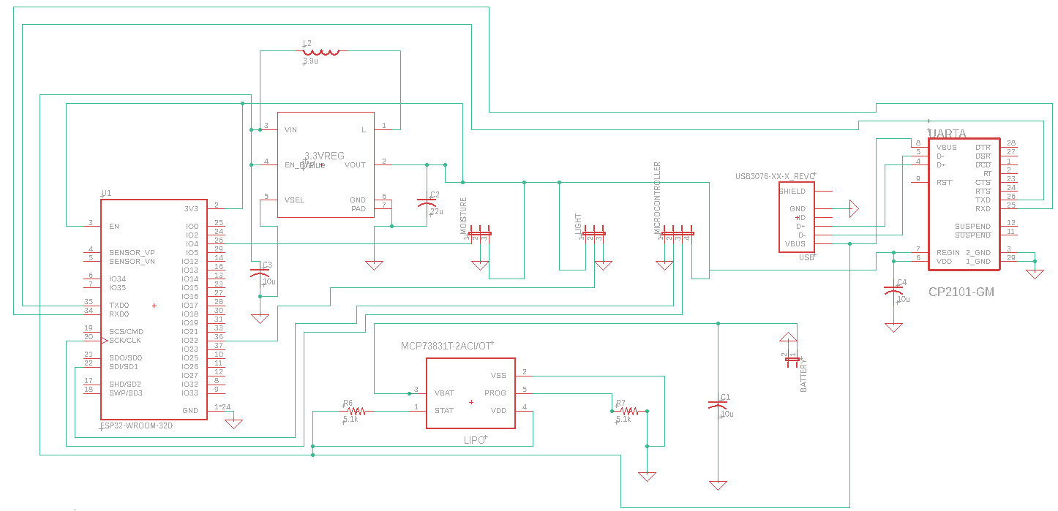
PCB Design Schematic
Kristen
Notes:
kristen

Slide 24
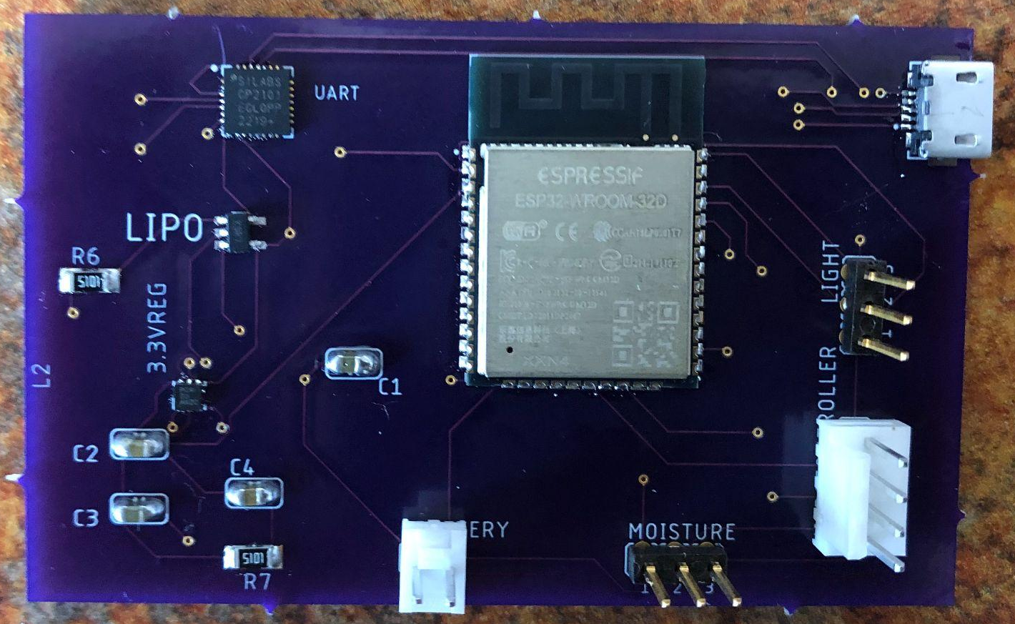
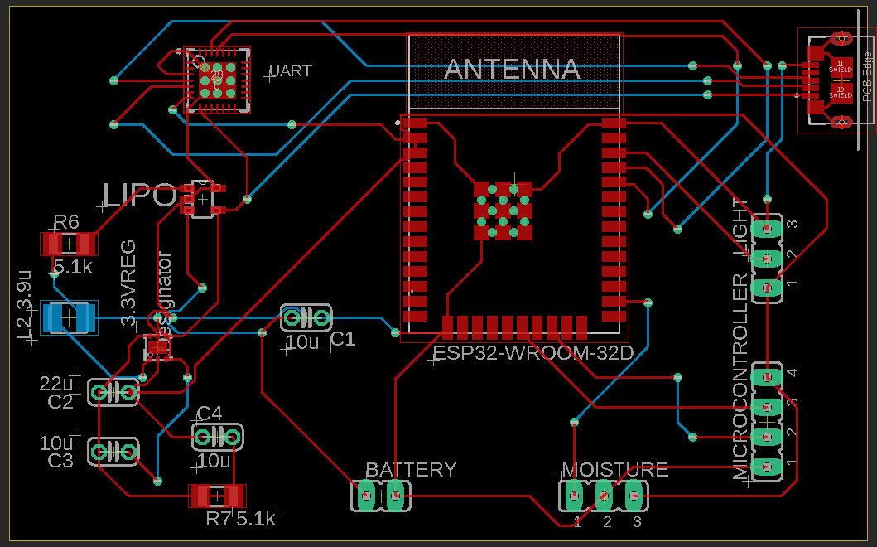
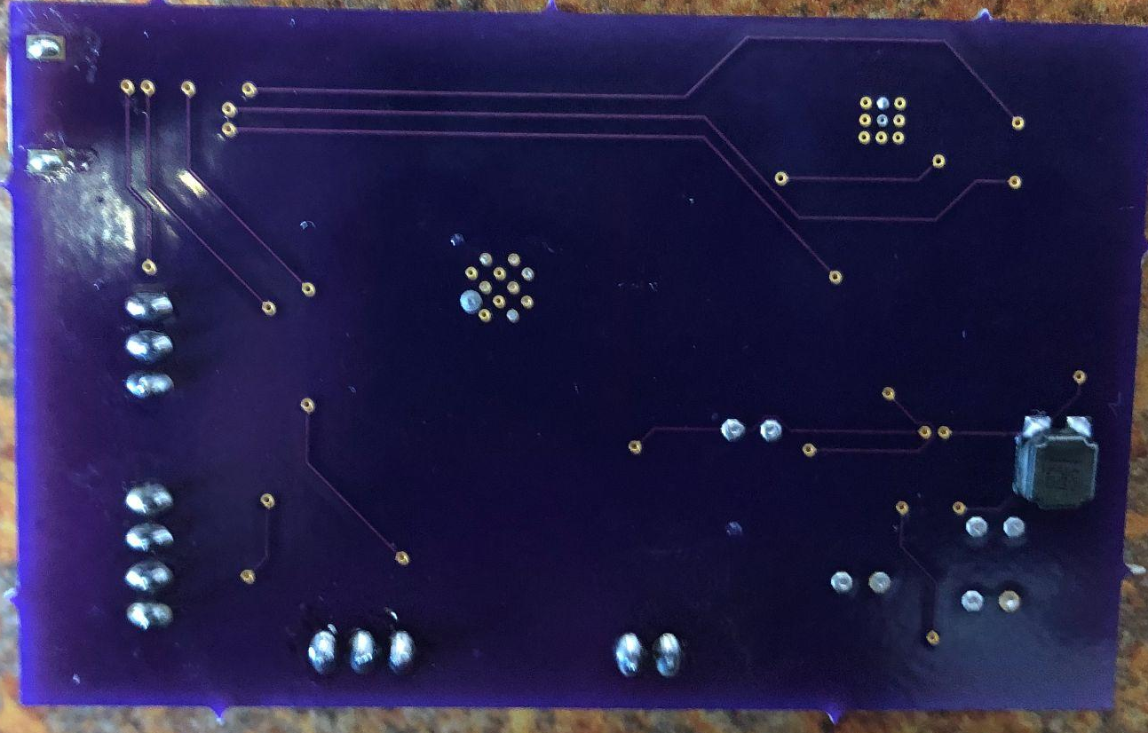
PCB Design Board Layout
Kristen
Notes:
kristen

Slide 25
Design Considerations
Hunter
We ran into economic constraints numerous times as price was an important factor when picking our components.
Due to senior design 2 taking place during the summer, there is a time constraint which must be taken into account.
PCB manufacturing issues (OSHPark)
When taking these constraints into consideration, the biggest thing that we need to consider is housing. The case needs to be able to protect the components at risk from the weather mentioned.
Notes:
Hunter

Slide 26
Design Standards
Hunter
IEE 802.11 Standard
IPC-2221 PCB Standards
ISO/IEC/IEEE 29119 Software Testing Standards
ISO/IEC 9899
Notes:
Hunter

Slide 27
Item | Package Cost | Quantity in package | Price
Battery | $24.50 | 1 | $24.50
Microcontroller | $24.95 | 1 | $24.95
Button | $2.50 | 10 | $0.25
USB micro-b | $4.75 | 5 | $0.95
LED | $6.99 | 100 | $0.07
LCD | $8.99 | 1 | $8.99
Light | $8.99 | 10 | $0.90
Humidity | $5.95 | 1 | $5.95
Moisture | $2.99 | 1 | $2.99
Temp | $1.86 | 3 | $0.62
Total (Pre-tax) | $98.46 | Total (Per-unit) | $76.16
Brendon
Project Subtotal Cost
Notes:
Brendon

Slide 28
 | Adafruit | Amazon | Mouser | Robotshop | Digikey | Xump
Subtotal | $53.70 | $24.97 | $5.95 | $2.99 | $1.86 | $5.99
Promotion | -$5.37 | $0.00 | $0.00 | $0.00 | $0.00 | $0.00
Shipping | $12.97 | $0.00 | $7.99 | $2.99 | $4.99 | $5.99
Taxes | $3.14 | $1.61 | $0.39 | $0.19 | $0.13 | $0.00
Tariff | $0.00 | $0.00 | $0.00 | $0.00 | $0.19 | $0.00
Total | $64.44 | $26.58 | $14.33 | $6.17 | $7.17 | $11.98
Grand Total | $130.67
Total/ Person | $32.67
Brendon
Project Actual Cost
Notes:
Brendon

Slide 29
Conclusion
Daniel
Time was a big constraint, and there are things we still wish to implement
  Single PCB design
  Revise sensors
  Minimize enclosure size
  Develop the mobile application further (Improved UI, more accurate database, synchronization with multiple devices)
The team plans to continue development post-graduation as we believe there is a true market for this product

