Slide 1
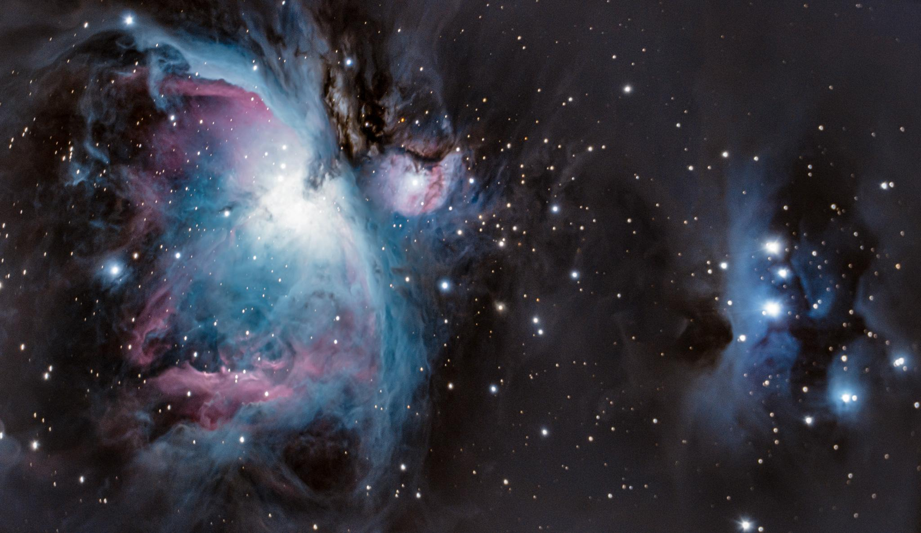
Spectral Telescope for Star Classification by Main Sequence (STSC-MS)
Notes:
Addison: I will speak here and introduce the group since I have the next slide

Slide 2
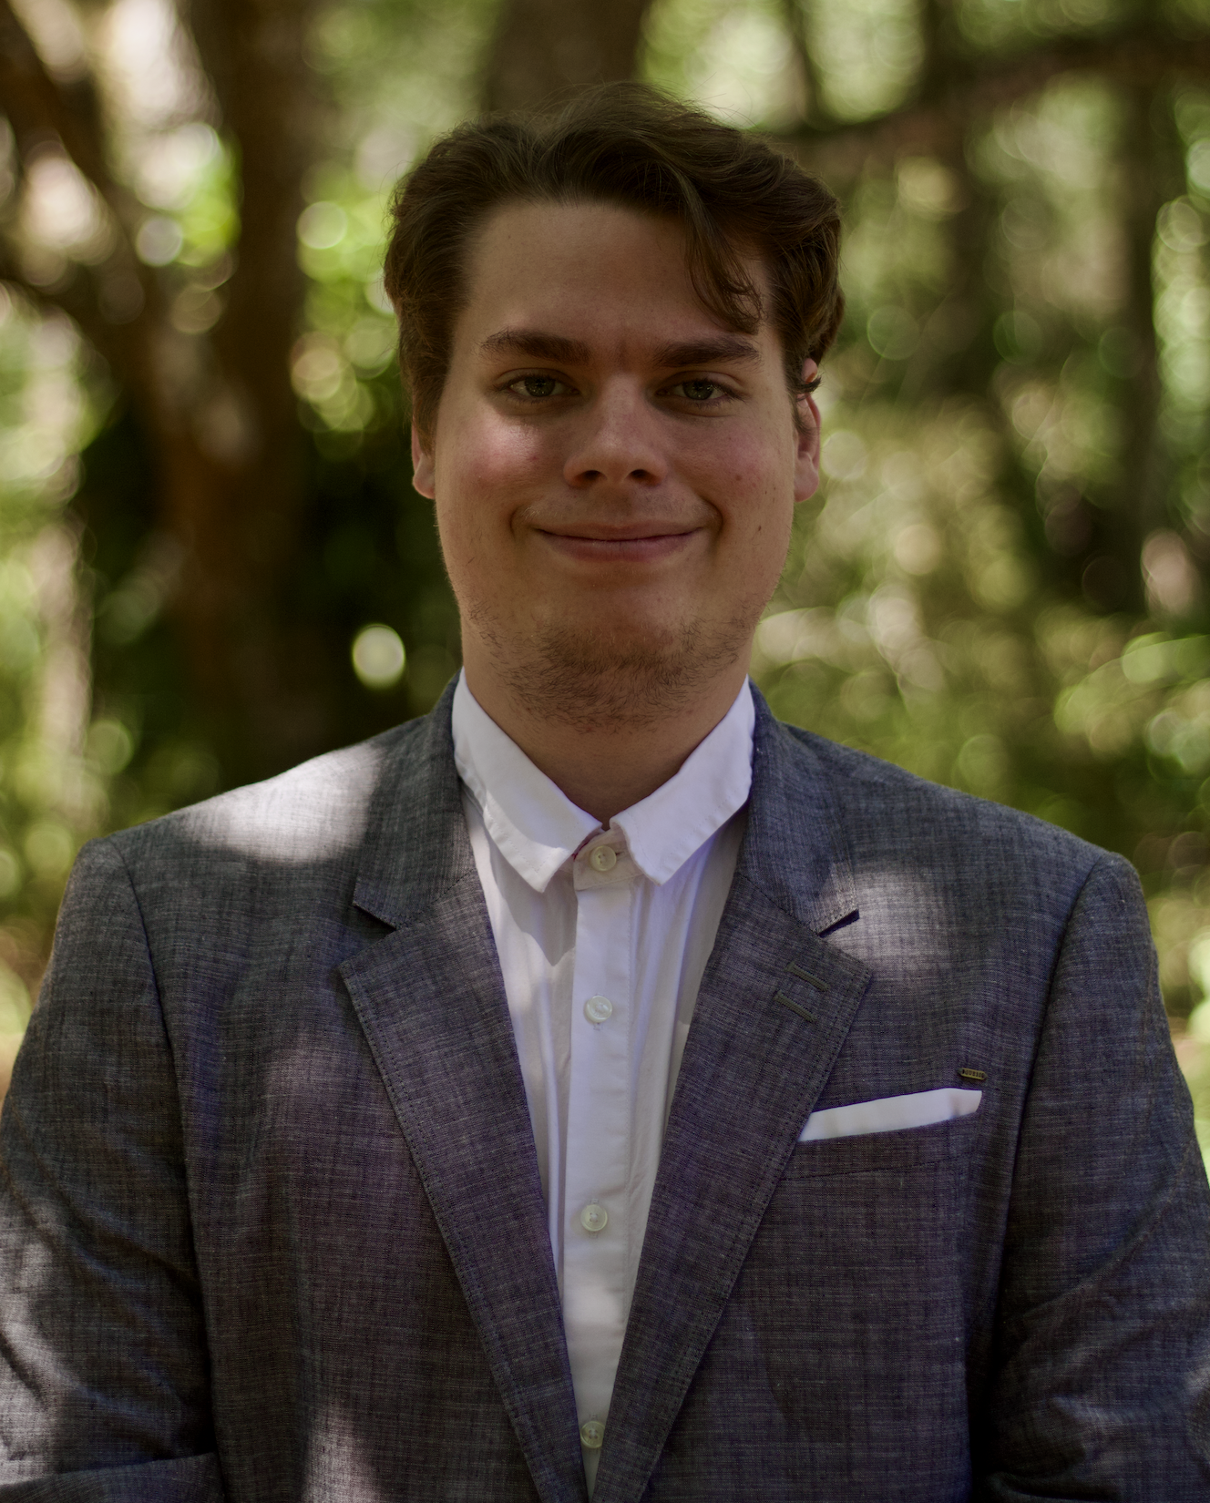
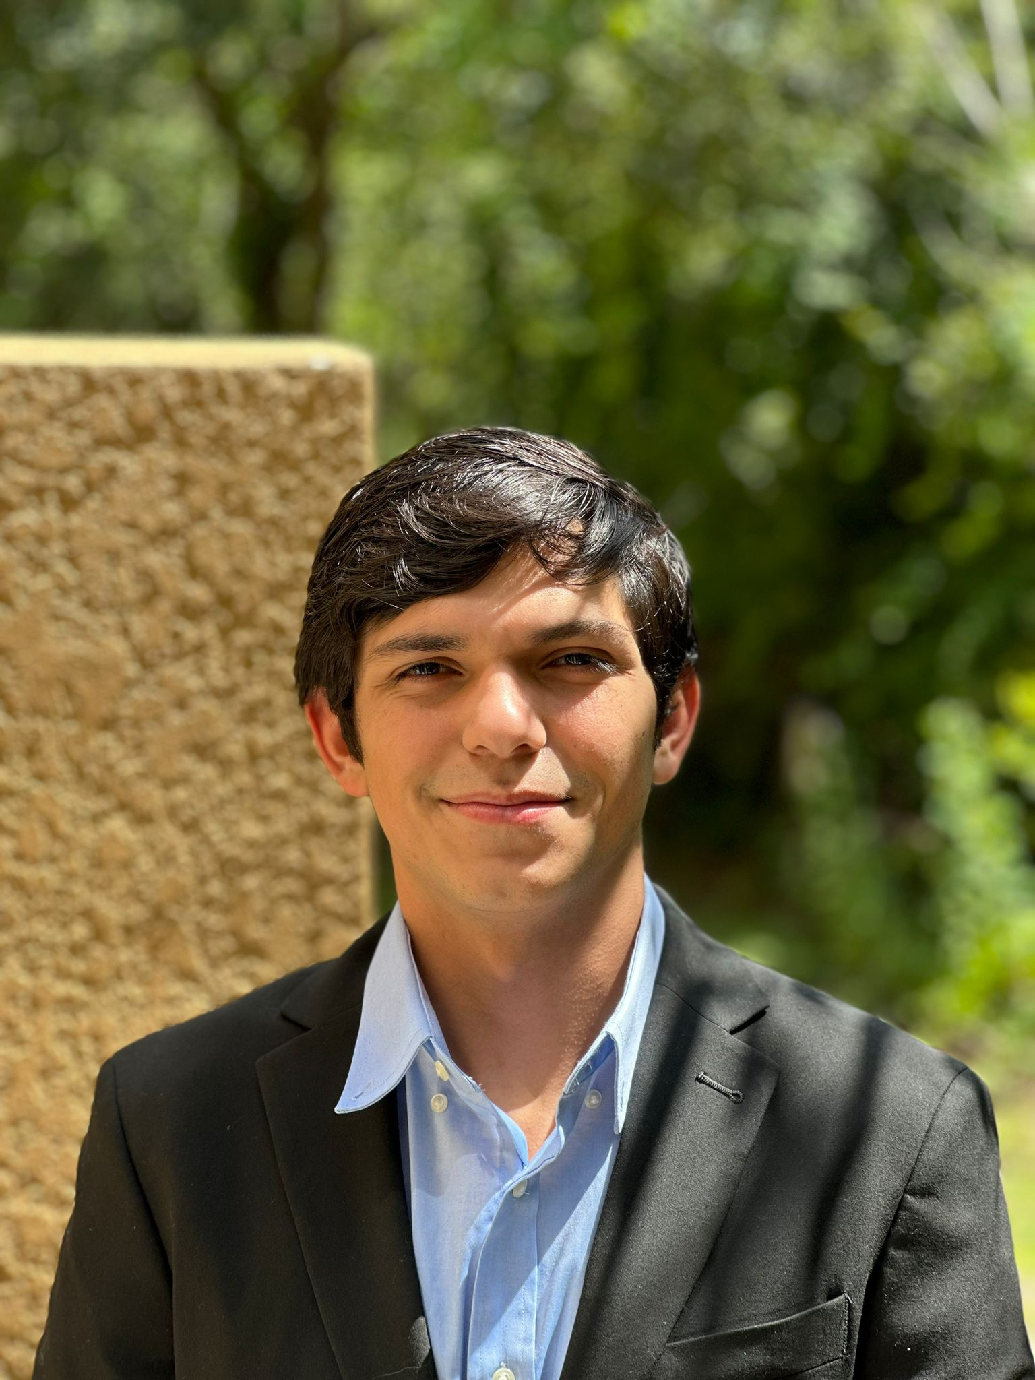
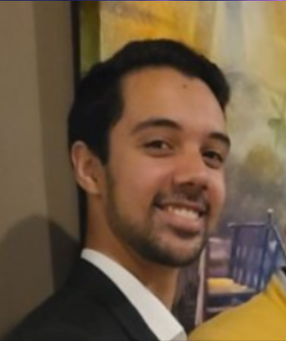
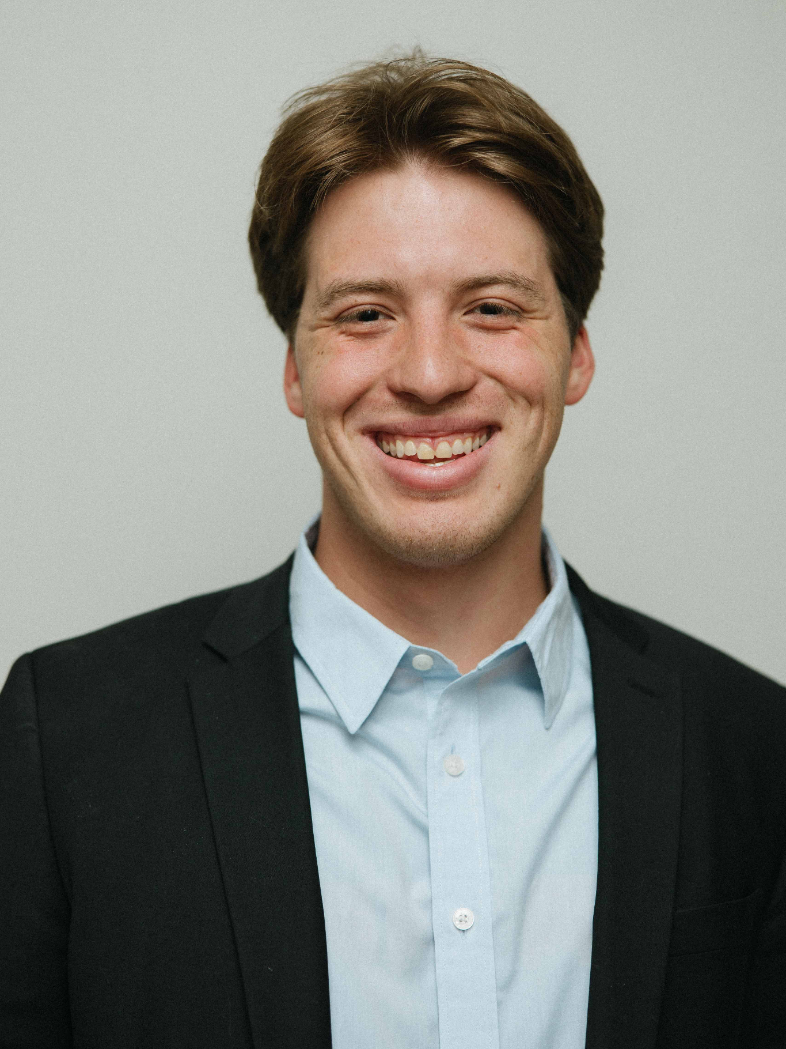
Meet Group 3!
Addison Long
Photonic Science and Engineering
Aaron Moreno
Computer Engineering
Alejandro Olivo
Computer Engineering
Sebastian Rowe
Electrical Engineering
Notes:
We will all present ourselves
(If you would like to use a script) Script: My name is [INSERT NAME HERE] and I am in the [INSERT COLLEGE HERE] program.
Ex: “My name is Alejandro Olivo and I am in the Computer Engineering program.”

Slide 3
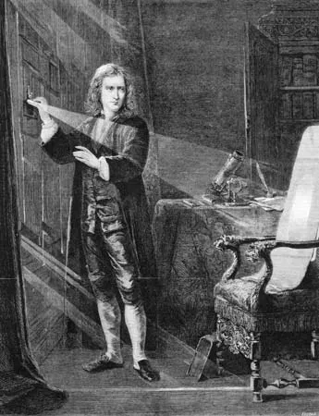
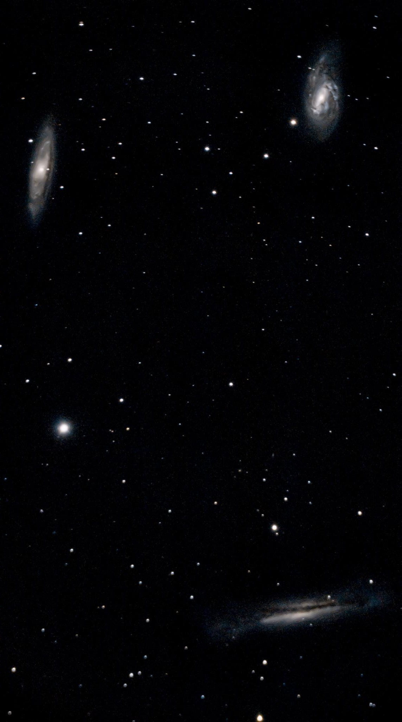
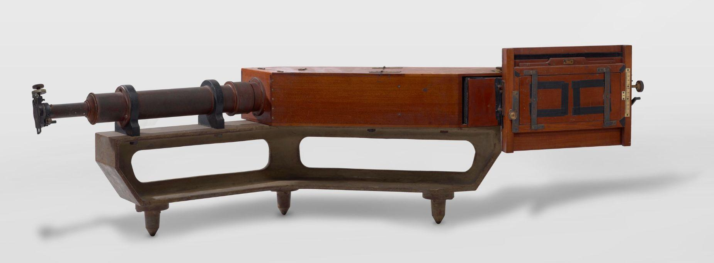
Motivation and Background
Curiosity
Market opportunity
Modern Resources
Notes:
Addison will speak
The night sky is home to many nebula, stars, and galaxies. In my time doing astrophotography, I have taken many photos of various deep sky objects, and the results are always fascinating, but the images I take lack information. I, like many other curious hobbyist astronomers, turn to spectroscopy. Spectroscopic methods enable us to thoroughly analyze the light from these deep-sky objects to infer their properties. The first spectrograms were initially gathered by Sir Isaac Newton of the Sun by simply placing a prism in the shutter of his window. Later, spectrograms were taken on film, but now, in the modern age, precisely machined ruled diffraction gratings are affordable, digital cameras are so sensitive to light that nearly every photon is captured, and auto-tracking and guiding are now reaching the mainstream. There is an emerging market of astrophotographers and hobbyist astronomers, and as a team, we aim to create a product that is affordable and adaptable to enable anyone to learn and explore the wonders of the cosmos.

Slide 4
Project Goals
Basic Goals
Broad Spectrum survey capabilities
User Interface implementation
General Control PCB
Intermediate Goals
Rudimentary Classification
Interfacing SE mount for guiding and tracking
imaging survey capabilities
Stretch Goals
MK Classification
Custom tracking mount
Identification of spectroscopic binary star systems
Live stacking and live plate solving
Notes:
Record screen; Everyone present this part. Addison will edit the good parts

Slide 5
Objectives
Basic Objectives
Spectrum acquisition
Embedded Monitor integration
Raspberry pi Control circuit
Tracking with 5 seconds of exposure time with trailing not exceeding 2 seconds of arc
Intermediate Objectives
Classification software based on Planck’s law
Driver design and implementation of PHD2 base mount implementation
Tracking with 30 seconds of exposure time with trailing not exceeding 2 seconds of arc
Stretch Goal Objectives
Reach MK standard of 10 Angstrom spectral resolution
15.04 arc second per second tracking
480mb/s file transfer rate to personal computer
Notes:
Record screen; Everyone present this part. Addison will edit the good parts

Slide 6
Specifications and Requirements
Component | Specification | Parameter
Spectrometer | Spectral range (for MK classification) | Δλ = 1 nm
Tracking Mount | Position accuracy, weight, motor input power, PCB input power, & plate-solving time | <3 arcminutes, <5 lbs, 12 VDC, 5 VDC, & <3 minutes
Diffraction Grating | Grating period & Grating type | 600 lines/mm & Holographic
Slit | Slit width | 3 mm
Concave Mirrors | Spectral range & Focal length | 450-700 nm & 100 mm
Flat Mirrors | Spectral range | 450-700 nm
Guide Camera | Pixel size & Frame refresh rate | 3.72 𝜇m & .25 s
Spectrometer Imaging Camera | Pixel size & Frame refresh rate | 3.72 𝜇m & 1 min>
Raspberry Pi | Clock speed | ∼3 GHz
Notes:
Addison will speak
At a spectral resolution of around 1 nm, we can resolve spectral features such as absorptions and emissions; with these details, we can perform general stellar spectral classification. With auto tracking and guiding at a rate lower than 25 arc mins in altitude and azimuth, we can take long exposures and pull out faint details. We hope to surpass my current tracking rig accuracy and achieve a tracking error of less than 25 arc mins in altitude and azimuth. At nearly 1 full degree of error in both altitude and azimuth, I managed this image of the M3 globular cluster with nice round stars, none of them stretching more than a few arc seconds. At a full 60 seconds of exposure time per subframe, we can be sure that our mount tracks are accurate enough to gather plenty of photons from even the dimmest sources while preserving fine details of the spectrum.

Slide 7
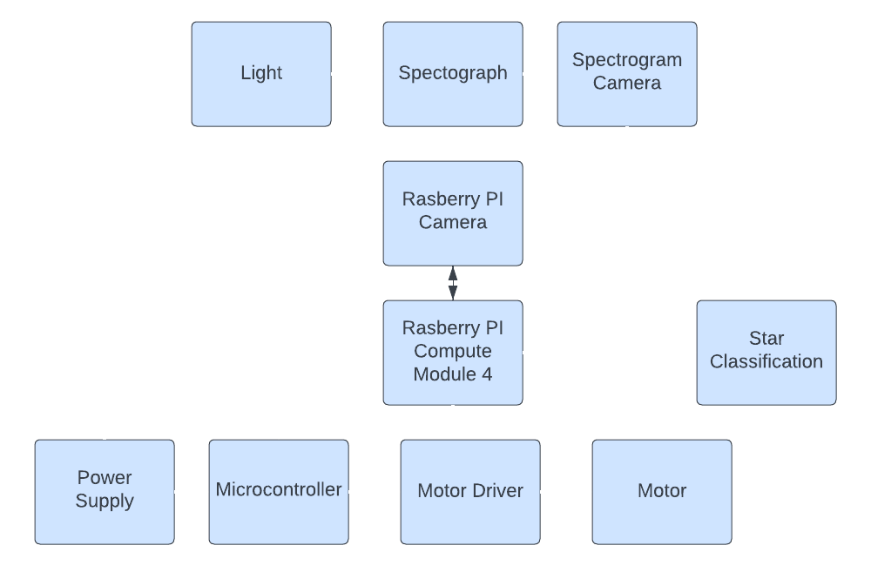
Overall Project Block Diagram
Legend:
★ Aaron
★ Addison
★ Alejandro
★ Sebastian
★
★
★
★
★
★
★
★
★
Notes:
Aaron will speak

Slide 8
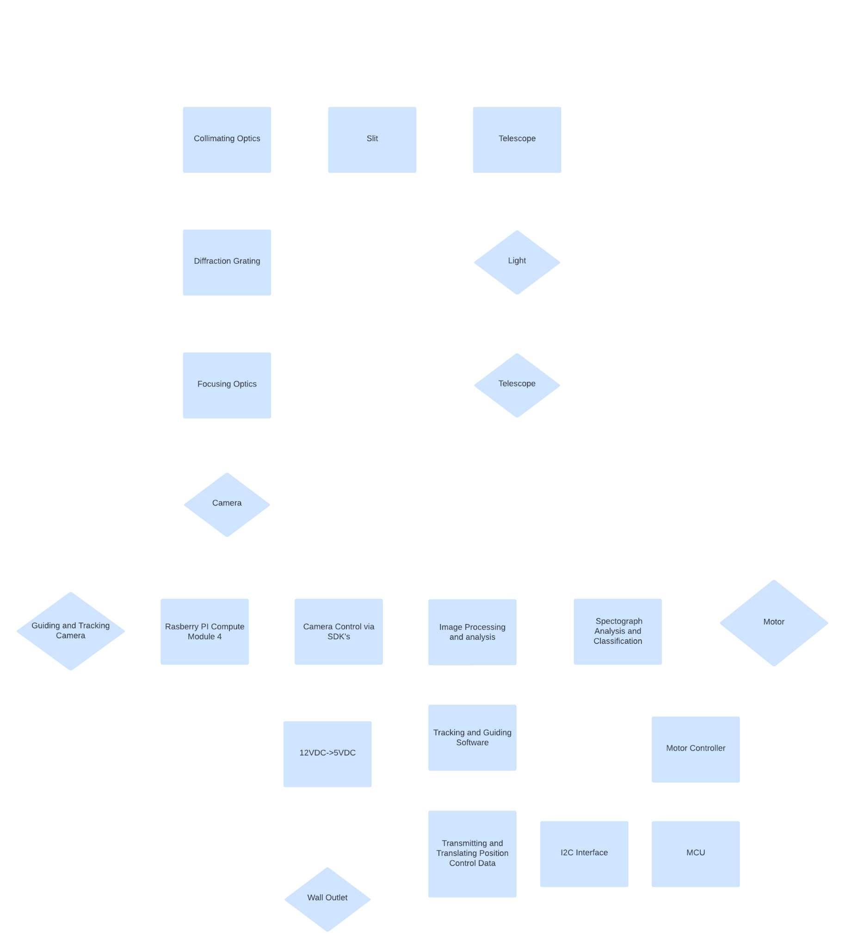
Operational Project Flow Diagram
Notes:
Aaron will speak

Slide 9
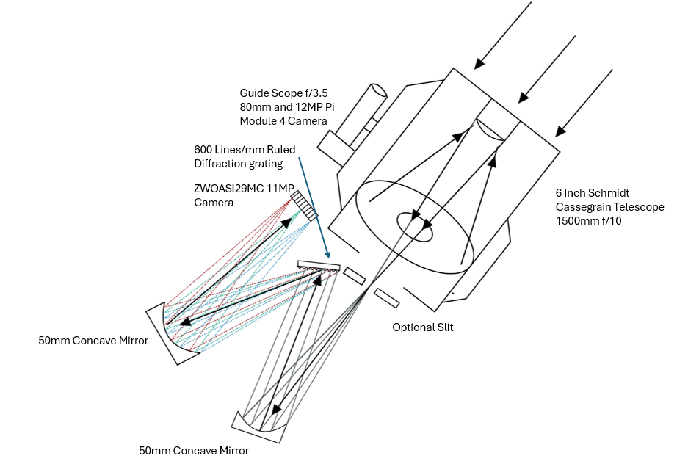
Project Design Approach
Notes:
Addison - Optics
When we decided to take on the challenge of capturing stellar spectra, we first had to identify all the complicating factors. First, individual stars are very dim, so gathering enough light for spectroscopy is difficult. We opted for a fully catoptric system to ensure we lose as little light as possible. However, that is only one piece of the puzzle. To maximize the signal, we need to take long exposures; star trails are evident because of the earth's rotation, even at short exposures. To combat earth's rotation, we need a tracking and guiding setup. I will now pass it on to Aaron to explain how we are going to approach the tracking and guiding problem
Aaron - CPE

Slide 10
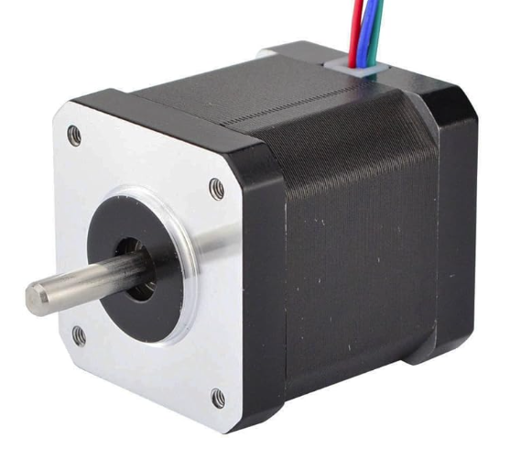
Motor Selection
Electrical Motor | Step Angle | Torque | Cost
17HM19-1684S | .9 Degrees | .44 Ncm | $23.99
MIKROE-1530 | 5.625 Degrees | .03 Nm | $8.00
SF2421-10B11 | 1.8 Degrees | .29 Nm | $28.32
WO-211-13-01-RO | 1.8 Degrees | .06 Nm | $43.60
Notes:
Sebastian will speak
Taking this information into account and applying it to our use case, we believe it best to use a stepper motor as they provide a very high degree of accuracy and stability. Though it does not move very fast, it does not need to move very fast as the motions we will be making with the motor are very very small. Furthermore, our entire rig will not be that heavy (less than 10lbs) and therefore we can get away with not having a huge stepper motor to get enough torque to move our rig.
What kind of electromechanical motor?
DC Motors
Simple control
Good for continuous rotation
Limited precision
Servo Motors
High precision
Feedback control
More complex and expensive
Stepper Motors
High precision
Simple control for position
Suitable for incremental movements
Choice → StepperOnline 17HM19-1684S
0.9 degree Step Angle
44 Ncm Torque
Affordable

Slide 11
Microcontroller Selection
Microcontroller | I/O Lines | Vin | Cost
ATMEGA328P (Arduino Mini Chip) | 23 Programmable I/O Lines | 2.7-5.5V Vin | $1.52
ATMEGA328PB-AU (Arduino Uno R3 Chip) | 27 Programmable I/O Lines | 2.5-5.5V Vin | $2.89
PIC16F18023 | 6 Programmable I/O Lines | 1.8-5.5V Vin | $0.71
Notes:
Sebastian will speak
What Microcontroller?
I2C Input from RPC4
High Speed Dout to Drivers
Low power for FPC bus power
Used on Arduino would be nice
Microchip ATMEGA328PB-AU
Internal 8MHz Oscillator
27 Programmable I/O Lines
2.5-5.5V Vin w/ active draw 0.24 mA
64KB ISP Flash Memory
Again, in the final design, the Arduino, nor the raspberry Pi will be present, their use early in the design stage allows for more time lenient prototyping and the advantage of existing infrastructure. Once it is determined more clearly exactly infrastructure is needed and not needed, these boards can be “caniballized” and ported to our PCB design with full integration with all the other peripherals required as well as the power distribution.

Slide 12
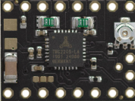
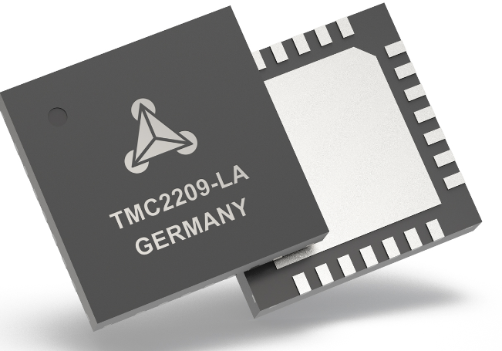
Driver Selection
Driver | Microstepping Capability | I-out | Cost
TMC2209SILENTSTEPSTICK | 102,400 steps/rev | 1.4A-3A | $30.19
DRV8825 | 12,800 steps/rev | 2.5A-3A | $11.88
DM332T | 12,800 steps/rev | 1A-3.2A | $22.99
Notes:
Sebastian will speak

Slide 13
Hardware Selection for the Spectrometer System
Component | Parameter | Purpose | Quantity | Cost
ZWOASI294MC Pro | 11MP Cooled Camera | Plenty of resolution and cooled camera give greater sensitivity to 700nm and longer wavelengths. | 1 | $999 (Already Owned)
Diffraction Grating | 600 Lines/mm | Spectrum fills camera sensor | 1 | $80
Concave Mirror | 12.7mm Diameter 50mm Focal Length | First mirror collimates the light second focuses the spectrum into the camera. | 2 | $43
Notes:
Addison will speak about cameras & optics
For the spectrometer diffraction Grating, I selected a 500line/mm ruled grating to ensure 1 nm wavelength separation while ensuring we can fit a spectrum from 400-700nm on the camera sensor. To prevent chromatic aberrations and signal loss, our system is catoptric with no transmissive elements other than the Schmidt Corrector plate for the telescope.
For the mirror choice, I decided to use silver-coated first surface mirrors for greater than 90% efficiency from 400nm-20um. For this project we will be using a Cooled Deep sky camera for its superior sensitivity. However, this system is not limited to a specific camera. It is adaptable to any camera given a 1.25 inch nosepiece adapter. Just like the camera, the telescope is also adaptable. The spectrometer is designed around the F/10 6 inch SCT from celestron. This telescope has a long focal length of around 1500mm, and the relatively slow f/# enables us to pick out stars easily, reducing spectrum contamination from background stars. However, this spectrometer can be easily adapted to any telescope, ensuring that it can cater to your specific equipment and needs.

Slide 14
Onboard Computer Selection
Onboard Computer | Processor | Max Ram | GPIO | Onboard GPU | Cost
Raspberry Pi Compute Module 4 | Broadcom BCM2711, Quad-core Cortex-A72 (ARM v8) 64-bit SoC @ 1.5GHz | 8 GB | I2C, SPI, UART, PWM, SDIO, PCIe 1x lane, USB 2.0, MIPI DSI display port, MIPI CSI camera port | Yes | 75.00 $
NVIDIA Jetson Nano | Quad-core ARM® Cortex®-A57 MPCore processor @ 1.43GHz | 4 GB | GPIO, I2C, I2S, SPI, UART, USB 3.0, USB 2.0, HDMI, MIPI CSI | Yes | 129.00 $
BeagleBone Black | AM335x 1GHz ARM® Cortex-A8 | 512 MB | GPIO, I2C, SPI, UART, ADC, PWM | Yes | 72.54 $
Notes:
Aaron will speak

Slide 15
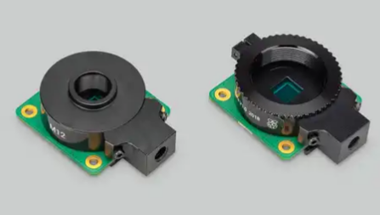
Guide Camera Selection
Guide Camera | Sensor | Lens Mount | Resolution | Pixel Size | Cost
Camera Module 3 | Sony IMX708 | N/A | 11.9 Megapixels | 1.4 µm x 1.4 µm | $25
HQ Camera | Sony IMX477 | C/CS- or M12-mount | 12.3 Megapixels | 1.55 µm x 1.55 µm | $50
GS Camera | Sony IMX296 | C/CS | 1.58 Megapixels | 3.45 µm x 3.45 µm | $50

Slide 16
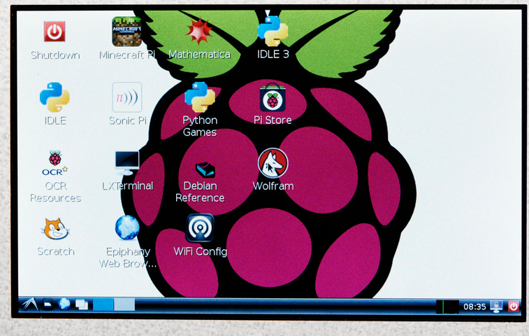
Embedded Display Selection
Embedded Display | Power Source | Touchscreen Support | Connectivity Type | Resolution | Cost
Raspberry Pi 7" Touchscreen Display | micro USB | Yes | DSI | 800x480 | $85.00
Adafruit HDMI 7" 800x480 Display Backpack | micro USB | No | HDMI | 800x480 | $79.95
Waveshare 7" HDMI LCD (C) | micro USB | Optional | HDMI | 1024x600 | $80

Slide 17
Software Selection
Programming Language | Attributes
C | Low-level design
 | Portability
 | Extensibility
Python | Extensive library
 | Ability to analyze data
 | Support of programming paradigms
Notes:
Alejandro will speak

Slide 18
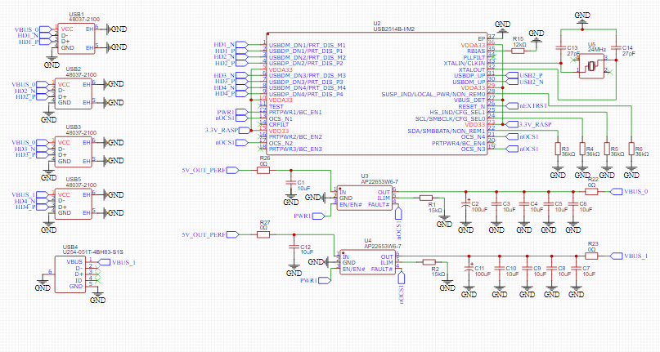
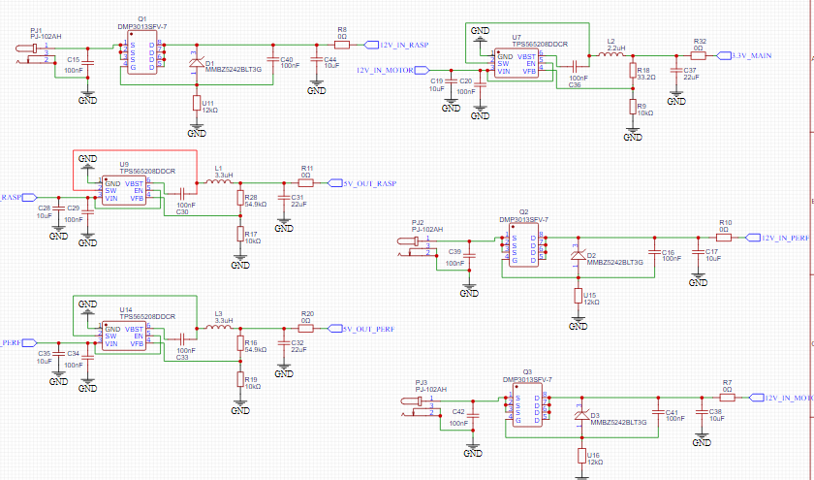
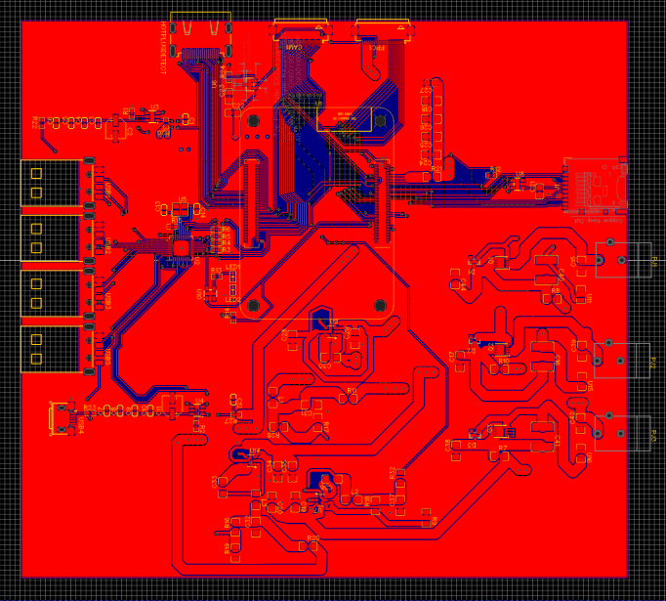
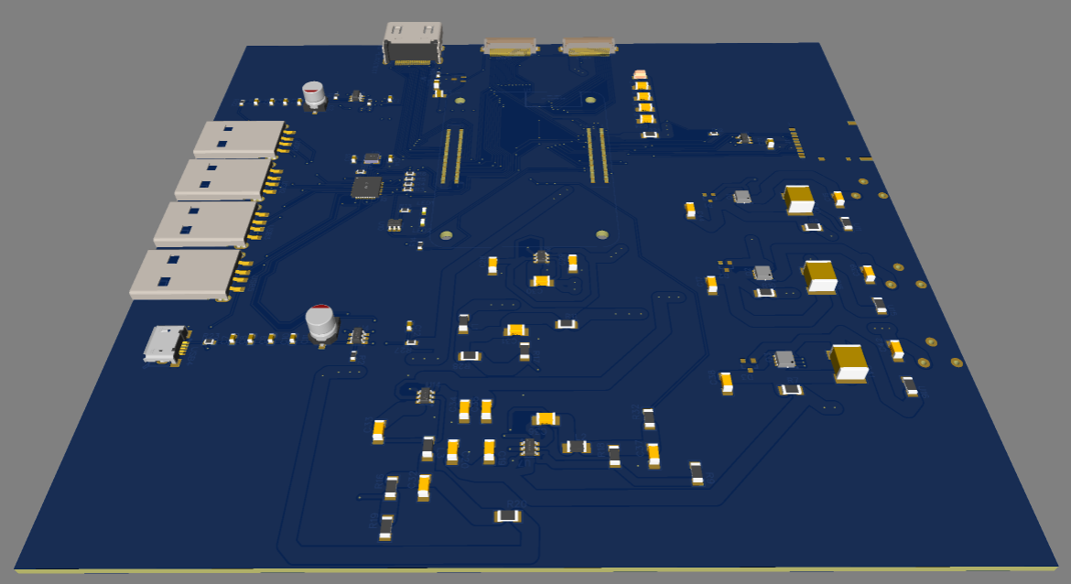
PCB Design
Challenges:
3 Barrel Jacks Needed to support a max Current of 12 Amps
Each Barrel Jack supports 4 amps requiring wide tracing making routing into the 0.4mm pitch connector difficult
4 USB ports to allow for all peripherals to be added
Notes:
Aaron will speak

Slide 19
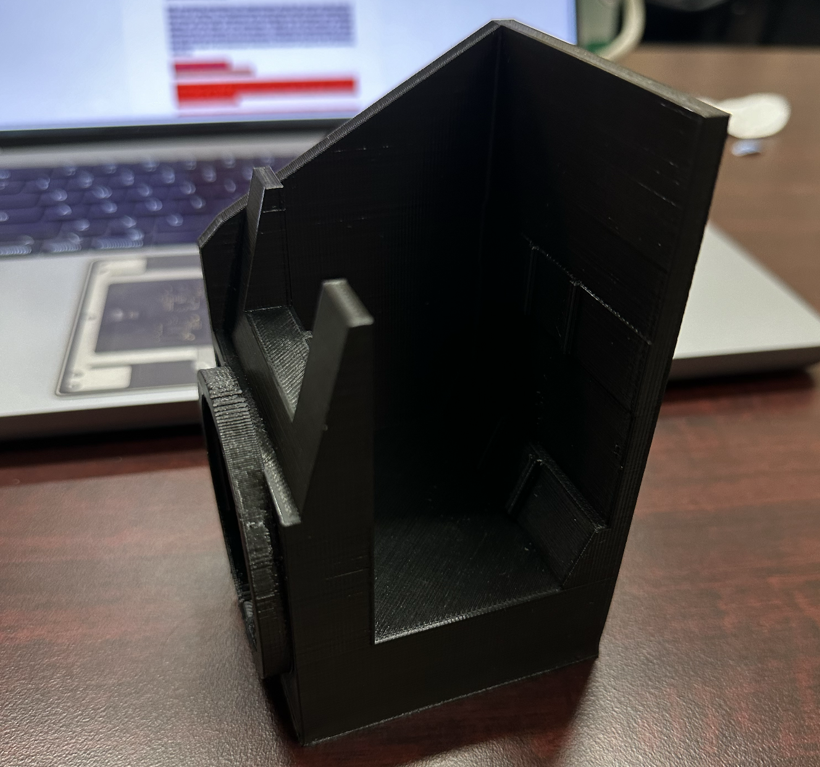
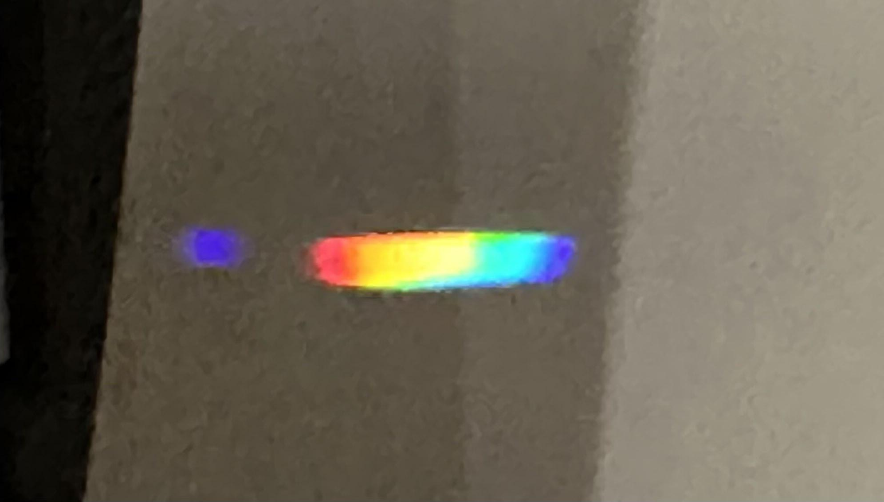
Spectrometer V1
Poor mirror mount method
No camera mount
No way to test on a star
Proof of concept
Notes:
Addison will speak
This is the first version of the spectrometer and it has many issues. First we mounted the mirrors using heavy duty double sided tape and because at this point in senior design we were not certain on what camera we wanted to use we just left a window that would allow us to project the spectrum onto a card. The tracking mount was not functional at this time so we had no way to test with a star but I was able to use a hand made cardboard slit and a camera lens I had to focus the light from my phone camera and create the spectrum you see on the card. We get a nice continuous spectrum but its sloppy since we are working in suboptimal conditions This was mostly a proof of concept and a confirmation of the simulation.

Slide 20
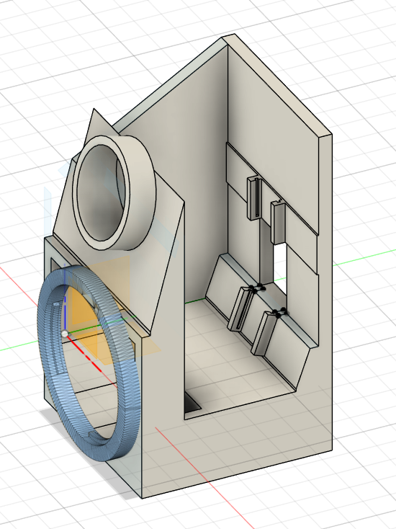
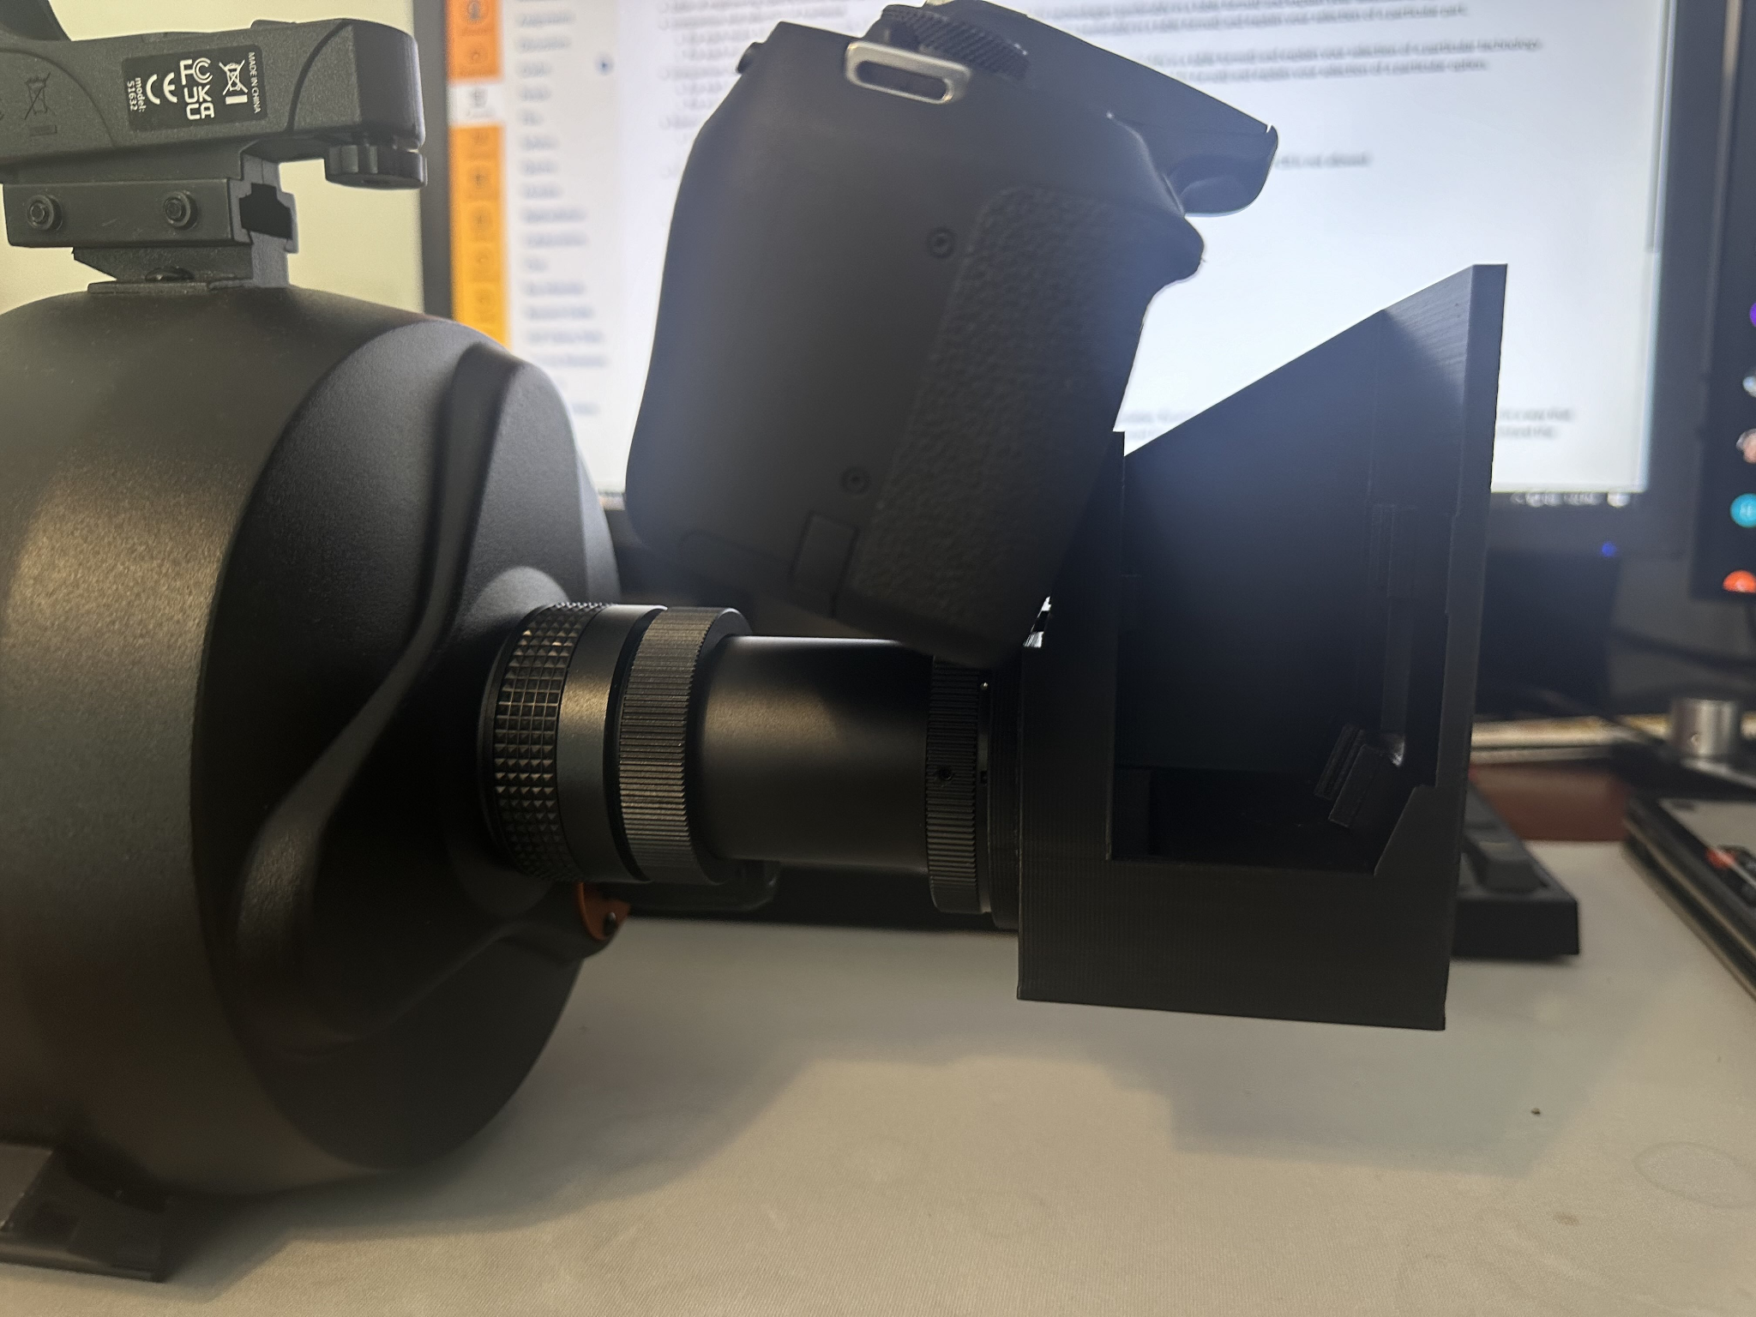
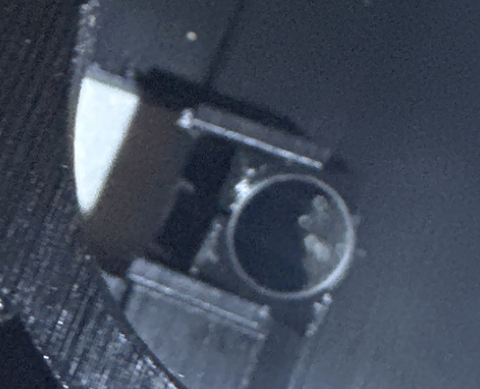
Spectrometer V2
Unexpected print error
Sturdy
Telescope mount works
Fusion 360 model of V3
Notes:
Addison Speaks
Unfortunately, version 2 of the spectrometer is not usable. We needed to develop our own mirror mounting method for our product to work. Despite using proper dimensions in 3d cad, the actual 3d print was around .2mm too small, which prevented our mirror mount from working since we needed to be precise to properly tension the mirror to hold it in place. Despite being unable to test the spectrometer output on the camera, we could at least mount both the camera and telescope to verify that the print is sturdy and that the telescope's center of mass does not deviate too much. V3 is currently in the design stage our current 3d model has been adjusted for print error and the schematic was changed from Cannons EF mount to a 1.25inch nosepiece which is a more universal camera adapter

Slide 21

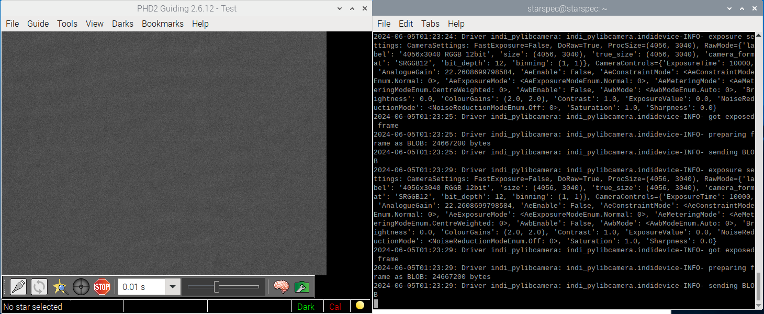
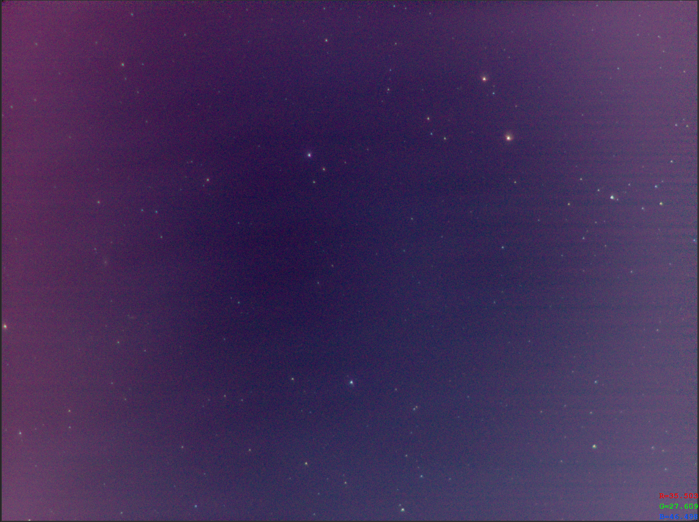
Prototyping
INDI Driver Installation & Testing
PHD2 Guiding & Tracking Test
Raspberry PI Camera HQ Testing
Notes:
Aaron will speak

Slide 22
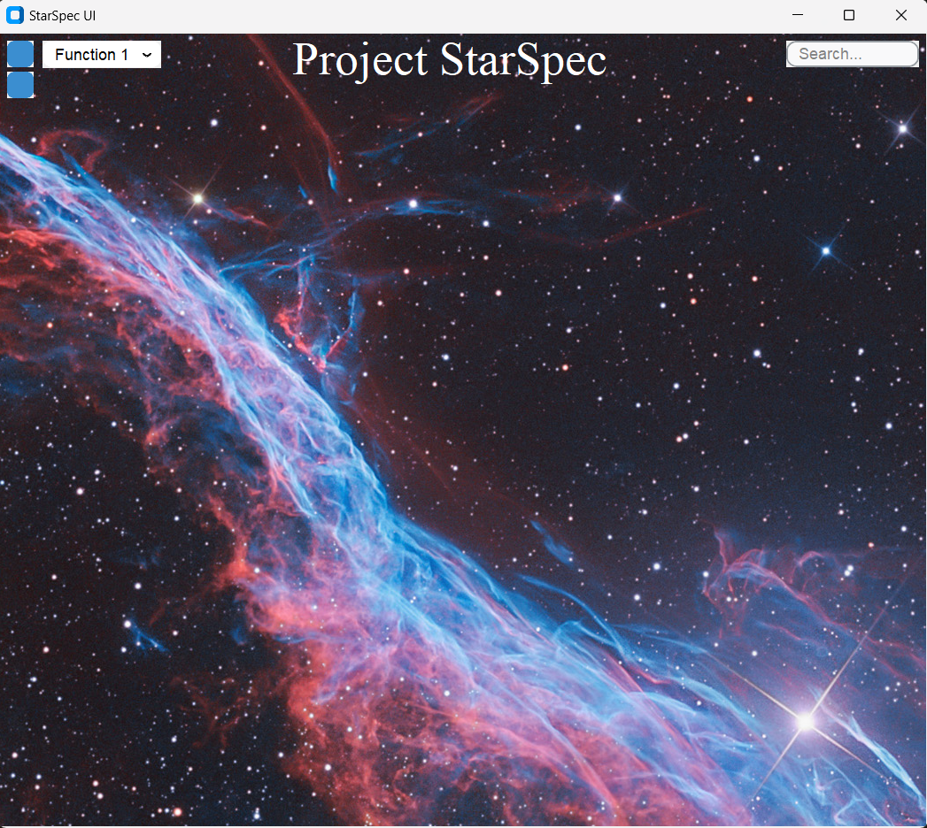
Software Prototyping
Foundation of our User Interface
Notes:
Alejandro will speak about UI stuff
Addison note: the nebula in the UI there is the veil nebula if you want to mention it.

Slide 23
Current Budget
Item | Quantity | Cost per Item
Diffraction Grating | 1 | $80
Protected Silver Coating Mirrors | 2 | $43
Main PCB | 1 | ∼$35
Secondary PCB | 1 | ∼$40
Stepper Motors | 2 | $23.99
Total | 7 | $288.98
Notes:
Sebastian will speak
Spectrometer 160$
1x Diffraction grating 600 lines/mm 12.7x12.7mm 80$
2x Protected silver coating mirrors 12.7mm diameter 95% reflective between 400-20um wavelengths $43 x2
Main PCB ~$35 ($30 is RPC4)
Stretch PCB ~$40 (2x $15 Motor Drivers)
Stepper Motor - $23.99

Slide 24
Bill of Materials
Item | Quantity | Cost
Telescope & Mount | 1 | $1000
Camera | 1 | $999
HDMI Display | 1 | $80
Total | 3 | $2079
Notes:
Sebastian will speak

Slide 25
Work Distribution
Task | Primary | Secondary
3D Print & Design | Aaron | Addison
Camera Control | Sebastian | N/A
Drivers | Aaron | N/A
Frontend User Interface | Alejandro | Sebastian
Hardware & Software Integration | Alejandro | Sebastian
PCB Design | Aaron | Sebastian
Task | Primary | Secondary
PHD2 Client Integration | Sebastian | Aaron
Software for Spectrum Classification & Analysis | Alejandro | Aaron
Spectrometer | Addison | N/A
Spectrum Analysis | Addison | N/A
Stretch Board (Motor Control) | Sebastian | Aaron
Notes:
Sebastian will speak

Slide 26
Progress and Plan for Completion (June)
Sunday | Monday | Tuesday | Wednesday | Thursday | Friday | Saturday
 |  |  |  |  |  | 1
2 | 3 | 4 | 5 | 6 | 7 | 8
9 | 10 | 11 | 12 | 13 | 14 | 15
16 | 17 | 18 | 19 | 20 | 21 | 22
23 | 24 | 25 | 26 | 27 | 28 | 29
30
June 30th:
Rudimentary classification
Notes:
Alejandro will speak

Slide 27
Progress and Plan for Completion (July)
Sunday | Monday | Tuesday | Wednesday | Thursday | Friday | Saturday
 | 1 | 2 | 3 | 4 | 5 | 6
7 | 8 | 9 | 10 | 11 | 12 | 13
14 | 15 | 16 | 17 | 18 | 19 | 20
21 | 22 | 23 | 24 | 25 | 26 | 27
28 | 29 | 30 | 31
July 1st:
Custom mount
(for stretch goal)
Notes:
Alejandro will speak

Slide 28
Progress and Plan for Completion (July)
Sunday | Monday | Tuesday | Wednesday | Thursday | Friday | Saturday
 | 1 | 2 | 3 | 4 | 5 | 6
7 | 8 | 9 | 10 | 11 | 12 | 13
14 | 15 | 16 | 17 | 18 | 19 | 20
21 | 22 | 23 | 24 | 25 | 26 | 27
28 | 29 | 30 | 31
July 18th:
Final adjustments
Notes:
Alejandro will speak

Slide 29
Progress and Plan for Completion (July)
Sunday | Monday | Tuesday | Wednesday | Thursday | Friday | Saturday
 | 1 | 2 | 3 | 4 | 5 | 6
7 | 8 | 9 | 10 | 11 | 12 | 13
14 | 15 | 16 | 17 | 18 | 19 | 20
21 | 22 | 23 | 24 | 25 | 26 | 27
28 | 29 | 30 | 31
July 19th:
Final Showcase
Notes:
Alejandro will speak

Slide 30
Questions?

